Slide 1
Operational procedures and tools for scheduled shutdowns at CC-IN2P3
Frédéric AZEVEDO, Philippe CORREIA, Thibaut SALANON
15 / 02 / 2017

Slide 2
Content
When and why we started change management
Developments
Organizing a site maintenance using GOA
Summary

Slide 3
Why we started change management
Data center and Service provider
  A lot of services and components
  More or less dependencies within each others
  Common dependencies for everything :
    Power supplies
    Cooling system
    Network
Since 2008 : 4 days of site maintenance per year
  Focus on high impact maintenances (implies service(s) outage)
    Major software updates
    Hardware renewal and upgrade
    Facility management components (chiller, power supplies, electrical components, …)
  Improve change management
    Avoid unexpected impacts on Services
    Have a global view on major changes
  Optimize downtime duration
  Improve communication (internal and external)

Slide 4
Developments
To help us with change management
  A global CMDB (Configuration Management Data Base)
    Collect information from several sources
      Puppet DB, sysadmin DB, services configuration, …
      Including components and services dependencies
    Work still in progress
  Impact analysis tool based on the CMDB
    Web application
    Given a component, we can see the impact on others, on services and on users
    We can also guess possible causes for a given failure

Slide 5
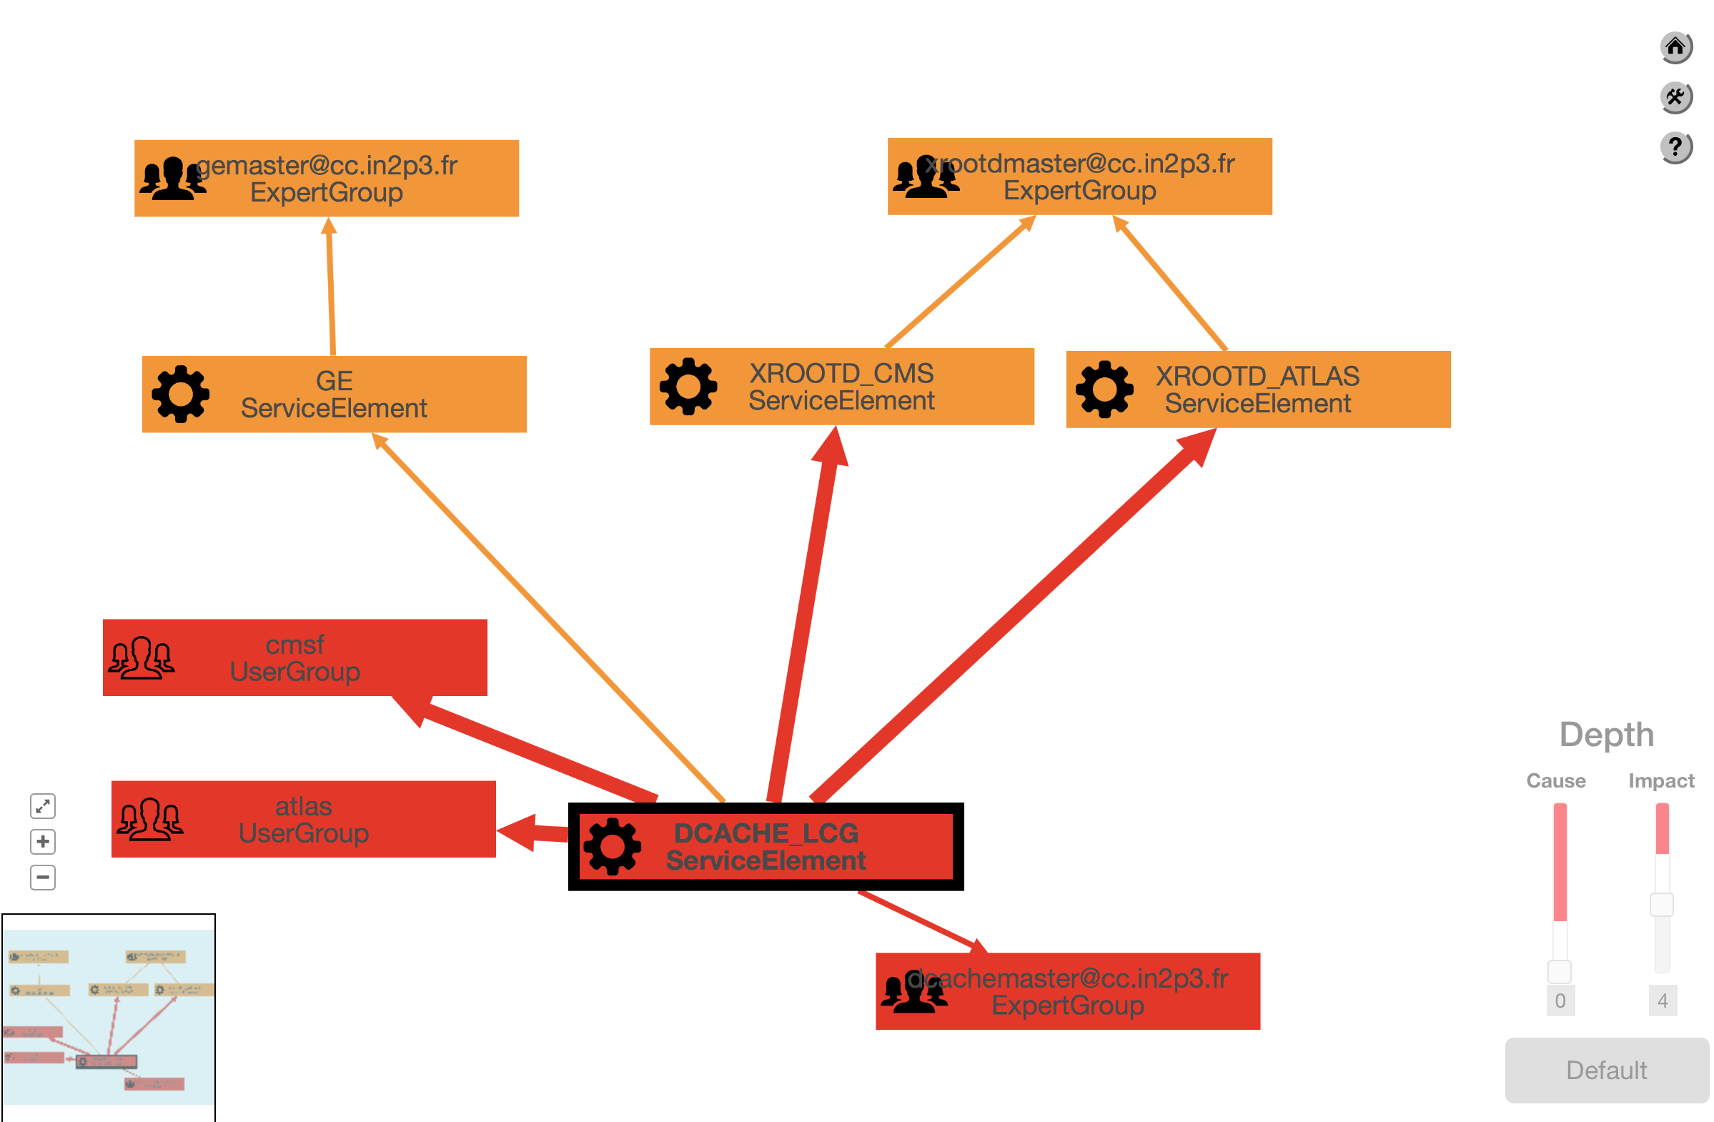
Developments - Impact Analysis

Slide 6
Developments - GOA
  GOA
    Web application
      Admin LTE 2 for the web interface (based on Bootstrap 3)
      Symfony (PHP framework and components)
      DHMTLXGantt : Javascript and HTML5 Gantt library
    Main objective is to improve the way we manage high impact changes
      For each site maintenance
        Timeline with 28 pre-defined tasks (for organisation and communication)
    Allows anyone to ask for a change request
    Handles different roles (user / moderator)
    Gives a global view of what will be done
    Displays a Gantt diagram to make things easy to read

Slide 7
Organizing a site maintenance using GOA
Timeline overview
  Collect the needs for changes
  Analyse the impact on other services and on users/experiments
    Identify conflicts or opportunities
  Approve the maintenance requests
    with the management if needed
  Establish and approve the planning
    with the management and the steering committee
  On D-day
    coordination and internal/external communication
    Update the status for ongoing tasks
  Global review with all people involved in maintenance tasks
1 or 2 meetings
1 meeting

Slide 8
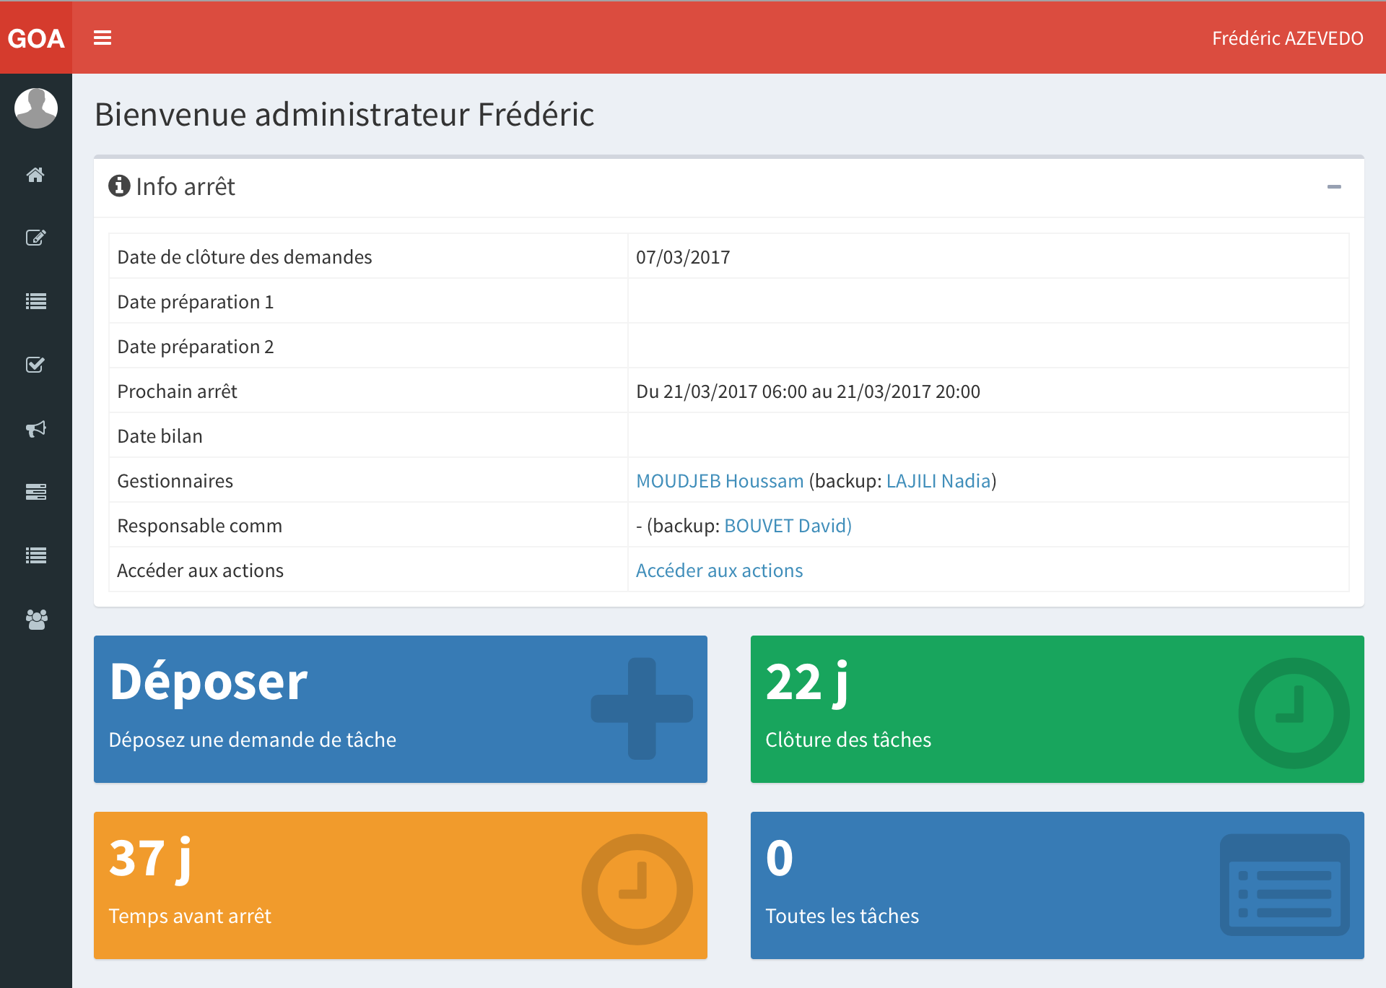
GOA – Main page

Slide 9
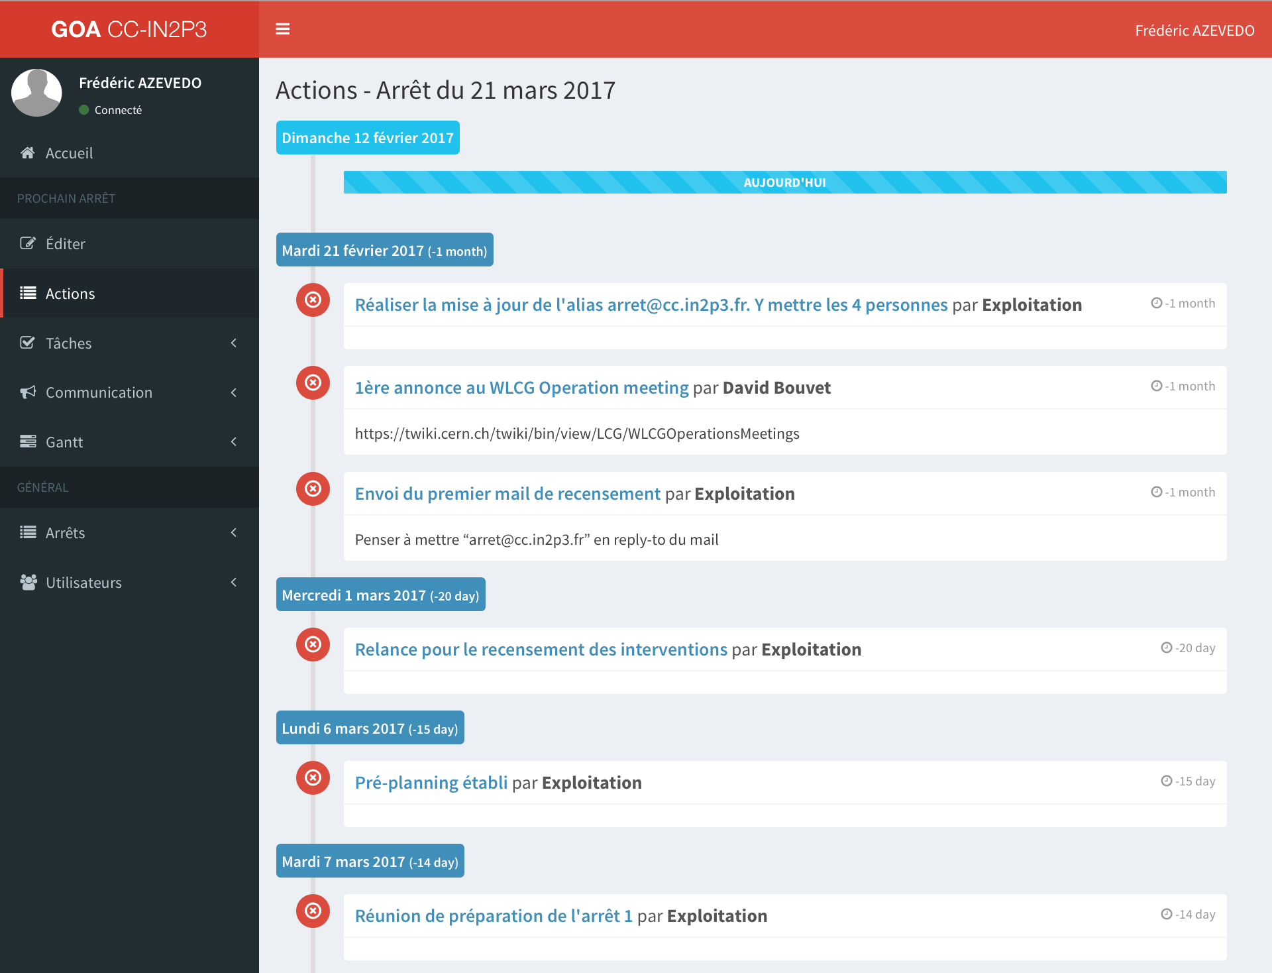
GOA – Timeline

Slide 10
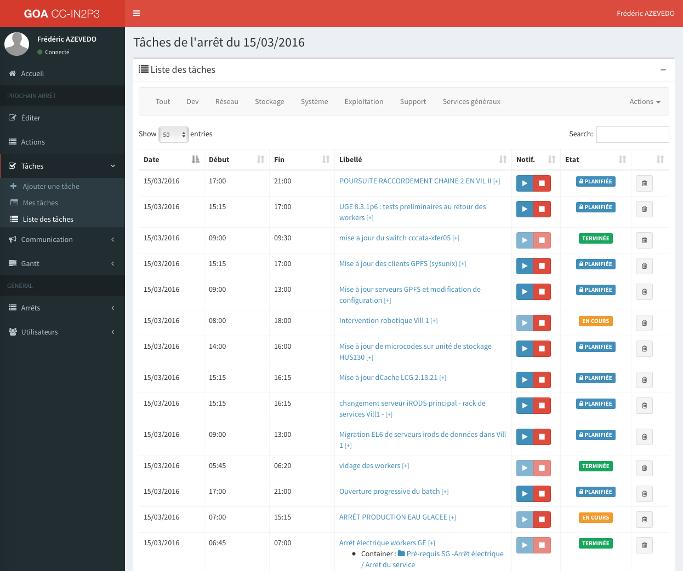
GOA – Tasks list

Slide 11
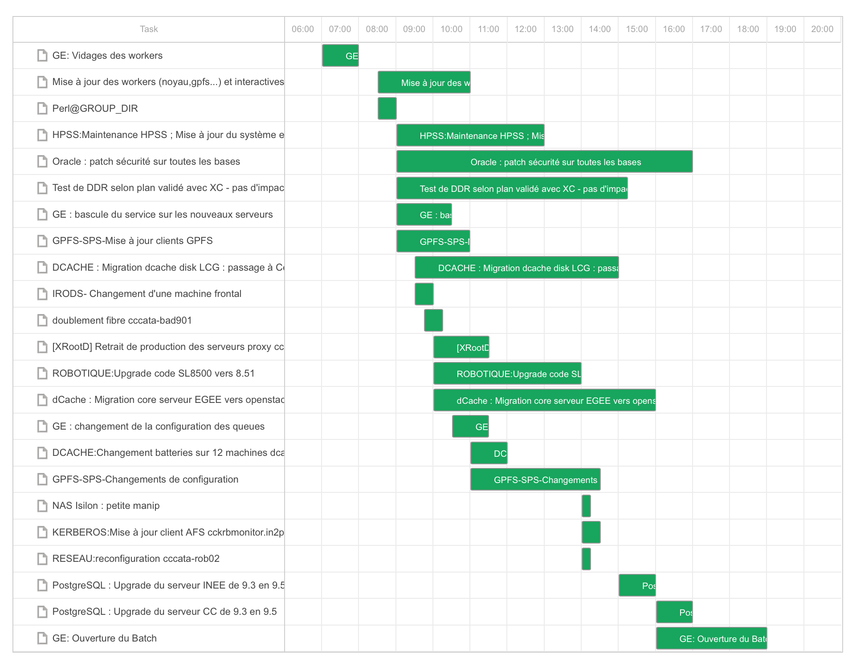
GOA – Gantt

Slide 12
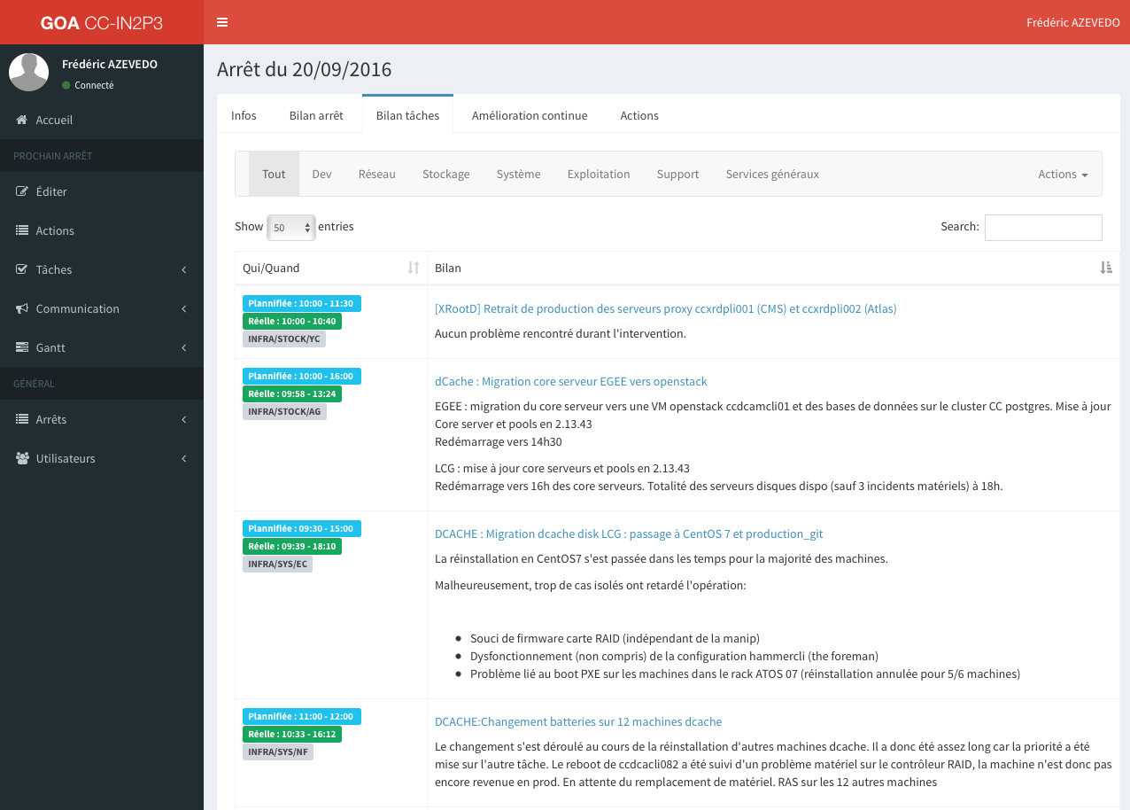
GOA – Final review
Notes:
Generally 2 days after, we have a final review
Go through every task
Identify difficulties
See the gap between the time expected vs real

Slide 13
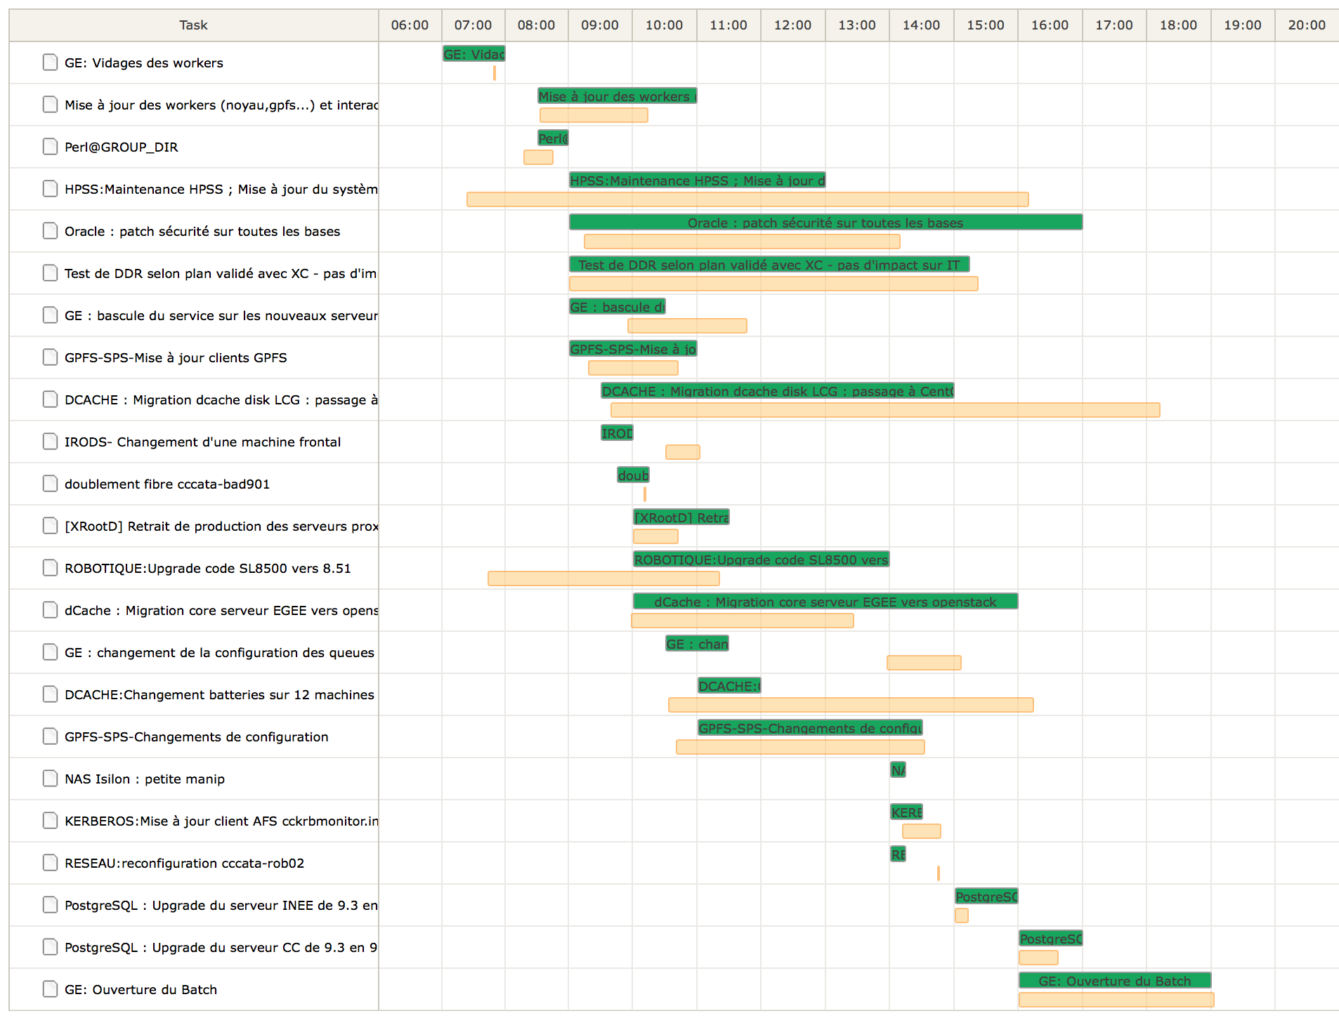
GOA – Final review

Slide 14
Summary
To improve our change management we choose to make some developments
  CMDB to have a gathered view of all configurations items and their relations
  Impact analysis tool based on this CMDB
    Manuel check for now
  GOA : a web application
    Define a timeline
    Collect changes requests
    Approve and schedule requests
    View the “real time” status on D-day
    Final review of single tasks and of the global site maintenance
  Still some possibilities to automate things.
Real meetings for discussions are still mandatory !

Slide 15
Thank you for your attention.
Any questions ?

