Slide 1
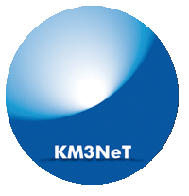


Measuring the Neutrino Mass Ordering with KM3NeT-ORCA
João Coelho
APC Laboratory
27 January 2017

Slide 2
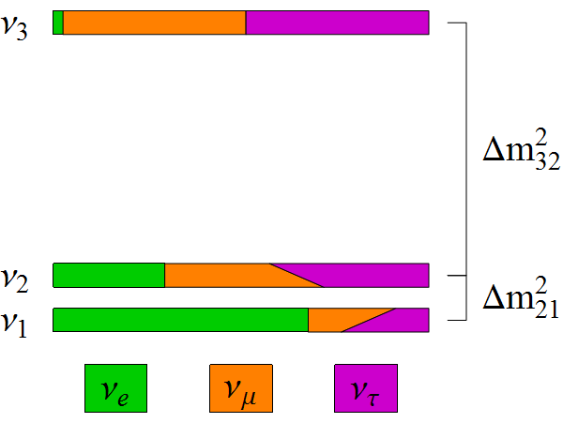
Neutrino Oscillations
Neutrinos are created in a superposition of mass states
Time evolution generates flavour oscillations
3 mixing angles (θ₁₂, θ₁₃, θ₂₃) and 1 CPV phase δ_{CP}
Simple QM
sin²θ₁₃
~ sin²θ₂₃
~ sin²θ₁₂
cosδ_{CP}

Slide 3
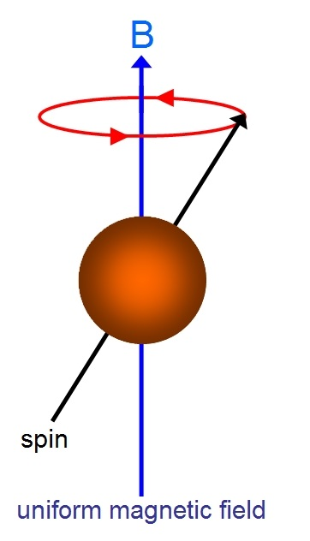
Neutrino Oscillations
Neutrinos are created in a superposition of mass states
Time evolution generates flavour oscillations
3 mixing angles (θ₁₂, θ₁₃, θ₂₃) and 1 CPV phase δ_{CP}
Simple QM
sin²θ₁₃
~ sin²θ₂₃
~ sin²θ₁₂
cosδ_{CP}

Slide 4
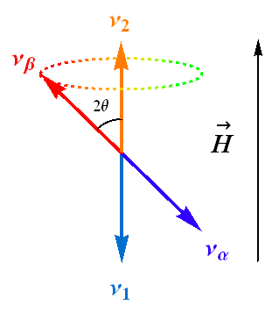
Neutrino Oscillations
Neutrinos are created in a superposition of mass states
Time evolution generates flavour oscillations
3 mixing angles (θ₁₂, θ₁₃, θ₂₃) and 1 CPV phase δ_{CP}
Simple QM
sin²θ₁₃
~ sin²θ₂₃
~ sin²θ₁₂
cosδ_{CP}

Slide 5
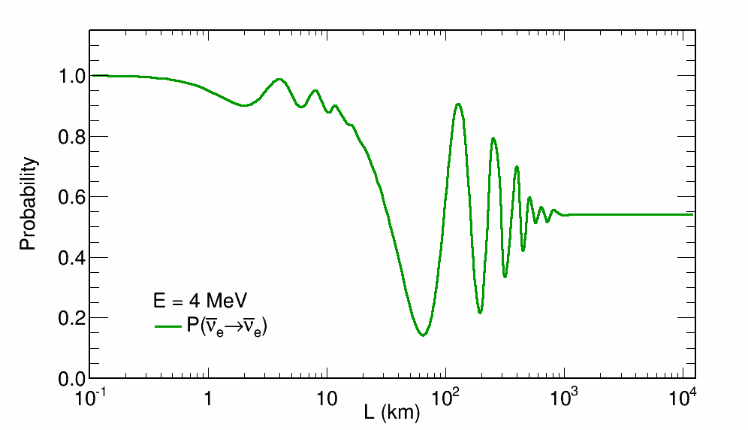
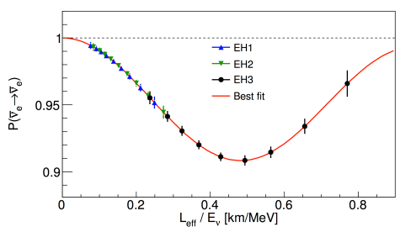
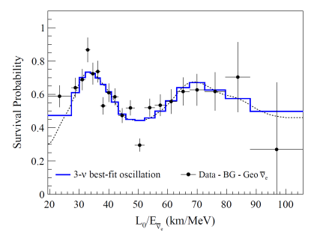
The Data: MeV
Reactor and solar nu’s measure θ₁₂, θ₁₃ and Δm²₂₁
θ₁₃
Δm²₂₁, θ₁₂

Slide 6
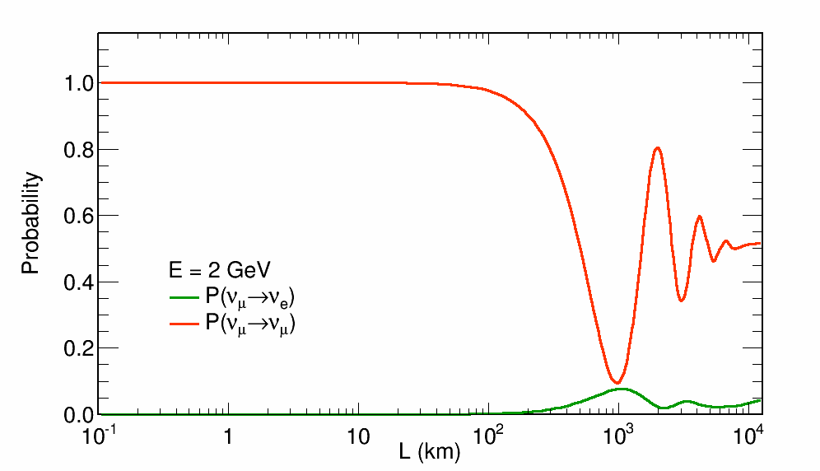
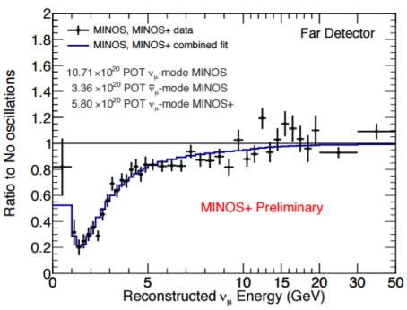
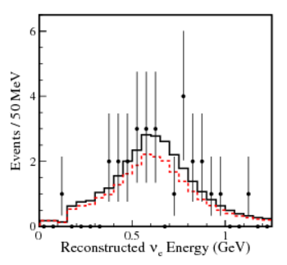
The Data: GeV
Atmospheric and accelerator nu’s measure θ₂₃ and Δm²₃₂ . Also sensitive to θ₁₃ and δ_{CP} .
Δm²₃₂, θ₂₃
δ_{CP} , θ₁₃

Slide 7
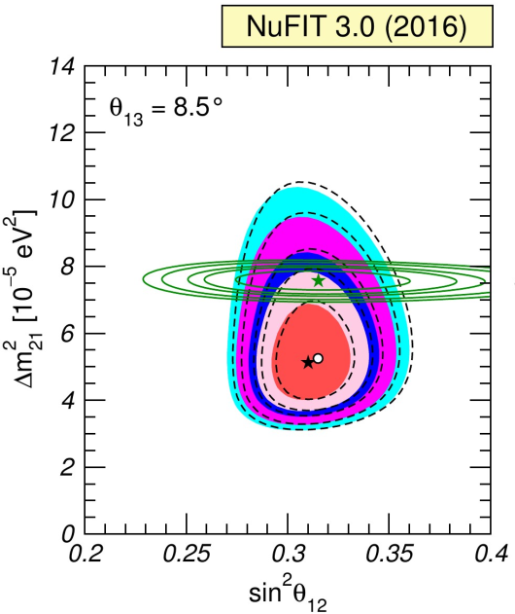
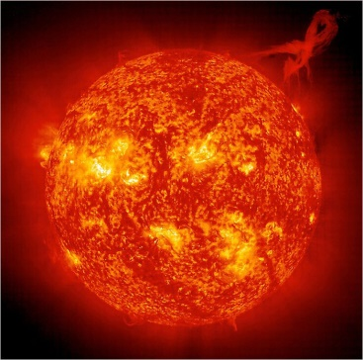
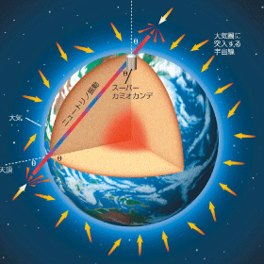
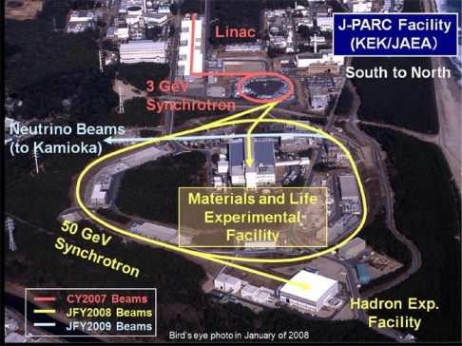
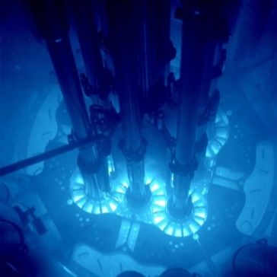
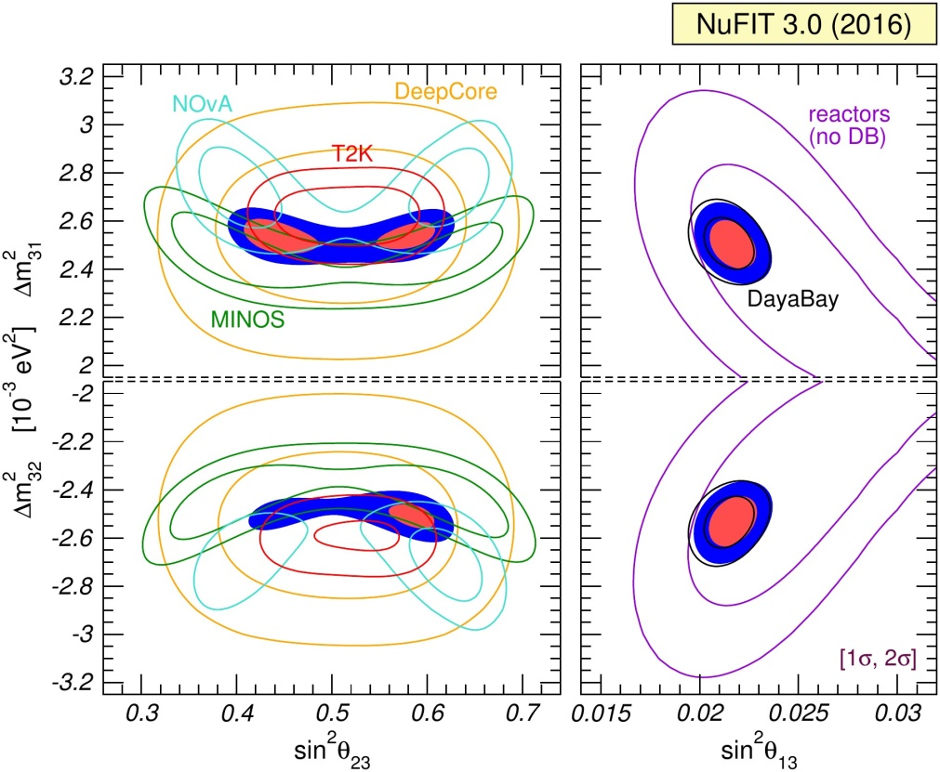
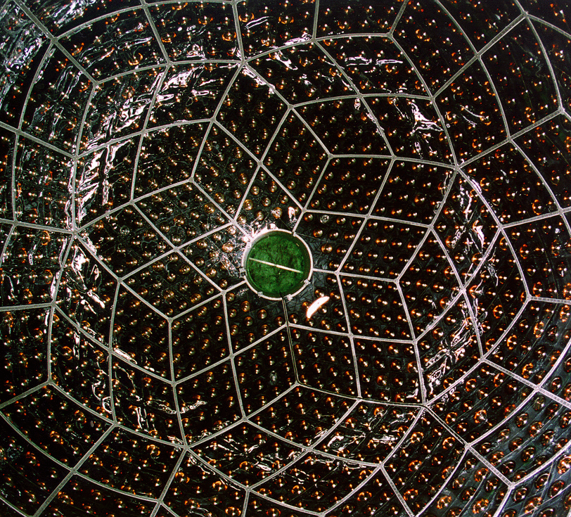
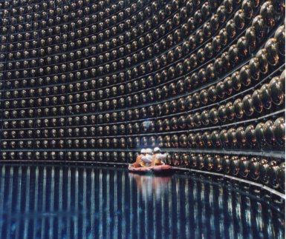
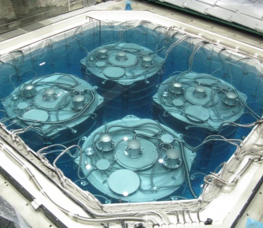
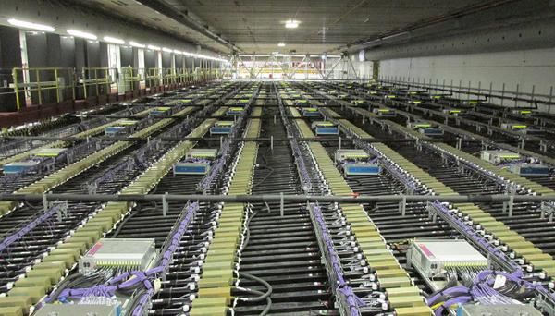
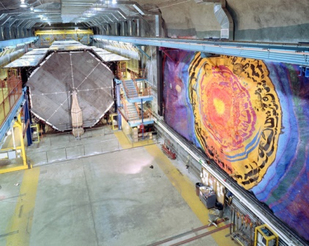
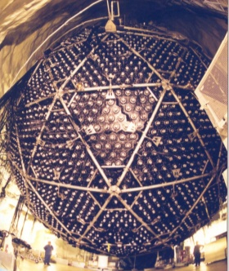
Global Picture
arXiv:1611.01514 [hep-ph]
Multiple sources
Multiple detectors

Slide 8
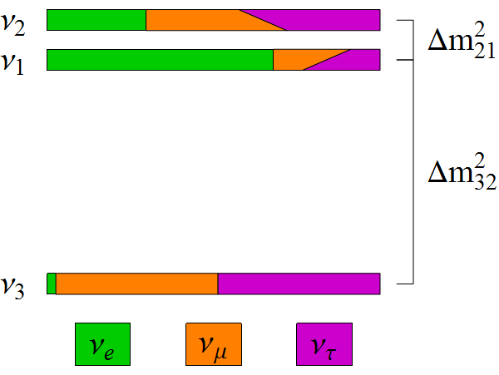
Missing Pieces
Do neutrinos violate CP? (δ_{CP})
What is the mass ordering? (Mass Hierarchy)
Is θ₂₃ = π/4? Underlying symmetry?
same?
δ_{CP} ?
Δm²₃₂ < 0 ?

Slide 9
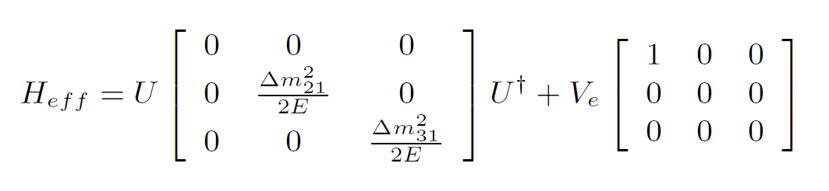
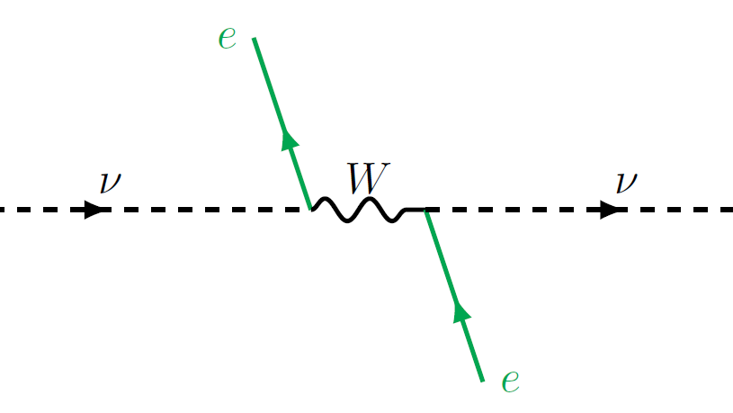
Matter Effects
H₀
V

Slide 10
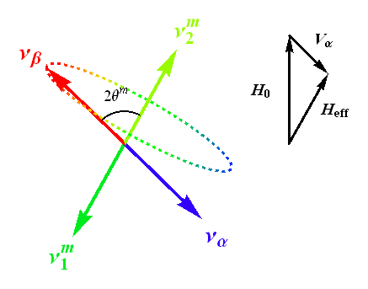
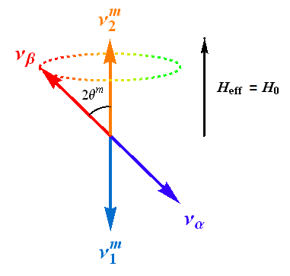
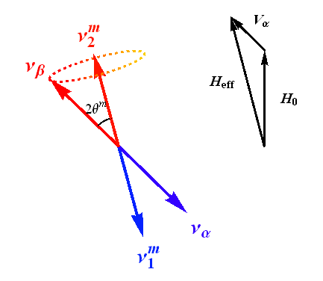
Matter Effects
H_{eff} = H₀ + V_{α}
H_{eff} = H₀ - V_{α}

Slide 11
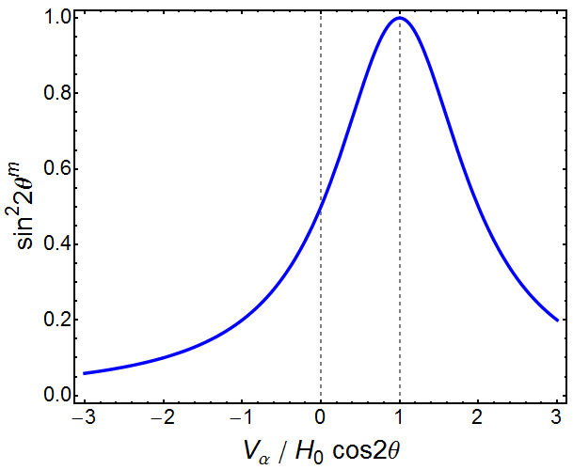
Matter Effects

Slide 12
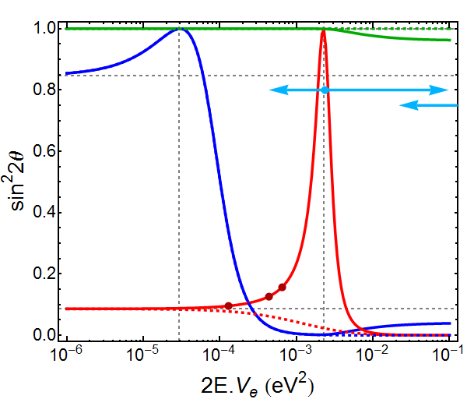
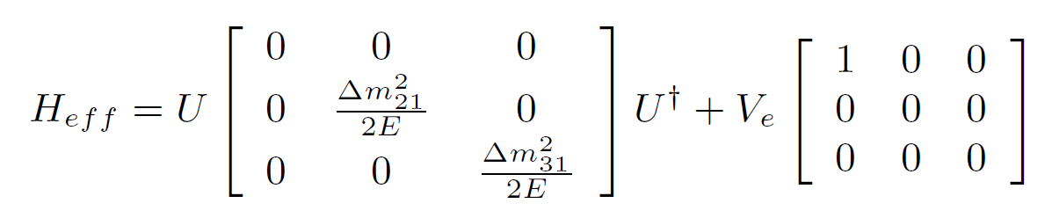
Resonances
θ₂₃
NH
θ₁₂
θ₁₃
IH

Slide 13
Resonances
θ₂₃
θ₁₂
Δm²₂₁ cos2θ₁₂
Δm²₃₁ cos2θ₁₃
θ₁₃

Slide 14
Resonances
θ₂₃
ORCA/PINGU
θ₁₂
ARCA/IceCube
DUNE
θ₁₃
NOvA
T2K

Slide 15
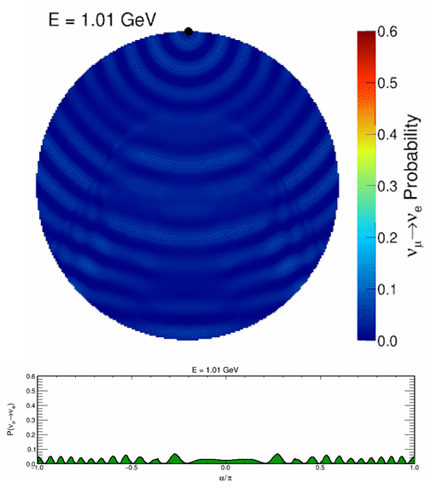
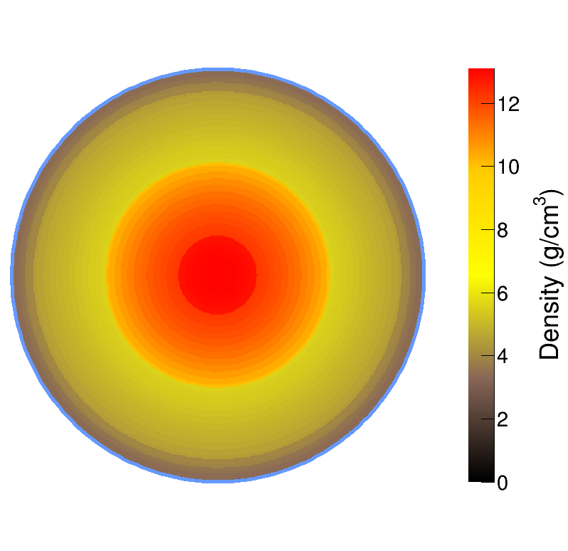
Atmospheric Neutrinos
mantle
core
Oscillations are resonant at certain energies
E_{res} ~ 7 GeV in Mantle
E_{res} ~ 3 GeV in Core
Nue appearance at the surface

Slide 16
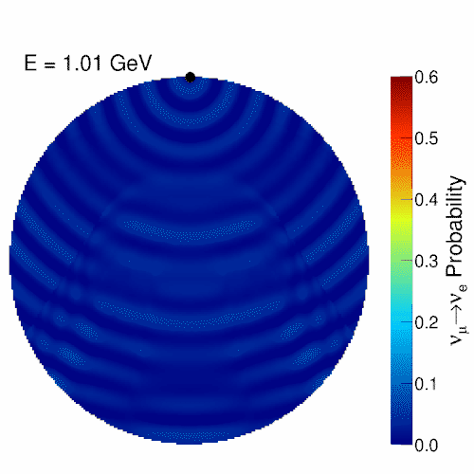
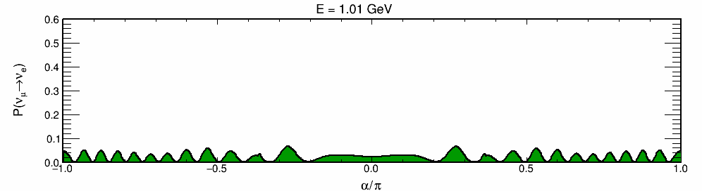
Atmospheric Neutrinos
mantle
core
Oscillations are resonant at certain energies
E_{res} ~ 7 GeV in Mantle
E_{res} ~ 3 GeV in Core
Nue appearance at the surface

Slide 17

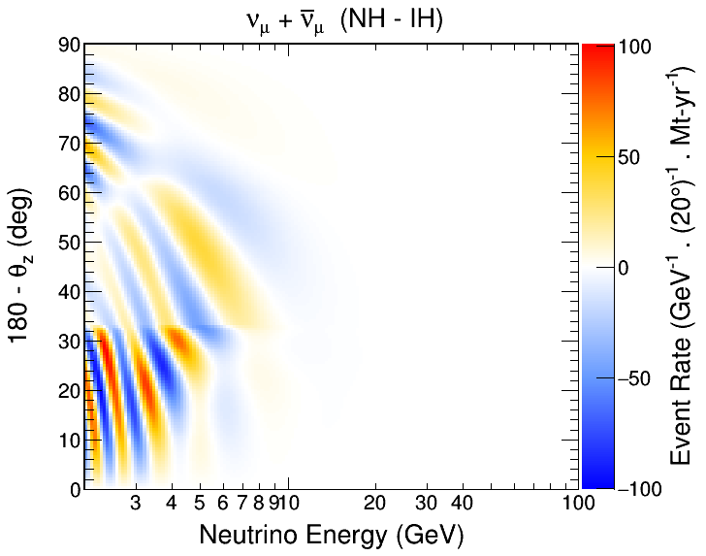
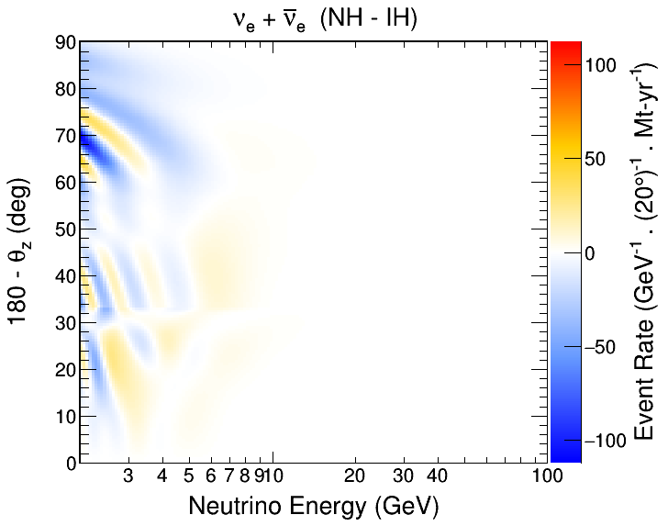
The Challenge
θ_{Z}
Measure neutrino direction and energy
Search for oscillation patterns from matter effects
Sensitive to difference in patterns between NH and IH
Requires large statistics and good energy and direction res.

Slide 18
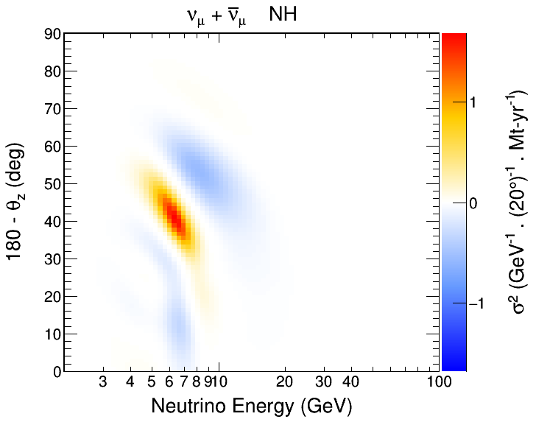
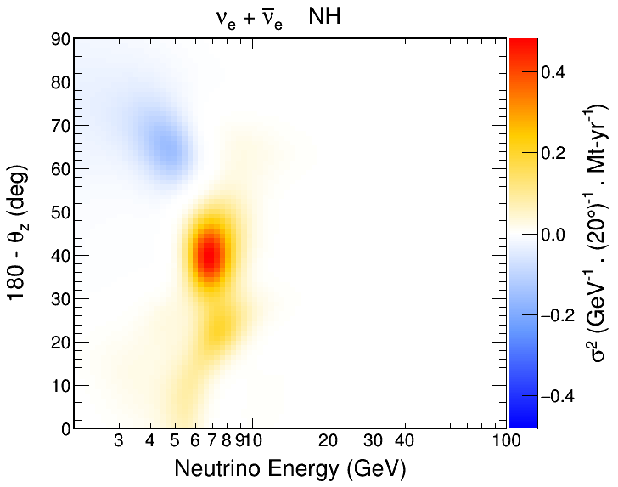
The Challenge
θ_{Z}
Measure neutrino direction and energy
Search for oscillation patterns from matter effects
Sensitive to difference in patterns between NH and IH
Requires large statistics and good energy and direction res.

Slide 19
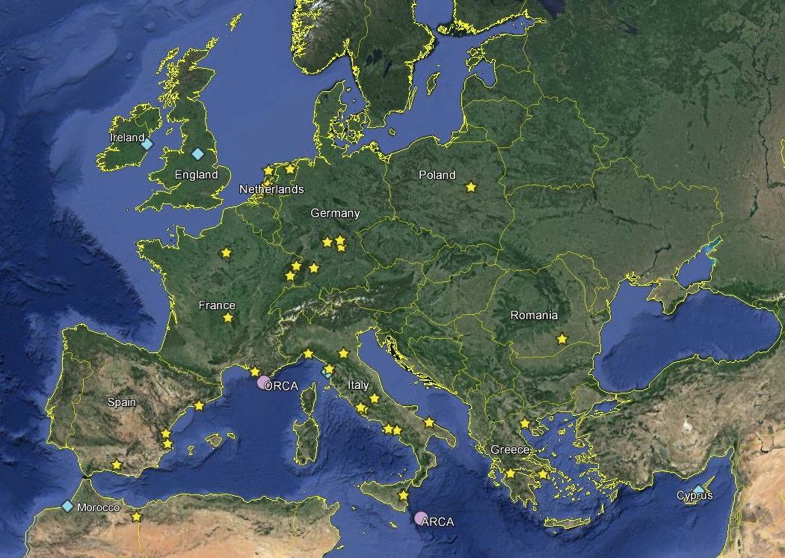


KM3NeT Collaboration
www.km3net.org
>200 scientists
>40 Institutions
9 Countries
ORCA Site:
40km from Toulon
ARCA Site

Slide 20
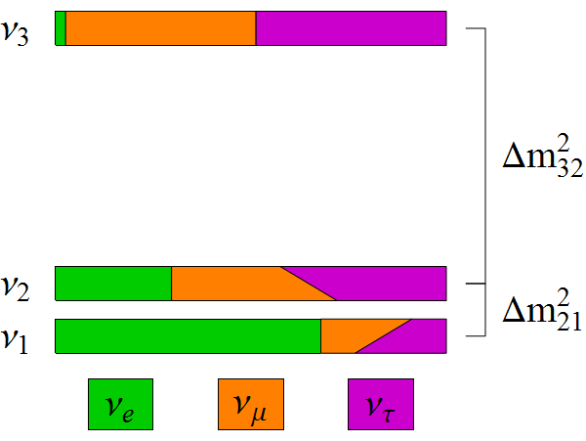
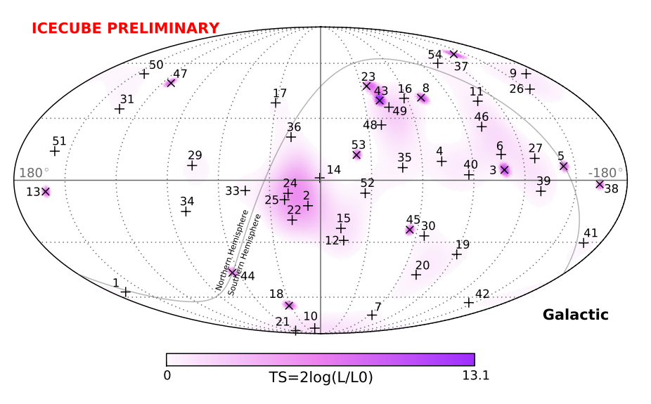
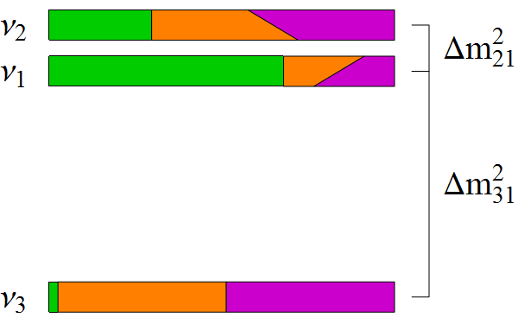
Objectives
ORCA: Determine the Neutrino Mass Hierarchy (NMH)
ARCA: Discover/Observe high-energy neutrino sources in the universe
m²
Normal Hierarchy
Δm²₃₂ > 0
m²
Inverted Hierarchy
Δm²₃₂ < 0

Slide 21
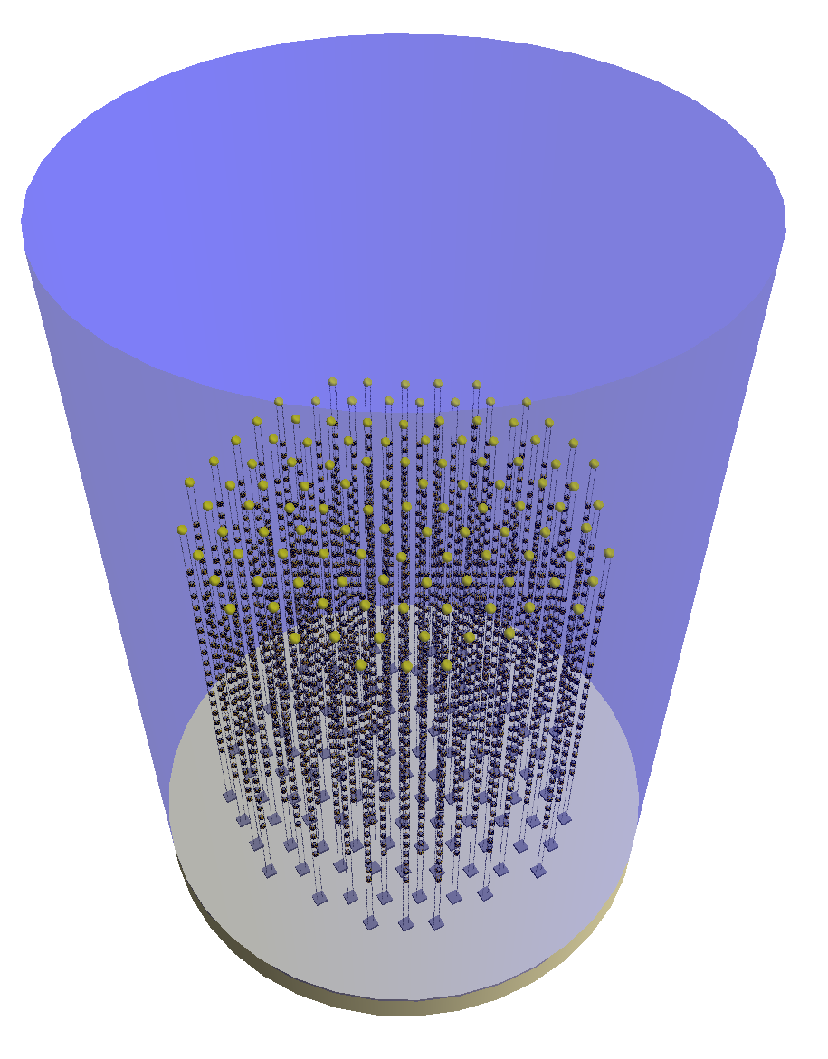
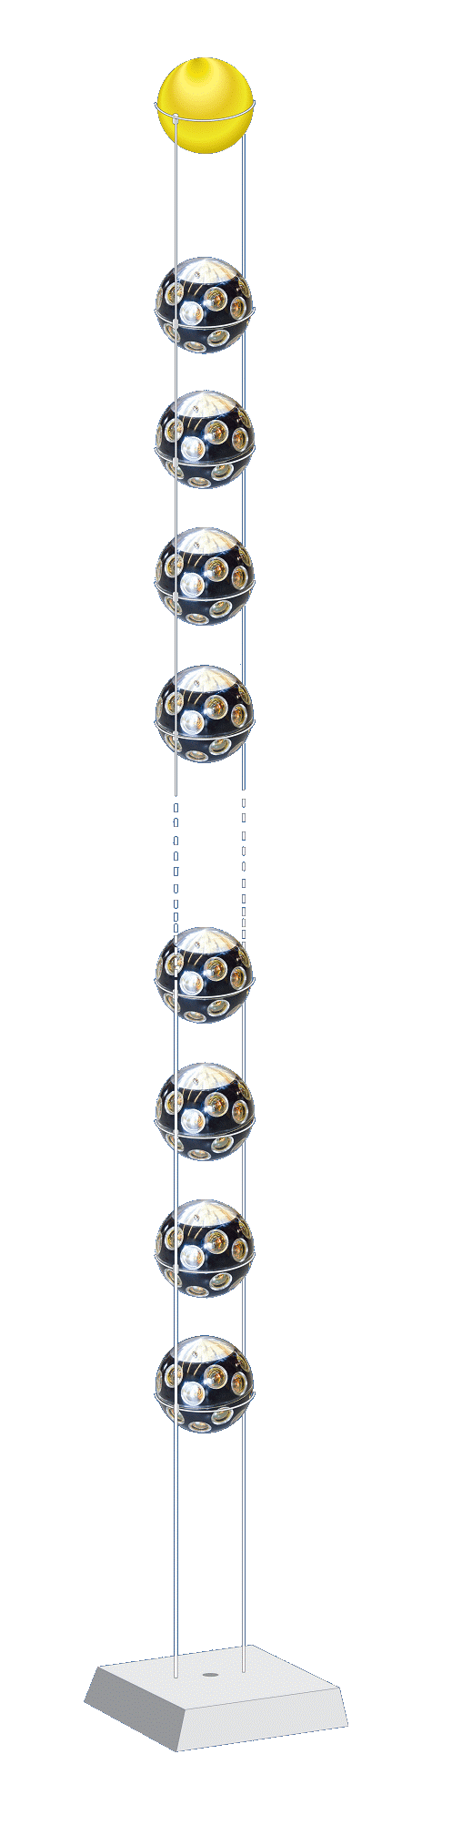
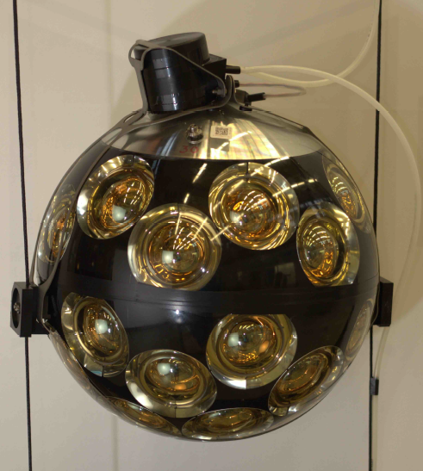
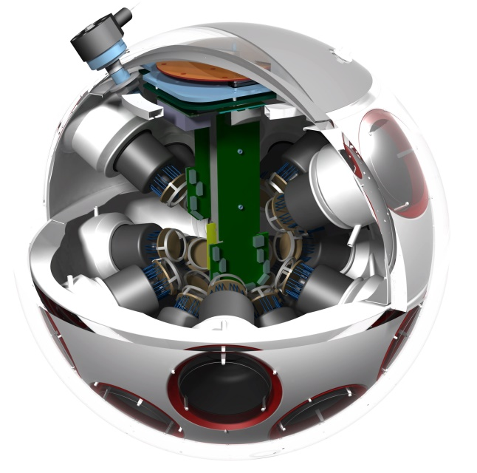
The ORCA Detector
~5.7 Mt instrumented
115 strings (~50 kt ~ 2 × SK)
18 DOMs / str (~3 kt ~ MINOS)
31 PMTs / DOM
Total: 64k PMTs
20 m
43 cm
9 m
~200 m
Optimized for MH sensitivity
~210 m

Slide 22
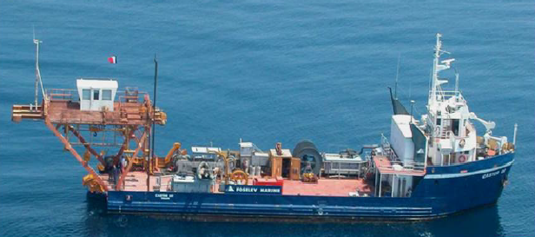
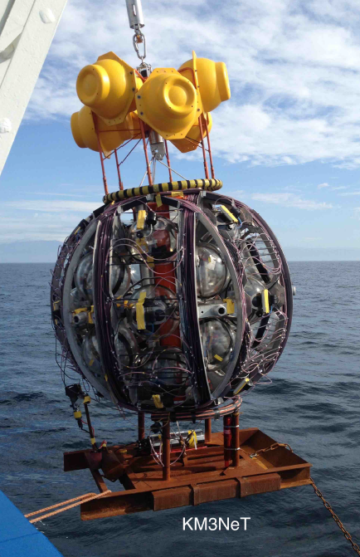
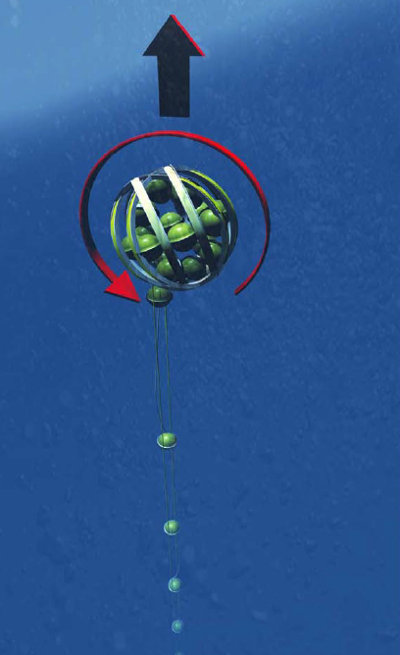

Deployment
String fitted to Launcher Vehicle
Delivered at a depth of 2450m
Dynamic Positioning: 1m precision
ROV connects cable to junction box
Boat triggers unfurling of the string
Watch ARCA string deployment at:
https://www.youtube.com/watch?v=tR8jwgG6uzk
ROV
LV
Unfurling

Slide 23



Measuring Neutrinos
Track-like
Shower-like

Slide 24

Trigger
Optical background mostly from ⁴⁰K decays in the water
Measured: 8 kHz uncorr., 340 Hz level-two coinc. / PMT [Eur. Phys. J. C 74, 3056 (2014)]
Look for coincidences in time and PMT direction to reduce trigger rate.
Causality further restricts space and time correlations for extra power.
⁴⁰K
⁴⁰K
⁴⁰K

Slide 25
Trigger
Optical background mostly from ⁴⁰K decays in the water
Measured: 8 kHz uncorr., 340 Hz level-two coinc. / PMT [Eur. Phys. J. C 74, 3056 (2014)]
Look for coincidences in time and PMT direction to reduce trigger rate.
Causality further restricts space and time correlations for extra power.
β
⁴⁰Ca
⁴⁰Ca
β
β
⁴⁰Ca

Slide 26

Trigger
Optical background mostly from ⁴⁰K decays in the water
Measured: 8 kHz uncorr., 340 Hz level-two coinc. / PMT [Eur. Phys. J. C 74, 3056 (2014)]
Look for coincidences in time and PMT direction to reduce trigger rate.
Causality further restricts space and time correlations for extra power.
Multiple coincidences keep rate below a threshold (~50 Hz)
β
⁴⁰Ca
⁴⁰Ca
β
β
⁴⁰Ca

Slide 27


Trigger Performance
Input a conservative noise rate of 10 kHz uncorr. (500Hz level-two coinc.)
Achieve a total triggered rate of 59 Hz
About 70% of events contain a muon (41 Hz)
High efficiency for ν_{μ} and ν_{e} above 4 GeV
Slightly more efficient for up-going neutrinos (Larger PMT coverage)
ν_{e}-CC

Slide 28
Reconstruction
Start with a track or shower hypothesis
Use causality to perform a robust hit selection
Find vertex and direction that best match hit pattern
Estimate track range for computing track energy (0.24 GeV / m)
Estimate Shower energy and direction from hit distribution after initial fit to the vertex position and time
Track Hypothesis
Shower Hypothesis
θ_{C}

Slide 29





Reco Performance
Energy resolution: ~25% (Close to limit arXiv:1612.05621)
Angular resolution: Better than 10 degrees at relevant energies
ν_{μ}-CC
ν_{e}-CC
θ Res.
θ Res.
ν_{μ}-CC
ν_{e}-CC
E Res.
E Res.

Slide 30


Slide 31




Full Statistical Analysis
Profile over 4 oscillation & 5 systematic parameters
Generate pseudo-experiments and compute
For each MH assumption, LLR distribution will peak at different values
Median sensitivity: probability of observing median LLR of wrong hierarchy for PEs generated with fixed true hierarchy
IH
NH
μ_{IH}
μ_{NH}
σ_{IH}

Slide 32


Sensitivity Results
~3σ MH sensitivity in 3 years
The combination of NH and upper octant of θ₂₃ would significantly improve sensitivity (5σ in 3 years)
The value of δ_{cp} has small but non-negligible impact on sensitivity
In the IH, sensitivity is mostly independent of octant of θ₂₃
Best case scenario could achieve >5σ by mid 2021 (1.5 years)

Slide 33

Other Parameters
High statistics and excellent resolution → Measure Δm²₃₂ and sin²θ₂₃
Competitive with NOvA and T2K projected sensitivity in 2020
Achieve 2-3% prec. in Δm²₃₂ and 4-10% in sin²θ₂₃
Also sensitive to:
Oscillation into tau neutrinos
Earth chemical profile
Non-Standard Interactions
Sterile Neutrinos
And more…
Inverted Hierarchy
T2K 2015
1σ contours
T2K 2020
NOvA 2020
MINOS
KM3NeT
KM3NeT (No E-Scale)

Slide 34
Beyond the Standard Model

Slide 35


Extended Models
Arbitrary
Perturbation
Non-Standard Interactions (NSI)
Sterile Neutrinos (3+N Flavours)
NC Contribution

Slide 36


Enhanced Matter Effects
NSI (ε_{eτ} = 0.2)
Steriles (“Curr.” Limits)
Visit https://goo.gl/CJyFoK for more

Slide 37
Non-Standard Interactions

Slide 38



NSI Motivation
Arbitrary
Perturbation
Non-Standard Interactions (NSI)
Dimension-6
+ Naturalness
TeV Scale
~ 10⁻²

Slide 39



Non-Standard Interactions
Direct limits are very weak on 3 of the 6 possible new couplings
Rich phenomenology, i.e. complicated analysis with many free parameters
Still need to study the ideal approach for ORCA
Often correlated:
J. Coelho et al., Phys. Rev. D86, 113015 (2012)
Direct Bounds
See T. Ohlsson, Rep. Prog. Phys. 76, 044201 (2013) for a review

Slide 40


Resonances w/ NSI
ε_{ee} = 1
ε_{eτ} = 0.5, ε_{ττ} = 0.25
θ₂₃
θ₂₃
θ₁₂
θ₁₂
θ₁₃
θ₁₃

Slide 41


NSI Phase Space
Very different from MH for nue
Sensitivity in both channels, but numu is correlated with MH
Still under unrealistic assumptions:
Perfect flavour selection
No systematics or nuisance pars.
ε_{eτ} = 0.2, ε_{ττ} = 0.04

Slide 42


NSI Phase Space
Very different from MH for nue
Sensitivity in both channels, but numu is correlated with MH
Still under unrealistic assumptions:
Perfect flavour selection
No systematics or nuisance pars.
ε_{eτ} = 0.2, ε_{ττ} = 0.04

Slide 43



ORCA et al.
[1] JHEP 0908:090 (2009)
[2] Phys. Lett. B594:347 (2004)
[3] PRD 86, 113015 (2012); PRD 88, 072011 (2013)
[4] Phys. Rev. D 84, 113008 (2011)
[5] M. Day and A. Karle, P3.093 Neutrino 2016
[6] Joao Coelho, P2.026 Neutrino 2016
[7] Phys. Lett. B739:357 (2014)

Slide 44
Sterile Neutrinos

Slide 45




Sterile Neutrinos (3+1)
|U_{τ4}|²
|U_{e4}|²
|U_{μ4}|²
App. Hints
Super-K
Super-K
MINOS+
MINOS+
IceCube
Solar+Reactors
Super-Kamiokande: Phys. Rev. D 91, 052019 (2015)
IceCube: Phys. Rev. Lett. 117, 071801 (2016)
MINOS+: Justin Evans, Neutrino 2016
Solar+Reactors: Mod. Phys. Lett. A 28, 1330004 (2013)
MINOS
IceCube

Slide 46


Resonances w/ Steriles
New resonant peak due to Δm²₄₁
Some intermediate behaviour between θ₁₃ and θ₁₄ resonances
θ₂₃ suppression seems to be fairly independent of Δm²₄₁
Δm²₄₁ = 0.3 eV²
θ₂₃ Suppression
θ₁₂
θ₂₃
θ₁₄
V_{e}
V_{n}
m₄²
θ₃₄
m₂²
θ₁₃
m₃²
m₁²
θ₂₄

Slide 47


Resonances w/ Steriles
New resonant peak due to Δm²₄₁
Some intermediate behaviour between θ₁₃ and θ₁₄ resonances
θ₂₃ suppression seems to be fairly independent of Δm²₄₁
Δm²₄₁ = 10 eV²
θ₂₃ Suppression
θ₁₂
θ₂₃
θ₁₄
V_{e}
V_{n}
m₄²
θ₃₄
m₂²
θ₁₃
m₃²
m₁²
θ₂₄

Slide 48


Tau Coupling
DeepCore
ORCA/PINGU
Super-K and DeepCore probed low-E with similar sensitivity
cosθ_{z} < -0.9
|U_{μ4}|² at IC limit
|U_{τ4}|² = 0.18
Probability Difference
δ₂₄ = {0, π/2, π, 3π/2}
IceCube Analysis
Region
U_{τ4} = 0
A. Terliuk, P2.024 Neutrino 2016
ORCA/PINGU can probe the U_{τ4} coupling at low energies
At high energies, effect is related to U_{μ4}
New constraints on U_{μ4} impact sensitivity at low energy too

Slide 49



ORCA Studies
Strong sensitivity with ν_{μ} channel
Very different from 3ν resonance
Still under unrealistic assumptions:
Perfect flavour selection
No systematics or nuisance pars.

Slide 50


Preliminary Sensitivities
Promising sensitivity in U_{τ4} mixing
Consider only 1-year of data (statistics dominated)

Slide 51
And more…

Slide 52

Earth Tomography

Slide 53


Slide 54
Summary
ORCA is being built in the Mediterranean sea to measure oscillations with atmospheric neutrinos
Main goal is to determine the Neutrino Mass Hierarchy
ORCA will also improve measurements of other oscillation parameters such as Δm²₃₂ and θ₂₃
Lots of potential for other searches: sterile neutrinos, NSI, earth tomography, tau neutrinos, etc.
If funded, NMH could be determined by 2023
Read our LoI at: J. Phys. G 43 (2016) 0840 https://arxiv.org/abs/1601.07459

Slide 55


Thank you!

Slide 56

Funding and Schedule
Construction is ongoing
2 strings in operation (ARCA)
7 strings funded for ORCA (11 M€ inc. infrastructure)
Total ORCA cost: ~45 M€
Ongoing funding requests to complete full detector
7 Strings
Operational
115 Strings
Full Detector
MH
Determination
ORCA Construction
2016
2017
2018
2019
2020
2021
2022
2023
2024
2025

Slide 57


Atmospheric Neutrinos
Factor of ~2 between nue and numu
Factor of ~2 between nu and nubar
nm + nm = (nm + nm + ne + ne) -> (nm + nm)

Slide 58


Resonance Formulas
Depends on
sign of Δm²₃₁ (MH)

Slide 59


Reco Performance
Better than 13˚ directional resolution above 5 GeV
Energy res. sensitive to vertical spacing between DOMs at low energies
ν_{μ}-CC
ν_{e}-CC
θ Res.
θ Res.
ν_{μ}-CC
ν_{e}-CC
E Res.
E Res.

Slide 60


Optimizing DOM Spacing
Simulated small (6m) vertical spacing detector
Mask off 1/3, 1/2 or 2/3 of DOMs to emulate larger spacing
Smaller spacing enables measurement at lower energies
Larger spacing improves statistics due to larger volume
Simulated small (6m) vertical spacing detector
Mask off 1/3, 1/2 or 2/3 of DOMs to emulate larger spacing
Smaller spacing enables measurement at lower energies
Larger spacing improves statistics due to larger volume
Tune spacing to obtain maximum sensitivity to Mass Hierarchy
ν_{μ} + ν_{μ} CC
ν_{e} + ν_{e} CC

Slide 61


Optimizing DOM Spacing
Simulated small (6m) vertical spacing detector
Mask off 1/3, 1/2 or 2/3 of DOMs to emulate larger spacing
Smaller spacing enables measurement at lower energies
Larger spacing improves statistics due to larger volume
Tune spacing to obtain maximum sensitivity to Mass Hierarchy
Derived from data in the KM3NeT 2.0 LoI: https://arxiv.org/abs/1601.07459

Slide 62

Simple χ² Analysis
9m spacing achieves best sensitivity
9m
12m
True NH
6m
Mass Hierarchy Sensitivity
True IH

