Slide 1
Top-EFT “discussion”
Jeremy Andrea, Frédéric Déliot

Slide 2
Introduction
Effective Field Theory as a tool to search for new physics.
With not direct signs of new physics, searches within the EFT framework is more and more relevant.
There are also strong arguments to move away from the so called ”Anomalous Couplings” interpretation to full EFT interpretation.
Outline :
Reminder about EFT,
Various ways of searching for EFT,
Modelling and MC challenges,
Toward a global fit,
LHCTopWG.

Slide 3
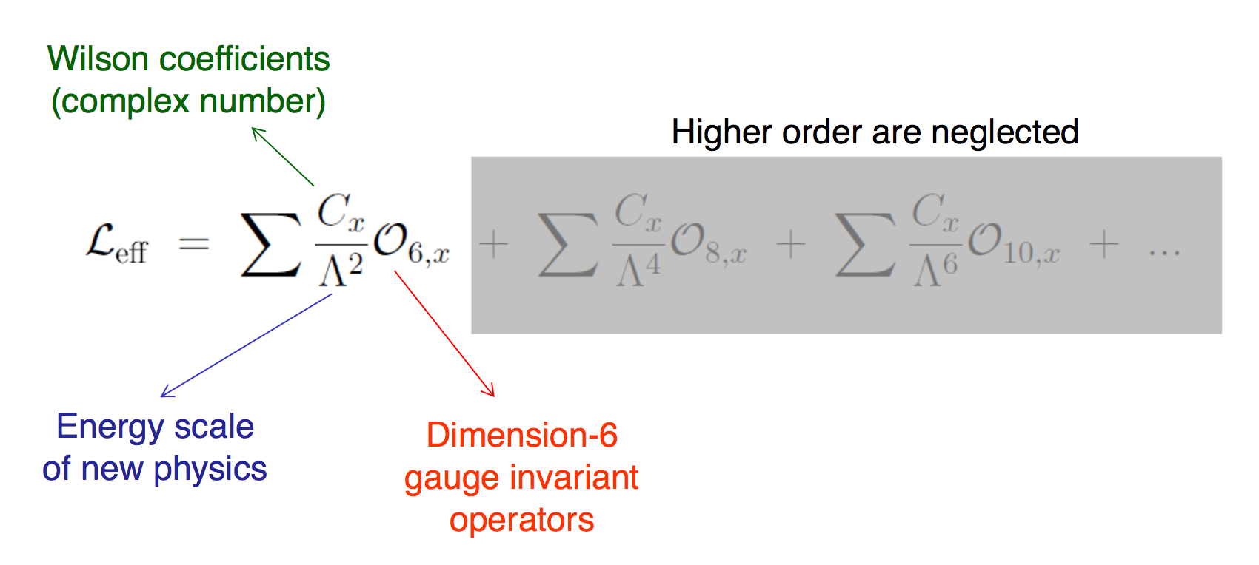
Effective Field Theory
New vertices arise from the contributions of new particles (new physics) living at the loop level.
If the new particles are heavy enough => modelling of the loop by a new interaction vertex.
Theoretically better defined than AC, preserve SM gauge symmetries.
Predict additional features
4 fermion interactions,
Inter-dependence of couplings,
Mixings at NLO.
3

Slide 4
EFT and anomalous couplings

Slide 5
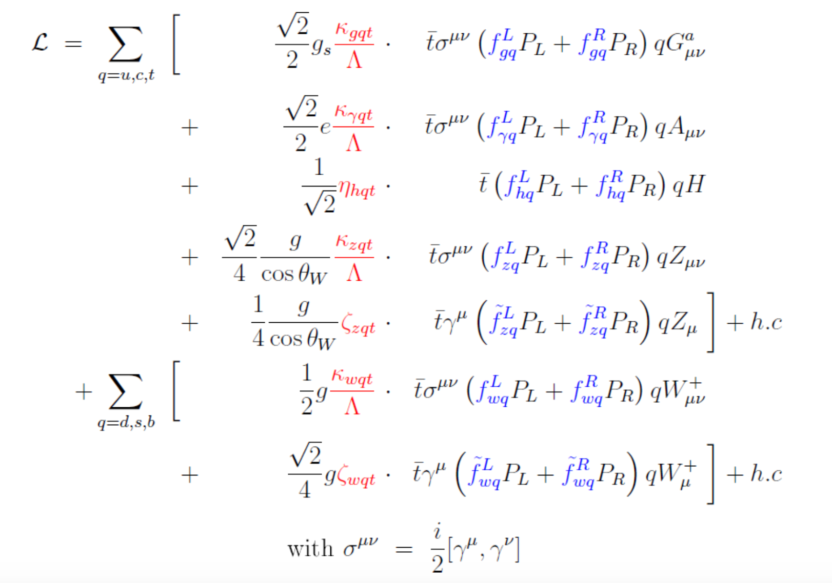
EFT and anomalous couplings
gluon
photon
Top FCNC
Higgs
Z-1
Z-2
Top-W AC
But also ttZ, ttH, tt$γ$, ttg

Slide 6
EFT and anomalous couplings
One can re-interpret anomalous couplings in terms of EFT couplings.
Here example for FCNC.
Warning : different conventions
Same EFT couplings can enters into different anomalous couplings !!
Anomalous couplings are not independent !!
Combinations of searches = improvement of the sensitivity.

Slide 7
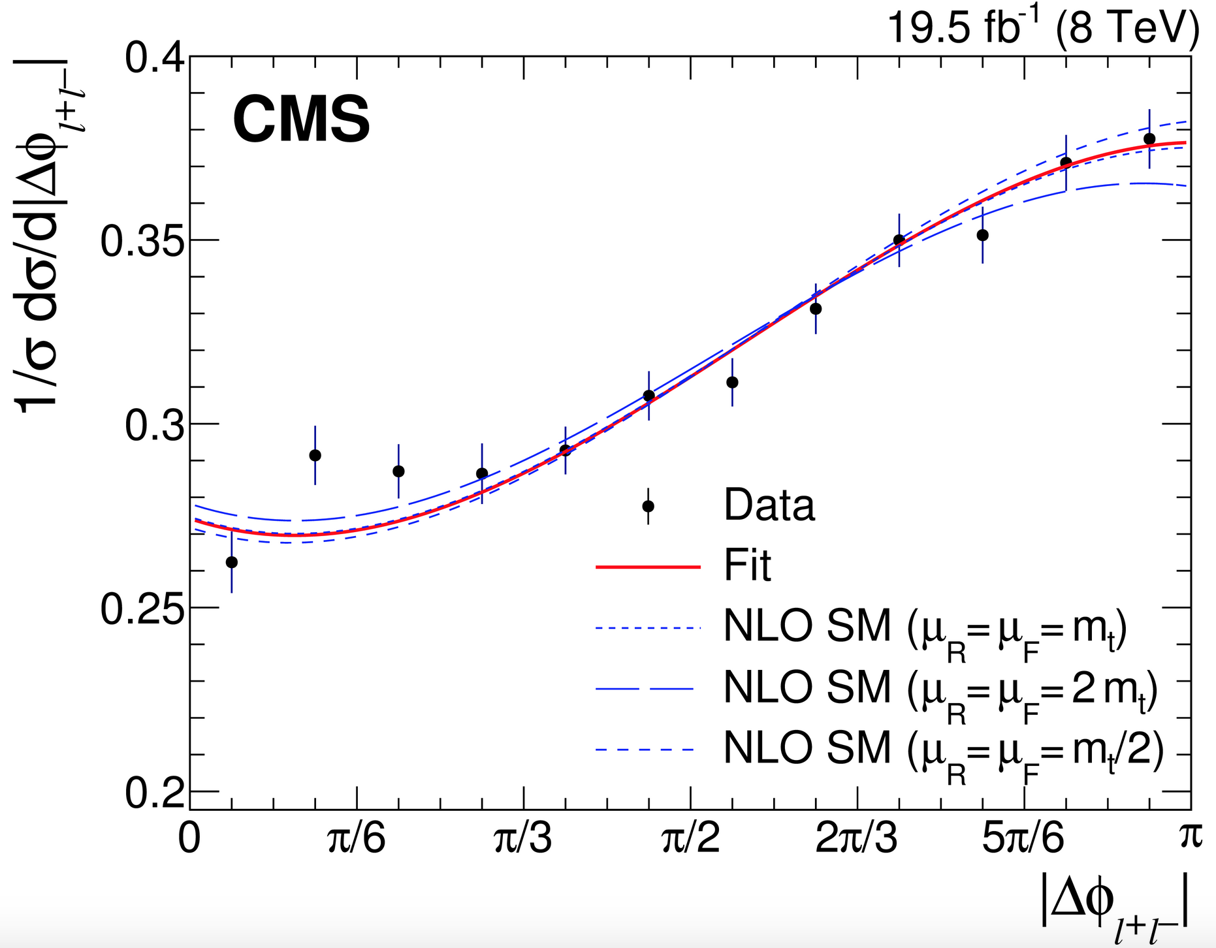
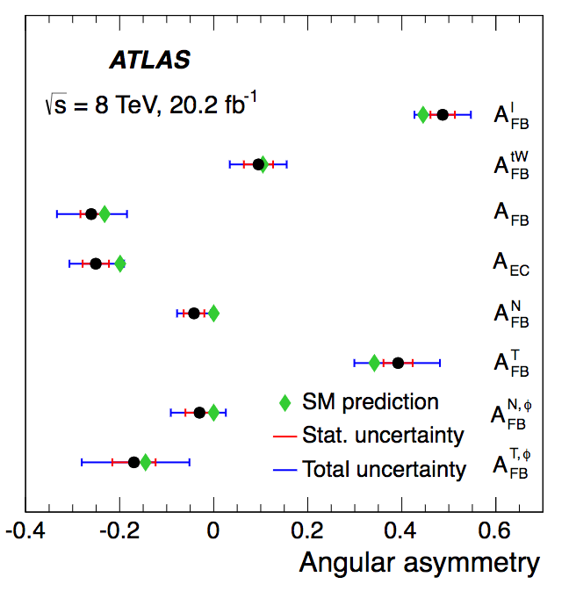
How to search for EFT: (1) Reinterpretation
Phys. Rev. D 93 (2016) 052007
Reinterpretation of existing measurements.
Inclusive and differential cross sections, top properties (spin correlation, polarisation, etc…),
Use unfolded/fiducial measurements.
Pros : relatively easy (technicalities), theorists should have access to the material needed for re-interpretation, measurements will be there in any case (”little” extra work).
Cons : not optimal, strategy difficult (impossible) for MVA-based analyses (like FCNC-searches).
arXiv:1702.08309

Slide 8
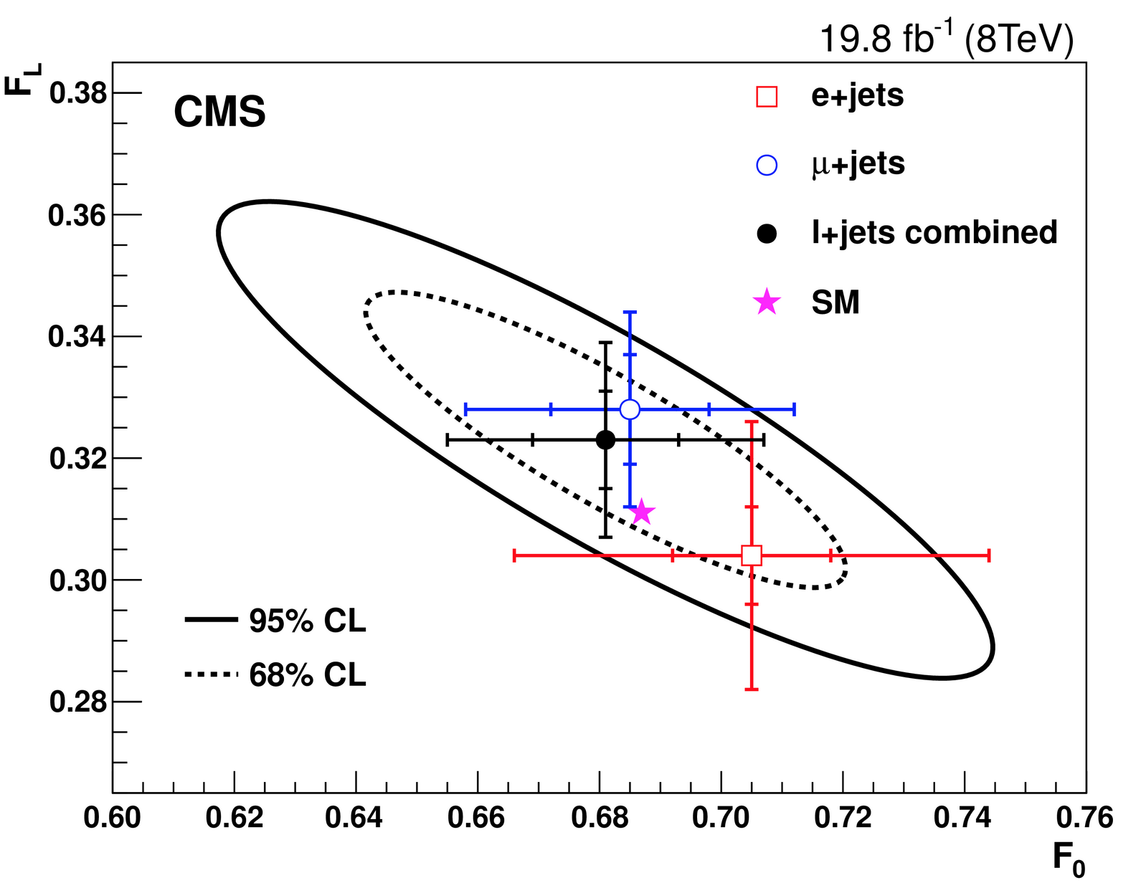
How to search for EFT: (2) Direct searches with PO
Pseudo-observables (PO) : physics observables which depend on EFT.
Typical example : W helicity fractions.
Pros : easier to interpret (more intuitive)?
Cons : have to be defined for all operators (a lot of pheno work needed).

Slide 9
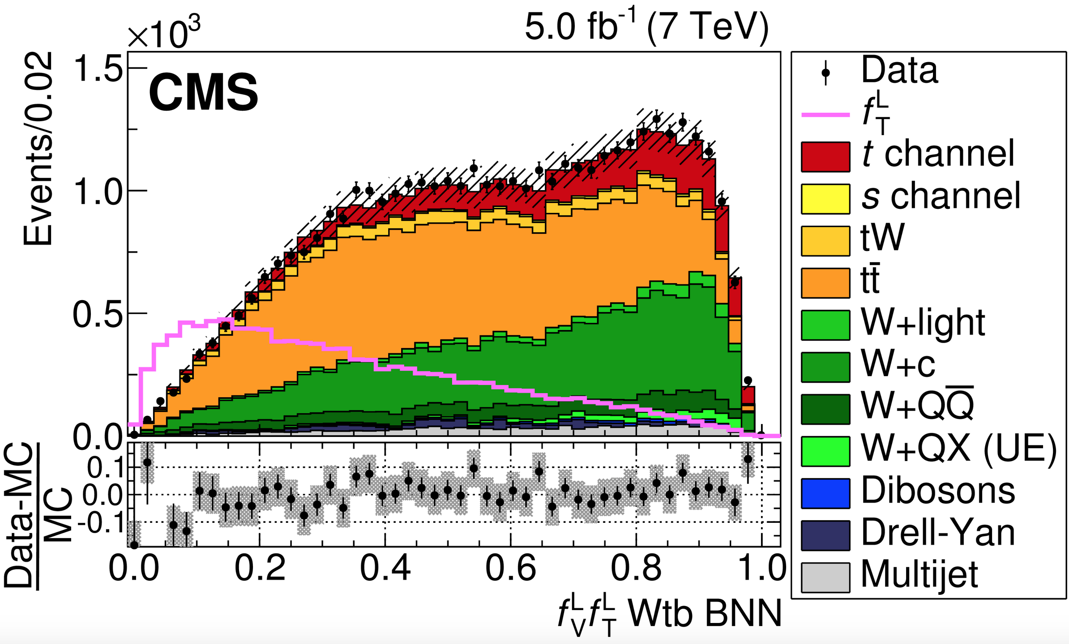
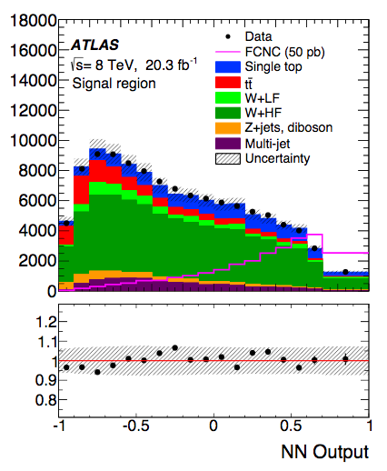
How to search for EFT: (3) Direct searches, EFT coupling
Direct searches for EFT couplings.
Somehow already done for FCNC (for example) and tWb anomalous couplings.
Pros : this is probably the most sensitive approach, only relevant strategy for some searches (like FCNC).
Cons : what material to provide to theorists for re-interpretation ? MC production can be heavy.
arXiv:1610.03545
Eur. Phys. J. C76 (2016) 55

Slide 10
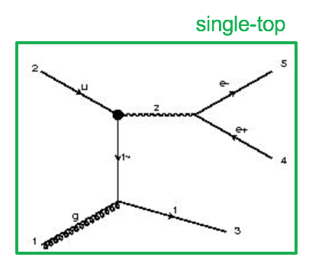
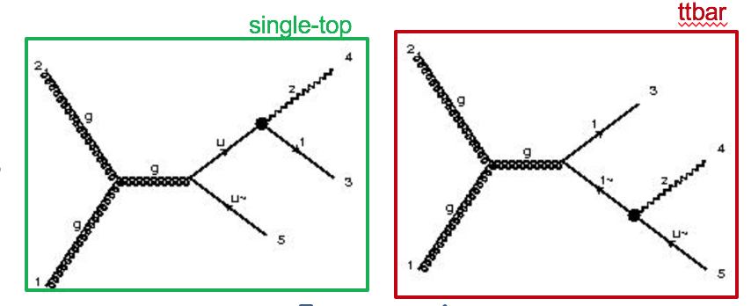
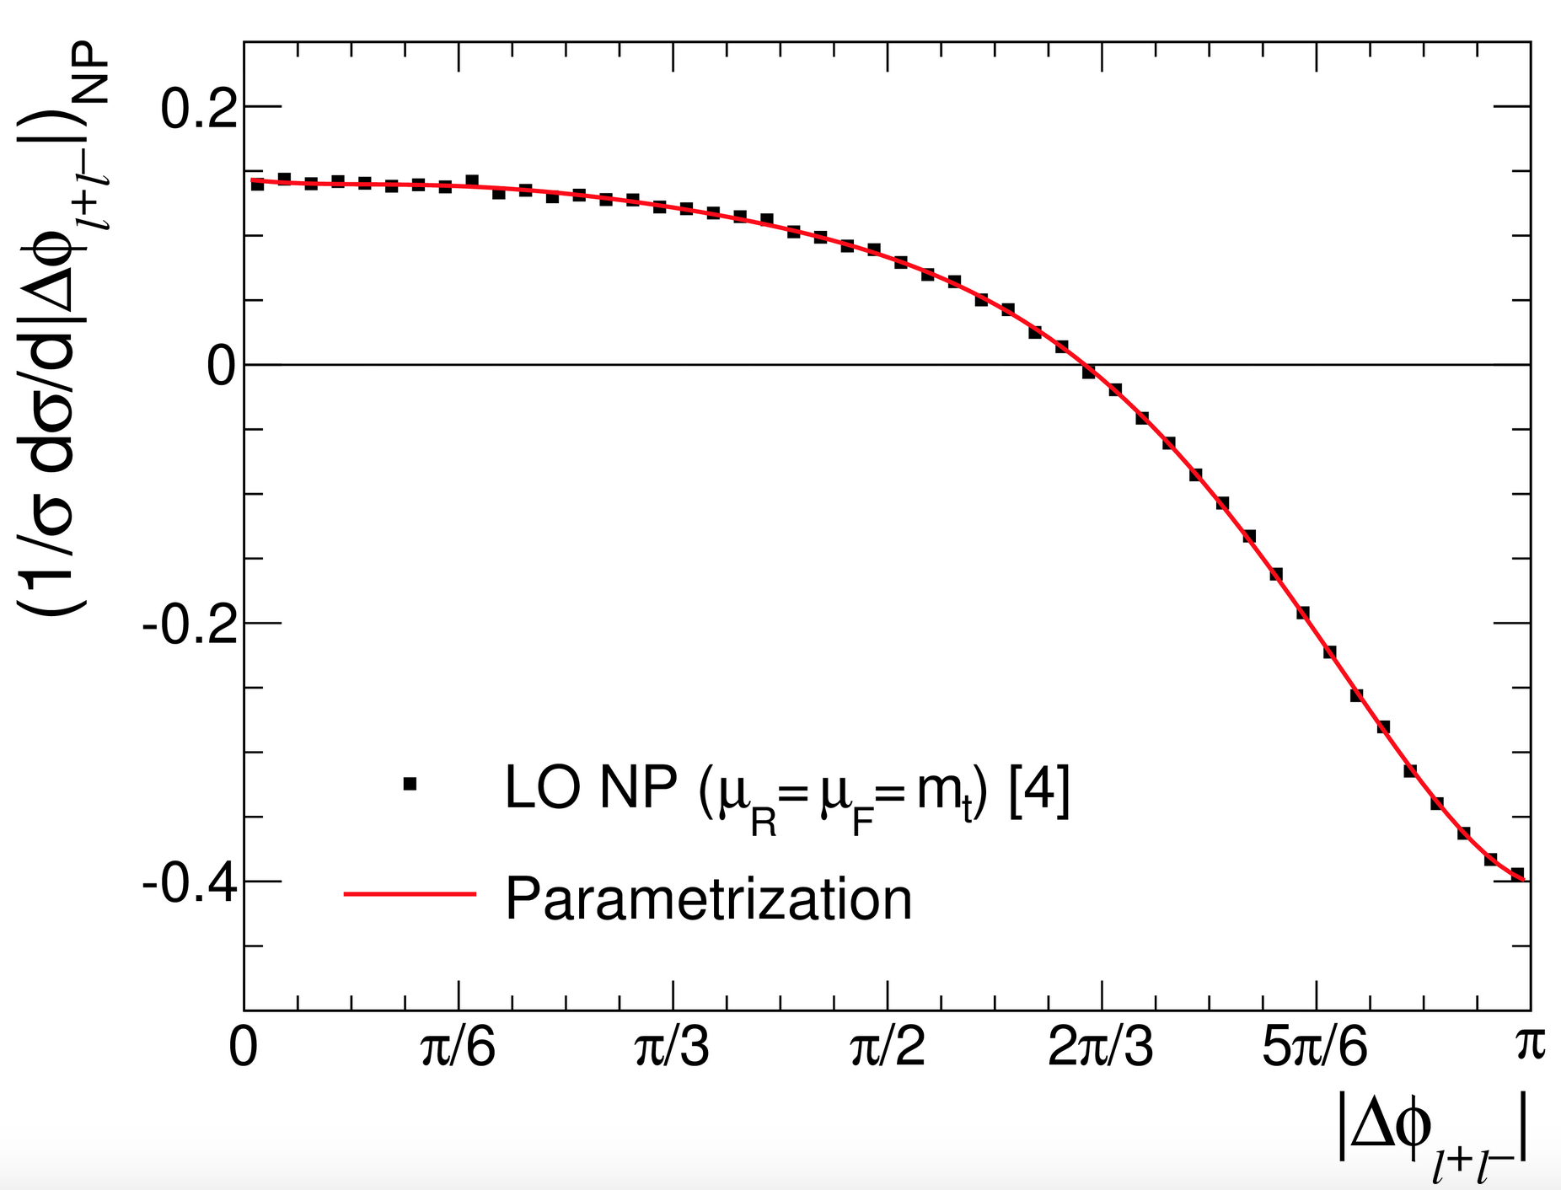
MC production : a real challenge
Interferences between single top and ttbar,
Difficult to generate (similar situation as tt-tWb interferences).
+0j
+1j
Interferences with the SM,
More relevant for SM-like signatures (CMDM for example)
Big number of dimension 6 operators.
very large MC productions,
can we factorize the MC production ? By generate interfering and non-interfering terms separately?
Can MC weights be used ?
Etc… etc...
Phys. Rev. D 93 (2016) 052007

Slide 11
Global fit for EFT
Why a global fit ?
multiple EFT operators can contribute to the same signatures,
same EFT operators can contribute to multiple signatures,
Operators even mix at the NLO.
To maximise the sensitivity, to resolve ambiguities, one can perform a so called “global fit”.
How can it be done ?
Using re-interpretation of fiducial measurements.
No MC generation needed, “just” cross sections (in the fiducial volume?).
Not very optimal.
Using dedicated searches.
Better optimised, so more sensitive,
Fit of templates needed, or development of tools,
MC production is complicated.

Slide 12
LHCTopWG and EFT
First discussions on a harmonized approach for EFT interpretation.
Questions to answer :
Same conventions for the modelling ?
What material to provide for re-interpretation ?
Is a global fit feasible, and how ?
…
Top-EFT working group has been formed, with representatives of ATLAS, CMS and theorists.
First step : provide a document to be used as a reference for EFT analyses :
Report “à la DM forum” link
A first draft will be provided by theorists in the coming weeks, then iteration with experiments,

Slide 13
Conclusions
EFT interpretation is an important way of searching for new physics => particularly if no direct signs of new physics observed.
Once a model is well define, various approaches are possible.
Reinterpretation of cross sections and unfolded measurements.
Probably possible with a limited amount of efforts,
Pheno : what material to provide ?
Experimental paper, interpretation to be considered in the design of analyses.
“Reco-level” analyses.
Probably higher sensitivity,
Requires more work on the generation/simulation sides.
Global fit is the ultimate goal, but very complicated. Strategy/feasibility to be tested with ”simple” cases ?

