Slide 1
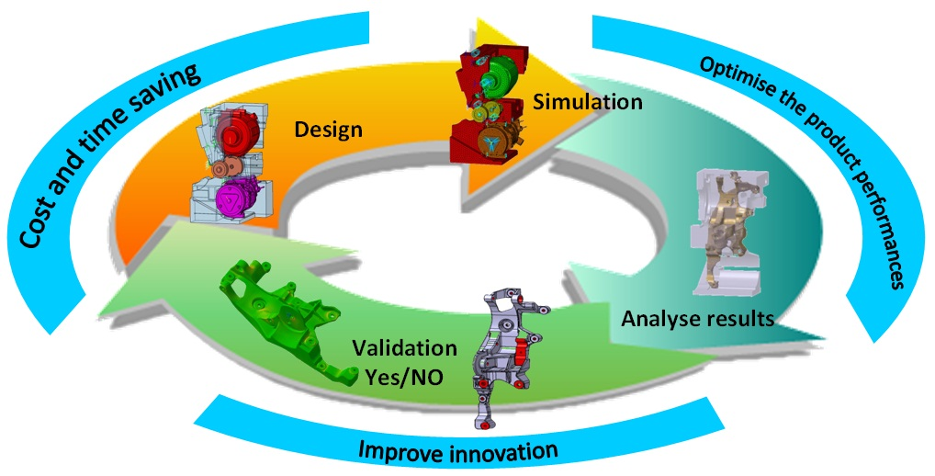
Review of electronics simulations
Pascal Baron (CEA-Irfu)
Instrumentation Days on gaseous detectors, GANIL, October 5, 2017

Slide 2
outline
  History of electronic simulation
  History of SPICE model
  Simulation environment (CADENCE framework)
  Simulation analysis
  Layout simulation
  Summary & Conclusion

Slide 3
History of electronic simulation

Slide 4
preamble
  In electronic, there is 2 domains: Analog & Digital.
  The design in this 2 domains doesn’t use the same tools coming from the high complexity of the digital circuit.
  For this talk, I will focus on the analog domain which forms the main part of the front-end electronic used for the readout of the gaseous detectors.
  Some of the content of this presentation was obtained using the CADENCE framework used by a large number of circuit designers.

Slide 5
Electronic simulator history
  The electronic (circuit) simulator first began to appear in the late 1960’s and early 70’s. It is the explosive growth of the integrated circuit market in the 1970’s that precipitated the rise of importance of circuit simulation.
  Two groups contributed significantly to the development of the modern circuit simulator. The ASTAP group at IBM developed many of the numerical method’s used. And the SPICE group at the University of California at Berkeley developed and propagated the de facto standard simulator.
  CANCER (Computer Analysis of Non-linear Circuits, Excluding Radiation): Early 1970s, developed by Professor Rohrer & Nagel at University of California Berkley. This Simulation program performs DC, AC and Transient Analysis. Components include diodes (Shockley equations) and bipolar transistors (Ebers-Moll equations).
  Bipolar describes by 18 parameters. [Circuit size < 400 components; 100 transistors & diodes].
  SPICE1 (Simulation Program with Integrated Circuit Emphasis): In 1972, Nagel & Pederson release SPICE1 into public domain. SPICE becomes industry standard simulation tool. Models for bipolar transistors changed to Gummel-Poon equations. JFET and MOSFET devices are added. It is written in FORTRAN code.

Slide 6
Electronic simulator history
  SPICE2: Nagel’ 1975 release offers significant improvements. Modified Nodal Analysis (MNA) which now supports voltage sources and inductors. Memory is dynamically allocated to accommodate growing circuit size and complexity. Adjustable time-step control speeds simulation. MOSFET and bipolar models overhauled and extended. Version SPICE2G.6 (1983) is the last FORTRAN version.
  SPICE3: In 1985, SPICE code rewritten in the C programming language. Features a graphical interface for viewing results. Includes polynomial capacitors, inductors and voltage controlled sources. New version eliminates many convergence problems. Added models: MESFET, lossy transmission line and non-ideal switch. Improved semiconductor models accommodate smaller transistor geometries. Not backward compatible with SPICE2. Improvements until 1993 (last version SPICE 3f5 by UC Berkeley).
  1980’s and BEYOND: Commercial versions released include: HSPICE, IS_SPICE and MICROCAP. MicroSim releases PSPICE, the first PC version of SPICE. SPICE attracts many more users in industry and academia. Companies integrate SPICE versions to their schematic and layout packages.
  TODAY: Circuit simulator tools are carried out by the 3 major EDA companies: Cadence, Mentor Graphics and Synopsys. Their simulators Spectre, Eldo and HSPICE added such features as steady-state and harmonic analysis for RF, Hardware Description Languages, Verilog-AMS and VHDL-AMS, and a slew of new semiconductor device models.
  Open-source SPICE software: Public-domain as NGSPICE, QUCS and XYCE.
  SPICE simulator + Component models from IC companies as Analog Devices and Linear Technology.

Slide 7
History of spice model

Slide 8
Spice model history
  Good algorithms are only one part of the accuracy equation in circuit simulation.
  The model of the semiconductor devices is the another part !!
  Device models used by SPICE simulations can be divided into five classes:
  First MOS-models came in the beginning of the 70’s: Three levels,
  Level 1 (L-> 5 µm), 1970: analytical mode, I_{D}(sat) is described by square law - strong inversion (with Channel Length Modulation).
  Level 2 (L-> 2 µm), 1980: analytical mode more detailed than MOS1. Includes second order effects, e.g. mobility degradation, small channel effects and sub-threshold currents.
  Level 3 (L-> 1 µm), 1981: Semi-empirical model. Uses simpler expressions than MOS2 plus empirical equations to fit experimental data. Improves accuracy and reduces simulation time. Accurate and efficient. Widely used.
  2nd generation :
  BSIM1 (L-> 0.8 µm), 1987: Berkeley Short Channel IGFET Model 1. New knowledge about short channel effects. Many fitting parameters for improved scaling
  BSIM2 (L-> 0.35 µm), 1990: Improved model continuity, specifically output conductance and sub-threshold current.

Slide 9
Spice model history
  3rd generation :
  BSIM3 (L-> 0.1 µm), 1994: Total re-write. The idea was to have a simple model with few physical parameters. It represents a MOSFET with many electrical and structural parameters, among which, only W and L are under control of the circuit designer. All the rest are fixed for all MOSFETs integrated in a given fabrication technology (there are over 200 parameters in some versions of BSIM3 models).
  4th generation :
  BSIM4 (L < 0.1 µm), 2000: It is the extension of BSIM3 model, addresses the MOSFET physical effect into sub-100 nm regime. It is used for the 0.13 µm, 90 nm, 65 nm, 45/40 nm, 23/28 nm and 22/20 nm technology nodes.
  5th generation :
  BSIM-BULK (BSIM6) (L < 0.1 µm), 2011: It is a charge-base model (BSIM4 is a threshold voltage-based model). It provides excellent accuracy compared to measured data in all regions of operation.

Slide 10
Simulation environment

Slide 11
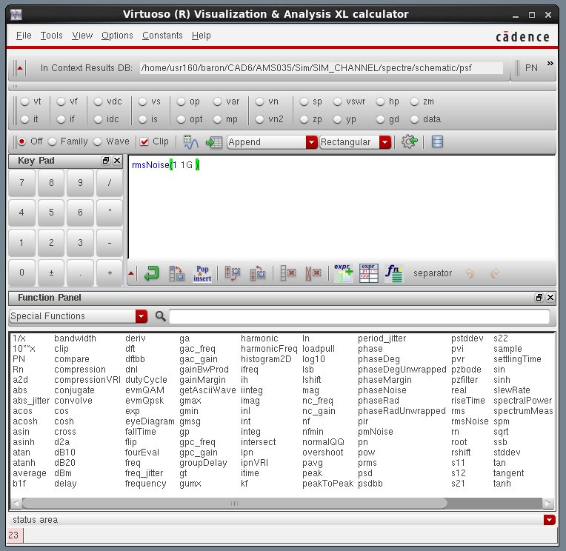
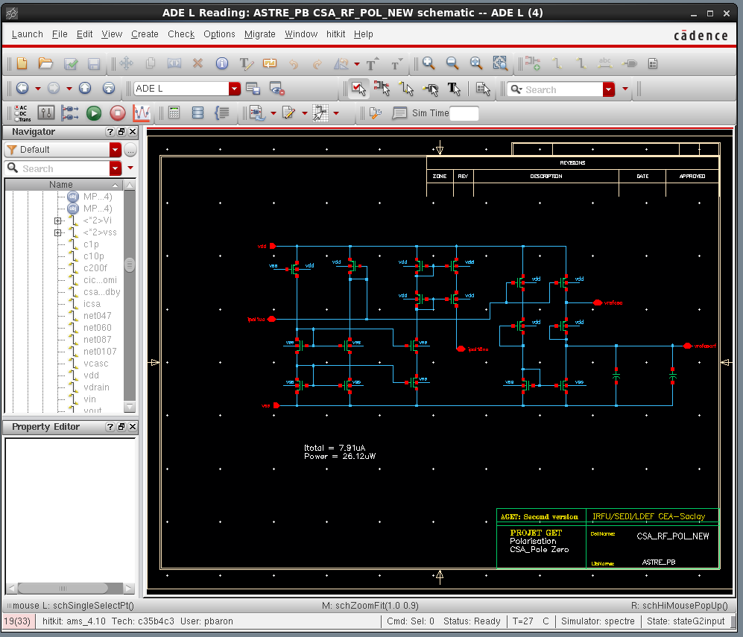
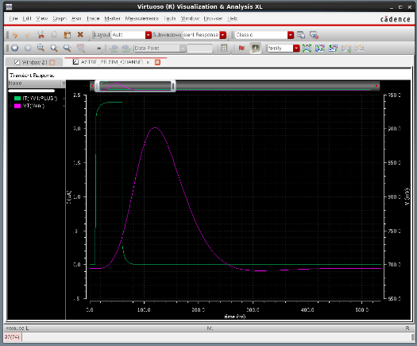
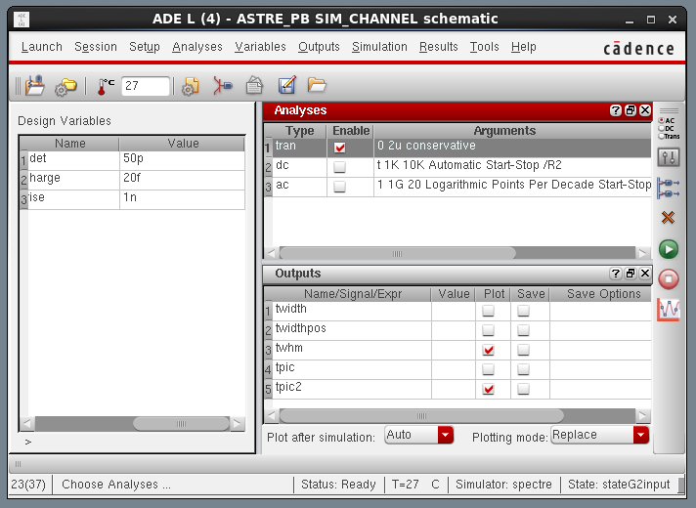
Simulation environment
  CAD tools: Framework (CADENCE, MENTOR GRAPHICS, SYNOPSYS ..): Schematic => Layout
  Process Design Kit: Delivers by Foundry & supported by the main EDA companies
Process Design Kit
Foundry
Schematic Symbols
SPICE Models
post-processing
CAD tools
Schematic Editor
(netlist)
Simulator
Visualization

Slide 12
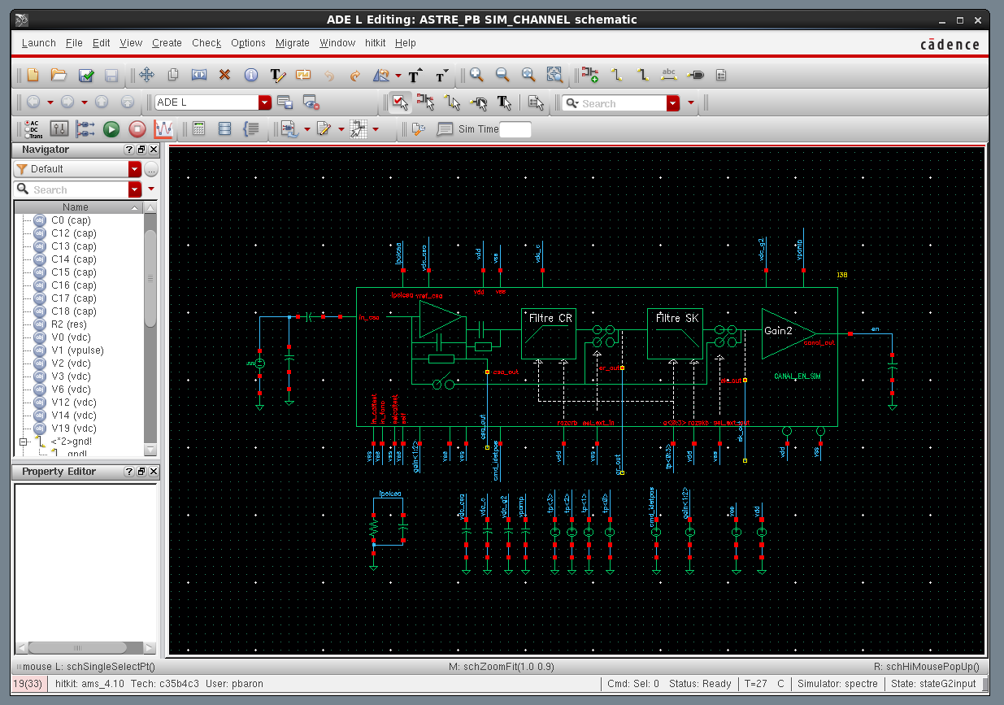
Schematic editor
  Schematic window: hierarchical structure (symbol -> schematic -> symbol ..)
Process Design Kit
Top Level
Schematic on
next page

Slide 13
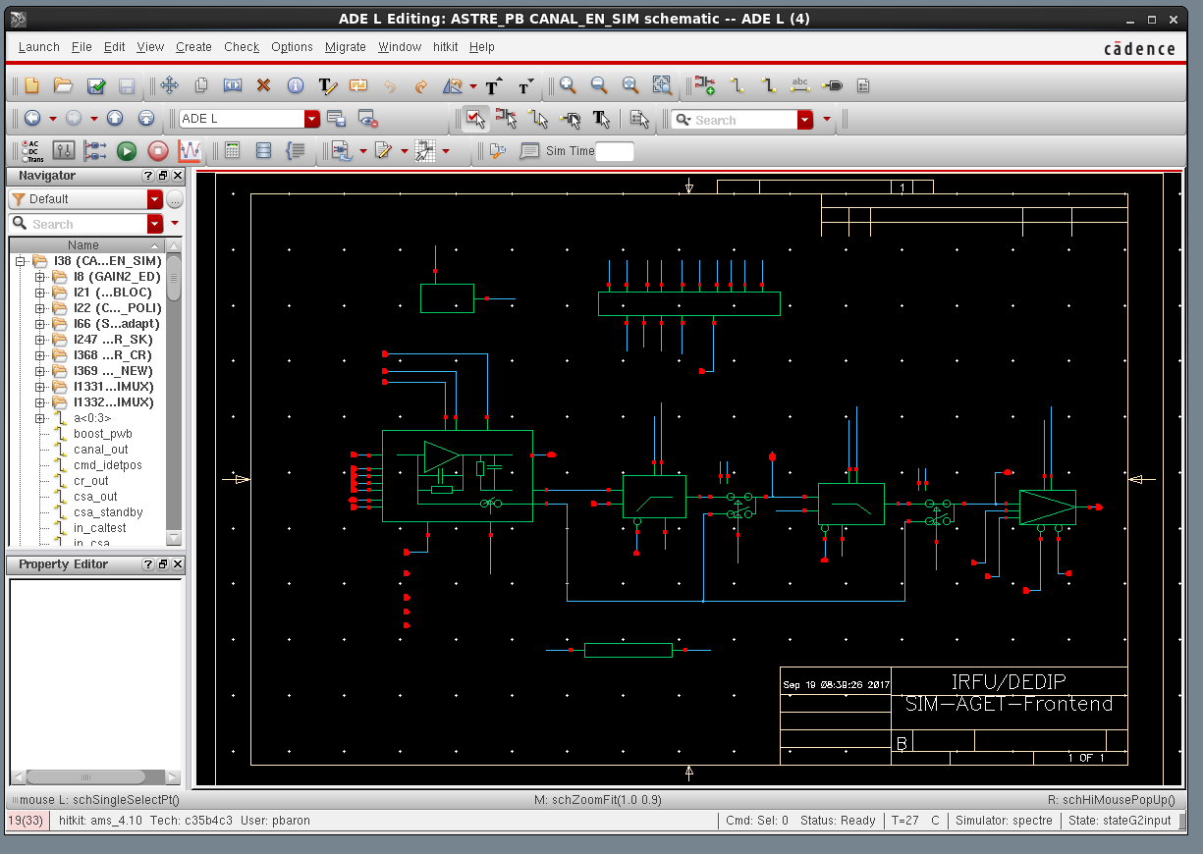
Schematic editor
  Schematic window: schematic of CANAL_EN_SIM (I38)
Process Design Kit
Schematic on
next page

Slide 14
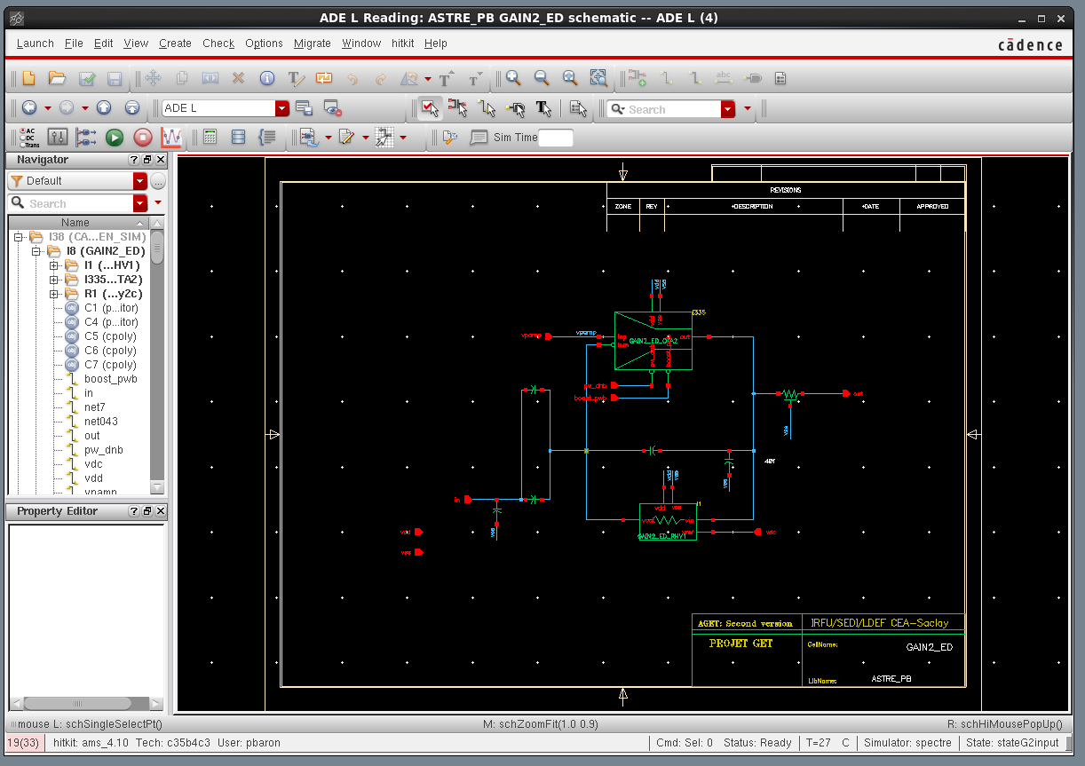
Schematic editor
  Schematic window: schematic of GAIN2_ED
Process Design Kit
Schematic on
next page

Slide 15
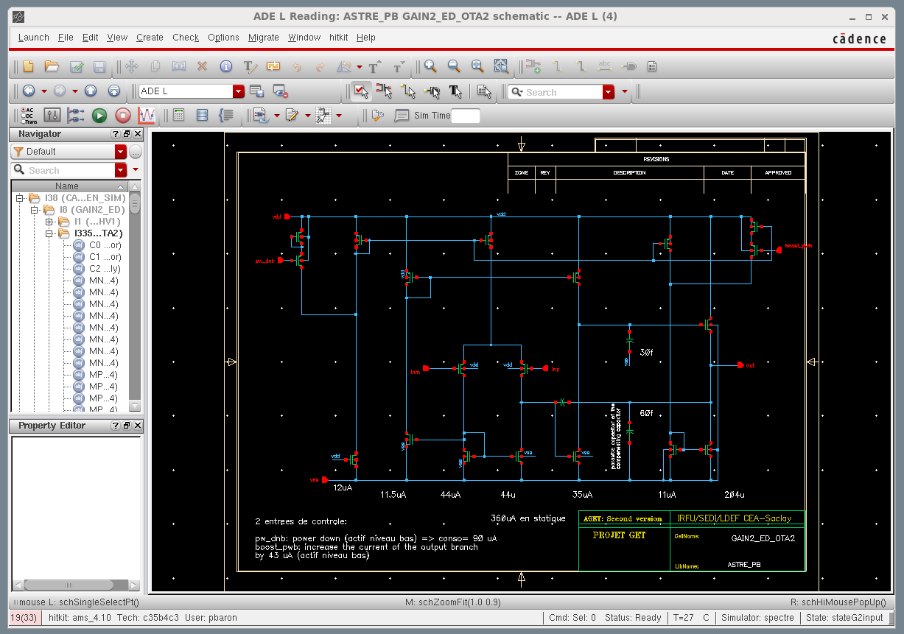
Schematic editor
  Schematic window: schematic of GAIN2_ED_OTA2
  It is the lowest level: Transistor, capacitor, resistor.
Process Design Kit

Slide 16
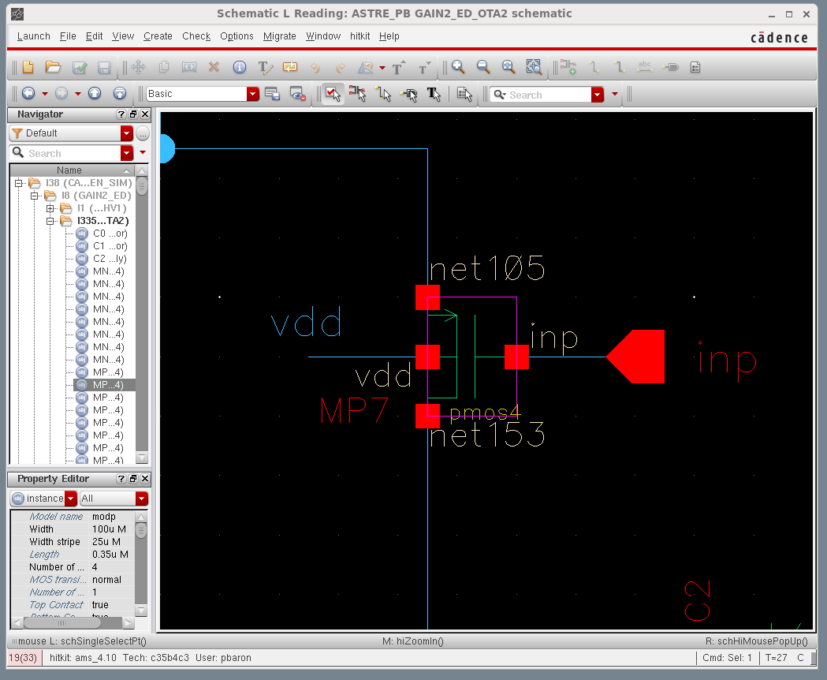
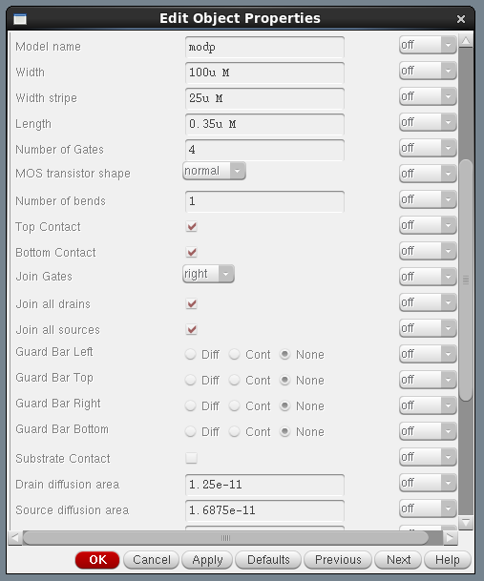
Component parameters
  Transistor MOS: model, W&L.
Process Design Kit

Slide 17
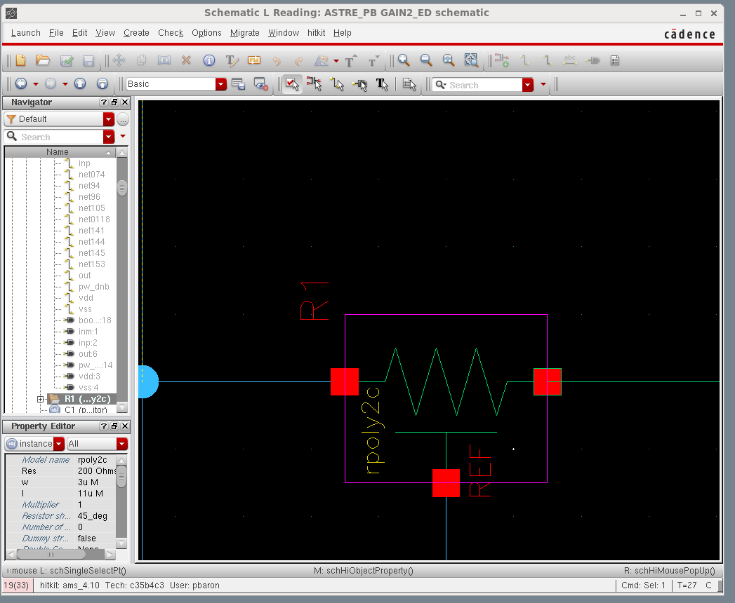
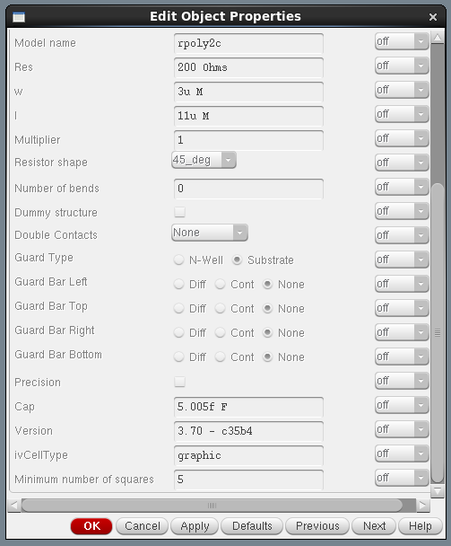
Component parameters
  Resistor: model, R (W&L).
Process Design Kit

Slide 18
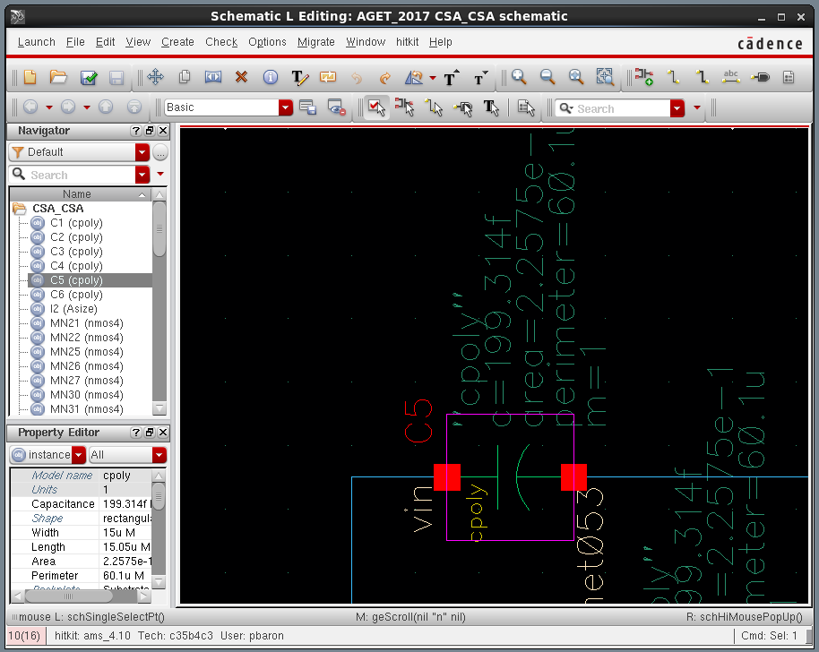
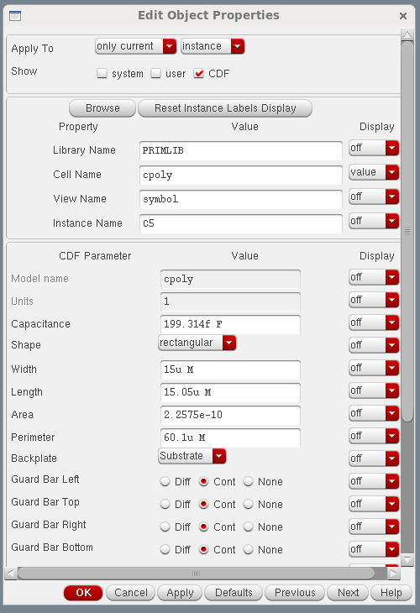
Component parameters
  Capacitor: model, C (W&L).
Process Design Kit

Slide 19
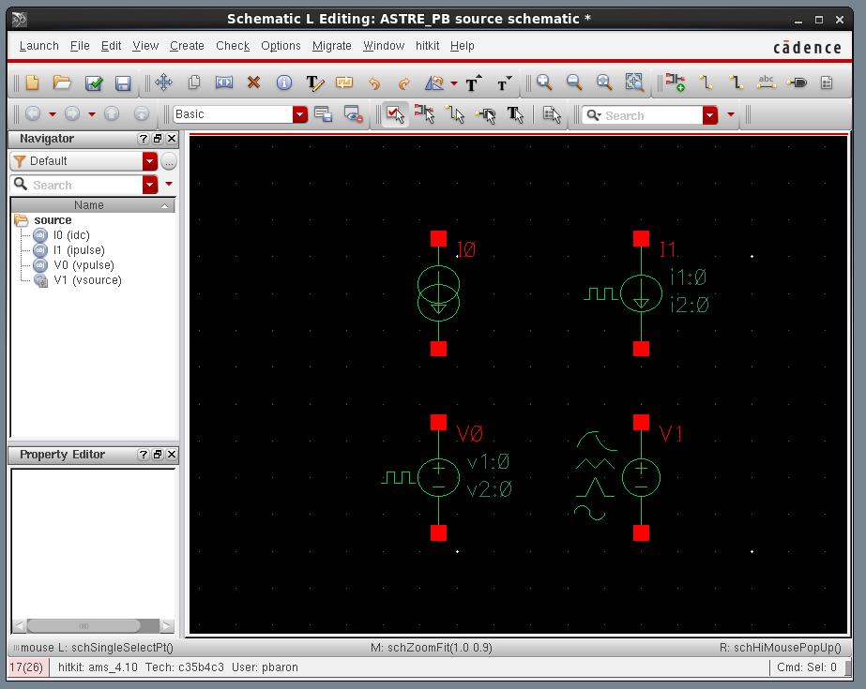
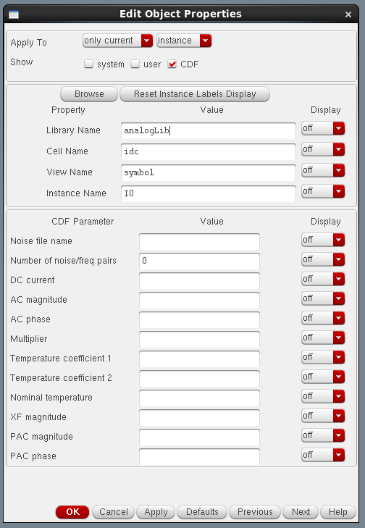
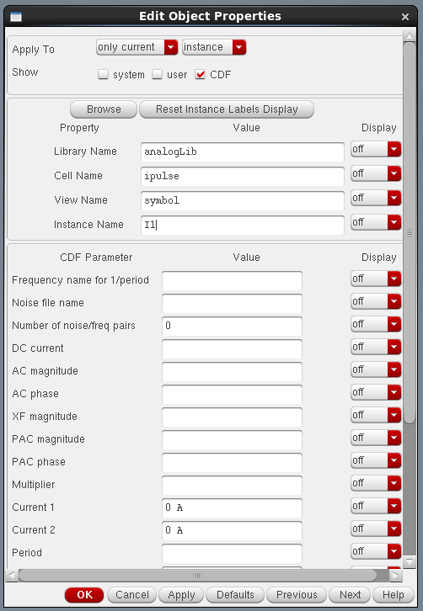
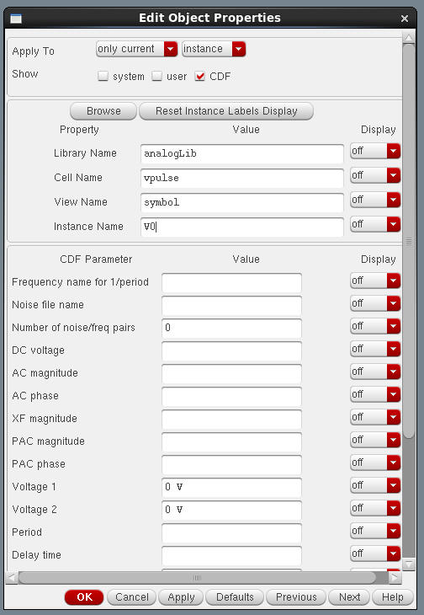
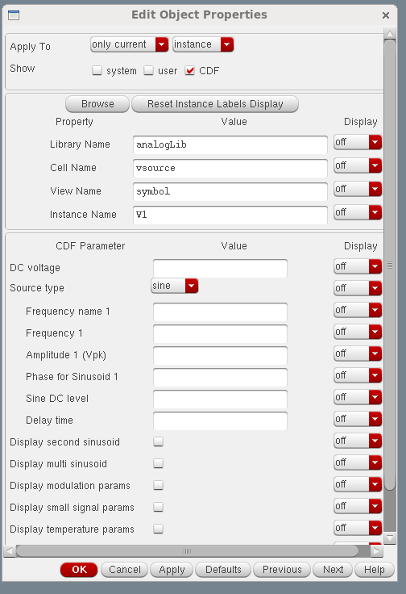
Voltage/current source parameters
  Voltage, current: AC, DC, Transient, File ...

Slide 20
Simulation analysis

Slide 21
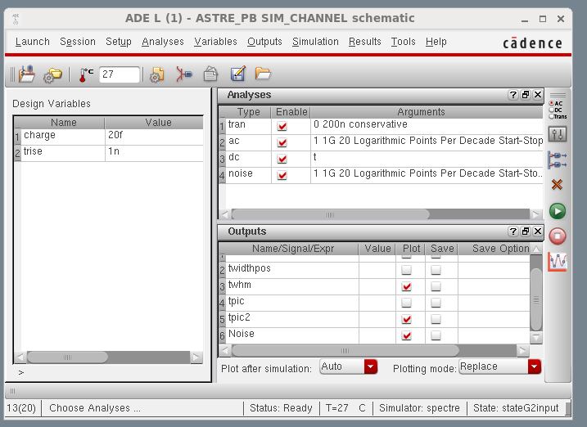
Simulation analysis
  The basic simulation types are: DC, AC, Noise and Transient
Analyses
Design
variables
Outputs

Slide 22
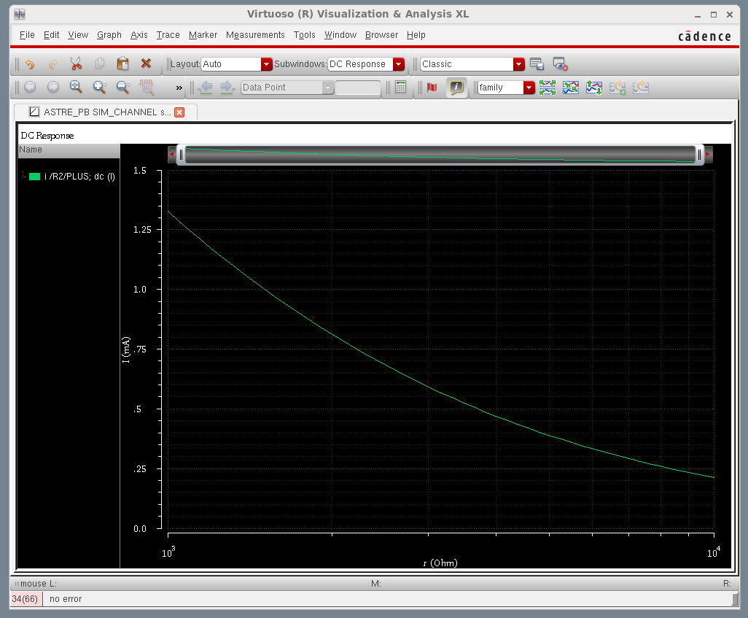
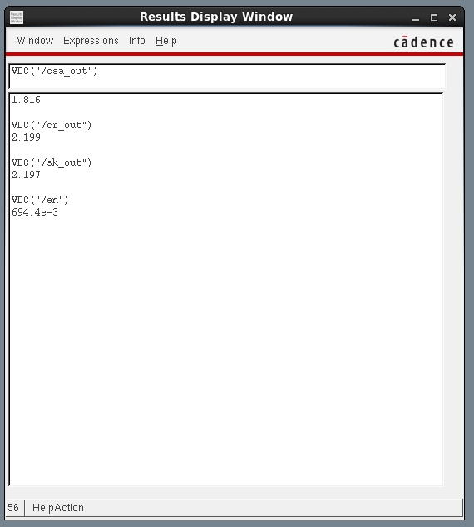
Dc analysis
  The DC analysis finds the DC operating point or DC transfer curves of the circuit
  The transfer curves need to specify a parameter and a sweep range

Slide 23
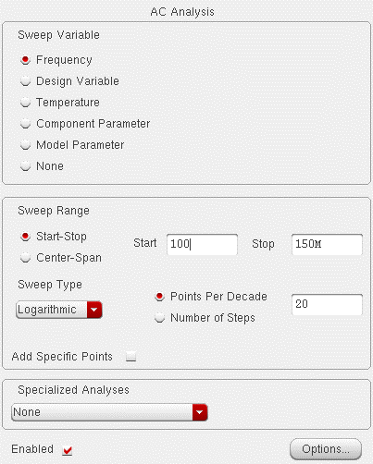
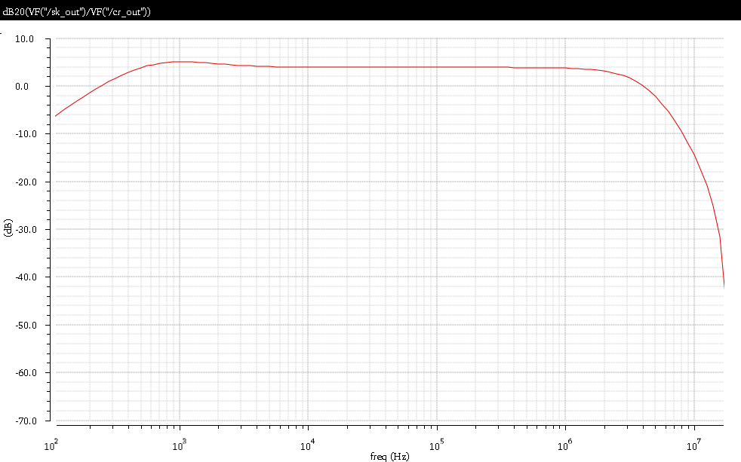
Ac analysis
  AC Small-Signal linearizes the circuit about the DC operating point and computes the response to a given small sinusoidal stimulus.
  Simulator can perform the analysis while sweeping a parameter.
  Note: since the circuit is linearized, no saturation effects will occur using AC analysis.

Slide 24
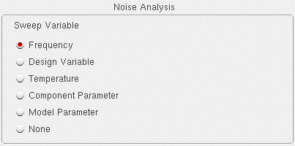
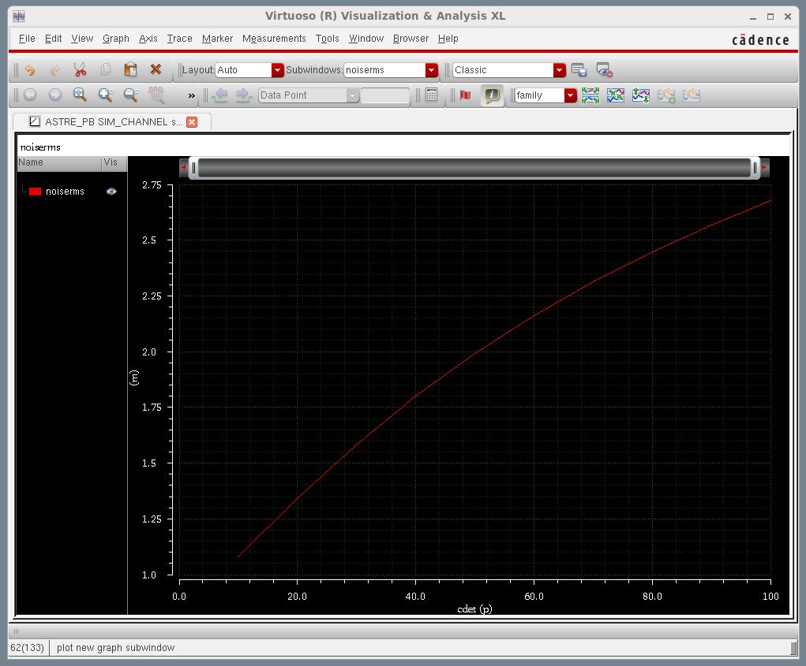
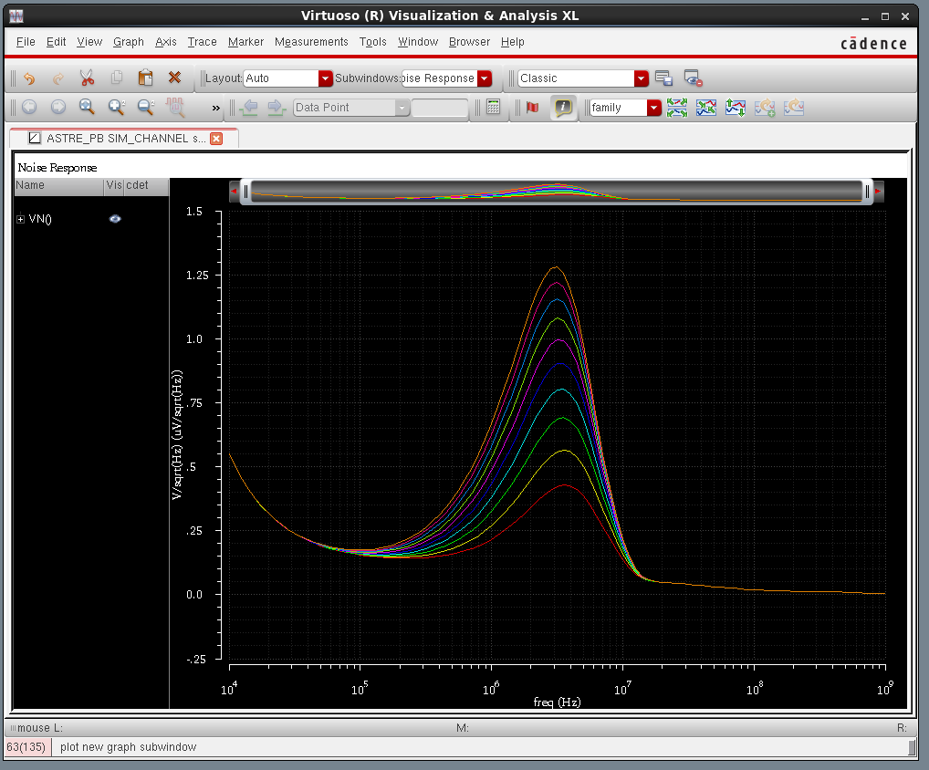
noise analysis
  Noise analysis linearizes the circuit about the DC operating point and computes the total noise spectral density at the output.
  If we specify an input probe, the transfer function and input-referred noise for an equivalent noise-free network is computed.

Slide 25
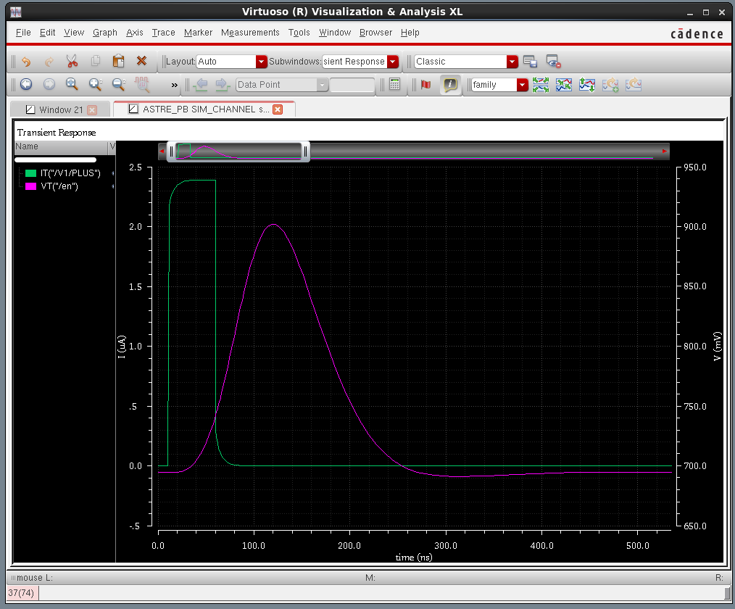
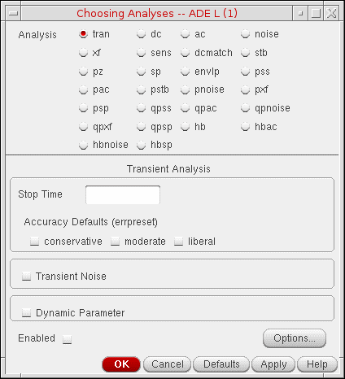
transient analysis
  The transient analysis computes the time response of a circuit.
  This analysis mode takes into account all nonlinearities of the circuit.
  The initial condition is taken to be the DC steady-state solution.

Slide 26
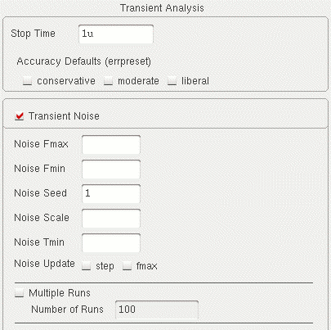
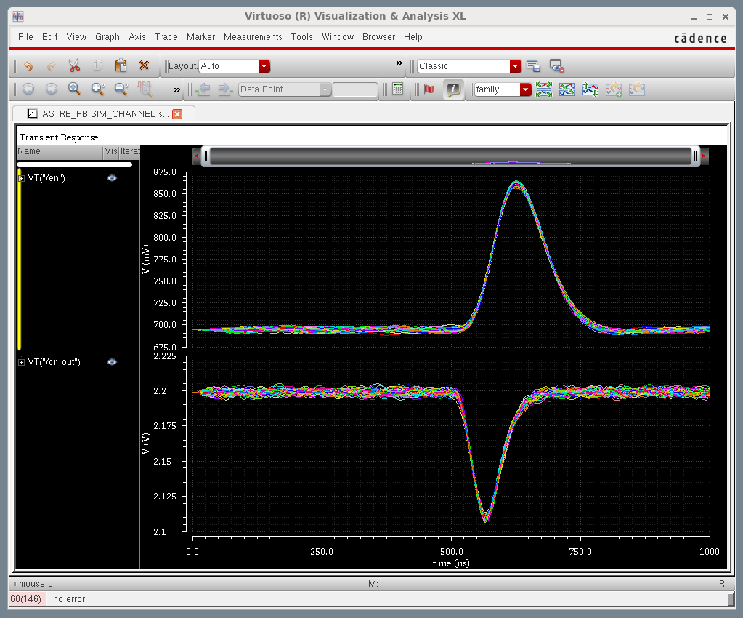
transient noise analysis
  The current transient analysis has been extended to support transient noise analysis.
  Transient noise provides the benefit of examining the effects of large signal noise on many types of systems. It gives the opportunity to examine the impact of noise in the time domain.
Noise Fmax The bandwidth of pseudorandom noise sources. A valid (nonzero) value turns on the noise sources during transient analysis. The maximal time step of the transient analysis is limited to 1/Noise Fmax.
Noise Fmin Below Noise Fmin, noise power density is constant. The default value is Noise Fmax, so that only white noise is included and noise sources are evaluated at Noise Fmax for all models. 1/Noise Fmin cannot exceed the requested time duration of transient analysis.

Slide 27
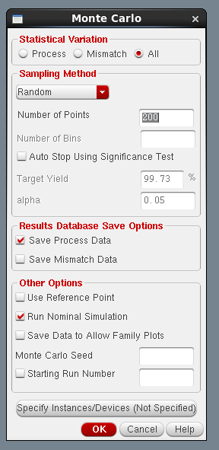
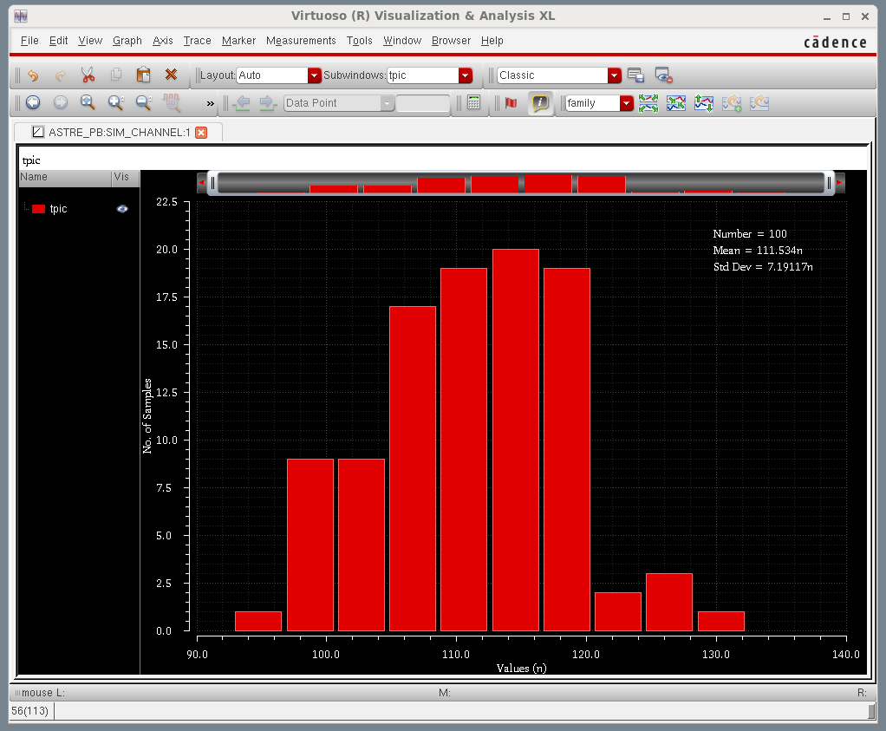
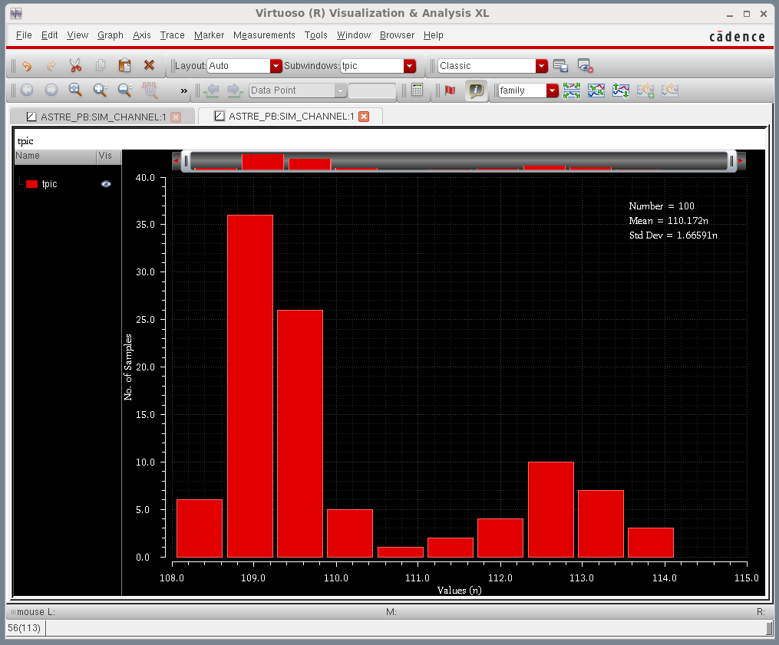
Monte carlo analysis
  The MC is a statistical analysis of the circuit which performs multiple runs of the selected analysis (DC, AC or transient).
  The first run uses nominal values of all components. Subsequent runs use variations on model parameters on each component.
Tpeak extraction: Process & Mismatch
Tpeak extraction: only Mismatch

Slide 28
Layout simulation

Slide 29
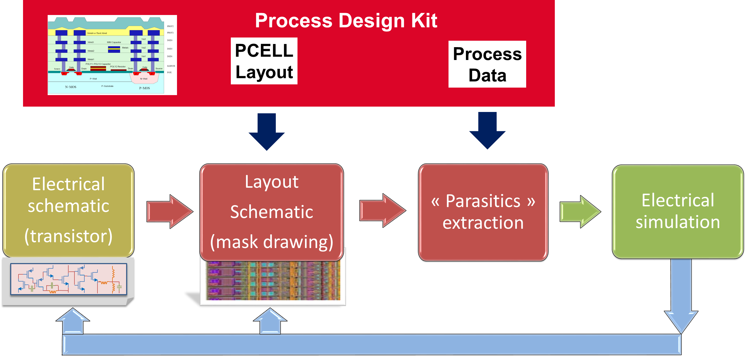
Layout simulation
  The contribution of the routing nets must be taking into account:
  net resistor & net capacitor (coupling net/net & net/Substrat)

Slide 30
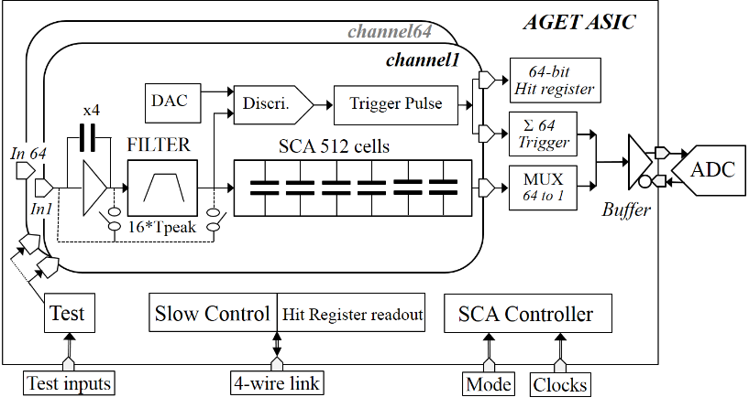
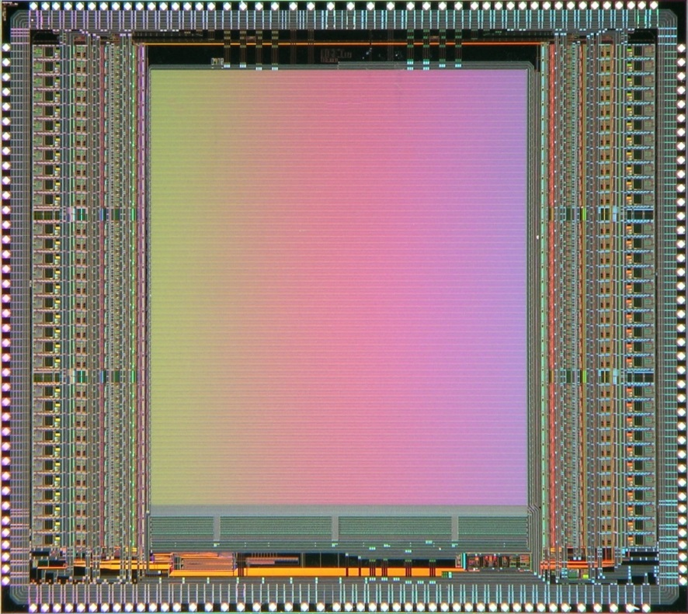
Layout simulation
  The contribution of the routing nets must be taking into account:
  => signal integration, lower gain, voltage drop ..
  Example: AGET ASIC, 2x 32 channels, large silicon area
8560 µm
Bus: VDD, VSS, VDC ..
Height: 7000 µm
If Met1 bus; resistivity = 70 mΩ/□,
W=0.5 µm => 980 Ω
W=50 µm => 9.80 Ω
7630 µm
SCA 512 cells
SCA Bus: 1 row; Length = 0,5 mm => Cparasite = 2 pF

Slide 31
summary

Slide 32
summary
  SPICE, from the University of California, at Berkeley, is the de facto world standard for analog circuit simulation
  Simulations permit to study and to validate the design of the Integrated circuit
  The basic simulation types are DC, AC, NOISE and TRANSIENT
  But the results are only as accurate as the model used. The transistor model is dependent of the technology choose and becomes more & more sophisticate according to the technology evolution (nano-scale device).
  The most accurate representation is based on 2D, 3D geometrical and processing characteristics of the device structure.
  These are models for device-level simulators referred to as Technology CAD (TCAD). Actually, they are impractical for circuit simulation due to the very complex and time-consuming solution needed for every single device, but tomorrow why not…

Slide 33
Thank you !!

