Slide 1

XLIVth Rencontres de Moriond
Experimental Summary & Highlights
Hassan Jawahery
University of Maryland
March 14, 2009

Slide 2
Our field is very active:
  At this meeting, we had >200 results in 45 experimental talks. Impossible to cover every topic presented here. Have tried to organize the summary along the lines of the main themes of the conference:
  Start of the LHC era:
    A huge amount of activities are discussed, planned, carried out in the context of the start of LHC physics. Everyone is asking for status report…., it’s the most famous physics machine ever.
  Precision tests of the Standard Model
  The search for the Higgs
    Tevatron is making major advances in both areas and more data is coming. Key results reported at this meeting
  Flavor Physics & CP violation
    A major milestone: The data taking phase of B factories is concluding: BaBar(2008), Belle (2009 or 2010). & plans are underway for new facilities
  Latest measurements in Neutrino physics
  Dark Matter search
  Latest on Ultra High Energy Cosmic rays

Slide 3
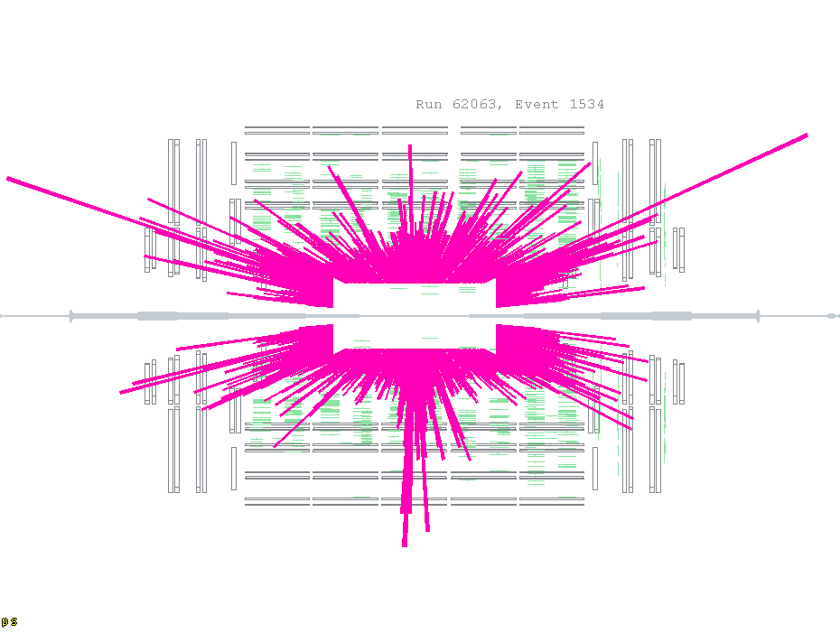
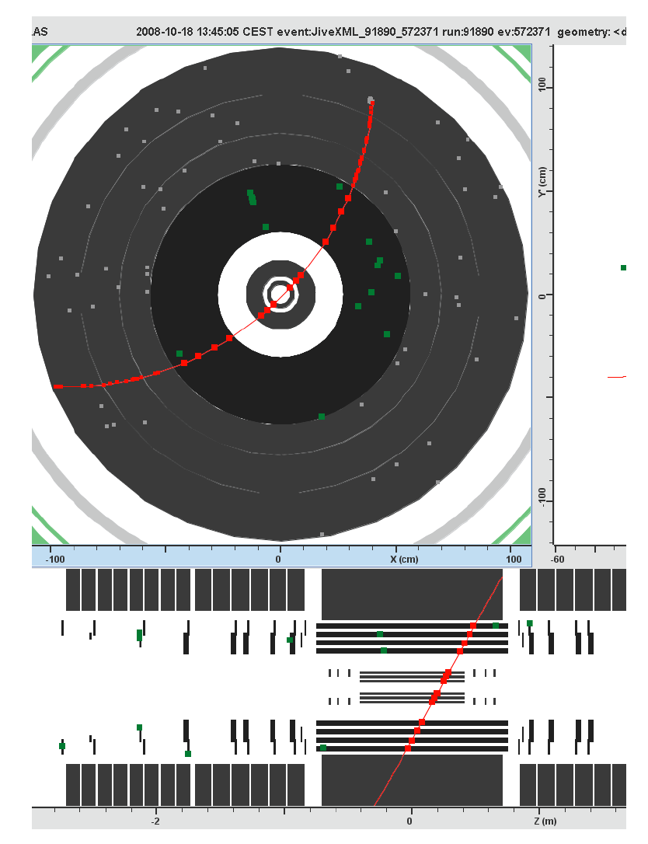
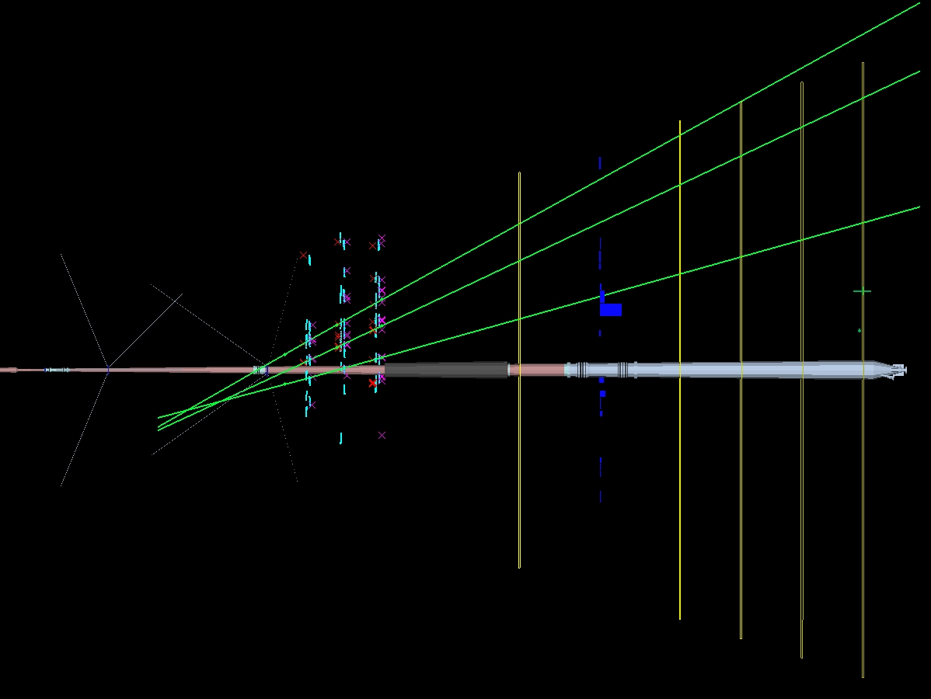
LHC experiments
(re)-start up is expected in Sept/Oct-2009. ATLAS, CMS, LHCB reported that they have been commissioning for ~3yrs; aligning & calibrating with cosmics & are ready for LHC beams.
Successfully run & recorded beam events in September 08 (2 day beam).
Even with the early data (~200/pb) some high impact physics is expected.
Thilo Pauly
Emilio Meschi
A cosmic event in ATLAS inner trackertracker
A beam event in CMS
A beam event in LHCB
Adriano Lai

Slide 4
Electroweak Physics
New measurements of M_{W} & M_{t} at Tevatron:
  New electroweak fit & Higgs mass prediction
  New W mass from D0/Run II; most precise measurement from a single experiment.
More results on Top quark:
  Observation of single top production →V_{tb}
  New top production cross section.
Pair production of gauge bosons (all possibilities: WW, ZZ, γW, γZ) measured at Tevatron- consistent with SM- no anomalous Triple-gauge coupling seen:
Electroweak measurements at HERA: Nao Okazaki
  Structure functions with & without polarized beams
    u/d axial and vector couplings to Z
  Search for violation from V-A; No evidence for right-handed currents
  Parity violation in interference of Z- γ

Slide 5
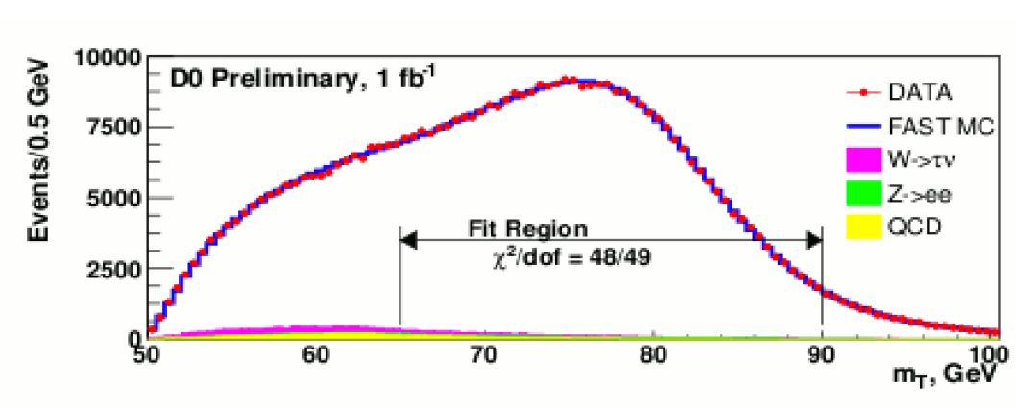
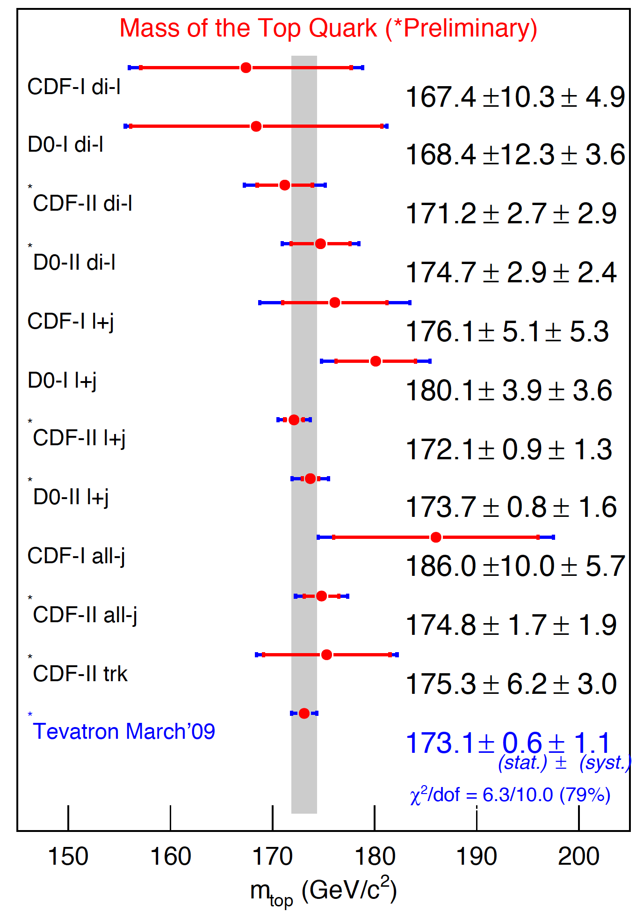
Electroweak measurements at Tevatron
W mass measurements (Jan Stark)
Meenakshi Narain
Top mass meas. at Tevatron
D0: M(W)=80.401+/-0.023+/- 0.037 GeV (M_{T})
Combined Tevatron
  M(W)=80.432+/-0.039 GeV
  LEP Average: 80.376 +/- 0.033 GeV
  M(t)=173.1 +/- 0.6 +/- 1.0
Next :
  M(W): Analysis >2.4/fb & each expect total error of ~25 MeV
  M(t): aiming for δm ~1 GeV (full runII)

Slide 6
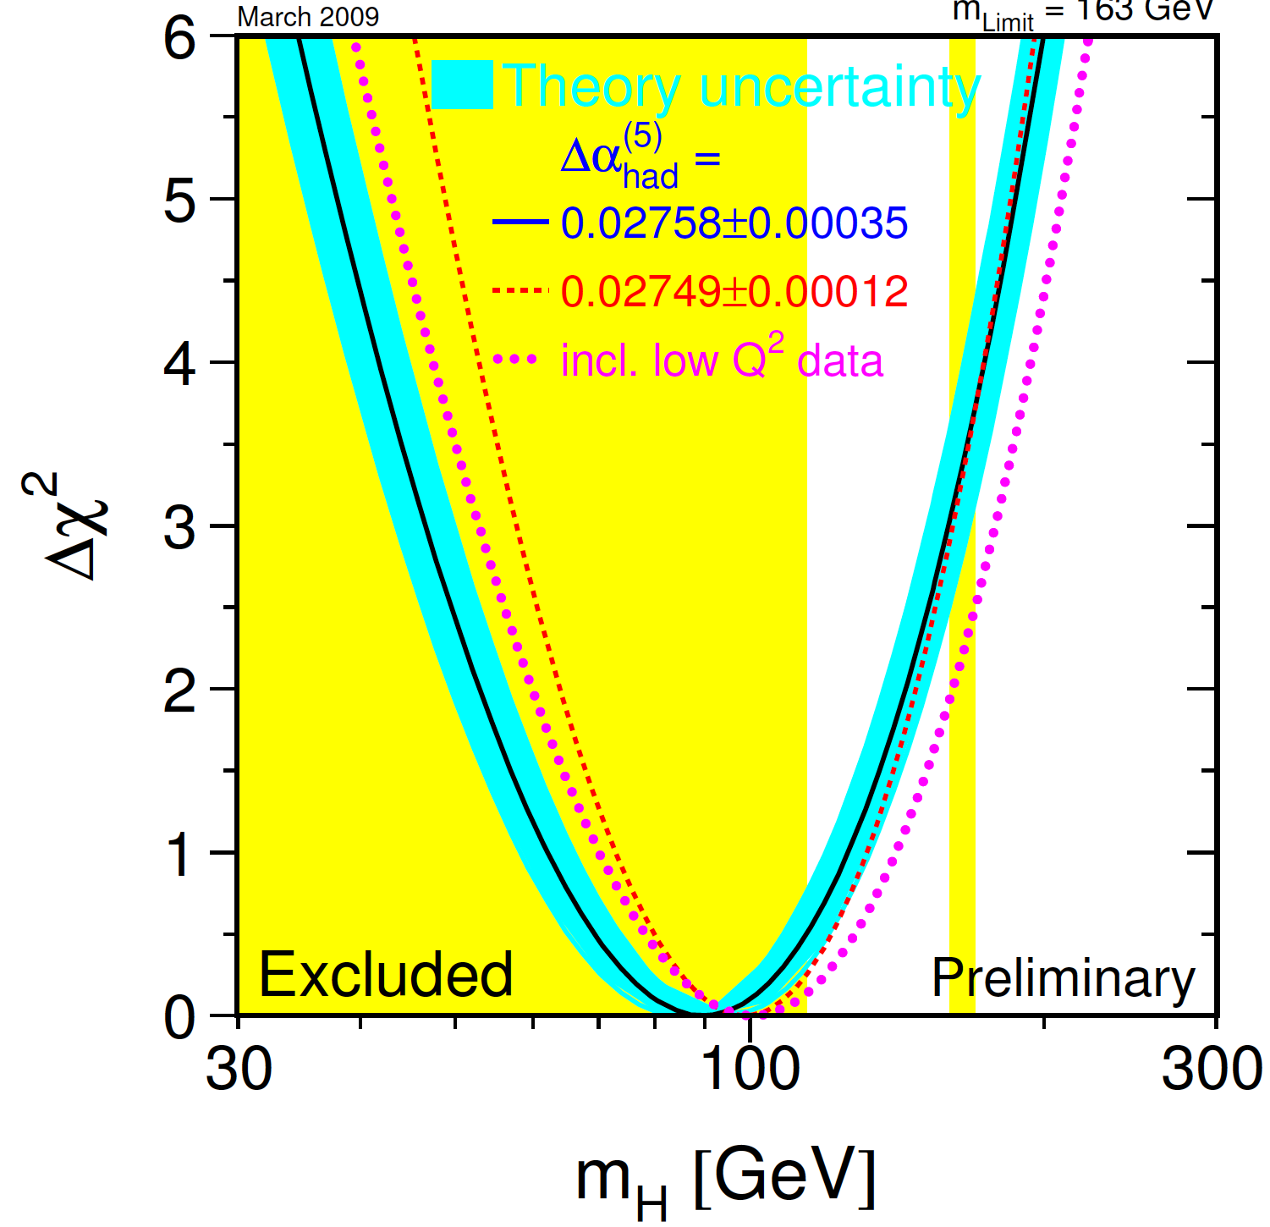
Global electroweak fit: Higgs mass
The E&W fit with latest averages of M(t) and M(W) averages
⬅

Slide 7
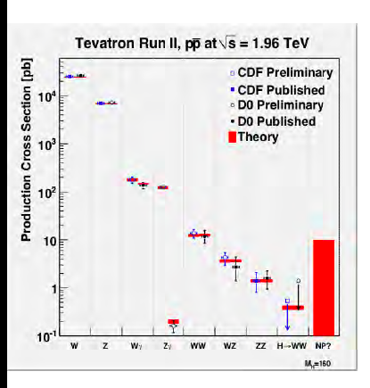
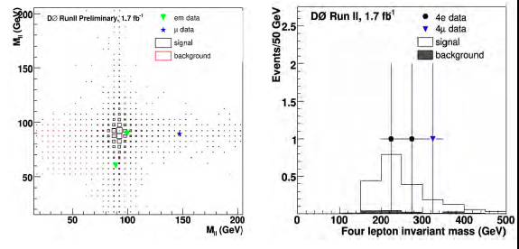
Electroweak Physics –Diboson production
(Thomas Phillips)
All di-boson type events are now seen at the Tevatron
Data consistent with the SM, constraining anomalous TGC couplings.
Searched for di-boson resonances – none found; constraining RS models.
Several channels are already systematic limited
Recent CDF&D0 observation of rarest type: ZZ

Slide 8
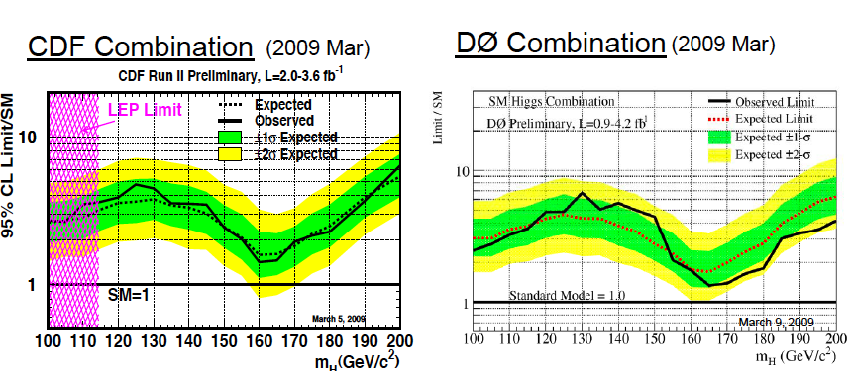
Direct Search for the SM Higgs
LEP limit: M(H)>114.4 GeV
CDF & D0 search:
  Low mass: M(H) <135 GeV- dominated by H→bb(bar)
  High Mass M(H)>135 GeV - dominated by H→WW^{(*)}
Yuji Enari
Douglas Benjamin
⬅

Slide 9
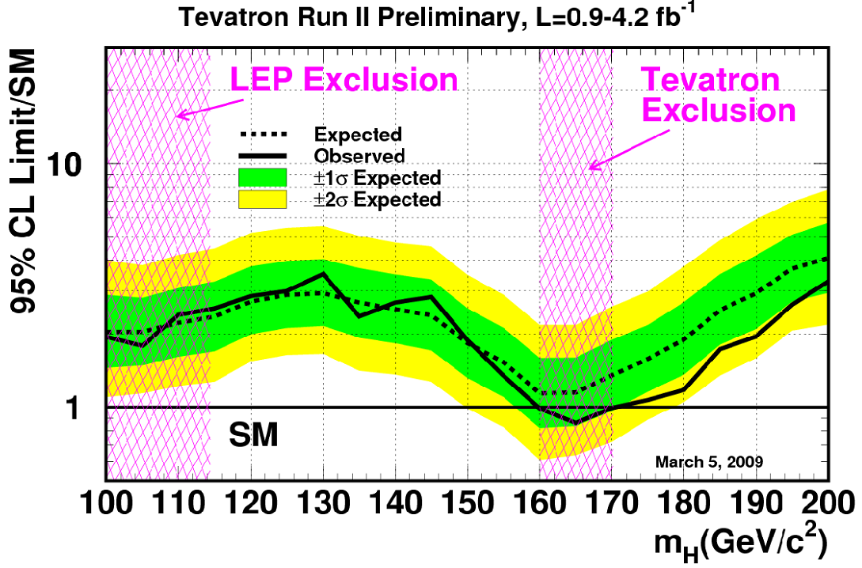
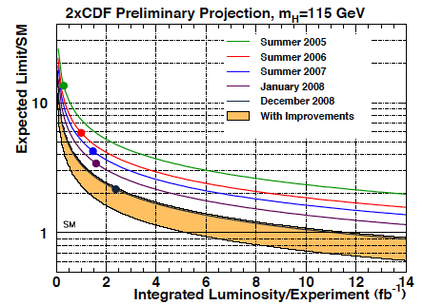
Direct Search for the SM Higgs
Yuji Enari
Douglas Benjamin
SM Higgs excluded in the mass range 160-170 @ 95% c.l.
⬅

Slide 10
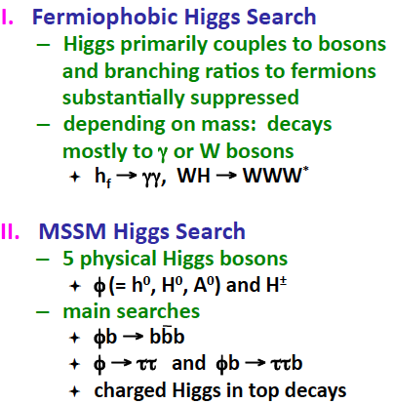

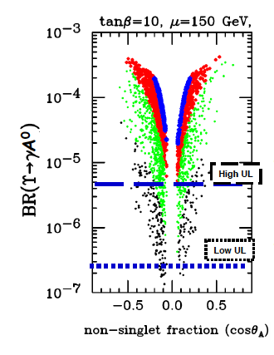

Search for Beyond SM Higgs
Abid Patwa
Joao Acosta
BaBar & CLEO searched for light pseduscalar Higgs with M<10 GeV in Υ decays- motivated in NMSSM
Tevatron searches extend to non-SM like Higgs:
NO excess found
Limits on parameter space
Exclude m(A)<2xm(τ)
On HyperCP Σ-->pμ+μ− with m(μμ)= 214.3 MeV
  BF(Υ(3S)→(μμ)γ)<.8x10⁻⁶ @90% c.l.
More results are underway

Slide 11
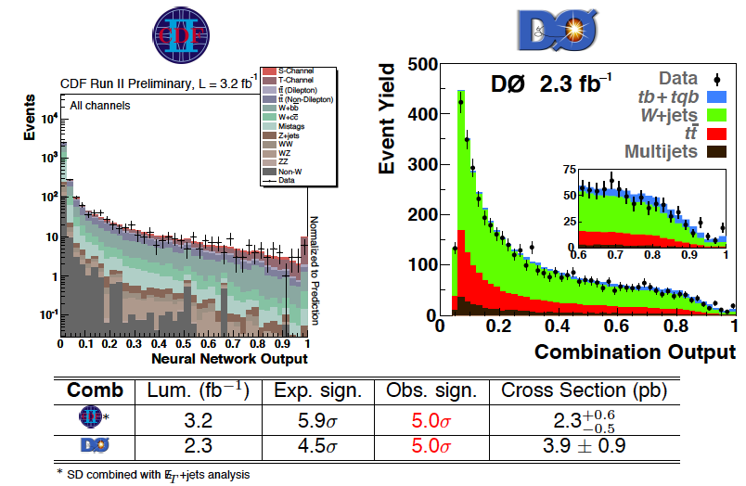

Single top production
First observation single top production: >~ 5 sigma signal by D0 and CDF
Enrico Palencia
Thomas Schwarz
Also:
Measured top pair cross section
Studied angular distribution to measure W helicity from t→Wb
  Consistent with V-A coupling in SM;
  No evidence anomalous couplings of W to t
  No evidence for resonance production of t
Top’s behaviour in good agreement with SM
Meenakshi. Narain
⬅

Slide 12
Searches for New Physics Particles
Tevatron and HERA presented new results on searches for New Physics particles- searching for anomolous event types and distributions:
Multijet+MET squark, gluinos
lll+ MET gauginos
Monojet+MET Large extra dimensions (RS)
γ+ MET Large extra dimensions (RS)
γγ+MET Gauge Mediatd SUSY Breaking
High Pt dielectrons or diphotons (RS)
Z’→μμ & ee
Long lived particles
Isolated leptons & multileptons at HERA
Speakers:
Marc Hohlfeld
Shin-Shan Yu
Thi Nguyet Thrinh
Data well described by standard sources. No significant excess seen in any channel.
  Is the data too well described by SM? Do we have enough deviations to satisfy skeptical statistician?
Limits on SUSY, LED, Leptoquark,GMSB.. Parameters.

Slide 13
Flavor Physics & CP Violation
Measurement of the CKM parameters:
    The Unitarity Triangle angles: α, β, γ
    CKM elements: V_{ub}, V_{cb}
    Overall consistency of the CKM matrix:
  CKM Passed all tests and led to 2008 Nobel Prize in Physics for Kobayashi & Maskawa
Search for New Physics with heavy flavor:
  Radiative B decays: b→sγ & B→K^{(*)}ll: rates, FB asymmetry, isospin,.
  CP violation in gluonic Penguin B decays
  Bs system: Γ_{s} & θ_{s} measurements
  The Kπ puzzle
Kaon decays:
  New measurement of R_{K3} & R_{K2} (KLOE & NA62)
Future:
  Super flavor Factories
  NA62: Rare Kaon decay

Slide 14
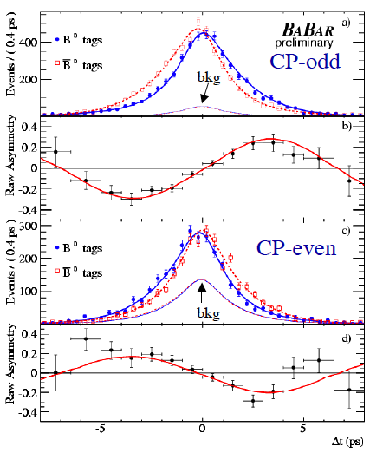

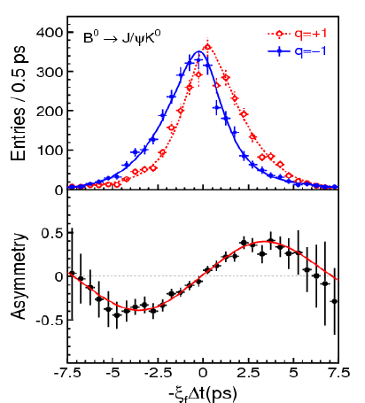
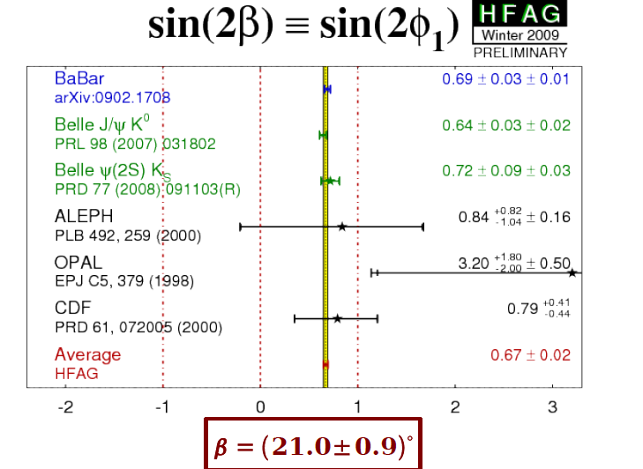
CKM parameters: sin2β
Karim Trablesi
BaBar – Final measurement

Slide 15
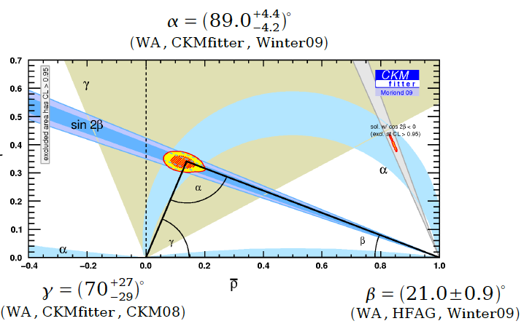
CKM parameters: α, β &γ
Karim Trablesi

Slide 16

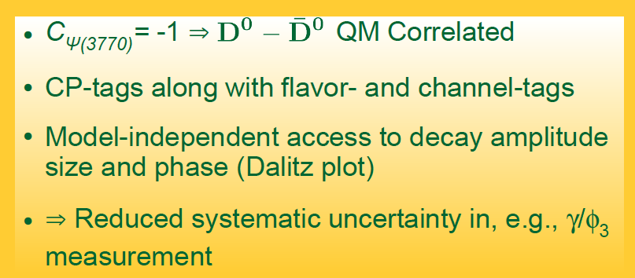
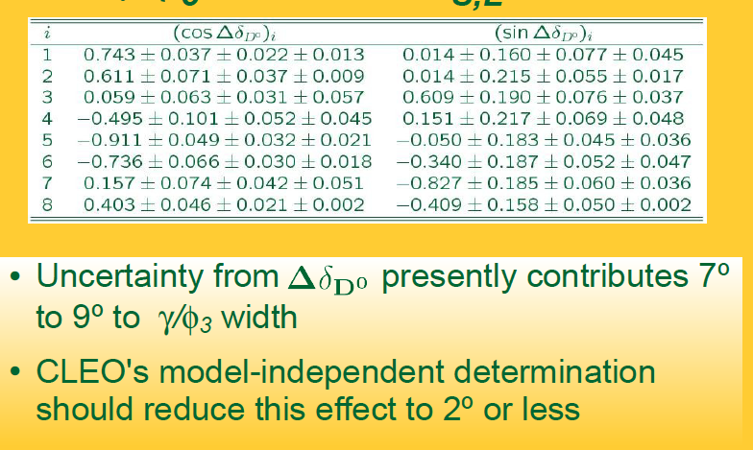
CLEO’s latest contribution to CKM
One of the key methods for the determination of angle γ is through direct CP violation in B→DK, where D→Kspi+pi- , measured via a Dalitz analysis.
The uncertainty in the knowledge of strong phase and amplitude variation the Dalitz plot is a major source of error in γ
Philip Rubin

Slide 17
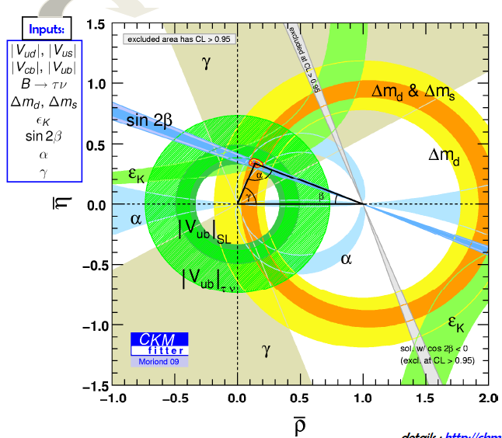
The Global fit to CKM parameters
Fabrizio Bianchi
Vincent Tisserand
  Tension between inclusive & exclusive measurements of |Vub| & |Vcb|.
  Also tension between |Vub| from B→τν & Semileptonic decays.
  All point to Form factors and decay constants from LQCD
Overall, good agreement between CP violating and CP conserving measurements: Except for ~2 sigma tension between Vub and sin2β
Better agreement if Vub exclusive is used.
⬅

Slide 18
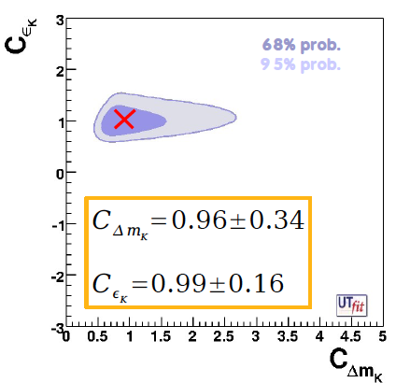
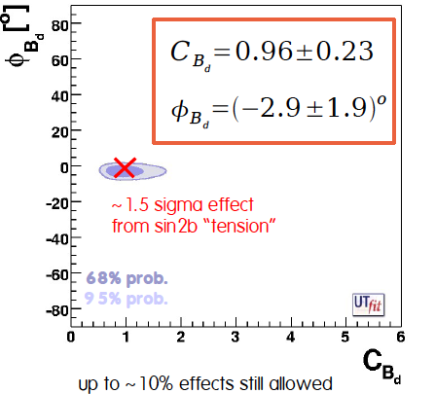
The CKM parameters: New Physics constraints
Allowed for deviation from SM & refit:
Viola Sordini
Consistency with SM is clear-
There is room for NP effects as long as the phase is close to the SM phase.
⬅

Slide 19
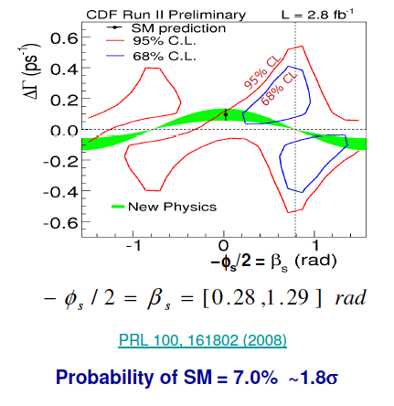
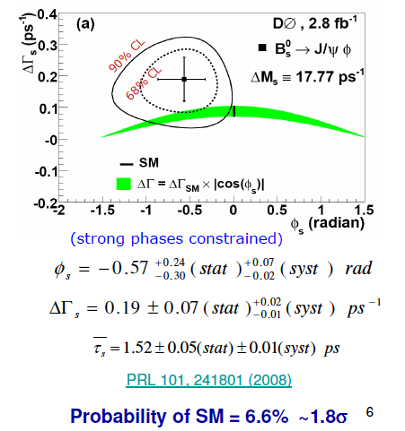
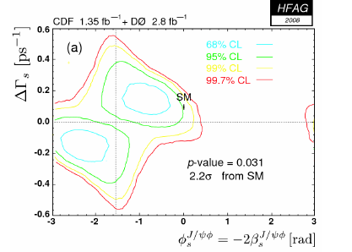
Bs oscillation: Γ_{s} & β_{s}
Avdhesh Chandra
Jonathan Lewis
Combined Tevatron result:
A 2.2 sigma deviation from SM
⬅

Slide 20

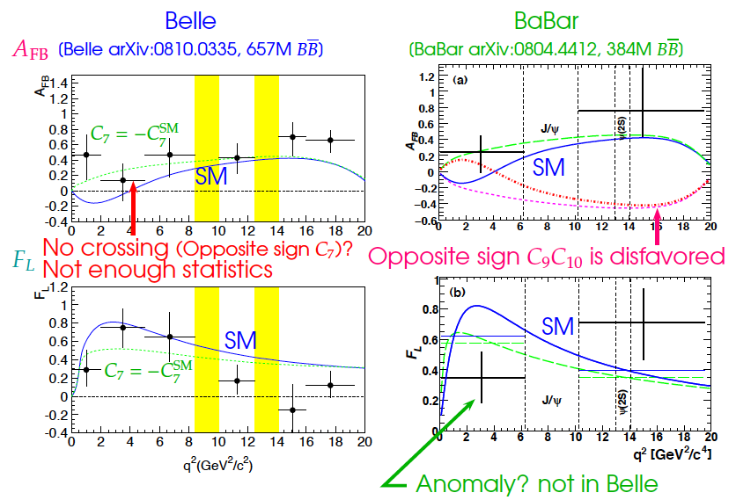
Search for New Physics with Heavy Flavor: Rare decays
Mikihiko Nakao
Elisabetta Barracchini
b→sγ & b→sl+l-
Data is systematically above the SM curve- some BSM scenarios’s are ruled out

Slide 21


Rare Kaon decays:
  New measurement by KLOE of: K→πlν :
    KLOE’s final results: |V_{us}|f+(0)=0.2157(6)
  New measurements of R_{K} = Γ(K→eν)/Γ(K→μν) :
    An important measurement for lepton universality tests and charged higgs constraint.
  KLOE’s final result:
  NA62: The data taken with the NA48 beamline and detector:
    Expect 0.4% accuracy
KTeV measurement of KL→π⁰π⁰μ⁺μ⁻
  Primarily motivated by the HyperCP Σ-->pμ+μ− with m(μμ)= 214.3 MeV
  Don’t see any signal:
Tommaso Sparado
Most precise meas.
Andreas Winhhart
David Phillips

Slide 22
Outlook for Flavor Physics
NA62 project at CERN: (Augusto Ceccucci)
  Principal aim: measuring K⁺→π⁺νν @Br~10⁻¹⁰
  Because of clean (~10%) theoretical predictions, it’s powerful way of measuring CKM.
LHCB: (Ulrich Uwer)
  Impressive physics reach with 10¹² B’s/2fb. Most promising area are likely to be measurement of the ange γ & exclusive radiative decays for studying New Physics effects.
e⁺e⁻ Super Flavor Factories: Will allow for comprehensive measurements of all B decay channels as well as charm & tau decays
  The SuperB project in Frascati: (Adrian Bevan)
    Its based on very low emittance beams (ILC level), small beta* and the use of crab-waist (rotating the beams at the IP to align the waist) to reach L~ 10³⁶ /cm²/s
  Super KEKB:
    Aiming for L~ 8X10³⁵ /cm²/s by pushing the beam currents from 2A to 10 A & the use of crab cavities.
⬅

Slide 23
What did we learn about neutrinos
Neutrino Flavor Transition: Standard picture remains intact:
  Atmospheric:
    OPERA presented first results on their 1st run. No physics results.
  Solar:
    new results from KAMLAND on Δm²_{sol}, θ₁₂
  LSND- type oscillation:
    Δm² ~0.1 to 1 ev² - not confirmed by MiniBoone’s ν_{μ} beam data- no evidence for sterile neutrinos.
    Anti-ν_{μ} data consistent with both LSND & no-mixing.
  sin²2θ₁₃ :
    New limit from MINOS.
    The primary focus of the next phase of neutrino experiments:
      Double CHOOZ, Daya Bay, T2K, NOνΑ, Reno, Angara
Majorna vs Dirac nature of ν & absolute mass scale:
  0ν ββ experiments: Final result from Cuoricino
  No report from beta decay experiment
Measuring ν cross sections:
  Sciboone studied coherent ν+Α scattering; no evidence found & limit set on the cross-section.
Natalia Di Marco

Slide 24
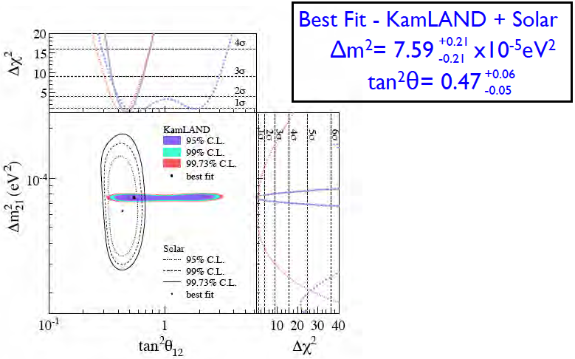
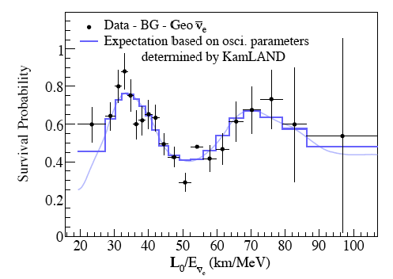
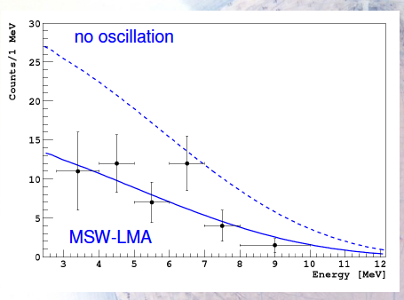

Neutrino mixing parameters –Solar
Lindley Winslow
KAMLAND’s new results- New analysis & lower threshold(?):
New solar neutrino results from Borexino:
Timo Lewke
Also measure ⁷Be – all results consistent with LMA + MSW
⬅

Slide 25
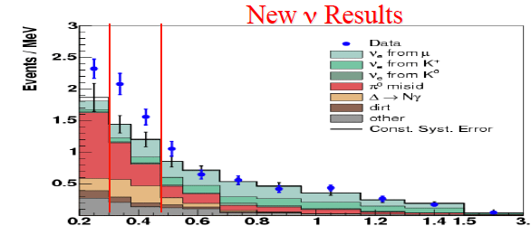
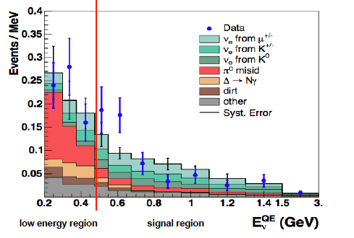
Search for LSND-like oscillation
Zelmir Djurcic
MiniBoonNE’s search for the LSND like oscillation of ν_{μ} − Δm² ~0.1 to 1 ev²
No excess of events corresponding to appearance of ν_{e} like events from a beam of ν_{μ}
Data matches nearly exactly matches the expectation in every bin!
The low energy excess remains to be understood
  New results anti-ν_{μ}beam – 1/9 their data with ν_{μ}
The anti-ν_{μ} data consistent with no oscillation and with LSND type oscillation
No excess at low energy.
Outlook:
  Studying their events from the NUMI beam to investigate low energy region in ν_{μ} data
  Have proposed to run for 3 more yrs with anti-ν_{μ}

Slide 26
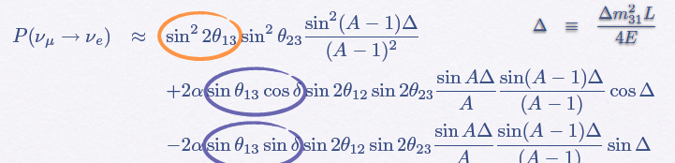
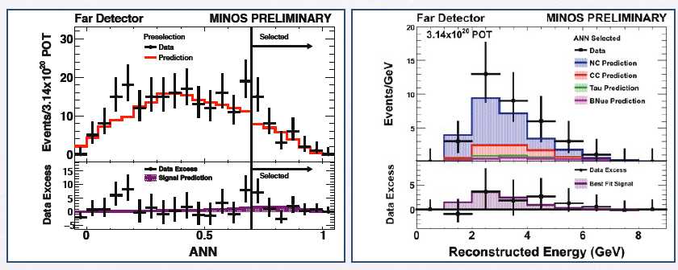
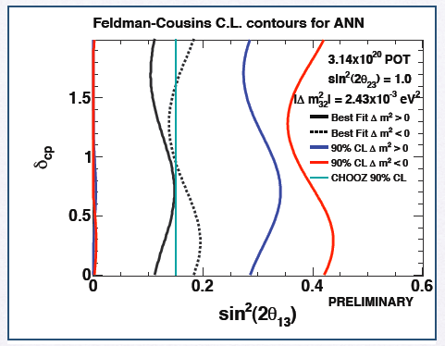

Minos on sin²2θ₁₃
Mayly Sanchez
An appearance measurement: ν_{μ} -->ν_{e}
Expect 27+/- 5 +/- 2
Observe: 35
CHOOZ limit
Sin²2θ₁₃<0.15 @90% c.l

Slide 27
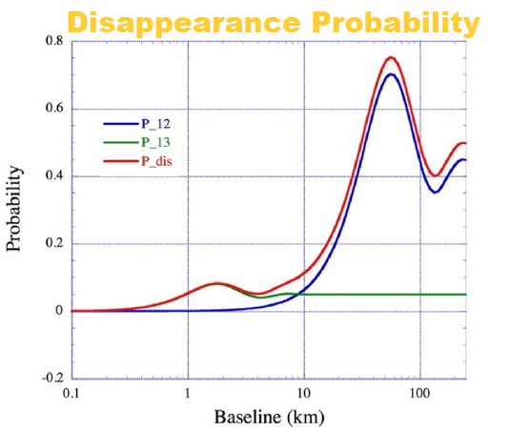
Future of θ₁₃
New short baseline experiments are being developed:
Double CHOOZ in France: 2-detector experiment ( 8.7 GW)- aiming for sin²2θ₁₃ <0.03
Daya Bay in China: 4 near detectors, 4 far detectors ( 11.3 GW) aiming for sin²2θ₁₃ <0.01
Experiments progressing well:
  Expect 1st data in ~2010 or 2011 + >3 yrs of running
Amanda Porta
Philip Rubin
The results from these experiments- along with T2K & (NOvA)- will determine if searching for CPV in neutrino sector will be fruitful- not possible if sin²2θ₁₃ <0.01 .

Slide 28
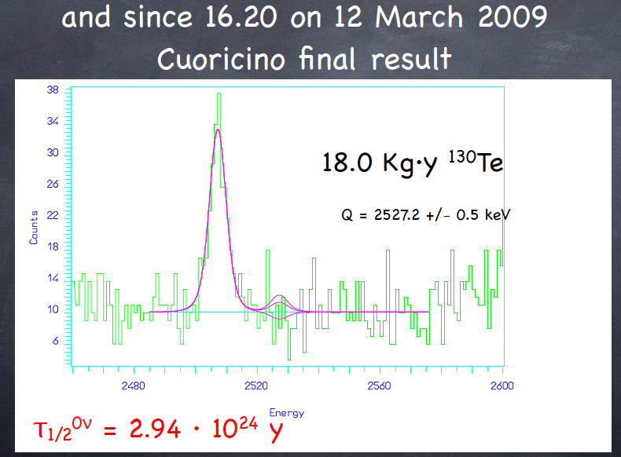
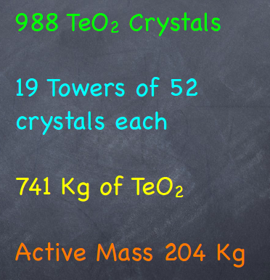
Dirac or Majorna & absolute scale of ν mass- 0νββ decays
Final results for CUORICINO: See excellent review by F. Ferroni
For ¹³⁰Te, measure:
Future: Cuoricino →CUORE
Aiming for τ ∼1.7x10²⁶

Slide 29
Dark Matter Search
Excellent reviews at this meeting
Jules Gascon on DM review
Theodoros Geralis on Axions

Slide 30
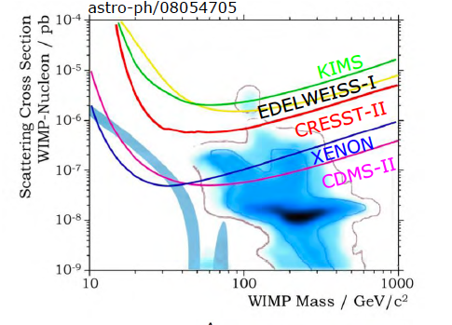
DM- direct search results
Riccardo Cerulli
  Search for elastic WIMP + nucleon scattering + search for seasonal modulation (~4% effect)
  DAMA effect: observation of seasonal modulation effect in recoil events. The signal corresponds to WIMP+nucleon cross section of ~ 10⁻⁵ pb (with no channeling effect).
Other experiments- specially CDMS-II & ZENON have reached cross section sensitivity of ~10⁻⁷ pb and see no effect thus far. The DAMA region- assuming spin-independent WIMP+Nucleon interaction- is excluded for M(WIMP)>10 GeV.
Channeling effect could be increasing DAMA’s quenching factor (E_measured/E_recoil)- e.g. they are probing lower cross-section region. Still largely ruled out for high mass WIMP. Some room still left M<10 GeV- (Kathryn Zurek).
DAMA
Jules Gascon

Slide 31
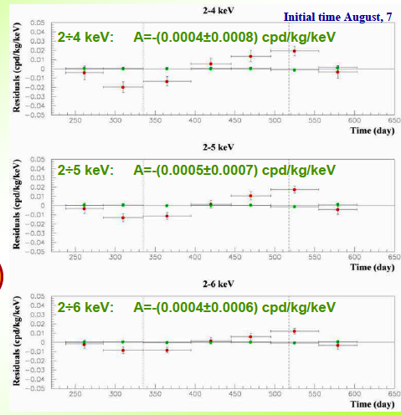
Direct Search for DM: DAMA result
Riccardo Cerulli
Can DAMA’s effect be the result of seasonal modulation in background or experimental conditions (e.g. temperature, humiditity etc).
They have done many checks to rule out these hypotheses
They see no modulation in multiple hit events, where no DM effect expected
No modulation seen outside
the 2-6 KeV energy region
DAMA/NaI (7 years) +
DAMA/LIBRA (4 years)
total exposure: 0.82 ton×yr

Slide 32
Dark Matter: Direct Searches
  DAMA results will need to be checked:
    Independent direct search with similar technique at a different site needed. Southern hemisphere was suggested (S. Adler).
    A light scalar DM (M<10 GeV) can be checked at colliders and B factories from Upsilon decays.
  The next phase of the DM search experiments involve larger target/detector mass & better background suppression aiming for the cross section of ~10⁻¹⁰ pb. Will this cover full MSSM DM?

Slide 33
Dark Matter: Indirect Searches
Indirect Search for Dark Matter:
  DM annihilation in galactic halo, the sun, or extra galactic sources
  Signature: excess gamma & antimatter rate,..
  New results from new instruments:
    FERMI is up and running: Beautiful results at this meeting.
      Have already dramatically changed the γ−ray landscape: found dozens of new gamma emmitting pulsars,…
      Excluded EGRET “GeV Excess”- a potential DM annihilation candidates
      Results on e+/e- energy spectrum to come
    ATIC
      electron+positron energy spectrum, showing an excess for E>300 GeV
    PAMELA:
      reports excess of positrons in the 10-100 GeV range, but no antiproton excess.
    ANTARES (Giada Carminati) & ICECUBE (Carsten Rott) are reporting first results on atmospheric neutrinos & searches for neutrino’s from point like sources and DM annihilation.

Slide 34
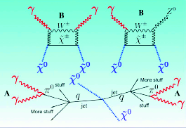
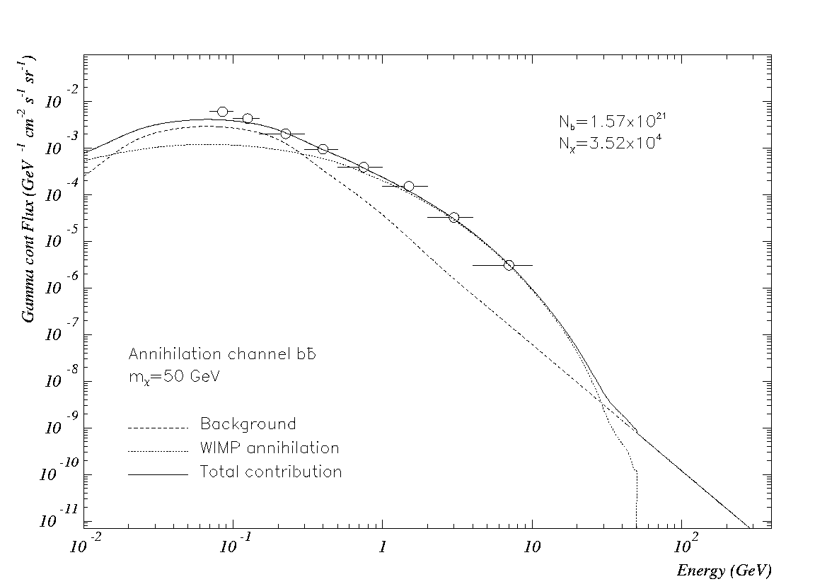
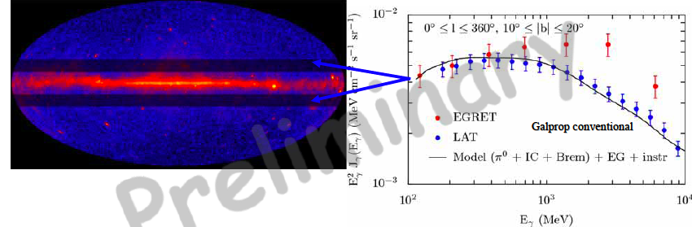
DM: Indirect Searches with ganma rays
Nicola Gigliettoi
EGRET data ex “GeV excess”
DM
contribution
Bkg
FERMI’s measurement of diffuse γ spectrum
FERMI Excludes EGRET’s “GeV Excess”

Slide 35
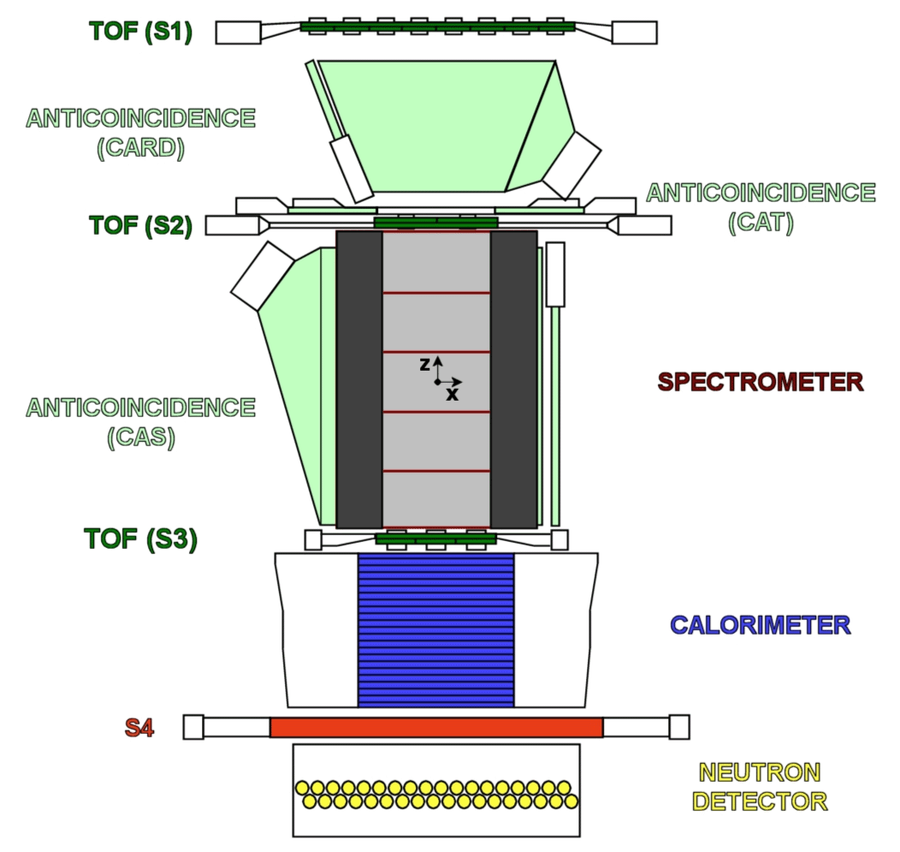
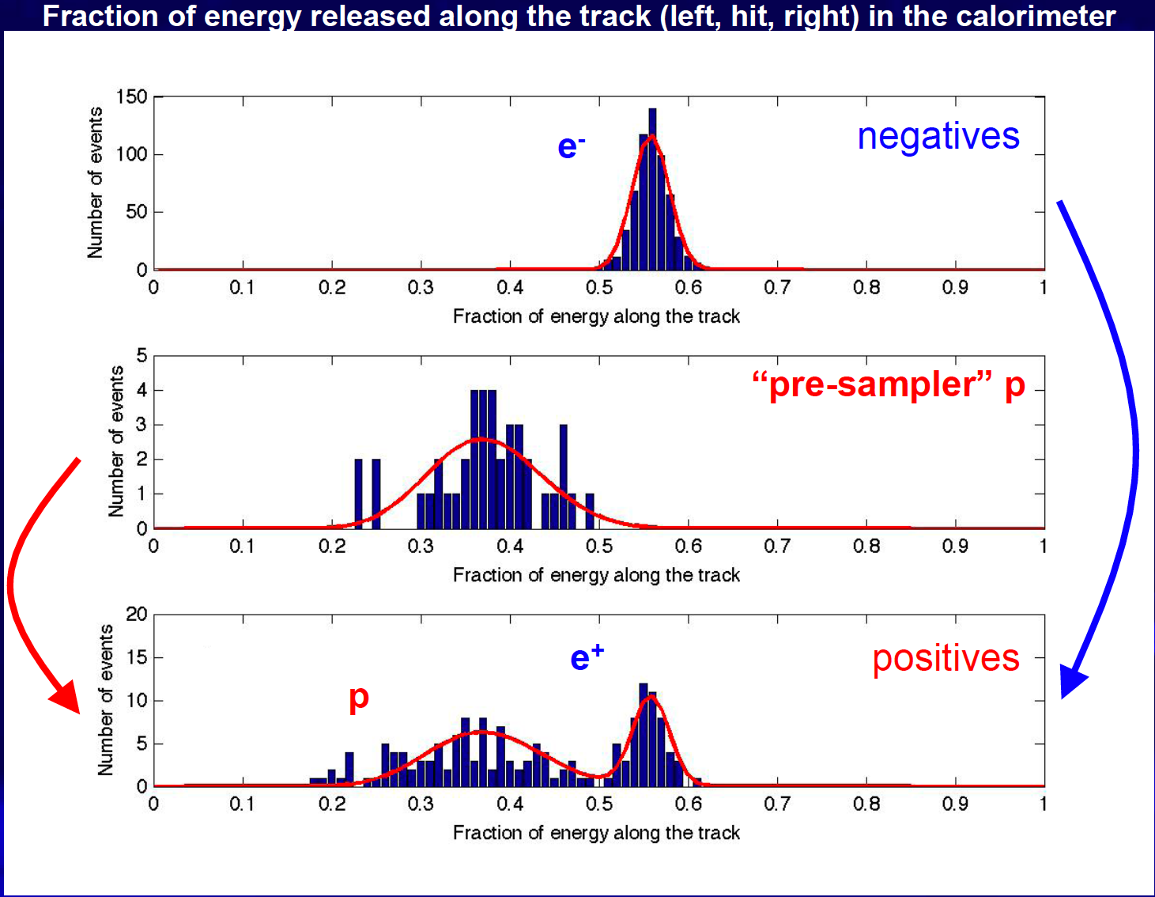
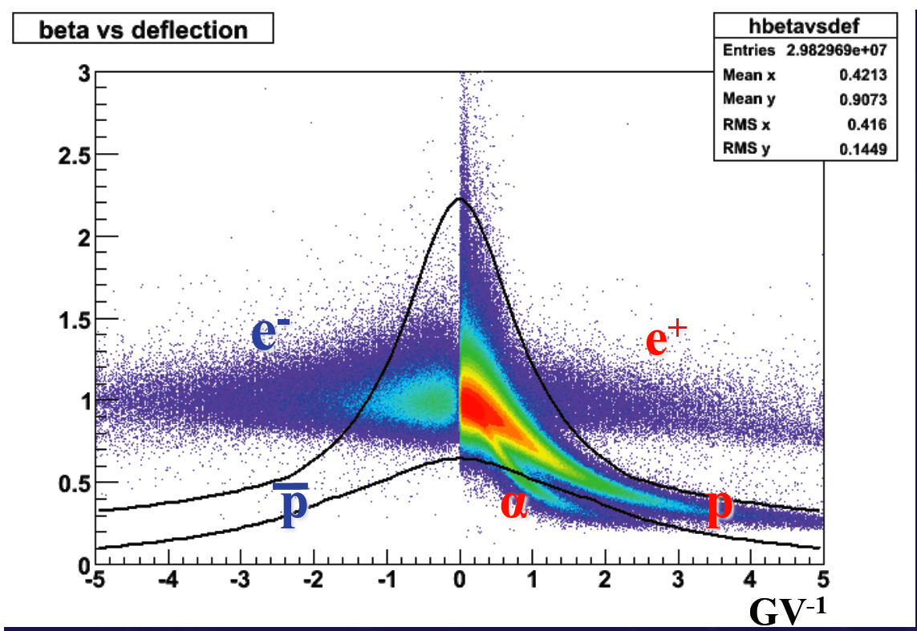
First Results from PAMELA
Emiliano Mocchiutti
Magnetic spectrometer PAMELA launched in 2006
Already reporting measurements of antiproton and positrons
Will run till December 2009
GV⁻¹

Slide 36
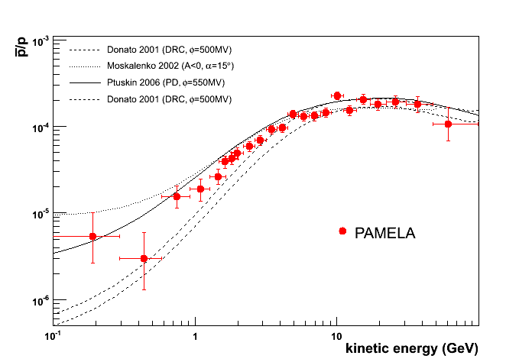
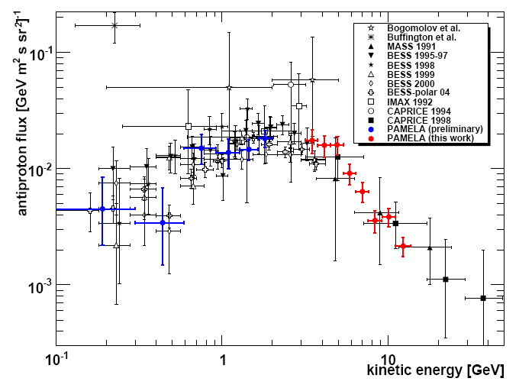
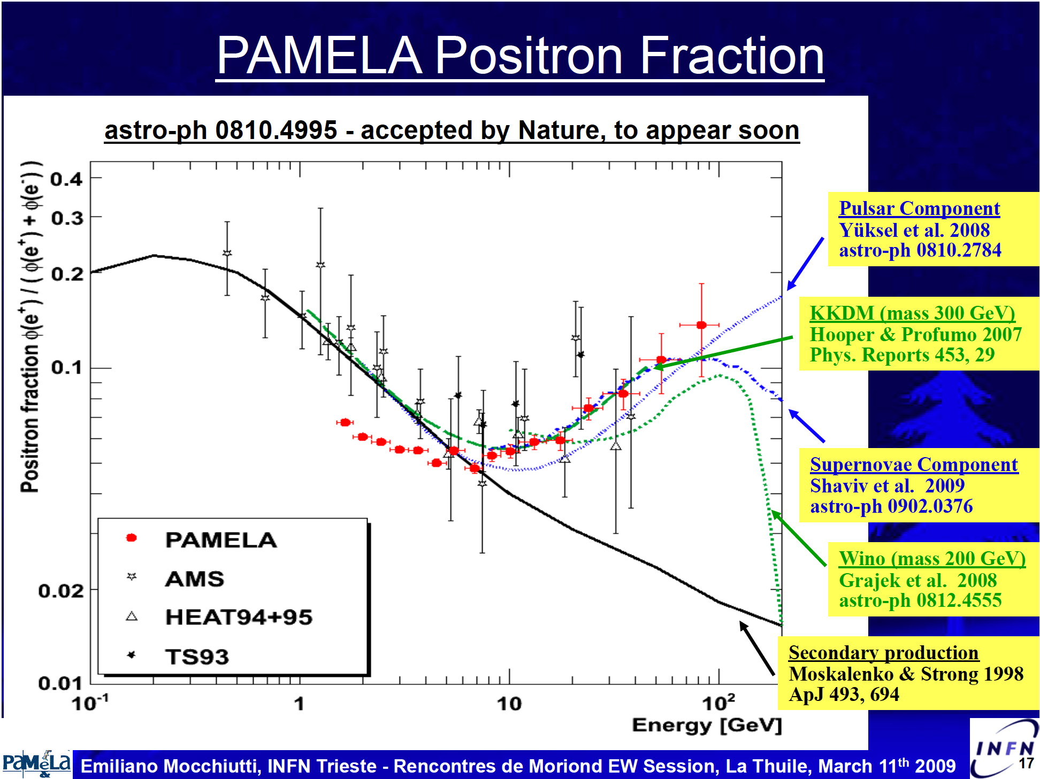
Results from PAMELA -2
Emiliano Mocchiutti
Preliminary
Evidence for Dark Matter
Annihilation?

Slide 37
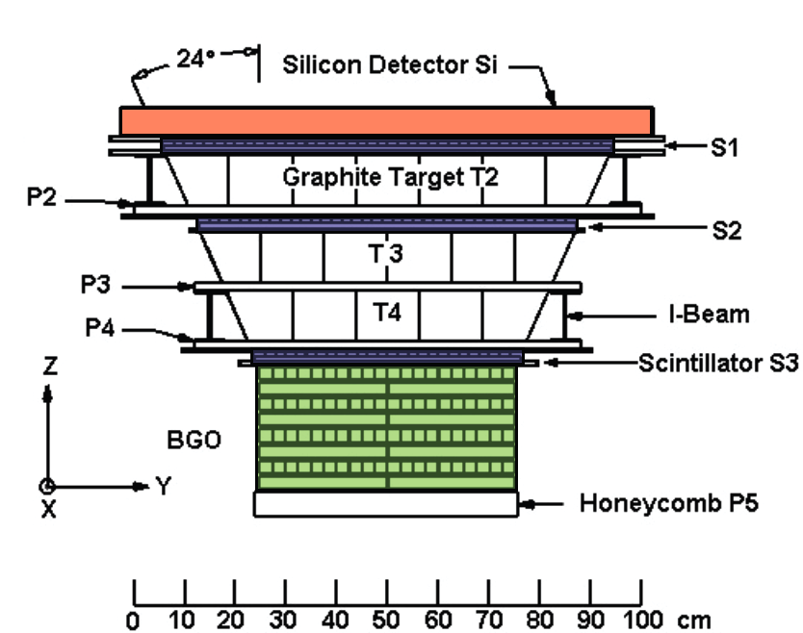


Results from ATIC
Joachim Isbert
Balloon Experiment- ATIC
Capable of measuring (e⁺ + e⁻ )
Good separation of e & P

Slide 38
Interpretation of PAMELA & ATIC results
  Standard SUSY WIMP at 150 GeV is not capable of producing
  ATIC (excess of electrons), PAMELA (excess of e+, and no-excess of anti-protons).
  DM candidates at 10 TeV with significant boost to the annihilation rate (either through cross section or DM density) can do the job?
  Astrophysicists can fit all of these data without invoking DM.
    Some without invoking anything new?
    Some need new nearby sources?

Slide 39
Indirect search for DM: Outlook
More data expected from PAMELA- running till fall 2009: extension beyond 100 GeV maybe possible.
ATIC planning to launch again (year?)
FERMI expects to present results on e+/e- spectrum soon; and more on gammas.
AMS has the capability of measuring charge and separating e’s from P’s. If it flies, it will be an important contributor to this topic.
ANTARES:
  Presented first results on cosmic muons and neutrinos
  Searched for point like sources of neutrinos (none found)
ICECUBE:
  Presented first results from the 22-strings data
  Searched for DM sources of neutrinos and set limit on spin-dependent couplings
  Marching towards 80 strings

Slide 40




New measurements of Ultra High Energy CR
Confirmation of GZK cut off arising from P+γ_{CMB}→Δ(1232)→P+π⁰
  A major step towards understanding the origin of CR, sources of acceleration of UHECR & charge particle astronomy.
Auger data inconsistent with no-cut off at 6 sigma level- confirming the observation of GKZ cut off by HIRES.
Pierre Sokolosky
Lorenzo Perrone
Open questions that HIRES and AUGER differ on:
  Composition in E>10¹⁸ eV – HIRES consistent with proton; Auger’s data favors mixed composition.
  Anisotropy: Most Auger events point to know AGN sources. HiRES does not see the effect.

Slide 41
Summary of Summary
We have had a truly science-rich meeting
Thanks to all speakers for excellent talks and physics.
Even with all the measurement from so many angles, Standard Model remains triumphant.
However, a list of (2 or 3 sigma) deviations is slowly growing, from flavor physics, DM candidates, … & some will likely survive and challenge SM.
All eyes are now on LHC, but it will likely need help from the precision front to complete the job.
Hopefully, we are able to bring to fruition the list of precision instruments that are needed to check these effects & help & complement LHC with its findings.

Slide 42
As the last speaker of the meeting, I have the honor of speaking on behalf of the participants of XLIVth Rencontres de Moriond
in
expressing our deep gratitude for establishing the tradition of Moriond conferences to
J. Tran Thanh Van
&
To the organizer of this meeting
Jacques Dumarchez
Etienne Augé
J.-M. Frere
L. Iconomidou-Fayard
S.Loucatos
F. Montanet
Claude Barthélemy
Vera de Sa Varanda
Isabelle Cossin
for all their effort for making it so fruitful.
THANK YOU

