Slide 1
LST AUX Cabling status report
E. Chabanne A. Fiasson

Slide 2
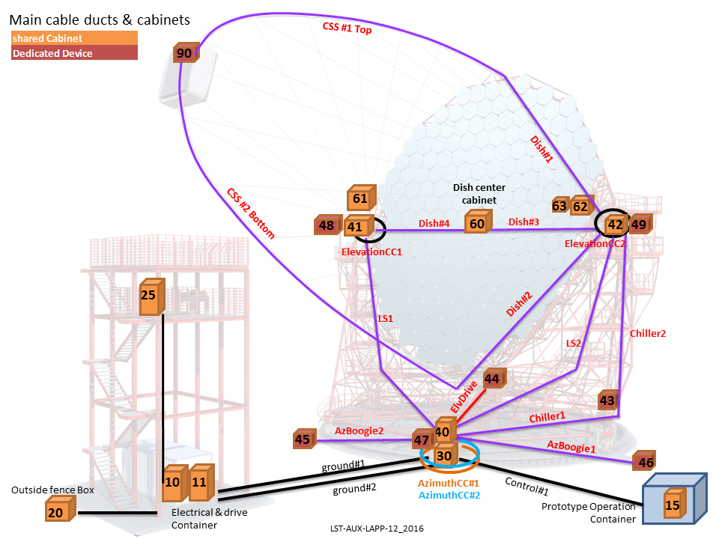
Main LST cable Paths and cabinets

Slide 3
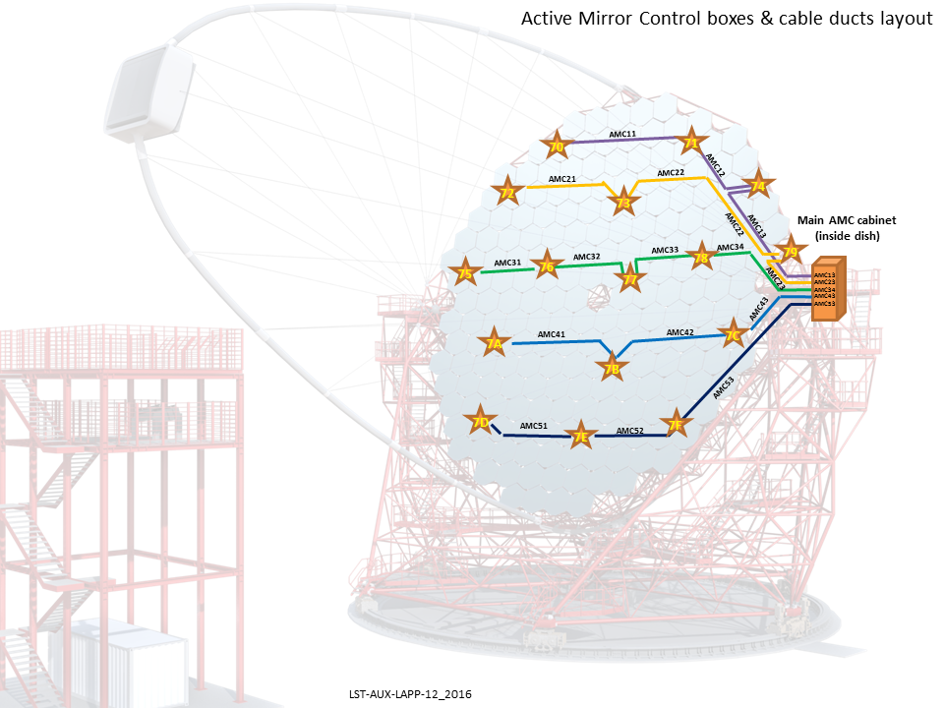
Main LST cable Paths and cabinets

Slide 4
Cabling architecture status
Subsystem responsibility verification and commitment towards procurement and installation
Cable Lengths still need to be validated
Still need to split POWER and DATA responsible inside ICDs
Cable Junction Cabinets are now clear of what goes inside and outside
Clarifications have also been done on the dish central cabinet
Optical fibers trunks will be assembled via fusion splicing (no connector)
=> Excel sheets updated regularly on sharepoint
Still few questions about LST Local Area Network (LST-LAN):
Who will care about network topology, network active equipment procurement and installation?
Who will configure and manage the LST LAN ?

Slide 5
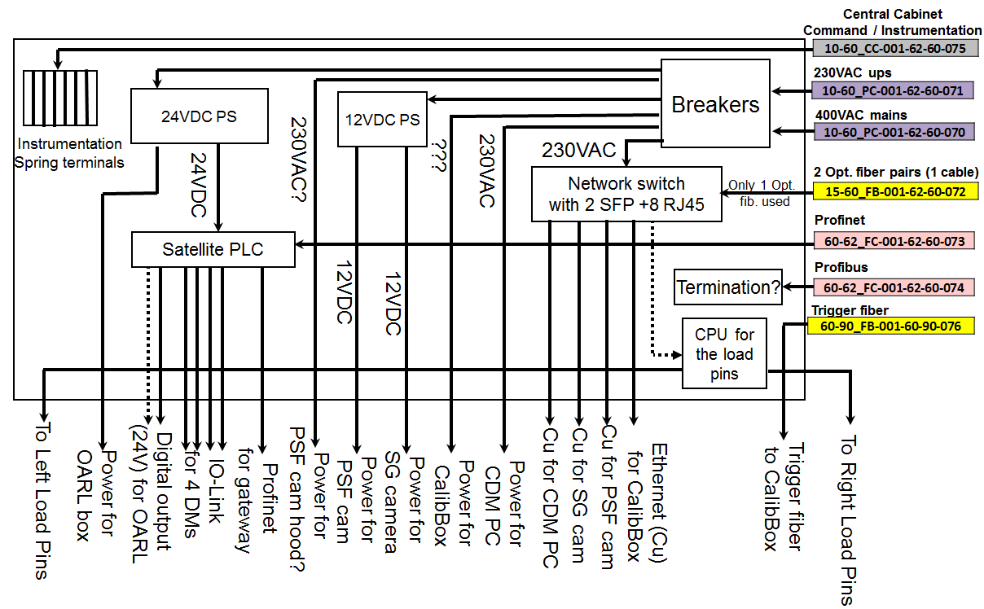
AMC Boxes cable paths
Clarifications have also been done on the dish central cabinet with Koji, yet some information are missing from calib boxes power supply voltage needs

Slide 6
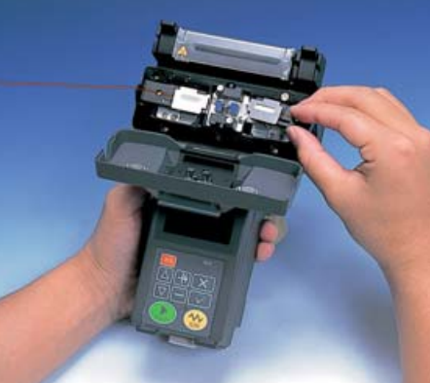
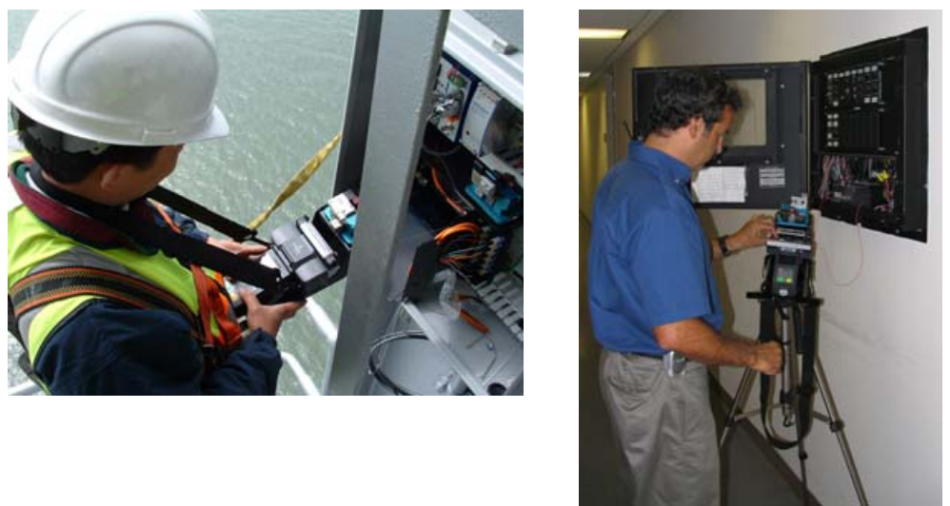
Optical fiber fusion splicing
For Optical fibers, fusion splicing is preferred for optical loss and for junction cabinet connector cost.
But to do this we need some tooling and training
Training is not complex and we need to know if tooling is available within LST institutes or can be bought or rent
(otherwise sub contracted to a local company)
Example handheld splicer with convenient accessories for reduced work spaces

Slide 7
Cable per cabinet listing
What cables are arriving at Cabinet 62/63 point

Slide 8
Cable per cabinet listing
And same for cables departing from cabinet 62/63

Slide 9
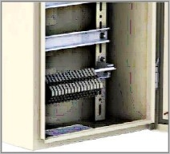
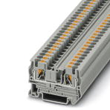
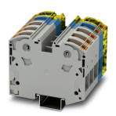
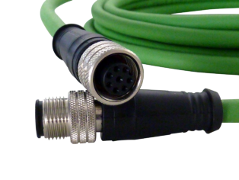
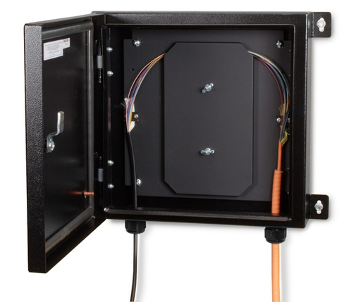
Cable per cabinet listing
Next step is to define what is connected inside and what is only “hosted” to be in waterproofed environment
E.g. : power supply cables and instrumentation/interlock cables are connected inside cabinets through spring block terminals
But motor connectors
And optical fibers will preferably housed
inside cabinets instead of being let outside

Slide 10
Perspectives 2017
Finaliser le repérage des câbles du LST
  ID & supports adaptés aux différents types de câble,
  lecture/identification automatique (documentation, install/maintenance)
Câblage/aboutement des fibres optiques
  Formation à l’utilisation du matériel
Avancer sur la spécification du LAN LST
  Localisation des équipements actifs,
  Définir/organiser le plan d’adressage IP
Renfort en install si besoin (et si budget…)

Slide 11
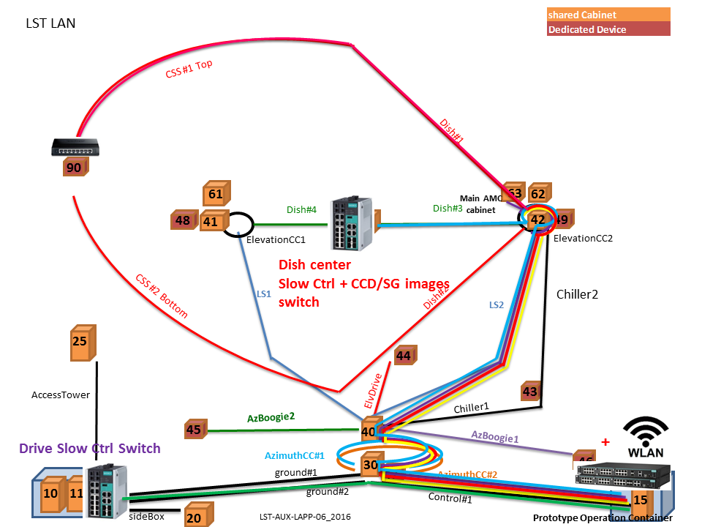
Main LST cable Paths and cabinets

