Slide 1


SVOM in the multi-messenger area
CEA-Irfu, Saclay
IAP, Paris
APC, Paris
CNES, Toulouse
NAOC, Beijing
XIOPM, Xi’an
IHEP, Beijing
SECM, Shanghai
IRAP, Toulouse
LAM, Marseille
CPPM, Marseille
GEPI, Meudon
LAL, Orsay
LUPM, Montpellier
University of Leicester
MPE, Garching
Sarah Antier
LAL, France
(antier@lal.in2p3.fr)
On behalf of the SVOM consortium
02/06/2017

Slide 2
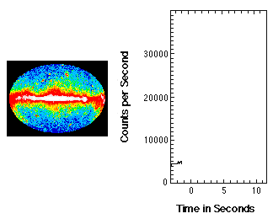
What are Gamma-ray bursts ?
Intense short pulse of gamma-rays : > 10⁵¹ erg
Fast-Fading afterglow in x-rays, optical and radio
Occur in distant galaxies
  → Current redshift range : 0.03 – 9.38
Long
Gravitational collapse of a massive star
Short GRBs:
Compact-object mergers
Black holes/Neutron stars

Slide 3


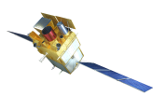
Open Questions
GRB studies
Progenitors and central engines
The physics of the relativistic ejecta
Multi-messenger emission
Using GRBs as a tool for cosmology
Spectroscopy of the line of sight
Host galaxies
Very distant GRBs : first stars/reionization of the intergalactic medium ?
Fermi : short GRBs and excellent coverage of the prompt emission
Swift : study of the afterglow and measurement of the redshift
Build a homogeneous sample of GRBs
with a good time and spectral coverage
With redshift measurement

Slide 4






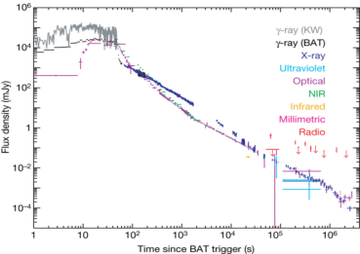
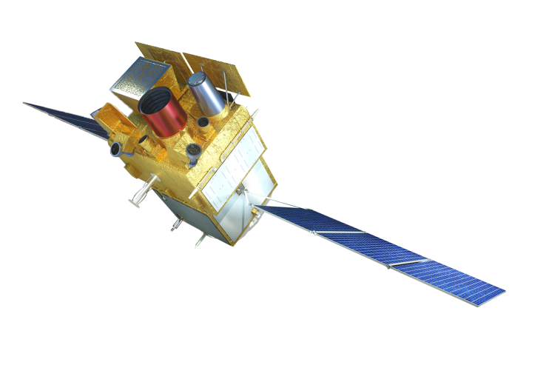




SVOM: Space-based multiband astronomical Variable Objects Monitor
Satellite to be launched in 2021
MXT
GRM
ECLAIRs
ECLAIRs
GWACs
MXT
F-GFT
GWACs
Visible
T0
ECLAIRs
Rayons – X durs
Temps T0
F-GFT
Proche infrarouge
T0 + 1 min
GRM
Rayons Gamma
T0
VT
Visible
T0 + 3 min
MXT
Rayons X-mous
T0 + 3 min
VHF Network
S, X Band antenna
VT
GRM
GWAC
VT
GFT-1
GFT-2
Cordier et al., PoS, Swift:10 (2015)

Slide 5
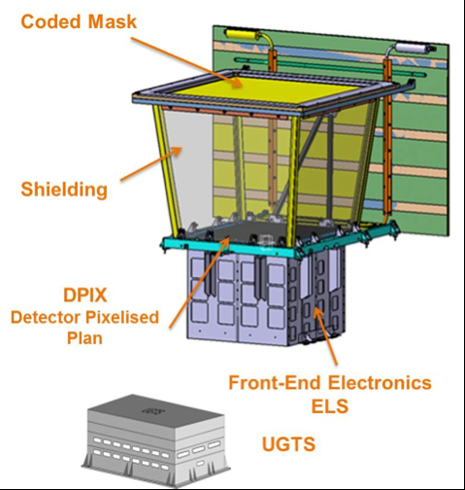
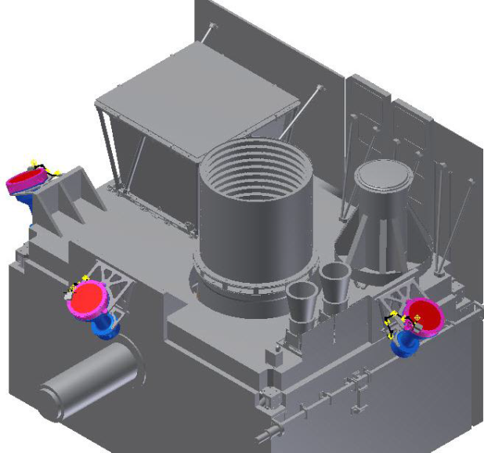
ECLAIRs - Trigger Camera
Prompt Emission
60 GRBs/yr
Coded mask telescope
Energy band | 4-150 keV
FOV | 2 sr
Mask | Open fraction = 0.4
Detector | 6400 CdTe pixels - 4x4x1mm³
Onboard processing | Count-Rate and Image Triggers
Localisation acc. | 14’ at detection threshold 3’ for bright sources
GRM - Gamma Ray Monitor
3 NaI detectors (GRDs)
Energy band | 15 keV – 5 MeV
FOV | 2 sr per GRD
Detector | 200 cm² (NaI, 1.5 cm thick)
Onboard processing | Count Rate Trigger
localisation accuracy | > 10°
90 GRBs/yr
GRD2
GRD1
GRD3

Slide 6
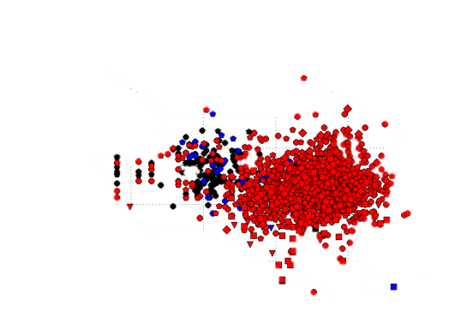
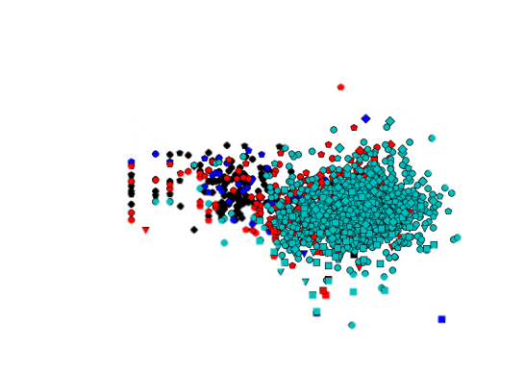
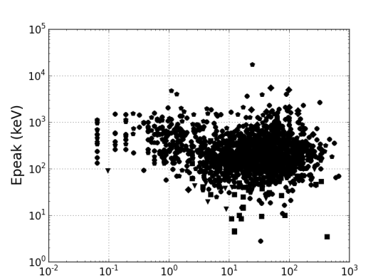
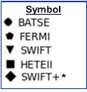
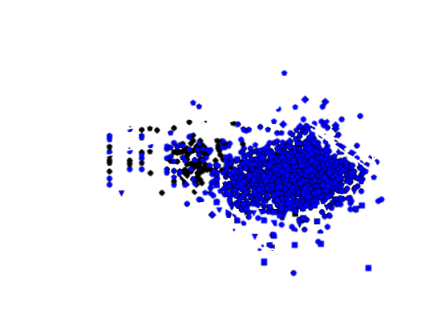
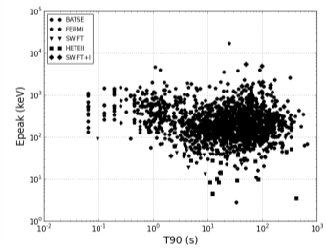
Caracteristics of the GRBs seen by ECLAIRs
Number of GRBs detected by ECLAIRs:
64 ± 18 GRBs/yr at the alert threshold and 56 ± 18 GRBs/yr at the slew threshold
Same proportion of short GRBs as Swift/BAT (8%) : 5±1 GRBs/yr
ECLAIRs > ɛ_{GRB}
Black > 0.2
Blue > 0.5
Red > 0.7
Cyan > 0.9
T90 < 2 s
Very Long GRBs ?
*Konus or GBM
Epeak < 30 keV
T90 (s)
ECLAIRs will be sensitive to all known GRBs
Input catalogs
S.Antier, F.Daigne, S.Schanne et al. (2016)

Slide 7
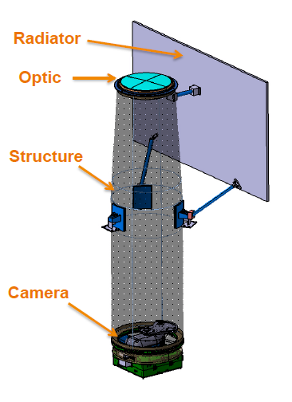
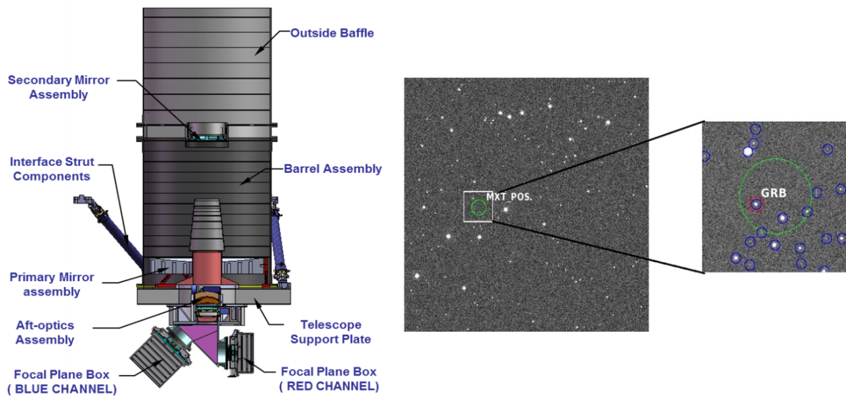
MXT – Micro-channel X-ray Telescope
Micropore Optics (MPO) “Lobster eye”
FOV | ~ 1 deg²
Focal Length | ~1 m
Camera | 256x256 PN CCD 27 cm² at 1 keV
Energy Band | 0.2 – 10 keV
Onboard processing | sources positions
Localization accuracy | < 2’ < 30’’ bright sources
90% of ECLAIRs GRBs observable
VT - Visible Telescope
Ritchey Chretien Telescope
Diameter | 40 cm
2 channels | 400 nm–650 nm (blue) 650 nm–950 nm (red)
Limiting Magnitude | 22.5 (5σ, 300s)
FOV | 26‘ x 26’
Spatial resolution | 0.77’’
Onboard Processing | List of potential transient srcs.

Slide 8
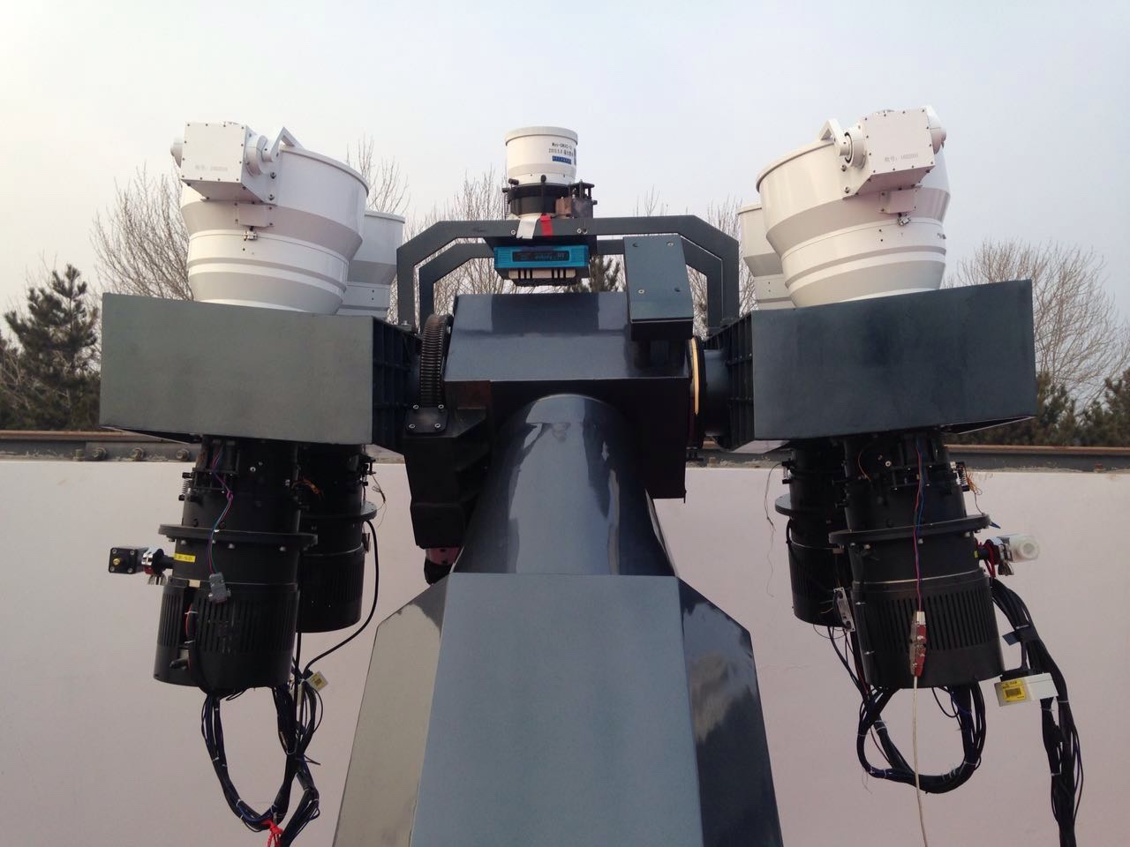
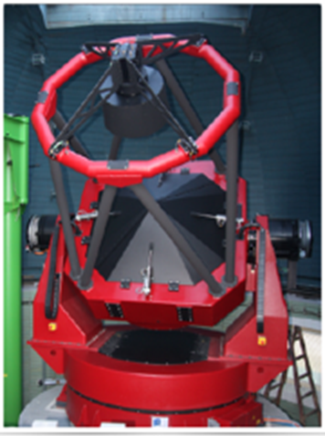
GWAC – Ground Wide Angle Cameras
Set-up with 36 cameras
Diameter | 18 cm
Focal Length | 22 cm
Camera | 4k x 4k CCD detectors
Wavelength | 500-800 nm
FOV | 5000 deg² (63% of the ECLAIRs FOV)
Limiting Magnitude | V=16.5 (5 σ,10s)
Temporal resolution | 1s
12% of ECLAIRs GRBs observable
F-GFT - Ground-based Follow-up Telescope
Chinese Ground Follow-up Telescope (C-GFT)
  Robotic 1-m class telescope, Xinglong observatory
  FoV = 21x21 arcmin², 400-950 nm
French Ground Follow-up Telescope (F-GFT)
  Robotic 1.3-m class telescope, San Pedro Martir (Mexico)
  FoV = 26x26 arcmin²
  Multi-band photometry (400-1700 nm, 3 simultaneous bands)
Contribution to the LCOGT network (12x1m+2x2m tel.)
>75% of ECLAIRs-detected GRBs immediately visible by one ground telescope (GFTs+LCOGT)

Slide 9
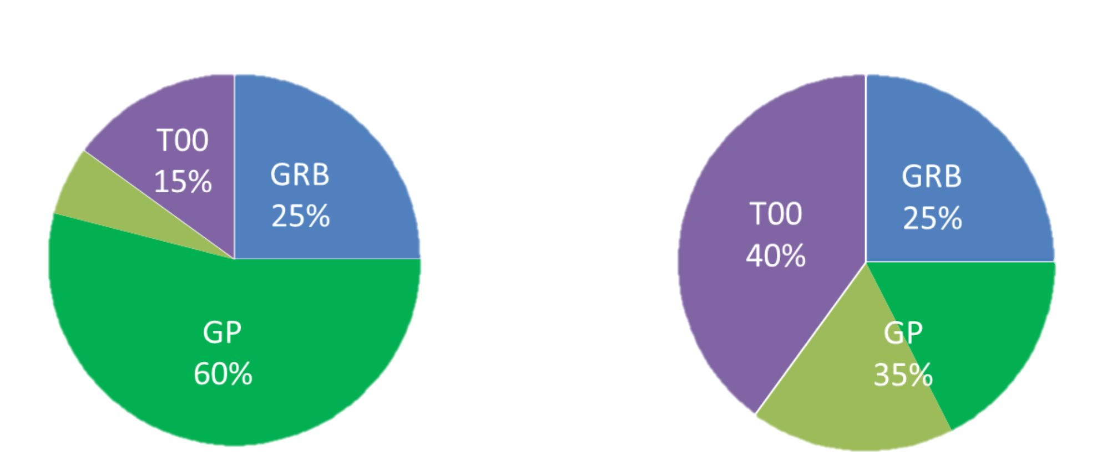
Observation Program:
GRB
Autonomous transient
detection by ECLAIRs
Top-Down
GP
General Program Pre-planned Observations
compliant with satellite law
ToO
Target of Opportunity
Bottom-Up
Nominal mission
Extended mission
We are currently enlarging the ToO capabilities of SVOM.
Very complex operations at system level
 | ToO-NOM | ToO-EX/ToO-MM
Frequency | 1/day | 1/month
Standard delay | < 48h | < 12 h
Duration | > 1 orbit | 7 – 14 orbits
Notes:
General Program (GP) : astrophysical targets of interest mostly compliant with the B1 law (satellite attitude law).
GP observation plan is uploaded to the satellite every 2 weeks
How to apply ? Call for observation proposals once per year. Selection by a TAC.
Example : survey of the Virgo cluster (TDEs, AGNs)
Autonomous transient detection by ECLAIRs :
known source (repointing only if above a given threshold)
unknown source : GRB (Core Program : CP) or other astrophysical transient (GP)
All transients will be notified in short time scales (<30s for 65% of alerts) to the FSC and then to the community.

Slide 10
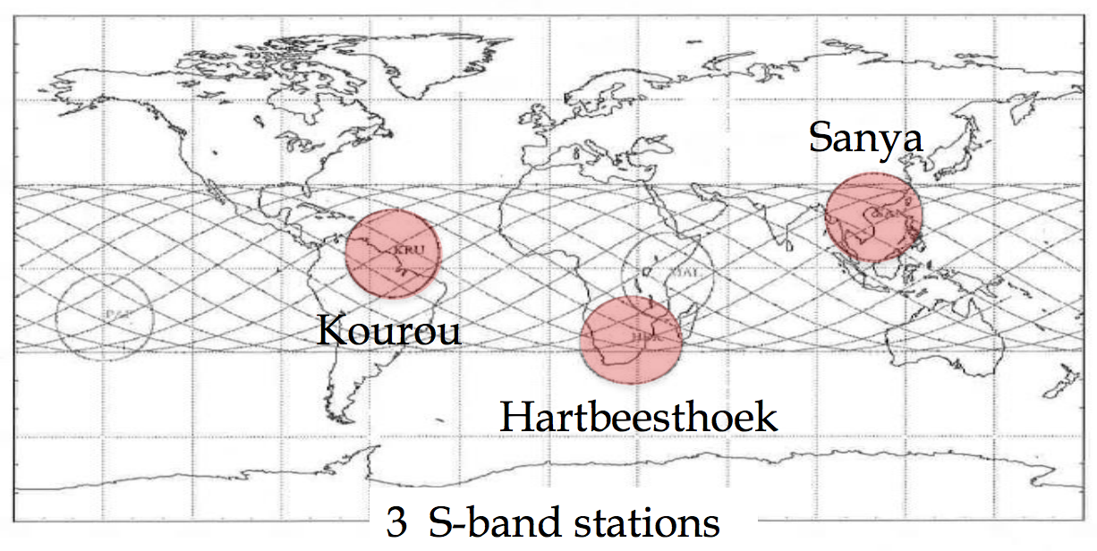
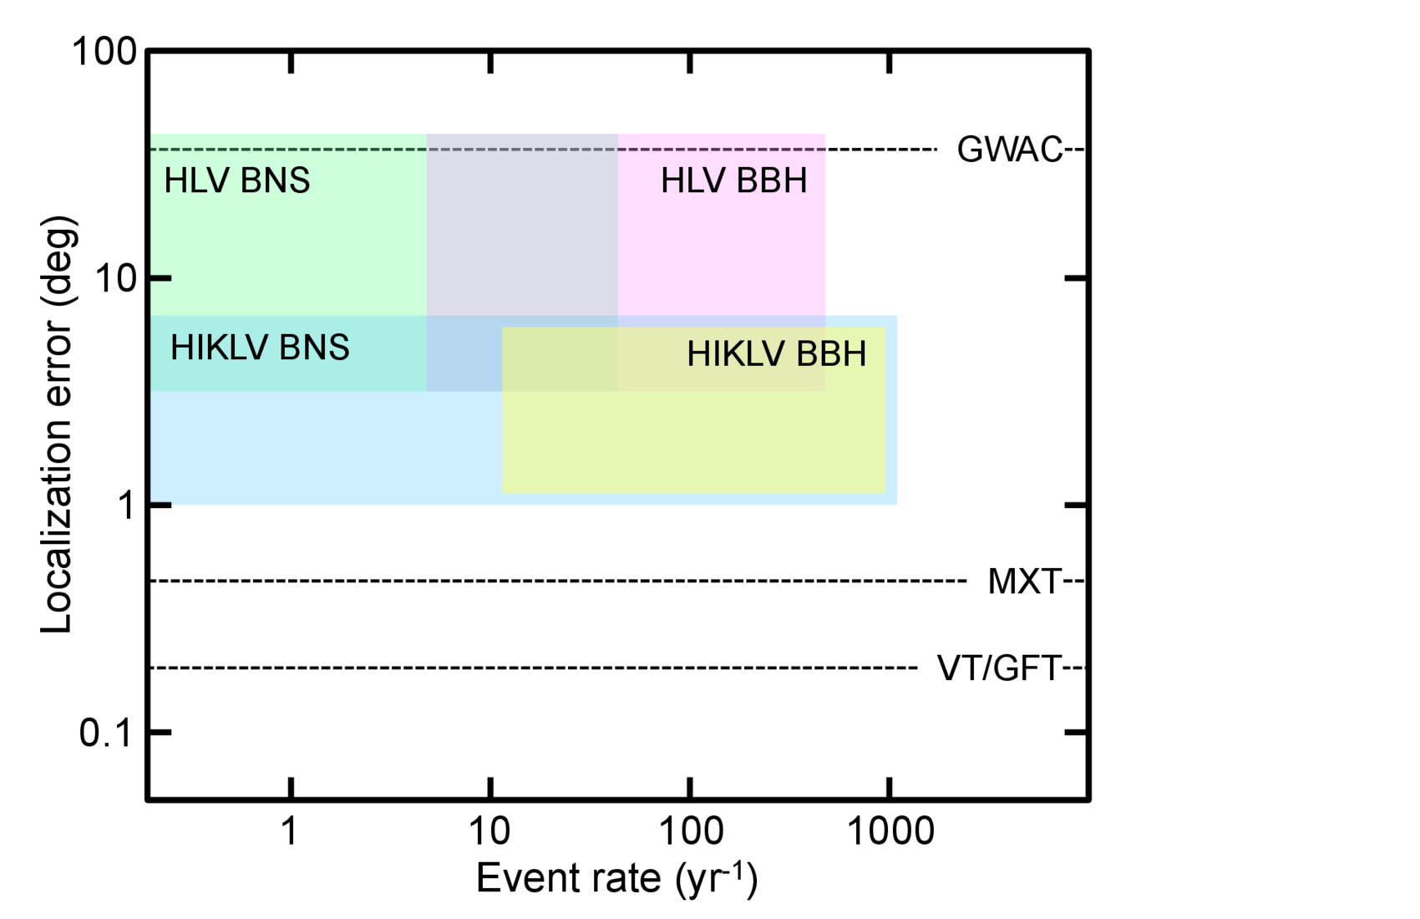
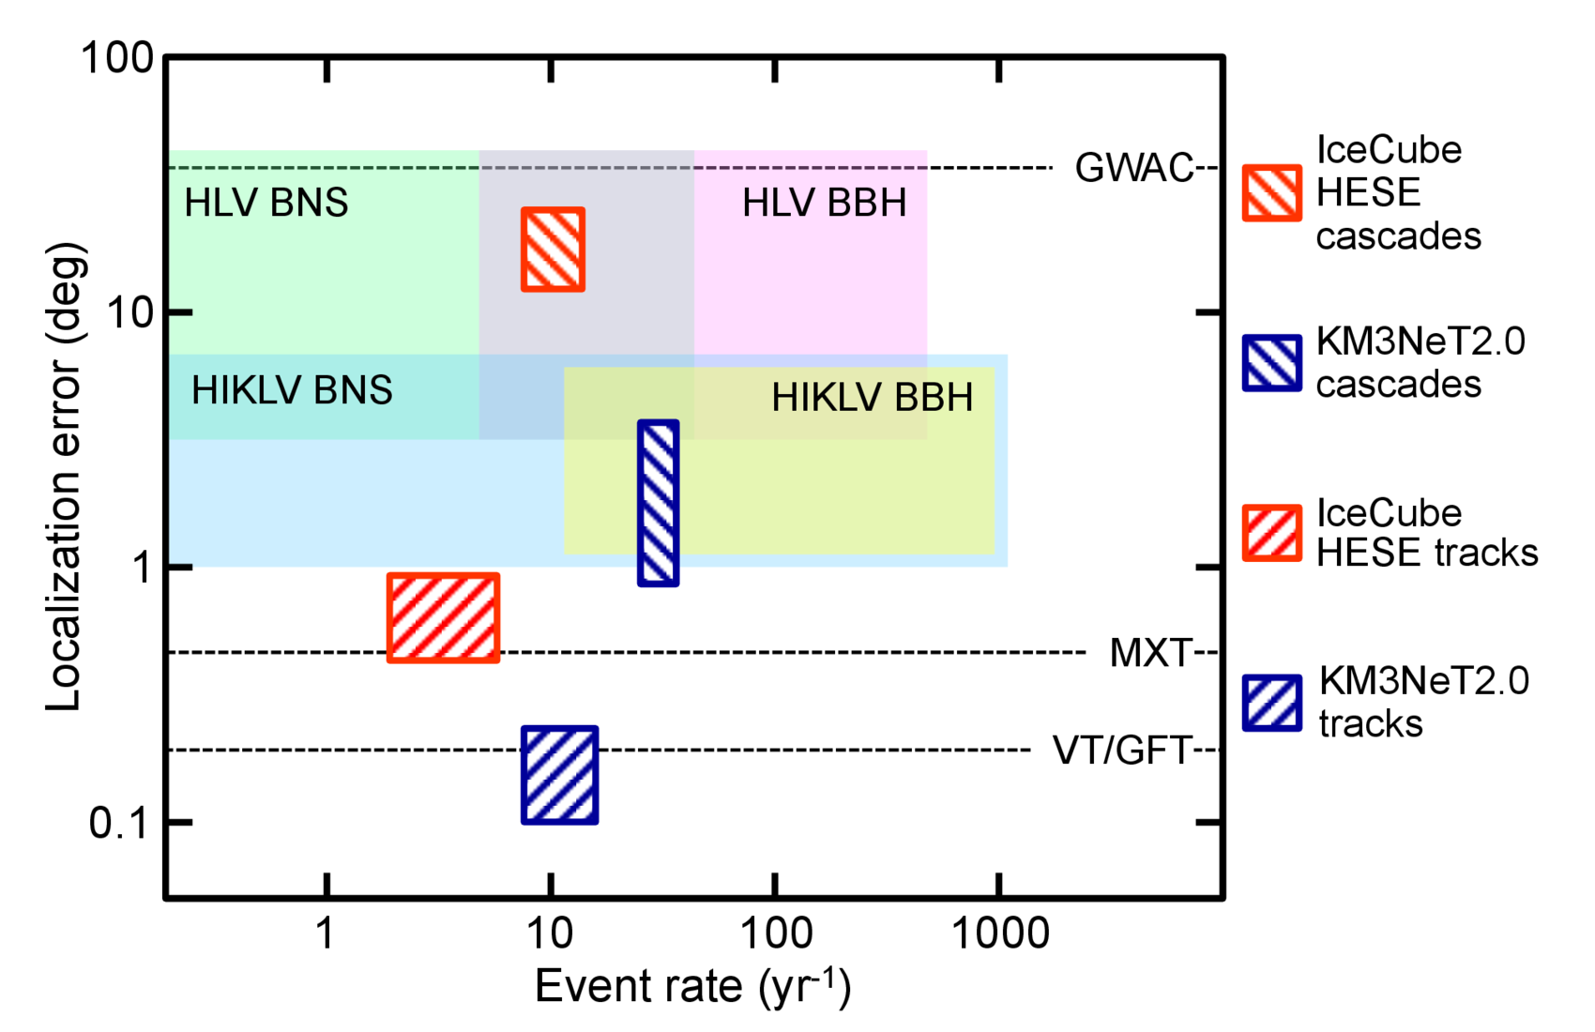
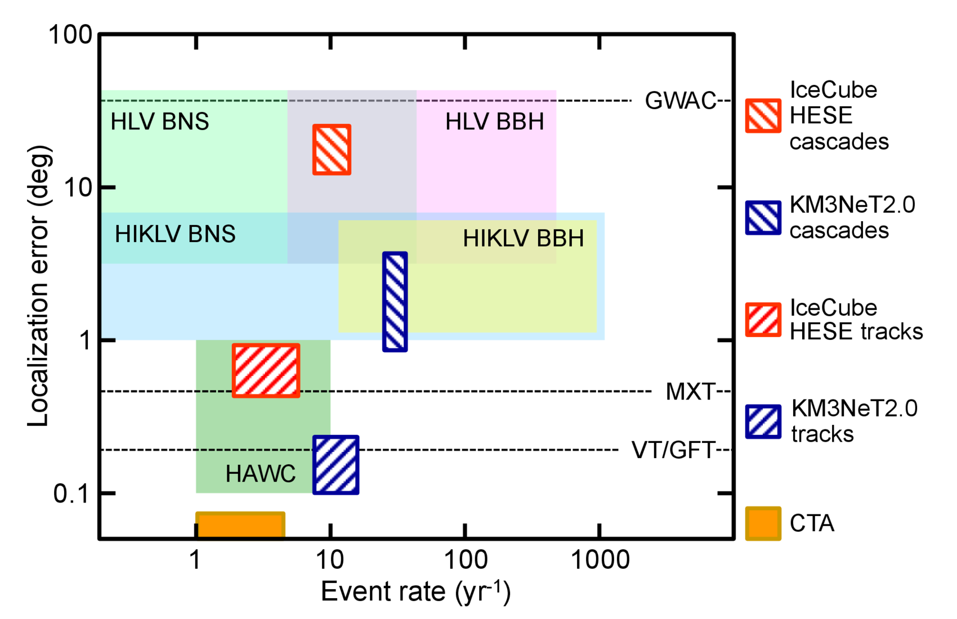
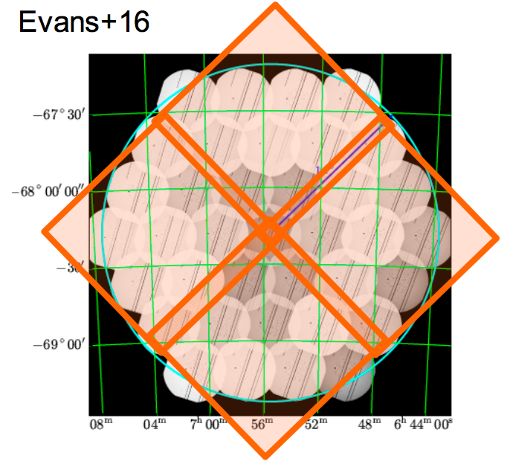

ToO-MM
ToO-MM is the ToO dedicated to EM counterpart search in response to a multi-messenger alert.
What differs from the ToO-NOM and ToO-EX is the unknown position of the source within a large error box…
Tiling required !
Swift/XRT slightly better than MXT (35%)
but MXT has a larger FOV!
J.Wei, B.Cordier, C.Lachaud, et al. (2016)
Send MXT photons through VHF link + ground analysis.
If anything found :
new ToO + Community alert
EVANS 2016, XRT tiling of the LMC
Notes:
OCG (Operation and Control Group) will check that the ToO can be performed given the constraints related to satellite health.
The OCG meets once per day (5d/7).
For ToO-EX or ToO-MM a special OCG meeting is requested (24h/24).
The new Work Plan is sent to the CCC (Chinese Control Center) to build the Telecommands and upload them to the satellite using the S-band antennas available in Sanya (for ToO-EX and ToO-MM, the CNES provides the antennas in Kourou and Hartbeesthoek)
(Abadie et al. 2010a)
Sur la figure, c’est le rate combien sont produits dans tous l’univers

Slide 11
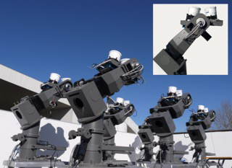
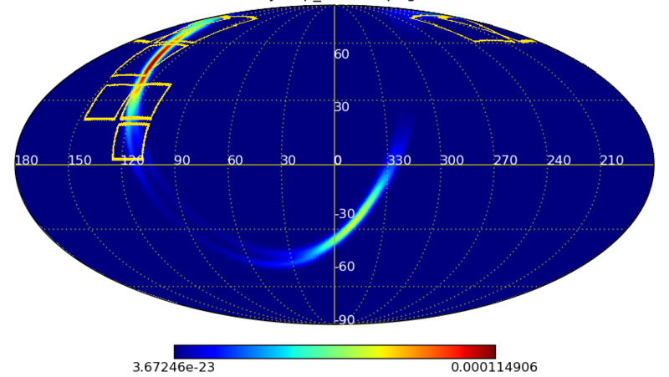
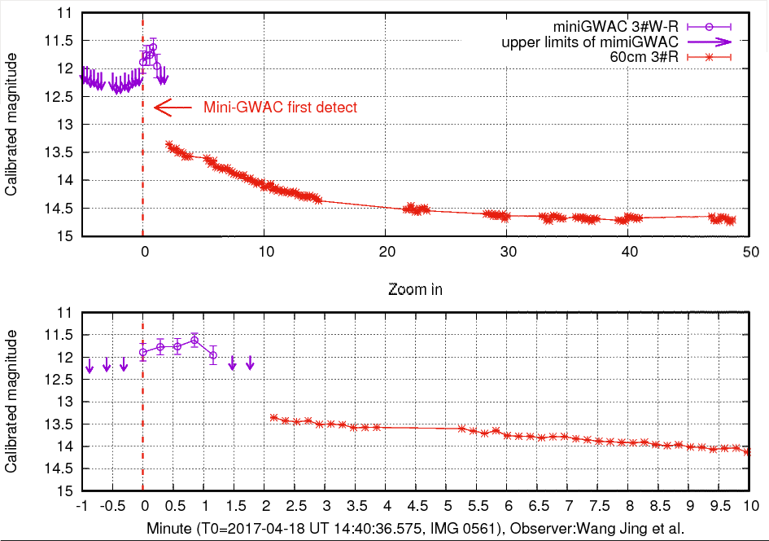
GW astronomy and SVOM
During O2 run: GW170104
Mini-GWAC observations (12 mag):
Perform routine observations every night
ToO from GW alerts and Antares neutrino alerts
GWAC available at fall 2017 (u.Limit 16 mag)
Flaire star found by mini-GWAC/60 cm telescope
Wang Jing et al. at 14:40:36 UTC 18/04/2017
(10:45:28.75, 35:51:17.90)
GCN20369
Starts Observations 2h20 after the GW trigger!
Bayesien probability coverage: 84.4 %
SVOM performs the Largest Probability coverage
for GW170104 in shortest latency for optical band
No interesting transient found
Possible (external) candidate follow-up :
2 robotics 60 cm telescopes (GCN20404)
1-m telescope (Xinglong)
2-m telescope (Xinglong)
2.16-m telescope in Lijiang Observatory
S.Antier on behalf on the SVOM/GWAC team

Slide 12
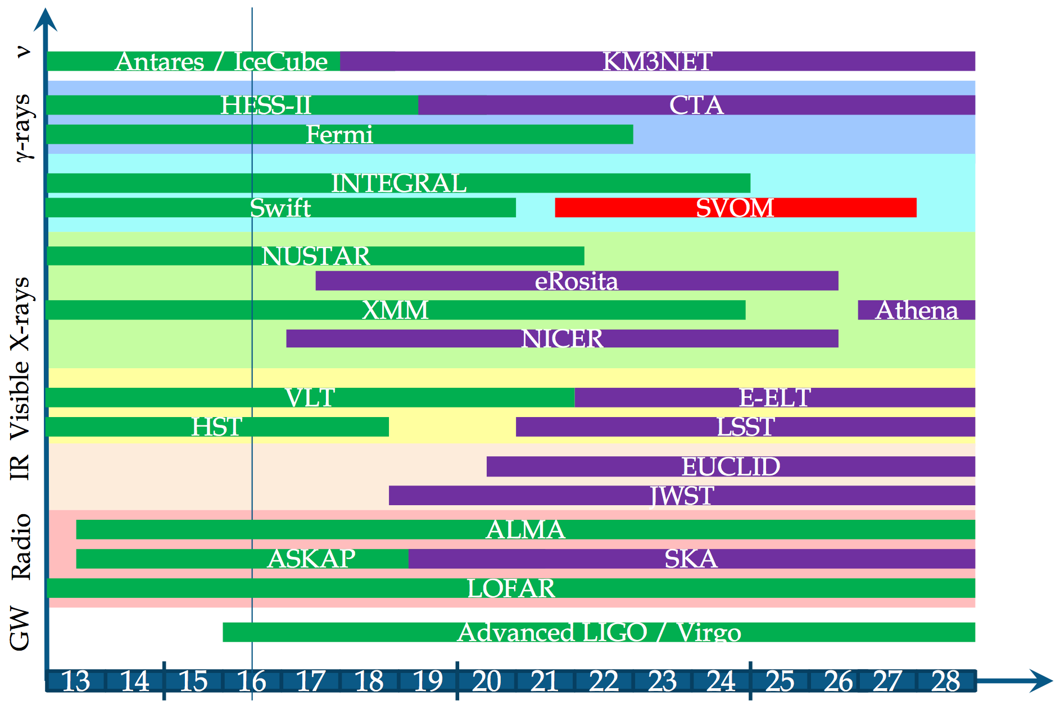
Conclusion and perspectives
Now, with the time domain and multi-messenger astronomy in strong developments, SVOM is ready to play an important role in the future…
Sarah Antier, LAL, Orsay – SVOM in the context of multi-messenger area

Slide 13
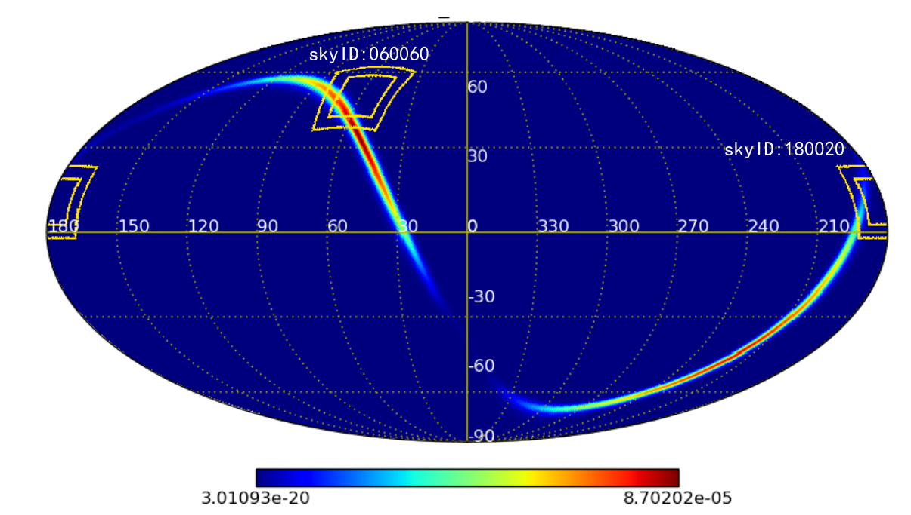
GW astronomy and SVOM
During O1 run: GW151226
Mini-GWAC observations
Observations 12 h and 13.6 h
after the trigger time (2015-12-26 at 3:38:53 UTC)
Duration 2.8 and 5.3 h
Upper limit 11 mag
Transient search with two pipelines:
Catalog crossmatch and difference imaging analysis

