Slide 1
The (future) evolution of the ground-based detectors
Sheila Rowan
University of Glasgow
GWIC Chair
GWPAW Annecy
30th May 2017
LIGO-G1701000

Slide 2
Plans for the coming era of gravitational wave astronomy and astrophysics
2015 to now:
    start of the era of gravitational wave astronomy and astrophysics
  Work of many 100’s of people for several decades now paying off
  Talk from Mike shows plans for the ongoing science runs
  Long term thinking has been a hallmark of the field
In 2007/8 the international GW community formed a vision for the future of the field;
  2009 Gravitational Wave International Committee (GWIC) Roadmap: https://gwic.ligo.org/roadmap.
  Perspective: to optimize the global science in the field
  30-year horizon
  Global advanced detector network envisioned

Slide 3

The global GW roadmap Circa 2009
advLIGO
advVirgo
LCGT
KAGRA
GEO-HF
(InDIGO)
ET
US3G
We are here
From the Gravitational Wave International Committee (GWIC roadmap – available at: http://gwic.ligo.org/roadmap/ )

Slide 4
The global GW roadmap
Some timescales need revised but vision remains intact
advLIGO
advVirgo
LCGT
KAGRA
GEO-HF
(InDIGO)
ET
US3G
We are here
From the Gravitational Wave International Committee (GWIC roadmap – available at: http://gwic.ligo.org/roadmap/ )

Slide 5
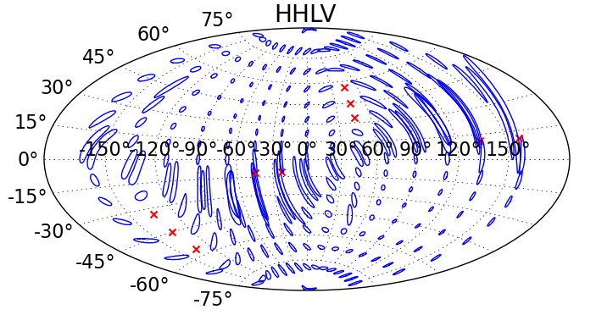
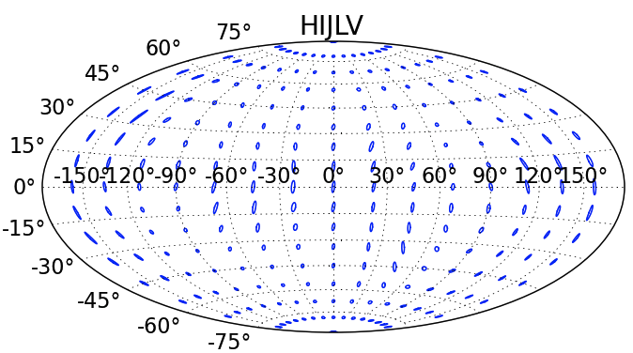
Sky localization with 3 sites …
Completing the advanced detector network
… and with 5 sites
c. 2020+
Typical 90% error box areas for Neutron Star-Neutron Star binaries
  median > 20 sq deg
Fairhurst, CQG 28 105021 (2011)
LIGO-G1301140
Notes:
“localization accuracy for face on BNS at 160 MPc in various networks of advanced detectors. The ellipses contain the 90% localization regions for sources from various points in the sky. A × is plotted at points where the network would not confidently detect the system.”

Slide 6
Completing the advanced detector network
- LIGO-India

Slide 7

LIGO-India 'in principle’ Approval
By Indian Union cabinet on Feb 17, 2016
… on a positive note with a BIG BANG !!!!

Slide 8
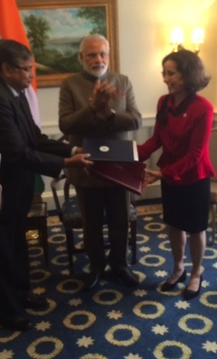
LIGO-India: Indo-US MoU signed
Indo-US MOU between
Department of Atomic Energy &
Department of Science &Tech., India
and
National Science Foundation, USA
signed on March 31, 2016
at Washington DC
in the personal presence of
Hon. Prime Minister of India

Slide 9


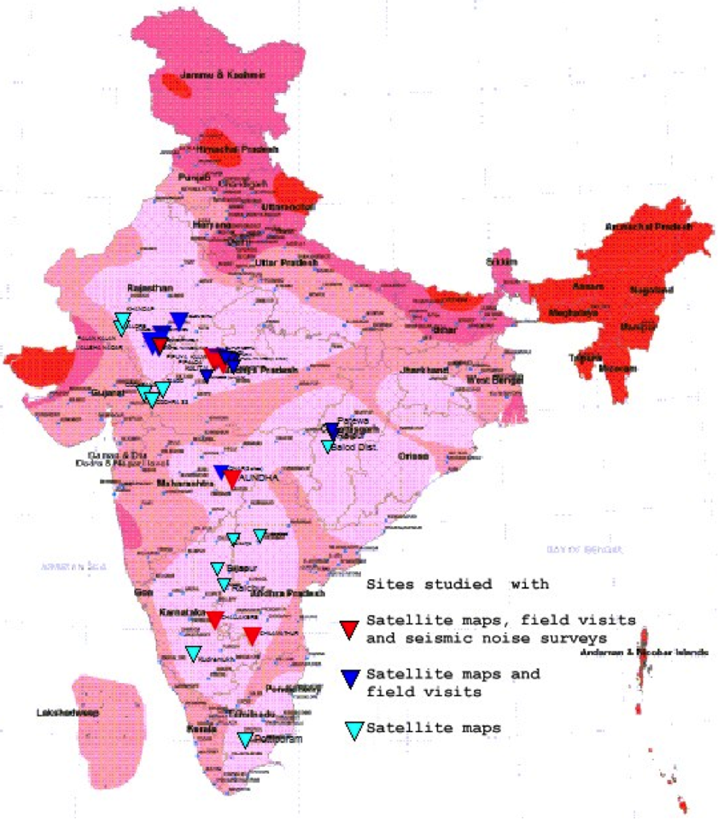
LIGO-India Site search
lrd
Led by IUCAA
LIGO-India selection
39 site leads followed up
(since Sept 2011)
Recommendation for primary and backup site Jul 2016

Slide 10
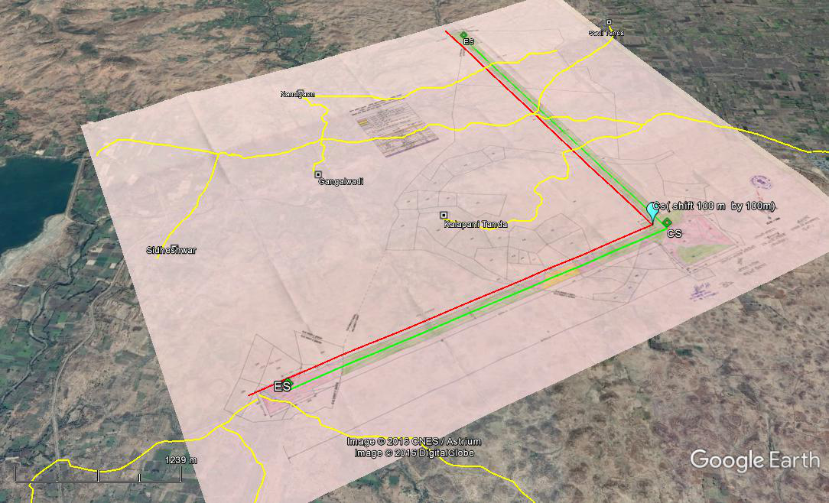
LIGO-India ‘preferred’ site
Maharashtra, India

Slide 11
LIGO-India: site acquisition
Important Steps undertaken :
Formal letter from Secretary, DAE to State chief Secretary for Special project status : expected soon
Joint Measurement survey completed in Feb 2017
Restricted development zones 5km, 10km, 15km around LIGO-India implemented in district development plans
Payment of fees for initiating land acquisition procedure
Identification of land for LIGO-India campuses in neighbouring towns

Slide 12


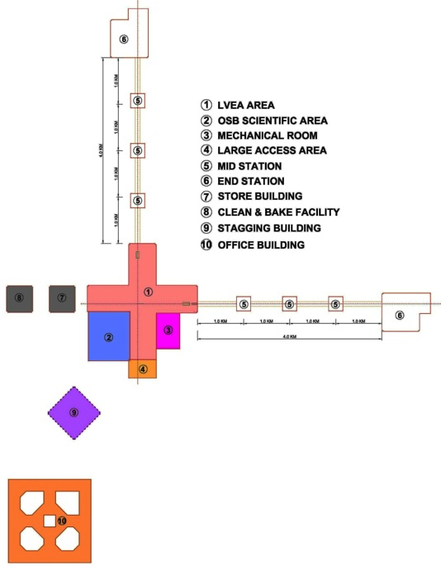
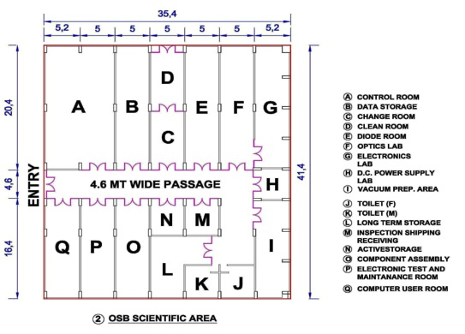
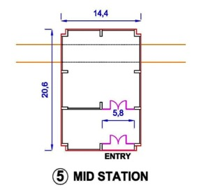
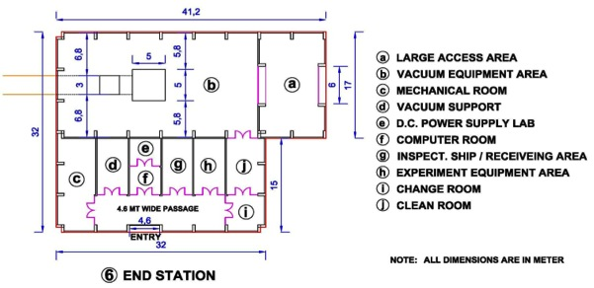
Civil Infrastructure
System Requirement Document for civil infrastructure & conceptual design of Civil infrastructure has been completed.
SRD for Civil infrastructure reviewed
Final civil infrastructure designs being prepared

Slide 13

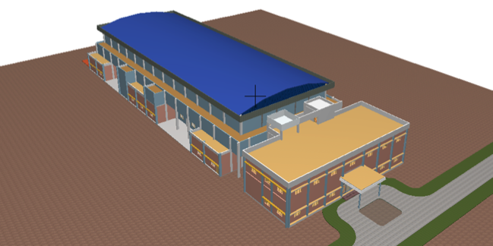
LIGO India off-site facility
Detector Testing and validation lab--Area 2650 Sq.m. Large span hall as enclosure for clean room and supporting facility for seismic isolation assembly & testing
Development lab block - Area of 1260 Sq. m. Two storied RCC structure to house optics, laser, instrumentation and coating lab.
Off-site facility to enable training
prior to LIGO-India construction

Slide 14

Buildup of Science
LIGO–India construction, installation and commissioning involve number of scientific issues
  Meeting stringent noise budgets in construction of infrastructure with regard to foundation, building design, installation of allied facilities.
  Scientific oversight of design, fabrication & installation of vacuum infrastructure
  Trained manpower for installation, commissioning, detector characterisation. Structured training program with LIGO USA & LSC.
  R&D to Advanced LIGO+ configuration in 2024.
  LIGO-India is expected to start in a much more advanced configuration than the advanced LIGO of 2015 or even 2018.
Creating a sizable science community commensurate with scale of LIGO-India megascience
Meeting LIGO–India promise for Indian S&T impetus.

Slide 15

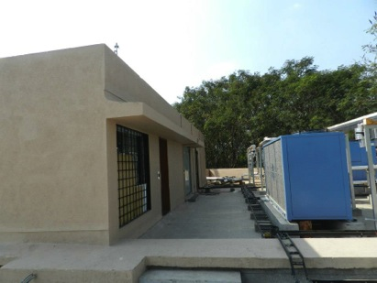
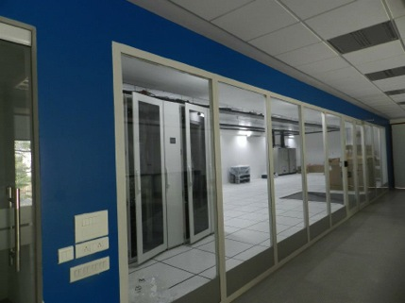
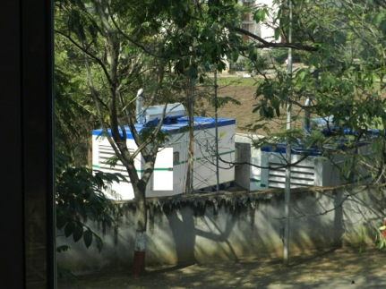
GW Data Centre @ IUCAA
Current IUCAA data centre: (oper. Jan 2013) 30Tf , 600 Tb [10Tf for GW]
GWDA centre: ~100Tf, 2400 cores (LSC Tier2 level) [Jan 2016]
Open to LSC at 50%. Expect usage in second science run of Advanced LIGO
Future Tier-1 LIGO data centre post LIGO-India operations
All infrastructure for future expansion to ~500 Tf in place

Slide 16
Completing the advanced detector network
LIGO-India
KAGRA

Slide 17



KAGRA Project
Host: ICRR UTokyo, Co-host: KEK, NAOJ
300+ collaborators from 90+ institutes
Constructed in Kamioka mine
Underground and cryogenic

Slide 18
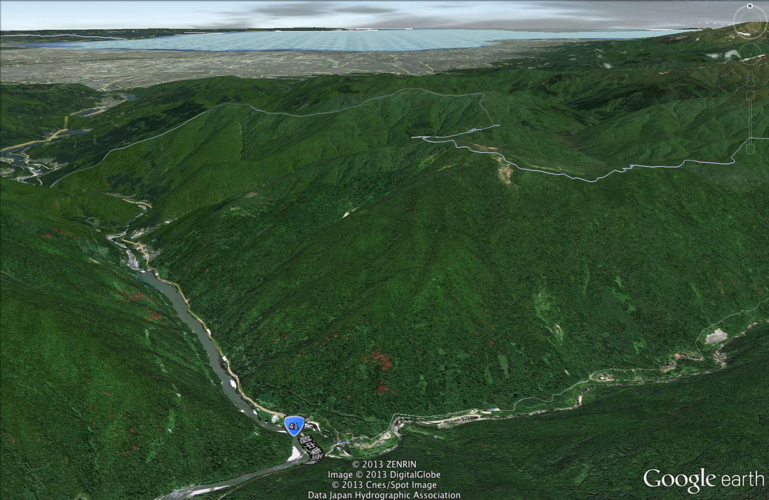
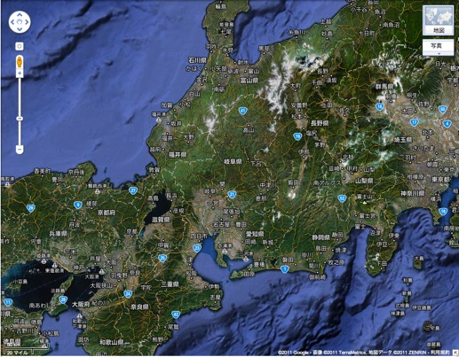
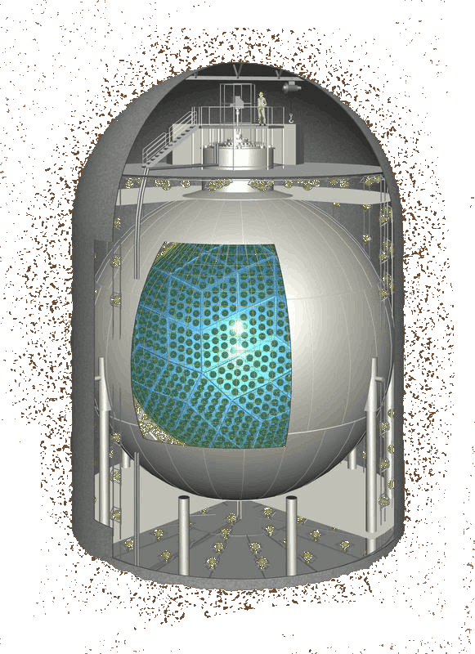
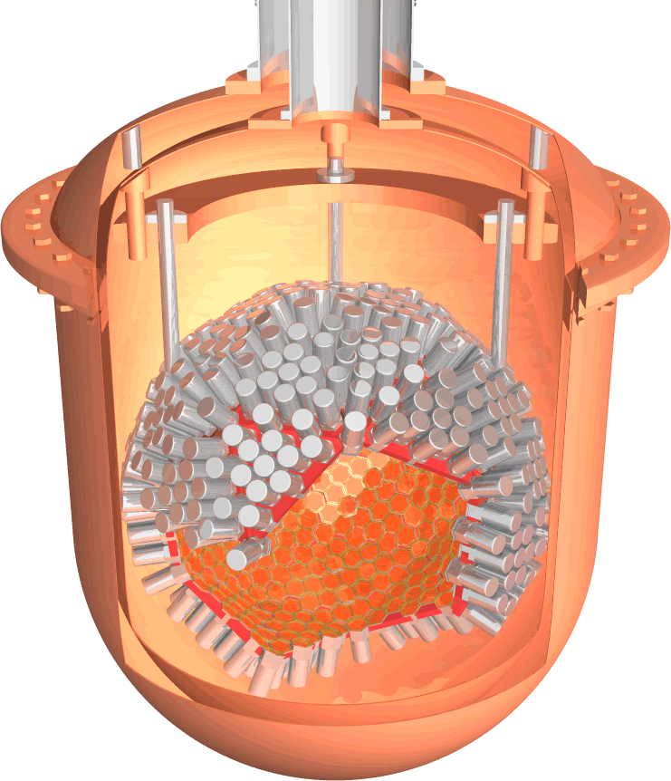
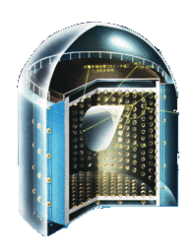
Kamioka
220km
KAGRA is located in Kamioka mine underground
  220km away from Tokyo
  360m altitude
Big laboratory area
Tokyo
XMASS
(dark matter)
KAMLAND
(neutrino)
XMASS
Kamland
CLIO
(GW)
Suprer Kamiokande
(neutrino)
CLIO
Super Kamiokande
Office/
Control room
KAGRA
(GW)
KAGRA
3km
KAGRA entrance

Slide 19
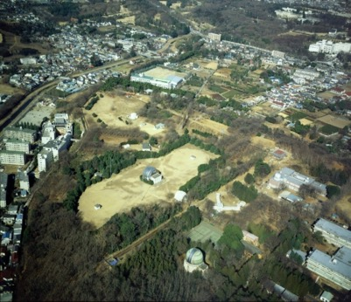
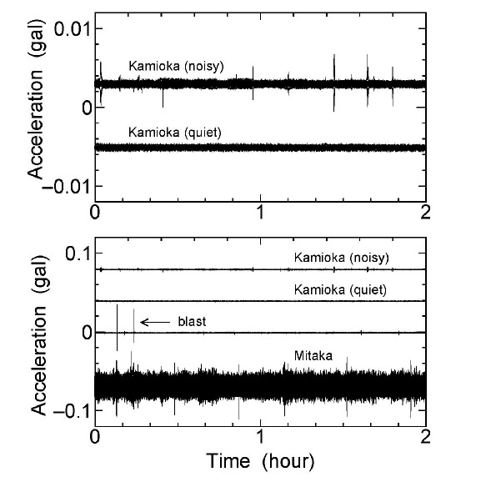
Quiet underground site
ＴＡＭＡ３００
Surrounded by hard rock (Hida-gneiss)
  5 km/sec sound speed

Slide 20
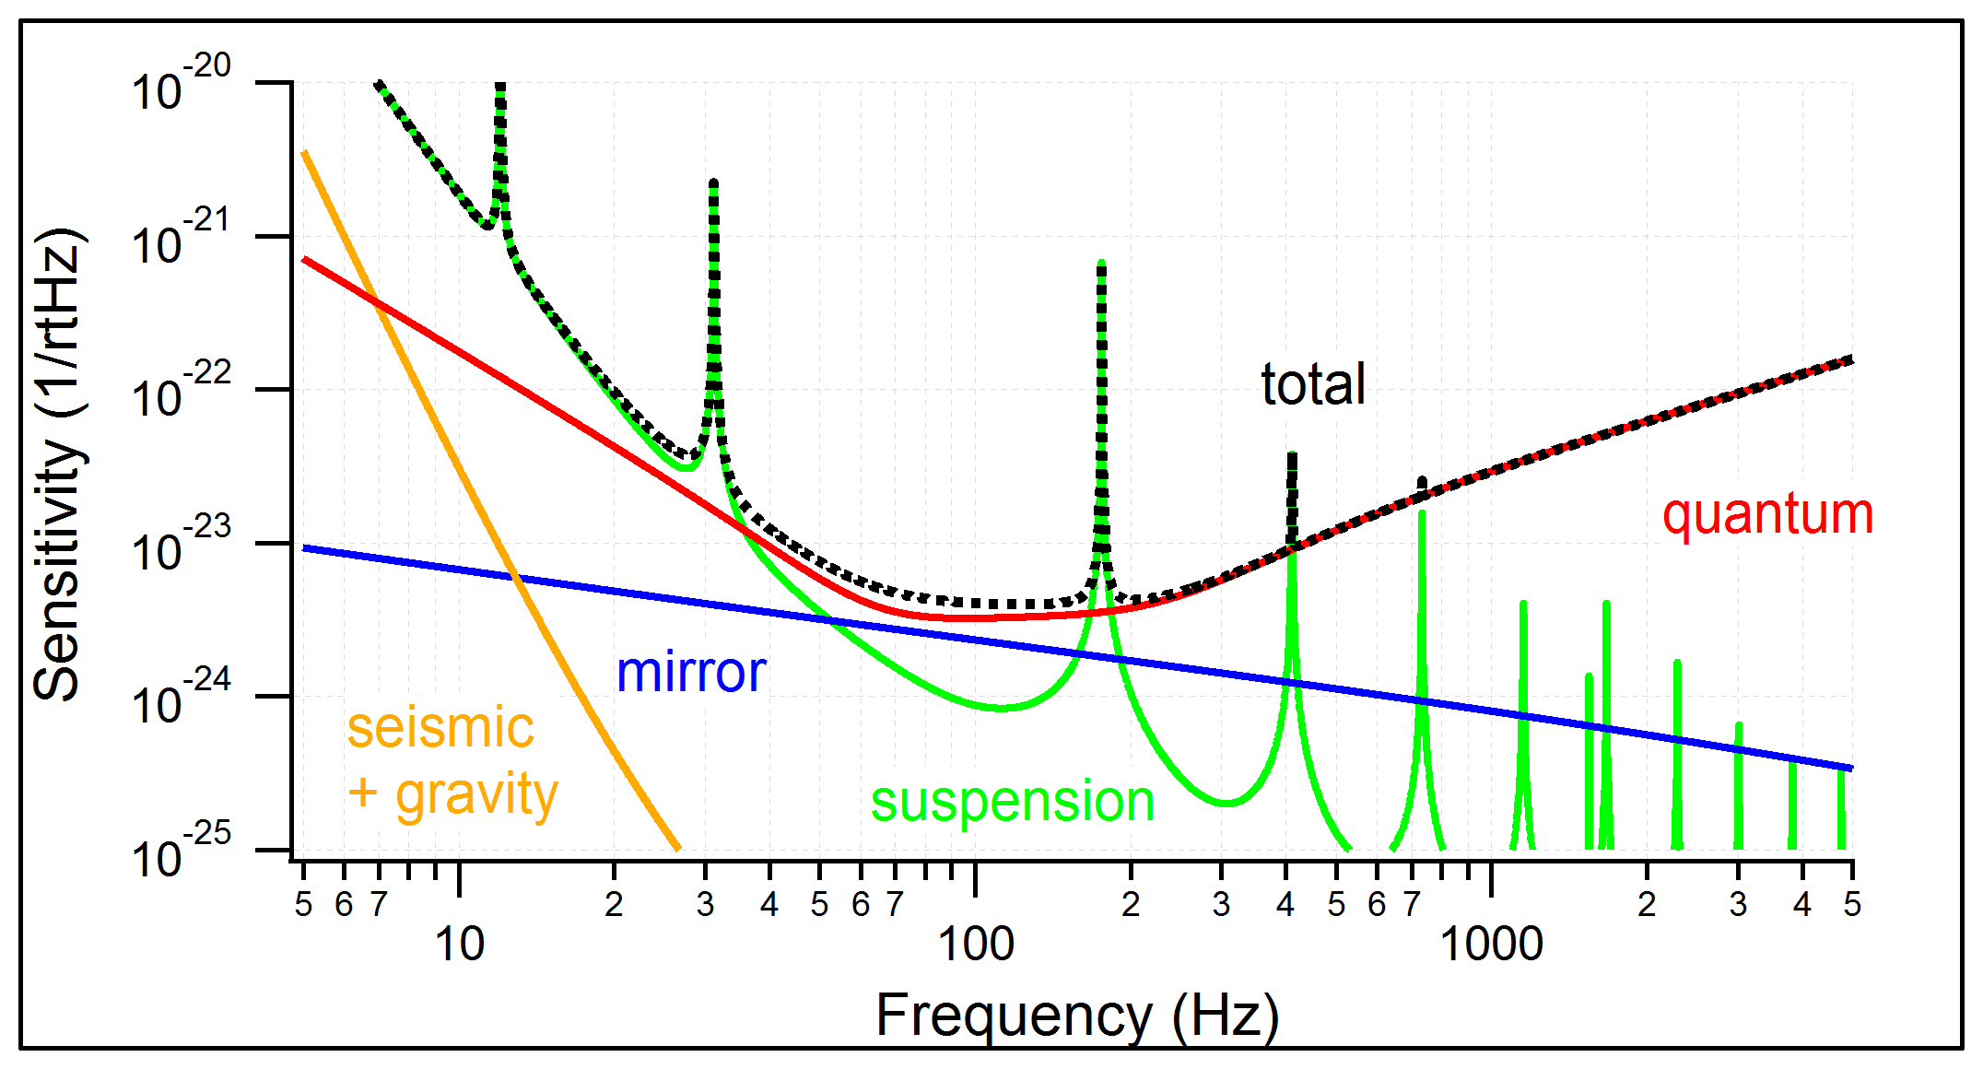
KAGRA Baseline Sensitivity
NSNS Range = 151Mpc

Slide 21
Overall plan
Phase 1
Michelson with two cryogenic mirrors.
Phase 2
Four cryogenic
mirrors.
Phase 3
DRFPMI with four
cryogenic mirrors.
Observation run
Initial KAGRA
Michelson at room temp.

Slide 22
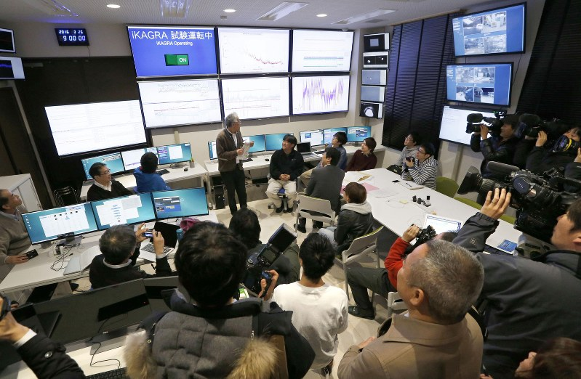
iKAGRA Test Run in 2016
Period: March 25 to 31 and April 11 to 25
obtain experiences of the management and operation of the km-class interferometer
test controls, data transfer, observation shift, etc.

Slide 23
bKAGRA phase 1
BRT
ETMY
Mode Cleaner
PRM
PR2
IMMT
ETMX
BRT
IFI
BS
PR3
SR2
Cryogenic Michelson Interferometer
Full scale suspensions
High power compatible input optics
SR3
GW signal
Start operation by the end of March 2018

Slide 24
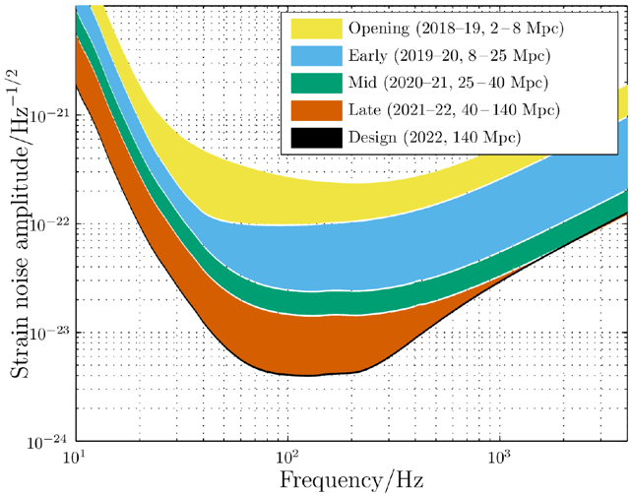
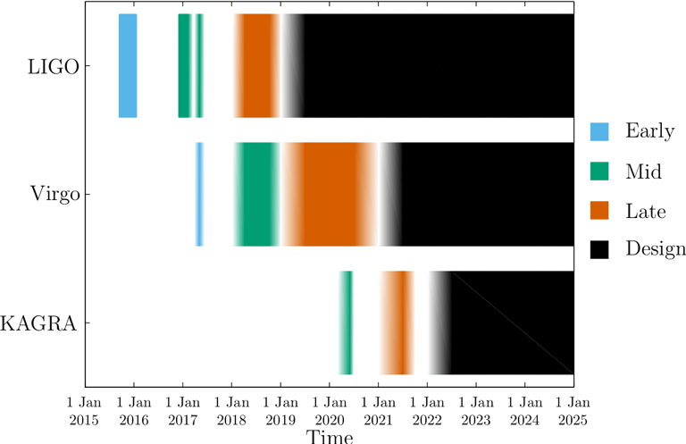
Observation Scenario (Under discussion)
bKAGRA Phase 3
Binary neutron-star range:
25-40 Mpc in 2020,
40-140 Mpc in 2021

Slide 25
Summary – KAGRA planning
iKAGRA: Initial 3km test run successfully done with very limited resources.
  Room temperature, simple Michelson, only one KAGRA style isolation system.
bKAGRA Phase 1 : The first cryogenic test run is planned in March 2018.
  Simple Michelson, two low temperature mirrors.
  Schedule is tight due to installations of KAGRA style isolation system.
bKAGRA Phase 2 : Two more cryogenic mirrors.
bKAGRA Phase 3: The first observation run in ~2020

Slide 26
What Next?
Upgrades to Advanced detectors
(keeping the current infrastructure)

Slide 27
A bit of history
Evolution of the GW detectors:
Limit of the current infrastructures
First detection
Initial astrophysics
A+, AdV+
Test of “advanced” techs
UL physics
Advanced
detectors
Detection distance (a.u.)
Proof of the working principle
Upper Limit physics
enhanceddetectors
Commissioning
& first runs
Infrastructure realization and detector assembling
Same
infrastructure
Same
infrastructure
Same
infrastructure
Same
Infrastructure
(≥20 years old for Virgo, even more for LIGO & GEO600)
year
2003
2008
2011
2017
2022

Slide 28
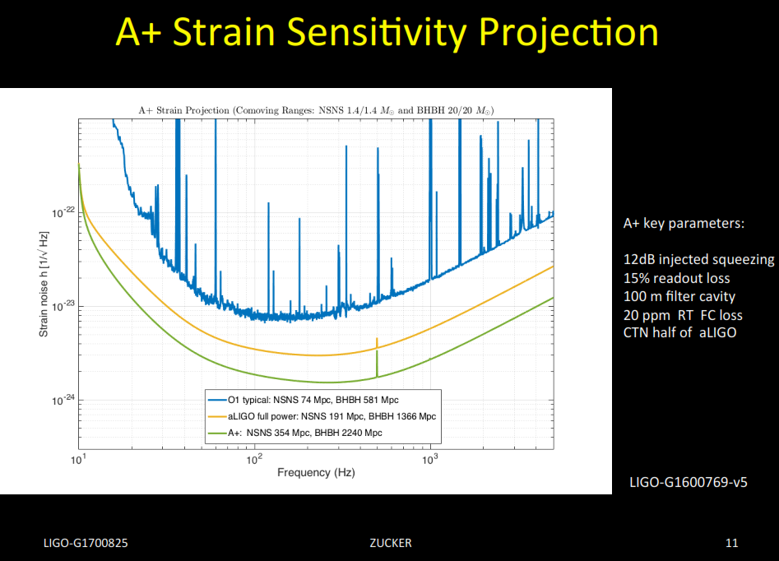
(Advanced LIGO +)
Key hardware improvements
Similar hardware features incorporated into LIGO-india, Advanced Virgo to give A+ global network?

Slide 29
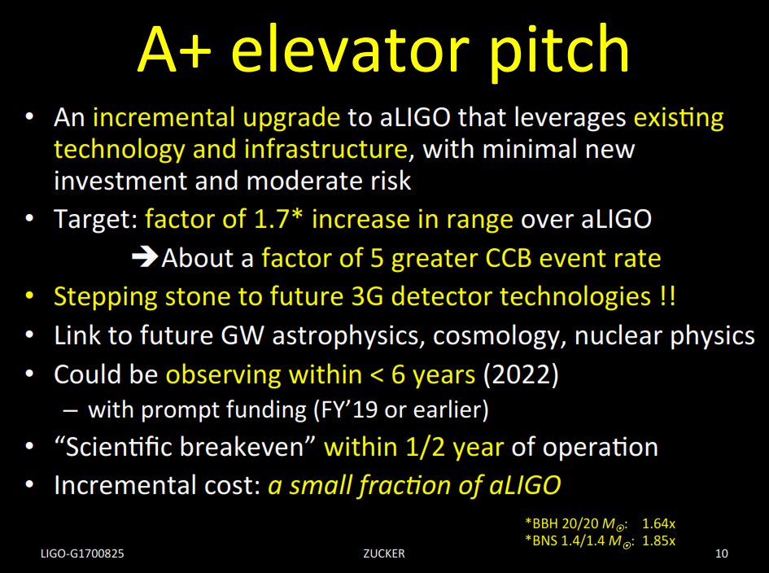

Slide 30
A bit of history
Precision Astrophysics
Cosmology
?
Evolution of the GW detectors:
×10
Limit of the current infrastructures
First detection
Initial astrophysics
A+, AdV+
Test of “advanced” techs
UL physics
Advanced
detectors
Detection distance (a.u.)
Proof of the working principle
Upper Limit physics
enhanceddetectors
Commissioning
& first runs
Infrastructure realization and detector assembling
Same
infrastructure
Same
infrastructure
Same
infrastructure
Same
Infrastructure
(≥20 years old for Virgo, even more for LIGO & GEO600)
year
2003
2008
2011
2017
2022

Slide 31
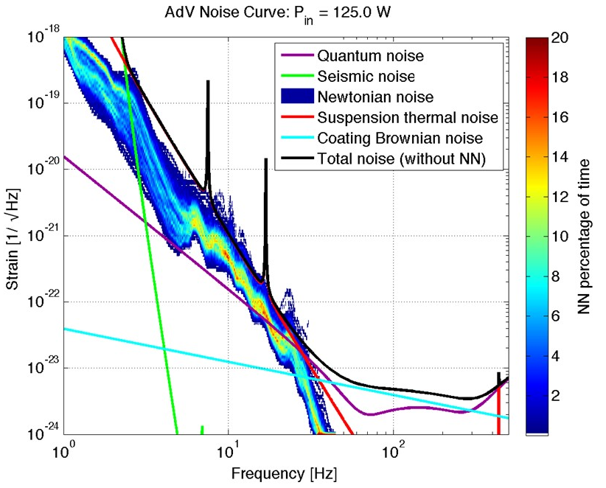
Limits of the Infrastructures?
Obsolescence
Length of the arms
Low frequency:
  Seismic and Newtonian noise
  Cryogenic apparatuses
Medium frequency:
  Size of the beam (thermal noise)
High/medium frequency:
  Long filtering cavities (squeezing)
Additional DoF:
  New geometries or topologies
  Multiple interferometers

Slide 32

The Einstein Telescope design study
The “what next” question has been posed since 2004:
  ESF funded in 2005 an “Exploratory Workshop” on 3G GW observatories
    Design Study idea
Design study funded by the EC in FP7 (2008-2011)
  Involving France, Germany, Italy, the Netherlands, UK
Now the ET community includes also Hungary, Poland and Spain
Project included in sectorial roadmaps (GWIC, APPEC, OECD,. …) and worldwide recognized as leading 3G project

Slide 33
The 3G/ET idea
To realise a 3G new GW observatory
  3G: Factor 10 better than advanced (2G) detectors
  New:
    We need a new infrastructures because
      Current infrastructures will limit the sensitivity of future upgrades
      In 2030 current infrastructures may be tending towards obsolescence
  Observatory:
    Wide frequency, with special attention to low frequency (few HZ)
      Stellar mass Black Holes
    Capable to work alone (characteristic to be evaluated)
      Localization capability
      Polarisations
      High duty cycle: redundancy
    50-years lifetime of the infrastructure
      Capable to host the upgrades of the hosted detectors

Slide 34
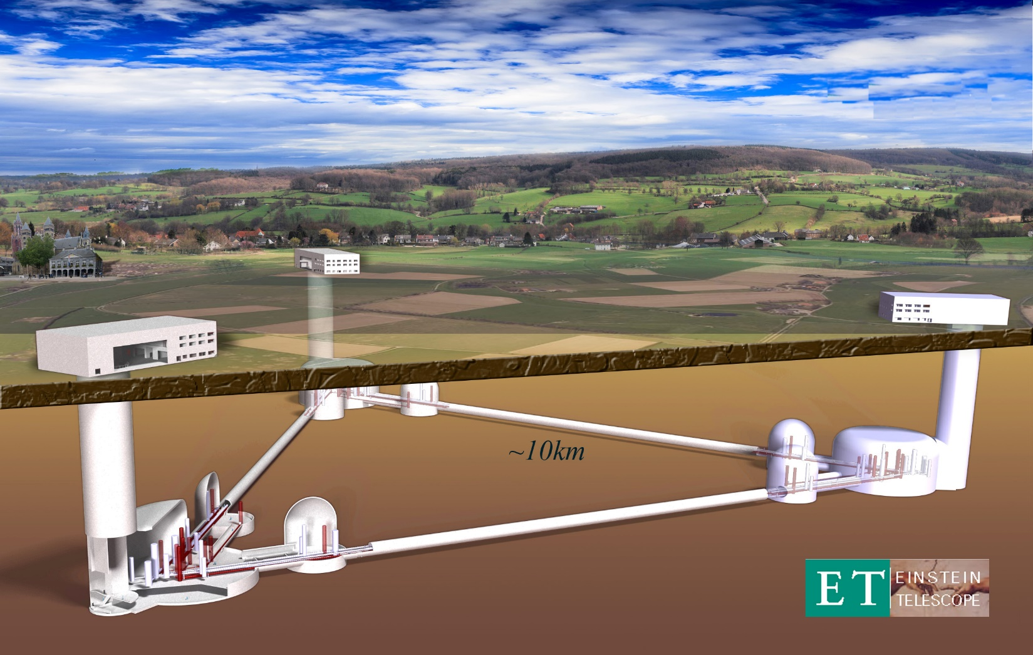
The Einstein Telescope

Slide 35
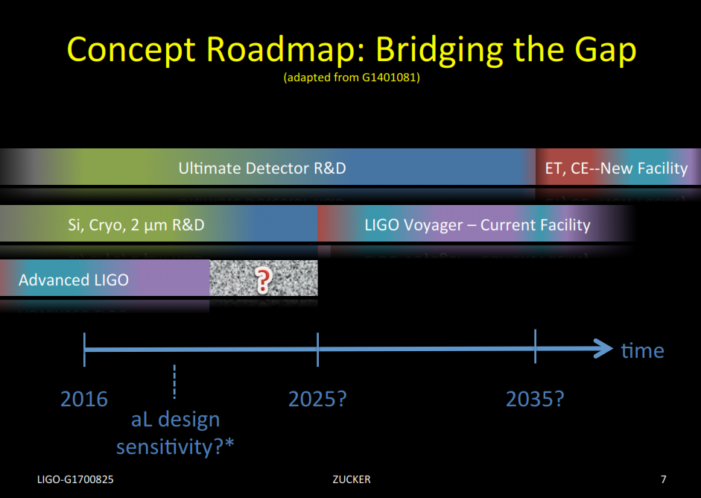
Limits of the Infrastructures?
The path to 3G – adding in planning in the US
Obsolescence
Length of the arms
Low frequency:
  Seismic and Newtonian noise
  Cryogenic apparatuses
Medium frequency:
  Size of the beam (thermal noise)
High/medium frequency:
  Long filtering cavities (squeezing)
Additional DoF:
  New geometries or topologies
  Multiple interferometers

Slide 36
GWIC 3G sub-committee
GWIC is conscious of the relevance of the global approach to 3G matters
A sub-committee has been formed to deal with this subject:
  Co-chairs: Dave Reitze, Michele Punturo
  Members:
  Federico Ferrini - EGO Director/interface to Virgo related
  organisations
  Takaaki Kajita - KAGRA Director
  Harald Lueck - interface to German agencies
  Jay Marx - Big Project Expertise
  David McClelland - interface to Australian agencies
  Michele Punturo - ET Design Study Lead
  David Reitze - LIGO Director/interface to NSF
  Sheila Rowan - GWIC Chair
D. Shoemaker (secretary)
V. Kalogera
B. Sathyaprakash
Expertise in astrophysics/analysis

Slide 37
GWIC 3G sub-committee mandate
WG under composition: chairs V. Kalogera, B. Sathyaprakash
“Examining the path to a future network of observatories / facilities, specifically”:
1) Science Drivers for 3G detectors:
  commission a study of ground-based gravitational wave science from the global scientific community, investigating potential science vs architecture vs. network configuration vs. cost trade-offs, recognizing and taking into account existing studies for 3G projects (such as ET) as well as science overlap with the larger gravitational-wave spectrum.
2) Coordination of the Ground-based GW Community:
  develop and facilitate coordination mechanisms among the current and future planned and anticipated ground-based GW projects, including identification of common technologies and R&D activities as well as comparison of the specific technical approaches to 3G detectors. Possible support for coordination of 2G observing and 3G construction schedules.
3) Networking among Ground-based GW Community:
  organize and facilitate links between planned global 3G projects and other relevant scientific communities, including organizing:
    town hall meetings to survey the community
    dedicated sessions in scientific conferences dedicated to GW physics and astronomy
    focused topical workshops within the relevant communities

Slide 38
GWIC 3G sub-committee mandate
4) Agency interfacing and advocacy:
  identify and establish a communication channel with funding agencies who currently or may in the future support ground-based GW detectors; communicate as needed to those agencies officially through GWIC on the scientific needs, desires, and constraints from the communities and 3G projects (collected via 1) – 3) above) structured in a coherent framework; serve as an advocacy group for the communities and 3G projects with the funding agencies.
5) Investigate governance schemes:
  by applying knowledge of the diverse structures of the global GW community, propose a sustainable governance model for the management of detector construction and joint working, to support planning of 3rd generation observatories"
The subcommittee should provide a preliminary report and set of proposed actions recommendations to GWIC no later than the 2017 GWIC meeting.
Subsequent reports should be delivered future GWIC meetings.

Slide 39
GWAC – Gravitational Wave Agency Correspondents
GW “funding” Agencies Committee
Promoted by NSF, involving:
  Australian Research Council (ARC)
  Canada Foundation for Innovation (CFI)
  Centre National de la Recherche Scientifique (CNRS)
  Consejo Nacional de Ciencia y Tecnología (CONACYT)
  Deutsche Forschungsgemeinschaft (DFG)
  Istituto Nazionale di Fisica Nucleare (INFN)
  National Aeronautics and Space Administration (NASA)
  Science & Technology Facilities Council (STFC)
  +++ open invitation to interested agencies

Slide 40
Conclusions
GW detection is a wonderful achievement, but it is mainly the beginning of the new era of the GW astronomy and astrophysics.
New instruments will be needed to investigate the universe and a 3G observatory network is our future target
New technologies and new infrastructures are needed and now it is time to articulate the science case, design and build them
Thanks to Tarun Souradeep, Michele Punturo, Matt Evans, Mike Zucker, Osamu Miyakawa for slides

Slide 41
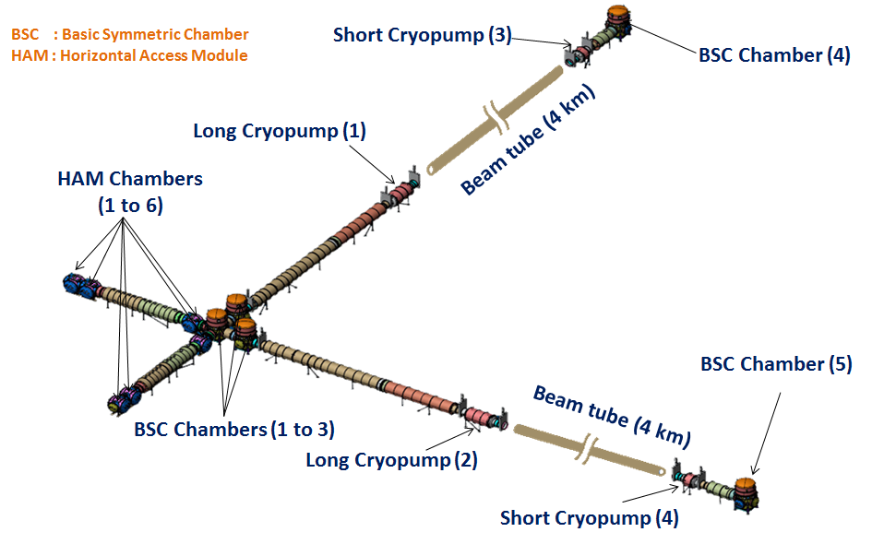
Vaccum Infrastructure
3-D View
System Requirement Document for Vacuum infrastructure under discussion.
Drawings in LIGO DCC
SRD for Vacuum infrastructure to be reviewed by LIGO-US committee
Modeling vacuum chamber layout: The process of generating the CAD models of all the components in each BSC and HAM chamber has been taken up and the work is in progress at RRCAT.
Cross-validation of IPR vacuum drawings: Dimensional checking of the drawings generated by IPR team for the BSC & HAM chambers is in progress at RRCAT.

