Slide 1
Einstein Probe
A mission to explore the transient X-ray sky
Shuang-Nan Zhang (IHEP/NAOC)
on behalf of
Weimin Yuan (PI of EP, NAOC)
on behalf of the EP team (based at NAOC & IHEP)

Slide 2
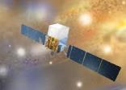
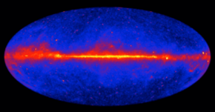
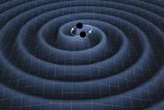
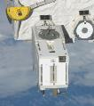
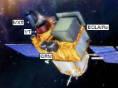
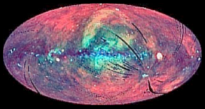
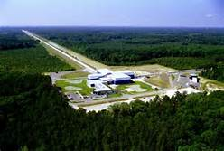
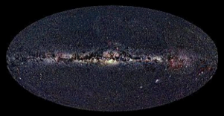
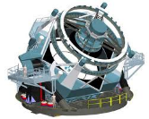
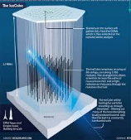
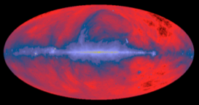
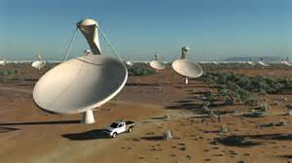
2020+ : multi-wavelength & multi-messenger time-domain astronomy
Multi-wavelength
Multi-messenger
GW, neutrino
γ-ray
X-ray
SVOM
Soft X-ray yet to cover
optical
Adv. LIGO
LIGO/VIRGO/Kangra
LSST
radio
Time
LOFAR、SKA
IceCube

Slide 3
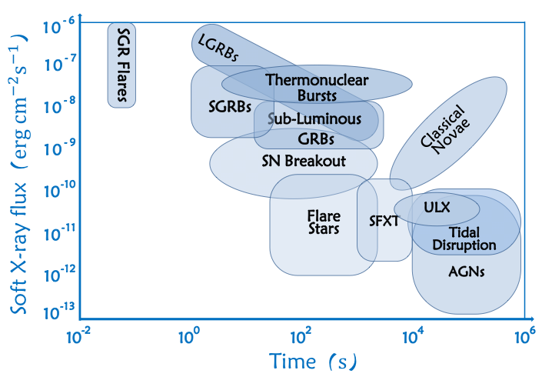
Needs for more sensitive surveys of X-ray transients
SWIFT/BAT
SVOM/Eclairs
MAXI
Largely unexplored
Z>10 GRBs
Requirements: higher sensitivity, large FoV, and high cadence

Slide 4
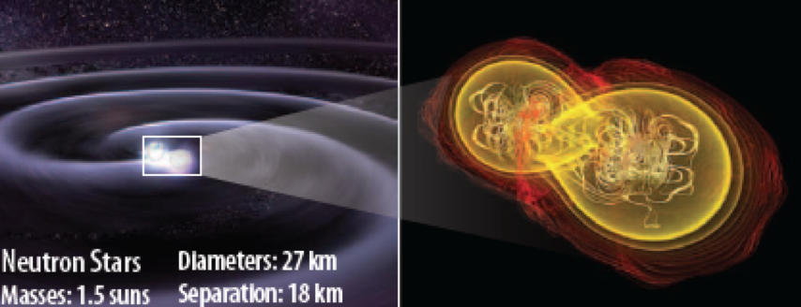
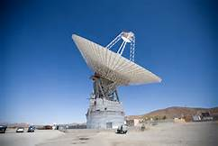
Electromagnetic sources of gravitational wave events
NS-NS/BH-NS mergers
High frequency GW
GW
Of great scientific significance
LIGO/VIRGO
EM counterparts
EM spectrum
radio
IR/optical
X-ray
γ-ray
Notes:
One particularly exciting topic is detecting the EMC of GW events.
LIGO and VIRGO are expected to

Slide 5
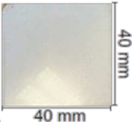
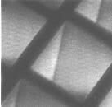
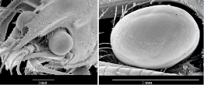
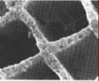
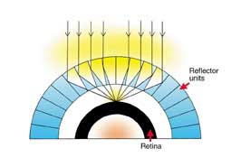
Lobster-eye micro-pore optics for wide-field imaging
Concept proposed by R. Angel in 1979
Device industrialised in recent years
20μ
lobster eye in the optical
True imaging
Wide FoV, no vignetting effect
Good angular resolution: ~ arcmin (c.f. ~ degrees for Swift, MAXI, …)
High sensitivity
Low weight
Ideal for X-ray wide-field monitor

Slide 6
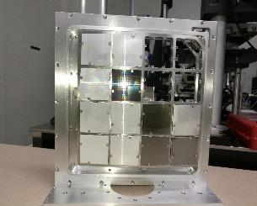
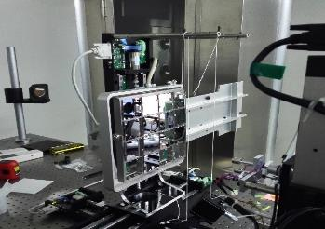
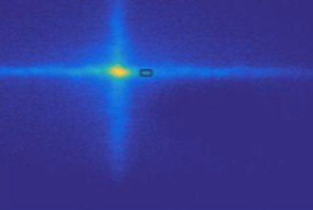
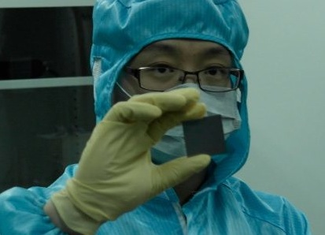
Development of X-ray MPO applications at NAOC
Development started form 2010 at X-ray Imaging Lab, NAOC
(lead: Zhang S.-N.)
Prototype MPO lobster-eye camera and X-ray image
true focal spot

Slide 7
Einstein Probe (EP)
a small mission for time-domain all-sky monitoring in soft X-ray to discover high-energy transients and study variability
one order-of-mag. more sensitive than those currently in orbitwith X-ray follow-up & fast alert downlink capability
payload
Wide-field X-ray telescope (12 modules)
3600 sq. deg. (1.1 sr) vignetting free FoV in 0.5-4keV band
Follow-up X-ray telescope, 0.5-10keV
Payload weight: 450kg (~900kg total)
Fast alert data downlink (and possible uplink)

Slide 8
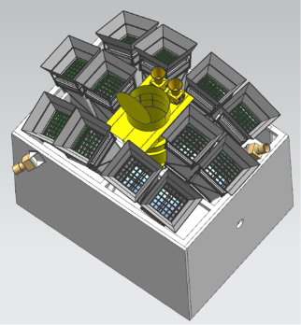
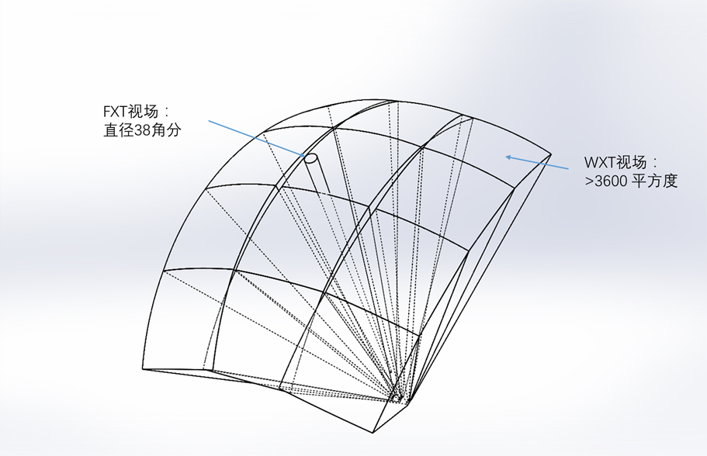
EP payload
Wide-field X-ray telescope (WXT)
star sensor
WXT
X-ray optics: lobster-eye MPO
Detectors: CMOS array
Focal length: 370mm
FoV: 3600 sqr. deg. (1.1 sr)
FWHM: ~ 5 arcmin
Bandpass: 0.5-4 keV
Fellow-up X-ray telescope (FXT)
X-ray optics: Wolter-I type
Focal length: 1.6m
Effective area: > 120cm² @1keV
FWHM: < 2 arcmin (30” goal)
FoV: ~30 arcmin
Detector: CCD
Bandpass: 0.5-8 keV
FXT
FoV

Slide 9
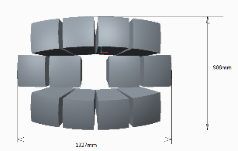
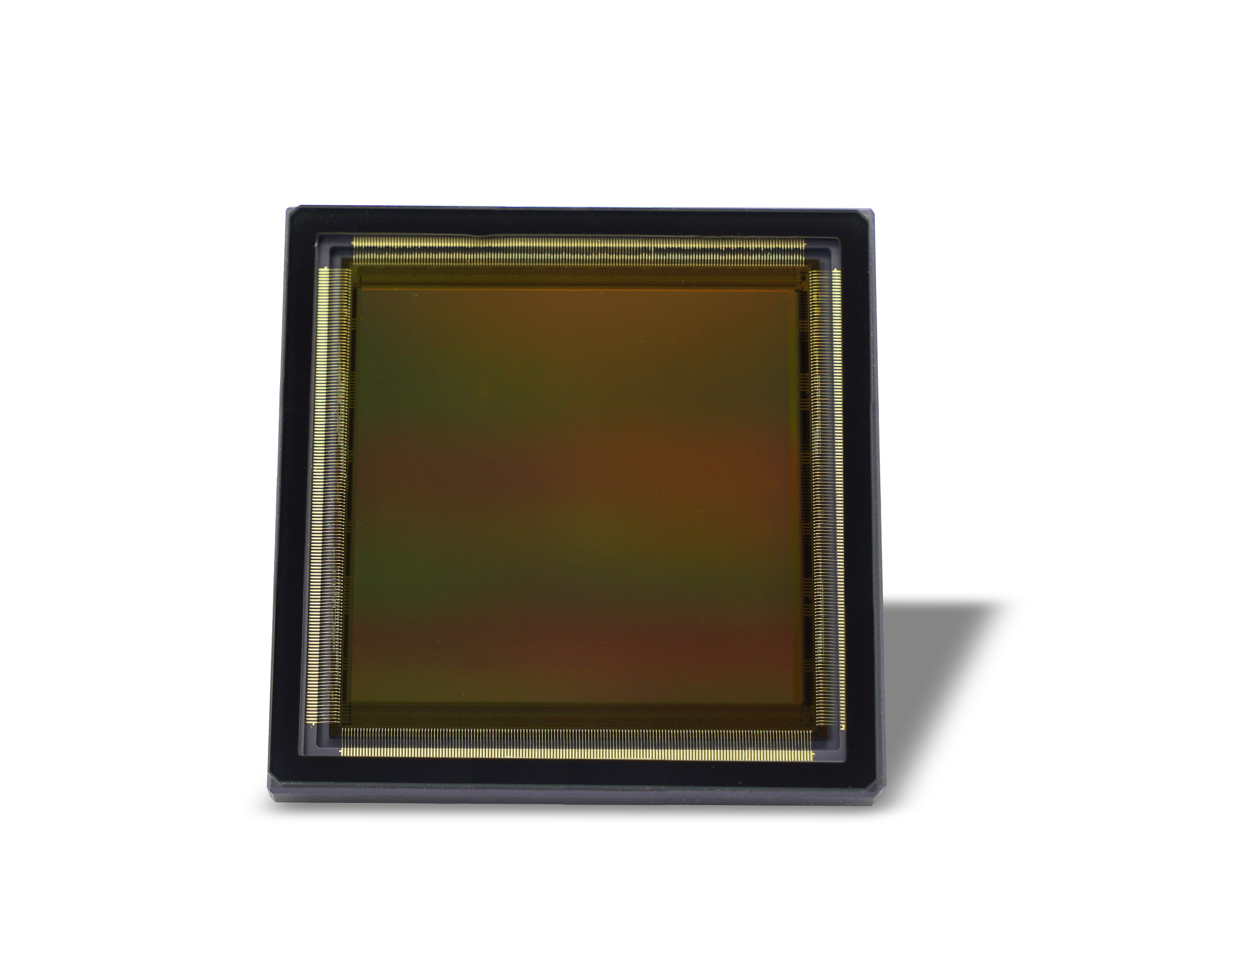
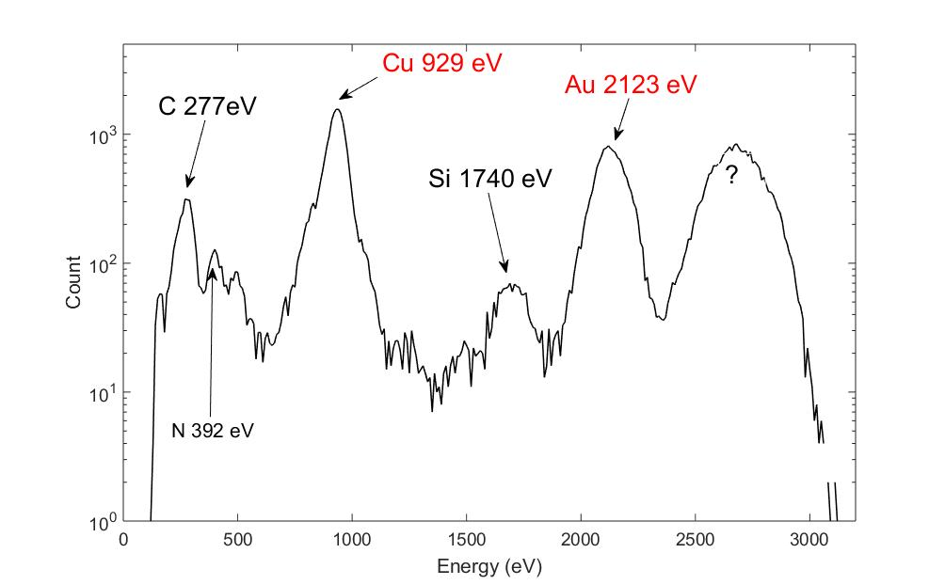
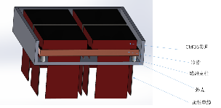
Wide-field X-ray telescope
12 modules
~300 sq.deg. each
Weight: 240kg
Power: ~300W
detector: back illuminated CMOS
energy resolution 210 eV
@ 5.9 keV @ room temp.
Available: back illuminated
2cm x 2cm (2kx2k)
future: 6cm x 6cm 4kx4k
CMOS chip for test and the design of focal plane unit for a WXT module

Slide 10
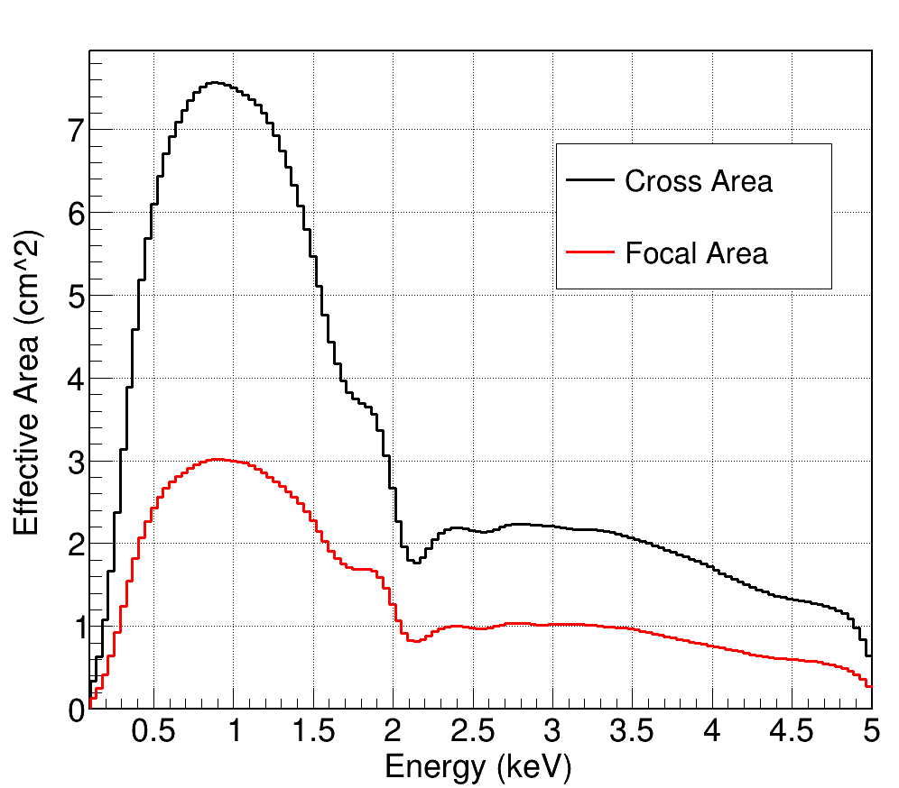
Simulated performance of WXT
Effective area (simulated)
PSF (simulated)
Ir coating
FWHM ~ 5 arcmin
Zhao et al. 2017, Exp. Astro.

Slide 11
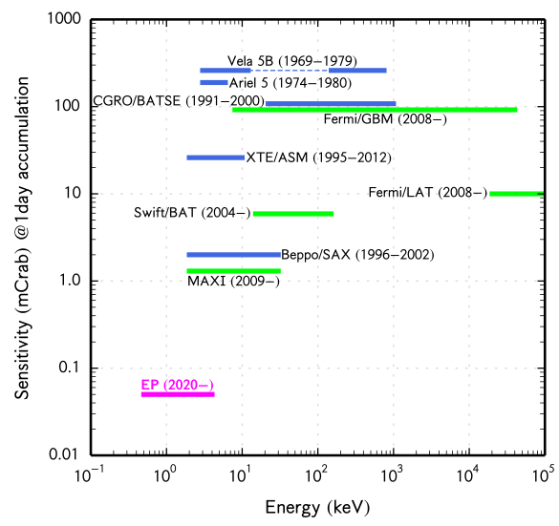
Monitoring sensitivity of EP

Slide 12
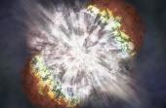
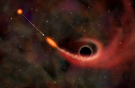
Core science goals
Systematic survey of soft X-ray transients and variability of X-ray sources at high sensitivity and high cadence
Uncover quiescent Black holes at all astrophysical mass scales and other compact objects via capturing their transient flares
Detect and localize electromagnetic-wave sources of gravitational-wave events by synergy with GW detectors

Slide 13
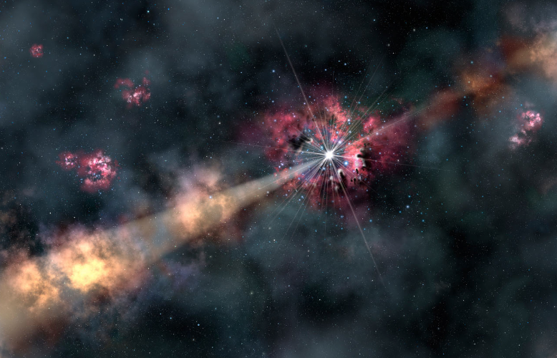
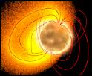
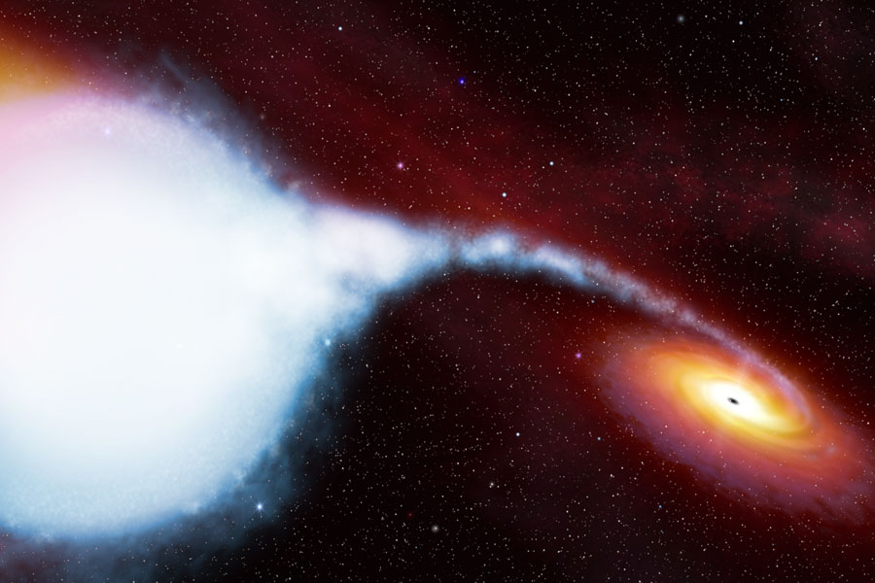
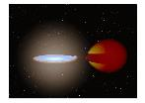
Scientific objectives: systematic survey of transients & monitoring variability in X-ray
X-ray flash
& LL GRB
GRB physics
Active galactic nuclei
Extreme gravity, BH accretion/jets/growth
High-redshift GRB
Trace first stars/BH
Early universe
Neutron-star merger
EM counterparts of GW sources
BH Tidal disruption
Quiescent MBH finder
BH accretion/jets
SN shock breakout
SN physics
Size of progenitors
Star X-ray flares
Magnetic fields
Corona activity
SGR/magnetar
extreme magnetic Field
BH X-ray binary
Extreme gravity
BH physics/accretion
Thermal nuclear burst
Neutron stars physics
Notes:
EP will detect X-ray transients from our neighbour stars, magnetars, bursts form neutron star and white dwarfs,
BH X-ray binaries in our Galaxy and nearby galaxies, intermediate-mass BH, TDE of SMBH in normal galaxies, and
Active galactic nuclei, and to the high-redshift GRB (perhaps at redshift around 10 and beyond).
It can also detect charge exchange emission from comets in our solar system.
The research will have impact on essentially all the fields of astrophysics.

Slide 14
Estimated detection rates of selected transients
Type of events | Estimated detections per year
Tidal disruption events (TDE) | 20-120
TDE with jets | 20 - 40
SN shock breakout | 7
GRB z > 6 (8) | 7 (3)
magnetar | 1
X-ray flash | ~10
Low-luminosity GRB | < 8
SFXT | ~ 13
Stellar flares | In large number

Slide 15
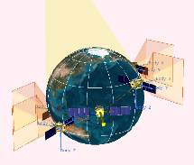
Mission profile
Orbit: 600km, incl. < 30deg
Observation mode
Survey mode: a series of pointings to the night-sky, each 11min exposure
cover the whole night sky in 3 orbits (97min each)
Follow-up mode: pointed observation with FXT (WXT remains operation)
Possible ToO mode
On-board transient data reduction
Quick alert data downlink
Baseline: Beidou navigation system
VHF network (French)
Nominal lifetime: 3 (+2) years
Night-sky zone

Slide 16
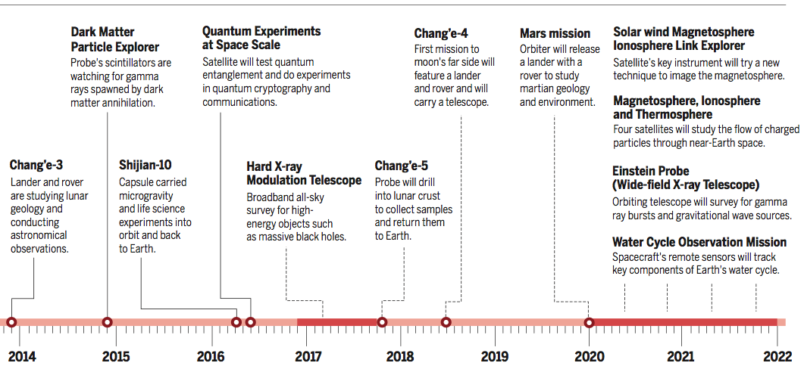
Current status
Among the top candidate missions in the 13th-5-year plan of CAS’s space science program; Currently under the final critical review, and the final adaption is expected to happen recently
Proposed launch: 2021/22
D. Normile 2016 Science
China’s space science & exploration road map

Slide 17
Summary
Time domain astronomy has come of a golden age of multi-wavelength & multi-messenger
New technology is needed to look both deeper & wider in soft X-rays
MPO lobster-eye is such a promising technique
The Einstein Probe is a small yet ambitious mission, which is expected to explore new discovery space …...
Thank you
http://ep.bao.ac.cn

