Slide 1

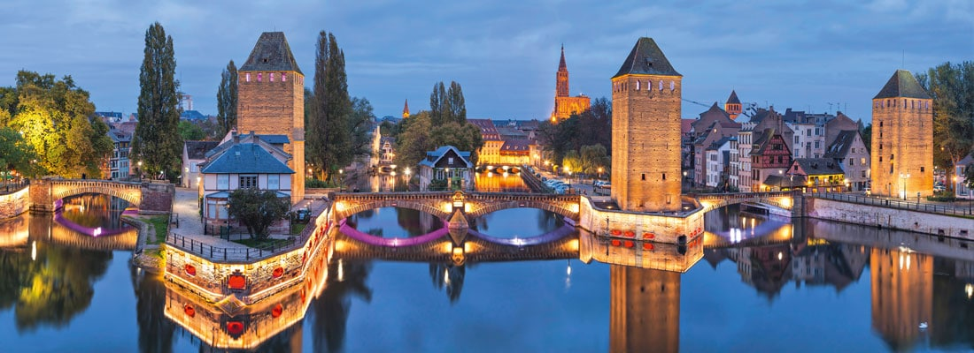
How small a Quark-gluon plasma can be?
Toward a unified paradigm to describe high energy hadronic collisions
Maxime Guilbaud⁽¹⁾
Seminaire - IPHC
28/04/17
RICE University, m.guilbaud@cern.ch

Slide 2
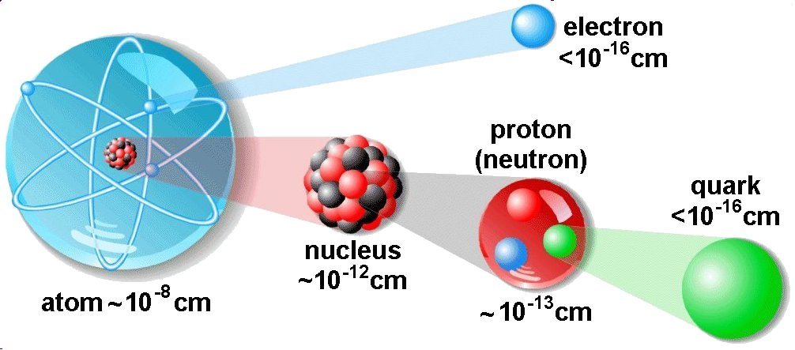
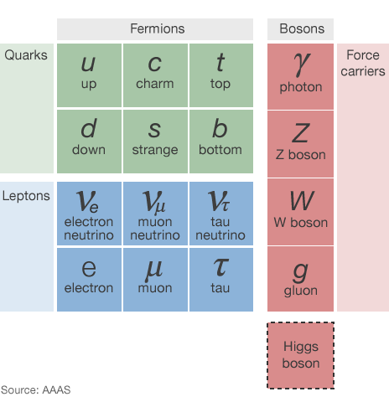
The most fundamental scale
Theory of strong interaction:
Quantum ChromoDynamics (QCD)
28/04/17
How small a Quark-gluon plasma can be?
1
Notes:
Dire que je suis dans la communauté ions lourds

Slide 3
The most fundamental scale
Theory of strong interaction:
Quantum ChromoDynamics (QCD)
28/04/17
How small a Quark-gluon plasma can be?
1
Notes:
Dire que je suis dans la communauté ions lourds

Slide 4
Quark confinement
Quarks carry a color charge (blue, green, red)
28/04/17
How small a Quark-gluon plasma can be?
2
Notes:
Dire que je suis dans la communauté ions lourds

Slide 5

Quark confinement
Quarks carry a color charge (blue, green, red)
colorless
How to explain the quark confinement in hadrons?
Is it possible to deconfine quarks?
28/04/17
How small a Quark-gluon plasma can be?
2
Notes:
Dire que je suis dans la communauté ions lourds

Slide 6
Quark confinement
Quarks carry a color charge (blue, green, red)
colorless
How to explain the quark confinement in hadrons?
Is it possible to deconfine quarks?
Only colorless object are observed
=
no free quark
28/04/17
How small a Quark-gluon plasma can be?
2
Notes:
Dire que je suis dans la communauté ions lourds

Slide 7
Phase transition
How to explain the confinement in Is it possible to deconfine quark?
hadrons?
28/04/17
How small a Quark-gluon plasma can be?
3

Slide 8
Phase transition
How to explain the confinement in Is it possible to deconfine quark?
hadrons?
High energy (small distance) ➔ weak coupling
28/04/17
How small a Quark-gluon plasma can be?
3

Slide 9
Phase transition
How to explain the confinement in Is it possible to deconfine quark?
hadrons?
High energy (small distance) ➔ weak coupling
Low energy (large distance) ➔ strong coupling
28/04/17
How small a Quark-gluon plasma can be?
3

Slide 10
Phase transition
How to explain the confinement in Is it possible to deconfine quark?
hadrons?
Lattice QCD calculations (lQCD):
  Indicate a phase transition at T_{c}≈155 MeV
High energy (small distance) ➔ weak coupling
Low energy (large distance) ➔ strong coupling
28/04/17
How small a Quark-gluon plasma can be?
3

Slide 11
Phase transition
How to explain the confinement in Is it possible to deconfine quark?
hadrons?
Lattice QCD calculations (lQCD):
  Indicate a phase transition at T_{c}≈155 MeV
High energy (small distance) ➔ weak coupling
Low energy (large distance) ➔ strong coupling
New phase of the matter called Quark and Gluon Plasma (QGP)
28/04/17
How small a Quark-gluon plasma can be?
3

Slide 12
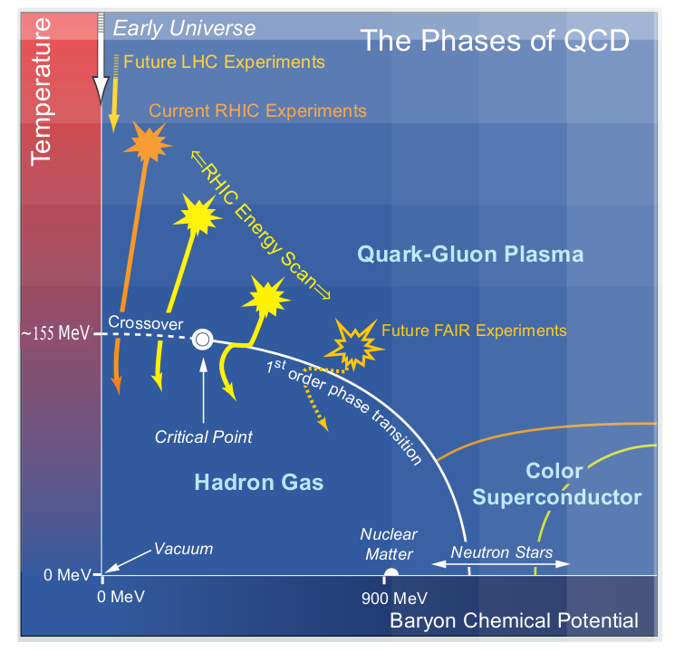
Nuclear phase diagram
LHC Experiments
What are the goals?
Probe the nuclear phase diagram
  Transition order?
  Critical point?
  …
Characterize the QGP
  Equation of state?
  Dynamics?
  …
Experimentally: Heavy Ion (HI) collisions are used to study QGP
28/04/17
How small a Quark-gluon plasma can be?
4
Notes:
Dire que je suis dans la communauté ions lourds

Slide 13
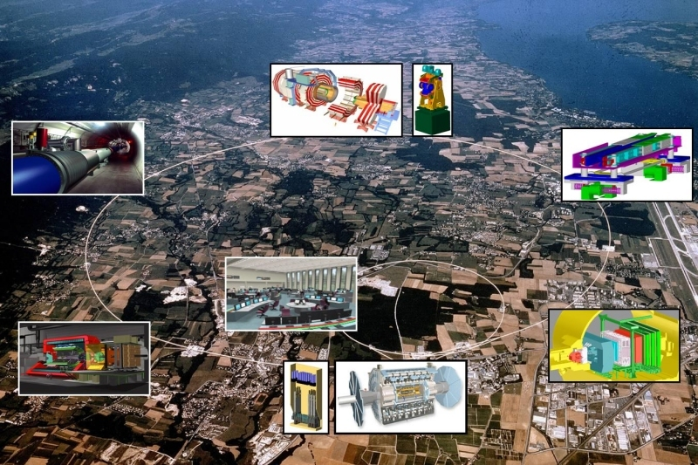
What are the tools to study the QGP: A collider
LHC at CERN:
  Circumference: 26.7 km
  Depth ~ 100 m
  3 running modes:
    p-p
    p-Pb
    Pb-Pb
4 main experiments
  LHCb
  CMS
  ATLAS
  ALICE
system | Energy (TeV)
p-p | 0.9, 2.36, 2.76, 5.02, 7, 8, 13
p-Pb | 5.02, 8.16
Pb-Pb | 2.76, 5.02
28/04/17
How small a Quark-gluon plasma can be?
5
Notes:
Dire que je suis dans la communauté ions lourds

Slide 14
What are the tools to study the QGP: A Compact Muon Solenoid detector
28/04/17
How small a Quark-gluon plasma can be?
6
Notes:
Dire que je suis dans la communauté ions lourds

Slide 15
What are the tools to study the QGP: A Compact Muon Solenoid detector
TRK
HF
28/04/17
How small a Quark-gluon plasma can be?
6
Notes:
Dire que je suis dans la communauté ions lourds

Slide 16
What are the tools to study the QGP: A Compact Muon Solenoid detector
TRK
HF
η gap
28/04/17
How small a Quark-gluon plasma can be?
6
Notes:
Dire que je suis dans la communauté ions lourds

Slide 17
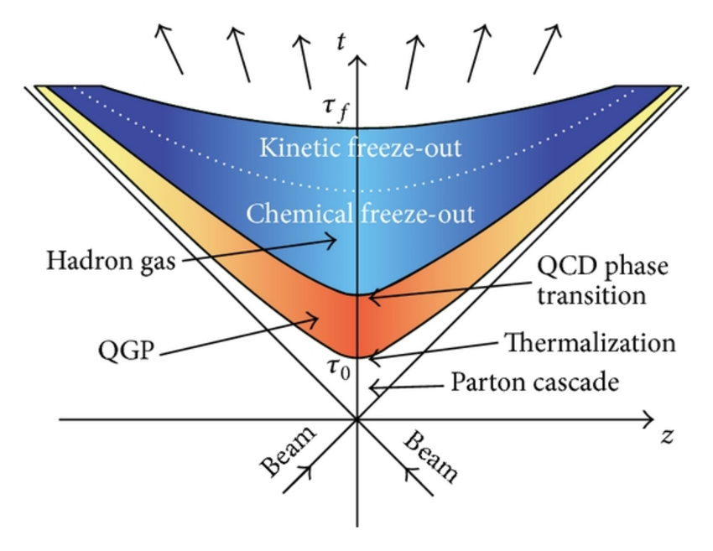

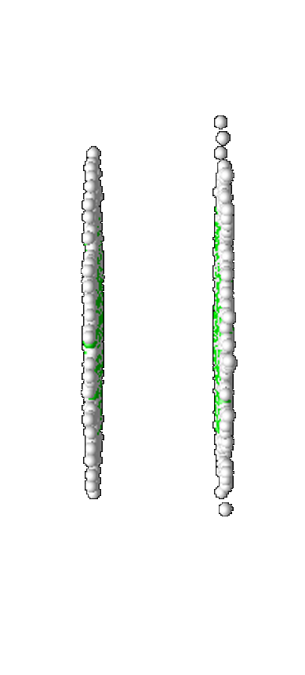
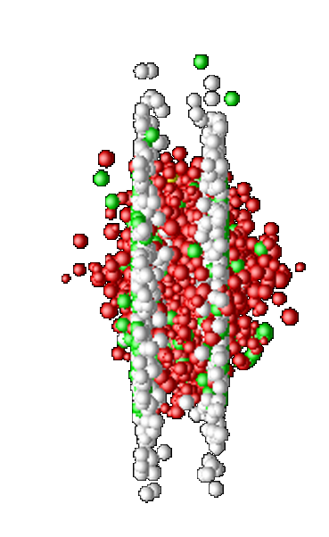
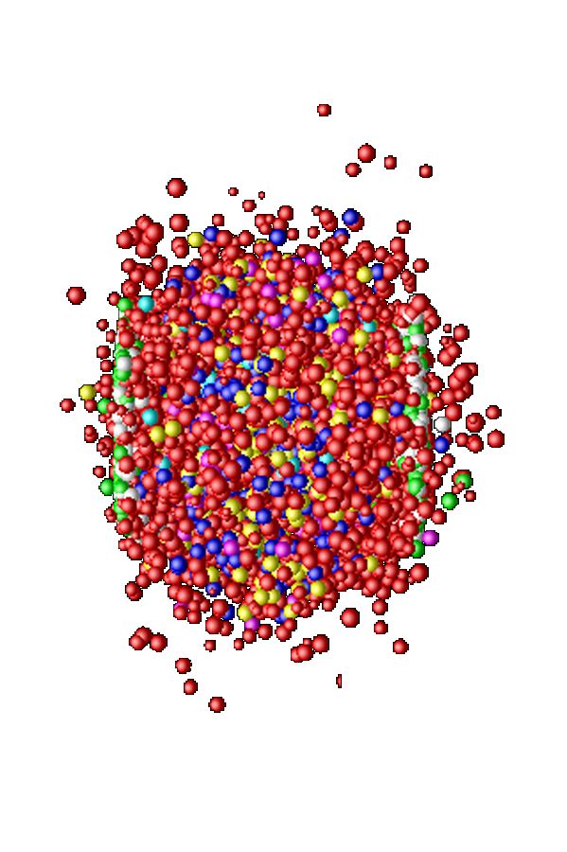

Heavy Ion collisions
Initial state
QGP
Thermalized?
2 fm/c
Hadronization
Chemical & thermal freeze-out
28/04/17
How small a Quark-gluon plasma can be?
7
Notes:
Dire que je suis dans la communauté ions lourds

Slide 18
Heavy Ion collisions
Initial state
0 fm/c
Thermalized?
2 fm/c
Hadronization
Chemical & thermal freeze-out
28/04/17
How small a Quark-gluon plasma can be?
7
Notes:
Dire que je suis dans la communauté ions lourds

Slide 19
Heavy Ion collisions
Initial state
0 fm/c
QGP
Thermalized
2 fm/c
Chemical & thermal freeze-out
28/04/17
How small a Quark-gluon plasma can be?
7
Notes:
Dire que je suis dans la communauté ions lourds

Slide 20
Heavy Ion collisions
Initial state
0 fm/c
QGP
Thermalized
2 fm/c
Hadronization
Chemical & thermal freeze-out
28/04/17
How small a Quark-gluon plasma can be?
7
Notes:
Dire que je suis dans la communauté ions lourds

Slide 21
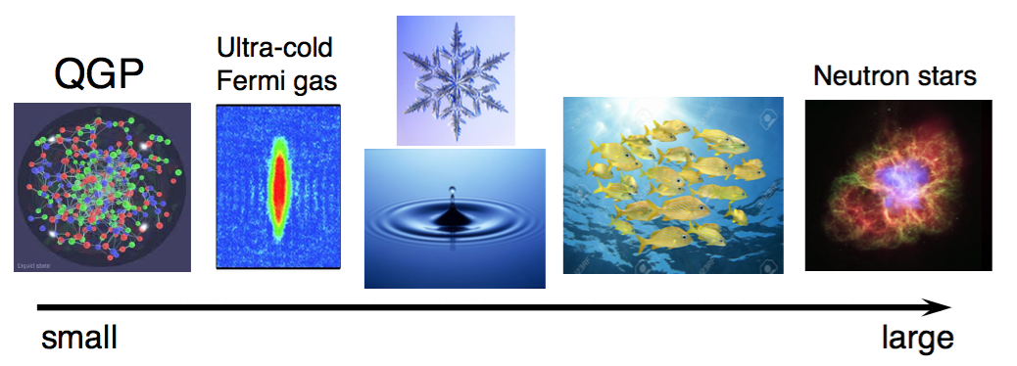
How to characterize the QGP?
Collective phenomena a central theme in the study of strongly correlated, interacting many-body systems
28/04/17
How small a Quark-gluon plasma can be?
8
Notes:
Dire que je suis dans la communauté ions lourds

Slide 22
How to characterize the QGP?
Collective phenomena a central theme in the study of strongly correlated, interacting many-body systems
The key questions:
  What is the underlying mechanism to drive?
  Can be understood from fundamental forces?
28/04/17
How small a Quark-gluon plasma can be?
8
Notes:
Dire que je suis dans la communauté ions lourds

Slide 23
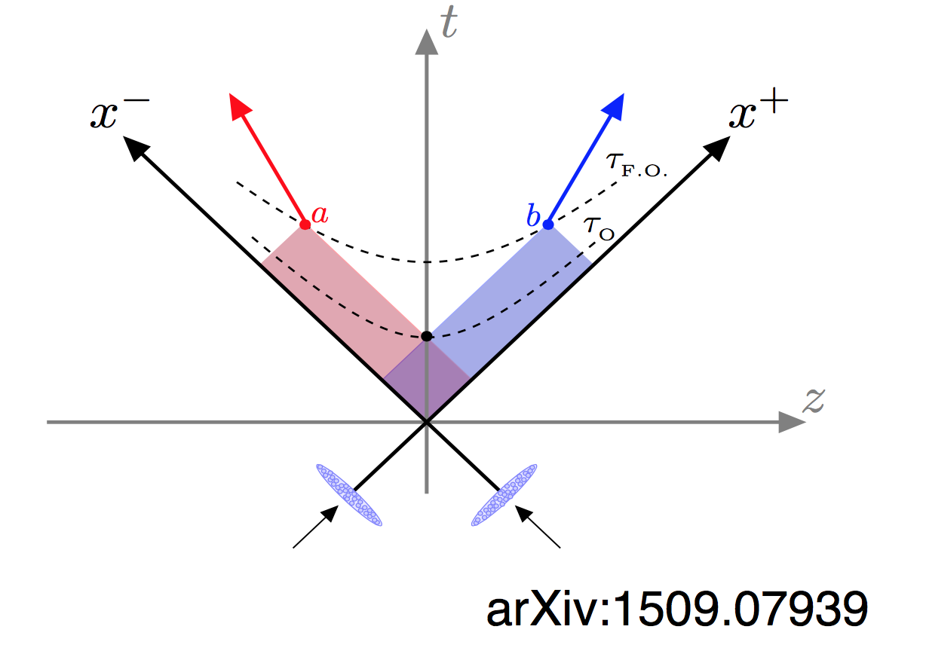
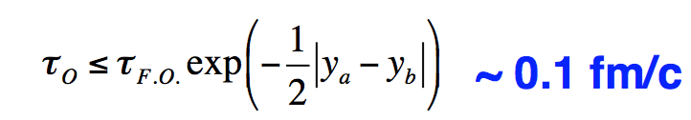
Collectivity and azimuthal anisotropies
Observed long-range correlations in η
Rooted in intial/early stage
28/04/17
How small a Quark-gluon plasma can be?
9
Notes:
Dire que je suis dans la communauté ions lourds

Slide 24
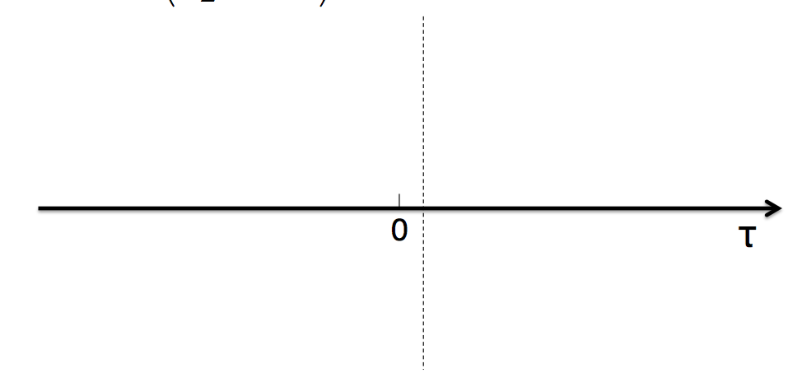
Collectivity and azimuthal anisotropies
Observed long-range correlations in η
Rooted in intial/early stage
28/04/17
How small a Quark-gluon plasma can be?
9
Notes:
Dire que je suis dans la communauté ions lourds

Slide 25
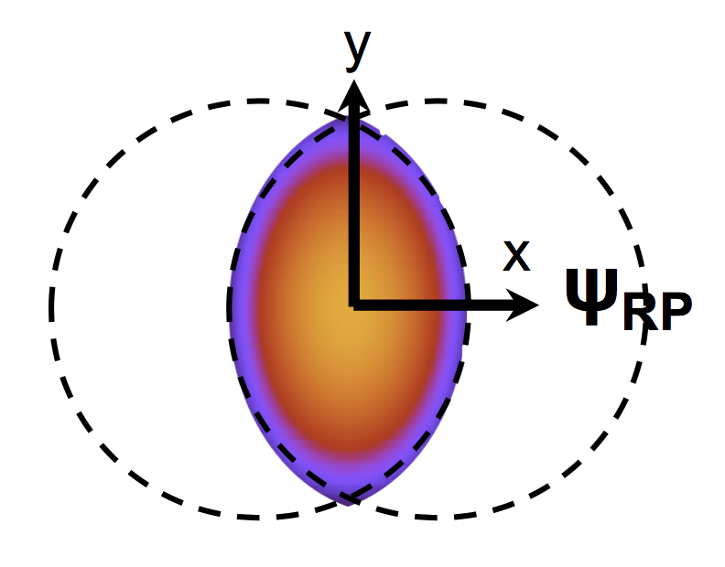
Collectivity and azimuthal anisotropies
Observed long-range correlations in η
Rooted in intial/early stage
Initial spatial ε_{s}
28/04/17
How small a Quark-gluon plasma can be?
9
Notes:
Dire que je suis dans la communauté ions lourds

Slide 26
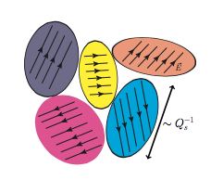
Collectivity and azimuthal anisotropies
Observed long-range correlations in η
Rooted in intial/early stage
Initial spatial ε_{s}
+ final interactions
Initial spatial ε_{p}
28/04/17
How small a Quark-gluon plasma can be?
9
Notes:
Dire que je suis dans la communauté ions lourds

Slide 27
Collectivity and azimuthal anisotropies
Observed long-range correlations in η
Rooted in intial/early stage
Scenario #1
Initial spatial ε_{s}
+ final interactions
Hydrodynamics
Parton transport, escape
Initial spatial ε_{p}
28/04/17
How small a Quark-gluon plasma can be?
9
Notes:
Dire que je suis dans la communauté ions lourds

Slide 28
Collectivity and azimuthal anisotropies
Observed long-range correlations in η
Rooted in intial/early stage
Scenario #1
Initial spatial ε_{s}
+ final interactions
Hydrodynamics
Parton transport, escape
Initial spatial ε_{p}
by initial interactions
28/04/17
How small a Quark-gluon plasma can be?
9
Notes:
Dire que je suis dans la communauté ions lourds

Slide 29
Collectivity and azimuthal anisotropies
Observed long-range correlations in η
Rooted in intial/early stage
Scenario #1
Initial spatial ε_{s}
+ final interactions
Hydrodynamics
Parton transport, escape
Scenario #2
Initial spatial ε_{p}
by initial interactions
CGC Glasma
Color-field domains, etc.
28/04/17
How small a Quark-gluon plasma can be?
9
Notes:
Dire que je suis dans la communauté ions lourds

Slide 30
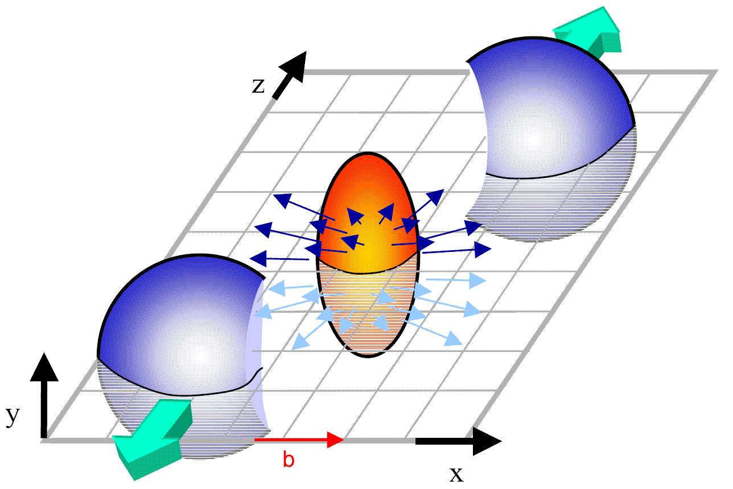
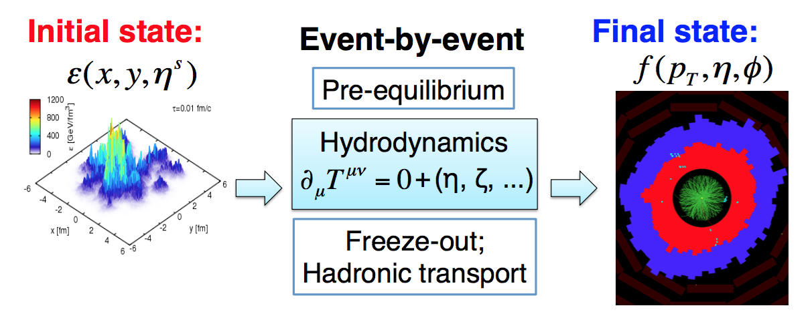
Perfect fluid paradigm in AA collisions
Initial state
28/04/17
How small a Quark-gluon plasma can be?
10
Notes:
Dire que je suis dans la communauté ions lourds

Slide 31
Perfect fluid paradigm in AA collisions
Initial state
Event by Event
Pre-equilibrium
Hydrodynamics
δ_{μ}T^{μυ} = 0 + (η, ζ, …)
Freeze-out
Hadronic transport
QGP behave like a nearly perfect fluid
(small η/s)
28/04/17
How small a Quark-gluon plasma can be?
10
Notes:
Dire que je suis dans la communauté ions lourds

Slide 32
Perfect fluid paradigm in AA collisions
Initial state
Event by Event
Final state
Pre-equilibrium
Hydrodynamics
δ_{μ}T^{μυ} = 0 + (η, ζ, …)
Freeze-out
Hadronic transport
QGP behave like a nearly perfect fluid
(small η/s)
28/04/17
How small a Quark-gluon plasma can be?
10
Notes:
Dire que je suis dans la communauté ions lourds

Slide 33
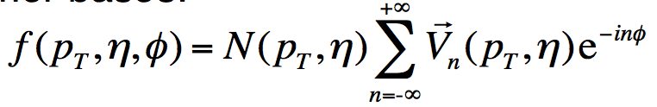
Perfect fluid paradigm in AA collisions
Initial state
Event by Event
Final state
Pre-equilibrium
Hydrodynamics
δ_{μ}T^{μυ} = 0 + (η, ζ, …)
Freeze-out
Hadronic transport
V₂
QGP behave like a nearly perfect fluid
(small η/s)
Fourier bases:
28/04/17
How small a Quark-gluon plasma can be?
10
Notes:
Dire que je suis dans la communauté ions lourds

Slide 34
Perfect fluid paradigm in AA collisions
Initial state
Event by Event
Final state
Pre-equilibrium
Hydrodynamics
δ_{μ}T^{μυ} = 0 + (η, ζ, …)
Freeze-out
Hadronic transport
V₂
QGP behave like a nearly perfect fluid
(small η/s)
Fourier bases:
Anisotropic flow
V_{n} = v_{n}e^{inΨn}
28/04/17
How small a Quark-gluon plasma can be?
10
Notes:
Dire que je suis dans la communauté ions lourds

Slide 35
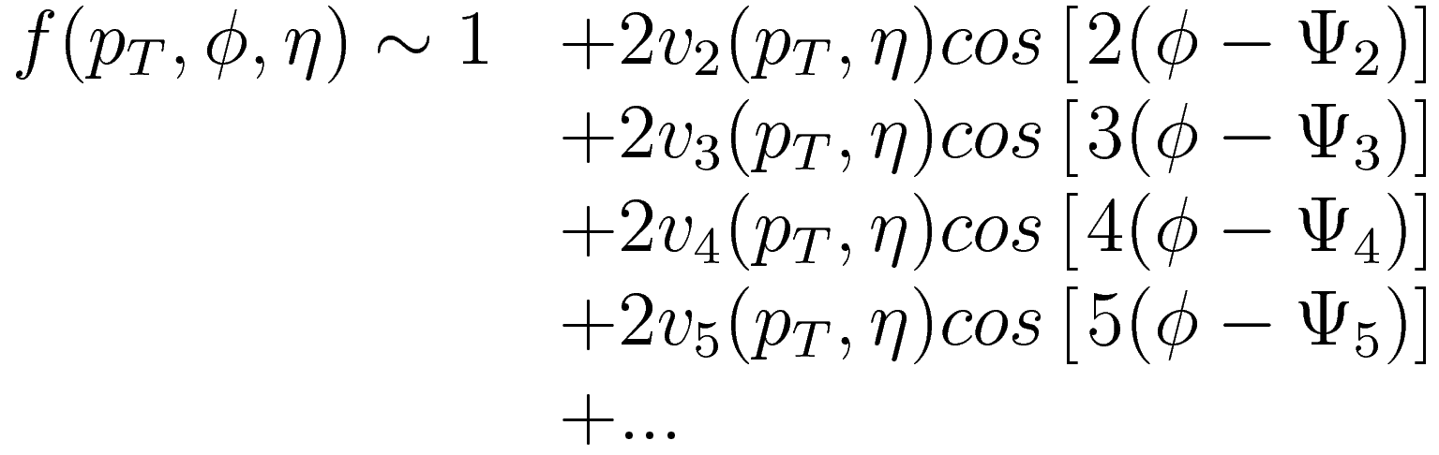
What does the flow harmonic coefficients mean in AA?
Initial-state anisotropy
Flow
≈
Geometry
Final state:
Elliptic flow
28/04/17
How small a Quark-gluon plasma can be?
11
Notes:
Dire que je suis dans la communauté ions lourds

Slide 36
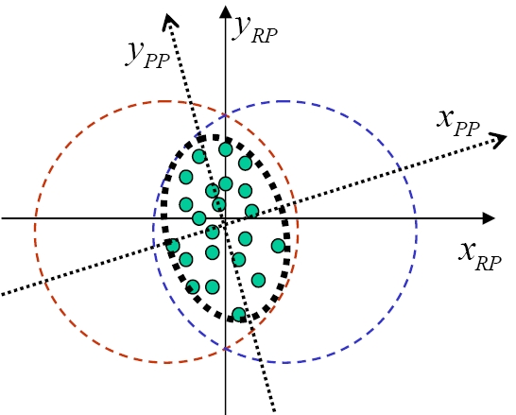
What does the flow harmonic coefficients mean in AA?
y
Ψ_{EP}
x
Initial-state anisotropy
Initial-state inhomogeneity
Flow
≈
Geometry
Ψ_{EP}: Direction of maximum particle density
Final state:
28/04/17
How small a Quark-gluon plasma can be?
11
Notes:
Dire que je suis dans la communauté ions lourds

Slide 37

What does the flow harmonic coefficients mean in AA?
y
Ψ_{EP}
Ψ₂
x
Ψ₃
Initial-state anisotropy
Initial-state inhomogeneity
Flow
≈
Geometry
+
Fluctuations
Ψ_{EP}: Direction of maximum particle density
Final state:
Triangular flow
28/04/17
How small a Quark-gluon plasma can be?
11
Notes:
Dire que je suis dans la communauté ions lourds

Slide 38
What does the flow harmonic coefficients mean in AA?
y
Ψ_{EP}
Ψ₂
x
Ψ₃
Ψ₄
Initial-state anisotropy
Initial-state inhomogeneity
Flow
≈
Geometry
+
Fluctuations
Ψ_{EP}: Direction of maximum particle density
Final state:
28/04/17
How small a Quark-gluon plasma can be?
11
Notes:
Dire que je suis dans la communauté ions lourds

Slide 39
What does the flow harmonic coefficients mean in AA?
y
Ψ_{EP}
Ψ₂
x
Ψ₃
Ψ₄
Initial-state anisotropy
Initial-state inhomogeneity
Flow
≈
Geometry
+
Fluctuations
Ψ_{EP}: Direction of maximum particle density
Final state:
Phys. Rev. C 89, 0449076
CMS results
Phys. Rev. Lett. 110, 012302
IP glasma + MUSIC
28/04/17
How small a Quark-gluon plasma can be?
11
Notes:
Dire que je suis dans la communauté ions lourds

Slide 40
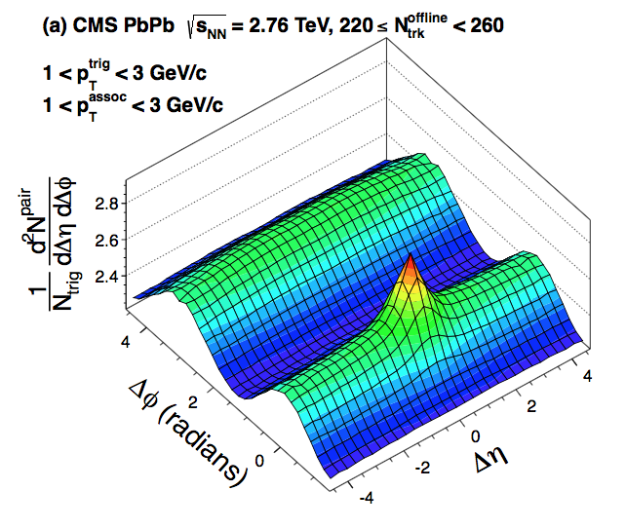
Looking for correlations in data:
2-particle correlations
Particle 1
(η₁, ϕ₁)
Δη = η₁ – η₂
Δϕ = ϕ₁ – ϕ₂
Particle 2
(η₂, ϕ₂)
28/04/17
How small a Quark-gluon plasma can be?
12
Notes:
Dire que je suis dans la communauté ions lourds

Slide 41
Looking for correlations in data:
2-particle correlations
Particle 1
(η₁, ϕ₁)
Δη = η₁ – η₂
Δϕ = ϕ₁ – ϕ₂
Particle 2
(η₂, ϕ₂)
+
Single jet contribution
Back-to-back jet contribution
28/04/17
How small a Quark-gluon plasma can be?
12
Notes:
Dire que je suis dans la communauté ions lourds

Slide 42
Looking for correlations in data:
2-particle correlations
Particle 1
(η₁, ϕ₁)
Δη = η₁ – η₂
Δϕ = ϕ₁ – ϕ₂
Particle 2
(η₂, ϕ₂)
+
Single jet contribution
Back-to-back jet contribution
28/04/17
How small a Quark-gluon plasma can be?
12
Notes:
Dire que je suis dans la communauté ions lourds

Slide 43
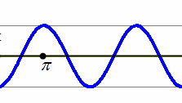
Looking for correlations in data:
2-particle correlations
Particle 1
(η₁, ϕ₁)
Δη = η₁ – η₂
Δϕ = ϕ₁ – ϕ₂
Particle 2
(η₂, ϕ₂)
+
+
Single jet contribution
Back-to-back jet contribution
Collective effect
28/04/17
How small a Quark-gluon plasma can be?
12
Notes:
Dire que je suis dans la communauté ions lourds

Slide 44
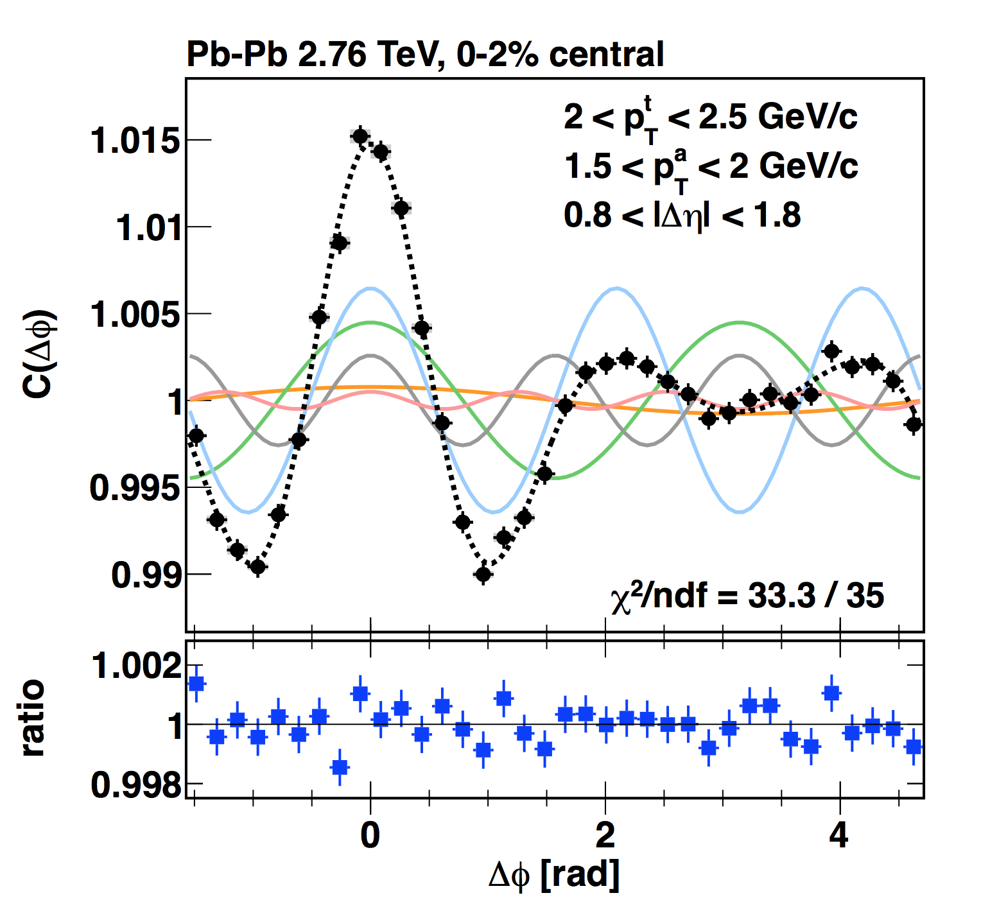
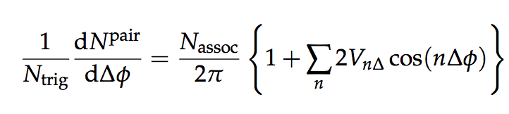
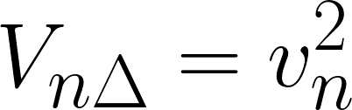
Looking for correlations in data:
2-particle correlations
Particle 1
(η₁, ϕ₁)
Δη = η₁ – η₂
Δϕ = ϕ₁ – ϕ₂
Particle 2
(η₂, ϕ₂)
Assuming factorization:
Still extremely sensitive to “non-flow” correlation like jets, dijets, etc.
N-particle correlations help to fix the issue
28/04/17
How small a Quark-gluon plasma can be?
12
Notes:
Dire que je suis dans la communauté ions lourds

Slide 45
“Surprising” long range correlation in small systems
PhysLettB.2013.06, 028, PhysLettB.2016.12, 009
28/04/17
How small a Quark-gluon plasma can be?
13
Notes:
Dire que je suis dans la communauté ions lourds

Slide 46
“Surprising” long range correlation in small systems
PhysLettB.2013.06, 028, PhysLettB.2016.12, 009
“collective effect” (two particles with very different η are “connected”)
Also observed in small system in high multiplicity events
28/04/17
How small a Quark-gluon plasma can be?
13
Notes:
Dire que je suis dans la communauté ions lourds

Slide 47
“Surprising” long range correlation in small systems
PhysLettB.2013.06, 028, PhysLettB.2016.12, 009
“collective effect” (two particles with very different η are “connected”)
Also observed in small system in high multiplicity events
Is it a sign of QGP formation in small system?
28/04/17
How small a Quark-gluon plasma can be?
13
Notes:
Dire que je suis dans la communauté ions lourds

Slide 48
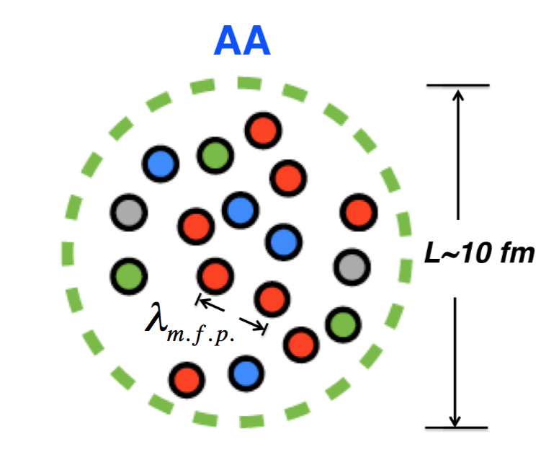
How small a QGP can be?
Hydrodynamics apply when:
L >> λ_{mfp} where λ_{mfp} ≈ (g⁴T)⁻¹
28/04/17
How small a Quark-gluon plasma can be?
14
Notes:
Dire que je suis dans la communauté ions lourds

Slide 49
How small a QGP can be?
Hydrodynamics apply when:
L >> λ_{mfp} where λ_{mfp} ≈ (g⁴T)⁻¹
  For g ≈ 1, LT >> 1
28/04/17
How small a Quark-gluon plasma can be?
14
Notes:
Dire que je suis dans la communauté ions lourds

Slide 50
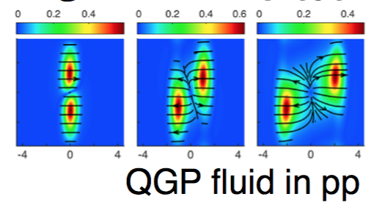
How small a QGP can be?
Hydrodynamics apply when:
L >> λ_{mfp} where λ_{mfp} ≈ (g⁴T)⁻¹
  For g ≈ 1, LT >> 1
  For g ∞ LT ≈ 1
28/04/17
How small a Quark-gluon plasma can be?
14
Notes:
Dire que je suis dans la communauté ions lourds

Slide 51
How small a QGP can be?
Hydrodynamics apply when:
L >> λ_{mfp} where λ_{mfp} ≈ (g⁴T)⁻¹
  For g ≈ 1, LT >> 1
  For g ∞ LT ≈ 1
Experimental conditions:
N_{trk} ≈ (LT)³ N_{trk} / L³ ≈ s ≈ T³
What is the smallest size for a QGP fuild?
28/04/17
How small a Quark-gluon plasma can be?
14
Notes:
Dire que je suis dans la communauté ions lourds

Slide 52
How small a QGP can be?
Hydrodynamics apply when:
L >> λ_{mfp} where λ_{mfp} ≈ (g⁴T)⁻¹
  For g ≈ 1, LT >> 1
  For g ∞ LT ≈ 1
Experimental conditions:
N_{trk} ≈ (LT)³ N_{trk} / L³ ≈ s ≈ T³
What is the smallest multiplicity/entropy for a QGP fuild?
28/04/17
How small a Quark-gluon plasma can be?
14
Notes:
Dire que je suis dans la communauté ions lourds

Slide 53
Fourier harmonics and 2-particle correlation in small systems
28/04/17
How small a Quark-gluon plasma can be?
15
Notes:
Dire que je suis dans la communauté ions lourds

Slide 54
Fourier harmonics and 2-particle correlation in small systems
28/04/17
How small a Quark-gluon plasma can be?
15
Notes:
Dire que je suis dans la communauté ions lourds

Slide 55
Fourier harmonics and 2-particle correlation in small systems
Low multiplicity subtraction applied
v₂:
  No energy dependence observed
  Similar shape as pPb and PbPb
  Smaller than bigger system
v₃:
  No energy dependence observed
  Different from pPb and PbPb
28/04/17
How small a Quark-gluon plasma can be?
15
Notes:
Dire que je suis dans la communauté ions lourds

Slide 56
Fourier harmonics and 2-particle correlation in small systems
Low multiplicity subtraction applied
v₂:
  No energy dependence observed
  Similar shape as pPb and PbPb
  Smaller than bigger system
v₃:
  No energy dependence observed
  Different from pPb and PbPb
28/04/17
How small a Quark-gluon plasma can be?
15
Notes:
Dire que je suis dans la communauté ions lourds

Slide 57
Fourier harmonics and multi-particle cumulants in small systems
2 particle correlations
v₂{2}
PhysLettB.2016.12, 009
28/04/17
How small a Quark-gluon plasma can be?
16
Notes:
Dire que je suis dans la communauté ions lourds

Slide 58
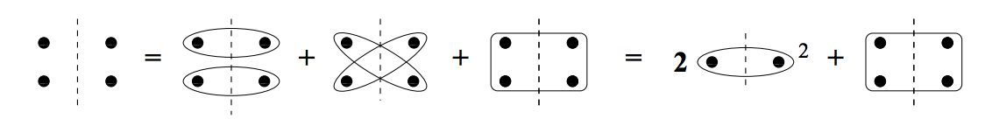
Fourier harmonics and multi-particle cumulants in small systems
4 particle correlations
v₂{4}
Less sensitive to non-flow (i.e. jet induced correlation)
Needs larger sample of events
PhysLettB.2016.12, 009
28/04/17
How small a Quark-gluon plasma can be?
16
Notes:
Dire que je suis dans la communauté ions lourds

Slide 59
Fourier harmonics and multi-particle cumulants in small systems
6 particle correlations
v₂{6}
Less sensitive to non-flow (i.e. jet induced correlation)
Needs larger sample of events
PhysLettB.2016.12, 009
28/04/17
How small a Quark-gluon plasma can be?
16
Notes:
Dire que je suis dans la communauté ions lourds

Slide 60
Fourier harmonics and multi-particle cumulants in small systems
8 particle correlations
v₂{8}
Less sensitive to non-flow (i.e. jet induced correlation)
Needs larger sample of events
PhysLettB.2016.12, 009
28/04/17
How small a Quark-gluon plasma can be?
16
Notes:
Dire que je suis dans la communauté ions lourds

Slide 61
Fourier harmonics and multi-particle cumulants in small systems
All particles
v₂{LYZ}
Less sensitive to non-flow (i.e. jet induced correlation)
Needs larger sample of events
PhysLettB.2016.12, 009
  Collectivity: v₂{2} ≥ v₂{4} ≈ v₂{6} ≈ v₂{8} ≈ v₂{LYZ}
  Well describe by hydrodynamic at low p_{T} ( < 3 GeV/c)
28/04/17
How small a Quark-gluon plasma can be?
16
Notes:
Dire que je suis dans la communauté ions lourds

Slide 62
Fourier harmonics and multi-particle cumulants in small systems
PhysLettB.2016.12, 009
  v₂{2} ≥ v₂{4} ≈ v₂{6} ≈ v₂{8} Collectivity!
28/04/17
How small a Quark-gluon plasma can be?
16
Notes:
Dire que je suis dans la communauté ions lourds

Slide 63
Fourier harmonics and multi-particle cumulants in small systems
PhysLettB.2016.12, 009
  v₂{2} ≈ v₂{4} ≈ v₂{6} Collectivity!
  v₂{2} ≈ v₂{4}: Possible interpretation from hydro (Scenario #1)
    Less fluctuating sources in the IS
28/04/17
How small a Quark-gluon plasma can be?
16
Notes:
Dire que je suis dans la communauté ions lourds

Slide 64
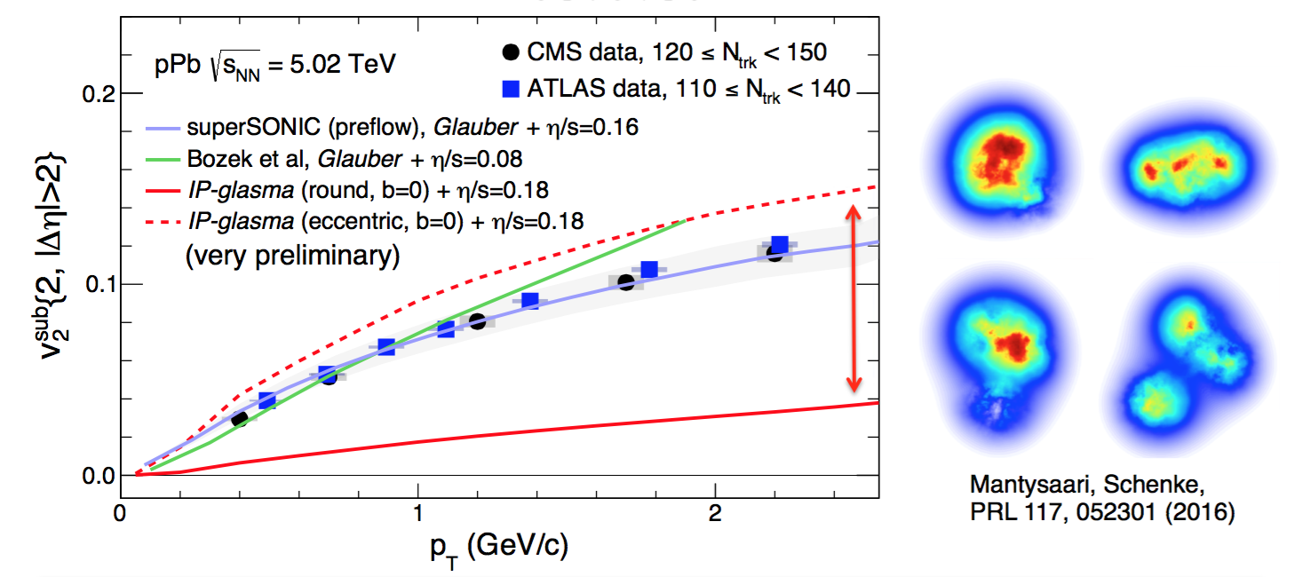
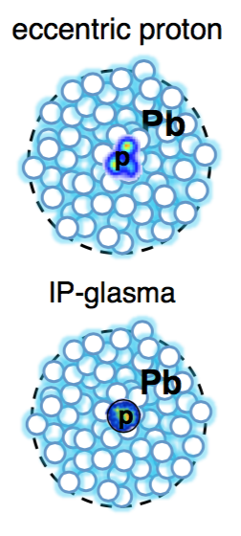
IS Geometry control
28/04/17
How small a Quark-gluon plasma can be?
17
Notes:
Dire que je suis dans la communauté ions lourds

Slide 65
IS Geometry control
28/04/17
How small a Quark-gluon plasma can be?
17
Notes:
Dire que je suis dans la communauté ions lourds

Slide 66
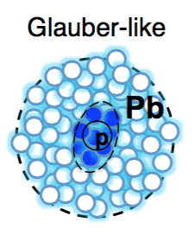
IS Geometry control
28/04/17
How small a Quark-gluon plasma can be?
17
Notes:
Dire que je suis dans la communauté ions lourds

Slide 67
IS Geometry control
  IS modeling has large impact on v_{n}
  Unique opportunities for probing subnucleonic quantum fluctuations in yoctoseconds
28/04/17
How small a Quark-gluon plasma can be?
17
Notes:
Dire que je suis dans la communauté ions lourds

Slide 68
IS Geometry control
  IS modeling has large impact on v_{n}
  Unique opportunities for probing subnucleonic quantum fluctuations in yoctoseconds
28/04/17
How small a Quark-gluon plasma can be?
17
Notes:
Dire que je suis dans la communauté ions lourds

Slide 69
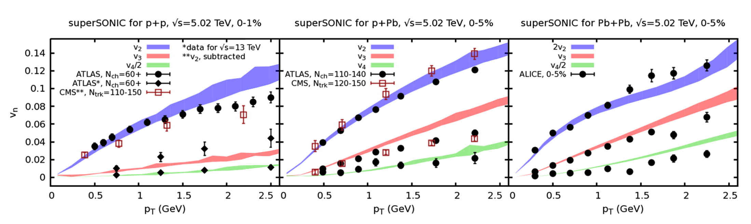
One fluid to rule them all
  Scenario #1
  Reproduce the data quite well
  Emergence of a unified paradigm?
    Not yet… Applicability of hydro is still questionable
arXiV:1701.071459
28/04/17
How small a Quark-gluon plasma can be?
18
Notes:
Dire que je suis dans la communauté ions lourds

Slide 70
One fluid to rule them all
  Scenario #1
  Reproduce the data quite well
  Emergence of a unified paradigm?
    Not yet… Applicability of hydro is still questionable
arXiV:1701.071459
28/04/17
How small a Quark-gluon plasma can be?
18
Notes:
Dire que je suis dans la communauté ions lourds

Slide 71
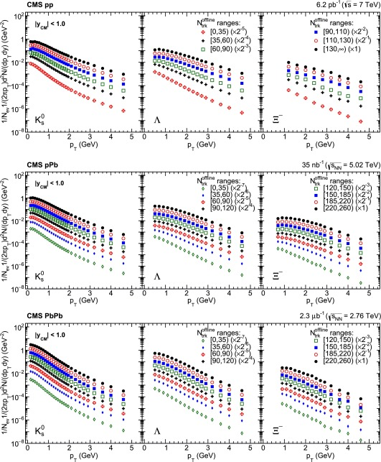
Particle ID and mass ordering
28/04/17
How small a Quark-gluon plasma can be?
19
Notes:
Dire que je suis dans la communauté ions lourds

Slide 72
Particle ID and mass ordering
  Large mass splitting at p_{T} < 2 GeV/c in high-multiplicity pp and pPb collisions
    Common velocity field
28/04/17
How small a Quark-gluon plasma can be?
19
Notes:
Dire que je suis dans la communauté ions lourds

Slide 73
Particle ID and mass ordering
  Larger mass splitting in pp and pPb than in PbPb
28/04/17
How small a Quark-gluon plasma can be?
19
Notes:
Dire que je suis dans la communauté ions lourds

Slide 74
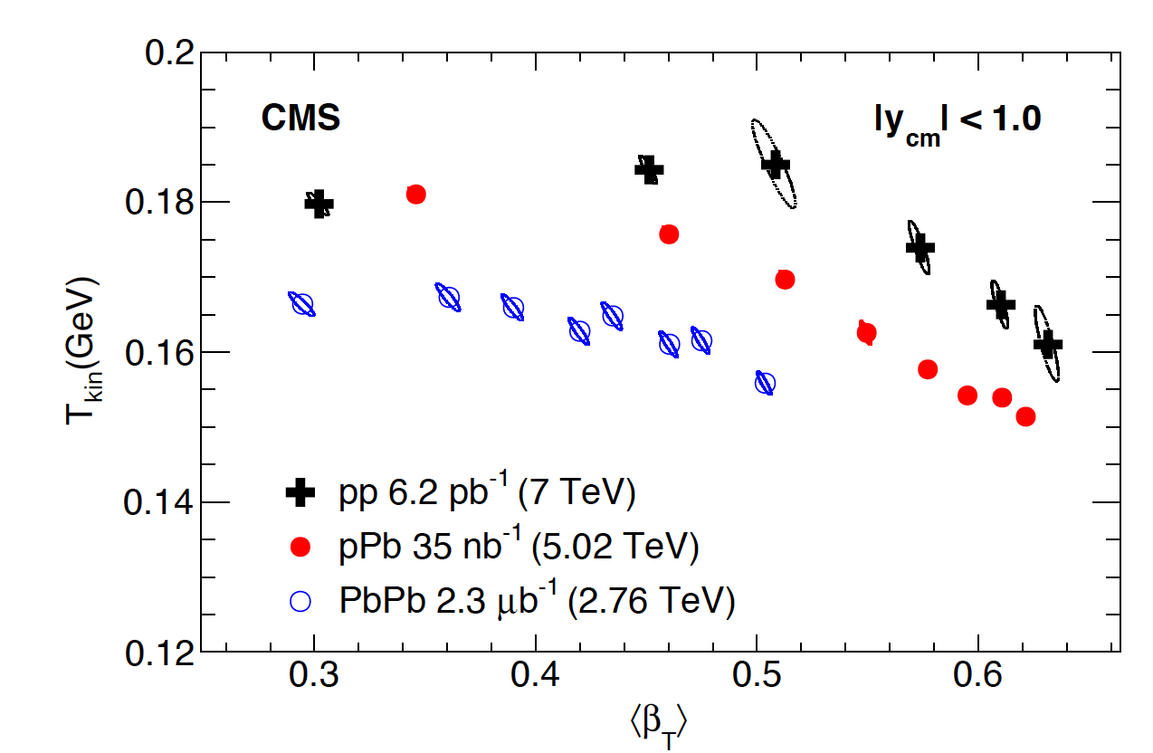
Particle ID and mass ordering
  Larger mass splitting in pp and pPb than in PbPb
    Lager radial flow in small systems
    More explosive systems
28/04/17
How small a Quark-gluon plasma can be?
19
Notes:
Dire que je suis dans la communauté ions lourds

Slide 75
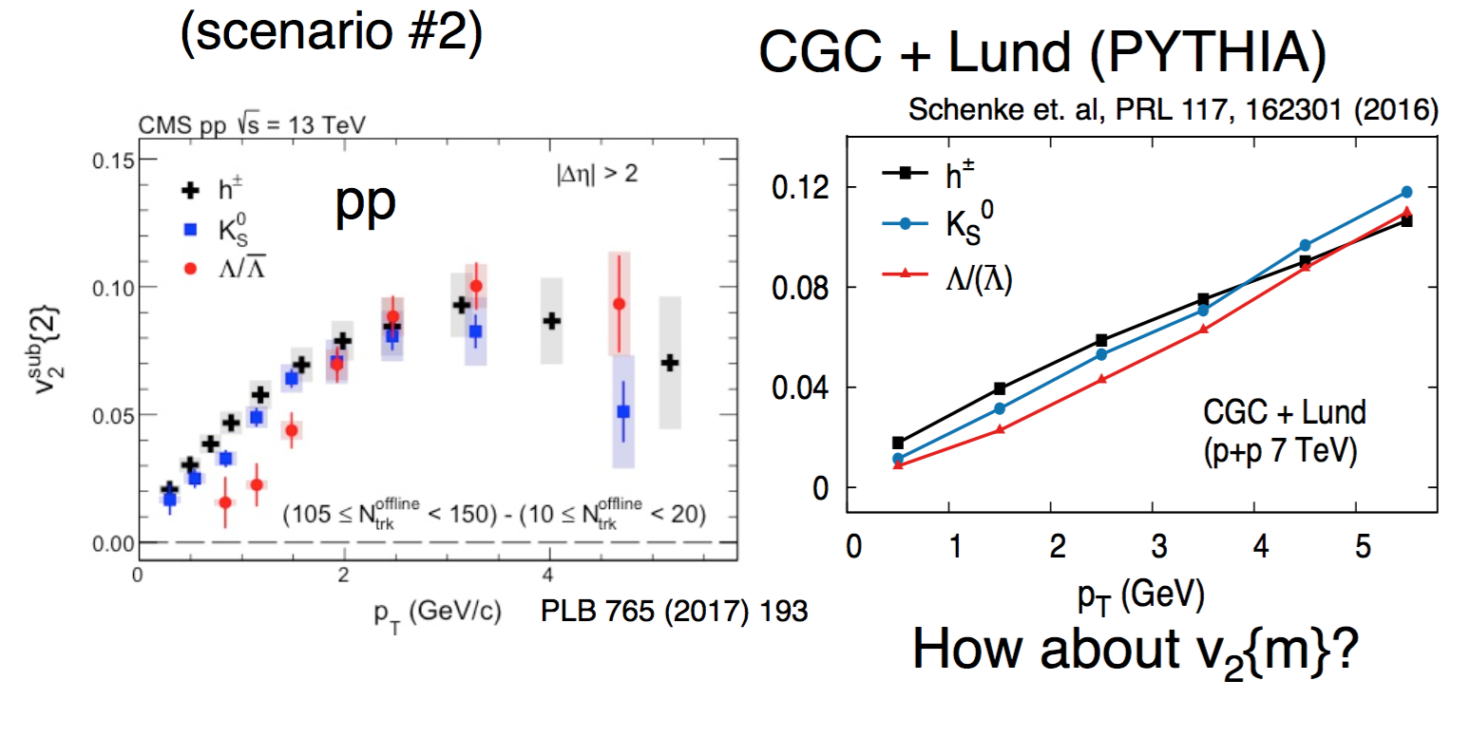
CGC + Lund fragmentation comparison
  Scenario #2
  Initial interaction model confronting the data
  Connection to the initial state is a key to further differentiate the two scenarios
28/04/17
How small a Quark-gluon plasma can be?
19
Notes:
Dire que je suis dans la communauté ions lourds

Slide 76
Looking into the details!
New insights to IS fluctuation of pp and pPb
  Can we do better?
  Correlations between flow harmonics access details about:
    Medium response (η/s, …)
    Initial correlations (geometry + fluctuations)
  How to study non-diagonal terms (v_{n}v_{m}) well understood in A-A collisions with hydro?
    Mixed harmonic
      see Shengquan’s talk tomorrow 8.50 am
    Event shape engineering
    Others?
28/04/17
How small a Quark-gluon plasma can be?
20
Notes:
Dire que je suis dans la communauté ions lourds

Slide 77
Looking into the details!
New insights to IS fluctuation of pp and pPb
  Can we do better?
  Correlations between flow harmonics access details about:
    Medium response (η/s, …)
    Initial correlations (geometry + fluctuations)
  How to study harmonic correlations (v_{n}v_{m})?
28/04/17
How small a Quark-gluon plasma can be?
20
Notes:
Dire que je suis dans la communauté ions lourds

Slide 78
Looking into the details!
New insights to IS fluctuation of pp and pPb
  Can we do better?
  Correlations between flow harmonics access details about:
    Medium response (η/s, …)
    Initial correlations (geometry + fluctuations)
  How to study harmonic correlations (v_{n}v_{m})?
    Mixed harmonic v_{n}(Ψ_{m})
28/04/17
How small a Quark-gluon plasma can be?
20
Notes:
Dire que je suis dans la communauté ions lourds

Slide 79
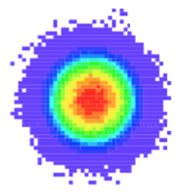
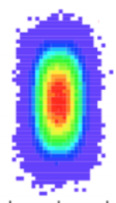
Looking into the details!
New insights to IS fluctuation of pp and pPb
  Can we do better?
  Correlations between flow harmonics access details about:
    Medium response (η/s, …)
    Initial correlations (geometry + fluctuations)
  How to study harmonic correlations (v_{n}v_{m})?
    Mixed harmonic v_{n}(Ψ_{m})
    Event Shape Engineering (ESE)
q₂ cut:
Same centrality (initial geometry)
Different ellipticity
PhysRevC.92, 034903
ATLAS results
28/04/17
How small a Quark-gluon plasma can be?
20
Notes:
Dire que je suis dans la communauté ions lourds

Slide 80
Looking into the details!
New insights to IS fluctuation of pp and pPb
  Can we do better?
  Correlations between flow harmonics access details about:
    Medium response (η/s, …)
    Initial correlations (geometry + fluctuations)
  How to study harmonic correlations (v_{n}v_{m})?
    Mixed harmonic v_{n}(Ψ_{m})
    Event Shape Engineering (ESE)
    Symmetric cumulant
q₂ cut:
Same centrality (initial geometry)
Different ellipticity
PhysRevC.92, 034903
ATLAS results
28/04/17
How small a Quark-gluon plasma can be?
20
Notes:
Dire que je suis dans la communauté ions lourds

Slide 81
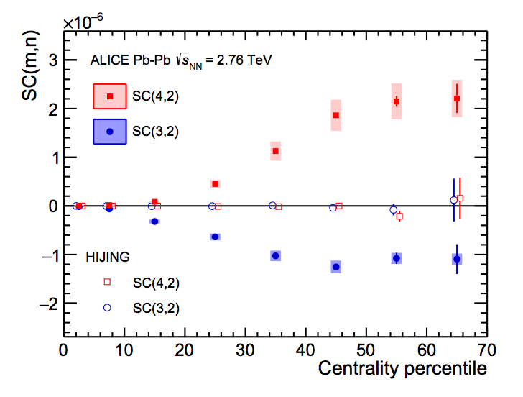
Symmetric Cumulants (SC) in A-A
  Correlation between harmonics:
  Symmetric Cumulant (SC) developed by ALICE
    New observable
    Base on 4-particle cumulant technique
    Non-flow free at first order
PhysRevLett.117, 182301
ALICE results
28/04/17
How small a Quark-gluon plasma can be?
21
Notes:
Dire que je suis dans la communauté ions lourds

Slide 82
Symmetric Cumulants (SC) in A-A
  Correlation between harmonics:
  Symmetric Cumulant (SC) developed by ALICE
    New observable
    Base on 4-particle cumulant technique
    Non-flow free at first order
PhysRevLett.117, 182301
ALICE results
28/04/17
How small a Quark-gluon plasma can be?
21
Notes:
Dire que je suis dans la communauté ions lourds

Slide 83
Symmetric Cumulants (SC) in A-A
  Correlation between harmonics:
  Symmetric Cumulant (SC) developed by ALICE
    New observable
    Base on 4-particle cumulant technique
    Non-flow free at first order
PhysRevLett.117, 182301
ALICE results
SC(2,3) < 0 ➔ v₂ and v₃ are anti-correlated
SC(2,4) > 0 ➔ v₂ and v₄ are correlated
28/04/17
How small a Quark-gluon plasma can be?
21
Notes:
Dire que je suis dans la communauté ions lourds

Slide 84
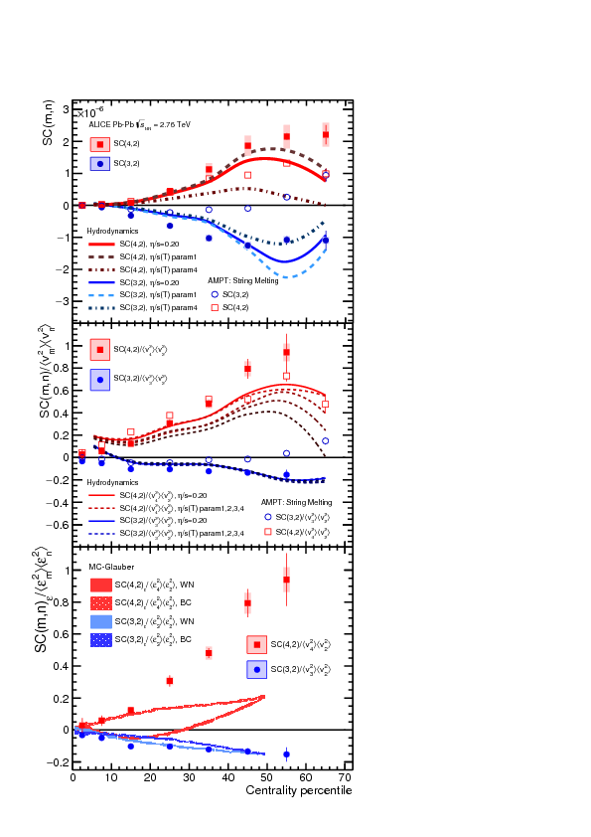
Normalized SC in A-A
  SC normalized by <ε_{n}²>.<ε_{m}²>
    Only <v_{n}²>.<v_{m}²> accessible experimentally
    Normalized by v_{n} magnitude
    Apple-to-apple comparison across systems (p-p, p-Pb and Pb-Pb)
    Stringent constrains on models!
      Giacalone et al.
      Gardim et al.
      Norhona-Holster et
    Odd-Oven correlation IS fluctuation
    Even-Even correlation medium response + IS fluctuation
PhysRevLett.117, 182301
ALICE results
28/04/17
How small a Quark-gluon plasma can be?
22
Notes:
Dire que je suis dans la communauté ions lourds

Slide 85
Normalized SC in A-A
  SC normalized by <ε_{n}²>.<ε_{m}²>
    Only <v_{n}²>.<v_{m}²> accessible experimentally
    Normalized by v_{n} magnitude
    Apple-to-apple comparison across systems (p-p, p-Pb and Pb-Pb)
    Stringent constrains on models!
      Giacalone et al.
      Gardim et al.
      Norhona-Holster et al.
      Welsh
    2-3 correlation: IS fluctuation
    2-4 correlation: medium response + IS fluctuation
PhysRevLett.117, 182301
ALICE results
28/04/17
How small a Quark-gluon plasma can be?
22
Notes:
Dire que je suis dans la communauté ions lourds

Slide 86
Normalized SC in A-A
  SC normalized by <ε_{n}²>.<ε_{m}²>
    Only <v_{n}²>.<v_{m}²> accessible experimentally
    Normalized by v_{n} magnitude
    Apples-to-apples comparison across systems (p-p, p-Pb and Pb-Pb)
    Stringent constraints on models!
      Giacalone et al. arXiv 1605.08303
      Gardim et al. arXiv 1608.02982
      Norhona-Holster et al. arXiv 1609.05171
      Welsh et al. arXiv 1605.09418
    2-3 correlation: IS fluctuation
    2-4 correlation: medium response + IS fluctuation
PhysRevLett.117, 182301
ALICE results
28/04/17
How small a Quark-gluon plasma can be?
22
Notes:
Dire que je suis dans la communauté ions lourds

Slide 87
Normalized SC in A-A
  SC normalized by <ε_{n}²>.<ε_{m}²>
    Only <v_{n}²>.<v_{m}²> accessible experimentally
    Normalized by v_{n} magnitude
    Apples-to-apples comparison across systems (p-p, p-Pb and Pb-Pb)
    Stringent constraints on models!
      Giacalone et al. arXiv 1605.08303
      Gardim et al. arXiv 1608.02982
      Norhona-Holster et al. arXiv 1609.05171
      Welsh et al. arXiv 1605.09418
    2-3 correlation: IS fluctuation
    2-4 correlation: medium response + IS fluctuation
PhysRevLett.117, 182301
ALICE results
What about small colliding systems?
28/04/17
How small a Quark-gluon plasma can be?
22
Notes:
Dire que je suis dans la communauté ions lourds

Slide 88
SC in small systems
  SC can be measured in small system (p-p and p-Pb)
    Never measured
    Little knowledge
28/04/17
How small a Quark-gluon plasma can be?
23
Notes:
Dire que je suis dans la communauté ions lourds

Slide 89
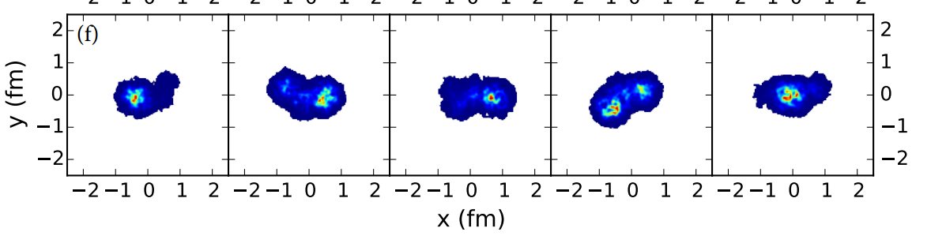
SC in small systems
  SC can be measured in small system (p-p and p-Pb)
    Never measured
    Little knowledge
J. Quian, U. Heinz (eccentricity correlation only) arXiv 1605.09418
quark width
multiplicity
fluctuations
28/04/17
How small a Quark-gluon plasma can be?
23
Notes:
Dire que je suis dans la communauté ions lourds

Slide 90
SC in small systems
  SC can be measured in small system (p-p and p-Pb)
    Never measured
    Little knowledge
J. Quian, U. Heinz (eccentricity correlation only) arXiv 1605.09418
Anti-correlation predicted in p-Pb
28/04/17
How small a Quark-gluon plasma can be?
23
Notes:
Dire que je suis dans la communauté ions lourds

Slide 91
SC in small systems
  SC can be measured in small system (p-p and p-Pb)
    Never measured
    Little knowledge
J. Quian, U. Heinz (eccentricity correlation only) arXiv 1605.09418
28/04/17
How small a Quark-gluon plasma can be?
23
Notes:
Dire que je suis dans la communauté ions lourds

Slide 92
SC in small systems
  SC can be measured in small system (p-p and p-Pb)
    Never measured
    Little knowledge
J. Quian, U. Heinz (eccentricity correlation only) arXiv 1605.09418
Correlation predicted in p-p
Related to the number of fluctuating sources
28/04/17
How small a Quark-gluon plasma can be?
23
Notes:
Dire que je suis dans la communauté ions lourds

Slide 93
SC as a function of multiplicity
Correlation between v₂ and v₄
Anti-correlation between v₂ and v₃
CMS-PAS-HIN-16-022
28/04/17
How small a Quark-gluon plasma can be?
24
Notes:
Dire que je suis dans la communauté ions lourds

Slide 94
SC as a function of multiplicity
Large contribution from non-flow (e.g. dijets, …)
CMS-PAS-HIN-16-022
28/04/17
How small a Quark-gluon plasma can be?
24
Notes:
Dire que je suis dans la communauté ions lourds

Slide 95
SC as a function of multiplicity
CMS-PAS-HIN-16-022
Very small energy dependence observed for p-Pb results
pPb similar to PbPb:
  Naturally explained by initial geometry! Scenario #1
  A new challenge to initial interaction models?! Scenario #2
28/04/17
How small a Quark-gluon plasma can be?
24
Notes:
Dire que je suis dans la communauté ions lourds

Slide 96
SC as a function of multiplicity
CMS-PAS-HIN-16-022
Very small energy dependence observed for p-Pb results
pPb and pp? similar to PbPb:
  Naturally explained by initial geometry! Scenario #1
  A new challenge to initial interaction models?! Scenario #2
    Some workaround currently worked on: correlated hot spot
28/04/17
How small a Quark-gluon plasma can be?
24
Notes:
Dire que je suis dans la communauté ions lourds

Slide 97
SC as a function of multiplicity
28/04/17
How small a Quark-gluon plasma can be?
24
Notes:
Dire que je suis dans la communauté ions lourds

Slide 98
SC as a function of multiplicity
Different v_{n} magnitude:
Normalization needed for a fair comparison across systems
28/04/17
How small a Quark-gluon plasma can be?
24
Notes:
Dire que je suis dans la communauté ions lourds

Slide 99
SC normalized
SC normalized by <v_{n}²>.<v_{m}²>
CMS-PAS-HIN-16-022
arXiv 1605.09418
Wounded nucleon model
arXiv 1609.05171
Similar behavior in p-Pb and PbPb
Points to similar IS fluctuations
First calculations (ε_{n} correlations only)
  Right sign
  Magnitude is off
Ordering observed:
p-p > p-Pb > Pb-Pb
May point to different transport properties or contribution from initial correlation
28/04/17
How small a Quark-gluon plasma can be?
25
Notes:
Dire que je suis dans la communauté ions lourds

Slide 100
SC normalized
SC normalized by <v_{n}²>.<v_{m}²>
CMS-PAS-HIN-16-022
Similar behavior in p-Pb and PbPb
Points to similar IS fluctuations
First calculations (ε_{n} correlations only)
  Right sign
  Magnitude is off
Ordering observed:
p-p > p-Pb > Pb-Pb
May point to different transport properties
28/04/17
How small a Quark-gluon plasma can be?
25
Notes:
Dire que je suis dans la communauté ions lourds

Slide 101
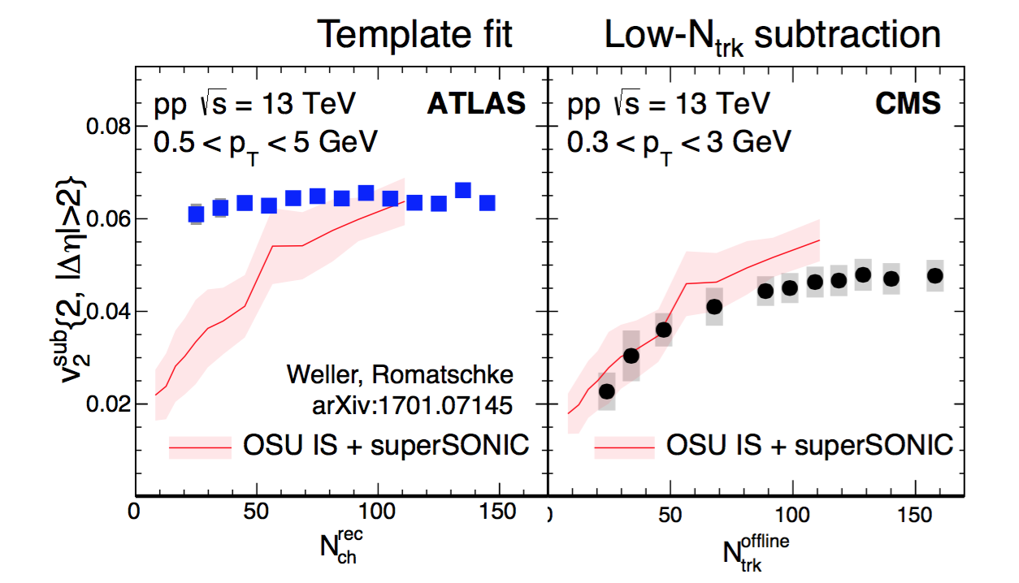

What still need to be understood?
Does the collectivity turn off at low N_{trk}?
If hydro is the explanation, v₂ should go down!
New methods using N-particle correlations with gap
28/04/17
How small a Quark-gluon plasma can be?
26
Notes:
Dire que je suis dans la communauté ions lourds

Slide 102
Summary
Clear evidence of long-range, collective phenomena! universal in all high-multiplicity hadronic collisions
Scenario #1
Scenario #2
Initial spatial ε_{s}
+ final interactions
Initial spatial ε_{p}
by initial interactions
AA is consistent with Scenario #1: nearly perfect fluid
In pp/pA?
The understanding of the initial and its fluctuation is the key to disentangle #1 and #2
Small system are unique probes of subnucleonic fluctuations
v_{n}{m}, PID v_{n} and SC results suggest that a unified paradigm to describe all hadronic system is plausible
28/04/17
How small a Quark-gluon plasma can be?
27
Notes:
Dire que je suis dans la communauté ions lourds

Slide 103
Outlook
Do we form a QGP in small systems?
28/04/17
How small a Quark-gluon plasma can be?
28
Notes:
Dire que je suis dans la communauté ions lourds

Slide 104
Outlook
Do we form a QGP in small systems? Maybe…
28/04/17
How small a Quark-gluon plasma can be?
28
Notes:
Dire que je suis dans la communauté ions lourds

Slide 105
Outlook
Do we form a QGP in small systems? Maybe…
YES
Correlation results may suggest we can form a QGP in small system at high multiplicity
  Similarity with AA in all the observable
  Collectivity have been shown
This is supported by the observation of strangeness enhancement by ALICE in small systems
  Small systems sounds more and more similar to PbPb
28/04/17
How small a Quark-gluon plasma can be?
28
Notes:
Dire que je suis dans la communauté ions lourds

Slide 106
Outlook
Do we form a QGP in small systems? Maybe…
YES
Correlation results may suggest we can form a QGP in small system at high multiplicity
  Similarity with AA in all the observable
  Collectivity have been shown
This is supported by the observation of strangeness enhancement by ALICE in small systems
  Small systems sounds more and more similar to PbPb
NO
No in medium parton interaction observed so far
  No jet quenching
  No HF suppression
28/04/17
How small a Quark-gluon plasma can be?
28
Notes:
Dire que je suis dans la communauté ions lourds

Slide 107
What next?
Seems important to bridge the gap between peripheral PbPb and high multiplicity pp or pA collisions
At low multiplicities, non-flow contribution becomes dominant and new tools has to be developed to get ride of it more efficiently
The search for in medium parton energy loss could be pursue with correlation studies looking at charged hadrons or HF v_{n} at high-p_{T} in particular
28/04/17
How small a Quark-gluon plasma can be?
29
Notes:
Dire que je suis dans la communauté ions lourds

