Slide 1


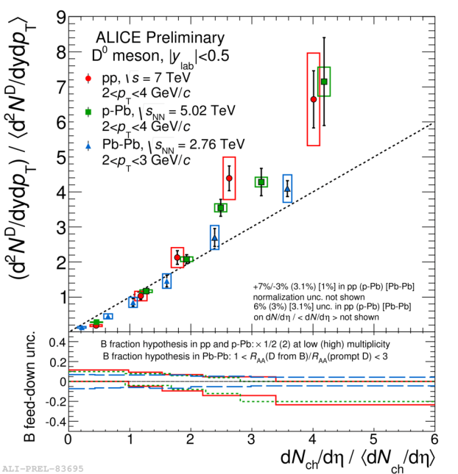
Multi-Parton Interaction (MPI) measurement at LHC
(A bias view)
Sarah Porteboeuf-Houssais
Kick-off meeting GDR QCD – group A
Simple and multiple interactions within partons in nucleons
IPNO 29th -30th September 2016

Slide 2
Summary
What are MPI (experimental point of view) ?
Why do we need them ?
How do see them in data ?
Double Production (see Y. Li talk)
Charm and bottom production as a function of multiplicity (see Z. Conesa talk)
Underlying event measurements
Multiplicity dependence of two-particle azimuthal correlations
Conclusions and questions

Slide 3
Multiple Parton Interaction (MPI)
A naïve picture
Several interactions, soft and hard, occur in parallel
The number of elementary interactions is connected to the multiplicity
Several hard interactions can occur in a pp collision
In this picture : particle yield from hard processes should increase with multiplicity
A less naïve picture
Some of the parallel interactions are soft
Energy and momentum conservation
Impact parameter dependence
Re-interaction of partons with others: ladder splitting
Re-interaction within ladders either in initial state (screening, saturation), or in final state (color reconnections)
Initial state radiation (ISR) and final state radiation (FSR), hadronic activity around hard processes
Test interaction between hard component and soft component in pp collisions : full collision description, color flow, energy sharing.

Slide 4
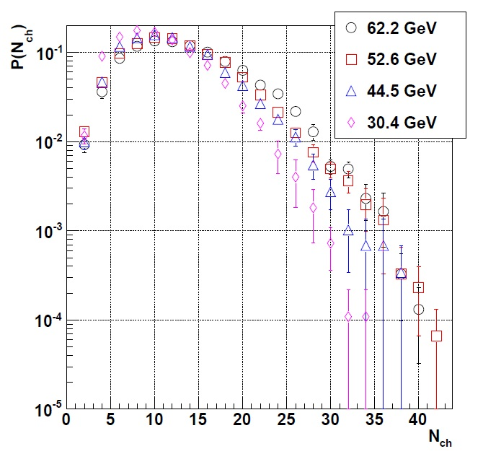
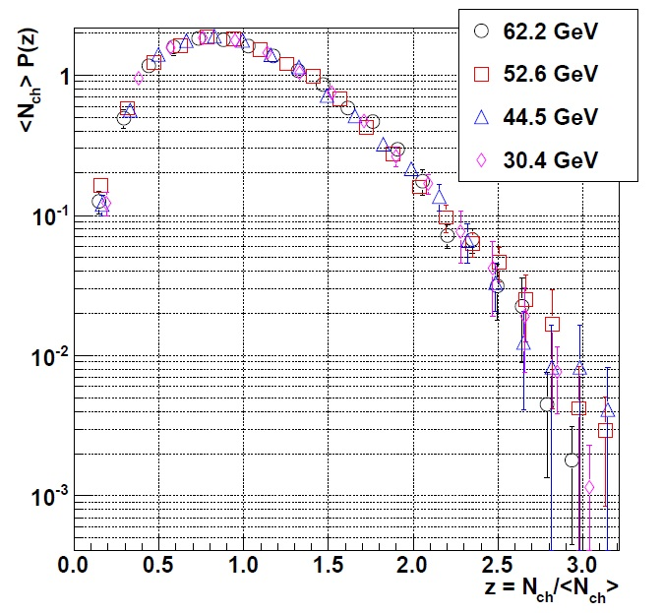
Needs for MPI
Koba-Nielsen-Oleson (KNO) scaling
Evolution of the charged particle multiplicity distribution in proton-proton collisions P(N_{ch}) with √s follows KNO-scaling with
Scaling variable
and
Energy independent function
Different multiplicity distributions
When self normalized : KNO scaling
NSD events in full phase space measured by the SFM (Split Field Magnet) at ISR energies
Compilation from J. Phys. G 37 (2010) 083001
Up to √s=200 GeV, it works pretty well!

Slide 5
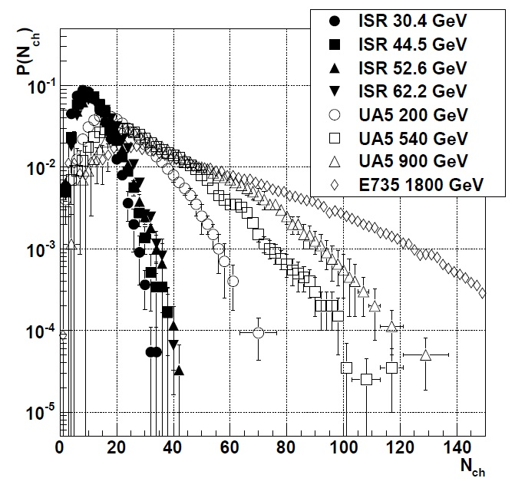
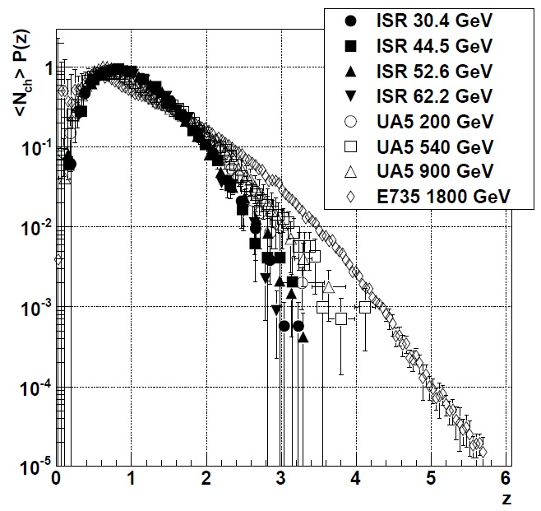
Needs for MPI
Koba-Nielsen-Oleson (KNO) scaling
At energies greater than √s=200 GeV in pp and pp collisions,
NSD events in full phase space
Compilation from J. Phys. G 37 (2010) 083001
Violation of KNO-scaling (√s > 200 GeV)
Phys. Lett. B 167 (1986) 476
Deviation from KNO-scaling increases with √s
Can be interpreted as a consequence of particle production through (soft) MPI
Phys. Rev. D 84 (2011) 034026 Hep-ph/1106.4959
Phys. Rept. 349 (2001) 301 Hep-ph/0004215
J. Phys. G 37 (2010) 083001

Slide 6
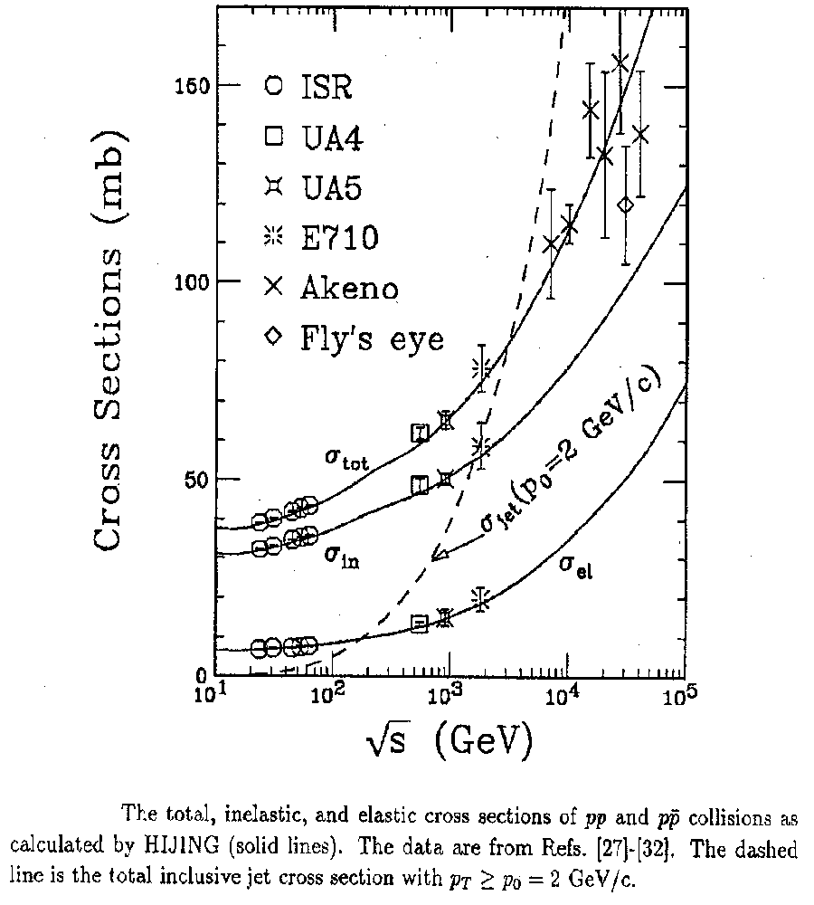
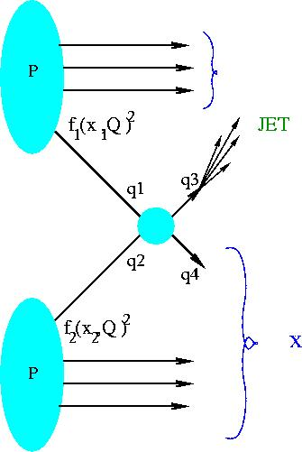
pQCD and inclusive observables
Needs for MPI
Limitation at high energy
(hard) MPI needed at high energy
Jet production cross section:
Inclusive cross section: pp -> Jet +X
X.N.Wang, M.Gyulassy, Phys. Rev. D45 (1992) 844-856

Slide 7
Needs for MPI
A naïve picture
A less naïve picture
A more complex picture
High multiplicity 7 TeV pp events comparable to RHIC Cu-Cu collisions PHOBOS, Phys. Rev. C 83, 024913 (2011)
dN_{ch}^{pp}/dƞ up to 70, dN_{ch}^{Cu-CU}/dƞ= 75 in 25-30% at √s=200 GeV, dN_{ch}^{Au-AU}/dƞ= 73 in 50-55% at √s=200 GeV
Collectivity in pp K. Werner at al. Phys.Rev.C83:044915,2011 / k. Werner at al. J.Phys.Conf.Ser.316:012012,2011
Final state effects on quarkonium production in pp collisions S. Vogel et al. J.Phys.Conf.Ser. 420 (2013) 012034/ T. Lang Phys.Rev. C87 (2013) 024907
Quarkonium production mechanism still to be understood, while open charm and beauty production is well described by pQCD
Understanding of elementary interactions in pp collisions is crucial:
Interplay soft-hard, MPI structure, Underlying event (UE)

Slide 8

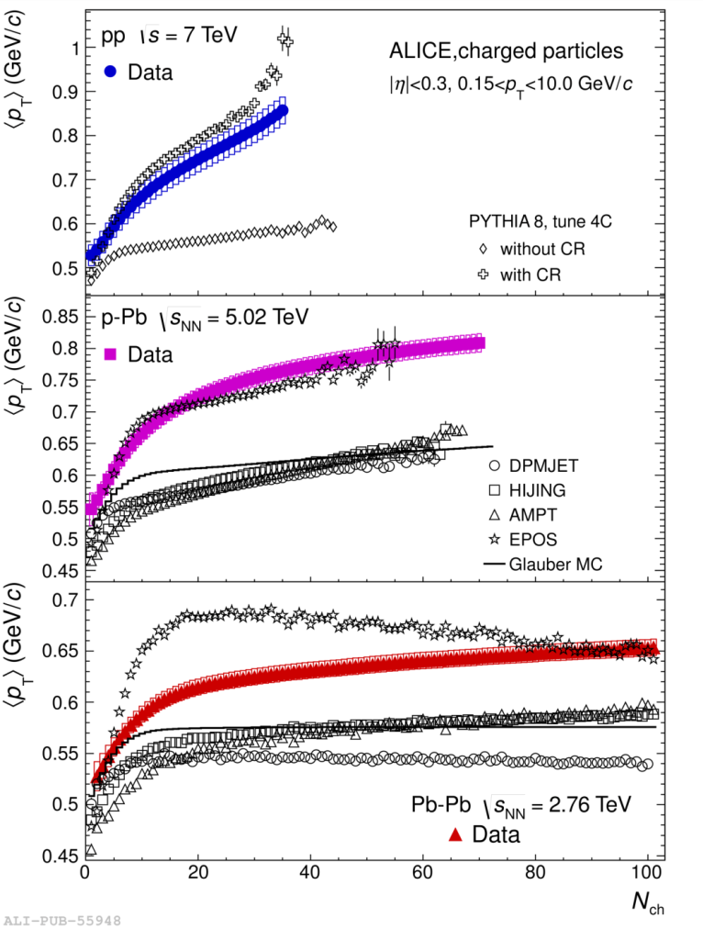
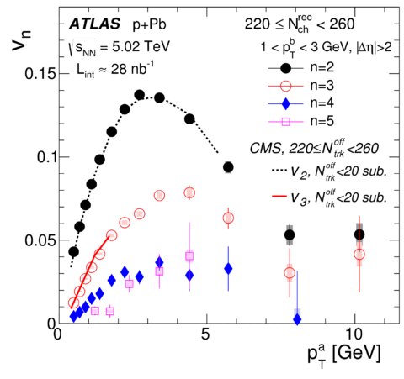
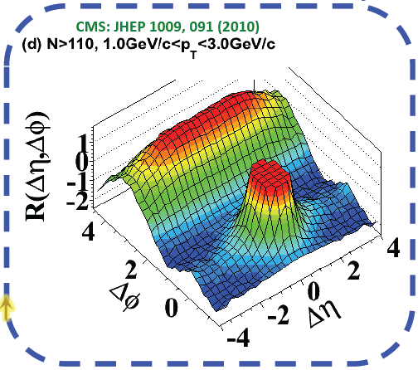
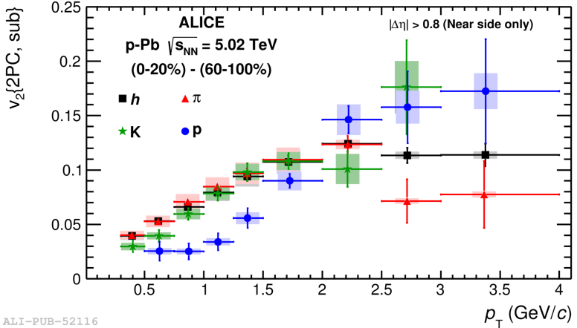
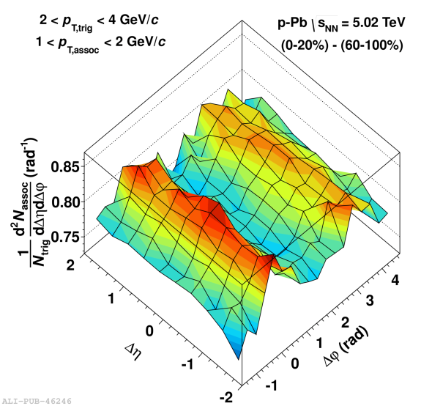
A question asked by LHC Run I
Phys. Rev. C 90, 044906
Phys. Lett. B 727 (2013) 371
Phys. Lett. B 726 (2013) 164–177
+ many other observables in pp and p-Pb : HBT radii, λ/K₀, e-h correlations, multiparticle azimuthal cumulants, femtoscopy
Phys. Lett. B 719 (2013) 29-41
Looks like signs, hints (something) of collectivity in small systems (pp and p-Pb)
Do we understand initial conditions?
Importance of multi-parton interactions in hadronic collisions
Study of MPI and collectivity related

Slide 9
Where to look for MPI?
We have been knowing since the 90th that MPIs are necessary to describe all features of pp collisions at high energies both for soft and hard production
MPI directly connected with multiplicity
Multiplicity differential studies and exclusive measurements
In article title :
… as a function of charged particle multiplicity
Multiplicity dependence of …
… Underlying event …
Double/pair production …
Disclaimer : not an exhaustive review,
see. talks at GDR PH-QCD School “Correlations between partons in nucleons”
https://indico.in2p3.fr/event/9917/other-view?view=standard
Or MPI@LHC conference
No discussion in this talk of <p_{T}> vs. N_{ch}; λ/k0; long range angular correlations (ridge)

Slide 10
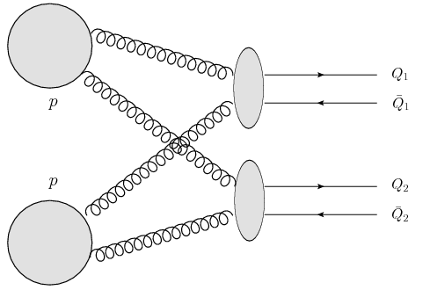
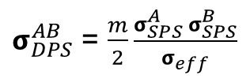

Double production and Double Parton Scattering
Two independent scattering processes
Two hard interactions
A
Assume factorisation of PDF’s
Cross section:
B
m=2 when A and B are distinguishable
m=1 when indistinguishable
Represent the probability for a scattering B to occur, given A already done
LHCb
Observation of double charm production involving open charm in pp collisions at √s = 7 TeV
JHEP 06 (2012) 141 + 1403 (2014) 108
Observation of J/ψ-pair production in pp collisions at √s=7 TeV
Phys. Lett. B 707 (2012) 52
Double charm and J/ψ production as well as Υ agree better with models including double parton scattering (DPS)
CMS
Observation of Υ(1S) pair production at CMS
https://cdsweb.cern.ch/record/2154307/files/BPH-14-008-pas.pdf
Same sign WW
CMS-PAS-FSQ-13-001
ATLAS
W± + 2jets; W± + J/ψ prompt; Z + J/ψ; four-jet
N. J. Phys 15 (2013) 033038; JHEP 1404 (2014) 172; EPJC 75 (2015) 229; ATLAS-CONF-2015-058
See Yiming Li talk on Friday afternoon

Slide 11
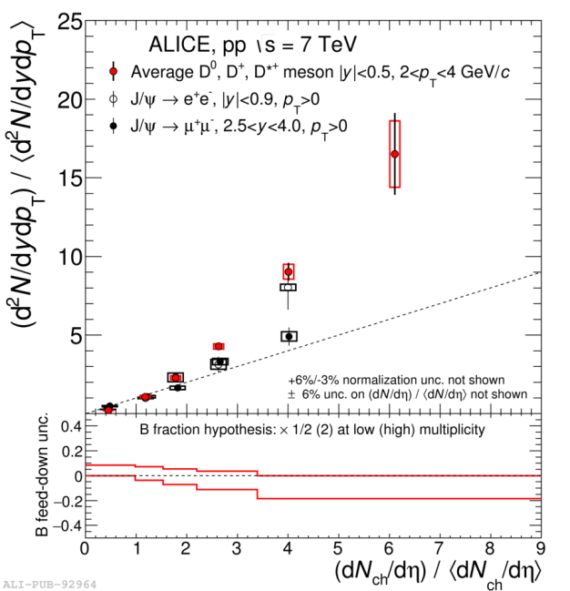
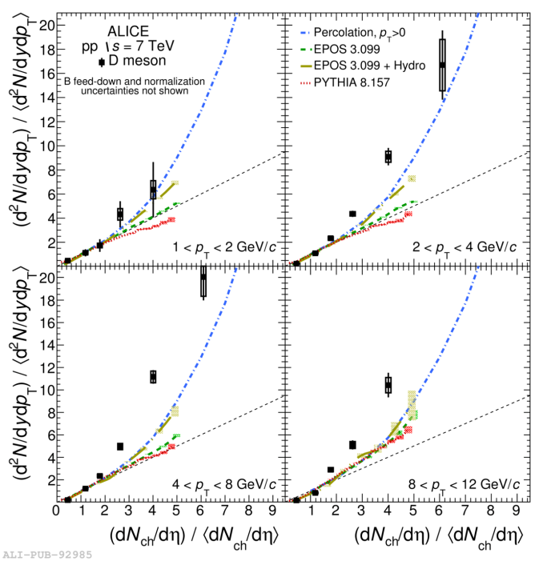
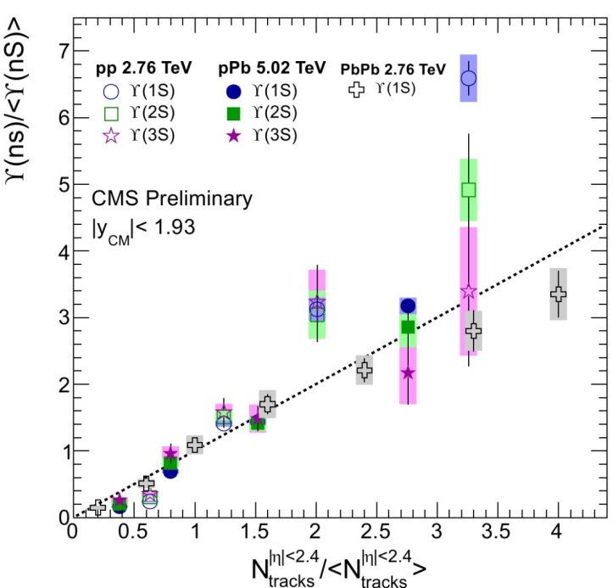
Charm and bottom as a function of multiplicity
Interplay between hard and soft component, link between colliding systems (pp, p-Pb, Pb-Pb)
ALICE
CMS
J/Ψ production as a function of multiplicity in pp and p-Pb collisions
ϒ production as a function of multiplicity
Phys. Lett. B 712 (2012) 3, 165–175
D-meson production as a function of multiplicity in pp and p-Pb
STAR
Non-prompt J/Ψ as a function of multiplicity in pp collisions
J/Ψ production as a function of multiplicity in pp
See Zaida Conesa talk this afternoon

Slide 12
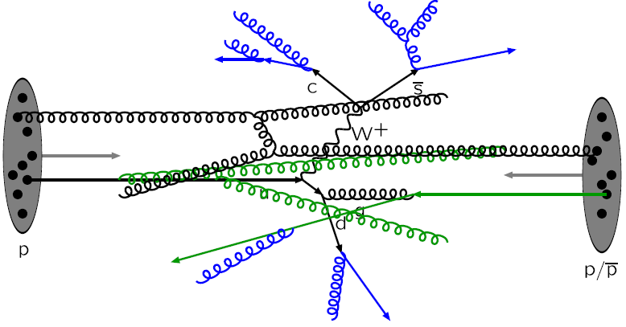
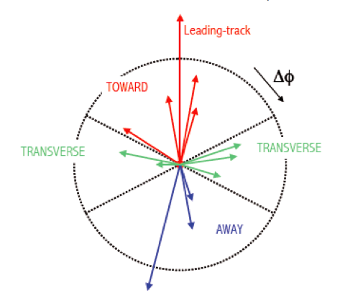
Underlying event measurements
pp collision description “à la” PYTHIA
1 hard scattering on top of underlying event (UE) activity
UE = fragmentation of beam remnants
+ MPI
+ initial and final state radiation (ISR/FSR)
Energy scale given by the leading particle
(approximation to the original outgoing parton momentum)
Toward: |Δϕ|<π/3
Transverse: π/3<|Δϕ|<2π/3
Away: |Δϕ|>2π/3
√s=0.9 and 7 TeV, p_{T} threshold: 0.15, 0.5 and 1 GeV/c
Study of charged particle in the three regions gives insight into the UE behavior

Slide 13
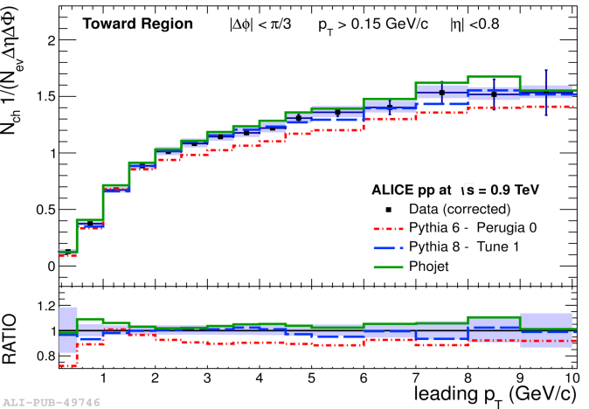
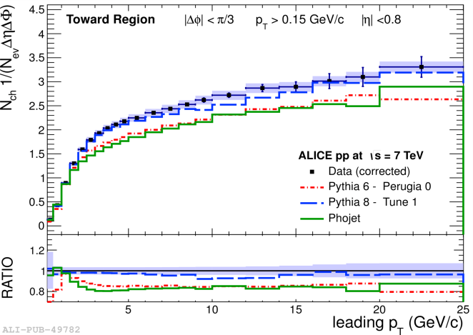
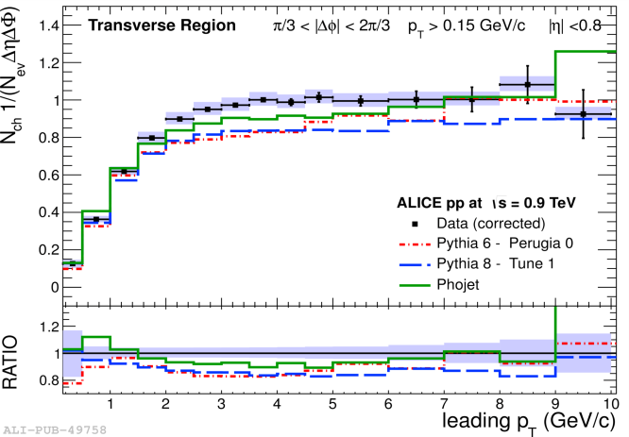
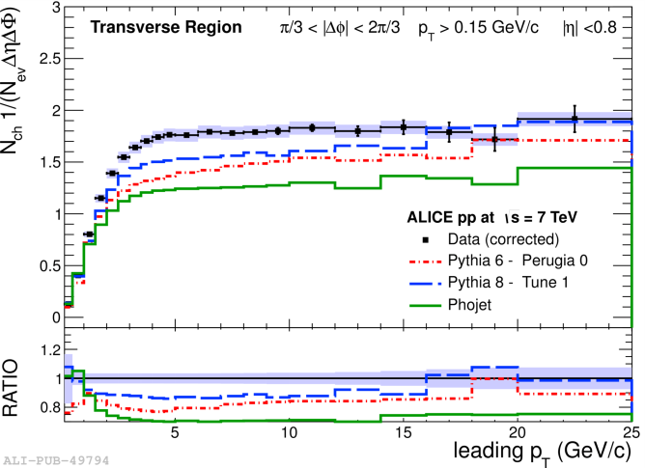
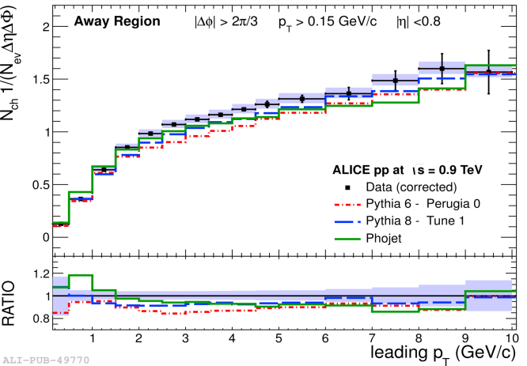
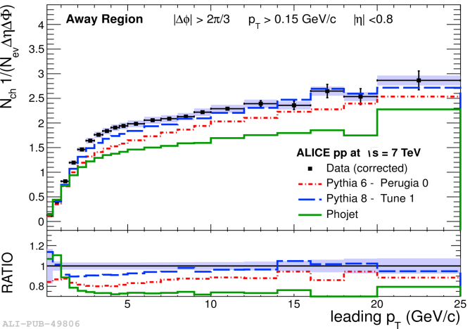
Underlying event measurements
√s = 0.9 TeV
√s = 7 TeV
Average charged particle density vs. leading track transverse momentum p_{T,LT}
Toward
Toward
Toward and Away
Monotonic increase with leading p_{T}
regions dominated by jet fragmentation,
↑ leading p_{T}: ↑ hadronic activity
Transverse
Transverse
Transverse
Increase interpreted in term of MPI
In PYTHIA: higher p_{T} biases towards more central collisions (higher MPI probabilities)
Away
Away
Plateau at ~4 GeV/c : production independent of hard scale
sarah@clermont.in2p3.fr
ALICE JHEP 1207 (2012) 116
13

Slide 14
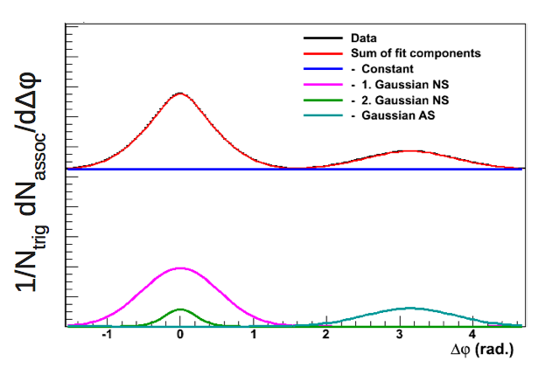
Multiplicity dependence of two-particle azimuthal correlations
Probability distribution of the azimuthal difference: Δϕ=ϕ_{trig}-ϕ_{assoc}
Trigger particles: p_{T, trig} > p_{T,trig}^{min}, |ƞ|<0.9
N_{trig}: number of trigger particles
Associated particles: p_{T, assoc} > p_{T, assoc}^{min}, |ƞ|<0.9
N_{assoc}: number of associated particles
Pair-yield per trigger as a function of Δϕ:
Fit-function to unravel the azimuthal correlation main components
Combinatorial background
Near-side peak: 2 Gaussians
Near-side
Away-side
Away-side peak: single Gaussian
The fitting parameters are used to construct observables
ALICE JHEP 09 (2013) 049

Slide 15
Multiplicity dependence of two-particle azimuthal correlations
Observables definition
Per-trigger pair yield in the combinatorial background
Per-trigger pair yield in the near-side peak
Per-trigger pair yield in the away-side peak
Average number of trigger particles
Average number of uncorrelated seeds
N_{trigger} sensitive to MPI and parton fragmentation
The ratio reduces fragmentation contribution
Number of uncorrelated sources of particles
linked with the number of MPI in the event
JHEP 09 (2013) 049

Slide 16
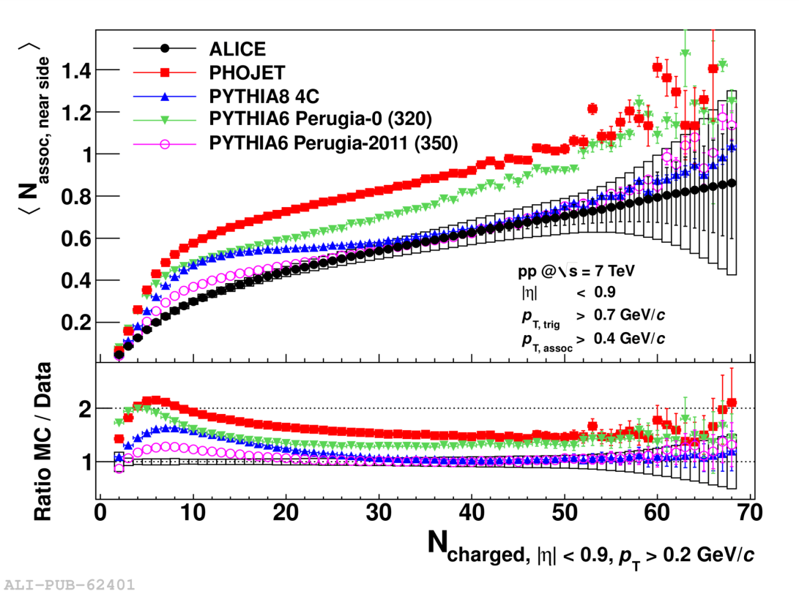
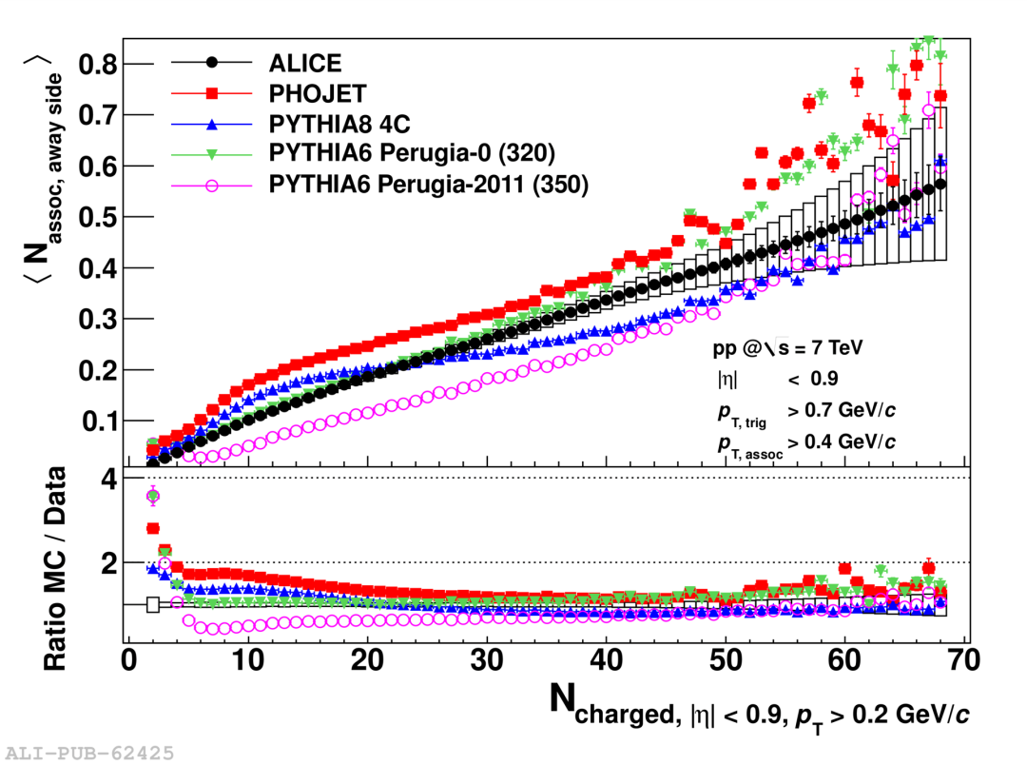
Multiplicity dependence of two-particle azimuthal correlations
ALICE JHEP 09 (2013) 049
Per-trigger pair yield in the near-side peak
Per-trigger pair yield in the away-side peak
Near-side pair yield grows as a function of multiplicity
Away-side pair yield grows as a function of multiplicity
General trend (increase with multiplicity) present in MC
None of the MC is able to describe near-side and away-side simultaneously

Slide 17
Conclusions
MPI structure of proton-proton collisions theoretically described since a while
Needed to explain data measurement only recently
Physics interpretation strongly connected with the question of collectivity in small systems (initial state)
LHC made us enter a new era for the understanding of proton-proton collisions and multi-parton interactions with measurements all pointed to MPI
    double-parton production,
    charm and bottom vs. multiplicty,
    underlying event study
    two-particle azimuthal correlation
Questions
Link between MPI, Factorization and PDF
Possible impact of unintegrated PDF (and/or “nucleon tomography”) on MPI studies

Slide 18
BACKUP

Slide 19
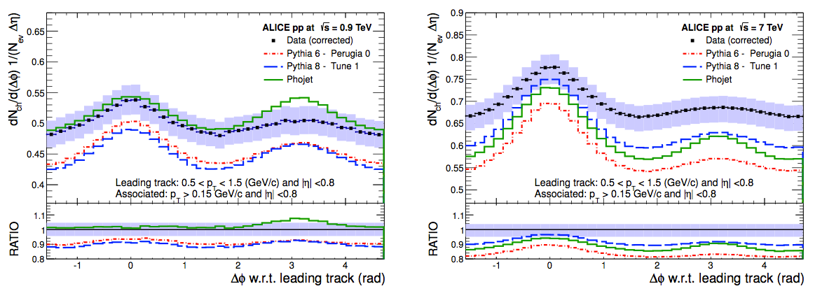
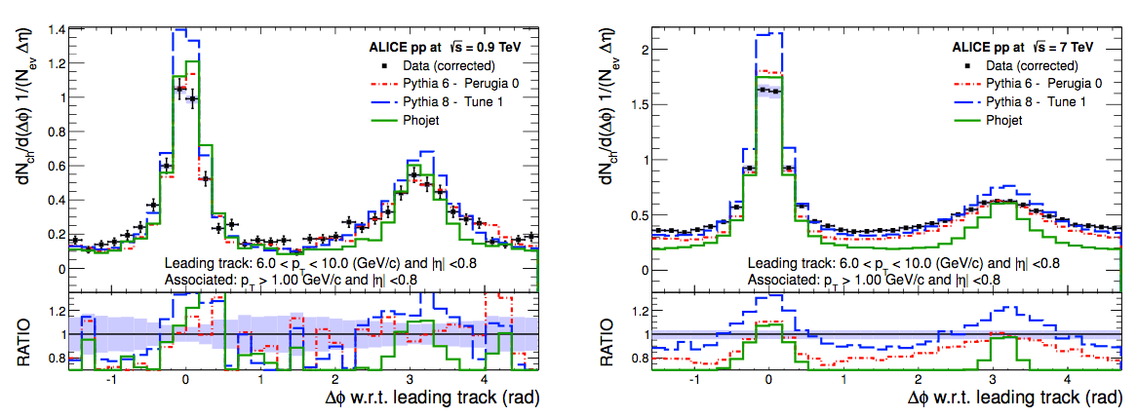
Underlying event measurement – Δϕ-correlation
Δϕ-correlation between tracks and the leading track
sarah@clermont.in2p3.fr
JHEP 1207 (2012) 116

Slide 20
Underlying event measurement – Number density
√s = 0.9 TeV
√s = 7 TeV
Average charged particle density vs. leading track transverse momentum p_{T,LT}
Toward
Toward
Toward and Away
Monotonic increase with leading p_{T}
regions dominated by jet fragmentation,
↑ leading p_{T}: ↑ hadronic activity
Transverse
Transverse
Transverse
Increase interpreted in term of MPI
In PYTHIA: higher p_{T} biases towards more central collisions (higher MPI probabilities)
Away
Away
Plateau at ~4 GeV/c : production independent of hard scale
sarah@clermont.in2p3.fr
JHEP 1207 (2012) 116

Slide 21
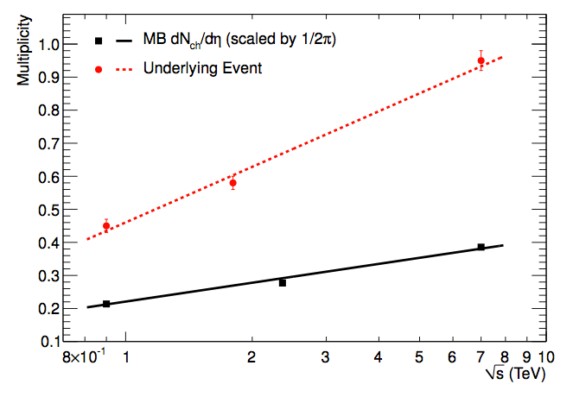
Underlying event measurement – Number density
Comparison of number density in the plateau of the Transverse region (underlying event)
And dN_{ch}/dƞ in minimum bias event
UE number density grows logarithmically and faster than MB dN_{ch}/dƞ
JHEP 1207 (2012) 116

Slide 22
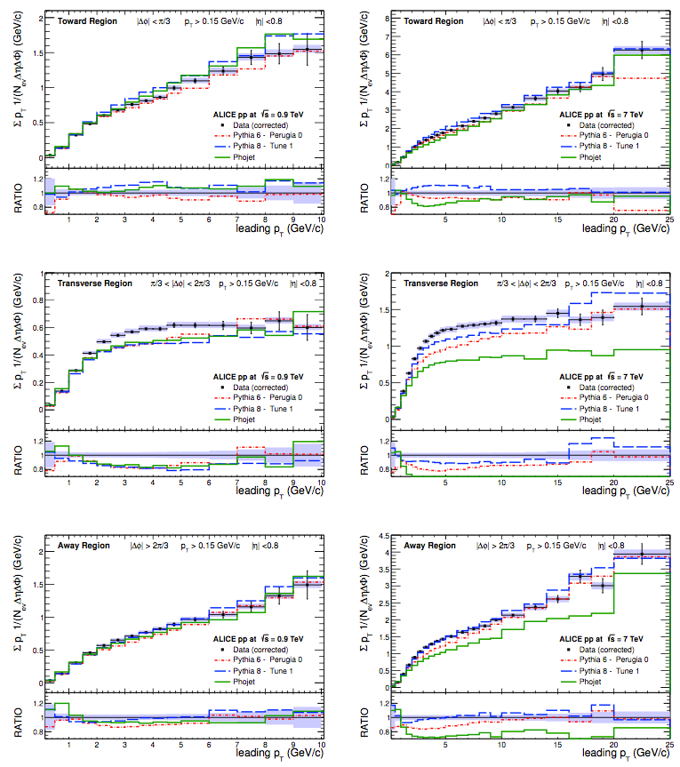
Underlying event measurement – Summed p_{T}
√s = 0.9 TeV
√s = 7 TeV
Toward
Toward
Average summed p_{T} density vs. leading track transverse momentum p_{T,LT}
Transverse
Transverse
Same behavior and interpretation as for number density
Away
Away
sarah@clermont.in2p3.fr
JHEP 1207 (2012) 116

Slide 23
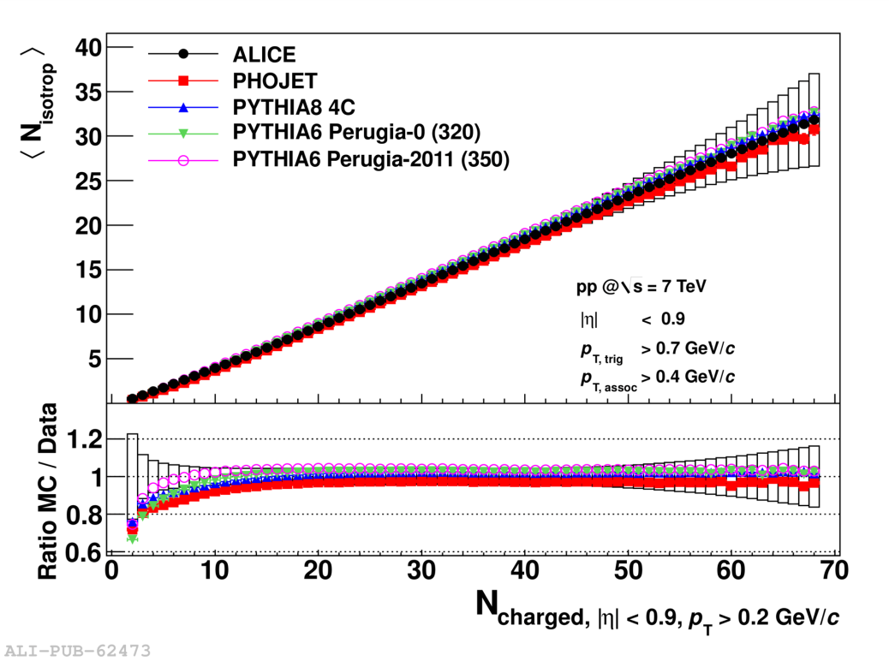
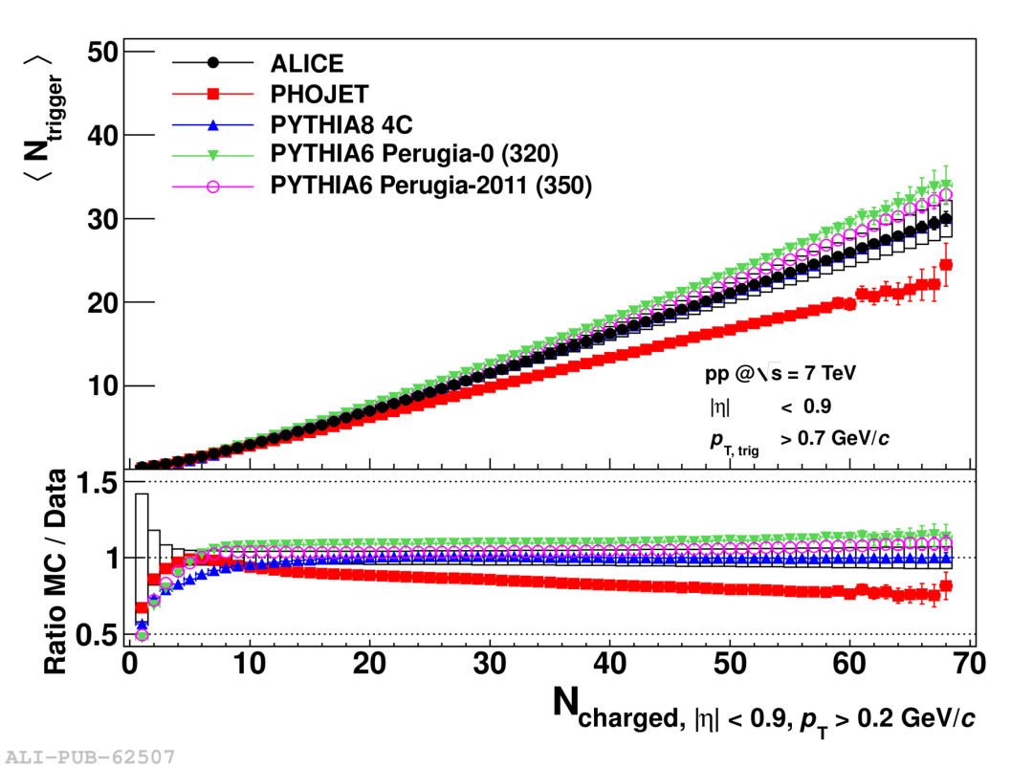
Multiplicity dependence of two-particle azimuthal correlations
Per-trigger pair yield in the combinatorial background
Average number of trigger particles
Linear increase as a function of multiplicity
Deviation from linear increase at high multiplicity
Well described by the MC
Both MPI and hadronic activity increase with multiplicity, leading to an increase of particle above a p_{T} threshold, not reproduced by PHOJET
JHEP 09 (2013) 049

Slide 24
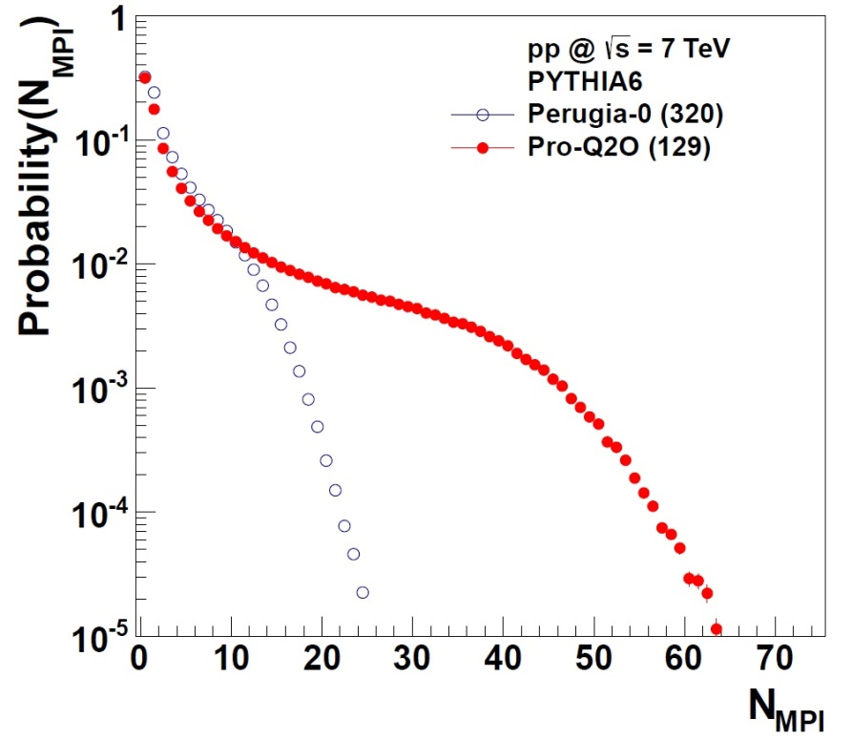
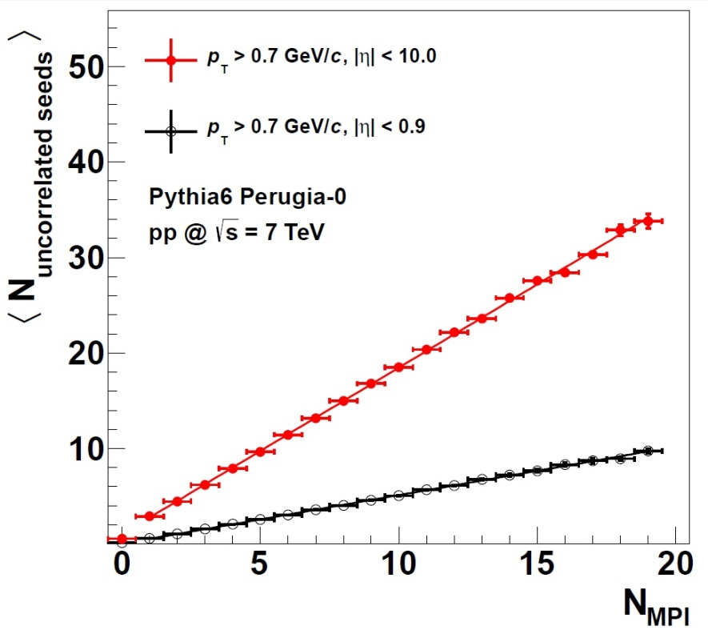
Multiplicity dependence of two-particle azimuthal correlations
Average number of uncorrelated seeds in PYTHIA
N_{MPI} = number of hard or semi-hard scatterings in a single pp collision
Perugia-0 and Pro-Q20: 2 different tunes with a good description of Tevatron data and LHC predictions Phys. Rev. D 82 (2010) 074018
Lead to different probability distributions of N_{MPI}
N_{uncorrelated seeds} directly proportional to N_{MPI}
JHEP 09 (2013) 049

Slide 25
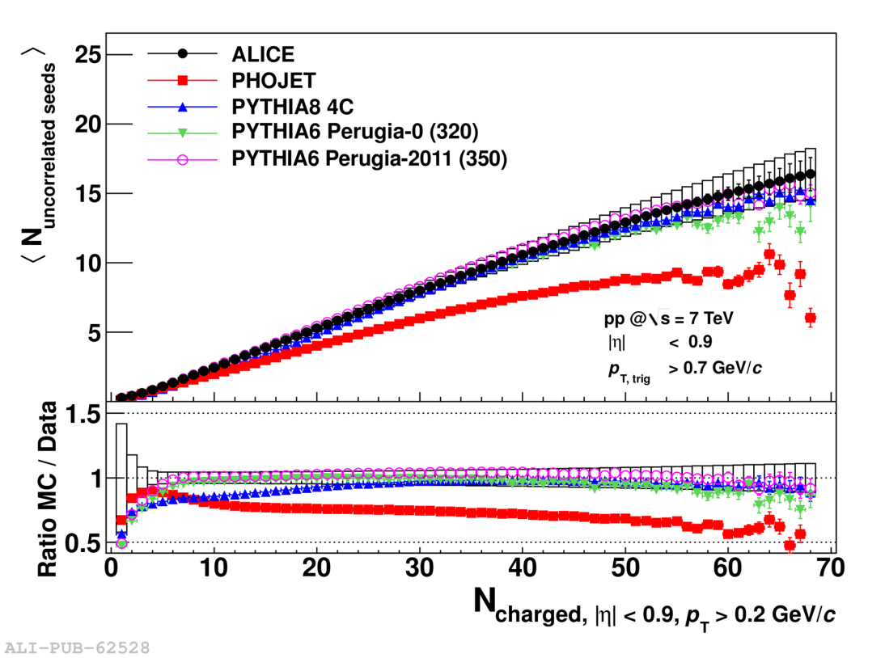
Multiplicity dependence of two-particle azimuthal correlations
Average number of uncorrelated seeds
Low multiplicity: linear increase
High multiplicity: increase less than linear
JHEP 09 (2013) 049

Slide 26
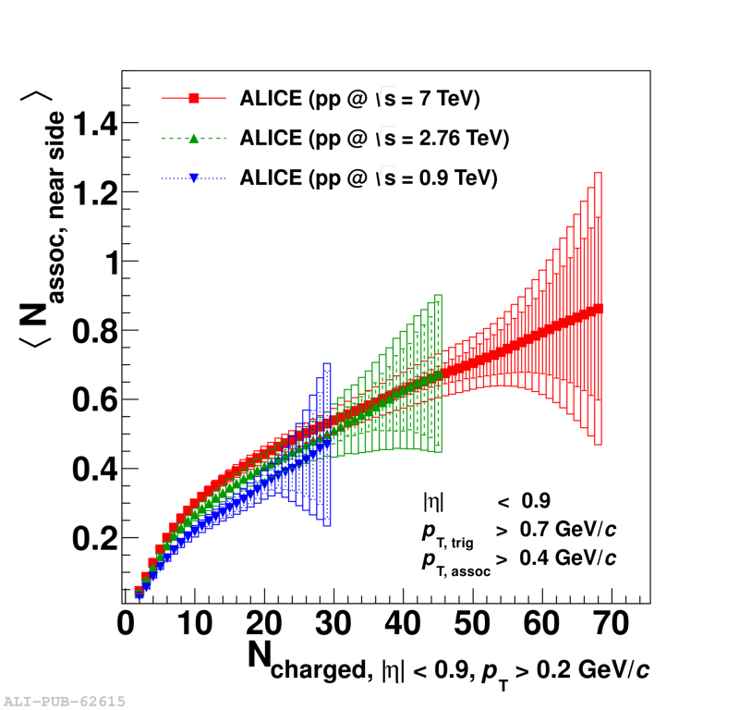
Multiplicity dependence of two-particle azimuthal correlations
Per-trigger pair yield in the near-side peak, evolution with √s
DATA
PYTHIA
PHOJET
Near side yield at same multiplicity bin grows with increasing center ­of ­mass energy
Splitting between slopes for different √s is larger for PHOJET
JHEP 09 (2013) 049

Slide 27
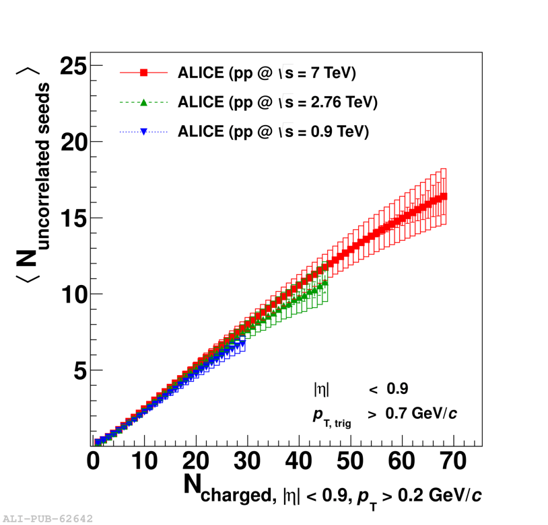
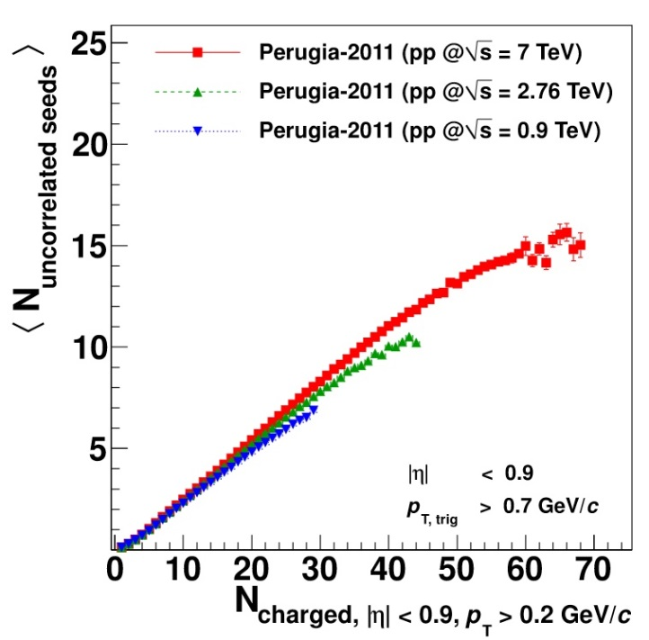
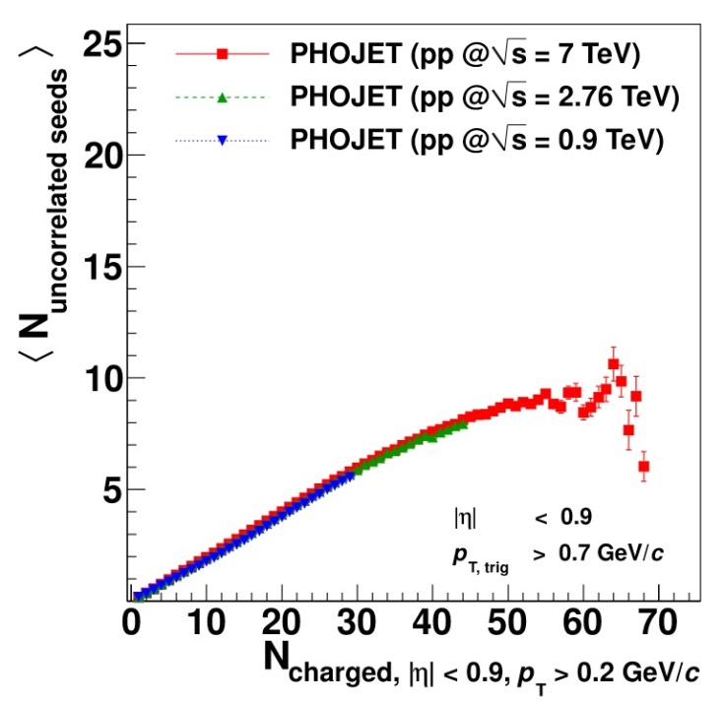
Multiplicity dependence of two-particle azimuthal correlations
Average number of uncorrelated seeds, evolution with √s
DATA
PYTHIA
PHOJET
Only a small √s dependence
At high multiplicities, the number of uncorrelated seeds saturates.
JHEP 09 (2013) 049

Slide 28
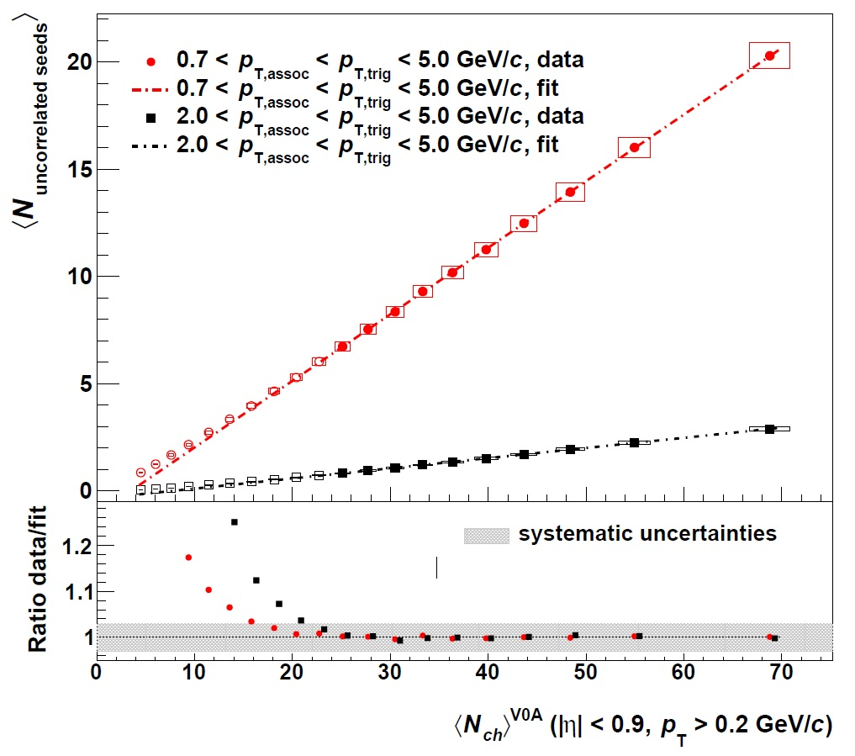
Multiplicity dependence of jet-like two-particle correlations in p-Pb collisions
Long-range angular correlation subtracted (ridge)
p-Pb √s_{NN}=5.02TeV
Linear increase (fit in dash-dotted)
No evidence of a saturation in the number of MPI
Similar behavior as in pp collisions
arXiv:1406.5463, submitted to PLB

