Slide 1
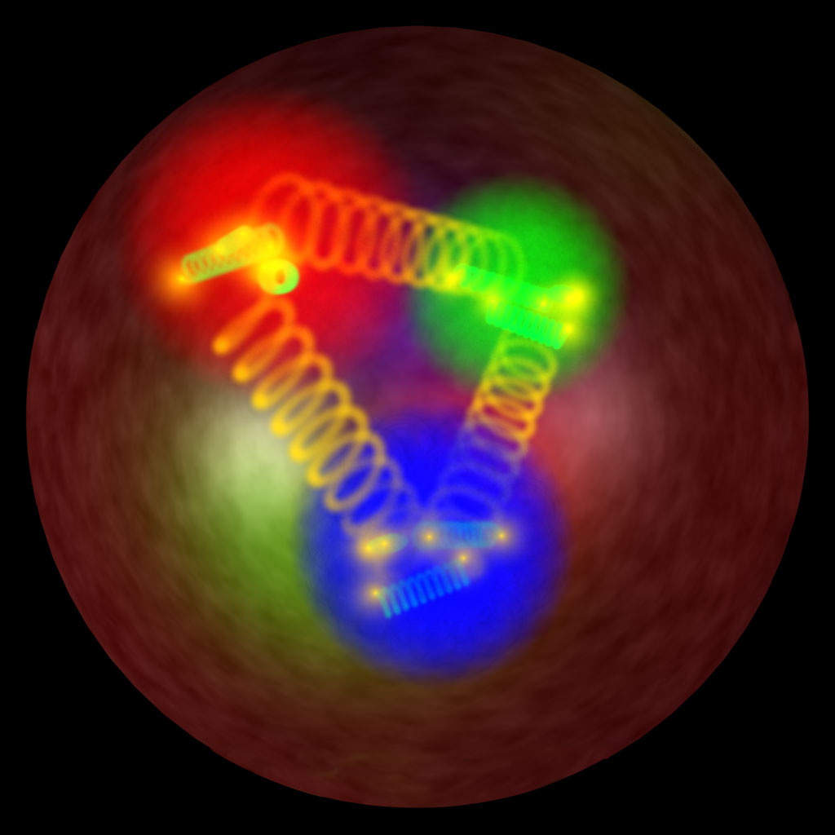
GDR QCD, 29/09/2016
Nucleon tomography
(from data to GPDs and proton charge radius)
Michel Guidal (IPN Orsay)

Slide 2
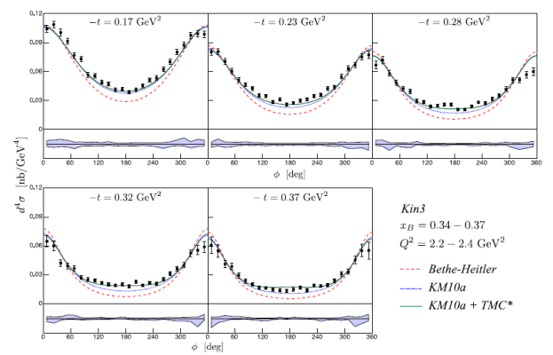
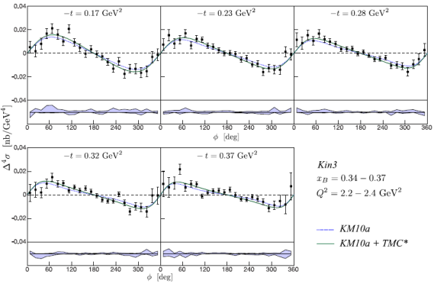
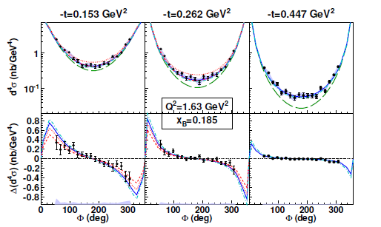
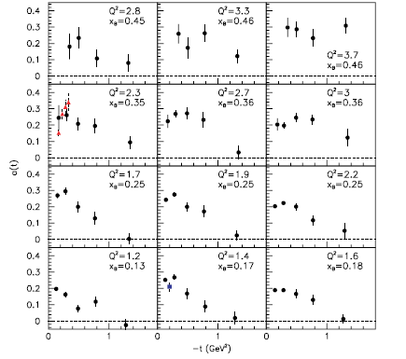
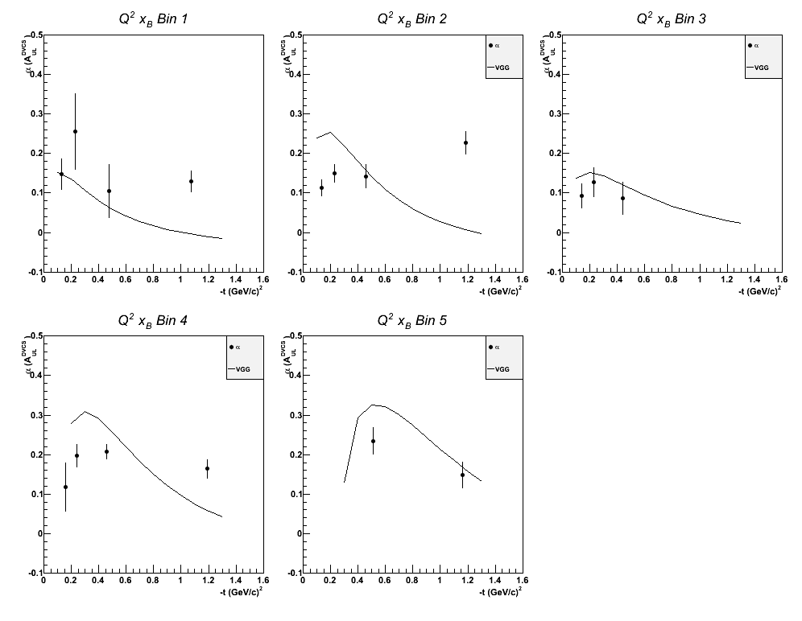
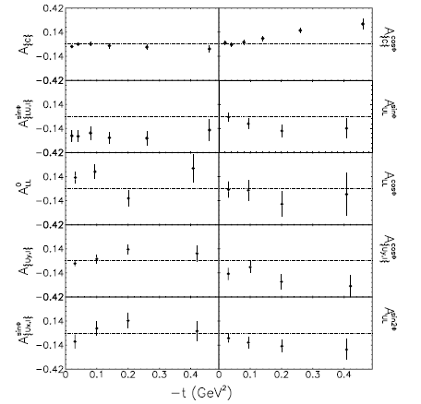
JLab
Hall A
DVCS
unpol. X-section
DVCS
B-pol. X-section
JLab
CLAS
DVCS
BSA
DVCS
lTSA
DVCS unpol. and
B-pol. X-sections
HERMES
DVCS
BSA,lTSA,tTSA,BCA

Slide 3
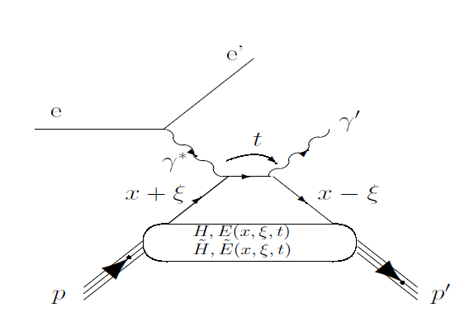
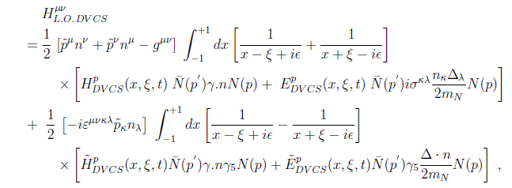
H^{q}(x,ξ,t) but only ξ and t experimentally accessible

Slide 4




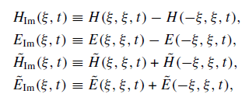

In general, 8 GPD quantities accessible
(sub-)Compton Form Factors
with

Slide 5
Given the well-established LT-LO DVCS+BH amplitude
DVCS
Bethe-Heitler
GPDs
Can one recover the 8 CFFs from the DVCS observables?
Obs= Amp(DVCS+BH) CFFs
Two (quasi-) model-independent approaches
to extract, at fixed x_{B}, t and Q² (« local » fitting),
the CFFs from the DVCS observables

Slide 6
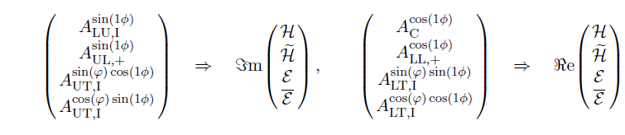
1/ Mapping and linearization
If enough observables measured, one has a system
of 8 equations with 8 unknowns
Given reasonable approximations (leading-twist dominance,
neglect of some 1/Q² terms,...), the system can be linear
(practical for the error propagation)
~
Δσ_{LU} ~ sinφ Im{F₁H + ξ(F₁+F₂)H -kF₂E}dφ
~
~
Δσ_{UL} ~ sinφIm{F₁H+ξ(F₁+F₂)(H + x_{B}/2E) –ξkF₂ E+…}dφ
K. Kumericki, D. Mueller, M. Murray Phys.Part.Nucl. 45 (2014) 4, 723

Slide 7


2/ «Brute force » fitting
χ² minimization (with MINUIT + MINOS) of the
available DVCS observables at a given x_{B}, t and Q² point
by varying the CFFs within a limited hyper-space (e.g. 5xVGG)
The problem can be (largely) underconstrained:
JLab Hall A: pol. and unpol. X-sections
JLab CLAS: BSA + TSA
2 constraints and 8 parameters !
However, as some observables are largely dominated by
a single or a few CFFs, there is a convergence (i.e. a well-defined
minimum χ²) for these latter CFFs.
The contribution of the non-converging CFF enters in
the error bar of the converging ones. For instance (naive):
If -10<x<10:

Slide 8
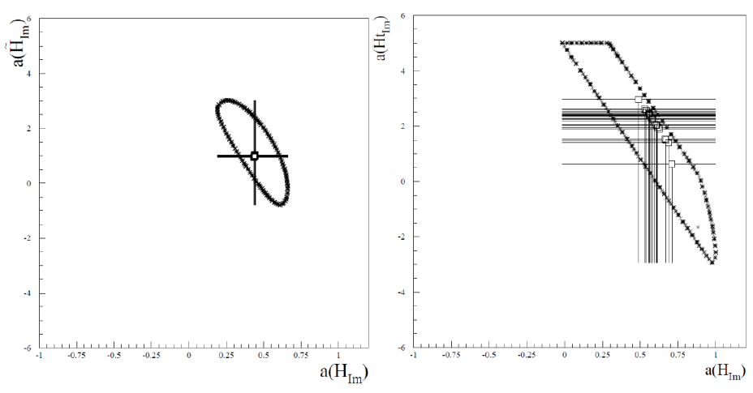
~
Examples of correlation between H_{Im} and H_{Im}
Polarized beam, unpolarized target (BSA) :
~
Δσ_{LU} ~ sinφ Im{F₁H + ξ(F₁+F₂)H -kF₂E}dφ

Slide 9
2/ «Brute force » fitting
χ² minimization (with MINUIT + MINOS) of the
available DVCS observables at a given x_{B}, t and Q² point
by varying the CFFs within a limited hyper-space (e.g. 5xVGG)
The problem can be (largely) underconstrained:
JLab Hall A: pol. and unpol. X-sections
JLab CLAS: BSA + TSA
2 constraints and 8 parameters !
However, as some observables are largely dominated by
a single or a few CFFs, there is a convergence (i.e. a well-defined
minimum χ²) for these latter CFFs.
The contribution of the non-converging CFF enters in
the error bar of the converging ones.
M.G. EPJA 37 (2008) 319
M.G. PLB 689 (2010) 156
M.G. PLB 693 (2010) 17
M.G. & H. Moutarde EPJA 42 (2009) 71
M.G. & M. Boer J.Phys.G 42 (2015) 034023

Slide 10
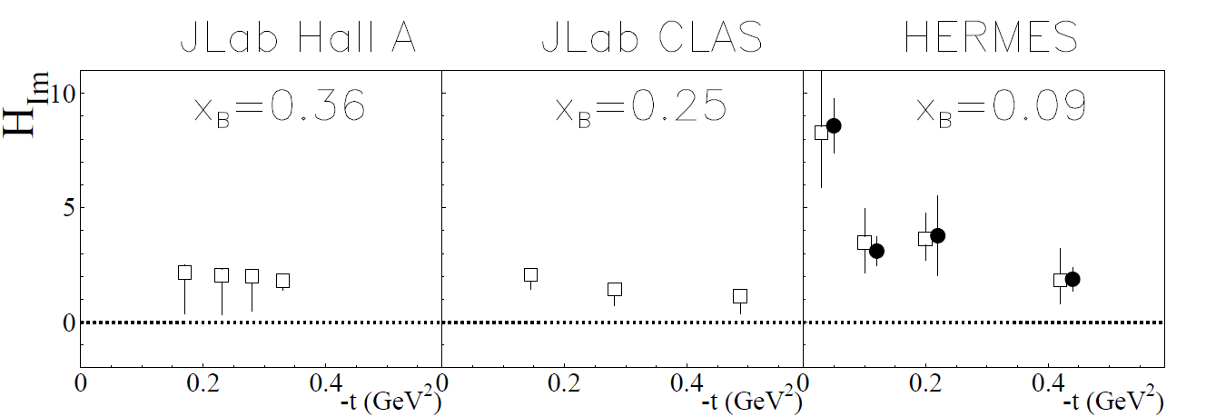
unpol.sec.eff.
+
beam pol.sec.eff.
χ² minimization
Notes:
Avec « ma » methode, extraction obtenue pour Him en fittant les sec.eff. (pol. et non-pol.) du Hall A

Slide 11
unpol.sec.eff.
+
beam pol.sec.eff.
beam spin asym.
+
long. pol. tar. asym
χ² minimization
Notes:
Avec « ma » methode, extraction obtenue pour Him en fittant les BSA et les TSA (Shifeng) de CLAS

Slide 12
unpol.sec.eff.
+
beam pol.sec.eff.
beam spin asym.
+
long. pol. tar. asym
beam charge asym.
+
beam spin asym
+
…
χ² minimization
linearization
Notes:
Avec la methode de KM et la mienne, extraction obtenue pour Him en fittant les asymetries d’HERMES.

Slide 13
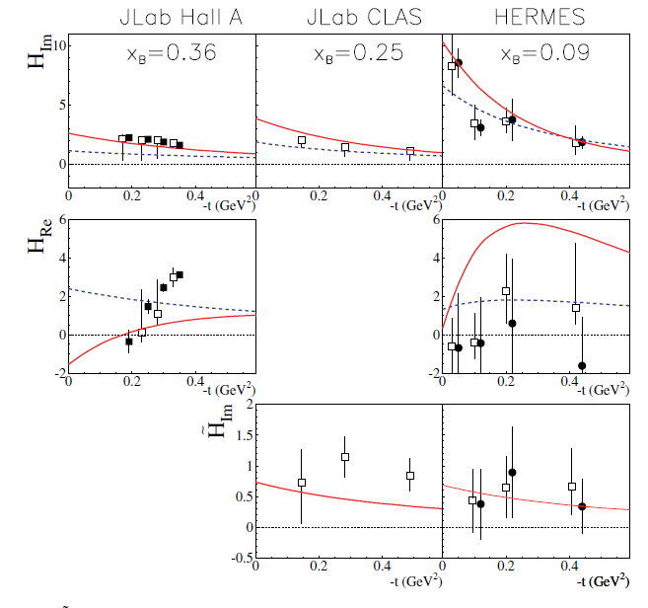
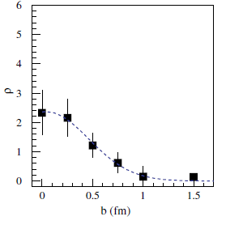
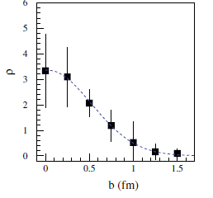
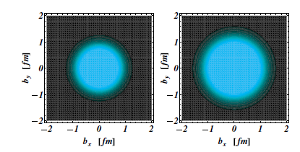
M.G., H. Moutarde,
M. Vanderhaeghen
Rept.Prog.Phys. 76 (2013) 066202

Slide 14
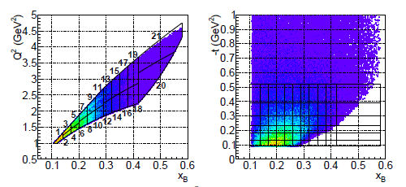
New recent data from JLab:
CLAS coll.
PRL 115 (2015), 212003
(unpol. and beam-pol.
x-sections)
Hall A coll.
PRC92 (2015), 055202
CLAS coll.
PRL 114 (2015), 032001
CLAS coll.
PRD91 (2015), 052014
(unpol. and beam-pol.
x-sections)
(lTSA)
(lTSA)

Slide 15
CLAS coll. PRL 115 (2015), 212003

Slide 16
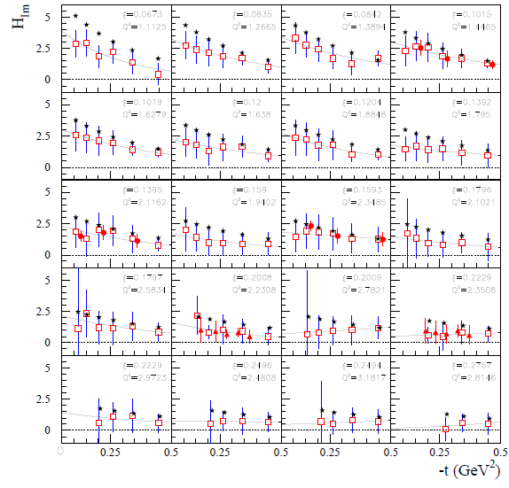
R. Dupré, M.G.,
M. Vanderhaeghen
arXiv:1606.07821
[hep-ph]
CLAS σ & Δσ
CLAS σ, Δσ,
lTSA & DSA
Hall A σ & Δσ

Slide 17

R. Dupré, M.G.,
M. Vanderhaeghen
arXiv:1606.07821
[hep-ph]
CLAS σ & Δσ
CLAS σ, Δσ,
lTSA & DSA
Hall A σ & Δσ

Slide 18
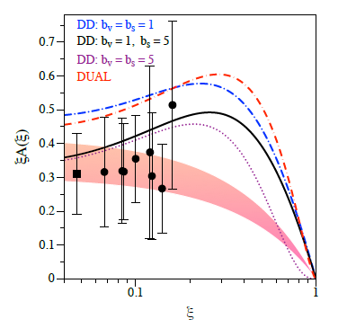
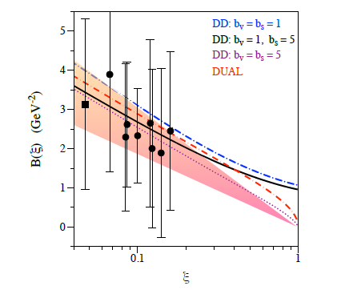





Slide 19








(M. Burkhardt)
If
However, this formula involves:
While we extract:
Need to estimate:
(assuming
)

Slide 20
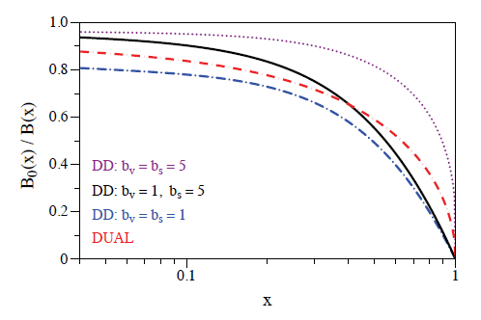

for

Slide 21
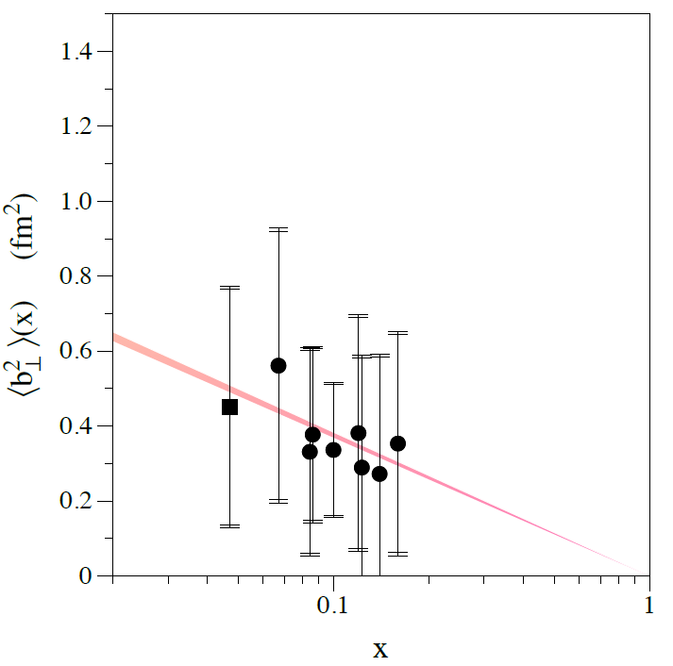

« Integrated » radius from elastic form factor F1 using:

Slide 22
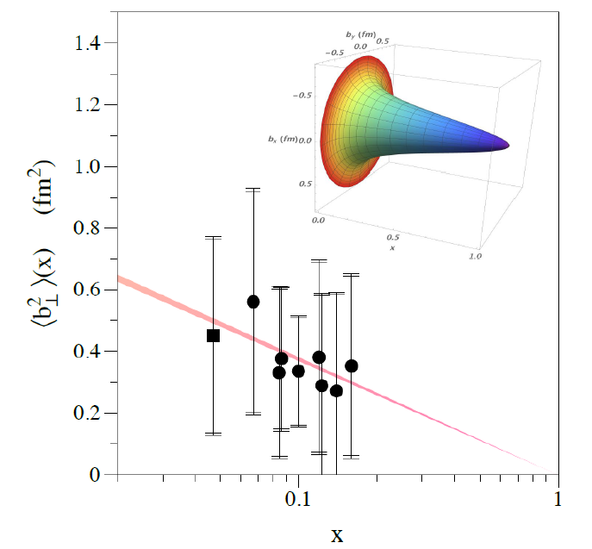

Slide 23
recent COMPASS measurement (IWHSS2016)

Slide 24
The axial charge (H_{im}) appears to be more « concentrated » than the electromagnetic charge (H_{im})
~
Notes:
Resultats pour HtildeIm

Slide 25
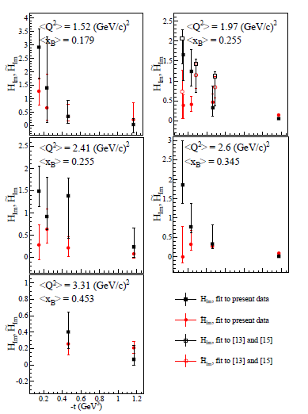
Confirmed by new CLAS A_UL and A_LL data: Phys.Rev. D91 (2015) 5, 052014

Slide 26
We have developped a fitting method to extract CFFs from data
in which the influence of the subdominant CFFs end up in
the uncertainties of the dominant CFFs
First new insights on nucleon structure already emerging
from current data: in particular, the rise of the proton radius
(and density) as x decreases

Slide 27
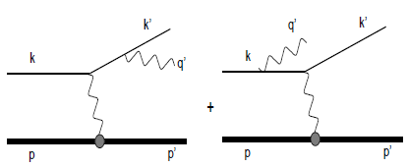

The Bethe-Heitler process

Slide 28
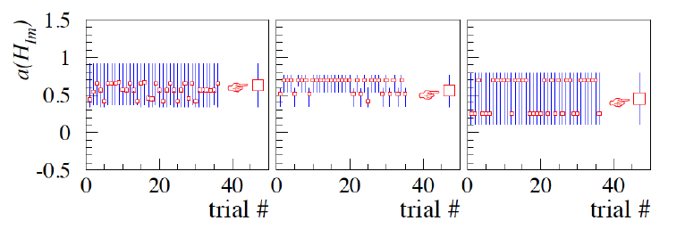
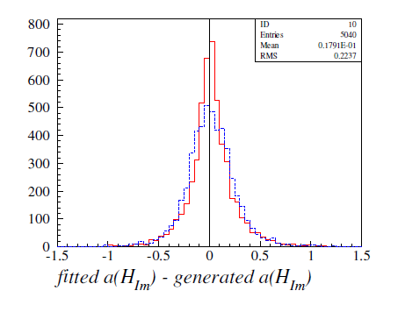

Slide 29
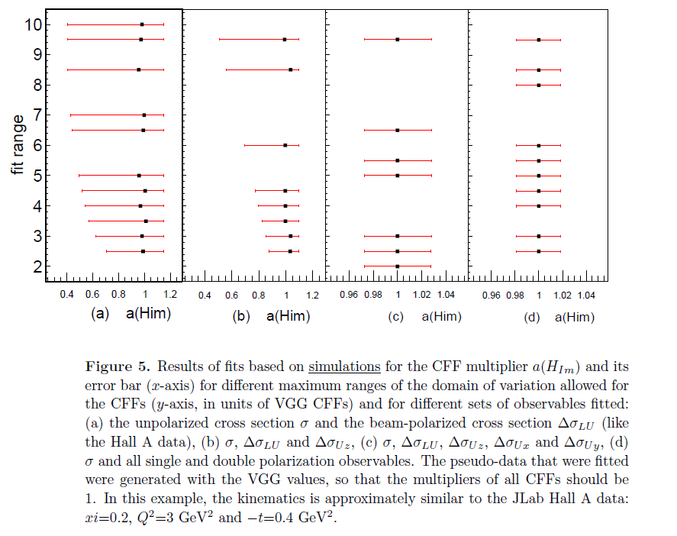
M. Boer, MG J.Phys. G42 (2015) 3, 034023

Slide 30
M. Boer, MG J.Phys. G42 (2015) 3, 034023

Slide 31
M. Boer, MG J.Phys. G42 (2015) 3, 034023

Slide 32
M. Boer, MG J.Phys. G42 (2015) 3, 034023

