Slide 1
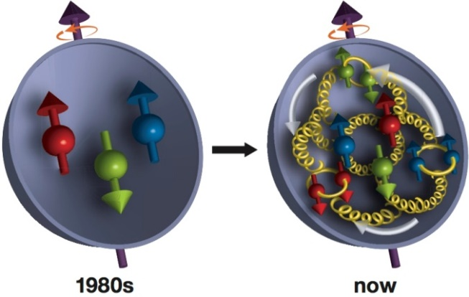
Meeting de lancement du GDR QCD
interactions simples et multiples
entre partons dans les nucléons
Distributions partoniques simples
dans le nucléon
Cédric Lorcé
CPHT
September 29th, IPNO, Orsay

Slide 2
Foreword
This presentation …
… is meant to stimulate discussions, so don’t hesitate to interrupt
… is a potpourri of miscellaneous thoughts and questions
… is inevitably biased by my own interests, for which I apologize
… is certainly incomplete
… is focused on the study of the nucleon but can easily be extended

Slide 3
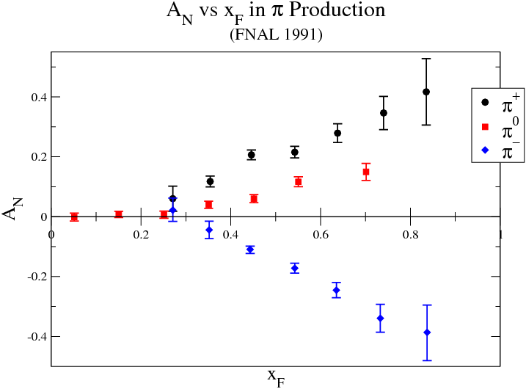
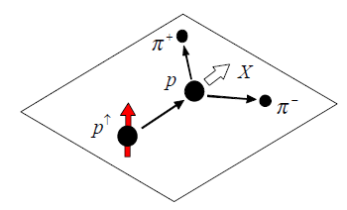
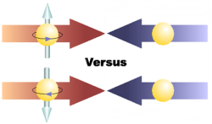
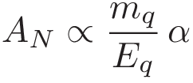
What do we want ?
QCD-based description of observed asymmetries ?
E.g.
Price for helicity flip
Collinear twist-2
Too small !
[Kane, Pumplin, Repko (1978)]
Intrinsic k_{T}
Collinear twist-3

Slide 4
What do we want ?
Better understanding of nucleon internal structure ?
Origin of nucleon mass ?
Origin of nucleon spin ?
Confinement mechanism ?
Chiral symmetry breaking ?
…

Slide 5
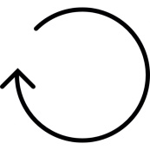
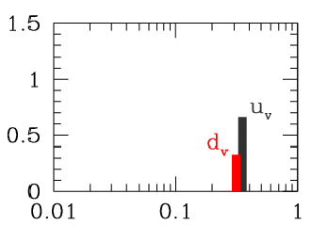
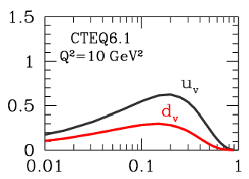
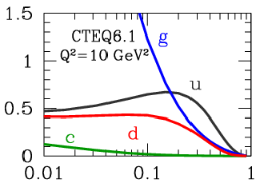
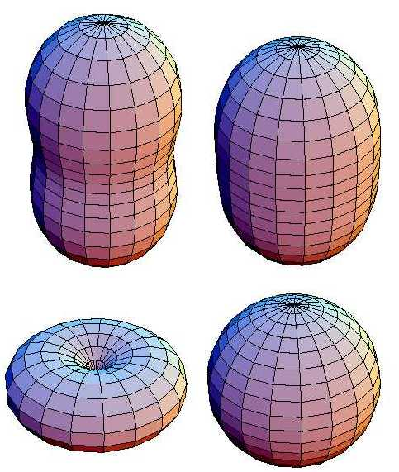
Parton distributions
PDFs
Momentum fraction
EM FFs
Charge density
[Miller (2007)]
[Carlson, Vanderhaeghen (2008)]
Size ?
Shape ?
FFs at small ?

Slide 6
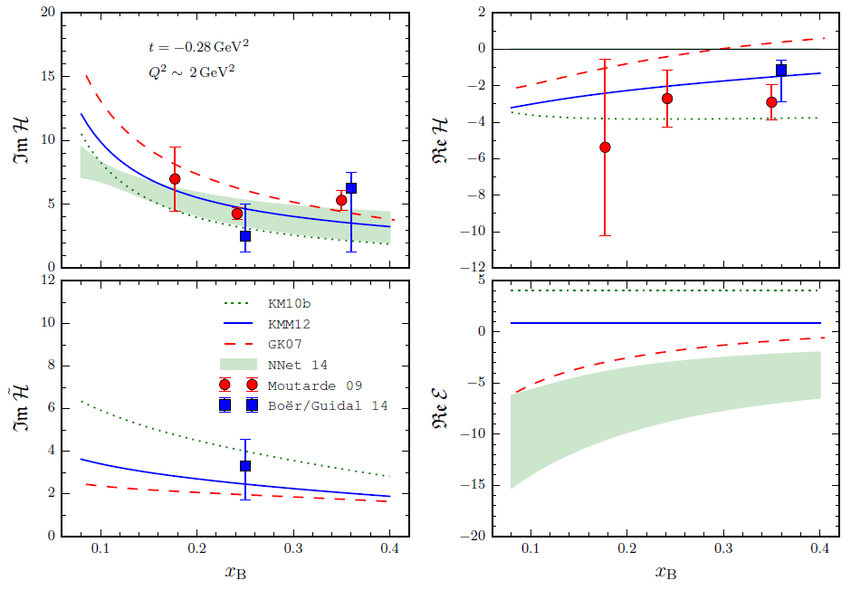
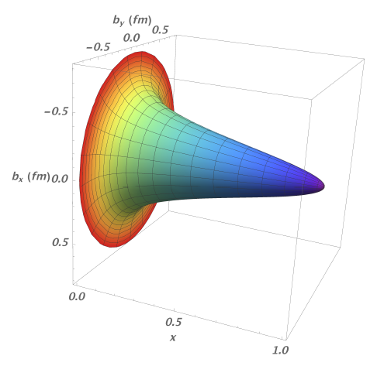
3D internal structure
More detailed information about the structure
3D imaging or tomography
GPDs
PDFs
FFs
GPDs constitute a major focus of the GDR
Extracted Compton FFs
x-dependent proton extent
[Kumericki, Liuti, Moutarde (2016)]
[Dupré, Guidal, Vanderhaeghen (2016)]

Slide 7
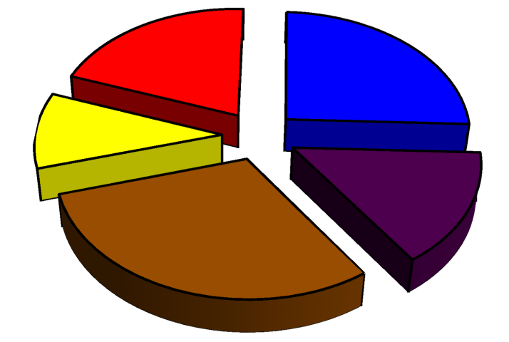
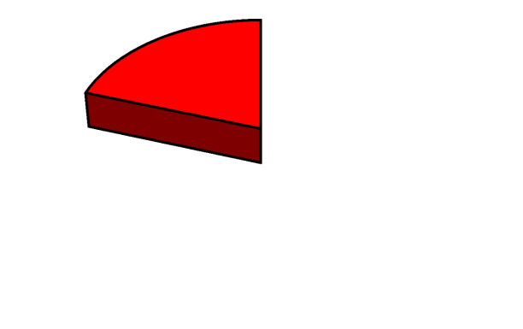
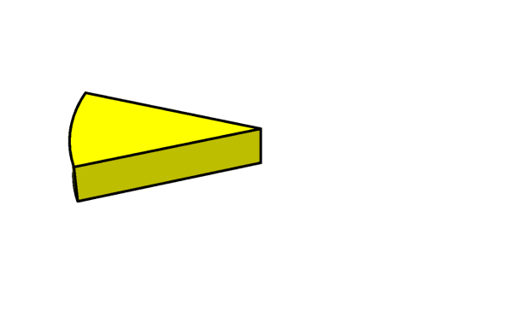
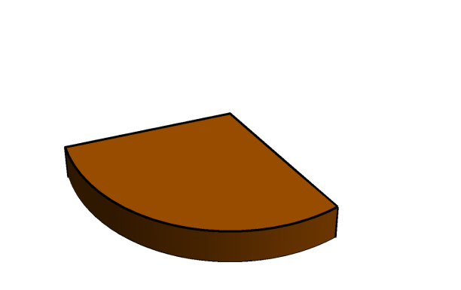
Modern spin decomposition
[Leader, C.L. (2014)]
L_{q}
S_{q}
L_{pot}
S_{G}
L_{G}
Canonical
Kinetic
[Jaffe, Manohar (1990)]
[Chen et al. (2008)]
[Ji (1997)]
[Wakamatsu (2010)]
L_{q}
L_{q}
L_{pot}
L_{pot}
L_{G}
L_{G}

Slide 8
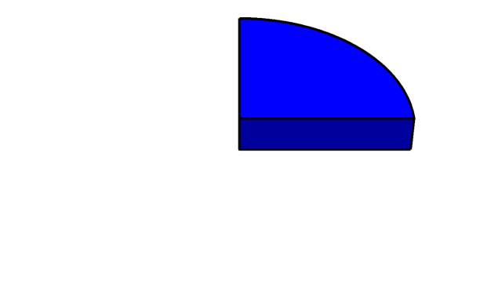
Ji relation
L_{q}
S_{q}
L_{pot}
S_{G}
[Ji (1997)]
L_{G}
Genuine AM sum rule
Vanishing total anomalous gravitomagnetic moment
[Teryaev (1999)]
[Brodsky, Hwang, Ma, Schmidt (2001)]
Focus on ?
Gluon contributions (JLab12, EIC, …) ?
Role played by lattice ?

Slide 9
Penttinen-Polyakov-Shuvaev-Strikman relation
Twist-3 GPDs
L_{q}
[Penttinen et al. (2000)]
[Kiptily, Polyakov (2002)]
[Hatta, Yoshida (2012)]
Quark AM sum rule
or equivalently
Exploration of twist-3 sector and hence dynamics ?
Separation of kinematical higher-twist effects (finite-t, target mass, …) ?
Lattice calculations with asymmetric EMT or quasi distributions ?

Slide 10
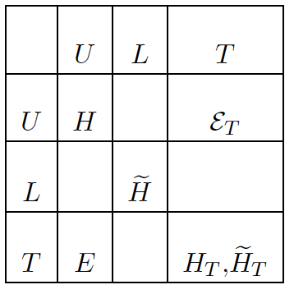
Spin-orbit correlations
Quark OAM
Quark spin-orbit correlation
[C.L. (2014)]
GPDs
Quark polarization
Nucleon polarization
[C.L., Pasquini (2016)]
Increase interest in other AM correlations ?

Slide 11
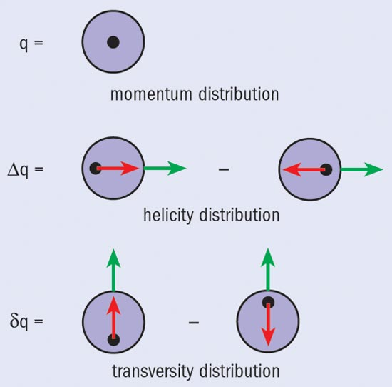
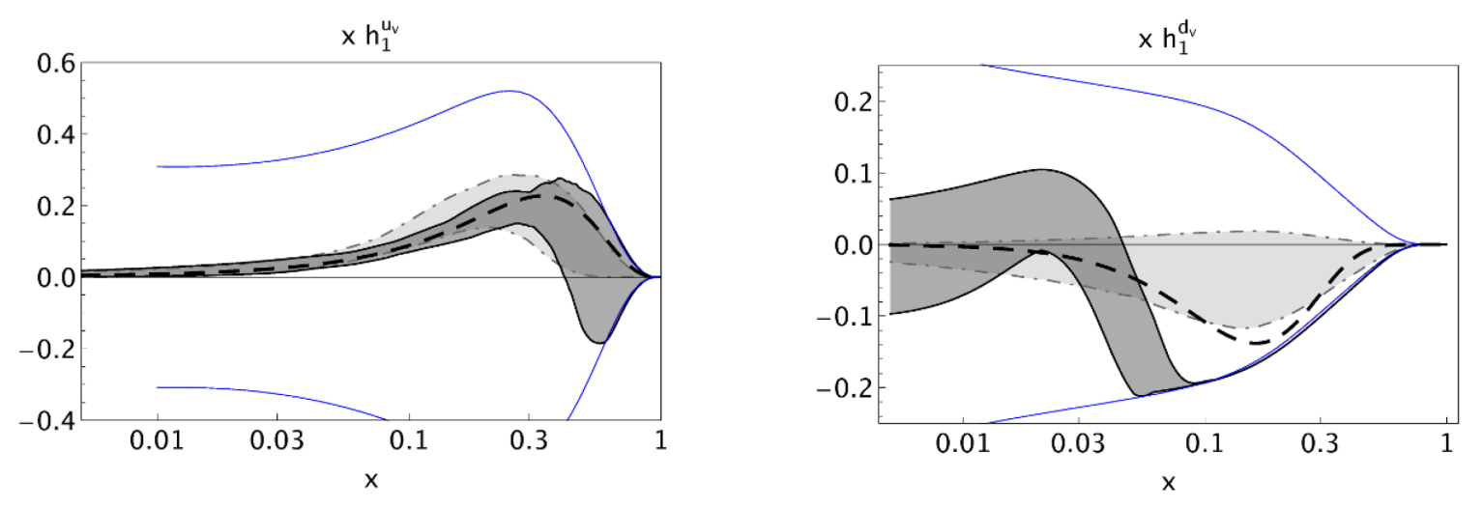
Transversity GPDs
Relativistic effects
Transversity (helicity-flip) is not a simple rotation of helicity
[Ralston, Soper (1979)]
[Jaffe, Ji (1991)]
[Barone, Drago, Ratcliffe (2002)]
BSM physics can in principle couple to any nucleon charge !
Focus on DVMP ?
Comparison with other constraints (SIDIS, dihadron) on nucleon tensor charge ?
Violations of Soffer bound ?
[Radici et al. (2015)]

Slide 12
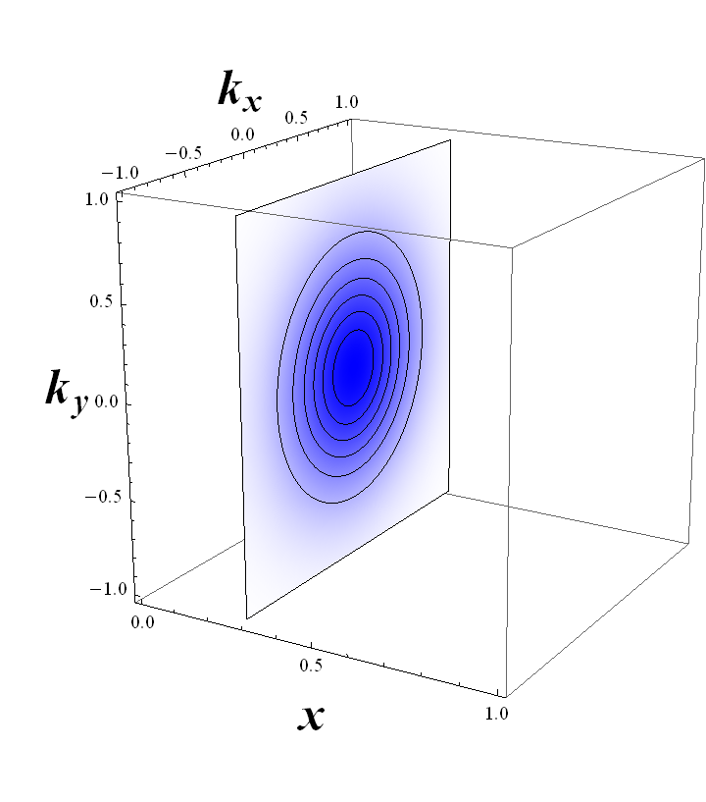
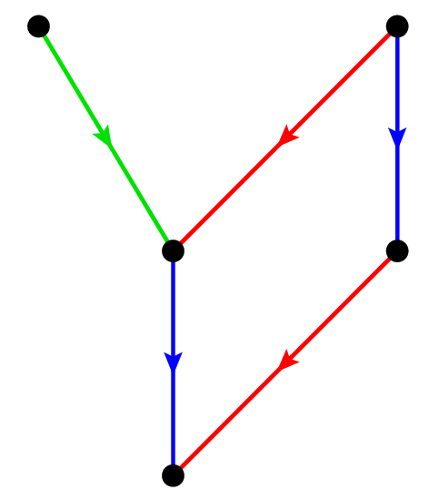
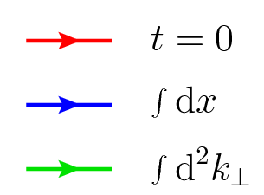
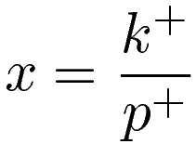
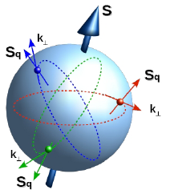
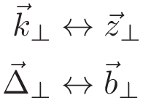
The other 3D internal structure
Momentum-space imaging
No direct relation !
TMDs
GPDs
PDFs
FFs
Spin-momentum correlations
Charges
Average momentum
Position shift
Momentum space
Position space
Momentum transfer
Average position

Slide 13
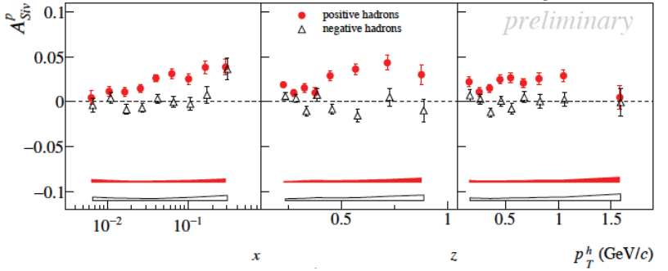
Importance of the gauge link
Non-trivial gauge link
[Belitsky et al. (2003)]
[Boer et al. (2003)]
Drell-Yan
SIDIS
ISI
FSI
CPT invariance
Fundamental test !
Naive T-odd
Clear SIDIS experimental signal

Slide 14
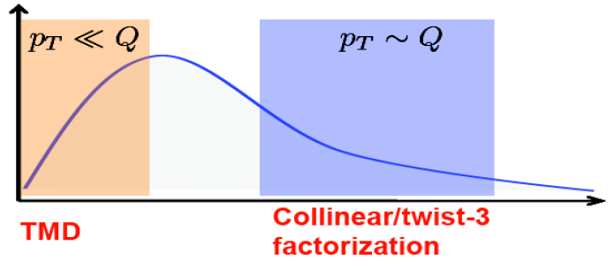
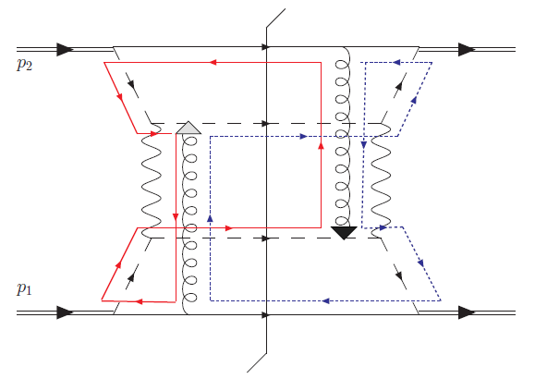
Many open questions and problems
Tests of universality (e.g. with DY) and TMD evolution ?
Model dependence, parametrization and extrapolations ?
Precise determination of polarized TMDs ?
Extraction of gluon TMDs ?
Reduction to standard PDFs ?
Relation with higher-twist distributions ?
Link with low x, k_{T} factorization ?
Sign mismatch with collinear twist-3 approach ?
Factorization breaking in some pp scattering ?
Information on quark OAM ?
…
Entangled color flow
Via Sivers TMD
Direct extraction
[Rogers, Mulders (2011)]
[Kang et al. (2011)]

Slide 15
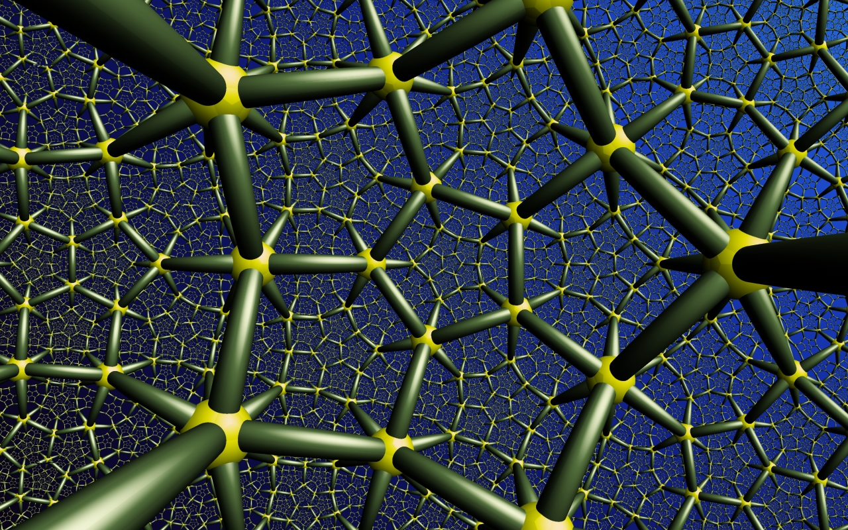
Higher-dimensional internal structure

Slide 16
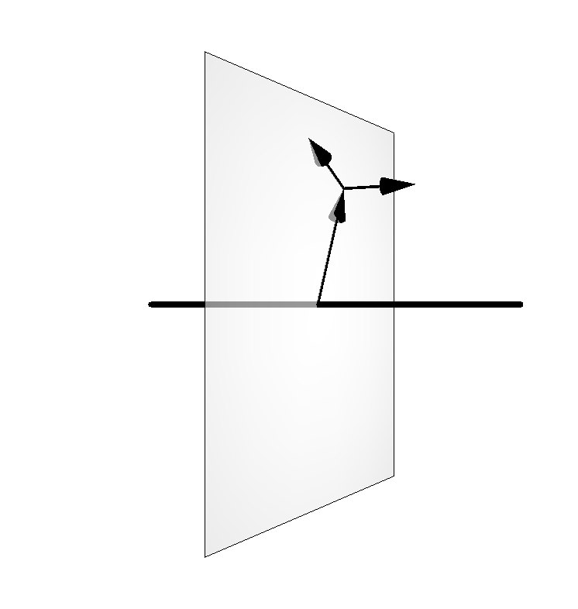
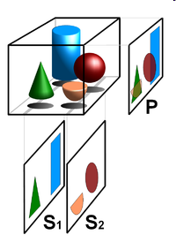
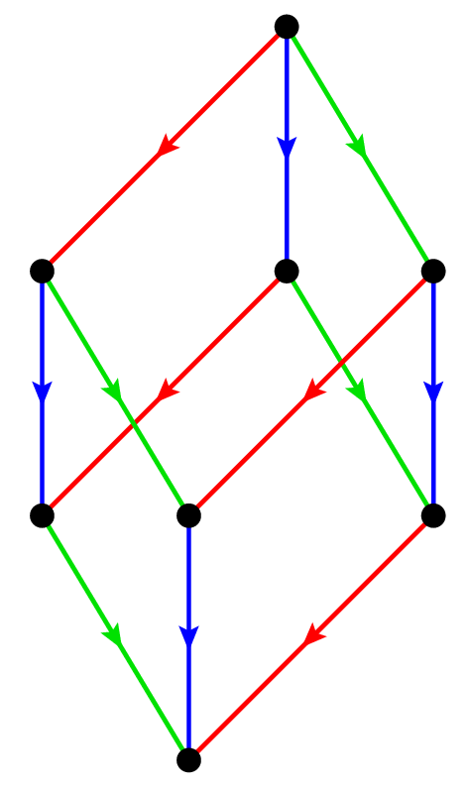
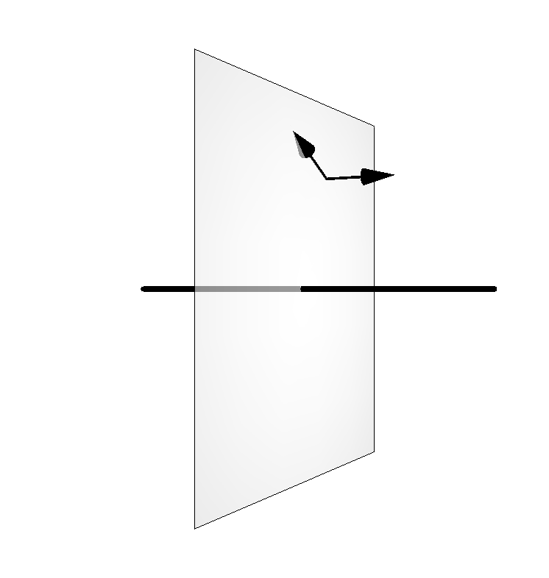
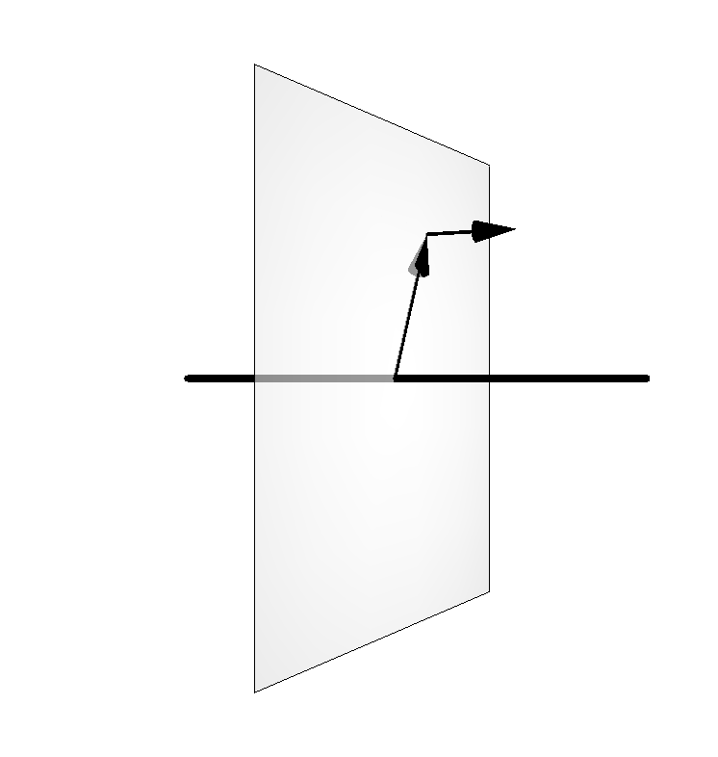
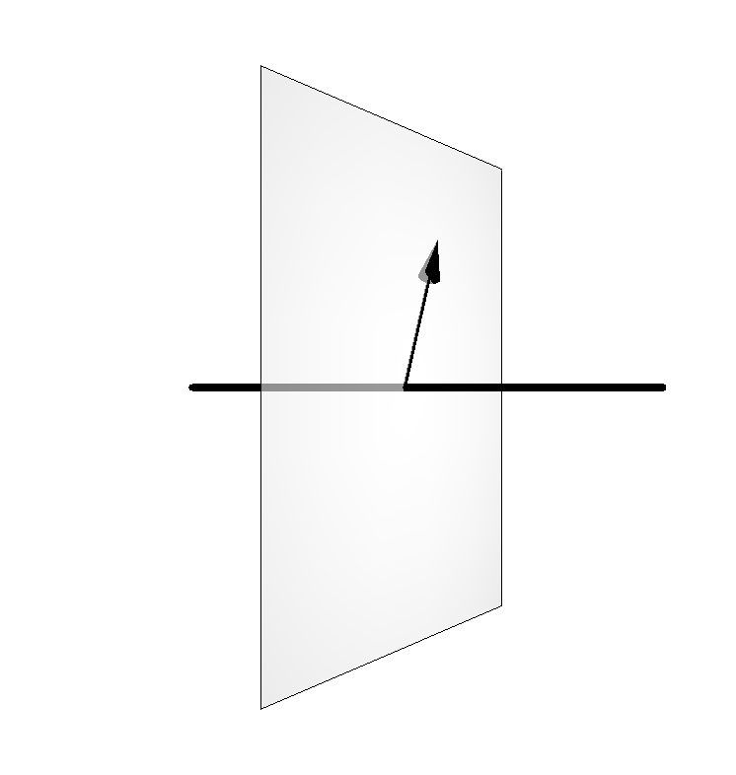
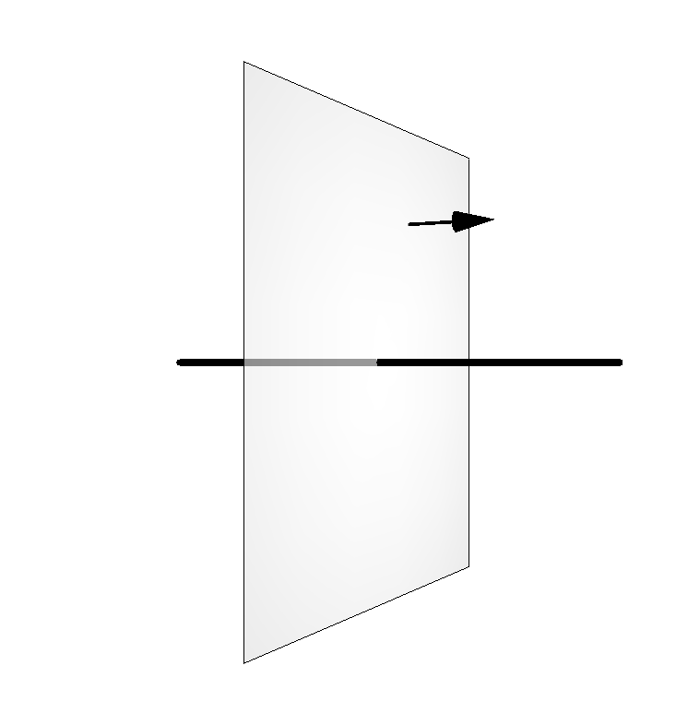
Unifying picture
LFWF
Phase-space (Wigner) distribution
Theoretical tools
GTMDs
2+3D
TMDs
GPDs
0+3D
2+1D
PDFs
FFs
«Physical» objects
2+0D
0+1D
Charges
[C.L., Pasquini, Vanderhaeghen (2011)]

Slide 17
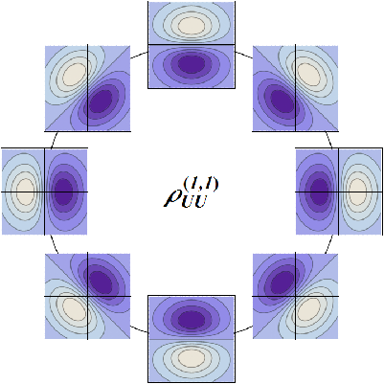
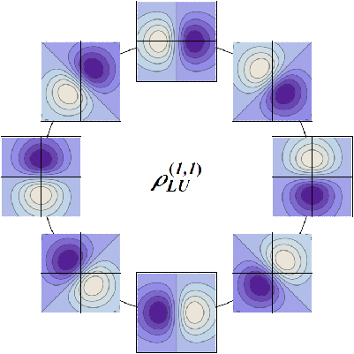
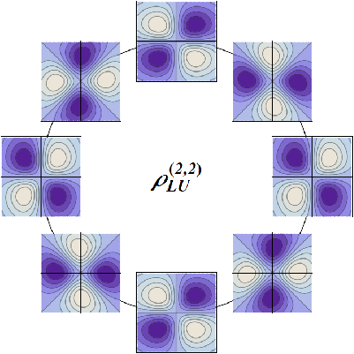
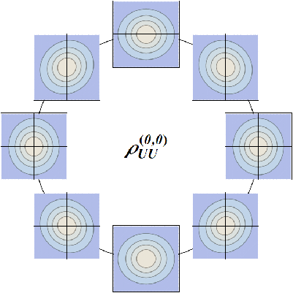
Phase-space structure
Natural relation to OAM
[C.L., Pasquini, Xiong, Yuan (2012)]
[C.L. (2013)]
ISI/FSI
ISI/FSI
Density mode
Inflation mode
Orbital mode
Spiral mode
(Partly) accessible via GPDs & TMDs
[C.L., Pasquini (2016)]

Slide 18
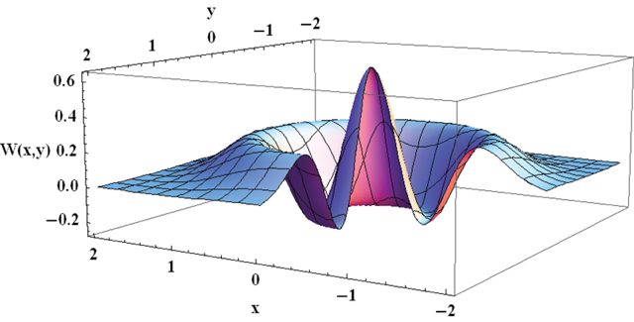
Observability and challenges
Possibility to access gluon GTMDs at low x ?
[Hatta, Xiao, Yuan (2016)]
[Altinoluk et al. (2016)]
[Hagiwara, Hatta, Ueda (2016)]
CGC
Reduction to GPDs ?
Link with collinear evolution ?
Interpolation between GPD and TMD parametrizations ?
Processes at high x ?
Signature of the Heisenberg’s uncertainty relations ?
Gauge links and process dependence ?
Factorization ?
Semi-classical picture and analogy with hydrodynamics ?
New information about the EMT ?
Lattice simulations ?
…

Slide 19
Miscellanei
How to « sell » our work to people outside our community ?
Role played by automated codes and libraries (PARTONS, TMDlib, …) ?
Missing data and required precision for better phenomenological extractions ?
Higher-spin targets (light nuclei) ?
New processes and observables ?
New phenomenological strategies and approaches ?
Preparing ourselves for the EIC ?
Extension of our approach to nuclear physics, heavy quarks, SM, BSM, … ?
Cross-talk with other groups (multiparton, nuclear effects, heavy ions …) ?

Slide 20
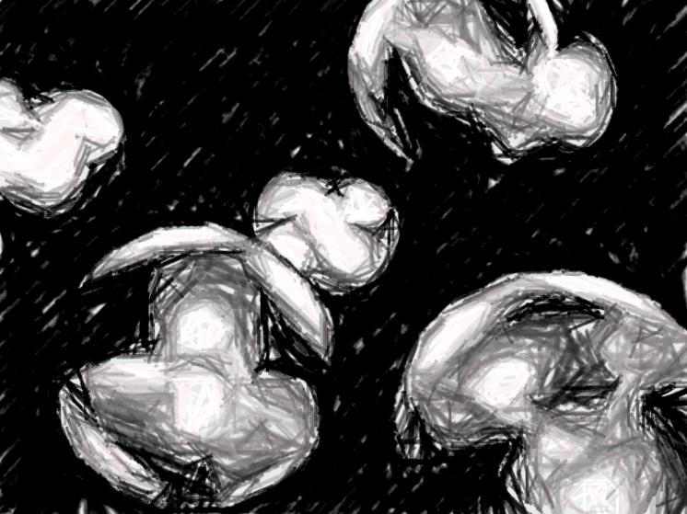
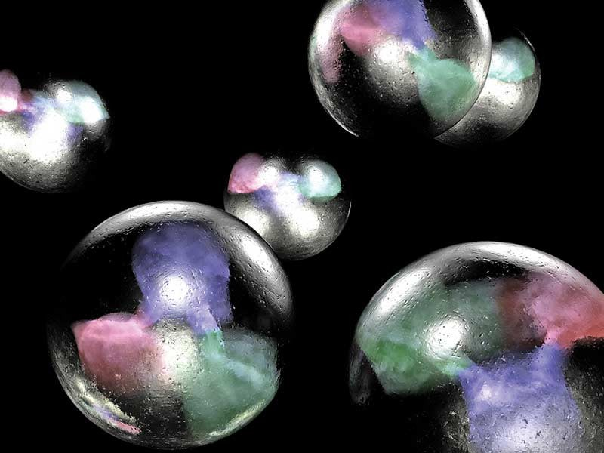
Conclusion
Today
Tomorrow ?
GDR

Slide 21
Backup slides

Slide 22
Accessing the contributions with TMDs
Transversity relation
Model-dependent !
L_{q}
L_{pot}
[Ma, Schmidt (1998)]
Pretzelosity relation
Model-dependent !
[She, Zhu, Ma (2009)]
[Avakian et al. (2010)]
[Efremov et al. (2010)]
[C.L., Pasquini (2012)]
Lensing relation
Model-dependent !
L_{q}
[Burkardt (2004)]
[Bacchetta, Radici (2011)]

Slide 23
Accessing the contributions with GTMDs
L_{q}
F₁₄ relation (staple gauge link)
L_{pot}
L_{G}
[C.L., Pasquini (2011)]
[Hatta (2011)]
F₁₄ relation (straight gauge link)
L_{q}
[Ji, Xiong, Yuan (2012)]
[C.L. (2012)]
[Liu, C.L. (2015)]

Slide 24
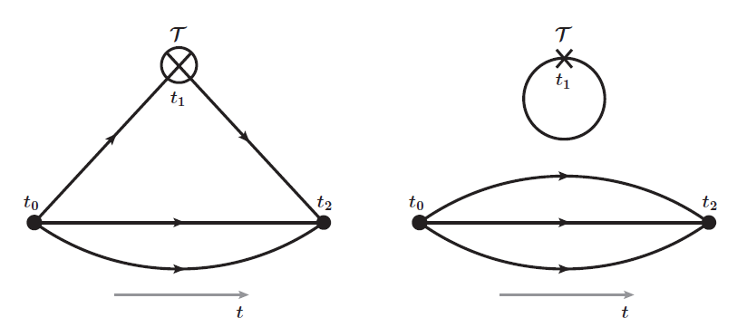
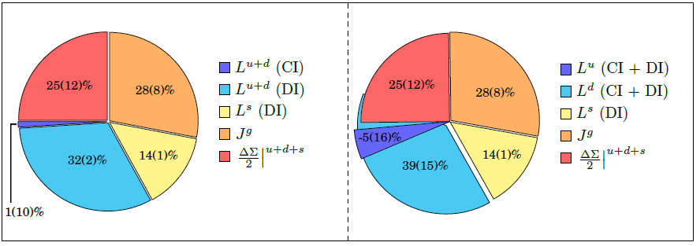
Accessing the contributions with EMFFs
Ji relation
L_{q}
S_{q}
L_{pot}
[Ji (1997)]
S_{G}
L_{G}
Lattice
CI
DI
χQCD collaboration
[Deka et al. (2015)]

Slide 25
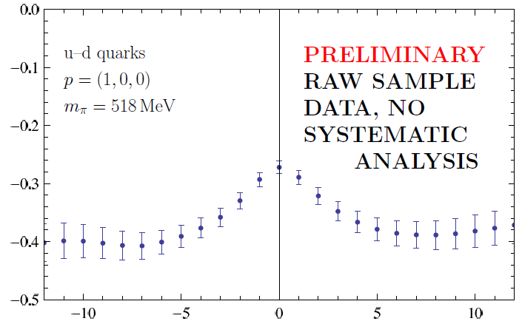
Accessing the contributions with quasi-distributions
L_{q}
Large momentum effective theory
S_{q}
L_{pot}
S_{G}
[Ji (2013)]
[Ji, Zhang, Zhao (2015)]
[Zhao, Liu, Yang (2016)]
L_{G}
M. Engelhardt, POETIC6 (2015)
Staple length

Slide 26
Density level
At the density level
[C.L., Pasquini, Yuan (2012)]
but …
[C.L. (2012)]
[C.L., Liu (2016)]
Lorentz invariance relation
[Rajan et al. (2016)]

