Slide 1
GDR QCD
Interactions simples et multiples
entre partons dans les nucléons
Kick-off meeting, some (biased) ideas for the closing discussion
Raphaël Dupré, Hervé Moutarde, Sarah Portebeouf-Houssais
Communities : hadron structure, heavy ion at high energy, pp collisions at high energy
Kick-off meetings, 29 participants on Indico

Slide 2
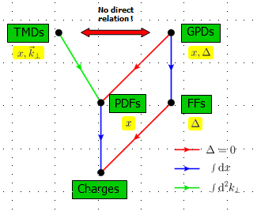
Proton-proton collision : initial stage
How a better comprehension of proton structure can lead to a better description of proton-proton collision at high energy ?
Change use of PDF in the direction of TMD’s or GPD’s,
Naïve guess: observable dependent, can we make a list?
how can we use automatic codes in the context of LHC ?
What do we learn on nucleon structure ?
Cédric Lorcé
What do we learn on non perturbative regime of QCD ?
CGC and gluon TMD’s : measurement of di-jet at small x
C. Marquet
Heavy quarks production (ccbar, bbar) polarization measurement :the link with TMD ?
MPI in pp collision at high energy
2 explicit hard interactions
Thomas Kasemets, Y. Li
More interactions
Z. Conesa Del Valle, S. Porteboeuf-Houssais

Slide 3
Heavy ion initial stage
The nucleon is not free in the nucleus
I. Schienbein
Nuclear effects => (anti)-shadowing, EMC (still not understood)
Interactions between nucleons in the nucleus
nPDF’s and realistic uncertainties
Factorization in pA and AA?
Which observables can probe factorization breaking ?
Alternative to nPDF’s ?
Link with initial stage in pp
with CGC done in some region of the phase space
with MPI ?
Extendsion of DPS framework to pA and AA
nuclear GPD’s?
C. Hadjdakis

Slide 4
TOOLS
Event generators level
Data Fits to extract properties : nucleon tomography, PDF, nPDF, GPD (PARTON)
Impact of lattice QCD development?
…

Slide 5
What can we do together
during next 4 years ?

