Slide 1
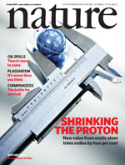
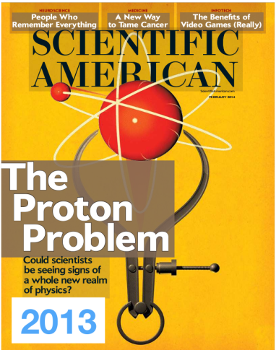
Measurement of the
Proton Electric Form Factor
G_{E}(Q²) at Low Momenta
ProRad @ PRAE
Eric Voutier
Institut de Physique Nucléaire d’Orsay
Orsay, France
Electromagnetic form factors
The proton radius puzzle
Experimental perspectives
The PRAE project
Summary
Meeting de lancement du GDR QCD
Orsay, September 29th-30th, 2016

Slide 2

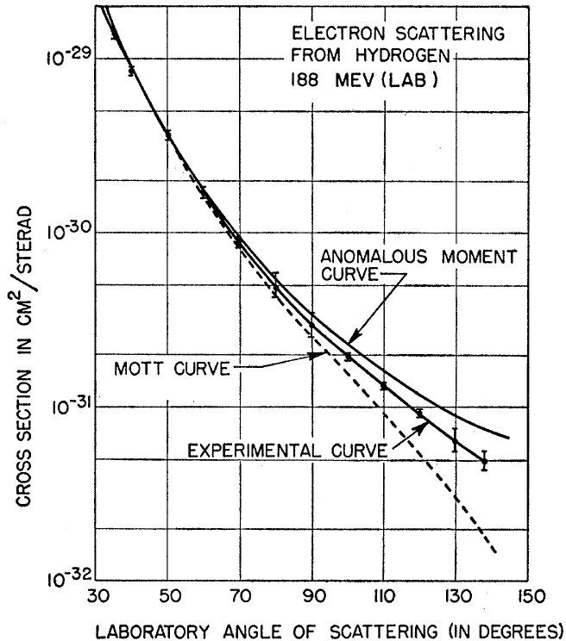
Electromagnetic form factors
Eric Voutier
Elastic Electron Scattering
The scattering of electrons off protons reveals the complex nature of the nucleon.
Electron energy-angle
correlation
Proton kinetic energy
Probe resolution
R. Hofstadter, R.W. McAllister, PR 98 (1955) 217
The nucleon is not a point-like object.
1961 Nobel Prize
Orsay, September 29th-30th, 2016
2/23

Slide 3
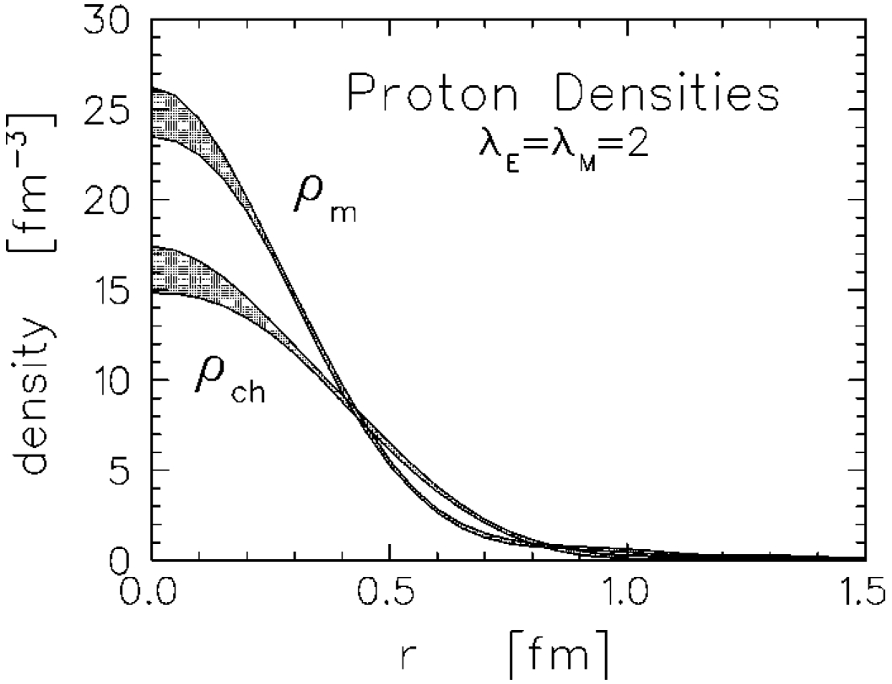
Electromagnetic form factors
Eric Voutier
Charge & Current Densities
Within a non-relativistic approach, electromagnetic form factors can be interpreted as the Fourier transform of the charge and current densities inside the nucleon.
J.J. Kelly PRC 66 (2002) 065203
Dipole behaviour
Orsay, September 29th-30th, 2016
3/23

Slide 4
The proton radius puzzle
Eric Voutier
The Dilemma
Courtesy of M. Distler
7σ
The proton radius extracted from muonic hydrogen spectroscopy differs from the one extracted from electronic hydrogen spectroscopy
and electron scattering experiments.
Orsay, September 29th-30th, 2016
4/23

Slide 5
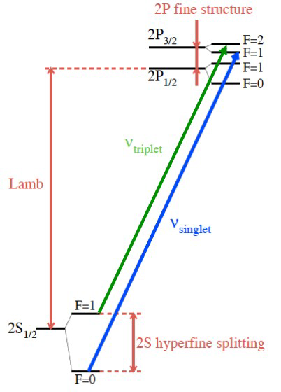
The proton radius puzzle
Eric Voutier
Lamb Shift Measurement
R. Pohl et al., Nature 466 (2010) 213 A. Antognini et al., Science 339 (2013) 417
Measurement of the 2S → 2P Lamb shift transition in muonic hydrogen.
Confirmed by new data on both the 2S → 2P Lamb shift and the hyperfine splitting
r_{p} = 0.84087(39) fm
r_{p} = 0.84184(67) fm
Orsay, September 29th-30th, 2016
5/23

Slide 6
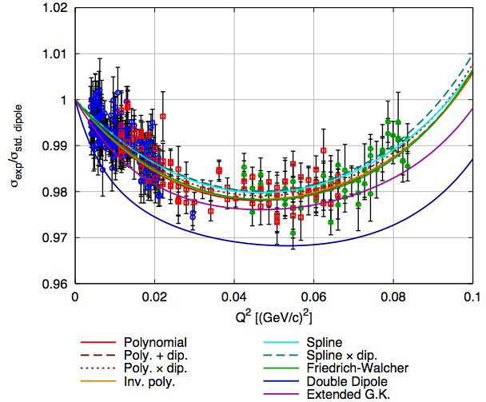
The proton radius puzzle
Eric Voutier
Elastic Electron Scattering
J.C. Bernauer et al., PRL 105 (2010) 242001; PRC 90 (2014) 015206
Measurement of ep elastic at different beam energies covering the
0.004-1.000 (GeV/c²)² momentum range with
1400 cross-section data points with uncertainties about 0.4%.
Global fitting analysis of all the data points studying different fit function effects
r_{p} = 0.879(8) fm
r_{m} = 0.777(17) fm
Orsay, September 29th-30th, 2016
6/23

Slide 7
The proton radius puzzle
Eric Voutier
Explanations ?
Experimental issues
Underestimated uncertainties, bad radius extraction…
New physics beyond the Standard Model
Lepton non-universality, new force/particle (dark photon?)…
Novel hadronic physics
Proton polarizability correction (4th power of the lepton mass) leading to enhance
2γ exchange contributions for µp
…
There is no concensus in the Community for explaining this disagreement.
Need for more data !!
Orsay, September 29th-30th, 2016
7/23

Slide 8
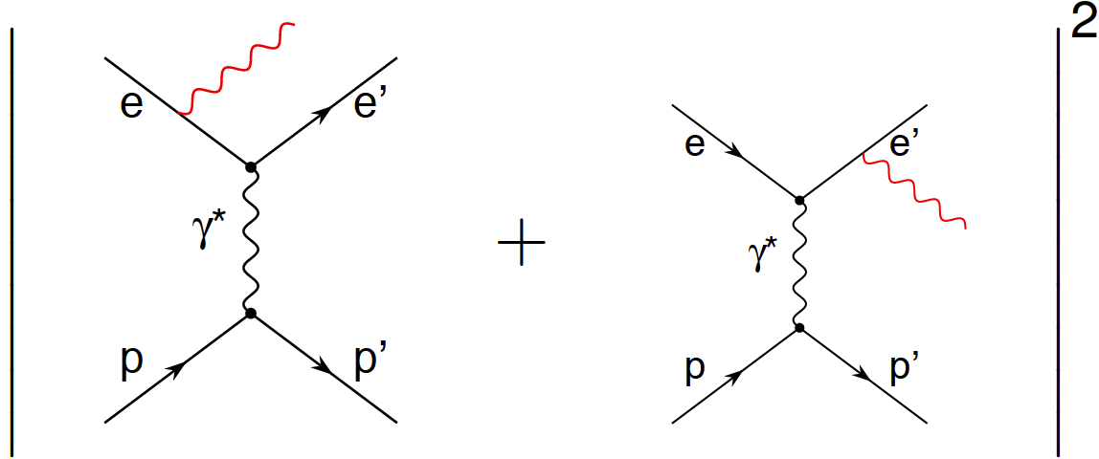
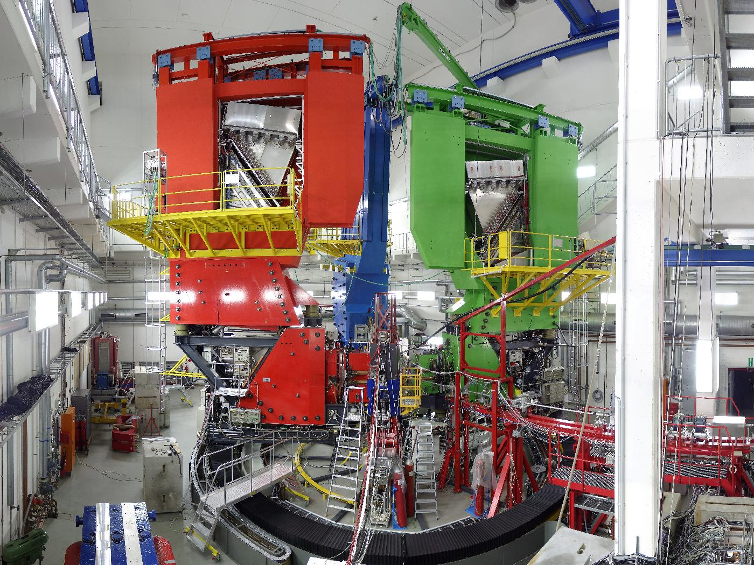
Experimental perspectives
Eric Voutier
ISR @ MAMI
Initial State Radiation
ISR
FSR
Reaching low Q² in the Bethe-Heitler reaction by tagging beam electrons radiating energetic γ.
Orsay, September 29th-30th, 2016
8/23

Slide 9
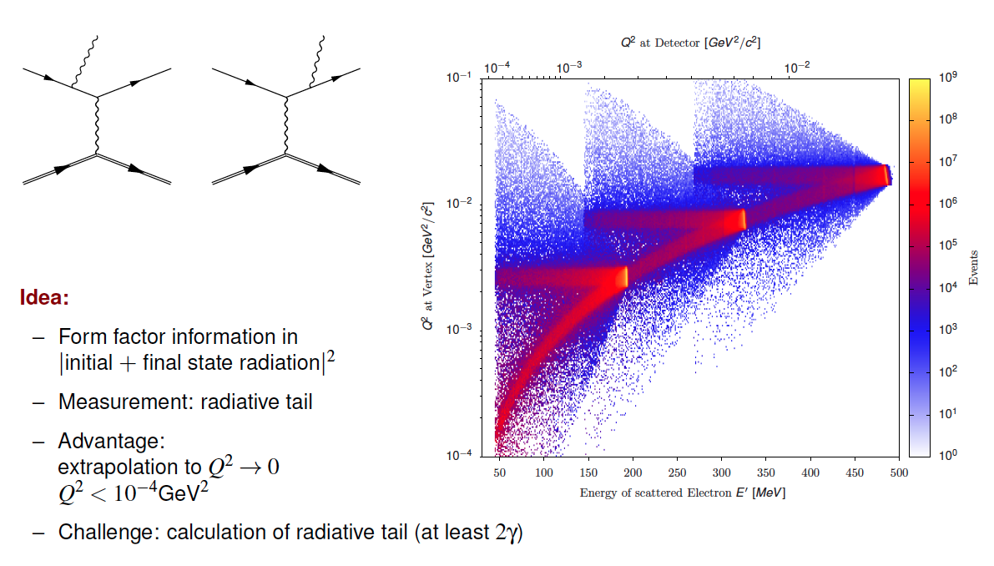
Experimental perspectives
Eric Voutier
T. Mihovilovič et al.
FSR
E=495 MeV
E=330 MeV
ISR
E=195 MeV
Measurement of the momentum spectrum of scattered electrons
Requires very accurate understanding of QED radiative corrections and FSR (beyond the 2γ exchange)
Access 2×10⁻⁴ (GeV/c²)²
Orsay, September 29th-30th, 2016
9/23

Slide 10
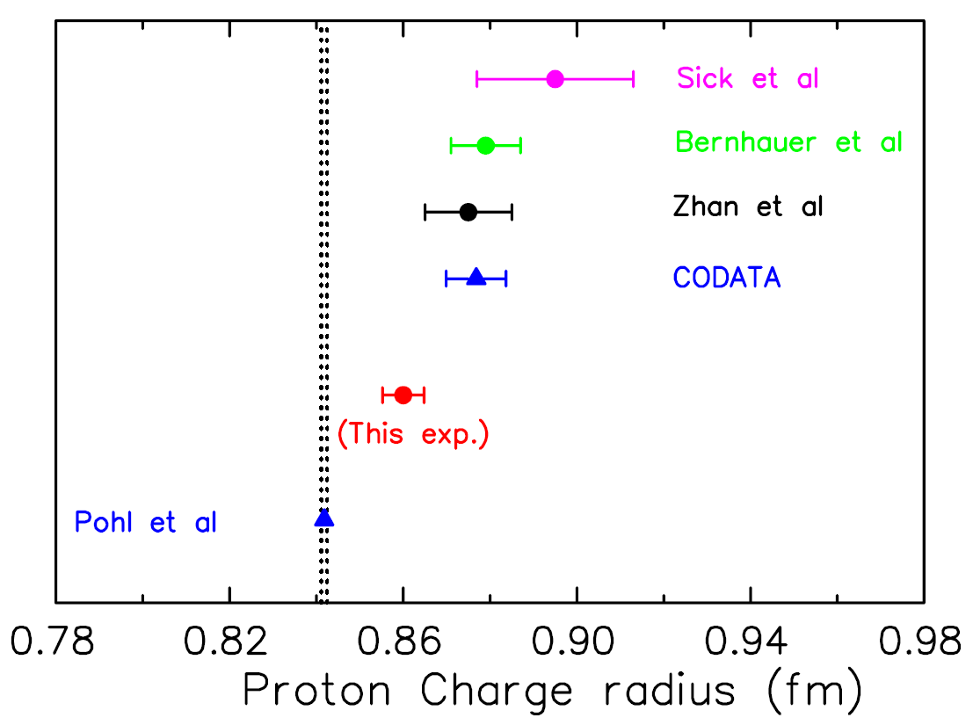
Experimental perspectives
Eric Voutier
PRad @ Jlab
Proton Radius experiment
(E12-11-106 Experiment) D. Dutta, H. Gao, A. Gasparian, M. Khandaher et al.
The PRad experiment aims at the simultaneous measurements (~2017) of
the proton elastic and Møller in the angular range 0.5-3.0° corresponding to the
10⁻⁴-10⁻² (GeV/c²)² four-momentum range.
Two beam energies (1.1 and 2.2 GeV) to cover the planned Q²-range leading to a 0.6% determination
of the proton charge radius.
PRad
projection
Window less gas target
High resolution and large acceptance calorimeter
High control of corrections and systematics effects
Orsay, September 29th-30th, 2016
10/23

Slide 11
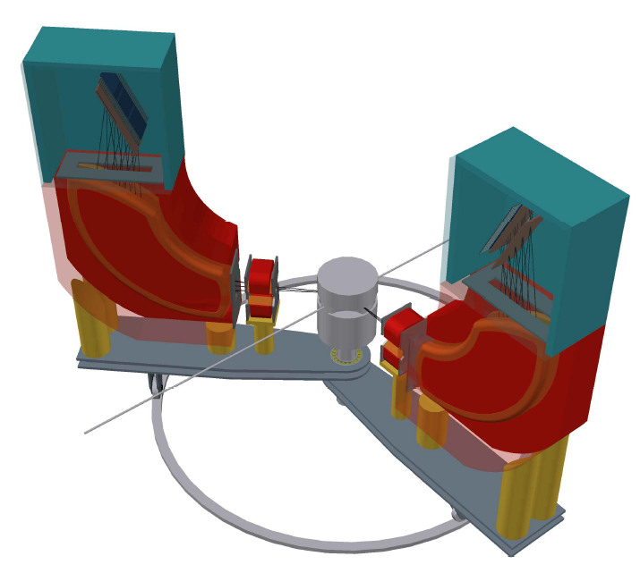
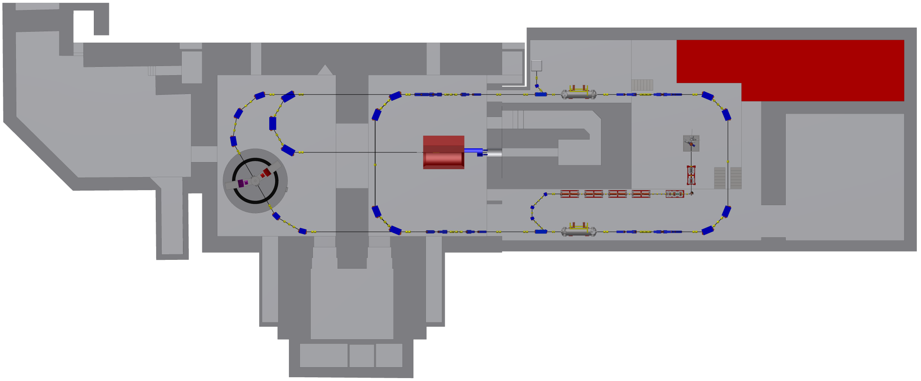
Experimental perspectives
Eric Voutier
MAGIX @ MESA
MesA Gas Internal target eXperiment
A. Denig et al.
The Mainz Energy recovering Superconducting Accelerator is a new machine under construction (2017) at the University of Mainz for high luminosity polarized experiment.
Beam Mode | I (mA) | E (MeV) | L (cm⁻²s⁻¹)
External | 0.15 | 200 | 10³⁹
Internal (ERL) | 10.0 | 150 | 10³⁶
δp/p < 10⁻⁴
ΔΩ ~ ±50 mrad
MESA
projection
1 mA
ERL beam
Operation of a high intensity electron
beam with an internal gas target.
Orsay, September 29th-30th, 2016
11/23

Slide 12
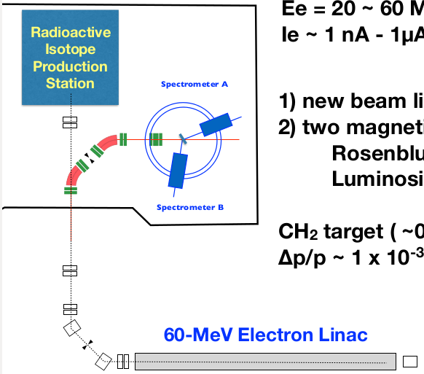
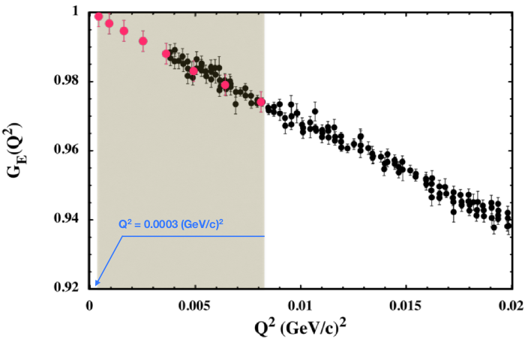
Experimental perspectives
Eric Voutier
ULQ² @ RCEPS.Sendai
T. Suda et al.
The ULQ² experiment at the Tohoku University will measure G_{E}(Q²) in the range 3x10⁻⁴-8x10⁻³ (GeV/c²)² via Rosenbluth separation on a CH₂ target.
Discrete coverage of the 30-150 angular range
Measurements in the 20-60 MeV beam energy range
Absolute cross section with respect to ¹²C(e,e)¹²C
Beam line and spectrometers under construction
ULQ²
Projection
(2019)
Orsay, September 29th-30th, 2016
12/23

Slide 13
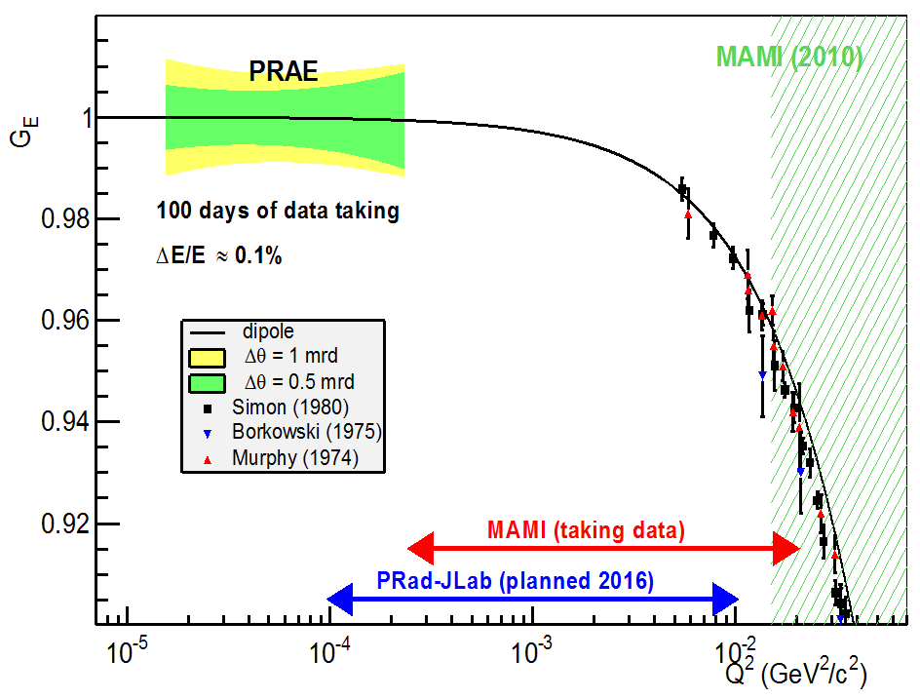
Experimental perspectives
Eric Voutier
ProRad @ PRAE
(PRAE Collaboration) E. Voutier et al.
The ProRad experiment at PRAE aims at sub-percent measurements of G_{E}(Q²) in the unexplored range 10⁻⁵-10⁻⁴ (GeV/c²)² .
Discrete coverage of the 5º-15º angular range
Measurements at three different beam energies
Use of a solid hydrogen target
Simultaneous measurements of the elastic and Møller cross sections
The full experiment from the electron source up to the data acquisition is under development and construction.
First data taking expected during the second semester of 2019.
ULQ² (2019)
MAMI (analysis)
PRad (analysis)
Orsay, September 29th-30th, 2016
13/23

Slide 14





The PRAE project
Eric Voutier
Platform for Research and Applications with Electrons
PRAE
S. Barsuk, P. Duchesne et al.
PRAE aims at creating a multidisciplinary facility within the Orsay campus for innovative R&D in instrumentation, radiotherapy, and nuclear physics… based on a high performance electron beam in the 30-140 MeV energy range.
Radiotherapy
Detector R&D
Nuclear Physics
Accelerator
PRAE
Orsay, September 29th-30th, 2016
14/23

Slide 15


The PRAE project
Eric Voutier
Team
P. Ausset, S. Barsuk, M. Ben Abdillah, L. Berthier, P. Bertho, J. Bettane, J.-S. Bousson,
L. Burmistrov, F. Campos, V. Chaumat, J.-L. Coacolo, N. Dosme, O. Duarte, R. Dupré,
P. Duchesne, N. El Kamchi, M. El Khaldi, A. Faus-Golfe, L. Garolfi, B. Genolini, A. Gonnin,
X. Grave, M. Guidal, H. Guler, P. Halin, G. Hull, M. Imre, M. Josselin, M. Juchaux, W. Kaabi, R. Kunne, M. Langlet, P. Laniece, F. Lefebvre, C. Le Galliard, E. Legay, P. Lepercq,
C. Magueur, B. Mansoux, D. Marchand, A. Maroni, B. Mathon, A. Mazal, B. Mercier,
S. Meyroneinc, H. Monard, C. Muñoz Camacho, T. Nguyen Trung, S. Niccolai, M. Omeich,
Y. Peinaud, L. Pinot, Y. Prezado, K. Pressard, V. Puill, B. Ramstein, S. Rousselot, A. Said,
A. Semsoum, C. Sylvia, C. Vallerand, M.A. Verdier, O. Vitez, E. Voutier, J. van de Wiele,
S. Wurth
Consider
joining this effort as Partner or User
(marchand@ipno.in2p3.fr)
PRAE Kick-off Meeting in Spring 2017
Orsay, September 29th-30th, 2016
15/23

Slide 16
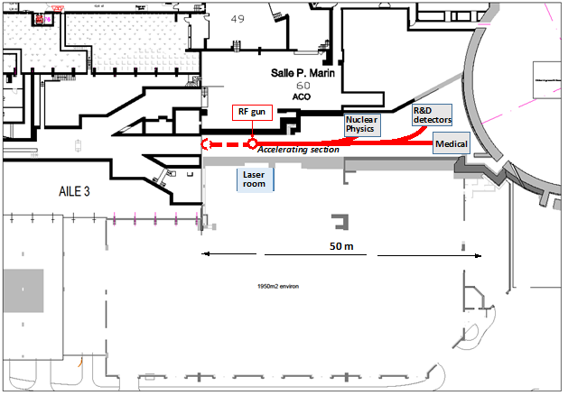
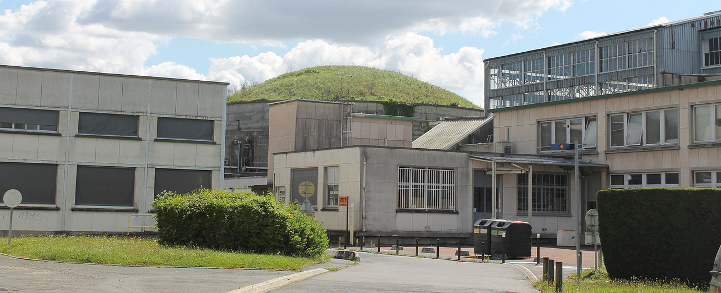
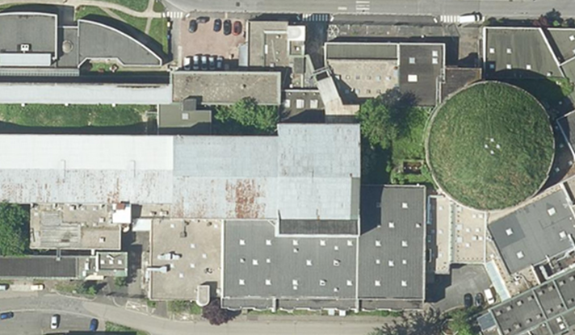
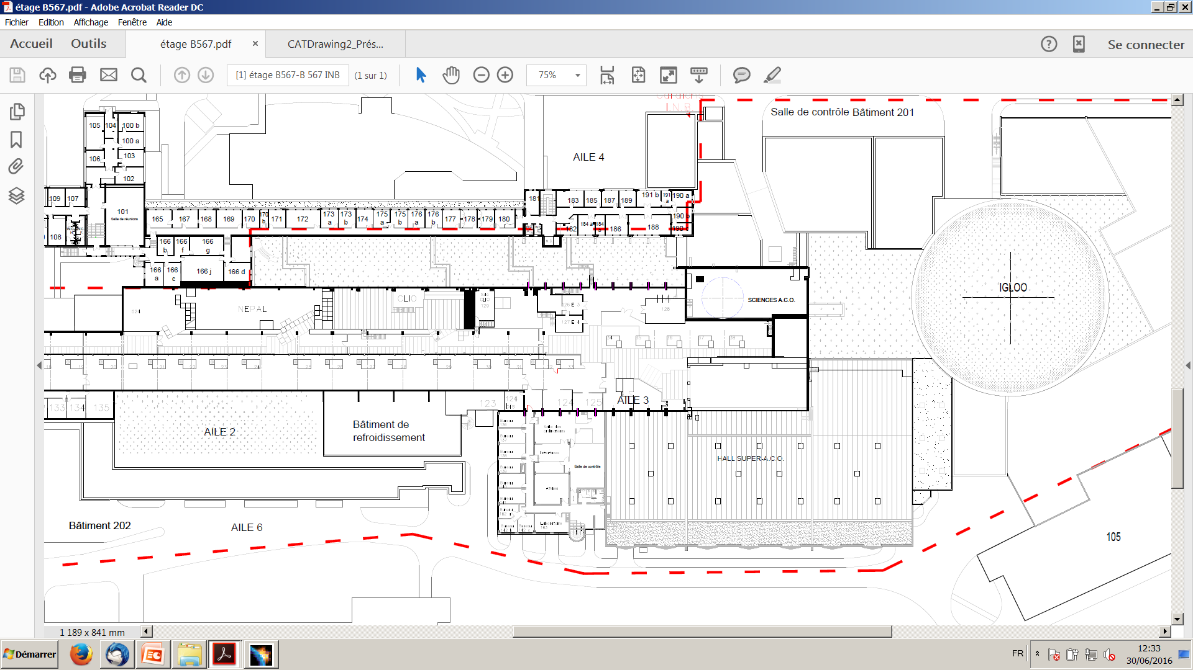
The PRAE project
Eric Voutier
Experimental Site
Nuclear
Physics
R&D
Detector
R&D
Radiobiology
Former linear accelerator site (1959-2003)
50 m
14/15
Orsay, October 15th-16th, 2015
16/23
Orsay, September 29th-30th, 2016

Slide 17
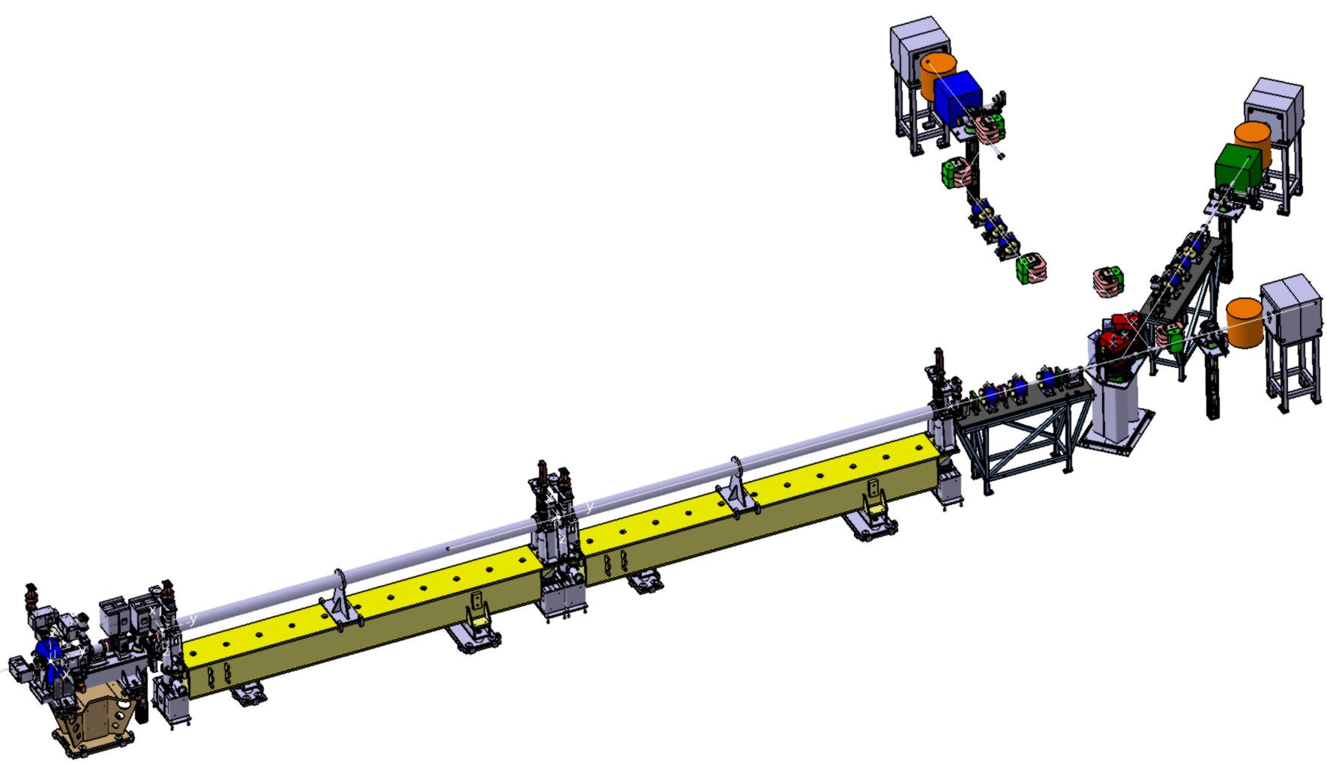
The PRAE project
Eric Voutier
Accelerator
A. Faus-Golfe et al.
Beam parameters | Time phase 1 (2)
Energy, MeV | 50-70 (100-140)
Charge (variable), nC/bunch | 0.00005 – 2
Normalized emittance, mm.mrad | 3-10
RF frequency, GHz | 3.0
Repetition rate, Hz | 50
Transverse size, mm | 0.5
Bunch length, ps | < 10
Energy spread, % | < 0.2
Bunches per pulse | 1
3.5 m
4,8 m
Up to 140 MeV
High Gradient S-band Linac @ 25 MV/m
Orsay, September 29th-30th, 2016
17/23

Slide 18
The PRAE project
Eric Voutier
Instrumentation Platform
B. Genolini, V. Puill et al.
A test platform with performant capabilities for the spatial characterization of the
time and charge response of detectors
Performant Beam
Timing reference (< 10ps)
Charge accuracy (< 2×10⁻³ rms)
Spatial accuracy (<500 µm)
Low straggling (high energy)
Mono-electron capabilities
Efficient tools for R&D
Single user interface
Remote control
Fast signal digitizer: charge, ps timing + possible trace recording/processing
Movable Profiler (Timepix)
Cerenkov counter
Spectrometer output
Beam
Detector under test
Collimator
Calorimeter
  DAQ + Slow Control
30 digitization signals (WaveCatcher NIMA(2011))
Graphical User Interface
DCOD = NARVAL + ENX
Online signal processing
Beam coarse detection
& positioning
PC controlled 2-axis trolley
Orsay, September 29th-30th, 2016
18/23

Slide 19
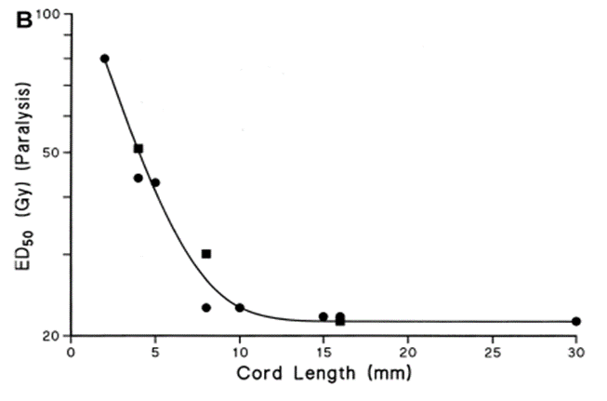
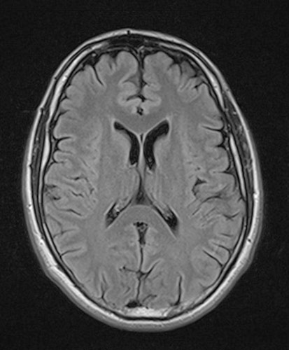
The PRAE project
Eric Voutier
Radiobiological Research
Y. Prezado et al.
The main challenge in radiotherapy is to find novel approaches combining high biological efficiency for tumors with low biological efficiency for normal tissue
and with lowest irradiation dose at the lowest cost.
◊◊◊ Enhanced tolerance of X-ray minibeam radiation therapy (MBRT) ◊◊◊
submillimetric field sizes + spatial fractionation of the dose
instead of several cm²
instead of homogeneous distributions
Tolerance
Spinal cord
Field size (mm)
Orsay, September 29th-30th, 2016
Y. Prezado et al. Rad. Res. 184 (2015) 3
19/23

Slide 20
The PRAE project
Eric Voutier
High Energy Electron Grid Therapy
eHGRT
I. Martinez-Rovira, G. Fois, Y. Prezado Med. Phys. 42 (2015) 685
View of the grid
2D dose distributions
Dose deposition in depth
Beams get wider in depth due to multiple Coulomb scattering.
Normal tissues benefit from spatial fractionation of the dose while a (quasi) homogeneous dose distribution is achieved in the tumor.
Needs to be quantitatively validated by pre-clinical studies.
Orsay, September 29th-30th, 2016
20/23

Slide 21
The PRAE project
Eric Voutier
Nuclear Physics Research
E. Voutier, G. Hull et al.
The Nuclear Physics beam line is designed to host high accuracy experiments. It will feature :
- an improved beam energy dispersion (<10⁻⁴);
- an accurate beam energy measurement (<10⁻³);
- a precise monitoring of the beam (profile, position);
- an accurate measurement of the beam charge.
The Nuclear Physics beam line will primarily host
the ProRad experiment.
2×10⁻⁵ (GeV/c²)²
Orsay, September 29th-30th, 2016
21/23

Slide 22
The PRAE project
Eric Voutier
ProRad Challenges
Accurate cross section measurement (1%) for sub-percent G_{E}(Q²)
High statistics requirement (>10⁶)
Hunt for minimal systematics (energy, angle, normalisation…)
Accurate control of radiative effects
Orsay, September 29th-30th, 2016
22/23

Slide 23
Summary
Eric Voutier
In Brief
Measurements of the electric form factor of the proton at low momenta
are challenging but important experiments for the understanding
of the proton radius puzzle.
They provide a better control of the zero momentum extrapolation required to extract the proton radius from elastic electron scattering.
Any deviation with respect to 1 would indicate genuine novel effects.
The PRAE platform being built in Orsay will offer a high performance electron beam up to 70(140) MeV.
Orsay, September 29th-30th, 2016
23/23

