Slide 1
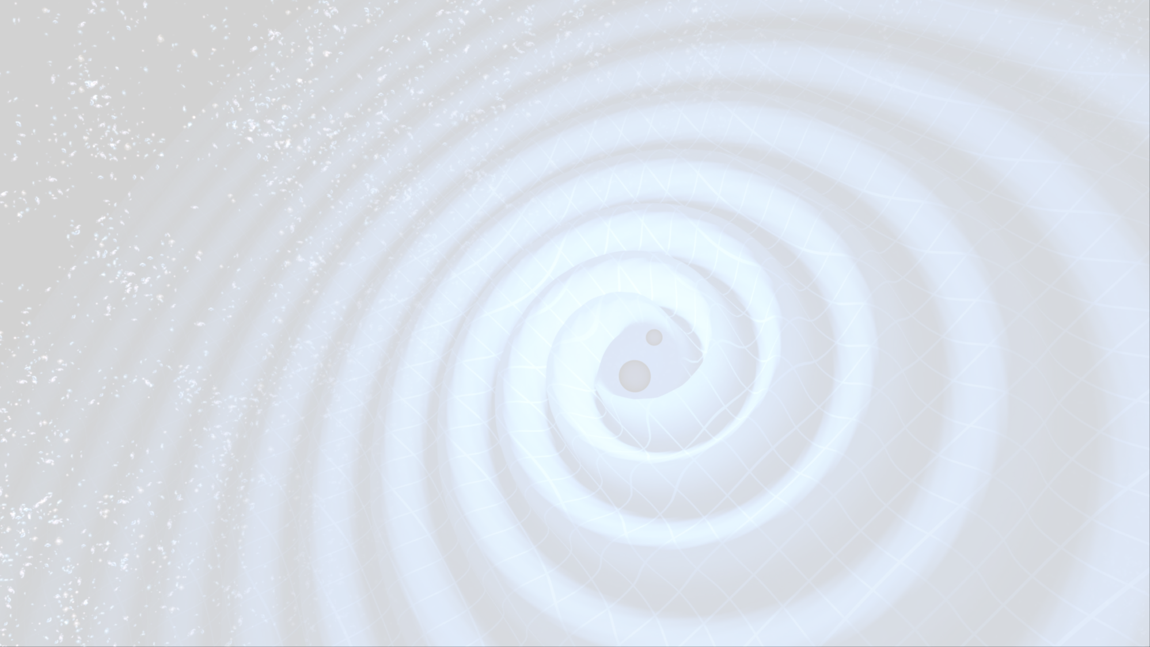
Résumé de la conférence GR21
D. Verkindt

Slide 2
GR21
GR21 : Conference on General Relativity and Gravitation , Columbia University , New York , 10-15 July 2016
Sous l’égide de l’ISGRG (International Society on General Relativity and Gravitation)
http://www.gr21.org/program.html
1955 : GR0 (Berne) : cinquantenaire de la théorie de la relativité. Nathan Rosen argumente contre l’existence des ondes gravitationnelles
1957 : GR1 (Chapel Hill) : Pirani et Feynman argumentent en faveur de l’existence et de la détection expérimentale des ondes gravitationnelles

Slide 3
GR21
4 matins de sessions plénières:
Precision gravity tests, Black Holes, Gravitational waves detection,
Numerical relativity, symetries and General Relativity, Quantum tests of gravity, …
4 après-midis de sessions parallèles:
- A1 a A4: théorie 1 (exact solutions of General Relativity, mathematical relativity, alternative theory of gravity…)
- B1 a B4: sources (astrophysics, numerical relativity, perturbation theory, cosmology)
- C1 a C4: Expérimental (Pulsar timing arrays, GW data analysis and futur detectors, experimental gravitation)
- D1 a D4: théorie 2 (quantum gravity, strings, branes, entanglement, …)
+ 1 session spéciale consacrée aux ondes gravitationnelles
+ 1 session posters
+ 1 présentation publique sur les débuts des détecteurs d’ondes gravitationnelles (R. Weiss, K. Thorne)

Slide 4
Theoretical considerations:
MQ and gravitation, extensions of GR…
MQ: small masses , large coherence time
Gravitation: large masses , small coherence time
Feynman at Chapel Hill (1957): proposes experiments for gravitational quantum effects
Test gravitational decoherence
Test induced gravitational MQ entanglement
…
Supertranslations: BMS symetry group <> Poincare group
Soft graviton theorem (Weinberg 1965) related to BMS by Ward identity
Link with the GW memory effect
…
…

Slide 5
1 Les ondes gravitationnelles détectées
2 Pulsars et observations radio
3 Tests de la Relativité Générale
4 Retour aux ondes gravitationnelles

Slide 6
Les ondes gravitationnelles détectées!
G. Gonzalez :
Searching for - and finding! - gravitational waves
M. Branchesi :
Multi-messenger astronomy
S. Nissanke :
Clash of the Titans: new astrophysics of binary black holes from LIGO’s observations

Slide 7
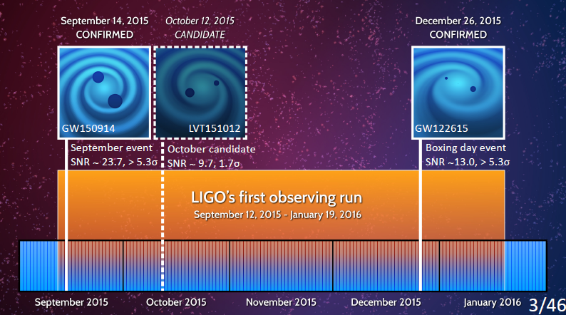
From S. Nissanke

Slide 8
From S. Nissanke

Slide 9
From S. Nissanke

Slide 10
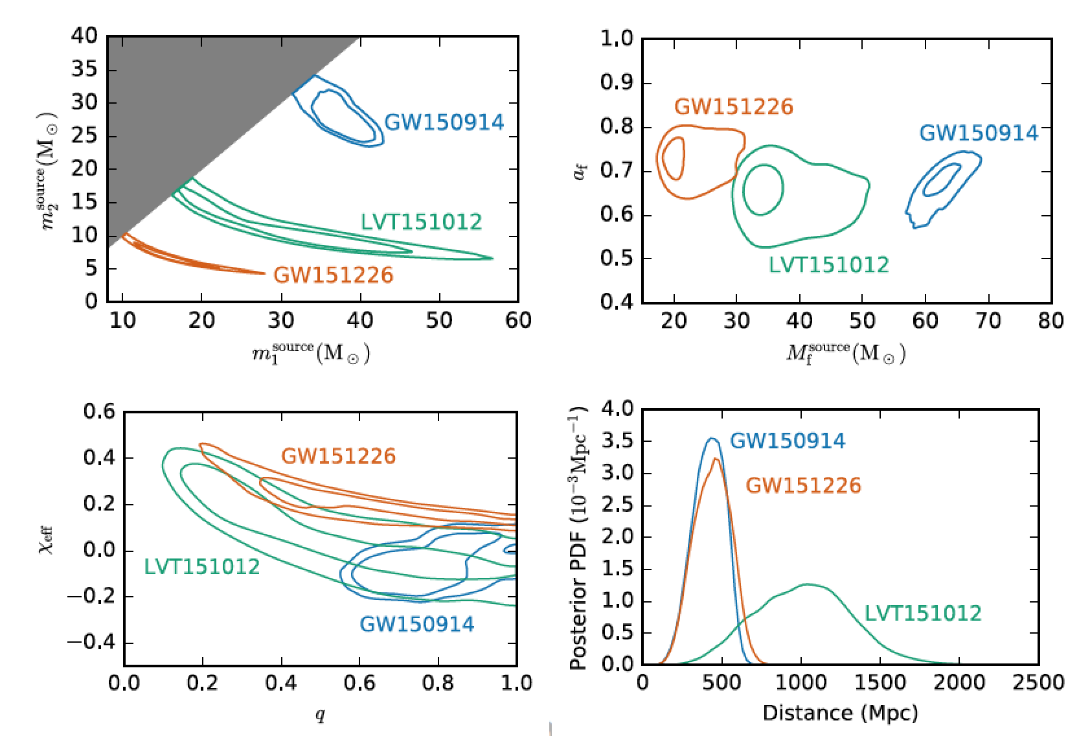
Parameters of the BBH systems
arXiv:1606.04856
50% and 90% credible regions
from G. Gonzalez

Slide 11
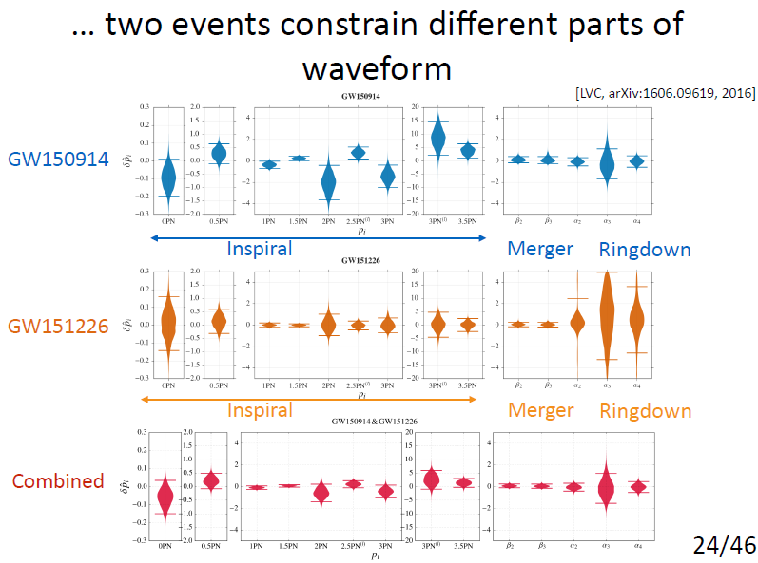
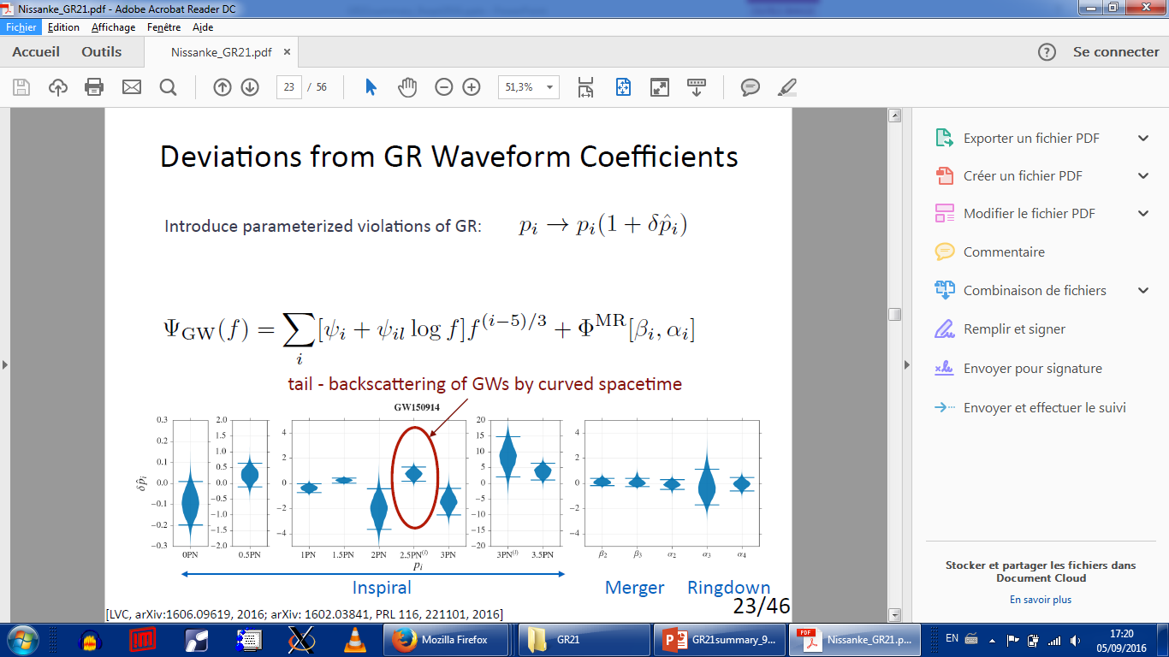
Introduce parametrized violations of GR:
From S. Nissanke

Slide 12
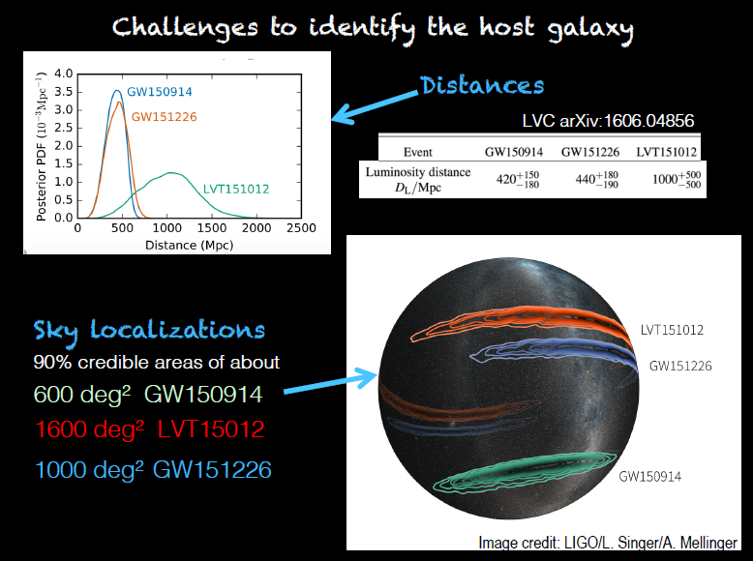
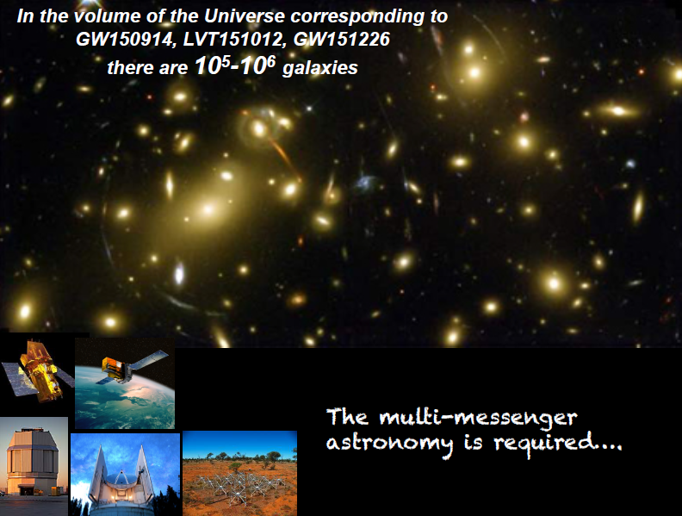
Localisation of the source of GW
from M. Branchesi

Slide 13
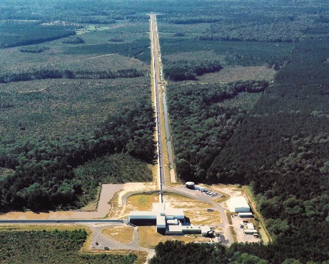
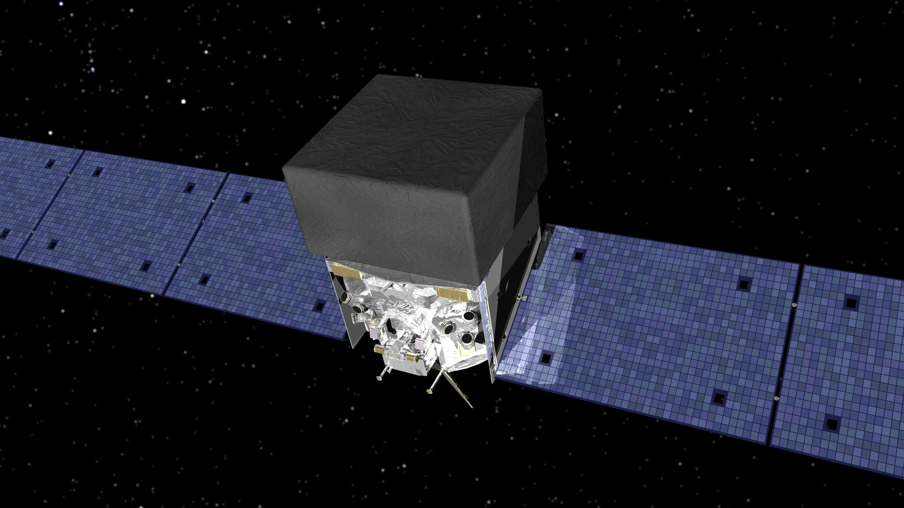
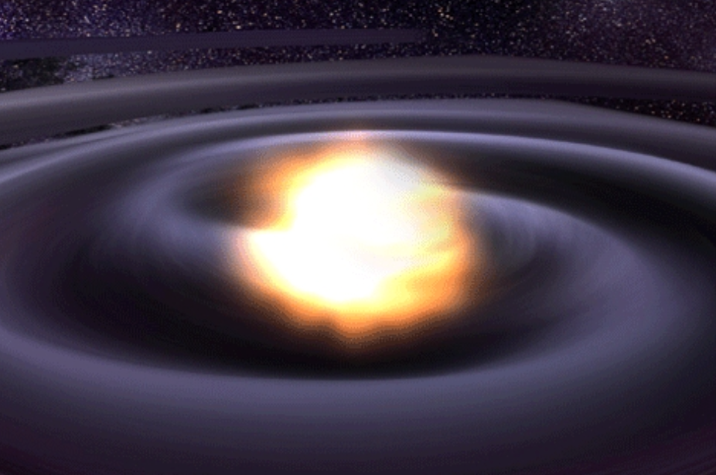
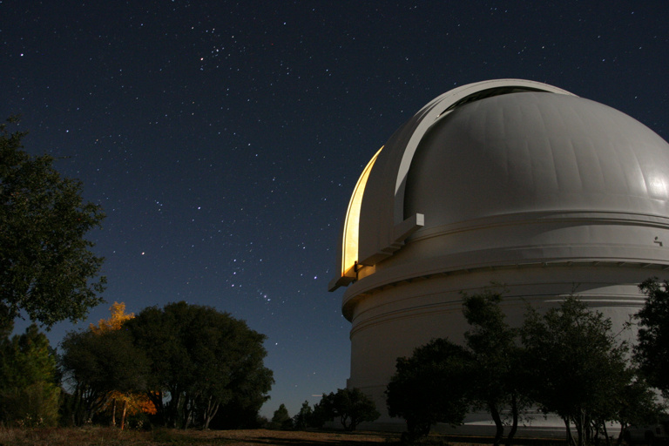
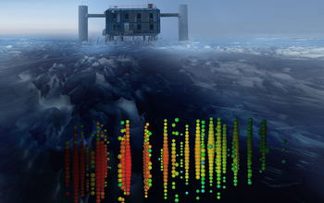
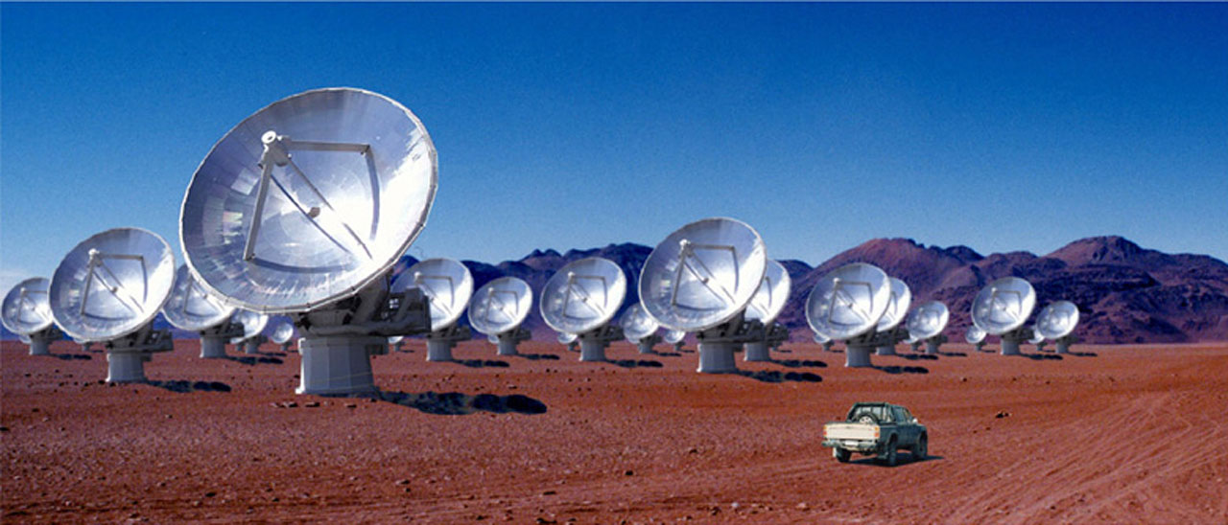
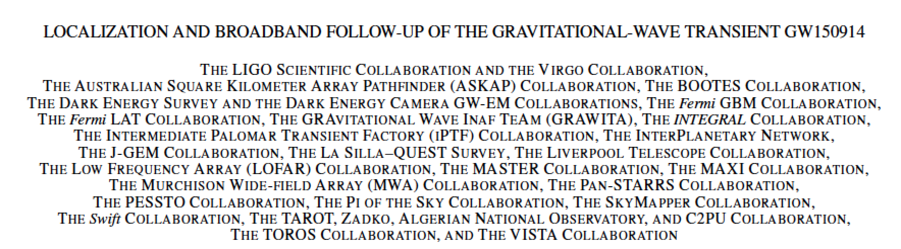
Multi-messenger Astronomy with Gravitational Waves
Binary Merger
X-rays/Gamma-rays
Gravitational Waves
Visible/Infrared Light
Neutrinos
Radio Waves
arXiv:1602.08492
from G. Gonzalez

Slide 14
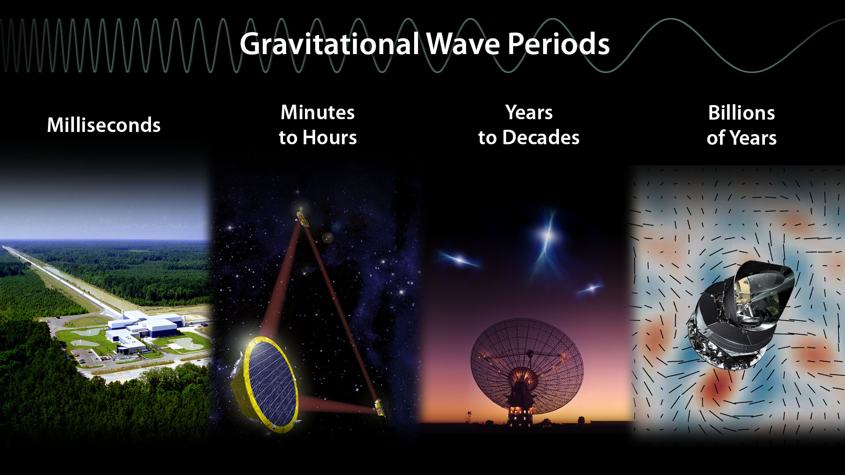
from G. Gonzalez

Slide 15
GW multi-detection
Sesana,1602.06951
From S. Nissanke

Slide 16
GW highlights session of Tuesday
C. Capano:
Results of BBH searching in O1
LVT151012 seen by pyCBC (FAR=1/2.7y) and gstlal (FAR=1/5.9y) → 87% prob that it is a GW
GW151226 has at least one component with spin > 0.2 …
BBH rate limit : 9-240 Gpc⁻³ yr⁻¹
D. Reitze:
Impact of first detections on interferometer design
Plans for O2
N. Yunes:
Annus mirabilis for NR : 2005
Theoretical physics implications of the BBH merger GW150914
Probing extreme gravity.
Constraints on post-newtonian framework

Slide 17
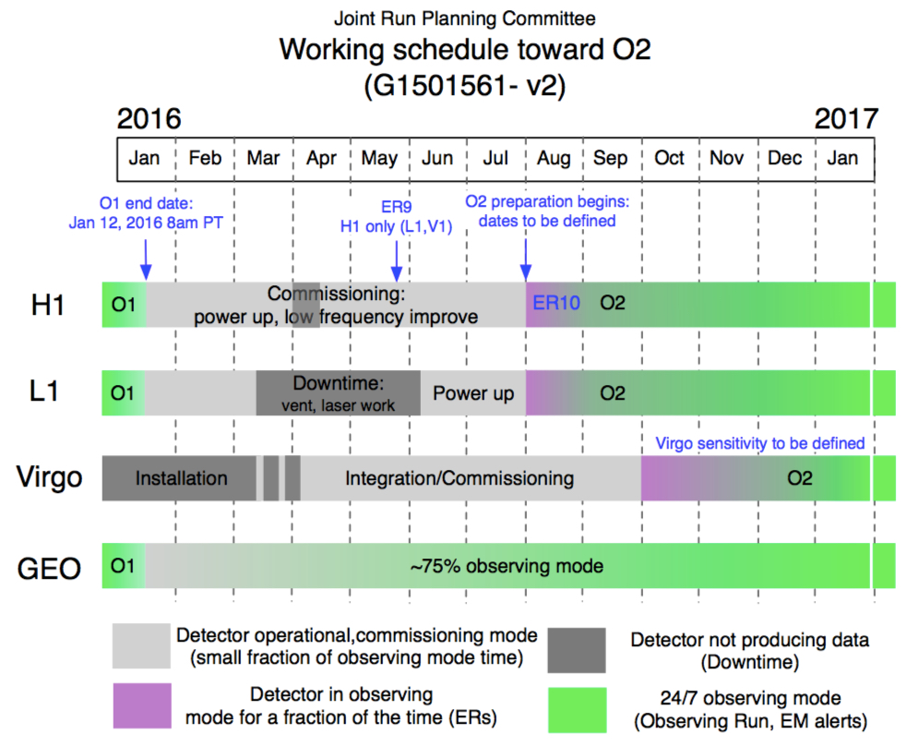
Plans for O2: start before October 2016, 3+3 months with 1-2 months break.
From D. Reitze

Slide 18
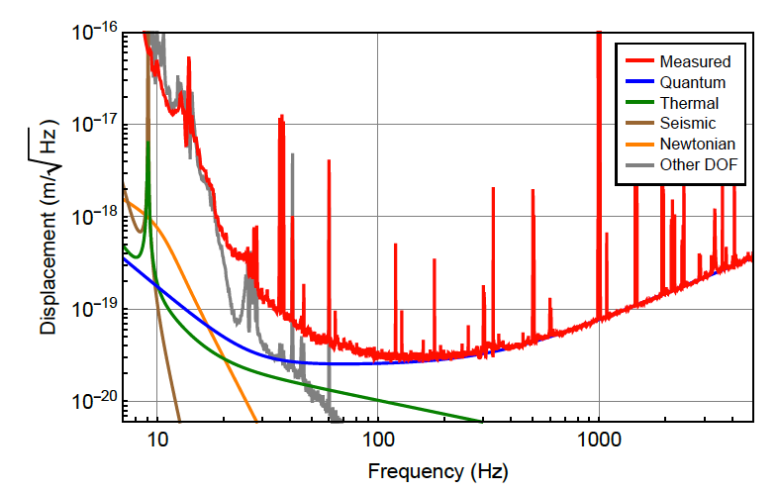
The Advanced LIGO Detector Sensitivity During O1
O2:
15-25% sentivity improvement with respect to O1,
30-100 Hz noises not well understood: no gain here
From D. Reitze
Abbott, et al. ,LIGO Scientific Collaboration and Virgo Collaboration, “GW150914: The Advanced LIGO Detectors in the Era of First Discoveries”, Phys. Rev. Lett. 116, 131103 (2016).

Slide 19
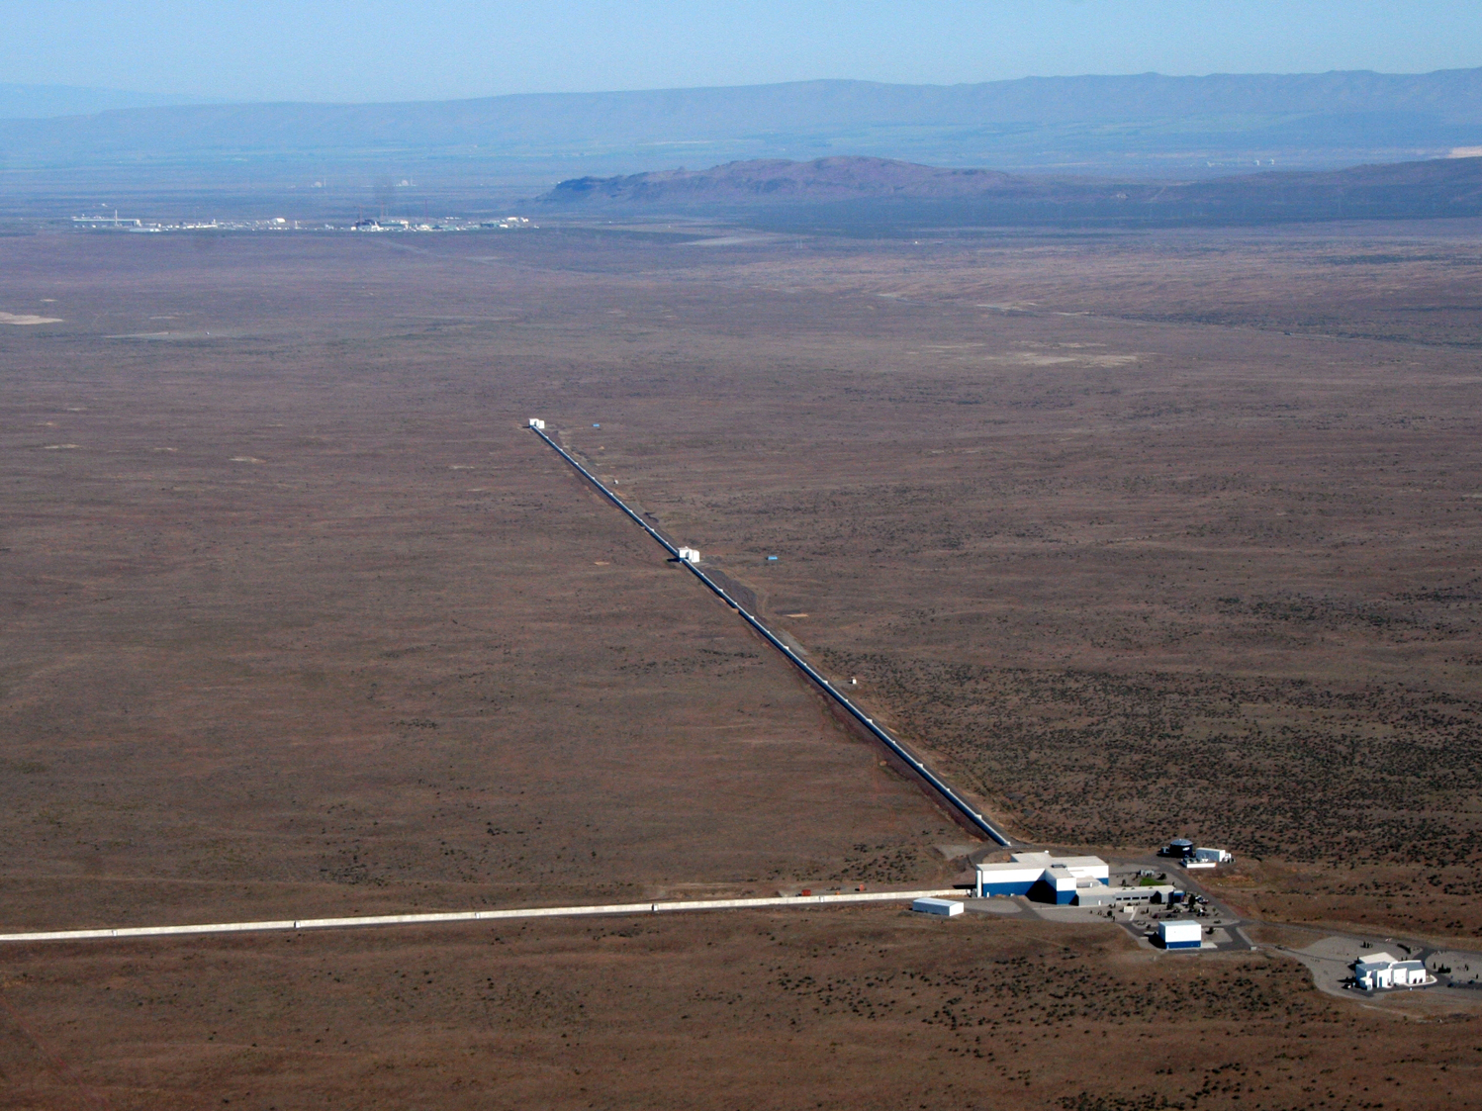
Aim: Horizon ~ 90 Mpc
Duty cycle: O1=43% O2 > 50%
Frequency dependent squeezing may be used
From D. Reitze

Slide 20
GW highlights session of Tuesday
C. Capano:
Results of BBH searching in O1
LVT151012 seen by pyCBC and gstlal,
GW151226 has at least one component with spin > 0.2 …
BBH rate limit is 9-240 per Gpc and per year
D. Reitze:
Impact of first detections on interferometer design
Plans for O2
N. Yunes:
Annus mirabilis for NR : 2005
Theoretical physics implications of the BBH merger GW150914
Probing extreme gravity.
Constraints on post-newtonian framework
GW generation + GW propagation → test fundamental pillars of GR
GW tests of extreme gravity will necessarily become much stronger
More interplay between Particle Theorists and eXtreme Gravity

Slide 21
Pulsars and radio observations
S. Chatterjee :
Fast Radio Bursts (FRB)
J. Weisberg:
Last measurements on PSR B1913+16
N Wex:
Precision tests of GR with radio pulsars
Some history about the first papers of Einstein
Pulsar observed in binary with first exoplanet
Pulsar never observed in binary with a black hole
2003: observation of PSRJ0737-3039: first double pulsar
Spin periods: 23 ms / 2.8 s
Orbital period: 2.45 h
Eccentricity: 0.088
2014: PSR J0337+1715: first observation of a triple system: 1 pulsar + 2 white dwarfs
P = 2.7 ms, MPSR = 1.44 Mo
Inner orbit: 1.63 d, MWD = 0.20 Mo
Outer orbit: 327 d, MWD = 0.41 Mo
Pulsar Timing Array

Slide 22
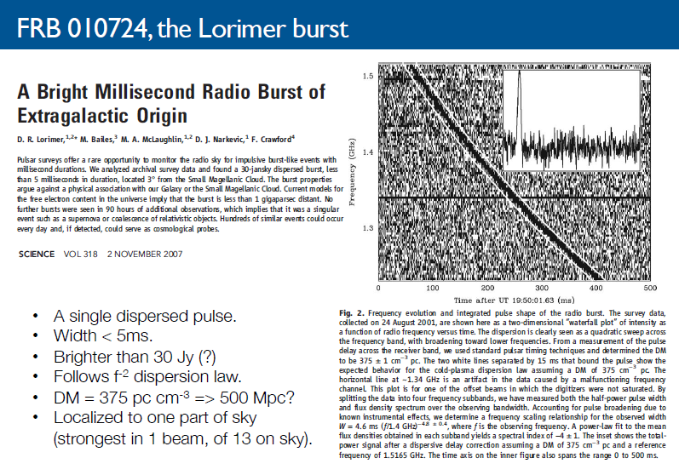
From S. Chatterjee

Slide 23
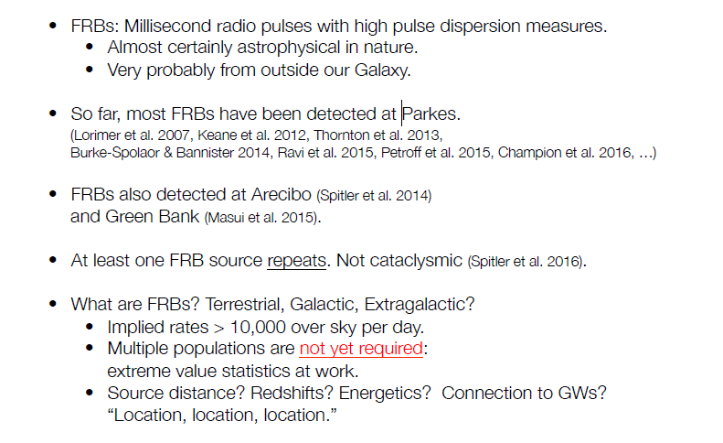
Que sont les FRB (Fast Radio Bursts) ?
From S. Chatterjee

Slide 24
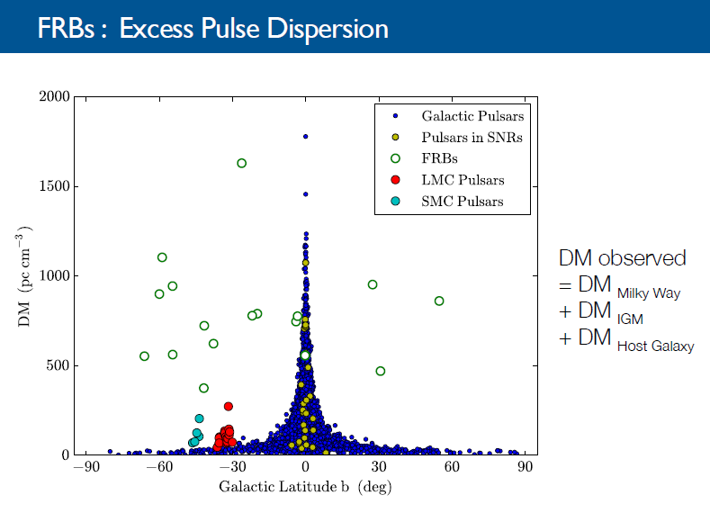
DM = dispersion measure = column density of free electrons on the radio wave path
From S. Chatterjee

Slide 25
Pulsars and radio observations
S. Chatterjee :
Fast Radio Bursts
J. Weisberg:
Last measurements on PSR B1913+16
N Wex:
Precision tests of GR with radio pulsars
Some history about the first papers of Einstein
Pulsar observed in binary with first exoplanet
Pulsar never observed in binary with a black hole
2003: observation of PSRJ0737-3039: first double pulsar
Spin periods: 23 ms / 2.8 s
Orbital period: 2.45 h
Eccentricity: 0.088
2014: PSR J0337+1715: first observation of a triple system: 1 pulsar + 2 white dwarfs
P = 2.7 ms, MPSR = 1.44 Mo
Inner orbit: 1.63 d, MWD = 0.20 Mo
Outer orbit: 327 d, MWD = 0.41 Mo
Pulsar Timing Array

Slide 26
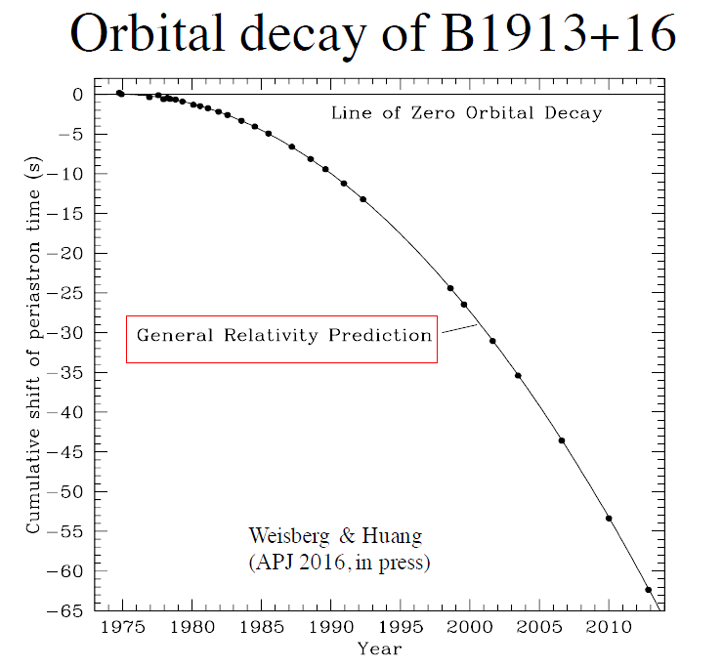
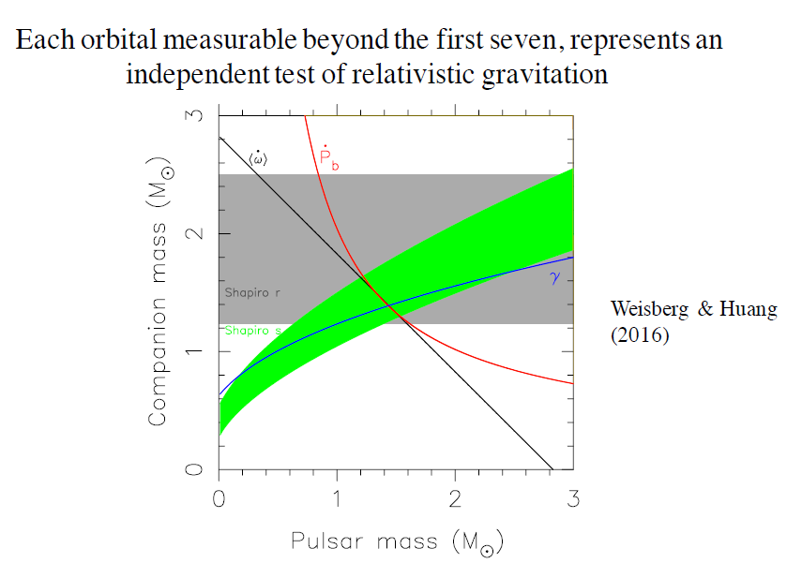
From J. Weisberg

Slide 27
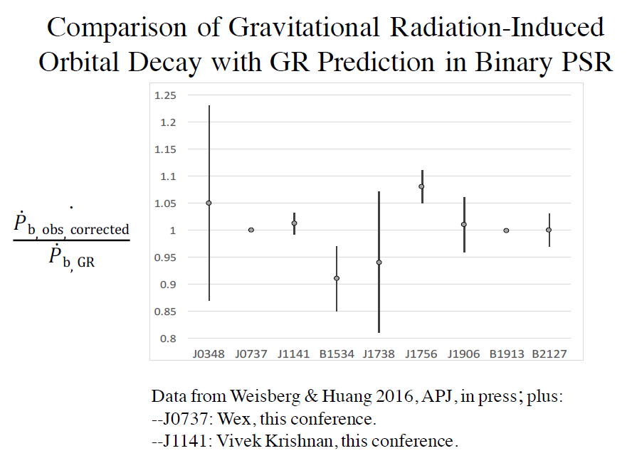
From J. Weisberg

Slide 28
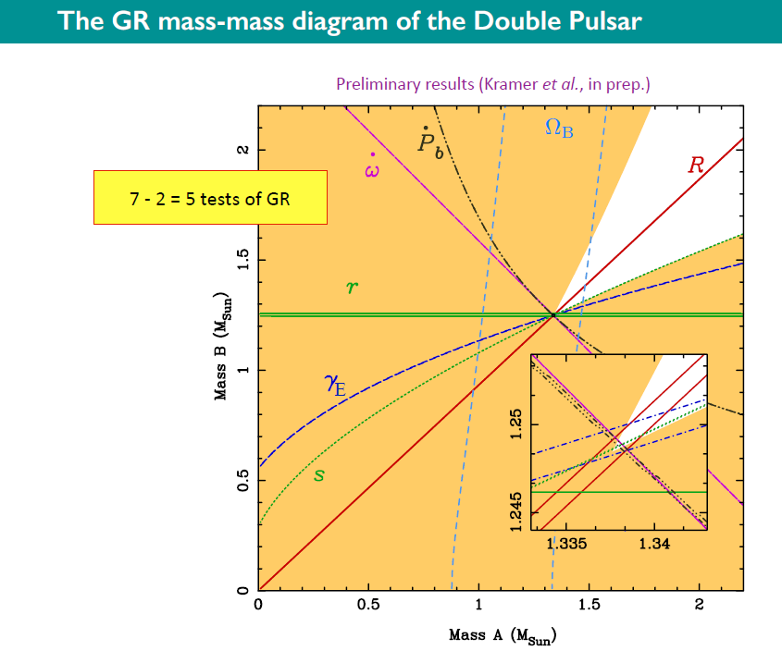
Pulsar double
PSRJ0737-3039
From N. Wex

Slide 29
Pulsars Timing Array

Slide 30
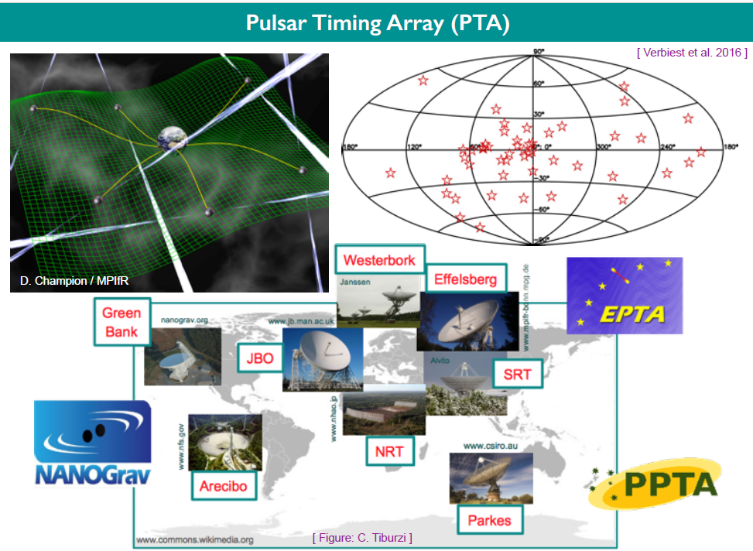
From N. Wex

Slide 31
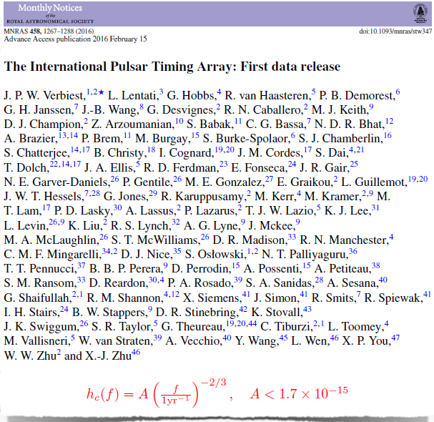
arXiv:1602.03640
See also arXiv:1508.03024
The NANOgrav nine years data set
In the coming decade, the construction and use of the
Square Kilometre Array (SKA) will commence and … will multiply the number of pulsars available for PTA research … It will likely commence the field of low-frequency GW astronomy
From N. Wex

Slide 32
Tests de la Relativité Générale
C. Will:
GR tests review
MQ interference and gravity: Colella et al. (PRL 34, 23 1975)
Kasevitch et al.: Δg/g = 10⁻⁶ in 1991 , Δg/g = 2x10⁻¹¹ in 2014
Tino et al. : ΔG / G = 10⁻⁴ with two atomic fountains
???:
Test of frequency shift using two Galileo satellites on wrong orbits (e=0.15)
M. Crosta:
the GAIA experiment: astrometry over one billion of galactic stars
M. List:
Satellite MICROSCOPE. Principe d’équivalence mesuré à 10⁻¹⁵
J. Maidem:
Testing the strong-field dynamics of General Relativity with Binary Black Hole observations

Slide 33
Tests de la Relativité Générale
C. Will:
GR tests review
MQ interference and gravity: Colella et al. (PRL 34, 23 1975)
Kasevitch et al.: Δg/g = 10⁻⁶ in 1991 , Δg/g = 2x10⁻¹¹ in 2014
Tino et al. : ΔG / G = 10⁻⁴ with two atomic fountains
???:
Test of frequency shift using two Galileo satellites on wrong orbits (e=0.15)
M. Crosta:
the GAIA experiment: astrometry over one billion of galactic stars
M. List:
Satellite MICROSCOPE. Principe d’équivalence mesuré à 10⁻¹⁵
J. Maidem:
Testing the strong-field dynamics of General Relativity with Binary Black Hole observations

Slide 34
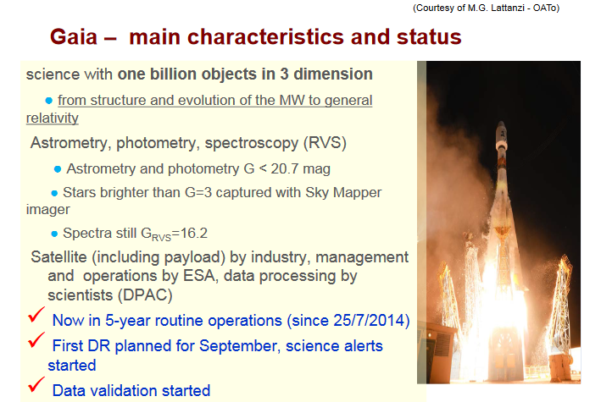
A real Galilean experiment in space:
a massive repetition of the Eddington et al.
Astrometric test of GR with 21st century technology, thank to the interfacing of analytical&numerical relativity methods
From M. Crosta

Slide 35
Tests de la Relativité Générale
C. Will:
GR tests review
MQ interference and gravity: Colella et al. (PRL 34, 23 1975)
Kasevitch et al.: Δg/g = 10⁻⁶ in 1991 , Δg/g = 2x10⁻¹¹ in 2014
Tino et al. : ΔG / G = 10⁻⁴ with two atomic fountains
???:
Test of frequency shift using two Galileo satellites on wrong orbits (e=0.15)
M. Crosta:
the GAIA experiment: astrometry over one billion of galactic stars
M. List:
Satellite MICROSCOPE. Principe d’équivalence mesuré à 10⁻¹⁵
J. Maidem:
Testing the strong-field dynamics of General Relativity with Binary Black Hole observations

Slide 36
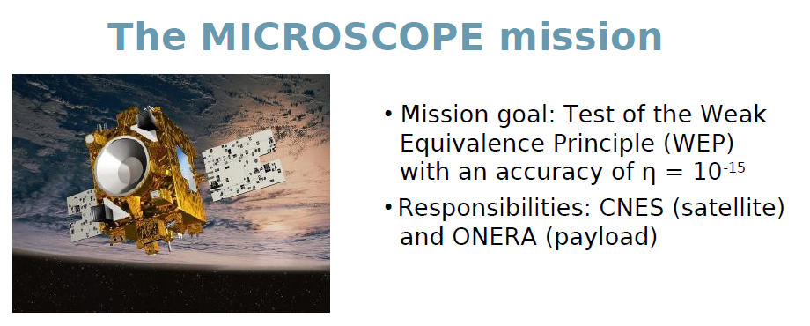
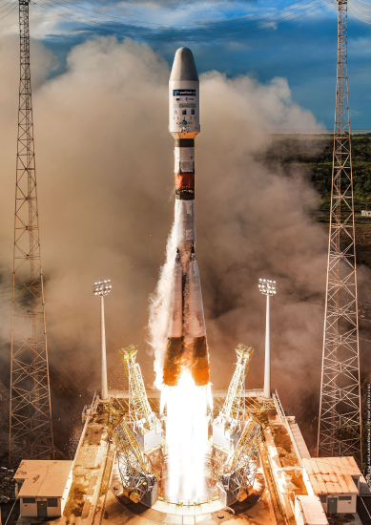
MICROSCOPE Successful launch in April 2016…
From M. List

Slide 37
Tests de la Relativité Générale
C. Will:
GR tests review
MQ interference and gravity: Colella et al. (PRL 34, 23 1975)
Kasevitch et al.: Δg/g = 10⁻⁶ in 1991 , Δg/g = 2x10⁻¹¹ in 2014
Tino et al. : ΔG / G = 10⁻⁴ with two atomic fountains
???:
Test of frequency shift using two Galileo satellites on wrong orbits (e=0.15)
M. Crosta:
the GAIA experiment: astrometry over one billion of galactic stars
M. List:
Satellite MICROSCOPE. Principe d’équivalence mesuré à 10⁻¹⁵
J. Maidem:
Testing the strong-field dynamics of General Relativity with Binary Black Hole observations

Slide 38
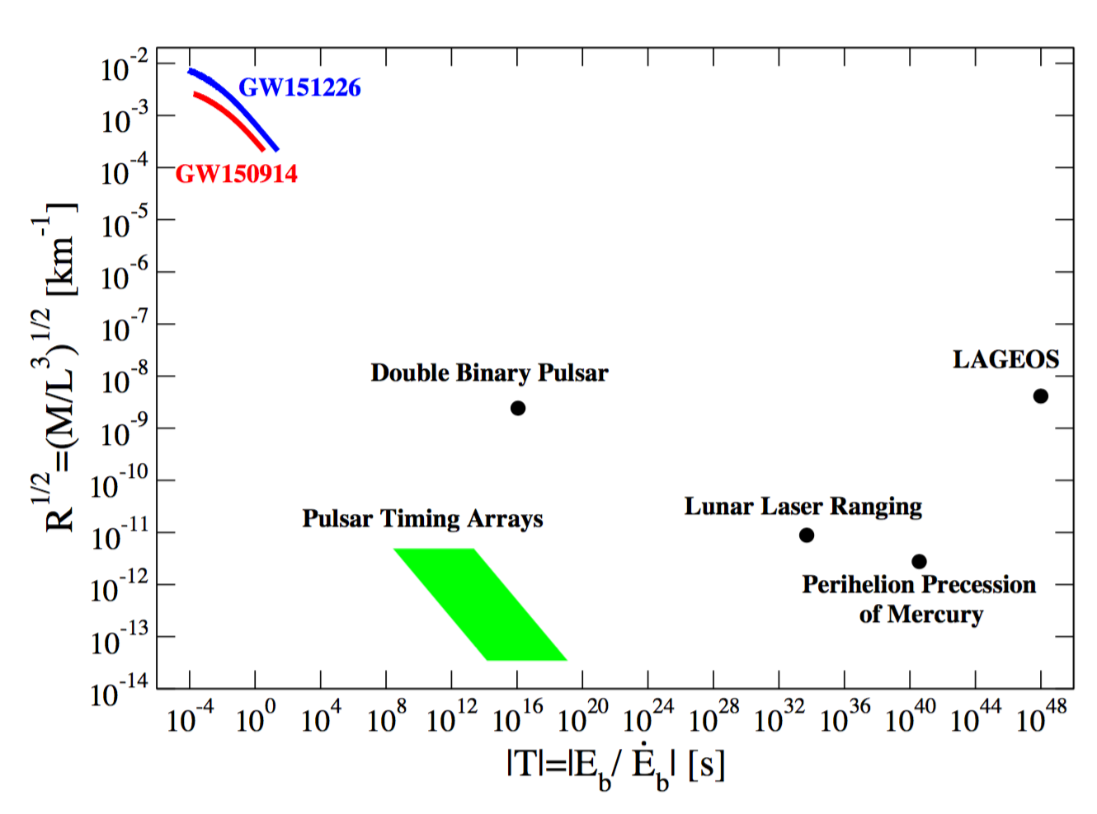
GW150914 within GR tests
Yunes at al., arXiv:1603.08955 [gr-qc] (2016)
From J. Meidam

Slide 39
Retour aux ondes gravitationnelles
J. Miller:
Squeezed states of light for Advanced LIGO and beyond
K. Kokeiyama:
First Test Operation of Underground Gravitational-Wave Detector, iKAGRA, and future plans
S. Vitale:
LISA Pathfinder results

Slide 40
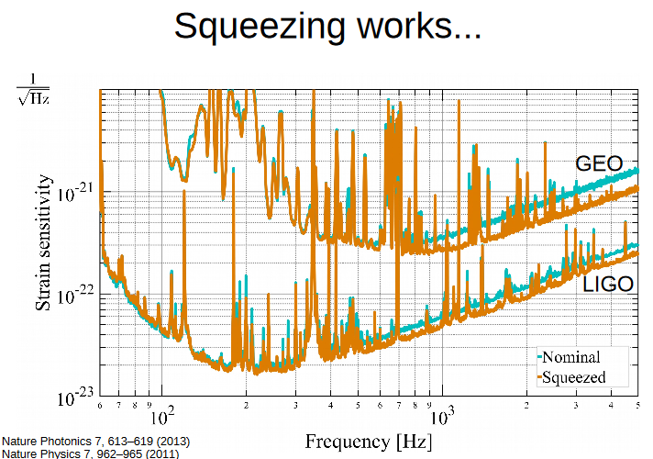
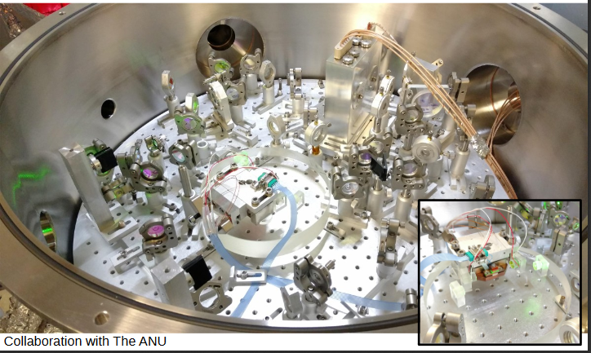
Optical bench
From J. Miller

Slide 41
Retour aux ondes gravitationnelles
J. Miller:
Squeezed states of light for Advanced LIGO and beyond
K. Kokeiyama:
First Test Operation of Underground Gravitational-Wave Detector, iKAGRA, and future plans
S. Vitale:
LISA Pathfinder results

Slide 42
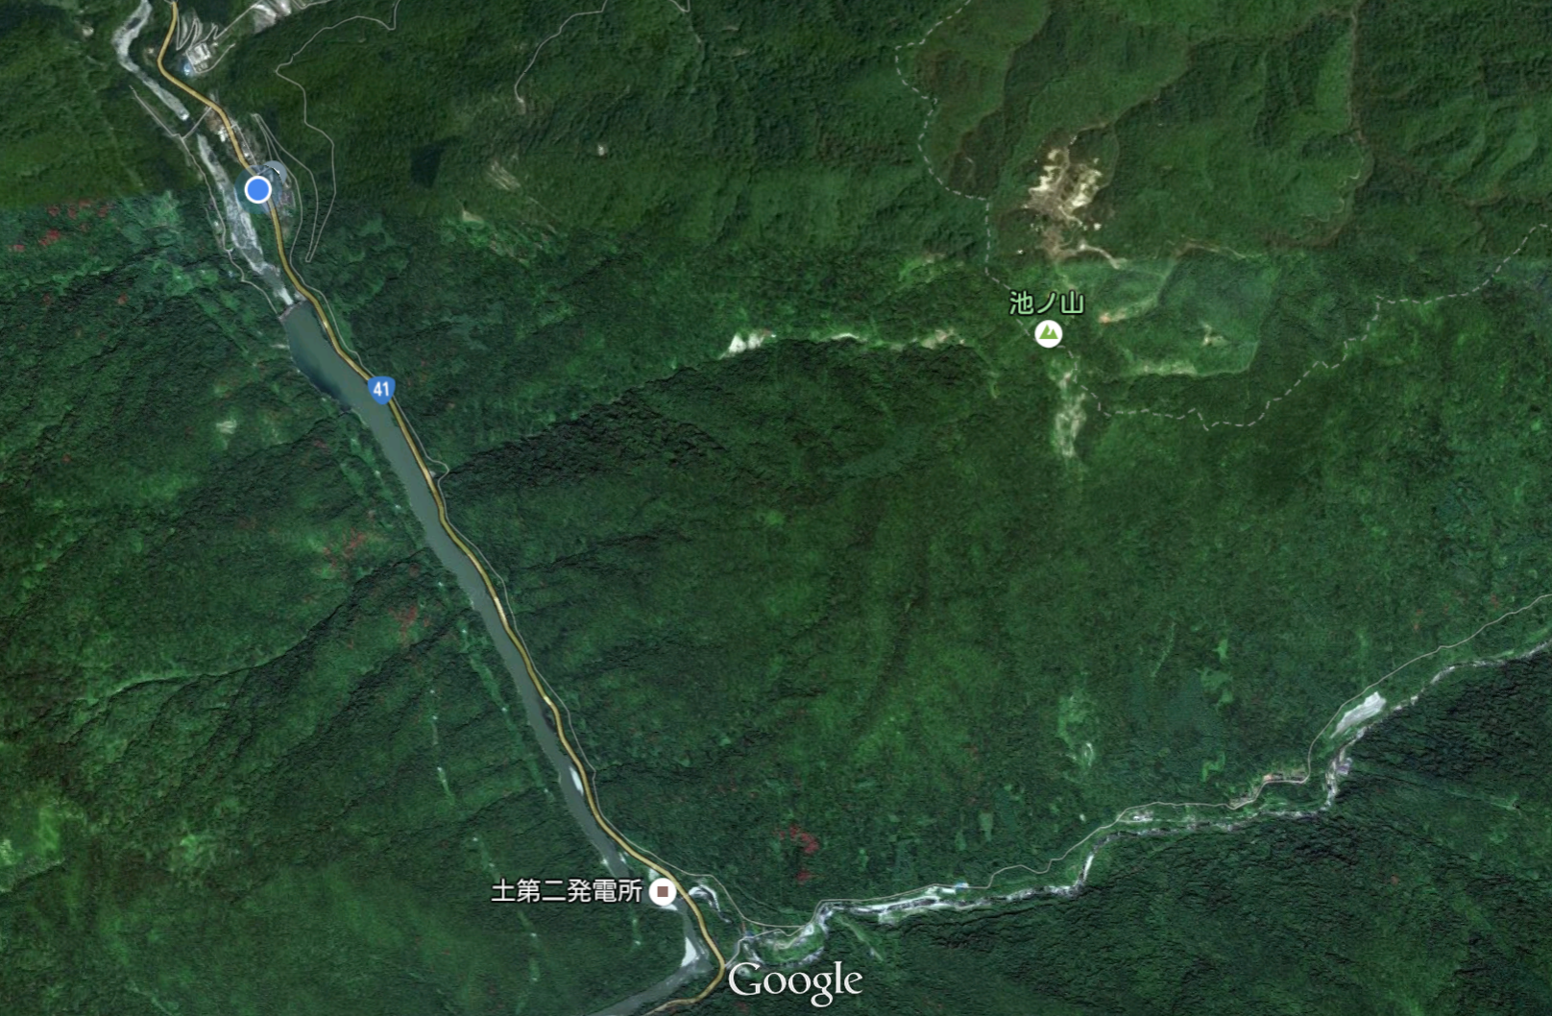
Old mine tunnel
GW Office
Mozumi village
XMASS
(Dark Matter)
Mt. Ikenoyama
CLIO
(GW)
Kamland
(Neutrino)
Super Kamiokande
(Neutrino)
3km Y Tunnel
Route 41
KAGRA
3km X Tunnel
New Atotsu Entrnce
From K. Kokeiyama

Slide 43
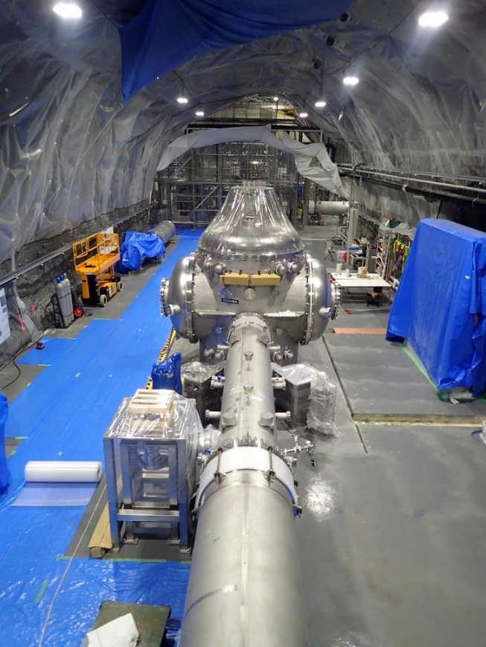
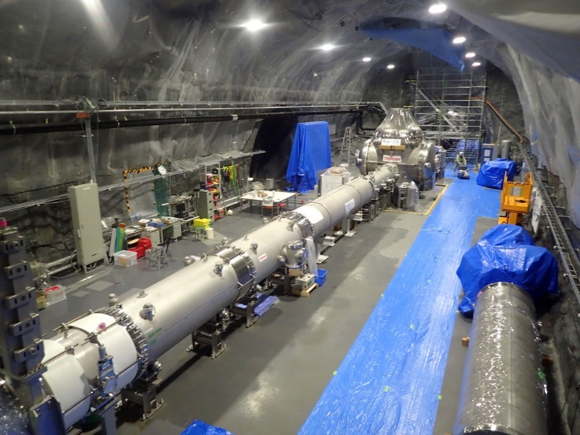
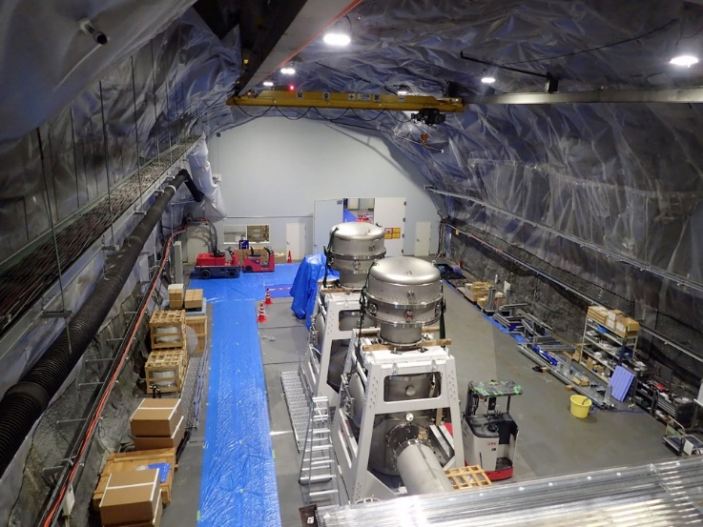
KAGRA
Working Underground...
Y
BS
To 3km tunnel
Laser room
X
BS
Detection
Port side
From K. Kokeiyama
2018. 3. bKAGRA-phase1 3km simple Michelson ifo in cryogenic w/ large suspensions
2019 bKAGRA-phase2 Full configuration in cryogenic
Later 2019 bKAGRA-phase3 Design sensitivity

Slide 44

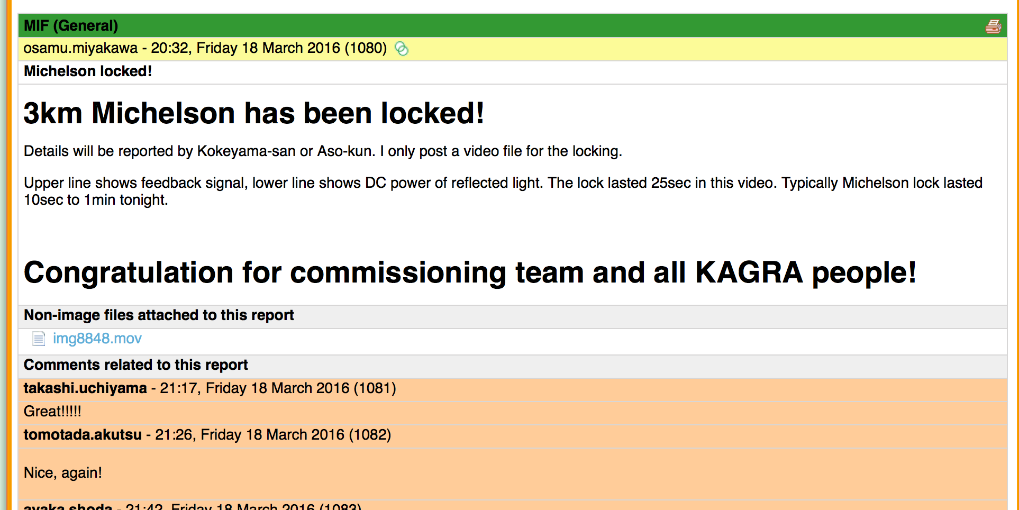

Slide 45
LISA Pathfinder
S. Vitale:
LISA Pathfinder launched on 11 Feb 2016
Started operation on 01 March 2016.
On April 2016, LISA pathfinder got already the LISA requirements : noise at 5x10⁻¹⁵ ms⁻²Hz^{-1/2} at 10⁻³ Hz
Continue until May 2017
LISA call for L3 mission of ESA: fall of 2016 instead of 2019 → launch of LISA: 2029

Slide 46
May 16-18, 2016
From S. Vitale

Slide 47
Future opportunities
Make precision measurements of black holes to test details of GR predictions.
  QNM’s
  EMRI’s
Observe the Planck-era universe through gravitational wave signatures in
  CMB polarization
  Stochastic background of gravitational waves
Detect dark matter
Understand dark energy
… serendipitous discovery of any new phenomena …
From P. Saulson
GR21 (2016) s’est déroulée dans une période charnière
où l’astronomie des ondes gravitationnelles commence,
où l’on engrange beaucoup de mesures et d’informations nouvelles sur l’univers
Et où nous avons encore tant à découvrir sur son contenu et sa dynamique…

Slide 48
Backup slides

Slide 49
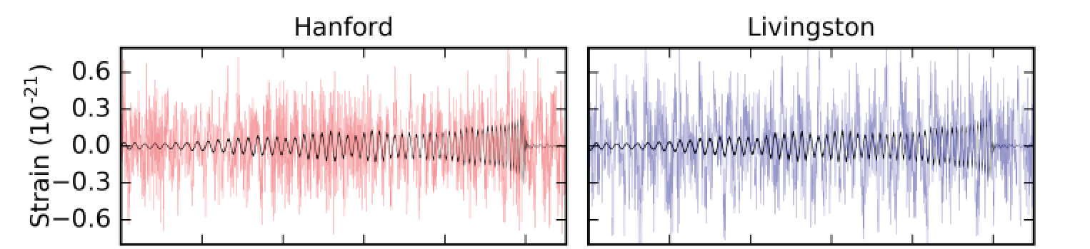
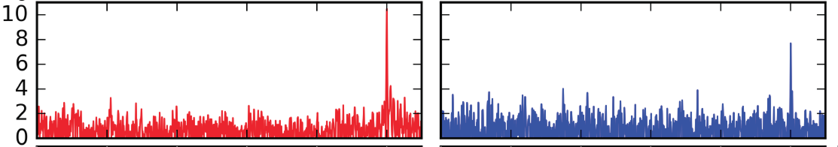
GW151226 : Filtered detector output and filtered best matching waveform
Signal-to-noise (SNR) when best template matches at coalescence time
from G. Gonzalez
Phys. Rev. Lett. 116, 241103 (2016)

Slide 50
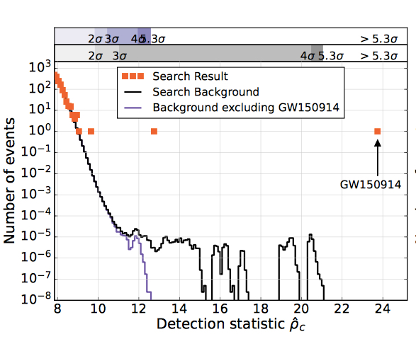
LVT151012
GW151226

Slide 51
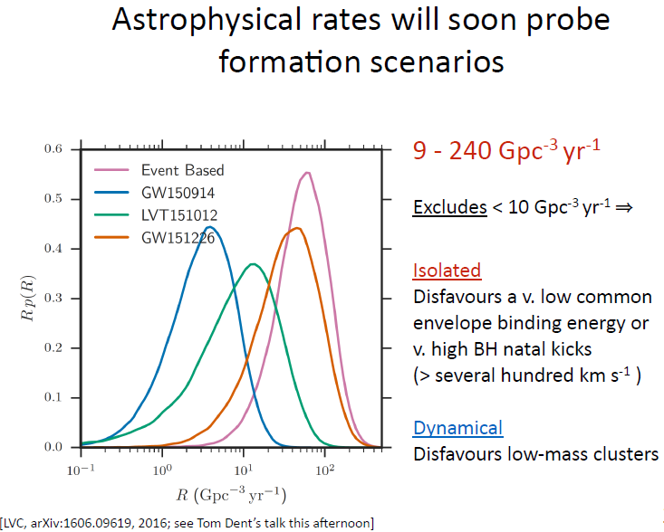
From S. Nissanke

Slide 52
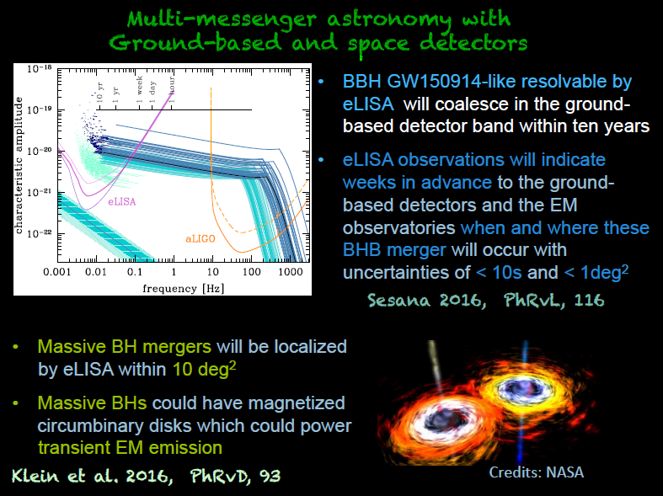
from M. Branchesi

Slide 53
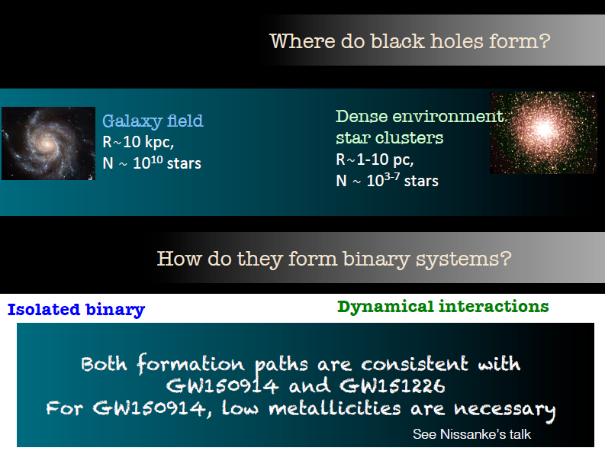
from M. Branchesi

Slide 54
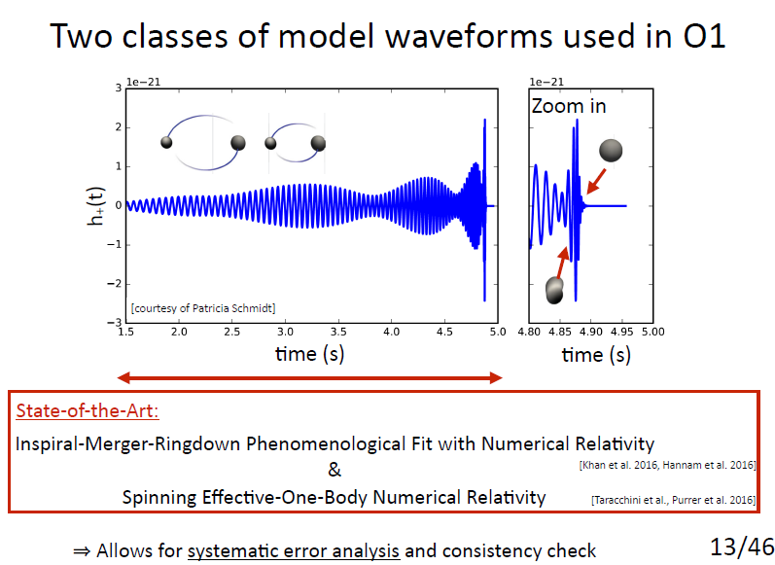
From S. Nissanke

Slide 55
From S. Nissanke

Slide 56



Gravitational Wave Generation
Gravitational Wave Propagation
Scalar/Vector Field Activation
Modified Dispersion Relations
Gravitational Parity Violation
Modified Kinematics
Test Fundamental Pillars
of GR
Gravitational Lorentz Violation
Gravitational Lorentz Violation
Extra-Dimensional Leakage
Cosmological Screening
Time-Variation of G
Time-Variation of G
Spacetime Dimensionality
Speed of Gravity
Parity Violation
Mass of Graviton
Lorentz Violation
Lorentz Violation
SEP Violation
SEP Violation
From N. Yunes

Slide 57

GW consistency with GR places constraints
on modified gravity in eXtreme regime
GW tests of extreme gravity will necessarily become much stronger
(more detections, higher SNR, more physical effects, other binaries e.g. NSNS, electromagnetic counterparts, etc.)
More interplay between Particle Theorists and eXtreme Gravity
(how are GW bounds related to other bounds and to coefficients in an effective action, like SME action? Are there other LV effects we can constrain?)
From N. Yunes

Slide 58
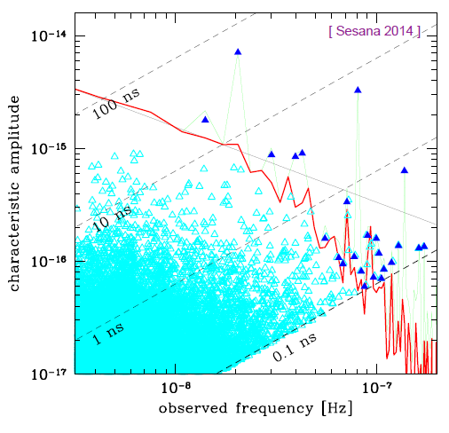
The nano-Hertz stochastic gravitational wave background
See also
arXiv:1407.5693
From N. Wex

Slide 59
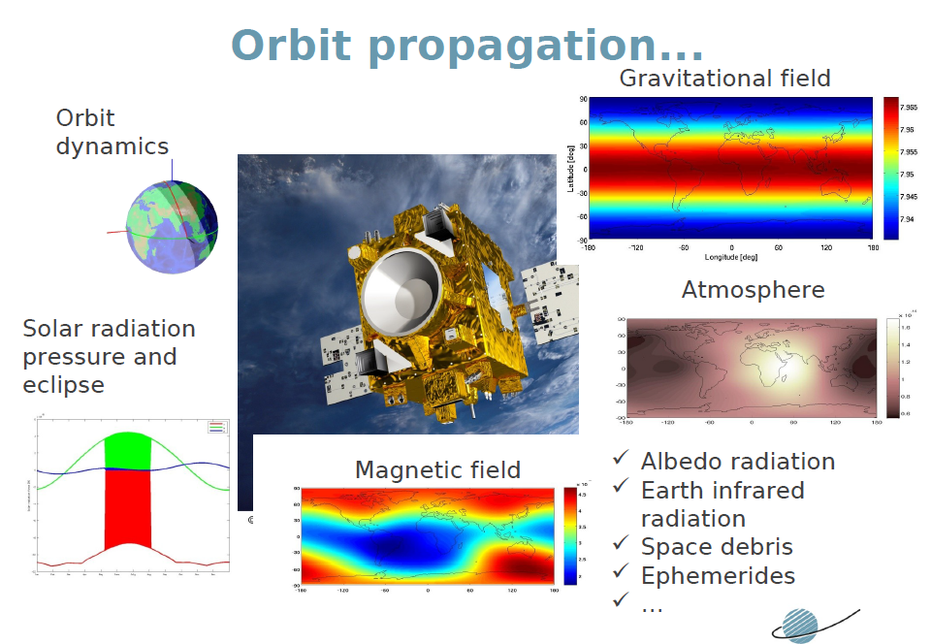
MICROSCOPE
From M. List

Slide 60
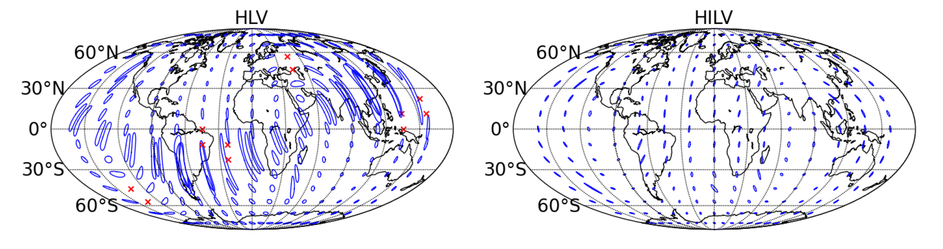
From K. Kokeiyama

Slide 61
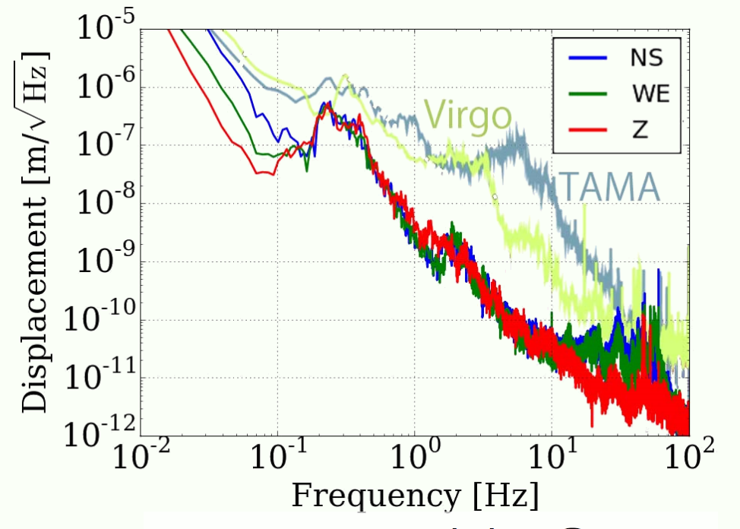
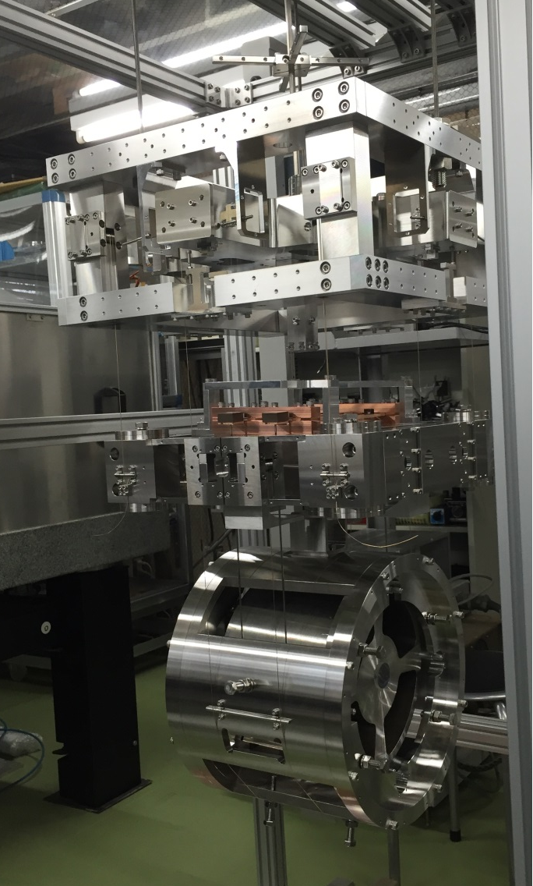
Some news about KAGRA
Underground Cryogenic
Cryo-payload (prototype)
From K. Kokeiyama
Photo by Tomaru, JGW-G1605303

Slide 62


iKAGRA bKAGRA
FY 2010 - 2015
FY 2016 -
Simple MI
Room Temperature
Simpler suspensions
To obtain experiences
Full configuration
Large suspensions
Cryogenic
To start GW astronomy
From K. Kokeiyama

Slide 63
Some news about KAGRA
 | 2010 | 2011 | 2012 | 2013 | 2014 | 2015 | 2016 | 2017 | 2018
Project Start
Tunnel
iKAGRA
bKAGRA
Operation
iKAGRA Run
Large SUS installation
Cryogenic prep.
Cryogenic run
2018. 3. bKAGRA-phase1 3km simple Michelson ifo in cryogenic w/ large suspensions
2019 bKAGRA-phase2 Full configuration in cryogenic
Later 2019 bKAGRA-phase3 Design sensitivity
From K. Kokeiyama

Slide 64

bKAGRA phase 1
2017.10 (cryo payload)
2017.11 (full sus)
2017.3
2017.10 (cryo payload)
2018.3 (Full sus)
2017.5
From K. Kokeiyama

Slide 65

From S. Vitale

Slide 66


Slide 67

From S. Vitale

