Slide 1
GeantV – Particle Transport Spanning CPUs and Accelerators
John Apostolakis (CERN) for the GeantV development team
G.Amadio (UNESP), Ananya (CERN), J.Apostolakis (CERN) , A.Arora (CERN), M.Bandieramonte (CERN), A.Bhattacharyya (BARC) , S.Behera(BARC), C.Bianchini (UNESP), R.Brun (CERN), Ph.Canal (FNAL), F.Carminati (CERN), G.Cosmo(CERN), J. de Fine Licht (CERN/Univ. of Copenhagen), L.Duhem (intel), D.Elvira (FNAL), A.Gheata (CERN), M.Gheata (CERN), I.Goulas (CERN), F.Hariri (CERN), R.Iope (UNESP), S.Y.Jun (FNAL), D.Kostantinov (CERN), H.Kumawat (BARC), G.Lima (FNAL), A.Mohanty (BARC), T.Nikitina (CERN), M.Novak (CERN), W.Pokorski (CERN), A.Ribon (CERN), R.Sehgal (BARC), O.Shadura (CERN), S.Vallecorsa (CERN), S.Wenzel (CERN), Y.Zhang (CERN)
Notes:
Version 0.5.1 1 Nov 2014 @18:00

Slide 2
Needs and opportunities
Experiments need a large increase of statistics from detector simulation for HL-LHC (2025), with constant budget
Detector simulation is consuming ~50% LHC grid computing resources, most of it full simulation using the Geant4 toolkit
Today’s hardware has deep memory hierarchies & SIMD abilities that are under-exploited by today’s HEP software incl. simulation ( Instructions / clock cycle= 0.6-0.8)
Several emerging architectures
GPUs & accelerators (Xeon Phi)
Future evolution
What will lead in 2025 ?
Scalar
SIMD
Instructions
Data
Results

Slide 3
Outline GeantV Goals
Goals
Approach
How to go faster?
Creating a testbed
A new, realistic geometry
Vectorised physics modeling for gammas and electrons
Challenges
Scheduling lots of similar tracks – as many as possible
Staying within available memory
Status and prospects
Develop an all-particle transport simulation toolkit with
Physics models ‘a-la Geant4’ but faster, or new improved (where appropriate)
Performance gain of 2 to 5 times vs Geant4
Integrated options for fast simulation
Portable on diverse archi-tectures, e.g. accelerators (GPU, Xeon Phi, ..)
Deploy improved geometry & physics in Geant4

Slide 4
What consumes CPU time in particle transport?
The key components for CPU consumption in a detector simulation are Geometry & Physics
Example from a ‘standalone’ simulation of CMS – i.e. using its detector description and field, but not hits, actions
Events pythia pp → H → ZZ (Z→ all decays) @ = 14 TeV using Geant4 10.2
Other
Geometry
Tracking
Physics
Processes

Slide 5
How we seek to go faster
Collect tracks into ‘sets’ with common attributes (‘baskets’)
Currently tracks inside a logical volume are put into ‘geometry’ baskets
Baskets for tracks undergoing one physics process in development
A basket of tracks dispatched if full (or work queue is low)
Tracks inside the same volume have much work in common
Both the geometry data (daughter tracks) and code are shared
Challenges: overcome extra work & memory of baskets
Work of extra copying for track data is an overhead
Must keep amount of memory for ‘waiting’ tracks under control

Slide 6
Flow of tracks / actions
Scheduler
geometry baskets
Workload manager
Basketizer
Flow
Controller
Event
Server
concurrent
queues
Primary generator
Filters
Geom
Transport
manager
(Fast)
Phys
Physics SOA
Geometry SOA
in development
Physics
(propose step)
Geometry
Interfaces
physics baskets
Field
Propagator
User application
Concurrent
I/O
Hits
MC truth
User
actions
Physics actions
(along step, post step, at rest)
Notes:
The core of GeantV is the track propagator. This is composed by a workload manager, taking as input a basket of tracks in the same logical volume and calling the geometry and physics methods required to perform a “multi-particle” step, plus a scheduler, doing the filtering and basketizing of tracks coming from transport into vectors of tracks grouped by geometry or physics locality criteria. The work is balanced by a concurrent queue shared by many workers.

Slide 7
Components of GeantV
CORE
RUN MANAGER
CONFIGURATION
USER APPLICATION
PHYSICS
EVENT SERVER
BASKETIZER
SCHEDULER
PROPAGATOR
EVENT GENERATOR
GEOMETRY NAVIGATION
CONCURRENCY SERVICES
VecCore
BACKENDS
CONCURRENT I/O
Notes:
Main components of the system in the form of an overview. Several bits and pieces of the initial prototype that grew-up in different phases of the project and now are making up a more coherent framework.

Slide 8
Creating portable code for ‘vectors’/baskets: Part 1: ‘Core’ and Geometry
2 November 2016
From one geometry shape to a full detector

Slide 9
SIMD Programming Models
Auto-vectorization
OpenMP 4.1
Compiler Pragmas
float a[N], b[N], c[N];
for (int i = 0; i < N; i++)
a[i] = b[i] * c[i];
float a[N], b[N], c[N];
#pragma omp simd
#pragma ivdep
for (int i = 0; i < N; i++)
a[i] = b[i] * c[i];
SIMD Libraries, e.g. Vc
Compiler Intrinsics
Inline Assembly
#include <Vc/Vc>
Vc::SimdArray<float, N> a, b, c;
a = b * c;
#include <x86intrin.h>
__m256 a, b, c;
a = _mm256_mul_ps(b, c);
asm volatile(“vmulps %ymm1, %ymm0”);

Slide 10
VecCore Library API
namespace vecCore { …
// Get/Set template <typename T> Scalar<T> Get(const T &v, size_t i); template <typename T> void Set(T &v, size_t i, Scalar<T> const val); // Gather/Scatter template <typename T, typename S = Scalar<T>>
T Gather(S const *ptr, Index<T> const &idx);
template <typename T, typename S = Scalar<T>>
void Scatter(T const &v, S *ptr, Index<T> const &idx); // Mask / Blend template <typename T> void MaskedAssign(T &dst, const Mask<T> &mask, const T &src); template <typename T> T Blend(const Mask<T> &mask, const T &src1, const T &src2); …
} // namespace vecCore
Get()
Set()
Gather()
Scatter()
Blend()
MaskedAssign()
mask

Slide 11
Portable SIMD with VecCore
Need: common source for scalar/vector CPU, GPU (CUDA)
Seek near-native performance (near ‘intrinsics’)
Used C++ templates and created concept of ‘backend’
Abstraction of (scalar & vector) versions of (types & operations)
Vc::Vector Backend
Vector ‘backends’
Vc library
UME::SIMD
‘Loop’ scalar for auto-vectorisataion
Other ‘backends’
Scalar
CUDA
#include <Vc/Vc> namespace vecCore { template <typename T> struct TypeTraits<Vc::Vector<T>> { using ScalarType = T; using MaskType = typename Vc::Vector<T>::MaskType; using IndexType = typename Vc::Vector<T>::IndexType; }; namespace backend { template <typename T = Real_s> class VcVectorT { public: using Real_v = Vc::Vector<T>; using Float_v = Vc::Vector<Float_s>; using Double_v = Vc::Vector<Double_s>;
using Int_v = Vc::Vector<Int_s>; using Int32_v = Vc::Vector<Int32_s>; using Int64_v = Vc::Vector<Int64_s>; using UInt_v = Vc::Vector<UInt_s>; using UInt32_v = Vc::Vector<UInt32_s>; using UInt64_v = Vc::Vector<UInt64_s>; }; using VcVector = VcVectorT<>; } // namespace backend } // namespace vecCore

Slide 12
Code Example: Quadratic Solver
Simple Implementation
VecCore API Implementation
template <typename T> int QuadSolve(T a, T b, T c, T &x1, T &x2) { T delta = b * b - 4.0 * a * c; if (delta < 0.0) return 0; if (delta < std::numeric_limits<T>::epsilon()) { x1 = x2 = -0.5 * b / a; return 1; } if (b >= 0.0) { x1 = -0.5 * (b + std::sqrt(delta)) / a; x2 = c / (a * x1); } else { x2 = -0.5 * (b - std::sqrt(delta)) / a; x1 = c / (a * x2); } return 2; }
template <typename Float_v, typename Int32_v> void QuadSolveVecCore(Float_v const &a, Float_v const &b,
Float_v const &c,
Float_v &x1, Float_v &x2, Int32_v &roots) { Float_v a_inv = Float_v(1.0f) / a; Float_v delta = b * b - Float_v(4.0f) * a * c; Mask<Float_v> mask0(delta < Float_v(0.0f)); Mask<Float_v> mask2(delta >= NumericLimits<Float_v>::Epsilon()); Float_v root1 = Float_v(-0.5f) * (b + math::Sign(b) * math::Sqrt(delta)); Float_v root2 = c / root1; root1 = root1 * a_inv; MaskedAssign(x1, mask2, root1); MaskedAssign(x2, mask2, root2); roots = Blend(Mask<Int32_v>(mask2), Int32_v(2), Int32_v(0));
Mask<Float_v> mask1 = !(mask2 || mask0); if (MaskEmpty(mask1)) return; root1 = Float_v(-0.5f) * b * a_inv; MaskedAssign(roots, Mask<Int32_v>(mask1), Int32_v(1)); MaskedAssign(x1, mask1, root1); MaskedAssign(x2, mask1, root1); }

Slide 13
VecGeom: Requirements + Goals
Geometry is one of the most important pillars of simulation
GeantV needs geometry library …
able to handle baskets/vectors of tracks in all algorithmic parts (basket API)
designed for any heavily multi-threaded frameworks, allowing for rapid track/context switches
able to compile/run on accelerators (GPU, KNL, …) and take advantage of their specificity
Target performance and SIMD acceleration in all aspects
Target SIMD speedup by handling vectors of tracks
Or SIMD speedup of complex algorithm handling one track (internal vectorization)

Slide 15
Typical algorithic pipleline in navigation

Slide 16
VecGeom: Improving each Shape
Better algorithms compared to previous implementations
Basket interface with SIMD gains (in simple geometry primitives)
Portable code (CPU and GPU/CUDA)
Portable SIMD (SSE to AVX-512)
1
2
Speedup of basket treatment (100,000 tracks) against VecGeom scalar CPU version
1
2
1
1
 | SSE | AVX 2 | AVX-512 | CUDA
Dist. To In | 1.6 | 2.1 | 2.5 | 32
Safety To In | 2.4 | 2.5 | 3.6 | 22
Con-tains | 1.7 | 2.2 | 3.4 | 14
2
2
|SafetyToIn|
Time for a tube segment’s key methods
Notes:
these numbers are just to show the principle …
more detailed numbers to be shown in accelerator section

Slide 17
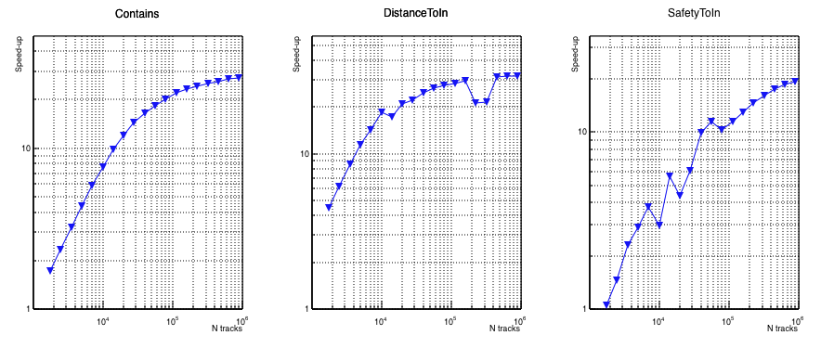
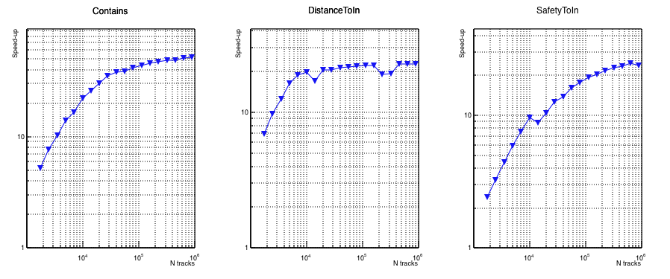
GPU
Tube
Tube
Tube
10
Demonstrated that we can use on GPU the same source code as CPU
Investigated performance scaling with size of input track
Calculation only – assume communication is overlapped
’Reasonable’ x20 speedup requires O(10⁴) tracks!
10
10
THOST /TGPU
THOST /TGPU
THOST /TGPU
Contains
DistanceToIn
SafetyToIn
Ntracks
10⁵
10⁶
10⁴ 10⁵ 10⁶
10⁵
10⁶
10⁴ 10⁵ 10⁶
10⁴
10⁴
10⁴
10⁵
10⁶
Ntracks
Ntracks
10⁴ 10⁵ 10⁶
Trapezoid
Trapezoid
Trapezoid
10
10
10
THOST /TGPU
Contains
THOST /TGPU
DistanceToIn
THOST /TGPU
SafetyToIn
10⁴ 10⁵ 10⁶
10⁶
10⁵
10⁶
10⁴ 10⁵ 10⁶
10⁴
10⁴
10⁵
10⁴ 10⁵ 10⁶
Ntracks
Ntracks
Ntracks
10⁴
10⁵
10⁶

Slide 18
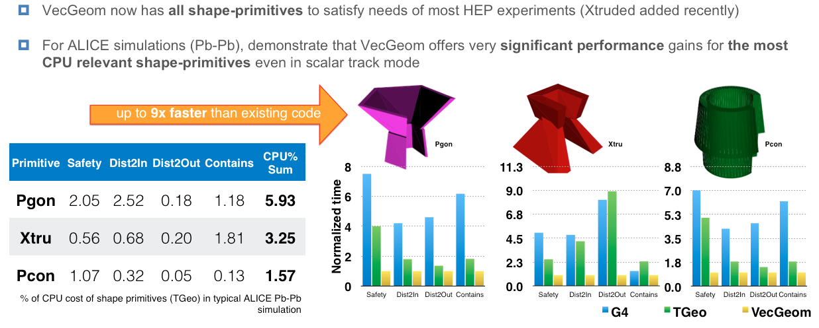
Shape Primitives Status: The ALICE Use-Case
Depending on experiment, a few % in CPU simulation cost could be gained by
switching to VecGeom primitives (integration effort into G4/TGeo under way)
Depending on experiment, a few % in CPU simulation cost gainable by switching to VecGeom primitives (integration effort into G4/TGeo under way; see separate talk)
Depending on experiment, a few % in CPU simulation cost gainable by switching to VecGeom primitives (integration effort into G4/TGeo under way; see separate talk)

Slide 19
The Navigation Module
“Single-object” problem
Geometry primitives provide algorithms for simple ray - shape problems (individual object)
“From individual objects to setups/scenes”
Navigation provides “multi-object” algorithms:
provides next colliding object + distance in a “multi-object” scene
provide object after the next boundary crossing
simulations spend significant time in navigation module (ALICE ~30% with TGeo, similar in CMS, …)
“Multi-object” problems
Goals / Targets:
Implement navigation system in VecGeom scaling to many particles and many threads
Implement acceleration structures for fast candidate rule-out (scaling ~log(N) - see voxel techniques of G4/TGeo)
Target explicit SIMD acceleration
“toy” 2D representation

Slide 20
SIMD Acceleration of Voxel Navigation
Canonical solution for fast hit-detection: tree structures, lookup structures, bounding boxes, …
How to combine this with SIMD paradigm?
Followed idea based on using (aligned) bounding boxes of geometry objects to filter good hit candidates
ray bounding box intersection test
=
ray bounding box intersection test
“done in same CPU time“
Get SIMD gain from treating group of boxes in concert
Get scaling from hierarchies of bounding box groups (forming regular trees)
Inspired from literature & existing ray tracing libraries (Intel Embree). In particular
Shallow bounding volume hierarchies for fast SIMD ray tracing of incoherent

Slide 21
Navigators: general & specialized
More
Navigation checks all or just ‘relevant’ volumes – harder to speed up in complex setups since much work is not common
New vector-friendlier voxelization (general) and use of ‘static’ knowledge about exact volumes (specialized) retains VG speed gain!
Volume | G4 | TGeo | VecGeom Normal | VecGeom Specialized | G4/VecGeom Specialized
ZNST | 0.24 | 0.28 | 0.10 | 0.06 | 4
ZNGx | 0.09 | 0.18 | 0.06 | 0.03 | 3
AFaGraphiteCone | 0.74 | 0.36 | 0.11 | 0.03 | 25
preliminary
Time (sec) for 500K tracks; worst=red; best=blue. Ratio
Important volumes (by number of steps in ALICE Pb-Pb simulation) and measured time to do one “step” (per track) in the volume
Navigator specialization delivers extra speedup – this requires extra pre-processing of geometry or use of JIT compiler at runtime.
Notes:
Note:

Slide 22
Part 1 - Summary
Created a “platform” VecCore for writing code kernels which are
portable between scalar/vector CPUs and accelerators/GPUs, and
harness the performance potential of each hardware type.
Extended the existing USolids library to deal with multiple tracks (and also vectorise some shapes for single track)
Demonstrated the performance potential of VecCore – e.g. speedups 2.0-3.5 for different shapes’ algorithms on today’s CPU hardware using AVX instructions.
Created new navigation algorithms in VecGeom
demonstrate good speed for the case of single track (voxelisation)
Tackling the most difficult case of handling multiple-tracks for volumes with many daughters (candidates), with
providing excellent speedup in realistic benchmarks taken from LHC experiment use cases using the first (‘normal’) & second generation (‘specialised’) navigators.
Looking to bring 2nd generation into GeantV production, and seek further avenues for improvement

Slide 23
Creating portable code for ‘vectors’/baskets: Part 2: EM Physics
2 November 2016
Models for gammas, electrons & positrons

Slide 24
GeantV Physics
Initial rough ‘physics’ sampled from ‘tables’ pre-computed
Interactions sampled at fixed energies (‘tabular’) only meant/used as a start-up crutch (to allow ‘full’ but approximate showers)
Models for photon used distributions from Geant4 models,
vectorized the sampling of final states
verification tool created to aid development of sampling methods
New models for electrons & positrons – from ground up
Multiple scattering fully redone – incorporates all ingredients of model developed by Kawrakow and Bielajew
Bremsstrahlung and ionization also re-derived & fully redone
Approaches chosen to be suitable for vectorized sampling

Slide 25
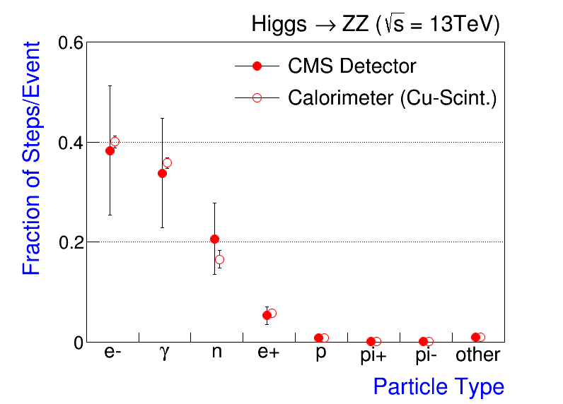
First Target : EM Physics
Fraction of the number of steps/event by the particle type (roughly) Fraction of CPU
e and are major consumers of physics for the typical HEP detector simulation: ~80%
EM physics alone → ~30% of the total CPU time (i.e, 40% x 80%)
Neutron adds +10% (of course, primary interactions of other hadrons are still very important parts of HEP simulation)

Slide 26
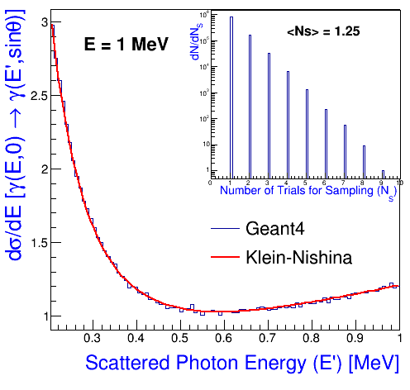
Sampling Algorithms - challenge
Composition and rejection method used in Geant4 physics models: accurate, simple and (reasonably) efficient
Intrinsic problems for SIMD/SIMT
Non-deterministic loop counter (the number of trials in sampling)
Ex: Compton Scattering
// sample x and y for a given yo
do { x = f(r1);
y = g(x,r2);
} while (y < yo);
Not-vectorizable
Cause threads on GPU to diverge
Seek → alternative methods

Slide 27
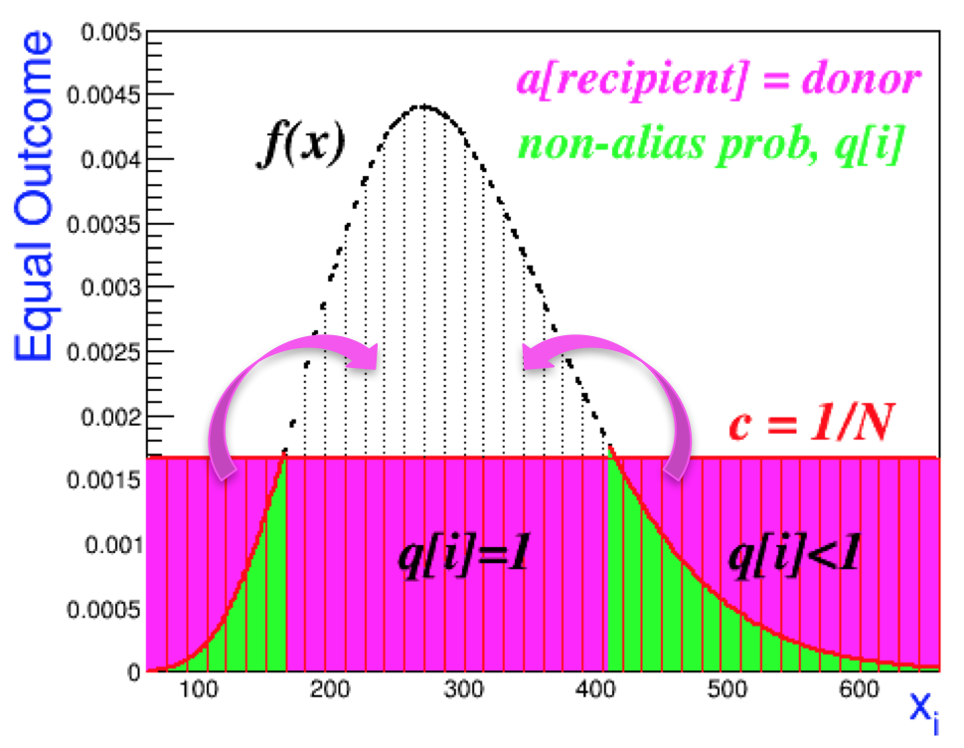
Vectorizable Sampling Algorithms
One of the algorithms examined is the alias method
Recast p.d.f f(x) → c, N equal probable events, each with likelihood 1/N = c
Alias, a[recipient] = donor
Non-alias probability, q[i]
Effectively vectorizable
one time sampling with gather
// uniform sampling: u(0,1)
N $∙$ u = i + α;
j = u< q[i] ? i : a[i];
x_{d} = j dx , x_{u} = (j+1)dx
x_{j} = (1-a) x_{d} + a x_{u}
p.d.f, p[j] = f(x_{j}) for the linear interpolation within the bin dx

Slide 28
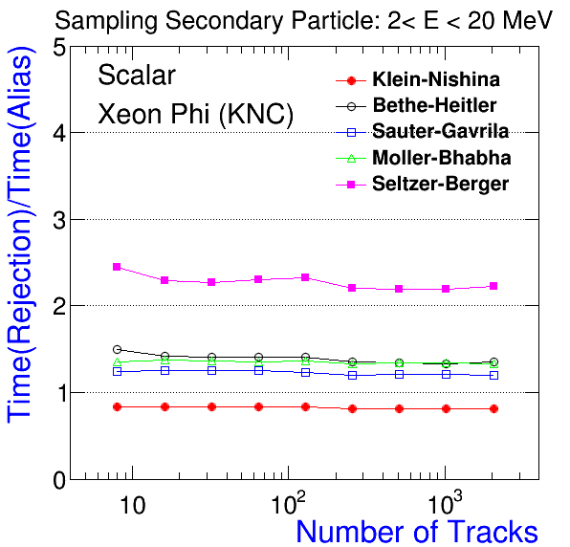
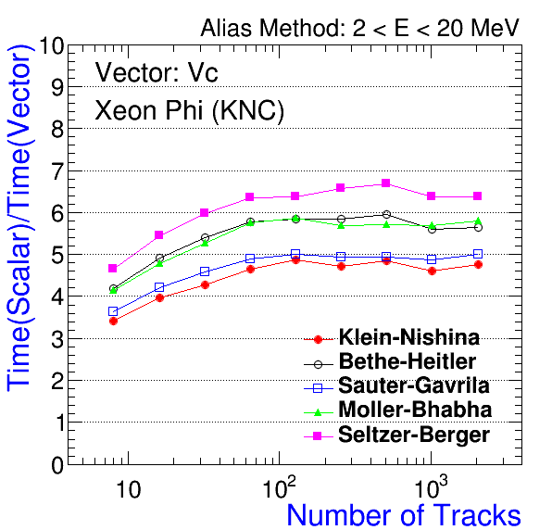
Performance of EM Models: Intel KNC
KNC (Xeon Phi 5110P 60 cores @1.013 GHz): IMCI (8 vectors for double precision)
Simulation of interactions (sampling with alias methods)
Scalar: alias method vs. rejection
Vector: Vc backend + IMCI
Algorithm change
Gain from vectors & multiple tracks

Slide 29
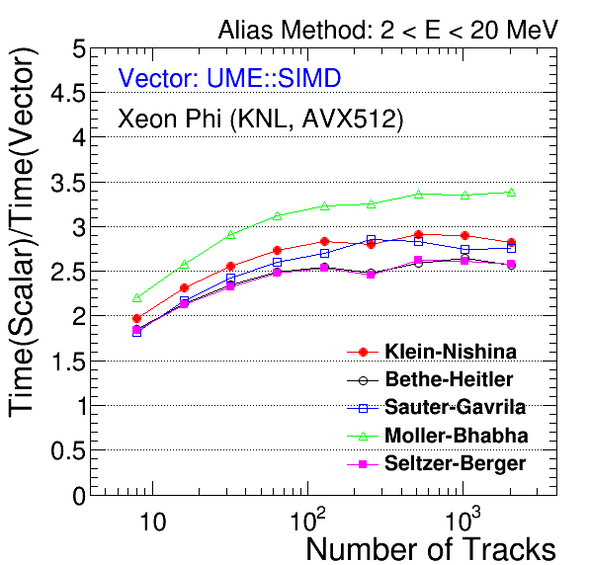
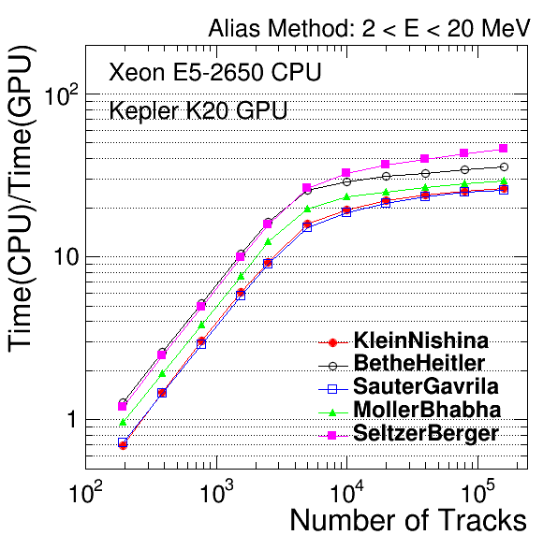
Performance on KNL and GPU
KNL: Xeon Phi 7120 64 cores @1.3GHz: using AVX512 (vectors of 8 double precision)
CUDA: K20 GPU (2496 cores @ 0.7GHz with blocks=26, threads=196) + Xeon E5 (1 core, 2.6GHz)
Vector: UME::SIMD + AVX512
CUDA: Scalar backend
~3
~30

Slide 30
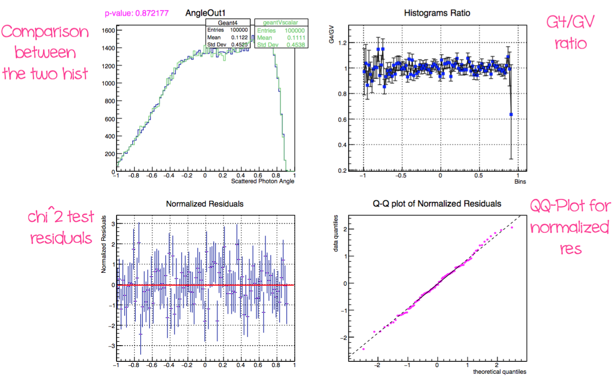
Validation: Statistical Tests
Tests by
Models
Sampling methods
Fixed energies
Pearson-χ² test for comparing weighted and unweighted histograms
Analysis of residuals
QQ-Plots

Slide 31
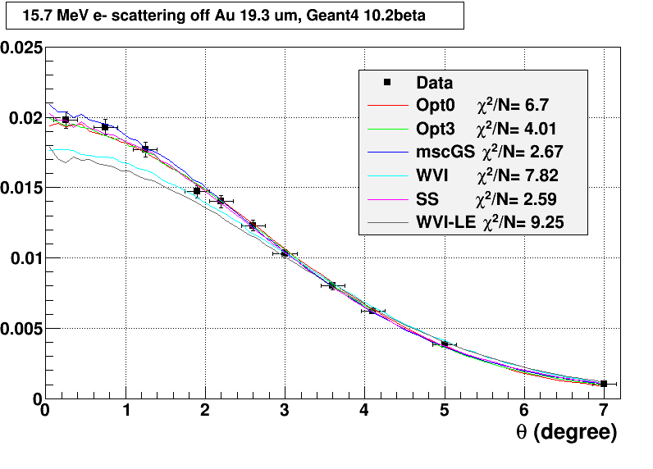
Reviewed e-/e+ multiple scattering
The effects of the new treatment of the angular distributions:
significant speed-up
old : sampling artefacts
new: no any sampling artefacts
New multiple scattering (more):
re-derived from scratch
includes transformation that makes pre-computed angular distributions very smooth
Apply very fast and accurate sampling algorithm for deflection
angular deflection is the most expensive and important part of a multiple scattering model
New stepping algorithm
Implemented to use new sampling
Better accuracy with looser parameters (than G4 Urban model)
option for ‘precise’ boundary crossing’
Provided in Geant4 10.2.beta
Replaced older, slower ‘GS’ model
Implementation continuously improved
* [Exp: A.O.Hanson et al., Phys. Rev. 84(1951)534 ; Geant4 electromagnetic/TestEm5

Slide 32
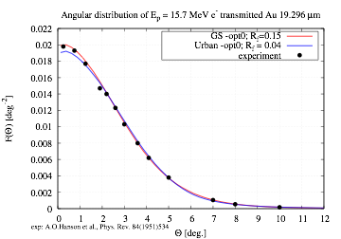
Reviewed models for e-/e+ interactions: multiple scattering
October 2016
The effects of the new treatment of the angular distributions:
significant speed-up
old : sampling artefacts
new: no sampling artefacts
* [Exp: A.O.Hanson et al., Phys. Rev. 84(1951)534 ; Geant4 electromagnetic/TestEm5
geant-dev@cern.ch

Slide 33
New multiple scattering - stepping
October 2016
The effects of the new treatment of the angular distributions:
significant speed-up
old : sampling artefacts
new: no sampling artefacts
The effect of the new stepping algorithm ^{(*)}:
more accurate longitudinal and lateral distributions
more accurate stepping
longer/less steps
Simplified ATLAS barrel calorimeter: 10 [GeV] e⁻, cut 1 [mm]
 | Geant4 EM-std-opt0 | Geant4 EM-std-GS | GS/opt0
#gammas | 5080 | 5080 | 1
#electrons | 8700 | 8710 | 1.001
#positrons | 539 | 538 | 0.998
#charged steps | 35594.2 | 30131.3 | 0.846
#neutral steps | 36433.9 | 36650 | 1.006
* [ I.Kawrakow,A.F.Bielajew, NIMB 142(1998)253-280 Geant4 electromagnetic/TestEM3
geant-dev@cern.ch

Slide 34
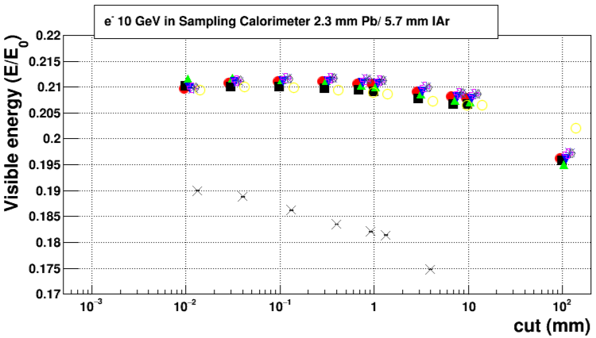
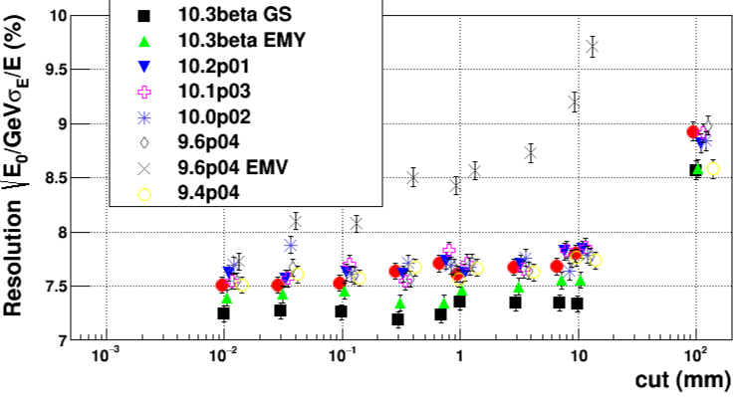
New multiple scattering in calorimeter setups
Open problem:
more accurate multiple scattering models/stepping-settings (GS/EMY) result in underestimated resolution
energy loss fluctuation model and its stability against varying step lengths must be investigated
Geant4 electromagnetic/TestEM3
geant-dev@cern.ch

Slide 35
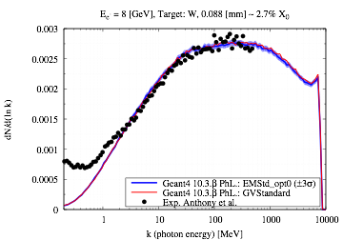
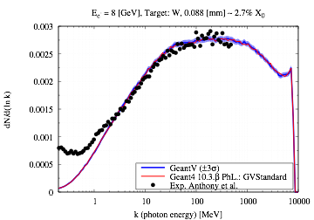
First simulation with new GeantV physics models
Comparison of bremsstrahlung benchmark data from SLAC E-146 in simplified geometry setup
Geant4 full vs Geant4 with γ-physics only
Geant4 vs GeantV – both γ-physics only
[Experimental data: P.L.Anthony et. al, Phys.Rev.D. 56(1997)1373]

Slide 36
EM Physics – Summary & outlook
Vectorized sampling for photon processes created
Adopted alias model – competitive CPU time & vectorisable
Shown good vector speedup for AVX512 (8-wide vectors)
On GPU O(10^4) particles needed for 20x-30x speedup
Validation suite to enable regression testing
Investigating alternative sampling methods
Review of multiple scattering – creating new GS model :
a significantly faster, more accurate version of the model
competitive in CPU speed with the G4 Urban model (in several cases it performs better: accuracy, speed)
new model is fully theory based (i.e. no surprises) – unlike the Urban model
basis for further improvements (e.g. Mott correction for angular distributions)
the model is ready for vectorization and integration into GeantV

Slide 37
Monitoring and tuning the scheduler

Slide 38
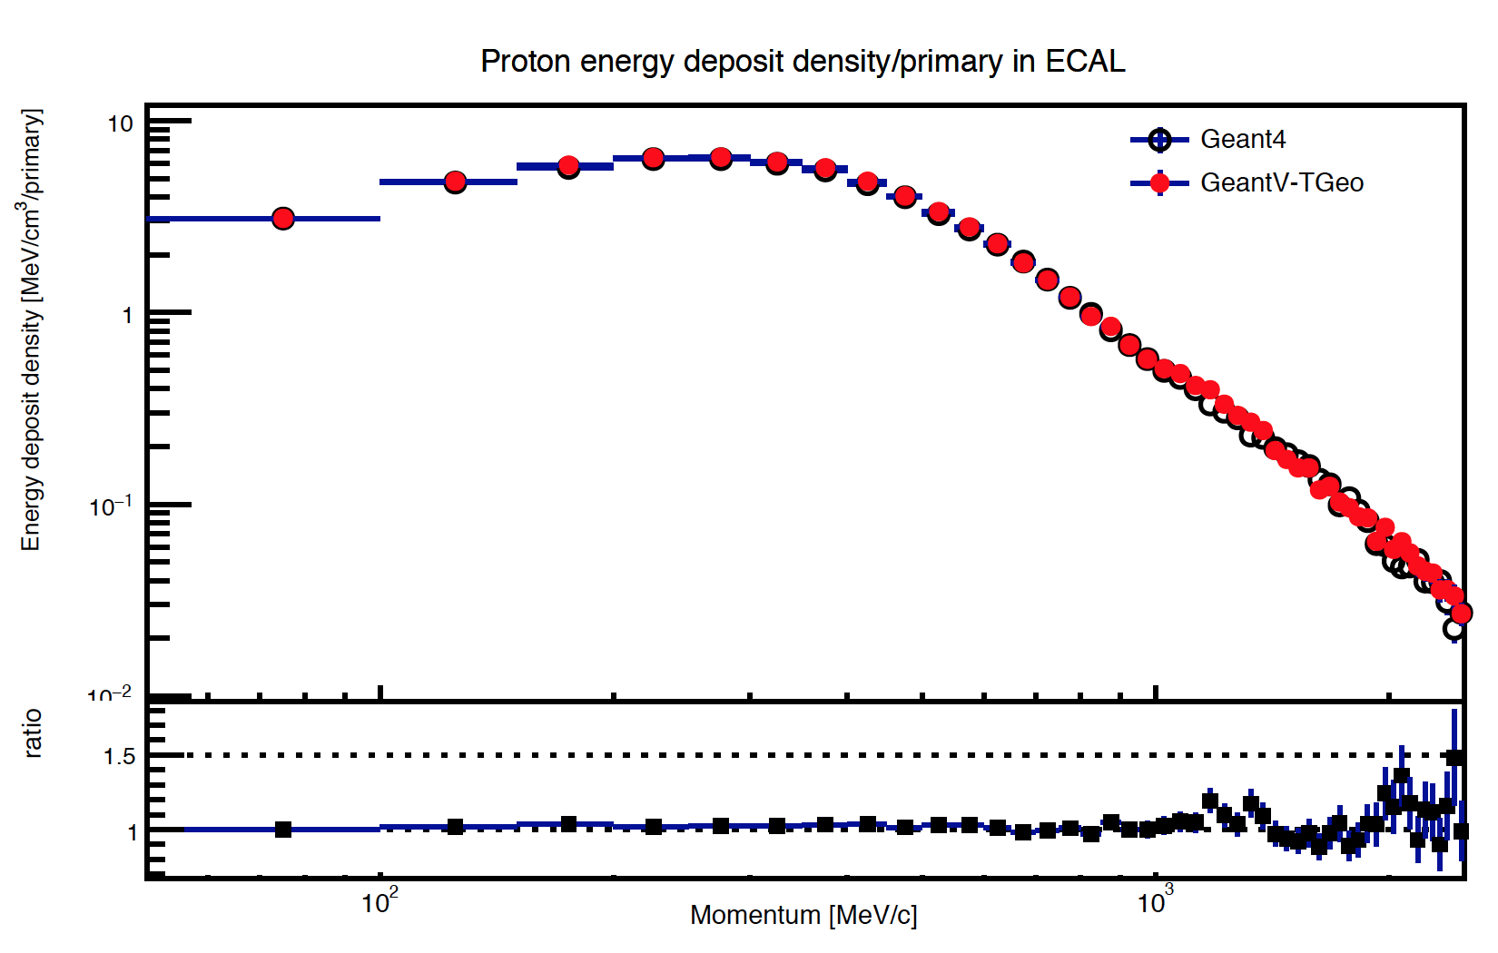
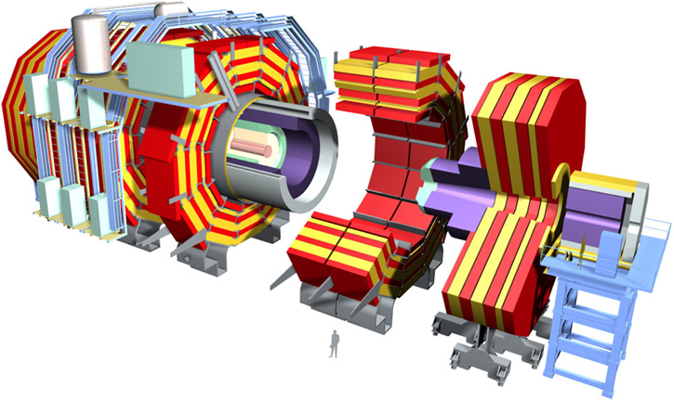
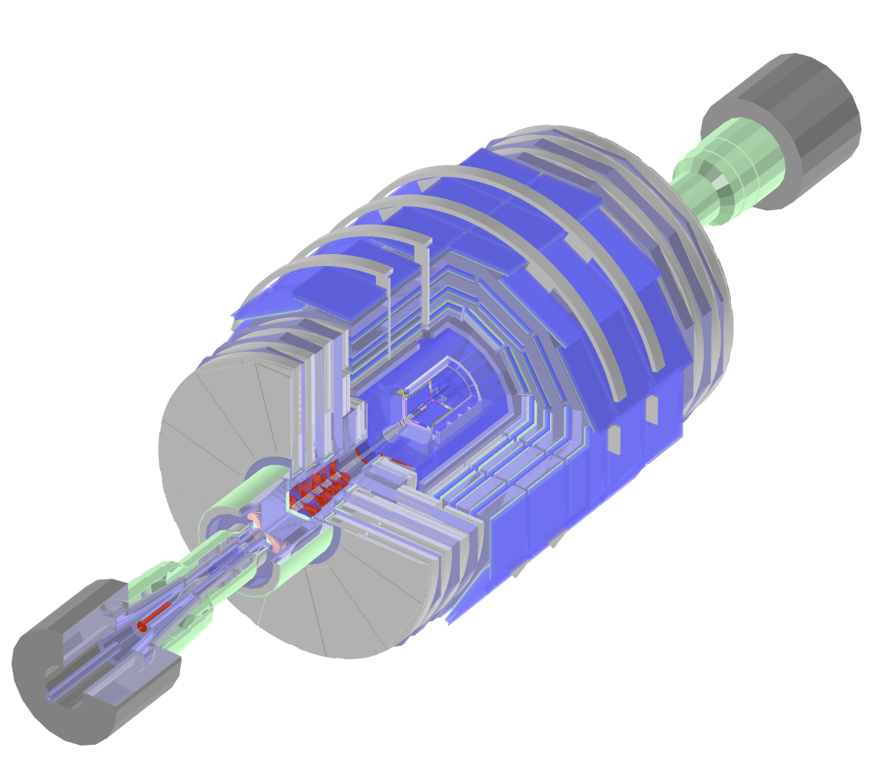
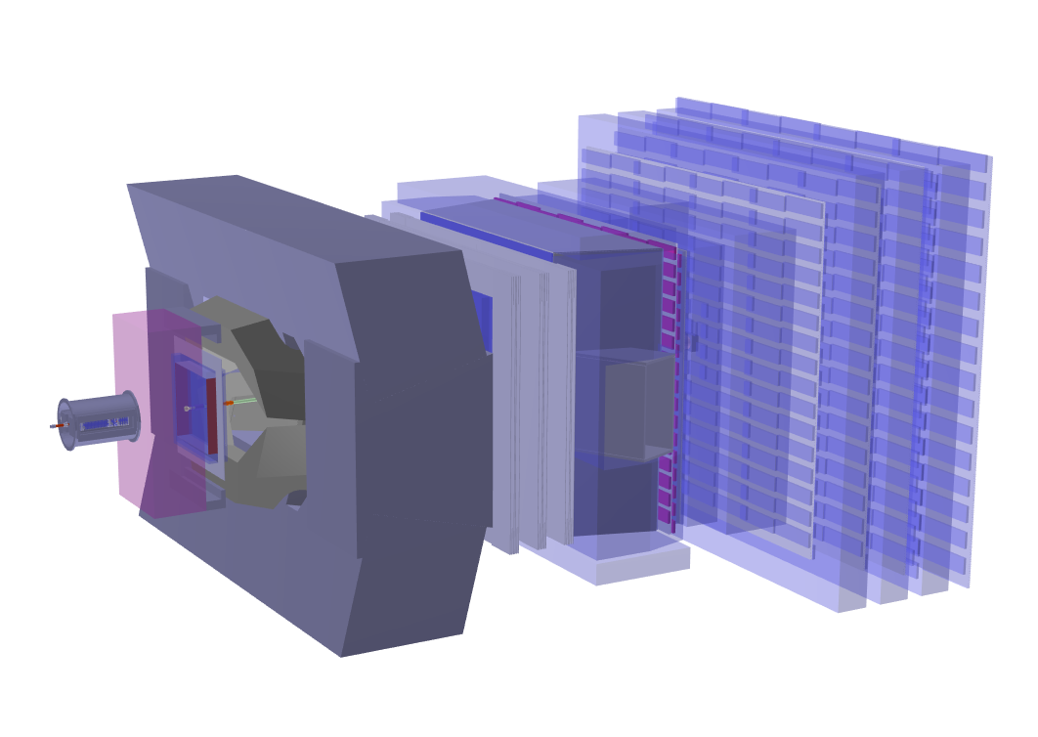
Early trials with LHC setups
Exercise at the scale of LHC experiments (CMS & LHCb)
Full geometry converted to VecGeom + uniform magnetic field
Tabulated physics, fixed 1MeV
Measuring several cumulative observables in sensitive detectors
Energy deposit and particle flux densities for p, π, K
Comparing GeantV single threaded with the corresponding Geant4 application
Geant4.10.2, special physics list using tabulated physics
Comparable signal,
number of secondaries, total steps and physics steps within statistical fluctuations.
T_{G4}/T_{GV} = 3.5
T_{G4}/T_{GV} = 2.5
Speed-up due to:
1.5 - Infrastructure optimizations
2.4 - Algorithmic improvements in geometry
3.5 - Extra locality/marginal basket vectorization
To be profiled
Physics is very simplified => this just checks that baskets do not kill benefits!
Notes:
The results show that the overheads from rebasketizing are under control. The global approach does not benefit yet from relevant vectorization throughput. This is pre-empted by recent R&D in VecGeom related to navigation specialization, opening these opportunities. Some of the improvements (geometry scalar) can be back-ported to G4.

Slide 39
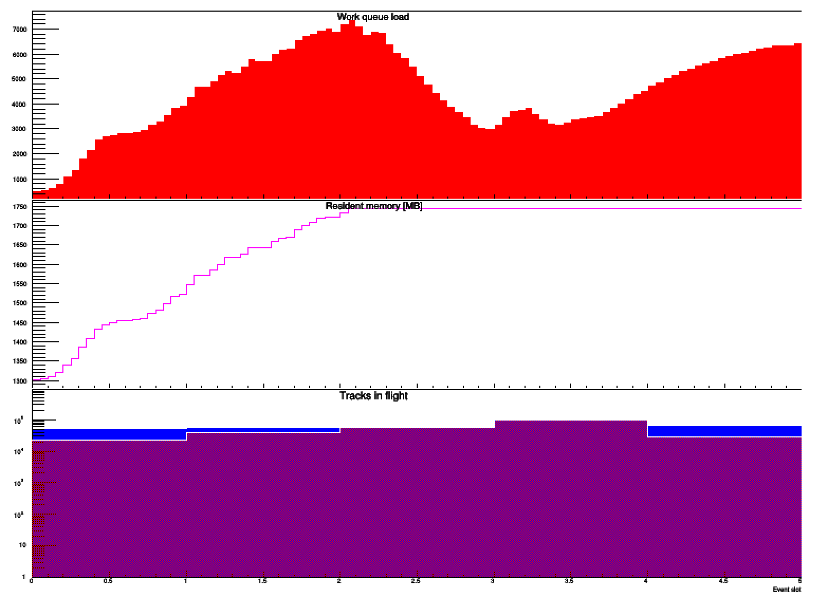
Memory use: monitor & control
Memory proportional to number of tracks “in flight”
Determined by showering and the number of events “in flight”
Control of memory is critical for low values of production cuts
Number of secondary particles produced can ‘explode’, i.e. flood memory
Currently delete empty baskets when a memory watermark is reached
Keeps the memory constant
Extra levers (future work):
Reduce dynamically the number of events in flight
Add “back burner” – waiting queue for high(er) energy tracks
queued baskets
memory
tracks in flight
Notes:
High energy tracks represent a lot of ”future” work. They can be put on waiting queues to allow low energy particles to fade and disappear if memory is stressed. Idle threads may take with priority from such queue in case memory is fine. Future work)

Slide 40
Ongoing
The VecGeom shape library (USolids) is being integrated in Geant4, where it will become be ‘hardened’ to production quality and replace the existing ‘G4Solids’
Vectorisation of electron/positron models
Integration & validation of vectorised photon models
Integration & validation of propagation in magnetic field
Improved scheduler (reduce copying, add physics baskets. )
Key target: full simulation with all user hooks & complete set of e/γ models by end of 2017.
Aim for full set of hadron physics (using adapted G4 modeling) by end of 2018.

Slide 41
Summary
A substantial set of ‘vector’ geometry primitives (solids) developed in GeantV show promising CPU speedup (~3)
USolids (based on VecGeom code) is available for testing in Geant4, and is the planned replacement of Root & G4 solids.
Navigation: new algorithms developed to maintain speed advantage
New algorithms & use of extra ‘static’ information are key advances
New physics models for electrons created (ready for vectors)
Source code portable to GPUs – requires O(10⁴) tracks for x20 speedup
Working towards benchmark with showers for e-/e+/γ using vectorised geometry & physics
Recent HEP Community Meeting https://indico.cern.ch/event/570876

Slide 42
BACKUP Slides

Slide 43
VecCore Backends
Scalar Backend
Vc::Vector Backend
namespace vecCore { template <typename T> struct TypeTraits { using ScalarType = T; using MaskType = bool; using IndexType = size_t; }; namespace backend { template <typename T = Real_s> class ScalarT { public: using Real_v = T; using Float_v = Float_s; using Double_v = Double_s; using Int_v = Int_s; using Int32_v = Int32_s; using Int64_v = Int64_s; using UInt_v = UInt_s; using UInt32_v = UInt32_s; using UInt64_v = UInt64_s; }; using Scalar = ScalarT<>; } // namespace backend } // namespace vecCore
#include <Vc/Vc> namespace vecCore { template <typename T> struct TypeTraits<Vc::Vector<T>> { using ScalarType = T; using MaskType = typename Vc::Vector<T>::MaskType; using IndexType = typename Vc::Vector<T>::IndexType; }; namespace backend { template <typename T = Real_s> class VcVectorT { public: using Real_v = Vc::Vector<T>; using Float_v = Vc::Vector<Float_s>; using Double_v = Vc::Vector<Double_s>; using Int_v = Vc::Vector<Int_s>; using Int32_v = Vc::Vector<Int32_s>; using Int64_v = Vc::Vector<Int64_s>; using UInt_v = Vc::Vector<UInt_s>; using UInt32_v = Vc::Vector<UInt32_s>; using UInt64_v = Vc::Vector<UInt64_s>; }; using VcVector = VcVectorT<>; } // namespace backend } // namespace vecCore

Slide 44
Vc Library
“Vc: A C++ library for explicit vectorization”, Software: Practice and Experience (2011), M. Kretz and V. Lindenstruth, http://dx.doi.org/10.1002/spe.1149
Vc supports SSE2, SSE3, SSE4.2, AVX, AVX2, and IMCI (MIC).
Vc works very well with both GCC and Clang compilers, and performs best on hardware supporting up to the AVX2 instruction set.
Support for ARM NEON, Nvidia CUDA, and AVX512 is under development, but not yet available. Matthias Kretz is working with C++ standard committee to add SIMD support into the language.

Slide 45
UME::SIMD Library
UME::SIMD is a library for explicit vectorization developed by Przemyslaw Karpinsky (CERN OpenLab).
UME::SIMD has a homogeneous interface for accessing functionality of SIMD registers of AVX, AVX2, AVX512 and IMCI (KNCNI, k1om) instruction sets, and offers the best performance on the Intel® Xeon Phi™ Knights Landing (KNL). UME::SIMD also supports ARM and support for
PowerPC’s Altivec is nearly complete.
UME::SIMD was developed as part of an
ICE-DIP (European Industrial Doctorate) project at CERN.

Slide 46
Real Code Sample: VecGeom Box
Box Implementation of DistanceToIn()
template <typename Real_v> void DistanceToIn(UnplacedStruct_t const &box, Vector3D<Real_v> const &point, Vector3D<Real_v> const &direction, Real_v const &stepMax, Real_v &dist) { const Vector3D<Real_v> invDir(Real_v(1.0) / NonZero(direction[0]),
Real_v(1.0) / NonZero(direction[1]), Real_v(1.0) / NonZero(direction[2])); const Real_v distIn = Max((-Sign(invDir[0]) * box.fDimensions[0] - point[0]) * invDir[0], (-Sign(invDir[1]) * box.fDimensions[1] - point[1]) * invDir[1], (-Sign(invDir[2]) * box.fDimensions[2] - point[2]) * invDir[2]);
const Real_v distOut = Min((Sign(invDir[0]) * box.fDimensions[0] - point[0]) * invDir[0], (Sign(invDir[1]) * box.fDimensions[1] - point[1]) * invDir[1], (Sign(invDir[2]) * box.fDimensions[2] - point[2]) * invDir[2]);
dist = Blend(distIn >= distOut || distOut <= Real_v(kTolerance), Infinity<Real_v>(), distIn); }

Slide 47
New in VecGeom: Reasons for Improvements
Algorithmic improvements
Increased logical decomposition of kernels
Increased pre-computation/caching
Use modern C++; promote inlining; promote better compiler optimization
Explicitly targeting inner SIMD acceleration where appropriate
Template shape specializations
Placement shape specializations

Slide 48
Performance measurements for LHC setups: test matrix
Semantic changes
Scheduler | Geometry | Physics | Magnetic Field Stepper
Geant4 only | Legacy G4 | Various Physics Lists | Various RK implementations
Geant4 or GeantV | VecGeom 2016 scalar | Tabulated Physics Scalar Physics Code | Helix (Fixed Field) Cash-Karp Runge-Kutta
GeantV only | VecGeom 2015 VecGeom 2016 vector Legacy TGeo | Vector Physics Code | Vectorized RK Implementation
3
2
1

Slide 49
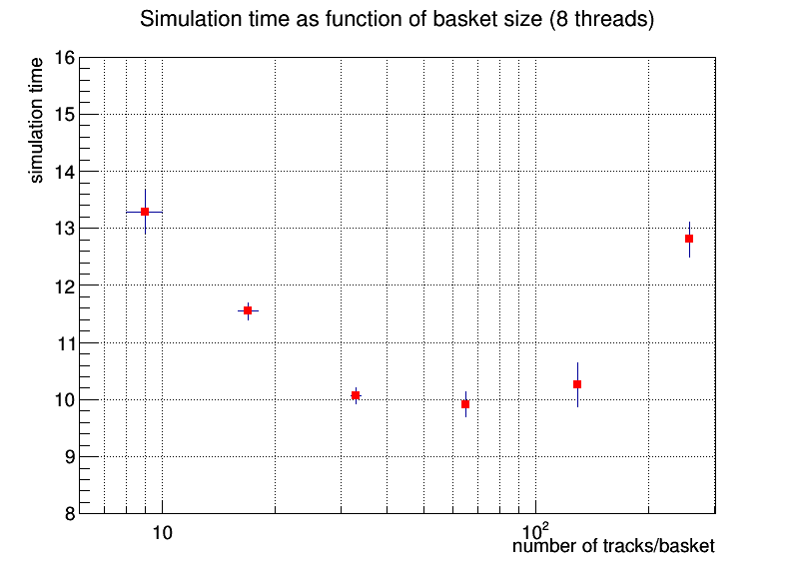
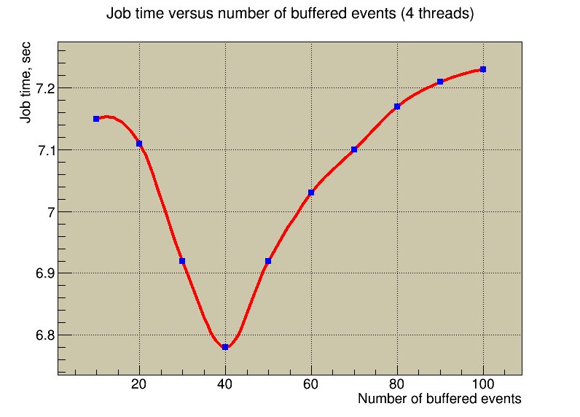
Influence of the scheduler’s parameters
Checking dependence of key characteristic – potential targets for optimisation
E.g. memory vs. computing time
Shallow minima in variation of one parameter at a time
Seeking to explore further
Slowed by frequent refinements
Investigating different approaches for optimisation

Slide 50
Data structures: AOS versus SOA
GeantTrack
GeantTrack_v
Contiguous, aligned buffer
00
40
80
C0
00
fEvent
fNode
fParticle
fPDG
…
fXpos
fYpos
fZpos
fXdir
fYdir
fZdir
…
Edep
Pstep
Snext
Safety
*fPath
*fNextpath
*fEventV
*fNodeV
*fParticleV
*fPDGV
…
*fXposV
*fYposV
*fZposV
*fXdirV
*fYdirV
*fZdirV
…
*fEdepV
*fPstepV
*fSnextV
*fSafetyV
**fPathV
**fNextpath
vector 1
fEventV
fNodeV
fParticleV
…
AOSOA considered also (more cache friendly):
{(xxxx)(yyyy)(zzzz)},
{(xxxx)(yyyy)(zzzz)},
…
fXPosV
fYPosV
fZPosV
…
SOA of fNtracks
fSnextV
fSafetyV
192 bytes + 2*sizeof(VolumePath_t)
fPathV
fNextpathV
vector 2
fEventV
fNodeV
32 tracks ~ 7kBytes
AOS
(xyz)(xyz)(xyz)(xyz)…
SOA (needed for vectorization)
(xxx…)(yyy…)(zzz…)
Ready to use, SIMD-ized, serializable
Overheads for basketizing, data copy, reshuffle operations, larger memory footprint
Morphing AOS->SOA needed during transport

