Slide 1



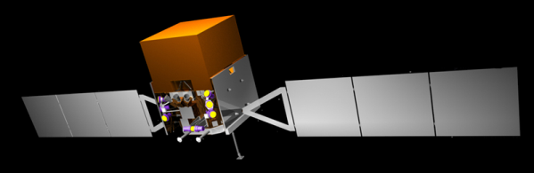
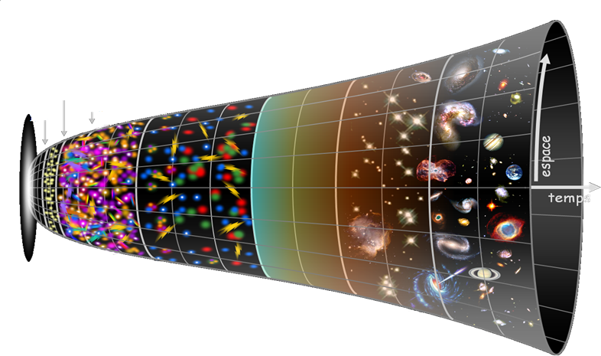
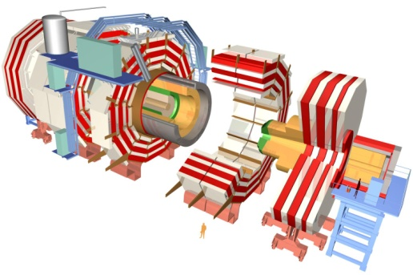
Laboratoire Leprince-Ringuet
our universe
today
~13.7 billions
years old
From elementary particles…
5x10⁺⁹ans
380 000
ans
10⁺⁹ans
10⁻³⁴s
10⁻⁶s
10⁻²s
10⁺²s
10⁻⁴³s
10⁻¹⁰s
Big Bang
… to the heart of galaxies

Slide 2
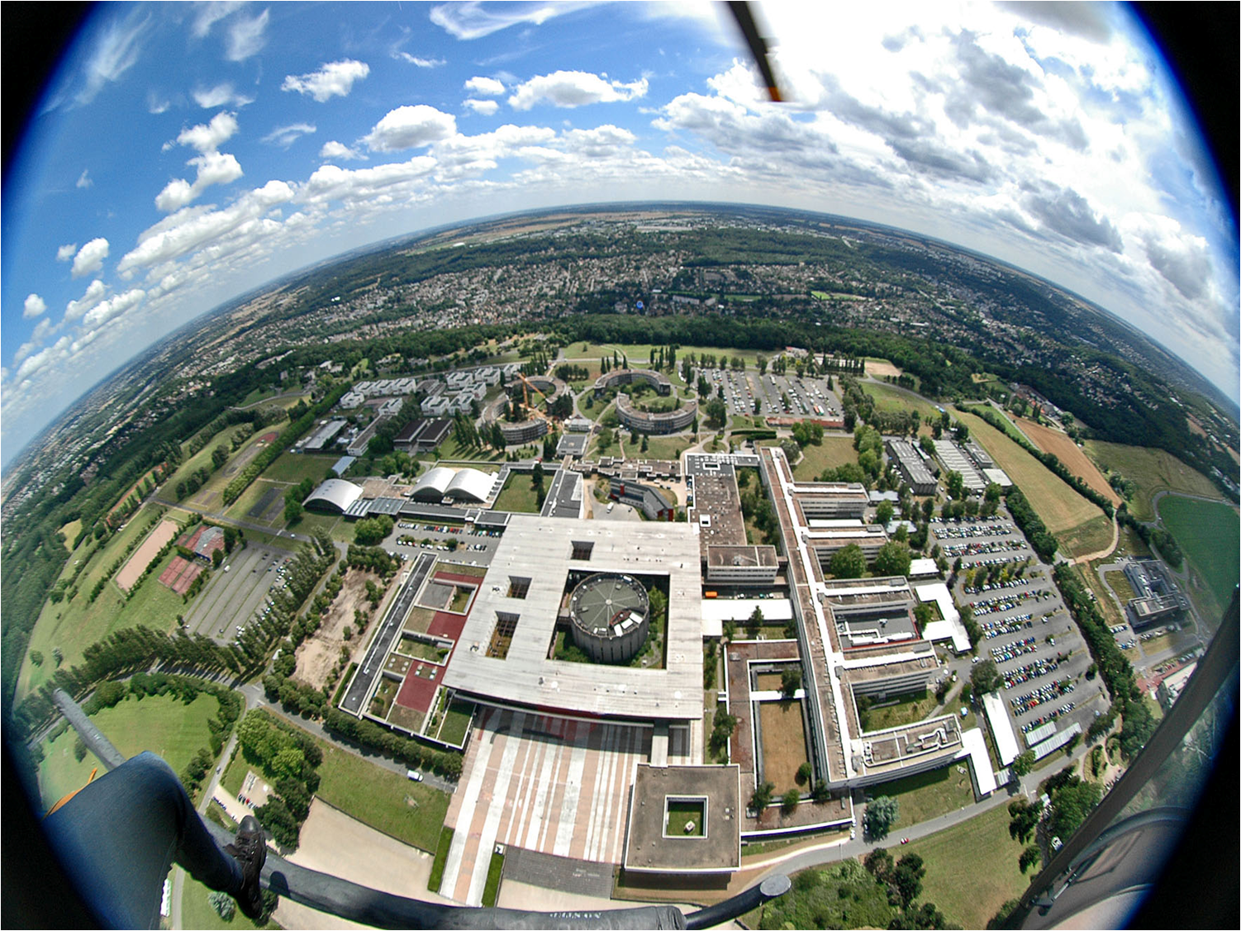
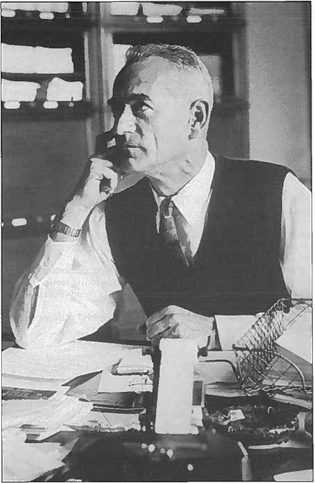
Oldest lab of Ecole Polytechnique (1936)
~ 40 researchers (staff+ postdocs)
~ 50 engineers and technicians
~ 10-15 PhD students
Research centre
22 labs
(9 in physics)

Slide 3
Laboratoire Leprince-Ringuet
The research themes
Particle physics
  CMS at LHC (CERN)
  CALICE for the future linear collider ILC
  Neutrino: T2K in Japan, joining JUNO in China
Astroparticles
  HESS gamma telescope in Namibia
  FERMI satellite
  CTA project
  HARPO project
Applications and transverse activities
  New acceleration technics: acceleration of electrons with laser/plasma
  Medical applications: profiler of beam for the hadrontherapy
} not shown here

Slide 4
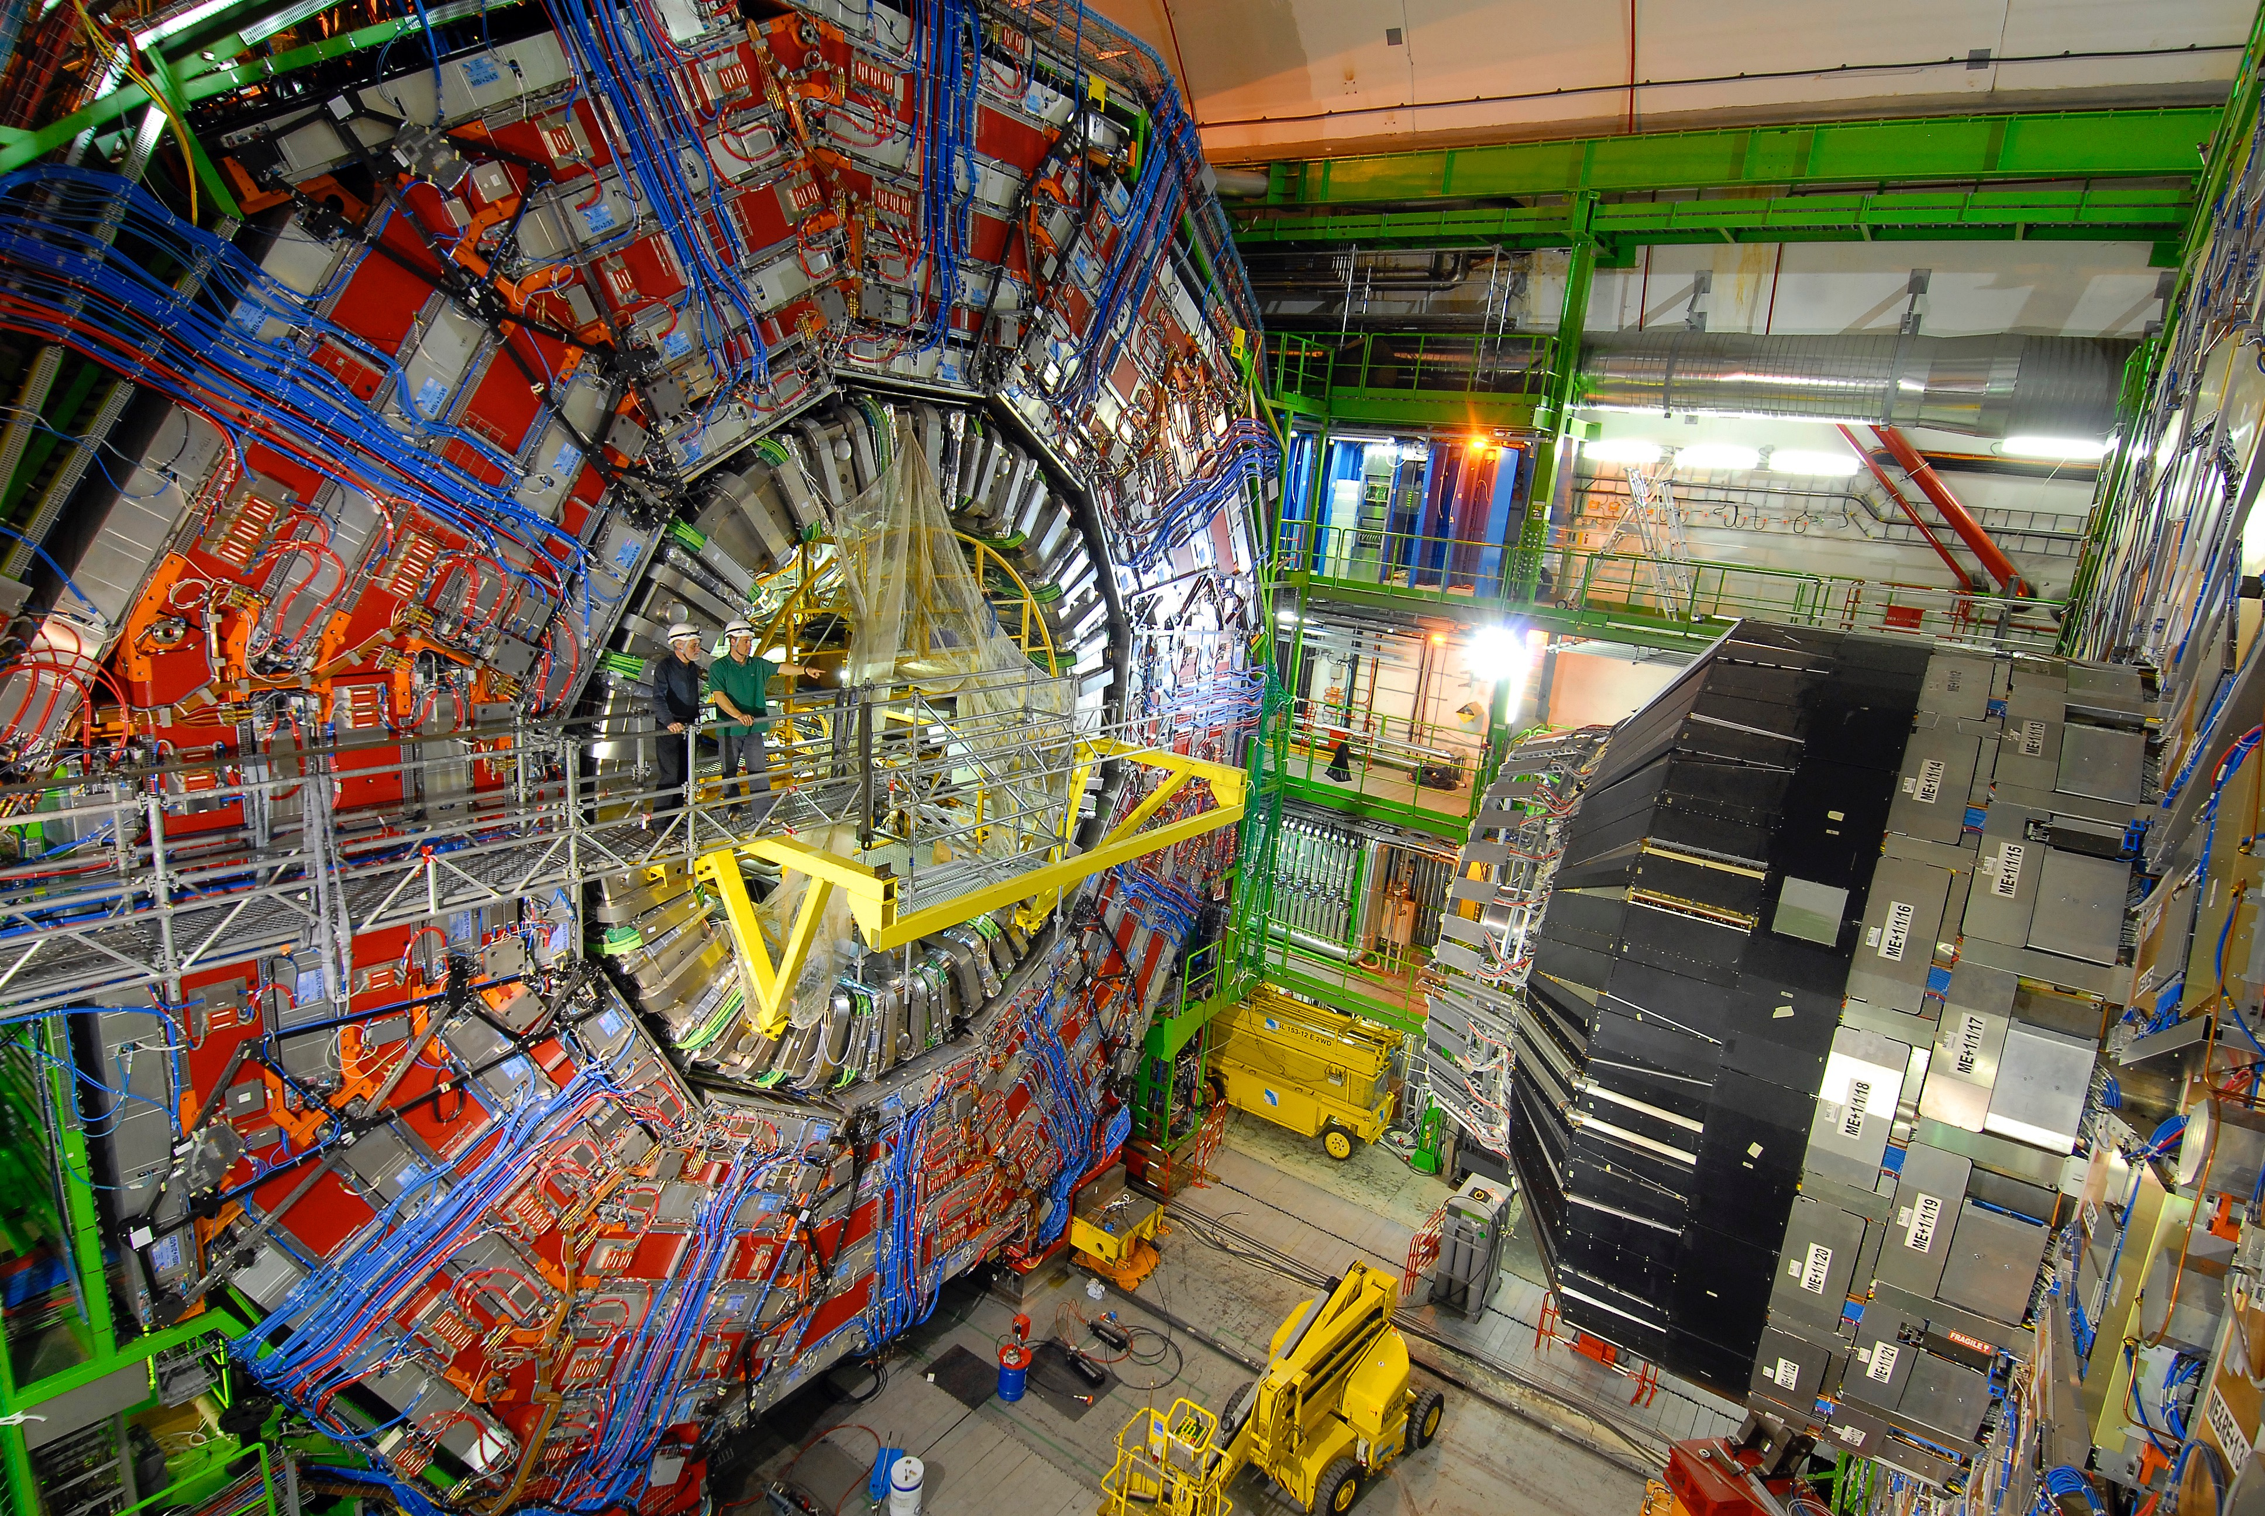
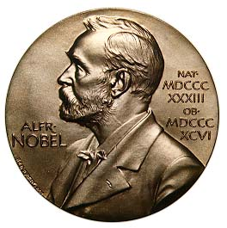
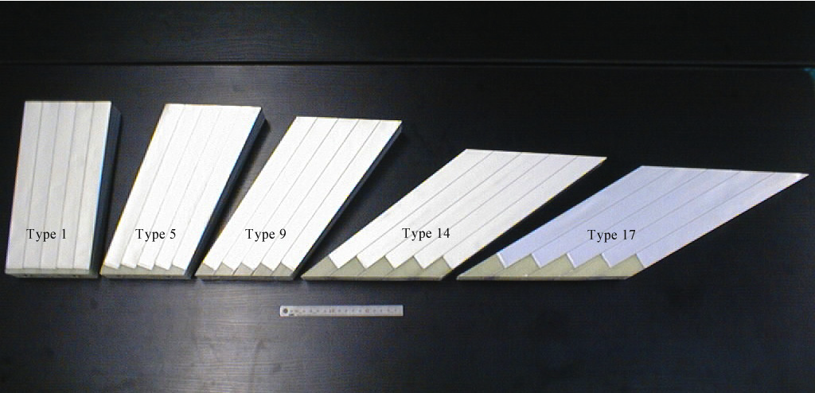
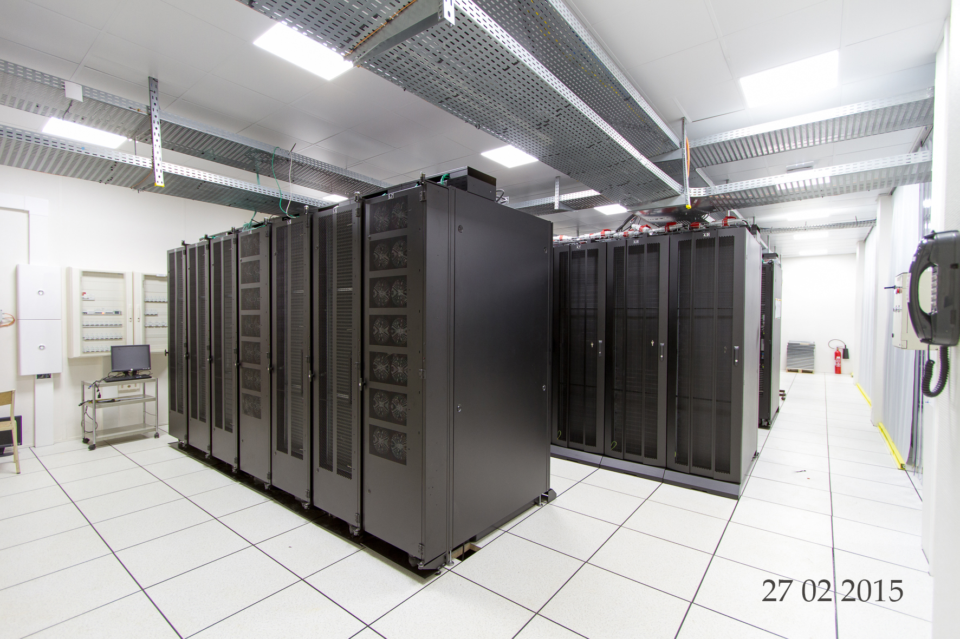
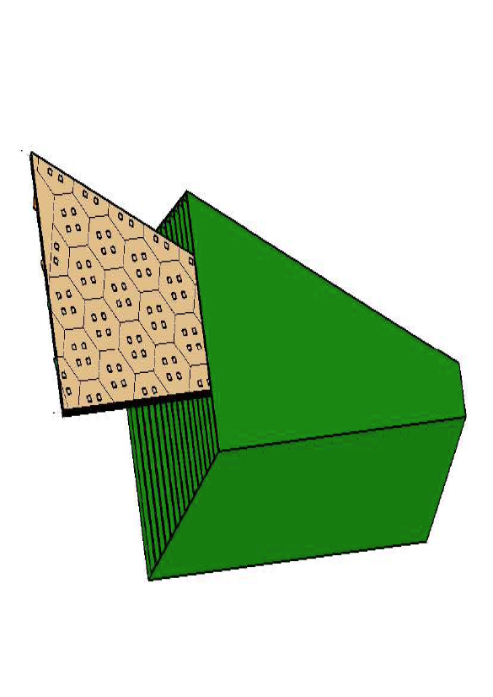
Higgs boson discovery
CMS
Past and running achievements
ECAL
alveolar
structure
Grid node at Ecole Polytechnique
Upgrade
Phase 2
HGCal

Slide 5

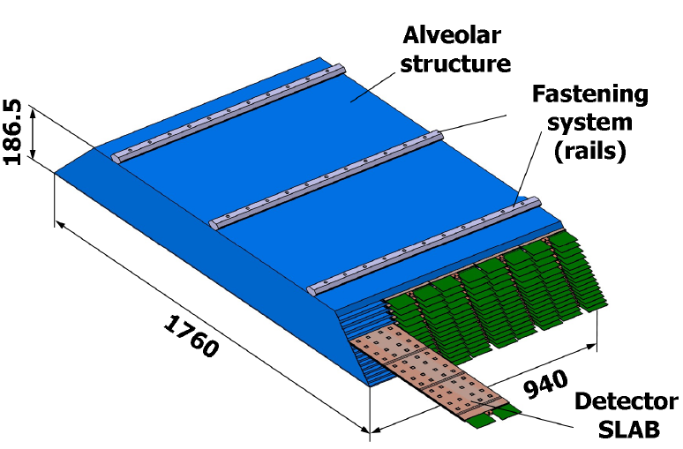
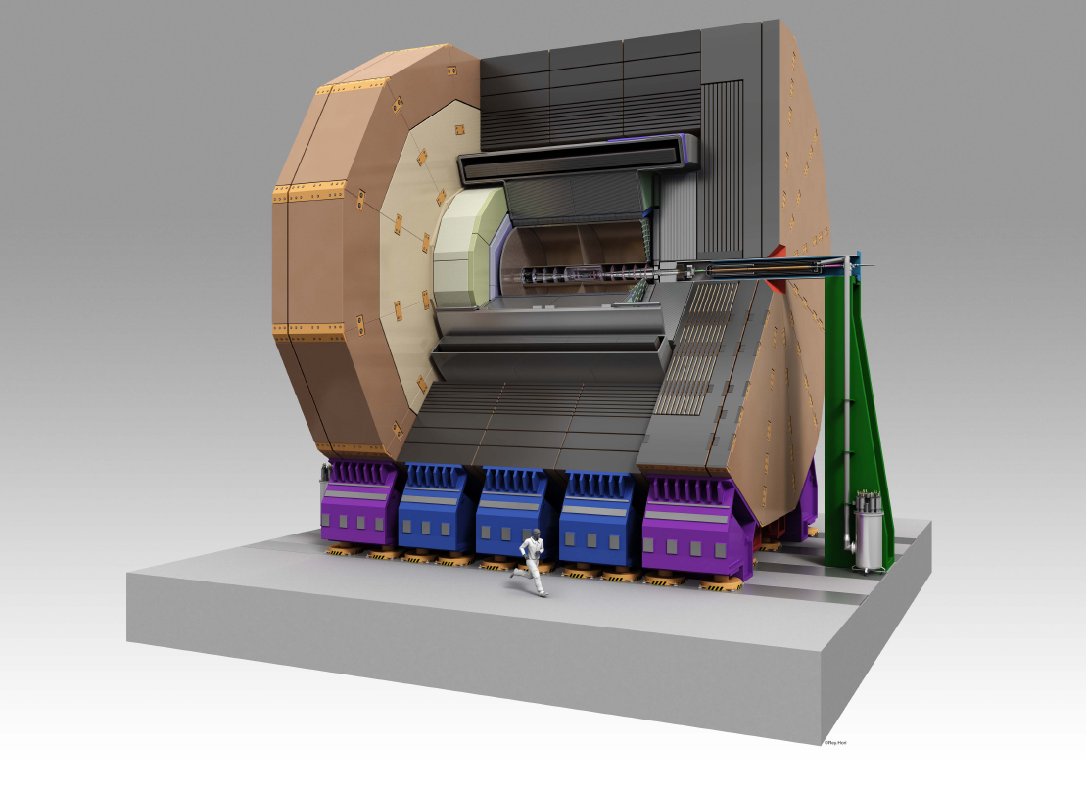
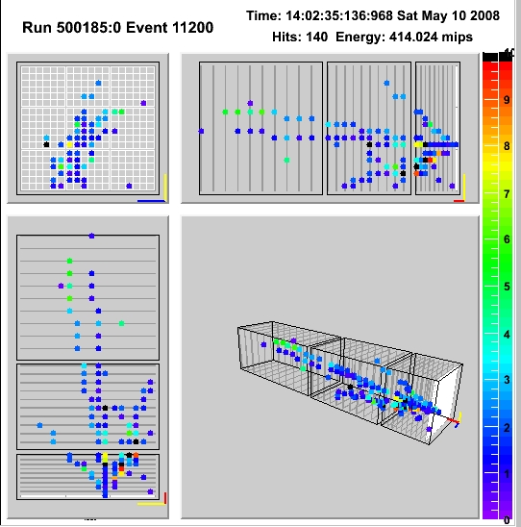
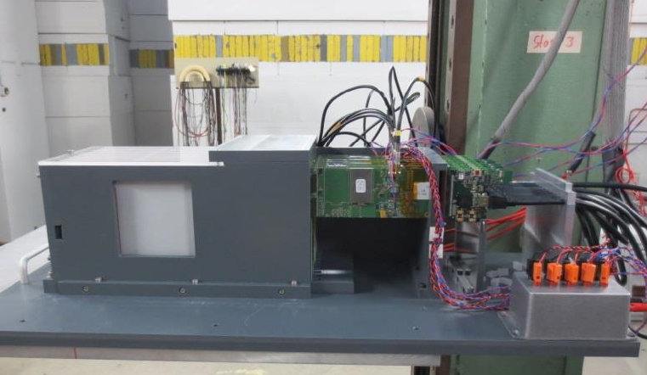
Future detectors:
Ultra-granular calorimetry for e⁺e⁻ (linear) collider
Calorimeter silicon-tungsten

Slide 6
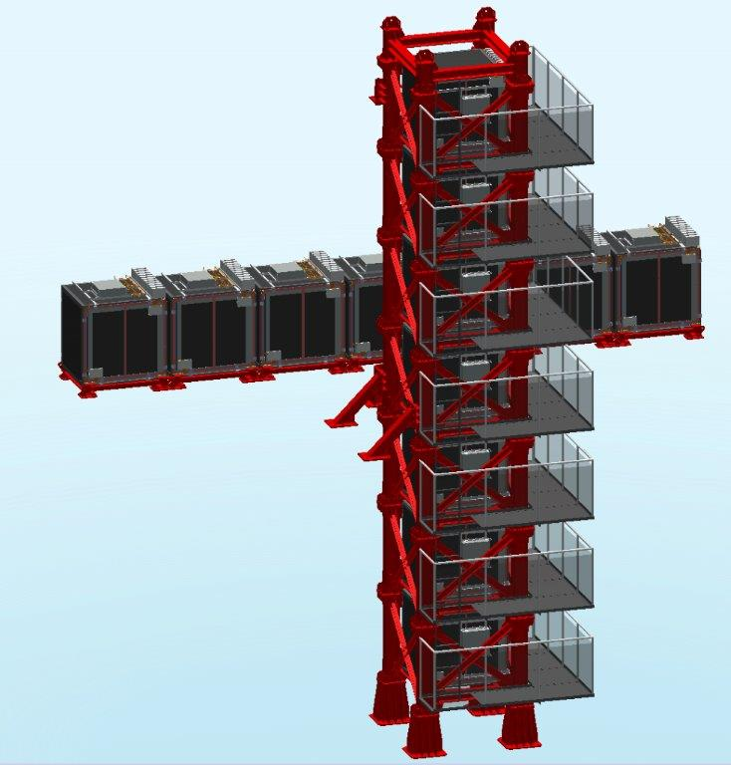

Neutrino physics
T2K : Tokai to Kamiokande
Neutrinos in JUNO
Detector of neutrinos INGRID
  Mechanics
  Calibration
JUNO
LLR joining JUNO effort
(physics driven by mass
hierarchy determination)
Notes:
16 modules of 7 tons made of irons and plane of de 11 plans de scintillators

Slide 7
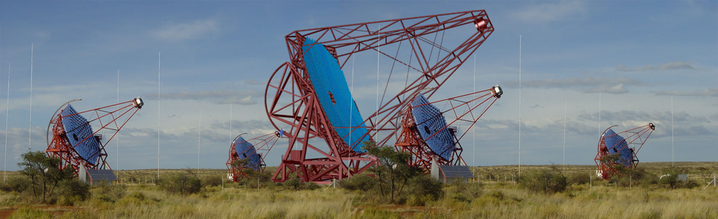
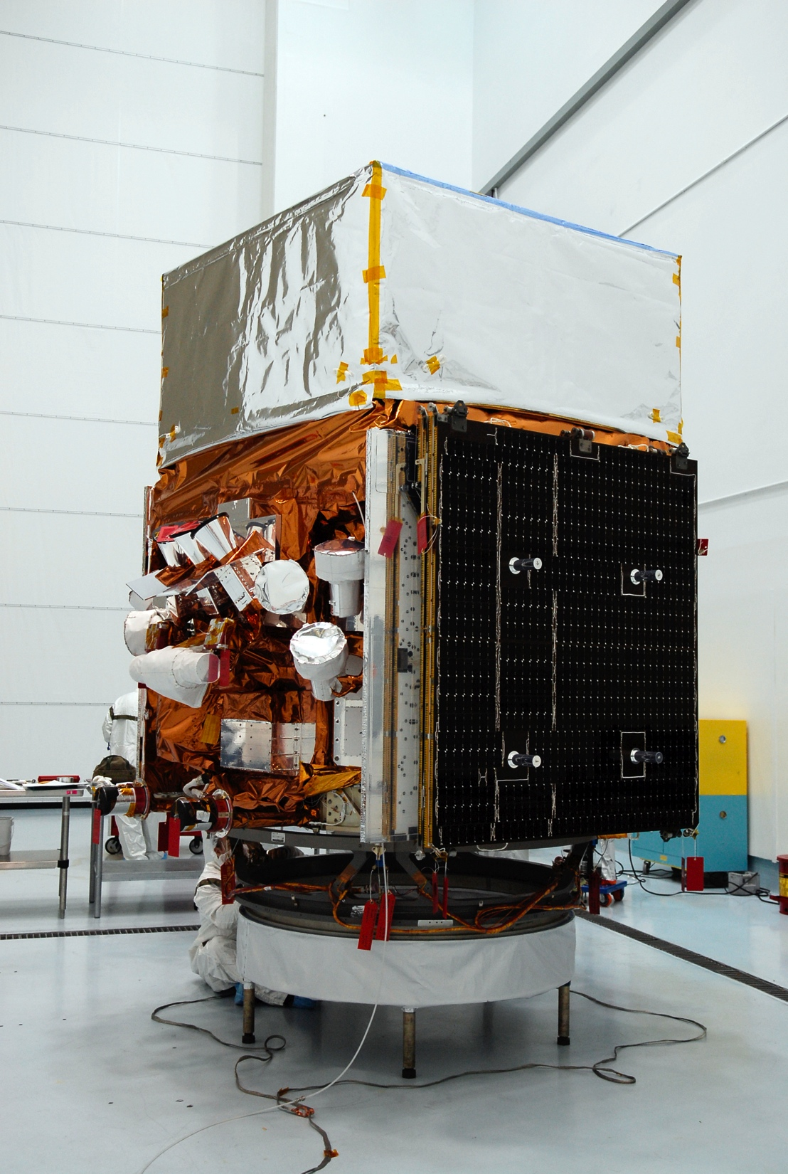
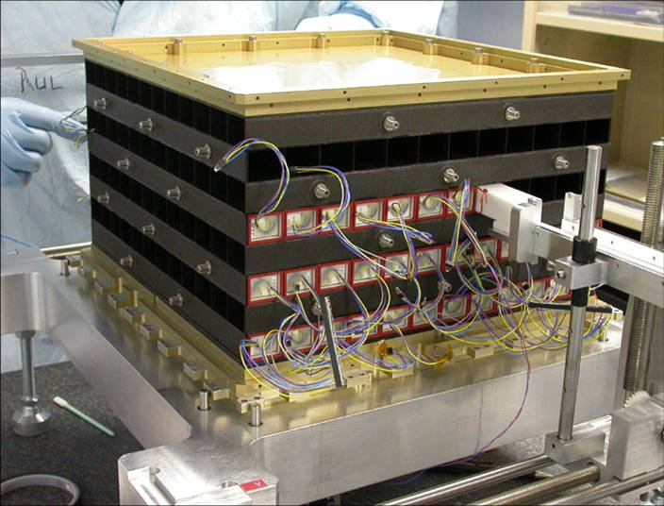
HESS in Namibie
Conception and realisation of the mechanical structure of the « cameras »
The spatial FERMI telescope
Modules of the
FERMI calorimeter

Slide 8


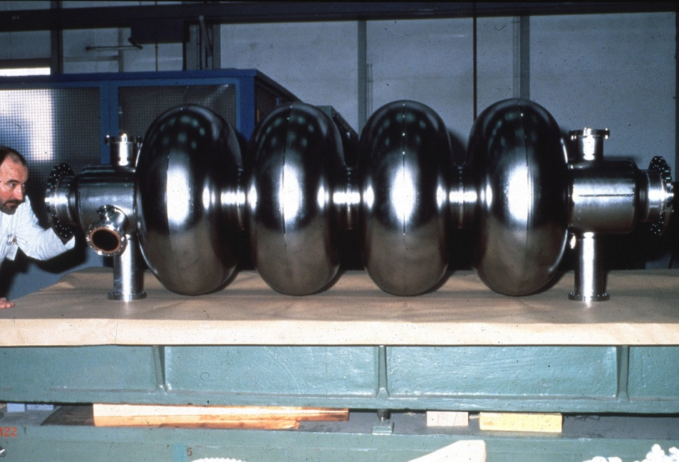
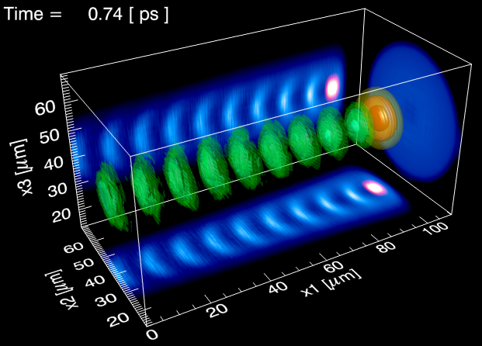
The future accelerators:
Laser-Plasma
Radiofrequency wave (RF) v/s plasma waves
resonator = RF cavity
resonator = plasma
~ 300 000 MV/m
Simulations extremely
CPU-intensive (see A. B.’s talk)

Slide 9
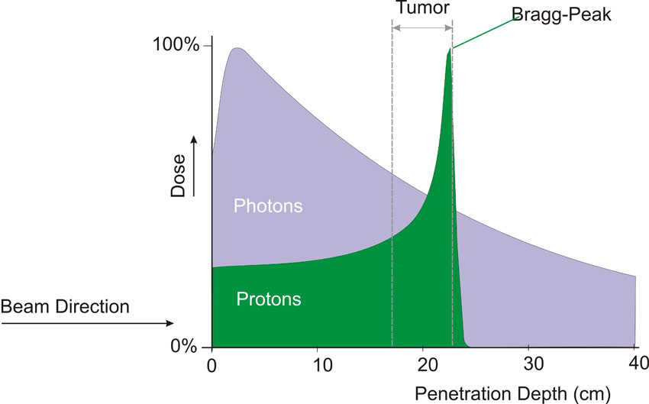
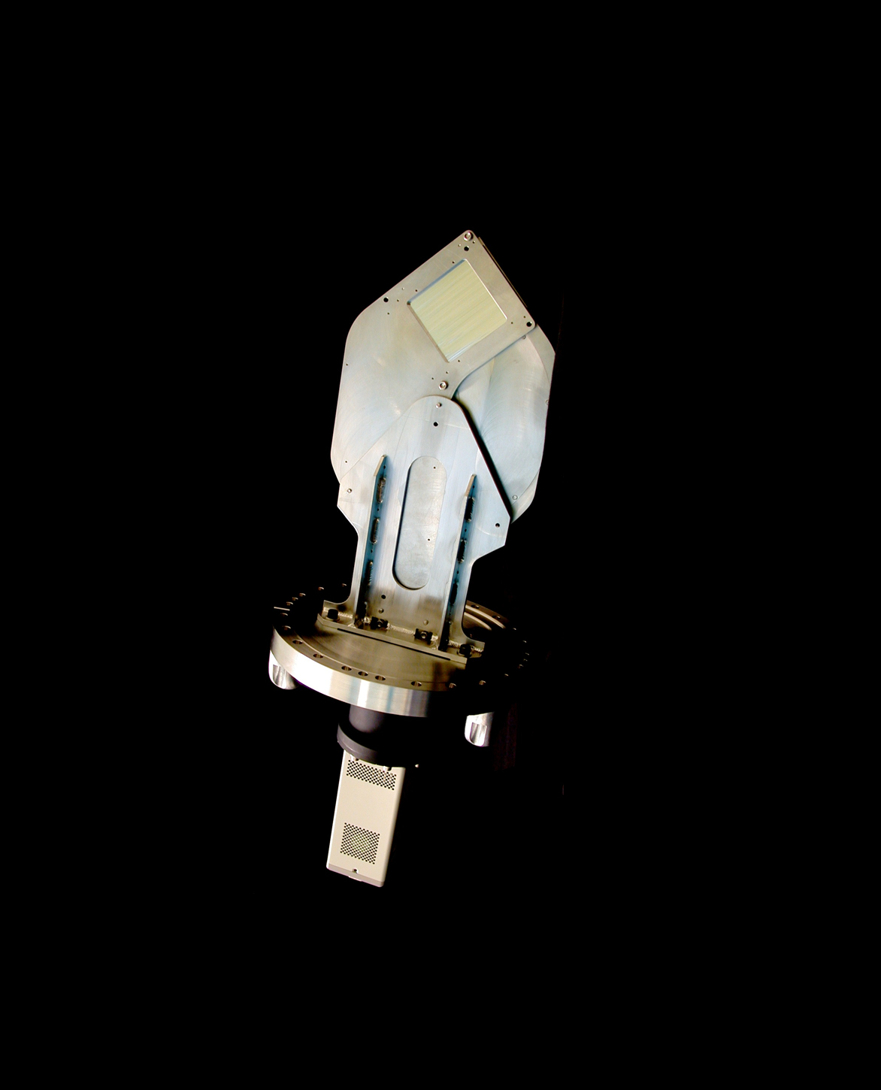
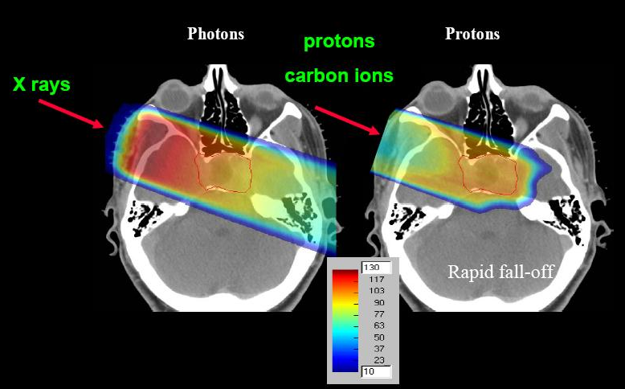
Medical applications
Energy deposit of protons and ions more localized than for photons
Hodoscope
(beam profiler)

Slide 10




LLR and its partners
Other on-site laboratories

Slide 11
LLR computing strategy (1)
The LLR being founding member of the CMS experiment, it early took the road of the HTC
A GRID computing farm has been setup as early as 2005. It is part of Grif and has a remarkable stability/availability (cf. A.S’s talk)
Polytechnique’s site particularity:
The machines are hosted in the ”aile ø”
  Cooling and electrical power taken in charge by the Ecole
  Financial contribution to purchase hardware

Slide 12
LLR computing strategy (2)
Technology watch : we saw the parallel computing becoming a promising solution to tackle the increasing computing needs of the simulation/reconstruction/analysis
Decided to launch R&D in the lab on HPC end of 2011
  Manpower
  Hardware
See G.G.’s and A.B.’s talks

Slide 13
Local collaborations
LLR is not the only on-site lab with HPC needs, but undoubtedly the most expert in terms of developments
The lab initiated a collaboration with the Laboratoire des Solides Irradiés and proposed to share the resource of a HPC cluster
The idea of creating a mésocentre “Ecole Polytechnique” is currently emerging. (3 labs decided to go alone)
On-going discussions on the possibility of shared storage capabilities between different labs

Slide 14
Future
Clearly we will look simultaneously at two different scales
  Global (WLCG, European projects) in coordination with IN2P3
  Local (X, UPSay), especially for HPC

