Slide 1
FATALIC
in wrap up of June Test Beam activities
Roméo Bonnefoy, Romain Madar, François Vazeille
and the micro-electronics team
6 July 2016
Short summary of performances and problems
Tests during the next Expert Week
Set-up for September
Next actions

Slide 2
Short summary of performances and problems
• Set-up
▪ Assembly of complete Drawers 3 (10 PMTs) and 4 (11 PMTs) for a LB module,
with Standard Main Boards, Daughter Boards and Remote HV system.
▪ Insertion of Drawer 3 only (Drawer 4 for QIE).
▪ Connection to the PPR.
• Reference tests at LPC on individual PMT Blocks connected one by one
to the same channel of the MB Prototype (HV off) → Pedestals + electronic noise.
counts
High Frequency High Gain noise
Mean noise over 21 PMTs:
2.80±0.05 counts
or 6.74±0.05 fC
with:
minimum: 5.77±0.16 fC
maximum: 7.64±0.29 fC
PMT location

Slide 3
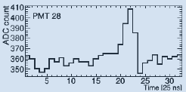
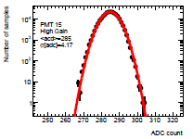
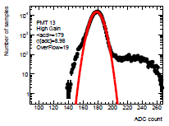
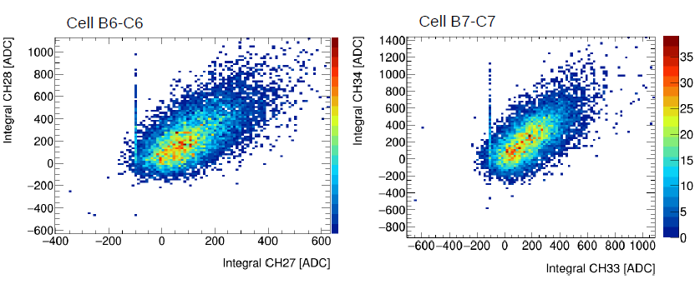
• Measurements at CERN using the Standard MB + DB + PPR
+ FLVPS and Remote HV on the Drawer 3 inside LB
Good working of the whole MB-DB-PPR communication,
despite the PPR spectra invert the time!
→ PMTS at their nominal gains.
Pathological aspects of some of the Pedestal spectra and/or increased width
as far as the MB channel input is far from its FPGA! (See Back up slides)
▪ Explanation: bad transmission of some bits
from FATALIC to the FPGA’s on the Main Board,
because of the capacitance effect of tracks.
▪ How to cure it? To boost the digital information
with a buffer on the All-in-One card (to validate)
then inside FATALIC → New FATALIC5 specif.
PMT30, close
PMT26, far
PMT correlation on the same cell
- Rough calculation.
- Hadrons at 90°.
→ Other data taken after the official Test Beam period … not yet analyzed.

Slide 4
Tests during the next Expert Week
• First Cesium tests using the digital summation over 10 ms of HF data.
• Requests the access to the Drawer 3 in order to modify the FPGA firmware,
and to the PPR data stream (in principle close to the Chicago one).
(Wednesday 20 to Friday 22)
September Test Beam
• The same set-up as this one of June, but with the Drawers 3 and 4 on LB Module.
• The recorded data will be more significant on the channels close to their FPGA.
• Study of the Optimal Filtering.
Next actions
• Validation of the buffer concept by using a modified All-in-One card.
• New simulations of FATALIC with an additional buffer inside (→ FATALIC5).
• New studies of a complementary analog integrator for very low currents
(Ilya’s request): will be reported at the October TileCal week.
• It is urgent to coordinate the radiation studies ← to quantify the requested funds.
• The dates of the 2017 Test Beam periods will condition the FATALIC5 availability.

Slide 5
BACK UP

Slide 6
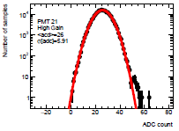
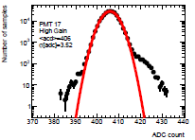
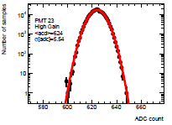
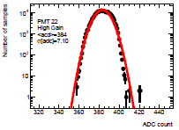
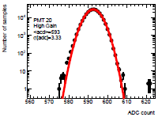
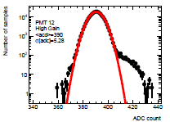
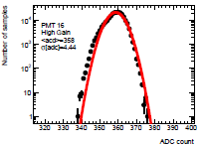
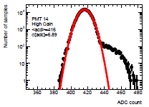
High Gain
Pedestals, RMS and positions
(Straight line distances*)
5.5
4.2
9.0
5.9
3.5
36(280mm)
34(175mm)
32(60 mm)
30(55 mm)
28(60 mm)
26(175 mm)
X
X
X
X
X
4
2
3
1
X
X
X
X
X
35(175 mm)
33(60 mm)
31(55 mm)
29(60 mm)
27(175 mm)
25(280 mm)
Example:
pathological
Example:
large
4.4
6.9
7.1
3.3
5.3
*Warning: Distances not taking into account
the bending path in MB and the PMT Block connections.

Slide 7
Pedestal CERN/Pedestal LPC
Noise CERN/Noise LPC
PMT position (Straight line distance)
26/31
5.9/2.7
624/644
5.5/2.8
285/291
4.2/3.1
406/401
3.5/2.6
179/179
9.0/2.6
36(280mm)
34(175mm)
32(60 mm)
30(55 mm)
28(60 mm)
26(175 mm)
X
X
X
X
X
4
2
3
1
X
X
X
X
X
35(175 mm)
33(60 mm)
31(55 mm)
29(60 mm)
27(175 mm)
25(280 mm)
384/391
7.1/2.8
593/577
3.3/2.6
358/356
4.4/3.2
390/397
5.3/2.4
416/435
6.9/3.2

Slide 8
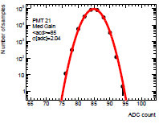
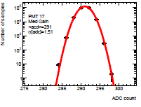
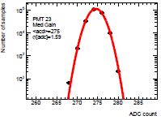
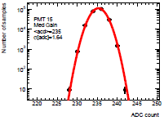
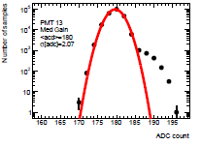
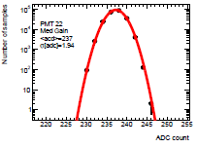
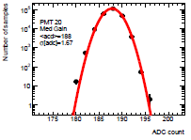
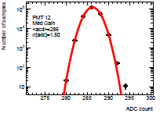
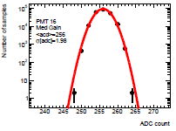
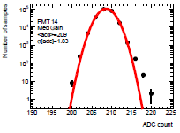
Medium Gain
Pedestals, RMS and positions
(Straight line distances*)
1.6
1.6
2.1
2.0
1.5
36(280mm)
34(175mm)
32(60 mm)
30(55 mm)
28(60 mm)
26(175 mm)
X
X
X
X
X
4
2
3
1
X
X
X
X
X
35(175 mm)
33(60 mm)
31(55 mm)
29(60 mm)
27(175 mm)
25(280 mm)
2.0
1.8
1.9
1.7
1.5
*Warning: Distances not taking into account
the bending path in MB and the PMT Block connections.

Slide 9
Pedestal CERN/Pedestal LPC
Noise CERN/Noise LPC
PMT position (Straight line distance)
85/82
2.0/1.6
275/277
1.6/1.2
235/233
1.6/1.4
291/286
1.5/1.3
180/183
2.1/1.4
36(280mm)
34(175mm)
32(60 mm)
30(55 mm)
28(60 mm)
26(175 mm)
X
X
X
X
X
4
2
3
1
X
X
X
X
X
35(175 mm)
33(60 mm)
31(55 mm)
29(60 mm)
27(175 mm)
25(280 mm)
237/229
1.9/1.3
188/171
1.7/1.5
256/246
2.0/1.3
286/287
1.5/1.4
209/211
1.8/1.4

Slide 10
RMS in ADC counts for High Gain
Straight distance in mm (rough approximation)
Conclusion:
- Pedestal peaks comparable to the individual results of PMT Blocks alone.
- Pedestal shapes and/or RMS values are better for channels close to their FPGA,
and slightly above the individual RMS results:
Examples for HG: # 28: 3.5 (8.4 fC) instead of 2.6 counts (PMT Block alone)
# 31: 3.3 ( 7.9 fC) instead of 2.6 counts
# 30: 4.2(10.1 fC) instead of 3.1 counts
# 29: 4.4 (10.6 fC) instead of 3.2 counts
Comment: The set-up is more complete with respect to PMT Block alone.
- Pedestal shapes and/or RMS values worst for channels far from their FPGA.
Warning: this RMS should be better if we considered only High Frequency noise.

