Slide 1


SIGMA: a detector for γ-ray spectroscopy & imaging
Dr Laura Harkness-Brennan
@LauraHBPhysics
AGATA/GRETINA Collaboration Meeting ljh@liverpool.ac.uk

Slide 2
Outline
DESPEC at FAIR
DEGAS
SIGMA detector design
Theoretical response
AGATA/GRETINA Collaboration Meeting ljh@liverpool.ac.uk

Slide 3
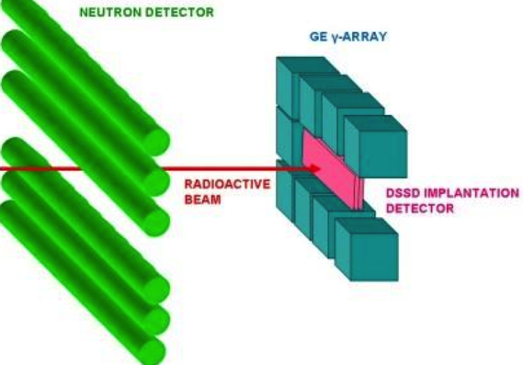
DESPEC
Low Energy Branch of Super-FRS, FAIR
Half-lives, isomer decays & 𝛽-decays to be measured for 1st time in exotic nuclei
Implanting short-lived exotic nuclei into AIDA
Observe subsequent decays in DEGAS HPGe detector array
AGATA/GRETINA Collaboration Meeting ljh@liverpool.ac.uk

Slide 4
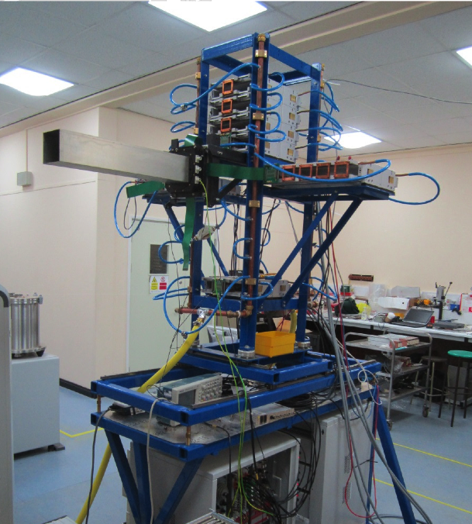
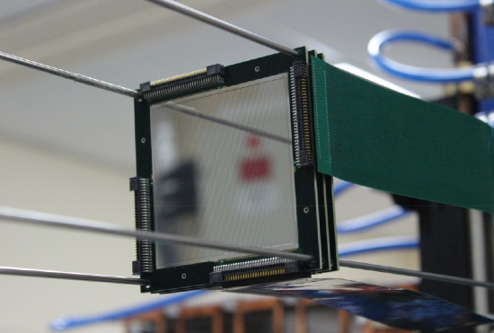
AIDA
80x80x1mm Si DSSD (128x128 strips)
ASIC, low (<12keV) noise
AGATA/GRETINA Collaboration Meeting ljh@liverpool.ac.uk

Slide 5
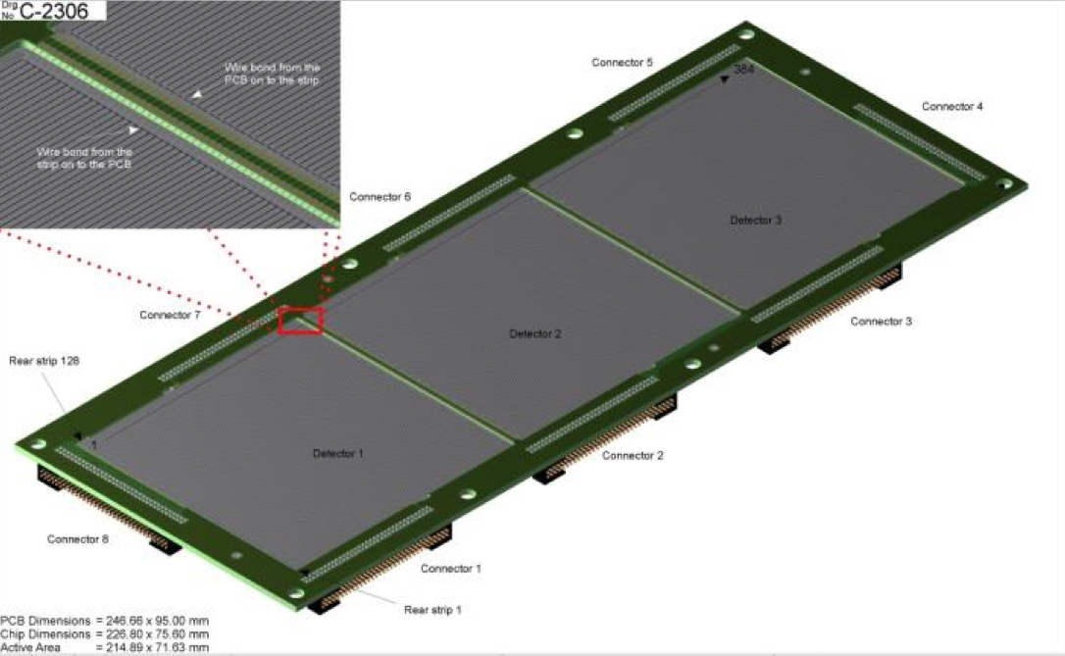
AIDA
80x80x1mm Si DSSD (128x128 strips)
ASIC, low (<12keV) noise
AGATA/GRETINA Collaboration Meeting ljh@liverpool.ac.uk

Slide 6
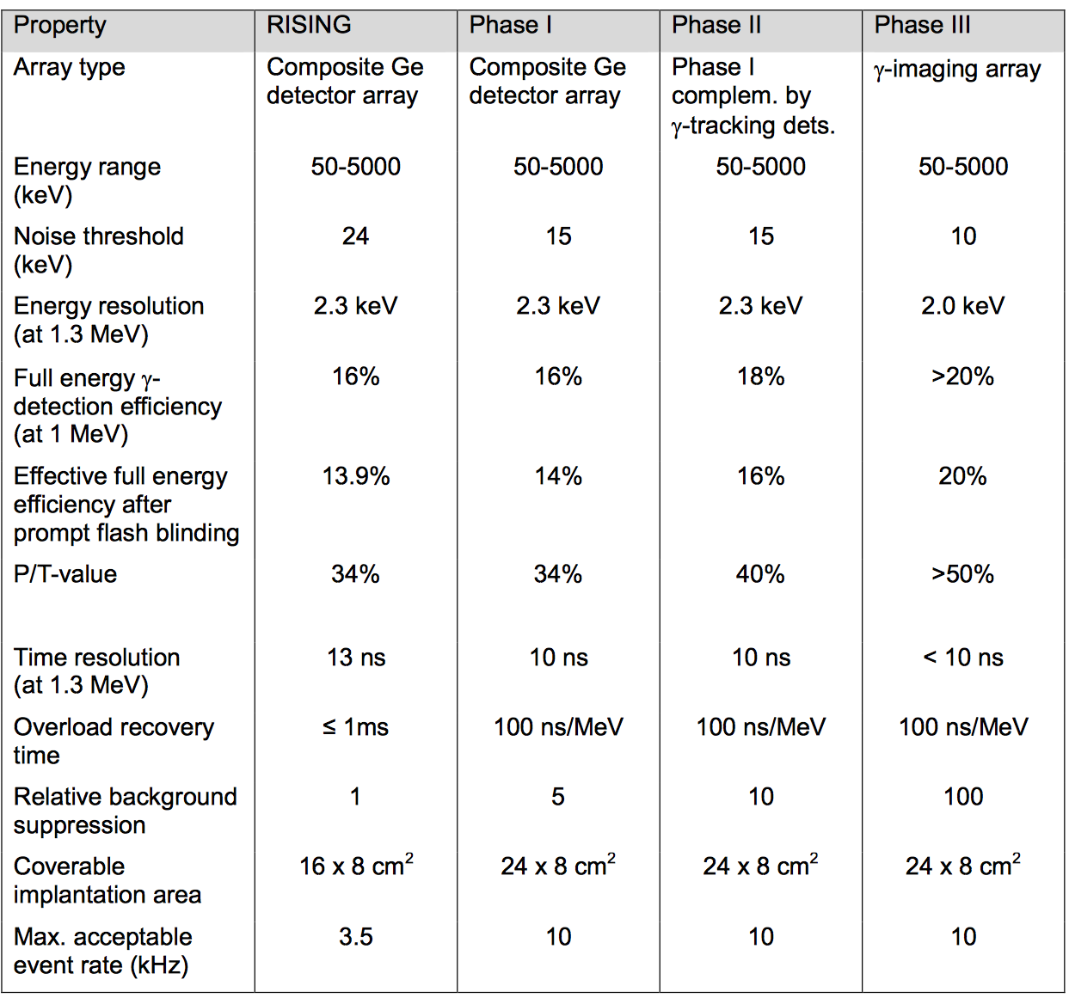
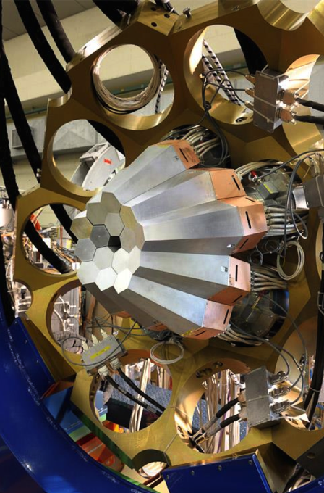
DEGAS Requirements
AGATA/GRETINA Collaboration Meeting ljh@liverpool.ac.uk

Slide 7
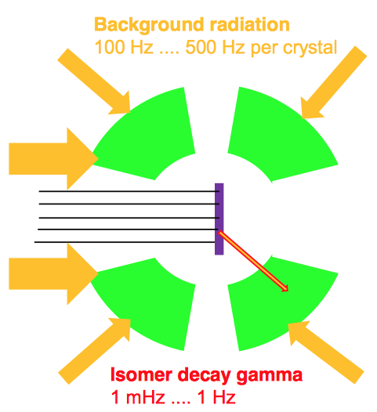
DESPEC Challenges
Efficient detection of 𝛾-rays 50keV to 5MeV
Wide focal plane: 24 x 8 cm²
Low yields in high background
Prompt radiation flash
Correlating events for (1) isomeric decay (t_{1/2} 10ns-100ms, 1mHz-1Hz rate) and (2) 𝛽-delayed 𝛾-ray emission from exotic ions implanted in AIDA
AGATA/GRETINA Collaboration Meeting ljh@liverpool.ac.uk

Slide 8
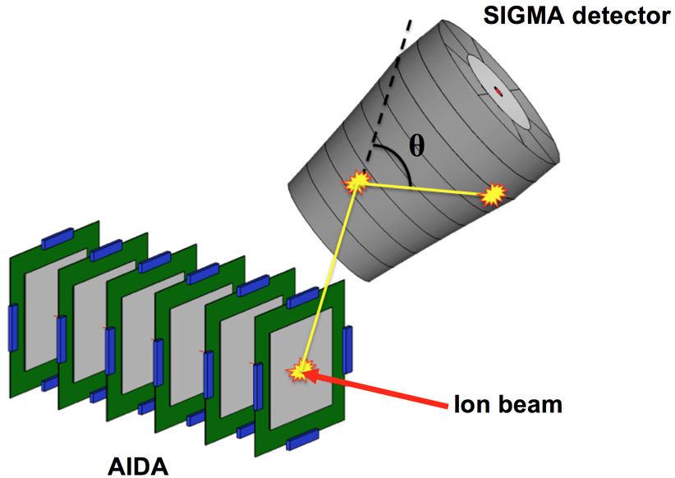
Methodology
Use gamma-ray tracking to (1) suppress background & (2) correlate to 𝛽 detected in AIDA
Requirements: segmented detector with excellent energy resolution and <1mm³ position resolution, digital acquisition electronics for pulse shape analysis and deconvolution of pile-up events
AGATA/GRETINA Collaboration Meeting ljh@liverpool.ac.uk

Slide 9
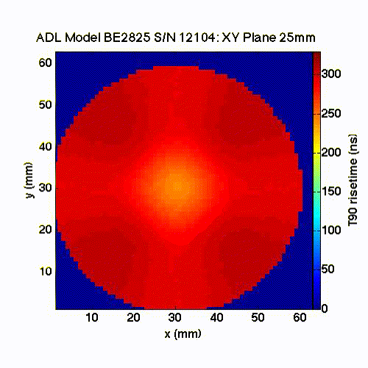
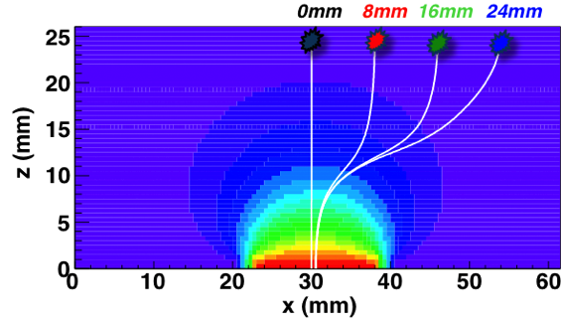
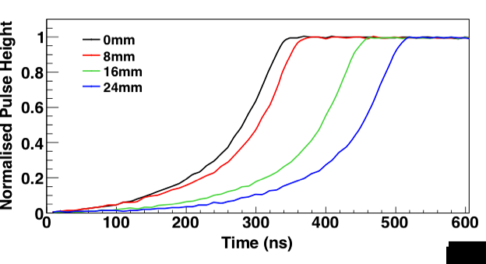

Point (small) contact detectors
Low capacitance
Excellent energy resolution (~0.5keV @ 122keV, 1.7keV @ 1332keV)
Broad Energy Germanium (BEGe) detectors
  GERDA, MAJORANA neutrinoless double 𝛽 decay
  ALBEGA
AGATA/GRETINA Collaboration Meeting ljh@liverpool.ac.uk

Slide 10
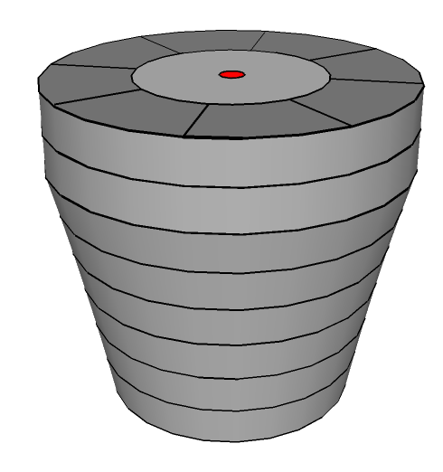
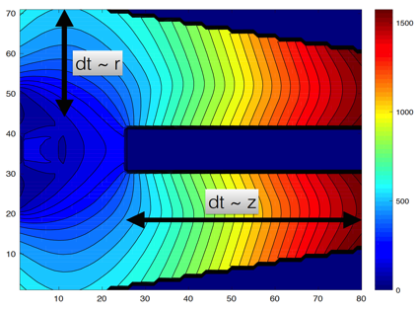
Development of SIGMA
Segmented Inverted-coaxial GerMAnium Detector
Low electronic noise -> excellent energy resolution
Expected factor of 2-3 improvement in position resolution over gamma-tracking arrays (R Cooper NIM A 665 2011)
Simpler to analyse multiple interactions
Fewer readout channels
Reduction in cost and complexity
FieldGen/SigGen: D Radford
AGATA/GRETINA Collaboration Meeting ljh@liverpool.ac.uk

Slide 11
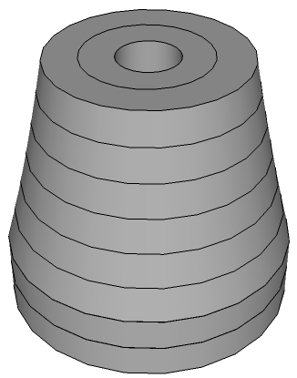
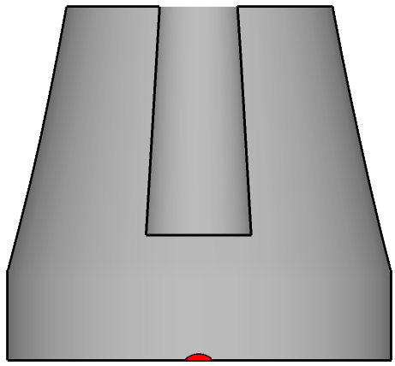
SIGMA Segmentation
P-type crystal, 8 longitudinal rings, 2 concentric segments on front face, 8 sectors, 1 core segment, 1 point-like contact
Azimuthal, ϕ
Radial, r
80mm
Small contact
Longitudinal, z
75 mm
AGATA/GRETINA Collaboration Meeting ljh@liverpool.ac.uk

Slide 12
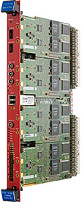
Data Acquisition
Multi-channel readout
V1724 digitisers (each 8 x channel)
14-bit 100MHz
Data: timestamp, energy, digitised trace
Energy calculation – MWD algorithm, parameters to be optimised for long charge collection times
Post processing: PSA and tracking
AGATA/GRETINA Collaboration Meeting ljh@liverpool.ac.uk

Slide 13
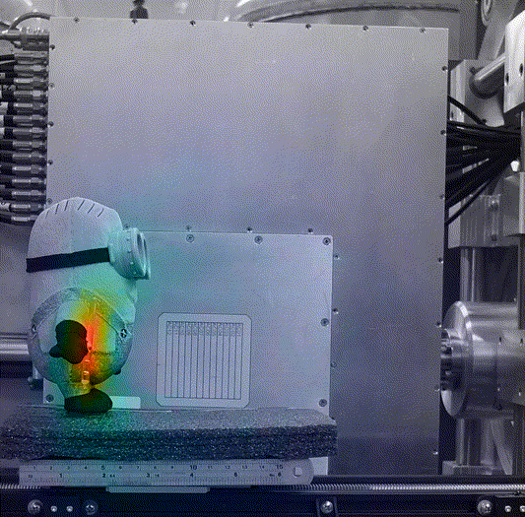
Project status
Key Milestones
2016
SIGMA detector in production
DAQ tested with unsegmented SAGe well detector
Integrated Geant4/SigGen/FieldGen model
2017
Detector to be delivered
PSA and gamma-ray tracking evaluation
2018
Imaging demonstrated, in-beam tests
AGATA/GRETINA Collaboration Meeting ljh@liverpool.ac.uk

Slide 14
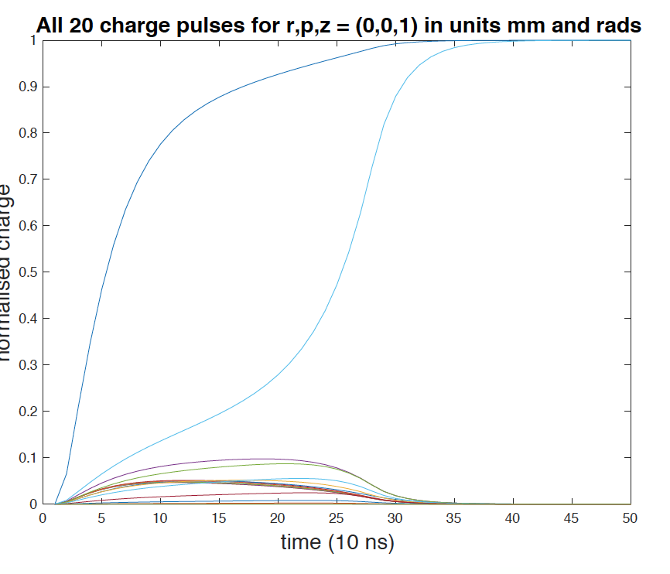
Theoretical signals
Signals calculated by FieldGen/SigGen (Radford)
Basis set generated
AGATA/GRETINA Collaboration Meeting ljh@liverpool.ac.uk

Slide 15
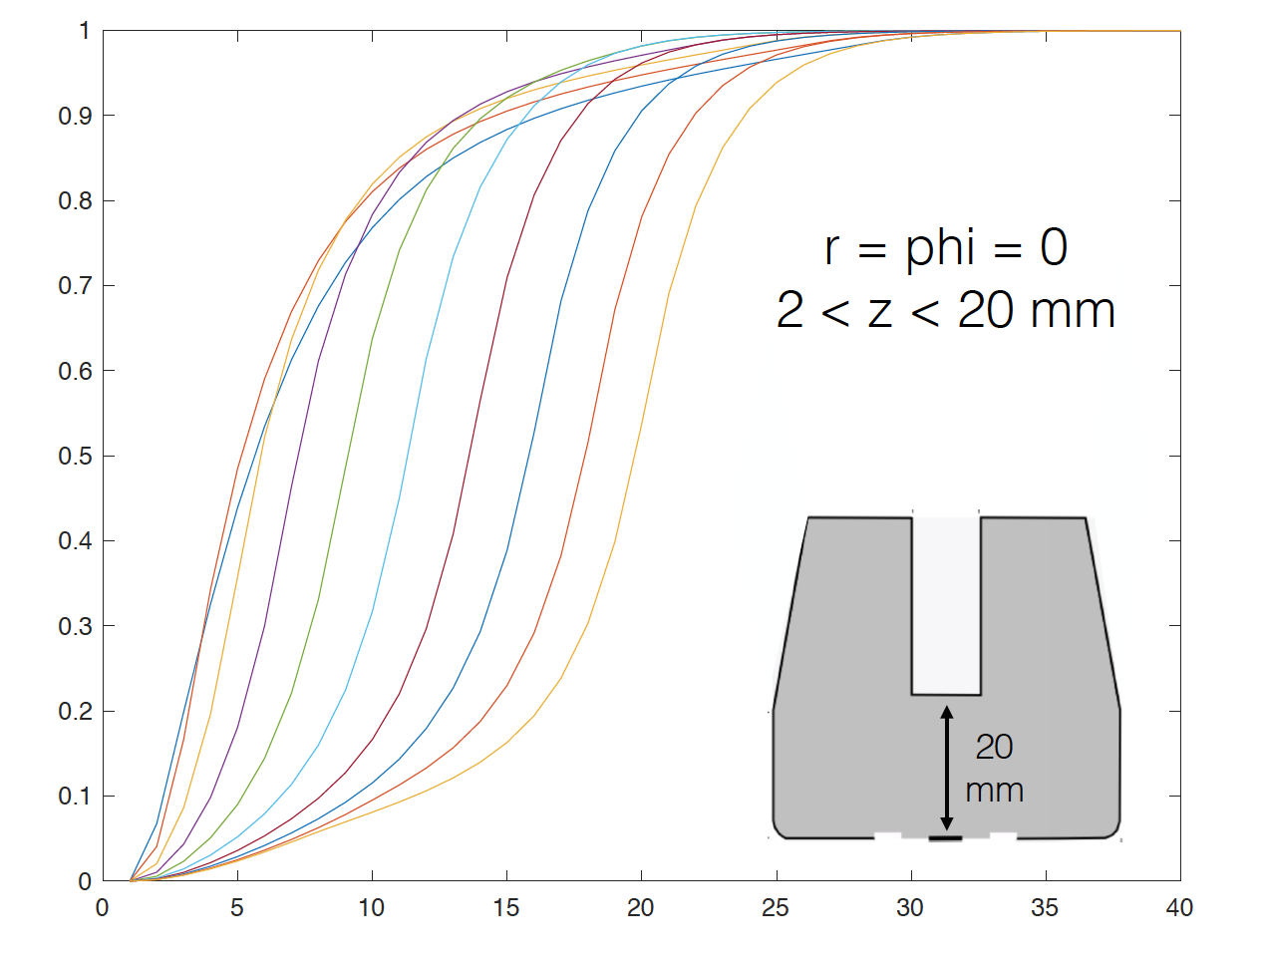
Position sensitivity
AGATA/GRETINA Collaboration Meeting ljh@liverpool.ac.uk

Slide 16
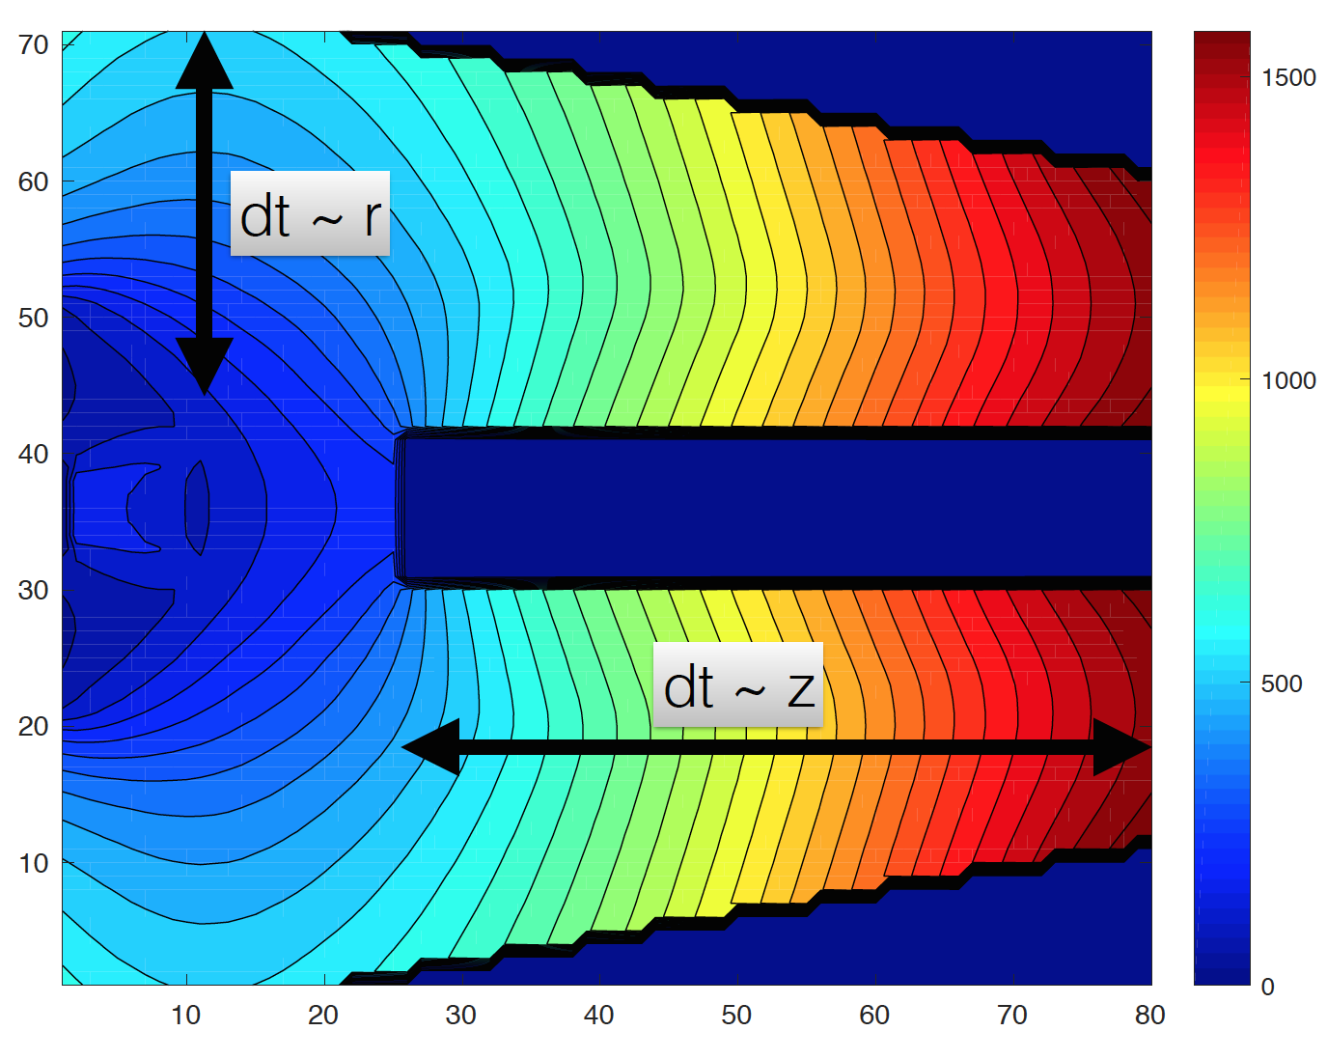
Drift times
dt=t_{95%}-t_{0%}
AGATA/GRETINA Collaboration Meeting ljh@liverpool.ac.uk

Slide 17
Theoretical signals
Development of the SIGMA detector
Single Interaction
Double Interaction
AGATA/GRETINA Collaboration Meeting ljh@liverpool.ac.uk

Slide 18
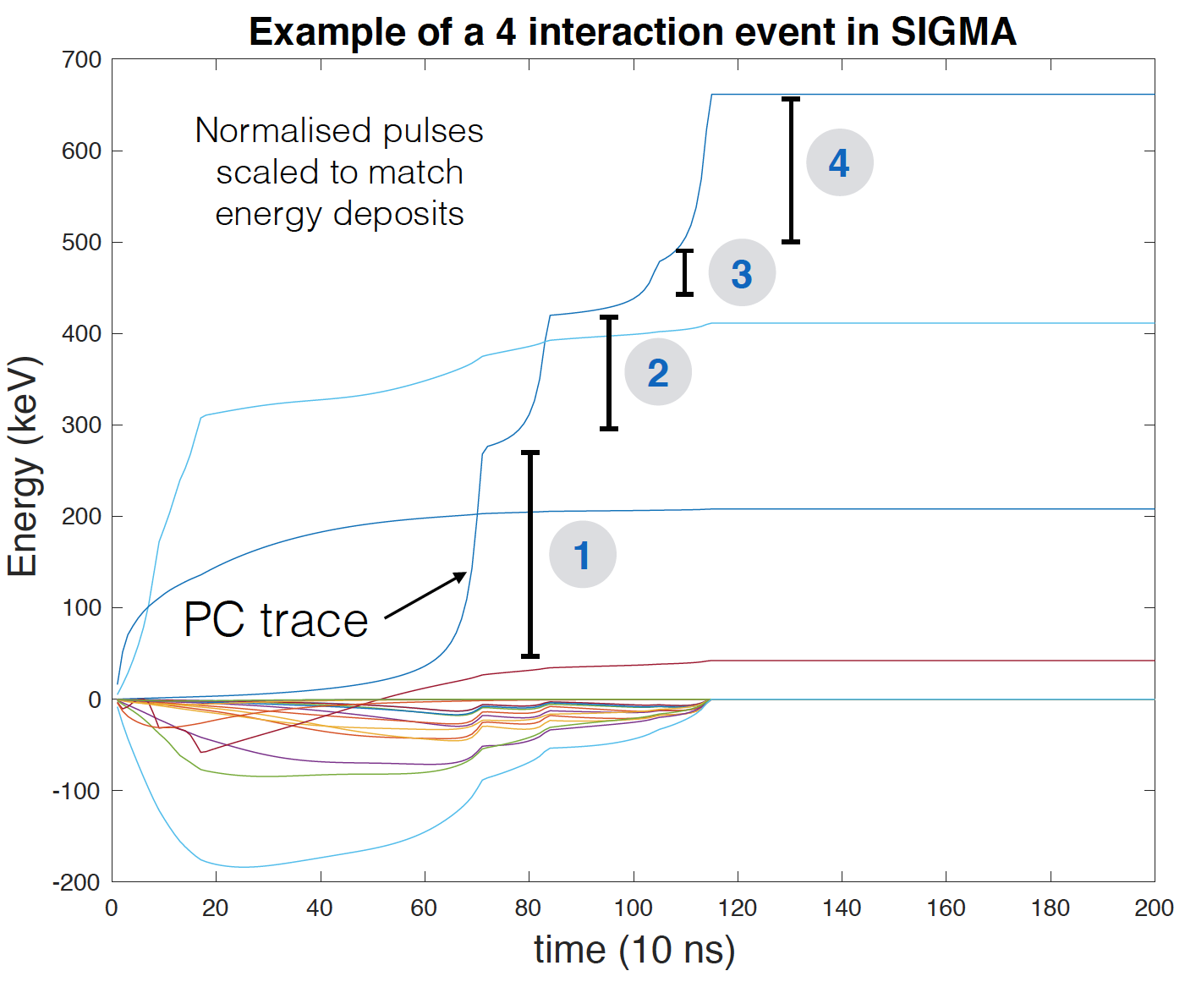
Multiple Interactions
Geant4 x,y,z,E and fieldgen/siggen
AGATA/GRETINA Collaboration Meeting ljh@liverpool.ac.uk

Slide 19
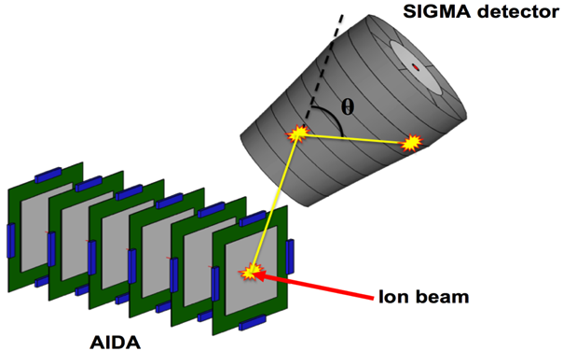
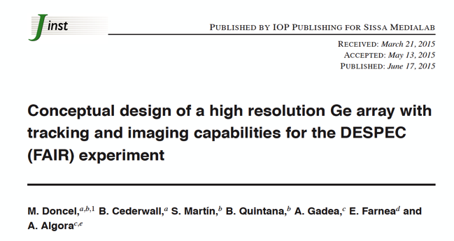
SIGMA DEGAS Array
Development of the SIGMA detector
Investigate performance of various configurations of SIGMA detector arrays for DEGAS (Marc Labiche and Jon Wright)
Array efficiency calculations to be compared with previously investigated DEGAS array configurations (M Doncel 2015)
AGATA/GRETINA Collaboration Meeting ljh@liverpool.ac.uk

Slide 20
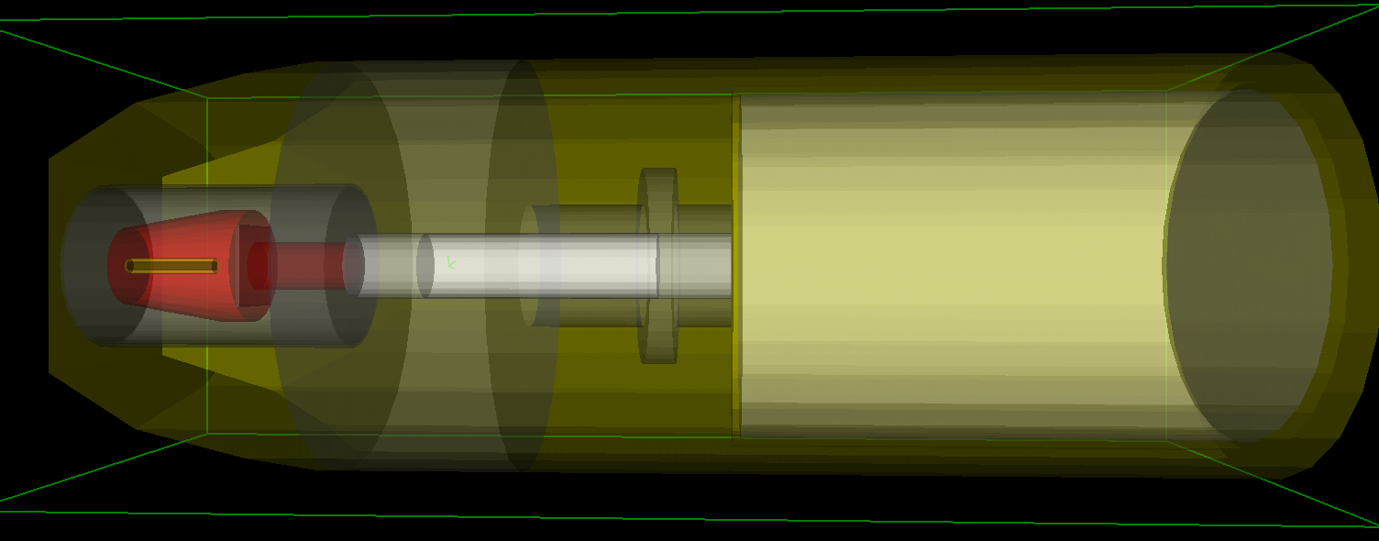
Geant4 model
Development of the SIGMA detector
AGATA G4 toolkit
HPGe crystal
Preamp housing
Cryostat
Dewar
AGATA/GRETINA Collaboration Meeting ljh@liverpool.ac.uk

Slide 21
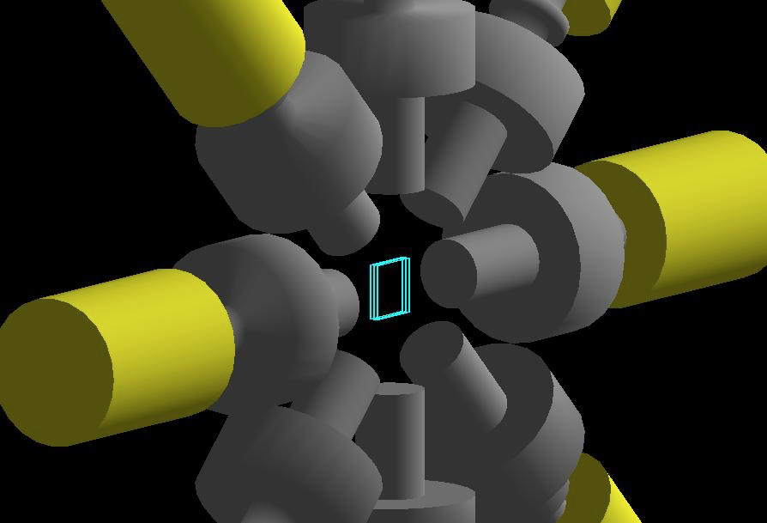
Geant4 model
Development of the SIGMA detector
Under investigation – Jon Wright
AGATA/GRETINA Collaboration Meeting ljh@liverpool.ac.uk

Slide 22
Absolute Efficiency (Geant4)
Development of the SIGMA detector
To be reproduced experimentally
55% relative efficiency at 1332 keV
AGATA/GRETINA Collaboration Meeting ljh@liverpool.ac.uk

Slide 23
Peak to Total (Geant4)
Development of the SIGMA detector
To be reproduced experimentally
AGATA/GRETINA Collaboration Meeting ljh@liverpool.ac.uk

Slide 24
Summary
DESPEC requires an array for spectroscopy of 𝛾 transitions following 𝛽, alpha and isomer decay of exotic nuclei in the AIDA implantation detector
SIGMA detector will use point-like contact technology to provide excellent energy resolution and segmentation/PSA will provide position resolution
SIGMA detector will be evaluated for future 𝛾-ray tracking and event-by-event correlation with AIDA events, and industrial imaging
Comparisons to be made between ORNL and Liverpool detectors

Slide 25
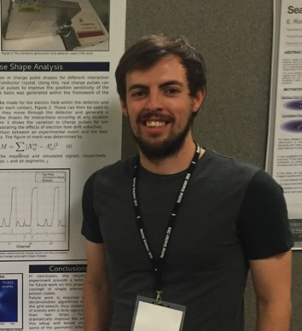
Collaboration and Thanks
University of Liverpool: Jon Wright , Andy Boston, Dan Judson, Paul Nolan, Robert Page, Fiona Pearce, Carl Unworth
STFC Daresbury: Marc Labiche, John Simpson
Special thanks to David Radford at ORNL and to Ren Cooper, Heather Crawford, Marco Salathe (and others) at Berkeley
AGATA/GRETINA Collaboration Meeting ljh@liverpool.ac.uk

