Slide 1

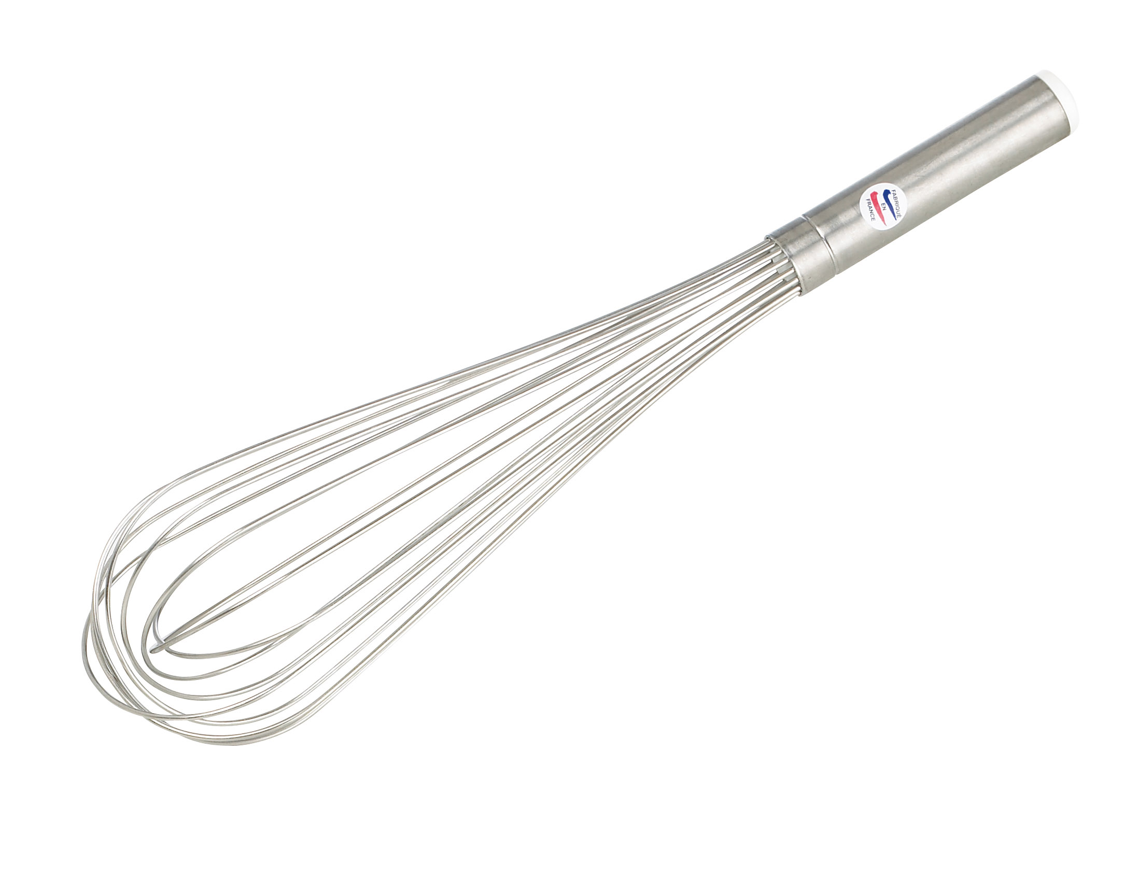
Beyond the Standard Model (BSM)
Loïc Valéry
IFAE Barcelona
lvalery@cern.ch
JRJC 2016
(un endroit près d’) Angers

Slide 2
Outline
Why going beyond the Standard Model ?
What to look for ?
  SUSY
  Extra-dimensions
  Vector-like quarks
Following talks

Slide 3
Why New physics ?

Slide 4
The Standard Model: successes (I)

Slide 5
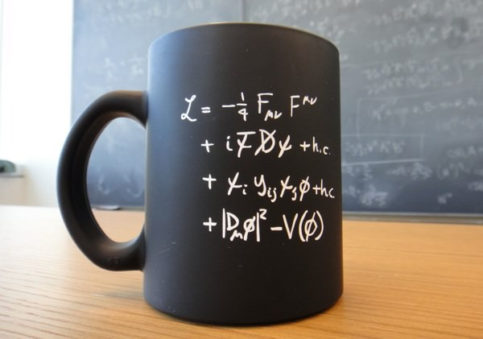
The Standard Model: successes (I)
Not just a formula on a mug …

Slide 6
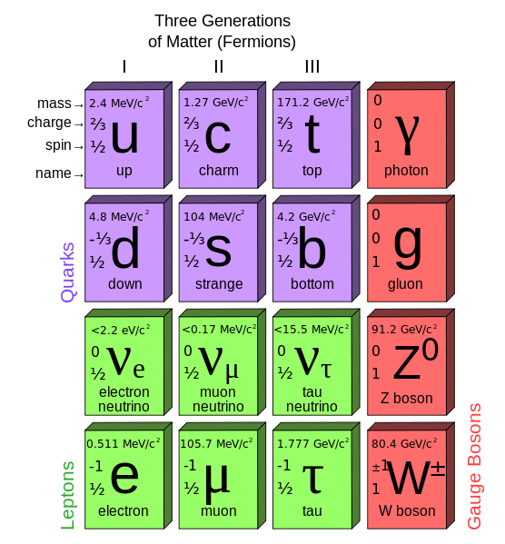
The Standard Model: successes (I)
Not just a formula on a mug …
But a complete theoretical framework to describe elementary particles and interactions
  Gauge bosons
    Carry interactions
  Fermions
    Elementary constituents of matter
  And Higgs boson …
    Manifestation of mechanism through which
    particles acquire their masses
Thouroughly tested @ LHC
  And pretty succesully so far ☺ ☹
~125 GeV
0
0
H
Higgs

Slide 7

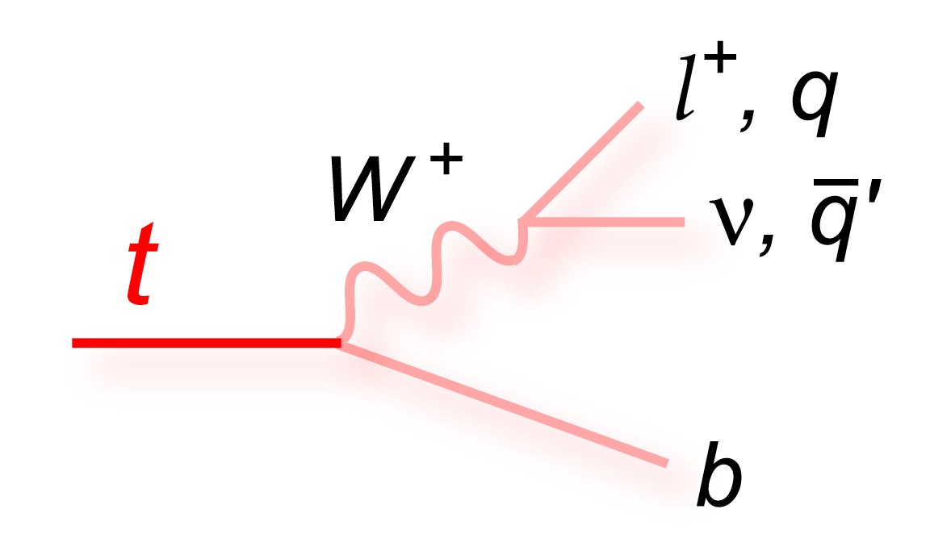
The Standard Model: successes (I)
Not just a formula on a mug …
But a complete theoretical framework to describe elementary particles and interactions
  Gauge bosons
    Carry interactions
  Fermions
    Elementary constituents of matter
  And Higgs boson …
    Manifestation of mechanism through which
    particles acquire their masses
Thouroughly tested @ LHC
  And pretty succesully so far ☺ ☹
Top quark is very special … Heaviest particle in SM
~125 GeV
0
0
Will be back later !!
H
Higgs

Slide 8
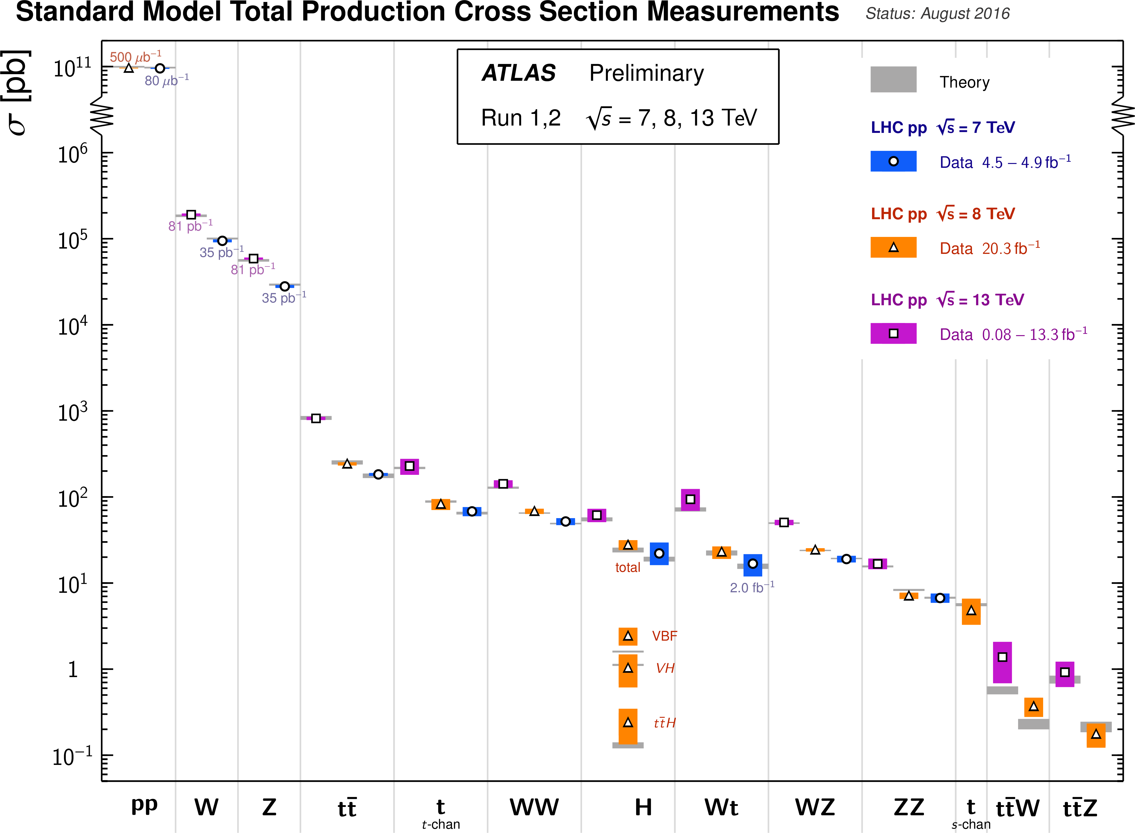
The Standard Model: successes (II)
Pretty amazing measurements done in ATLAS (same in CMS)
  SM predictions verified over a wide range of cross-section, energies, …
Could the SM be the end of the story ?

Slide 9
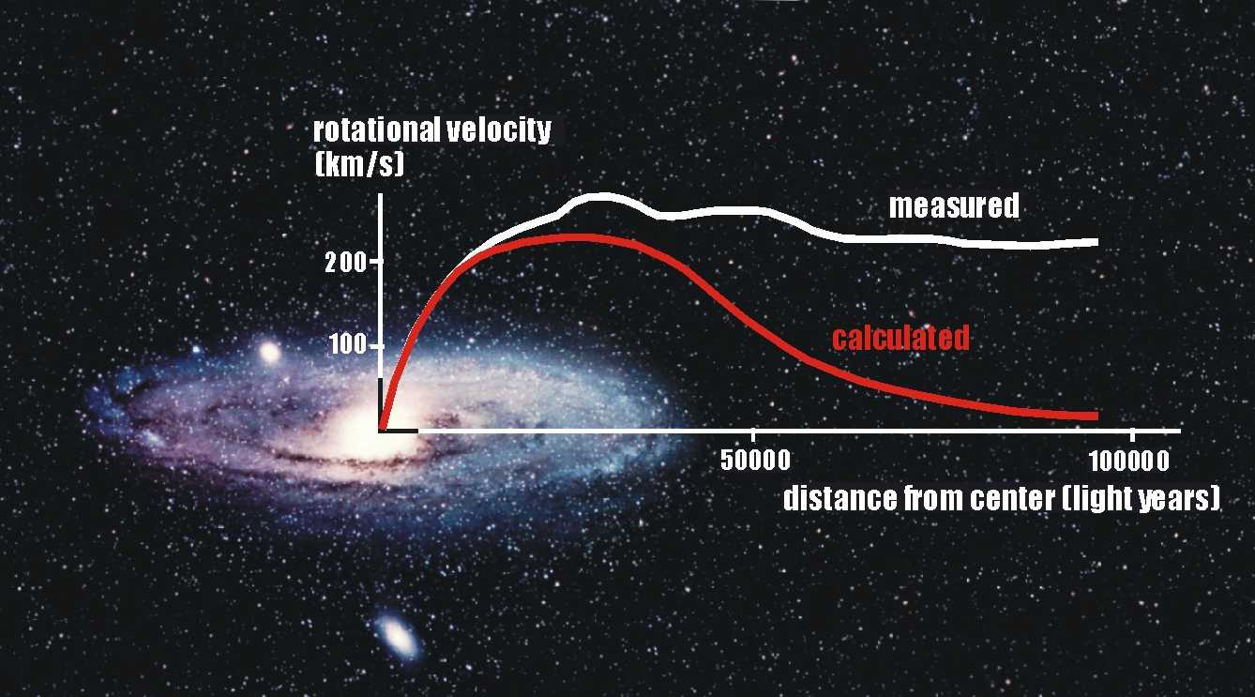
The Standard Model: limitations (I)
Dark matter
  Already discussed quite a lot in previous sessions …
  Astrophysical observations motivate its existence
    Galaxy rotation velocity: ~ constant for large distance from center
    Gravitation lensing
    ...
Dark matter not described/predicted in the Standard Model
NB/ Actually, gravitation itself is not included in the Standard Model
See Julien’s great talk about evidences for Dark Matter

Slide 10
The Standard Model: limitations (II)
Naturalness problem
  Related to radiative corrections to the Higgs mass
  m measured at ~125 GeV
  Λ_{c} the SM cut-off (limit of validity) … can be the Planck scale ...
  λ_{f} the fermion Yukawa coupling (i.e. coupling to the Higgs)

Slide 11
The Standard Model: limitations (II)
Naturalness problem
  Related to radiative corrections to the Higgs mass
  m measured at ~125 GeV
  Λ_{c} the SM cut-off (limit of validity) … can be the Planck scale ...
  λ_{f} the fermion Yukawa coupling (i.e. coupling to the Higgs)
Where is the problem ?
  m measured at a small value …
  So, m₀ and the quadratic Λ_{c} terms have to compensate ...
  Actually ... m₀ and λ_{f} have to be adjusted up to the 32th decimal …
  Not natural ...

Slide 12
New Physics ?
© Passeport pour les deux infinis

Slide 13
How to solve these problems ?
Naturalness problem as an example
  Adding another correction to balance quadratic divergences
    For instance:
      Scalar and fermion corrections to the Higgs mass have opposite signs …
        They can cancel each other !
      If each fermion has a scalar partner ... Divergences should mostly cancel !
    This is supersymmetry !

Slide 14
How to solve these problems ?
Naturalness problem as an example
  Adding another correction to balance quadratic divergences
    For instance:
      Scalar and fermion corrections to the Higgs mass have opposite signs …
        They can cancel each other !
      If each fermion has a scalar partner ... Divergences should mostly cancel !
    This is supersymmetry !
  Reducing the scale Λ
    Λ can be large because Planck scale is large ➔ gravitation is weak at our scale
    But why is gravitation weak ?
    Because it is propagating through more than 4 dimensions ?
    So, need for additional dimensions !

Slide 15
How to solve these problems ?
Naturalness problem as an example
  Adding another correction to balance quadratic divergences
    For instance:
      Scalar and fermion corrections to the Higgs mass have opposite signs …
        They can cancel each other !
      If each fermion has a scalar partner ... Divergences should mostly cancel !
    This is supersymmetry !
  Reducing the scale Λ
    Λ can be large because Planck scale is large ➔ gravitation is weak at our scale
    But why is gravitation weak ?
    Because it is propagating through more than 4 dimensions ?
    So, need for additional dimensions !
  And what if Higgs was not really the Higgs ?
    Composite Higgs ?
    Additional Higgs doublets

Slide 16
WHAT To look for ?

Slide 17
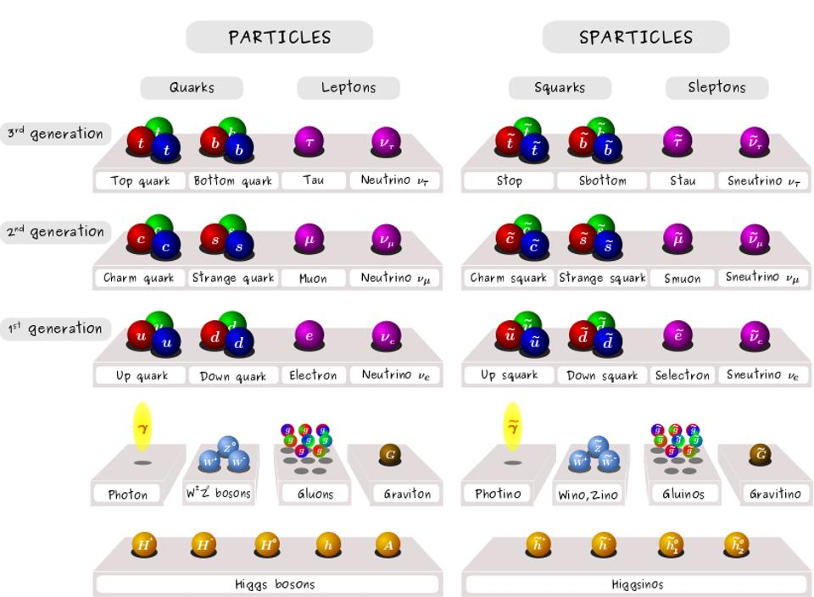
Supersymmetry (I)
General idea
Fermion / Boson symmetry
But a bit more complex in “reality”
  Extended Higgs sector
    Additional Higgs doublet
    3 neutrals
      scalar, and pseudo scalar
    2 charged
  Mixings all around the place …
    Neutral (EW gauginos + Higgisnos)
      Neutralinos (4)
    Charged (charged Higgsinos, Winos)
      Charginos (2)
    sfermion chirality states mixing

Slide 18
Supersymmetry (II)
Summary (for now)
  SUSY extends particle content (by about a factor 2)
  Main types of particles
    Squarks
    Sleptons (Charged sleptons, or sneutrinos)
    Electroweakinos (neutralinos and charginos)
    Gluinos

Slide 19
Supersymmetry (II)
Summary (for now)
  SUSY extends particle content (by about a factor 2)
  Main types of particles
    Squarks
    Sleptons (Charged sleptons, or sneutrinos)
    Electroweakinos (neutralinos and charginos)
    Gluinos
Back to symmetries …
  If symmetry is exactly realized: masses should be identical
    Masses of super-partners should be ~ same as SM particles
    Experiments: They are not the same !!
  So, SUSY is broken !

Slide 20

Interest for SUSY
SUSY was solving naturalness problem
If SUSY is broken … its interest disappeared
If you find an interest, call theorists, don’t try to explain it by yourself

Slide 21
Supersymmetry (III)
No ! SUSY is still awesome !
  To keep (most of) interesting properties: SUSY can be softly broken
    Softly: not reintroducing quadratic divergences in Higgs mass
The SUSY breaking mechanism is unknown ☹
  Some proposals exist … but lead to models with >120 parameters
  Hard to search for ... can be anything/anywhere …
    Use phenomenologically-motivated configurations
      Mass spectra in particular
      MSSM, mSUGRA, …
    Use simplified effective models
      Only limited number of SUSY particles, fixed branching ratios, ...

Slide 22
Supersymmetry (IV)
R-parity and dark matter
  R-parity defined as
    B and L the baryonic and leptonic numbers
    s the spin
    Consequence:
      R = -1 for SUSY particles
      R = +1 for SM particles
  Experimental constraints (protect proton lifetime) ➔ R-parity conserved
    Has to be conserved in all SUSY production / decay scenarios
  Consequences
    SUSY particles pair-produced
    SUSY particle decays have to contain one SUSY particle
      SUSY provides a dark matter candidate
R = 1
R = -1
R = 1
R = 1
R = -1

Slide 23
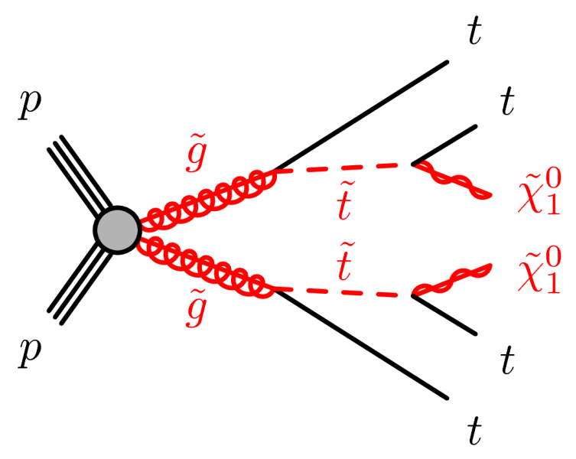
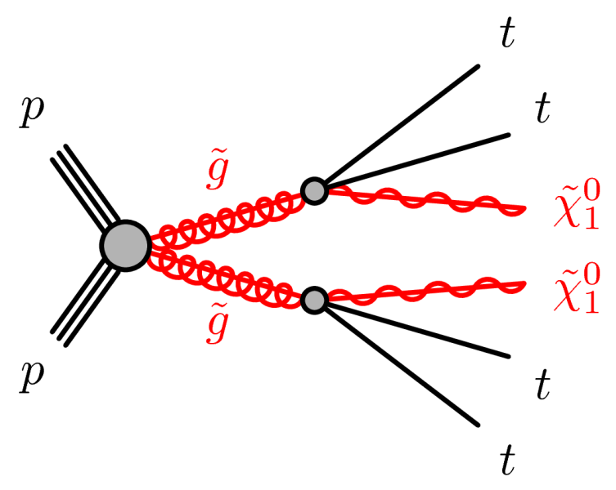
Supersymmetry (V)
SUSY vs. LHC
First data of LHC run 2 very promising for strong SUSY production
  13 TeV gluino pair-prod cross-section multiplied by 40 – 2000 wrt 8 TeV
  Huge discovery power !!
Probed through (very) simple benchmarks
Only two parameters: gluino and neutralino masses
  Easy !

Slide 24
[Statistical break]

Slide 25

[Statistical break]

Slide 26
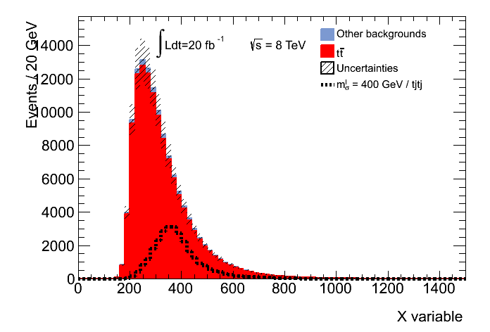
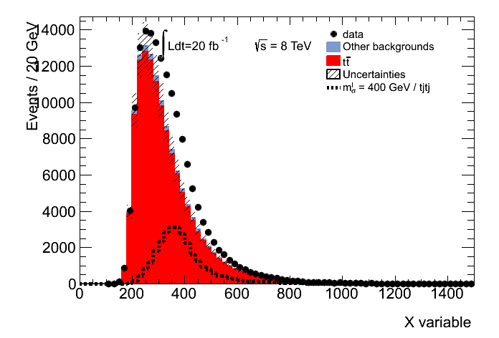
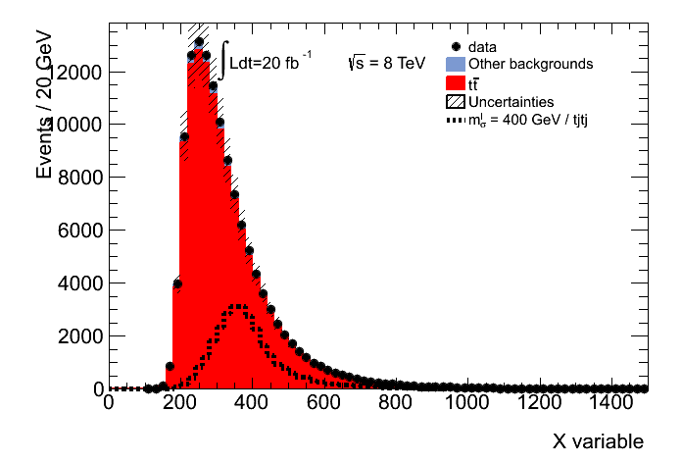
[Statistical break] Hypothesis test (I)
How big should be an existing signal to be seen ?
Let’s assume that our signal has a large production rate
No new physics ☹
Discovery ☺
  If this signal existed … we would have seen it !
  If we don’t see anything ➔ signal likely doesn’t exist
    This signal (at this rate) is excluded

Slide 27



[Statistical break] Hypothesis test (II)
How big should be an existing signal to be seen ?
Let’s assume that our signal has a tiny production rate
New physics in !
No new physics
  Even if this signal existed … we couldn’t have seen it !
  No sensitivity for this signal (at this rate)

Slide 28
Supersymmetry (VI)
SUSY vs. LHC
Limits set in the mass plane
  Expected and observed agree (too) well ☹
Optimistic
  No hint SUSY yet
Pessimistic
  RIP SUSY
Gluinos (if existing) should be heavy …
ATLAS-CONF-2016-052

Slide 29
Supersymmetry (VII)
MANY results in Run 2 from ATLAS and CMS …
  Not really in favour of SUSY ☹
But SUSY can appear in many other ways ... See following talks !
  e.g. EW SUSY
Other scenarios discussed in following talks !

Slide 30
Extra-dimension theories (I)

Slide 31

Extra-dimension theories (I)
General idea

Slide 32
Extra-dimension theories (I)
General idea
  New dimension(s) in which some interactions would propagate (gravitation)
  Gravitation
    Force:
    But of course … planet’s orbits are all screwed up ....
  New dimensions need to be compactified

Slide 33
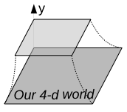
Extra-dimension theories (II)
© S. Calvet
JJC 2015
“Flat”
Periodicity conditions on field … Fourier expansion
“Warped”
Kaluza-Klein modes
(infinite number)
Warp factor

Slide 34
Extra-dimension theories (III)
Classes of theories
  Depend on
    number of extra-dimensions: 1 or ≥2
    Topology (flat or warped)
    Fields propagating along new dimensions
  Lots of combination … leading to different phenomenologies
Example: mUED (providing dark matter candidate)
  No gravity included ☹
  All SM fields propagating
  KK-parity conserved ➔ dark matter candidate !
Heavily looked for at LHC
  KK resonances (ttbar systems, 4tops final states, ...)
  Not hint yet ☹

Slide 35
Vector-like quarks (I)
General idea
  Different models predict new quark states: vector-like quarks (VLQ)
    Left-handed (LH) and RH components transformed in same way under SU(2)
    Mass not coming from the Higgs (gauge invariant mass term)

Slide 36
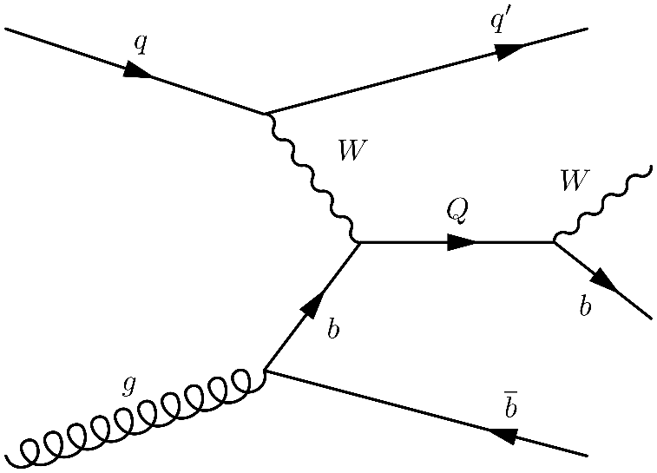
Vector-like quarks (I)
General idea
  Different models predict new quark states: vector-like quarks (VLQ)
    Left-handed (LH) and RH components transformed in same way under SU(2)
    Mass not coming from the Higgs (gauge invariant mass term)
More details
  VLQ mix with SM quarks
    Larger mixing to 3rd generation quarks (top / bottom)
  VLQ can appear in SU(2) singlets, doublets or triplets
    T, B, T^{5/3}, B^{-4/3}
  Production can be mediated by strong or electroweak interactions
    Pair production: strong interaction ➔ dominates for low masses
    Single production: EW interaction ➔ dominates for high masses

Slide 37
Vector-like quarks (I)
General idea
  Different models predict new quark states: vector-like quarks (VLQ)
    Left-handed (LH) and RH components transformed in same way under SU(2)
    Mass not coming from the Higgs (gauge invariant mass term)
More details
  VLQ mix with SM quarks
    Larger mixing to 3rd generation quarks (top / bottom)
  VLQ can appear in SU(2) singlets, doublets or triplets
    T, B, T^{5/3}, B^{-4/3}
  Production can be mediated by strong or electroweak interactions
    Pair production: strong interaction ➔ dominates for low masses
    Single production: EW interaction ➔ dominates for high masses
  Decays
    Several are possible

Slide 38

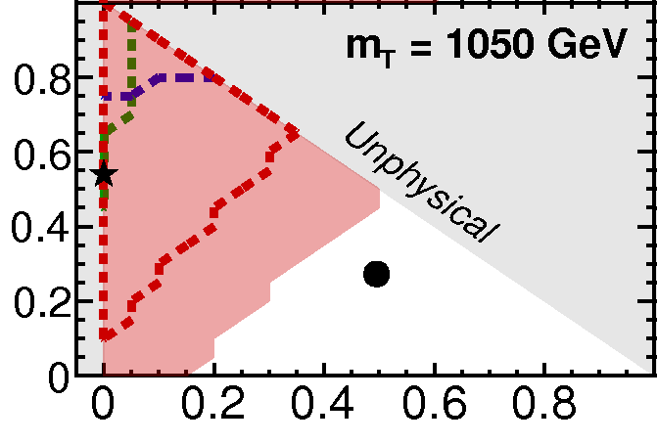
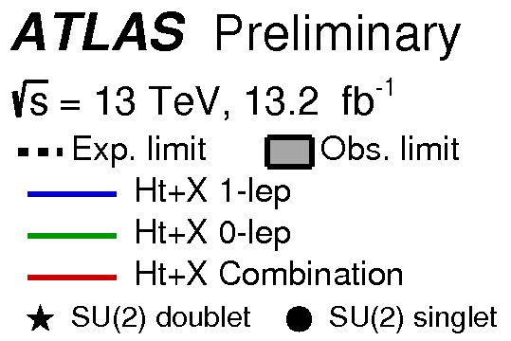

Vector-like quarks (II)
Typical example
  TT pair production
  Decay through T → Ht, T → Wb, T → Zt
    X different final states
  Limits set for various branching ratios
ATLAS-CONF-2016-104

Slide 39
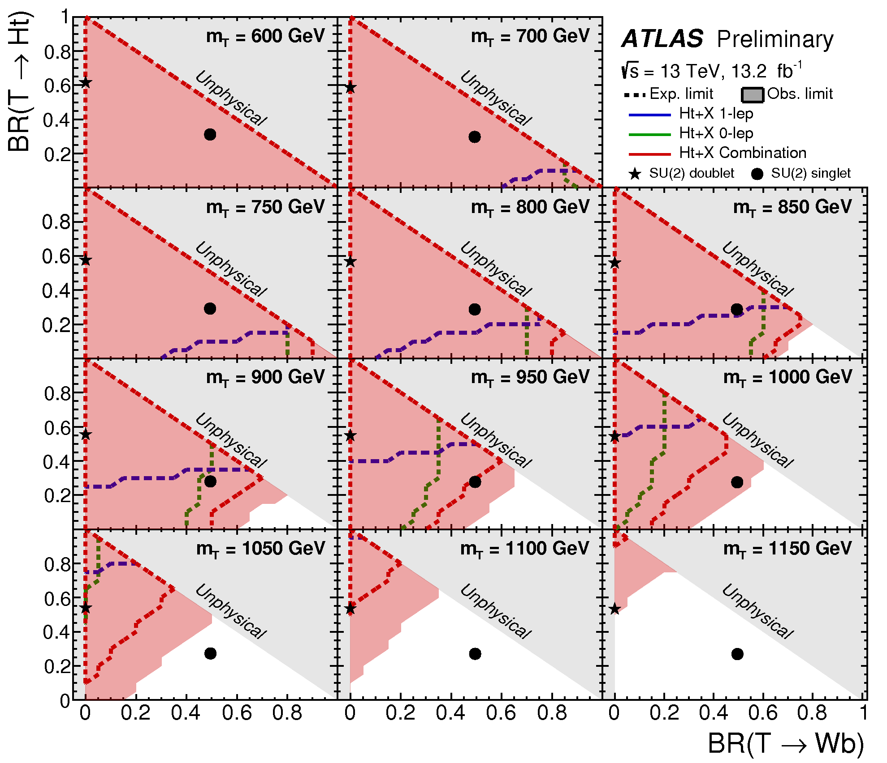
Vector-like quarks (II)
Typical example
  TT pair production
  Decay through T → Ht, T → Wb, T → Zt
    X different final states
  Limits set for various branching ratios
ATLAS-CONF-2016-104

Slide 40
Summary
New Physics motivated by limitations of LHC
  Dark matter
  Naturalness problem
  Number of families
  Hierarchy problem
  …
Many models can extend SM and cure some limitatations
  SUSY, extra-dimensions, vector-like quarks, ...
  No real hint yet at LHC (despite HUGE number of searches in past months)
Not all presented today ... (would have needed days and days)
  But more presented right now !

Slide 41


Lots of possible needles
In so many real haystacks !

Slide 42
AND NOW ?

Slide 43
Grand Unification Theories (GUT)
  Description of all interactions in context of a single symmetry SO(10)
Inclusion of dark matter scenarios in GUT

Slide 44

Electroweak SUSY (production of electro-weakinos) in Higgs final states
  SUSY’s future
B-tagging plays a key role in analysis: performance studies shown !

Slide 45
Extended Higgs sector (as in MSSM) can solve naturalness issue
  2HDM models (additional Higgs doublet) ➔ after EW breaking: 5 Higgs bosons
  Particular decay to gamma-gamma is VERY recognizable in ATLAS
    Predicated at high and low masses

Slide 46
Mono-X signatures very characteristic for indirect DM searches
  Mono-X: X + high MET
  Higgs has interesting decays that make the final state very recognisable
Final state with large MET
  Further improvement by using refined MET-related variable

