Slide 1
Short news on the FATALIC project
Wednesday Tile Upgrade meeting
2016 May 4
Roméo Bonnefoy and François Vazeille
Communication Main Board-Daughter Board 4: Stand by since the expert week
← Delivery the next week of a new laptop dedicated to the readout under Linux.
← Software get from CERN (Thank you Alberto) and soon put on the laptop.
Ongoing studies on the FATALIC-integrator for very low currents:
several options are considered.
Delivery of new PCBs for 60 new Dividers and 60 new All-in-One cards.
Cabling started (see next slides):
→ enough cards to equip 2 Mini-Drawers (about 30 of each type).
Milling of 2 Mini-Drawers performed to welcome cooling bridges,
+ additional holes to fix the Clermont-Ferrand Main Boards (see next slides).

Slide 2
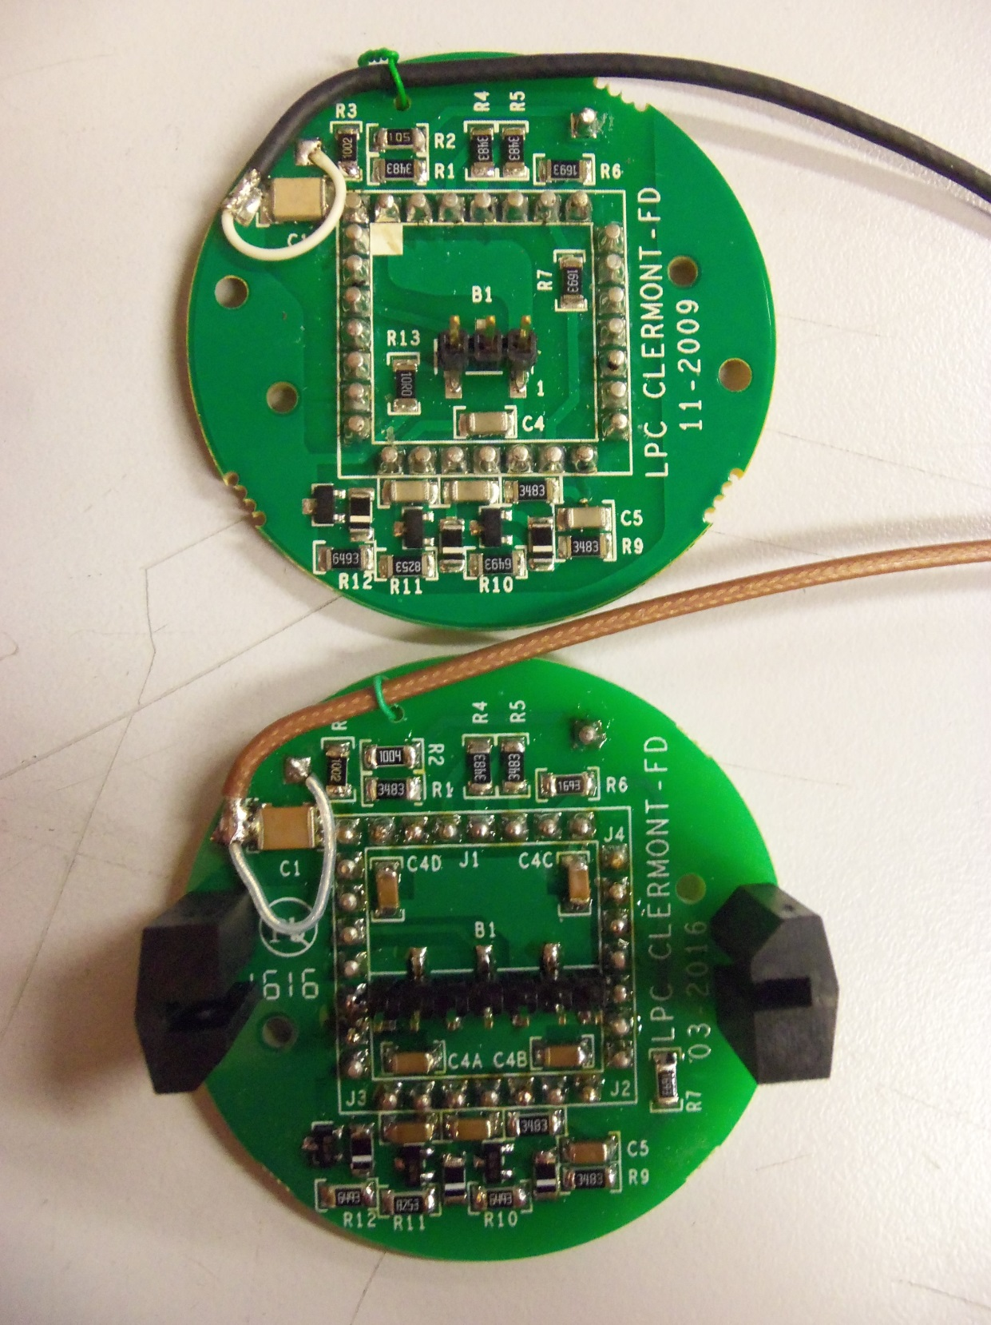
Active Dividers
Old
Improved ground connections.
All Dynode 8 PMT pins used.
7 pin-connector.
New

Slide 3
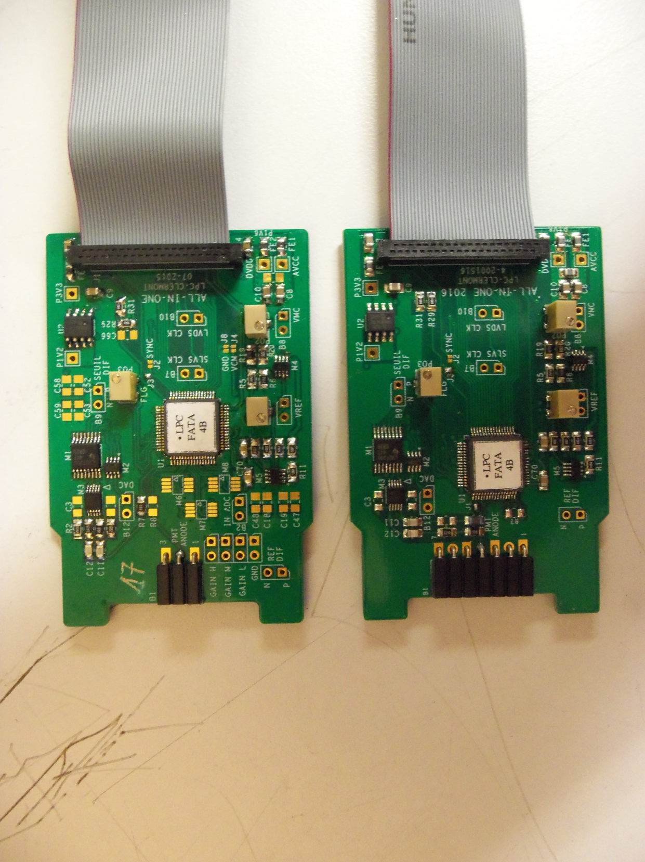
All-in-One cards
Improved ground connections.
FATALIC close to connector
and analog track shorter .
7 pin-connector.
Old
New

Slide 4
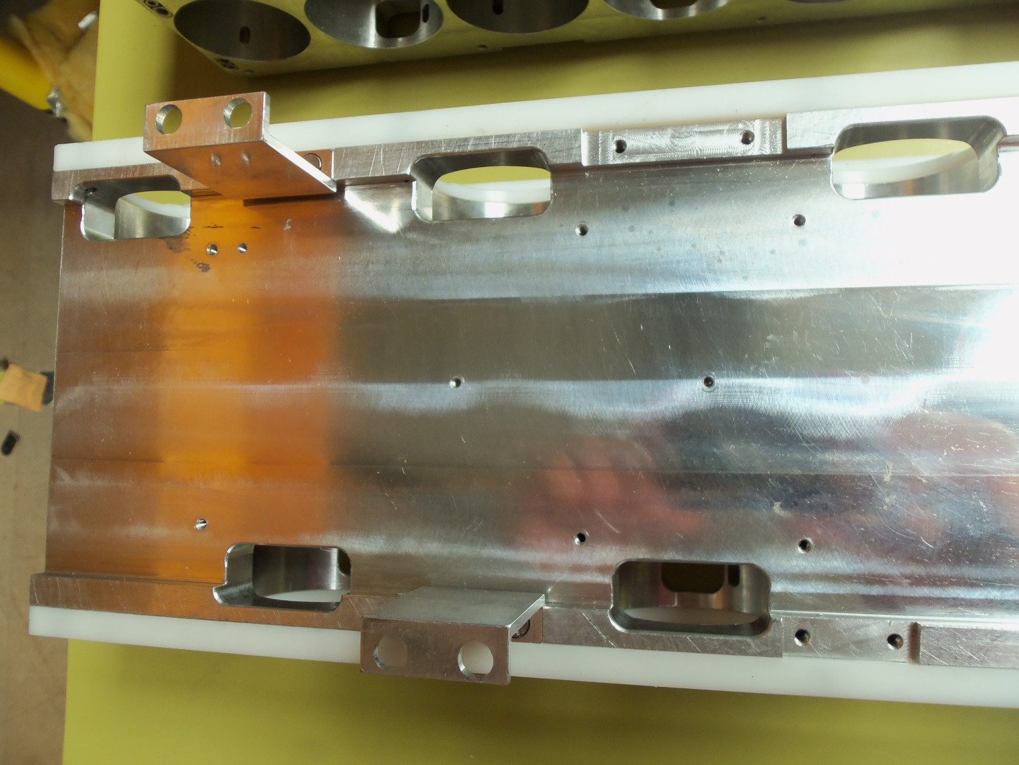
Mini-Drawers
Milling for the cooling bridge
New threads for the
Main Board

