Slide 1
Discussion on the integrator specifications
with comparison of the 3 options
Debriefing meeting at LPC , 28 April 2016
François Vazeille
Summary of the TileCal Calibration systems in the upgrade scheme.
TileCal data for the Cesium source moving.
TileCal data for the Luminosity measurements.
Chicago integrator.
Argonne integrator.
Clermont-Ferrand integrator.
Summary of specifications.

Slide 2
• Summary of the TileCal Calibration systems
in the upgrade scheme
4 complementary systems acting at various levels of the whole electronic chain
+ likely a 5th system for the Back end electronics not shown here.
1. At the Tile/Fiber level: Cesium radioactive source and p-p Minimum Bias events.
2. At the Light Mixer/PMT level: Laser.
3. At the Very Front End electronics level: Charge Injection System.
4. At the Front End Board digital level: Digital tests.
1. PMT gain adjustment/calibration and long term monitoring,
plus calibration transport from the ATLAS Test Beam.
2. Short term monitoring and calibration.
3. Electronics calibration in pC.
4. Working tests of the Main Board/Daughter board communication.

Slide 3
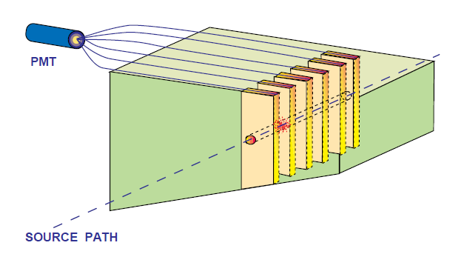
Minimum Bias events
Tile and Fiber
Cesium source
Laser
Mixer
Drawer
PMT Block
PMT
High
Voltage
Divider
FATALIC
Charge injection system
All-in-One
Low
Voltage
Main board
Digital tests
Daughter
Board
Back End
electronics

Slide 4
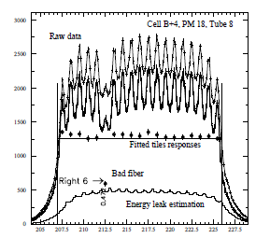
• TileCal data for the Cesium source moving
Source speed: 30 cm/s.
TileCal scheme
Steel Master = 5.0 mm
Steel Spacer = 4.05 mm
Plastic Tile = 3 mm
Period = 18.325 mm
= 5 + 4.05 + 5 + 4.05 + G
= 18.10 + G G = Glue
18.325
- Transit time:
In a Tile: 0.3/30 = 0.01 s = 10 ms.
From a Tile to the following one: 1.8325/30 = 61.08 ms.
- The optimum integration time is 10 ms,
that can be increased by two means:
- Digital sum without any problem.
- Analog integration using different time constants.

Slide 5
▪Orders of magnitude from Ilya’s talk
E1
E2
E3
E4
Collisions
Beams
By taking into account the non-replacement of the sources (Decreased activity)
Cells A to D: 60 to 90 nA.
Cells E1&E2: ≤ 4 nA.
Cells E3&E4: ∼ 0.06 nA.
but no Cs in them
Improvements of scintillators/Dividers are possible.
Comment: for the E cells, the constraint of 10 ms with respect to adjacent Tiles
is no longer relevant ⇒ digital sums are possible,
and/or use of a 20 ms time in the analog mode
in order to reach these low values.

Slide 6
• TileCal data for the Luminosity measurements
▪ Orders of magnitude from Ilya’s talk
♦ Maximum value at the highest Luminosity:
- A13 cell: 8 µA.
- E cells: 100 µA ⇒ no saturation for Argonne and Clermont-Ferrand.
Minimum value for the vdM scan at very low Luminosity:
up to 0.02 nA to cover almost all the A and E cells and part of B cells,
if not 0.05 nA.
with which accuracy?
1% is impossible,
5 % ? 3% ?

Slide 7
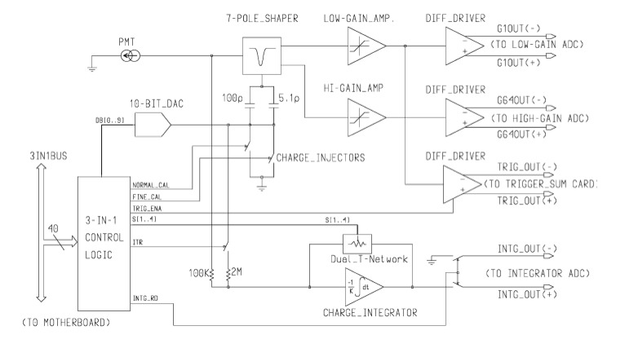
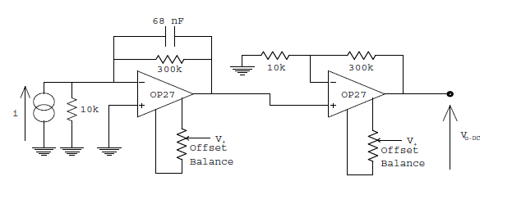
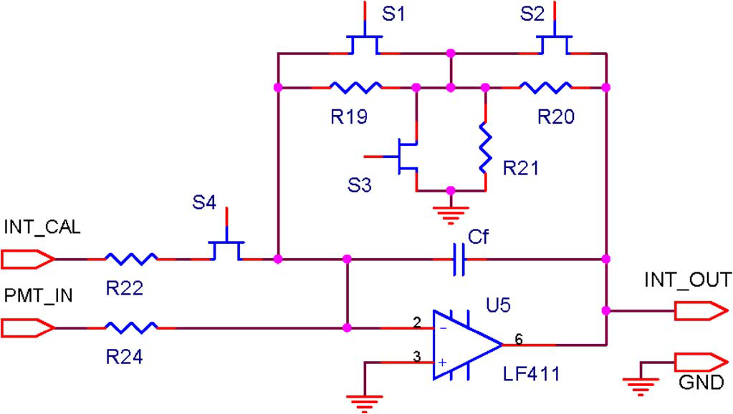
• Chicago integrator
▪ Principle (Present ATLAS scheme):
in 2 steps
Amplification
because 1% signal used
1%
Integration time
from feedback capacitance/resistor
Combination of switches to control
Timing and Gain.
DC injection for calibration.
T = 10 + RC in ms, with C=0.1 10⁻⁹
From Ilya (Present 3-in-1): R from 2.7 to 100 MΩ
⇒ 10. 27 ms to 20 ms. (Ilya said 10.3 to 20).

Slide 9
▪ Performances
Present ATLAS scheme (from TIPP 2011 Chicago)
- Range 0.01 nA-1.4 µA.
- Non linearity < 1%.
- 12 bit ADC.
- Signal noise 0.003 nA
Not credible
(never demonstrated)
The PMT dark current is ≤ 2 nA at 800 V, well above this noise !

Slide 10
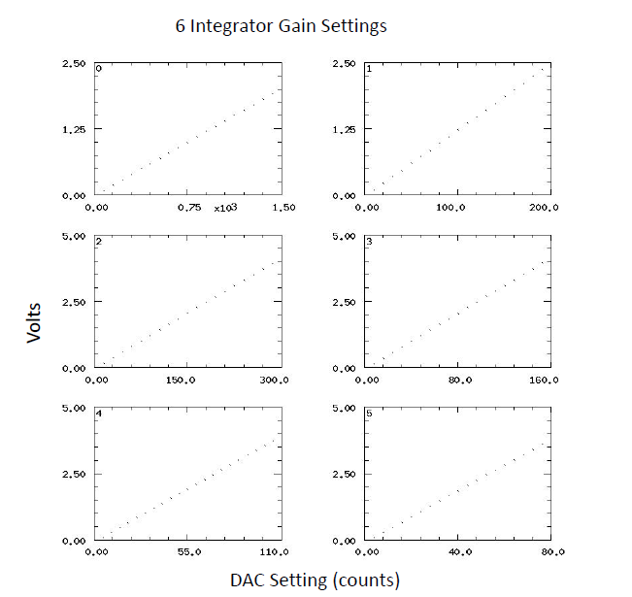
Upgrade scheme
- 6 gains … not given in current
(as for the present ATLAS)
0: 0-750
1: 0-200
2: 0-300
3: 0-160
4: 0-110
5: 0-80
0-2.5 V
0-5.0 V
DAC
counts
- Does not correspond to python soft
sent by Kelby very recently
maxval = [3200,180,300,120,160,90]
minval = [64,6,4,4,4,9]

Slide 11
For times > 20 ms ⇒ summations
Example of a reply of Ilya to a question of FV about current of 0.5 nA
in the current ATLAS scheme.
Hi Francois, yes, these points are averaged over about 10 measurements
each having the int.time of 20ms.
So effectively the int.time is about 200ms on this plot.
Best,
Ilya
On Fri, Apr 8, 2016 at 1:20 PM, François Vazeille <vazeille@clermont.in2p3.fr> wrote:
Hello Ilya, looking at your very interesting and useful talk on the Cs system,
I have a question about the VdM scan through the cell A13 (slide 6) where you measured
a current of 0.5 nA.
What was the integration time of this measurement?
Did you add several measurements in order to increase the integration time?
With my best regards,
François

Slide 12
• Argonne integrator
▪ Up to 8 µA: external
≥ 40% signal used
- Integration time of 2 ms, but will be fixed later at a constant value (10 ms ?).
- 16-bit ADC range, having 122 pA/count → That does mean it is the accuracy.

Slide 13
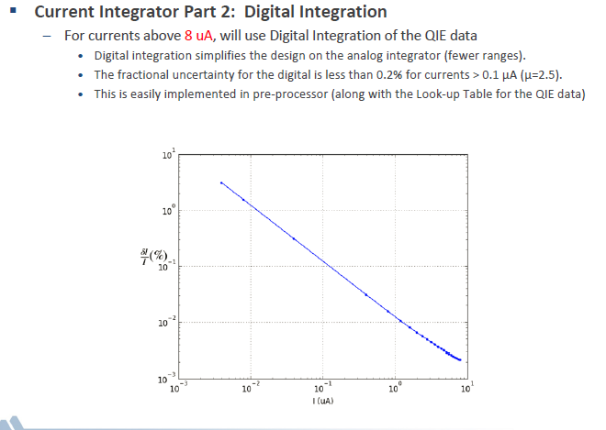
▪ Above 8 µA: internal from digital sum
- It is a simulation.
- The integration time
is not indicated,
but it is 10 ms from Ilya.
- This plot goes up to 6 nA, but with an error of about 4%.
- 0.2% above 100 nA but the noise level is very optimistic.
- Used in fact above 8 µA.

Slide 14
• Clermont-Ferrand integrator
▪ Accuracy calculations on digital sum from the present noise performance
Noise over the whole frequency spectra: 8 fC. (and not 7 fC HF noise only).
For a realistic pulse shape (triangular), it corresponds to 400 nA, or 50 nA/fC.
A “sum number” of 1 corresponds to the sum of 400 000 samples at 40 MHz.
Cesium scan | Cell value | Time (ms) | Sum number | Accuracy %
 | A to D 60 nA | 10 | 1 | 1.05
 | A to D 90 nA | 10 | 1 | 0.70
 | E1-E2 < 4 nA | 10 | 2 | > 11.2
 | E3-E4 ∼ 0.06 | Impossible, no Cs
 | Limit 1% 63 nA | 10 | 1 | 1.0039
 | Limit 1% 45 nA | 10 | 2 | 0.9938
- For cesium scan, OK for A to D above 45 nA with an accuracy of 1% or better.
- E scintillators are likely thicker than Tiles
⇒ a time > 20 ms could be chosen , but not too much.

Slide 15
- For Luminosity scans, larger times can be used.
- We must consider two extreme case: HL-LHC (7 10³⁴ cm⁻² s⁻¹ )
and vdM scans (some 10³⁰ ).
- For vdM scans, we take a time of 2 minutes imposed by Luminosity blocks.
Luminosity scan | Cell value | Time (ms) | Sum number | Accuracy %
 | HL minimum > 100 nA from (B-C) | 10 | 1 | < 0.63
 | vdM A-B 0.02 nA | 10 | 12000 | 28.9
 | vdM A-B 0.05 nA | 10 | 12000 | 11.5
 | A, Limit 1% 0.58 nA | 10 | 12000 | 0.9954
 | A, 3% 0,192 nA | 10 | 12000 | 3.007
 | A, 5% 0.115 nA | 10 | 12000 | 5.02
- No problem for HL scans, up to the 100 µA value on E cell without saturation.
- vdM scan possible for A cells with an accuracy ≥ 3%.

Slide 16
▪ Requirements on Analog measurements
♦ For Cesium scans with times of 10 or 20 ms
- Must overlap the Digital approach ⇒ Maximum value of 150 nA.
- Must reach low values up to some nA for E1-E2.
♦ For Luminosity scans at Low Luminosity:
to reach 0.05 nA in order to scan the B cells with an accuracy of 3%
over durations of 2 minutes.
Dynamics from 0.05 nA on means to 150 nA in 10 or 20 ms.

Slide 17
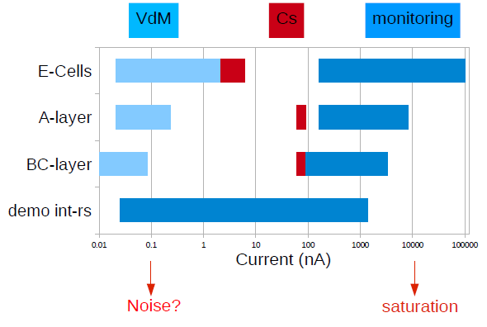

Slide 18
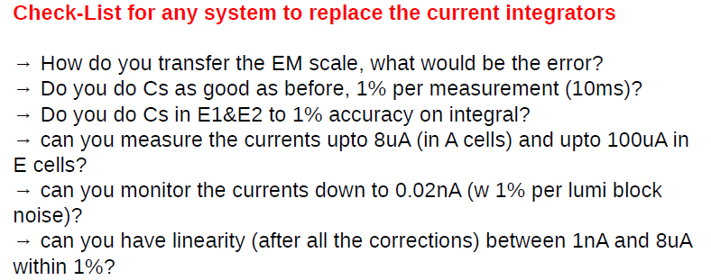
• TileCal data for the Cesium source moving
▪ Recommendations from Ilya’s talk

Slide 19
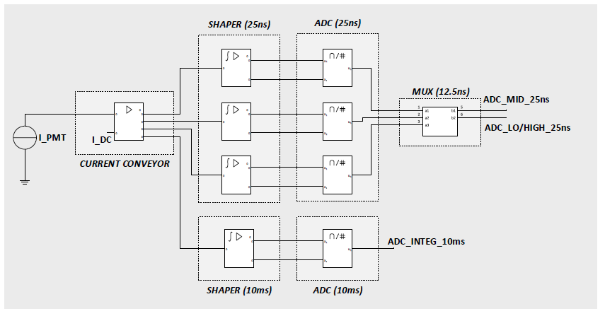
▪ Our specifications for the Analog approach
- A fourth current copy
with the ADC inside the chip.
- A DAC calibration
via current injection.
- Possibility of 2 integration times: 10 ms and 20 ms.
- Is it possible to use the same DAC ?
- Dynamics for Cesium scans
Maximum: 150 nA.
Minimum: 0.5 nA for E1-E2 cells.
- Dynamics for Luminosity scans
Maximum: no constraint ⇒ we keep 150 nA and saturation accepted above.
Minimum: means are possible over 2 minutes ⇒ to reach 0.05 nA.

