Slide 1
Status of FATALIC and its MB
Tile Upgrade session during the AUW
Wednesday, 20 April 2016
François Vazeille on behalf of the Clermont-Ferrand team,
in particular
Roméo Bonnefoy, Romain Madar, Samuel Manen, Dominique Pallin, Laurent Royer and Sergey Senkin
First phase of the noise study of the FATALIC readout
and impact on the design of the electronics cards
• Main Board-Daughter Board communication
• Impact of a wider integrator current range
Sharing and pooling of the radiation tests
Conclusion and prospect

Slide 2
First phase of the
noise study of the FATALIC readout
and impact on the design of the electronics cards
Summary of the talk at Weekly Tile Upgrade meeting (2016 March 23)
https://indico.cern.ch/event/505441/
TileCal specifications on the noise
Main objectives of FATALIC/noise
Systematic study
First conclusions

Slide 3
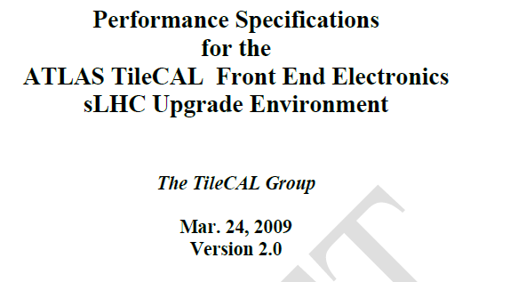
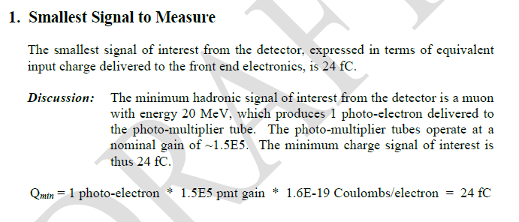
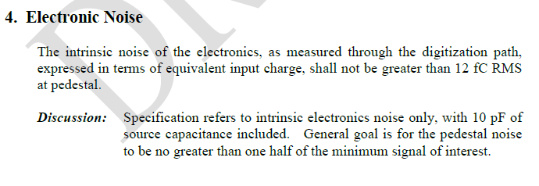
• TileCal specifications on the noise
- The rule: electronic noise = half the minimum charge of interest of 24 fC
corresponding to 1 photo-electron ⇒ 12 fC for the design of FATALIC.
- This document is nowhere: it should be put on CDS.
- BUT: there was a mistake, the nominal PMT gain is 10 ⁵ and not 1.5 10 ⁵
⇒ the electronic noise should reach 8 fC !

Slide 4
• Main objectives of FATALIC/noise
Main objectives of the FATALIC readout
An electronic noise ≤ 12 fC on the High Gain.
An external RMS noise < intrinsic noise of FATALIC.
A noise practically independent from the environment.
From the point 1 to the point 3,
these goals will be more and more difficult to reach.
… and why not to be better than 12 fC.

Slide 5
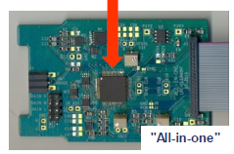
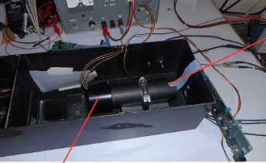
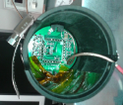
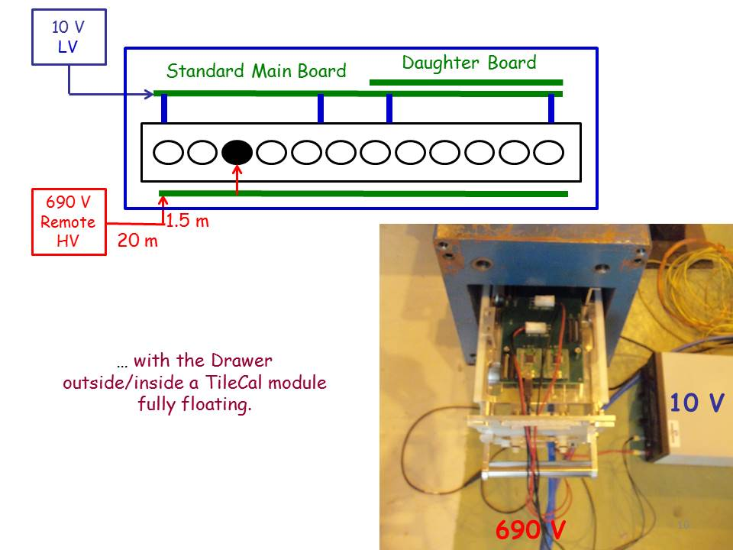
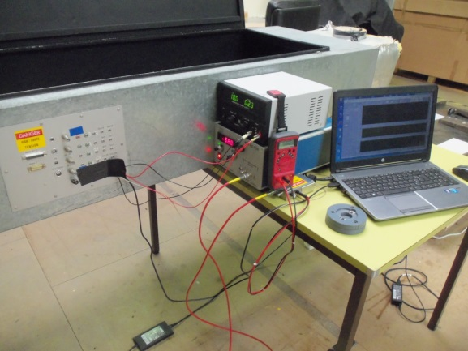
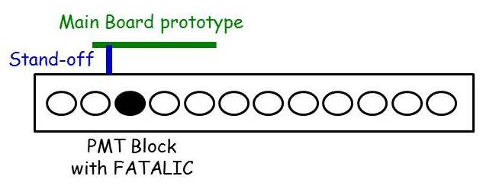
• Long systematic study, step by step, with improvements
FATALIC
1. Alone
2. Inside
PMT Block
3. Inside
FATALIC Test Bench
LV
HV
4. Inside Drawer
+ Main Board proto
5. Inside TileCal
at CERN
+ Main Board
+ Daughter Board
6. Inside Large box
at LPC
+ Main Board
+ Daughter Board

Slide 6
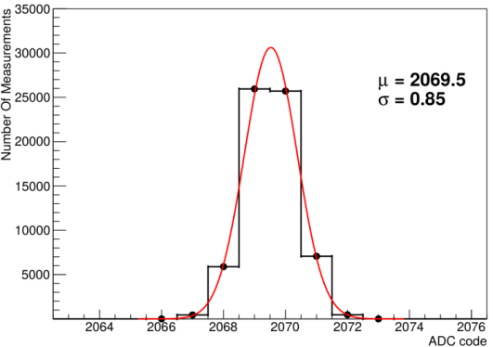
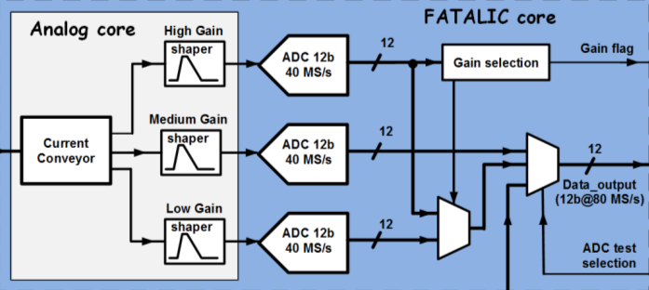
▪ There was a step O (Laurent Royer, TWEPP 2015 Lisbon)
intrinsic noise estimates from simulations of FATALIC alone.
High Gain noise:
2 ADC counts
ADC noise:
0.85 ADC count
ADC noise
Total noise (quadratic sum) = 2.2 ADC counts for the High Gain
or 5.5 fC.

Slide 7
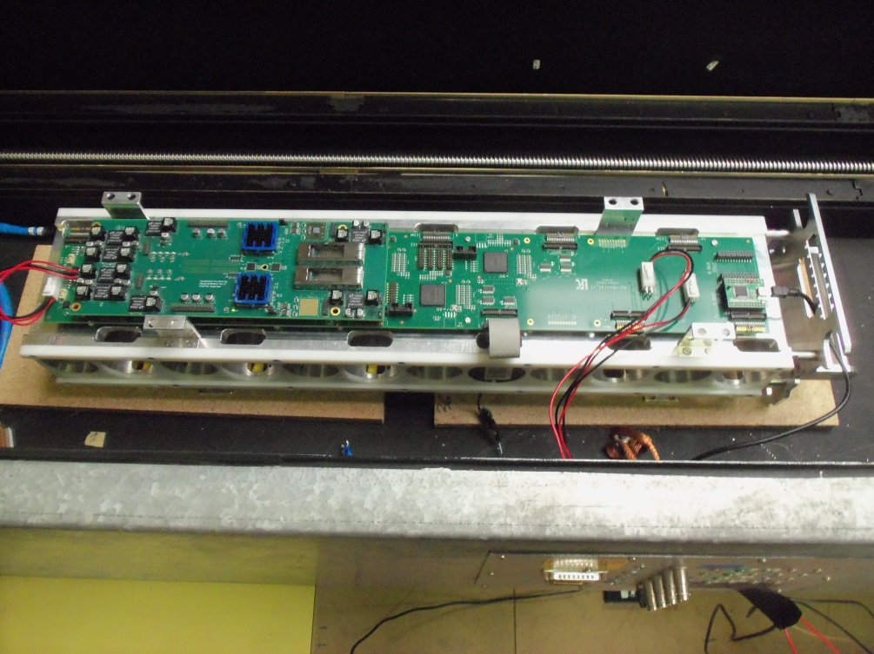
▪ Experimental set-up (Example of Step 6):
PMT Block-Drawer-Main Board-Daughter Board inside a Big Test Box
+ LV/HV powers + laptop
FPGA memory of Main Board read out by USB interface
LV
HV
USB link
Monitoring and data recording by LabVIEW on laptop.
Readout supplied by LV regulators of Main Board.

Slide 8
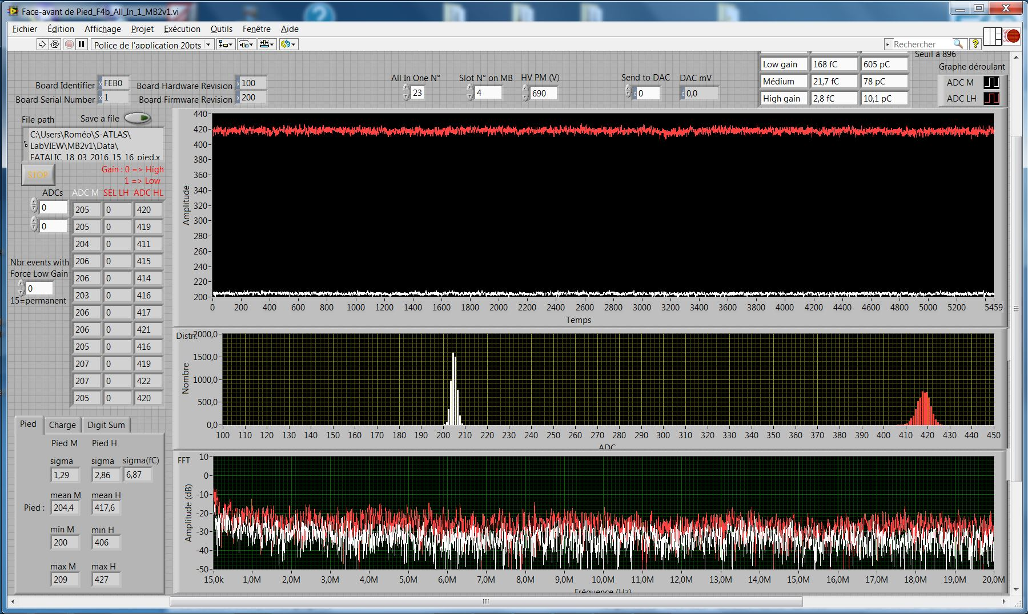
Gain selection (0 or 1)
Medium Gain
High Gain
RMS
FFT (Fast Fourier Transform)
▪ Data: 5460 samples at 40 MHz.
▪ Frequency spectra: 136.5 µs range → 15 kHz to 20 MHz (Shannon theorem).
▪ RMS accuracy: ~ 0.15 to 0.20 ADC count.
▪ Charge calibration: 1 ADC count = (2.40±0.05) fC.

Slide 9
▪ Step 1: All-in-One alone
FATALIC
All-in-One# | 13 | 15 | 23 | 21 | Mean
Noise (ADC counts) | 2.7 | 3.0 | 3.0 | 2.7 | 2.85±0.17
- Measured intrinsic noise not far from simulation of 2.2 ADC counts.
- Equivalent noise in charge units: 6.84±0.43 fC.

Slide 10
▪ Grounding aspects
Signal
PMT
High
Voltage
Divider
PMT Block
Drawer
FATALIC
In blue: Signal and/or digital information
In red : Grounding aspects
All-in-One
Main board
Low
Voltage
We played with all these objects
including the Black box (TileCal or box)
to minimize the noise level
Daughter
Board
Back End
electronics

Slide 11
▪ Steps 2 and 3:
PMT Block alone
and inside FATALIC test box
PMT Block
Test Bench
▪Dramatic:
- Intrinsic noise increased about 4-5 times when connecting the PMT/Divider.
+ Noise peak at 2.6-2.7 MHz.
- Big sensitivity to the environment: position in the Test Box, cover or not…
HV
Test box
PMT block
MB
LabVIEW
LV

Slide 12
Peak at 2.6-2.7 MHz
Zoom
Other peaks arose also at any moment

Slide 13
▪ Improvements from steps 4 to 6 (CERN, Clermont-Ferrand),
performed in the following order with a continuous noise decrease
1. A single ground on the active Dividers instead of 2.
2. Additional grounds connections on the active Dividers … but not too much.
3. Noise killers (Filters with 1 kΩ resistor on HV power and return).
4. Well distributed metallic stand-off’s between cards or drawer body.
5. New connectors with more ground pins between Divider and All-in-One card.
6. Connections of the 4 pins of Dynode 8 instead of 1.
See the talk talk of the Weekly Tile Upgrade meeting (2016 March 23)
https://indico.cern.ch/event/505441/
showing the noise evolution.

Slide 14
1. Single Divider ground
▪ 2 different grounds in the standard scheme:
Analog ground → FATALIC ground
Power ground → HV ground
▪ Not suited to an ASIC structure.
With a 10 Ω resistor connection
Replacements of the resistor by a direct connection

Slide 15
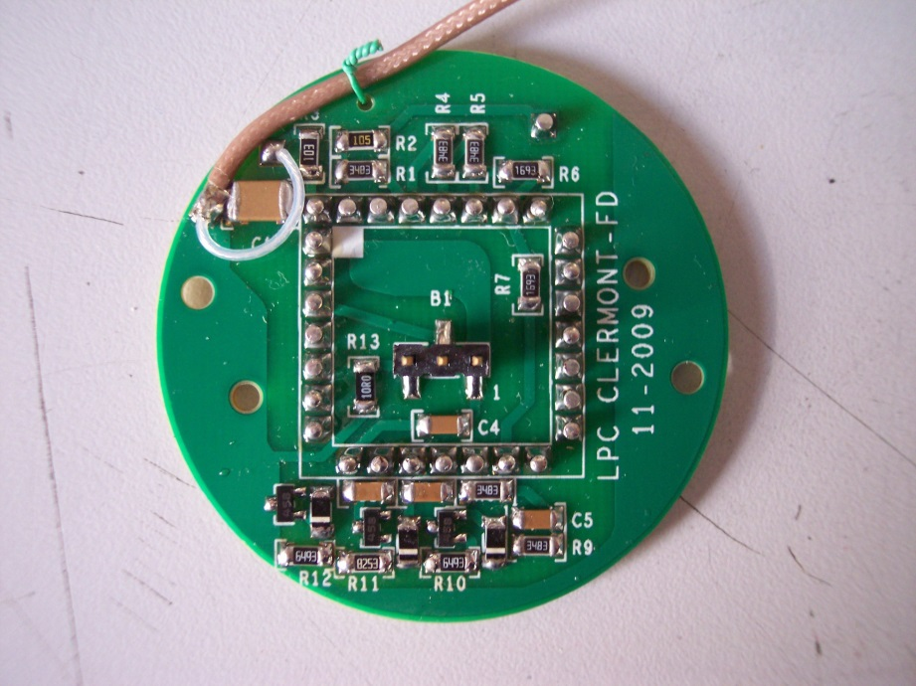
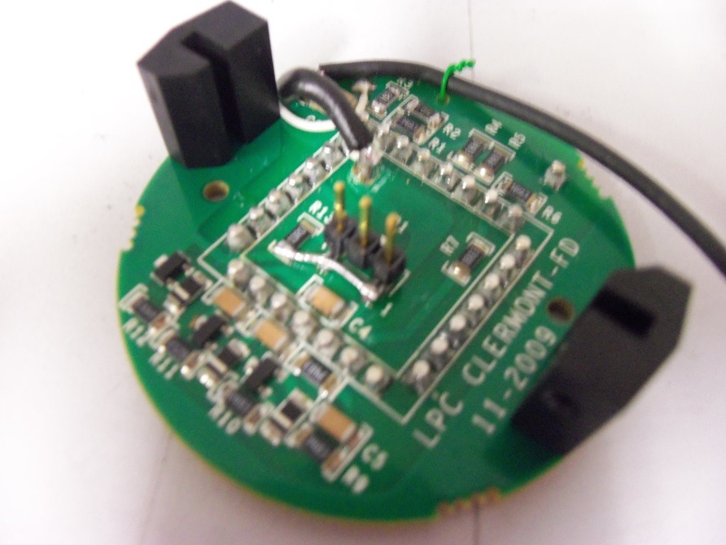
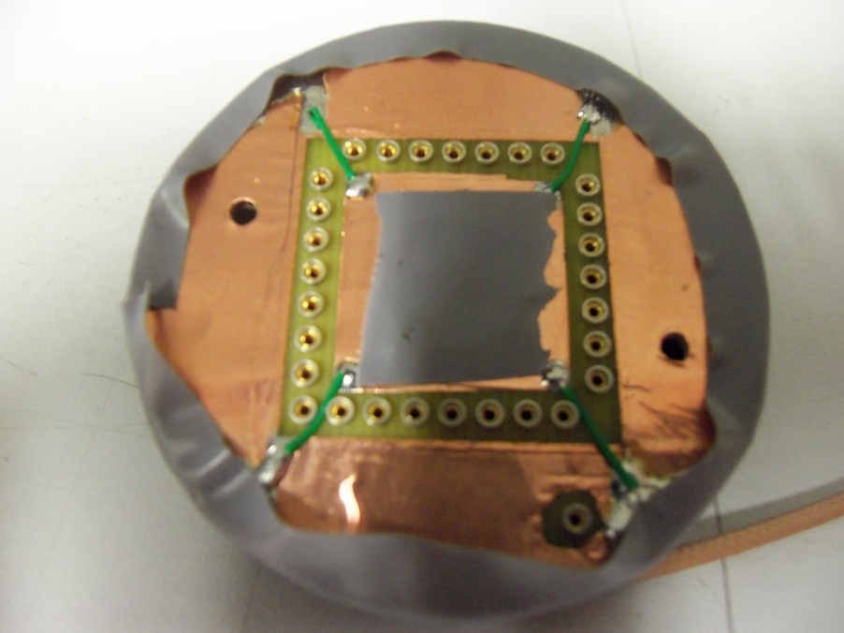
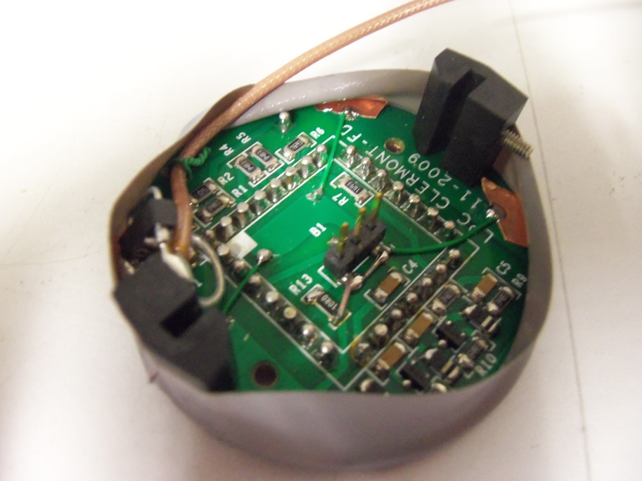
The
best
1 single ground +
some ground wires
2. Additional ground wires
1. Standard Divider
2. Modified Divider
3. Modified Divider + new grounds
Verso
Recto

Slide 16
4. Well distributed metallic stand-off’s
CERN
Drawer body/PMT Block/ MB/DB grounds at the same potential

Slide 17
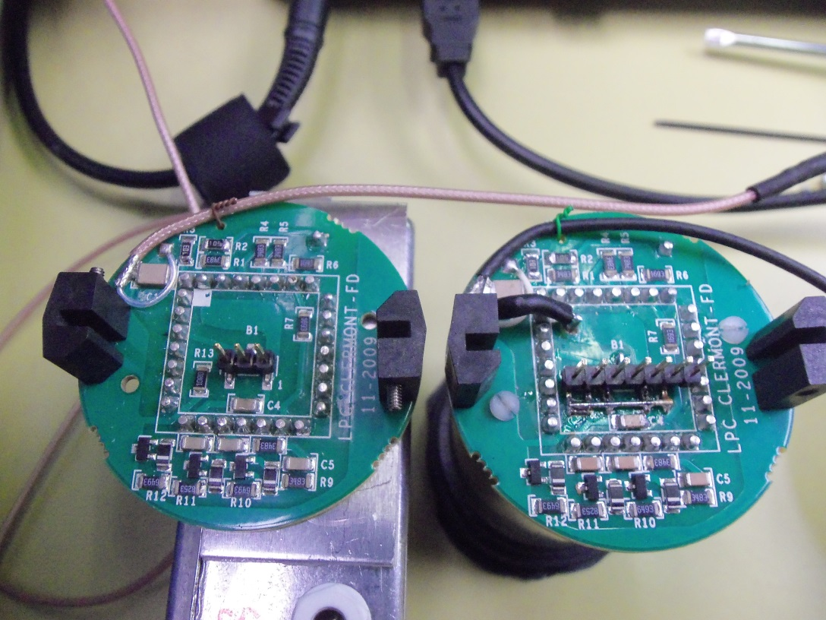
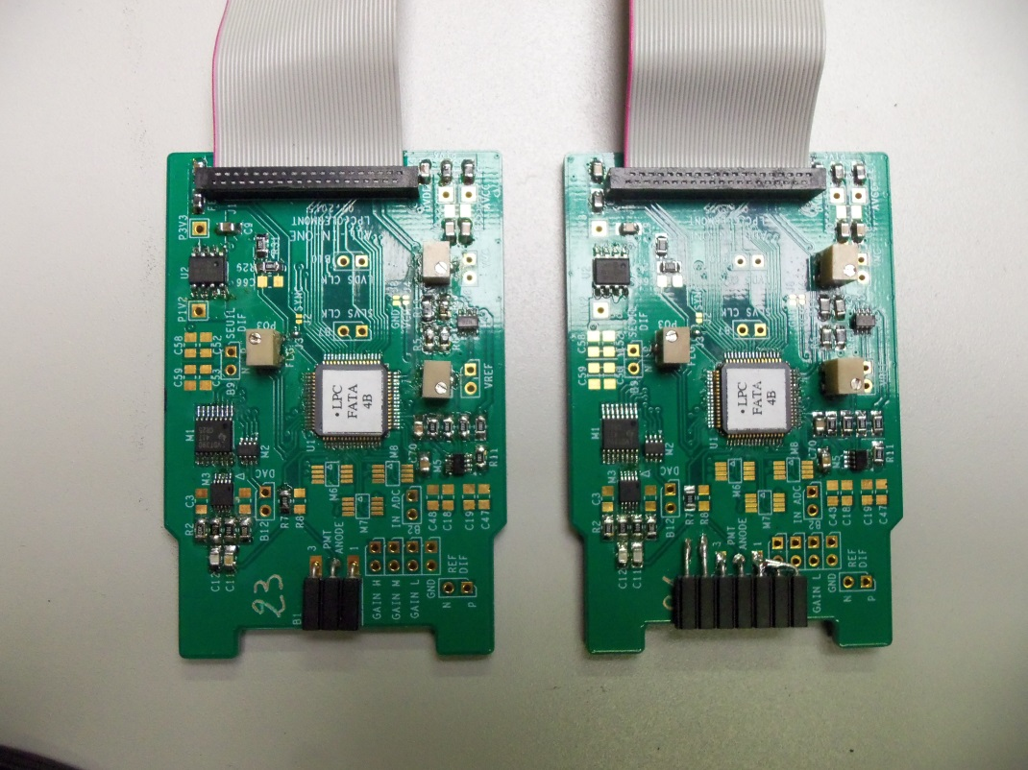
5. New connectors on Divider/All-in-One cards
NEW
NEW
- Previous scheme: 3 pins (Central: anode signal, Sides: ground).
- Changes: 7 pins (Central: anode signal, Others: ground).

Slide 18
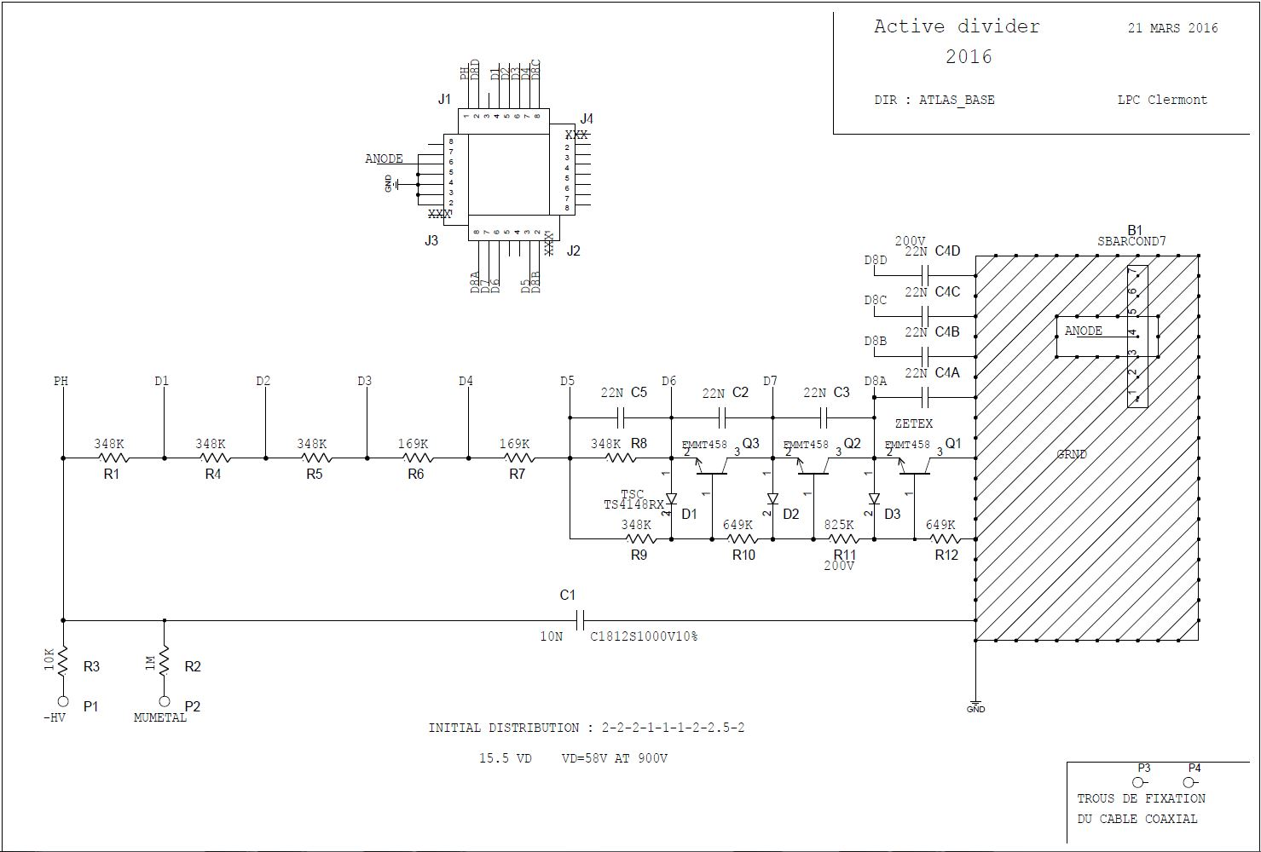
6. New “discovery”: last dynode (D8) connected to 4 pins of socket,
but till now in ATLAS, only 1 (D8A) is used (Decoupled/ground.)
(D8 is roughly a dynamic ground/anode).
D8D
D8C
D8A
D8B
New active Divider
with:
Single ground.
Wire grounds.
4 D8 pins.
Modification: use of the 4 pins with 22 nF capacitors to the ground.

Slide 19
⇒ Final results
◊ Effect of Noise killer: kills Peak at 2.6-2.7 MHz
Zoom

Slide 20
◊ Noise values in ADC counts then in fC
Gain | HV | Mean ± RMS
High | Off | 3.35±0.30
 | On | 3.47±0.51
Medium | Off | 1.36±0.12
 | On | 1.37±0.11
Low | Off | 1.17±0.03
 | On | 1.17±0.03
In/out Black Box | Gain | HV off | HV on
In | High | 3.00 | 2.90
 | Medium | 1.25 | 1.26
 | Low | 1.14 | 1.15
Out | High | 2.8 | 2.9
 | Medium | 1.28 | 1.26
 | Low | 1.15 | 1.15
PMT Block outside Drawer | High | 3.00
 | Medium | 1.27
 | Low | 1.14
PMT Block
alone
Card# 21
Means over
cards# 13, 15,21
Card# 21
- High gain noise in fC with HV off (On): 8.04±0.74 fC (8.33±1.24 fC ).
- External noise: 1.76 ADC counts < intrinsic noise of 2.85 ADC counts.
- Noise independent from the environment, with a low sensitivity to HV.
- Rough estimates (from the noise levels of the 3 gains)
of the analog (Shaping) and digital (ADC) noise parts for HV off:
Analog: 3.3 ADC counts (Simulation: 2 ADC counts).
Digital : 1.1 ADC count (Simulation: 0.8 ADC count).
⇒ Perhaps some margin of improvement of the analog noise.

Slide 21
▪ First conclusions
- The 3 main noise objectives of the FATALIC read out are reached.
- The HV induced noise is negligible, within the uncertainties.
- Ground improvements are identified on the Dividers/All-in-One boards.
- Is it possible to improve again the electronic noise ?
Difficult because the noise is already very low,
but not impossible because of 3 reasons:

Slide 22
1. The RMS values are calculated over the whole frequency spectra,
while only the high frequency noise should be considered (5.7-20 MHz).
Results on 3 All-in-One cards alone: noise reduction in % from
direct comparison of RMS values from HF and total frequency data (15 points)
Card # | 13 | 15 | 21
Card alone | 16.5±5.3 | 13.1±2.3 | 9.35±1.76
Simple mean | 13.0±3.6
Weighted mean | 11.1±1.6
A noise reduction of at least 11.1% is expected
⇒ Noise close to 7 fC.
2. Cleaner modifications will be made on the new Divider and All-in-One.
3. A reduction of the analog noise could come from the following change
on All-in-One:
to reduce the distance between FATALIC and connector.

Slide 23
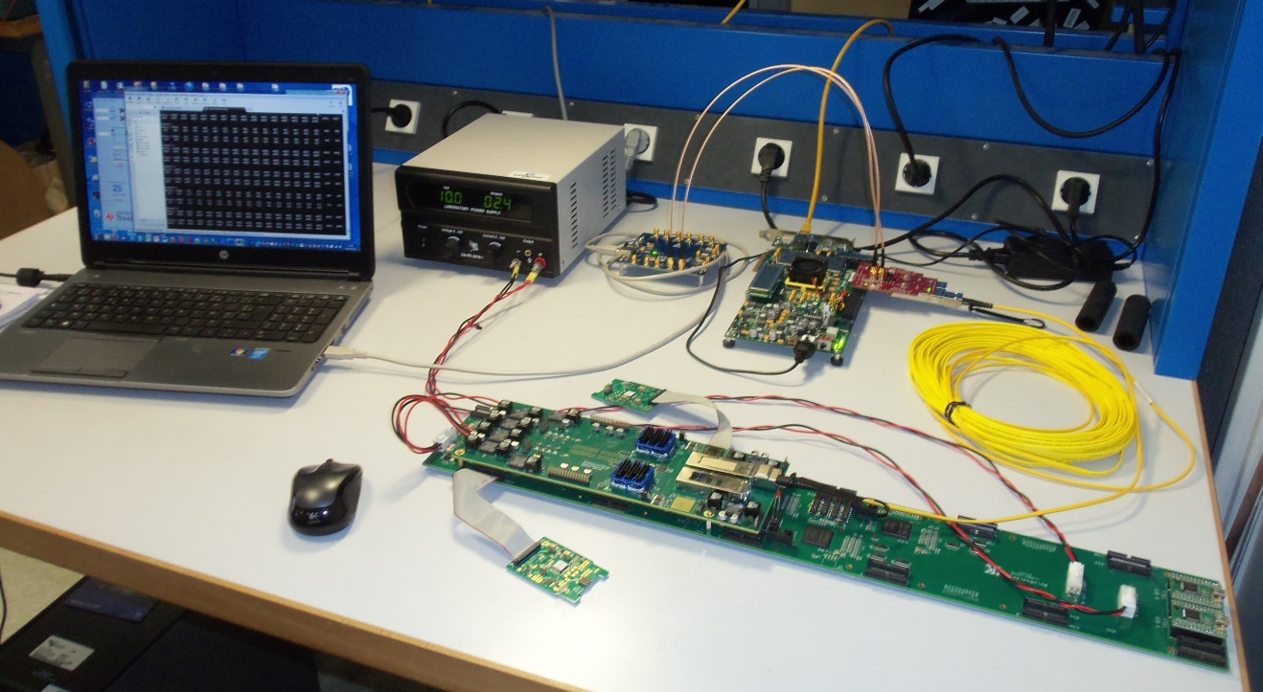
Main Board-Daughter Board communication
▪ Communication working
with Daughter Board V3
at 320 Mbits/s,
using VC707 and laptop.
it was a long and difficult task:
successful works of Roméo !
LPC
▪ Works during this expert week with Eduardo
- Test OK with Daughter Board V3.
- Use of the Daughter Board V4 with the new firmware: a short time to progress
◊ Data read but not in the right order.
◊ The debugging will go on at Clermont-Ferrand.
▪ As soon as V4 will be operational:
- Systematic tests are foreseen on a complete Drawer.
- Results will be given as soon as they will be significant.

Slide 24
Impact of a wider integrator current range
Initial goals and specifications
Additional goal and new specifications
FATALIC approach

Slide 25
• Initial goals and specifications
1. Cesium calibration of channels ← Current integration over 10 ms*
*10 ms is the Cesium source transit time across a Tile.
2. Minimum Bias current ← Current integration over 10 ms or more.
- Detector calibration at known Luminosity.
- LHC Luminosity stability at nominal value with a stable detector
from some 10³³ to 10³⁴ cm⁻² s⁻¹
⇒ Currents from 0.1 nA to 1.2 µA.
• Additional goal and new specifications
from Ilya’s talk of last Tile upgrade week https://indico.cern.ch/event/491599/
- LHC Luminosity calibration at very low values ∼ 10³⁰ cm⁻² s⁻¹
during the vdM calibrations of the LHC (van der Meer).
- HL-LHC Luminosity (5 times nominal value, aging aspects, etc.)
See also the ATLAS papers at 7 and 8 TeV:
Luminosity determination in pp collisions … (19th February 2016)
Submitted to EPJ C
⇒ currents from 0.02 nA (A/B cells) to 100 µA (E cells).

Slide 26
Strong impact on the electronics:
- Noise aspects at the lower limit of 0.02 nA.
- Saturation aspects at the highest limit of 100 µA.
• FATALIC approach
What was foreseen with FATALIC before Ilya’s talk ?
To perform a digital sum of samples at 40 MHz.
Digital sum realistic above a given current threshold (to fix)
with respect to the present electronic noise of ∼8 fC on every frequency,
without saturation problems at the highest values.
Proposal of a possible complementary design for the low currents
→ Current measurement over at least 10 ms,
with possibility of summing adjacent measurements.
→ With an overlap with the pure digital approach.
→ Fully implemented inside FATALIC:
with both the current integration stage and the ADC stage.

Slide 27
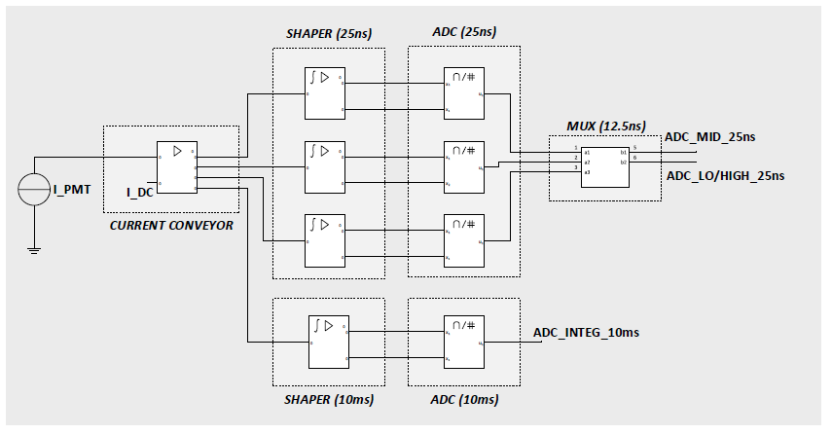
- In its principle, it is easy to perform current copies inside FATALIC:
at present, 3 copies are made → 1 per Gain.
- Why not a fourth one → dedicated to the current integration ?
Simulation studies are in progress,
in particular the accessible range of low currents

Slide 28
Sharing and pooling of the radiation tests
• The organization is urgent because of several reasons:
- We must establish the list of components taken by each Institute.
- We have to design special cards supporting the tested components (20),
and also mechanical supports … depending from the chosen site.
- The funds must be spent this year at Clermont-Ferrand,
even though the tests will be made the next year.
• There is a critical point: the SEE tests of FPGA.
- SEE results depending from the code implemented at the irradiation time.
- If the code is different one day later … or 10 years later: obsolete conclusion.
- Same situation if the manufacturer modifies the chip (What is very likely !).
Moreover, the ATLAS radiation policy obliges us to test 20 chips !
⇒ Schedules, works and cost problems difficult to solve.
⇒ Discussion with Philippe Farthouat some weeks ago:
For the FPGA SEE tests, it will be enough to test some (1 or more) pieces,
repeated later before the final production for Phase II.

Slide 29
• Table of Clermont-Ferrand components (Sent on March 16)
11 active components to test from Main Board and All-on-One
with 5 of them (perhaps 6) are common withy Chicago
MB2v1 2015 common to FATALIC and QIE
MB2v2 2016 for FATALIC only
Grey: Removed or no required test
Red: Common with Chicago
Orange: Close to Chicago components
Identification | Manufacturer | Reference | Supplier | Nbr ver 2015 | Nbr ver 2016 | Remark
EP4CE30F23C7N | Altera |  |  | 4 | 4 | FPGA ALTERA *
EPCS4-SI8N ou EPCS16-SI8N | Altera |  |  | 4 EPCS16 | 4 EPCS4 | ALTERA memory
LTM 4619 EV | Linear Technology | 2115887 | Farnell | 6 | 6 | Regulator
Diode schottky 6CWQ03FNTR | Vishay Formely | 1298453 | Farnell | 4 | 4 | Power diode
AD8030ARJZ | Analog Devices | 2102502 | Farnell | 2 | 2 | AOP for voltage measurement
LTC 2360 ITS8 | Linear Technology | 1715090 | Farnell | 4 | 4 | ADC only for temperature
Oscillator 40 MHz -7C-40.000MBB-T | TXC | 1842044 | Farnell | 2 | 2 | For test without CLK TTC 40 Mhz
Transistor MOSFET SI7848BDP-T1-GE3 | Vishay Siliconix | 2101455 | Farnell | 2 | 0 | Removed -5 V
LT 3759 EMSE | Linear Technology | LT 3759 EMSE#PBF-ND | Digikey | 2 | 0 | Removed - 5V
SN65LVDS389DBT | Texas | 1234907 | Farnell | 12 | 0 | Removed Buffer
 |  |  |  |  |  | * For MB1 Chicago: EP4CE10F17C7N
All-in-One FATALIC
Identification | Maufacturer | Reference | Supplier | Nbr: All-in-One FATALIC4b |  | Remark
FATALIC4b chip | LPC |  | LPC | 1 |  | FATALIC4 or 4b
AD8030ARJZ | Analog Devices | 2102502 | Farnell | 2 |  | AOP for voltage reference
MCP1726-1202E/SN | Microchip | 1851966 | Farnell | 1 |  | Voltage reference 1.2 V
SN65LVDT390PW | Texas | 2335526 | Farnell | 1 |  | LVDS Buffer towards LVTTL
LTC 2640AITS8-LZ12 | Linear Technology | 1715125 | Farnell | 1 |  | DAC for injector
TS5A23160DGSTG4 | Texas | 1494944 | Farnell | 1 |  | Analog switch for injector
Active Divider already radiation certified
Identification | Manufacturer | Reference | Supplier | Nbr | Nbr : ver 2016 | Remark
FMMT458 | ZETEX | 9526684 | Farnell | 3 | 3 | Transistor
TS4148 RXG | TSC | 8150214 | Farnell | 3 | 3 | Diode

Slide 30
Conclusion and prospect
• Crucial points in progress
▪ Good results on the Noise level on pulse analysis:
- Expected close to 7 fC, well below the initial specification of 12 fC,
and even below the strongest specification of 8 fC.
- Environmental noise < intrinsic noise.
- Noise independent of the environment
and with a low sensitivity to the applied HV.
▪ Grounding improvements on active Dividers and All-in-One cards.
▪ Main Board Daughter V3 communication operational, soon V4.
▪ Delivery of the list of components for radiation certification
for a sharing and pooling of tests.

Slide 31
Started or foreseen works
▪ Production started on new Dividers and new All-in-One cards
for test beam.
▪ Preliminary study of a new current copy in FATALIC for calibration.
▪ Standard use (PPR) of the Daughter Board V4 with help of experts.
▪ Continuation of the FATALIC characterization .
▪ Building of a first dedicated Optimal Filtering.
▪ Phase II of the noise study on a complete Drawer
through the MB-DB communication
⇒ Better statistics (12 channels).
⇒ Same measurements
+ High Frequency noise measurements from pedestal widths.
+ Low Frequency noise for Calibration/Lumi purposes.
+ Comparison of Linear/Switching LV external power supplies
Comment: electronics already supplied by the regulators of the MB
which are switching power supplies.

Slide 32
With data through DB
10 V
LV
Daughter Board
Standard Main Board
690 V
HV
HV Bus board with Noise killers
1.5 m
/20 or 100 m

Slide 33
BACK UP

Slide 34
Distribution and frequency spectra for the 3 gains
High
Medium
Low
Medium

