Slide 1
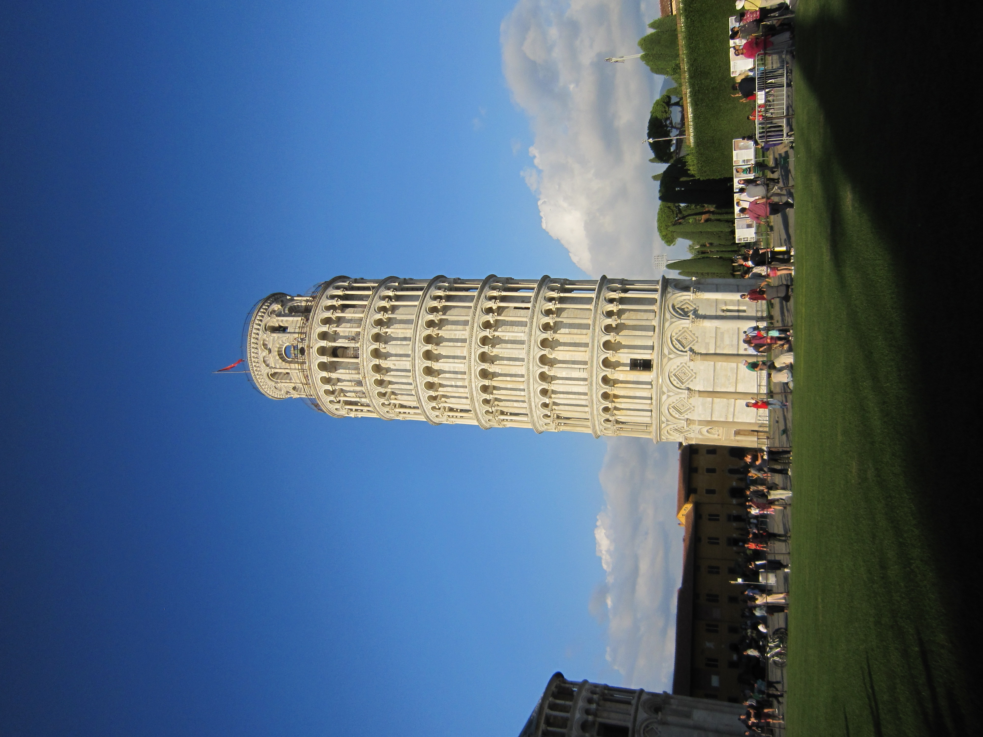
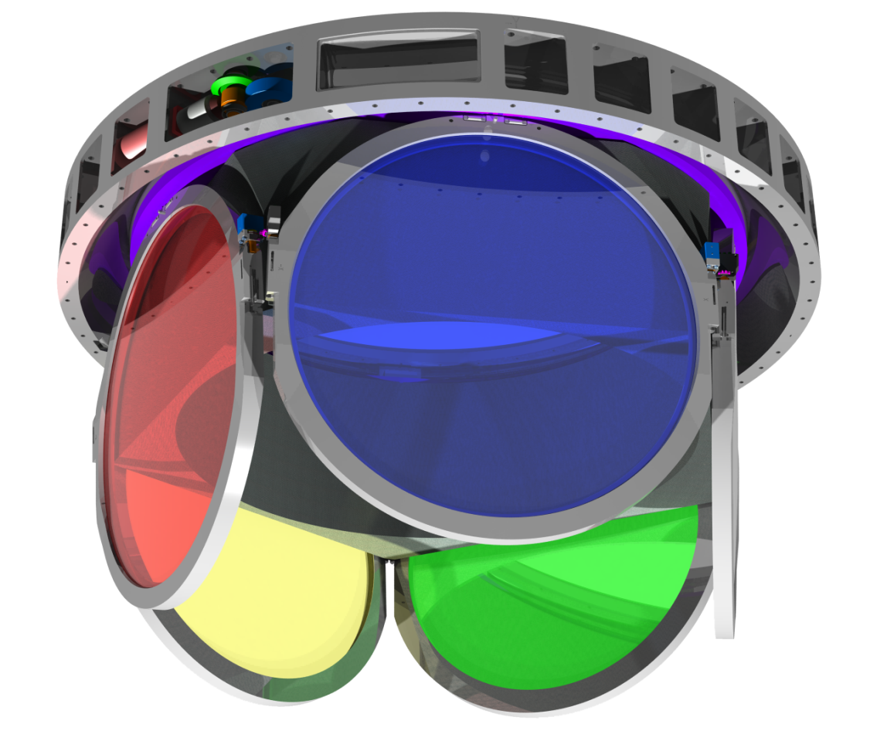
Carrousel
Biennale
2016
Pise
Didier Laporte
ATRIUM-130278

Slide 2
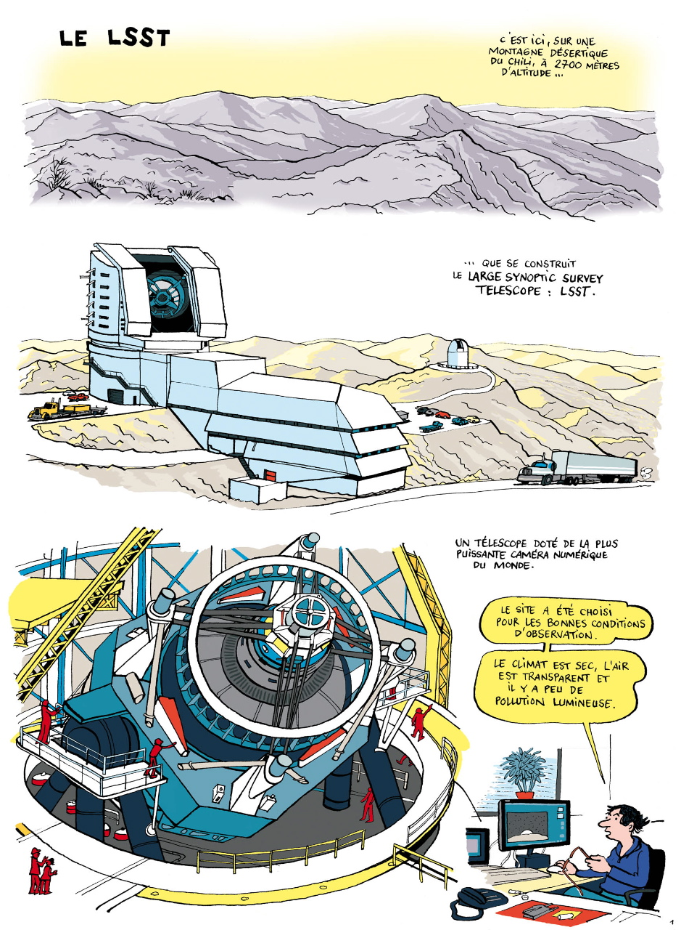

Slide 4
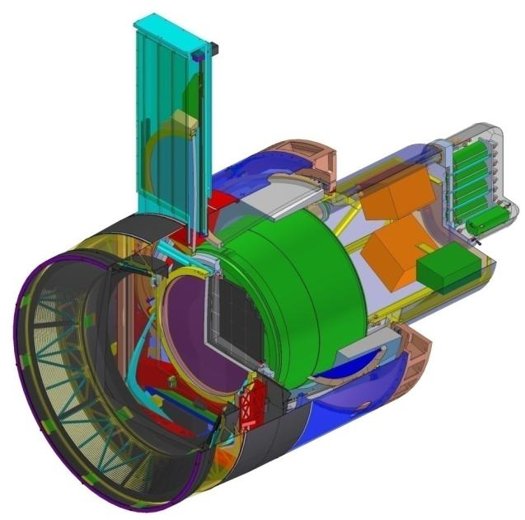
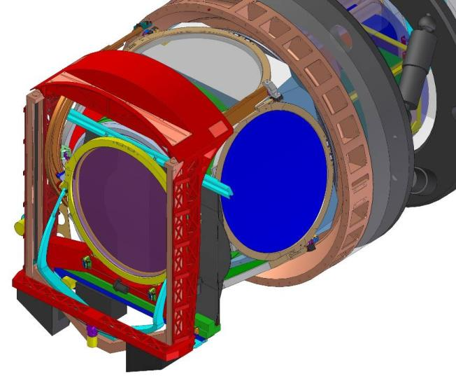
Filter Exchange System – Découpage
LPSC
APC
Loader
Filter Control System
CPPM
LPNHE
Auto-Changer
Carousel
Cryostat
Focal Plan
On-line Filter
Shutter

Slide 5
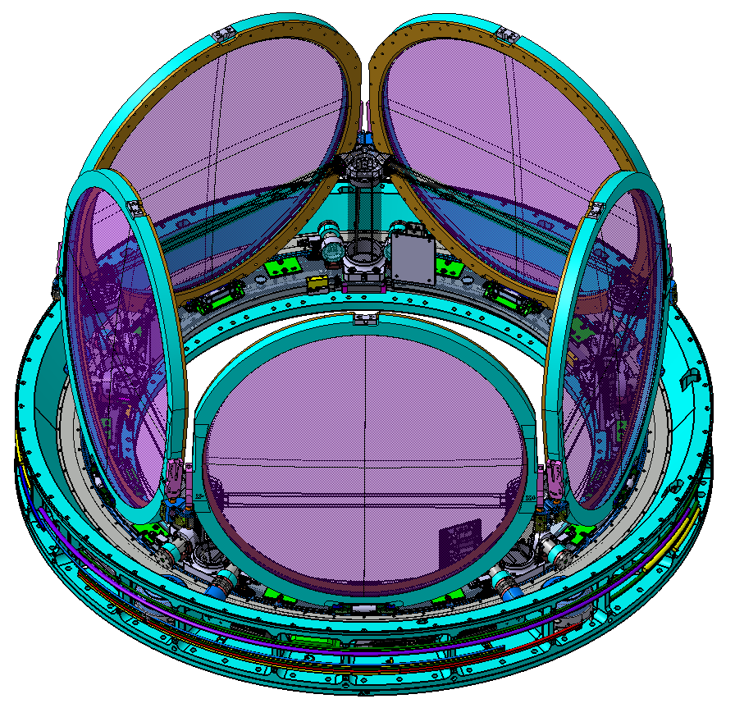
Spécifications
Durée de vie : 15 ans (C-EXCH-001)
Un filtre doit pouvoir être changer sans démonter la caméra du télescope (C-EXCH-096)
Le système changeur de filtre doit accepter des filtres de masse différente (30 à 44 kgs) (C-EXCH-009)
Un filtre doit être changer en moins de 89 secondes (C-EXCH-013)
Température de fonctionnement : -5°C à 30 °C (C-EXCH-143)
Température de survie : -15°C à 40° C (C-EXCH-144)
Le carrousel doit peser moins de 250 kgs (C-EXCH-046)
La position du centre de gravité du carrousel est contrainte (C-EXCH-047)
Le carrousel doit avoir 5 positions de filtre disponible (C-EXCH-049)
Le carrousel doit pouvoir faire 35 000 rotations (C-EXCH-050)
Le carrousel doit pouvoir verrouiller et déverrouiller les filtres 30 000 fois (C-EXCH-106)
Sismique
Sécurité
Maintenance

Slide 6
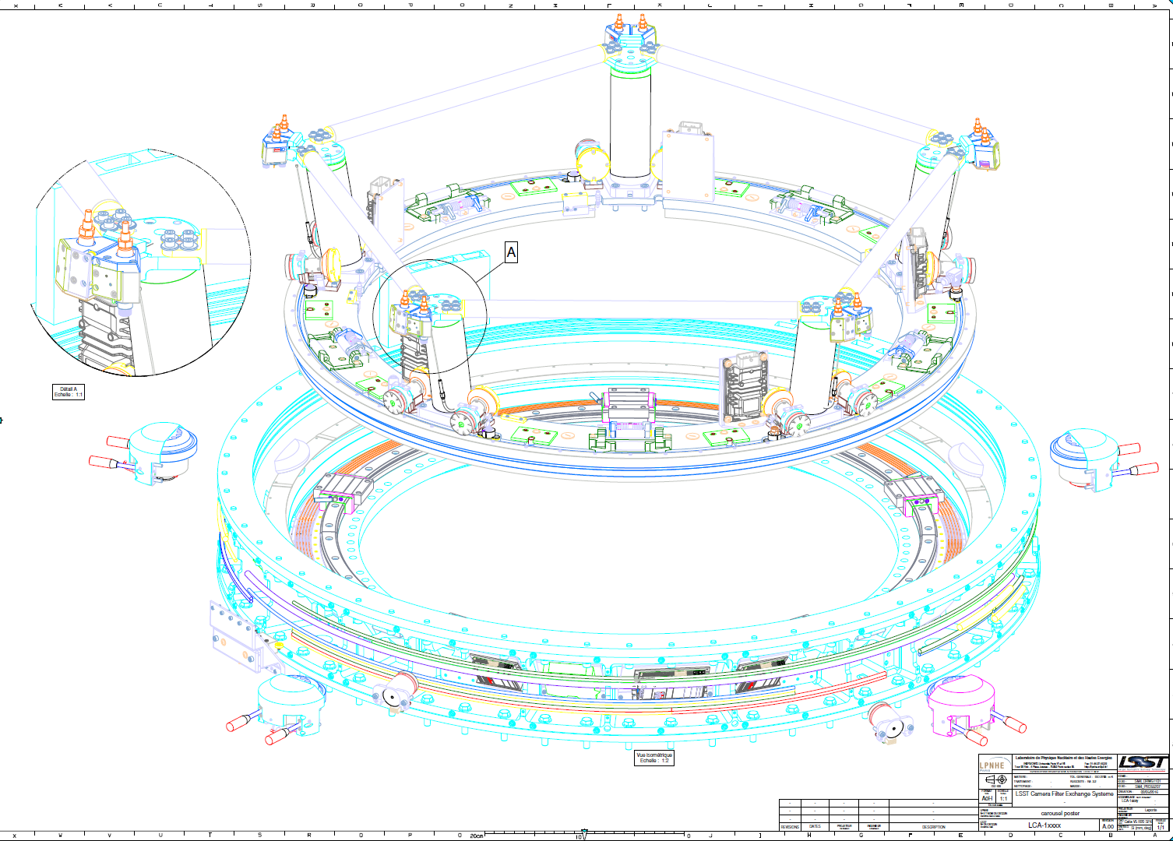

Slide 7
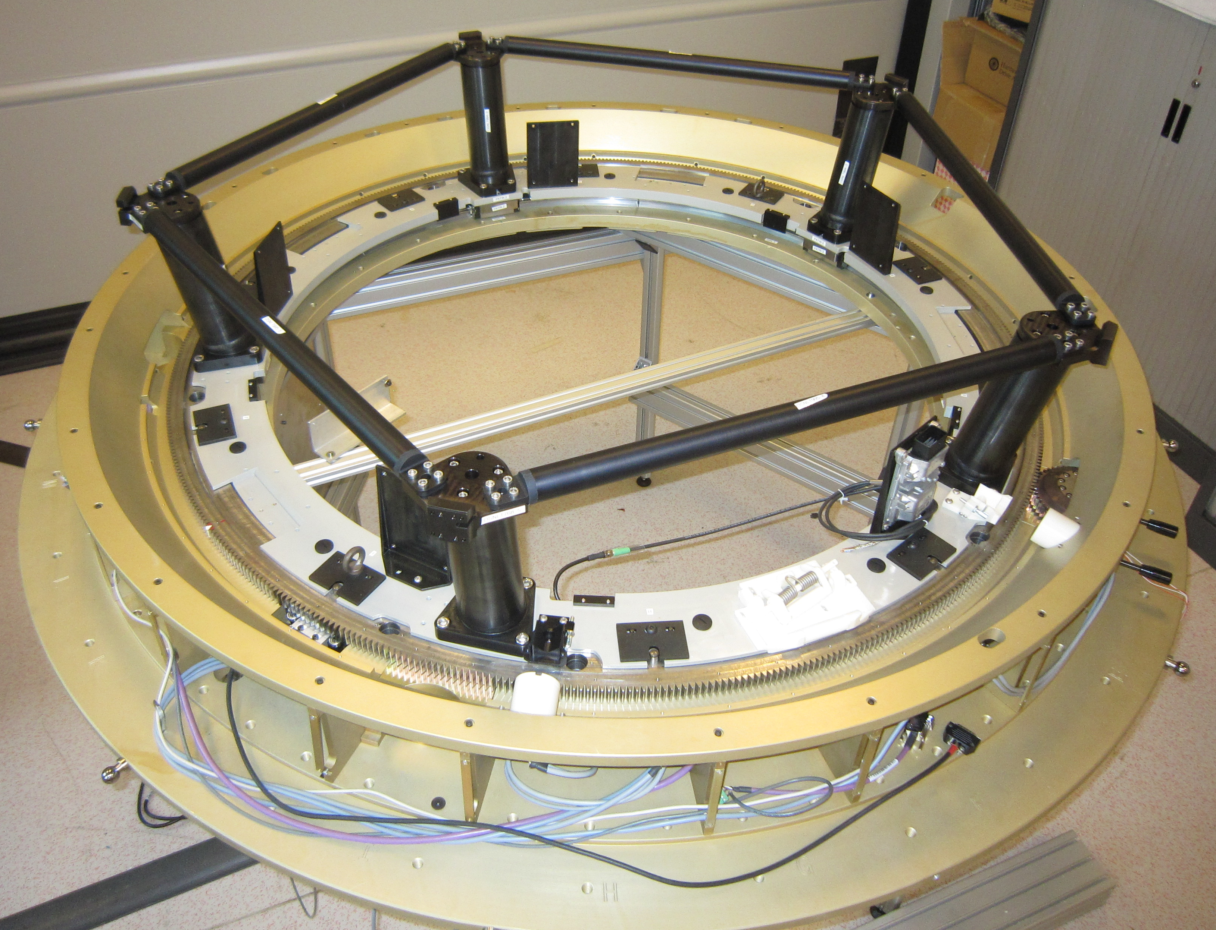

Slide 8
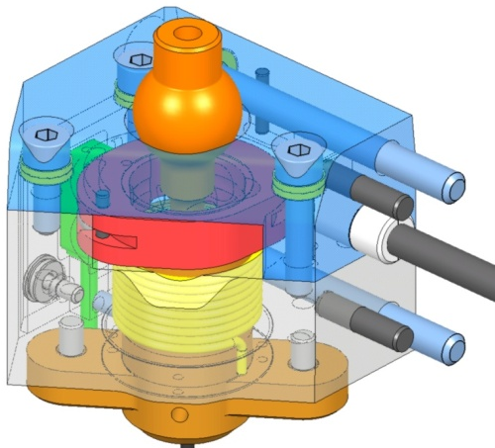
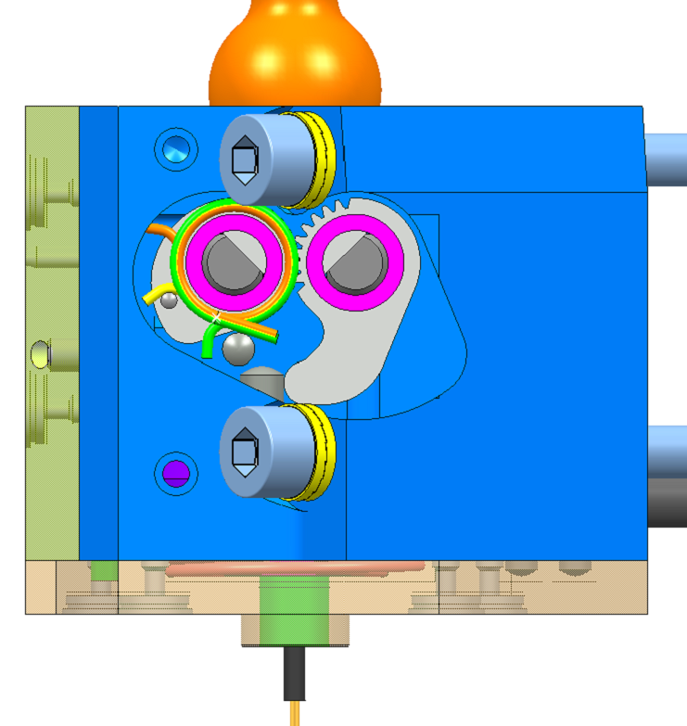
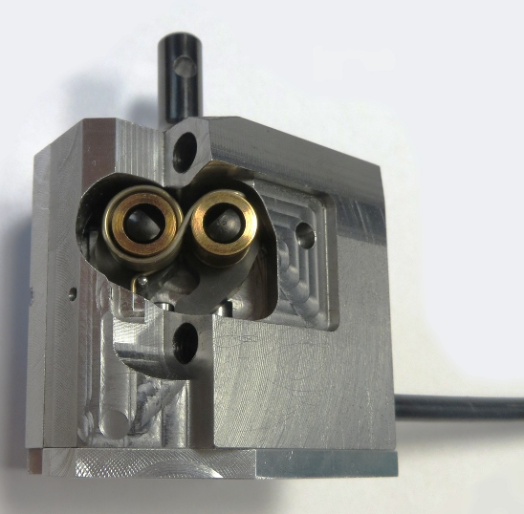
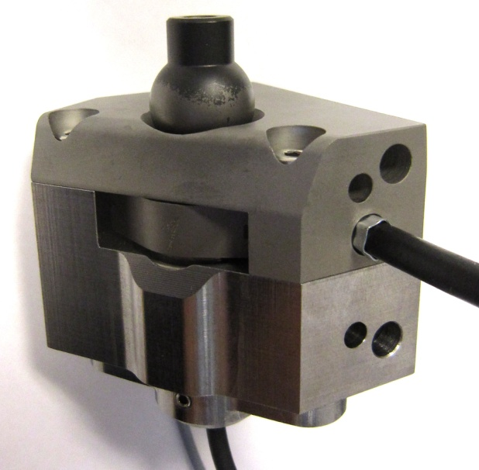
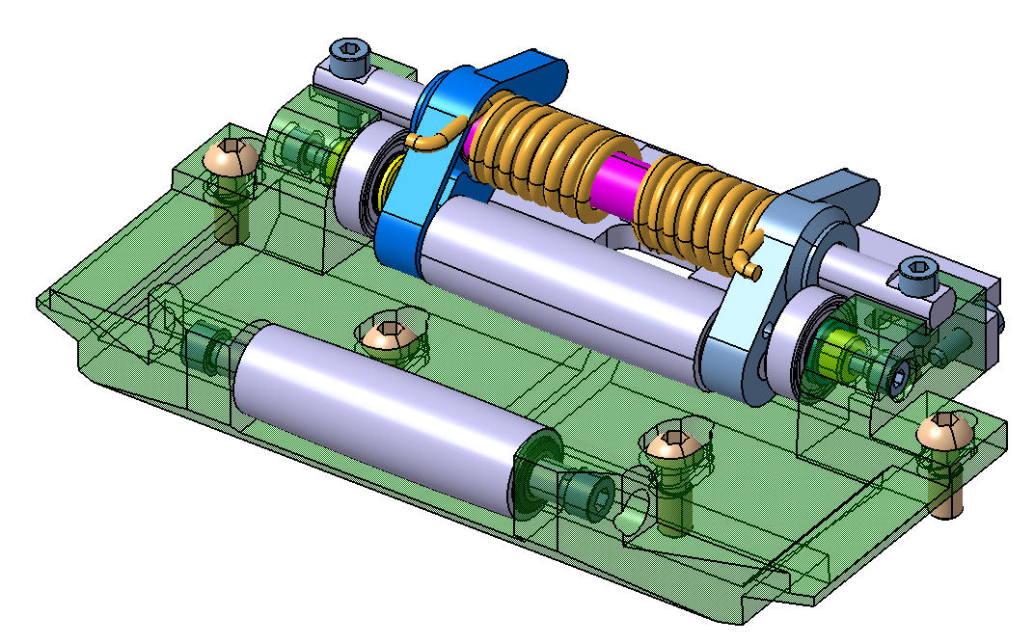
Carousel – maintien filtre
Ball joint
Z
Sliding ball joint
Point

Slide 9
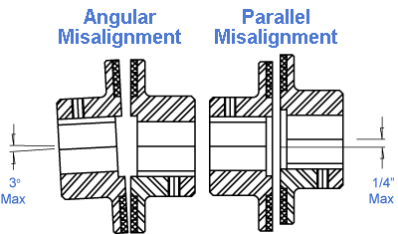
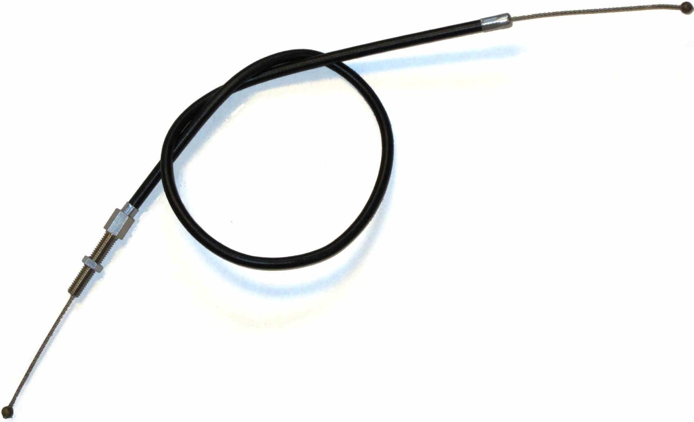
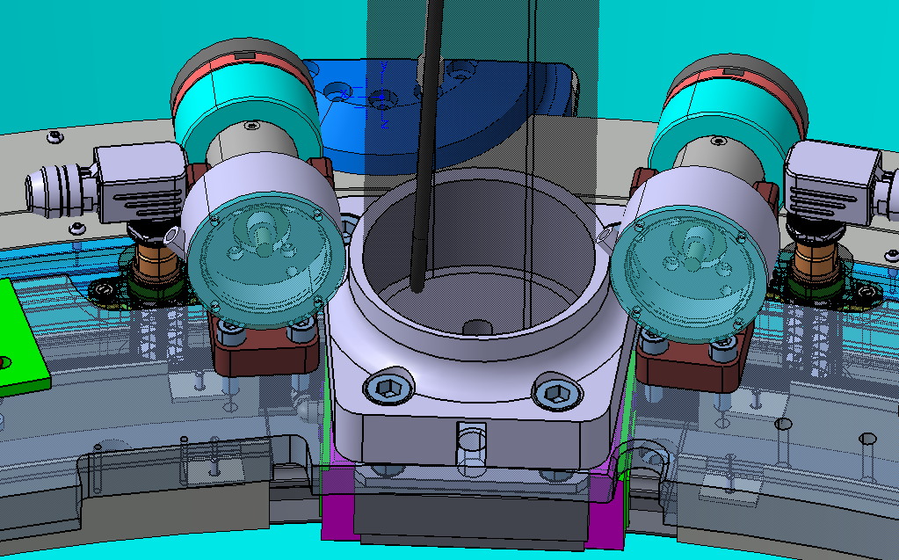
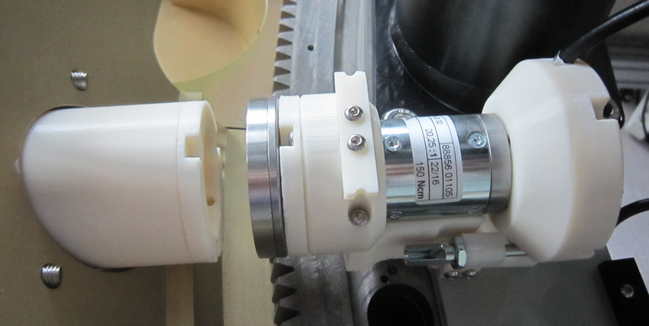
Carousel – mécanisme de déverouillage
Design baseline
  Fixe actuator on the flange
    Detailed design done
    Maintenance: entire actuator replacement (2 screws + 1 connector)
  Magnetic coupling transmit power on the carousel
    Misalignment allowed → successfully tested
    0.6 Nm magnetic coupling can pull 80N thru a reducer
  Unlocking force transmitted to clamps by cable

Slide 10
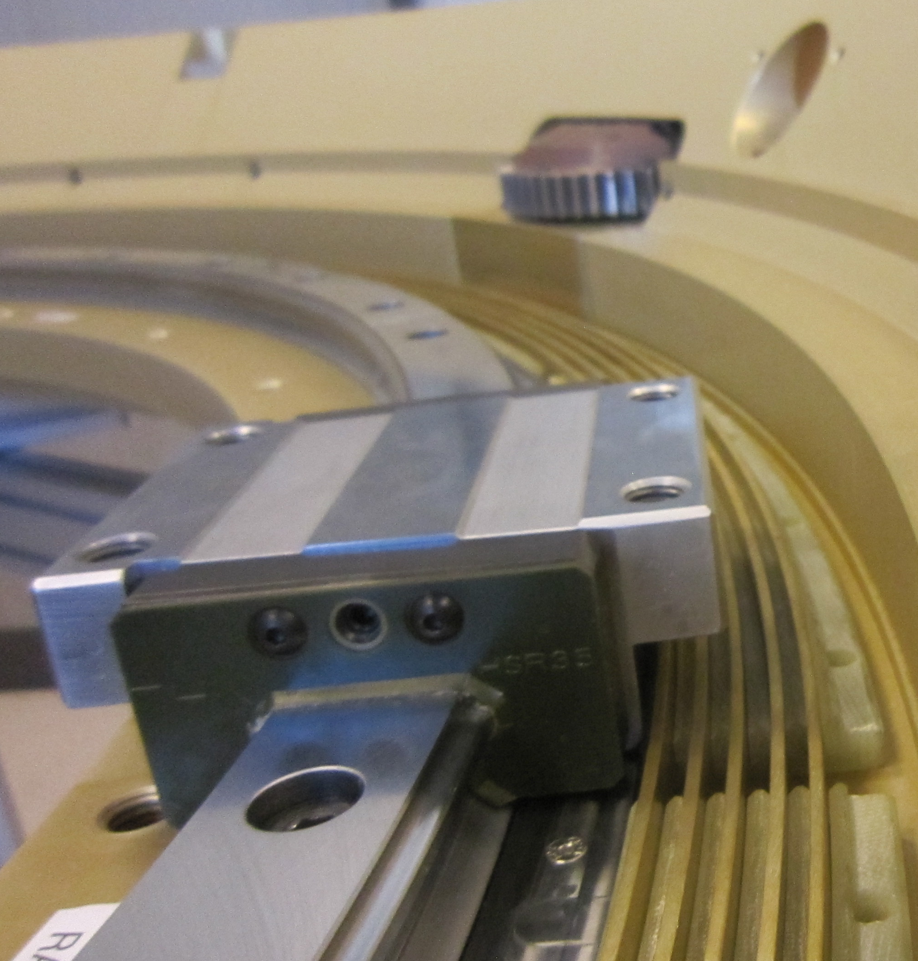
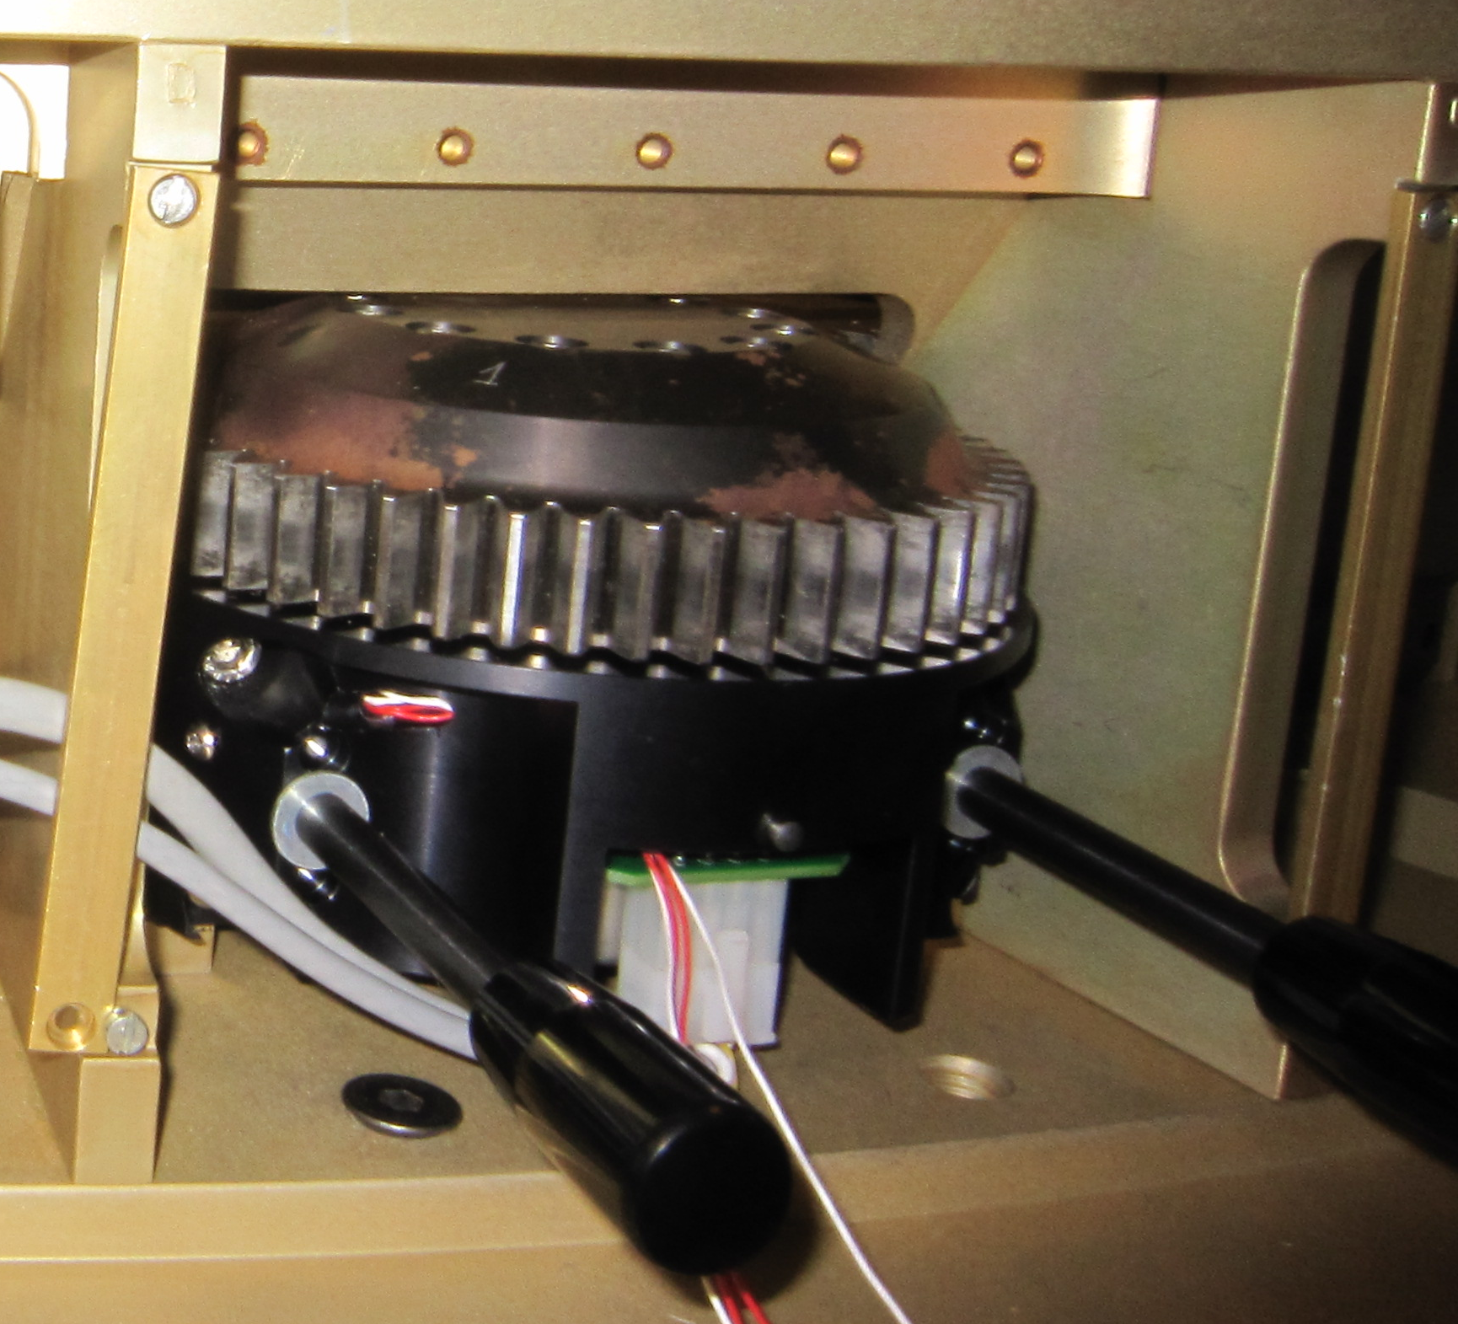
Guidage, slip-ring et moteur/freins

Slide 11
Le carrousel dans le temps
Fin 2006 : Discussion avec Kirk Gilmore des contributions techniques IN2P3 à la caméra LSST
01/2007 : R&D carousel au LPNHE
06/2010 : Totalité du changeur de filtre à l’IN2P3
12/2012 : Installation du single filter test au CPPM
02/2015 : Commandes des 2 rings
04/2015 : Revue validation design → des points à éclaircir
10/2015 : Delta Revue validation design
05/2016 : Arrivée au LPNHE du dummy backflange
08/2016 : le carrousel commence à tourner
09/2016 : Revue validation calculs

Slide 12
Validation de la conception : FEA
Pour valider certaines conceptions, nous avons besoin de faire des calculs.
Jusqu’à fin septembre 2015, les calculs étaient réalisés au laboratoire,
01/2016 : négociation avec l’équipe de SLAC pour faire les calculs du carrousel
09/2016 : Présentation des calculs et clôture des réserves sur la conception (RFA)

Slide 13
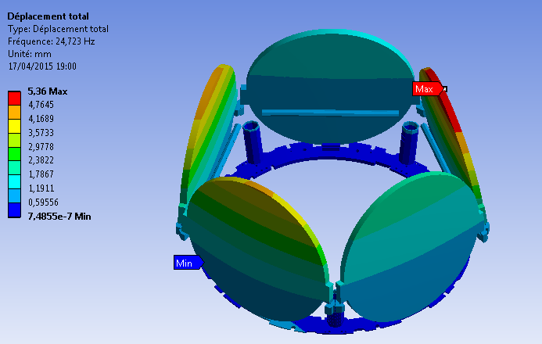
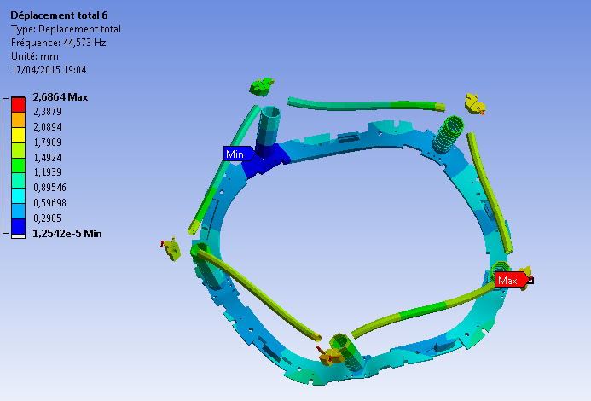
    Carousel – Structure Analysis: Natural modes
Natural frequencies
  Filters (simplified)
    Around 25 Hz
  Structure
    Higher than 44 Hz
  Ring gear
    Around 45 Hz
Mode | Frequency [Hz]
1 | 24.723 | Filter bending
2 | 24.848 | Filter bending
3 | 29.634 | Filter bending
4 | 29.731 | Filter bending
5 | 33.335 | Filter bending
6 | 44.573
7 | 49.206
8 | 49.466
9 | 54.697
10 | 55.267

Slide 14
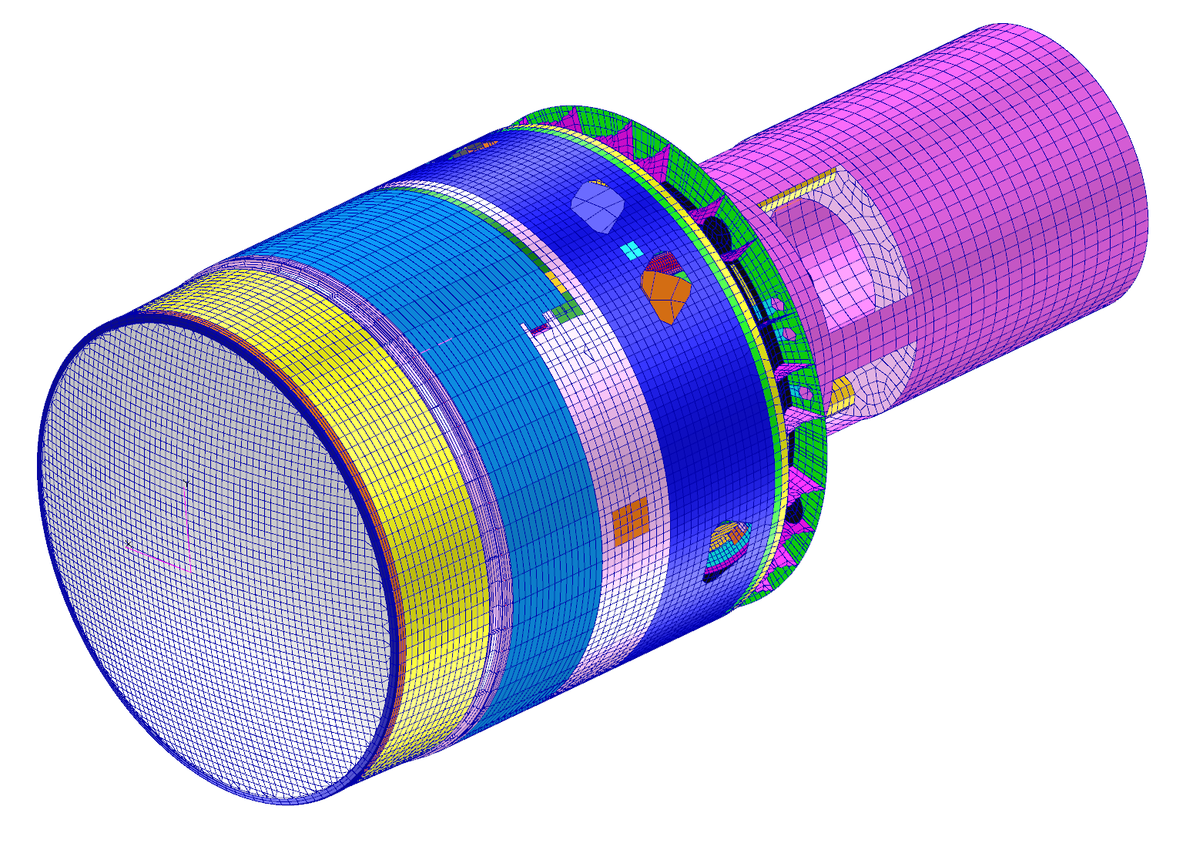
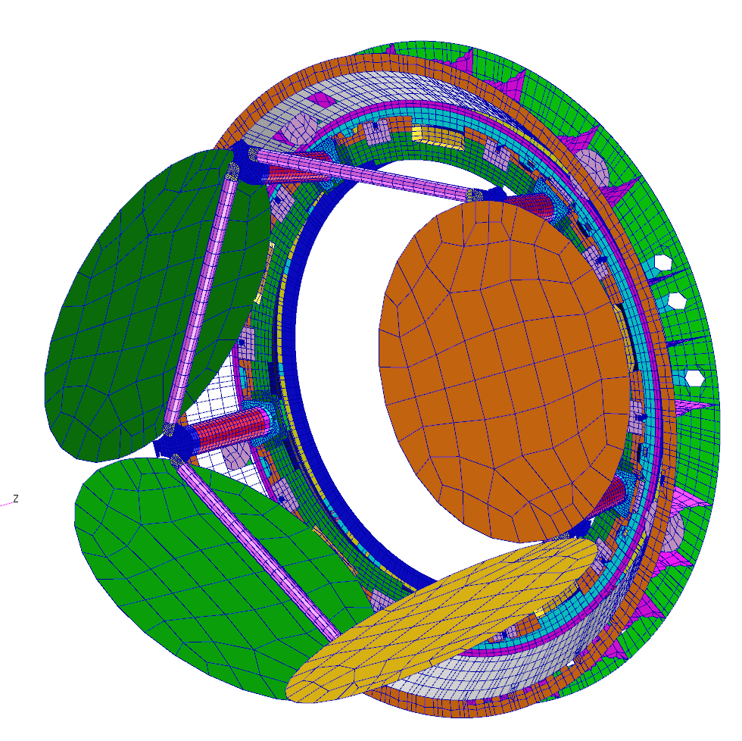
Carousel FEA Model
By SLAC team
Utility Trunk
L1-L2 Assy
Back Flange
Camera Body Housing
Camera Body Shroud
Full Carousel assembly modeled including THK Rail and carriages, bearing stiffnesses, tubes, welds, fasteners, pins
Every bolted and welded joint is modeled with a rigid element connecting coincident nodes.
Since the full camera model is used, all of the interface loads into the Carousel are realistic, with realistic interfaces, stiffnesses and masses
Carousel FEA model incorporates all of the latest design features, including the 3mm filter offset
Total Carousel model represents approximately 125K DOF (~15% of Integrated model)

Slide 15
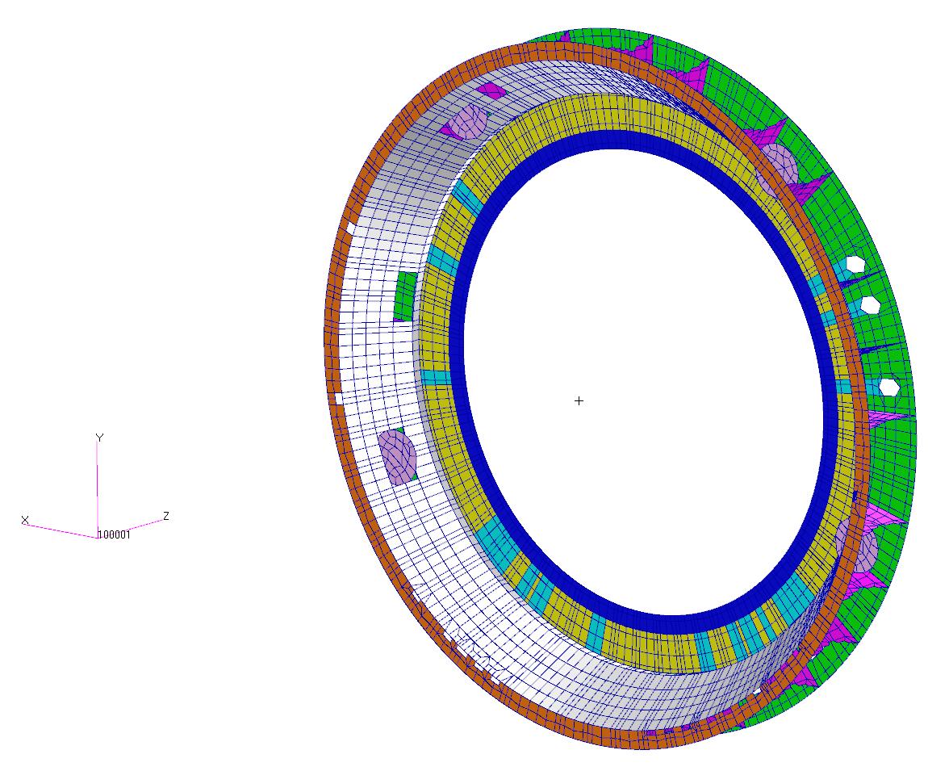
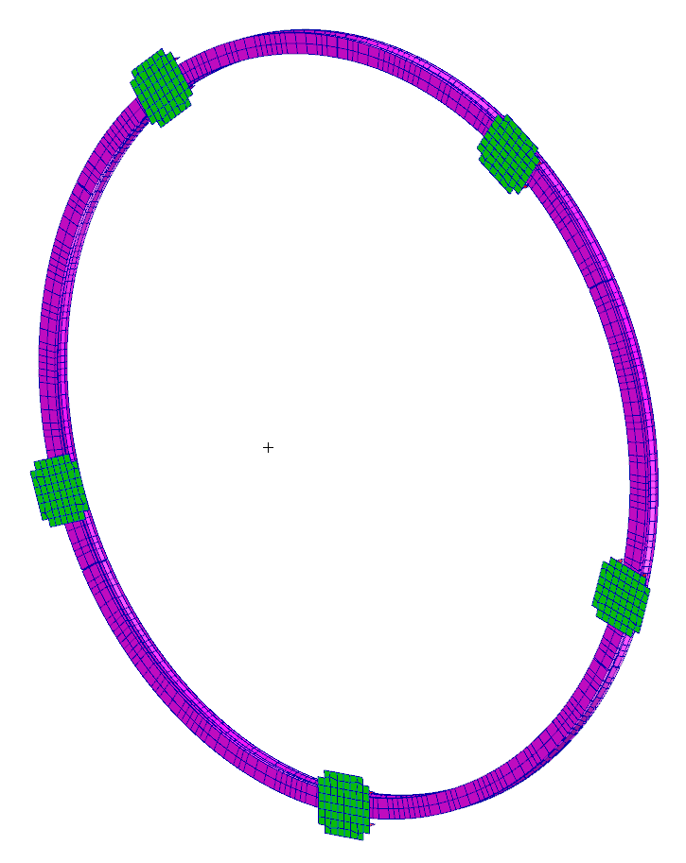
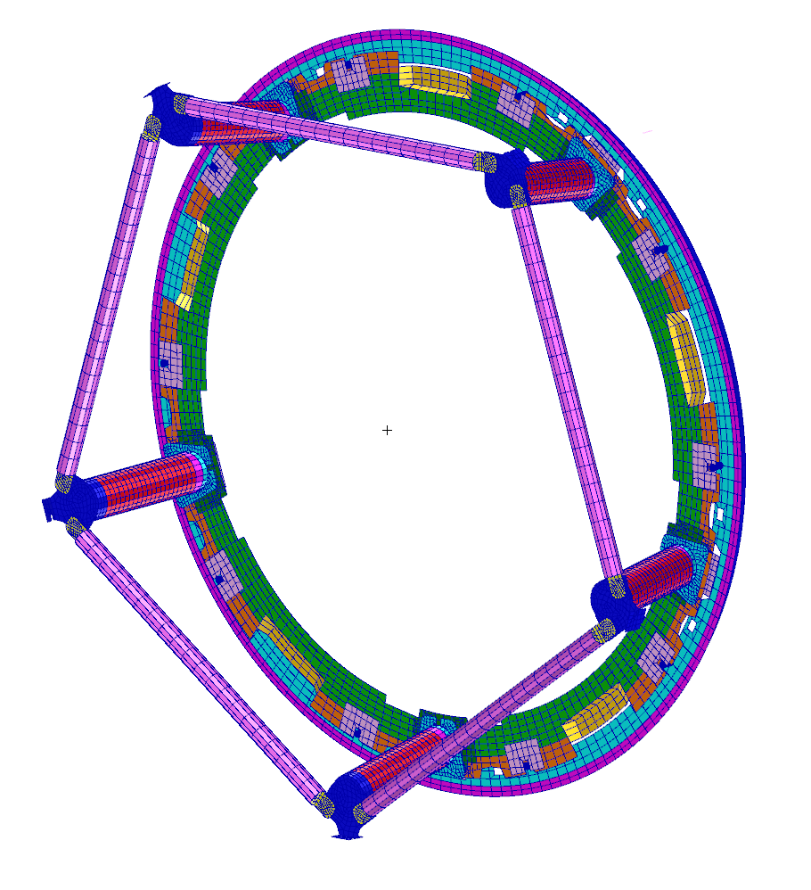
Carousel FEA Model
Due to the rotating parts of the carousel, many structural connections require separate local coordinate systems (very critical point)
In the whole camera, the carousel has the most complex connections and load paths of any structure
Back Flange
Motors and Brakes
Rotating Assembly
Pentagon Rods (5)
Support Posts (5)
Carriages (5)
THK Rail
Synchro Plates (10)
Shear pins
Ring Gear
Aluminum Ring
By SLAC team

Slide 16
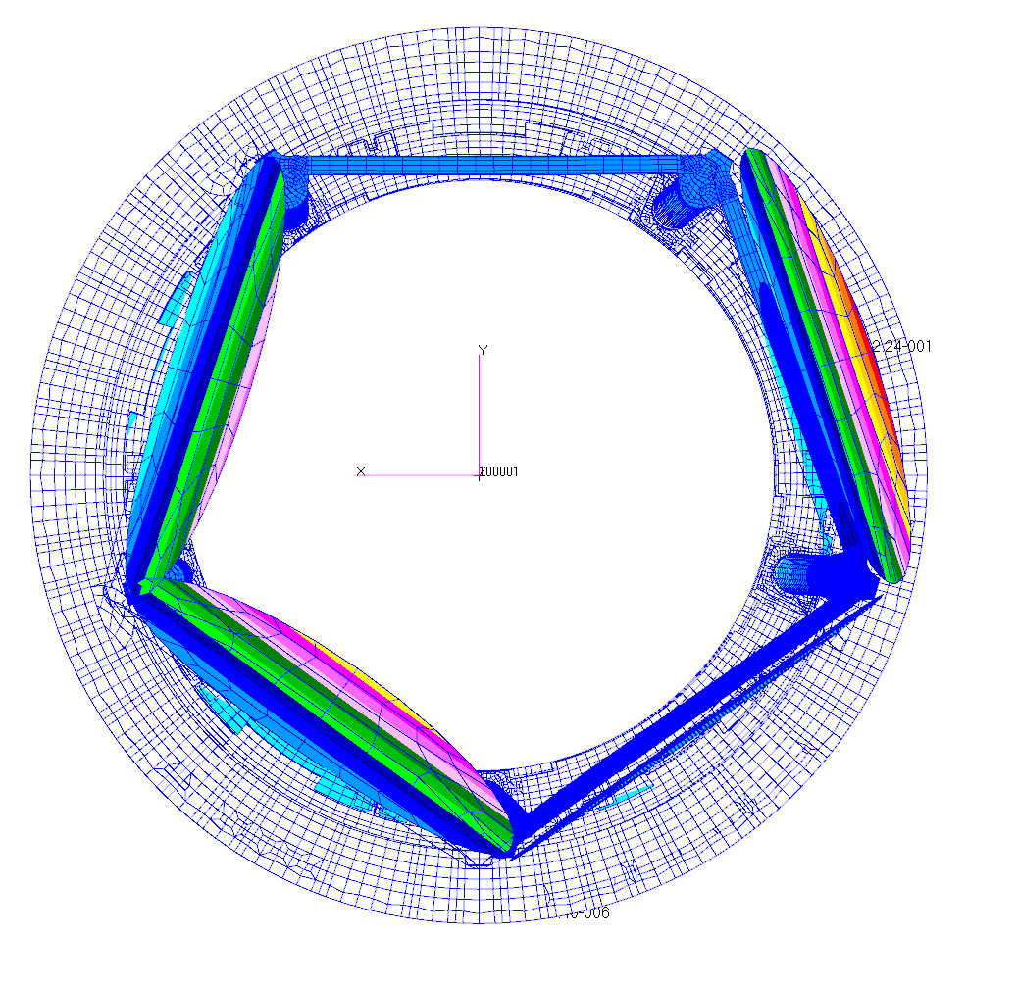
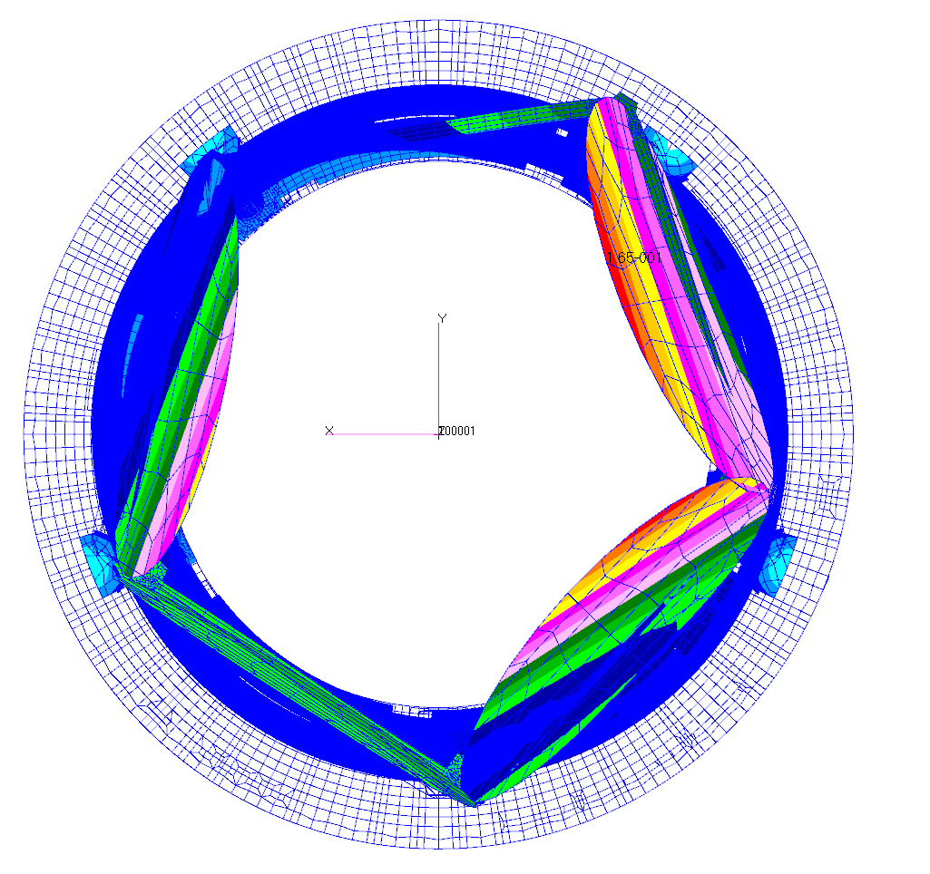
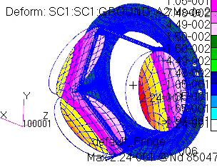
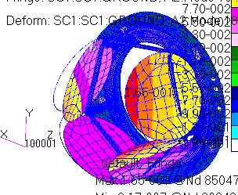
Carousel Dynamic Modes
By SLAC team
Camera Mode2@ 24.8 Hz
Carousel Lateral X
Camera Mode18@ 37.17 Hz
Carousel Rotation

Slide 17
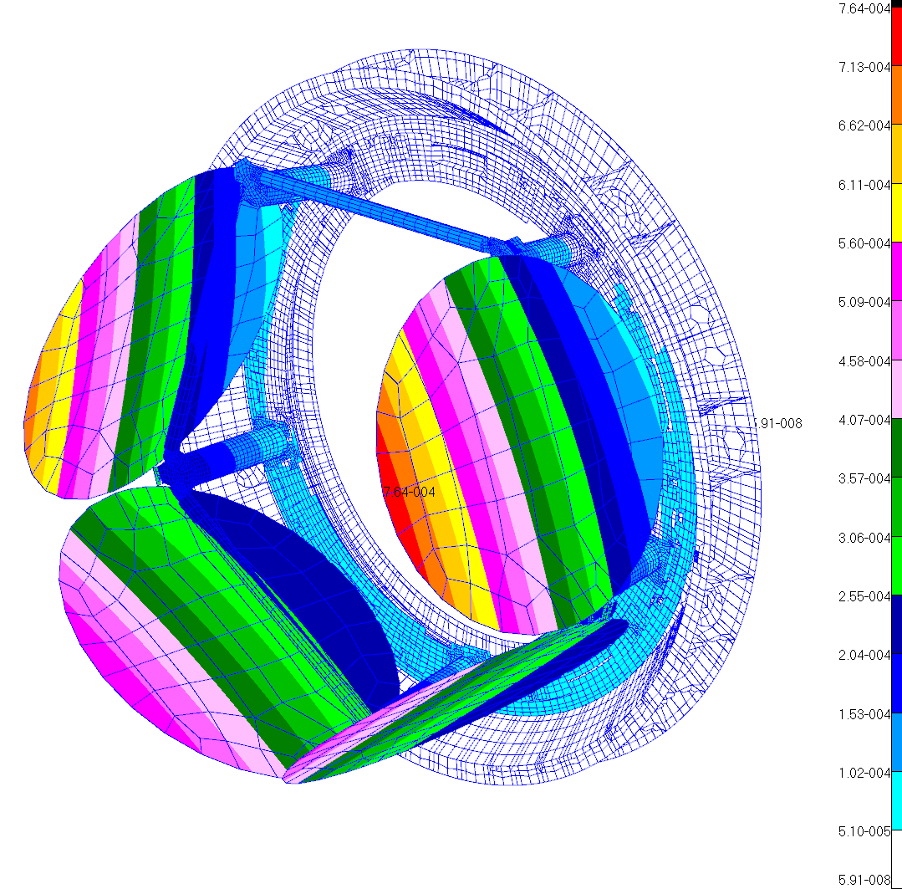
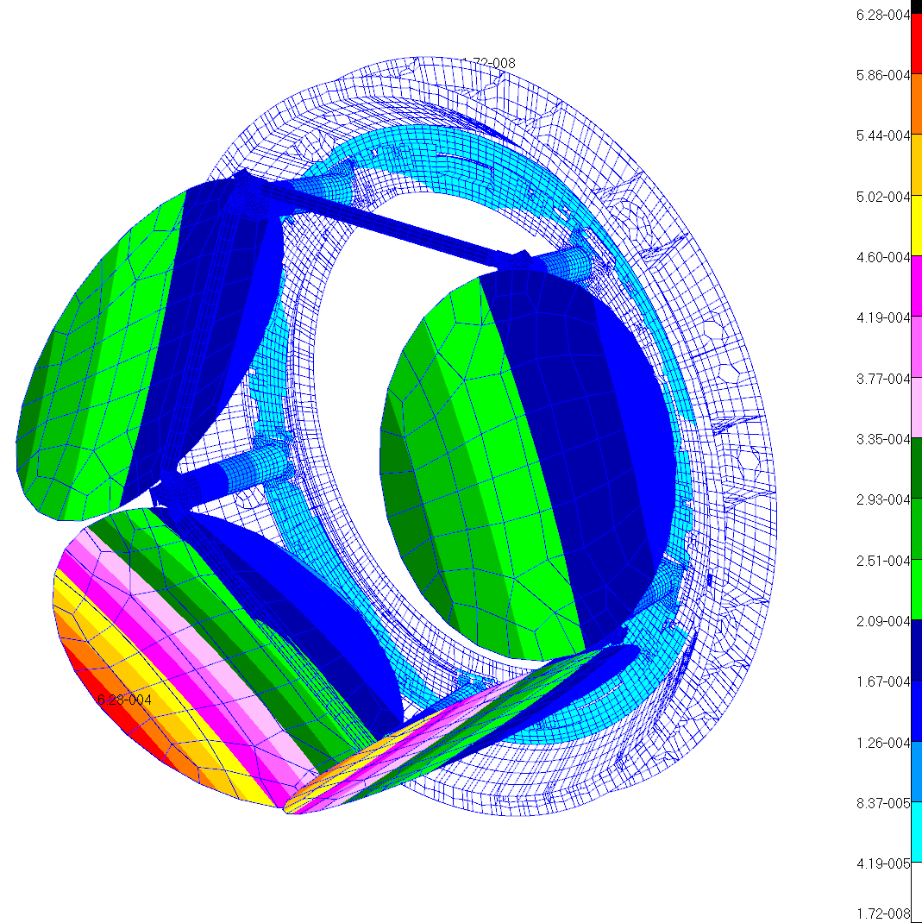
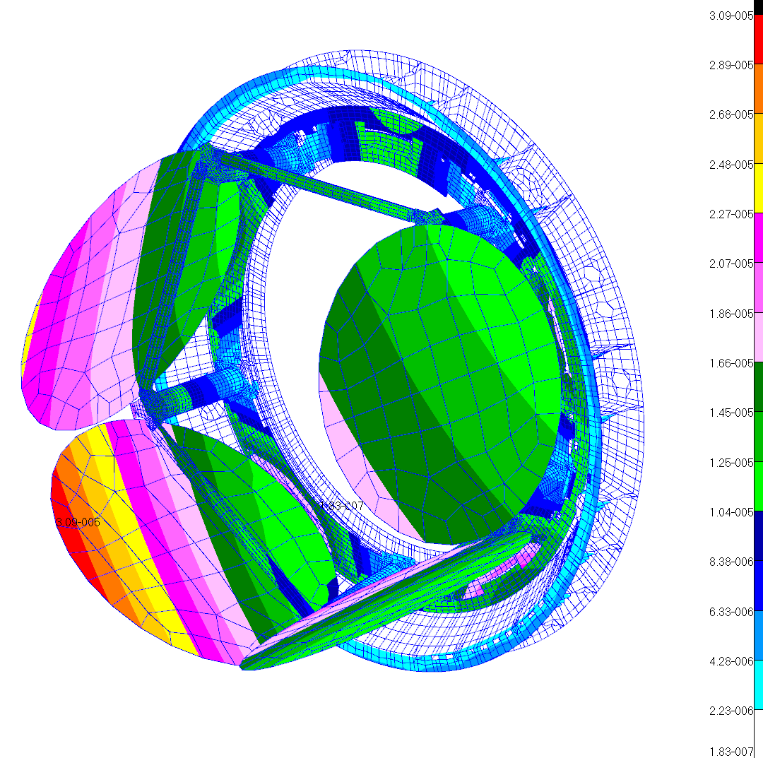
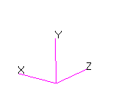
Camera Body Deflections under 1GX
By SLAC team
Gravity in X direction
Gravity in Y direction
Gravity in Z direction
X Component
d_{max}=747μm
@ Filter
Unsymmetric loading results in greatest displacements
Y Component
d_{max}=628μm
@ Filter
Symmetric Loading
Z Component
d_{max}=30.9μm
@ Filter
Min distance from filter tip to cryostat = 35.6 mm

Slide 18
Allocations: natural frequency
By SLAC team
Although it does not strictly meet subsystem requirement, it meets integrated camera requirement.
After extensive parametric analyses, increasing the lateral mode is difficult with the dead weight of four filters

Slide 19
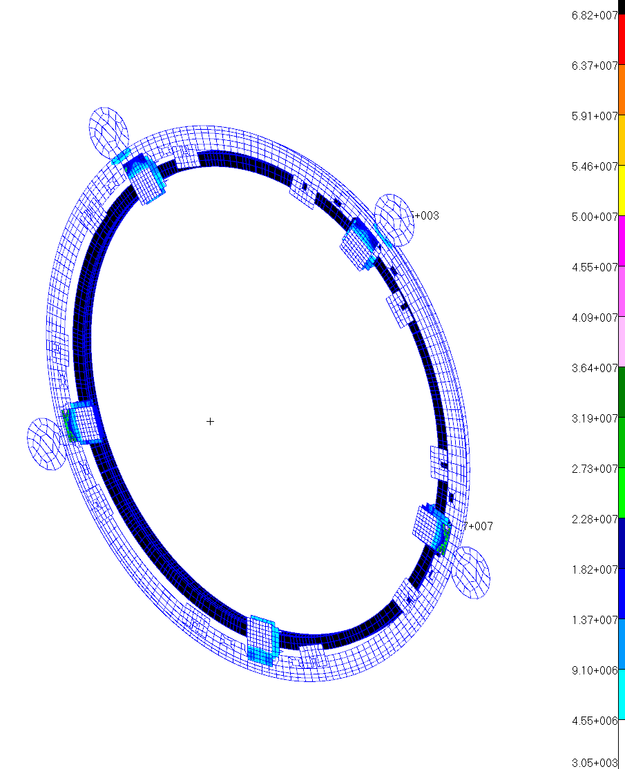
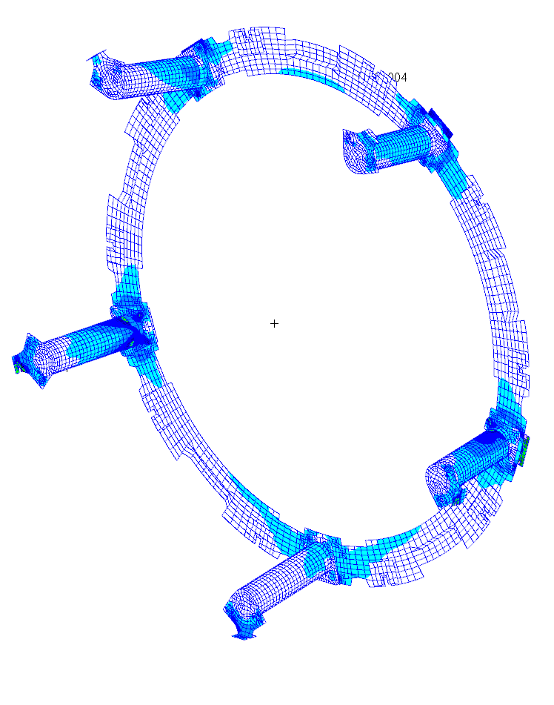
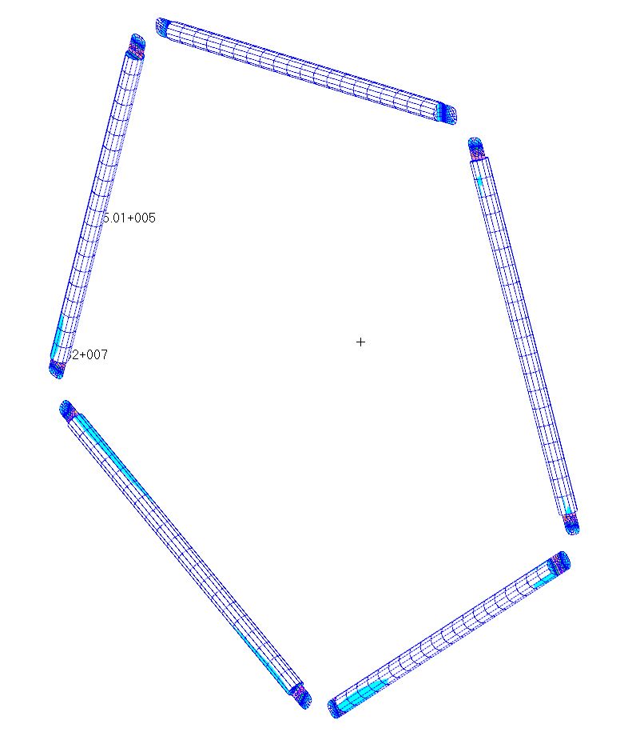
Stresses due to Survival Seismic Loads
By SLAC team
Load paths are not very efficient due to space constraints (posts take significant moment loads)
The stress fringes shown are maximum stresses from combined survival seismic inertial loads, still healthy margins even with no-test safety factors.
Fty=241MPa
Ftu=290MPa
Significant shear load in Z-coupling plate; 39.7MPa
Pentagon tube fittings see maximum stress of 68.2 MPa
Stress risers at clamp interfaces; 57.8 MPa

Slide 20
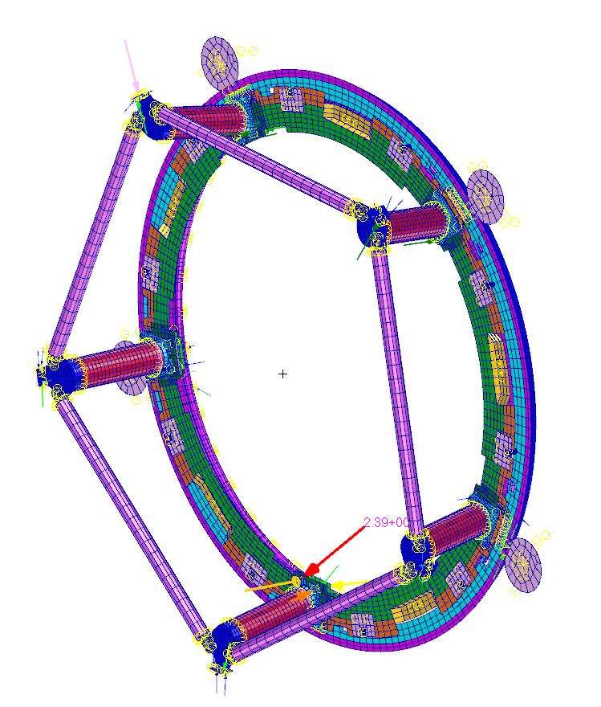
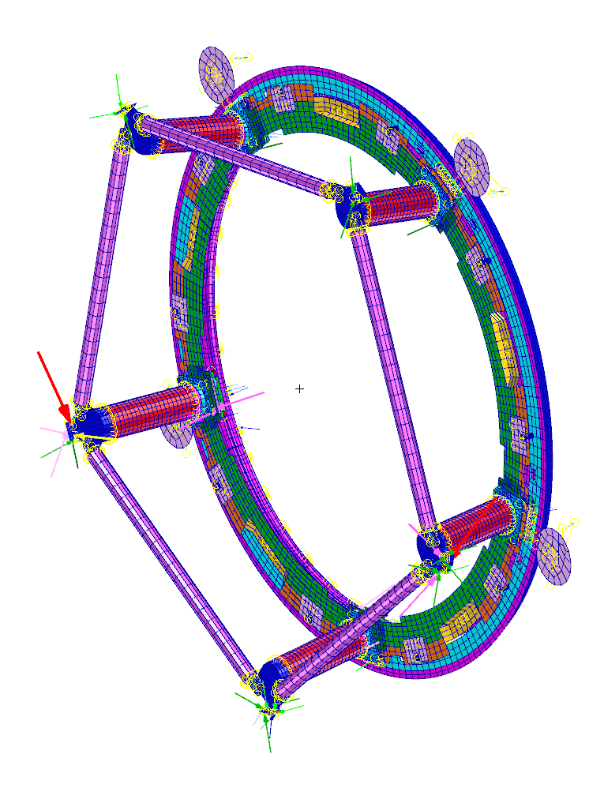
Interface Forces
The forces between the Carousel joints are outputted for the bolted joint analysis
  Every bolted joint is modeled, so bolt forces can be easily extracted and used in the bolt calculation (for preload against gapping and strength calculations)
  All fastener interfaces are designed to be robust and redundant, with high margins of safety
  The vector components of the interface forces are combined in linear superposition to derive the worst case forces for all of the static load cases described above
2390N Post fastener prying force @ 1gX
329N Pentagon tube pin shear @ 1gZ

Slide 21
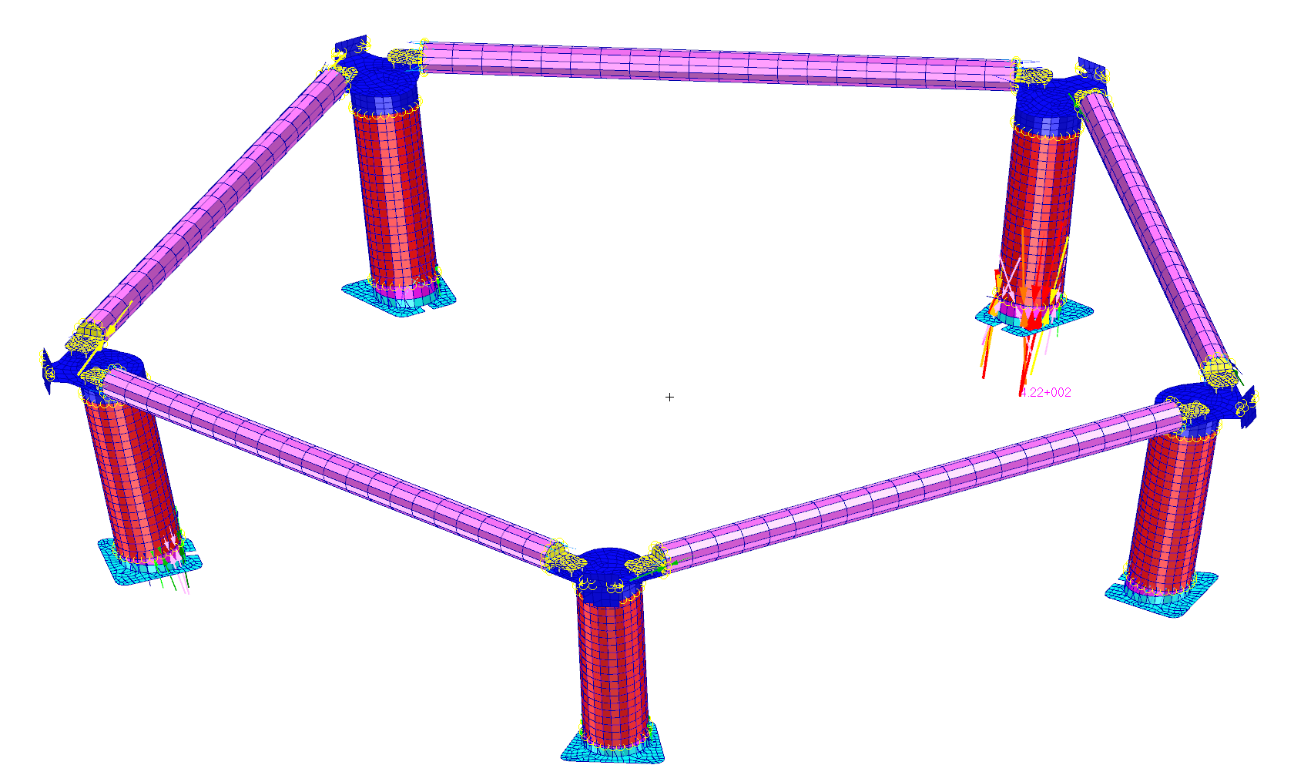
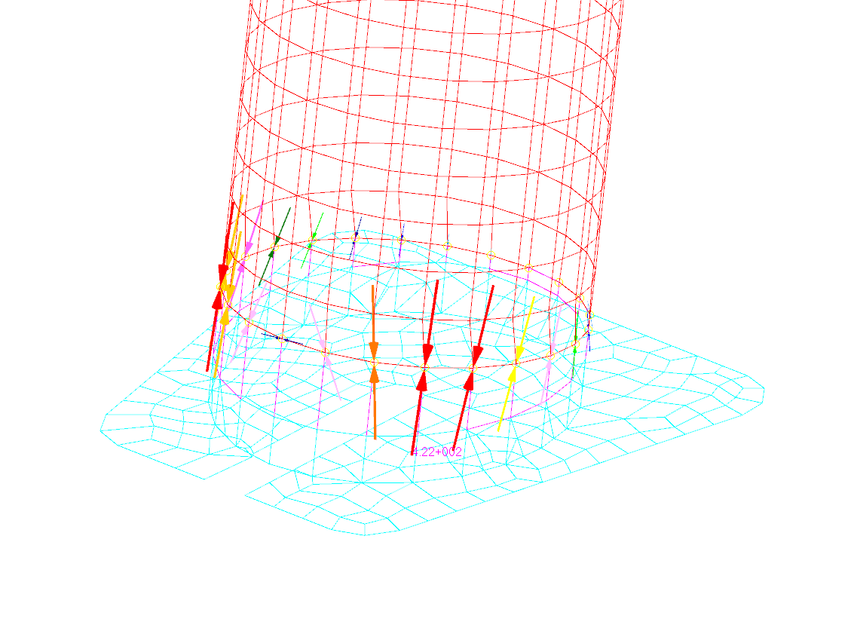
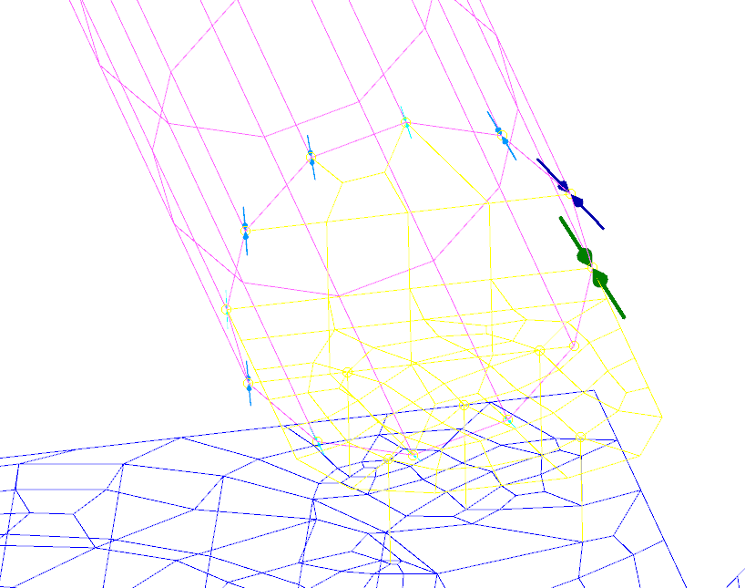
Weld calculations Line load calculation
By SLAC team

Slide 22
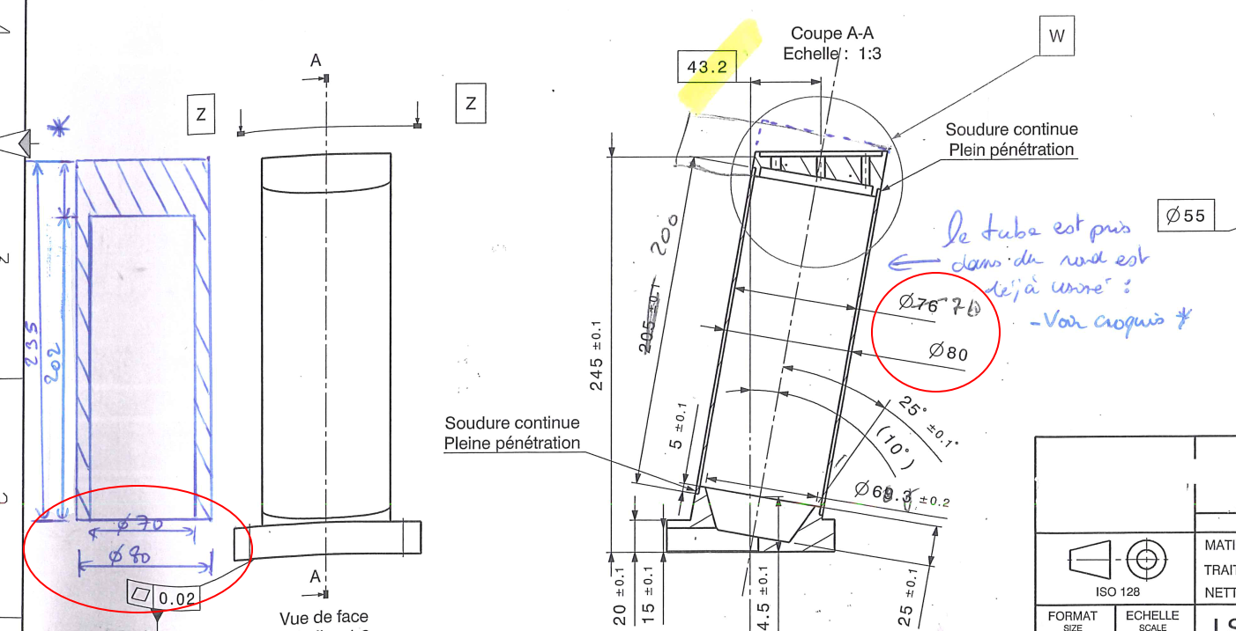
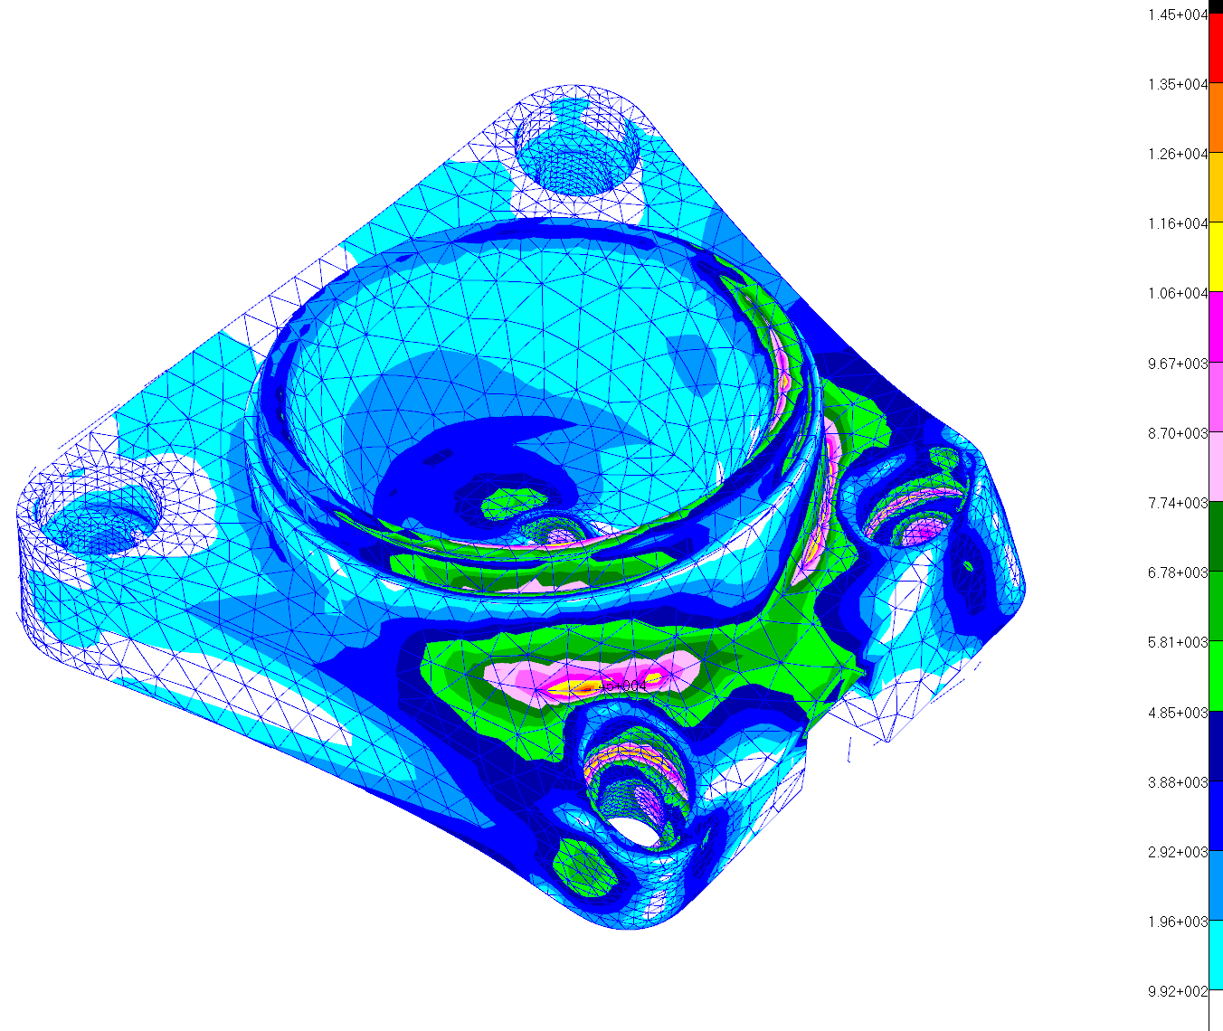
1 – Support Tubes
By SLAC team
Support tubes: Investigate steel posts for the support tubes, welded to or bonded to the end fittings, to simplify the design and allow design issues to be resolved quickly.
After the ΔFDR, the posts were changed to welded steel tubes
The analysis reflects the current design (5mm tube wall)
The current design supports the stiffness and strength requirements

Slide 23
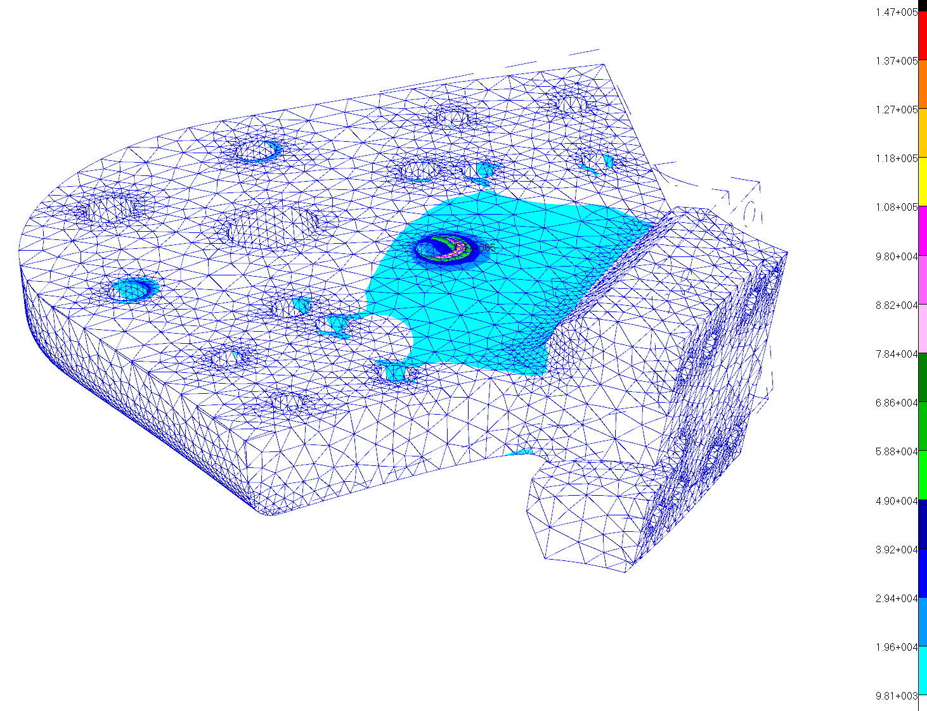
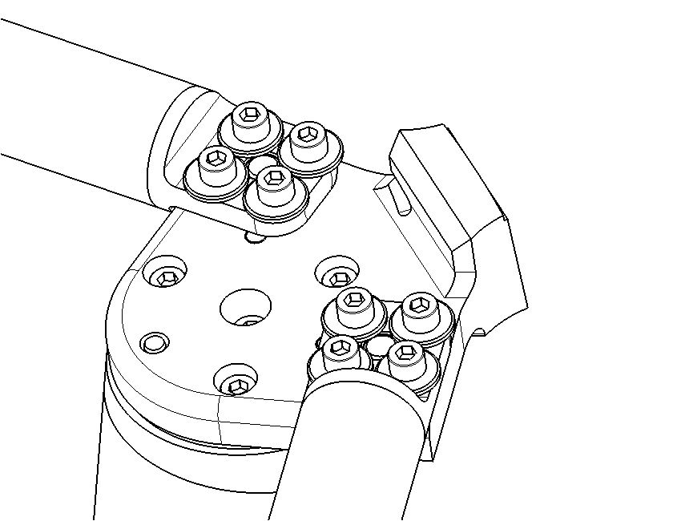
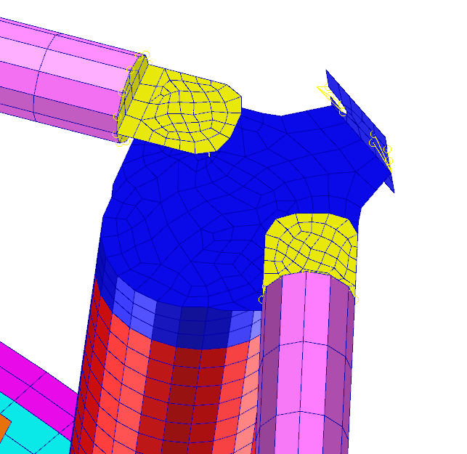
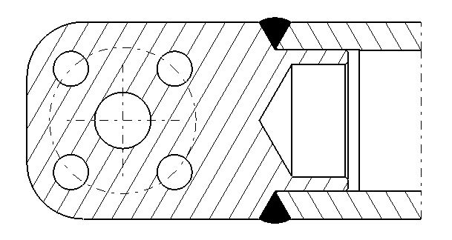
2 – Pentagon Rods
By SLAC team
Pentagon rods: Finalize the design of pentagon rod connections of the tubes to end fittings (welded or bonded) and their bolted connections to corner brackets.
The pentagon rod design is complete, being aluminum tube with welded end fittings
The analysis reflects the current design
The current design supports the stiffness and strength requirements
Fastener head pull through
MS = High

Slide 24
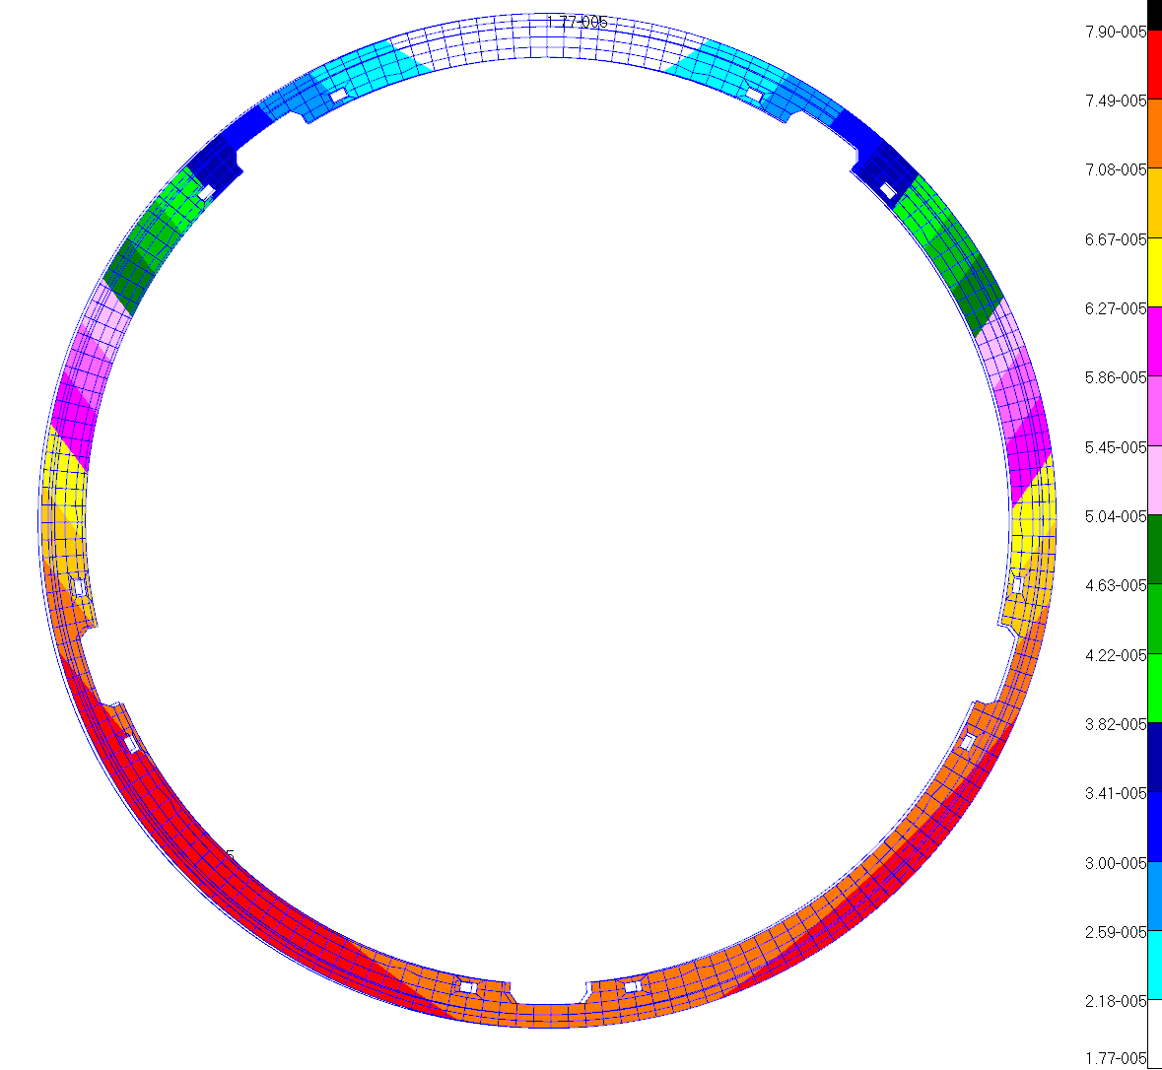
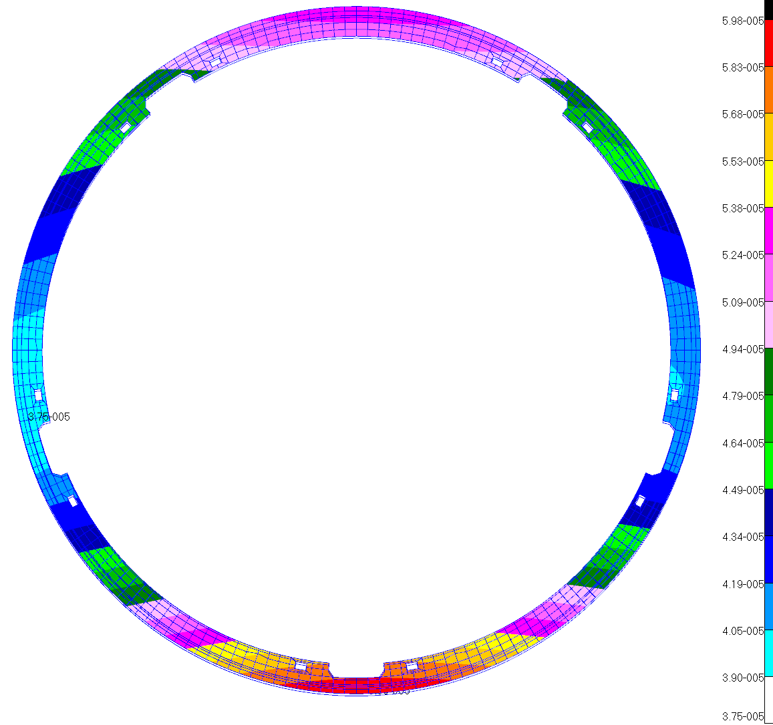

8 – Ring gear analysis write up
By SLAC team
Complete and write up ring gear analysis: show deflection of final ring gear design and effect on pinion gear teeth meshing, given the non-standard mounting method and design geometry.
Updated analysis shows the ring gear macro deformations are insignificant under normal operation and will maintain correct gear mesh during operation
Detailed stress analysis of tooth and contact was deemed to be the same as in the previous analysis, so further analysis was not needed
1gX
1gY
1gZ
Max Disp = 79.0 μm
Diametral Dev. = ~3.8 μm
Max Disp = 59.8 μm
Diametral Dev. = ~2.5 μm
Max Disp = 16.2 μm
Diametral Dev. = ~1.5 μm
Notches do not cause any significant loss in ring gear circularity
Displacements shown at 100X

Slide 25

Pendant ce temps au LPNHE

Slide 26

9 – THK Rail Stiffness
By LPNHE team
THK rail stiffness: run tests to empirically determine rotational stiffness of the carriages on the rails. Use this to update the FEA model.
This has been answered in: 4-FEA boundary conditions, i.e.
Stiffness testing of the THK Rail and carriage was performed, and the FEA model was correlated to the test results
We have a high confidence on the fidelity of the FEA model stiffness at this critical interface
THK Rail
Position indicators
Loads

Slide 27



10 – Pin Flexure Testing
By LPNHE team
Pin flexure testing: test case-hardened pin to define allowable loads to be used for the pin. Don’t rely on the analysis to develop this, since stress margins were very small and material properties of the case-hardening were not clear.
This has been answered in 7-Pin Analysis, i.e.
Pin analysis was deemed impractical. Instead a strength test simulating the worst case pin loading was performed and shown to have significant margin of safety
Load cell
No visible permanent deformation before 3000N
No rupture before 5000N (> 1655N of the test plan)
Position indicators
Test pin

Slide 28
Conclusions FEA
By SLAC team
A comprehensive system structural analysis of the Carousel Assembly has been completed
The current design is proven to have adequate margins of safety against stress, and meets stiffness criteria
Analysis issues explained in the Tier 1 and Tier 2 RFA’s have been addressed and are found to not be an issue
All RFA’s related to the structural analysis of the Carousel can now be closed

Slide 29
Le futur du carrousel
24/10/2016 : Bâti (LPC Clermont) dispo dans le hall (LPNHE)
10/2016 : Unbalanced test
10/2016 : Début commande pieces finales à Paris
10/2017 : backflange final à Paris pour intégration
04/2018 : Intégration finale à SLAC
12/2019 : Opérationel au Chili

