Slide 1
AERA: Radio detection of cosmic rays in the Pierre Auger Observatory
Charles Timmermans

Slide 2
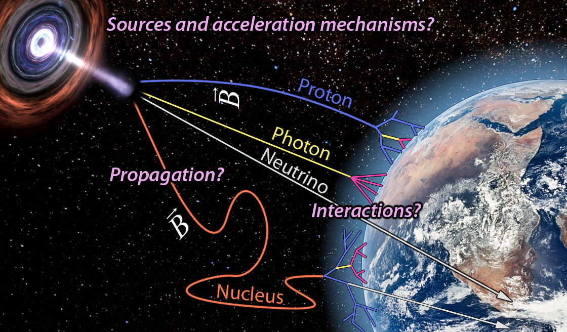
Study of Cosmic Rays
Rigidity is the key!

Slide 3
Auger:
3000 km²
Laser facilities
for monitoring
and calibration
weather
balloons
Lidar monitoring
and calibration
3 / 24

Slide 4
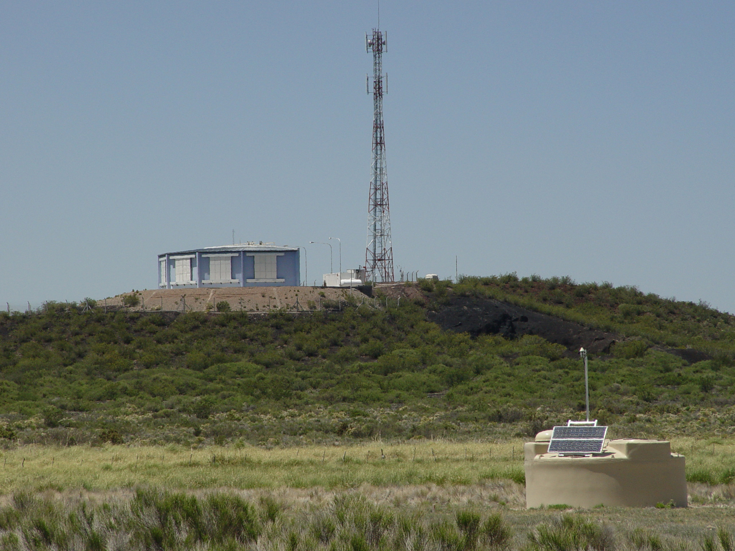

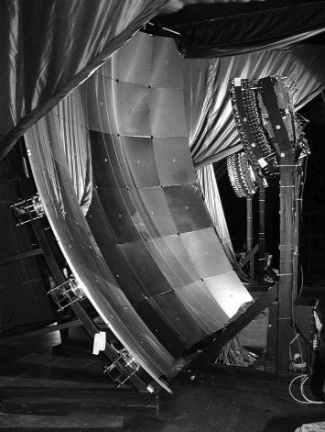
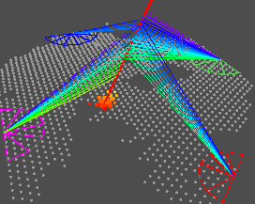
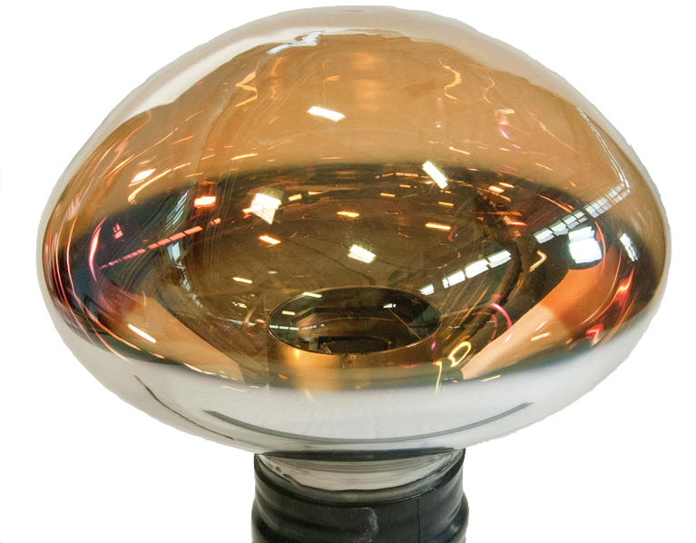
State-of-the-Art: Pierre Auger Observatory
Established in 1995
Collecting data since 2004
~500 scientists, 90 institutions, 16 countries
Fluorescence
Detector FD
Hybrid detection
Surface
Detector SD

Slide 5
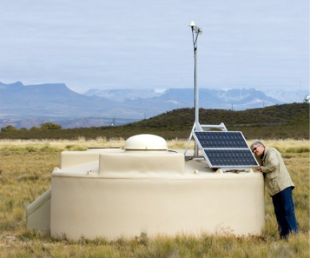
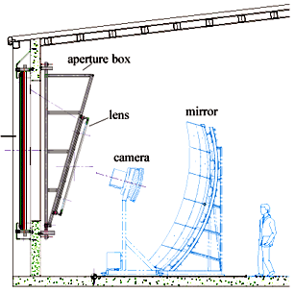
The Auger Observatory
Composition
Energy
Direction
10% uptime
Energy
Direction
100% uptime

Slide 6
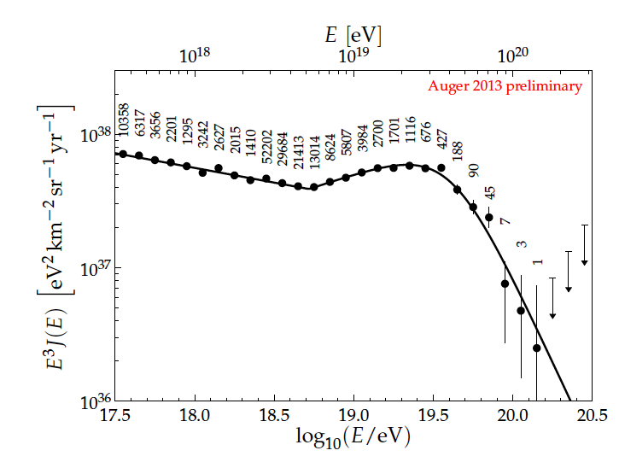
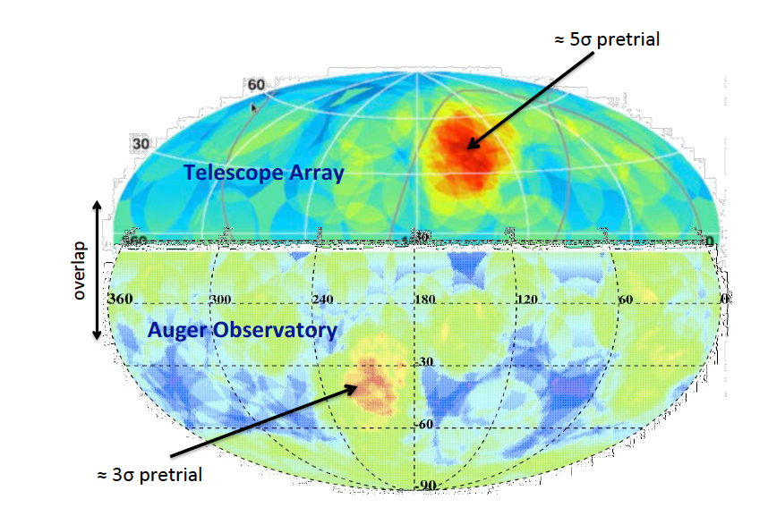
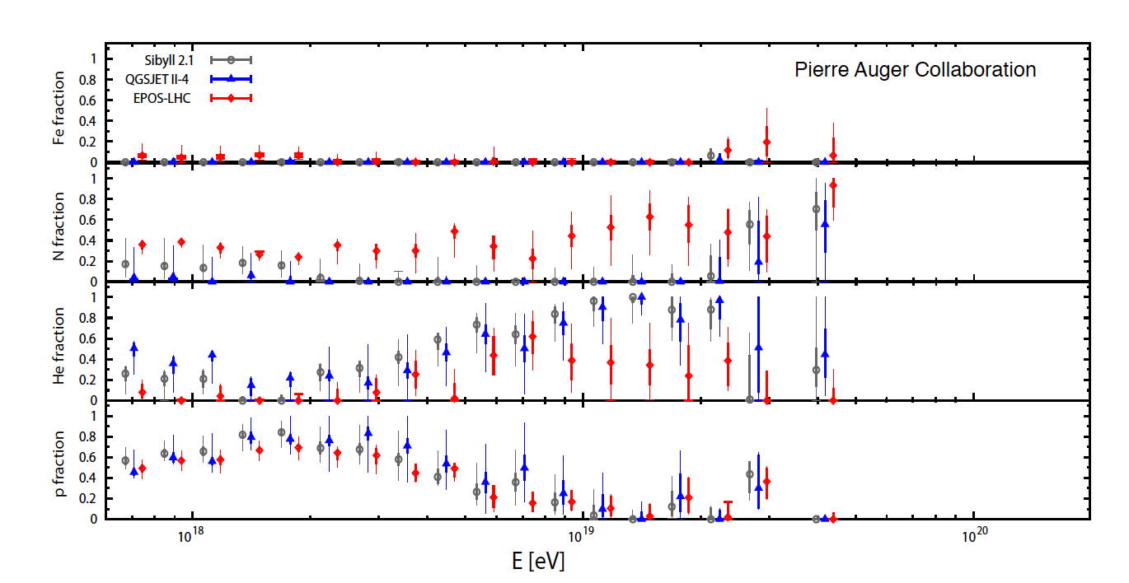
Key Results of the Auger Observatory
Very strong flux suppression
Top-down scenarios ruled out
Challenging level of isotropy
  7% dipole at E>8x10¹⁸ eV
Unexpected mass composition or change of hadronic interactions for E>10^{18.5} eV
Air showers have surprisingly high number of muons (not yet understood)

Slide 7
Challenge: Mass composition at the highest energies!

Slide 8
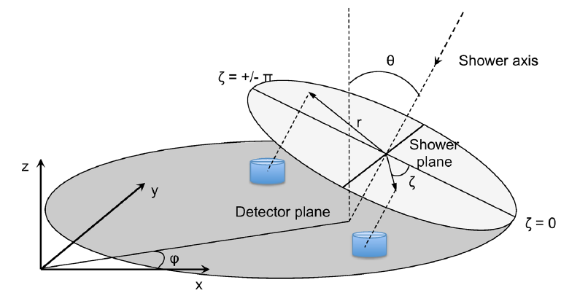
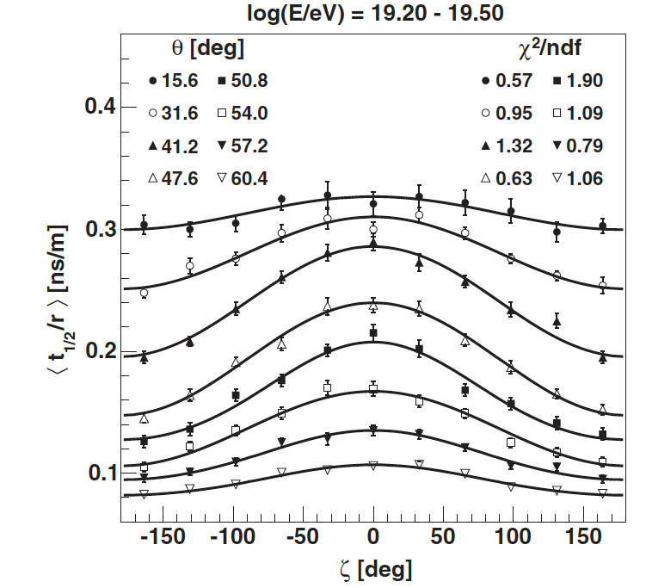
Use the Surface Detector

Slide 9
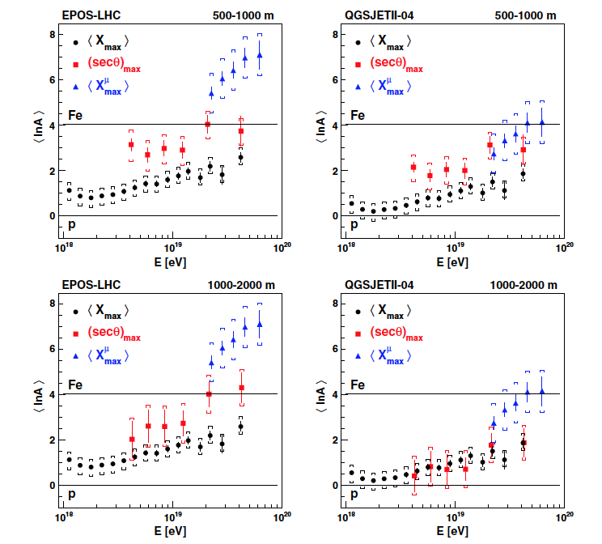
Cosmic Ray composition from the surface detector information
Problem: The interpretation has a large model dependence

Slide 10
Larger and better detector arrays
Promises of Radio detection:
  cheap
  100% duty cycle
  No particle fluctuations in front → excellent directionality
  Radio signal not attenuated in atmosphere → excellent energy resolution
  Shape of radio front good measure of depth of shower maximum → event-by-event measurement of nature of cosmic rays

Slide 11
Radio Detection of air showers
Detectability: characterization of signal
Angular Resolution
Understanding radio emission mechanisms
Energy Measurement
Composition of cosmic rays
Future utilization of Radio

Slide 12
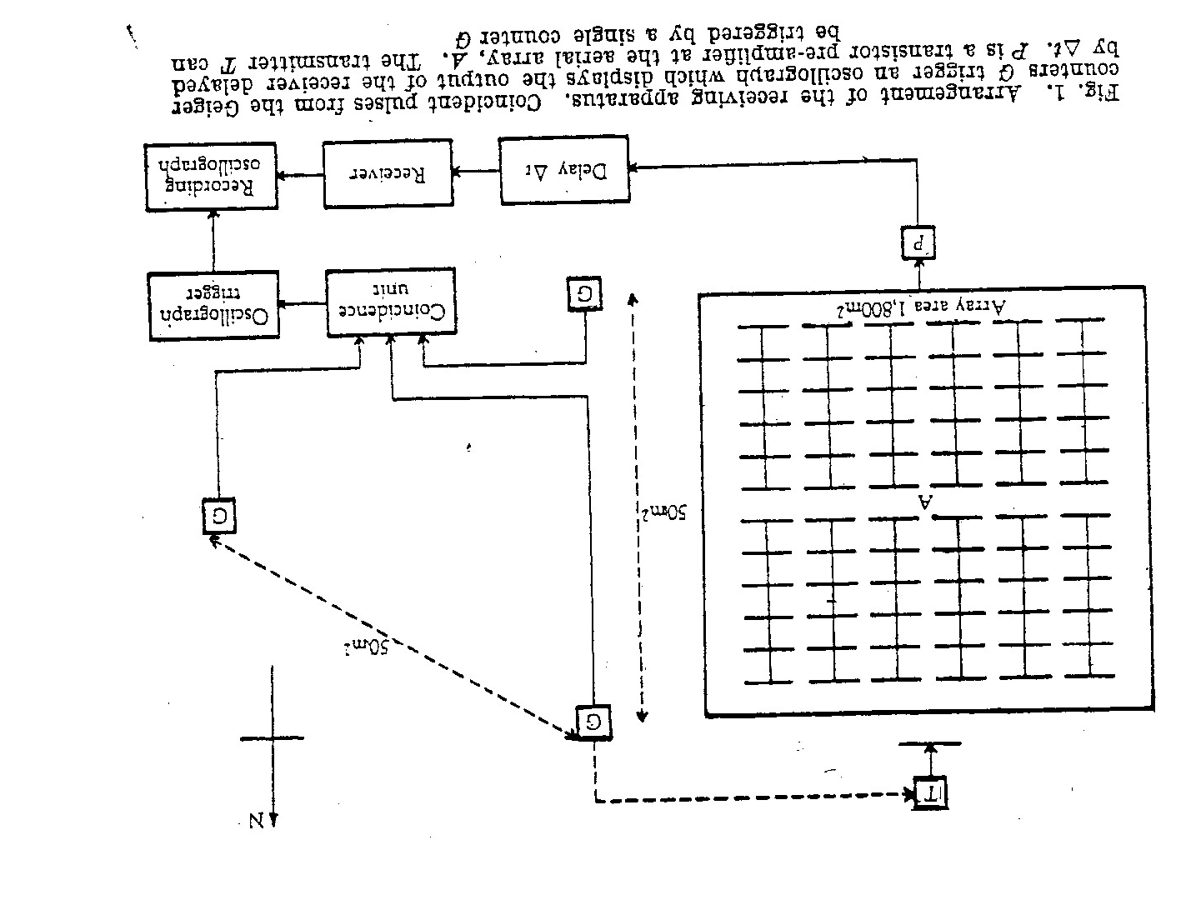
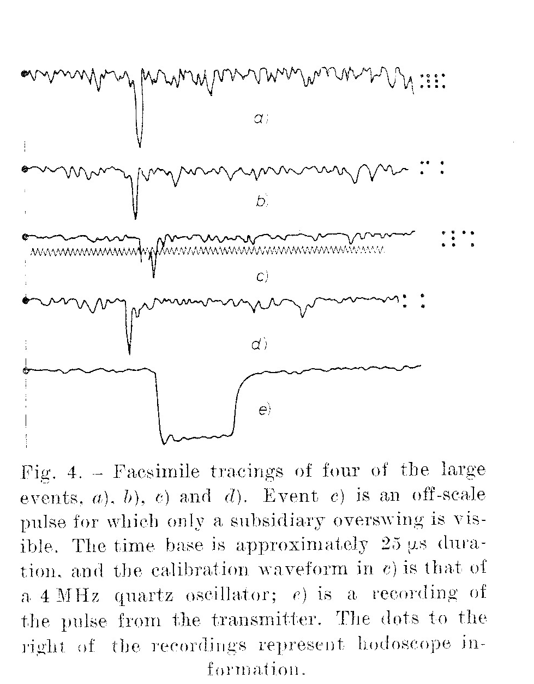
Radio Detection: Detectability
Jelley 1965
(from Nature, 23-1-1965)
(from Il Nuovo Cimento, 21-12-1966)

Slide 13
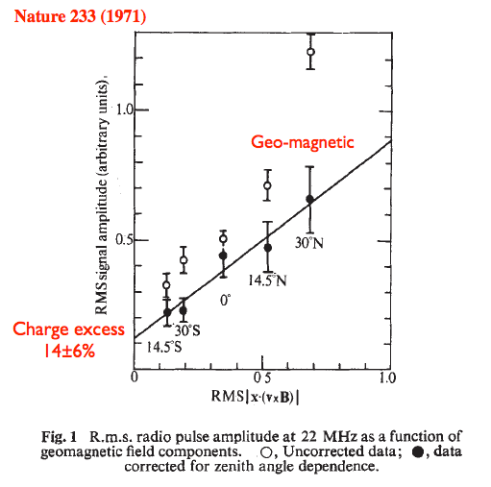
Mechanism: earlier experiments
Mostly geomagnetic
~14% charge excess

Slide 14
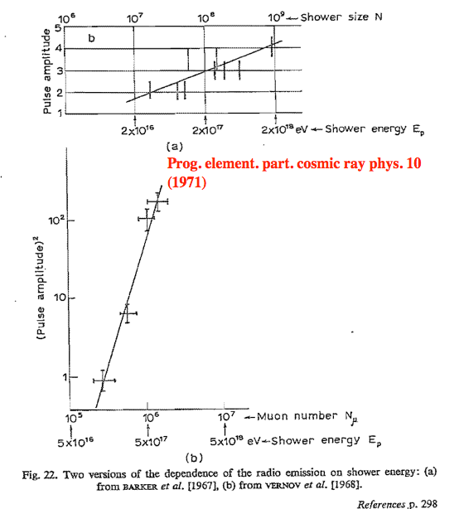
Early days: Energy measurement

Slide 15
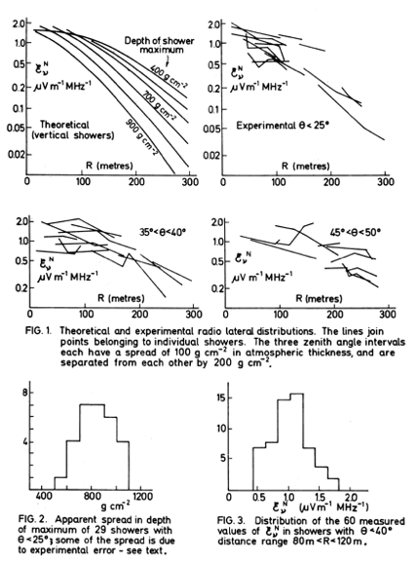
Early days: Shower development
First attempts to use the radio lateral distribution to infer the shower shape

Slide 16
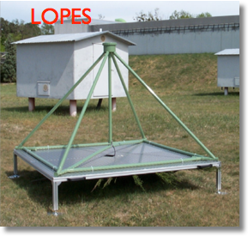
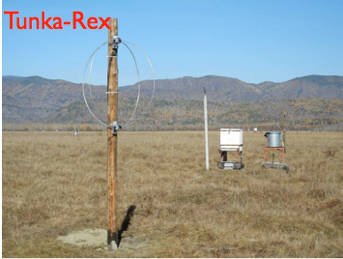
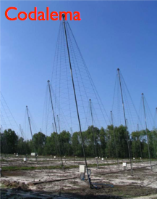
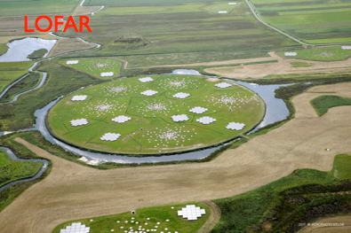
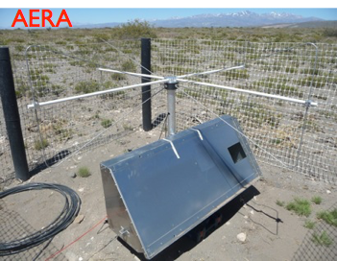
Modern experiments started around 2000

Slide 17
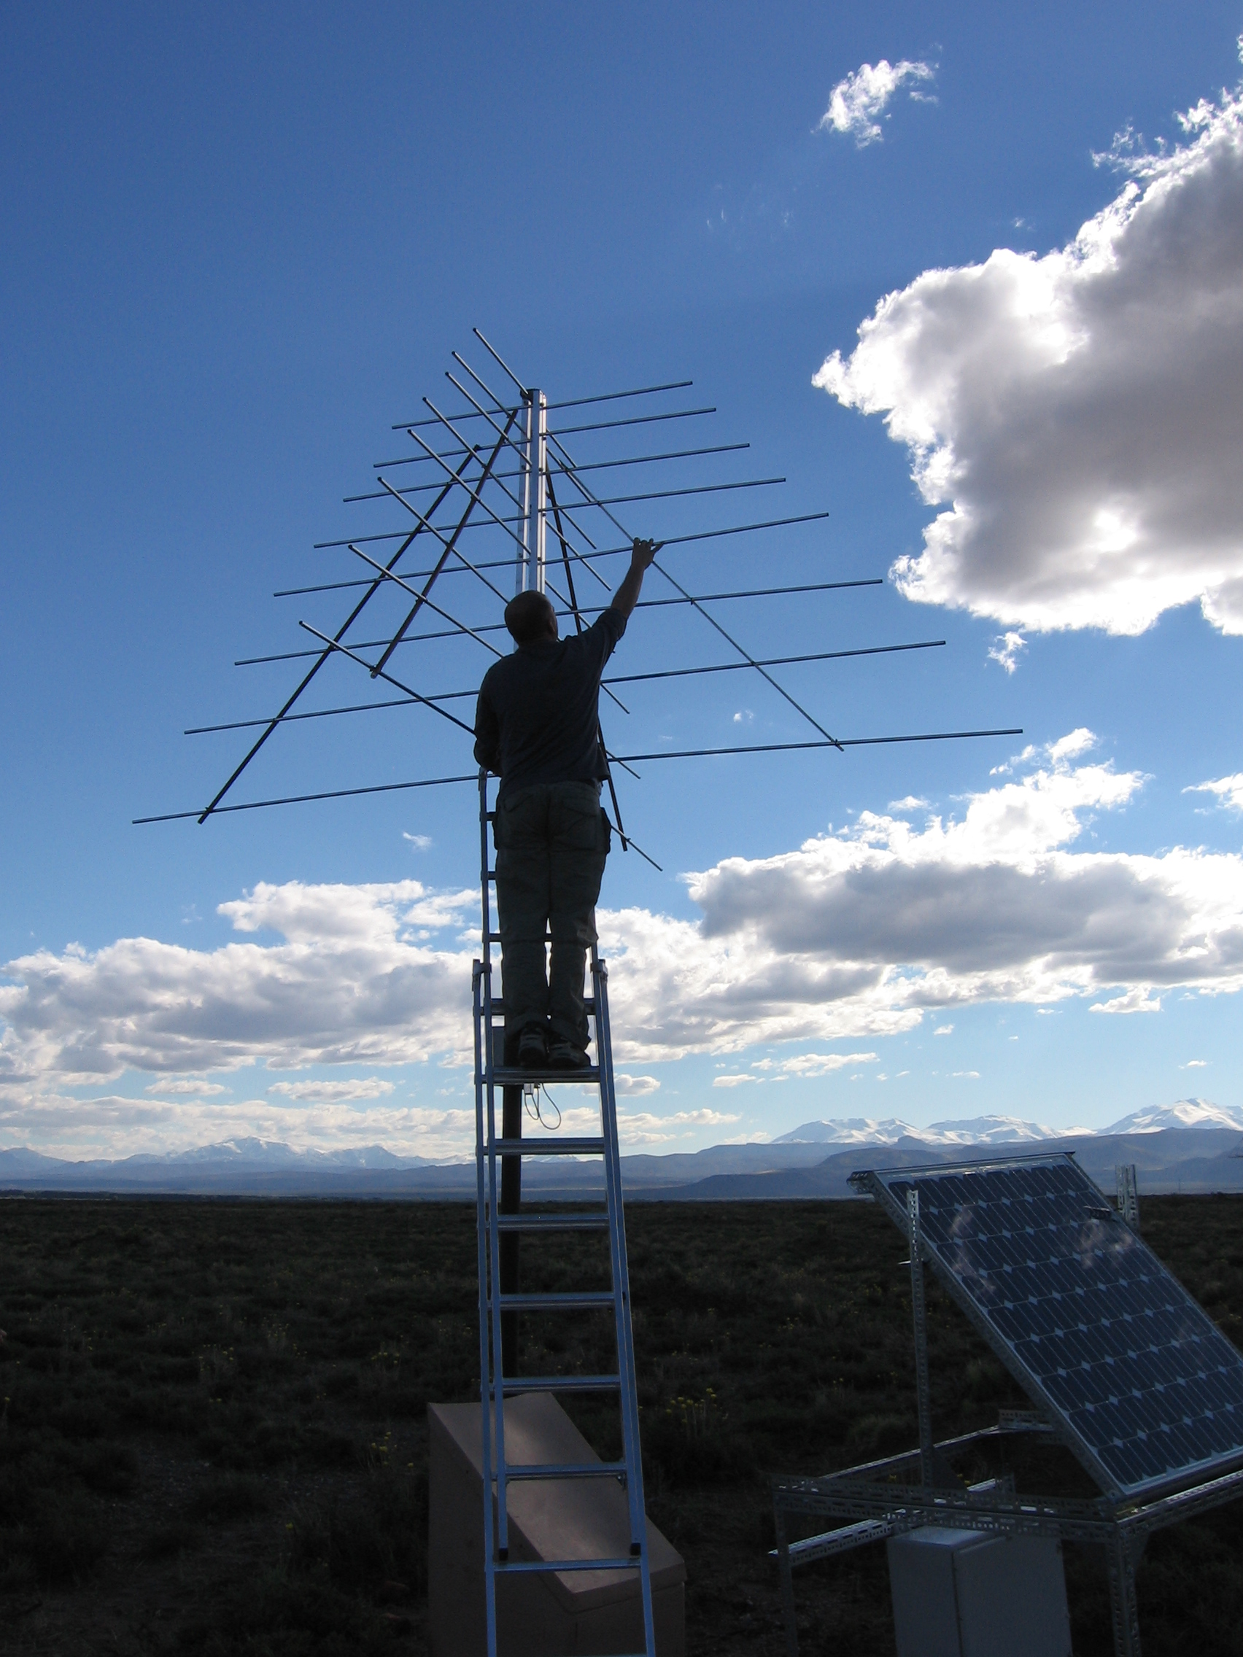
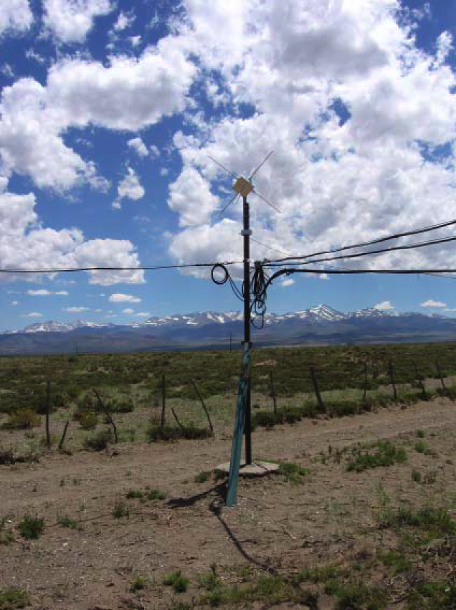
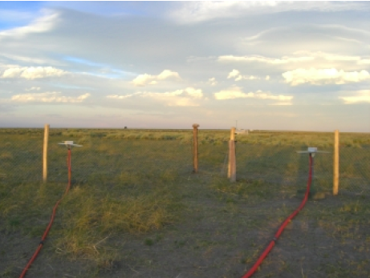
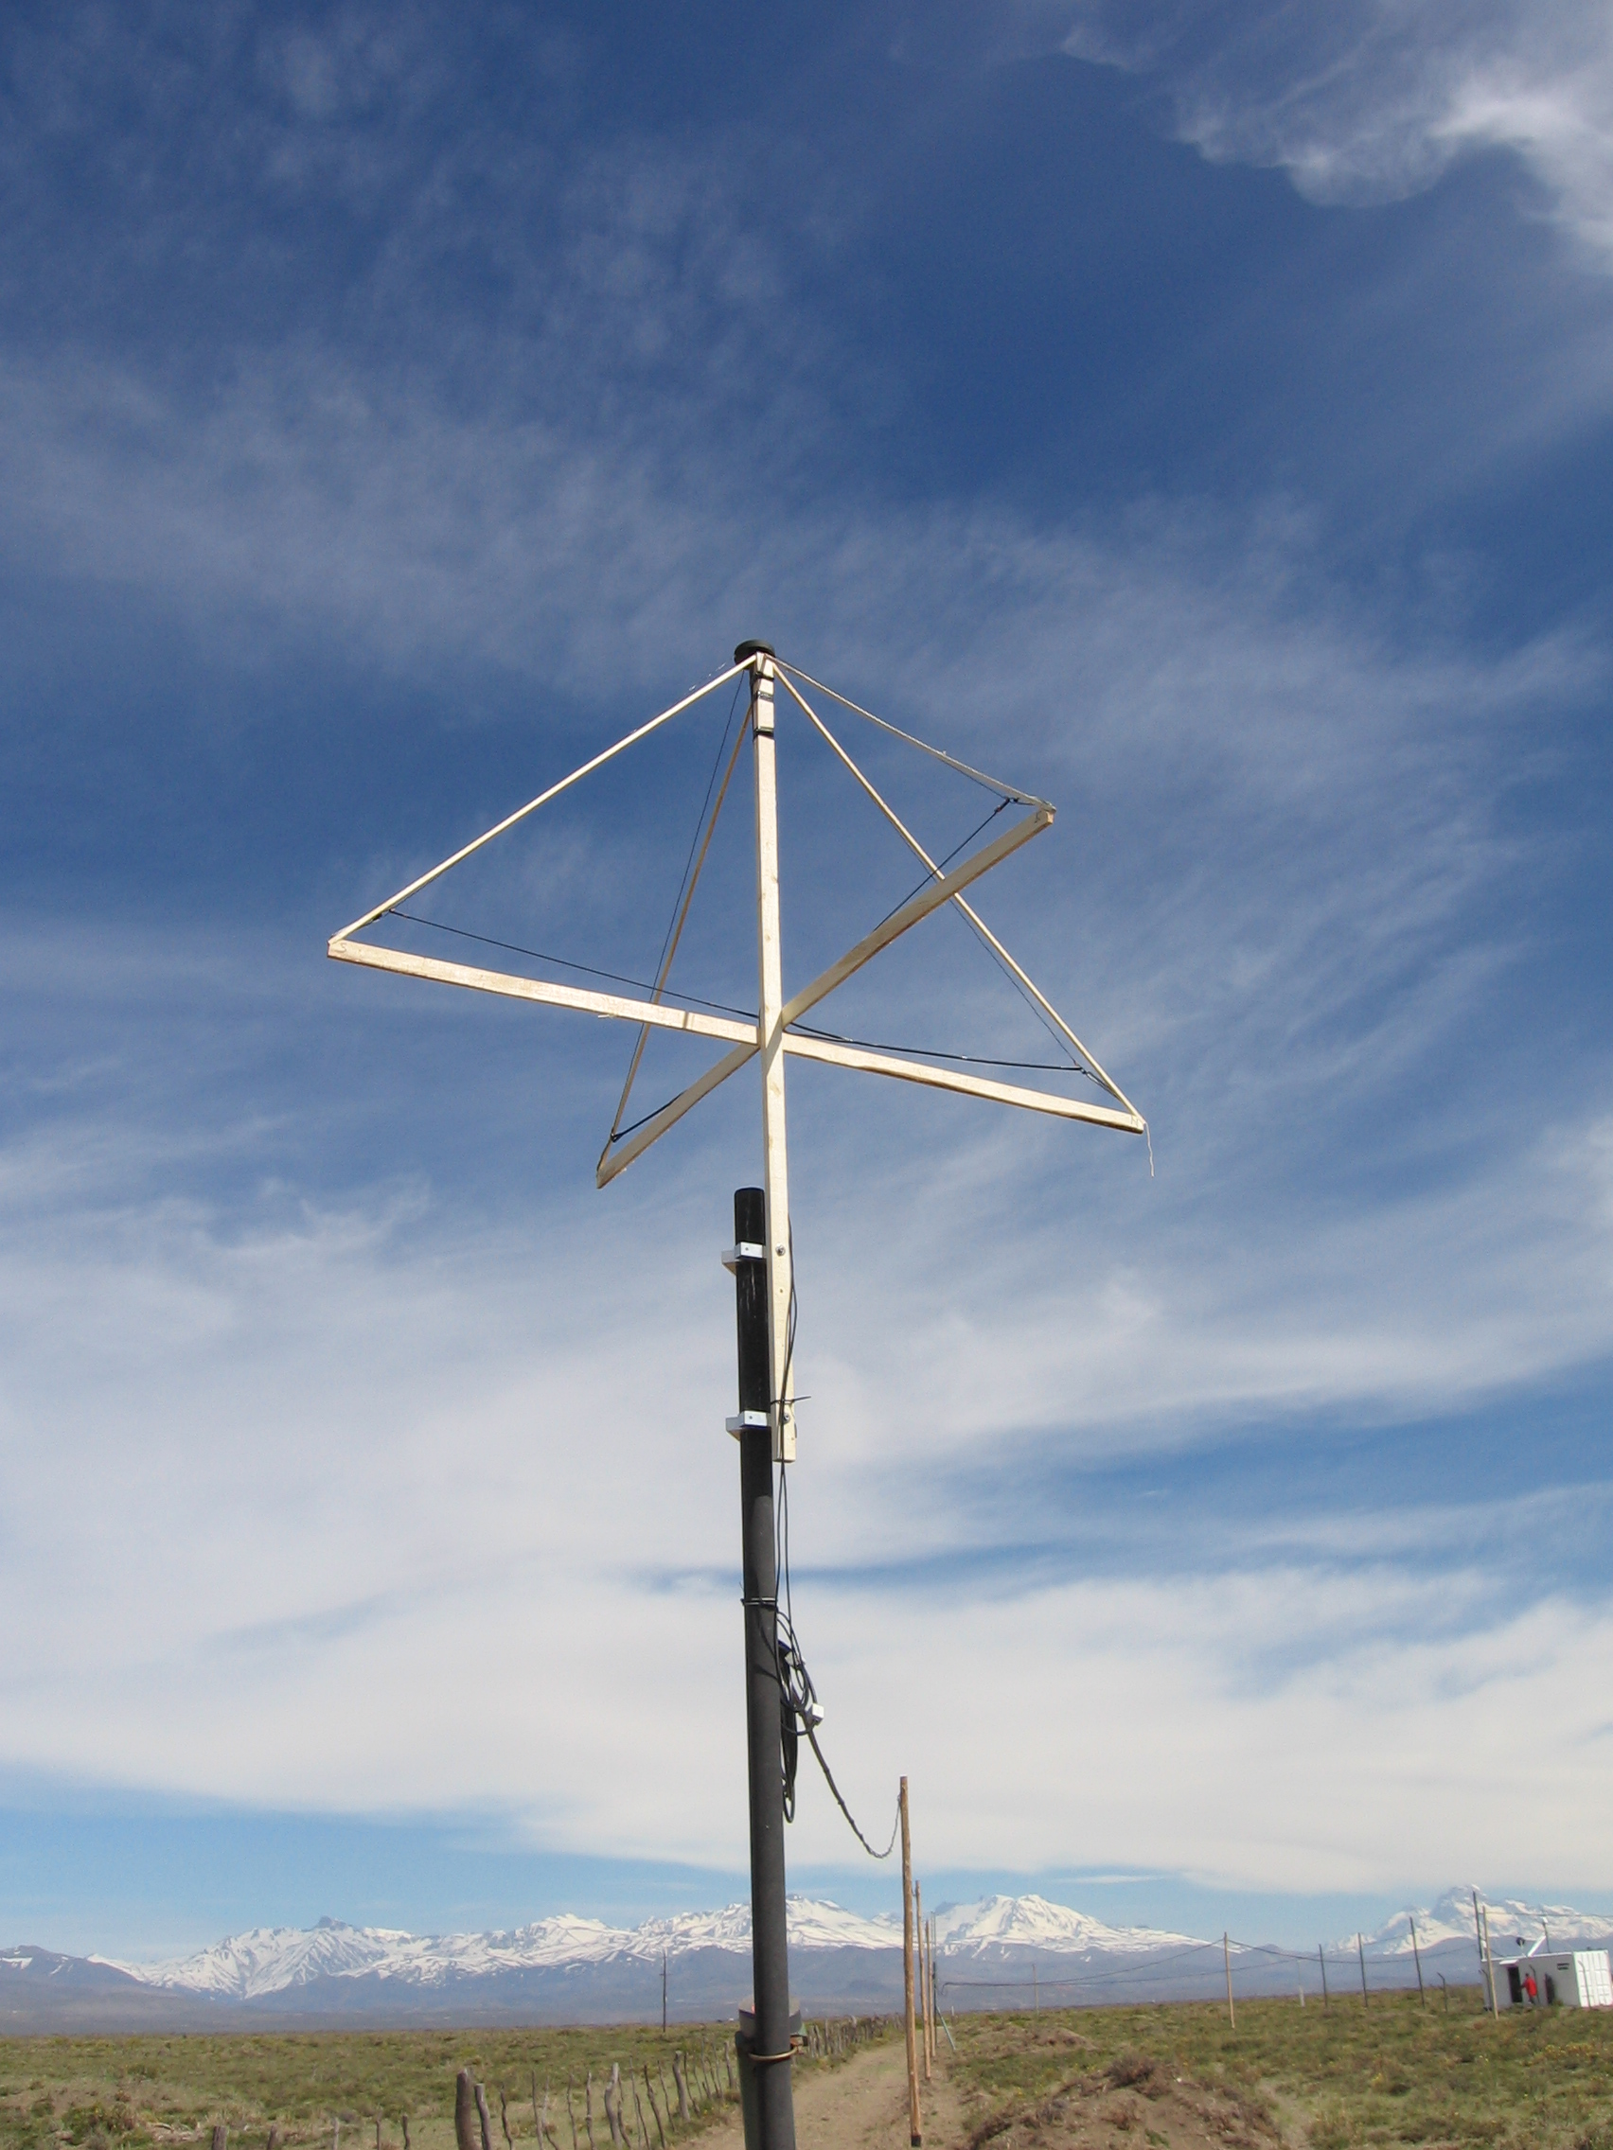
Testing of different antenna designs
Starting around 2005 in Argentina

Slide 18
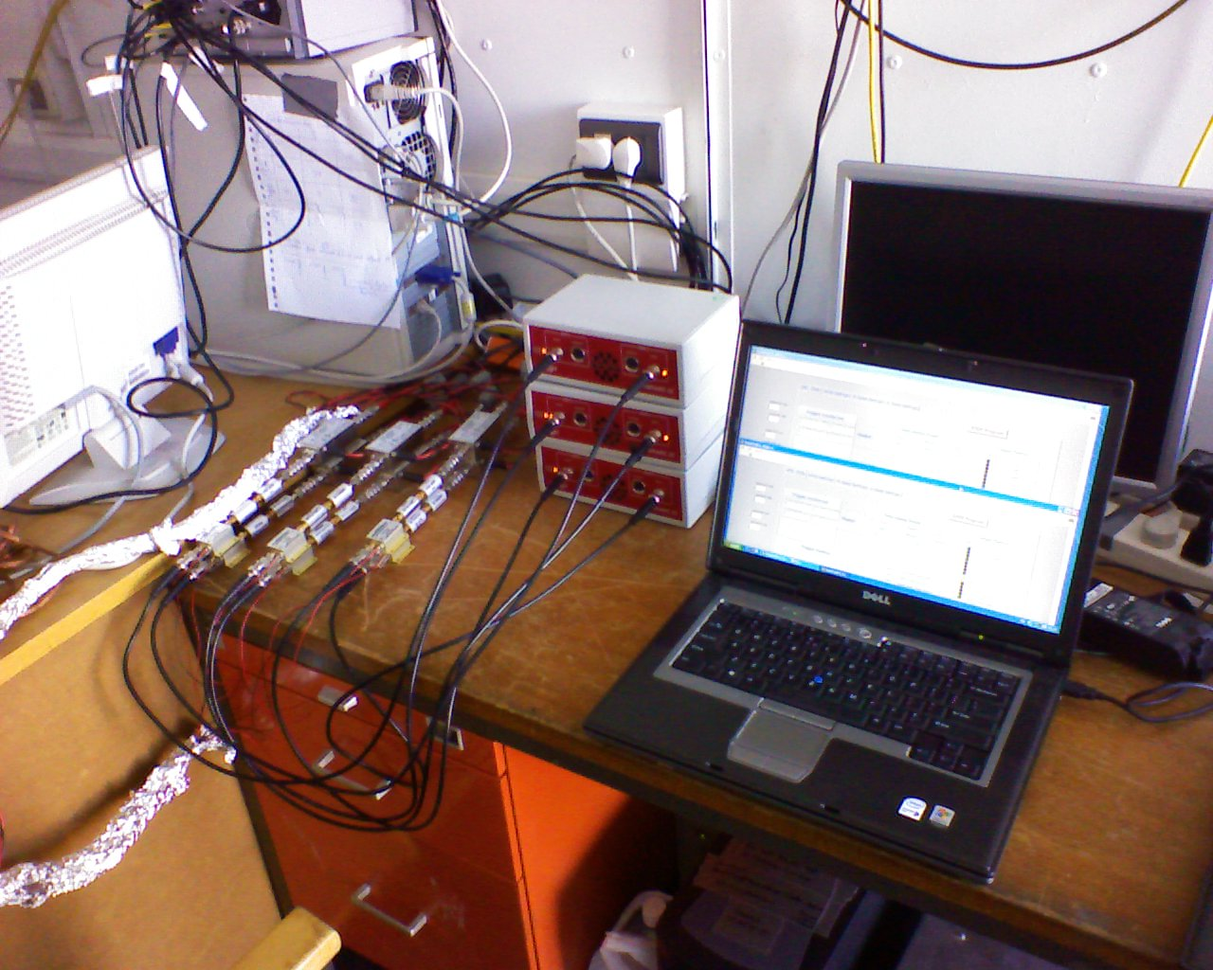
DAQ-Setup
400 MHz Scopes
Filtering
A: 25-70 MHz
B: 50-70 MHz
Amplification
30 dB
DAQ-pc

Slide 19
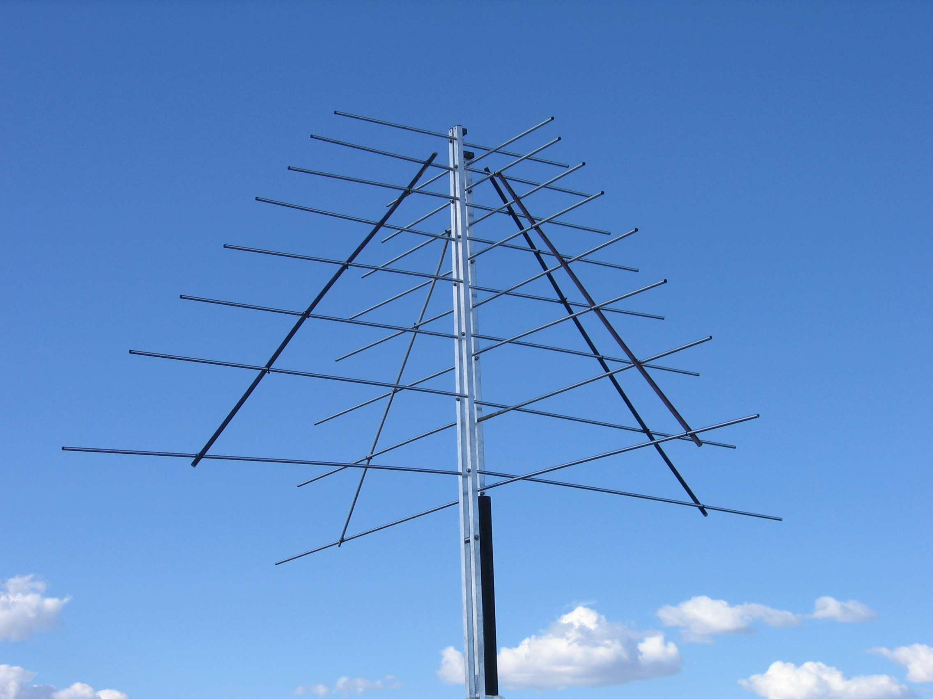
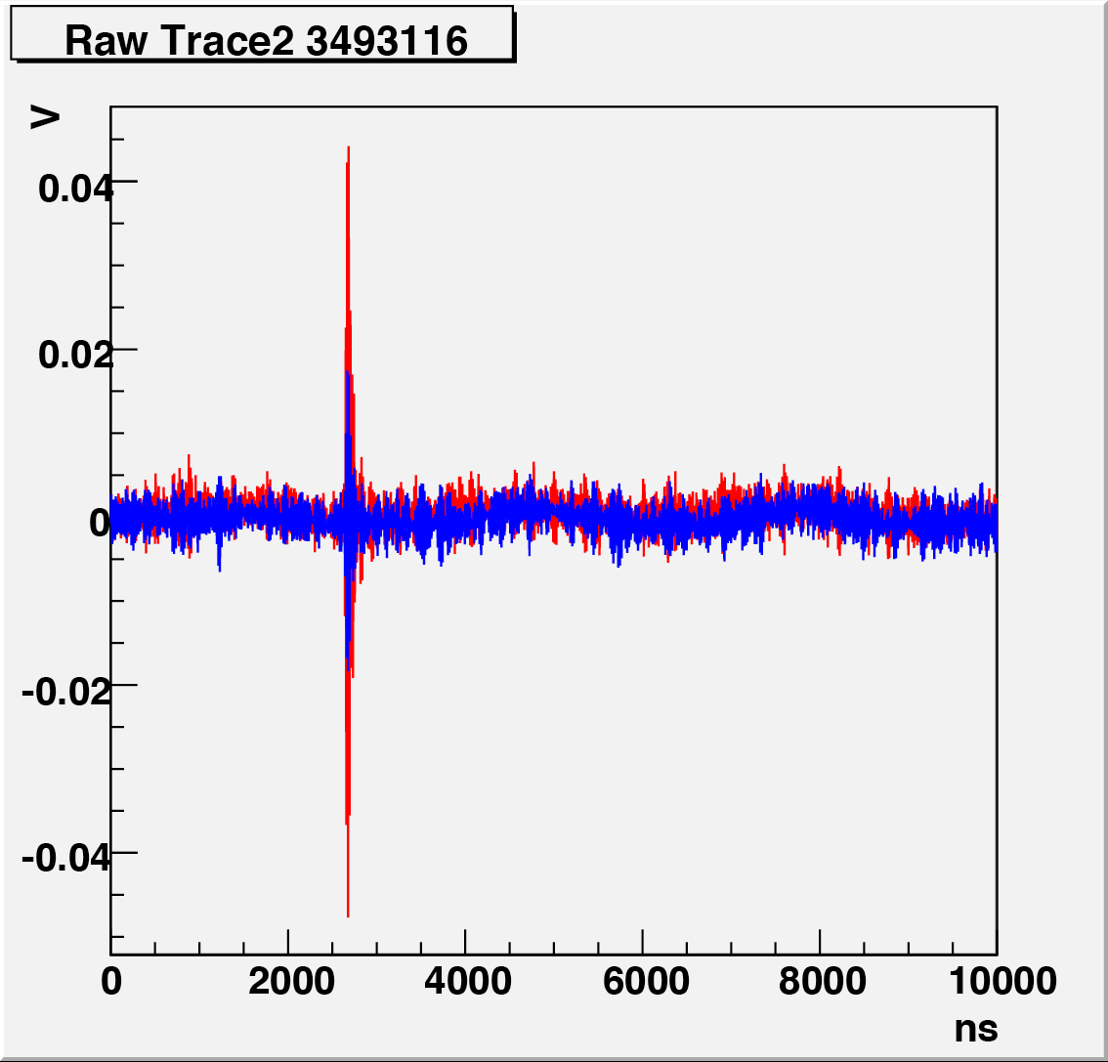
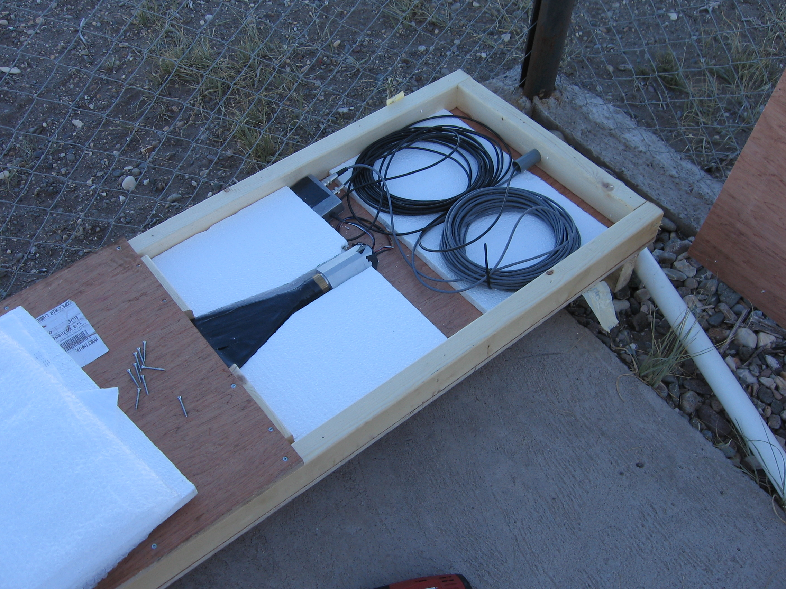
Shower in Antenna data
Triggered on a piece of scintillator (2007)

Slide 20
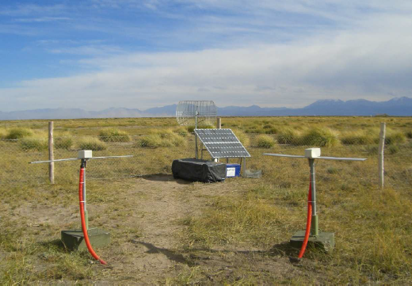
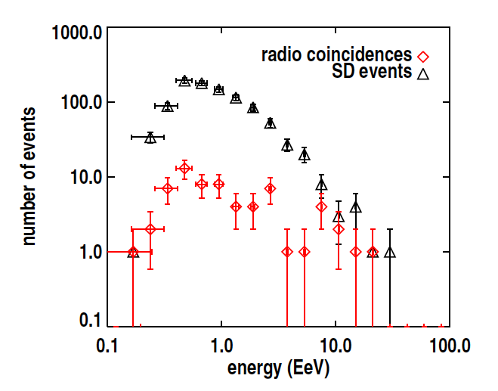
At the same time in Auger
Self triggering pioneered by a French team (B. Revenu, R. Dallier)

Slide 21
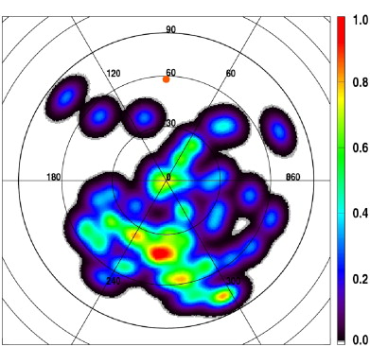
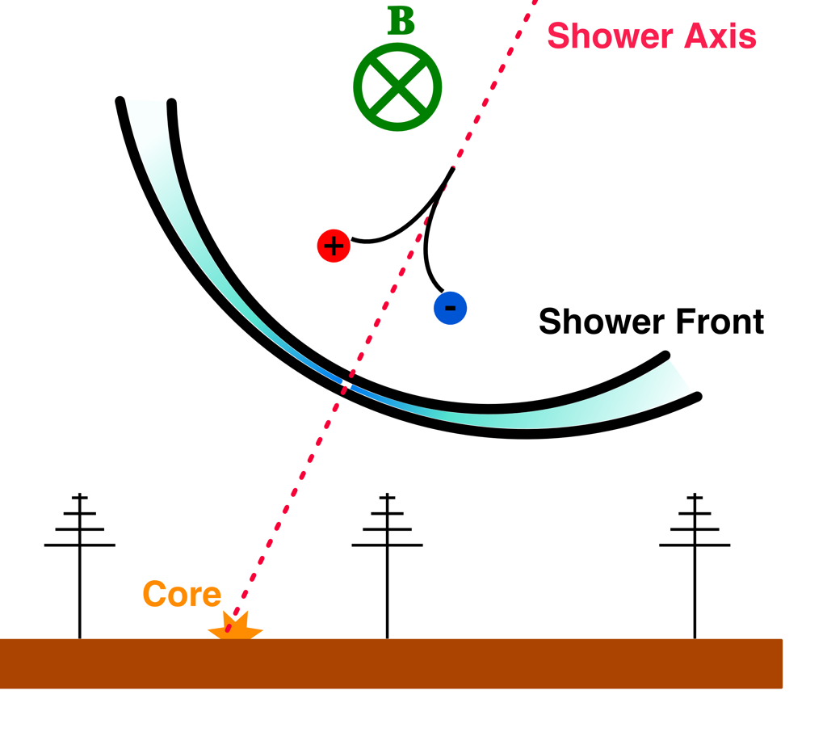
Nature of Radio signal confirmed
Deflection of particles in Earth’ magnetic field

Slide 22
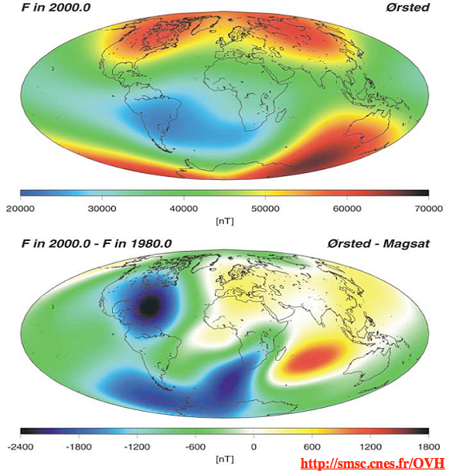
Keep in mind…
The Earth’ magnetic field is not the same everywhere and varies with time!
→ Measurements require slight modification when applied to other sites

Slide 23
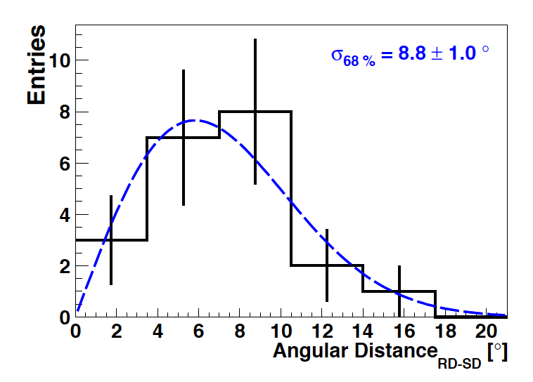
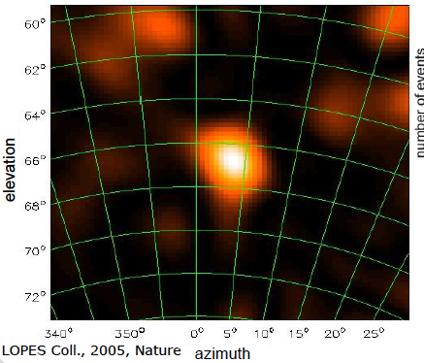
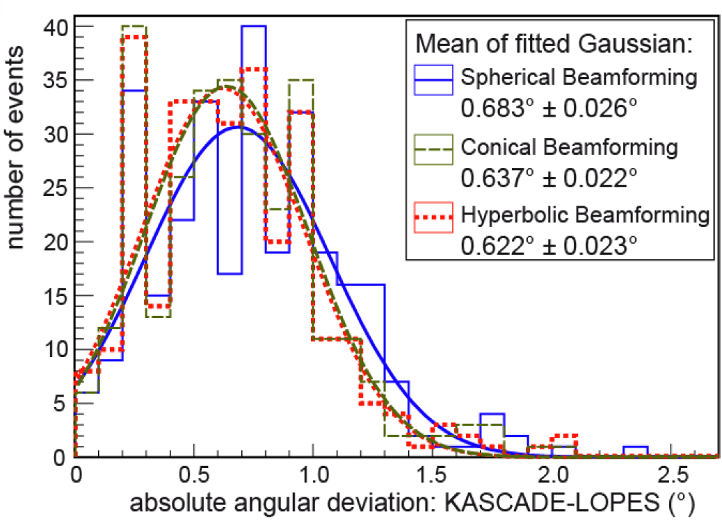
Angular Resolution
2009: Auger 100m baseline prototype setup
The LOPES collaboration (2014) reported an angular resolution of less than 1 degree

Slide 24
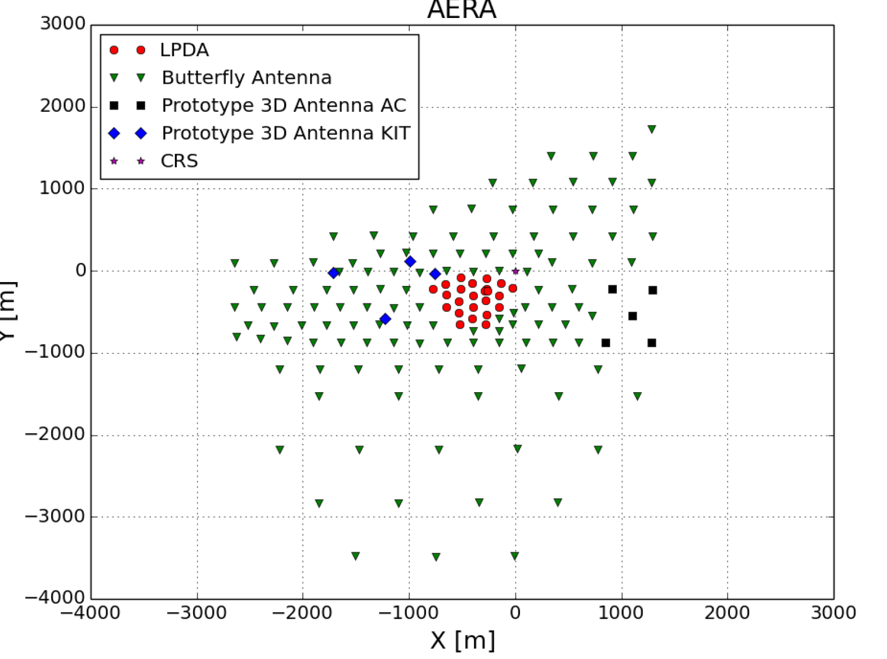
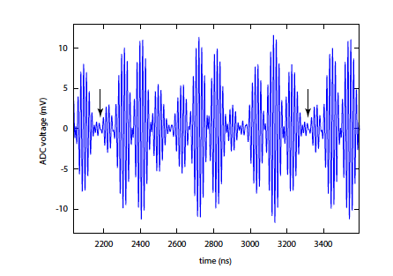
Combining Prototype work: AERA
3 stages:
1a: LPDA (144m) (2011)
2a: Butterfly (250 m) (2013)
2b: Butterfly (375 m) (2013)
3: Butterfly (750 m) (2015)
Timing: Radio transmitter at Coihueco

Slide 25
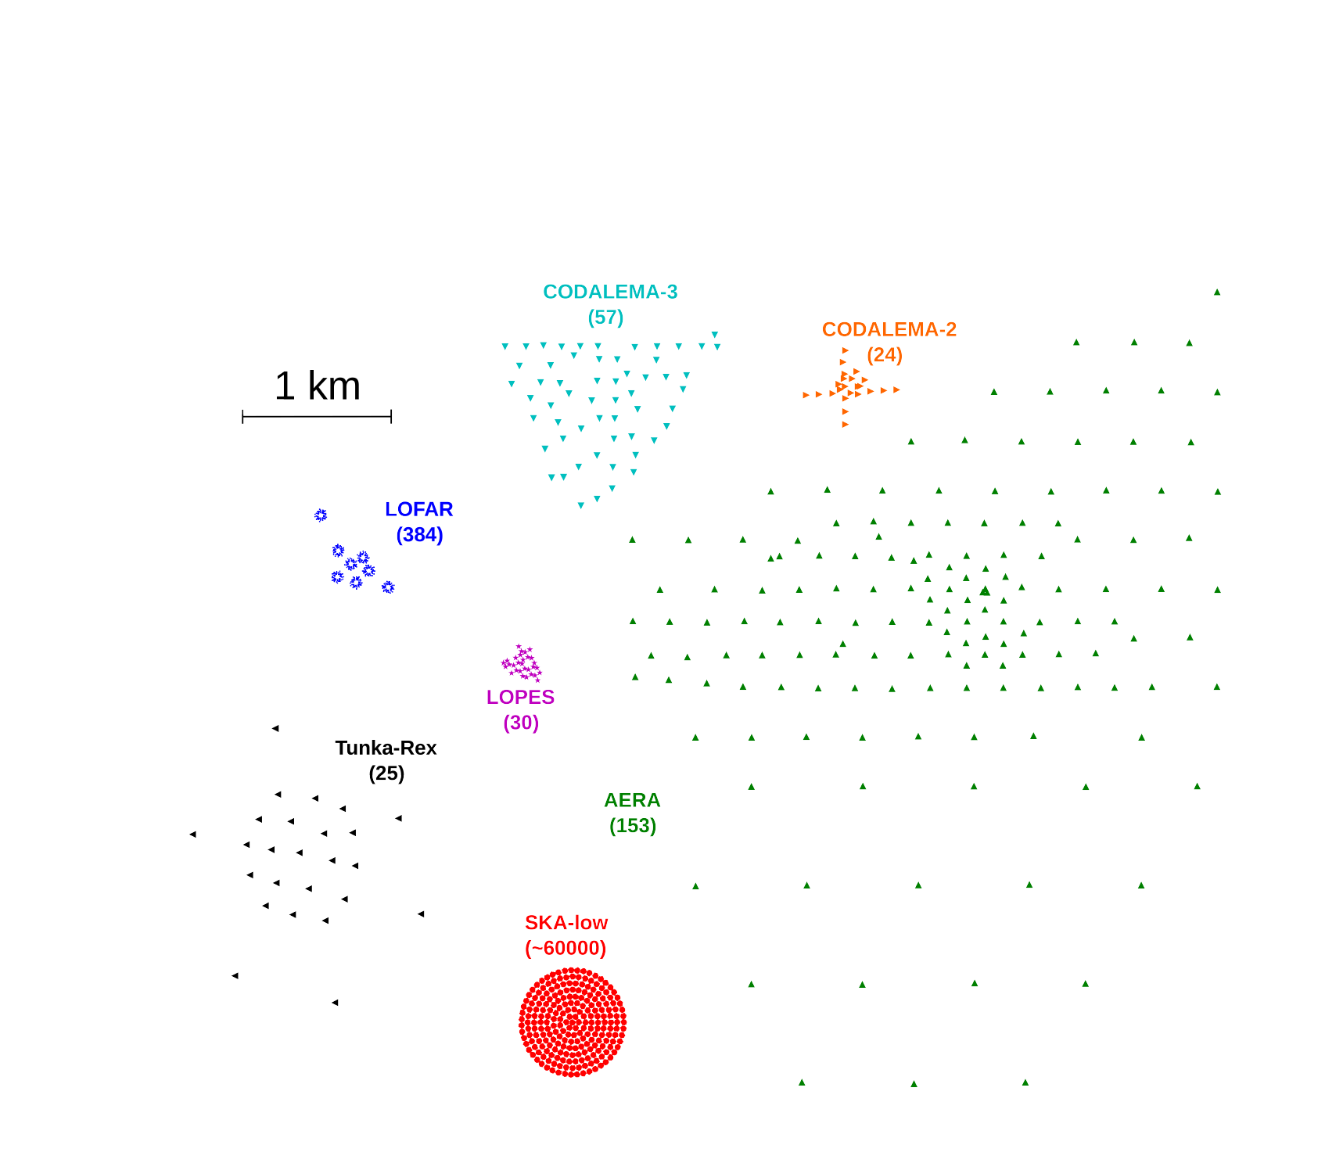
AERA and other modern radio detectors

Slide 26
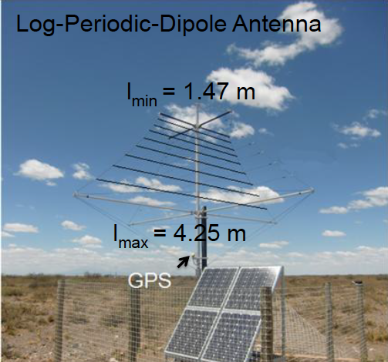
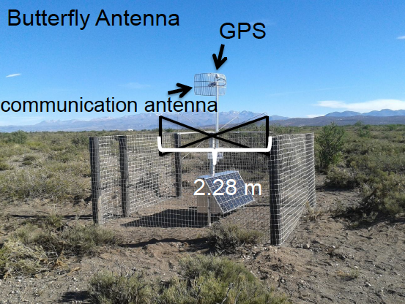
AERA Stations

Slide 27
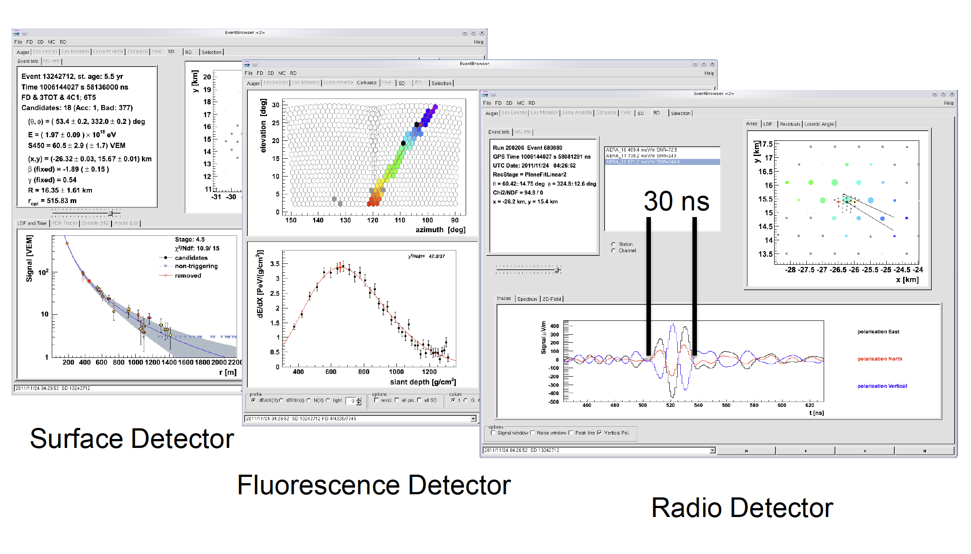
AERA: Superhybrid events!

Slide 28
AERA: Self-trigger tests
Removing RFI lines
Dynamically set threshold, based upon constant rate
Threshold very constant over time (shows Galactic variation)
Self trigger on EW channel
Efficiency ~30%
Moved to external trigger mode for statistics!

Slide 29
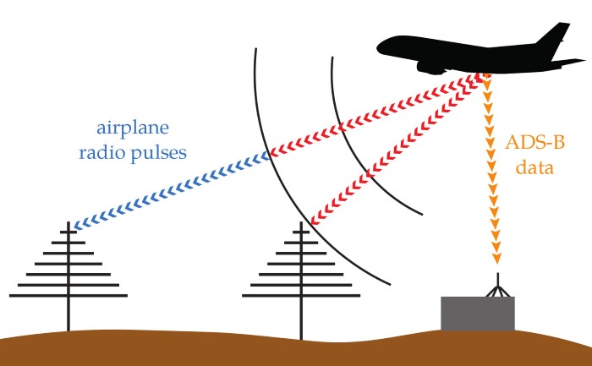
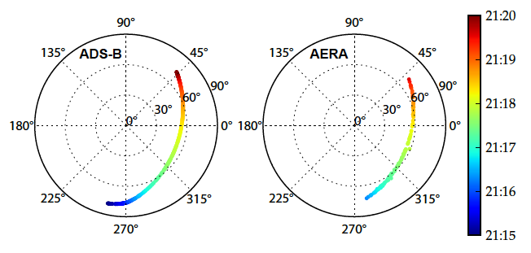
Timing and angular resolution
Using a simple USB device to know airplane locations
Angular agreement within 0.3 degrees

Slide 30
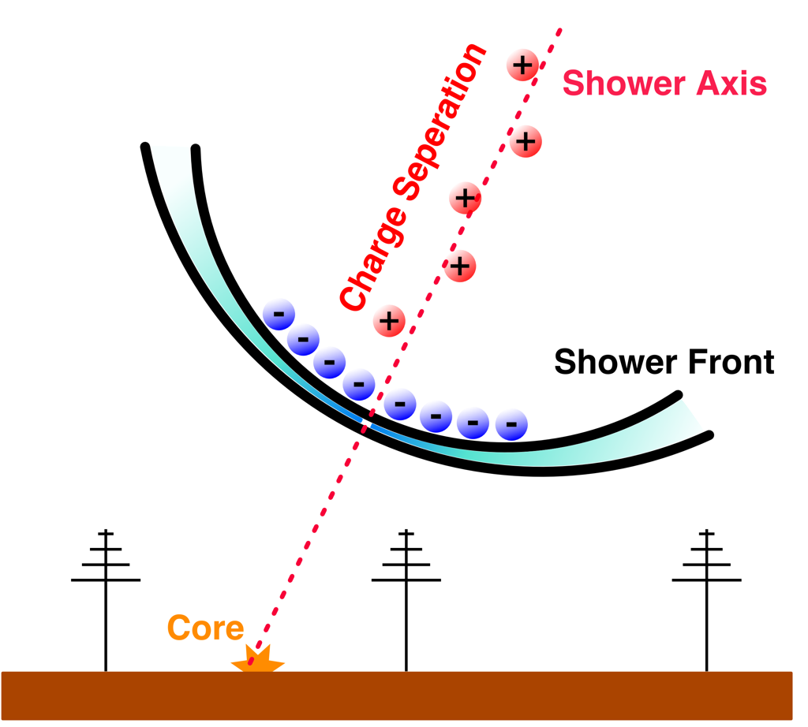
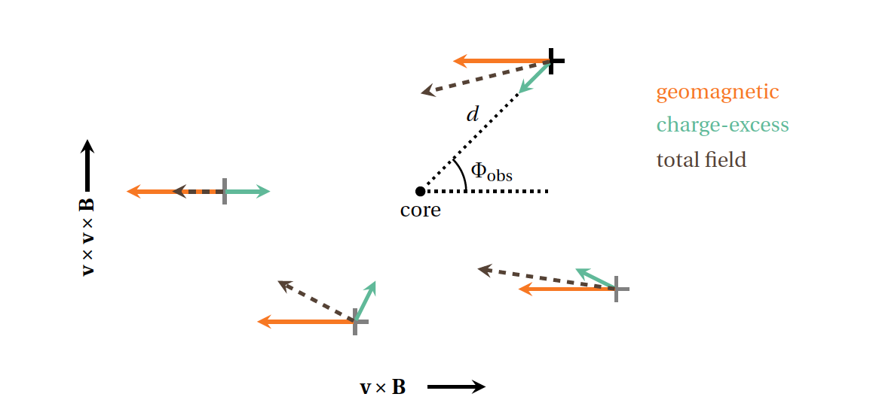
Secondary emission mechanism: Charge excess

Slide 31
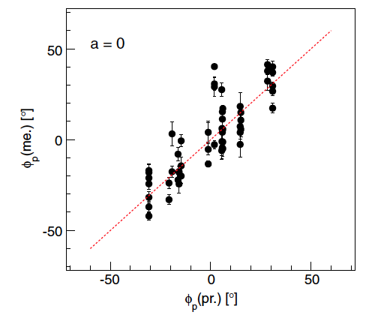


Average for AERA

Slide 32
Radio Emission of air showers
Main mechanisms:
~14 %
Deflection of charged particles in geo-magnetic field
Excess of a negative charge in the shower front

Slide 33

Lateral Distribution of Radio Signals
2 mechanisms: No longer a radially symmetric lateral distribution!

Slide 34


Comparison to high density LOFAR data shows that this shape is a good description of the data

Slide 35


Dependence on shower parameters

Slide 36



Energy measurement from radio
Tunka-Rex
LOFAR
CODALEMA
Maximum field
Signal at a certain distance
Fit parameter

Slide 37

LDF fit using AERA data
AERA uses the total energy in radio!

Slide 38




Slide 39

Shower development and radio LDF
Use the LDF: 2 showers of same energy and direction. Different Xmax 794 (left) and 573 (right) g/cm²

Slide 40


LDF Approach on measuring Xmax
Create a series of simulated showers of the right energy and direction and match the radio LDF of the shower (LOFAR)

Slide 41

Comparison to standard methods
Tunka-REX

Slide 42


AERA efforts
Width of LDF
Stay tuned
Wavefront
Pulse width in individual stations

Slide 43

Radio signal vs Zenith angle
Footprint of a 5 EeV shower depending on zenith angle.
Radio can be used even in a ‘sparse’ array

Slide 44
Conclusion
Radio signal is well understood
It has been shown that:
  The angular resolution is excellent
  The energy resolution matches current techniques
  Shower development can be obtained
If one wants to study horizontal showers, radio is a natural technique to use.

