Slide 1
First noise measurements
in the FATALIC option
Monday ATLAS/LPC Tile meeting
Roméo Bonnefoy, Dominique Pallin and François Vazeille
on behalf of the LPC team
2016 April 4
• The main electronic components of the readout
Performance specifications on electronic noise
Summary of various step studies
and present results from 3 All-in-One cards
Conclusion and next actions
From talk given at the Wednesday Tile Upgrade meeting of March 23
Reminder: there are 2 other concurrent options to FATALIC
- Chicago: evolution of 3-in-1 cards with discrete components, linear.
- Argonne: QIE option, with evolution of CMS asic, non linear.

Slide 2
The main electronic
components of
the readout
Signal
PMT
High
Voltage
Divider
PMT Block
Drawer
FATALIC
In blue: Signal and/or digital information
In red : Grounding aspects
All-in-One
We will play with all these objects
to minimize the noise level.
Main board
Low
Voltage
Daughter
Board
Daughter Board: Stockholm.
Back End: Valencia.
Back End
electronics

Slide 3
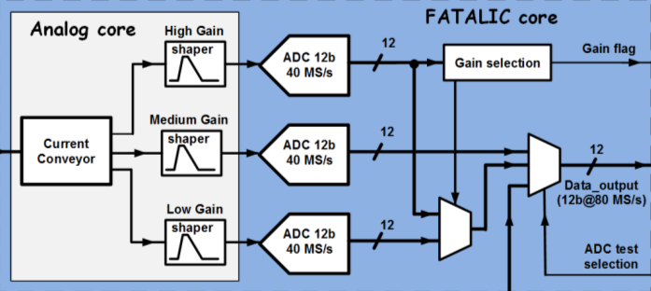
FATALIC has 3 gains (High: ~64, Medium: ~8, Low: ~1).
A 12-bit ADC per Gain.
Rough ranges:
High : “0” to 17.5 pC
Medium: 17.5 to 140 pC
Low : 140 to 1200 pC (and even above without saturation),
with overlaps of the Medium gain with the others.
“0” means electronic noise

Slide 4
Performance specifications on electronic noise
[From Performance Specifications for the ATLAS TileCAL Front End Electronics sLHC Upgrade Environment, The TileCal group (March 24, 2009)]
“4. Electronic Noise
The intrinsic noise of the electronics, as measured through the digitization path, expressed in terms of equivalent input charge, shall not be greater than 12 fC RMS at pedestal.”
It is justified by the rule of an electronic noise being
half the minimum charge of interest of 24 fC corresponding to 1 photo-electron.
This constraint of 12 fC RMS was a main issue
in the design of FATALIC and
in its implementation in the whole readout inside a Mini-Drawer.

Slide 5
It is impossible to find this paper on the web !
- This paper is in the indico agenda.
- It should be put on CDS as an official ATLAS reference.
“1. Smallest Signal to Measure
The smallest signal of interest from the detector, expressed in terms of equivalent input charge delivered to the front end electronics, is 24 fC.
Discussion: The minimum hadronic signal of interest from the detector is a muon with energy 20 MeV, which produces 1 photo-electron delivered to the photo-multiplier tube. The photo-multiplier tubes operate at a nominal gain of ~1.5E5. The minimum charge signal of interest is thus 24 fC.
Q_{min} = 1 photo-electron * 1.5E5 pmt gain * 1.6E-19 Coulombs/electron = 24 fC”
In this well documented document, the PMT gain is 1.5 10 ⁵ instead of 10 ⁵
WHY ?
If we set 10 ⁵ , the electronic noise request should become 8 fC.

Slide 6
Gary Drake talk on performances
It is no longer the
same specification:
2 times more
and even 3 times above:
WHY ?
Easier to reach ?
Pure QIE approach ?

Slide 7
Main interests of having a very low noise,
with the rule: it must be at most half the last significant physical value.
1. To fit the PMT performances: measurement of a single photo-electron
⇒ 8 fC for a PMT gain of 10⁵, 12 fC in the TileCal paper.
2. To measure muons in the smallest cells (350 MeV),
with a ratio signal/noise > 10 on a single PMT.
- 1 PMT 350/(10x2) MeV = 17.5 MeV.
- 1.15 pC/GeV for muons → 20.125 fC.
If we take larger cells (D cells), the energy (the charge) will be bigger.
3. To perform Cs calibrations of every cell (→ current measurement in 10 ms),
to contribute to the LHC Luminosity measurements (∼ 10³⁴ cm⁻²s⁻¹),
and even better to the vDM (van der Meer) low Luminosity calibrations
(10³⁰ cm⁻²s⁻¹),
via pulse mode or current measurements, at least on A and B cells.
→ Signals at a level of 1 photoelectron ⇒ noise of 8 fC.
Lower
currents

Slide 8
Main objectives of the FATALIC readout
An electronic noise ≤ 12 fC on the High Gain.
An external RMS noise < intrinsic noise.
A noise practically independent from the environment.
From the point 1 to the point 3,
these goals will be more and more difficult to reach.
… and why not to be better than 12 fC.
Noise study started beginning of January while first results were disturbing
→ Empirical and systematic studies of trouble sources.

Slide 9
Summary of various step studies
and present results from 3 All-in-One cards

Slide 10
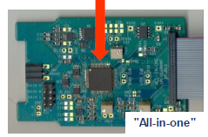
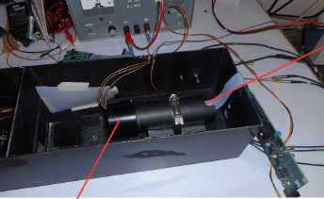
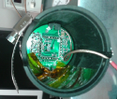
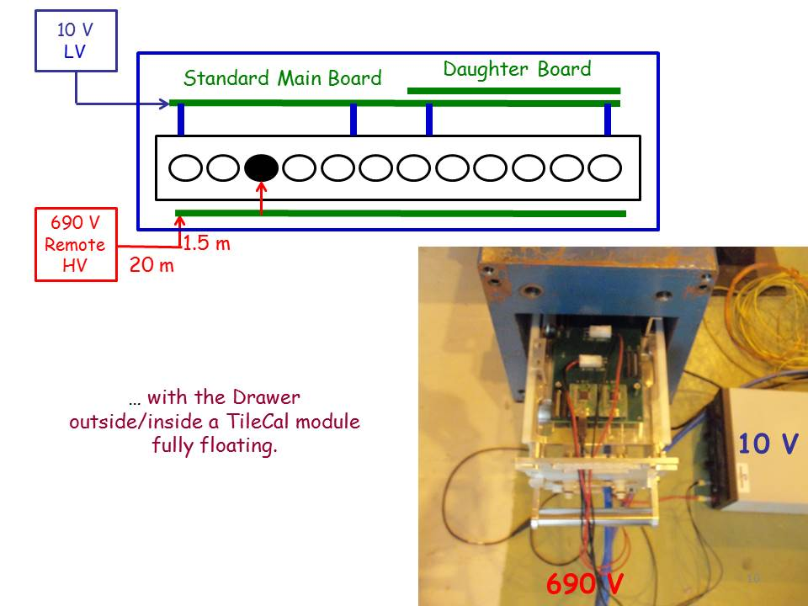
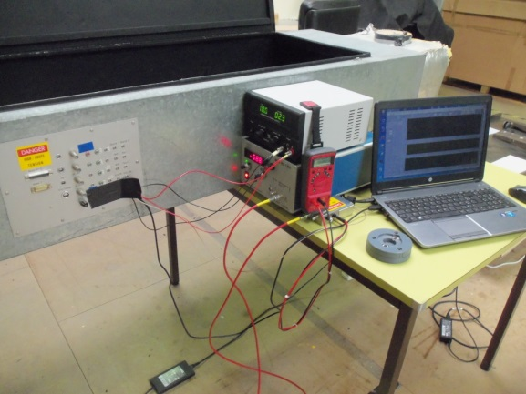
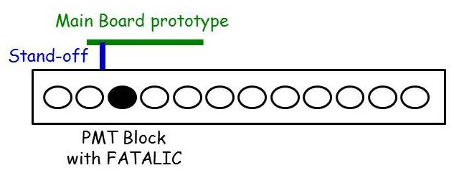
• Long systematic study, step by step, with improvements
FATALIC
1. Alone
2. Inside
PMT Block
3. Inside
FATALIC Test Bench
LV
HV
4. Inside Drawer
+ Main Board proto
5. Inside TileCal
at CERN
+ Main Board
+ Daughter Board
6. Inside Large box
at LPC
+ Main Board
+ Daughter Board

Slide 11
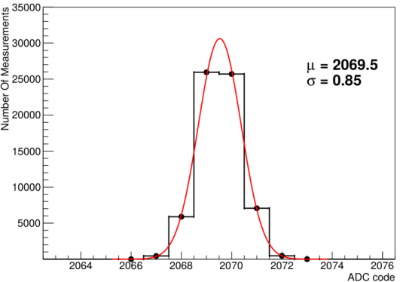
• There was a step O (Laurent Royer, TWEPP 2015 Lisbon)
intrinsic noise estimates from simulations of FATALIC alone.
High Gain noise:
2 ADC counts
ADC noise:
0.85 ADC count
ADC noise
Total noise (quadratic sum) = 2.2 ADC counts for the High Gain
or 5.5 fC.

Slide 12
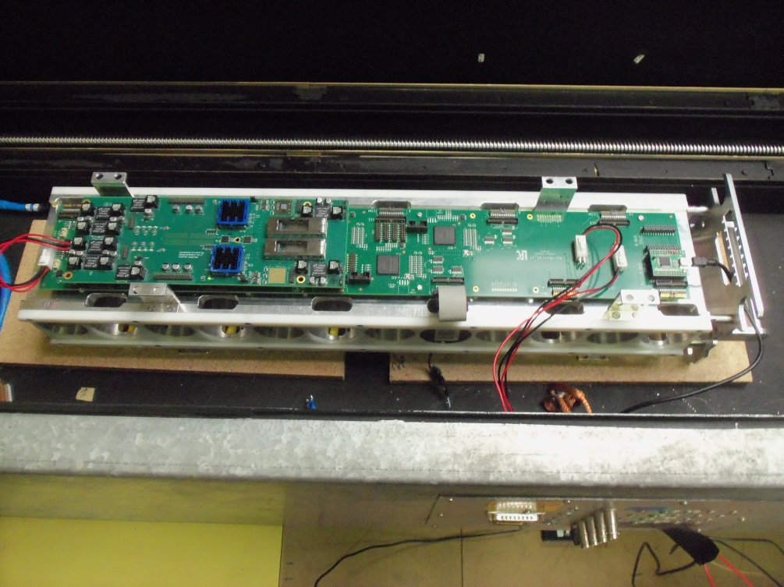
• Experimental set-up (Example of Step 6):
PMT Block-Drawer-Main Board-Daughter Board inside a Big Test Box
+ LV/HV powers + laptop
FPGA memory of Main Board read out by USB interface
LV
HV
USB link
Monitoring and data recording by LabVIEW on laptop

Slide 13
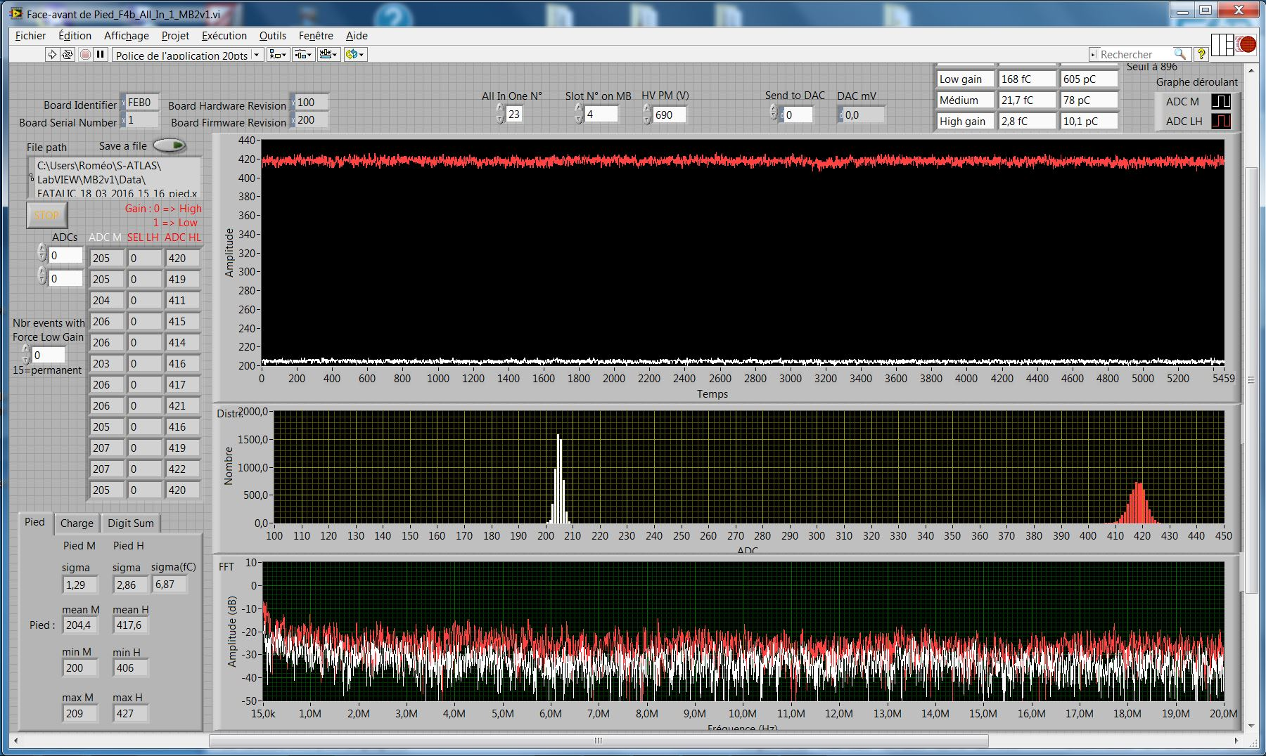
Gain selection (0 or 1)
Medium Gain
High Gain
RMS
FFT (Fast Fourier Transform)
▪ Data: 5460 samples at 40 MHz.
▪ Frequency spectra: 136.5 µs range → 15 kHz to 20 MHz (Shannon theorem).
▪ RMS accuracy: ~ 0.15 to 0.20 ADC count.
▪ Charge calibration: 1 ADC count = (2.40±0.05) fC.

Slide 14
FATALIC
• Step 1: All-in-One alone
All-in-One# | 13 | 15 | 23 | 21 | Mean
Noise (ADC counts) | 2.7 | 3.0 | 3.0 | 2.7 | 2.85±0.17
- Measured intrinsic noise not far from simulation of 2.2 ADC counts.
- Equivalent noise in charge units: 6.84±0.43 fC
Comments:
- The USB link can manage only 3 channels.
- Cards #13, 15 and 23 were used up to Step 5,
but in Step 6, #23 was killed … and replaced by #21.

Slide 15
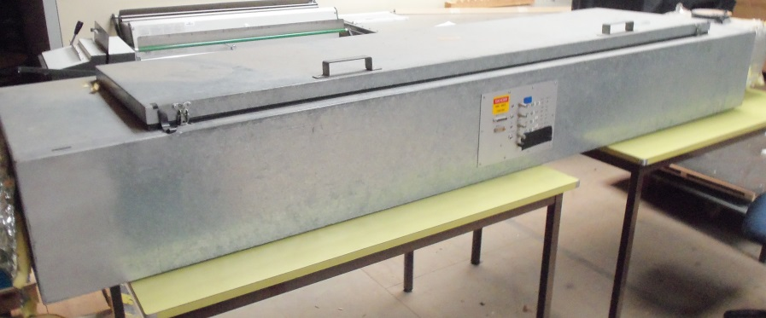
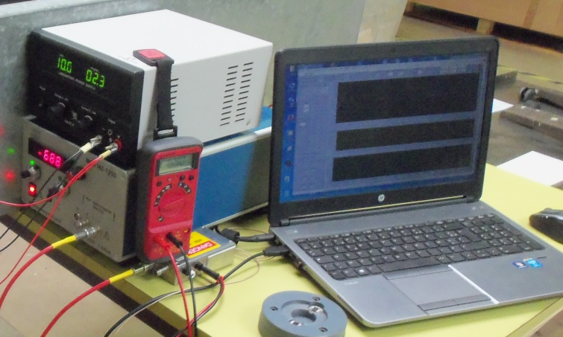
Grounding aspects: what will be the effect of the environment
and how to cure the noises coming from it ?
PMT Block+Drawer+Main Board+Daughter Board
Test Box
LV+HV+Laptop
The operator
What else ?
Many “things”
around FATALIC

Slide 16
• Steps 2 and 3:
PMT Block alone
and inside FATALIC test box
PMT Block
Test Bench
▪Dramatic:
- Intrinsic noise increased about 4-5 times when connecting the PMT/Divider.
+ Noise peak at 2.6-2.7 MHz.
- Big sensitivity to the environment: position in the Test Box, cover or not…
HV
Test box
PMT block
MB
LabVIEW
LV

Slide 17
Peak at 2.6-2.7 MHz
Zoom
Other peaks arose also at any moment

Slide 18
Theoretical approach
Divider scheme
2 different grounds:
Analog ground → FATALIC ground
Power ground → HV ground
With a 10 Ω resistor connection
▪ Official ATLAS divider scheme.
▪ Not suited to a current readout: case of FATALIC with current conveyors.

Slide 19
Comments:
- These 2 grounds resulted from long studies in the Test Beam, in order to mitigate
the noise increase from channel 1 to channel 48 (close to patch panel).
- We have just discovered that the present Chicago 3-in-1 cards connected these
grounds, whereas the 11 000 produced passive Dividers had the 2 grounds.
- I do not remember when this change was performed.
- We decided to connect these 2 grounds (to suppress the 10 Ω resistor)
then to compare 3 kinds of active Dividers, with more or less additional
grounds.
- We implemented the usual “Noise killers”
(Filter with 1 kΩ resistor on the HV power and on the return).

Slide 20
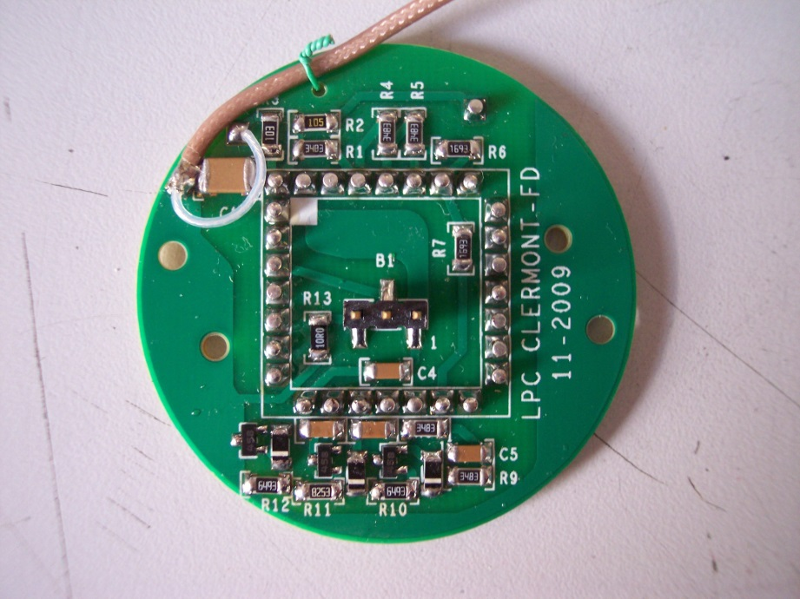
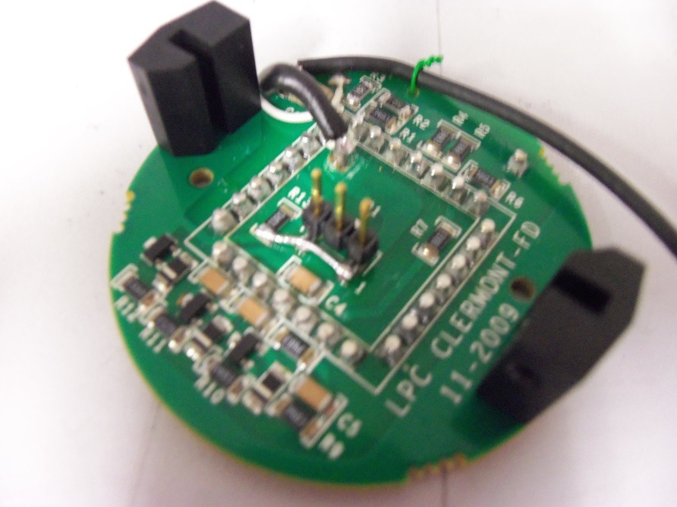
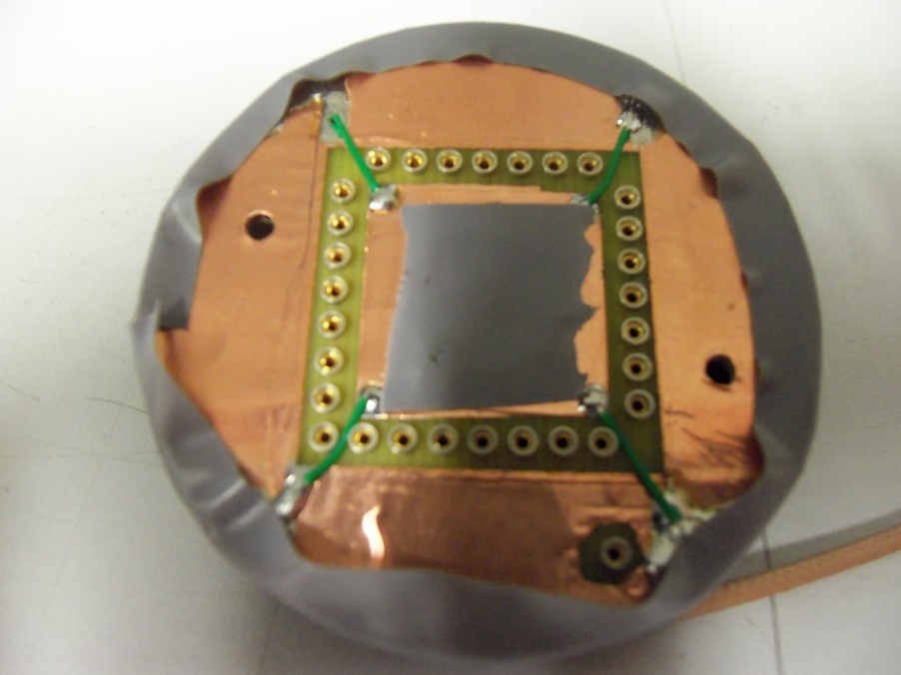
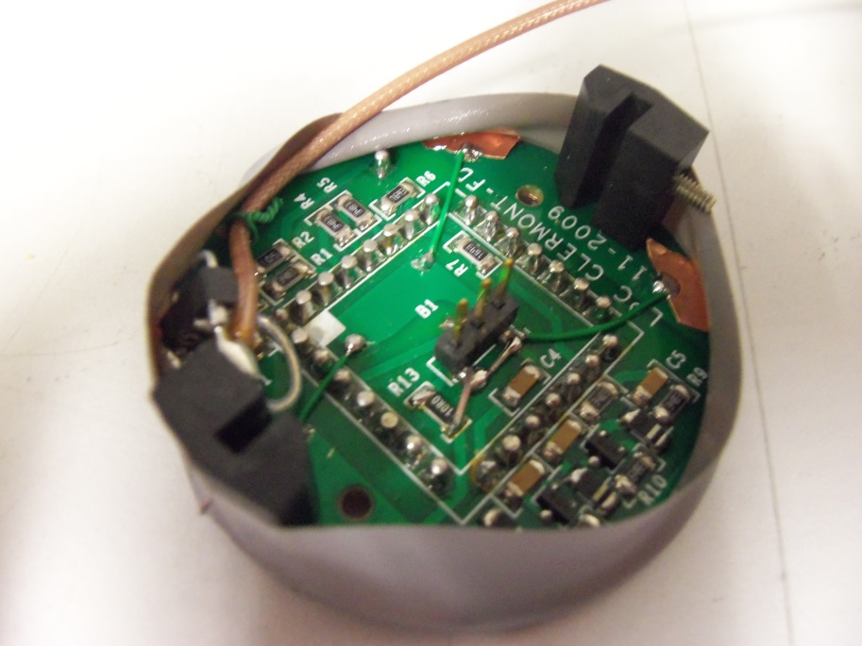
1. Standard Divider
2. Modified Divider
1 single ground +
some additional ground connections
3. Modified Divider + new grounds
Recto
Verso

Slide 21
Effect of Noise killer: kills Peak at 2.6-2.7 MHz
Zoom

Slide 22
- Tests with All-in-One # 13, 15 and 23.
- Results in ADC counts.
Divider |  |  | Standard | Modified | More grounds
PMT block outside | Body floating |  | 13.52 ± 3.44 | 3.77 ± 0.40 | 3.75 ± 0.25
 | Body grounded |  | 5.67 ± 0.74 | 4,75 ± 1.04 | 4.88 ± 1.66
PMT block inside test box | Body floating | Close wall | 16.35 ± 1.96 | 4.47 ± 0.47 | 4.32 ± 0.24
 |  | Far wall | 17,17 ± 5.02 | 4.67 ± 0.42 | 4.15 ± 0.22
 | Body grounded | Close wall | 5.05 ± 0.62 | 6.50 ± 1.60 | 5.83 ± 1.01
 |  | Far wall | 7.63 ± 1.57 | 6.02 ± 1.63 | 5.60 ± 1.23
Obvious effect of a single Divider ground.
No clear difference in between
modified and more grounded Dividers.
Worst in the Test box,
with sensitivity to the PMT Block location.
Best results in box with Body floating,
with noise at a level of 10-11 fC
… but very uncomplete set-up !
Test box
PMT block
Wall

Slide 23
• Step 4: inside Drawer
with Main Board proto
and a single Stand-off
(Only 1 Drawer thread in front)
- Tests with All-in-One # 13, 15 and 23.
- Results in ADC counts.
Divider |  | Modified | + More
Metallic stand off 20 mm | HV off | 12.63±1.66 | 14.52±2.21
 | HV on | 13.25±1.84 | 14.45±2.66
Plastic stand off 10 mm | HV off | 5.00±0.92 | 6.37±1.95
 | HV on | 5.02±1.04 | 6.40±2.00
Plastic stand-off 30 mm | HV off | 3.88±0.58 | 4.57±0.95
 | HV on | 3.93±0.52 | 4.67±1.95
A unique stand-off: ground loops in the case of a metallic stand-off ?
Increased ground loops with the modified Divider with more grounds ?
Better results with plastic stand-off’,
and better far away Drawer body: decrease of a capacitive effect ?
Low effect of HV supply.
⇒ Must be redone with the complete Main Board and more stand-off’s.

Slide 24
• Step 5: Whole set-up with Drawer
inside a TileCal module at CERN
- During the February expert week.
- More stand-off’s, but some are missing
because of the Drawer thread locations.
- Test with only the All-in-One card #13.
- Remote HV with 20 m long cable.
Set-up |  |  | Inside Module | Outside Module
Plastic 10 mm | Modified Base + additional | HV off | 6.5 | 5.9
 | Modified Base | HV off | 5.6/6.0 | 4.7/4.8
Plastic 20 mm* | Modified Base | HV off | 5.3 | 4.6
Metallic 12 mm | Modified Base | HV off | 4.8/4.6 | 7.8/6.8
 |  | HV on | 4.8/5.0
Results in ADC counts.
/ separates repeated measurements.
- * Drawer partially outside Module.
- Better results with metallic stand-off’s: noise slightly below 12 fC.
- Drawer body/PMT Block/ MB/DB grounds at the same potential.
- HV effect within uncertainties.
- Better results with modified Base with not too much grounds.
- Sensitivity to the environment: inside/outside TileCal module.

Slide 25
• Step 6: Whole set-up with
large Test box at LPC
▪ Goals:
- To reproduce the CERN set-up.
- To perform systematic studies with 3 All-in-One cards.
→ To bring new improvements if possible.
▪ Is it possible to reproduce at home what we had at CERN
using the All-in-One #13 ? One example of the results:
Site | CERN | LPC
Daughter Board OFF | 4.8/4.6 | 5.1-5.3
Daughter Board ON | 4.8/4.6 | 5.3
Slightly better at CERN,
but not far if we consider uncertainties
of 0.15 to 0.20 ADC count
and fatigue wear of connectors.
- Mounting/dismounting a lot of times the connectors damage the performance
⇒ Suddenly, the noise reached 35 ADC counts !
⇒ Can we find safer connectors ?
- During the tests, a bad mounting of the PMT Block destroyed the All-in-One #23
⇒ Replaced by a new card #21.

Slide 26
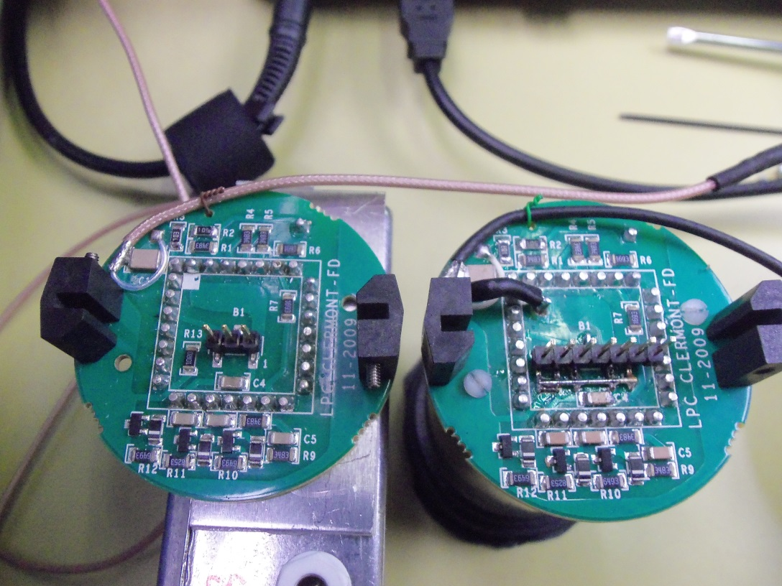
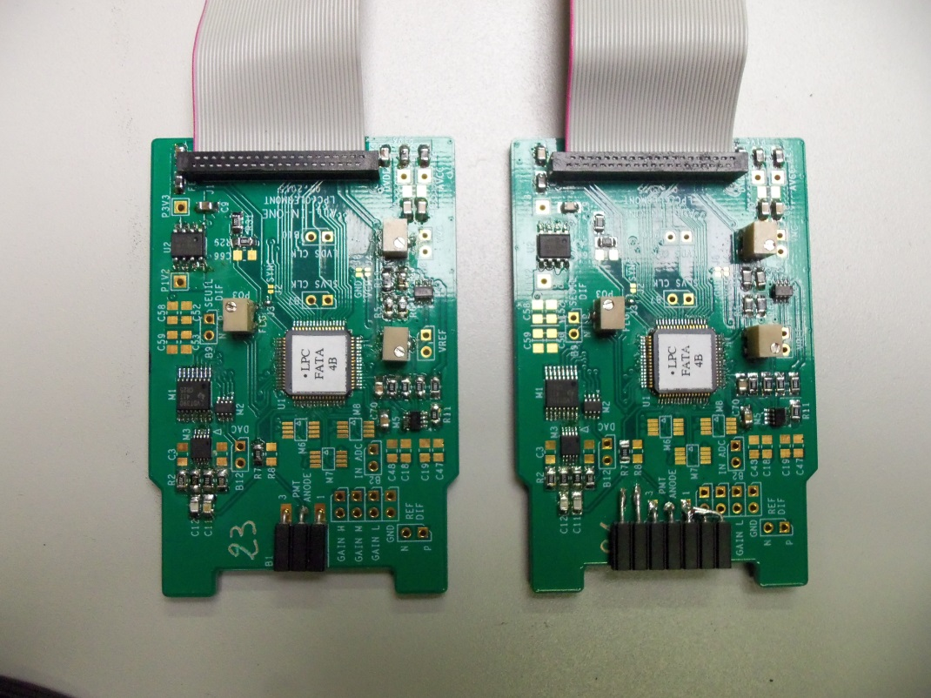
▪ New connectors on Divider/All-in-One cards
Previous scheme: 3 pin connectors (Central: anode signal, Sides: ground).
Changes: 7 pin connectors (Central: anode signal, Others: ground).
Comments:
- The Divider type is this one with common ground + additional wires,
that gave the best results till now.
- The ground distribution is not perfect on the All-in-One board.
NEW
NEW

Slide 27
Distribution and frequency spectra for the 3 gains
High
Medium
Low
Medium
03/04/2016
27

Slide 28
In/out Box |  | Average
High Gain | In | 3.60±0.26
 | Out | 3.62±0.32
Med. Gain | In | 1.32±0.06
 | Out | 1.32±0.08
Low Gain | In | 1.16±0.08
 | Out | 1.17±0.07
- All-in-One #13, 15 and 21.
- Results in ADC counts.
The noise is very low : 3.6 counts for the High Gain without HV.
By taking into account the uncertainty + this one on scale factor of 2.40±0.05
⇒ Noise of 8.64±0.65 fC.
There is no difference inside and outside test box
⇒ very low sensitivity to the environment.
The noise levels of other gains are small also.

Slide 29
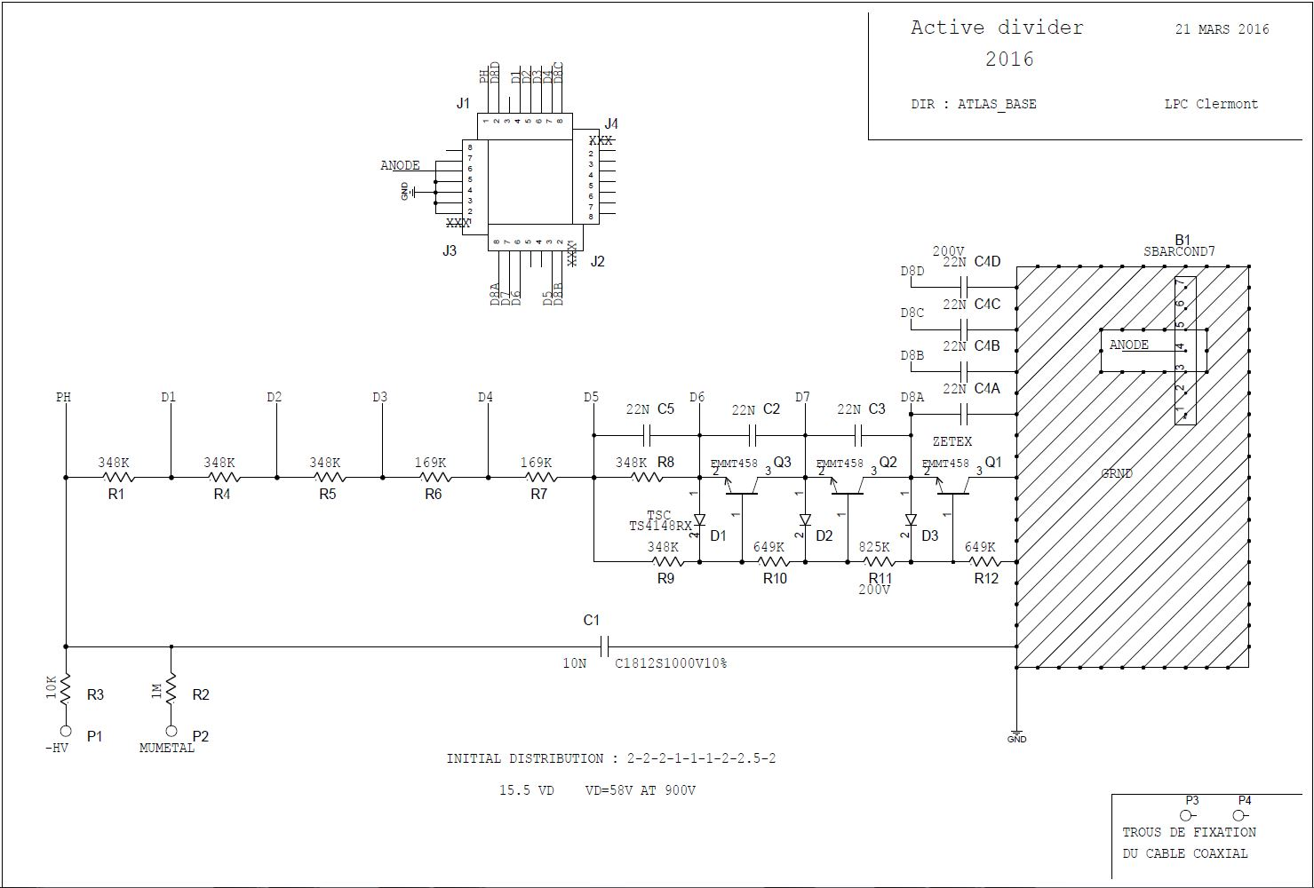
▪ New “discovery”: the last dynode (D8) is connected to 4 pins of socket,
but till now in ATLAS, only 1 (D8A) is used (Decoupled/ground.)
(D8 is roughly a dynamic ground/anode).
Modification: use of the 4 pins with 22 nF capacitors to the ground.
D8D
D8C
D8A
D8B
New active Divider
with:
single ground,
more grounds,
4 D8 pins.

Slide 30
- Results in ADC counts.
Gain | HV | Mean ± RMS
High | Off | 3.35±0.30
 | On | 3.47±0.51
Medium | Off | 1.36±0.12
 | On | 1.37±0.11
Low | Off | 1.17±0.03
 | On | 1.17±0.03
In/out Test Box | Gain | HV off | HV on
In | High | 3.00 | 2.90
 | Medium | 1.25 | 1.26
 | Low | 1.14 | 1.15
Out | High | 2.8 | 2.9
 | Medium | 1.28 | 1.26
 | Low | 1.15 | 1.15
PMT Block outside Drawer | High | 3.00
 | Medium | 1.27
 | Low | 1.14
PMT Block
alone
Card# 21
Means over
cards# 13, 15,21
Card# 21
- High gain noise in fC with HV off (On): 8.04±0.74 fC (8.33±1.24 fC ).
- External noise: 1.76 ADC counts < intrinsic noise of 2.85 ADC counts.
- Noise independent from the environment.
- Rough estimates (from the noise levels of the 3 gains)
of the analog (Shaping) and digital (ADC) noise parts for HV off:
Analog: 3.3 ADC counts (Simulation: 2 ADC counts).
Digital : 1.1 ADC count (Simulation: 0.8 ADC count).
⇒ Perhaps some margin of improvement of the analog noise.

Slide 31
Conclusion and next actions
The 3 main noise objectives of the FATALIC read out are reached:
1. A High Gain electronic noise of 8.04±0.74 fC < 12 fC.
It fits even the noise level of 8 fC: crucial for the Luminosity calibrations.
2. An external RMS noise 1.76 ADC count < intrinsic noise 2.85 ADC counts.
3. The noise levels of the 3 Gains are independent of the environment.
The HV induced noise is negligible, within the uncertainties.
Ground improvements are identified on the Dividers/All-in-One boards.
Is it possible to improve again the electronic noise ?
Difficult because the noise is already very low,
but not impossible because of 3 reasons:
- The RMS values are calculated over the whole frequency spectra,
while only the high frequency noise should be considered. (5.7 to 20 MHz).
- Cleaner modifications will be made on the new Dividers and All-in-One cards.
- A reduction of the analog noise could come
from the following change on All-in-One:
to reduce the distance in between FATALIC and connector.

Slide 32
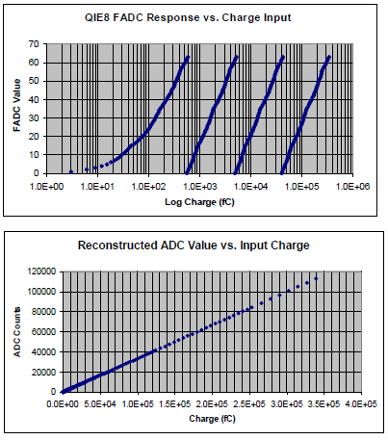
• And the 2 other options ?
▪ Chicago 3-in-1: 15 to 20 fC, in realistic conditions (Test Beam).
▪ Argonne QIE: not very clear.
◊ Intrinsic noise :
- No input current, no capacitance: ∼ 2.0 fC.
- DC current injector noise: ∼ 3.3 fC.
◊ In realistic conditions, with PMT/Divider and other electronics: no number.
◊ Moreover, they must add the quantization error
coming from the “linearization” of the readout
(logarithmic response).
QIE quantization error = Q_{Bin} /Sqrt(12)

Slide 33
• Next actions
▪ To produce modified active Dividers and All-in-One cards
for new noise tests and the next test beam in June.
▪ To perform the second phase of the noise study at LPC/CERN
on a complete Drawer through the MB-DB communication (and switching LV power supply)
⇒ Better statistics (12 channels).
⇒ Same measurements + High frequency noise measurements.
With noise data from DB
10 V
LV
Daughter Board
Standard Main Board
690 V
HV
HV Bus board with Noise killers
1.5 m
/20 or 100 m

