Slide 1

Simulation and characterization of HV/HR-CMOS sensors for radiation hardness
Mathieu Benoit
University of Geneva

Slide 2
Outline
Introduction to HV-CMOS processes
  What, why and how ?
  Available foundries
TCAD simulation and radiation damage
Test-beam and lab characterization results
Next steps

Slide 3

Introduction to HV-CMOS
FACULTÉ DES SCIENCES
Section Physique

Slide 4
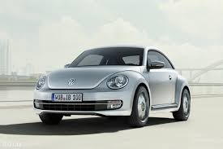
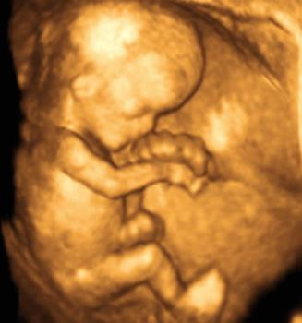

What is HV-CMOS
HV-CMOS is a family of CMOS processes where addition are made to allow for “High-Voltage (~120V)” to be used in the circuitry
  HV-NMOS,HV-PMOS, DMOS etc..
  Isolated LV-NMOS transistors , NPN bipolar transistors
HV-CMOS processes allow for the combination of standard CMOS circuitry and HV circuitry in the same chip
Focused on the Automotive, medical and photonics industry
FACULTÉ DES SCIENCES
Section Physique

Slide 5
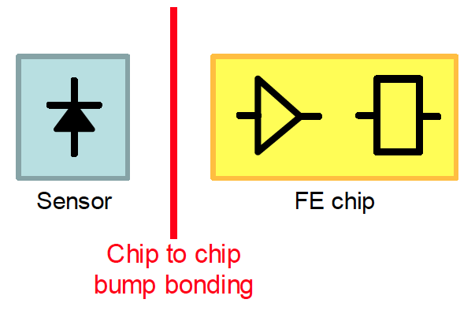
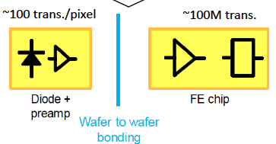
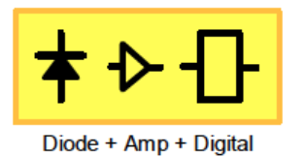
Why HV-CMOS for particle detection?
Current technology relies on Passive High-Resistivity sensors
  Specialty foundries -> small production capabilities (6” wafers)
  high-cost per unit
  Small signal -> requires micro-soldering for DC coupling -> large cost
CMOS Technology present many advantages
  Large scale, low-cost production possible
  In-Pixel amplification and logic possible (Well insulation) -> Capacitive coupling to readout CMOS ASIC
  Eventually , possibility to integrate full electronics in-pixel
FACULTÉ DES SCIENCES
Section Physique

Slide 6
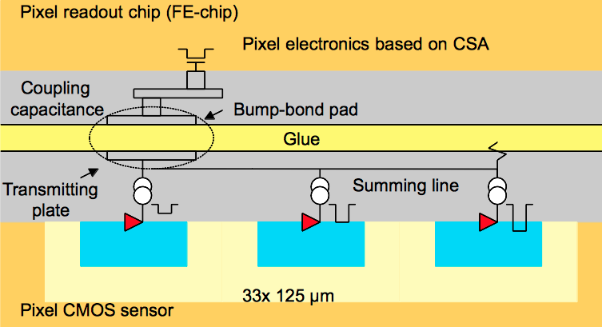
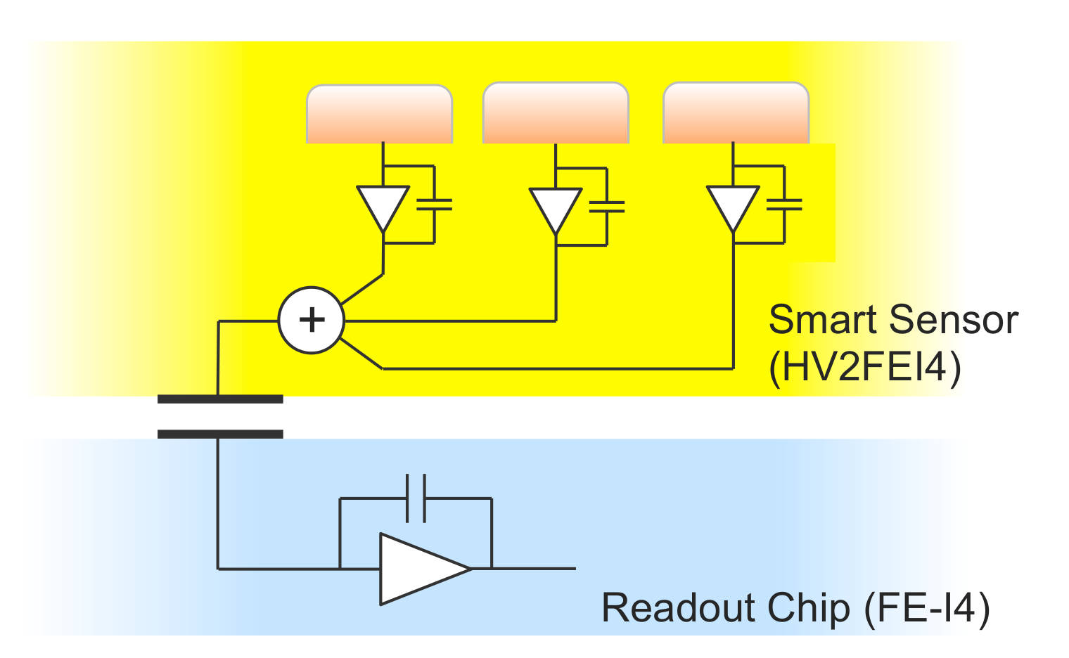
Why HV-CMOS for particle detection?
Large scale production capability
  HV-CMOS foundries typically use 8” wafers (48 x 2.5 x 2 cm² die per wafer)
  Production capability is usually 20k-50k Wafers/month
  Cost reduction is achieved by the downscaling of unit cost as produced surface is increased (10-100m²) : 5-10€/cm²
In-Pixel amplification and logic can be implemented
  Large amplified signal can be transmitted capacitively
  Sub-Pixel resolution could be achieved by encoding sub-pixel address into the signal transmitted to the readout ASIC
  For larger radius of the ATLAS inner tracker, all readout electronics can be implemented in the circuit -> Monolitic pixel detectors !
FACULTÉ DES SCIENCES
Section Physique

Slide 7
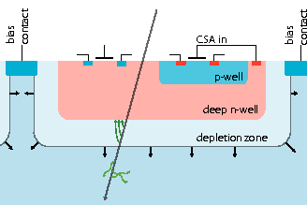
HV-CMOS sensors for HEP
Desired properties of HV-CMOS Process
  All CMOS electronics in DNWell
  Full in-pixel CMOS isolation
  High-Resistivity, fully depleted substrate for large signal, fast-rise time , high-voltage tolerance
  Thin substrate for low material budget (50-150 um)
  Backside contact with implant (maximized depletion and E-Field)
  Radiation tolerant up to 100-1000 Mrad , 1e15-1e16 n_{eq}/cm²
Timing accuracy < 25 ns
Charged particle detection accuracy >99.5% (80e/um of depleted volume)

Slide 8
HV-CMOS Foundries
AMS | LFoundry | XFAB | ESPROS
High-Voltage process with module up to 120V Possibility to use high-resistivity p-type wafers (experimental) CMOS 350nm and 180nm available No full CMOS insulation No backside processing | High-Voltage process High-resistivity p-type wafers part of standard process CMOS 150 nm available Full CMOS insulation No backside processing | SOI 150nm CMOS process 1.8/5V modules 100 Ohm*cm standard wafer material, possibility to go up to 1 kOhm*cm No backside biasing Sensor and CMOS volumes decoupled (SOI) | 150nm CMOS process with 14V module High-resistivity , 50um thin n-type wafers used a standard processing material Full CMOS isolation Backside processing part of the standard process
FACULTÉ DES SCIENCES
Section Physique

Slide 9
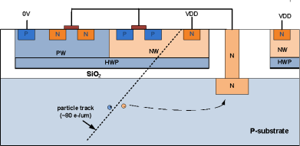
HV-CMOS Foundries
AMS H18/H35
LFoundry
TowerJazz & XFab
FACULTÉ DES SCIENCES
Section Physique

Slide 10

CMOS pixels Families
HV-CMOS Pixels
HR-CMOS Pixels
Digital pixels
No information on deposited charge is propagated
More complex circuitry, Discriminator , Trim DAC in sensor pixel but bigger signal for capacitive coupling
Good for very larger pixels
Allow for “smart pixel” design with sub pixel position encoding, time-walk compensation circuitry
Analog pixels
Preserve charge deposition information for ASIC to measure
Very simple circuitry, 1-2 stage amplifier only
Good for very small pixels
See talk by S. Kulis on CLIC vertex detector for nice results on small (25x25um²) pixels
FACULTÉ DES SCIENCES
Section Physique

Slide 11
CMOS pixels Families
CMOS Pixels
Digital pixels
No information on deposited charge is propagated
More complex circuitry, Discriminator , Trim DAC in sensor pixel but bigger signal for capacitive coupling
Good for very larger pixels
Allow for “smart pixel” design with sub pixel position encoding, time-walk compensation circuitry
Analog pixels
Preserve charge deposition information for ASIC to measure
Very simple circuitry, 1-2 stage amplifier only
Good for very small pixels
See talk by S. Kulis on CLIC vertex detector for nice results on small (25x25um²) pixels
FACULTÉ DES SCIENCES
Section Physique

Slide 12
CMOS pixels Families
CMOS Pixels
Backside biasing
Field distribution as in standard planar technology
Avoid High-Voltage on the top side
Require backside processing of the wafers
Top side biasing
Field distribution far from the text book planar diode -> Co-Planar diode
No backside processing required
FACULTÉ DES SCIENCES
Section Physique

Slide 13
Back-side versus top biasing
3.3V
-120V
-120V
TS bias, Low resistivity (20 Ohm*cm)
TS Bias, High resistivity (1k Ohm*cm)
FACULTÉ DES SCIENCES
Section Physique

Slide 14
Effect of Top and backside biasing
FACULTÉ DES SCIENCES
Section Physique

Slide 15
Effect of Top and backside biasing
FACULTÉ DES SCIENCES
Section Physique

Slide 16
Effect of substrate resistivity and radiation damage

Slide 17
H35DEMO Sensor

Slide 18
H35DEMO Sensor, TCT results

Slide 19
Experimental results : AMS H18
FACULTÉ DES SCIENCES
Section Physique

Slide 20
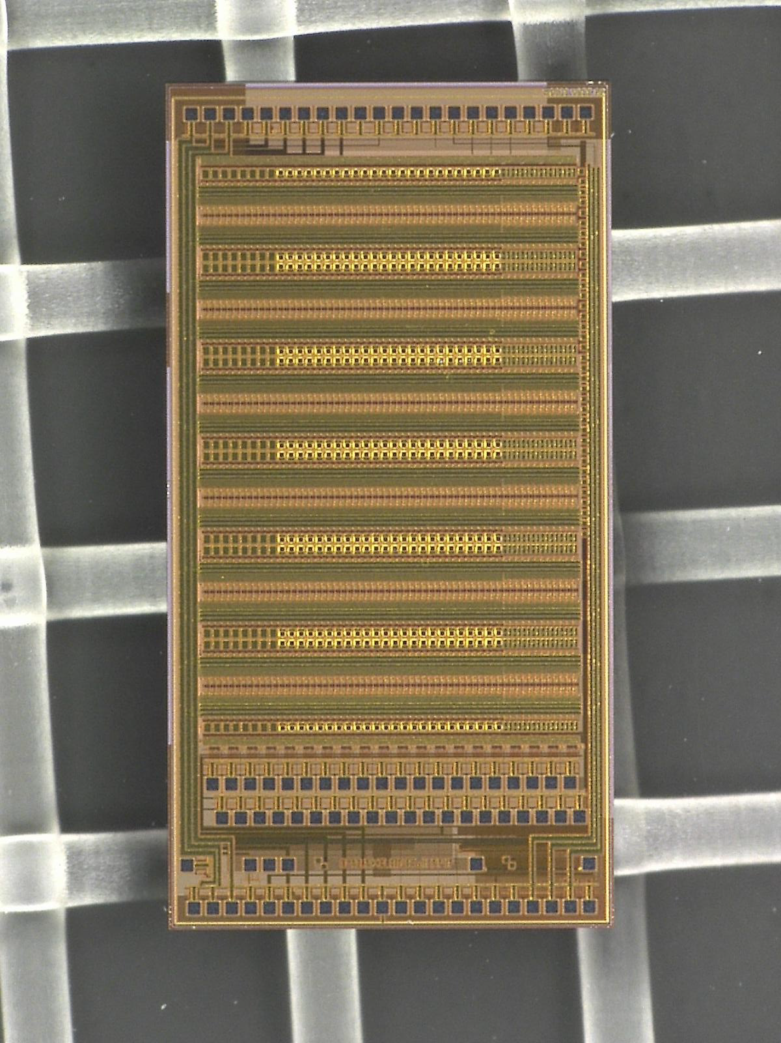
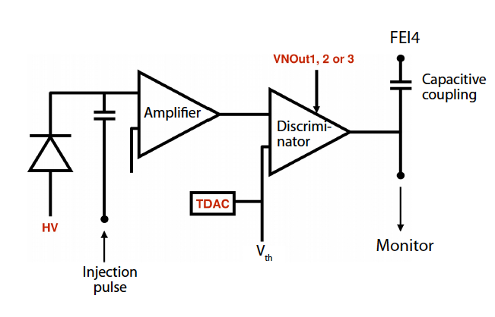
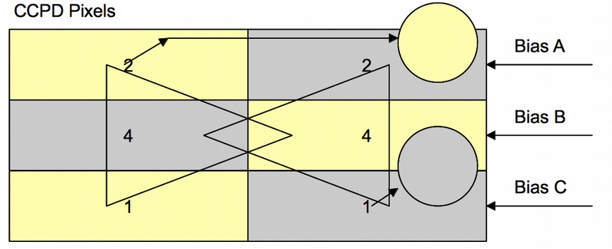
The CCPD sensor family
CCPDv2 (AMS H18)
Chip size: 2.2mm x 4.4mm
Pixel matrix: 60x24 (sub-)pixels of 33 μm x 125 μm
21 IO pads at the lower side for CCPD operation
40 strip-readout pads (100 μm pitch) at the lower
side and 22 IO pads at the upper side for (virtual)
strip operation
On chip bias DACs
Pixels contain charge sensitive amplifier, comparator
and tune DAC
Configuration via FPGA or μC: 4 CMOS lines (1.8V)
3 possible operation modes
  standalone on test PCB
  strip-like operation
  pixel (FE-I4) readout

Slide 21
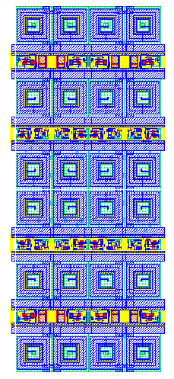
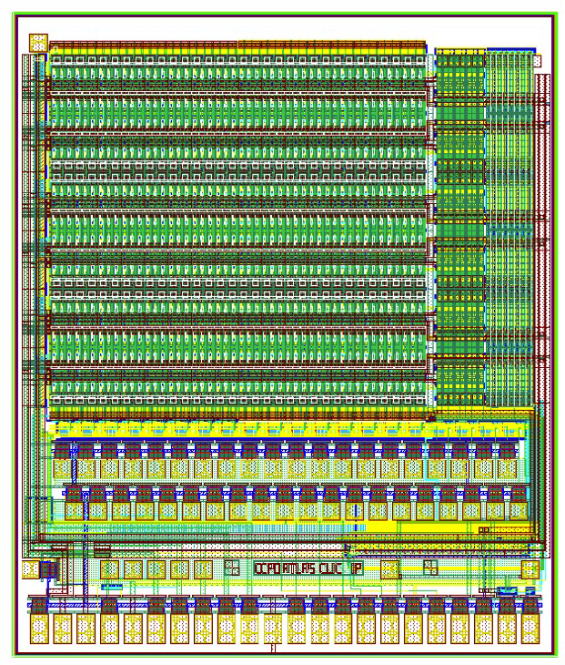
The CCPD sensor family
CCPDv4 (AMS H18)
focused on ATLAS-pixel readout, several noise improvements, segmented pixels, analogue pixels
4 types of pixels :
  Samp : Standard pixels (as in CCPDv3-1, contain comparator and tune DAC) with the current-mode amplitude coding – several improvements
  Stime : Standard pixels with (new) voltage-mode amplitude coding or the pulse length coding
  N: “NewPixels” – the pixels with separated electronic and electrode, sub pixel size 25um x 125um (as in CCPDv3 contain comparator and tune DAC)
  A: New: Analog pixels - size 25um x 350um – contain only amplifier - electronics similar as in CLIC pixels (CCPDv3). New analog summing scheme.
NewPixels
SAmp
STime
Analog pixels
33um

Slide 22
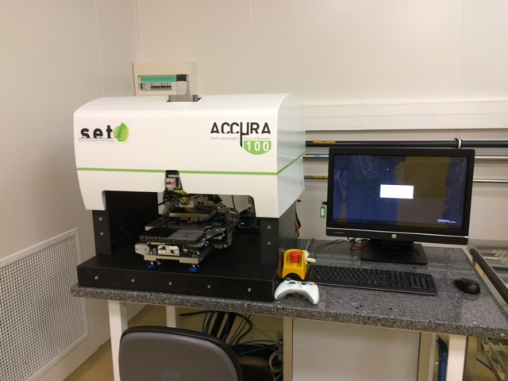
CCPD flip-chip gluing at SET with FC150
In partnership with SET, we have started a set of gluing using the FC150 to understand better the gluing process parameters
Glue viscosity
Pressure and temperature applied
Analysis of sample cross-sections ongoing, but results very positive so far :
Good glue layer uniformity over large area (~2x2cm)
Thin layer of glue can be obtained (~3um )
Good alignment (1-1.5um)
ACCμRA 100
ACCμRA 100 purchased by UNIGe and CERN-CLIC to be installed in July in Geneva
Automatic accurate glue dispenser
+-1um post-bonding accuracy
FACULTÉ DES SCIENCES
Section Physique
DPNC

Slide 23
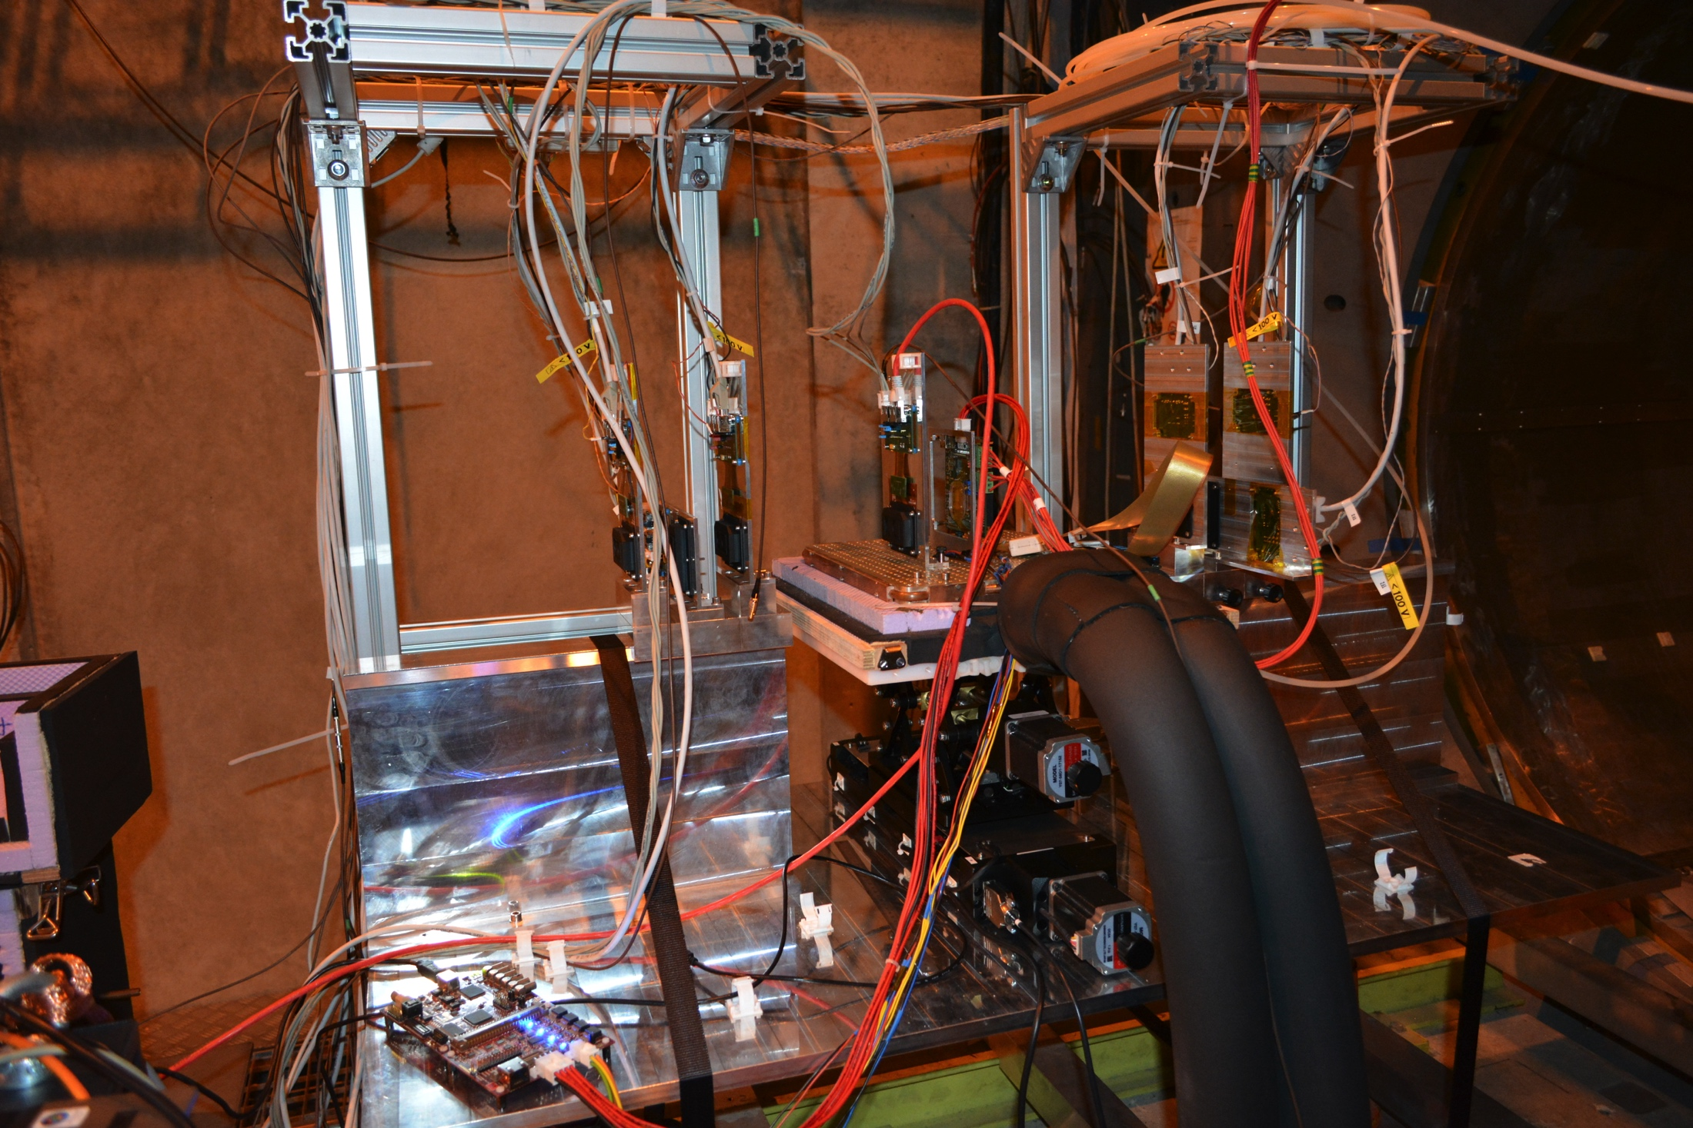
Principle of Test-Beam Characterization
The high-energy pion beam can be thought of a focused laser-like beam that interact very little with matter
Very straight trajectory
Localized interaction
Test beam characterization is performed using known pixel detectors to form a “telescope” that is used to perform a blind analysis of the Device under Test
Trajectories of particle reconstructed by the telescope and interpolated to the device under test
Pointing resolution O(um)
Pion Beam
FACULTÉ DES SCIENCES
Section Physique
DPNC

Slide 24
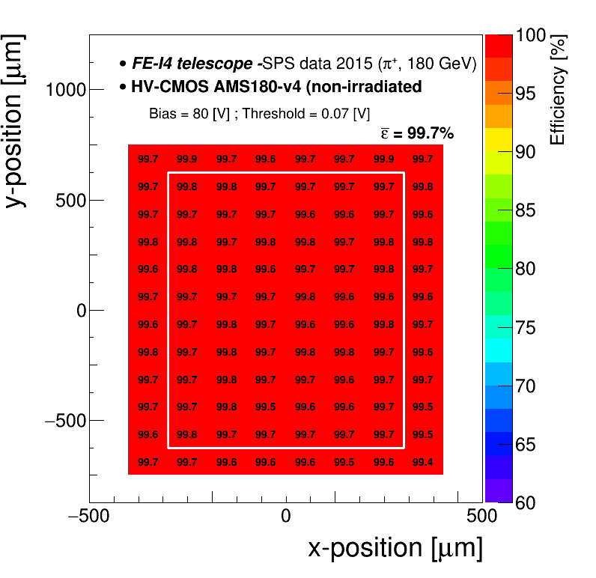
Efficiency map non-irradiated sample
To avoid edge-effects the outermost columns and rows have been excluded in the following studies
overall efficiency: 99.71 %
23/02/2016 F. A. Di Bello

Slide 25
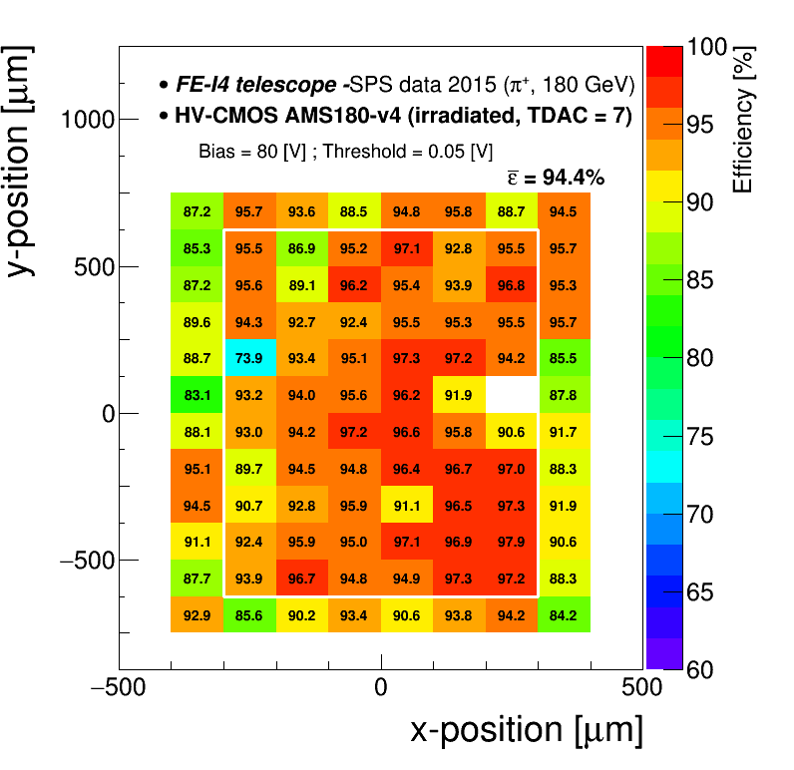
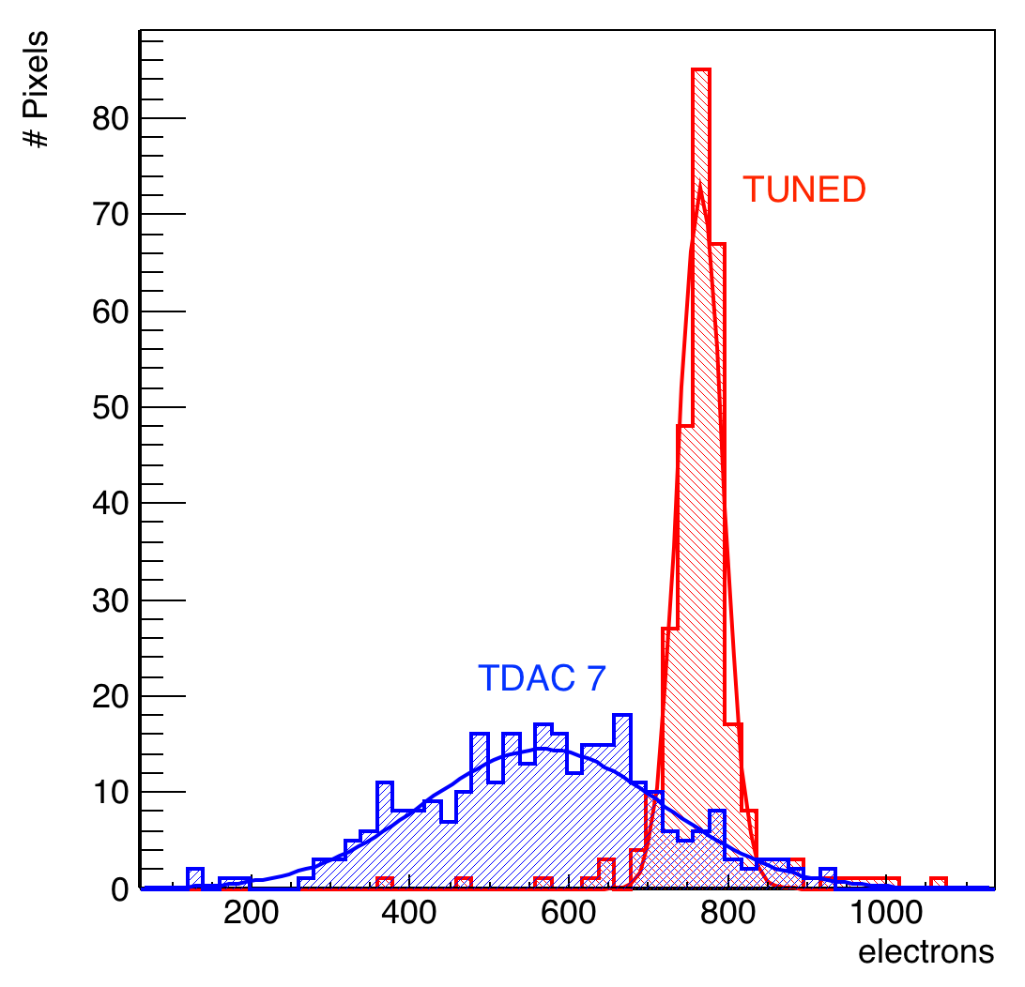
Efficiency map irradiated sample
Not-tuned -> non-homogeneus map
overall efficiency: 94.4 % , expected improvements after tuning
Thanks to M. Vicente for the plot
23/02/2016 F. A. Di Bello

Slide 26
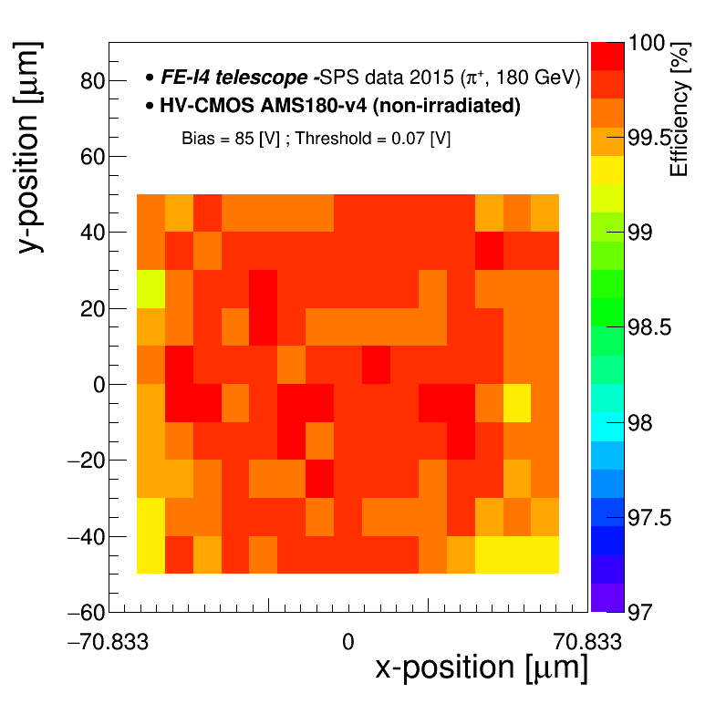
In-Pixel Efficiency
Using track information we can look at the efficiency inside one (virtual) pixel
Efficiency uniformly distributed inside one (virtual) pixel
23/02/2016 F. A. Di Bello

Slide 27
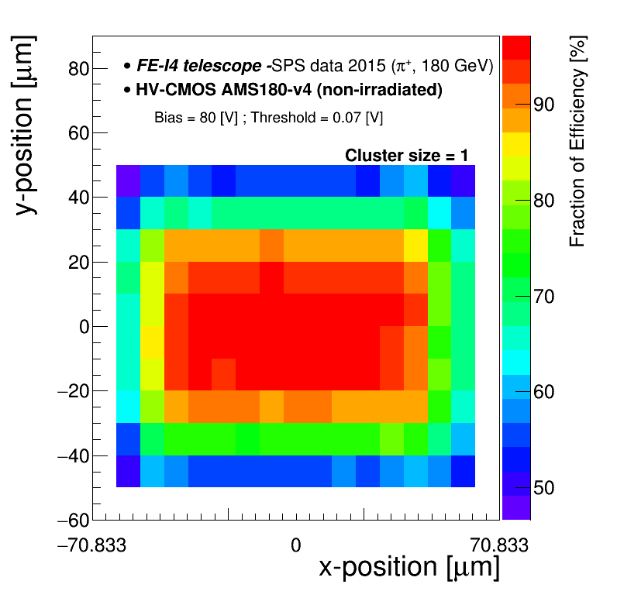
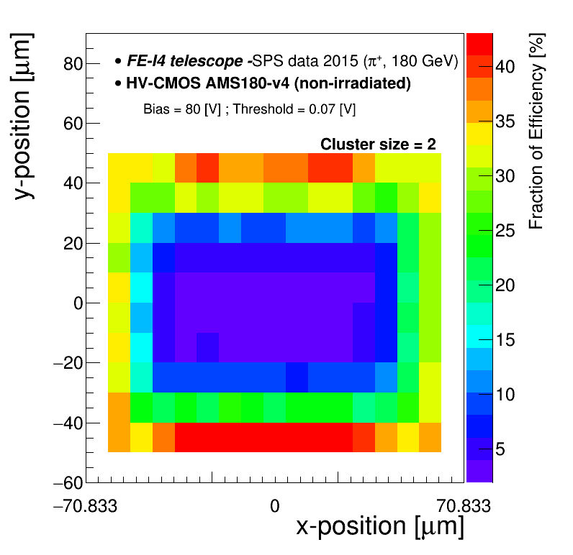
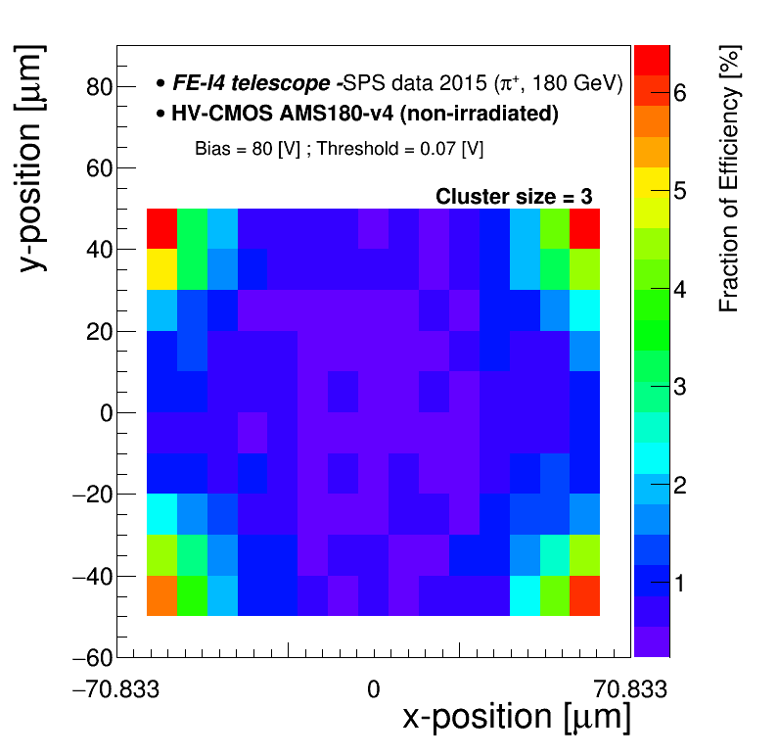
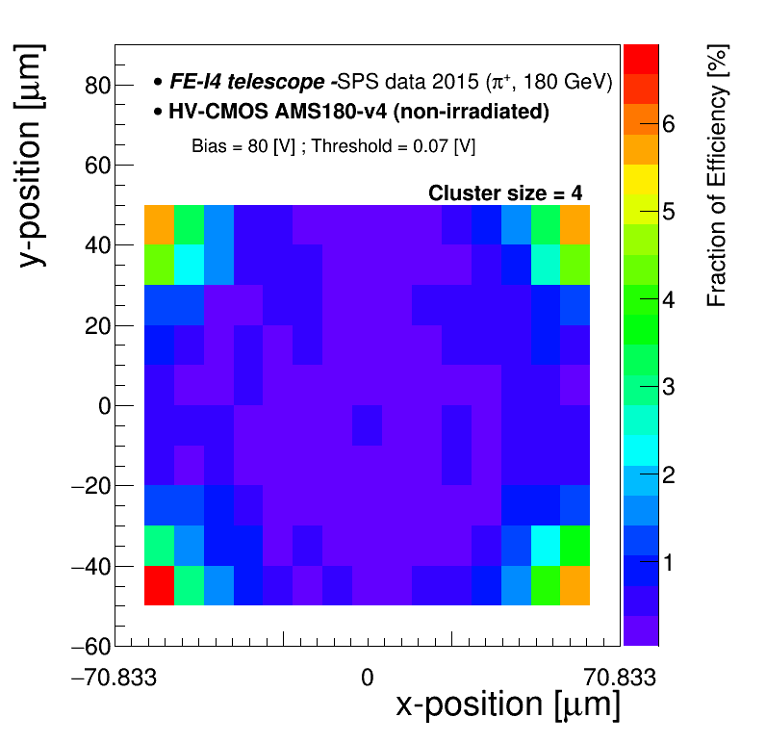
In-Pixel efficiency contribution for different C.S. Non-irradiated sample
C.S.=1
C.S.=2
C.S.=3
C.S.=4
23/02/2016 F. A. Di Bello

Slide 28
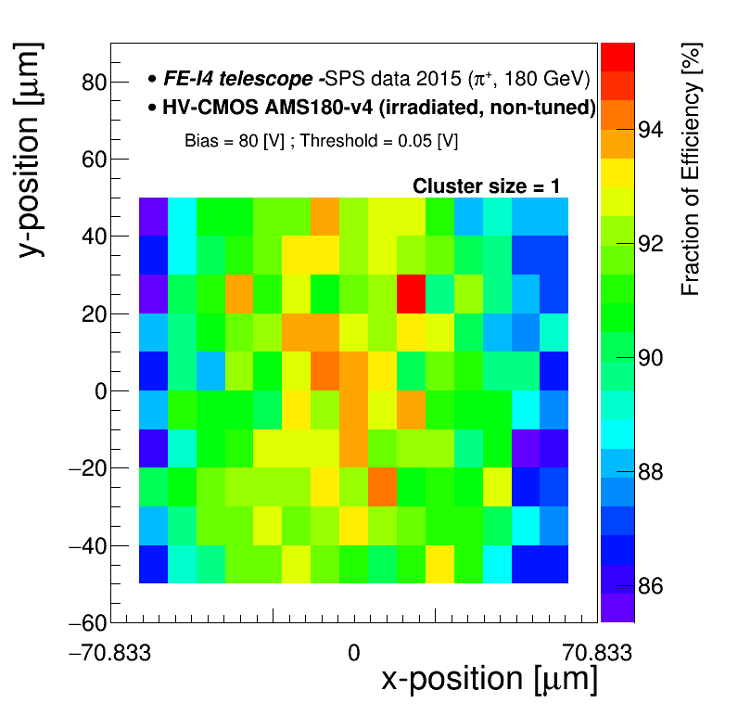
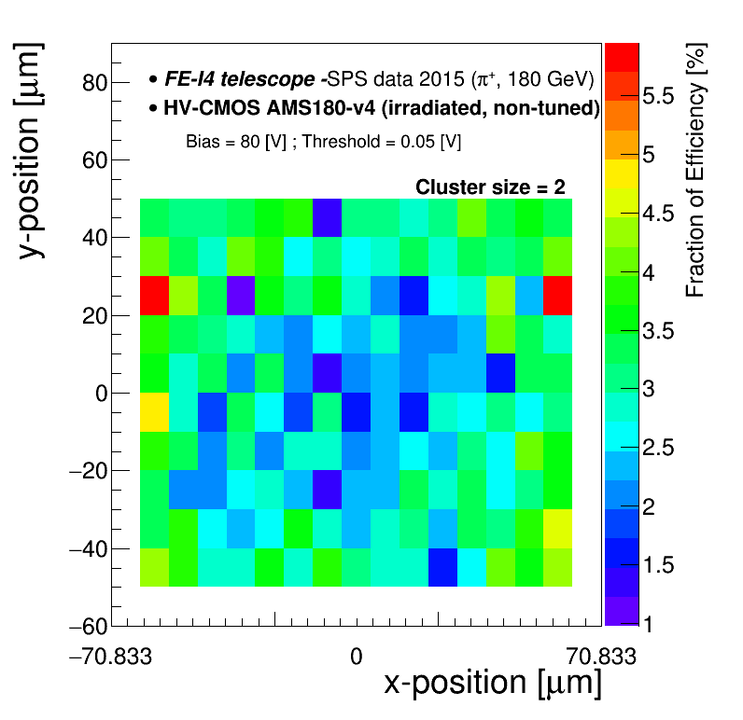
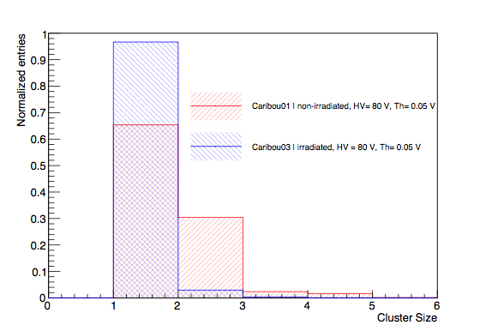
In-Pixel efficiency contribution for different C.S. Irradiated sample
C.S.=1
C.S.=2
CS > 1 is strongly reduced
compared with the non-irradiated sample -> diffusion suppression due to trapping
23/02/2016 F. A. Di Bello

Slide 29
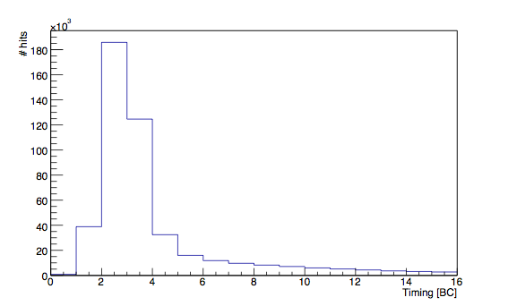
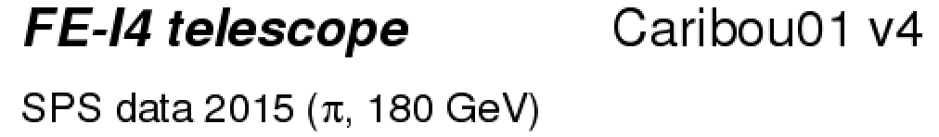

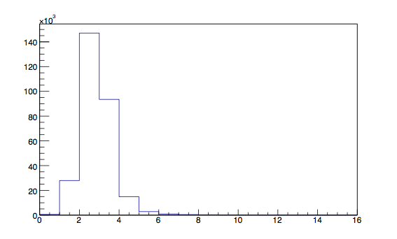

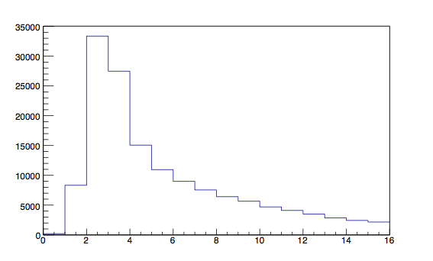
Timing Studies, distribution for matched clusters
Scan over 16 BC in clock bin of 25 ns around trigger
Long tail arises from C.S. > 1
C.S.=1
C.S.=2
23/02/2016 F. A. Di Bello

Slide 30
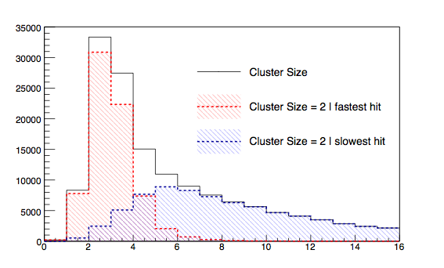
Timing Studies
Selecting the fastest hit in cluster the tail is strongly reduced
In the following I will show results taking fastest hit in clusters
23/02/2016 F. A. Di Bello

Slide 31
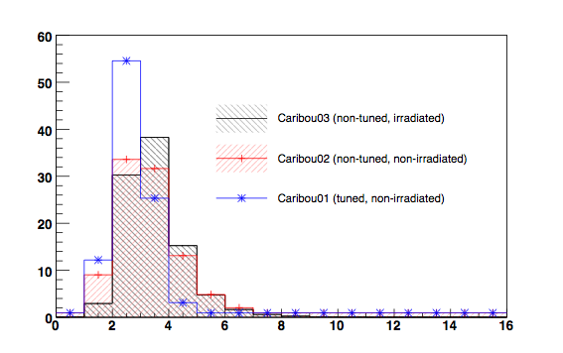
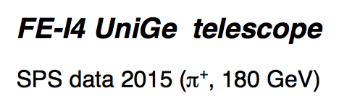



Timing Comparison of the 3 samples
Significant impact of the tuning
Expected improvements in both efficiency and timing
23/02/2016 F. A. Di Bello

Slide 32

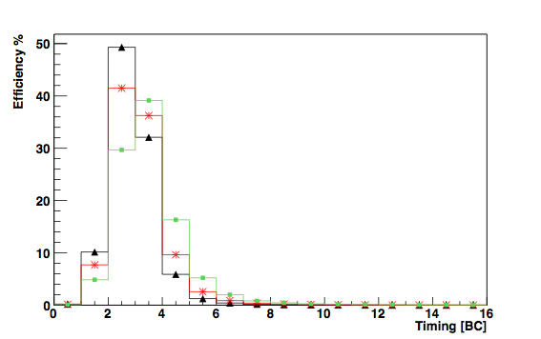

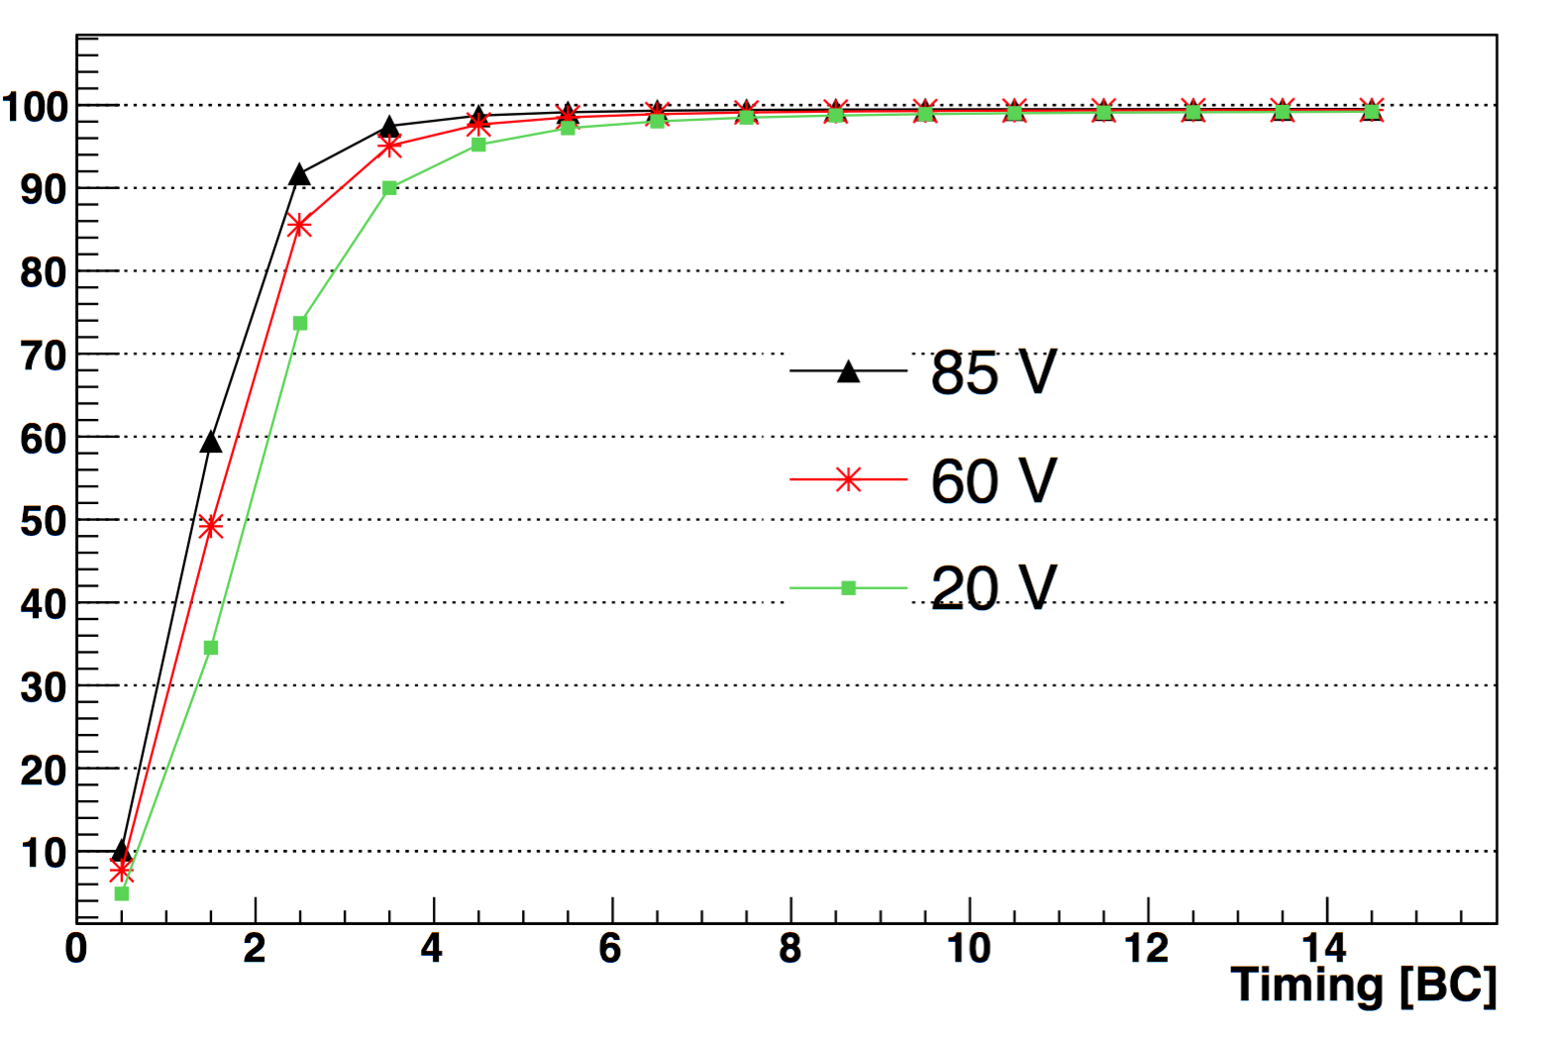

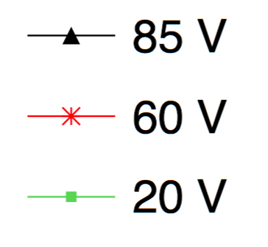
Timing Studies
Timing improves for higher HV
Efficiency ~ 80 % in time bins = 2 & 3 [BC] for HV=85 V
23/02/2016 F. A. Di Bello

Slide 33
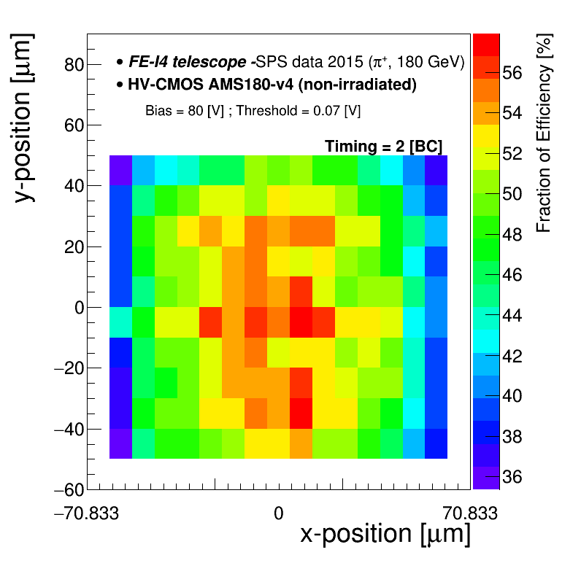
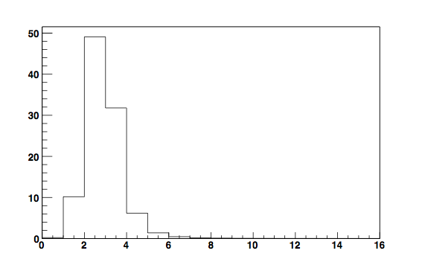

In-Pixel efficiency contribution per BC. HV= 80 V
23/02/2016 F. A. Di Bello

Slide 34
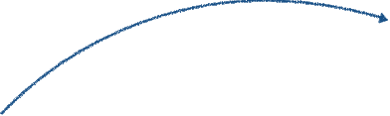
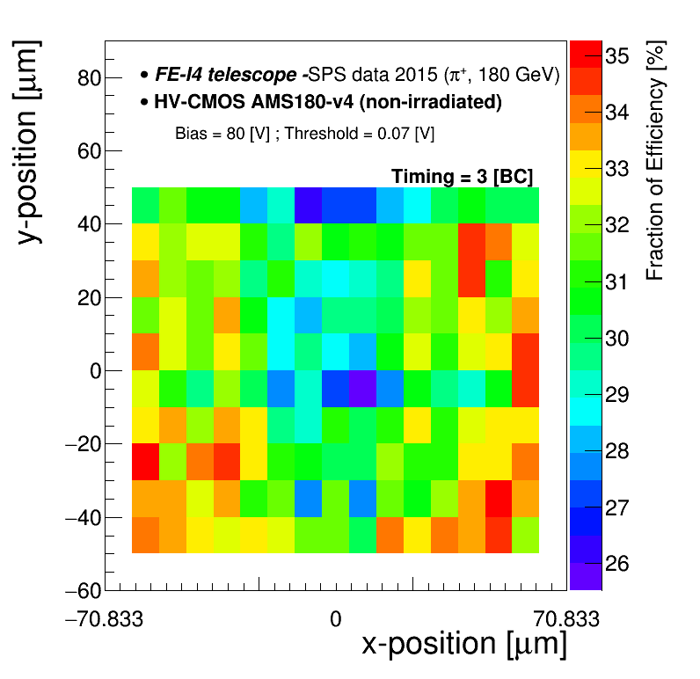
In-Pixel efficiency contribution per BC. HV= 80 V
23/02/2016 F. A. Di Bello

Slide 35

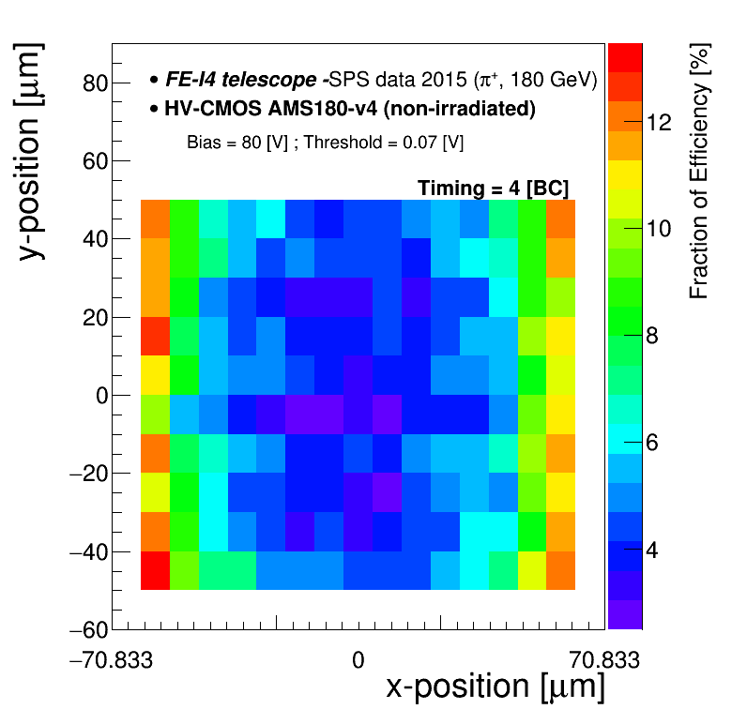
In-Pixel efficiency contribution per BC. HV= 80 V
23/02/2016 F. A. Di Bello

Slide 36

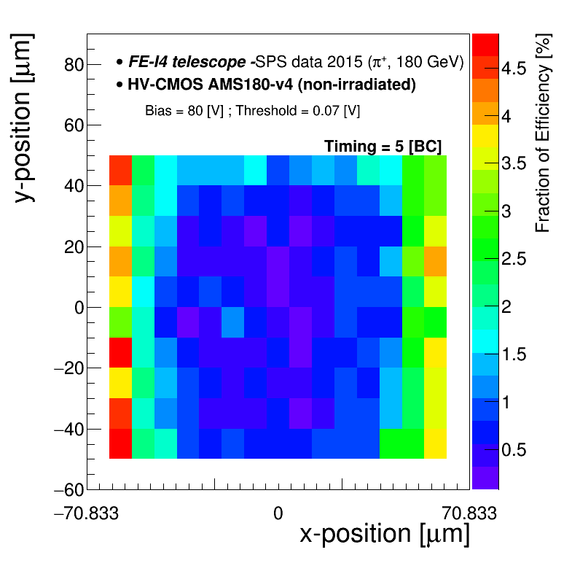
In-Pixel efficiency contribution per BC. HV= 80 V
23/02/2016 F. A. Di Bello

Slide 37
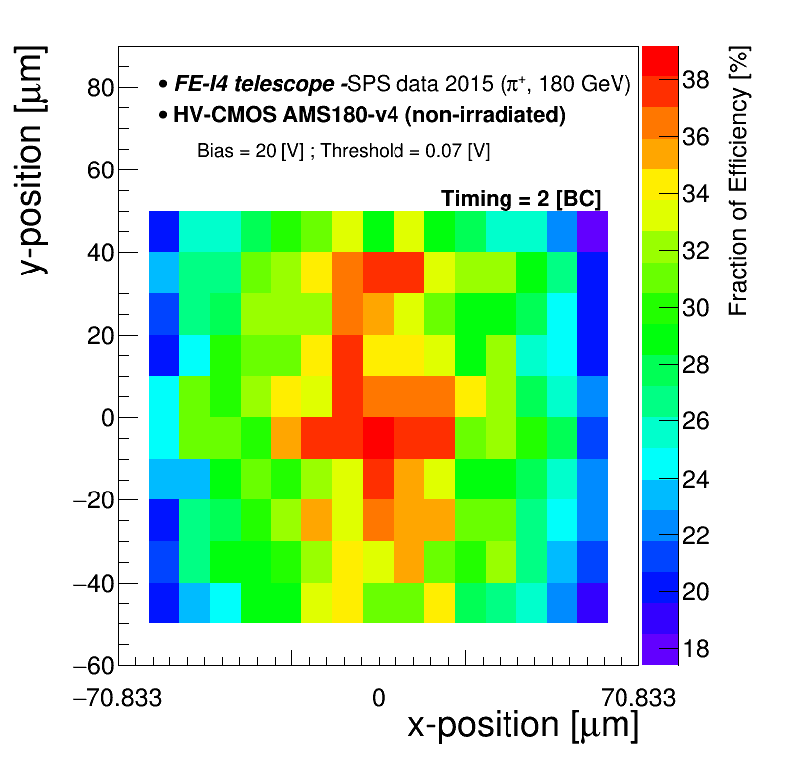
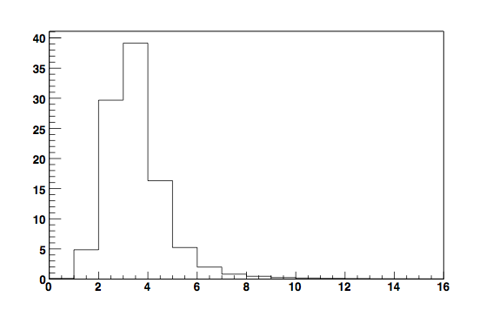

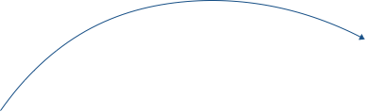

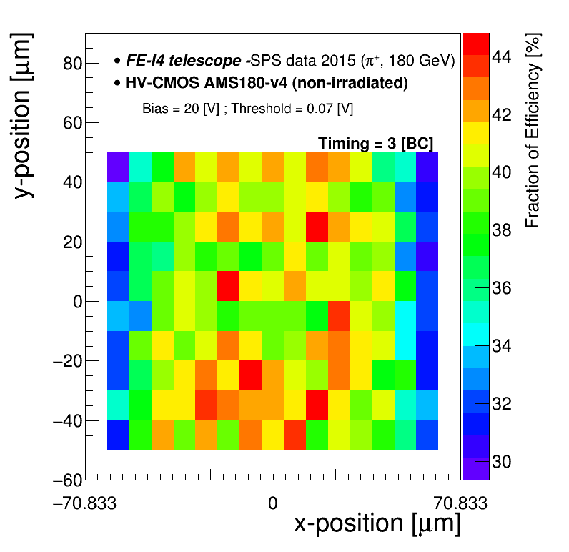
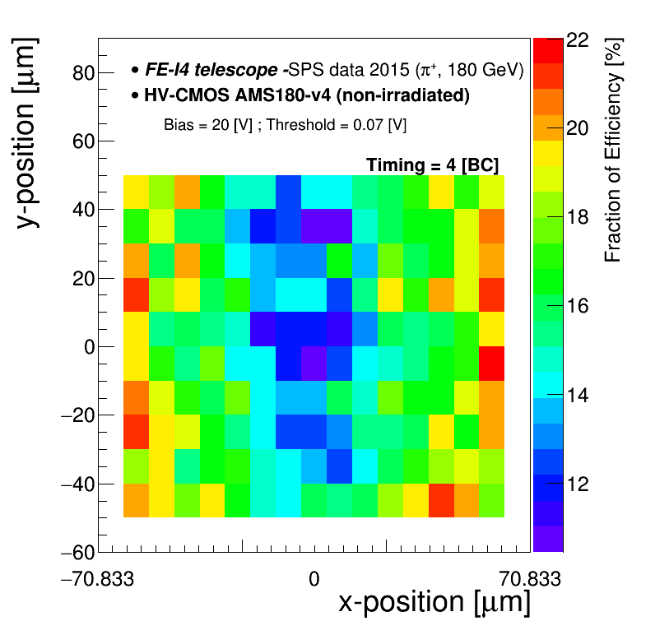
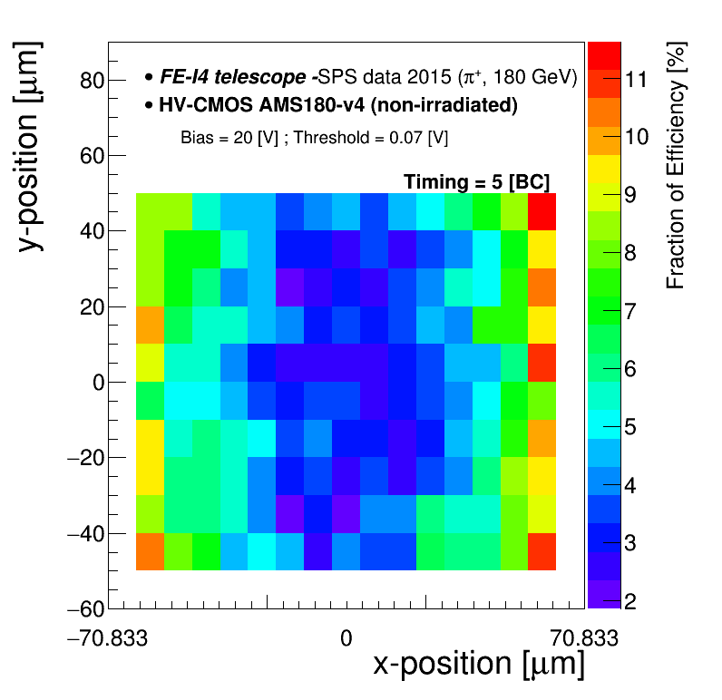
In-Pixel efficiency contribution per BC. HV= 20 V
23/02/2016 F. A. Di Bello

Slide 38


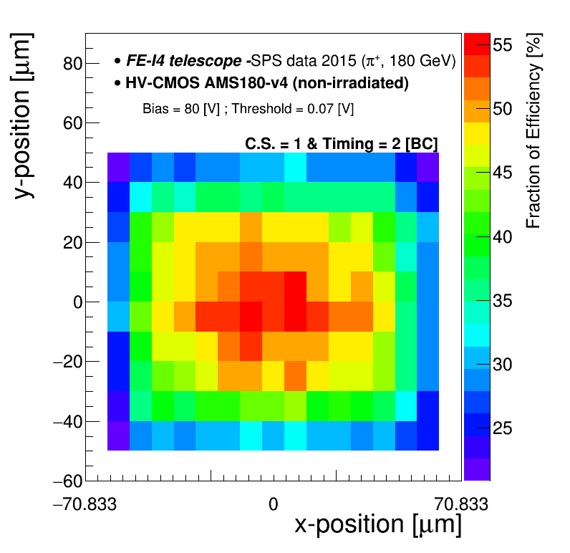

Timing= 2 BC as a function of C.S.
C.S.=1
C.S.=2
smaller HVCMOS PitchY ->higher charge sharing->smaller amplitude->slower hits->
Time Walk!
23/02/2016 F. A. Di Bello

Slide 39









In-Pixel efficiency contribution per BC. HV= 80 V, irradiated sample
23/02/2016 F. A. Di Bello

Slide 40




In-Pixel mean timing
For each bin:
Irradiation -> Smaller signal amplitude due to trapping -> Time-walk
Non-Irradiated, tuned
Non-Irradiated, non-tuned
Irradiated, non-tuned
23/02/2016 F. A. Di Bello

Slide 41
CLICPix and CCPD
With CLIC , we explored the limits of the HV-CMOS technology
CLICPix : 65nm ASIC with 25x25um pixels (non-rad hard)
CCPDv3 : Simple CMOS structure , only two stage amplification, no discriminator
FACULTÉ DES SCIENCES
Section Physique
DPNC

Slide 42
CLICPix and CCPD
FACULTÉ DES SCIENCES
Section Physique
DPNC

Slide 43
CLICPix and CCPD
FACULTÉ DES SCIENCES
Section Physique
DPNC

Slide 44

CLICPix and CCPD
bump pad
2µm
15µm
25µm
15µm
4µm
guard ring
Bump pad size is about 15 x 15 µm²
Guard rings around the bump pads are connected to the same low-noise, low-impedance voltage (i.e. V_{ssa}) and they minimize inter-pad (capacitive) coupling
FACULTÉ DES SCIENCES
Section Physique
DPNC

Slide 45
CLICPix and CCPD
FACULTÉ DES SCIENCES
Section Physique
DPNC

Slide 46
Conclusion
HV/HR CMOS is evolving quite fast and is the focus of a lot of studies from the community
  Commercial process ($$$)
  Possibility to go monolithic !
  Possibly able to meet HL-LHC specifications (~25ns timing, 95% efficiency at 1.5neq/cm²)
Multiple foundry propose HV-HR process with various interesting features
  High-resistivity substrate, High-Voltage, Backside processing
Next step : Large size monolithic demonstrators being designed with multiple foundries
  Submission in engineering runs by the end of the year
FACULTÉ DES SCIENCES
Section Physique
DPNC

Slide 47
Collaboration ?
A fully equiped >100m² clean room with:
  Delvotec wire bonder (can do irradiated stuff)
  Accura 100 flip-chip bonder,
  Particulars TCT setup
  CM300 300mm semi-automatic probe station with climate control (-60 to 300 C)
  multiple climate chambers (up to 2m objects ), and cooling systems is available
  Mechanical and electronic labs
A team of students trained in TCAD and Testbeam characterization and analysis
ASIC designers (Fadoua Guezzi and Pierpaolo Valerio),
electronic engineers (Yannick Favre, Stephane Debieux, and Daniel La Marra)
mechanical engineers (Franck Cadoux and Sebastien Michal )
As well multiple technicians are on staff.
A semi-permanent installation of a FEI4-based beam telescope at one of the CERN SPS north area beam lines is available. This allows testing of single sensor and integrated prototypes in a realistic setting with fast turn-around times.
FACULTÉ DES SCIENCES
Section Physique
DPNC

