Slide 1
A Bridge Too Far The Demise of the Superconducting Super Collider
Michael Riordan
UC Santa Cruz, Emeritus
Laboratory for Nuclear and High Energy Physics
Paris, France
24 October 2016

Slide 2
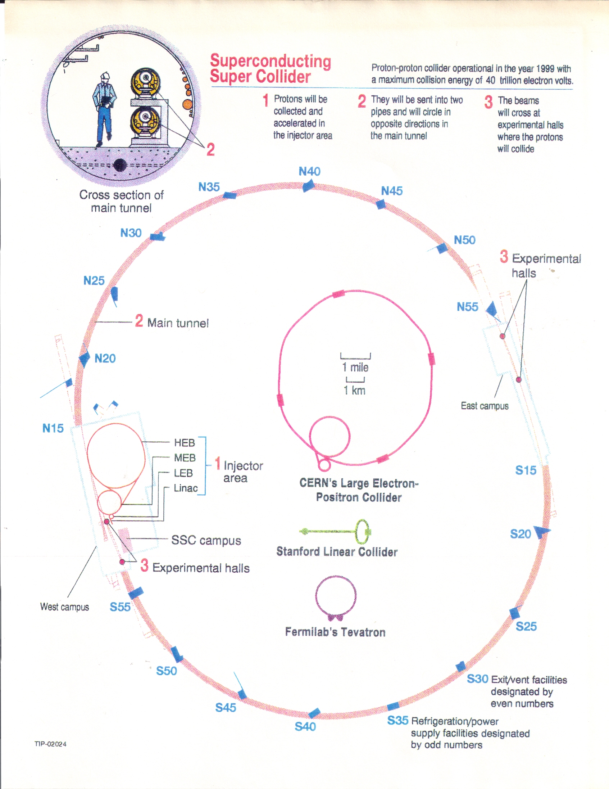
Large Projects in High-Energy Physics
Stanford Linear Accelerator Center
• construction 1961 to 1966
• $114 million (~ 550 million 1990$)
• Wolfgang Panofsky, SLAC Director
Fermi National Accelerator Laboratory
• construction 1968 to 1972
• $243 million (~ 750 million 1990$)
• Robert Wilson, Fermilab Director
CERN Large Electron Positron Collider
• construction 1983 to 1989
• 910 million Swiss francs* (budgeted)
• about $550 million at 1.65 CHF/$
• Herwig Schopper, CERN Director General
• Emilio Picasso, LEP Project Manager
*external costs of equipment only, as projected, in 1983 Swiss francs. They eventually exceeded 1 billion CHF.
Notes:
LEP project cost over $1 billion, when CERN labor costs included.
— first HEP project to cross this threshold
Panfosky and Wilson were both lab directors and project managers. Schopper and Picasso split the responsibilities involved.

Slide 3
“In all failures, the beginning is certainly half the whole.”
— George Eliot, Middlemarch

Slide 4
George A. Keyworth, “Science in a New Era of Competition”
Science, Vol. 217, No. 4560 (August 13, 1982), pp. 606-609.
“Today they [Brookhaven, Fermilab and SLAC] are starved into a state of near intellectual malnutrition.”

Slide 5
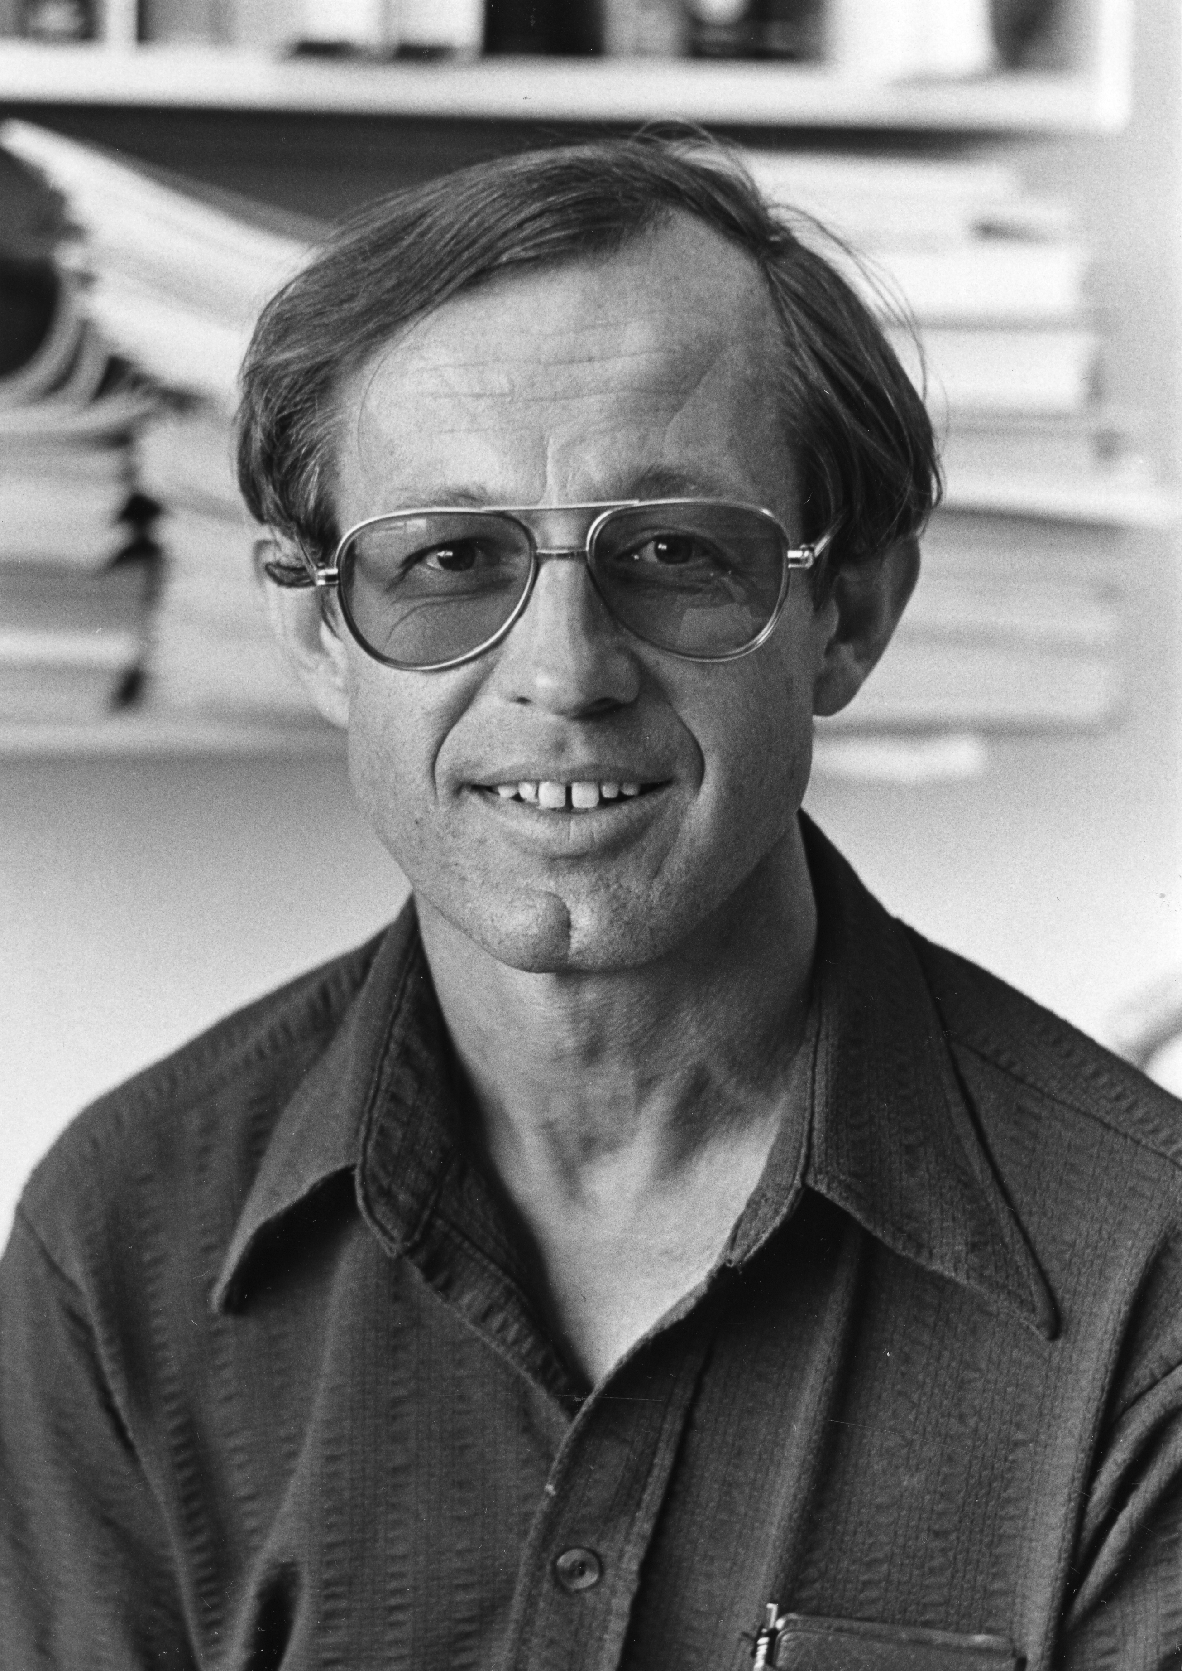
Wojcicki Subpanel Recommendations July 1983
• Build a new accelerator called the Superconducting Super Collider at a US site, roughly 30 km in diameter, with proton beam energies of 10-20 TeV and luminosity up to 10³³ cm⁻²s⁻¹ at a cost estimated at $2 billion.
• Complete both the Tevatron at Fermilab and SLC at SLAC; upgrade the Cornell Electron Storage Ring.
• Support accelerator technology research and development.
• Terminate the CBA/Isabelle project at Brookhaven.*
* not unanimously, but by 10-7 vote

Slide 6
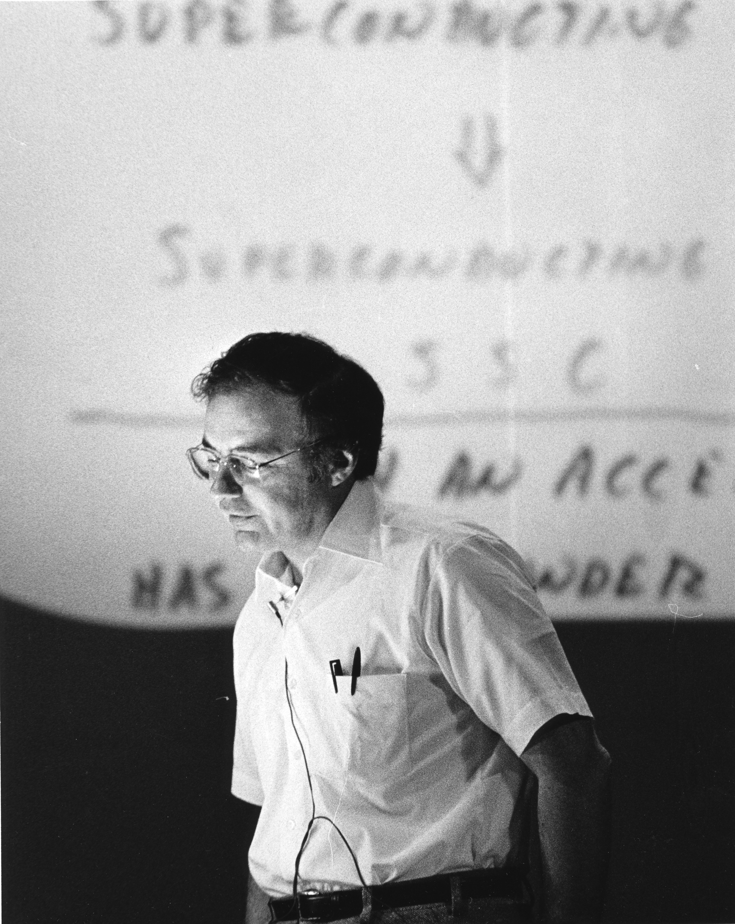
Superconducting Super Collider Conceptual Design
• Developed 1984-1986 by the SSC Central Design Group led by Maury Tigner
• 40 TeV proton collider with luminosity 10³³cm⁻²s⁻¹
• Report delivered to the DOE on April 1, 1986
* Total estimated cost was $3.01 billion (1986 dollars), excluding R&D, detectors, computers, commissioning
• Estimate based on 8600 superconducting dipoles, 52 mile circumference, and a 1 TeV proton injector
• Magnet apertures 4 cm
Notes:
A “bare bones” design. The Full Monty: 40 TeV. DOE didn’t add any contingency despite recognizing that 5 cm apertures might be needed after more R&D.

Slide 7
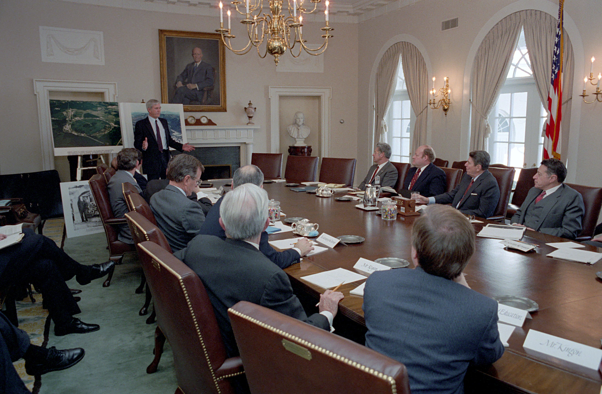
Domestic Policy Council meeting, January 29, 1987
Notes:
Director of Energy Research Alvin Trivelpiece, the other primary proponent of SSC project in Reagan years. Keyworth had left Administration in 1985.

Slide 8
“The United States has a long history of collaborative research efforts with other friendly nations. But this is an American Project, American leadership. We are going forward with it.”
— Energy Secretary John Herrington
January 30, 1987

Slide 9
The Winning SSC Site: Waxahachie, Texas
— Judged “excellent” or “good” on all six DOE site criteria
— Illinois/Fermilab received a “poor” rating on Setting

Slide 10
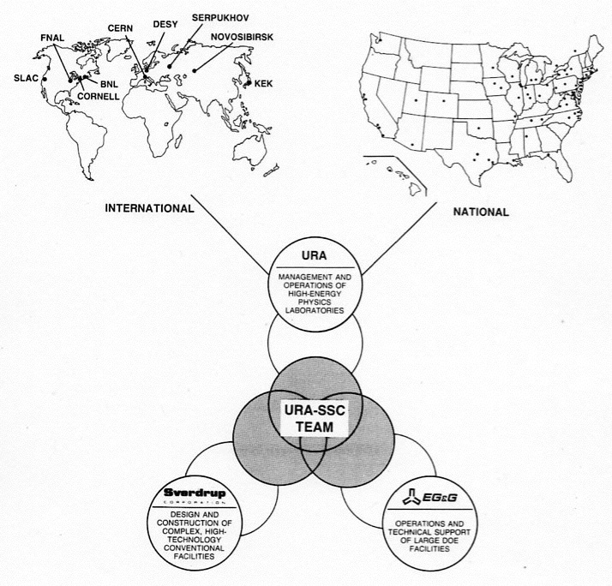
The Proposed URA Team*
Universities Research Association, Inc.
• non-profit corp. of ~ 80 universities
• corporate offices in Washington, DC
• had managed Fermilab since 1968
Sverdrup Corporation, St. Louis
• construction management firm
• Trident Submarine Base, Georgia
• Baltimore Harbor Tunnel
EG&G, Inc., Boston
• operations management firm
• Idaho Engineering Laboratory
• Nevada Test Facility
* from URA SSC Management and Operations Proposal, November 1988
Notes:
Making this unwieldy “teaming” arrangement work was going to require strong project management.

Slide 11
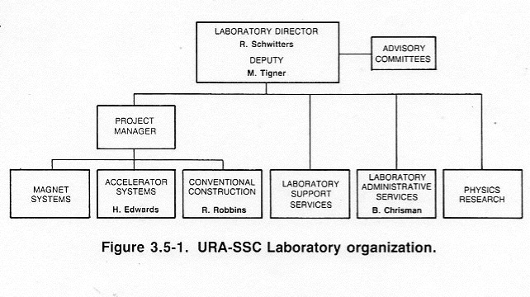
Proposed SSC Leadership, November 1988
Notes:
Glaring vacancy: Project Manager

Slide 12
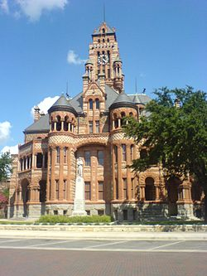
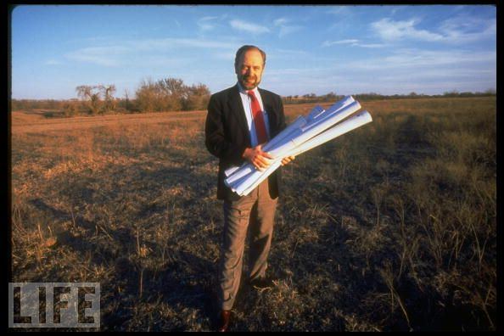
Roy Schwitters at Waxahachie Site

Slide 13
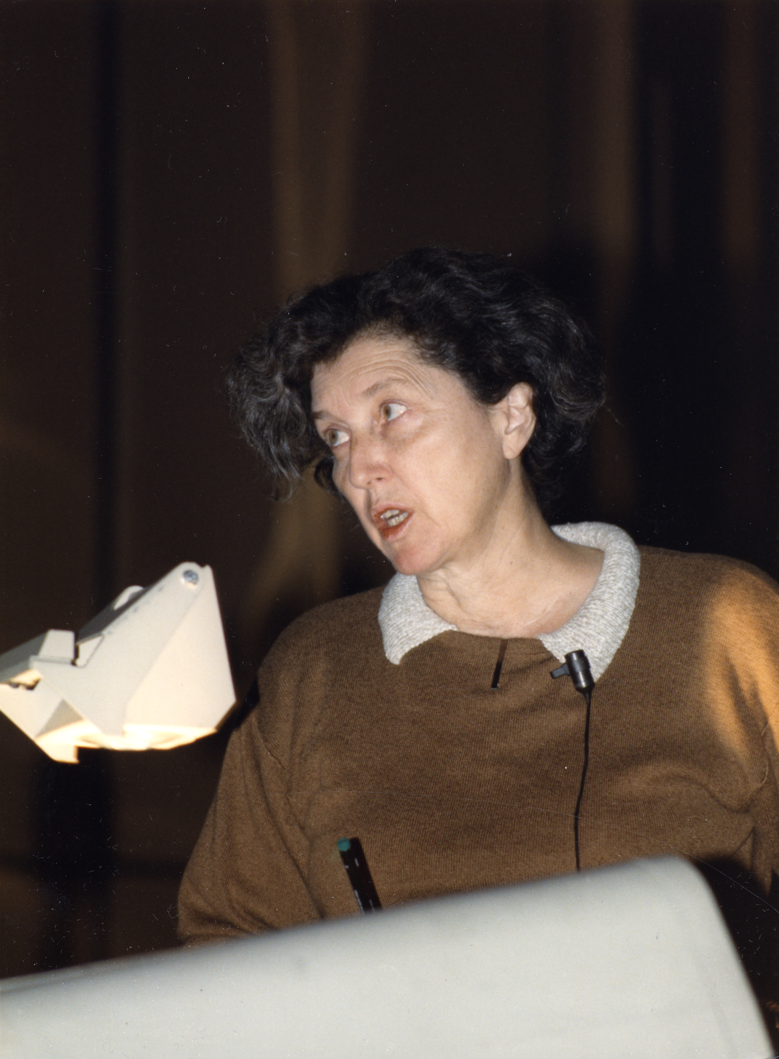
Site-Specific Design Changes
• Site-specific design team led by Helen Edwards
• Dipole magnet aperture increased from 4 cm to 5 cm*
• High Energy Booster energy increased from 1 TeV to 2 TeV
• Dipole magnet length to be reduced from 17.4 m to 15.8 m
• Number of dipole magnets increased from 8600 to 8800
• Main ring circumference increased from 52 to 54 miles
• Estimated cost increase: $1-2 billion, including other items
* but quadrupole magnet aperture curiously remained at 4 cm???

Slide 14
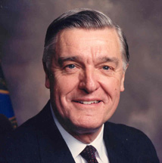
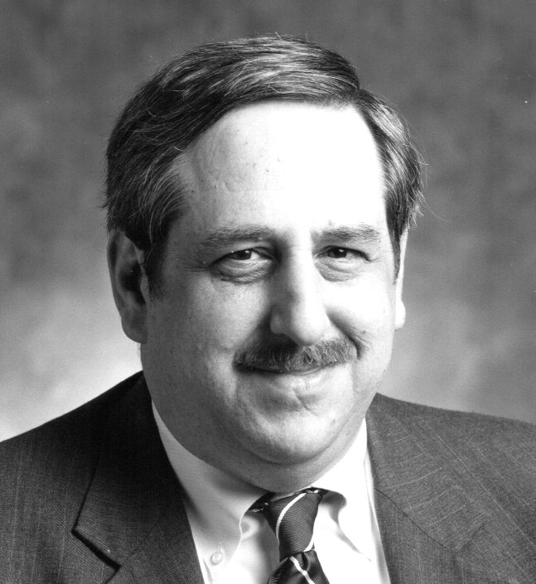
A Little Help from the Nuclear Navy
Admiral James A. Watkins
Edward J. Siskin, P.E.
Notes:
“Admiral Watkins had to be scraped off the ceiling when he learned of the cost increase.”

Slide 15
Edward J. Siskin, SSC General Manager
B.S. degree, Electrical Engineering, Univ. Pennsylvania, 1963
Naval Reactors Division, Atomic Energy Commission, 1970-84
— reported to Admiral Hyman G. Rickover
— knew Admiral Watkins from this experience
Executive Vice President, Stone & Webster Corp.*, 1984-89
— responsible for S&W operations in southeastern United States
— included all S&W nuclear work and chemical plant safety work
• Registered Professional Engineer in Electrical, Mechanical, Chemical, Civil and Nuclear Engineering
* Stone & Webster served as Oak Ridge construction manager during WWII.
Notes:
Siskin had the billion-dollar project management experience Watkins was looking for.
Had worked at S & W supervising turn-around of problem nuclear reactor facilities.
He was an “engineer’s engineer” registered in many states and professions.

Slide 16
Memorandum to the Secretary of Energy — September 14, 1990
“The URA position at the meeting was that it was unacceptable to them to have the AE/CM contract broken out and that while they admitted there were problems, they saw no advantage to changing their current management structure. They were very firm in their position that all aspects of the Lab had to report to the Laboratory Director or the scientific community would feel they were cut out of the process.”
— Joseph Cipriano,
Director, DOE Site Office
Notes:
Similar things had happened at Brookhaven and SLAC during AEC days
AEC took over construction management of first nuclear reactor. Bob?
Panofksy (and David Packard) convinced John Mc Cone to let Stanford control management of SLAC construction.

Slide 17
Total Estimated Cost of the SSC, 1991: $8.25 billion
— based on 40 TeV Main Ring with 5 cm dipole apertures and 2 TeV injector
— includes lab infrastructure, detectors, computers, contingency and inflation
Notes:
But ICE group came in with estimate of $11.8 billion and said it could go higher. Texas had committed $875 million of the total, but another $1.7 billion was needed.

Slide 18
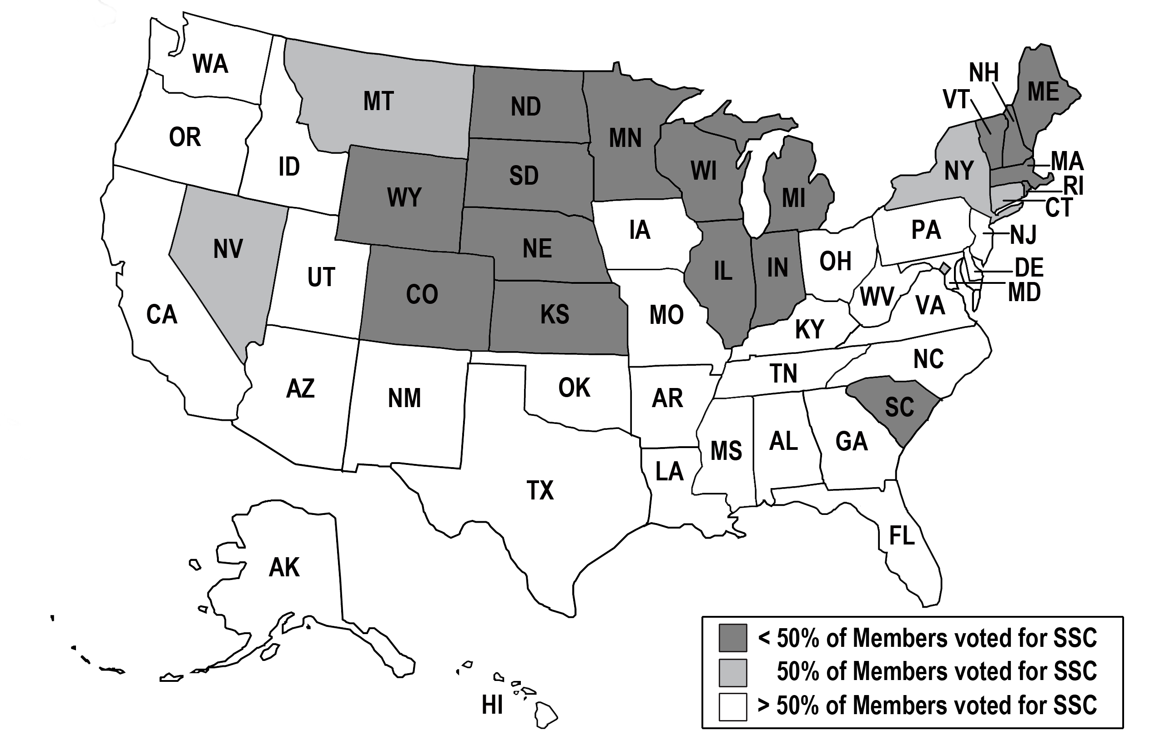
May 1991 House Vote: A seemingly comfortable victory margin
Slattery Amendment to kill the SSC defeated by 251 by 165.
But note rough North vs. South, Rust Belt vs. Sun Belt voting pattern.

Slide 19
The SSC Project Manager Parade:
N. Douglas Pewitt (acting), March to October 1989
— former high government official in OMB, DOE and OSTP
Richard J. Briggs, October 1989 to March 1990
— project manager on LLNL induction accelerator (~ $100 M project)
N. Douglas Pewitt (acting), March to May 1990
Theodore Kozman (acting), May to September 1990
— LLNL/LBL mechanical engineer, headed SSC Accelerator Systems Div.
Paul Reardon, September 1990 to December 1991
— former Fermilab Business Manager, BNL Associate Director (RHIC)
John Rees, January 1992 to October 1993
— project manager on SLAC PEP and SLC colliders (~ $100 M projects)

Slide 20
“Congressional support for the Super Collider is a mile wide and an inch deep.”
— NY Congressman Sherwood L. Boehlert

Slide 21
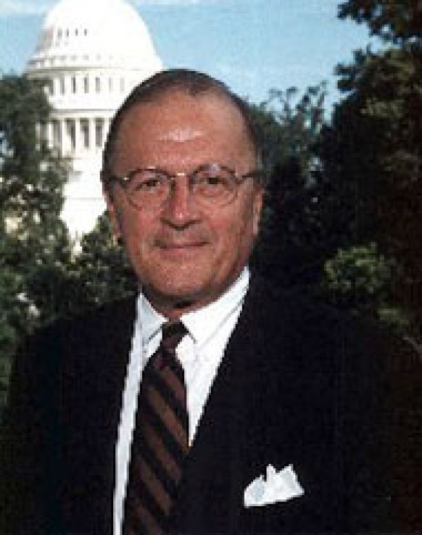
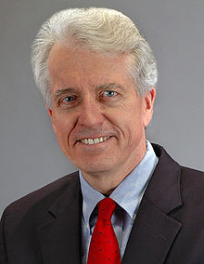
House Leaders of the SSC Opposition
Sherry Boehlert, R-NY
Jim Slattery, D-KS

Slide 22
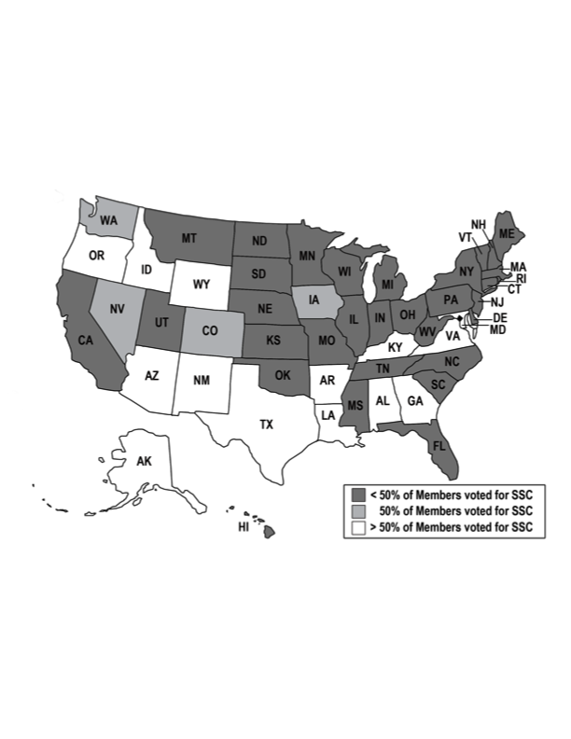
June 1992 House Vote: Lightning Strikes the SSC
Vote Margin Was 232 to kill the SSC versus 181 to continue funding it.
Compare that with the 251 to 165 margin in favor of the project in 1991.
And this was essentially the same House members voting both times.
Notes:
Leon Panetta quote: The SSC had become the poster child for Congressional pork.
Essentially the same House Members who voted on the 1991 Slattery amendment.

Slide 23
May 1991 House Vote: A seemingly comfortable victory margin
Slattery Amendment to kill the SSC defeated by 251 by 165.
But note rough North vs. South, Rust Belt vs. Sun Belt voting pattern.

Slide 24
June 1992 House Vote: Lightning Strikes the SSC
Vote Margin Was 232 to kill the SSC versus 181 to continue funding it.
Compare that with the 251 to 165 margin in favor of the project in 1991.
And this was essentially the same House members voting both times.

Slide 25
“The SSC had become the poster child for Congressional pork”
— CA Congressman Leon E. Panetta

Slide 26
President Bush Visits the SSC Lab, July 30, President Bush Visits the SSC Lab, July 30, 1992
To Bush’s right are Presidential Science Advisor Allan Bromley and Congressman Joe Barton (R-TX) of the Ennis district ; to his left are Deputy Undersecretary of Energy Linda Stuntz and Roy Schwitters.

Slide 27
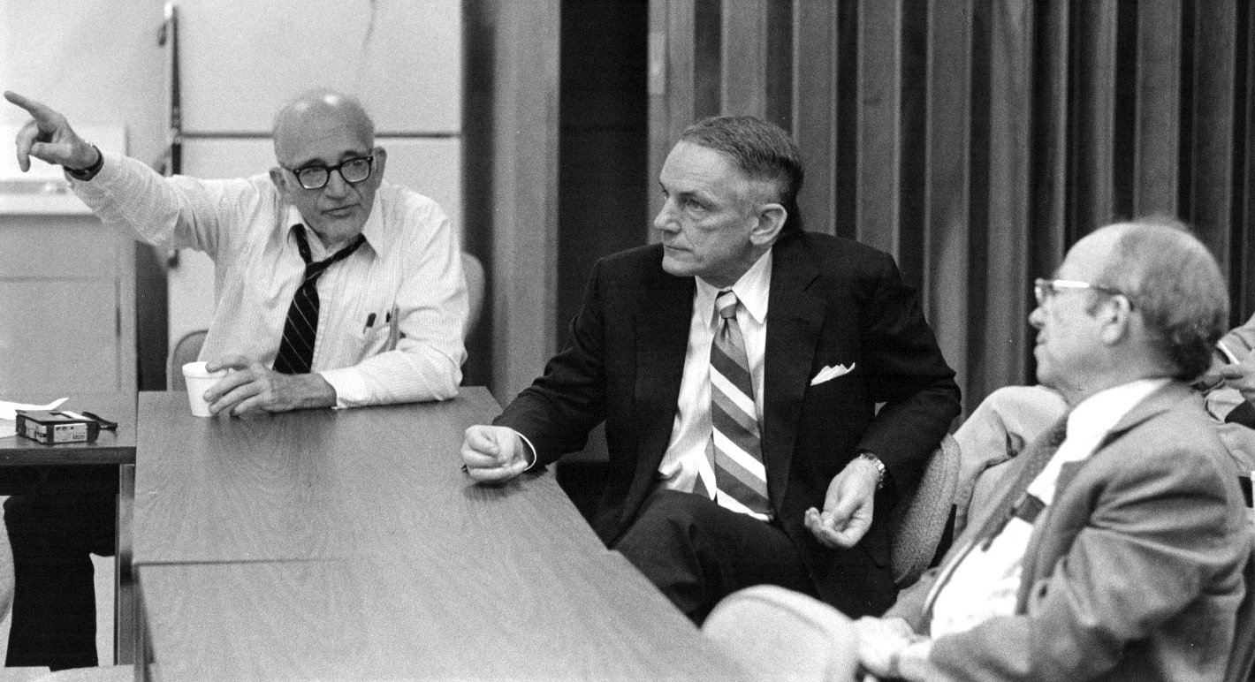
Senator J. Bennett Johnston at SLAC in 1992
Notes:
Senate 1992 vote: 62-32 to continue the SSC. Conference committee “compromised” and kept SSC in budget at $517M. House accepted it 245-143.

Slide 28
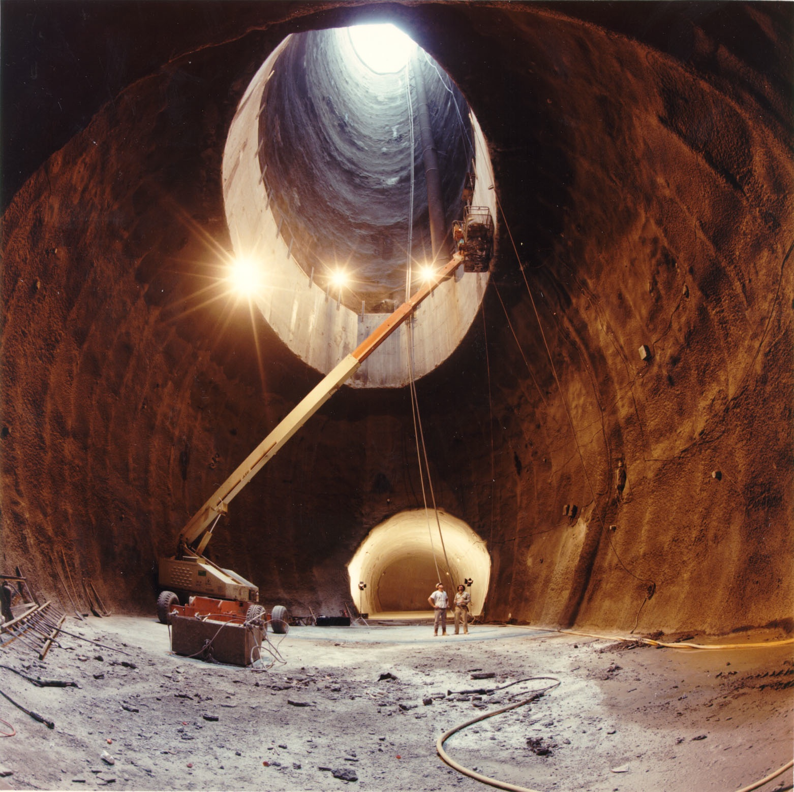
SSC North Campus and Tunnel, Early 1993

Slide 29
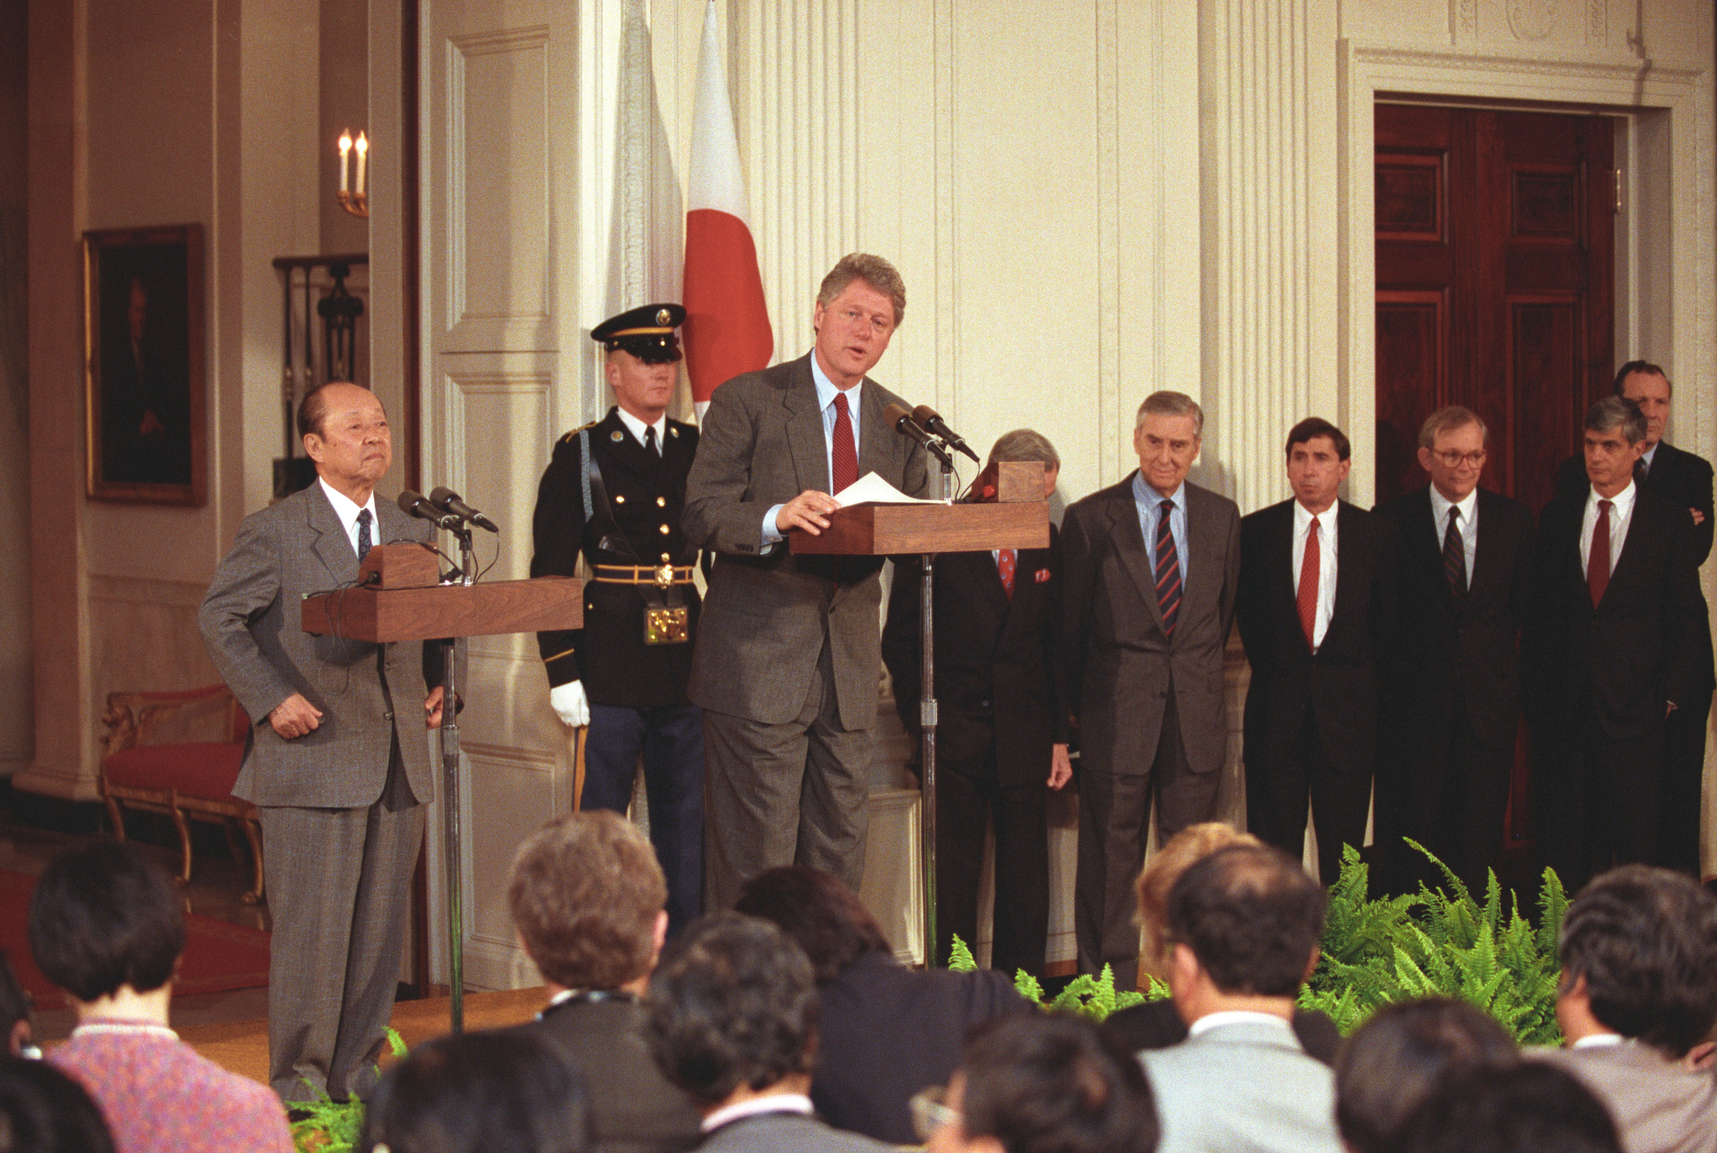
Clinton-Miyazawa Press Conference, April 16, 1993

Slide 30
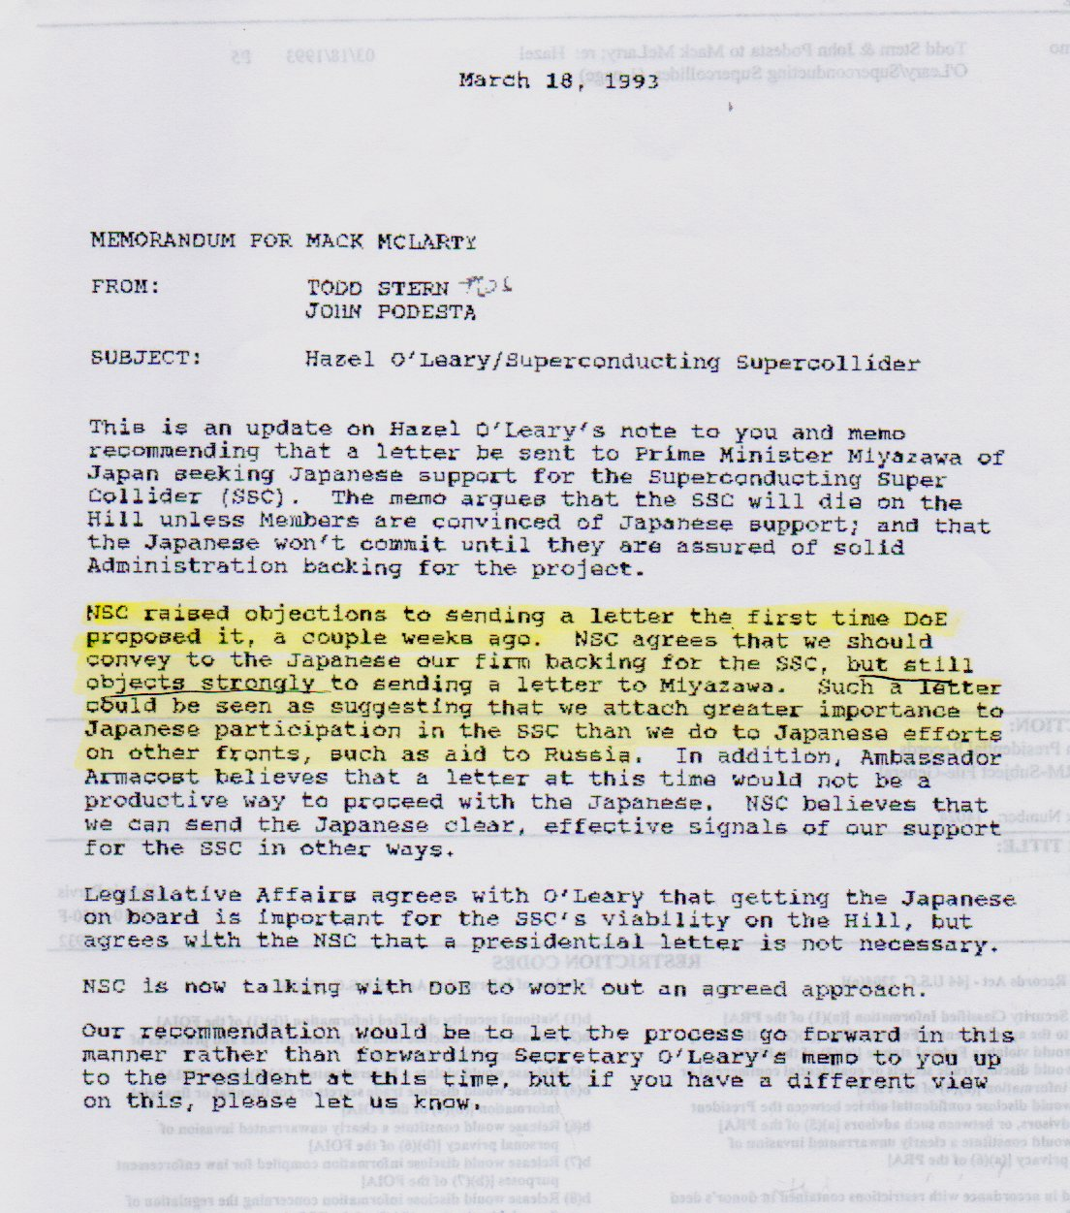
Todd Stern/John Podesta Memo for Mack McLarty* March 18, 1993
“NSC raised objections to sending a letter the first time DOE proposed it, a couple of weeks ago. NSC agrees that we should convey to the Japanese our firm backing for the SSC, but still objects strongly to sending a letter to Miyazawa. Such a letter would be seen as suggesting that we attach greater importance to Japanese participation in the SSC than we do to Japanese efforts on other fronts, such as aid to Russia.” [italics added]
NSC = National Security Council
* Clinton’s First Chief of Staff
Notes:
Emerged only 18 months ago, after FOIA request on DOE Secretary Hazel O’Leary.

Slide 31
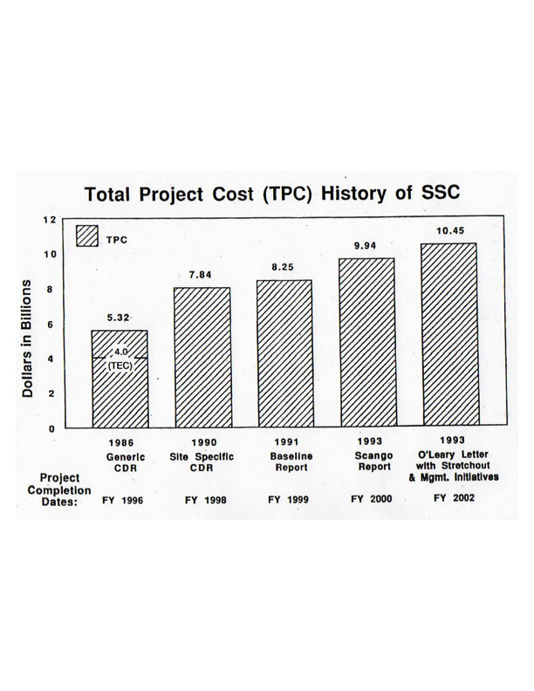
SSC Cost Growth, 1982-93
Snowmass meeting, 7/82: $1–3 billion
Wojcicki panel, 6/83: $1.4–2.2 billion
Conceptual design, 4/86: $3.01 billion*
Reagan endorsement, 1/87: $4.5 billion
Congress approval, 9/89: $5.9 billion
SSC “Green Book,” 2/91: $8.25 billion
Scango report, 8/93: $9.94 billion**
* collider cost only, in 1986 dollars.
** not including “Clinton stretch-out,” which would add over $1 billion.
Notes:
House voted 280-150 to kill SSC in June 1993, followed by Senate 57-42 vote in favor. House rejected conference bill 282-143, almost two to one.

Slide 32
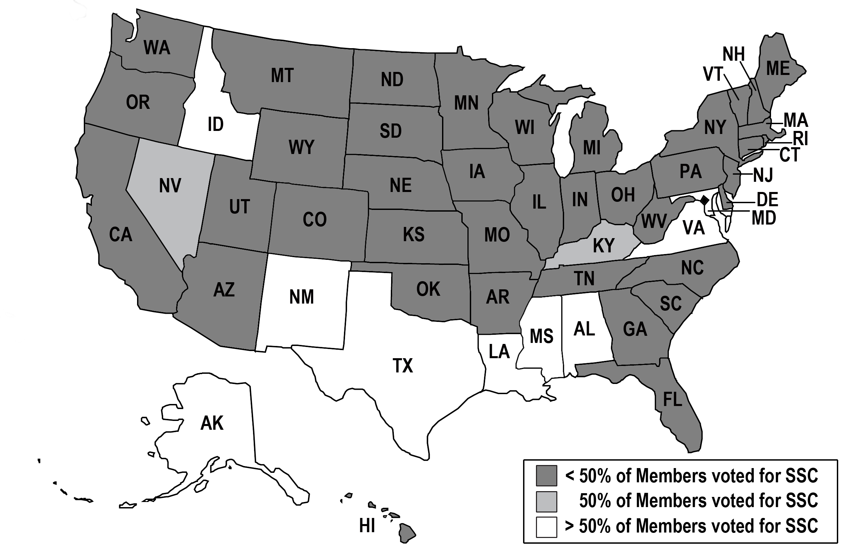
October 1993 House Vote: The Final Death Blow
Vote to terminate the SSC was 282 to 143, almost a 2 to 1 margin
This time the Senate could not withstand the “will of the House”

Slide 33
Two Daunting Tasks for the SSC Leadership:
• Building the physical SSC infrastructure
• Establishing the human lab infrastructure

Slide 34
The SSC: A Bridge Too Far
The cost of the SSC project was grossly underestimated.
— US physicists grabbed at Reagan’s “Throw deep!” (or “Think big!”)
— but multibillion-dollar US projects require political compromises
— didn’t have “political capital” to sustain project for over a decade
US turned its back on cooperative World Accelerator idea.
— and there was a fundamental flaw in the SSC’s founding rhetoric
— by the 1980s, aligned nations had to be treated as equal partners
The Cold War was ending and a new era about to begin.
— US “civil security” (Krige) no longer an important national priority
— basic research funding in physical sciences leveling off or declining

Slide 35
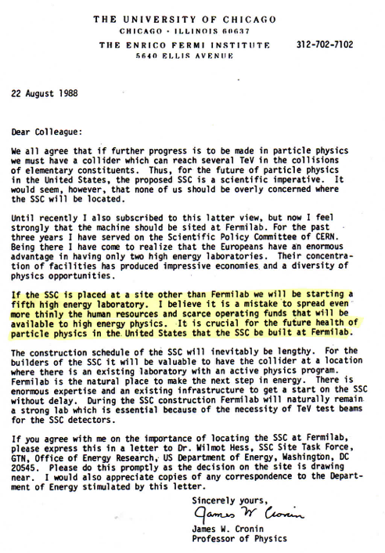
James W. Cronin* Dear Colleague Letter 22 August 1988
“If the SSC is placed at a site other than Fermilab, we will be starting a fifth high energy laboratory. I believe it is a mistake to spread even more thinly the human resources and scarce operating funds that will be available to high energy physics. It is crucial for the future health of particle physics in the United States that the SSC be built at Fermilab.”
* Nobel Laureate, physics

Slide 36
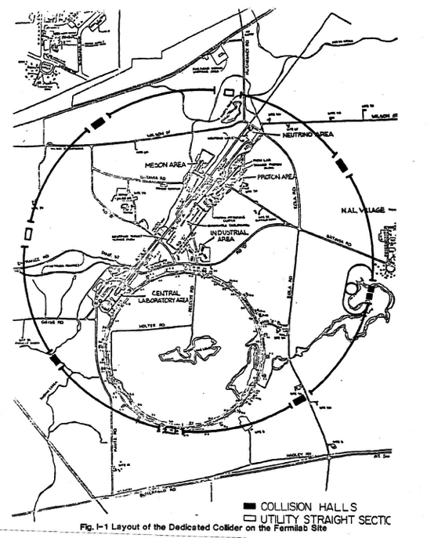
The Road Not Taken: Dedicated Collider at Fermilab Proposal dated May 1983 (to Wojcicki subpanel)
• 2 TeV on 2 TeV p-pbar collider
• luminosity over 10³¹ cm⁻²s⁻¹ (without any Main Injector added)
• could be built completely within the existing Fermilab site boundary
• to use recently successful Tevatron superconducting magnet technology
• total project cost less than $1 billion
• but Wojcicki subpanel deemed this collider insufficient to study the TeV energy scale (for proton constituents)

Slide 37
The Road Not Taken: Dedicated Collider at Fermilab Proposal dated May 1983 (to Wojcicki subpanel)
• 2 TeV on 2 TeV p-pbar collider
• luminosity over 10³¹ cm⁻²s⁻¹ (without any Main Injector added)
• could be built completely within the existing Fermilab site boundary
• to use recently successful Tevatron superconducting magnet technology
• total project cost less than $1 billion
• but this machine upgradable to a 6 TeV proton-proton collider with a luminosity of 10³³ cm⁻²s⁻¹ using SSC superconducting magnets (Lee Teng, March 1988)
Could such a Dedicated Collider have discovered the 125 GeV Higgs boson?

Slide 38
“There comes a point when the magnitude of the project is so large that the chance of success on a strictly national basis is less than on a genuinely collaborative basis despite the difficulties and compromises the latter implies.”
— John M. Deutch, May 1984
Memo to SSC Board of Overseers

Slide 39
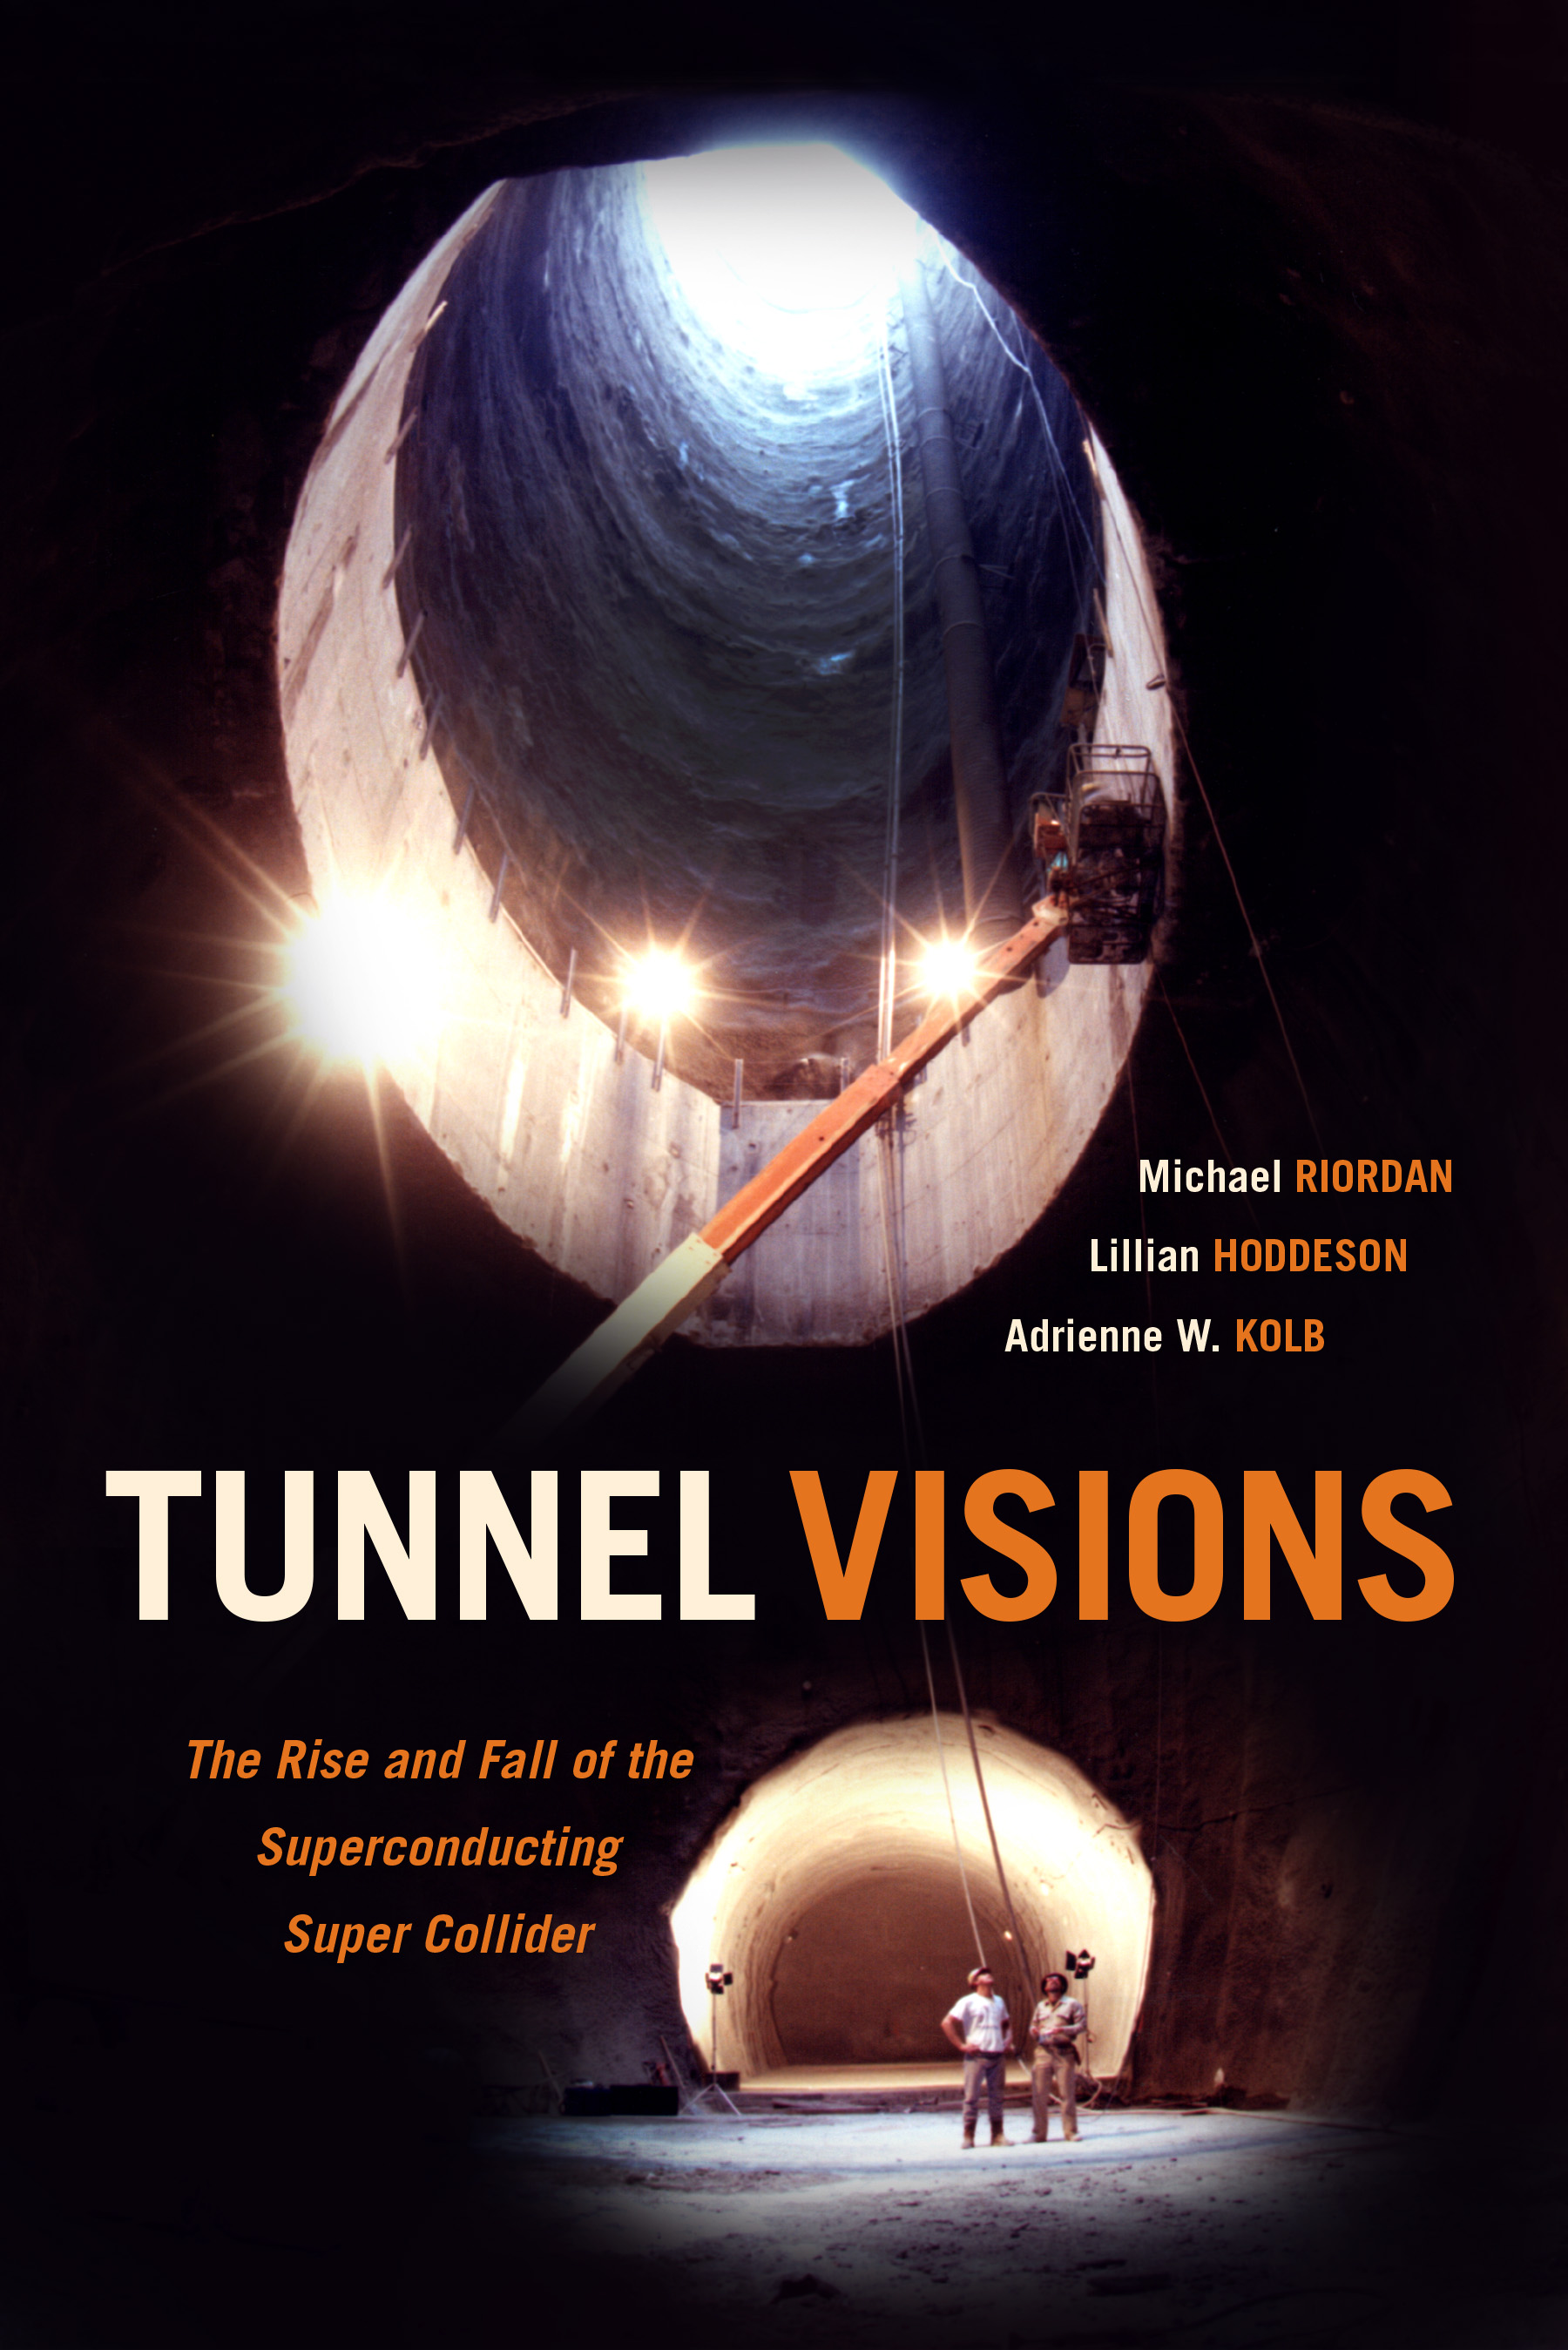
Tunnel Visions
The Rise and Fall
of the
Superconducting
Super Collider
by Michael Riordan, Lillian Hoddeson and Adrienne W. Kolb
Published November 2015 by University of Chicago Press
And be sure to read the notes!
Notes:
Getting this accomplished has been quite a project in itself! My most difficult experience in project management.

Slide 40
The Road Not Taken: Dedicated Collider at Fermilab Proposal dated May 1983 (to Wojcicki subpanel)
• 2 TeV on 2 TeV p-pbar collider
• luminosity over 10³¹ cm⁻²s⁻¹ (without any Main Injector added)
• could be built completely within the existing Fermilab site boundary
• to use recently successful Tevatron superconducting magnet technology
• total project cost less than $1 billion
• but this machine upgradable to a 3 TeV on 3 TeV proton-proton collider with luminosity 10³³ cm⁻²s⁻¹ using SSC superconducting magnets (Lee Teng, March 1988)
Could such a Dedicated Collider have discovered the 125 GeV Higgs boson?

Slide 41
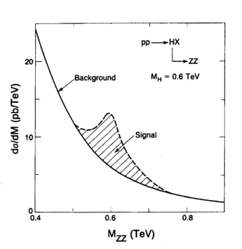
The Higgs Boson in the late 1980s
SSC Conceptual Design Report, 1986
M. Chanowitz, ARNS, 1988

Slide 42
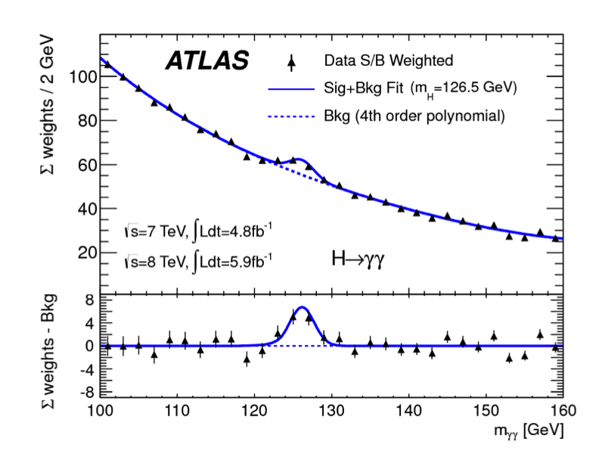
2012 Higgs Boson Discovery at the LHC
(at E_{cm} = 7 - 8 TeV and L ~ 10³³)

