Slide 1
Search for high-mass diphoton resonances
with the CMS experiment at the LHC
Suzanne GASCON-SHOTKIN
IPN Lyon (IN2P3-CNRS)/Université Claude Bernard Lyon 1
On behalf of the CMS Collaboration

Slide 2
Outline
Motivation, strategy and history
New Electromagnetic Calorimeter relative calibration
Event Triggering and Vertex Identification
Absolute Energy scale and resolution corrections
Event selection and photon identification
Signal and background modelling, statistical techniques
Results for √s =13 TeV: 95% CL Limits on σ X BR, local and global p-values
Combination of results from analyses at √s =8 and 13 TeV: 95% CL Limits on σ X BR, local and global p-values, consistency
Summary and conclusions
Acknowledgements
Note: Except as noted, all results presented here are from CMS-EXO-16-018, with integrated luminosities of ~19.7 fb⁻¹ at √s= 8 TeV and 3.3 fb⁻¹ at √s= 13 TeV

Slide 3
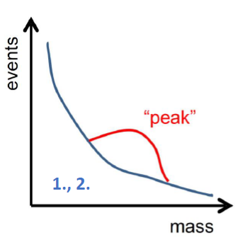
Motivation, strategy and history
Several models beyond the Standard Model (SM) predict the existence of diphoton resonances with m_{γγ} >500 GeV:
Additional Higgs bosons from extended sectors (J=0),
Resonances from models with extra dimensions Randall-Sundrum Gravitons (J=2)…
A clean final state and a simple strategy: Select events containing two high-p_{T}, isolated photon candidates and search for a localized excess in the m_{γγ} distribution
The devil is in the details:
Rigorous calibration of electromagnetic calorimeter (ECAL) deposits, updated from 2015 dataset
Measurement of photon candidate energy scale, resolution and identification efficiency from data
Events classified into categories for increased sensitivity
Background parametrized from data
Simultaneous unbinned likelihood fit to m_{γγ in} the different categories to obtain limits and p-values
Analysis performed blind
Revisiting of the following analysis elements to allow inclusion of 0.6 fb⁻¹ of data taken at B=0 T:
Event triggering, Vertex identification, Absolute energy scale and resolution corrections, photon identificaton

Slide 4
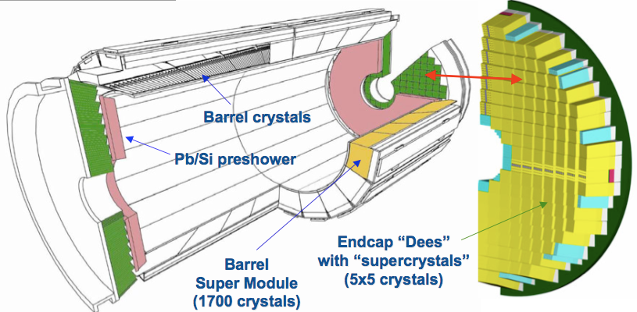
Motivation, strategy and history
Analysis ‘contours’:
Search range: 500 GeV< m_{γγ} < 4.5 TeV
Integrated luminosity at √s = 13 TeV : 3.3 fb⁻¹ (2.7 fb⁻¹ @ B=3.8T + 0.6 fb⁻¹ @ B=0T)
at √s = 8 TeV : 19.7 fb⁻¹
Four categories: {EBEB, EBEE} X {B=3.8T, B=0T} [EBEB (EBEE)➔both (one) photons reconstructed in ECAL barrel]
Analysis interpretations:
Done under both J=0 (scalar assuming gluon-gluon fusion production only) and J=2 (R-S graviton) assumptions
For each spin assumption assume three widths: (Γ/m=1.4x10⁻⁴, 1.4x10⁻², 5.6x10⁻²)

Slide 5
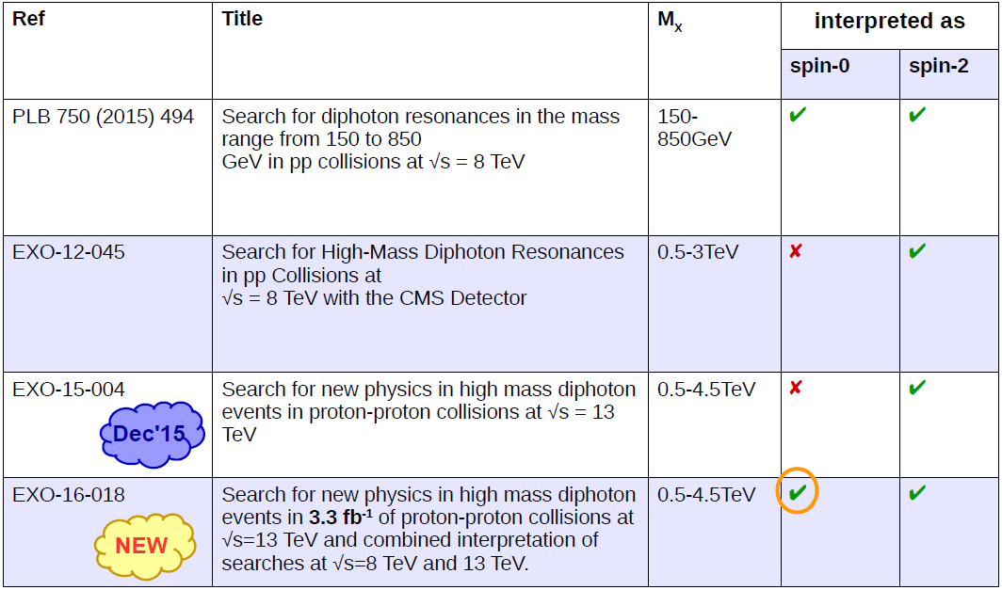
Motivation, strategy and history

Slide 6
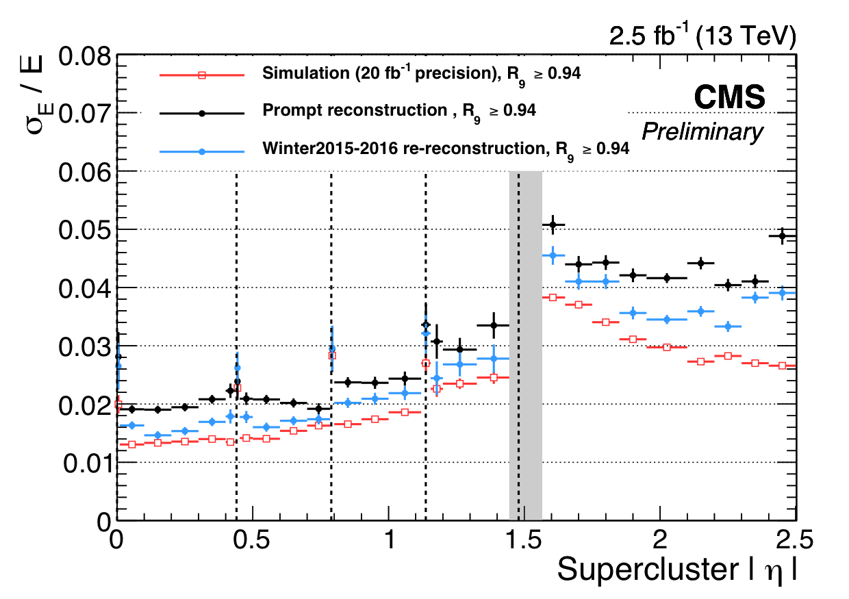
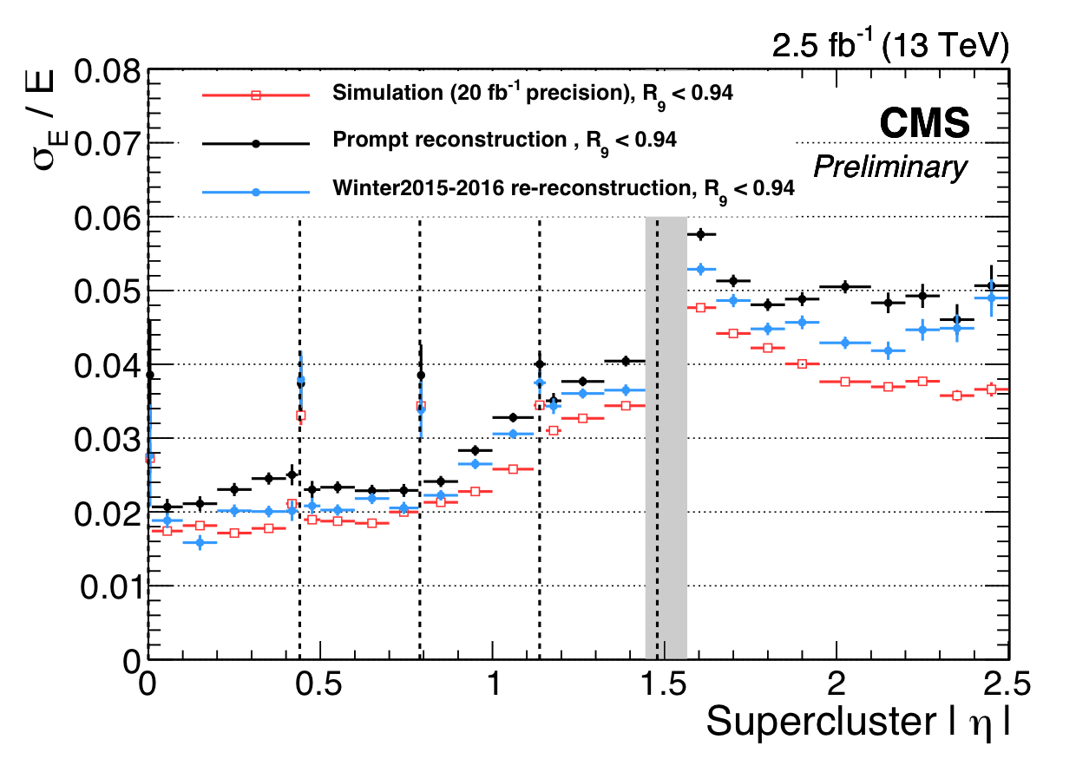
New Electromagnetic Calorimeter relative calibration
Calibration of individual ECAL channels: Crystal transparency monitoring and correction→calibration constants from low-energy deposits exploiting φ-symmetry, m_{γγ} peaks from π⁰ and η, E/p from W and Z electrons
ECAL Cluster energy correction by multivariate regression
CMS-DP-2015/057
Z→ee “Unconverted”
Z→ee “Converted”
ECAL cluster resolution for data re-reconstructed in Winter 2015-2016 with transported calibrations from 2012 combined with those obtained from 2015 (blue). Compare with resolution from 2012 calibrations (black) and Run 1 Simulation (red).

Slide 7
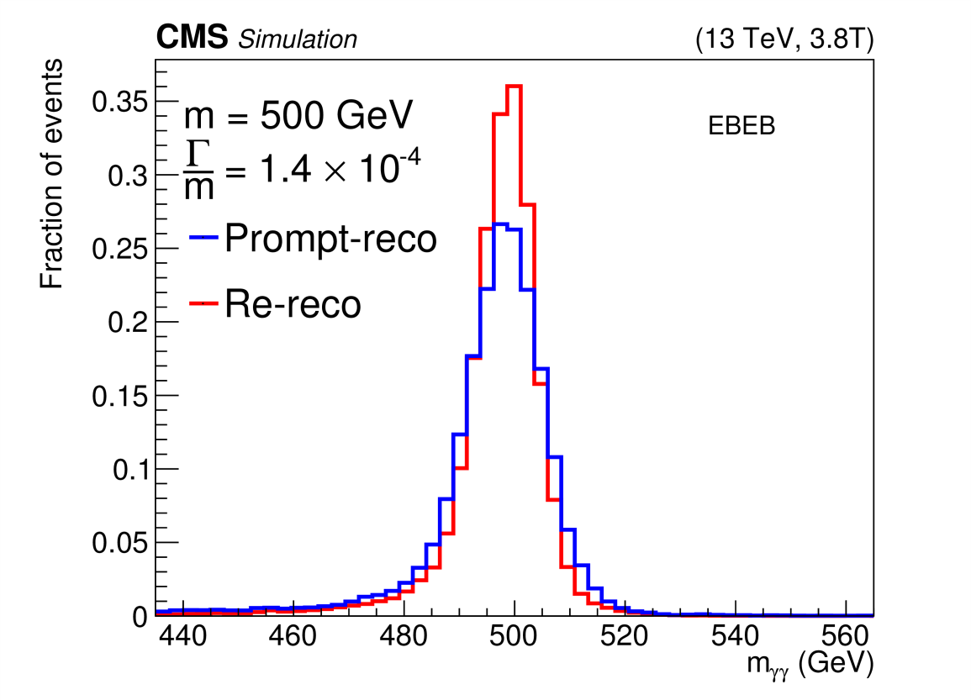
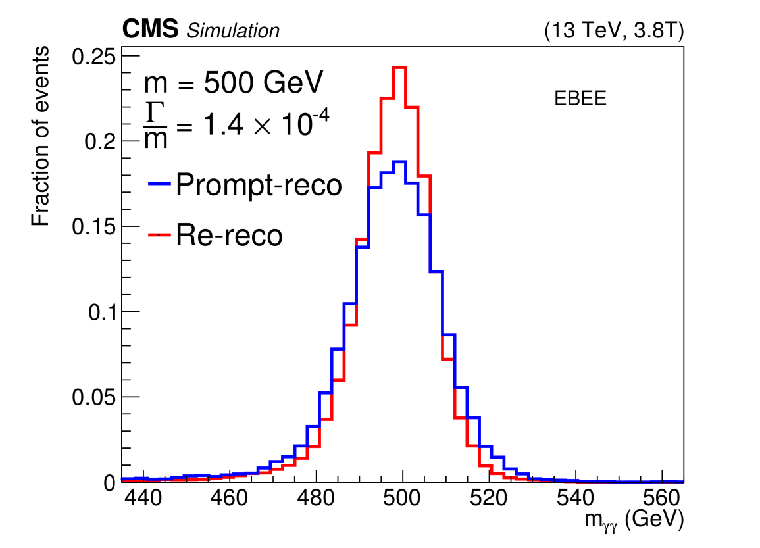
New Electromagnetic Calorimeter relative calibration
Use of new calibration constants produces 30% improvement in mass resolution for m_{X}>500 GeV

Slide 8
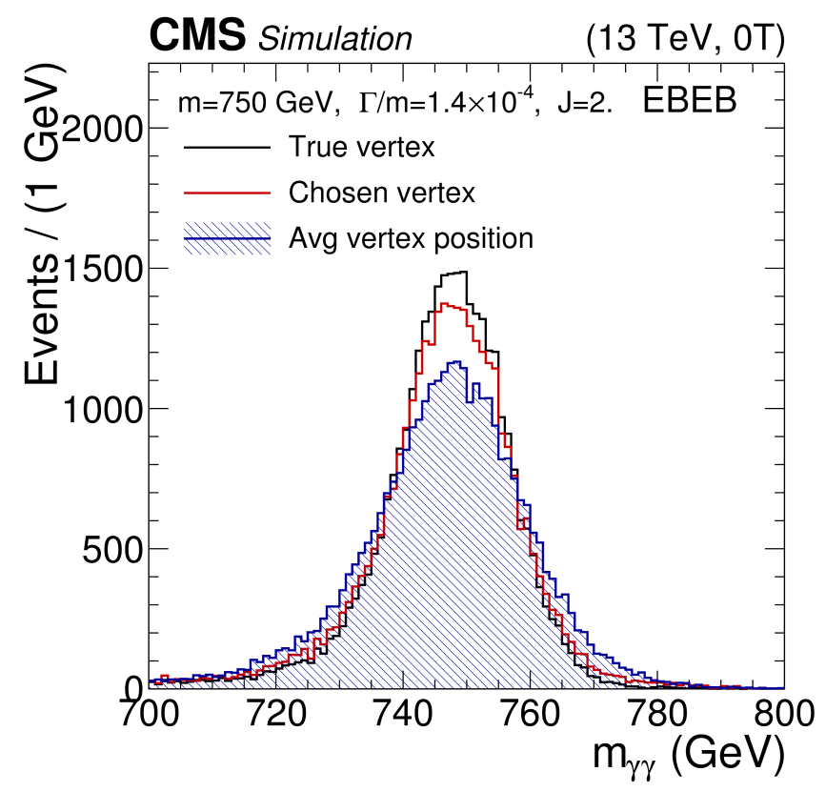
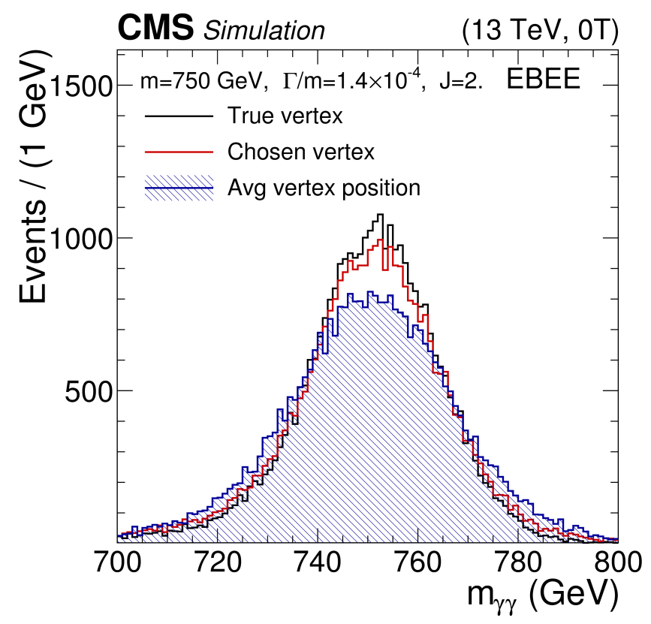
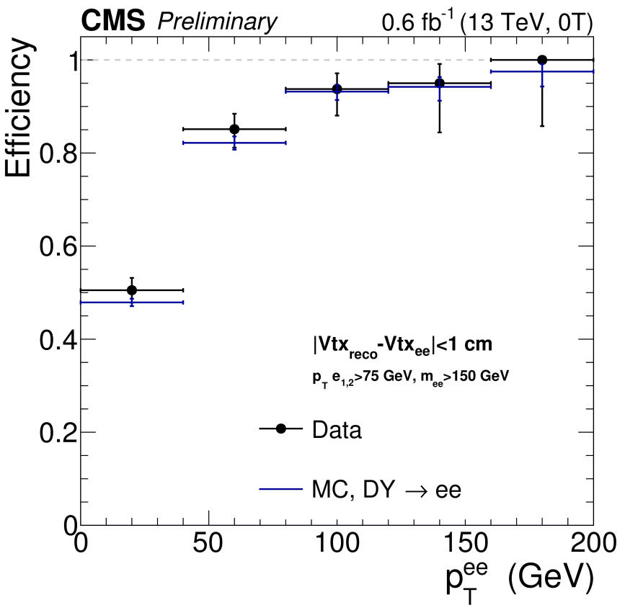
Event Triggering and Vertex identification
Trigger :
At least two photon candidates with p_{T} > 40 (60) GeV for B=0 (3.8)T datasets.
Ratio between energy in hadron calorimeters behind photon candidate to photon energy: ‘H/E’<0.15
Fully efficient for events with m_{γγ} >500 GeV
Electron tracks
removed
Vertex Id: B=3.8T: H→γγ MVA exploiting track p_{T} info B=0T: Vertex with max N_{track} since track momentum info lacking. 90% (60%) correct id for 3.8T (0T), validation with di-μ, γ+ jet (di-e).

Slide 9
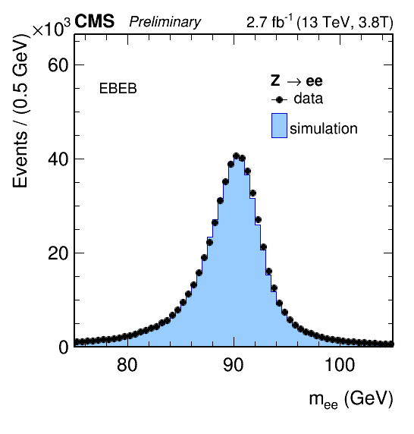
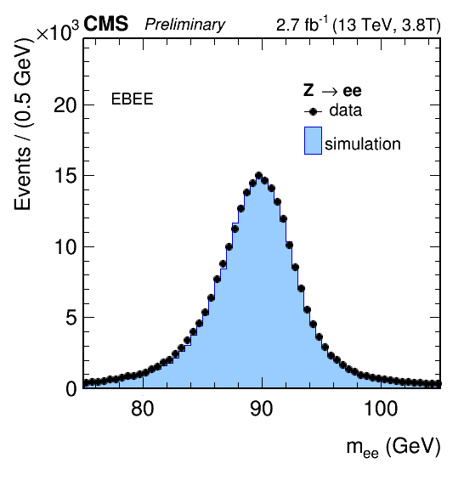
Absolute Energy scale and resolution corrections B=3.8T
Z→ee events used, corrections derived in 8 bins of {|η| X cluster shape} (H→γγ)
Scale corrections~ 0.5%, resolution corrections (add’l smearing) ~0.8-1.5 (2-2.5) for EB (EE)

Slide 10
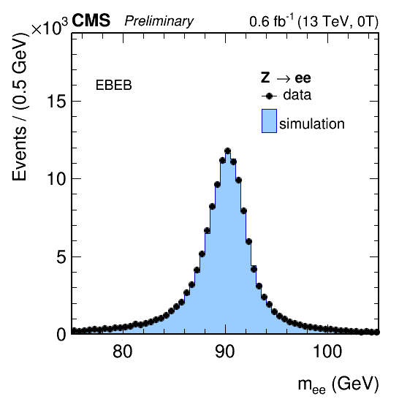
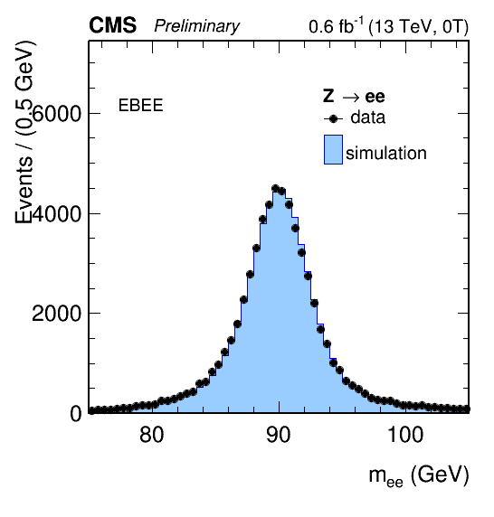
Absolute Energy scale and resolution corrections B=0T
B=0T: Corrections derived in bins of |η| only, scale corrections~1.5%, assign uncertainty of 1%
Transport to higher values of m_{γγ}: Check stability of corrections with boosted Z events, provide ‘photon’ candidates with p_{T} ~150 (100) GeV for EB (EE): Stable to 0.5% (0.7) for EB (EE). Additional uncertainty of 1% assigned on relative energy scale (both B=3.8, 0T).

Slide 11
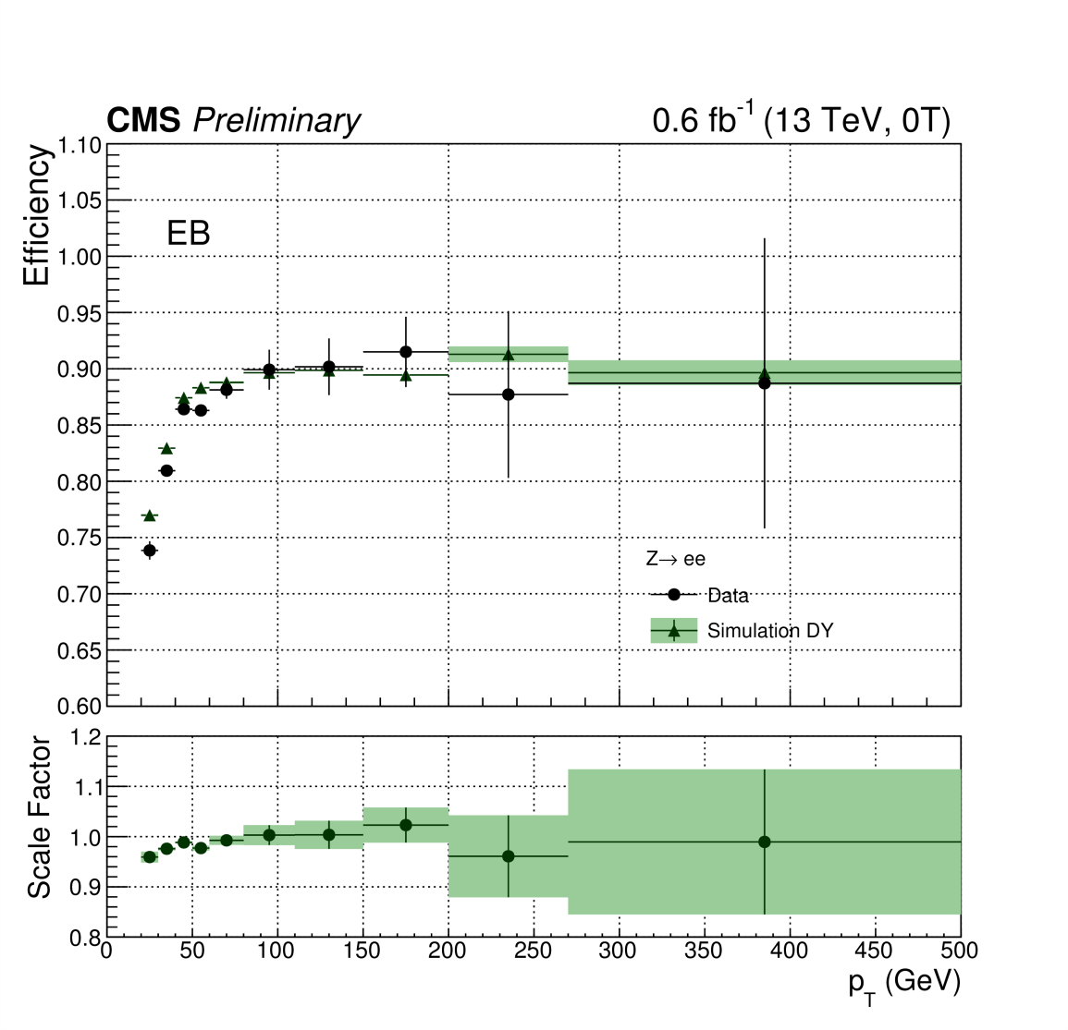
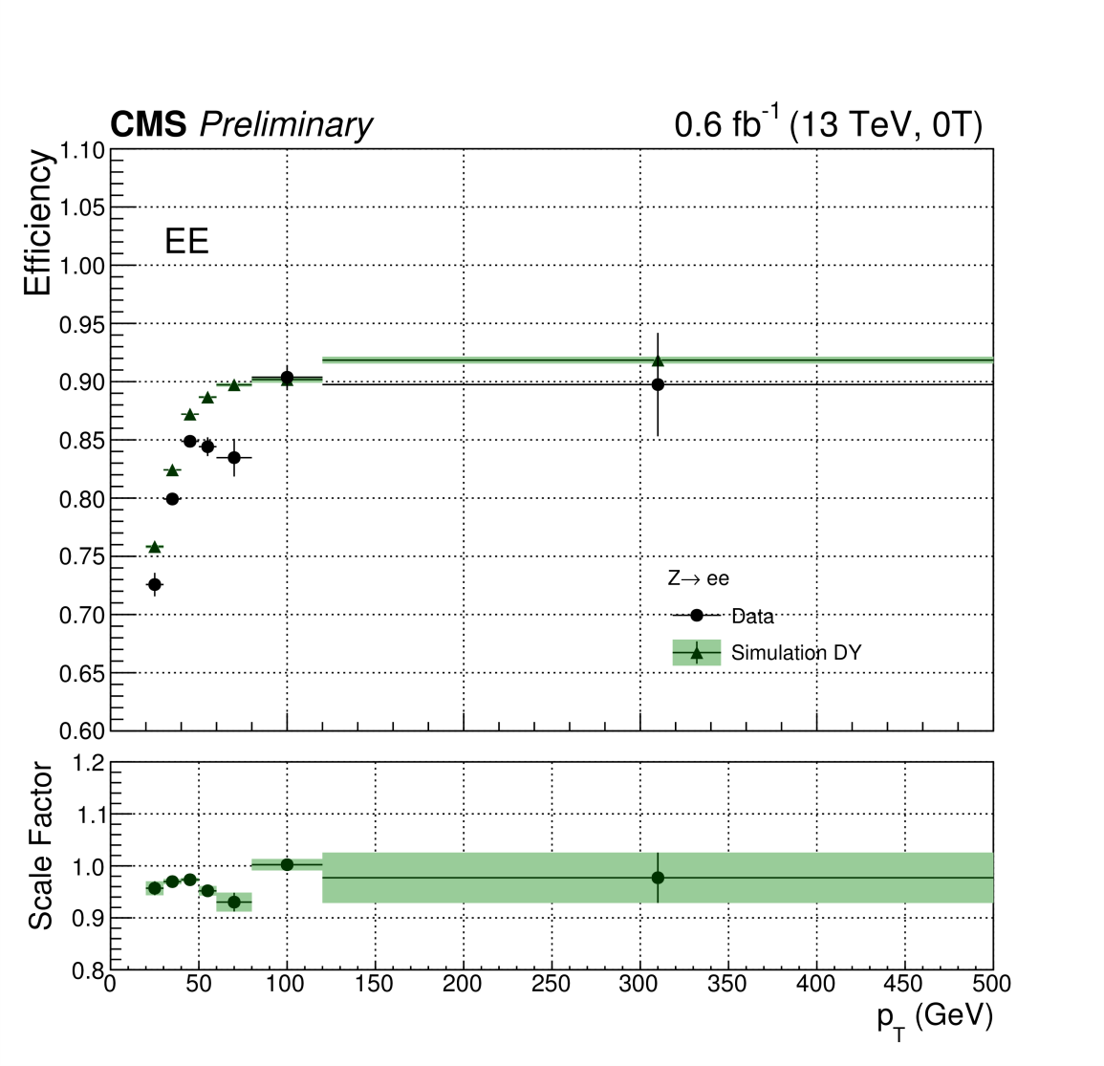
Event selection and photon identification
Photon pair selection: p_{T1,2} > 75 GeV, m_{γγ}>230 (320) GeV for EBEB (EBEE)
Cut-based photon identification: Variables 3.8T (0T): η (η,φ) transverse cluster size, H/E, particle-flow [PF] charged hadron isolation (maximum N_{tracks}), photon isolation, veto non-conversion-compatible electron tracks (require N_{missing hits} >1)
Efficiency from Z→ee events (exc. Electron veto, from Z→μμ (ee)γ for B=3.8(0)T
B=3.8 T: ε> 90%(85%) for EB (EE). B=0T: ε> 85(70)% for EB (EE).

Slide 12
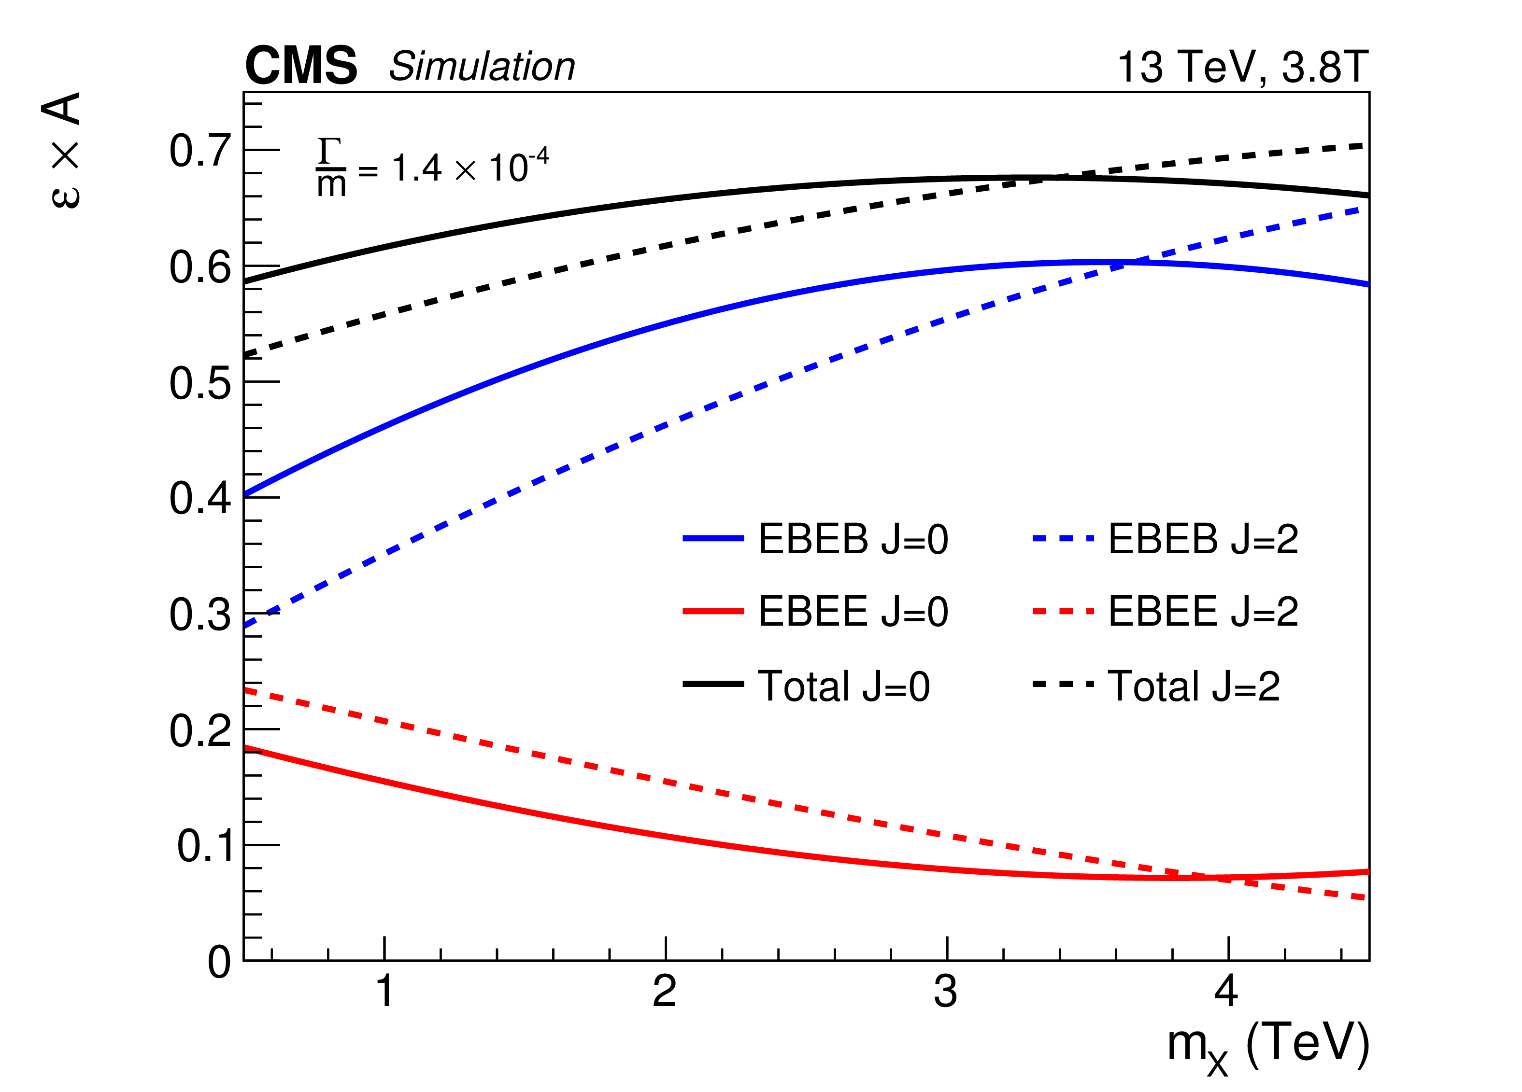
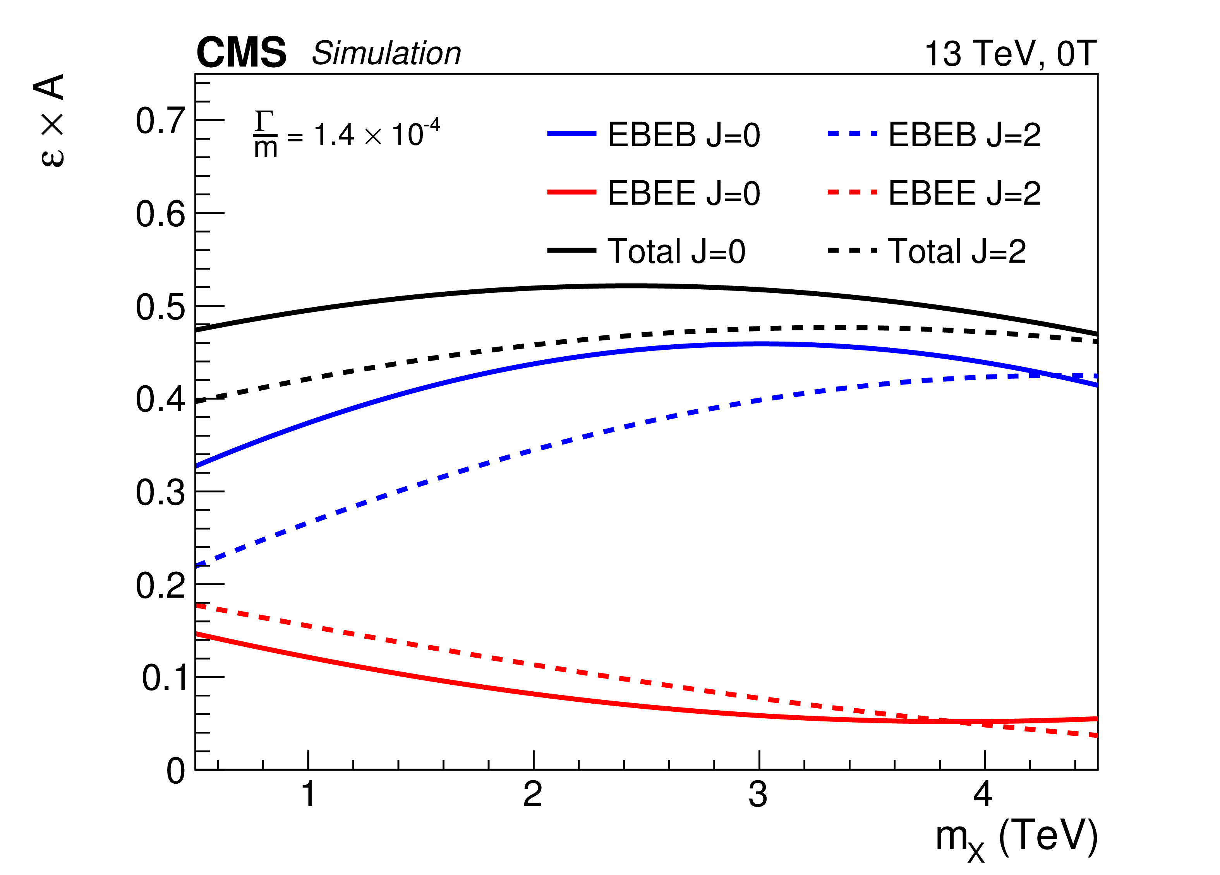
Event selection and photon identification
Efficiency convoluted with detector acceptance, B=3.8 and 0T, all categories, for J={0,2}, for Γ/m=1.4 X 10⁻⁴

Slide 13
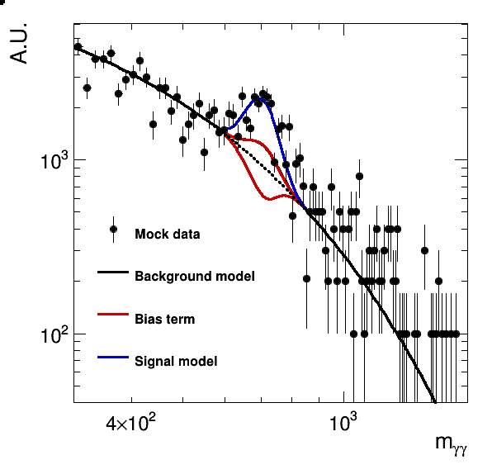
Signal and Background modelling
Signal model:
For both J={0,2}, shape from MC (B-W), convolute with detector response
Shapes from fine grid interpolated to intermediate points
NOT real data, for illustration only!!
Background model: Parametric function
Fit to data in each category, coefficients treated as unconstrained nuisance parameters
Ensure that bias from background model (producing spurious positive or ‘negative’ signals) is tolerable (small wrt statistical uncertainties)
Throw toys from ‘truth’ distribution from MC in 14 m_{γγ} windows, require <pull> <0.5
If criterion fails, additional ‘signal-like’ postive/negative background component added until criterion satisfied

Slide 14
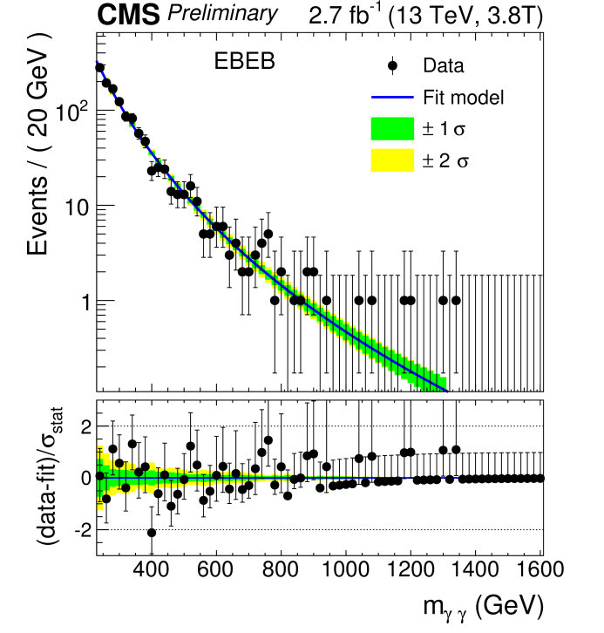
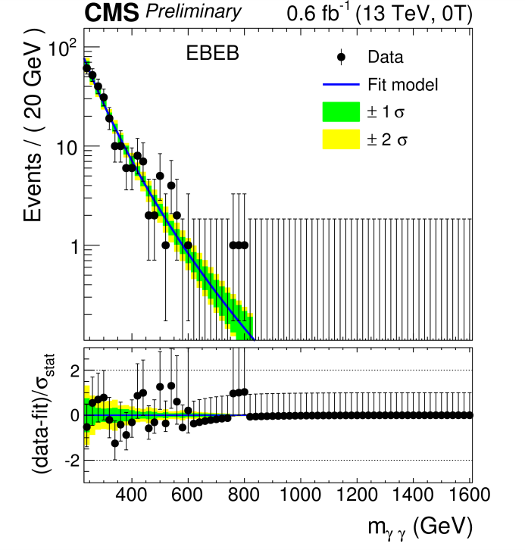
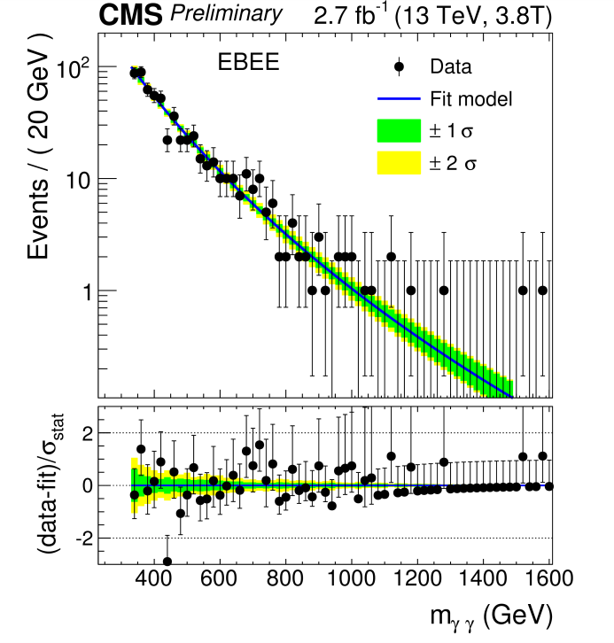
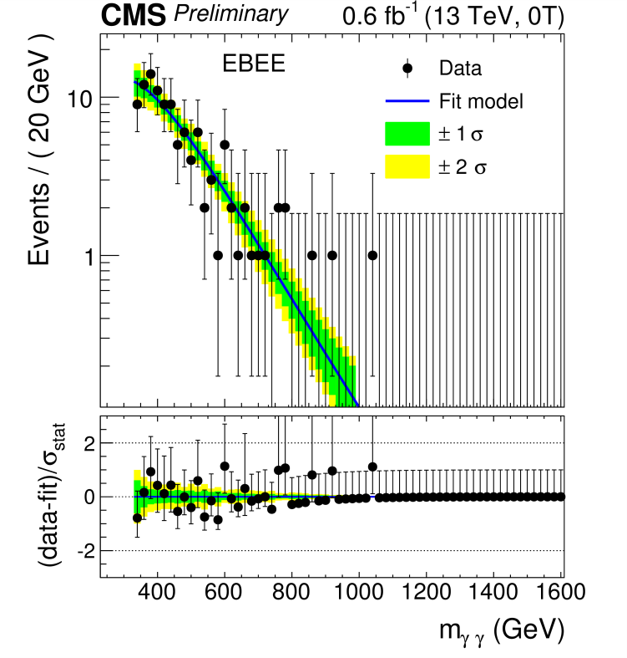
Background models in the four categories/statistical techniques
1236 γγ pairs
278 γγ pairs
665 γγ pairs
118 γγ pairs
Simultaneous unbinned likelihood fit to m_{γγ} in the different categories to obtain limits (CLs method) and p-values (background-only), asymptotic formulae used

Slide 15
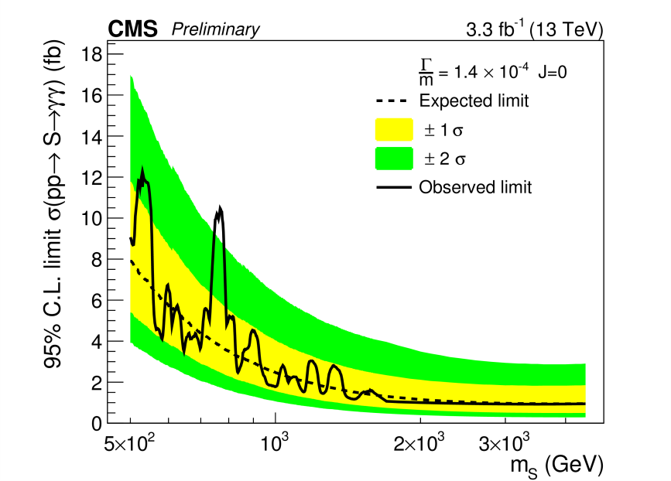
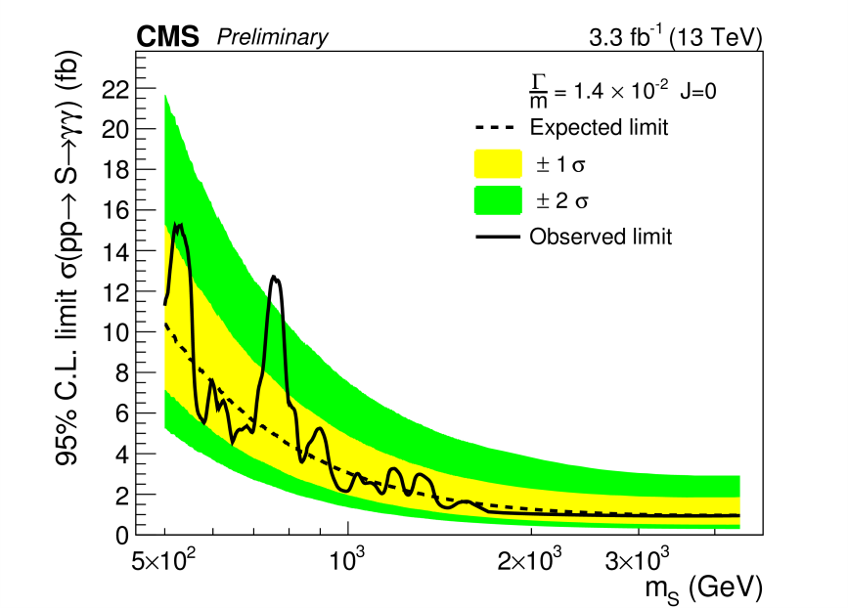
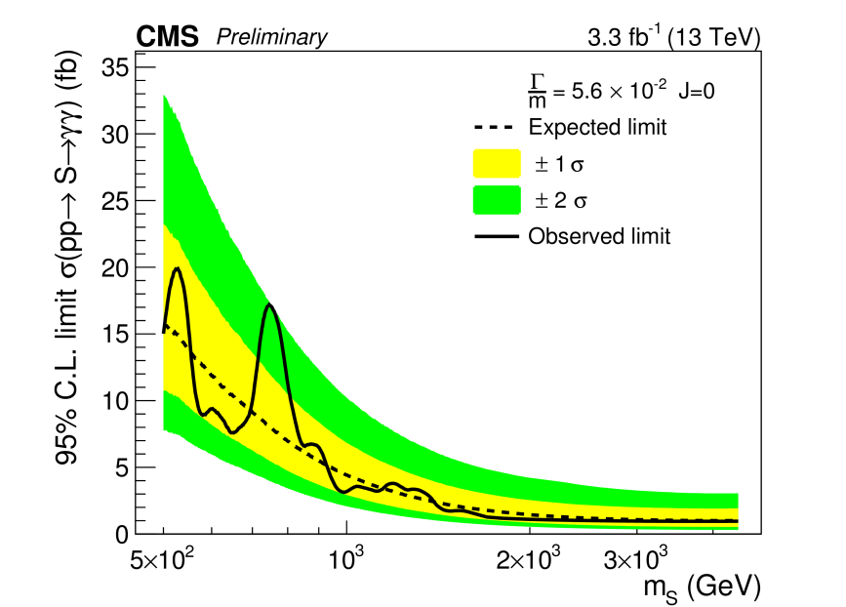
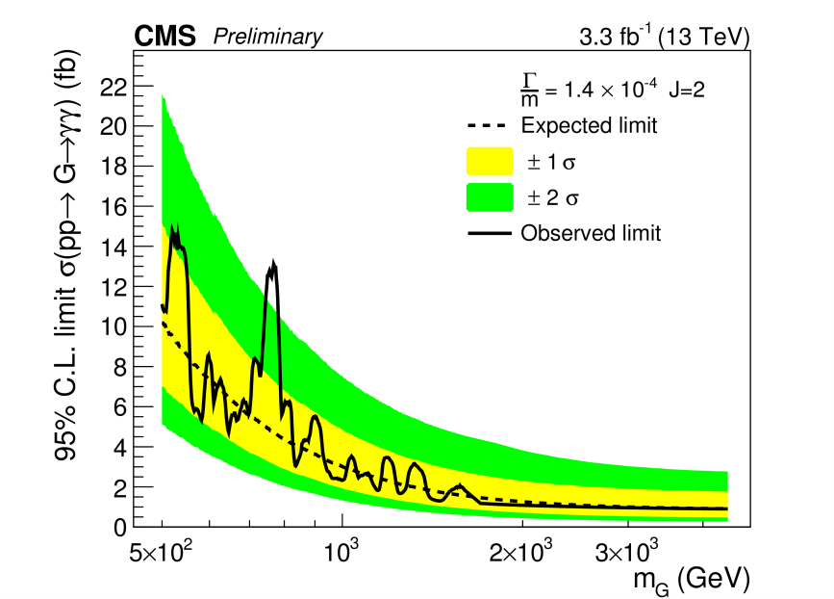
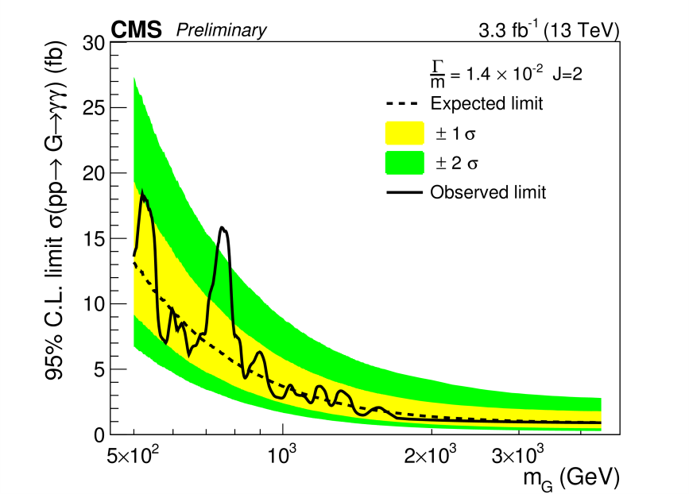
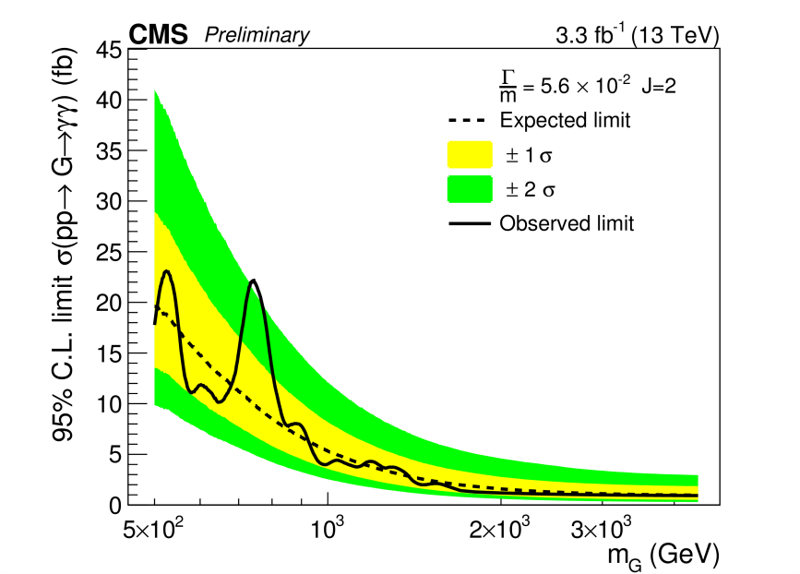
Results for √s =13 TeV: 95% CL Limits on σ X BR
Γ/M ={1.4 X 10⁻⁴, 1.4 X 10⁻², 5.6 X 10⁻²}
J=0
J=2
Excesses diminish with increasing width hypothesis
Notes:
Comments

Slide 16
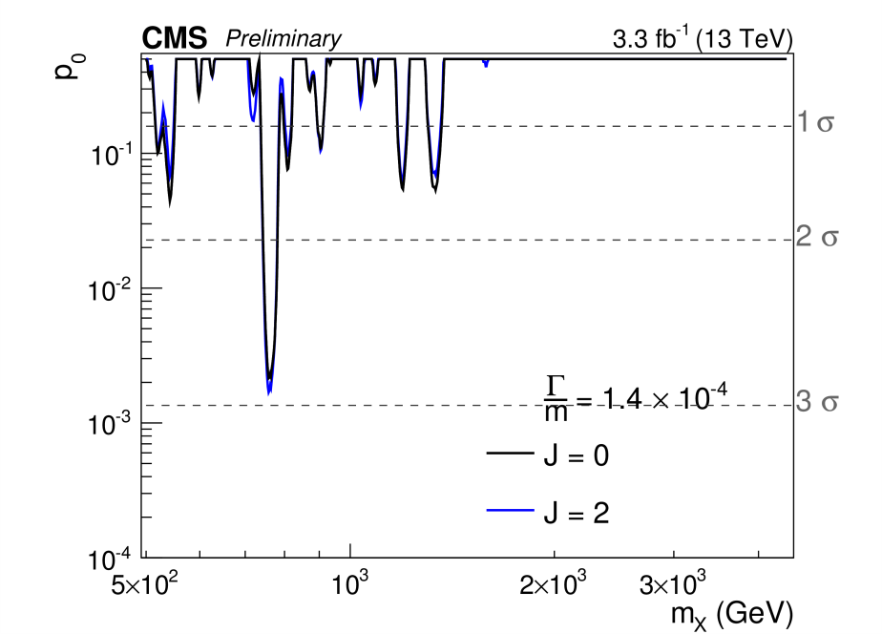
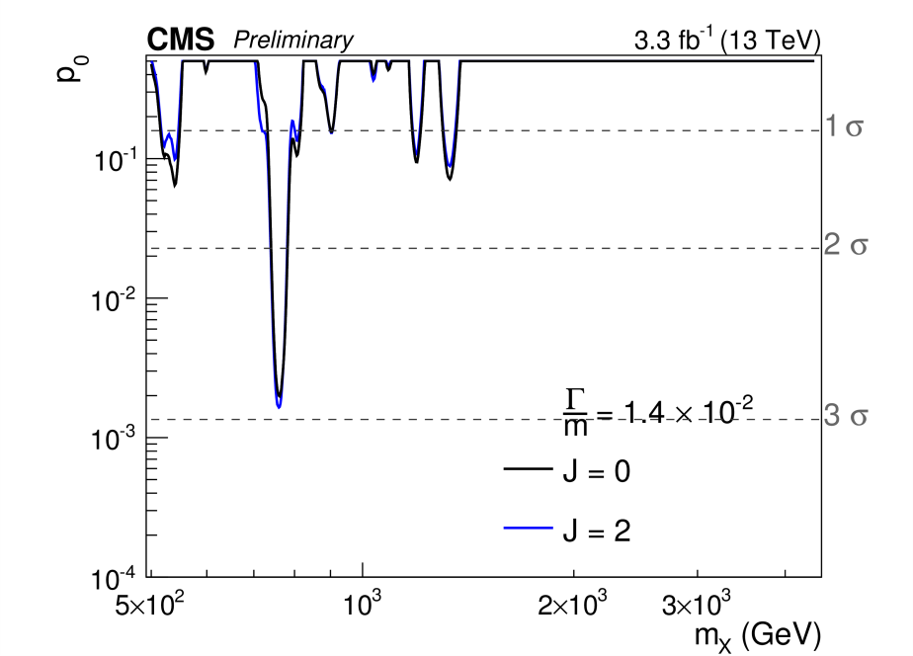
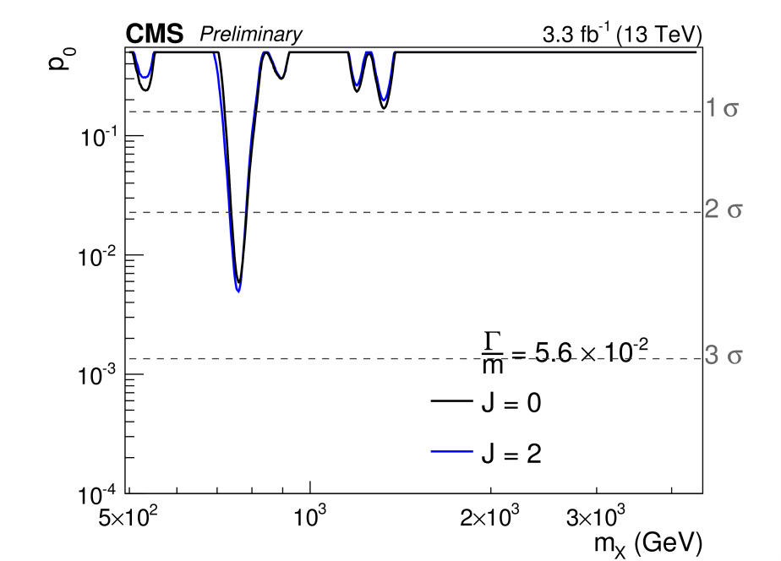
Results for √s =13 TeV: Local and global p-values
Local : Γ/M ={1.4 X 10⁻⁴, 1.4 X 10⁻², 5.6 X 10⁻²}
Most significant excess at m_{X} = 760 GeV, 2.8-2.9σ (two narrowest widths)
Global significance after taking into account ‘look-elsewhere’ effect <1σ

Slide 17
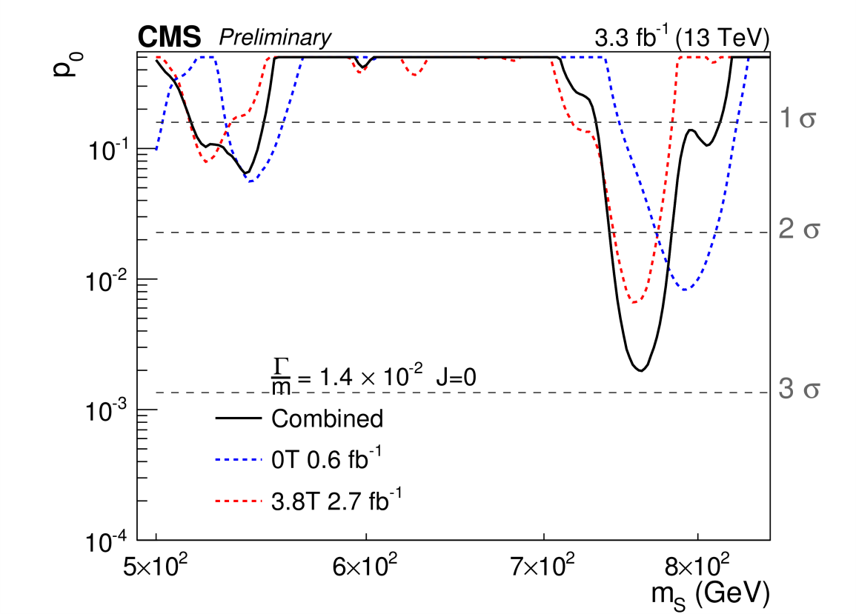
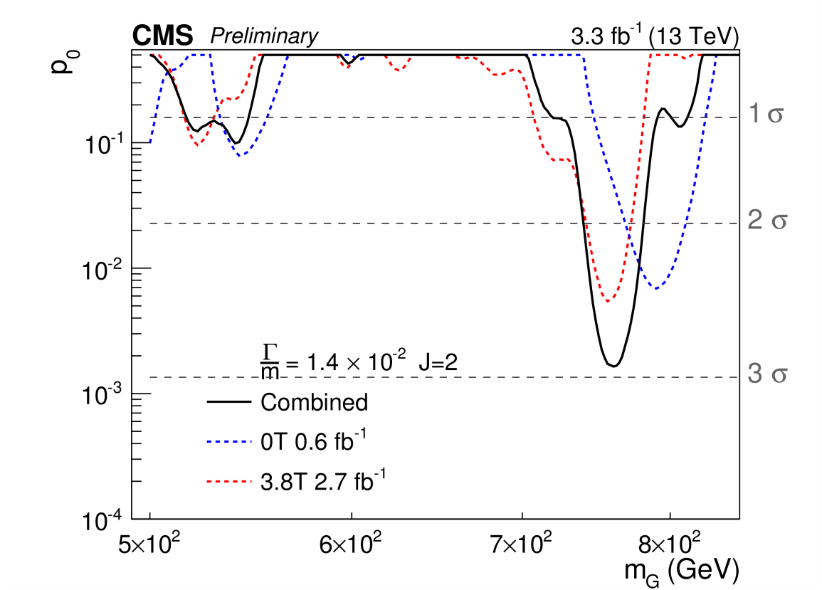
Results for √s =13 TeV: Local and global p-values
Local p-values for B={3.8,0T} datasets integrated over EBEB and EBEE for J={0,2}, for Γ/m=1.4 X 10⁻²
J=0
J=2

Slide 18
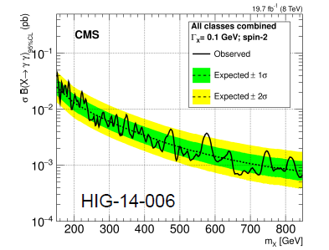
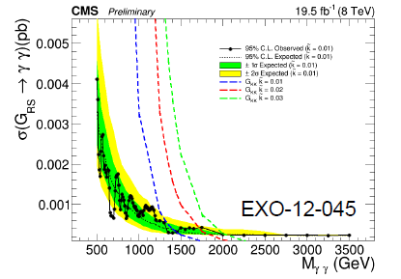
Combination of results from analyses at √s =8 and 13 TeV
Combine results of 2 searches done at √s = 8 TeV:
CMS-HIG-14-004 (PLB 750 (2015) 494): Search for diphoton resonances with 150 GeV< m_{γγ} < 850 GeV, interpretation as J={0,2}
EXO-12-045: Search for diphoton resonances with 500 GeV< m_{γγ} < 3000 GeV, interpretation as J=2 only
Total search range split between two analyses according to which analysis yields strictest limit: HIG-14-004 for 500 GeV< m_{γγ} < 850 GeV, EXO-12-045 for 850 GeV< m_{γγ} < 3000 GeV
Combine the √s =8 TeV results with those from √s =13 TeV normalizing 8 TeV signal cross sections to those at 13 TeV, assuming common signal strength modifier
J=0: σ(13TeV)/σ(8TeV) = 4.7
J=2: σ(13TeV)/σ(8TeV) = 4.2
Quote limits on σ_{13TeV} XBr, local and global p-values

Slide 19
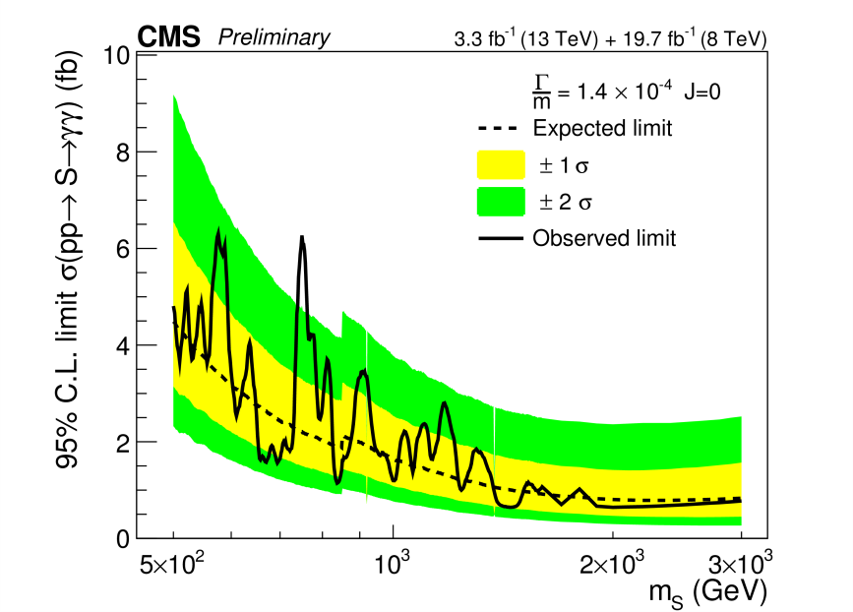
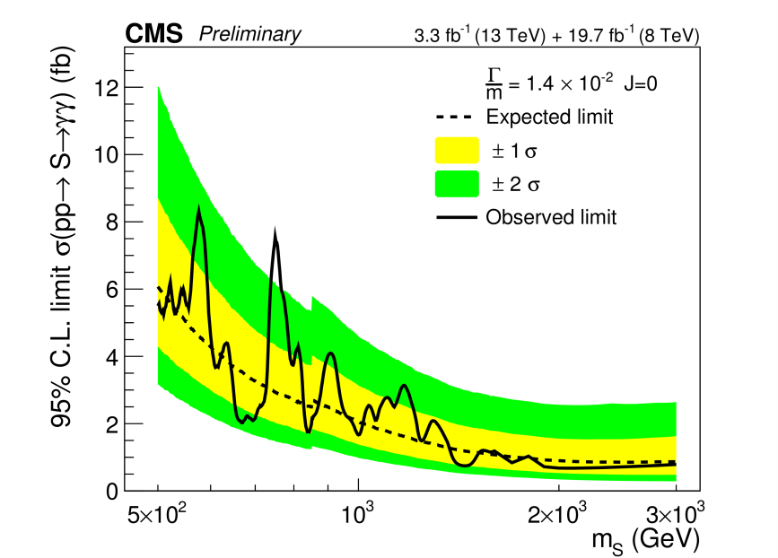
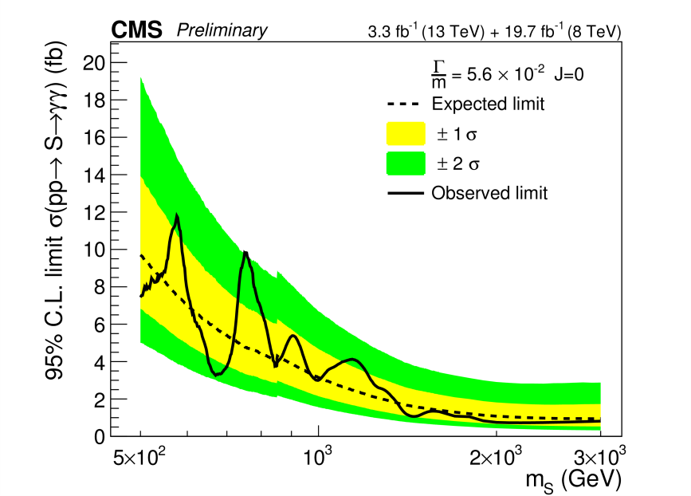
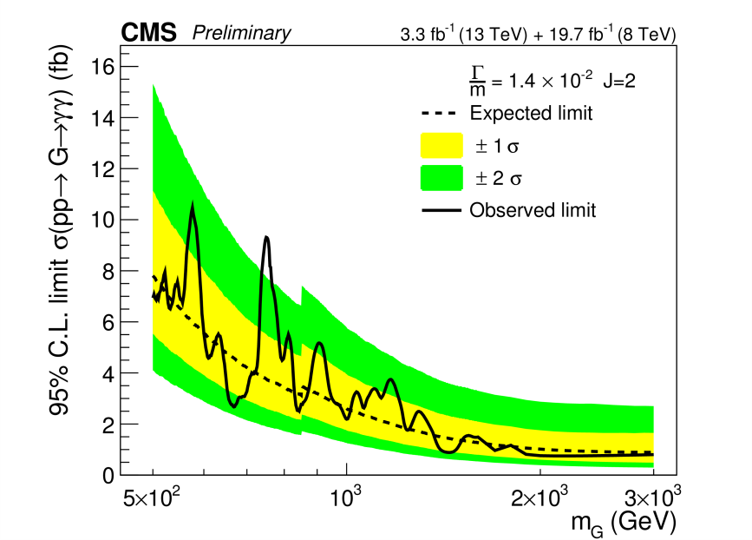
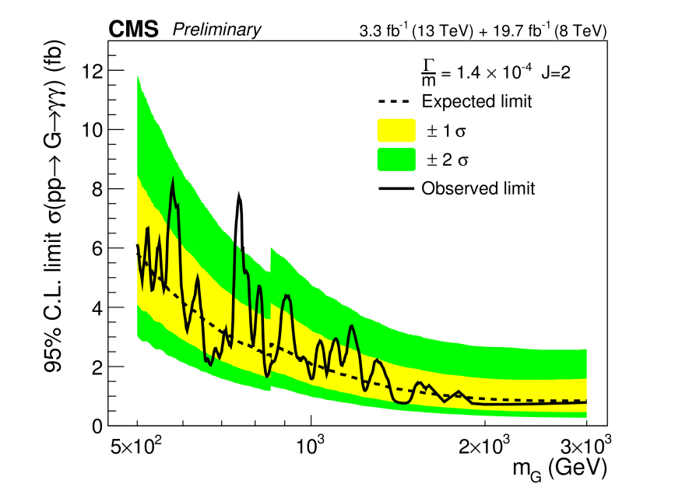
Combination of results from analyses at √s =8 and 13 TeV: 95% CL Limits on σ X BR (normalized to σ_{13TeV})
Γ/M ={1.4 X 10⁻⁴, 1.4 X 10⁻², 5.6 X 10⁻²}
J=0
Sensitivity improves by 20-40% wrt separate analyses for range m_{X} >1.5 TeV
J=2

Slide 20
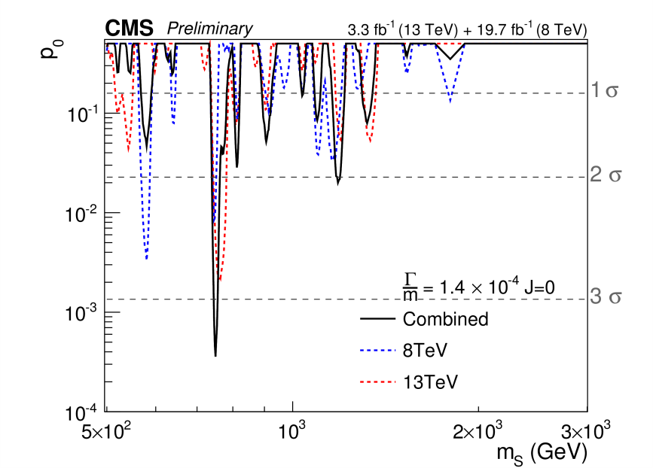
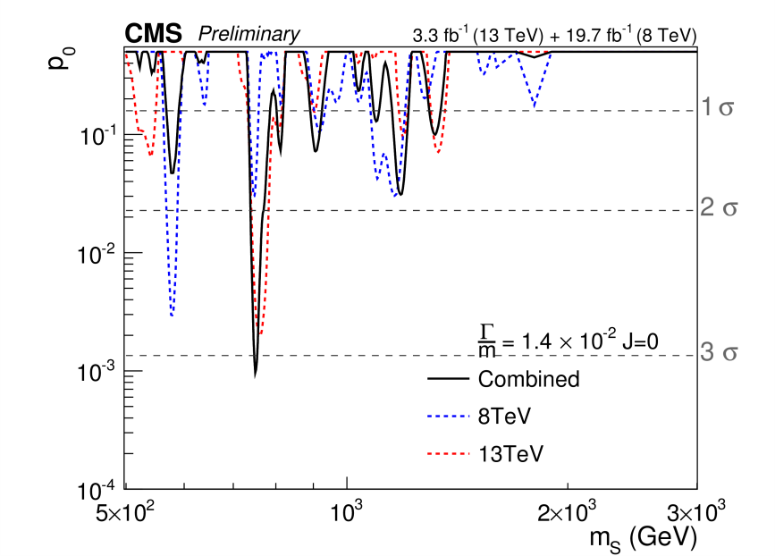
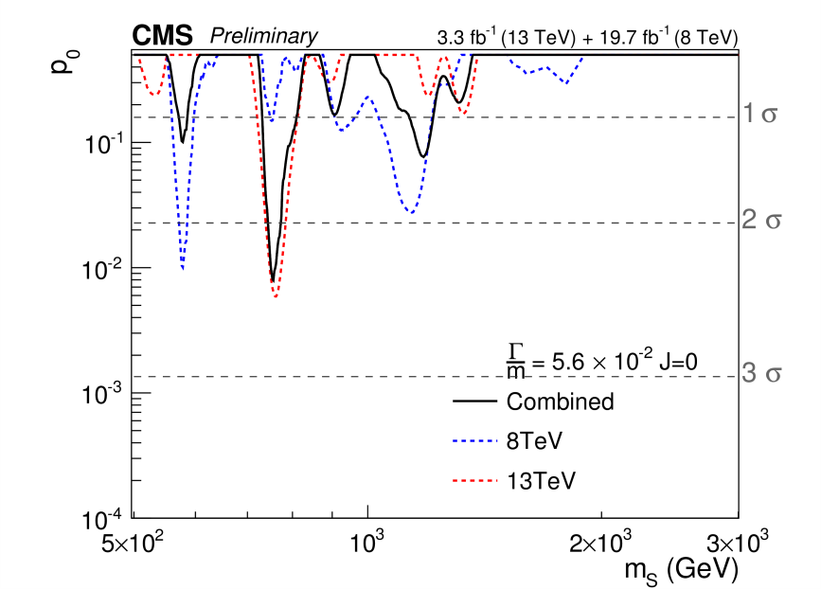
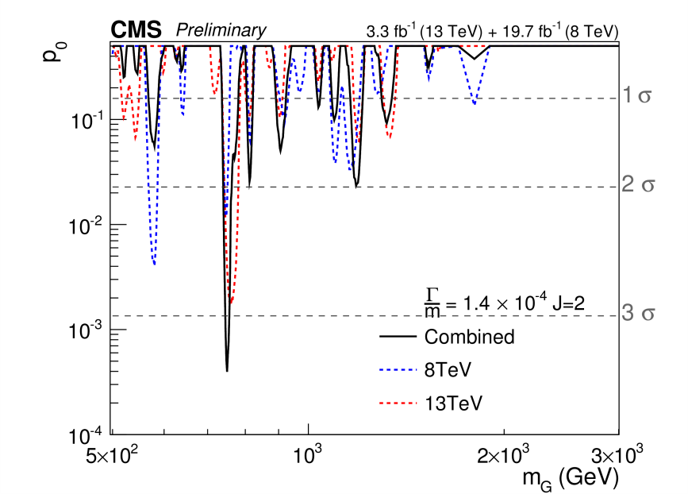
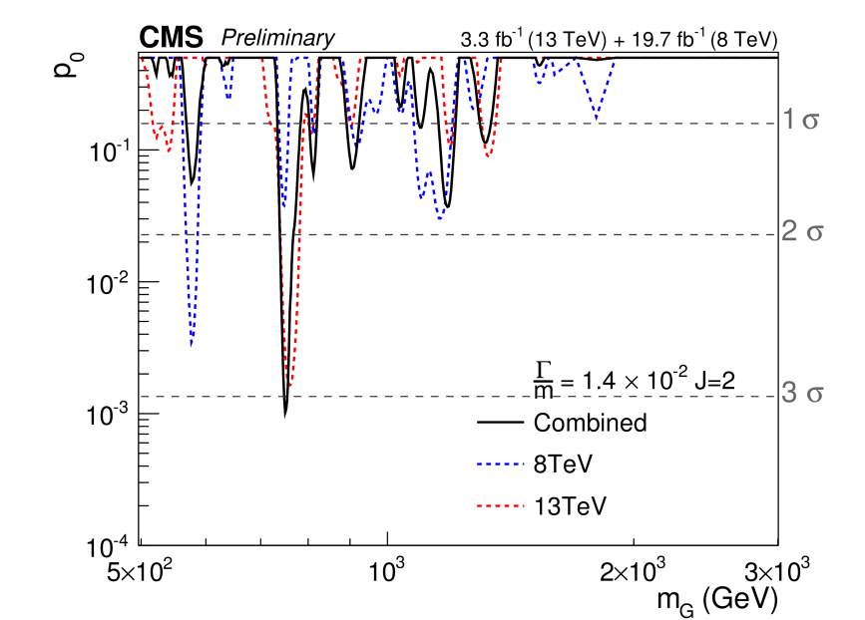
Combination of results from analyses at √s =8 and 13 TeV: Local and global p-values
Γ/M ={1.4 X 10⁻⁴, 1.4 X 10⁻², 5.6 X 10⁻²}
J=0
Largest excess @m_{X}=750 GeV, narrow width. Local (global) significance: 3.4 (1.6)σ
J=2

Slide 21
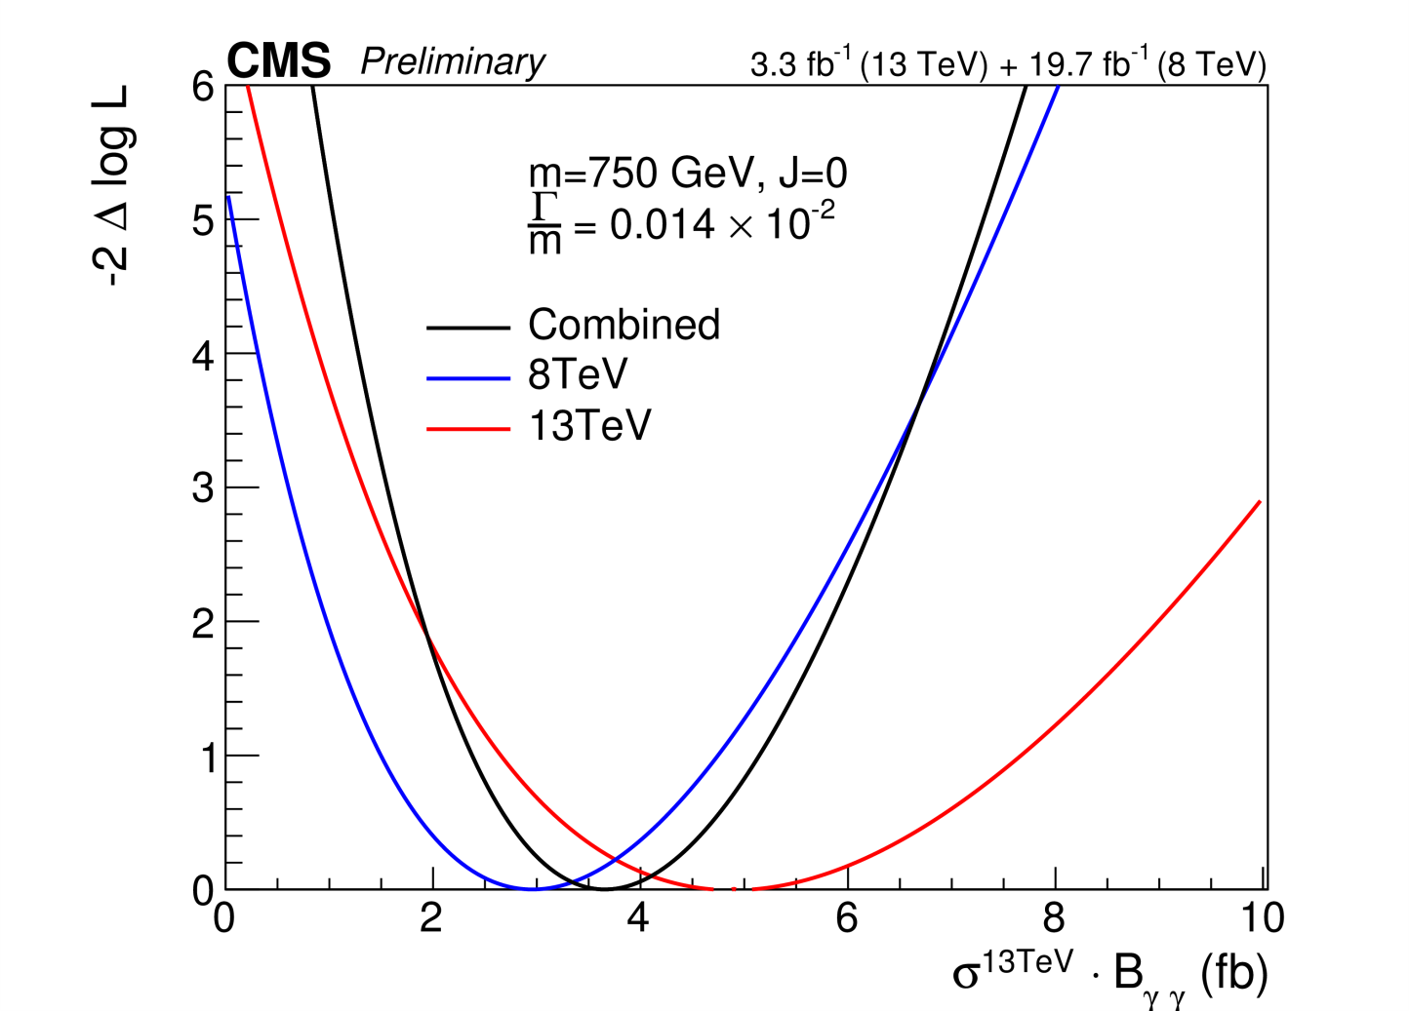
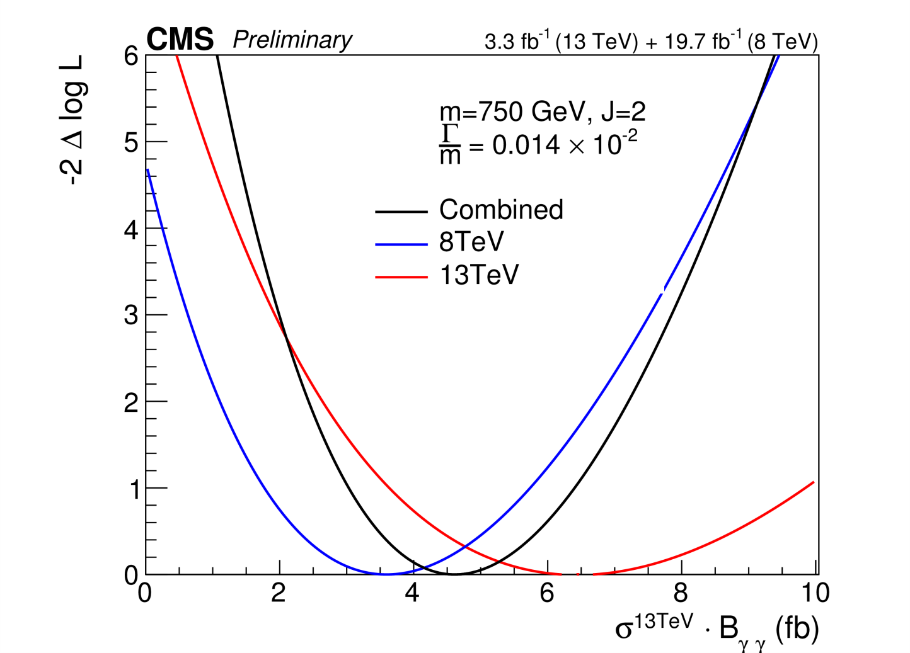
Combination of results from analyses at √s =8 and 13 TeV: Consistency
Likelihood scan of equivalent cross-section @13 TeV assuming m_{X}=750 GeV, Γ/M =1.4 X 10⁻² : minima for each √s value compatible to better than 1σ

Slide 22
Summary and Conclusions
The CMS search for diphoton resonances at √s =13 TeV in the range 500 GeV< mgg < 4.5 TeV has been reinforced by a new electromagnetic calorimeter calibration using 2015 data, and the inclusion of the data taken at 0T, resulting in an improvement in sensitivity of more than 20%
The combination of the results with those from analyses at √s =8 TeV has enabled an additional improvement in sensitivity of 20-40%
Interpretations as both a scalar (J=0) and a R-S graviton (J=2) for three different relative widths yield similar results:
Modest excess of events at m_{X} = 750 (760) GeV for the combined (√s =13 TeV) datasets
Local significance : 3.4 (2.9)σ , global significance: 1.6 (<1)σ
2016 data-taking is starting, ~25fb⁻¹ expected, new results forthcoming!

Slide 23
Acknowledgements
P. Musella, A. Lath, D. del Re, S. Valouev, T. Hryn’Ova, the CMS Exotica and Higgs Working Groups in general ….
The LIA-THEP INFRE-HEPNET CEFIP and the local Organizers and Staff
The French CNRS and INP
The French Embassy in India and the CNRS Office in India
The IISc and the ISTC

Slide 24
Backup

