Slide 1
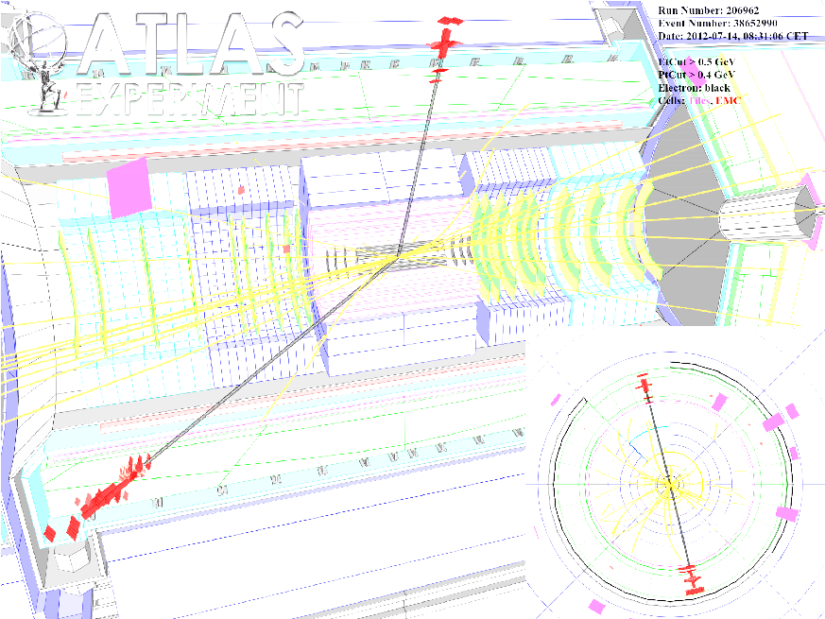
ATLAS Trigger Menu & Dilepton Searches
Tetiana Berger-Hryn’ova
3 June 2016

Slide 2
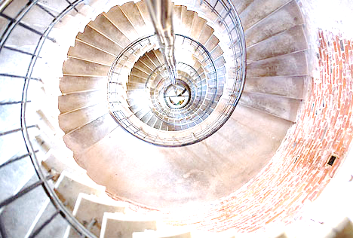
My timeline on ATLAS
2006-2009 Electron Triggers
2010-2012 Exotics Triggers
2013-2015 Trigger Menu for Run 2
2009-now Dilepton searches
https://www.flickr.com/photos/primejunta/2518179985

Slide 3
My timeline on ATLAS
2006-2009 Electron Triggers
2010-2012 Exotics Triggers
2013-2015 Trigger Menu for Run 2
2009-now Dilepton searches
https://www.flickr.com/photos/primejunta/2518179985

Slide 4
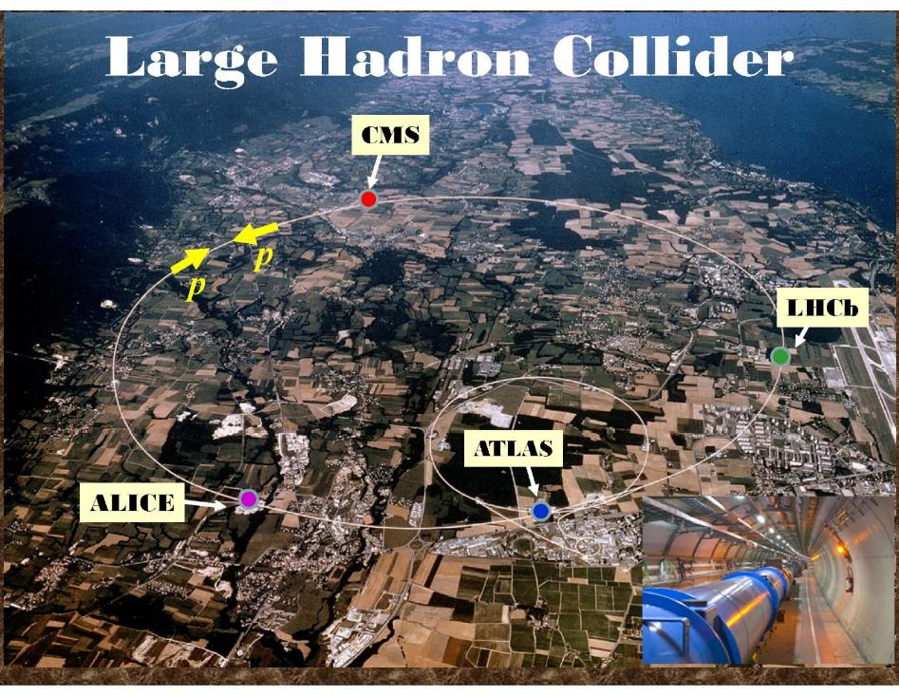
Heavy Ion data-taking is not discussed in this talk.

Slide 5
LHC timeline
Year | Peak Lumi 10³⁴cm⁻²s⁻¹ | Bunch Spacing | Pile-up* | Total Lumi [fb⁻¹]
Design | 1 | 25 | 25 | -
2011 | 0.37 | 50 | 9 | 5
2012 | 0.77 | 50 | 23 | 23
2015 | 0.5 | 25 | 14 | 4
2016* | ~1 | 25 | 43 | 25
*expected values
√s=
7
7
8
13
13
…
Run 1
Run 2
Run 3
5

Slide 6
ATLAS Detector

Slide 7
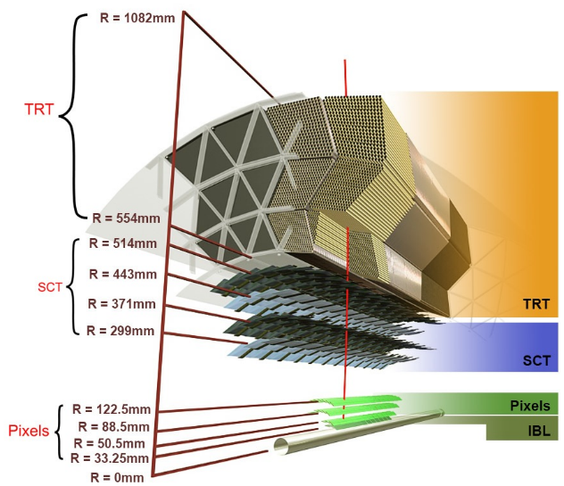
Inner Detector
Transition Radiation Tracker (TRT): drift tubes with gas (Xe or Ar), 350 k channels, 36 measurement points
Semiconductor Tracker (SCT) Silicon, 6.2 M channels, 4 layers
Pixel Detector: Silicon, 92 M channels, 4 layers

Slide 8
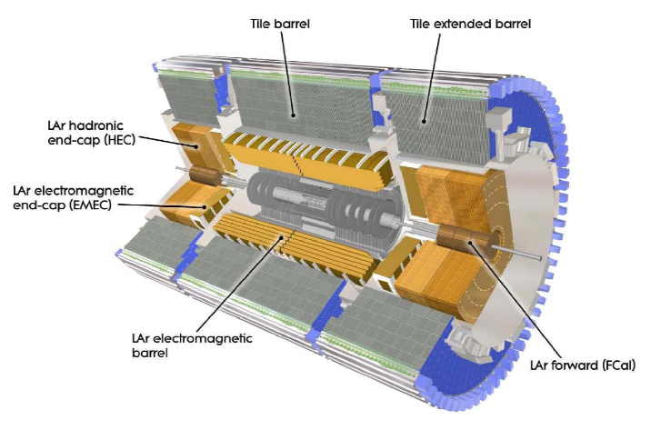
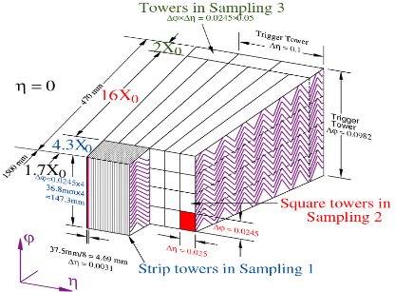
Calorimeters
Hadronic Barrel :
Scintillator/Fe, |η| < 1.7
EM Calorimetry :
Liquid-Argon/Pb accordeon, |η|<3.2
Cryostat
Hadronic End-cap:
Liquid Argon/Cu, 1.5 < |η| < 3.2
Forward Calorimeters:
Liquid Argon/Cu/W,
3.1 < |η| < 4.9

Slide 9
Muon Spectrometer
Muon Spectrometer : |η| < 2.7
Standalone:
Combined with
inner tracker:
Notes:
psis are mostly in the forward region (in ID endcap) => resolution not as good as In the barrel…

Slide 10
Trigger & DAQ
σ (proton-proton)
Trigger Menu
encodes configuration
of the trigger.

Slide 11
L1 Trigger Overview
Timing requirements <2.5µs

Slide 12
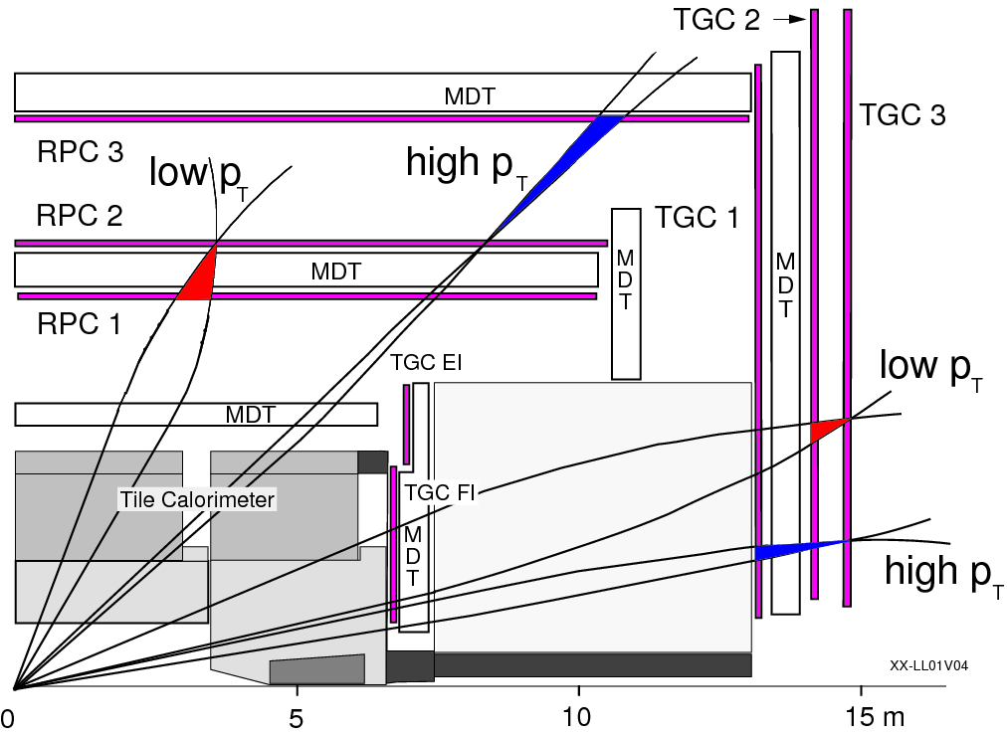
L1 Muon Trigger
coincidences in chamber layers
widths determines p_{T} threshold (6 possibilities L1_MU)

Slide 13
L1 Calorimeter Trigger
Objet | Type
Electron, Photon | EM
Tau | TAU
Jet | J
E_{T}^{Miss} | XE, XS
ΣE_{T} | TE
“I”
“H”
Threshold value (in GeV) can vary with η “V”

Slide 14
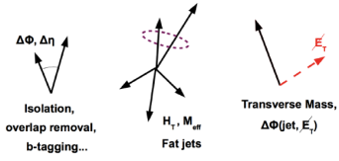
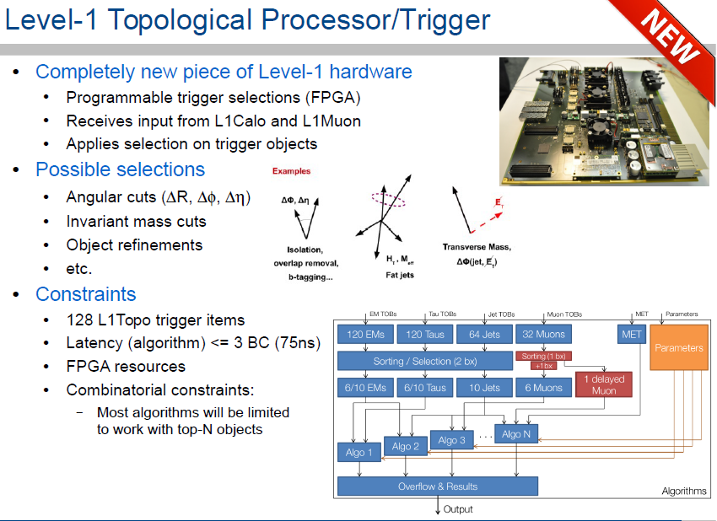
L1 Topo Trigger
Input “Objects”:
Muon, Missing E_{T}, EM,
Tau & Jet cluster
E_{T}/p_{T}, η, φ, & isolation.
All objects
sorted into lists:
“sorted” or
“abbreviated”
Up to 128 L1 Topo
trigger decisions possible

Slide 15
Central Trigger Processor
Multiplicities
Logical selection
Prescales
Bunch Crossing
Identification
Trigger Type
Region of Interest:

Slide 16
High Level Trigger
Electron Chain
  Software running on large commercial PC farms
  Limitations
    Size of the Farm:
    Rate x Timing = CPU used
    Total output rate ~1kHz
L1 RoI
Fast calorimeter reconstruction
Fast calorimeter selection
Fast track reconstruction
Fast electron reconstruction
Fast electron selection
Object | Notation
electron | e
photon | g
muon | mu
tau | tau
jet | j
b-jet | jet_b[TagType]
E_{T}^{Miss} | xe
Precision calorimeter reconstruction
Energy calibration
Precision calorimeterselection
Precision track reconstruction
Precision electron reconstruction
Precision electron selection

Slide 17
Electrons
Electron Chain
L1 RoI
Fast calorimeter reconstruction
Fast calorimeter selection
Fast track reconstruction
Fast electron reconstruction
Fast electron selection
Precision calorimeter reconstruction
Energy calibration
Precision calorimeterselection
Precision track reconstruction
Precision electron reconstruction
Precision electron selection

Slide 18
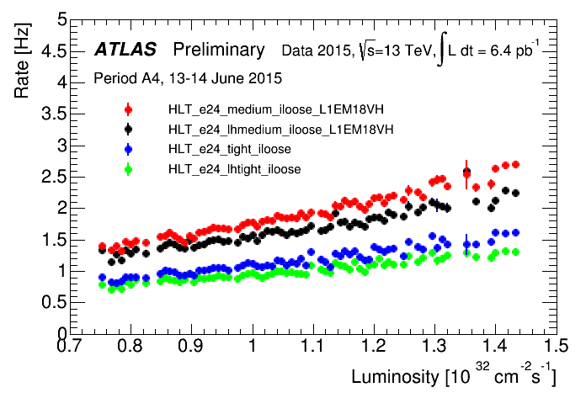
Electrons
Electron Chain
L1 RoI
Fast calorimeter reconstruction
Fast calorimeter selection
Fast track reconstruction
Fast electron reconstruction
Fast electron selection
Precision calorimeter reconstruction
Energy calibration
Precision calorimeterselection
Precision track reconstruction
Precision electron reconstruction
Precision electron selection

Slide 19
Electron Chain
Tau Chain
Jet Chain
Muon Chain
L1 RoI
L1 RoI
L1 RoI
L1 MU RoI
Fast calorimeter reconstruction
Precision calorimeter reconstruction
Precision calorimeter reconstruction
Fast muon track
reconstruction
Fast calorimeter selection
Energy calibration
Presicion jet reconstruction
Fast
muon track selection
p_{T} cut
Energy calibration
Fast track reconstruction
Precision jet selection
Fast track reconstruction
Fast electron reconstruction
Fast track reconstruction Step 1
Fast track selection
Fast electron selection
Fast track reconstruction Step 2
Matching
Cut on number of tracks
Final detector calibration and alignment constants not available online:
allow for the lower precision in the trigger cuts
Precision calorimeter reconstruction
Precision muon reconstruction
Energy calibration
Precision track reconstruction
Precision muon track
selection
Precision calorimeterselection
Precision tau reconstruction
Precision track reconstruction
Precision tau selection
Precision track reconstruction
Precision
track
selection?
Precision electron reconstruction
Precision muon reconstruction
Precision electron selection
Precision muon selection

Slide 20
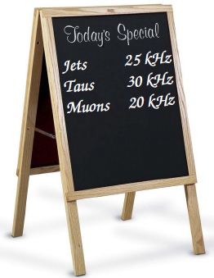
Trigger Menu = list of all triggers of interest
Luminosity
dependent!
σ (proton-proton)

Slide 21
Physics Menu Priorities
SM
Higgs
Exotics
SUSY
Top
B-Physics
&
Light States

Slide 22
Supporting triggers inputs
µ
Track
ing
SM
Higgs
τ
Exotics
Jet &
E_{T}^{Miss}
SUSY
Top
B-Physics
&
Light States
Flavor tagging
e/γ

Slide 23
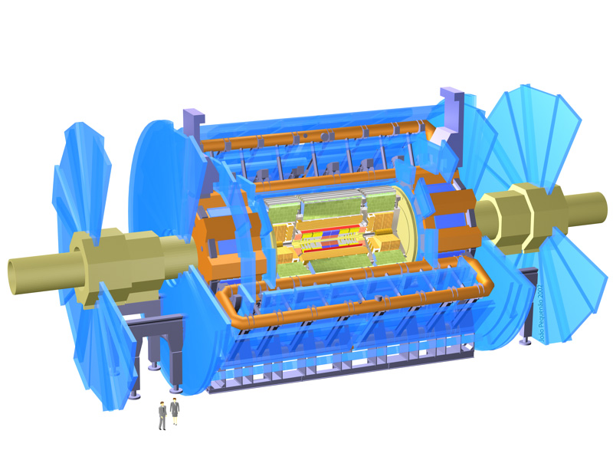
Monitoring, Calibration Inputs
µ
Track
ing
SM
Higgs
τ
Exotics
Jet &
E_{T}^{Miss}
SUSY
Top
B-Physics
&
Light States
Flavor tagging
e/γ

Slide 24
Physics Requests Summary
Keep triggers as inclusive & simple as possible!
  Single lepton (electron and muon triggers) below W
  Single/di/tri-object triggers at thresholds as low as possible
Topological, multi-object and dedicated triggers can be of huge benefit for certain analysis
Menu should be stable throughout the Run 2
Physics
Priorities
Constraints

Slide 25
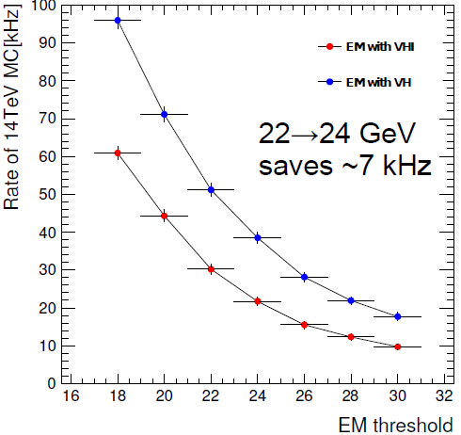
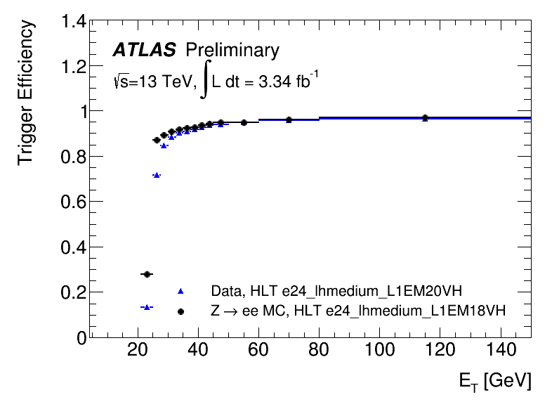
Single Electron Triggers
@ 2x10³⁴cm⁻²s⁻¹
Level | 0.5 10³⁴ | 1.0 10³⁴ | 1.5 10³⁴ | 2.0 10³⁴
L1 | EM18VH 25kHz EM20VH 18kHz | EM20VHI ~20kHz | EM22VHI ~20kHz | EM24VHI ~20kHz
HLT | e24_mediumlh (i?) | e24_lhtight_ivarloose | e26_lhtight_i… | e28_lhtight_i…
Numbers in italic are my estimate

Slide 26
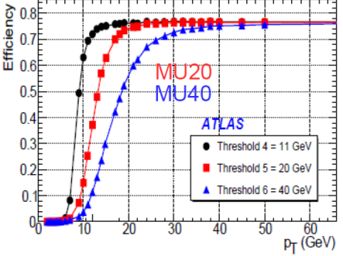
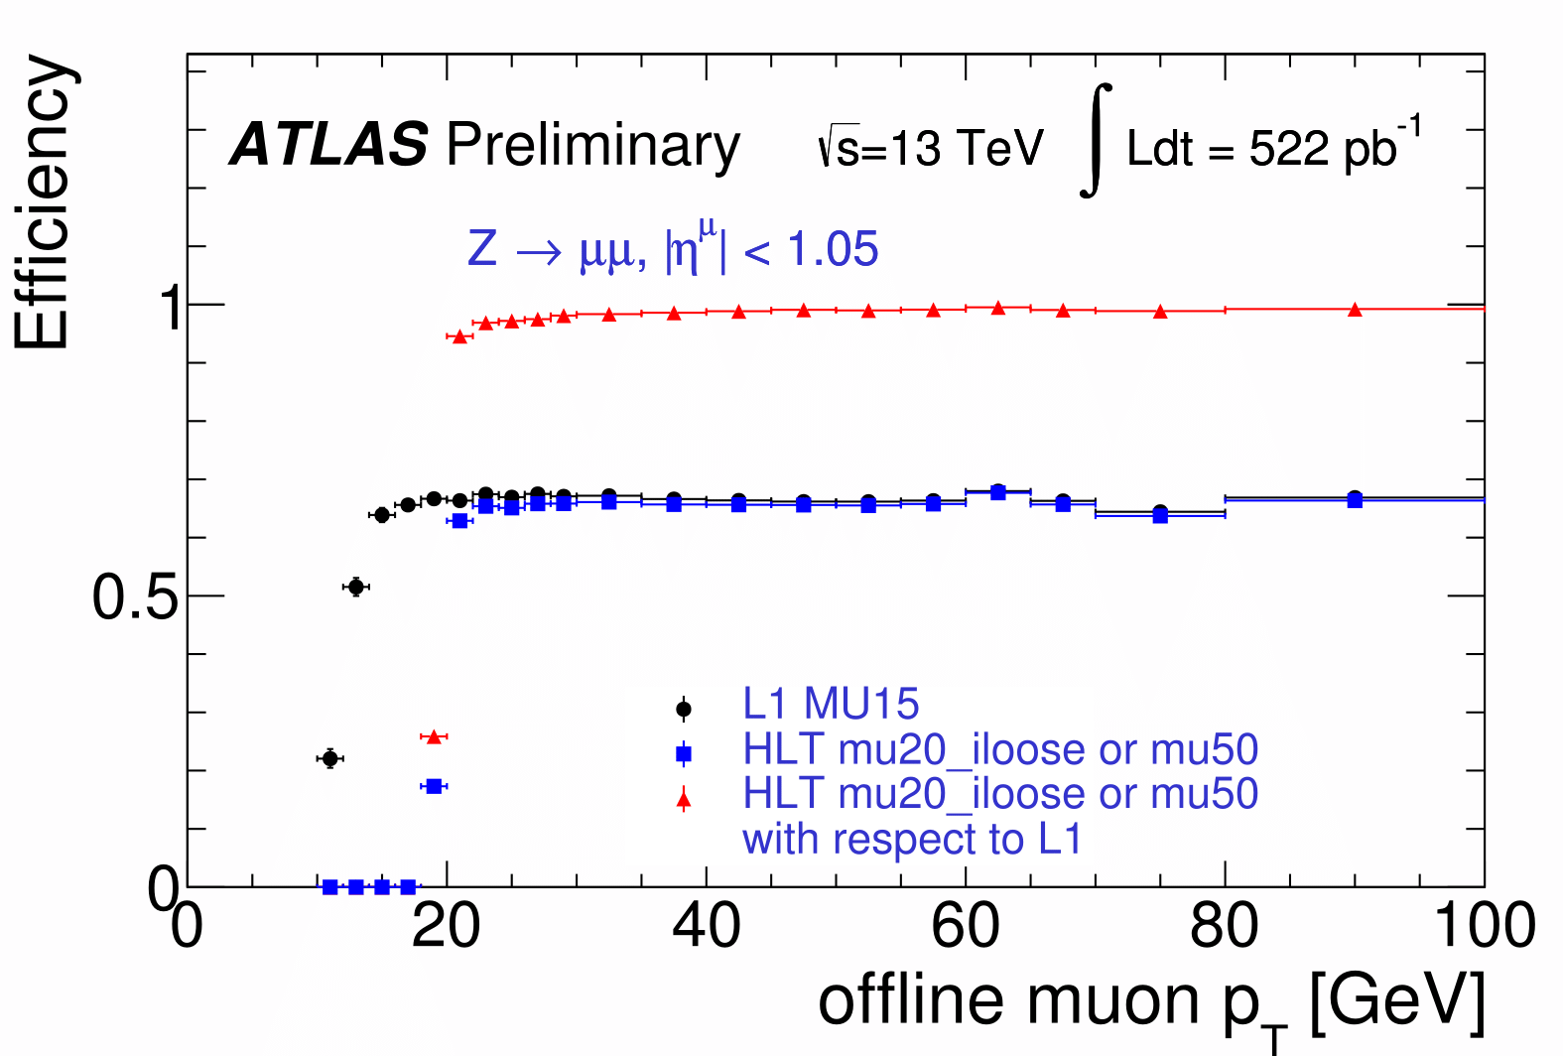
Single Muon Triggers
 | 0.5 10³⁴ | 1.0 10³⁴ | 1.5 10³⁴ | 2.0 10³⁴
L1 | MU15 7kHz | MU15 ~14kHz | MU20 ~14kHz | MU20 ~18kHz
HLT | mu20i | mu22i | mu24i | mu26i
Numbers in italic are my estimate

Slide 27
Single Muon Triggers
 | 0.5 10³⁴ | 1.0 10³⁴ | 1.5 10³⁴ | 2.0 10³⁴
L1 | MU15 7kHz | MU15 ~14kHz | MU20 ~14kHz | MU20 ~18kHz
HLT | mu20i | mu22i | mu24i | mu26i
Numbers in italic are my estimate

Slide 28
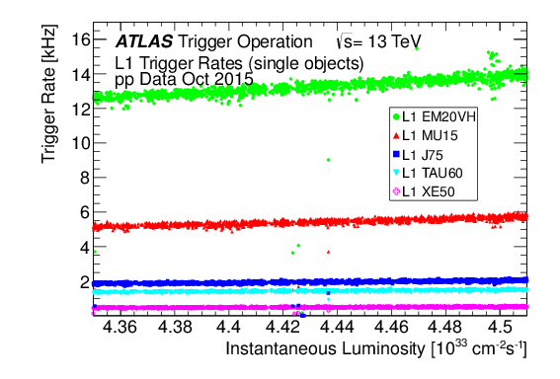
More on L1: single objects
Maximum of 512 L1 Trigger Items (including 128 of L1Topo)

Slide 29
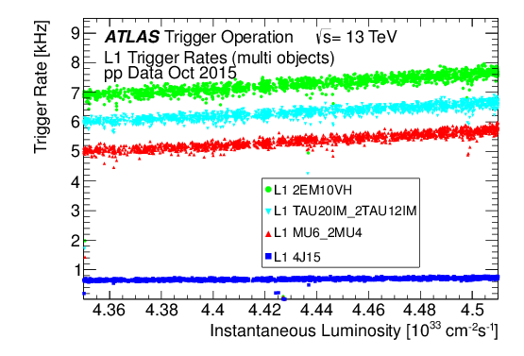
More on L1: multiobject
Maximum of 512 L1 Trigger Items (including 128 of L1Topo)

Slide 30

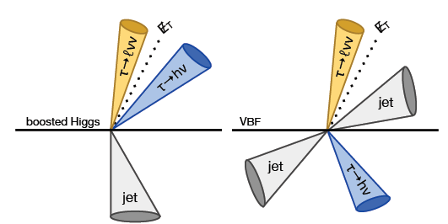
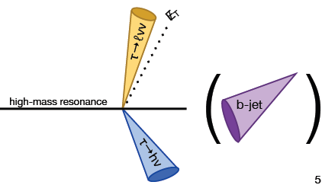
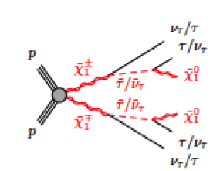
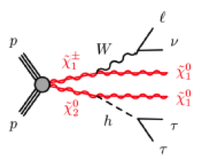
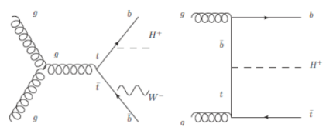
Tau Topologies for Run 2 L1 selection
with jets; no MET requirement
no jets, no MET
requirement
SUSY
MET, no jet
requirement
Charged Higgs
with MET, jet

Slide 31
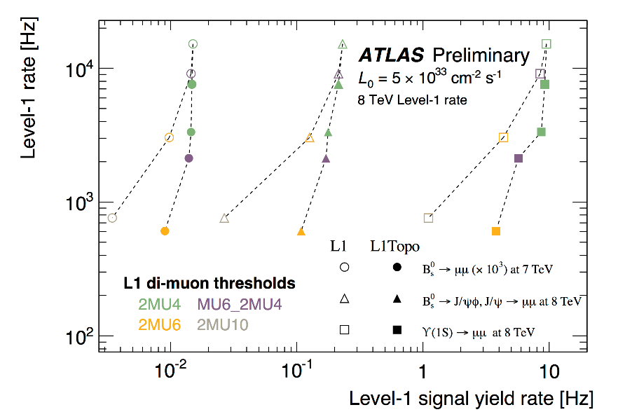
B Physics triggers

Slide 32
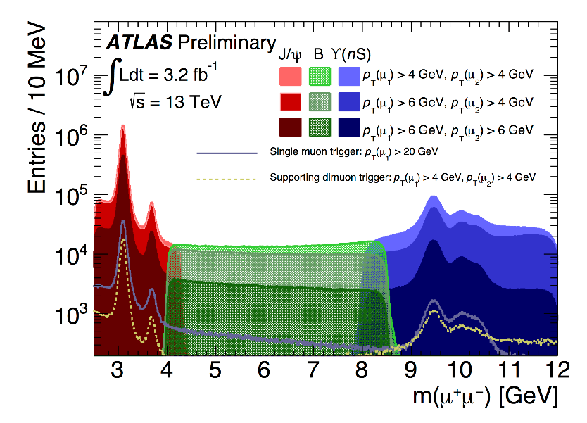
B Physics triggers

Slide 33
Thresholds for HLT primaries
 | e | mu | tau | g | j | b-jet
Single | 24 | 20i, 50 | 80 | 120 | 360 | 225
Di- | 2x12 | 2x10; 18&8 | 35, 25 | 35&25 | n/a | 150&50
Tri- | 15&2x7 | 3x6; 17&2x4 |  | 3x15 | 3x175 | n/a
Four |  |  |  |  | 4x85 | n/a
Five |  |  |  |  | 5x60 | n/a
Six |  |  |  |  | 6x45 | n/a
There are also combined triggers (e.g. mixed object types)

Slide 34
Dedicated Triggers:
Highly Ionizing
Particles

Slide 35
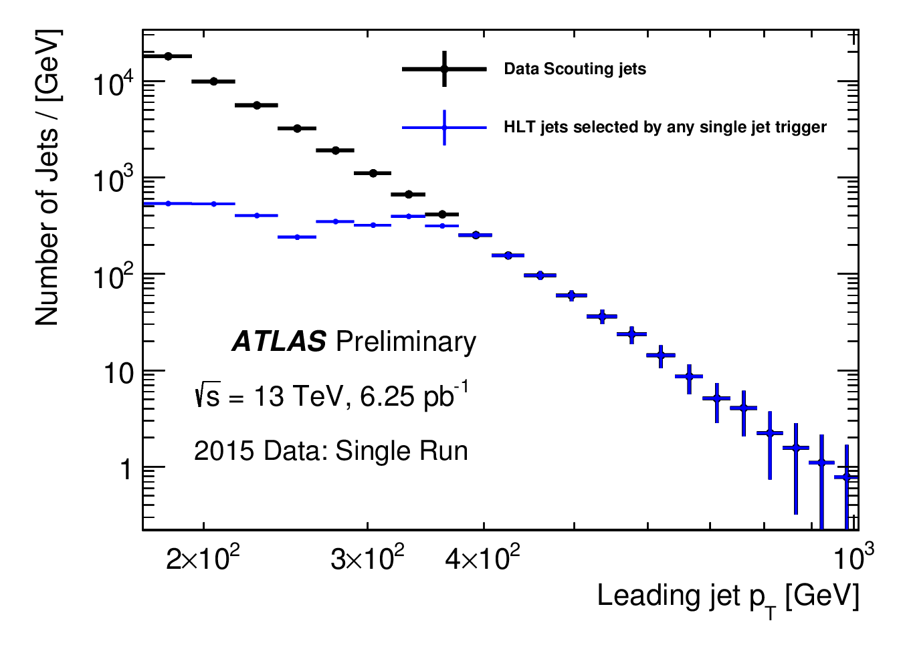
Trigger Level Analysis
3 kB/event @ ~1kHz
L=0.5 10³⁴cm⁻²s⁻¹

Slide 36
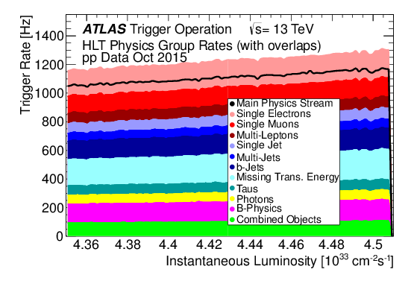
Menu Content
400 L1 trigger items and 1500 HLT trigger chains
Unprescaled primary triggers and backups for other lumi points
Prescaled primary triggers (jets, photons)
Alternative triggers including various algorithms or selections
Support triggers for efficiency measurements, backgrounds studies etc.
Triggers for calibration (partially built events)
Triggers for monitoring
Triggers for special runs

Slide 37
Menu Content
400 L1 trigger items and 1500 HLT trigger chains
Unprescaled primary triggers and backups for other lumi points
Prescaled primary triggers (jets, photons)
Alternative triggers including various algorithms or selections
Support triggers for efficiency measurements, backgrounds studies etc.
Triggers for calibration (partially built events)
Triggers for monitoring
Triggers for special runs
Trigger menu did its job in 2015 run.
Strategy is known for the rest of Run 2

Slide 38
My timeline on ATLAS
2006-2009 Electron Triggers
2010-2012 Exotics Triggers
2013-2015 Trigger Menu for Run 2
2009-now Dilepton searches
https://www.flickr.com/photos/primejunta/2518179985

Slide 39
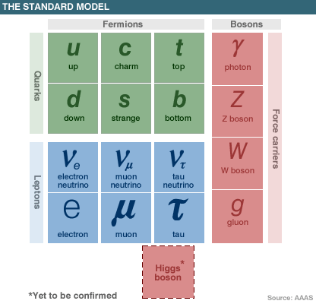
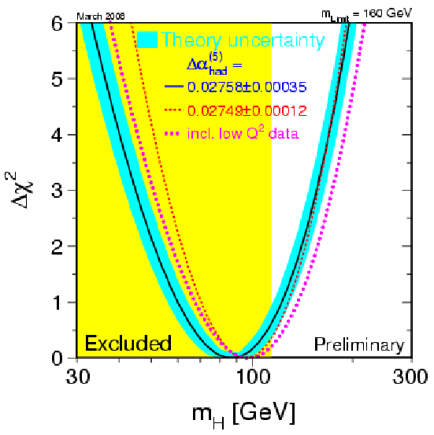
Before the start of LHC

Slide 40
Hierarchy problem of SM
SM is an effective theory valid up to a cut off scale Λ_{SM}
Radiative corrections to Higgs mass:

Slide 41


Searches for Physics Beyond SM
Look for deviations from Standard Model predictions
Direct observation:
new resonant or
non-resonant structures
In-direct observation:
discrepancies in rates of rare processes,
couplings measurements, etc.
THIS
TALK

Slide 42


Experimental Approach: Exotic Search
Search for any deviations from Standard Model predictions
Direct observation:
new (e.g. Exotic) resonant or
non-resonant structures
LOOK FOR SIGNATURES
MADE OF BASIC OBJECTS
Jets,
b-jets,
E_{T}^{Miss}
Bosons
(γ, W, Z)
Leptons
(e, µ, τ)
Unconventional
Particles
AS MANY
SIGNATURES
AS POSSIBLE
AS MODEL INDEPENDENT AS POSSIBLE
PROVIDE BENCHMARK MODEL RESULTS

Slide 43
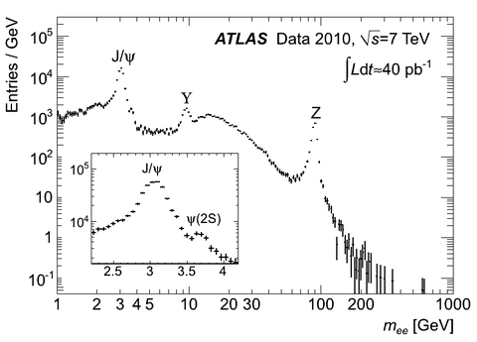
?
Eur.Phys.J. C74 (2014) 3071

Slide 44
Heavy
Vector
Bosons
Kaluza-
Klein
Bosons
Quantum Black Holes
Theories
With
Strong
Dynamics
?
Randal
Sandrum
Graviton
Exitations
…

Slide 45
Constraints from LEP
arXiv:hep-ex/0612034

Slide 46
Searches at TeVatron

Slide 47
Analysis Steps
Reconstruct and identify electrons & muons pairs
Compare dilepton mass distributions in data with (the best possible) SM background expectation: excess?
YES
Quantify,
study properties
NO
Set a limit in
a context of a benchmark model

Slide 48
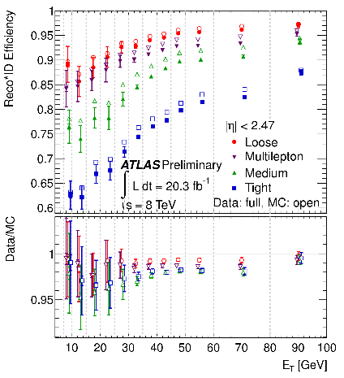
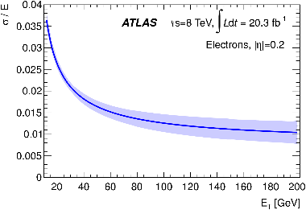
Electrons

Slide 49
Muons
Chain 1: statistical combination of MS and ID tracks using their track parameter covariant matrices
Chain 2: global refit to hits in ID and MS

Slide 50
Analysis selection
Dielectron
At least one primary vertex with more than two tracks
Trigger on two EM calorimeter clusters with E_{T}>35(25) GeV
|η|<1.37 or 1.52<|η|<2.47
Two electrons p_{T} > 40(30) GeV
Medium identification requirements
Isolation:
Leading: ΣE_{T}(ΔR<0.2)<0.05E_{T}+5GeV;
Subleading: ΣE_{T}(ΔR<0.2)<0.022E_{T}+6GeV
Dimuon
At least one primary vertex with more than two tracks and |z_{PV}|<200mm
Single muon trigger with p_{T}>25GeV (isolated) or >35GeV
Two muons of opposite charge with p_{T}>25GeV
High-quality inner detector track matched to high quality muon spectrometer track
Also “Loose” channel (|η|<1.015) with less stringent requirements
d₀ < 0.2 mm, z₀ < 1 mm
Isolation: Σp_{T}(ΔR<0.2)<0.05p_{T}
Retain highest p_{T} same–flavor dilepton pair per event above 80 GeV

Slide 51
Analysis Steps
Reconstruct and identify electrons & muons pairs
Compare dilepton mass distributions in data with (the best possible) SM background expectation: excess?
Process | Method
Drell-Yan | MC
Diboson | MC
ttbar | MC
Dijets & W+jets | Data-driven

Slide 52
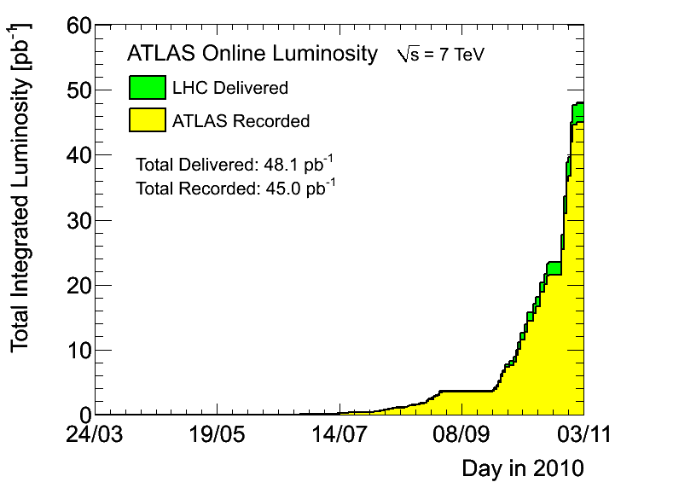
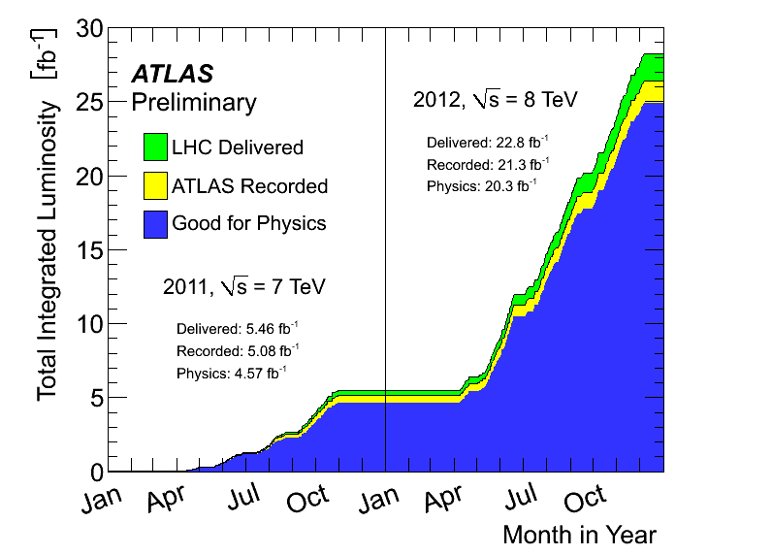
Run 1 Searches at ATLAS

Slide 53
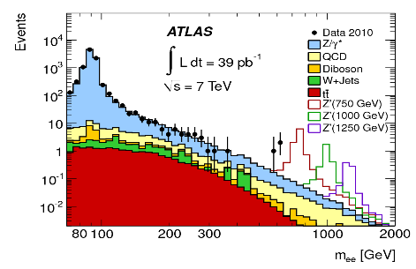
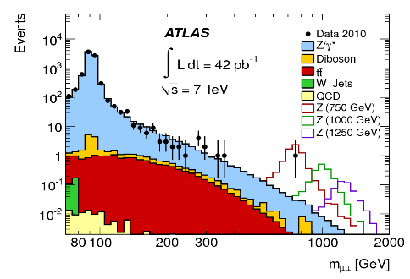
Run 1 Searches at ATLAS
PLB 700 169(2011)

Slide 54
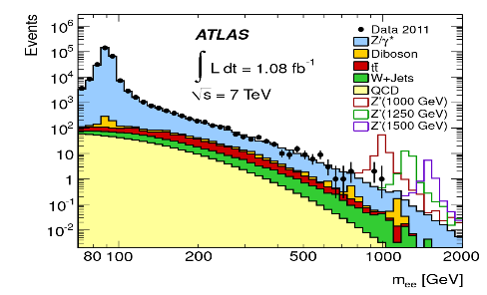
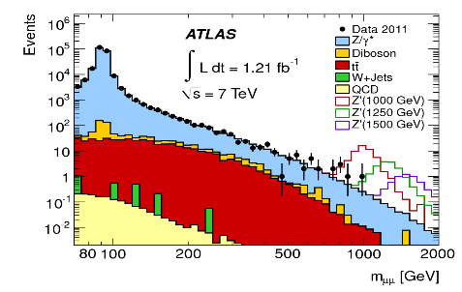
Run 1 Searches at ATLAS
PRL107 202007 (2011)

Slide 55
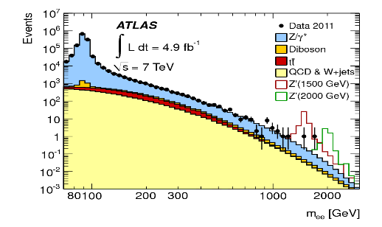
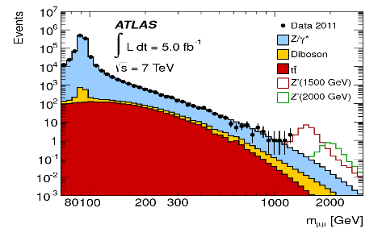
Run 1 Searches at ATLAS
JHEP 1211 138 (2012)

Slide 56
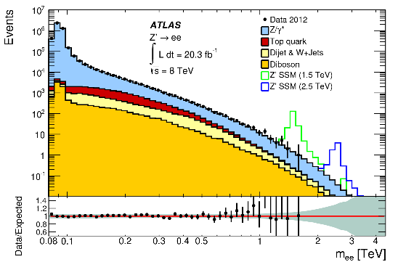
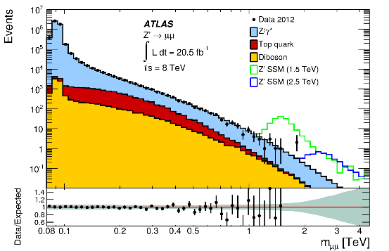
Run 1 Searches at ATLAS
PRD 90 052005 (2014)
JHEP 1211 138 (2012)

Slide 57
Analysis Steps
Reconstruct and identify electrons & muons pairs
Compare dilepton mass distributions in data with (the best possible) SM background expectation: excess?
YES
Quantify,
study properties
NO
Set a limit in
context of a benchmark
model

Slide 58
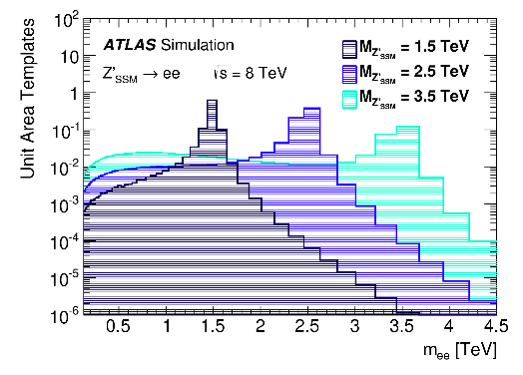
Signal
Drell-Yan
Arbitrary Units
m_{ee}[GeV]

Slide 59

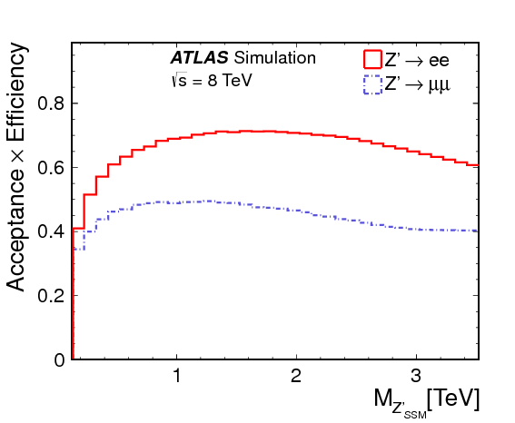
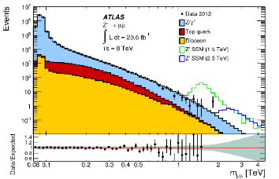
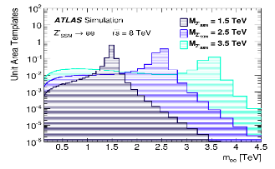
Inputs to limit setting
ee
µµ

Slide 60
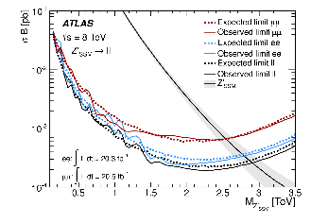
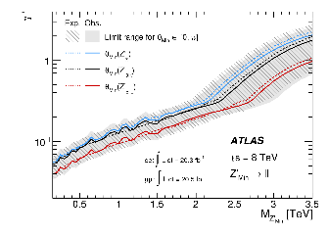
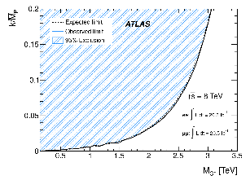
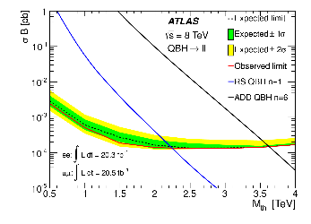


Limits

Slide 61

CMS

Slide 62


3%
1.2%
0.5%
3.4%
width

Slide 63

General Extension of SM: Effective Theory
Manuel Perez-Victoria

Slide 64

Vector Bosons decaying to Leptons
J.DeBlas et. al.JHEP01(2013)166

Slide 65


W’/Z’ Run 1 combination?
JHEP 09 (2014) 037

Slide 66
Heavy Vector Triplet combinations

Slide 67

A few words about LHC Run 2

Slide 68




Slide 69

“Now”
The LHC has achieved a peak luminosity of 7.9 10³³cm⁻²s⁻¹

Slide 70

“Now”

