Slide 1
Information about Multi-conductor cables
of the Remote HV option
Wednesday Tile upgrade meeting
10 February 2016
François Vazeille
(LPC Clermont-Ferrand)
A Cie offer about the HV cables of the
Remote HV option

Slide 2
• Problematic of the HV cables
…
HV regulation
electronics
in counting room
1024 TileCal Mini-Drawers
1024 Cables + spares + internal cables
Multi-conductor HV cables
(12 HV pairs /cable)
But tested at 3 kV
by Clermont-Fd
▪In ATLAS scoping document (Page 227):
- Each cable is 115 m long, internal cables request 5 m.
- Spares correspond to 7.5% : 1024 → 1100 cables.
▪ The presently used HV cables are CERN cables … not officially HV certified.
▪ The cost estimate in the scoping document is 2.55 €/m.

Slide 3
Contact with Cie
(which provided the current TileCal HV cables after a CERN market survey)
about the required HV cables for the Remote HV option
⇒ Data sheet.
⇒ Cost offer.
WARNING:
this cost could change with respect to the market prices of raw materials
that constitute the cables.

Slide 4
• Data sheet
Fits fully
the CERN policy
on cables

Slide 5
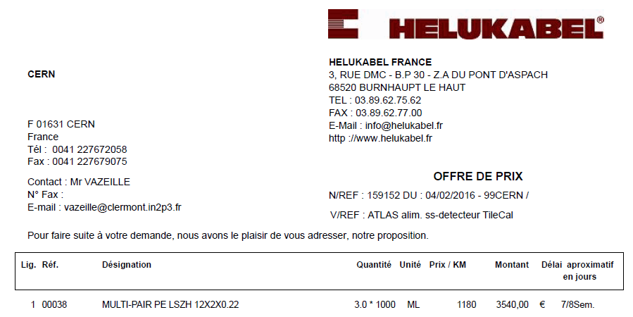
• Cost estimate
▪ From Helukabel
1.180 €/m
▪ From the scoping document 2015 p227
2.550 €/m
REV-1 | 09/12/2014
euros=> chf | 1,2
 |  | Sans Spares |  | Avec Spares |  | Remarques
Description | PU in € | Quantité | Price in € HT | Quantité | Price in € HT
HV Câbles |  |  |  | 7,5%
Câble HV 115m+5m (2,55€/m) | 306,00 € | 1 024 | 313 344 € | 1 100 | 336 600 €
Old cost
New cost
1.18 141.60 144 998 155 760

Slide 6
• First conclusions
▪Industry can provide the required HV cables of the Remote HV option
fitting all the specifications.
Comments:
1. A market survey will be an obligation if the Remote HV option was chosen.
2. The Round HV connectors are already HV certified.
▪ Delivery delay of 7/8 weeks.
▪The cost offer is 53.7 % lower than prices quoted in scoping document.
▪The lengths (as quoted in the scoping document) have to be estimated
more precisely.
▪Their routing in ATLAS must be studied by ATLAS experts.
Comment: Waiting for the request of Irene to ATLAS experts.

