Slide 1
The Tile PMTs
From the PMT design studies to the production and QA tests
François Vazeille
LPC Clermont-Ferrand
On behalf of many people who worked on the Tile PMTs
PMT Robustness mini workshop
CERN 26 January 2016
The design, making, production, qualification of Tile PMTS
were both a long story and a very difficult challenge that lasted 15 years
with revolutionary PMTs fitting all the TileCal specifications

Slide 2
First photodetector considered in RD1: 1991-1993
Large area APDs (Avalanche Photo Diodes) from Advanced Photonic (Los Angeles)
→ Good test beam results with comparison to standard PMTs
(High quantum efficiency close to 60%)
but irreversible damages of neutrons (Neutron generator at Clermont-Ferrand)
→ Thesis of Nourdine Bouhemaid in 1995.
Come back to PMTs with strong TileCal constraints
in RD34.

Slide 3
Worldwide overview of PMT manufacturers started in 1993
→ None having PMTs fitting TileCal needs (Compactness, linearity, etc.).
→ A single Cie, Hamamatsu, ready to perform free of charge R&D studies with us,
moreover, they offer a revolutionary PMT (R5600):
- Of a very small size, with a round photocathode.
- "Metal channel dynode structure with a metal package “.
⇒ PMT too small.
→ Evolution to a larger area with a square shape (∼ 4 R5600): R5900 series.
Start of 7 R&D years with Clermont-Ferrand
(Written in the Hamamatsu catalog !),
with contributions of other Institutes on tests (Pisa and Valencia),
followed by the production (2000-2002) and the qualification.

Slide 4
Main R&D improvements every year
- 1994: From the round shape to the square shape of larger PMTs.
- 1995: Mono-block dynodes → Improvement of uniformity.
- 1996: Improvement of the electrical contact cathode- package
→ Decrease of cathode resistivity.
- 1997: From 10 to 8 stages → Improvement of the linearity.
- 1997:New cathode window material and new activation process
→ Improvement of the quantum efficiency.
- 1998: Modification of the electrode supports
→ Improvement of the uniformity.
- 1998: Modification of the focus system
→ Increase of the photoelectron collection efficiency.
- 1998: Improvement of the “getter“
→ Gain drift reduction.
- 1999: New dynode compounds and new activation process
→ Down drift improvement.
These improvements were managed mainly by Michel Crouau and Gérard Montarou
with in parallel theoretical studies of Stano Tokar et al. (Bratislava)
and Gérard Montarou (Clermont-Ferrand).

Slide 5
TileCal specifications for
the market survey
Characteristics |  |  | Required value
Nominal amplification |  |  | 10⁵
Nominal High Voltage |  | Minimum | 600 V
 |  | Maximum | 800 V
Non linearity to pulses with a DC current of 50 mA |  |  | < 2%
Dark current | At 800 V |  | ≤ 2 nA
 | At 900 V |  | ≤ 8 nA
Quantum efficiency | Mean at 480 nm |  | ≥ 18%
 | Minimum at 480 nm |  | 15 %
 | Mean at 520 nm |  | ≥ 12.5%
Photocathode-first dynode HV for 90% photoelectron collection |  |  | 50 V
Gain drift | Short term |  | Maximum < 1.5%
 | Short term |  | Mean < 0.8%
 | Long term |  | Maximum < ± 5%
Rise time to pulses |  |  | < 2.5 ns
Aging to 100 C on anode |  |  | + 10, - 30 %
Photocathode uniformity |  |  | > 90 %
Length |  |  | < 60 mm
Photocathode area |  |  | 300 mm²
Sensitivity to 90 Gauss magnetic field |  |  | < 10%
Sensitivity to temperature |  |  | < 0.25%/°C
Some of them are coming from the
designs of Drawers and PMT blocks.

Slide 6
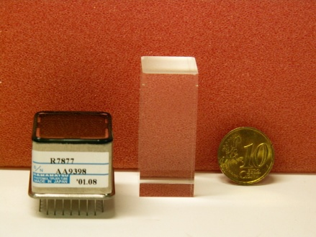
Official tendering procedures at CERN
- 1998: Market Survey.
- 1999: Invitation to tender IT-2573/EP/ATLAS
⇒ Only the Hamamatsu Cie was able to provide
a PMT fitting all the TileCal specifications.
Examples: Dark current average < 200 pA
Non linearity with a 50 mA DC current ≤ 1%
Safety factor to magnetic field with shielding > 50
…
⇒ Definition of control procedures with Hamamatsu for the series production
and of the production planning in 10 batches (February 2000-April 2002).
⇒ Development within TileCal institutes of a test bench model at Clermont-Fd
for the qualification of batches, with possible rejection of a batch,
then production of 7 identical test benches distributed to the Institutes.

Slide 7
Purchase of 10140 PMTs
▪ Total cost of TileCal: about 14 MCHF
Electronics cost: roughly half total cost.
PMT cost : roughly half electronics cost ∼ 3.5 MCHF.
▪ Shared by TileCal Institutes (2000-2002) in 10 batches:
1/3 : CERN, Lisbon, Pisa, Valencia
1/3: Arlington, Urbana (US funds)
1/3: Clermont-Ferrand
+ additional 400 PMTs in 2010 payed from TileCal funds.

Slide 8
Qualification tests supervised by Fabrice Podlyski
and data base supervised by Christophe Guicheney
▪ Using 7 identical test benches and the same software
- Identical components :
Commercial or home made in one place for a given component.
(The Pisa test bench is slightly different)
- 7 Institutes testing the 10140 PMTs
Arlington, Clermont-Ferrand, Dubna, Lisbon, Pisa, Urbana, Valencia
with Valencia testing part of the 3300 “Clermont-Ferrand PMTs”.
+ 400 new PMTs tested at Clermont-Ferrand in 2010-2011 (Reina Camacho).
▪ Automatic qualification of sets of 20 PMTs in 2 steps in a week (Mond-Friday)
- Step 1 (Special Dividers with relays) under a continuous light
⇒ Quantum efficiency, gain, collection efficiency, dark current, stability.
→ acceptance or rejection of the batch.
- Step 2 (Standard Divider coupled to its PMT) under pulsed light
⇒ Gain, linearity (with additional DC light), dark current.
→ PMT/Divider ranking for their next installation in TileCal.

Slide 9
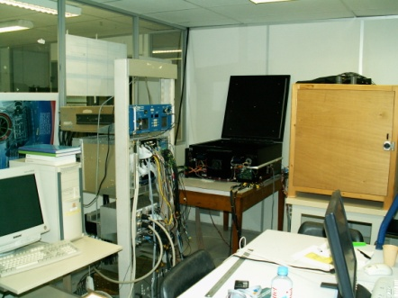
PMT box
Light box
Electronics:
DCS and readout
DAQ

Slide 10
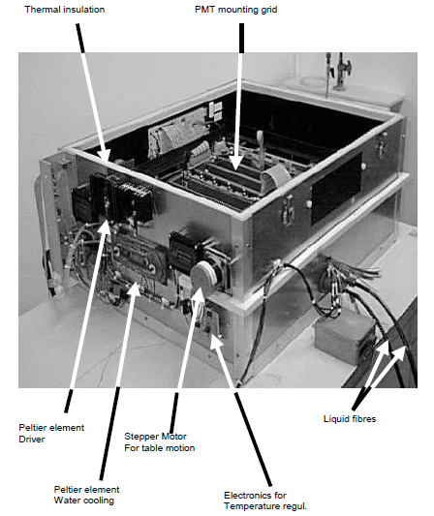
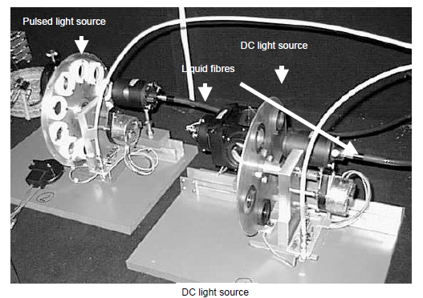
PMT box
DC and AC Light box

Slide 11
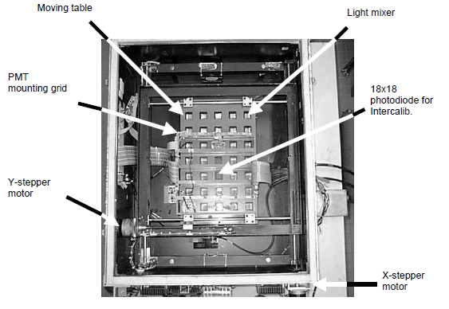
- Two mounting grids 5x5 : 1 for STEP1, 1 for Step2.
- 1 large area photodiode in the middle for channel calibration.
- 24 slots for PMTs:
4 Reference PMTs on the corners.
20 tested PMTs.
- 2 other Photodiodes to monitor the DC and the AC lights.
- Special suitcase holding 20 Reference PMTs travelling across the world.

Slide 12
Data from the 7 institutes were in a very good agreement:
The qualification results are independent of the Institute.

Slide 13
• Documents on the Tile PMT story
▪ The most comprehensive documents
- On PMTs
“Etude et caractérisation des photomultiplicateurs du calorimètre à tuiles scintillantes d’Atlas”, Thesis of Christophe Hébrard (Clermont-Ferrand, 1999)
“Characterization of the new 8 stages Hamamatsu photomultipliers for the July 98 Test Beam”
ATL-TILECAL-98-166, Camarena F., Crouau M., Grenier P., Hébrard C., Montarou G.
http://cds.cern.ch/record/683716/files/tilecal-98-166.pdf
- On qualification test bench
“Technical characteristics of the prototype of the TILECAL photomultipliers test bench”
ATL-TILECAL-98-148, Crouau M., Montarou G., Rey D.
▪ See list of all papers in Appendix

Slide 14
• Conclusion
▪ Many Institutes were skeptical when the works started on these PMTs.
▪ Many successful challenges
R&D and Test beam → Production → Qualification in 7 Institutes → TileCal.
The TileCal PMTs fit all the specifications.
▪ No official publication on the PMTs ! Perhaps I could try to do that !
▪ What about the robustness ?
- Radiation tests made by Clermont-Ferrand: NIEL, TID (See Hébrard’s thesis)
→ No modification of characteristics,
except a slight increase of the dark current staying within specifications.
- Effects of large integrated charge
Accelerated exposure to a big charge studied by Valencia
→ PMTs fitting specification, with an up-drift tendency.
Natural aging studied by Pisa
→ Same behavior.

Slide 15
Appendix:
All the papers on PMTs

