Slide 1
WG3 Summary High current and CW accelerators
S. Belomestnykh, E. Jensen, J. Hao

Slide 2
Reminder: WG Mandate: WG3: High current and CW accelerators
With growing interest in a future Higgs factory e+ e- collider - either via the ILC path or the FCC-ee path - co-chairs should identify the key issues for SRF for such accelerators, and encourage short presentations that address these issues. Similarly SRF for CW light sources such as ERLs have seen significant advances, so that major issues for this topic should be addressed. Include storage rings light sources issues as appropriate. Demonstrated and needed advances in couplers and tuners for both accelerator classes should be included. For their TTC summary talk on the last day, co-chairs should pull together and summarize the key developments in these areas, and the remaining necessary developments.

Slide 3
Wednesday, 6th July: “High current and CW accelerators”
Three talks on experience with operating machines
Three talks on SRF systems for future machines
Thursday, 7th July:
Joint session with WG4 (will be reported by WG4 conveners)

Slide 4
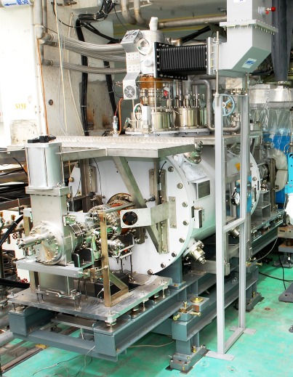
BEPC-II experience, P. Sha
BEPC-II Coupler, routinely operated at $80 kW$ for many years.
November 2015: something happened, beam lost, vacuum spike.

Slide 5
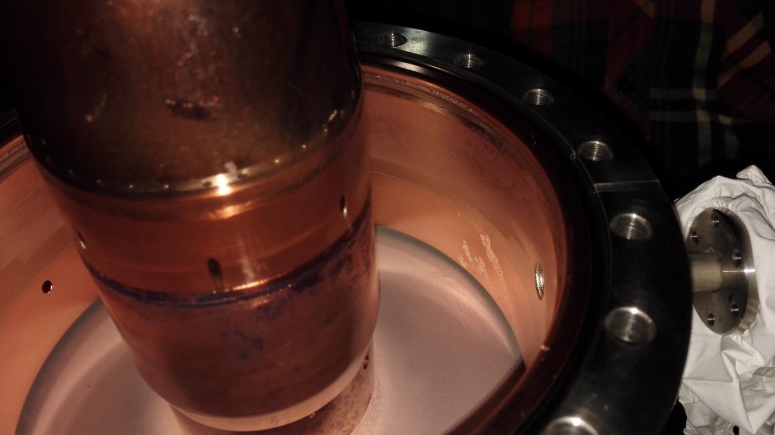
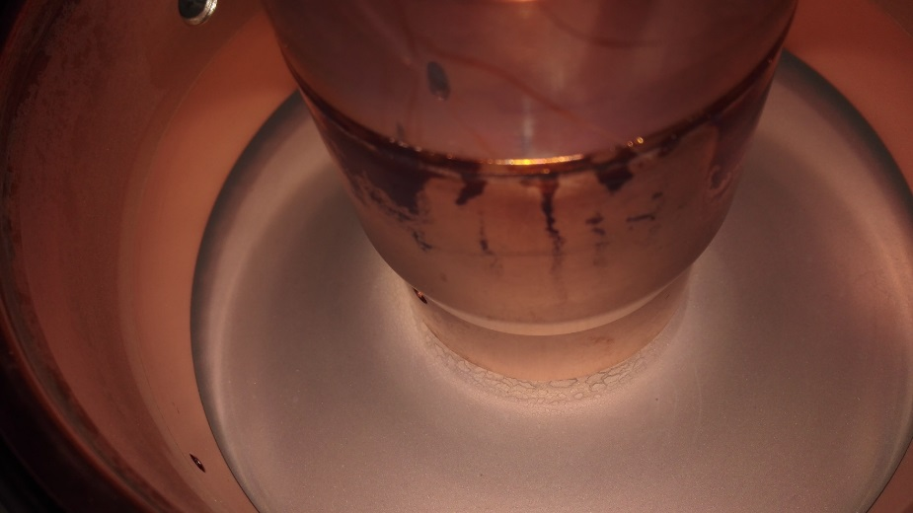
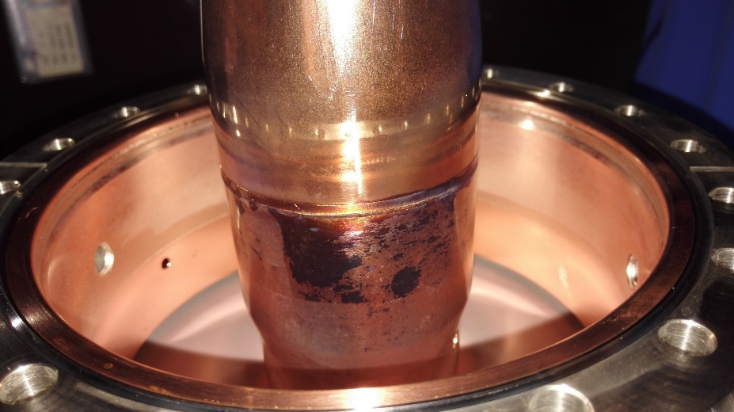
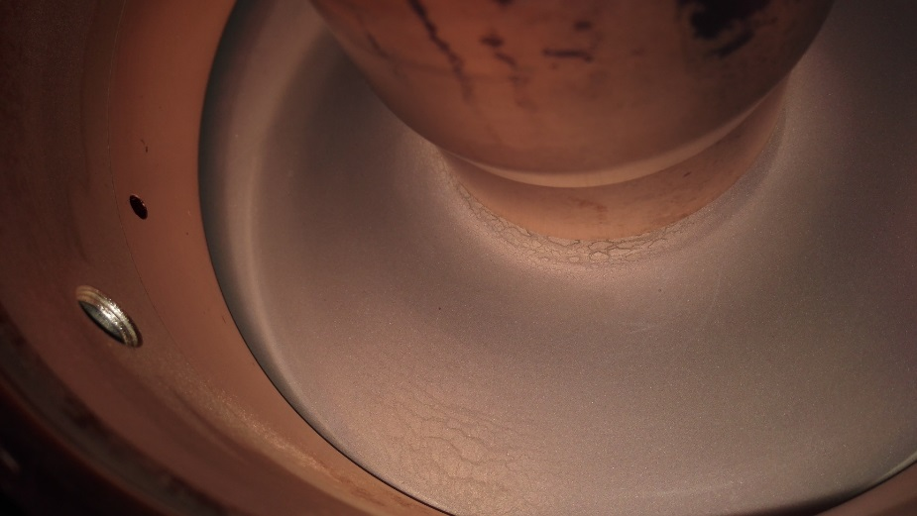
BEPC-II: Analysis of broken coupler
There are three snow figures on the outer conductor of the window vacuum side.
Feel rough
There is fish scale close on the ceramic.
The ceramic color turns dark.
The color close to the window–inner conductor EBW seam turns dark.

Slide 6
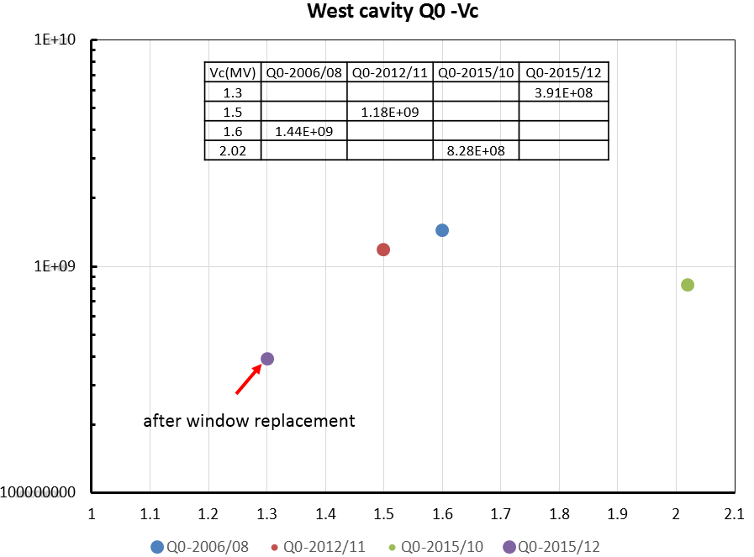
BEPC-II: Recovery of performance with new coupler (1)
Initially, cavity performance with new coupler performance was limited to 1.1 MV (nominal: 1.5 MV) – pollution?
Cavity has been polluted? It couldn’t run with Vc>1.1MV.

Slide 7
BEPC-II: Recovery of performance with new coupler (2)
N₂ bake of cavity at $90 ℃$ during one week!
$Q_{0}$ recovered after N₂ bake

Slide 8
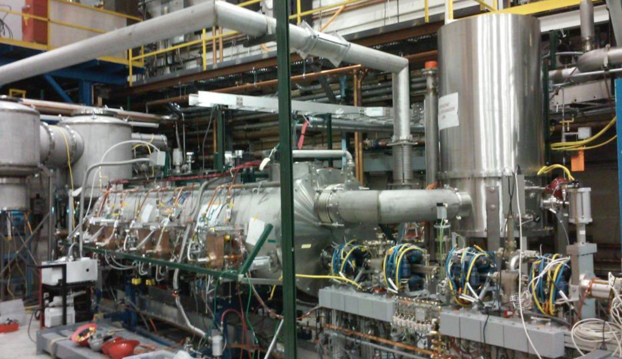
Cornell injector experience, R. Eichhorn
Parameters:
Number of 2-cell cavities 5
Acceleration per cavity 1 – 3 MeV
Accelerating gradient 4.3 – 13.0 MV/m
R/Q (linac definition) 222 Ohm
Q_{ext} 4.6×10⁴ – 4.1×10⁵
Total 2K / 5K / 80K loads: 30W / 60W / 700W
Number of HOM loads 6
HOM power per cavity 40 W
Couplers per cavity 2
RF power per cavity 120 kW
Amplitude/phase stability 10⁻⁴ / 0.1° (rms)
ICM length 5 m

Slide 9
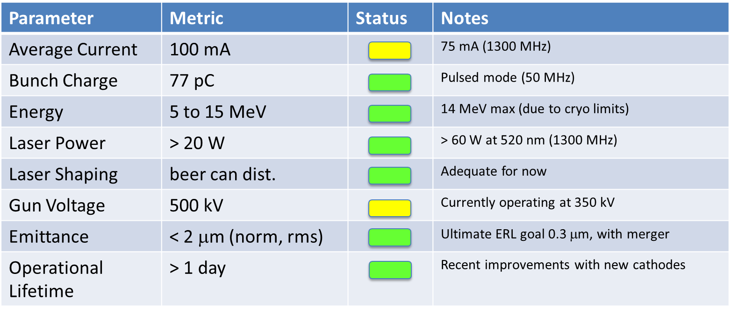
Cornell injector: Performance

Slide 10
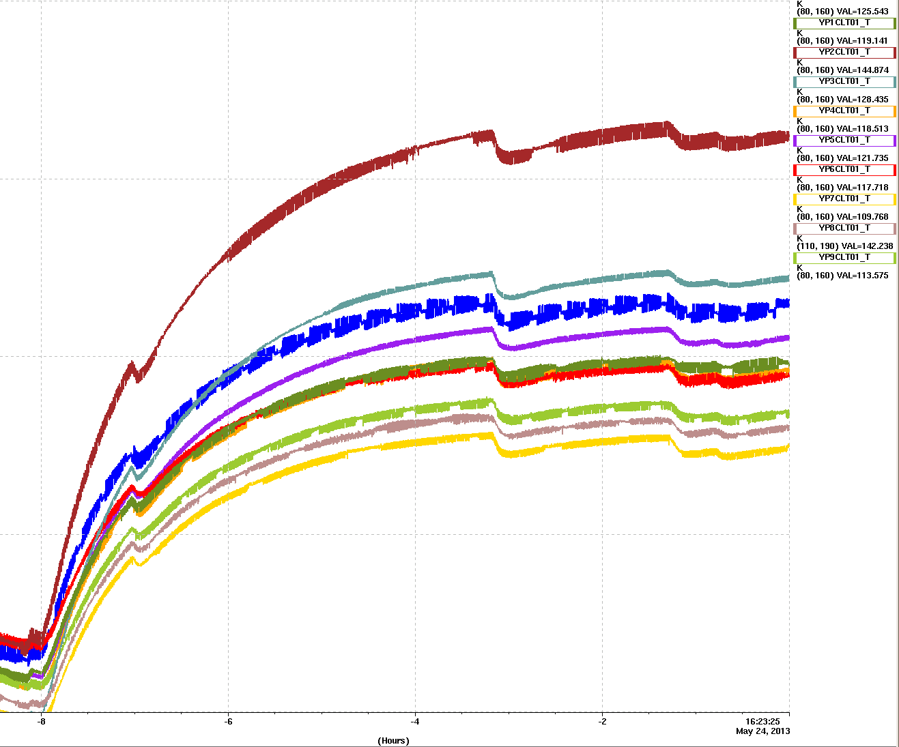
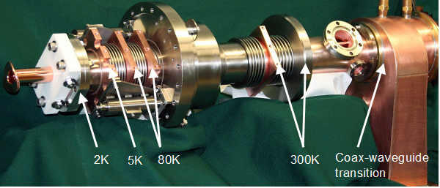
Cornell injector Limitation: FPC cooling (80 K intercept)
160 K
140 K
120 K
100 K
hours

Slide 11
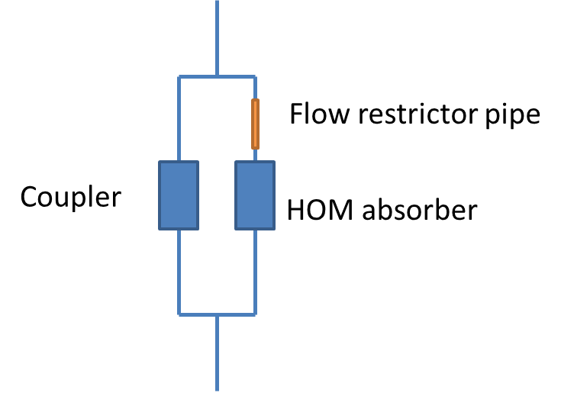
Cornell Injector: Problem analysis:
Parallel cooling channels with uneven heating is not effective: “the cooler channel steals the flow”.
Solution: restrict flow for HOM absorbers to better balance cooling:
 | Estimated | Found
Coupler | 50 W | 75 W
HOM absorber | 50 W | 5 … 10 W

Slide 12
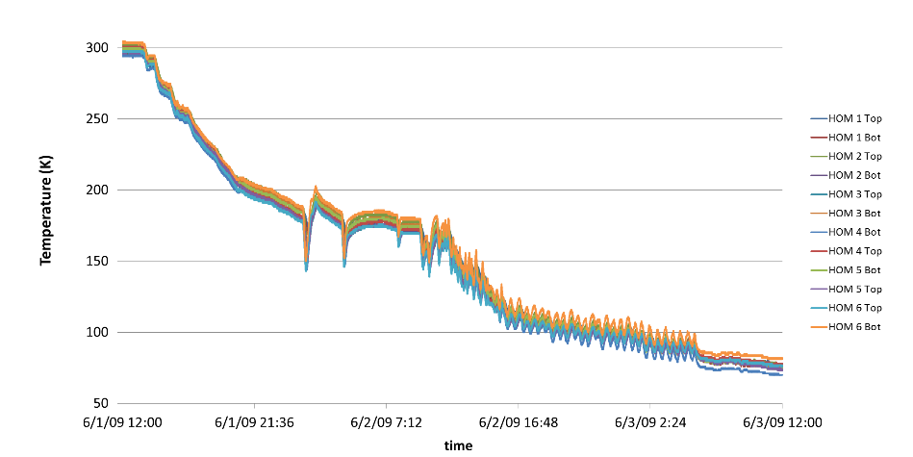
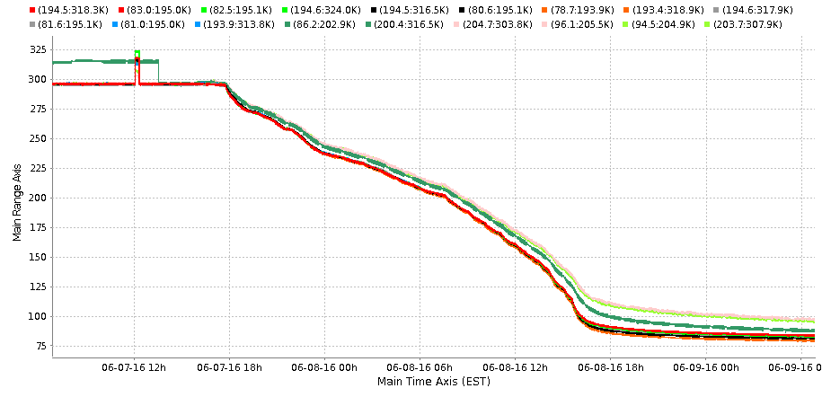
Cornell: heat exchanger improvement
ICM typical cooldown (about 2 days)
before
after
Implemented changes:
Cool-down lines added, separation of the 5K and the 80K mass-flow

Slide 13
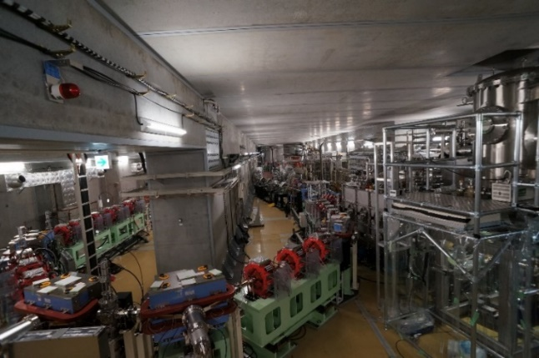
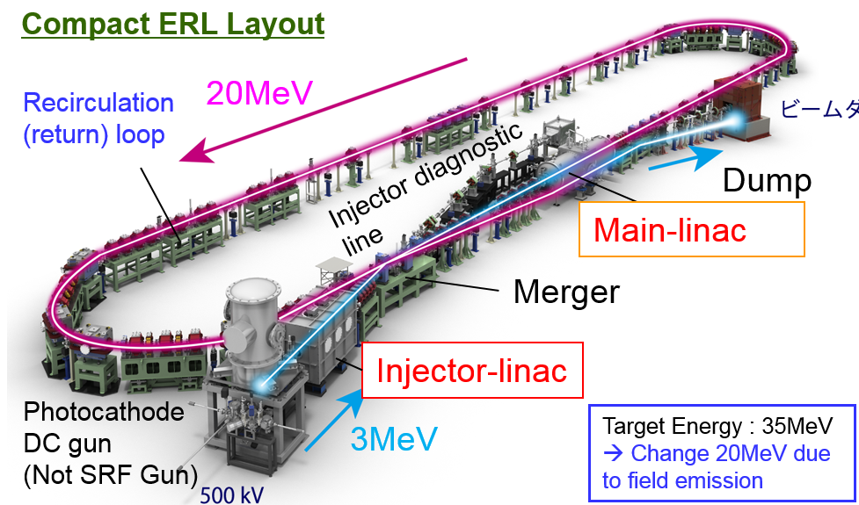
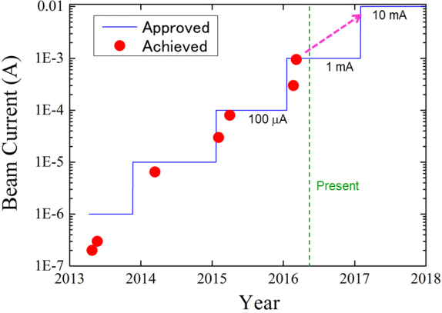
cERL experience, H. Sakai
Beam Currents: Achievement and Prospect

Slide 14
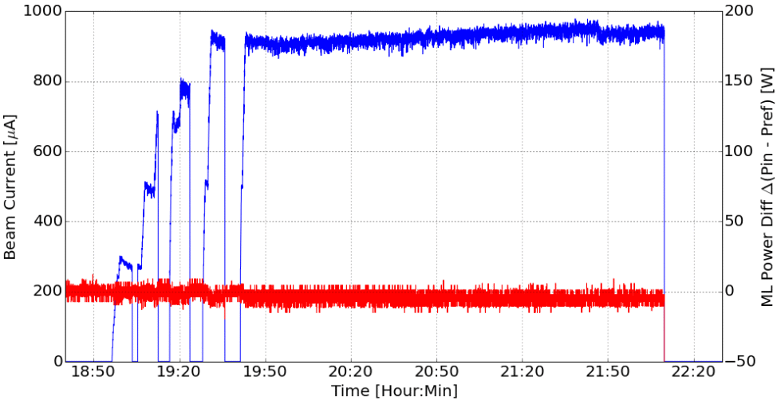
cERL, achieved:
$>900 μA$ stably!
Energy recovery $99.97\%$ !
No HOM-BBU!
Beam current (CW)
Δptotal=Δ(Pin1+Pin2-Pref1-Pref2)

Slide 15
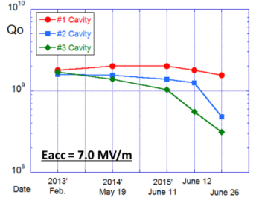
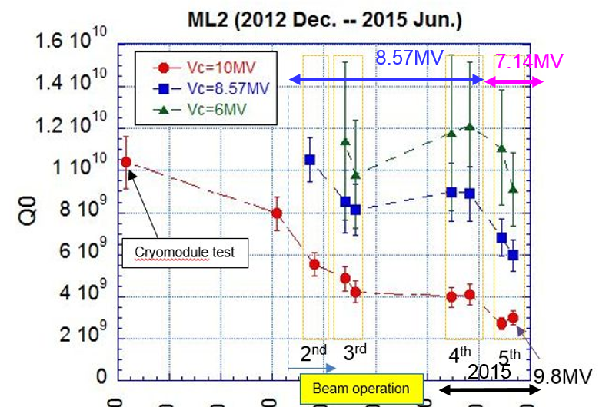
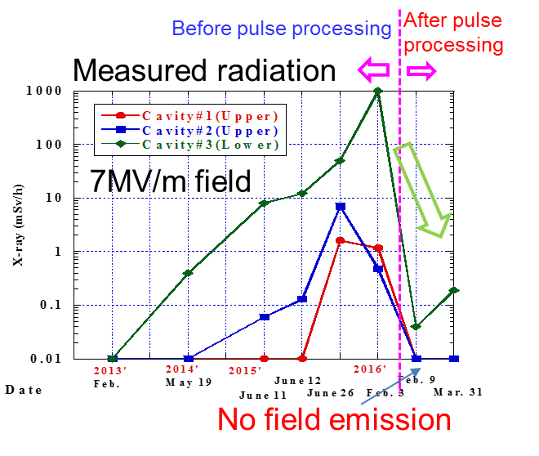
cERL: Degradation of performance and recovery:
Injector CM
Recovery by pulse processing
Main Linac CM
Recovery by pulse processing:
Onset of FE increased by 0.5 MV,
Radiation halved at same field level.
Pulse processing works well.
2012
2013
2014
2015

Slide 16
FCC SRF systems requirements, E. Jensen
“Ampere-class” machine
parameter | FCC-hh | FCC-ee
Physics working point |  | Z |  | WW | ZH | $$t\overline{t}$$
energy/beam [GeV] | 50,000 | 45.6 |  | 80 | 120 | 175
bunches/beam | 9,460 | 30180 | 91500 | 5260 | 780 | 81
bunch spacing [ns] | 25 | 7.5 | 2.5 | 50 | 400 | 4000
bunch population [10¹¹] | 1.1 | 1.0 | 0.33 | 0.6 | 0.8 | 1.7
beam current [mA] | 500 | 1450 | 1450 | 152 | 30 | 6.6
$𝓛$/IP$\left[{\left(nb∙s\right)}^{−1}\right]$ | 50 | 2100 | 900 | 190 | 51 | 13
energy loss/turn [GeV] |  | 0.03 | 0.03 | 0.33 | 1.67 | 7.55
Bunch length $σ [mm]$ | 75 | 0.9 | 1.6 | 2 | 2 | 2.1
synchrotron power [MW] | 6 | 100
RF voltage [GV] | 0.032 | 0.4 | 0.2 | 0.8 | 3.0 | 10
short bunches
“high gradient” machine

Slide 17
FCC design choices
Design converging:
2 designs cover all 4 FCC-ee machines and FCC-hh:
400 MHz single cell for FCC-hh, $Z$ and $W$ – 400/800 MHz multi-cell for $W$, $H$ and $t\overline{t}$
Cryomodule concepts (7 to 12 m long), HOM damper concepts (6 to 8 kW per CM) were elaborated.

Slide 18
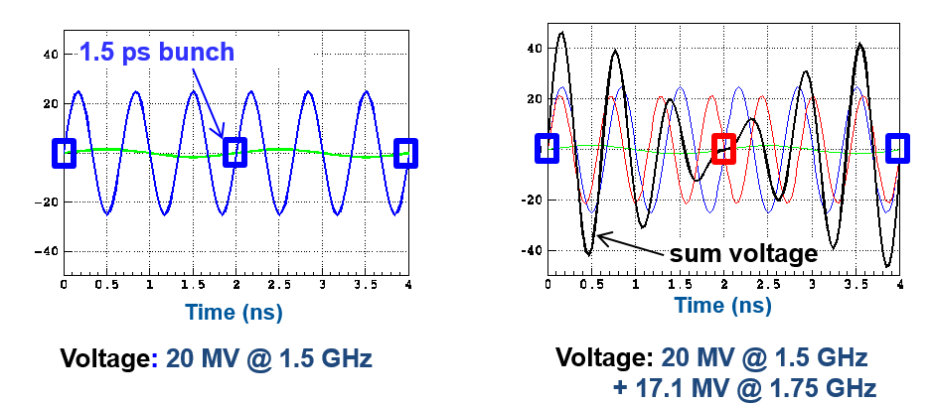
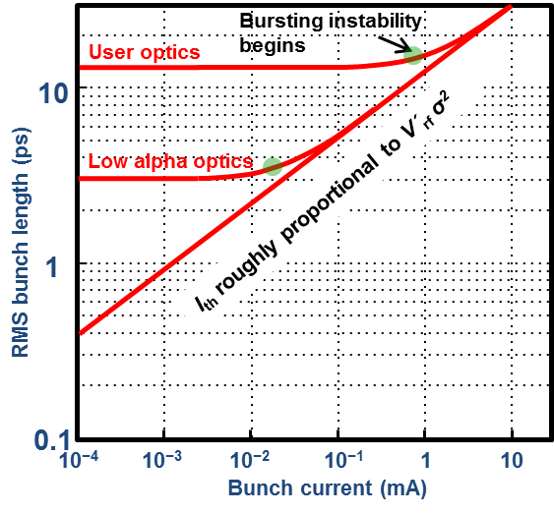
BESSY VSR (Variable Pulse Length Storage Ring), A. Vélez
Uses two operation frequencies: $1.5 GHz$ and $1.75 GHz$.
Bunch lengths between 1.5 ps and 15 ps by phasing.
Challenges:
CW operation at high field (20 MV/m)
High beam current (300 mA) requires strong HOM damping
Synergy with bERLinPro (different $f$).
Voltage addition: shortening Voltage subtraction: lengthening

Slide 19
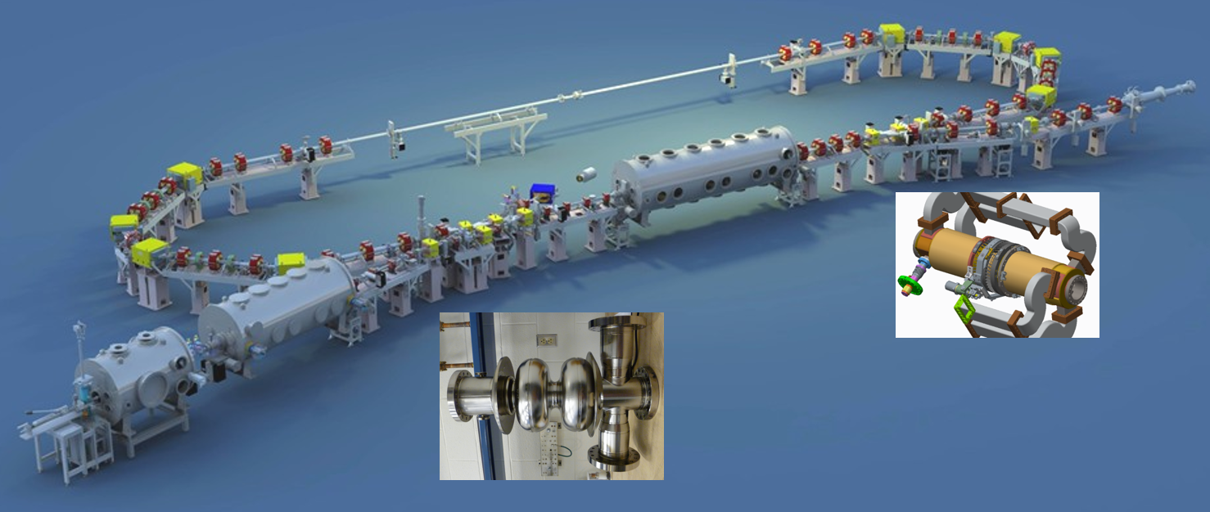
bERLinPro SRF system challenges, A. Neumann
HZB is developing for bERLinPro two types of cavities:
Booster cavities
Linac cavities
Linac cavity
Booster cavity

Slide 20
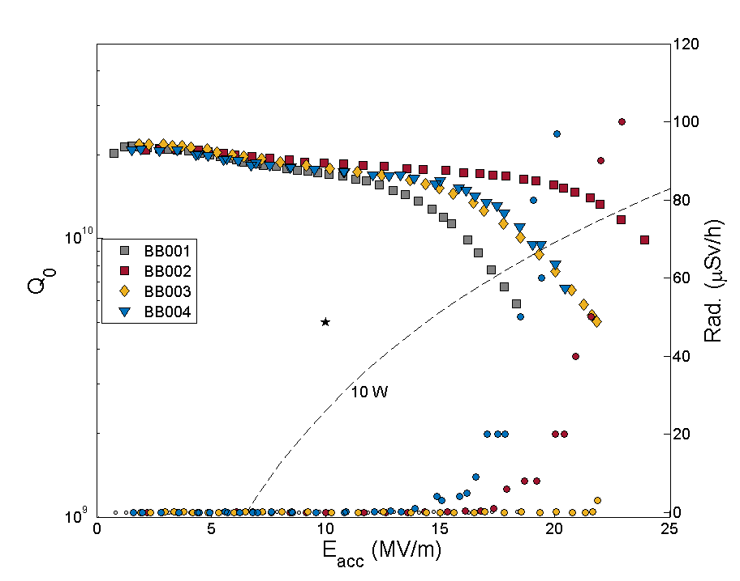
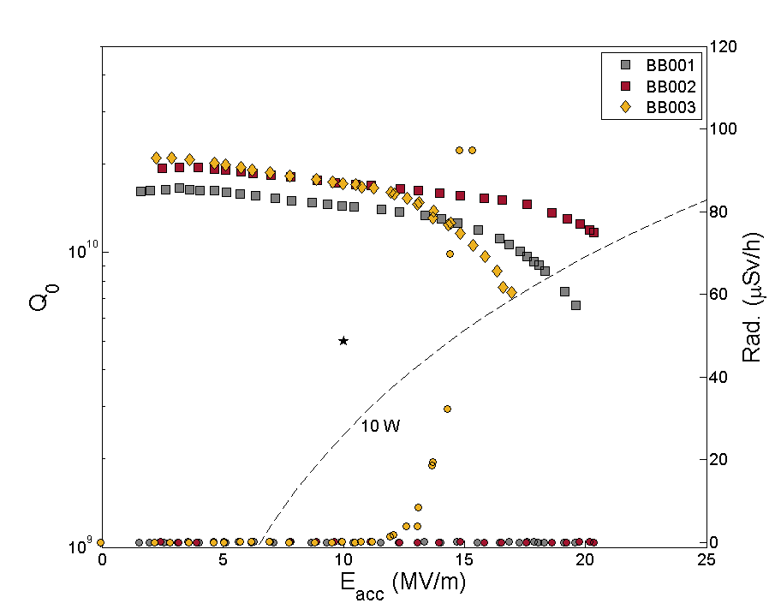
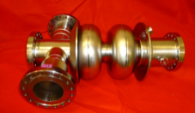
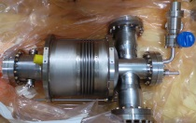
bERLinPro booster cavity performance
The booster cavities all are beyond specifications.
Maximum field with helium vessel mostly 10% lowered after helium vessel welding
All field emission onset are above the field level of 10 MV/m for bERLinPro
3 out of 4 cavities showed problem of leaking NbTi flanges in superfluid helium

Slide 21
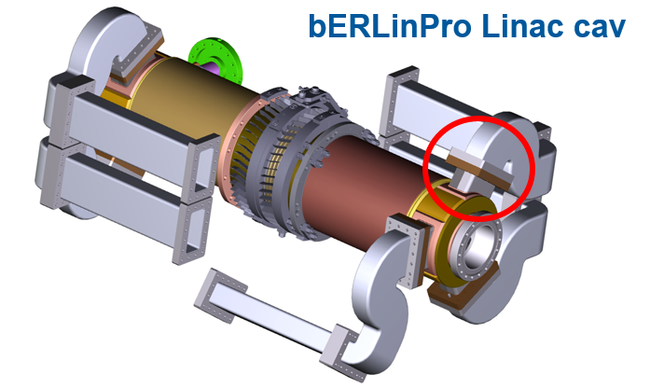
bERLinPro Linac Cavity design
Operating and RF parameters:
E_{acc}= 20 MV/m in CW
Beam current: 2 x 100 mA 180 deg. phase shifts w.r.t. RF
→ Low peak field ratios and strong HOM damping required
Challenges:
End group fabrication
Reliable and low-loss sealing between waveguide flanges

Slide 22
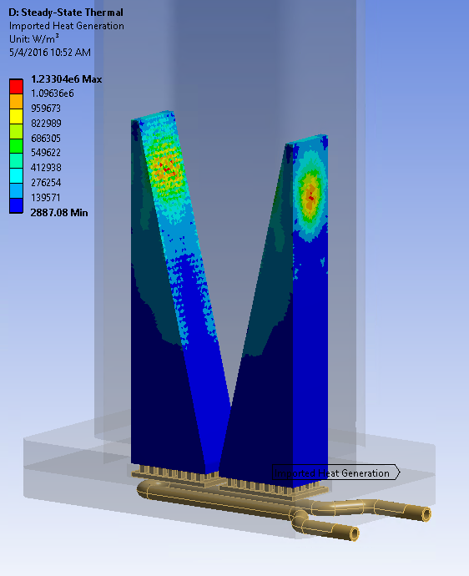
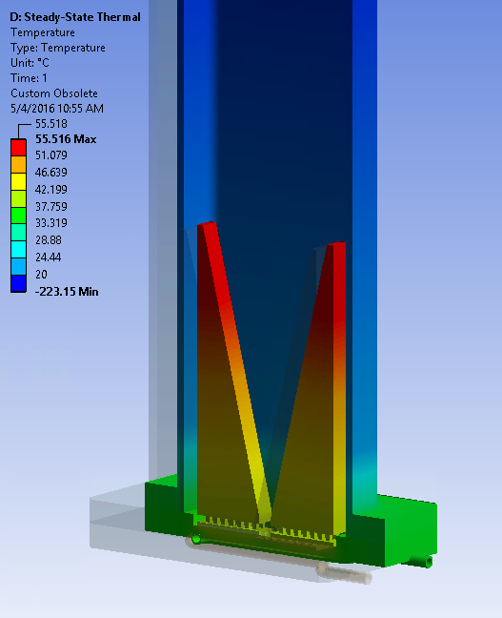
HOM load progress (VSR and bERLinPro)
First load designs for bERLinPro,
Collaboration with JLAB
Imported RF power losses mapped to the absorber
Thermal analysis results

Slide 23
WG3: High current and CW accelerators
Significant progress for high current and CW SRF systems!
Main subjects addressed:
FPC power limitations, performance recovery methods
Cavity performance recovery (N₂ bake, pulsed processing)
HOM absorbers.
CW beam currents state of the are: $\left(0.1 …1\right)A$ !
A big thanks for all the excellent work and presentations!

