Slide 1
ttc saclay 2016
Hasan Padamsee
Cornell University

Slide 2
Summary of TTC Collaboration Board Meeting
  Thanks for this TTC meeting
Closing talk

Slide 3
Summary of TTC Collaboration Meeting
Reports from 3 Working Groups
  High Q, High Gradient, Thin Films
Thoughts/discussion about the next TTC meeting
Several interesting possibilities under exploration
No conclusion yet

Slide 4
Thanks, Saclay!
Many thanks for the hard work of the working group chairs to organize the Working group sessions and the summaries
Many thanks to the local organizing committee for smoothly arranging all the logistics
And for a wonderful banquet.
And a special thanks to Catherine Madec for making sure that all ran smoothly

Slide 5
Closing Talk

Slide 6
Summary of Demands for Approved Projects
TTC activities will be robust for the next decade
With XFEL construction 800 cavities and 100 CM now nearly complete
On-going approved projects such as Upgrades, LCLS-II, FRIB, RAON, ESS, PIP-II…
Will require > 1200 cavities and > 200 CM
Projects seeking approval such as ERLs, eRHIC…
Will require > 1000 cavities and > 150 CM
And then there are: possible ILC, and possible FCC ee, CepC
ILC 16000 cavities, FCC ee >7000 cavities
SRF Infrastructure installed will continue to be needed for next few years for above projects

Slide 7

THE ILC

Slide 9
Short Review of Major Steps Towards ILC
1990 First International TESLA Workshop at Cornell
1992 TESLA Collaboration established with meetings at DESY on TESLA/XFEL
2004: International concept for ILC and Tesla Technology Collaboration(TTC)
2004 – 2013 international investment technology
  ~500 M US$ in total in world for SCRF, nano-beam for ILC, XFEL, etc
2007: GDE CDR
2013: GDE Technical Design Report
  The ILC is the most mature in its design and readiness for construction.
Expanding Industrial Base for SRF in all 3 regions
  RI, Zanon, Pavac, Roark, Alsyom, Thomson, Mitsubishi, Nomura
BIG Accelefator Prototypes underway
  Euro-XFEL(EU), LCLS-II (US), ATF(Japan) + much global R&D
ILC technology has a huge impact on many accelerators around the world
2014: ILC site candidate location at Kitakami in Japan

Slide 10

SRF Technology for ILC/XFEL and TTC Has a World-wide Presence and Impact
(From Akira Yamamoto)
DESY, INFN, E-XFEL
FNAL/ASTA, ANL
IHEP, PKU
Cornell
CEA-Saclay, LAL-Orsay
JLAB
KEK
SLAC, LCLS-II
IUAC, RRCAT

Slide 12
Cavity Gradient Progress
Yields from XFEL
(Adapted from Nick Walker)
ILC TDR assumed first pass yield 75% for 35 MV/m
Results using ILC recipe (=> RI results only)
  Max gradient average 35.2 MV/m, yield 85% ✓
  Usable gradient (Q > 10¹⁰) 33.5 MV/m, yield 63% ✗
ILC TDR assumed yield after first and second pass 90% for 35 MV/m
  Max gradient 35 MV/m, yield 95% ✓
  219/420 cavities exceeded 35 MV/m, some after re-treatment.
  47 cavities reached 40 – 43 MV/m, some after re-treatment
  Usable gradient 33.2 MV/m, yield 82% ✗ (but close)
=> Need more re-treatments, mostly HPR

Slide 13
Cryomodule Progress (The optimistic view)
Starting with Results from XFEL (From O. Napoli)
ILC goal is 31.5 MV/m
Average gradient XFEL CM is 27.9 MV/m
  18% above XFEL design of 23.6 MV/m
18 modules are over 30 MV/m on average
  adm limit 30.5 MV/m
How many cavities in the CM reached the 31 MV/m limit?
  47% of 776 cavities tested in all 97 modules reached 31 MV/m (admn limit)
  59% of 344 cavities in 43 modules ( assembled after improved clean room procedures) reached 31 MV/m limit
Fermilab ILC CM reached 33.2 MV/m
KEK STF 8/12 cavities reached 31.5 MV/m

Slide 14
News From ECFA LCWS in Spain
The Director General of KEK, Masanori Yamauchi summarized the present status of discussion in Japan about hosting the ILC.
MEXT
  The three committees set up by the Ministry of Education, Culture, Sports, Science and Technology (MEXT) are now preparing their final reports
  No final decision will be taken before the conclusion of LHC Run II.
    to determine max energy, project scope and definition
  Most likely the decision will be taken in 2018.

Slide 15
ECFA LCWS News continued
Satoru Yamashita, Project Professor at the University of Tokyo, summarized the actions aimed at gaining international support for the ILC.
  Bilateral discussions between MEXT and the US Department of Energy have started
  Formation of a discussion group to meet regularly to discuss important issues such as cost sharing, human resources, technology and governance.
  Joint Study of project management structure including industry sector
  COST REDUCTION R&D and design optimization are urgent.
  More effective publicity needed
    Explain why we need ILC

Slide 16
COST REDUCTION R&D (LINAC)
From C. Adolphsen
Americas ILC Linac Cost Versus
Cavity Gradient and Qo
ILC
Relative Linac Cost
Qo = 2e9
13%
Qo = 1e10
Cryo-Plant Cost
~ (Load)^1.0
Qo = 5e10
~ (Load)^0.6
Linac Gradient (MV/m)

Slide 17
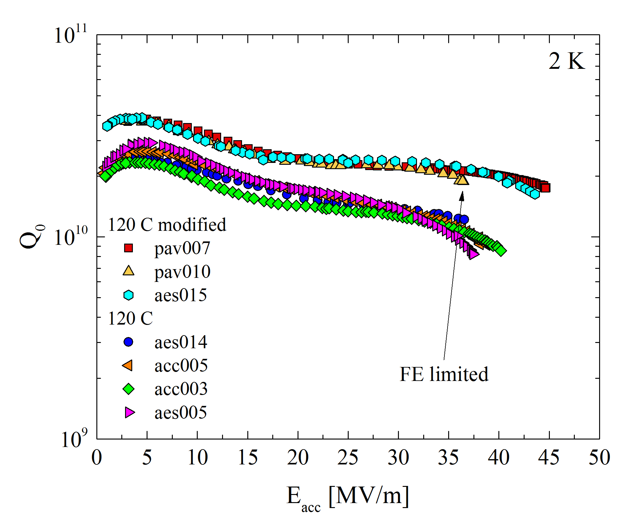
120C “modified” bake with N2 – repeatedly (4X) highest Q ever measured >2e10 at very high gradients>40 MV/m!
Higher gradients at Higher Q give a viable path to ILC cost reduction
News from High Q/High Gradient for Nb Cavities
A. Grassellino et al, TBP

Slide 18

  Publicity
Initial Publicity, excitement about ILC in Japan

Slide 19
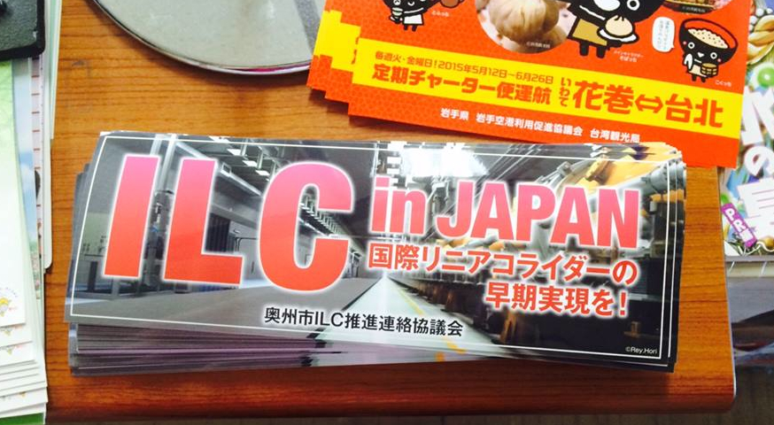

Slide 21
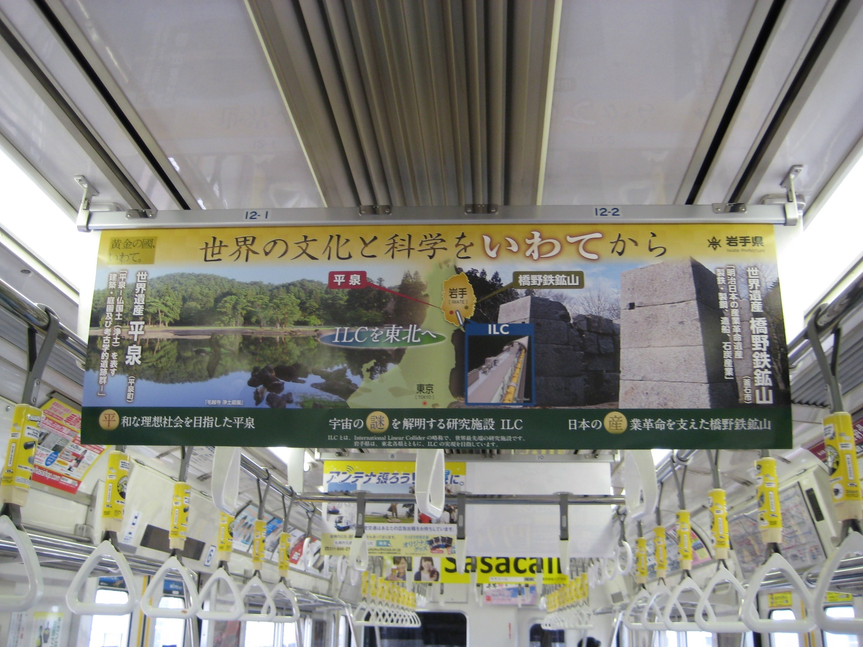
Welcome ILC! at Train Station

Slide 22

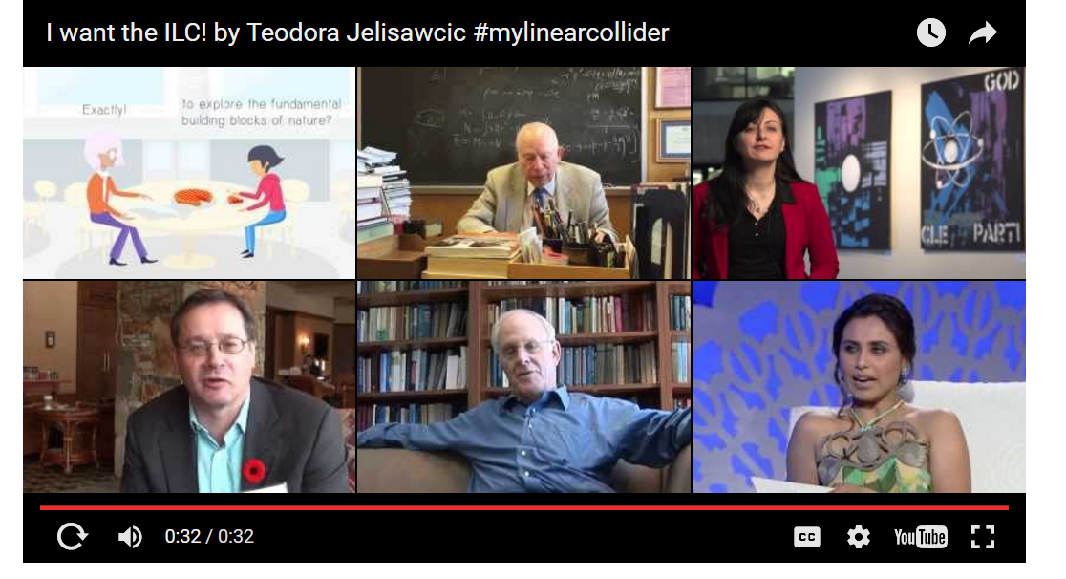
ILC Support Videos
Publicity Efforts Continue
Many Nobel Prize Winners endorse ILC on video presentations
Available on Youtube

Slide 23
More Comments on Publicity and Media from MEXT
HEP researchers direction is still NOT clear enough at the general public level
International physics communities are requested to talk with their governments to express their strong wishes for ILC…
Some steps already taken

Slide 24
At the latest LCB (Linear Collider Board) meeting, the way to communicate the physics case of the ILC to public was intensively discussed.
A short bulleted list of the physics case for the ILC was prepared:
The Higgs is a special particle;
The more accurately you measure it, the more new laws of physics one can reach.
Important properties are the interaction strength between Higgs and other particles.
ILC can measure them 3 to 10 times more accurately then the ultimate LHC.
  This means that the ILC is equivalent to 10 to 100 ultimate LHCs running simultaneously.
The energy of the ILC can be upgraded to match new discoveries

Slide 25
I took some liberties…
To add a few images/videos to this text

Slide 26
The Higgs is a special particle
  General Public: What is the Higgs? No idea!
    https://www.youtube.com/watch?v=m3-4Ez7Kc-o
The Higgs is a special particle; it’s discovery is just the beginning of the Higgs story
A story that began a long time ago!

Slide 27
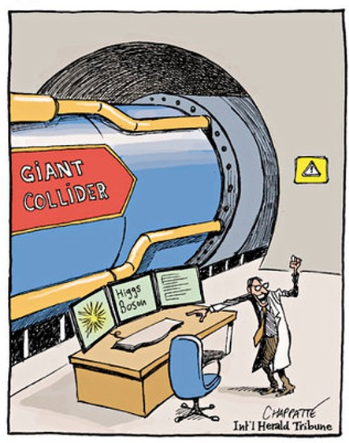

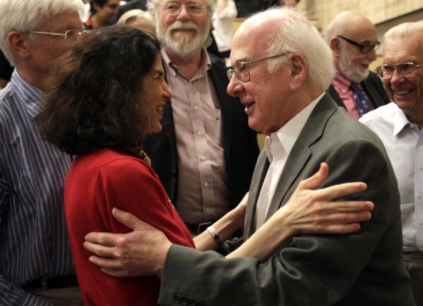
Collisions That Changed the World!
LHC discovers Higgs!
Explains the cause of mass
Newton invents concept of mass

Slide 28
Turning to the Master of Communication
  Brian Greene explains Higgs (extract)
  https://www.youtube.com/watch?v=tcHz3o4t6Rk

Slide 29

The more accurately we measure it, the more new laws of physics we can reach, the more mysteries of nature we can understand

Slide 30
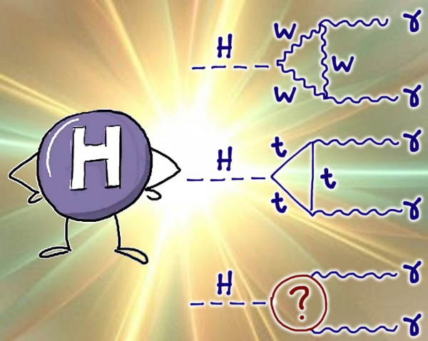
  The important properties are the interaction strength between Higgs and other particles (Z, W, top-quark...)

Slide 31
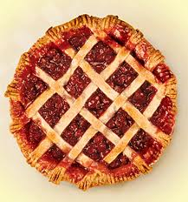
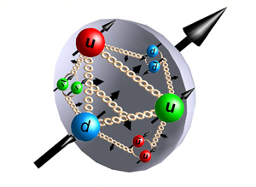
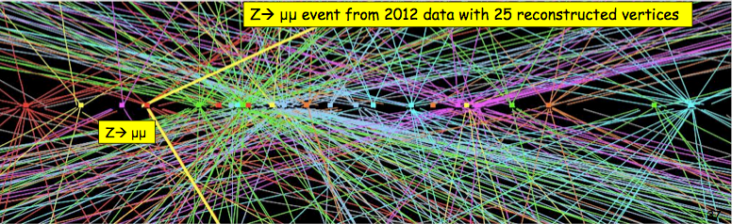
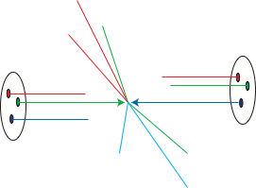


  From Murayama
  The ILC can measure these properties 3 to 10 times more accurately then the ultimate LHC (after upgrades).
  This means that the ILC is equivalent to 10 to 100 ultimate LHCs running simultaneously.
p
p
LHC
ILC
e⁺
e⁻

Slide 32
  AND
  The energy of the ILC can be upgraded to match new discoveries

Slide 33
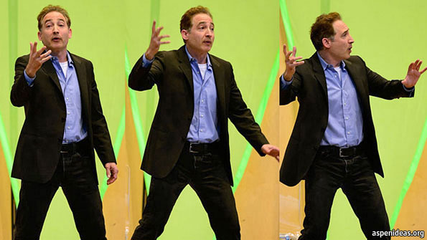
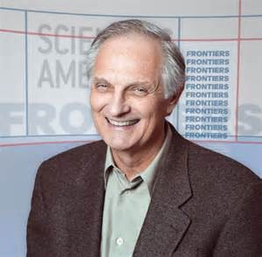
I am sure this is still not good enough for the general public!
Can we get well-known science popularizers to make
A video presentation to explain: WHY ILC ?
https://www.youtube.com/watch?v=HneFM-BvZj4
Brian Greene and Alan Alda explain Gravity
Alan Alda

Slide 34
ILC Features On All Road-maps for HEP (World-Wide)

Slide 35
ILC Features On All Road-maps for HEP (World-Wide)
ICFA (The International Committee for Future Accelerators)
  At the February meeting, ICFA reached a consensus that the international effort…for an ILC in Japan should continue.
ACFA: Asian Committee for Future Accelerators issued a statement about the ILC
  AsiaHEP and ACFA reassert their strong endorsement of the ILC, which is in a mature state of technical development…In continuation of decades of worldwide co-ordination
  We encourage redoubled international efforts at this critical time to make the ILC a reality in Japan.
European Strategy
  “There is a strong scientific case for an electron–positron collider, complementary to the LHC, that can study the properties of the Higgs boson and other particles with unprecedented precision and whose energy can be upgraded,”
  Europe looks forward to a proposal from Japan to discuss a possible participation
P5, US.
  Physics case for the ILC is “extremely strong” and that the “interest expressed in Japan in hosting the ILC is an exciting development

Slide 36
German particle physics community
Komitee für Elementarteilchenphysik KET workshop held in Munich in early May 2016
Participants discussed options for electron-positron colliders that are currently on the table.
Gives “strongest support” to ILC
Conclusions:
The physics case for a future e+e- collider, covering energies up to the TeV regime, is regarded to be very strong, justifying (and in fact requiring) the timely construction and operation of such a machine.
2. The ILC meets all the requirements discussed at this workshop. It is currently the only project in a mature technical state. Therefore this project, as proposed by the international community and discussed to be hosted in Japan, should be realized with urgency.

Slide 37
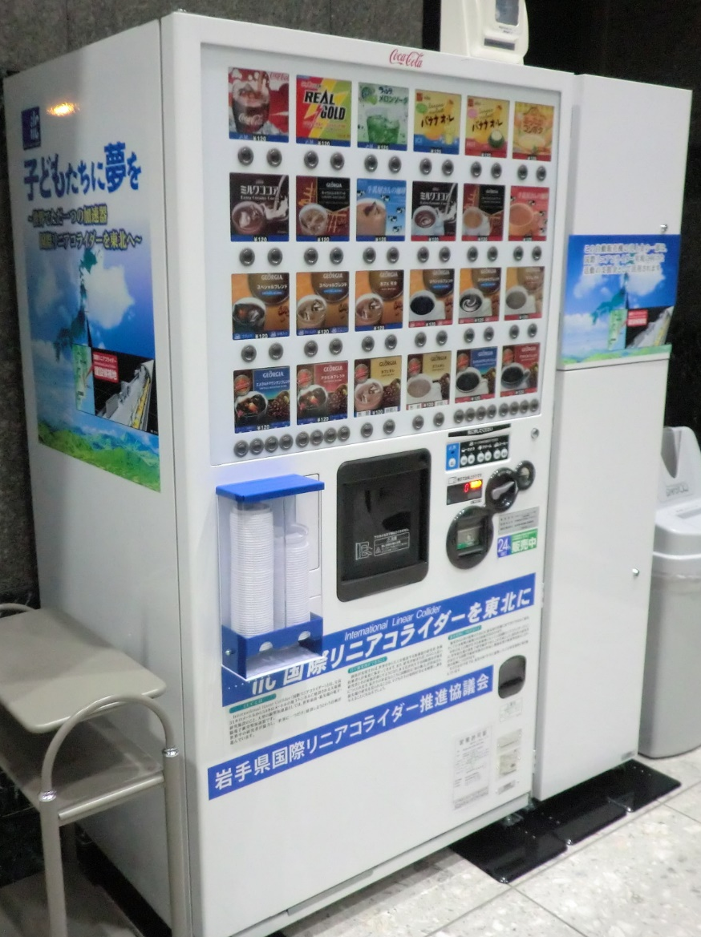
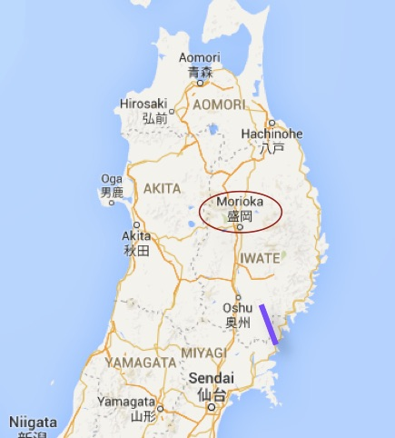
Next LCWS Workshop in Morioka December 2016.
If you go there, grab a coke from the ILC vending machine for your souveneer!

Slide 38
Next Steps Needed (From Yamashita con’t)
S&T national policy for 5 year-plan (2016-2020) defined under the Prime Minister’s leadership
  Requested increase of S&T budget to >200B US $ / 5 years
  For large scale project including accelerator projects.
Promotion of Local area development and local economy is now a central issue in the national cabinet policy.
  Especially after Olympics 2020 in Tokyo
Other important Milestones (that could impact)
Elections
  Upper house in July 2016, then lower house expected soon later
National budget still not in healthy condition.
  First need increase consumer tax
    8% -10% in April. 2017 will be delayed by Oct. 2019
  MEXT is busy and extra budget to be spent for Olympic game 2020 in Tokyo (by 2020).
  ILC will need budget in addition to current S&T budget…

Slide 39
Final Steps
Decision (by 2018?) to proceed by the government cabinet (Prime Minister)
  Backed by partner countries’ prospects
  Official Negotiations for detailed sharing.
International agreement
  Reassurance that world will join in
  But world wants to hear “Lets’ go!” before commitments

Slide 40




We are all very polite!
Who goes first?
After you!
World
ILC
No, after you !
Japan
In the meantime…

Slide 42
Benedict

Slide 44
Comments from Panels on FCC and CepC
The CERN Research Director Eckhard Elsen summarized the scientific programme of CERN at ECFA LCWS.
  Top priority is full exploitation of the LHC and its luminosity upgrade.
  Future long-term options are being prepared for the next European Strategy meeting, probably in 2019.
  These include a possible staged implementation of CLIC as well as other options like a very high-energy hadron collider (FCC) and an energy upgrade of the LHC.
German statements about FCC and CepC
  FCC-ee, as a possible first stage of FCC-hh, and CEPC could well cover the low-energy part of the e+e- physics case, and would thus be complementary to the ILC.
• US P5 recommendation 2014:
  ”….A very high-energy proton-proton collider is the most powerful tool for direct discovery of new particles and interactions under any scenario of physics results that can be acquired in the P5 time window….”
ACFA About CEPC, :
  We encourage the effort led by China in this direction, and look forward to the completion of the technical design in a timely manner.

Slide 45
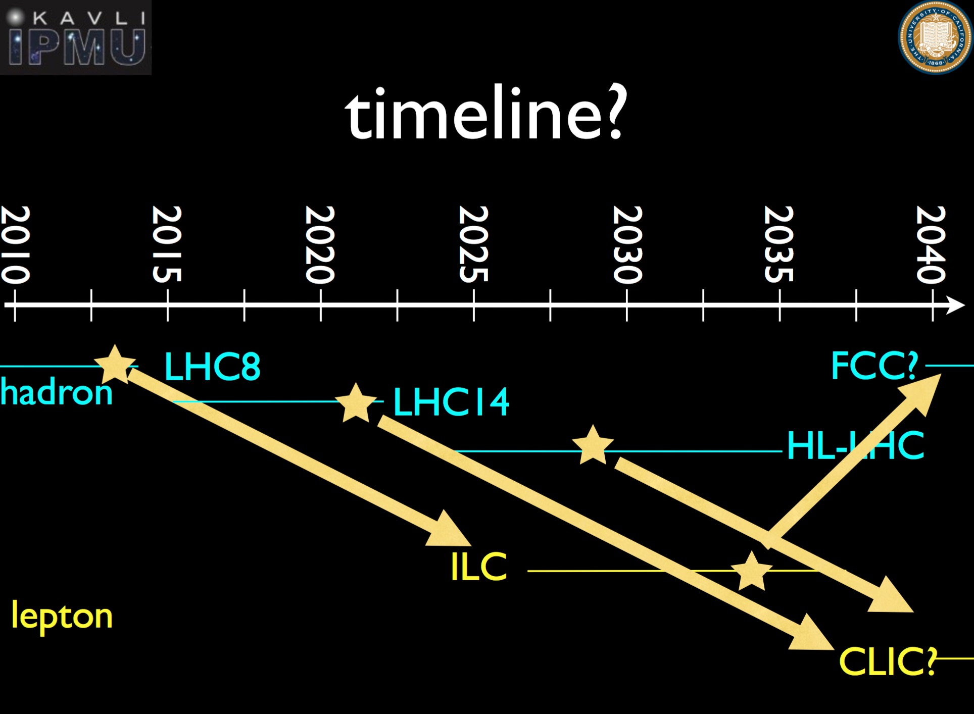

Slide 46
TTC will play a strong role in all future paths
Where will we go?
How will we get there?

Slide 47


