Slide 1
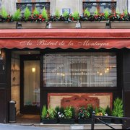
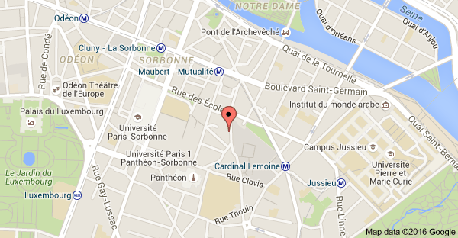
Dinner on THURSDAy, July 7th, 2016 at 20:45
Dinner will take place at
« Au Bistrot de la Montagne » restaurant
38 & 40 rue de la Montagne Sainte-Geneviève, 75005 Paris
Nearest RER B station: Luxembourg (11 minutes walking)
Nearest Metro station: Maubert Mutualité (3 minutes walking)

