Slide 1
FRIB summary of performance degradation - VTA to cryomodule
K. Saito MSU/FRIB SRF Development Manager

Slide 2
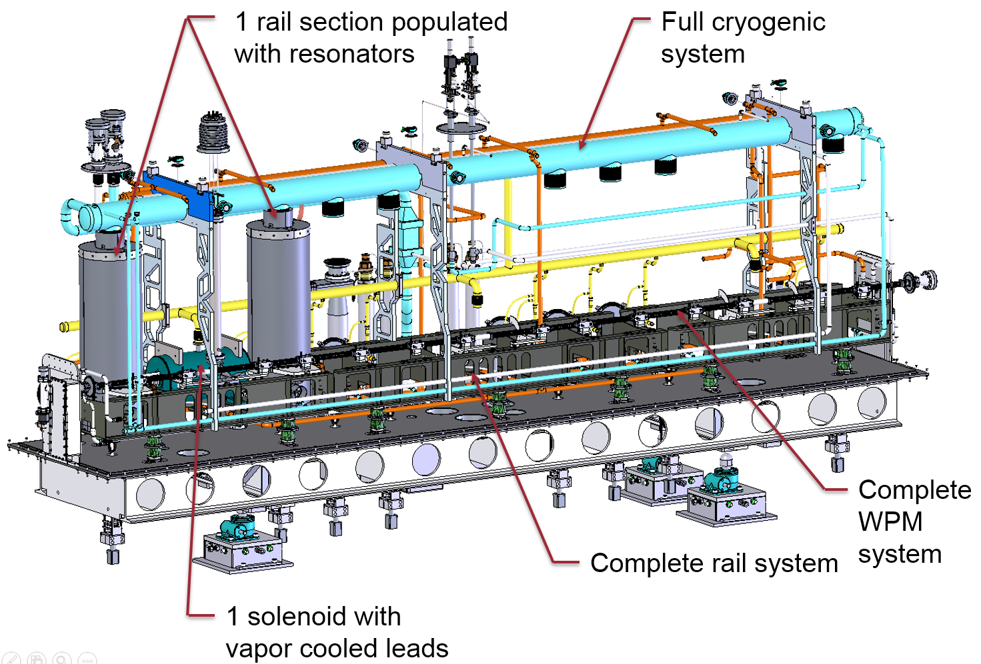
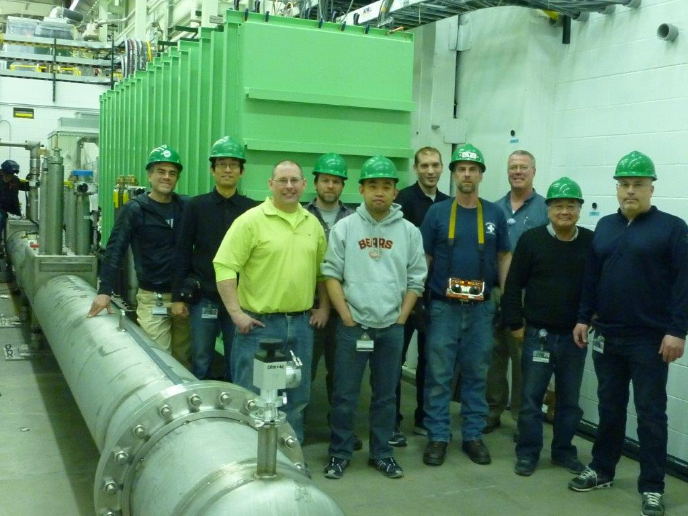
FRIB Cryomodule Design Validation: ReA6 tested in FRIB Operation Conditions
ReA6, 2-QWRs CM tested for final design validation of FRIB cryomodule and its subsystems
Installed on a FRIB-type cryogenic distribution box
QWR operation test at 4 K, in more demanding conditions than in FRIB due to larger pressure fluctuations, and at 2 K
Test of all parameters and simulation of FRIB operation:
Cooldow-warmup, repeated
Alignment, vacuum, instrumentation
Cryogenic losses
Cryogenic operation
SRF testing
SRF subsystems performance (QWRs, tuners, RF couplers, LLRF, HLRF)
Superconducting Solenoids testing
Long term CM locked operation in FRIB conditions
Steady state parameters measurements (cryogenics, SRF, amp-phase errors and detuning distributions, mechanical vibrations, etc…)
ReA6 installed in the “FRIB prototype” test stand

Slide 3
ReA6-1 Cavity Performance VT vs. Bunker
Dynamic heat load was measured at Eacc = 6.2 MV/m at bunker test, which includes the coupler dynamic load (simulation 0.15W) also.
Very difficult to measure individual cavity dynamic load due to small loss below the static heat load, two cavities are simultaneously measured at 2 K.
Some degradation is observed in Q_{O} but not conclusive in this stage.
 |  | VT at 2K | Bunker at 2K
Cavity 1 | Q_{O} | 5.5 x 10⁹ | ~ 4 x 10⁹
 | P_{loss} [W] | 1.3 | ~ 2.1
 | E_{acc} [MV/m] | 6.2 | 6.2
Cavity 2 | Q_{O} | 5.5 x 10⁹ | ~ 4 x 10⁹
 | P_{loss} [W] | 1.3 | ~ 2.1
 | E_{acc} [MV/m} | 6.2 | 6.2
4.2K Operation | Cryogenic Group | SRF Group | Simulation | Cavity1 | Cavity2
Static heat load | 5.16 W | 5.5 ±0.57 W | 4.8 W | - | -
Dynamic Heat load | - | 6.7 W | - | 3.1 W Q_{O} > 2.7x10⁹ at 6.2 MV/m | 3.6W Q_{O} > 2.3 x 10⁹ at 6.2 MV/m
2K Operation | Cryogenic Group | SRF Group | Simulation | Cavity1+Cavity2
Static heat load | - | 5.7W | 5.2 W
Dynamic Heat Load | - | 4.2 W | - | 4.2W (2.1W/cavity) Q_{O} ~ 4x10⁹ (at 6.2MV/m)
FRIB Goal |  |  |  | 3.85W/cavity (@5.67MV/m) Q_{O} = 1.8x10⁹ (at 2K)

Slide 4
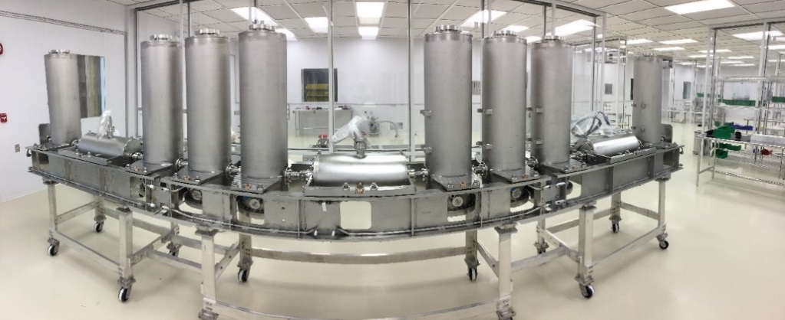
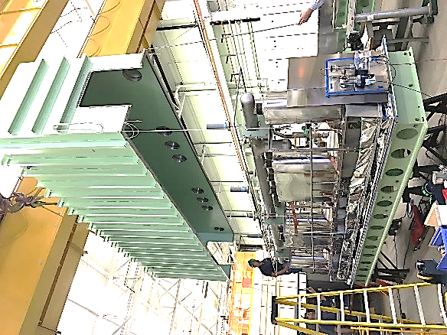
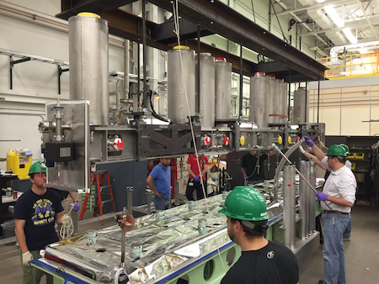
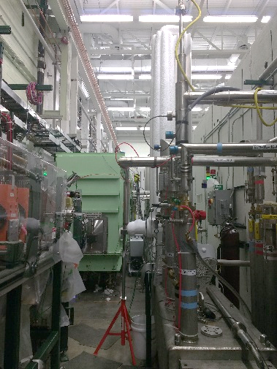
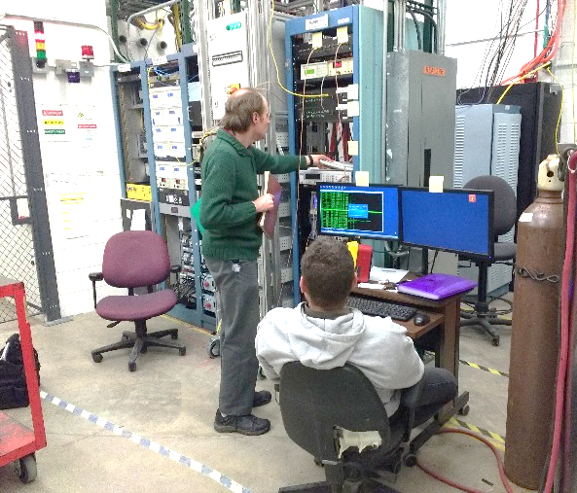
FRIB 0.085QWR first Cryomodule
Milestone for the FRIB-1 test completion
Events | Date
Coldmass assembly completed | 09/2015
Cryomodule assembly completed | 12/2015
First cooldown started | 01/23/16
Cavity integrated test 4 K completed | 02/23/16
Cavity integrated test 2 K completed | 03/10/16
Solenoid/magnetic shield test completed | 03/18/16
Low level control test completed | 05/20/16
FRIB SRF staff is working in parallel on cavity certification tests and integrated tests. The limited resources does not allow to concentrate to FRIB-1 CM test. FRIB-1 was kept at 4 K since January 23, for 4 months

Slide 5
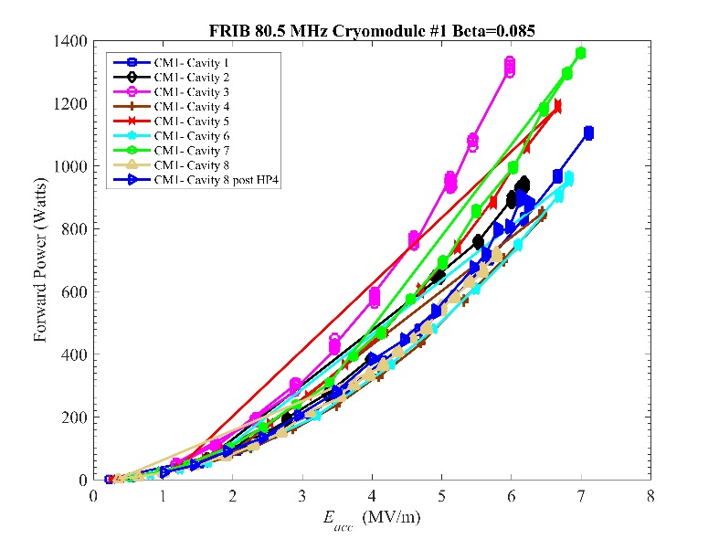
Integrated Test at 4 K/2 K with FRIB-1 Cryomodule
Two cavities simultaneous operation
Only two amplifiers and two low level RF control systems equipped at East highbay banker
Cavity gradient (Requirement 5.6 MV/m)
Result: Eacc ≧ 6 MV/m at 4 K, meets FRIB specifications, not tested at 2 K due to the limited cryo-capability in East Highbay.
Measured dynamic Loss at Eacc = 5.6 MV/m (requirement 3.85 W/ cavity, Q₀ =1.8 x 10⁹ at 2 K)
Result: 2.8 ± 1.5 W, Q₀=(2.5 ± 1.3 ) x10⁹ in average (included coupler dynamic heat load) at 2 K with ~ 40 % margin for FRIB spec.
VT test result is (2.7± 0.4) x 10⁹ in average.
No Q-degradation by cold mass assembly.
More data will be collected soon
Cavity gradient in FRIB-1 CM at 4 K
Cavity | Bandwidth [Hz] | Q₀ in VTA at 5.6 MV/m | Dynamic heat Load at 2 K (W)
#C1 (S85-009) | 20 | 2.3 x10⁹ | 6.2
#C2 (S85-011) | 39 | 2.3 x10⁹ | 2.4
#C3 (S85-005) | 44 | 2.4 x10⁹ | 2.5
#C4 (S85-008) | 37 | 3.0 x10⁹ | 1
#C5 (S85-003) | 25 | 2.8 x10⁹ | 2.4
#C6 (S85-004) | 27 | 2.4 x10⁹ | 2.5
#C7 (S85-006) | 27 | 2.9 x10⁹ | 2.4
#C8 (S85-007) | 26 | 3.1 x10⁹ | 2.6
Average | 31 ±9 | (2.7± 0.4) x10⁹ | 2.8 ±1.5

