Slide 1
Status of plasma processing at SNS
SCL systems group
Oak Ridge National Laboratory
TTC meeting
July, 2016

Slide 2
In-situ plasma processing to increase linac energy
Higher linac energy provides more margin for reliable operation at 1.4 MW
Most cavities at SNS are limited by field emission (FE) leading to thermal instability in end-groups
  Average accelerating gradients are 12 and 13 MV/m for the two cavity geometries
Developed in-situ plasma processing to reduce FE and increase accelerating gradients*
  Improves work function
  Reduce secondary emission yield
  Helps removing adsorbed gases
In-situ plasma processing
*M. Doleans et al. NIMA 812 (2016) pp50-59
P. V. Tyagi et al. Applied Surface Science 369 (2016) 29–35

Slide 3
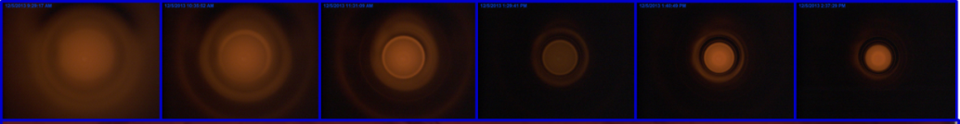
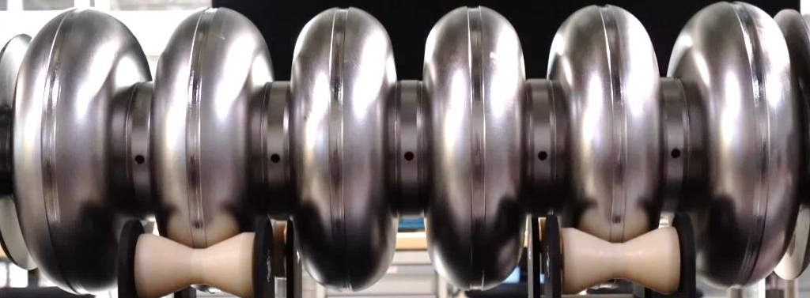
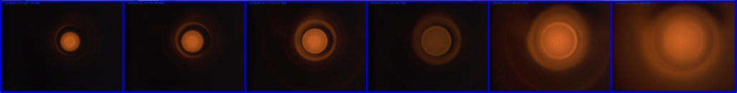
Reliable plasma generation in SNS HB cavities
Used successfully in ~20 cavities so far
Cells ignited sequentially
Filtered gas (3nm pore size filter)
  Neon (~150 mTorr) for plasma ignition and tuning
Oxygen added once plasma is ignited and stabilized in desired cell
  Oxygen cylinder is a non-flammable mixture with noble gas
  Typically percent level of oxygen in plasma mixture
Cell 1
Cell 2
Cell 3
Cell 4
Cell 5
Cell 6

Slide 4
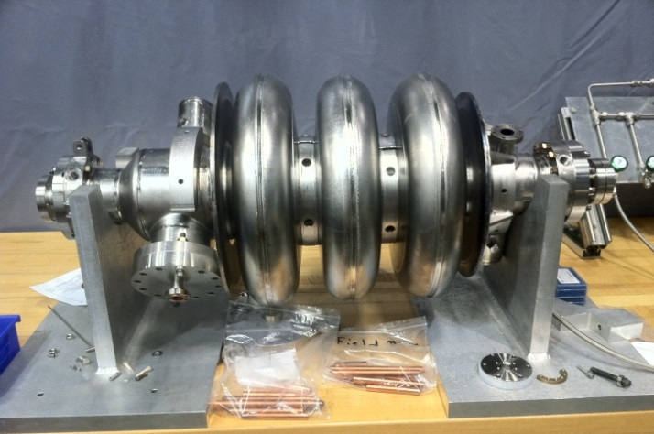
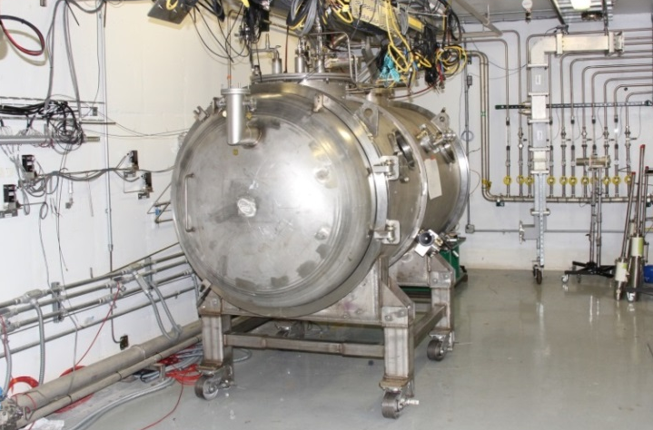
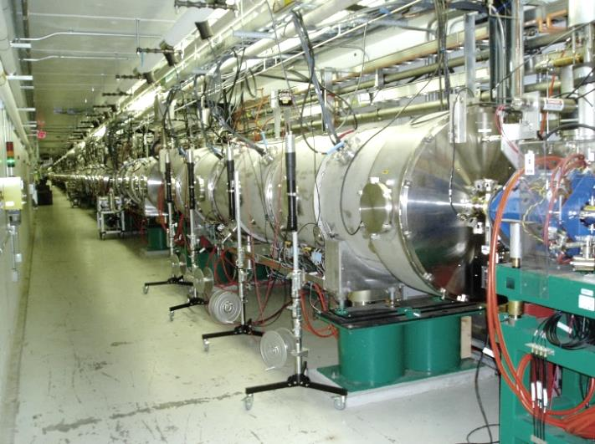
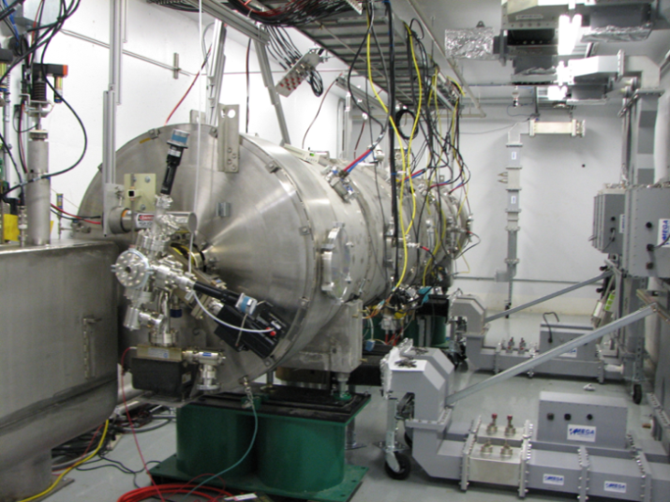
Plasma processing at SNS
HB49
HB52
1st phase
2nd phase
R&D with Nb samples and offline cavities
Processing of 6-cell cavity in HTA*
CM00022
CM00023
CM00012
On-going
FY16
FY17
4th phase
3rd phase
In-situ processing in linac tunnel
Processing of cryomodule in test cave
*HTA: Horizontal Test Apparatus

Slide 5
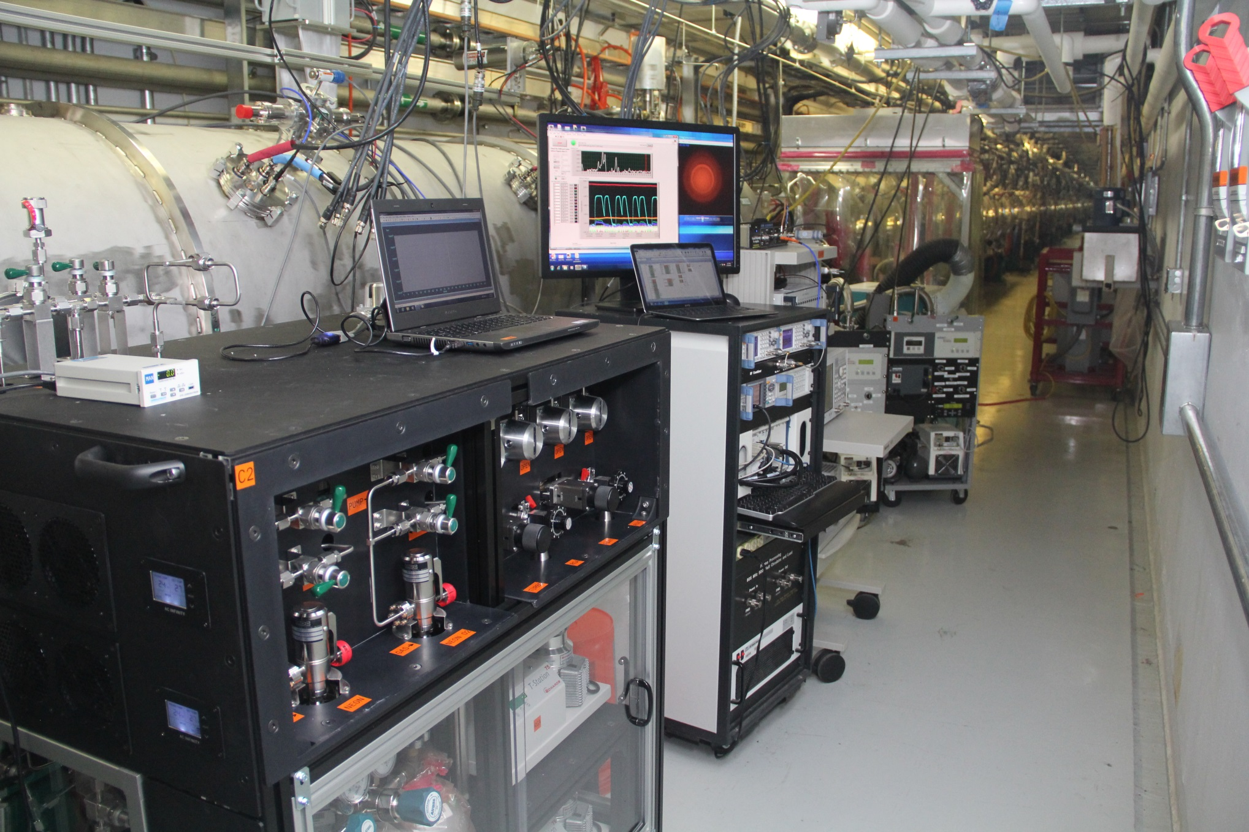
Plasma processing in SNS tunnel
Applied ALARA: Radiation survey indicated best location for minimum radiation exposure during work (<1 mrem/hr)

Slide 6
Cryomodule improvements
Three cryomodules plasma processed so far
  CM00012 (offline)
    3 MV/m average increase of Eacc per cavity
  CM00023 plasma processed in tunnel during winter shutdown FY 16
    3 MV/m average increase of Eacc per cavity
    11 MeV increase of linac output beam energy
  CM00022 plasma processed in tunnel during summer shutdown FY 16
    Test after plasma processing pending
  More to come in FY17!
Detailed presentation of results
  LINAC16 invited talk (M. Doleans)
Example of radiation measurement

