Slide 1
Future Thin Film Deposition Efforts at FNAL
G. Wu, M. Checchin, L. Phillips and Y. Xie
2016-07-05

Slide 2
Recommendations from HEPAP Subpanel
Recommendation 4. Direct appropriate investment in superconducting RF R&D in order to inform the selection of the acceleration technology for the multi-MW proton beam at Fermilab.
Recommendation 6. Increase funding for development of superconducting RF (SRF) technology with the goal to significantly reduce the cost of a ~1 TeV energy upgrade of the ILC. Strive to achieve 80 MV/m accelerating gradients with new SRF materials on the 10-year timescale.

Slide 3
Presentation purpose
Recently an LDRD to start a thin film R&D project at Fermilab was granted to Dr. Genfa Wu
The main goal of such R&D program is to produce thin SRF film technology exploiting niobium and new materials in order to meet the recommendations from HEPAP subpanel
Currently we are in the initial stage of assembling the deposition system and developing a research plan in collaboration with JLab and Cornell
The presentation will be therefore centered on the reasons why we are considering the thin films technology and on the future efforts we plan to make at Fermilab

Slide 4
Why Thin Films?

Slide 5
SRF Accelerator Cost Drivers
SRF Accelerator
  Cryomodule
    Cavity
    Coupler
    Tuner
  Cryogenic plant
    Cavity dynamic heat load
  RF Power Source
  Controls

Slide 6
SRF Accelerator Cost Drivers
Nb/Cu
SRF Accelerator
  Cryomodule
    Cavity
    Coupler
    Tuner
  Cryogenic plant
    Cavity dynamic heat load
  RF Power Source
  Controls
Metal cost per pound
Copper | $2.37
Niobium | $150.00

Slide 7
Lower Cost
Low frequency SRF accelerators may benefit from thin film technology:
Cavity dimensions inversely proportional to frequency
Larger size cavity requires thicker material
PIP-III is one good example
  650 MHz Linac material cost is ~$20M
FCC 400 MHz cavity option renews the interest in film cavities
  600 x 400 MHz SRF cavities material cost is ~$480M
Notes:
LCLS-II, 1.3 GHz, 9-cell, 300 cavity. $10 M.
PIP-3 Scale to 650 MHz = X8 x5cell/9cell. X4mm/3mm, 120 cavities (20 cryomodule), -> $20-$24 M$
FCC 12 GV/100MW, 400 MHz 5 cell. 4mm thick. 600 cavities. If 5-mm thick, cost goes to M$600

Slide 8
SRF Accelerator Cost Drivers
Higher T_{c} Materials
SRF Accelerator
  Cryomodule
    Cavity
    Coupler
    Tuner
  Cryogenic plant
    Cavity dynamic heat load
  RF Power Source
  Controls
Nb₃Sn, 4.2 K
D. Hall, SRF 2015
Nb₃Sn, NbN, etc.
Higher operational T
Lower R_{BCS} (higher T_{c})

Slide 9
Fermilab Effort in Thin Films Deposition

Slide 10
Superconducting Coatings @ Fermilab
Coating Goals
Niobium coating on elliptical copper cavity
  Thicker film (~ 20-50 µm) for EP and doping to achieve high Q-factors
Alternative material coating on niobium substrate and/or copper substrate
  Nb₃Sn/Nb
  Nb₃Sn/Cu
  NbN
  MgB₂
Field emission suppression coating
  Al₂O₃, AlN, …

Slide 11
Superconducting Coatings @ Fermilab
Coating Methods
ECR deposition
HiPIMS deposition
  Explore self sufficient niobium sputtering in vacuum (or minimize the inert gas pressure)
Post processing of thick film
Annealing to remove crystal defects
Doping to reduce BCS resistance
Electro-polishing to remove surface layer
Design a mechanically strong substrate cavity to satisfy the pressure safety requirement

Slide 12
HiPIMS Deposition
substrate
HiPIMS Principle
  High power pulses at the target
  Neutrals atoms sputtering
  Partial ionization of neutrals
  Ions returns to the target
  Self sputtering (metals ions sputter metal neutrals)
atoms to substrate
ions to substrate
Condition of self-sputtering runaway
Ionization
probability
Condition of steady-state
self-sputtering
sputter
yield
Probability for ion
to return to target
target
A. Anders, Surf. Coat. Technol. 205 (2011) S1.

Slide 13
HiPIMS deposition plans @ Fermilab
Research on Niobium Self Sputtering in Vacuum
  Using external magnetic field to increase ionization coefficient
  Design the magnetron to increase the self sputtering yield of niobium
Introducing an insulating layer
  Improve adhesion
  Eliminate thermal EMF due to bimetallic interface
  Allows fast cool down for magnetic flux expulsion
New materials
H//

Slide 14
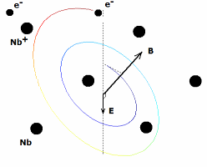
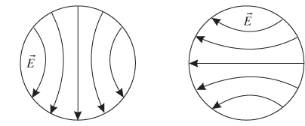
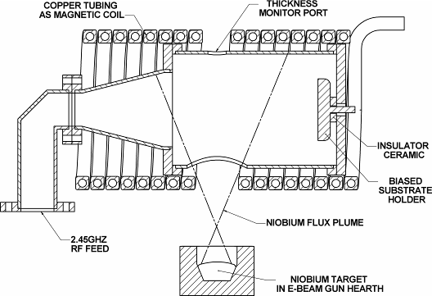
ECR Deposition
Plasma generation
  Neutral Nb vapor generated by electron beam
  Electron cyclotron resonance:
    RF power (@ 2.45GHz)
    Static B ⊥ E_{RF}
  Neutral Nb vapor ionized
Pros
  No working gas
  Ions produced in vacuum
  Singly charged ions 64eV
  Controllable deposition energy with Bias voltage
  Excellent bonding
  No macro particles
Cons
  So far limited to niobium
G. Wu, et al. J. Vac. Sci. Technol. A 21 (2003)

Slide 15
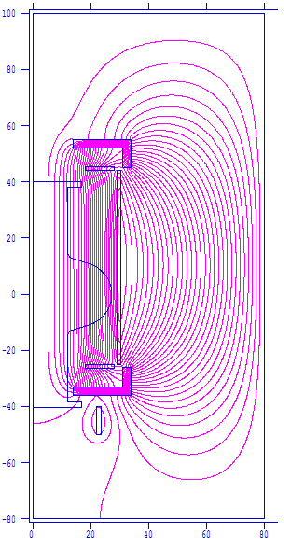
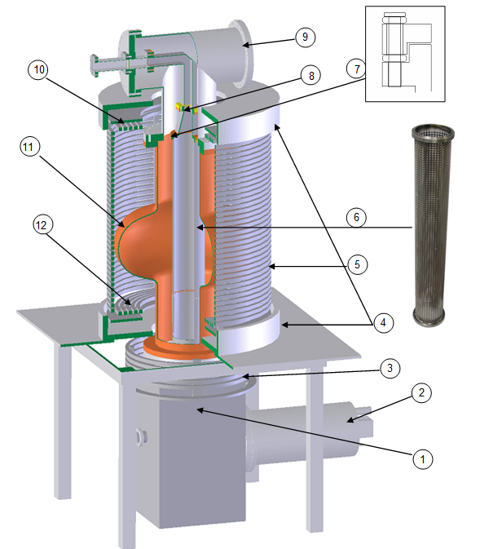
ECR Cavity Deposition System
Potential use for surface cleaning and Nb₃Sn, NbN coatings
14kW rod-fed E-gun
9000 l/s cryopump system
bucking coil for E-gun
top and bottom iron yokes (outer iron shield is removed for illustration)
center coils
Nb grid tube
bias insulator
WR284 waveguide E-bend and horn to the grid tube
“T” vacuum chamber
top pancake coil
Cu cavity
bottom pancake coil.

Slide 16
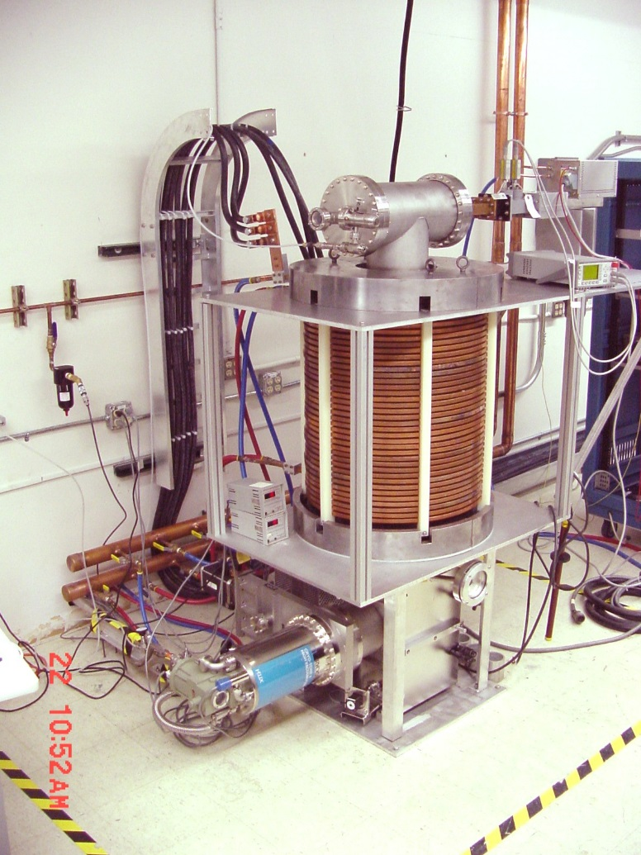
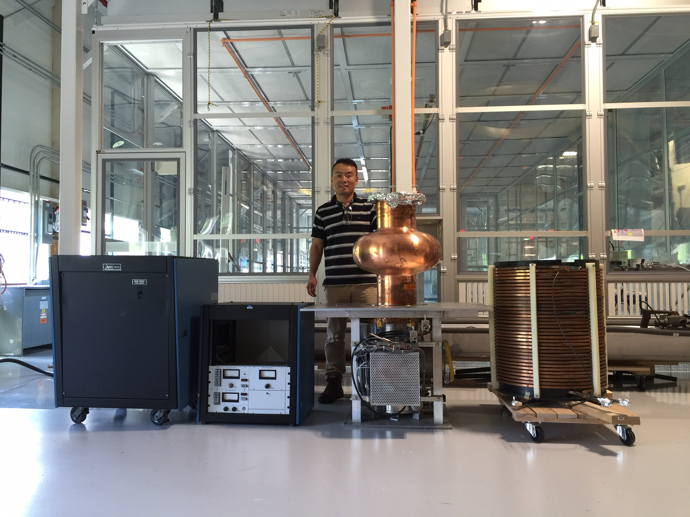
ECR Cavity Deposition System Moved to Fermilab
JLAB
Fermilab

Slide 17
Summary for Superconducting Coatings for Future SRF
HiPIMS deposition R&D will be pursued in order to achieve performing film-based SRF cavities, implementing:
  Self sputtering
  Thick film
  Processing technology of bulk niobium cavities
ECR coating showed promising results on samples. Fermilab is collaborating with JLab and Cornell to coat a copper cavity to test

Slide 18
Acknowledgments
Hasan Padamsee for his pivotal work on gluing together the collaboration
Charlie Reece for his blessing of the collaboration
Anna Grassellino and Alex Romanenko for their support on this LDRD

Slide 19
Thank you

