Slide 1
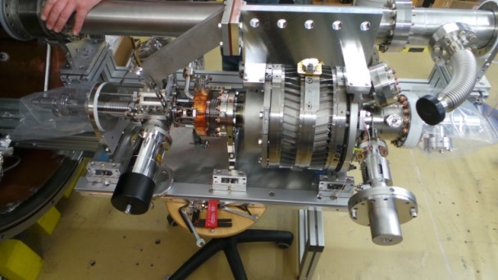
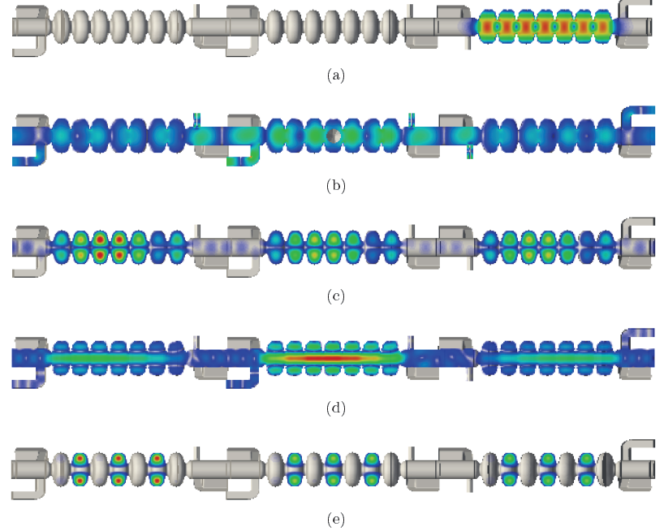
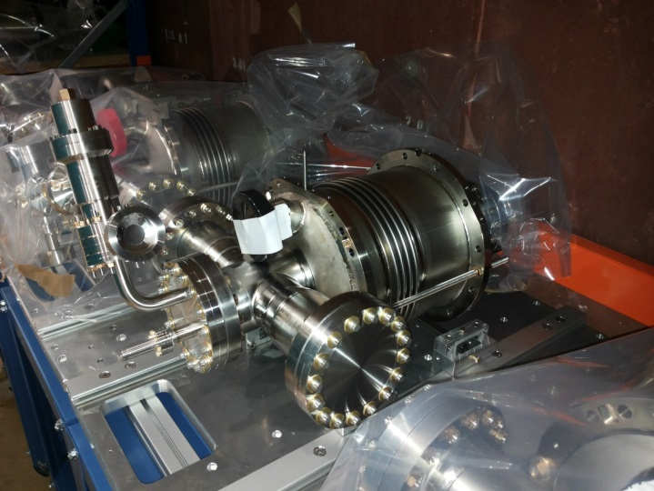
bERLinPro SRF systems - R&D topics and discussion
A. Neumann, TTC meeting at Saclay, 5th-8th July 2016
WG 3, Wednesday
T. Galek, U. Rostock

Slide 2
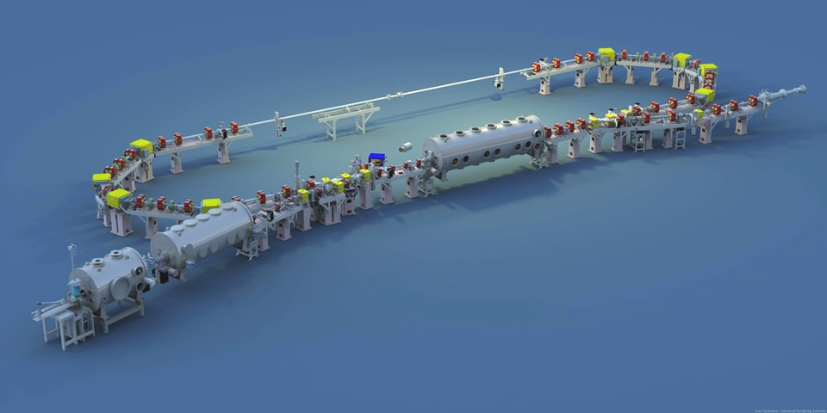
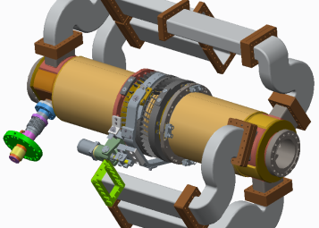
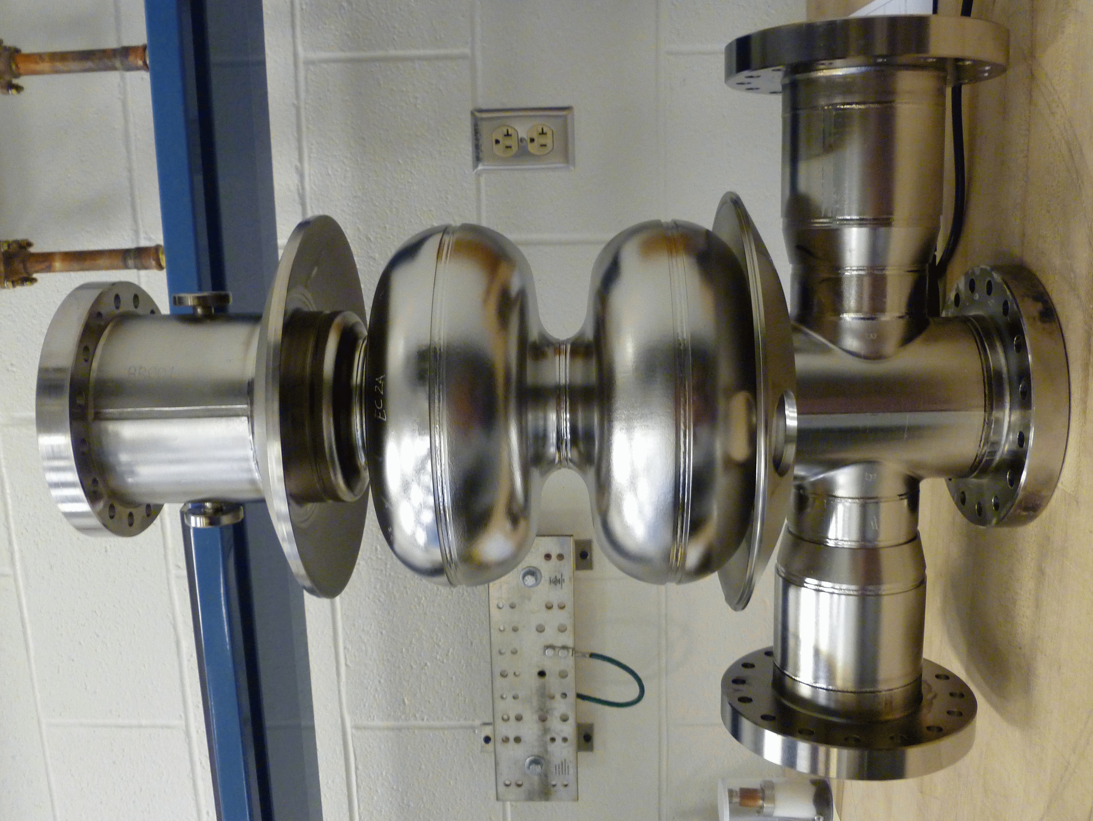
SRF for bERLinPro continued
Today:
Booster and Linac status
and open issues
Gun module covered within
talk on Tuesday

Slide 3
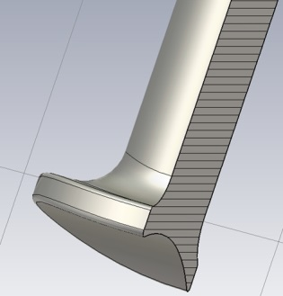
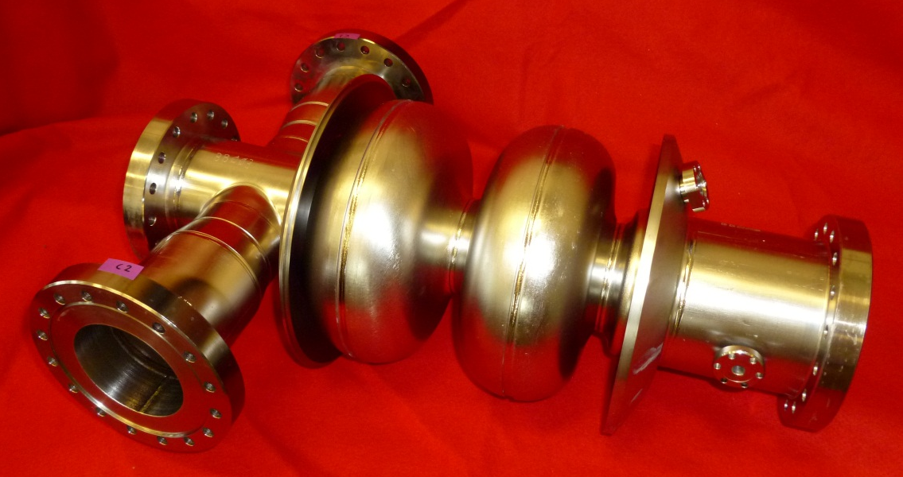
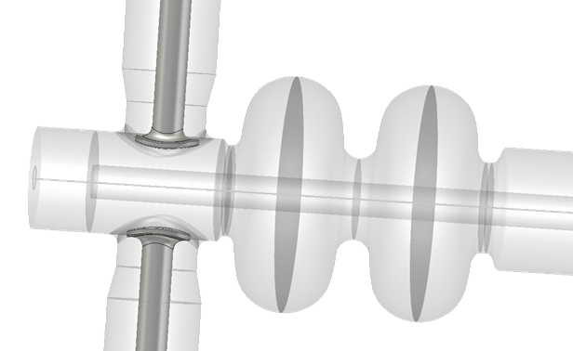
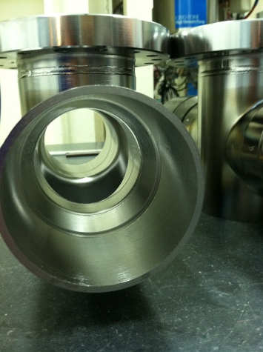
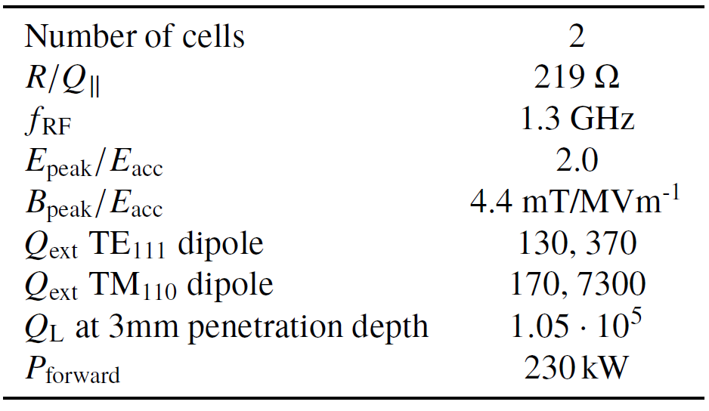
Booster cavity design
New transition
Made from sheet
metal
Cornell cell shape
Nice and shiny
Variation of input coupler section with
new 88mm Ø beam tube leaves RF
properties unchanged
New „Golf Tee“ coupler tip to increa-
coupling, lower penetration depth,
lower kick
Coupling section similar to KEK
booster design to allow easy integration
Will be equipped with blade tuner as
Gun using four symmetric piezos
(Cornell)

Slide 4
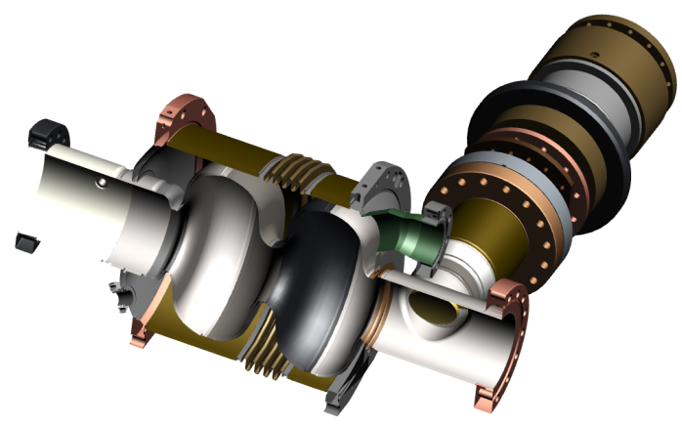
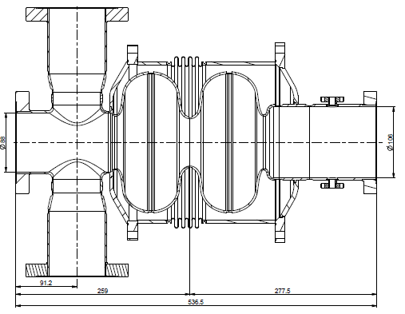
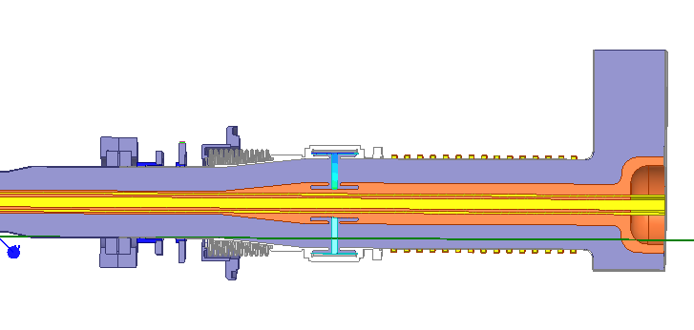
Task of the Booster module
The booster module needs to accelerate the beam from 2.3 to 6.5 MeV,
impose an energy chirp and is part of the low emittance injection scheme
(see B. Kuske et al., IPAC16).
Two cavities will deliver 210 kW beam power,
one is operated in zero-crossing
Operating field level is rather low (E_{acc}=10 MV/m)
Main issues are minimization of coupler kicks by proper alignment and orientation,
control of dark current to a minimum level by varying cavity positions in module
Most critical item is the design and production of the power coupler.

Slide 5
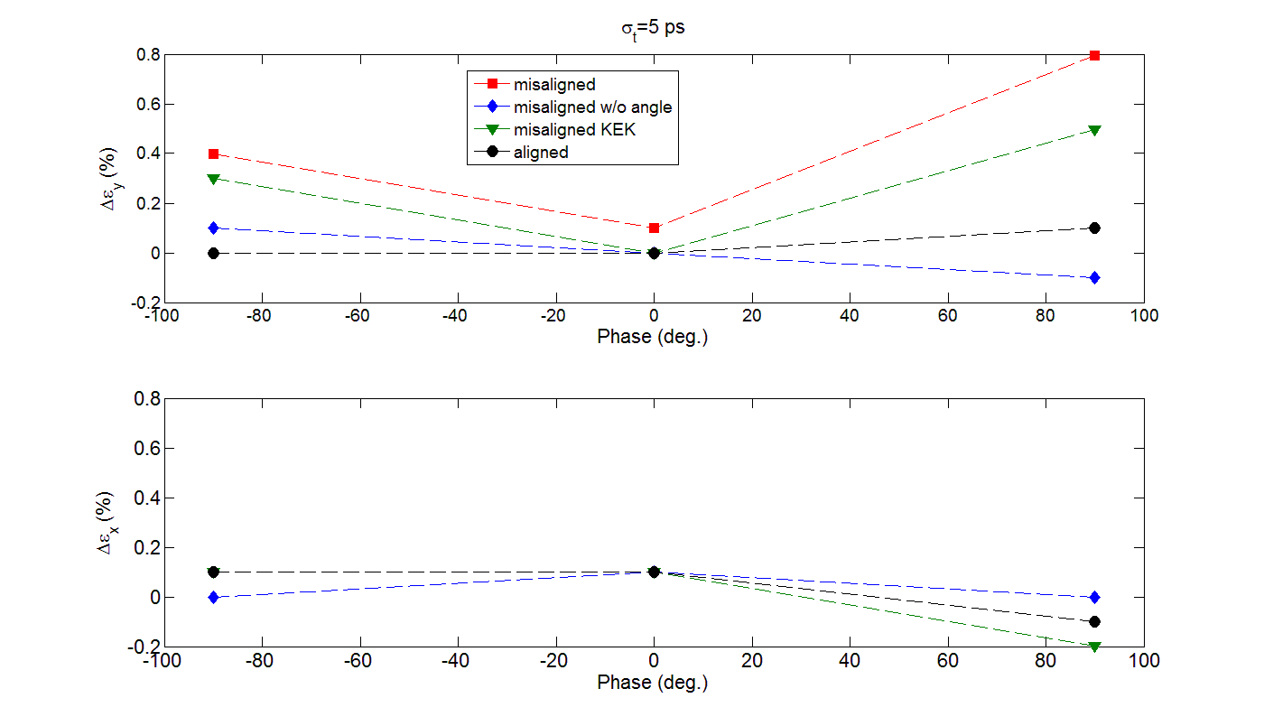
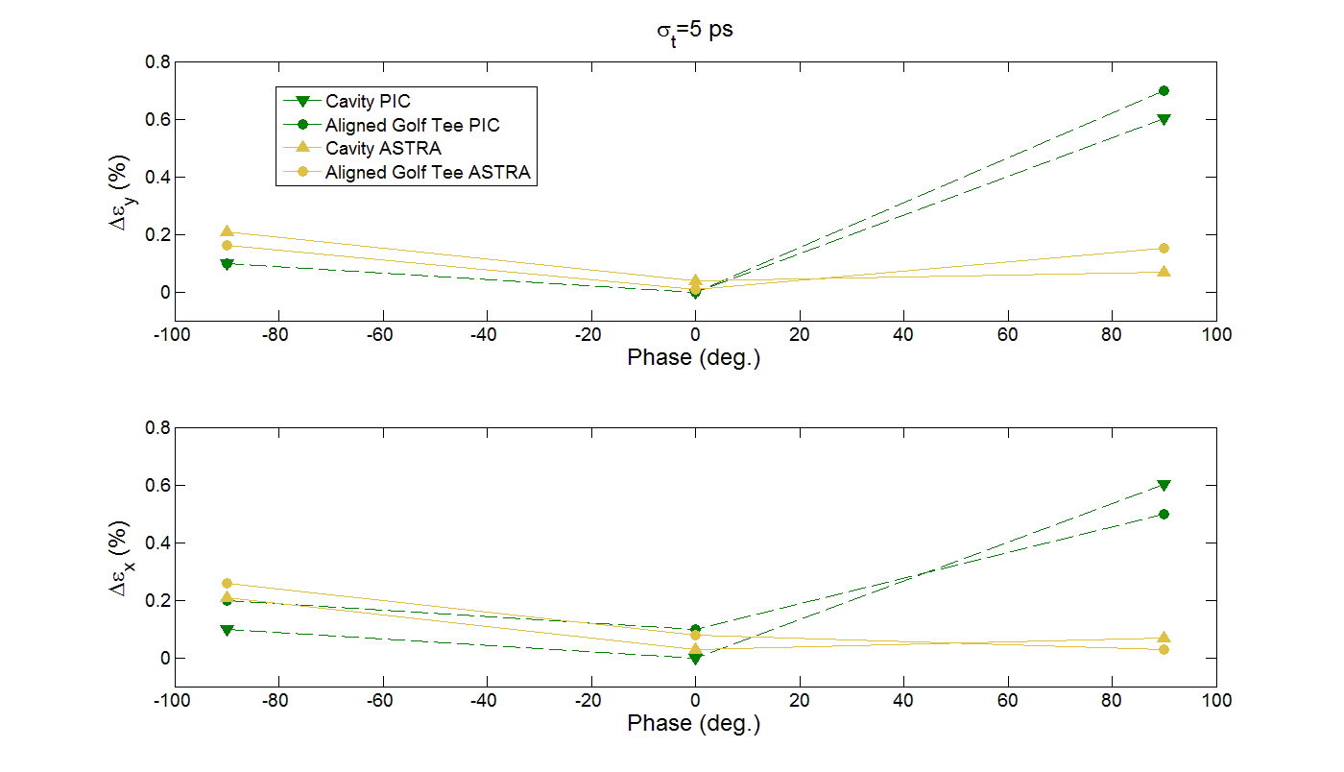
Emittance growth: CST PIC vs. ASTRA (thanks to S. Wesch)
For a similar misalignment scenario the ”golf tee” coupler is less perturbing the beam’s emittance than the original KEK design (blue vs. green curve)
In the misaligned case the emittance growth is on the percent level, but there is a rather strong kick at 0.4 mrad
For an aligned twin ”golf tee” the emittance growth is negligible (≤1e-3) and the focusing strength changes by 10 % with a 3 % imbalance between both vertical planes in the misaligned case (on-crest)

Slide 6
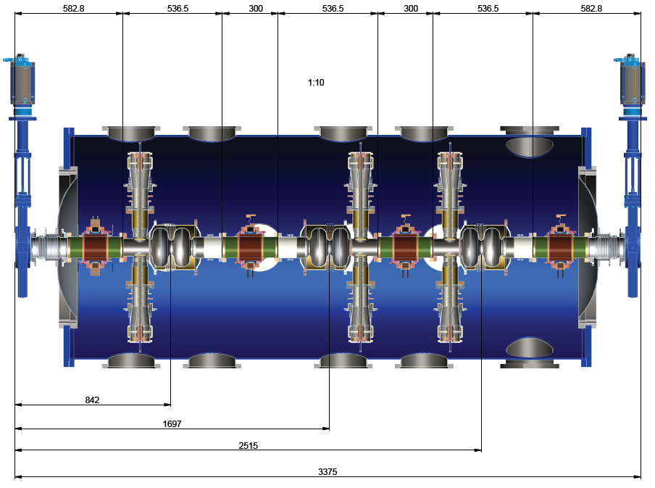
Current Booster module layout
Zero-crossing cavity
Minimize
required
tapering in
module
Decided
to have only
one HOM type
Beam
88mm
106 mm beam tube
88mm
106mm
2.1 MV cavities
HOMs, one type
Cavities are oriented to minimize coupler kicks (low effect) and
amount of possible dark current upstream to cathode
(ASTRA/CST 3D field based simulations, M. McAteer et al. IPAC16)
However, coupler port accesibility and layout of cryogenics partially omitted
to follow best orientation
→ Module design finalized w.r.t. required mechanical

Slide 7
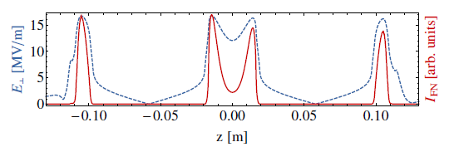
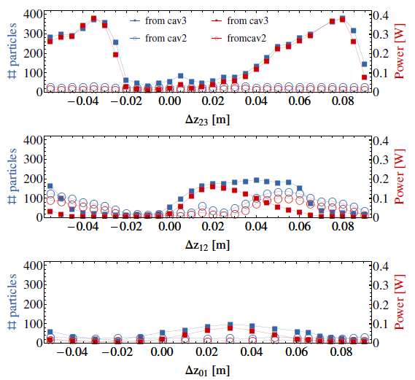
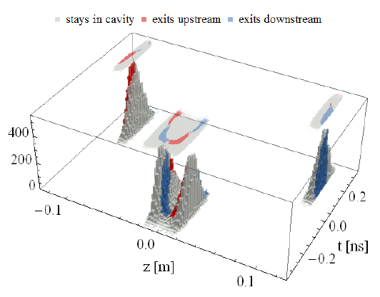
Optimizing Booster w.r.t. dark current on cathode
Surface field and normalized
Fowler-Nordheim emission
Most effect by distance
cavity 2 to 3
Iris
RF phase
1st cavity zero-crossing
M. McAteer et al., IPAC16

Slide 8

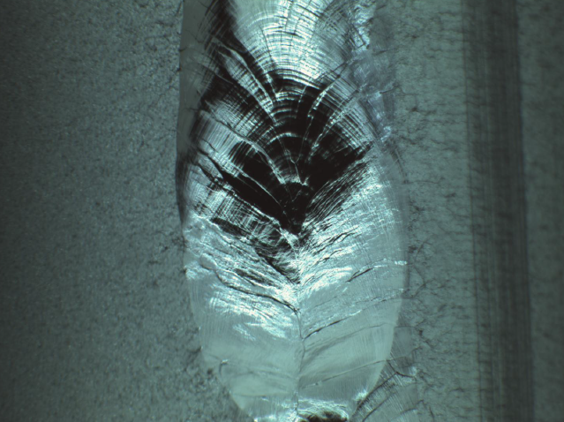
Some problems during production
2 cavities showed 1 mm Ø hole in the equator weld. They were fixed by inserting
a small high grade Nb cylinder and following welding this area.
Those spots do not seem to be of any problem for the field range required.
Weld repair inside
Weld repair outside
Courtesy G. Ciovati, JLab

Slide 9
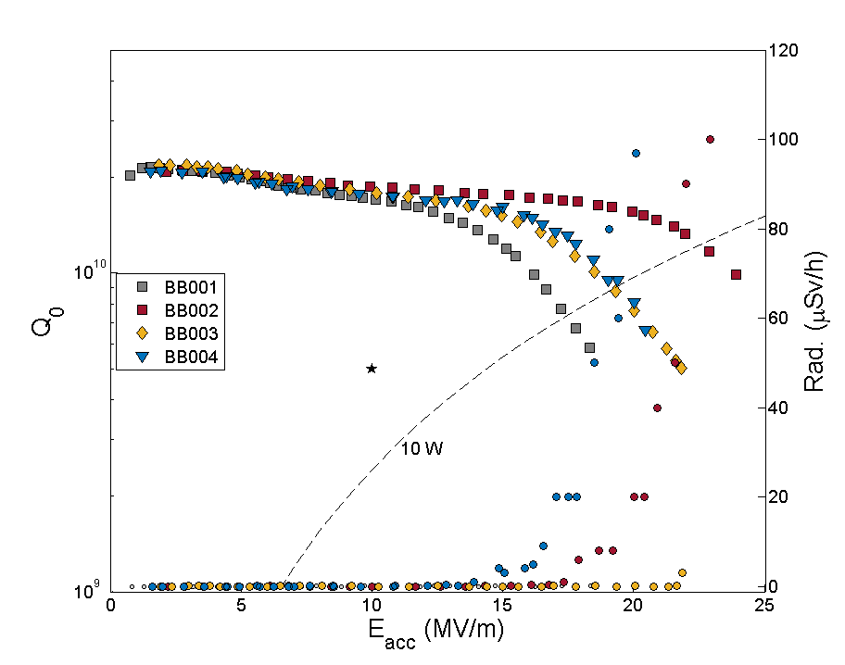
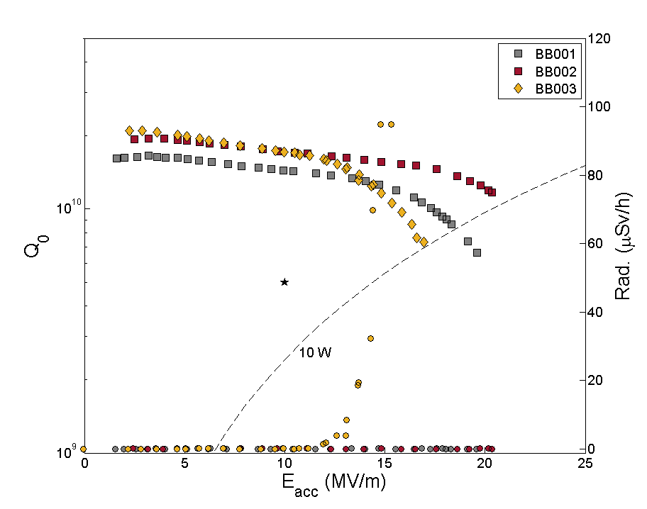
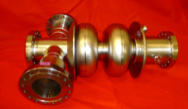
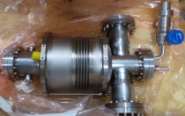
Status Booster Cavities
Booster cavity vertical tests at JLab before and after helium vessel welding (except for BB004) at 1.8 K.
Due to leakage problems below λ point at the FPC NbTi flanges, cavity BB001 was only measured at 2.0 K.
The booster cavities all are beyond specifications.
Maximum field with helium vessel mostly 10% lowered after helium vessel
welding
For cavity BB003 a field emitter was uncovered after HV welding, for BB002
the emitter vanished
All field emission onset are above the field level of 10 MV/m for bERLinPro
3 out of 4 cavities showed problem of leaking NbTi flanges in superfluid helium

Slide 10
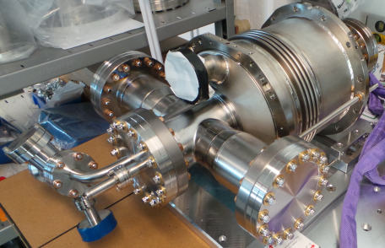
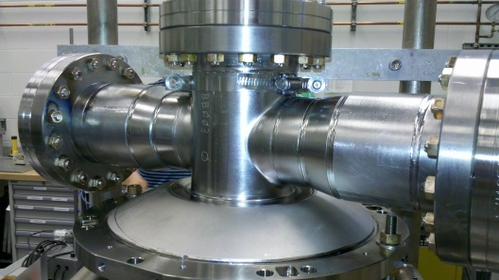
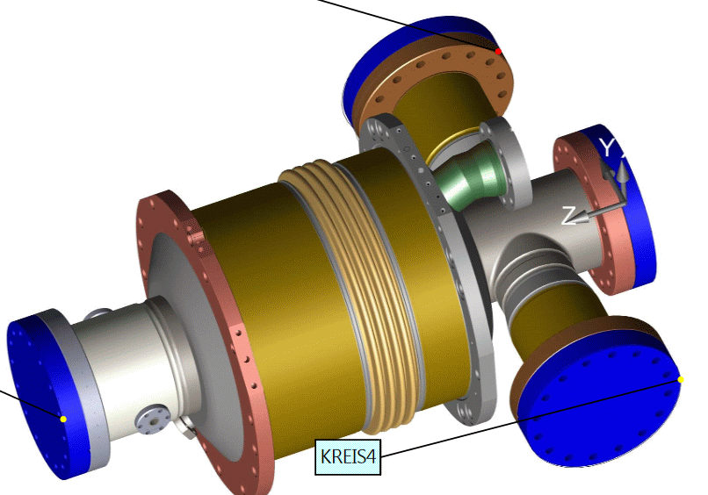
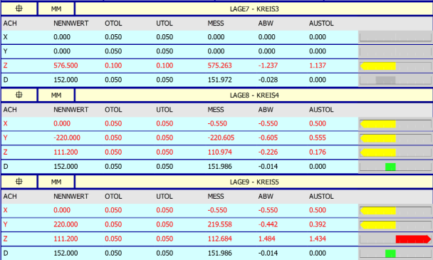
Next steps Booster
First Booster cavity was measured
with new CMM tool. At first glance
quite some deviations from drawings
→ compare with JLab CMM data
This cavity is mounted on
support platform and will be tested
in HoBiCaT coming quarter
Horizontal tests will show whether
the helium leaks found during
vertical tests at NbTi flange are of any
problem for module operation.
BB003
The tapered input
coupler section at
the 88mm beam tube
side
Deviations will complicate coupler alingment:
Variation of Q_{ext} and coupler kicks may result

Slide 11

Linac Cavity
Operating and RF parameters:
E_{acc}= 20 MV/m in CW
Beam current: 2 x 100 mA
180 deg. phase shiftes w.r.t. RF
→ Low peak field ratios and
strong HOM damping required

Slide 12
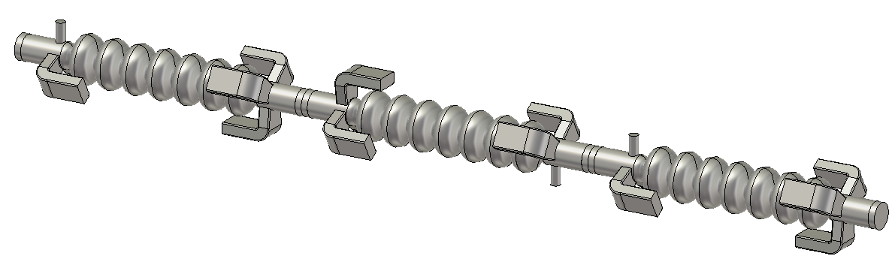
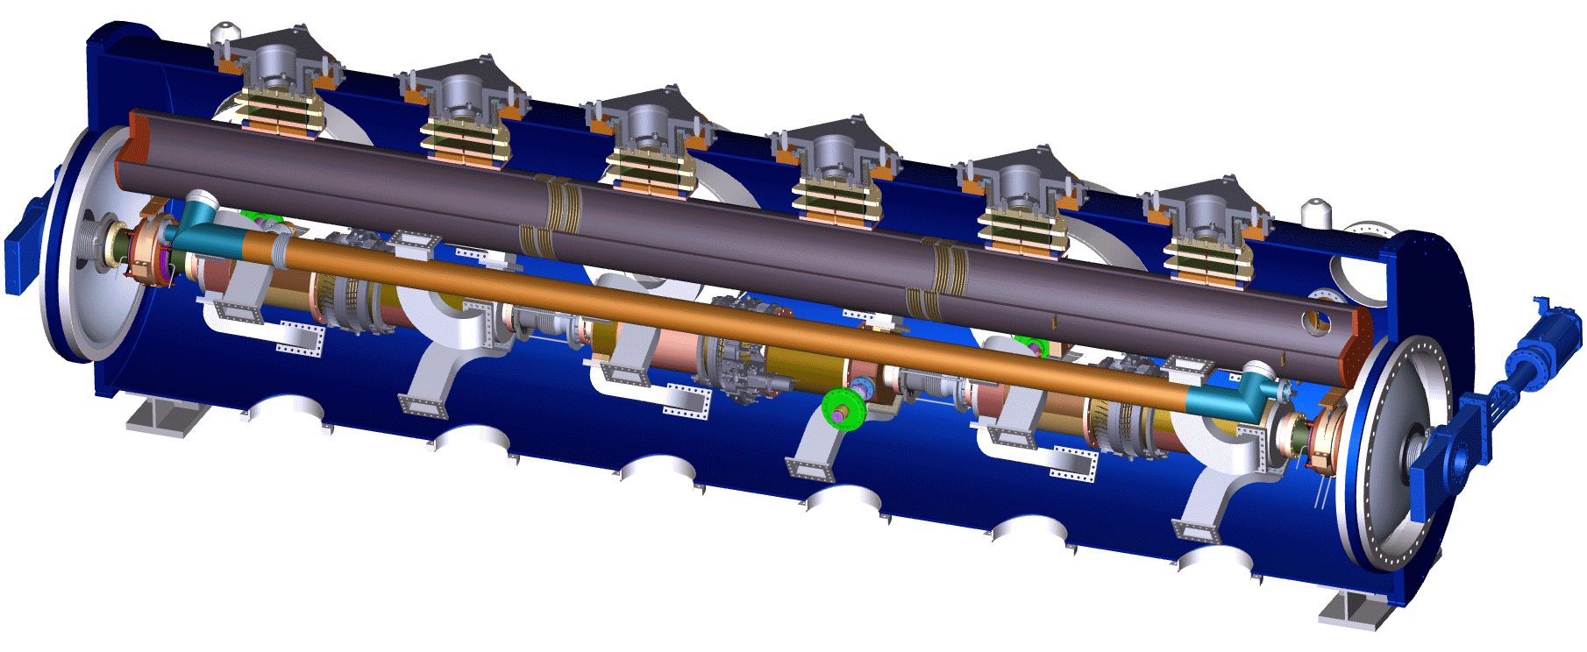
Linac Cavity requirements and main design goals
Current coupler arrangement
Iris 72 mm
Low to zero beam power,
thus high Q_{L} operation
at low power possible→
High mechanical stability
required
5 WG+
1 TTF-III
110 mm beam tube
The string needs to deliver 14.8 MV per cavity, thus E_{acc}⋍20 MV/m
Strong HOM damping required because of interaction with two 100 mA beams
Q_{ext} lowest dipole ≤5.10⁴
Beam is injected with 6.5 MeV, still soft → coupler kicks and emittance preservation
need to be considered…….further power overhead and tuning because of
incomplete recovery in one cavity
Bellows and
absorbers required
but also risk for
cavity operation
(Wakes, dust)
Bellows
Beam tube absorbers

Slide 13
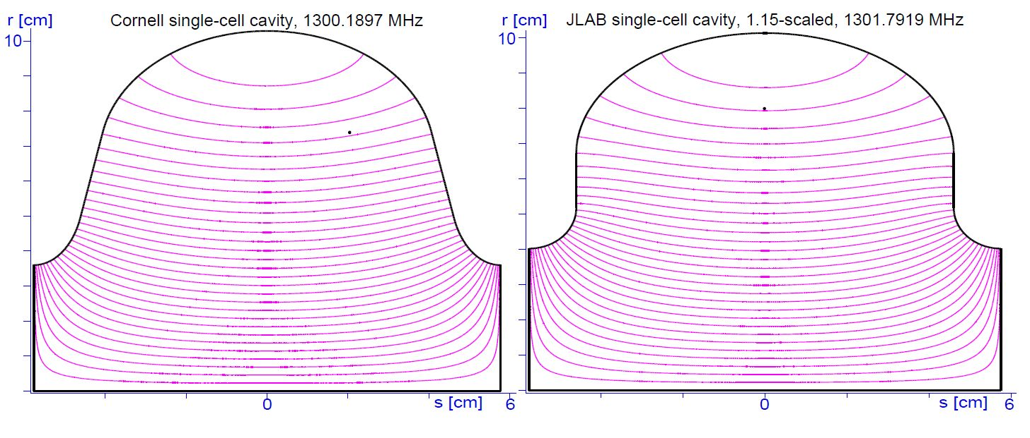
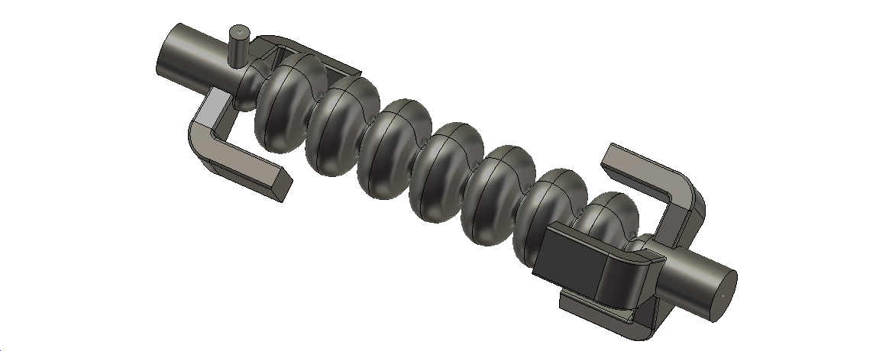
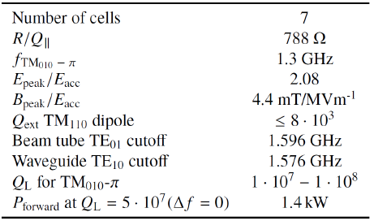
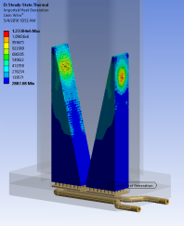
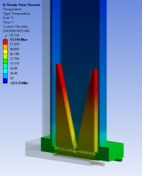
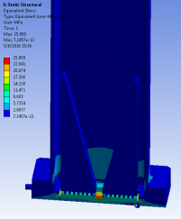
The Linac RF design
TTF-III for variable coupling:
High Q_{L}
operation possible
Cornell
JLAB
Cornell‘s ERL
mid-cell + modified end-cells
5 waveguides
to cover HOM
polarizations:
Well defined
cutoff
3rd order
spline nose
transition
to low
cutoff
beam tube
Combine Cornell‘s low peak
field design with JLab‘s HOM
damping approach
F. Fors, JLab

Slide 14
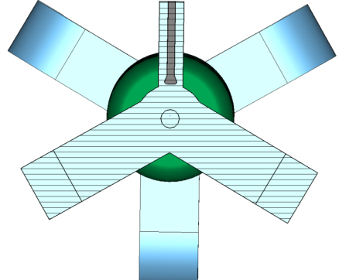
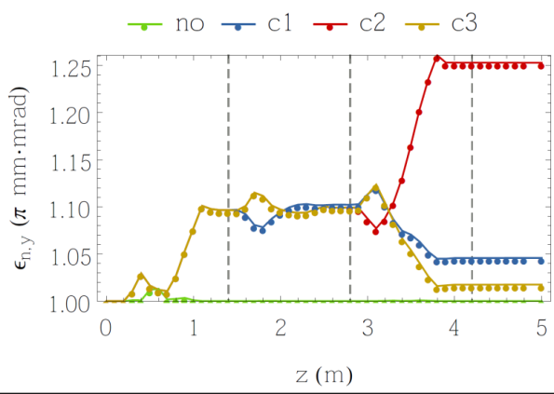
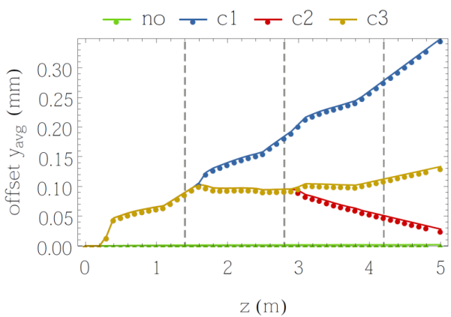
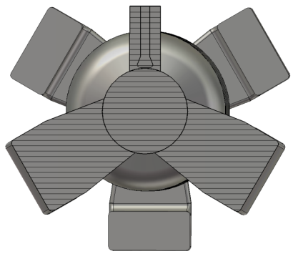
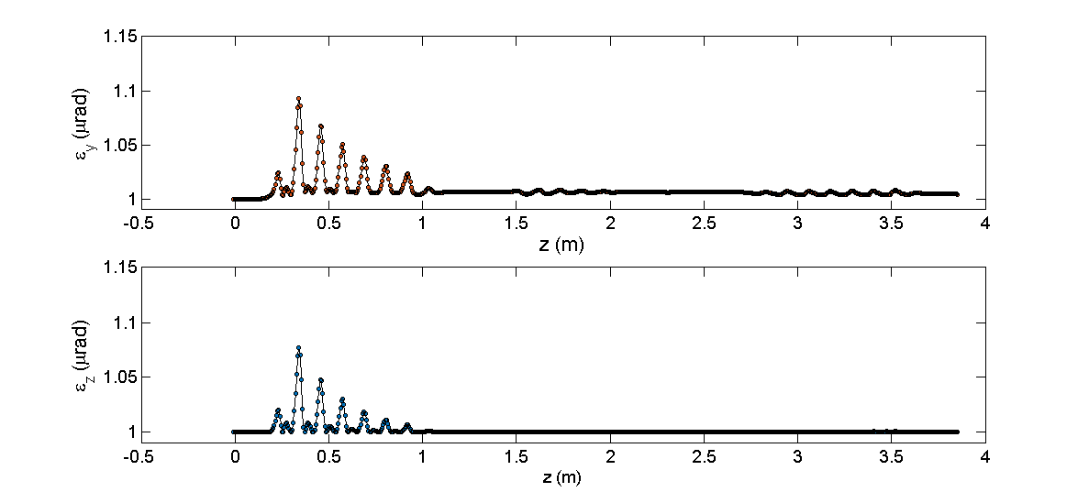
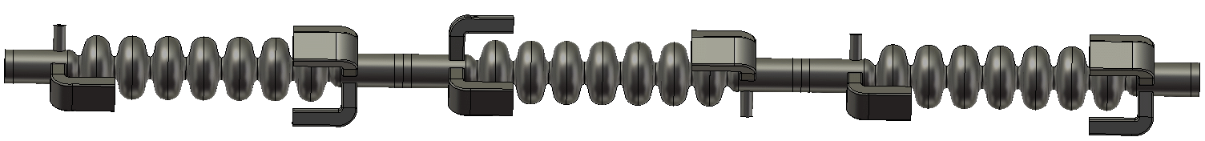
Module coupler kicks (S. Wesch, A. Neumann)
Old end-group:
Blue: All left
Red: 1 left, 2 right
Yellow: left, right, left
New design, worst case
Δε≤0.5 %
50x80 mm
50x105 mm

Slide 15
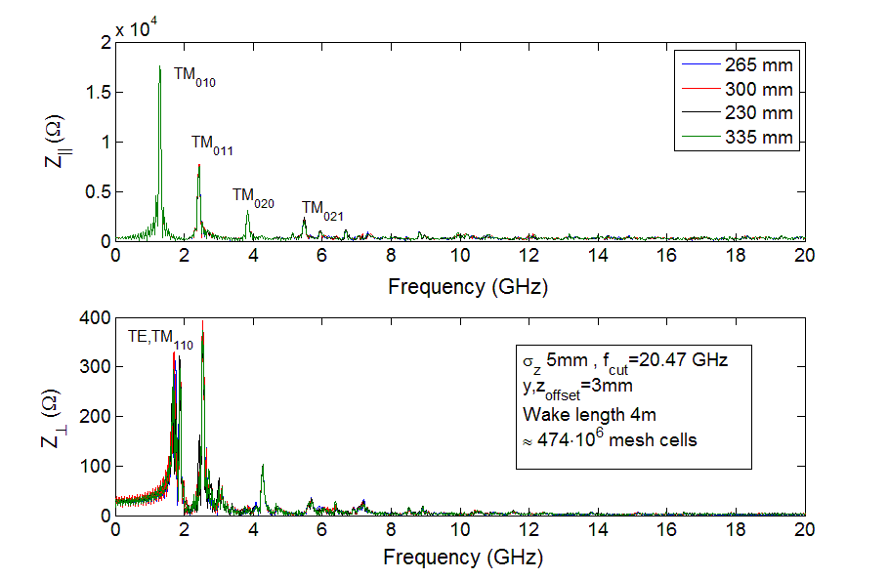
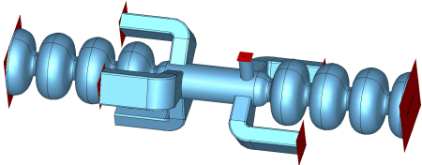
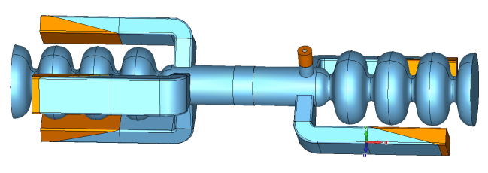
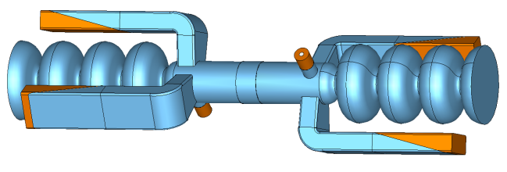
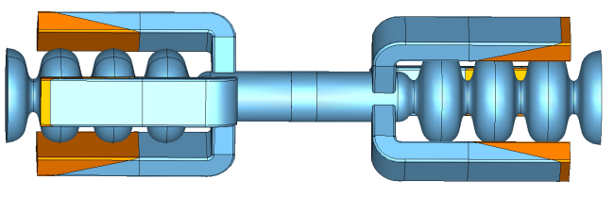
First module based HOM/Wake studies
Study influence of length of
interconneting beam tube on HOM
spectrum
Comparing reference run done
with full cavity as half cell
open boundary somewhat
inaccurate
Mode of TM₀₂₀ type closed
to beam harmonic at 3.9 GHz.
Typically they have low impedance
because of transit time effect
Resolution of Wake calculation
limited as very high computational
effort
But three different sets of interconnecting groups exist:
Absorber
5WG+1TTF
4WG+2TTF
6WG

Slide 16



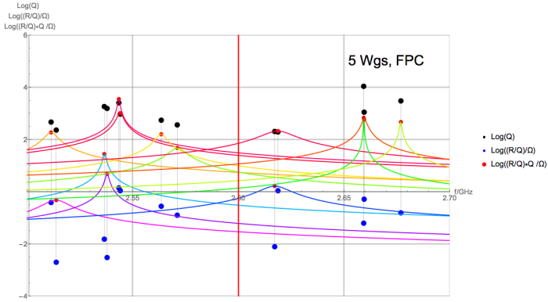
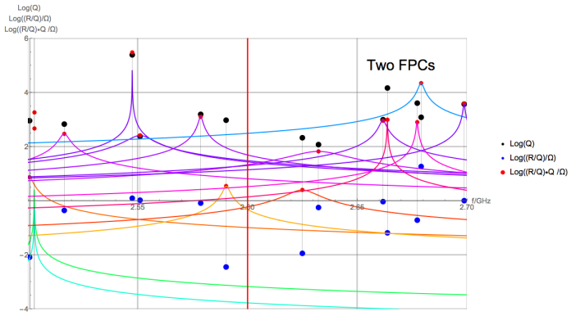







Intense Eigenmode search at 2.6, 3.9 and 5.2 GHz
1e6
1e-4
2.6 GHz
200 MHz
3.9 GHz
H.-W. Glock
5.2 GHz

Slide 17



Concatenation study of complete string (U. Rostock)
T. Galek et al.
Both orientations show similar performance
180°
Alternative 1, second version is by rotating first cavity
around longitudinal axis by 180 deg

Slide 18




One problem: What type of first flange?
Problems:
WG close to iris for HOM
propagation and damping
TM₀₁₀ mode leakage to WG part →
requires SC state thus LHe cooling
→ Include WG into helium vessel
→ Complicated weld order
Bellow has to be put on cavity before
end-group: Heat treatment, outside BCP??
At what distance to place first flange?
What type of flange, even Nb on Nb?
How long to fabricate WG, as this
affects HPR effectiveness
Endgroups will
be made by deep-
drawing
JLab: AlMg gasket, needs well polished surface,
expensive, time consuming

Slide 19




Qualifying flanges/gaskets
Requires brazing of steel on Niob: Limit on heat treatment below
600 °C
VATSEAL:
First test last week:
Warm test: ok
Quick cooldown 77K: leak
Warm: ok
Slow cool + retighten screws: ok
Warm: ok
Vacuum
Pump
port
Waveguide
stub
with gasket
to test:
Stainless on stainless
or NbTi on stainless
Cooling
Gaskets: Copper or copper coated with silver

Slide 20









Acknowledgements
Thanks to all collaboration partners and
A. Frahm, M. Schuster, J. Ullrich, F. Göbel, S. Klauke, B. Hall, H-W. Glock,
P. Echevarria, A. Ushakov, F. Glöckner, D. Böhlick, M. Schmeißer

