Slide 1
Retreatment of Superconducting Cavities for the European XFEL
Detlef Reschke – DESY for the EU-XFEL Accelerator Consortium
Notes:
How to edit the title slide
Upper area: Title of your talk, max. 2 rows of the defined size (55 pt)
Lower area (subtitle): Conference/meeting/workshop, location, date, your name and affiliation, max. 4 rows of the defined size (32 pt)
Change the partner logos or add others in the last row.

Slide 2
VT-CM comparison: USABLE GRADIENT
Vertical Test – min of
Maximum gradient (quench, RF power)
FE limit (top/bottom X-ray)
Q₀ limit (= 10¹⁰)
Cryomodule – min of
Maximum gradient (quench)
FE limit (front/back X-ray)
RF power limit at 31 MV/m
Acceptance criteria for “Usable gradient” in vertical test
INITIAL: > 26 MV/m (10% margin to required average design operating gradient)
NOW (after analysis of retreatment results in May 2014): > 20 MV/m (for optimized number of retreatments and retests)
Notes:
No update necessary

Slide 3
Definition of “Usable Gradient” in VT
Notes:
No update necessary

Slide 4
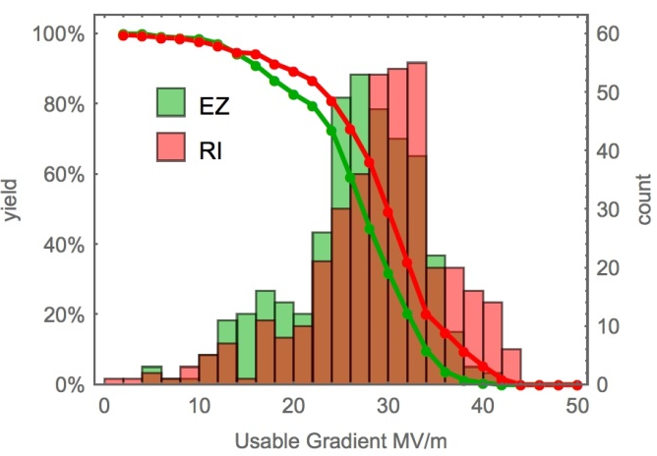
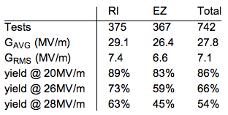
Results: Usable Gradient “As received”
accept for module
Both vendors well above Spec
RI shows ~ 3MV/m in average more than EZ: a) final EP b) low gradient quenches at EZ
Several cavities with < 20 MV/m accepted “as received”, especially if a) limitation = “bd“ + b) no FE
Average Q-values for both vendors: Q₀(4 MV/m) = 2.1·10¹⁰ Q₀(23.6 MV/m) = 1.3·10¹⁰
Missing ~90 cavities “as received”?
re-treat & retest
Notes:
updated

Slide 5
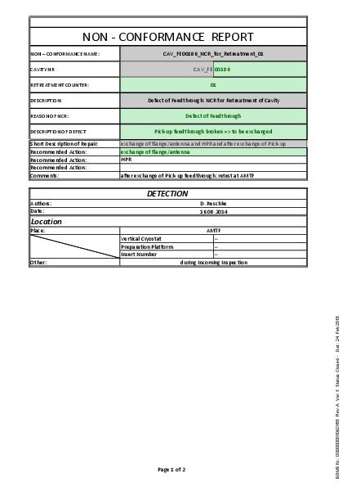
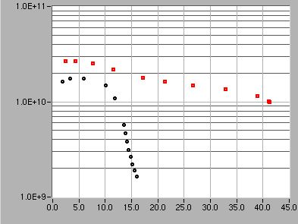
Retreatments
Why cavities w/o “as received” test? (“as received”: first test after delivery to DESY + cavity conform to Spec)
Three main categories for retreatment (rework):
Non-Conformities after delivery from vendor (~ 90 Tests) (mechanical, vacuum, defects, …) => retreatment/rework at DESY or vendor depending on NC-type
Performance (~160 Tests) (acceptance criteria for gradient or Q-value not met) - mainly by field emission (+ “Quench”, “low Q”) => first + successful retreatment High Pressure Ultrapure Water Rinse <E_{acc, usable}>: 19 MV/m => 26 MV/m <Q₀(4 MV/m)>: 2.1 · 10¹⁰ => 2.4 · 10¹⁰
Non-Conformity during string assembly (21 Cv)
Notes:
- Categories for test purpose + formalized decisions according to test result

Slide 6
Retreatment results: HPR
Now performance-related retreatments, only
In the following comparison analysis, "before" and "after" refer to a pair of vertical tests for a given cavity before and after retreatment
Analysis limited to "before" tests being "as received" (i.e. no second pass treatments are included)
129 data sets for “HPR only” shown

Slide 7
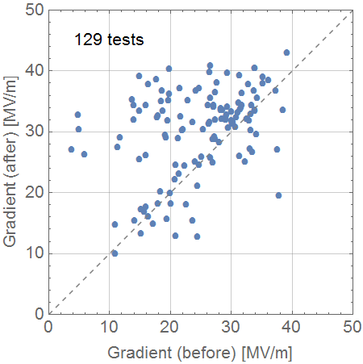
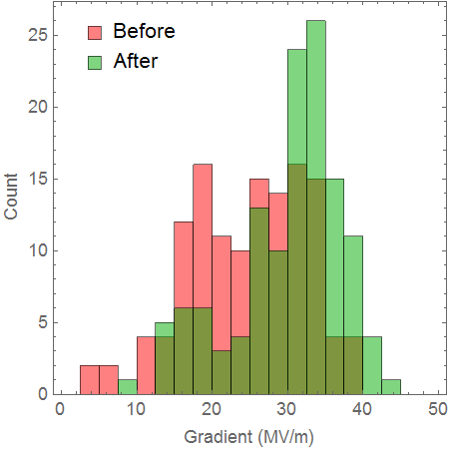
Retreatment performance: HPR Max gradient

Slide 8
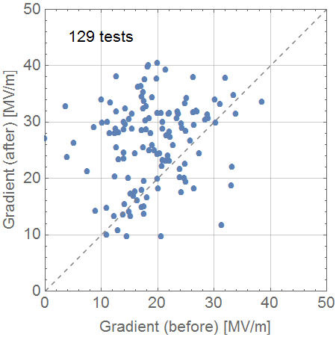
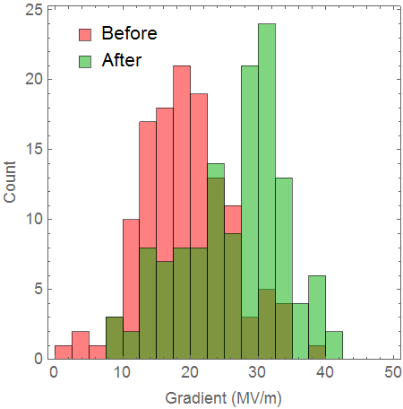
Retreatment performance: HPR Usable gradient

Slide 9
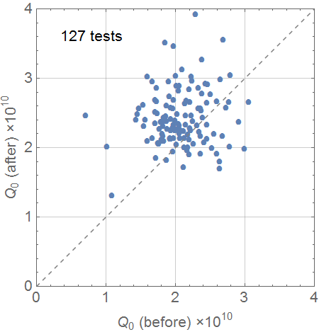
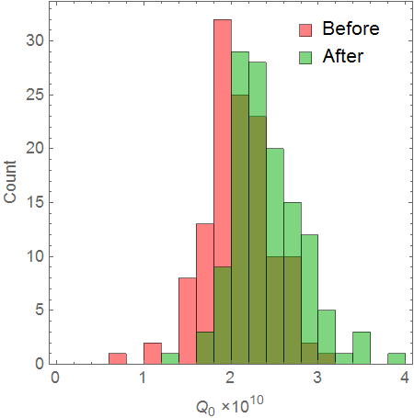
Retreatment performance: HPR Q-value at 4 MV/m

Slide 10
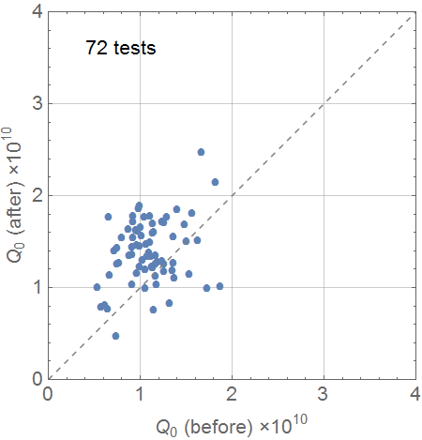
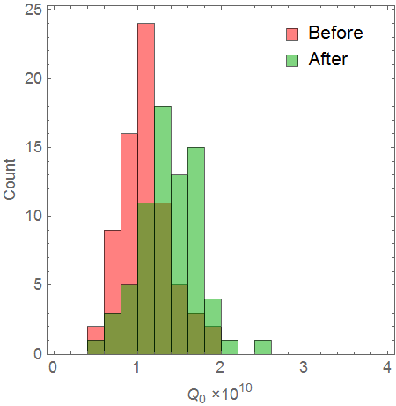
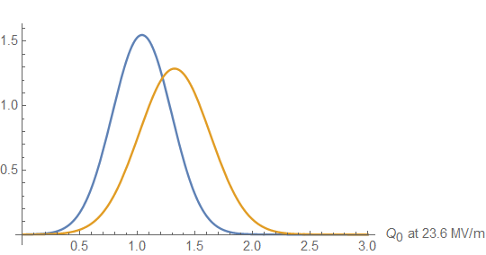
Retreatment performance: HPR Q-value at 23.6 MV/m

Slide 11
Retreatment results: BCP+HPR+120C bake
Now performance-related retreatments, only
In the following comparison analysis, "before" and "after" refer to a pair of vertical tests for a given cavity before and after retreatment
Analysis includes second, third,… pass treatments ("before" tests being "as received“
18 data sets available

Slide 12
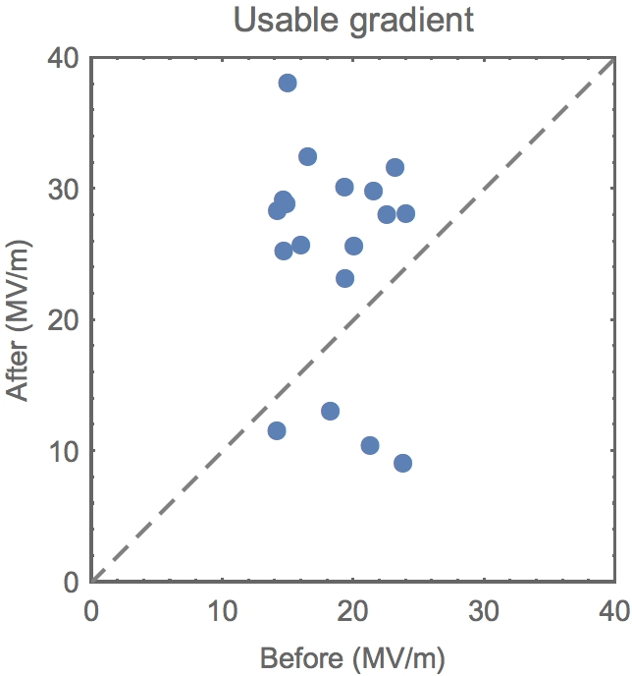
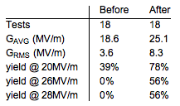
Retreatment results: BCP+HPR+120C bake Usable Gradient
Based on 18 tests

Slide 13
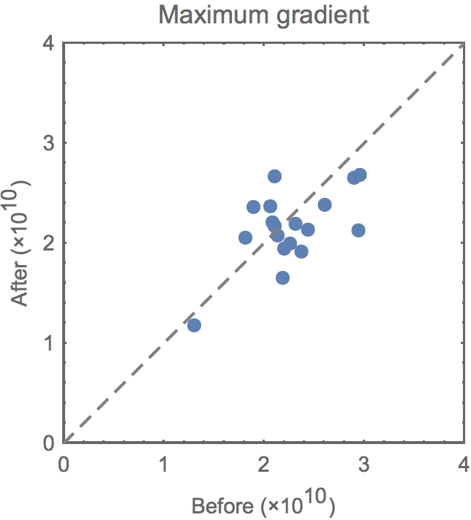
Retreatment results: BCP+HPR+120C bake Q-value at 4 MV/m
Based on 18 tests
No improvement on Q-value!
Mean
RMS

Slide 14
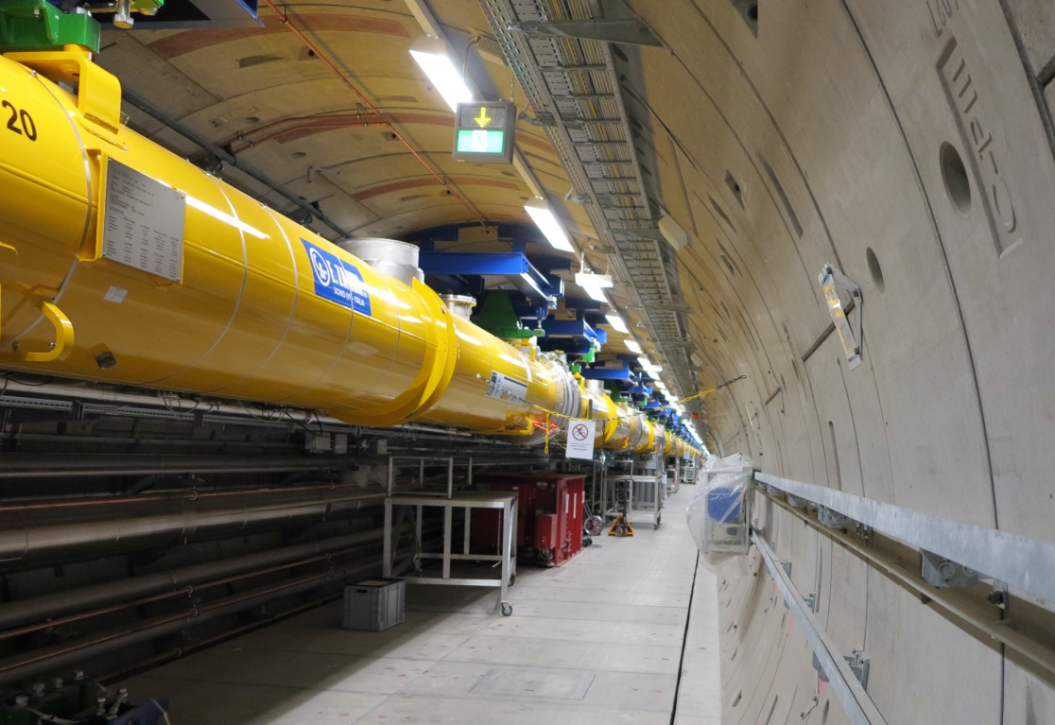
Thanks to all colleagues of:
- IFJ-PAN Krakow (esp. J. Swierblewski, M. Wiencek)
- CEA Saclay
- INFN Milano (esp. L. Monaco)
- E. Zanon
- Research Instruments
- Daher Transkem
- Alsyom
- DESY (esp. V. Gubarev, J. Schaffran, L. Steder, N. Walker, M. Wenskat, S. Yasar)

Slide 15
:
- Back-up
xxxxxxxx

Slide 16
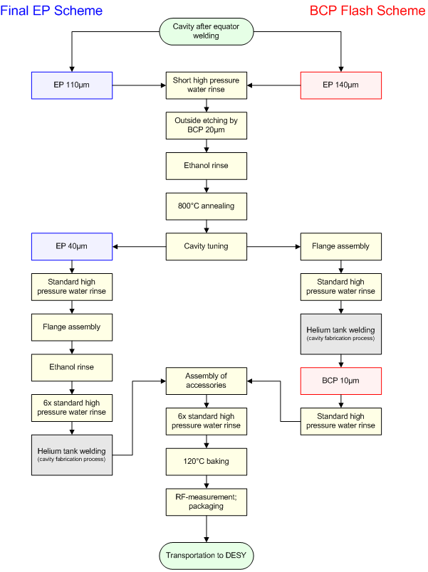
Cavity Surface Preparation
Two schemes for the final surface treatment: - E. Zanon: Final 10µm BCP (“BCP Flash”) - Research Instr.: Final 40µm EP
Successful mechanical production and surface preparation at both vendors!
No performance guarantee resulted in DESY taking responsibility for:
the risk of unexpected low gradient or field emission
retreatment (good cooperation/agreements with both vendors)
Final EP
BCP Flash

Slide 17
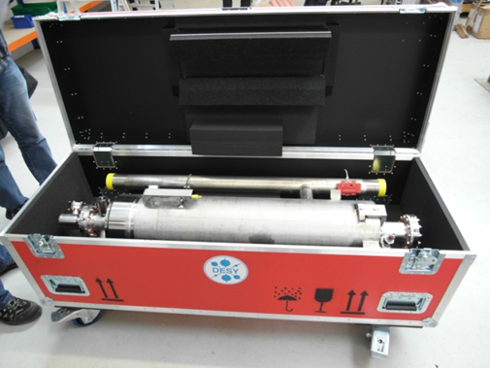
Transportation + Incoming Inspection
17
Transportation:
“Cavity ready for test” requires well-defined transport concept
Transport under vacuum => avoid particle transport
Dedicated boxes for horizontal transport by truck (Vendor => DESY => Saclay)
No performance degradation observed
Incoming inspection at DESY
Basic mechanical, electrical, RF checks + final vacuum leak check before test
Idea: Check for damages during transport
Found: - Assembly errors + contaminations - Mechanical + electrical damages - Few leaks
Incoming Inspection is mandatory
=> 54 Cv‘s back to vendor
Notes:
Remark:
Additional and comprehensive information about NC‘s + experiences with QC concept during production extend this talk => aware that this is missing

Slide 18
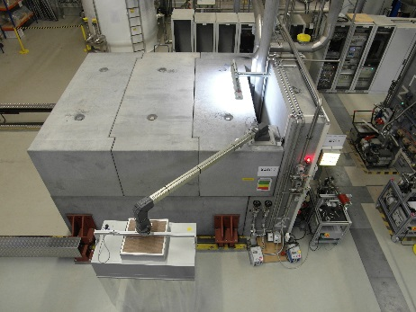
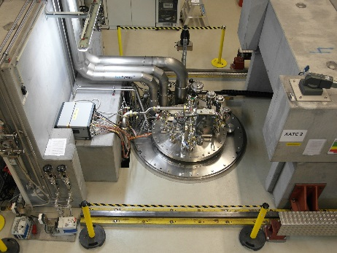
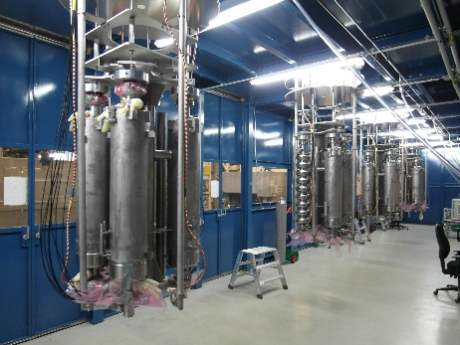
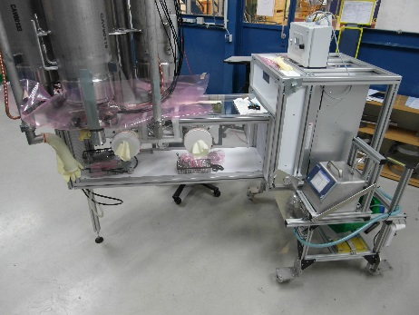
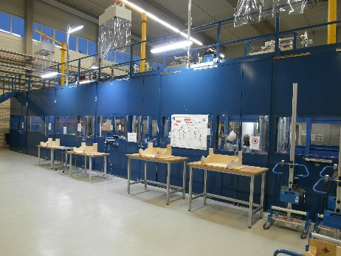
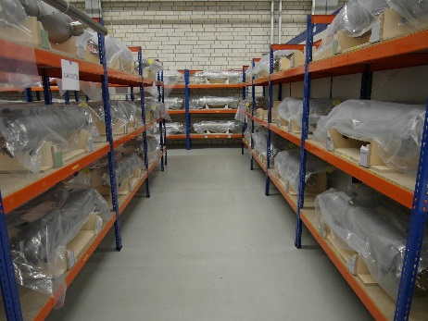
Vertical tests at AMTF

Slide 19
Statistics of Cavities + Vertical Acceptance Tests
19
Cavity production finished with last delivery in Mar 2016:
(800 + extra 4) Series Cavities
24 ILC “HiGrade”-Cavities (w/o He-tank; QC)
8 since equipped with He-tank and used for XFEL
16 Cavities for infrastructure commissioning
4 since used for XFEL
=> 816 cavities available and vertically tested for XFEL
Analysis of vertical acceptance tests includes
Series Cavities
ILC “HiGrade”-Cavities (w/o He-tank)
NO infrastructure commissioning tests
Stable average vertical test rate ~40 tests/month achieved
1225 vertical tests (few additional tests due to returns from string assembly possible)
Notes:
- updated

Slide 20
Analysis of Cavity Results
20
Fully statistical approach; (nearly) no individual cavity analysis => simplified vertical test procedure at 2K: - Q₀(E_{acc}), - fundamental mode spectra, - HOM-check (partially)
Work in progress: Analysis and possible correlations for E_{acc,max}, Q-value + x-rays
Nb-material: Vendor dependency
Cavity with vs. without He-tank
Surface treatment (not vendor)
Dependence on test infrastructure (RF test stand, cryostat, test inserts, …)
Cool down procedure => no special procedure applied, bad instrumentation, …
“Processing” vs. degradation in case of field emission; degradation after quench
Optical inspection, local repair
…
Error analysis
WEPMB007
Notes:
- updated

Slide 21
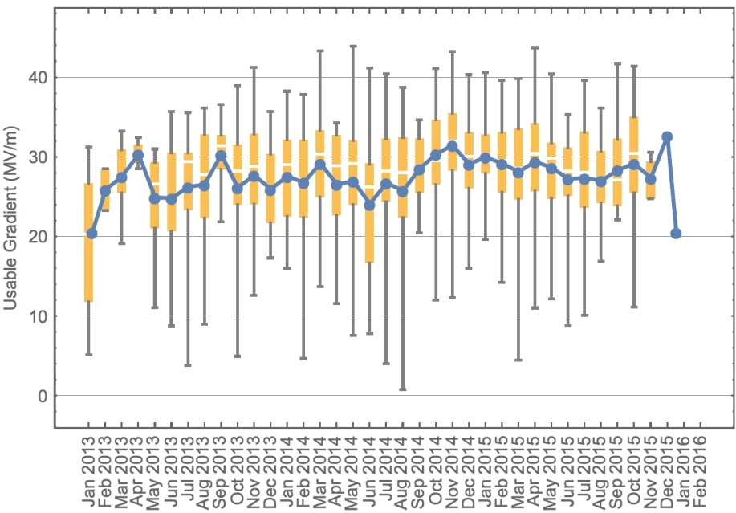
Trend of Usable Gradient “As received”
Good stability of average usable gradient over full production period

Slide 22
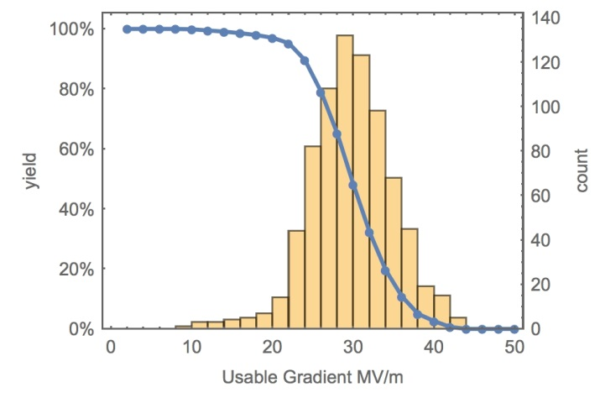
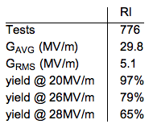
Finally: “Send to Saclay“
22
(nearly) all cavities shipped to CEA Saclay for string assembly
average usable gradient: ~ 30 MV/m
includes cavities for three modules below 20 MV/m
Mainly low gradient quenches => retreatment not successful => retreatment would run out of schedule
Consequence of missing performance guarantee
> 810
Notes:
- updated

