Slide 1

Is current state of the art in FE an obstacle to
40 MV/m (and beyond) operation?
Rong-Li Geng
Jefferson Lab
TTC Meeting at Saclay, July 5 - 8, 2016
A survey of achieved SRF operation gradient.
Field emission impact to accelerator operation.
Discussion on reducing field emission.

Slide 2
Operation

Slide 3
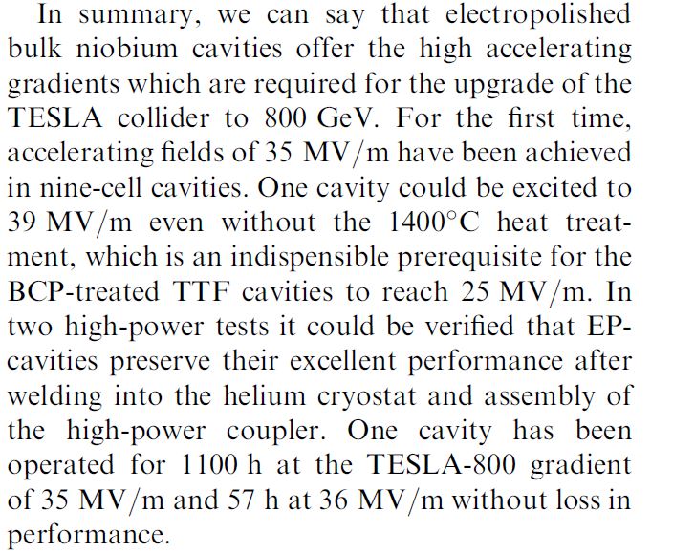
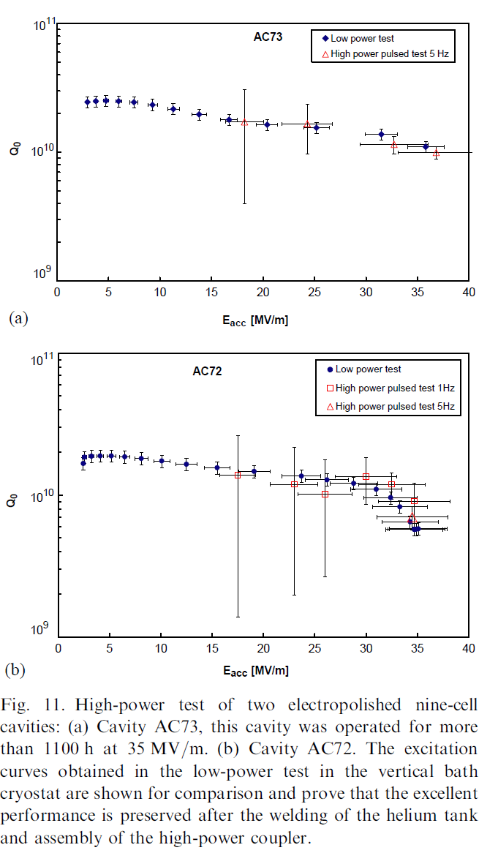
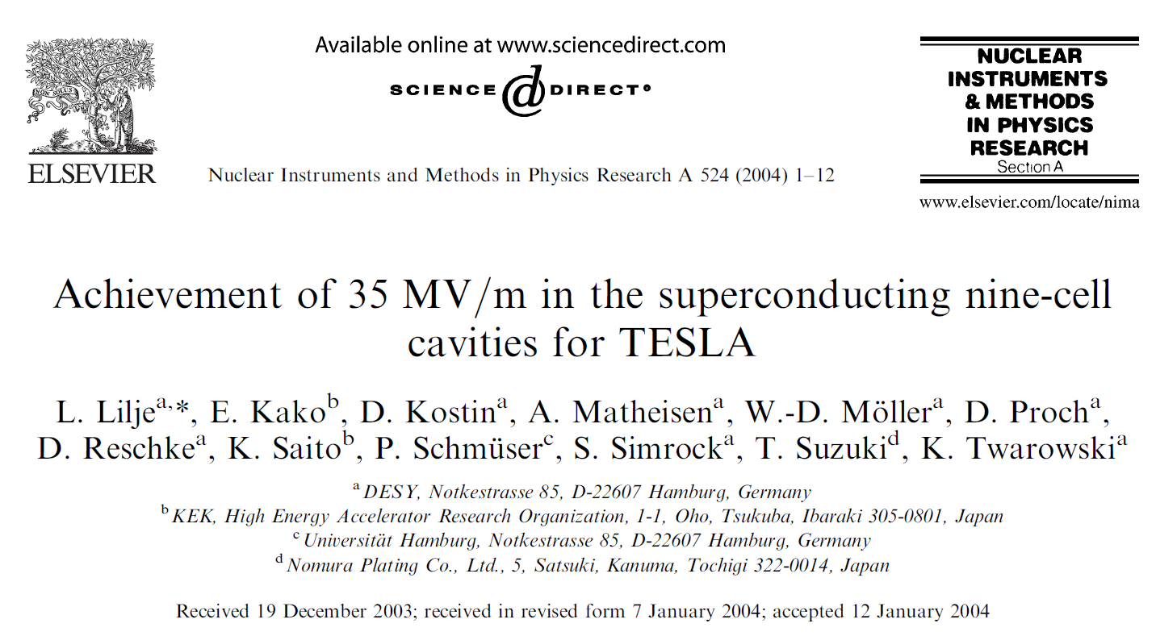
High Gradient Operation (w/o Beam)
Tested in TTF horizontal cryostat at DESY
Liquid helium tank welded
Equipped with a high-power coupler
Equipped with a frequency tuning mechanism
NO FE data reported

Slide 4
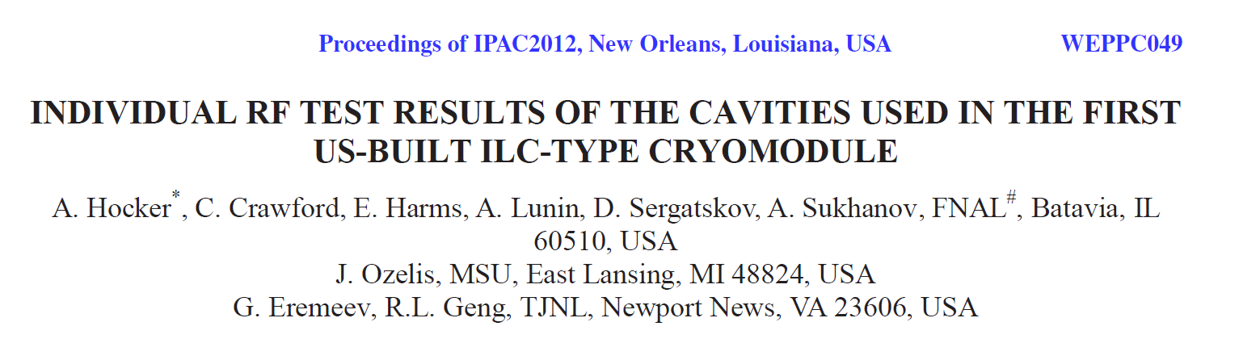
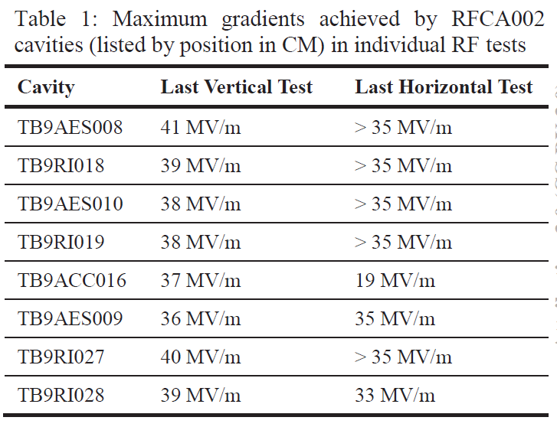
High Gradient Operation (w/o Beam)
Tested in HTS at FNAL
Admin limit 35 MV/m
Liquid helium tank welded
Equipped with a high-power coupler
TB9ACC016 copper flake from copper plated coupler antenna.
  Recovered by HPR later on
FE data next slide

Slide 5
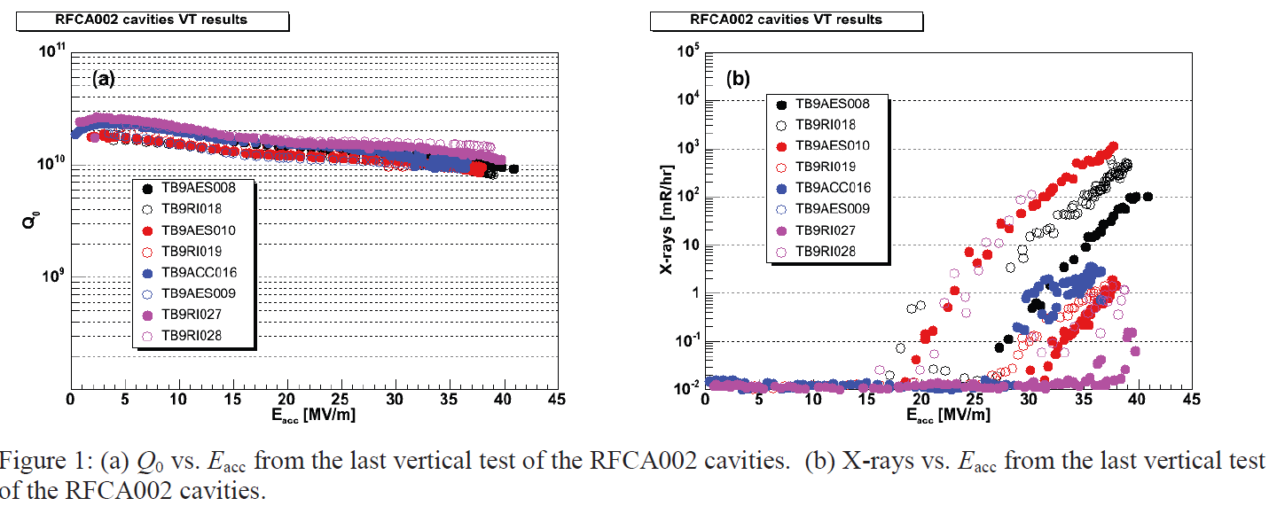
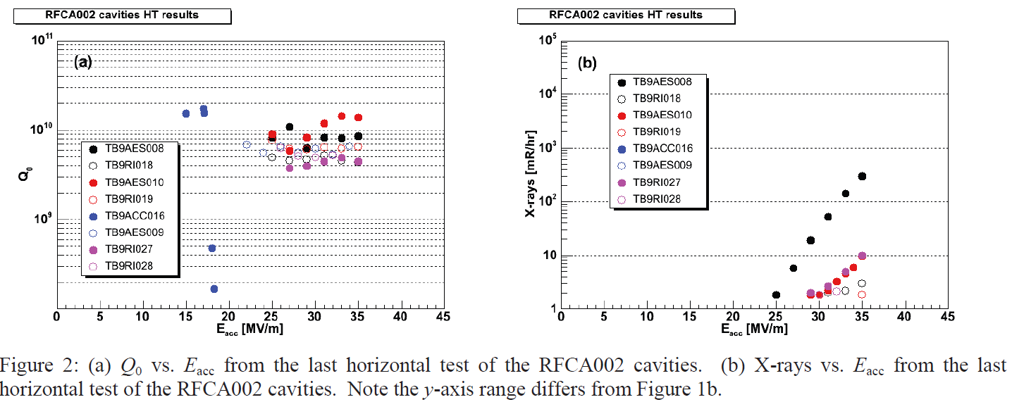
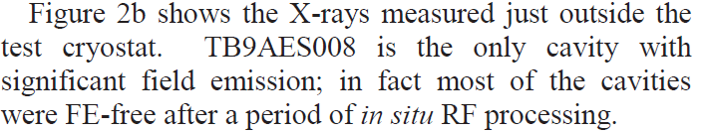
High Gradient Operation (w/o Beam)
!Caution!
X-ray detection not the same

Slide 6
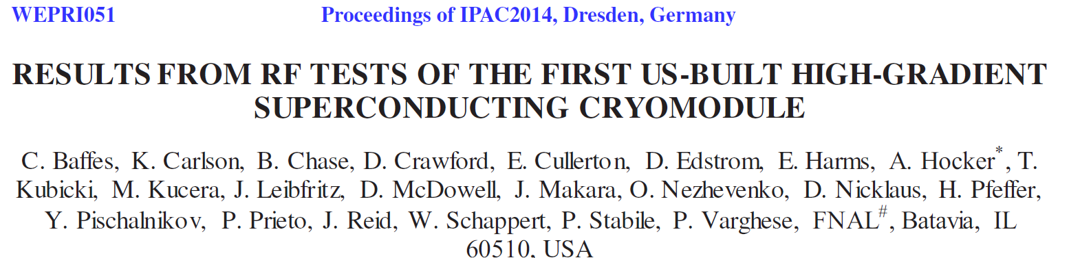
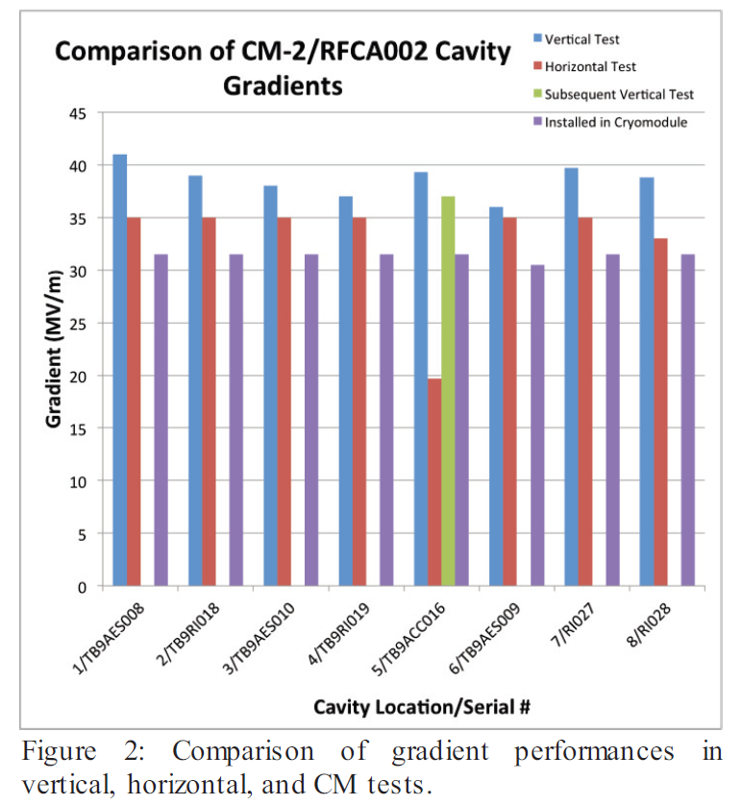
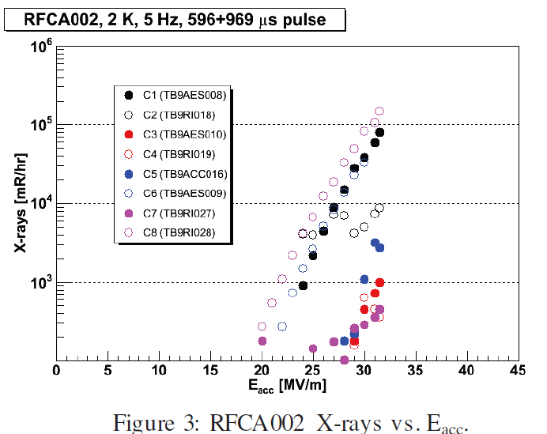
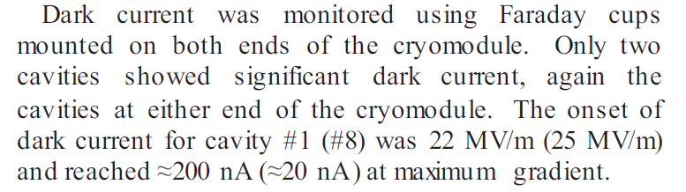
High Gradient Operation (w/o Beam)
Cryomodule test in ASTA at FNAL
One cavity at a time
Equipped with Piezo tunner
Admin limit 31.5 MV/m

Slide 7
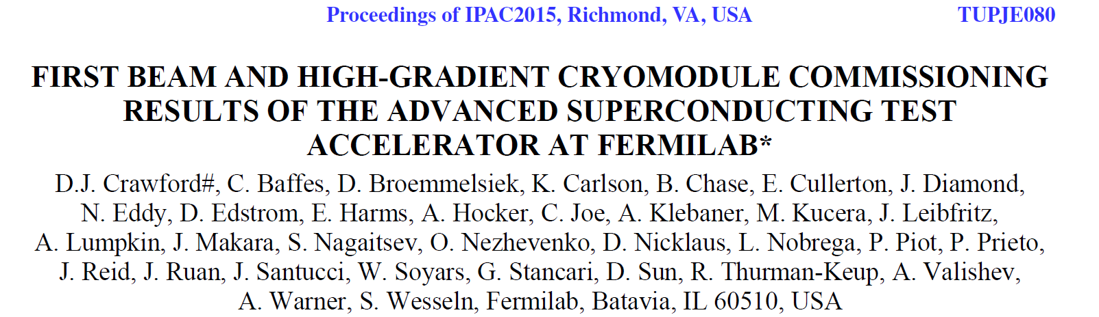
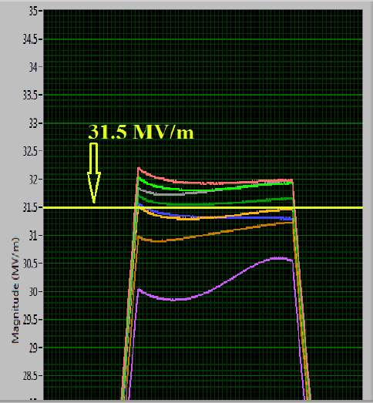
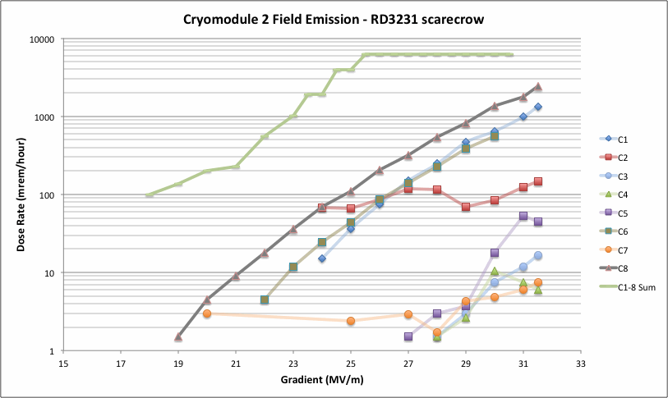
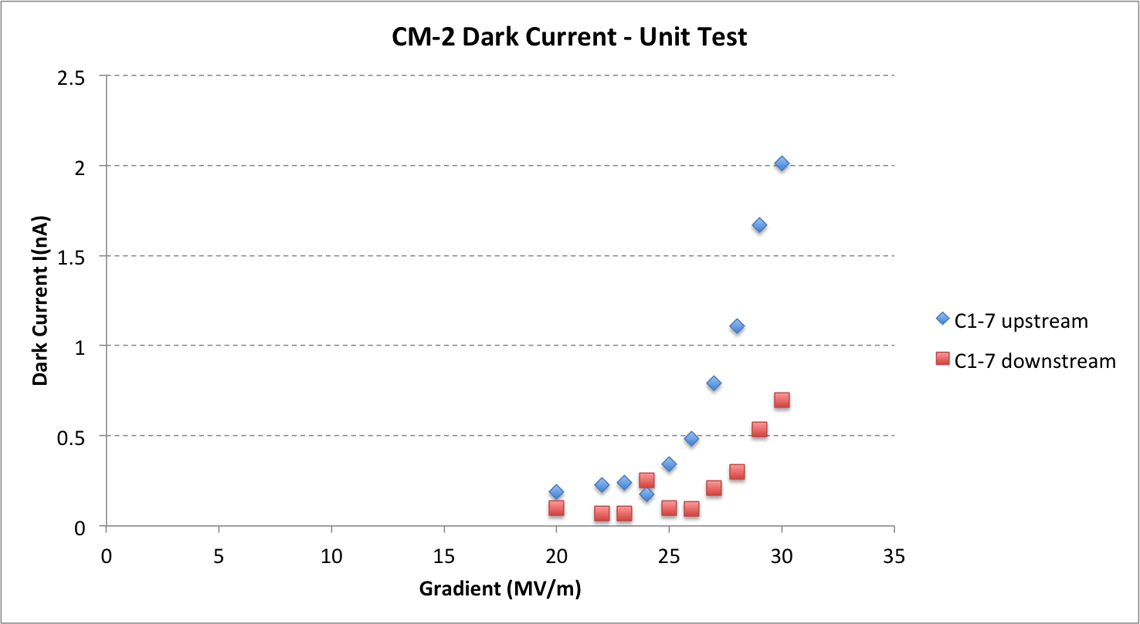
High Gradient Operation (w/o Beam)
Cryomodule test in ASTA at FNAL
All cavities simultaneously powered
Admin limit 31.5 MV/m
Cavities probably not phased
E. Harms, TTC 2014 at KEK

Slide 8
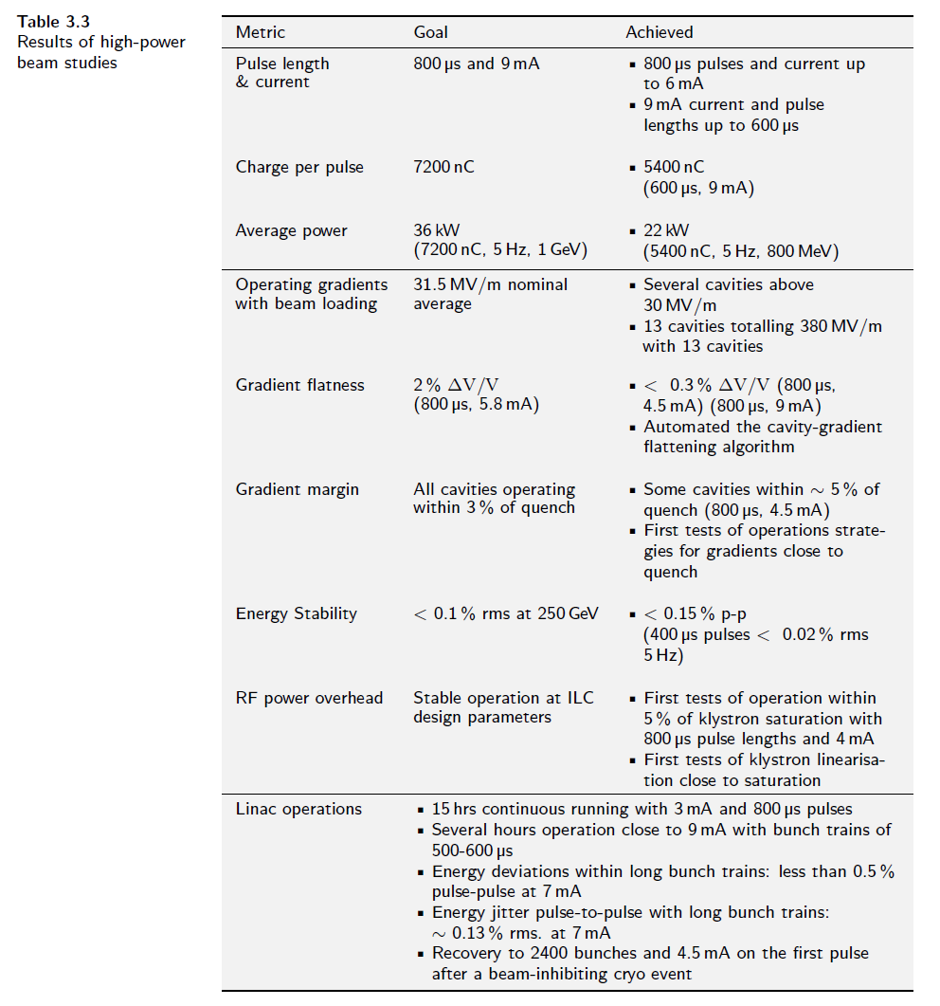
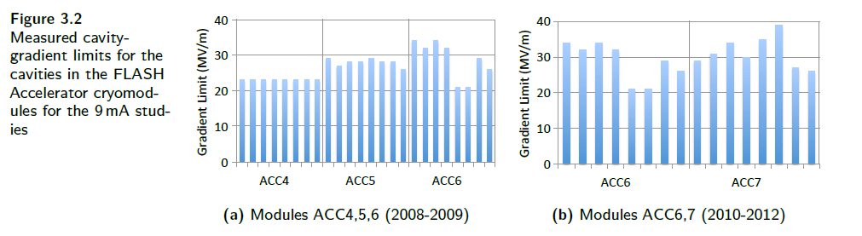
High Gradient Operation (w/ Beam)
ILC TDR
9mA test in FLASH at DESY
Several cavities above 30 MV/m
No FE data reported

Slide 9
Summary of Achieved High Gradient
50-60 MV/m, Best 1-cells, alternative shape
40-45 MV/m, best 9-cells, TESLA shape
36 MV/m one 9-cell without beam
  57hours
31.5 MV/m, 7 9-cell without beam
  unknown hours
> 30 MV/m, several 9-cells with beam
  15 hours at 3 mA
  Several hours close to 9 mA

Slide 10
Is current state of the art in FE an obstacle to 40 MV/m (and beyond) operation?
Not known as there is no data at all for a full-scale cavity to be operated at 40 MV/m without or with beam.
What is your opinion?

Slide 11
Field Emission Impact to Accelerator Operation
Added dissipation load to cryogenic (cost)
Beamline vacuum deterioration (reliability)
Radiation damage (reliability)
Beamline activation (maintainability/operability)

Slide 12
Discussion on Reducing Field Emission
What is the challenge?
Reliably create field-emission free surface
Reliably prevent post-contamination after individual cavity qualification test
  Cavity string assembly.
  Cryomodule assembly, transport, installation.
  Long term operation in tunnel.
Effectively remove field emitters in-situ.
Better shape for lowering E_{pk}/E_{acc} (and B_{pk}/E_{acc})
Quantification of FE uniquely or equivalently to allow meaningful comparison.

Slide 13
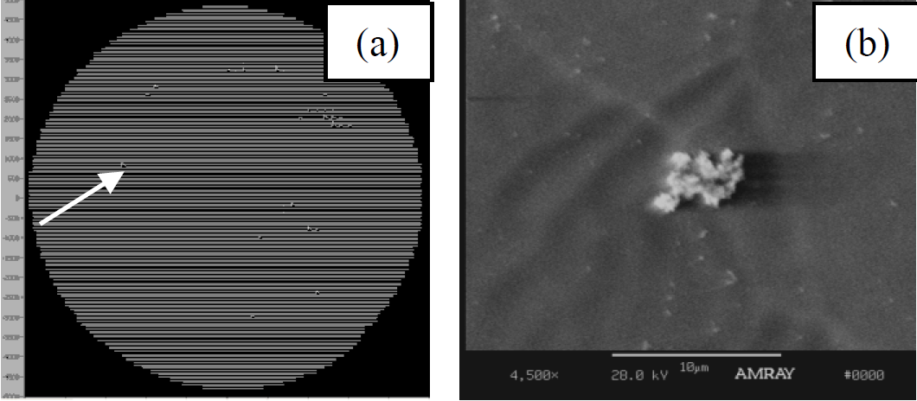
Particulate Field Emitters on High Gradient Surfaces
Nb sample EP’ed together w/ 9-cell cavity
Step-wise scanning of high-voltage tip reveals field emitters
Sample transferred into integrated SEM chamber
Identified field emitter analyzed
Nb_{x}O_{y} granules
SRF2009, TUPPO015

Slide 14
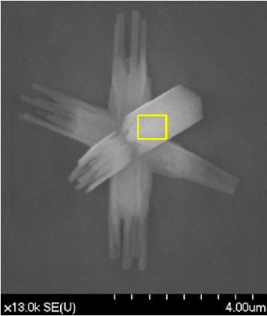
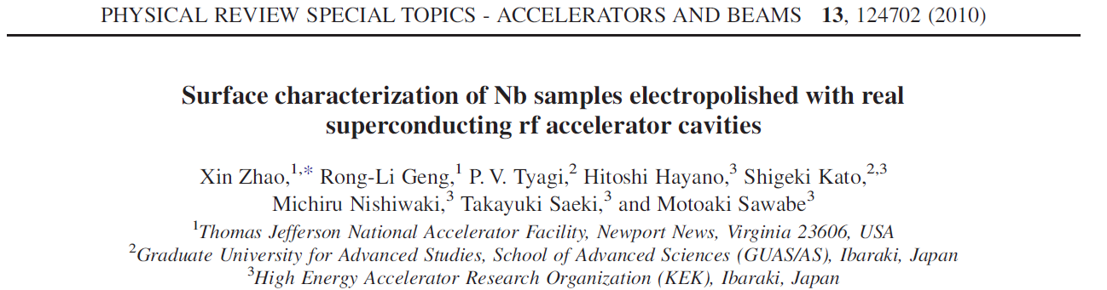
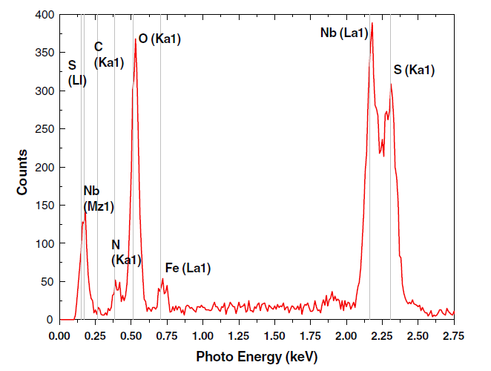
Particulate Field Emitters on High Gradient Surfaces
crystallite-like particle containing S, Fe, and N elements besides Nb and O

Slide 15
A Learning Process at JLAB
FE Onset = G for 1st X-Ray above background

Slide 16
A Learning Process at JLAB
FE Onset = G for 1st X-Ray above background
VTA onset scaled to reflect sensor difference

Slide 17
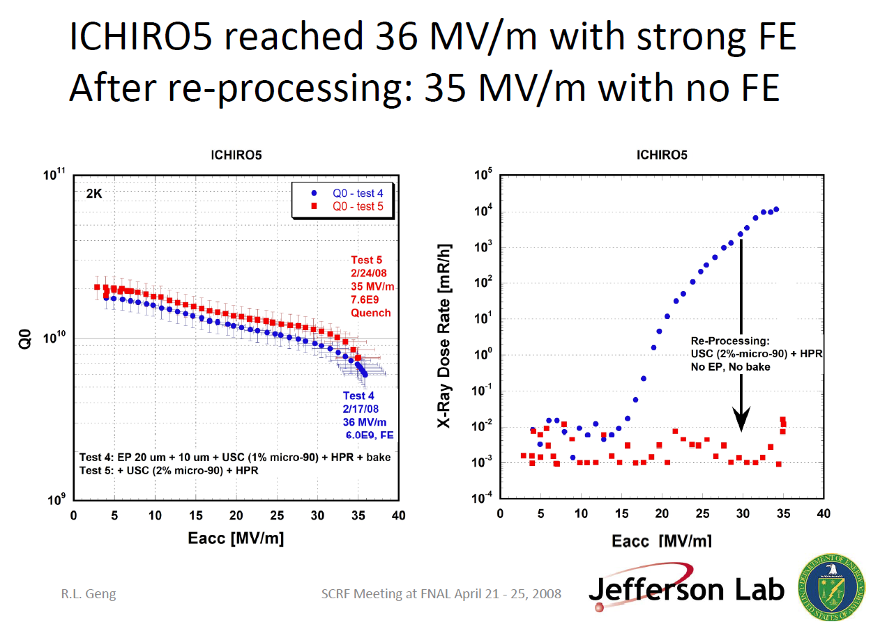
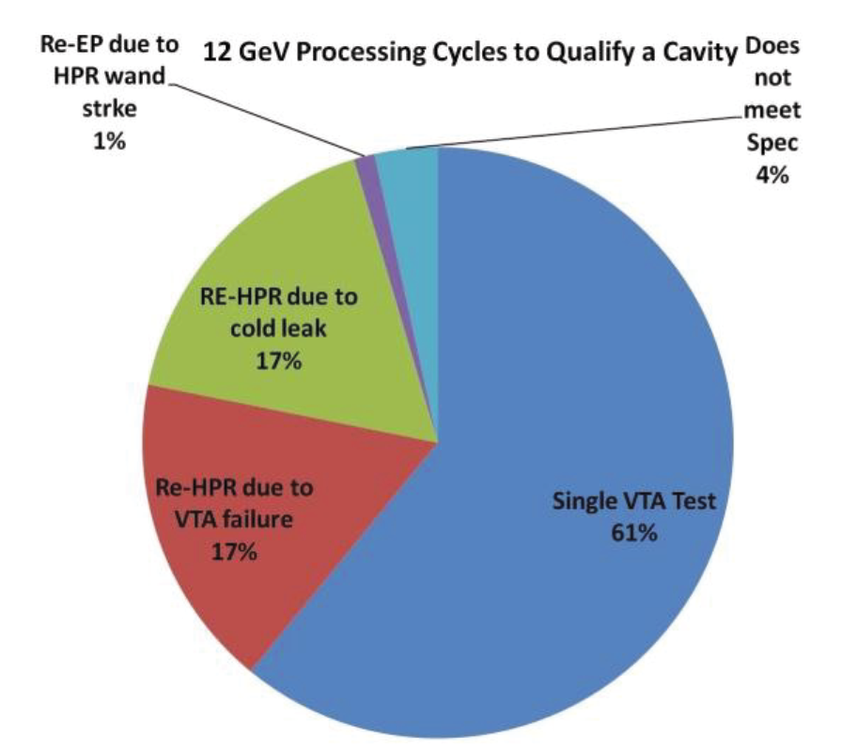
Creating Field Emitter Free Surface
Re-processing by USC+HPR or simply HPR
9-cell cavity ICHIORO#5
JLAB/KEK collaboration
A. Burrill et al., IPAC12, WEPPC089
First demonstration in 35 MV/m 9-cell cavity ICHIRO5 in 2008
More statistics in 9-cell ILC cavity testing in 2008-2010
Practiced for CEBAF upgrade cavity production processing in 2010-2012 ( ~20% cavities)

Slide 18
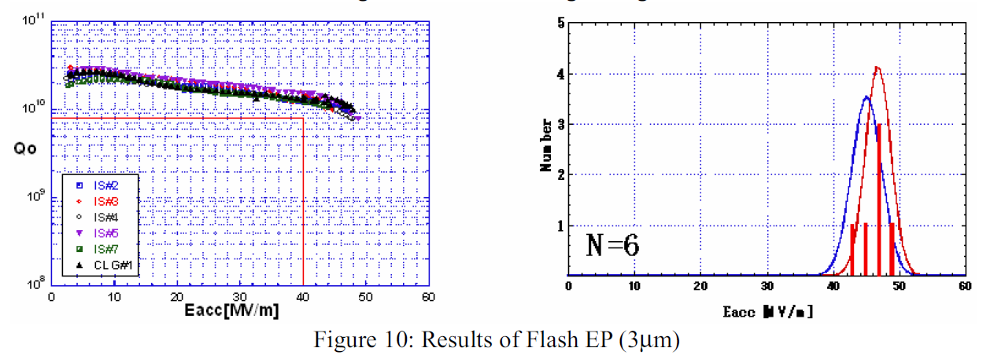
Creating Field Emitter Free Surface
Additional flash EP
Theory: Remove embed Nb_{x}S_{y} that can not be removed by USC or HPR alone
F. Furuta, K. Saito et al., SRF2007, TUP10

Slide 19
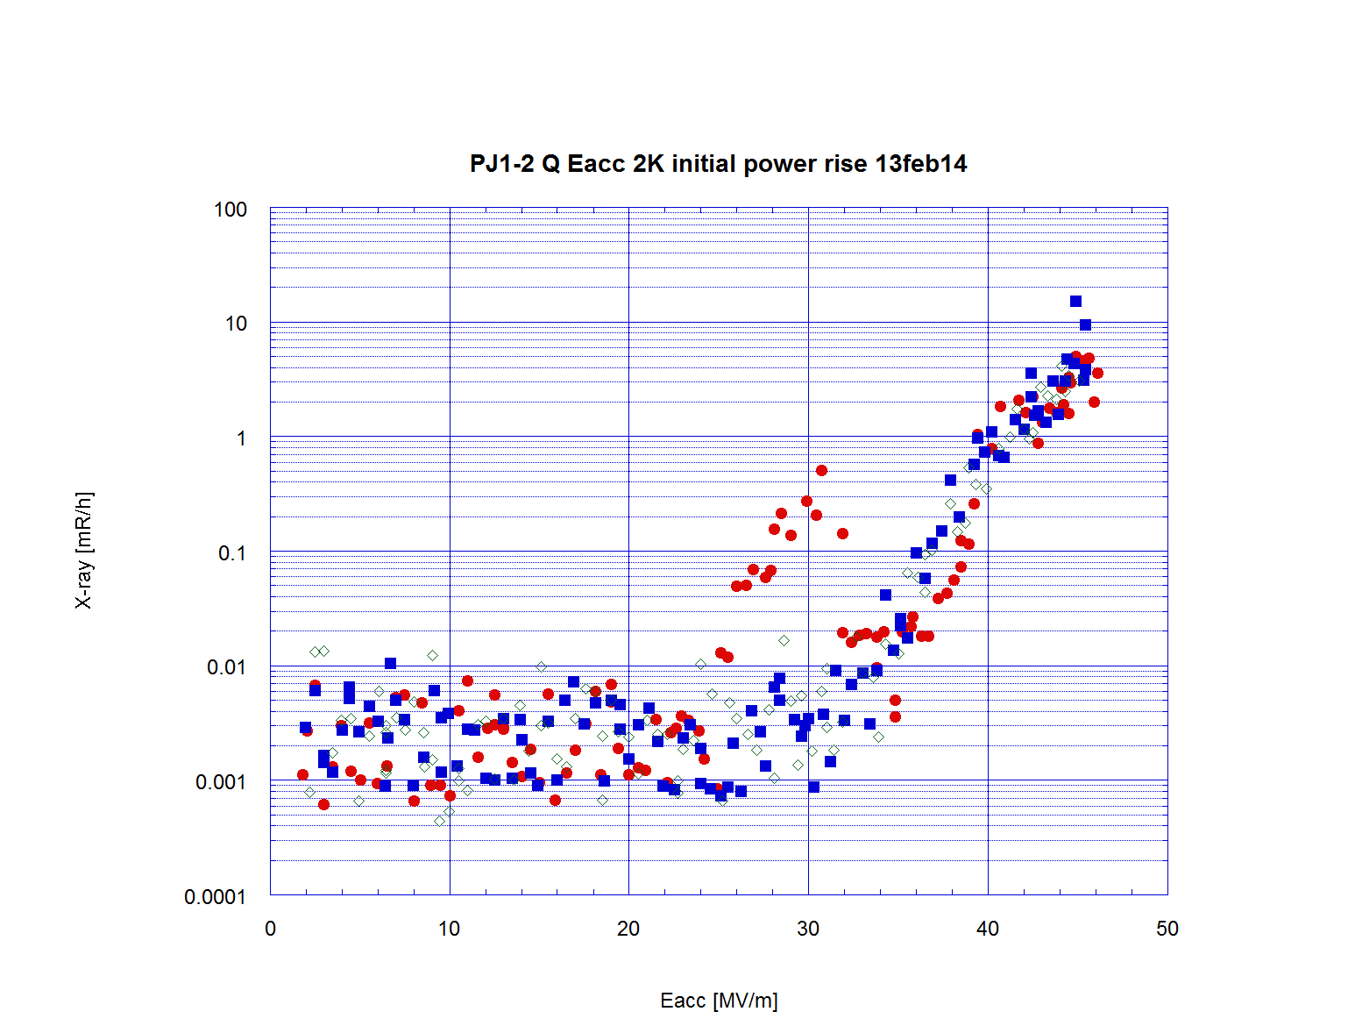
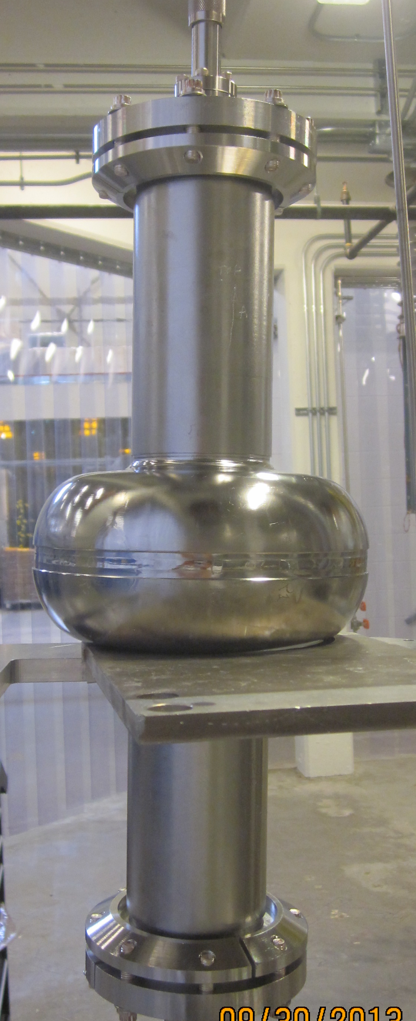
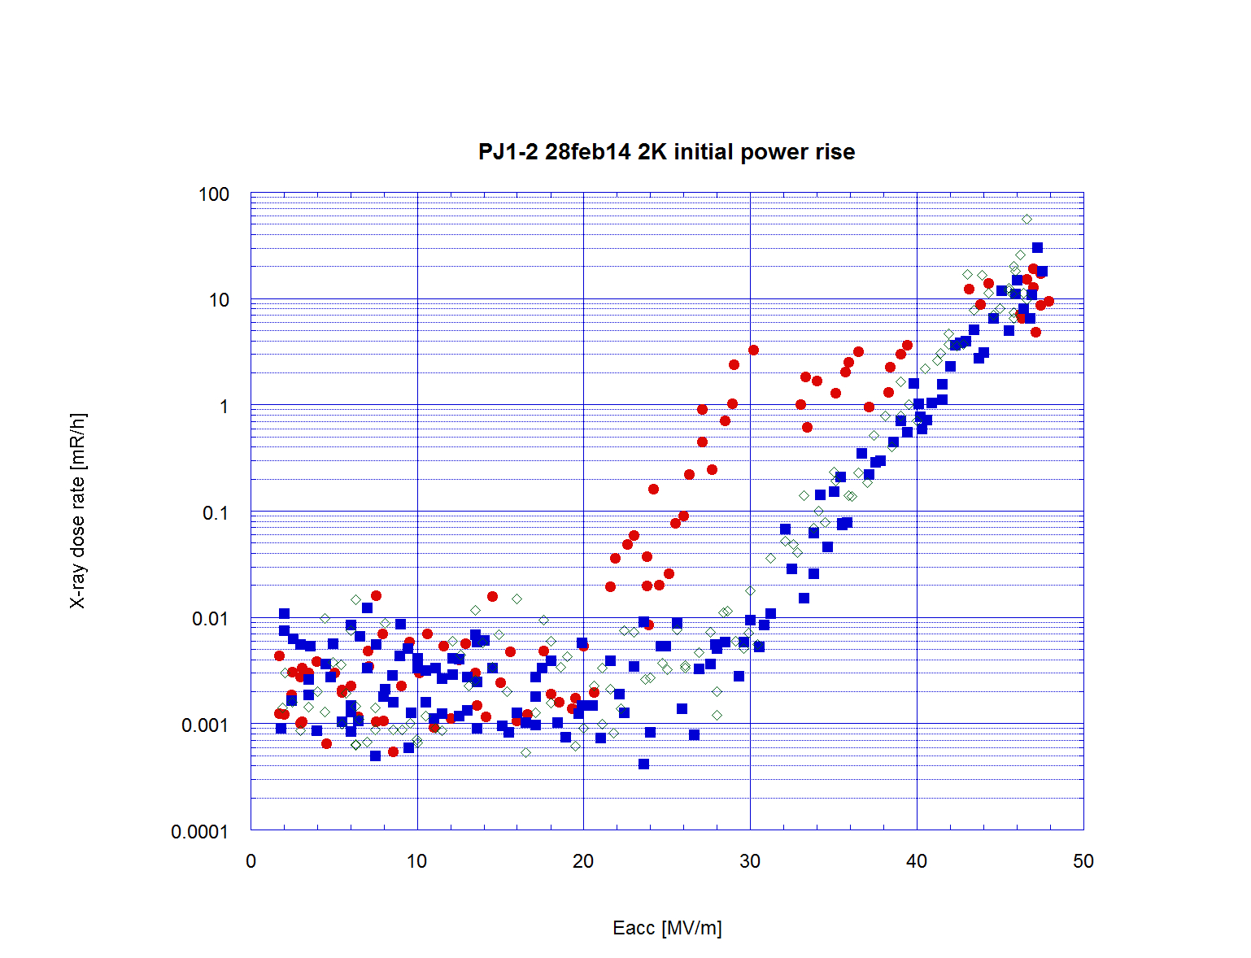
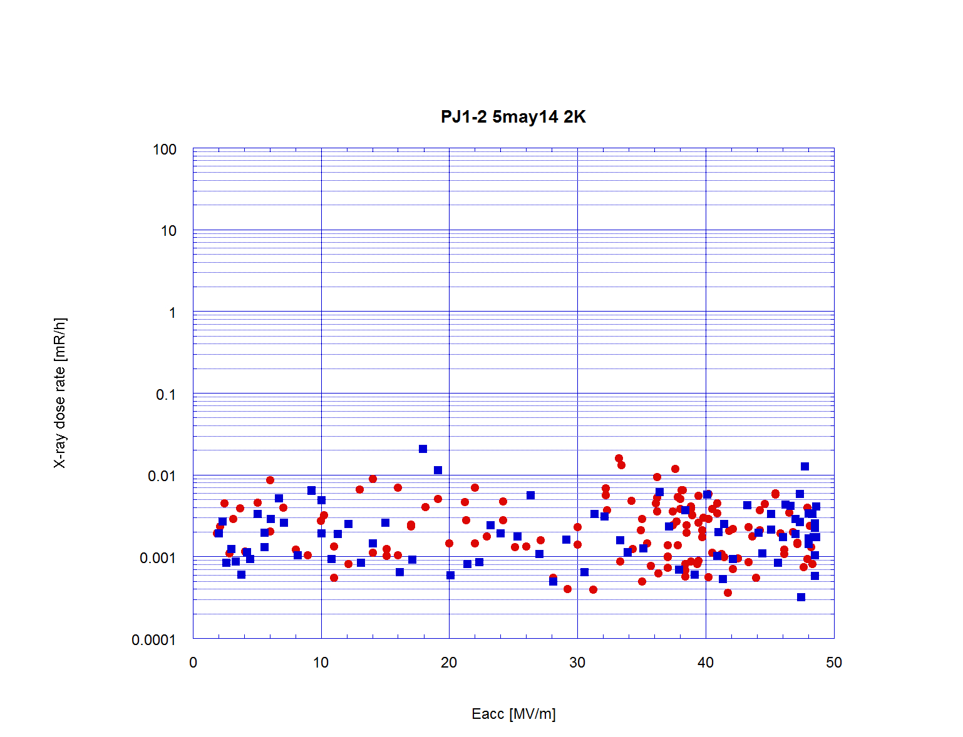
Demonstration of “FE Free” @ E_{pk}>100 MV/m
Field emission free
Epk 104 MV/m
Re-HPR only
Achieved by using standard ILC EP processing at JLab horizontal EP machine
This result encourages µEP effort based on vertical EP machine at Cornell (see F. Furuta, 2nd LCC/ILC Cavity Group Meeting, Nov. 6, 2013)
Next step is to test even less removal down to 1 µm
+ µEP + ER + USC + HPR

Slide 20
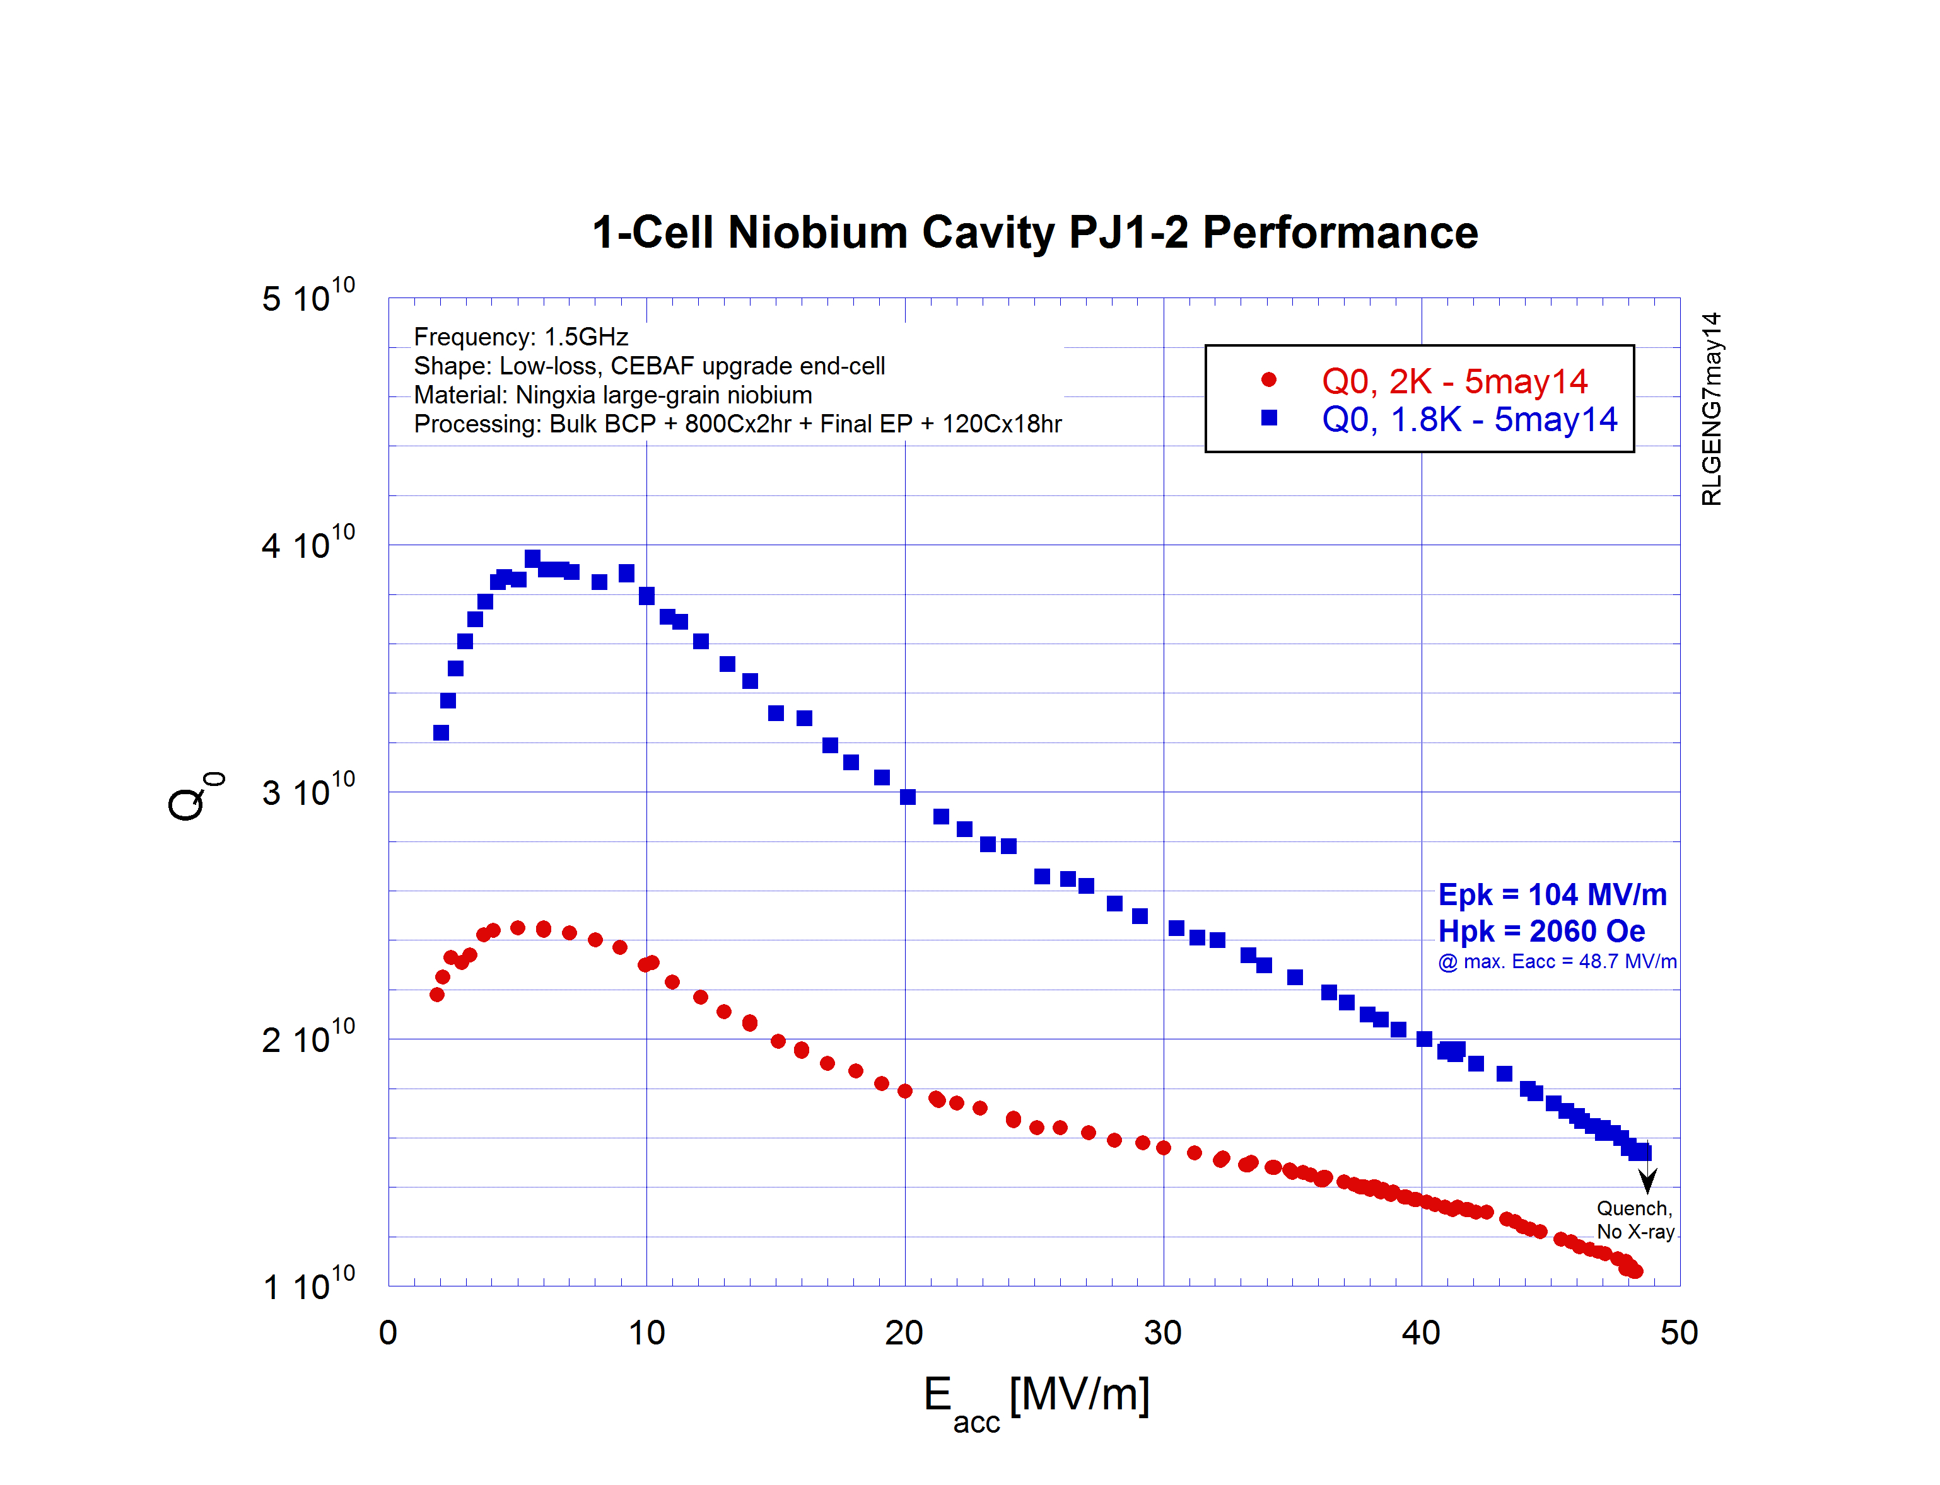
Demonstration of “FE Free” @ Epk>100 MV/m
Final Processing: + EP 10 um + 120cx18hr

Slide 21
Prevent Post-Contamination
Learning in this area requires large number of cavities and cryomodules AND a closed feed-back loop.
Opportunities are not many
  At JLAB, we had a recent internal workshop in reviewing our upgrade cavity experience (80 7-cell cavities in 10 cryomodules) on particulate field emitters from VTA to beam operation.
  Impacts: NEG pump replaces ion pump; cavity-grade cleaning of beamline UHV.
  New knowledge to be applied in re-work cryomodules.

Slide 22
In-Situ Removal of Field Emitters
At JLAB, helium processing has been used for reducing field emission in-situ.
Several CEBAF 12 GeV upgrade cryomodules were helium processed in the summer of 2015.
  FE onset increased on average.
  Some negative gain observed.
Other known in-situ techniques
  RF processing (CW or pulsed)
  Plasma processing (module at room temperature)
  High peak power RF processing

Slide 23
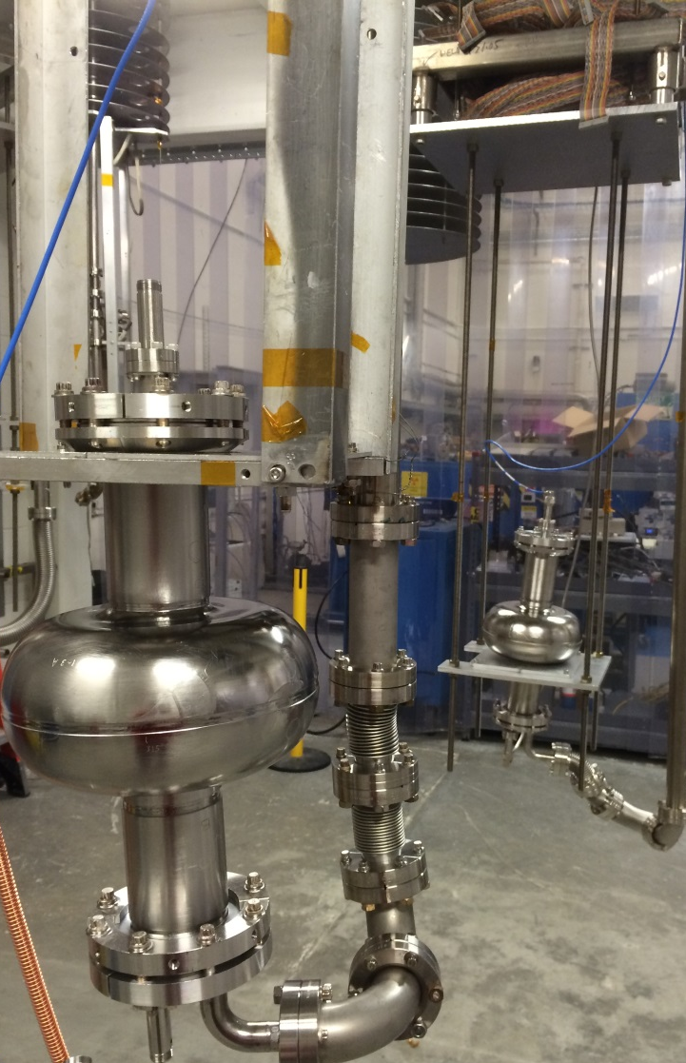
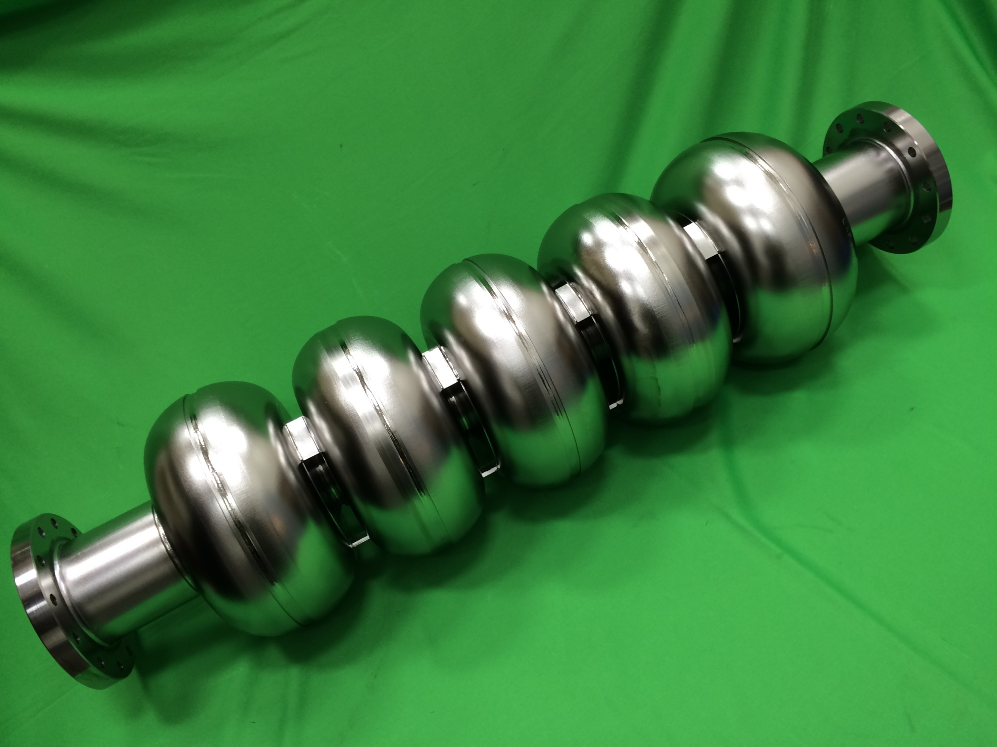
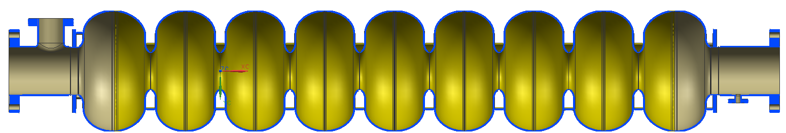
Better Cavity Shape for Lowered Surface Field
 |  | TESLA | Low-loss/ICHIRO | Re-entrant | Low-surface-field
frequency | MHz | 1300 | 1300 | 1300 | 1300
Aperture | mm | 70 | 60 | 60 | 60
Epk/Eacc | - | 1.98 | 2.36 | 2.28 | 1.98
Hpk/Eacc | mT/(MV/m) | 4.15 | 3.61 | 3.54 | 3.71
Cell-cell coupling | % | 1.90 | 1.52 | 1.57 | 1.27
G*R/Q | Ω² | 30840 | 37970 | 41208 | 36995
20% more efficient as compared to TESLA shape
Keep peak electric field ratio the same
Z. Li, C. Adolphsen, A New SRF Cavity Shape with Minimized Surface Electric and Magnetic Fields for the ILC, LINAC08 (2008).
R.L Geng et al., Development of Ultra High Gradient and High Q0 Superconducting Radio Frequency Cavities, IPAC13 (2013).

Slide 24
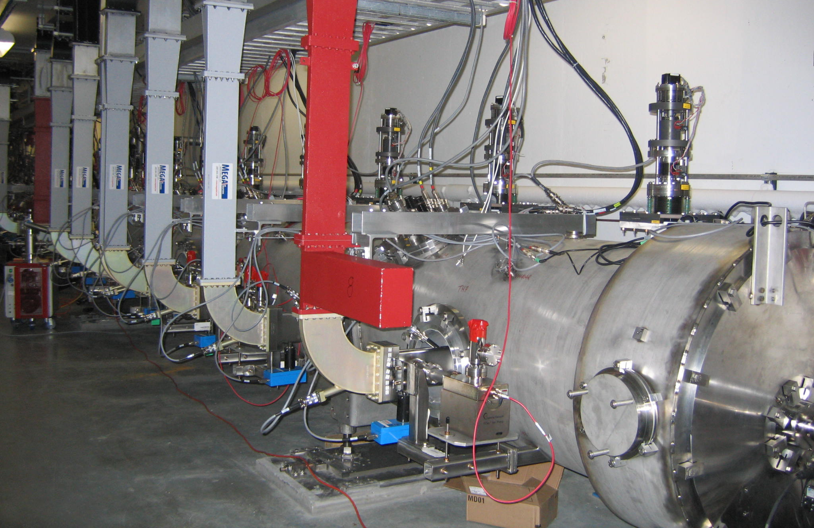
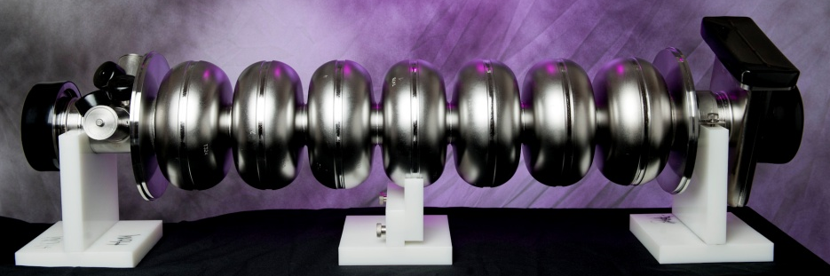
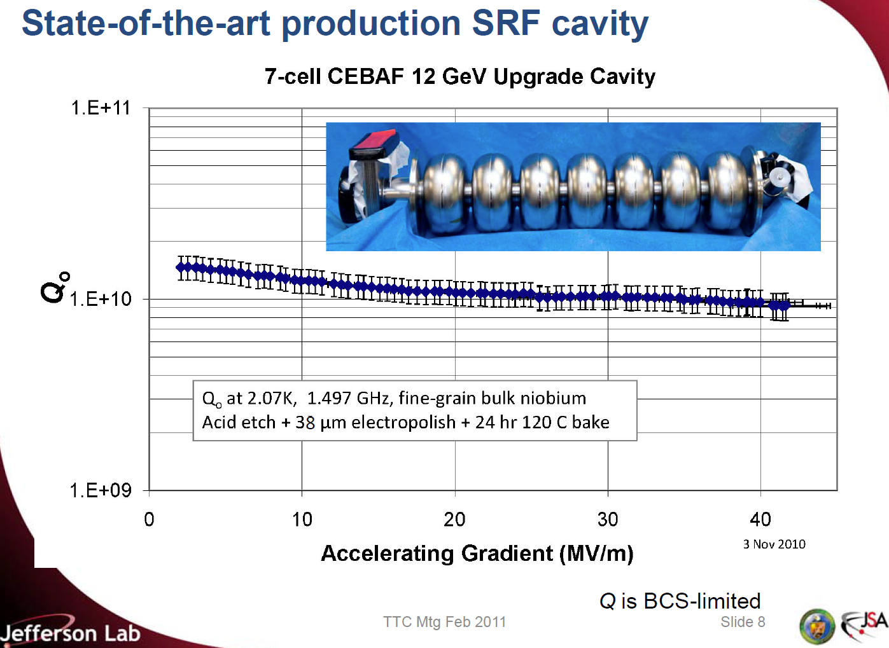
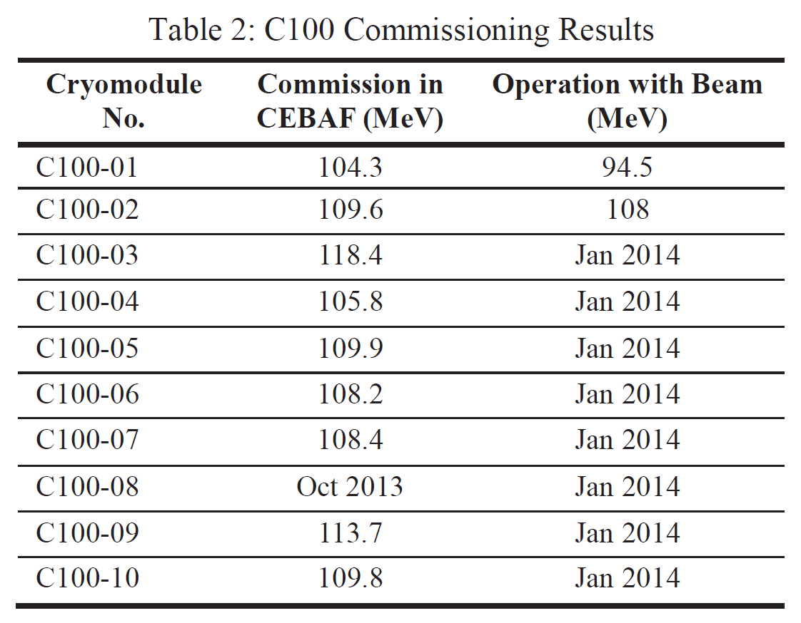
Low-Loss Shape Cavity Accelerating Beam
CEBAF 12 GeV Upgrade Cavity
1.5 GHz, Low-loss Shape, 53mm bore dia.
C. Reece, TTC Meeting, Feb. 28-Mar.3, 2011
J. Hogan et al., PAC2013, WEZAA2

Slide 25
Open Questions
Where lies the opportunity for beam operation testing of a 40 MV/m full-scale cavity?
  31 MV/m limit at XFEL due to RF
  31.5 MV/m admin limit in ASTA at FNAL
    Is it possible for such a test in CM2 at FNAL?
  Any possibility in STF at KEK?
How should the FE be quantified so it can be tracked and compared?
  JLAB/KEK collaborated on “at-cavity” X-ray instrumentation and tested in a full-scale CEBAF-style cryomodule.
    Can this be tested at KEK, FNAL or DESY also?
  DESY and FNAL both measure “dark current” with Faraday cup.
    Is similar measurement planed for LCLS-II cryomodule?
  how should we track FE over long term operation?

Slide 26
Open Questions
What are new ideas for creating reliable field-emission free surface at Epk 100 MV/m?
  The experience at KEK and JLab strongly indicate that a small (< µ10 m) final EP creates a high field surface without field emision.
  Cornell has demonstrated vertical EP and used to have a “µEP effort”.
    How can this test be applied to 9-cell cavities?
  Currently applied in-situ processing techniques (RF processing, helium processing, plasma cleaning) are mostly applied to lower gradient regime with rather limited gain.
    Are these techniques effective at high field?
    Where lie opportunities for effective in-situ field emitter removal at low as well as high field?
Should better cavity shape be studied?
    These cavity also benefit lowering large machine cost.

Slide 27
Open Questions
What is the current main remaining enemy for high gradient SRF?
  Field Emission at 40 MV/m
  Unbeaten, this enemy stands as a bottle neck, prevents good properties (lower surface losses, larger critical field) from being usable.
  Reducing FE a paramount priority at present time for ILC and its 1 TeV upgrade, the only machine requiring ~40 MV/m.

