Slide 1

Status of ESS Medium Beta Cavities prototype production
Michele Bertucci
on behalf of
INFN Milano – LASA ESS Team

Slide 2
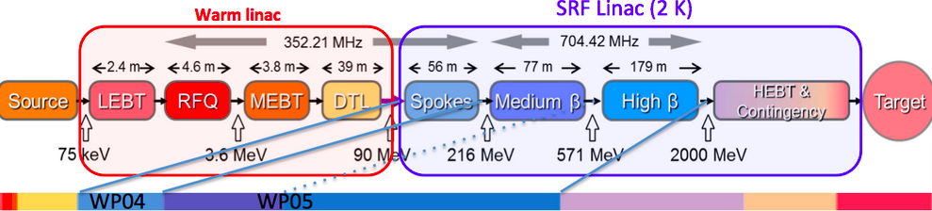
Medium beta cavities:
Technical Performances
MB cavity technical requirements
Frequency (MHz) | 704.42
Number of cells | 6
Geometric beta | 0.67
Nominal Acc. Gradient (MV/m) | 16.7
E_{peak} (MV/m) | < 45
RF peak power (kW) | 1100
Q external | 5.9-8 10⁵
Q₀ at nominal gradient | > 5 10⁹
Output energy to 571 MeV
36 superconducting 6-cells cavities at beta 0.67
9 cryomodules, 4 cavity each
Independent RF power source for each resonators

Slide 3
Medium beta cavities:
Technical Performances
INFN In-Kind contribution:
  Niobium procurement for the fabrication of 36 medium beta cavities.
  Cavity fabrication of 36 medium beta cavities in the industry, including treatments, tuning, Helium tank integration, accomplishing the ESS requirements in terms of performances and functional interfaces.
  Certification activities, documentation, ancillaries (flanges, vacuum valves, antennas, frames)
  Cold test in a qualified infrastructure (DESY).
  Transportation in special boxes and delivery at CEA cryomodule assembling facility.
  Man power for the above activities.
INFN R&D on prototypes, outside of in-kind contribution:
  Built prototypes of both medium and high beta cavities.
  INFN design, using Large and Fine Grain Nb, plug compatible with ESS cryomodule.
  Full treatment (BCP, HPR, clean room) done in industry.
  Final handling and test will be done in the qualified infrastructure at LASA.

Slide 4
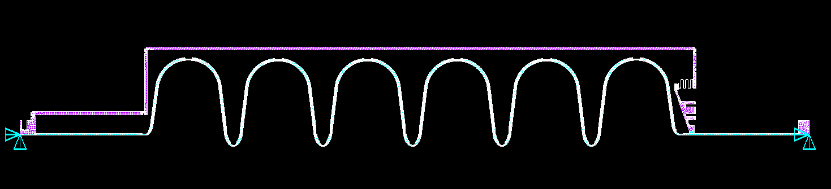
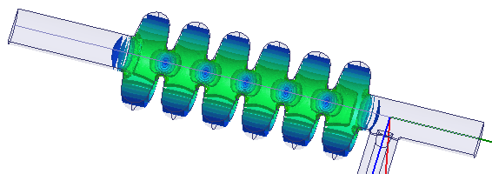
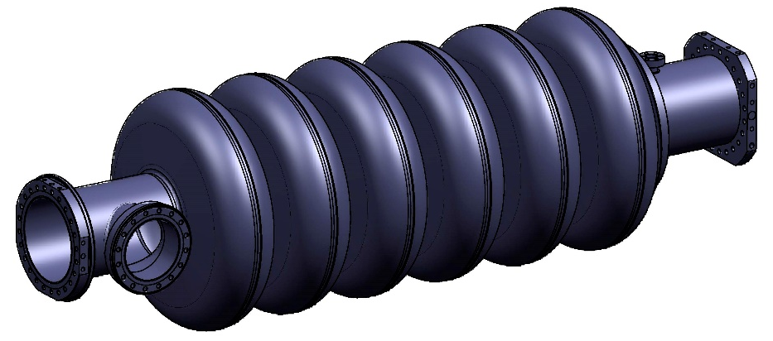
Prototypes: Design
Baseline: boost k to achieve better mode separation and HOMs coupling to outer cells
3D modeling with Siemens NX8
2D Mechanical and EM design tools with BuildCavity (interfacing to Superfish) and Ansys 2D
3D EM and mechanical design with Ansys Workbench and HFSS sharing the same cavity model
2D Model Cavity + He Tank
See WEPMB011 at IPAC16

Slide 5
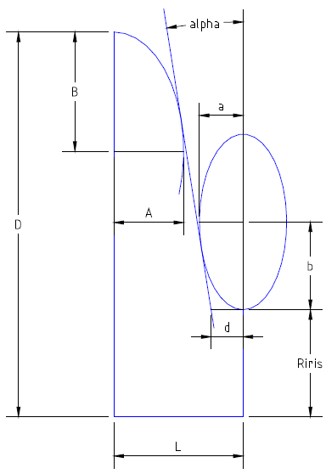
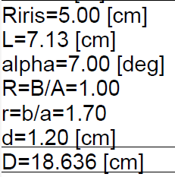
Prototypes: EM Design
Inner half-cell (HC) design
HC shape is defined by 7 parameters in Buildcavity
L=βλ/2=7.13 cm, correspond to β=0.67, f=704.42 MHz
R=B/A=1, to have a spheric equator, useful to limit multipacting
(In simulaton, L=7.13, R=1, α=7°, d=1.2 are fixed while the iris ratio r is always the value giving in the smallest E_{peak}, i.e. r=1.7 for R_{iris}=5 cm).
Riris = 5 cm, this large Riris gives us a large k, hence large modes seperation (+30%), also a better coupling of HOMs to the outer cells.

Slide 6
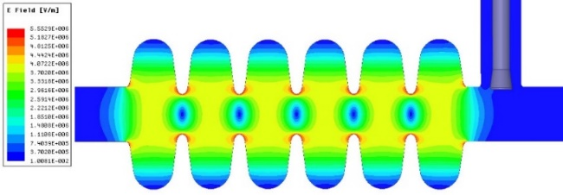
Prototypes: EM Design
Pi-mode E-field
Parameters | INFN design | Baseline
R_{iris} (mm) | 50 | ≥47
Geometrical beta | 0.67 | 0.67
Frequency (MHz) | 704.42 | 704.42
Acc. length (m) | 0.855 | 0.855
Cell to cell coupling k | 1.55%↗(+26%)
π-5π/6 mode sep.(MHz) | 0.70↗(+30%) | >0.45
G (Ω) | 198.8
Optimum beta, β_{opt} | 0.705 | 0.705
Max R/Q at β_{opt} (Ω) | 374 ↘ (-6%)
E_{acc} at β_{opt} (MV/m) | 16.7 | 16.7
E_{peak}/E_{acc} | 2.55 ↗ (+7%)
E_{peak} (MV/m) | 42.6 | < 45
B_{peak}/E_{acc}(mT/MV/m) | 4.95 ↗ (+3%)
Q₀ at nominal gradient | >5×10⁹ | >5×10⁹
Q_{ext} | 7.8×10⁵ | 5.9~8×10⁵
Fundamental modes R/Q

Slide 7
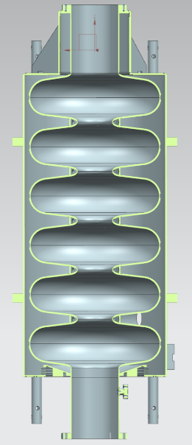
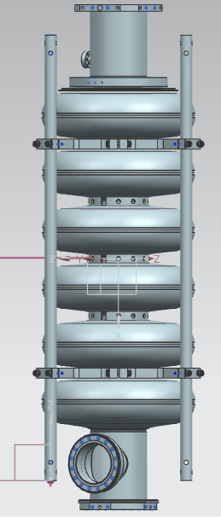
Prototypes: Model and materials
Cavity parameter | INFN Design
Cavity wall thickness (mm) | 4.3
Stiffening ring radius (mm) | 70
Beam tube diameter (mm) | 136
Cavity internal volume (l) | 69
Tank volume (l) | 45.3
Tank weight (kg) | 34.4
Cavity weight (kg) | 78.1
Internal surface (m²) | 1.8
Nb parameters | 295K | 4K
Young’s Modulus(GPa) | 106 | 125
Yield Strength(MPa) | 50-70 | 470-660
Density (kg/m³) | 8750
Poisson’s ratio | 0.4
The maximum pressure allowable is above
2.60 bar for 50 MPa VM (worst scenario)
3.64 bar for 70 MPa VM (best scenario)

Slide 8
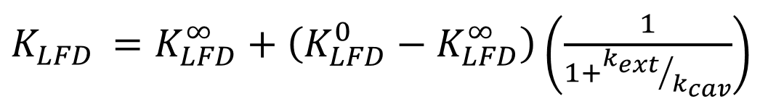
Prototypes: Mechanical Design
Mechanical parameter | INFN Design
Cavity wall thickness (mm) | 4.3
Stiffening ring radius (mm) | 70
Internal volume (l) | 69
Cavity internal surface (m²) | 1.8
Stiffness (kN/mm) | 1.59
Tuning sensitivity K_{T} (kHz/mm) | -210
Vacuum sensitivity K_{V} for K_{ext} ~ 21 kN/mm (Hz/mbar) | 36
LFD coefficient K_{L} for K_{ext} ~ 21 kN/mm (Hz/(MV/m)²) | -1.91
The Saclay-V type tuner will be used, designed by CEA and outside of INFN in-kind contribution
Tuner has nominally +/- 3 mm nominal stroke
  Up to +/- 600 kHz on INFN MB, ESS requires +/- 100 kHz
Two piezo stacks installed
  Actual fast tuning range to be cross-checked, 3 μm cavity strain assumed
Generally, LFD compensation is going to be challenging

Slide 9
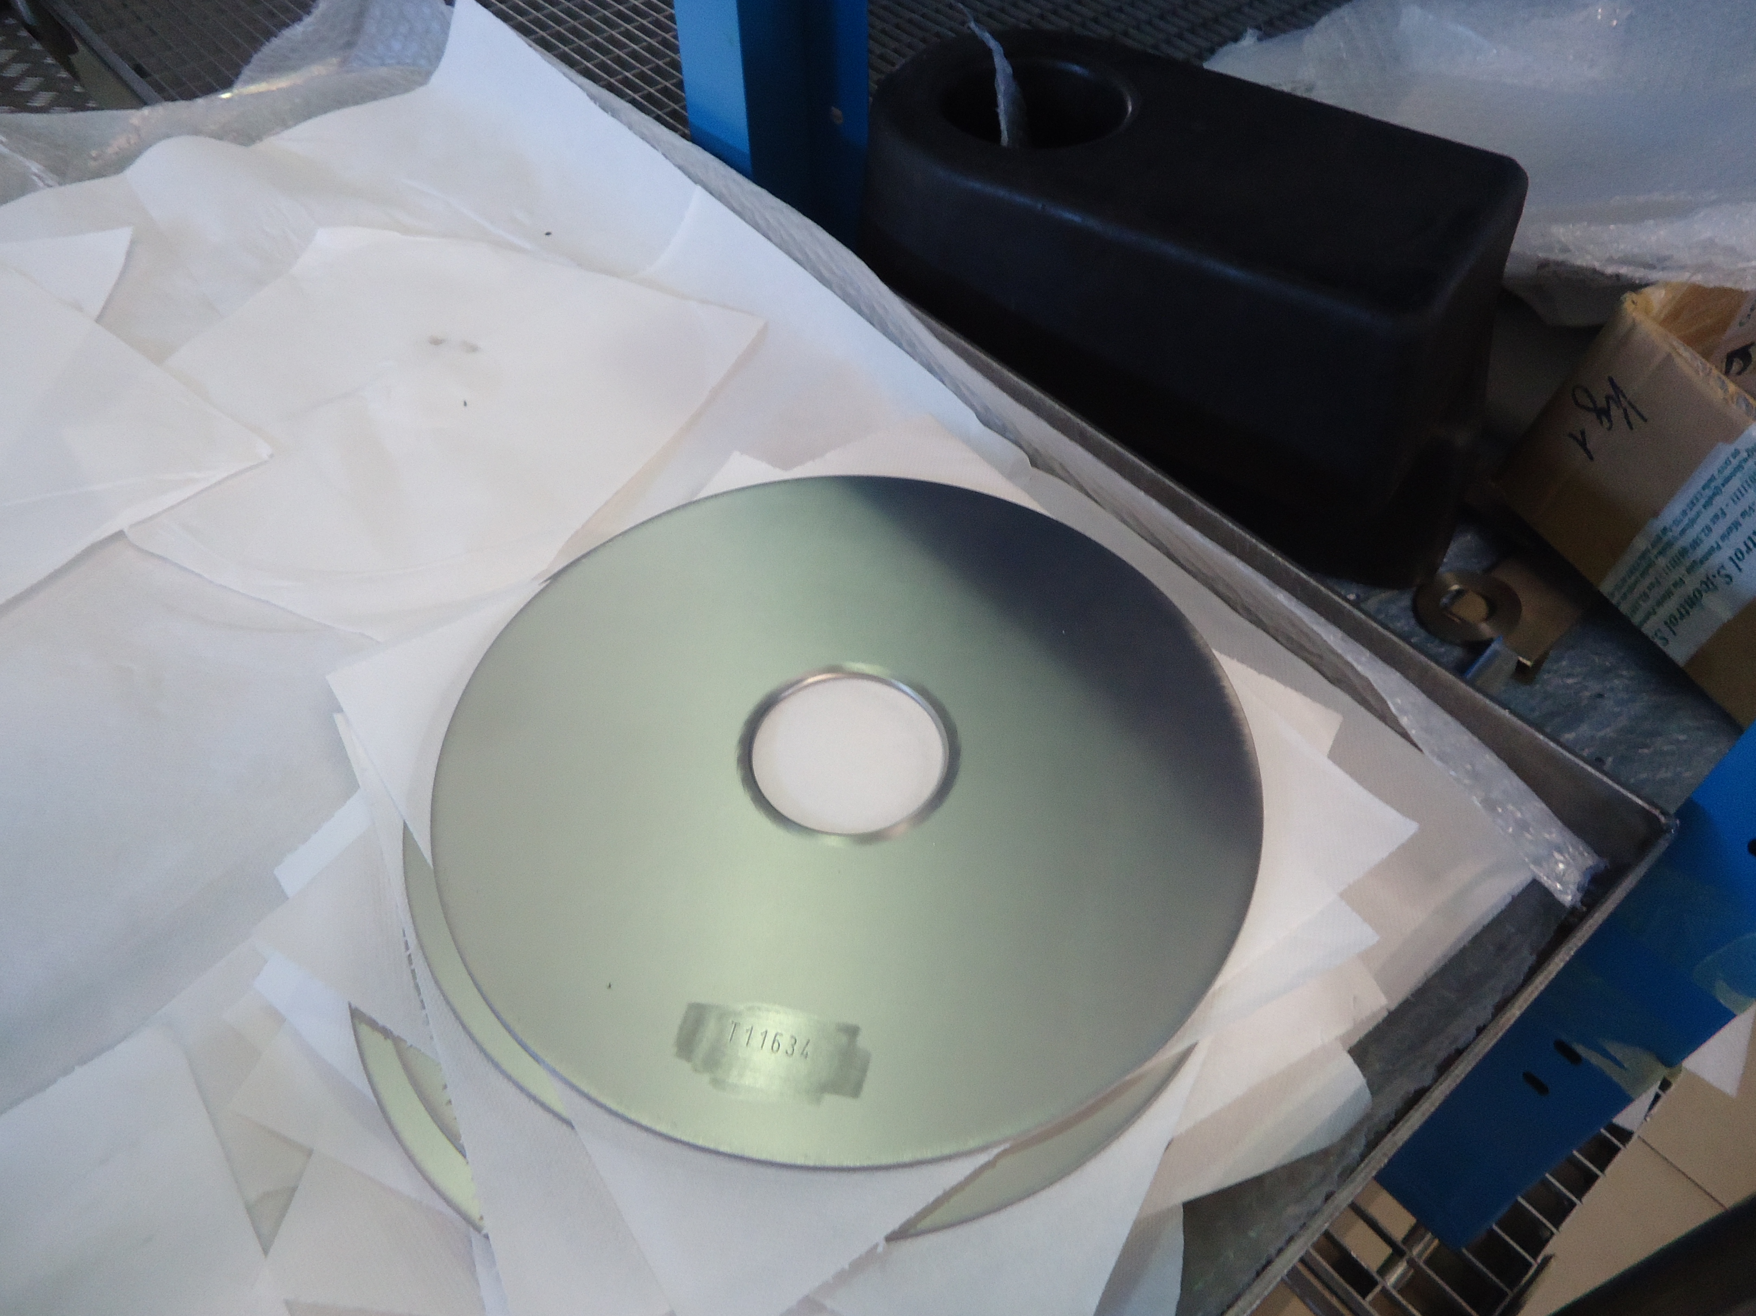
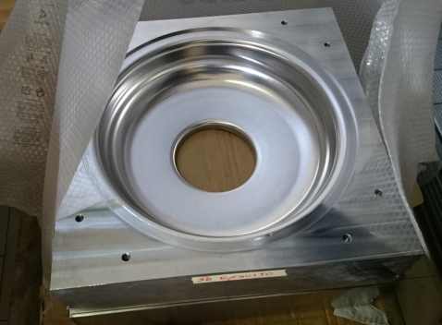
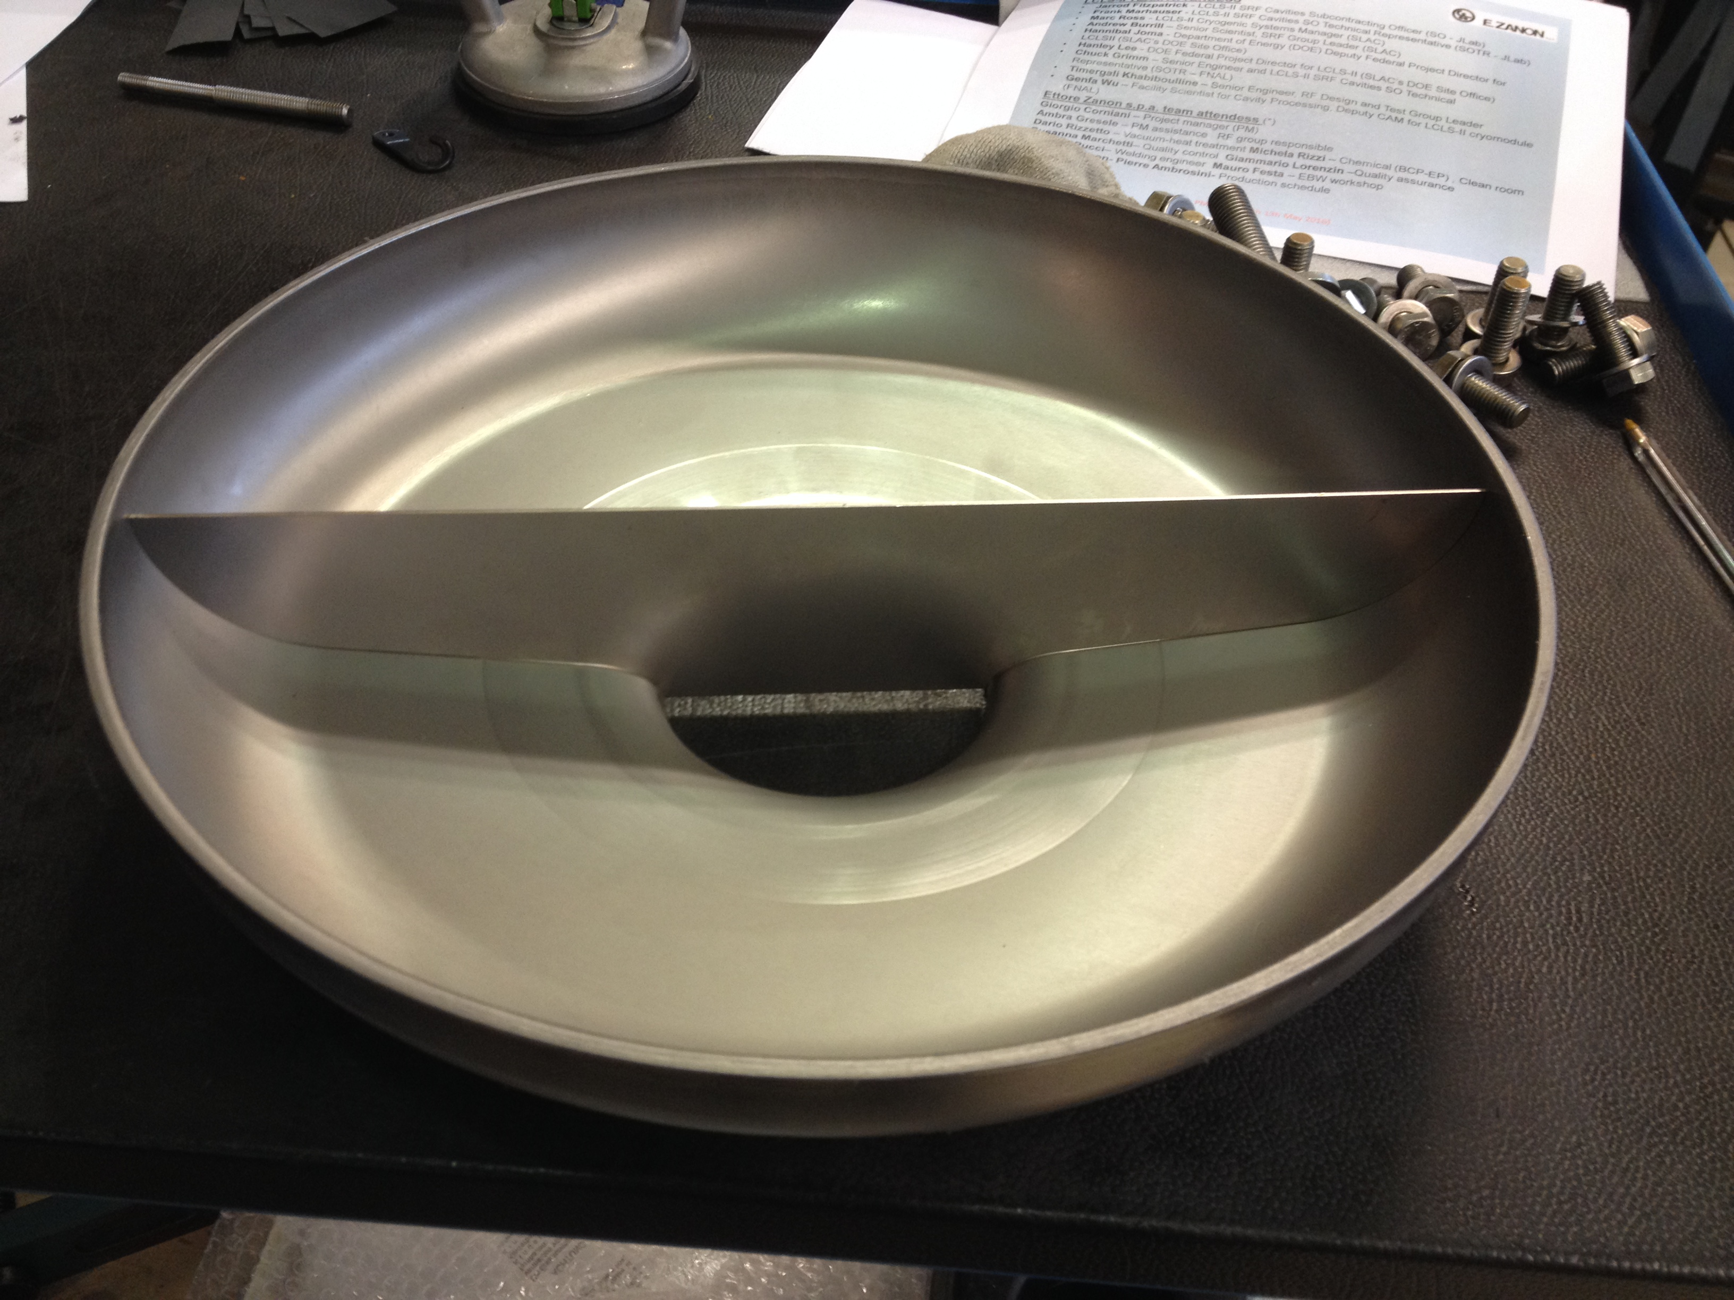
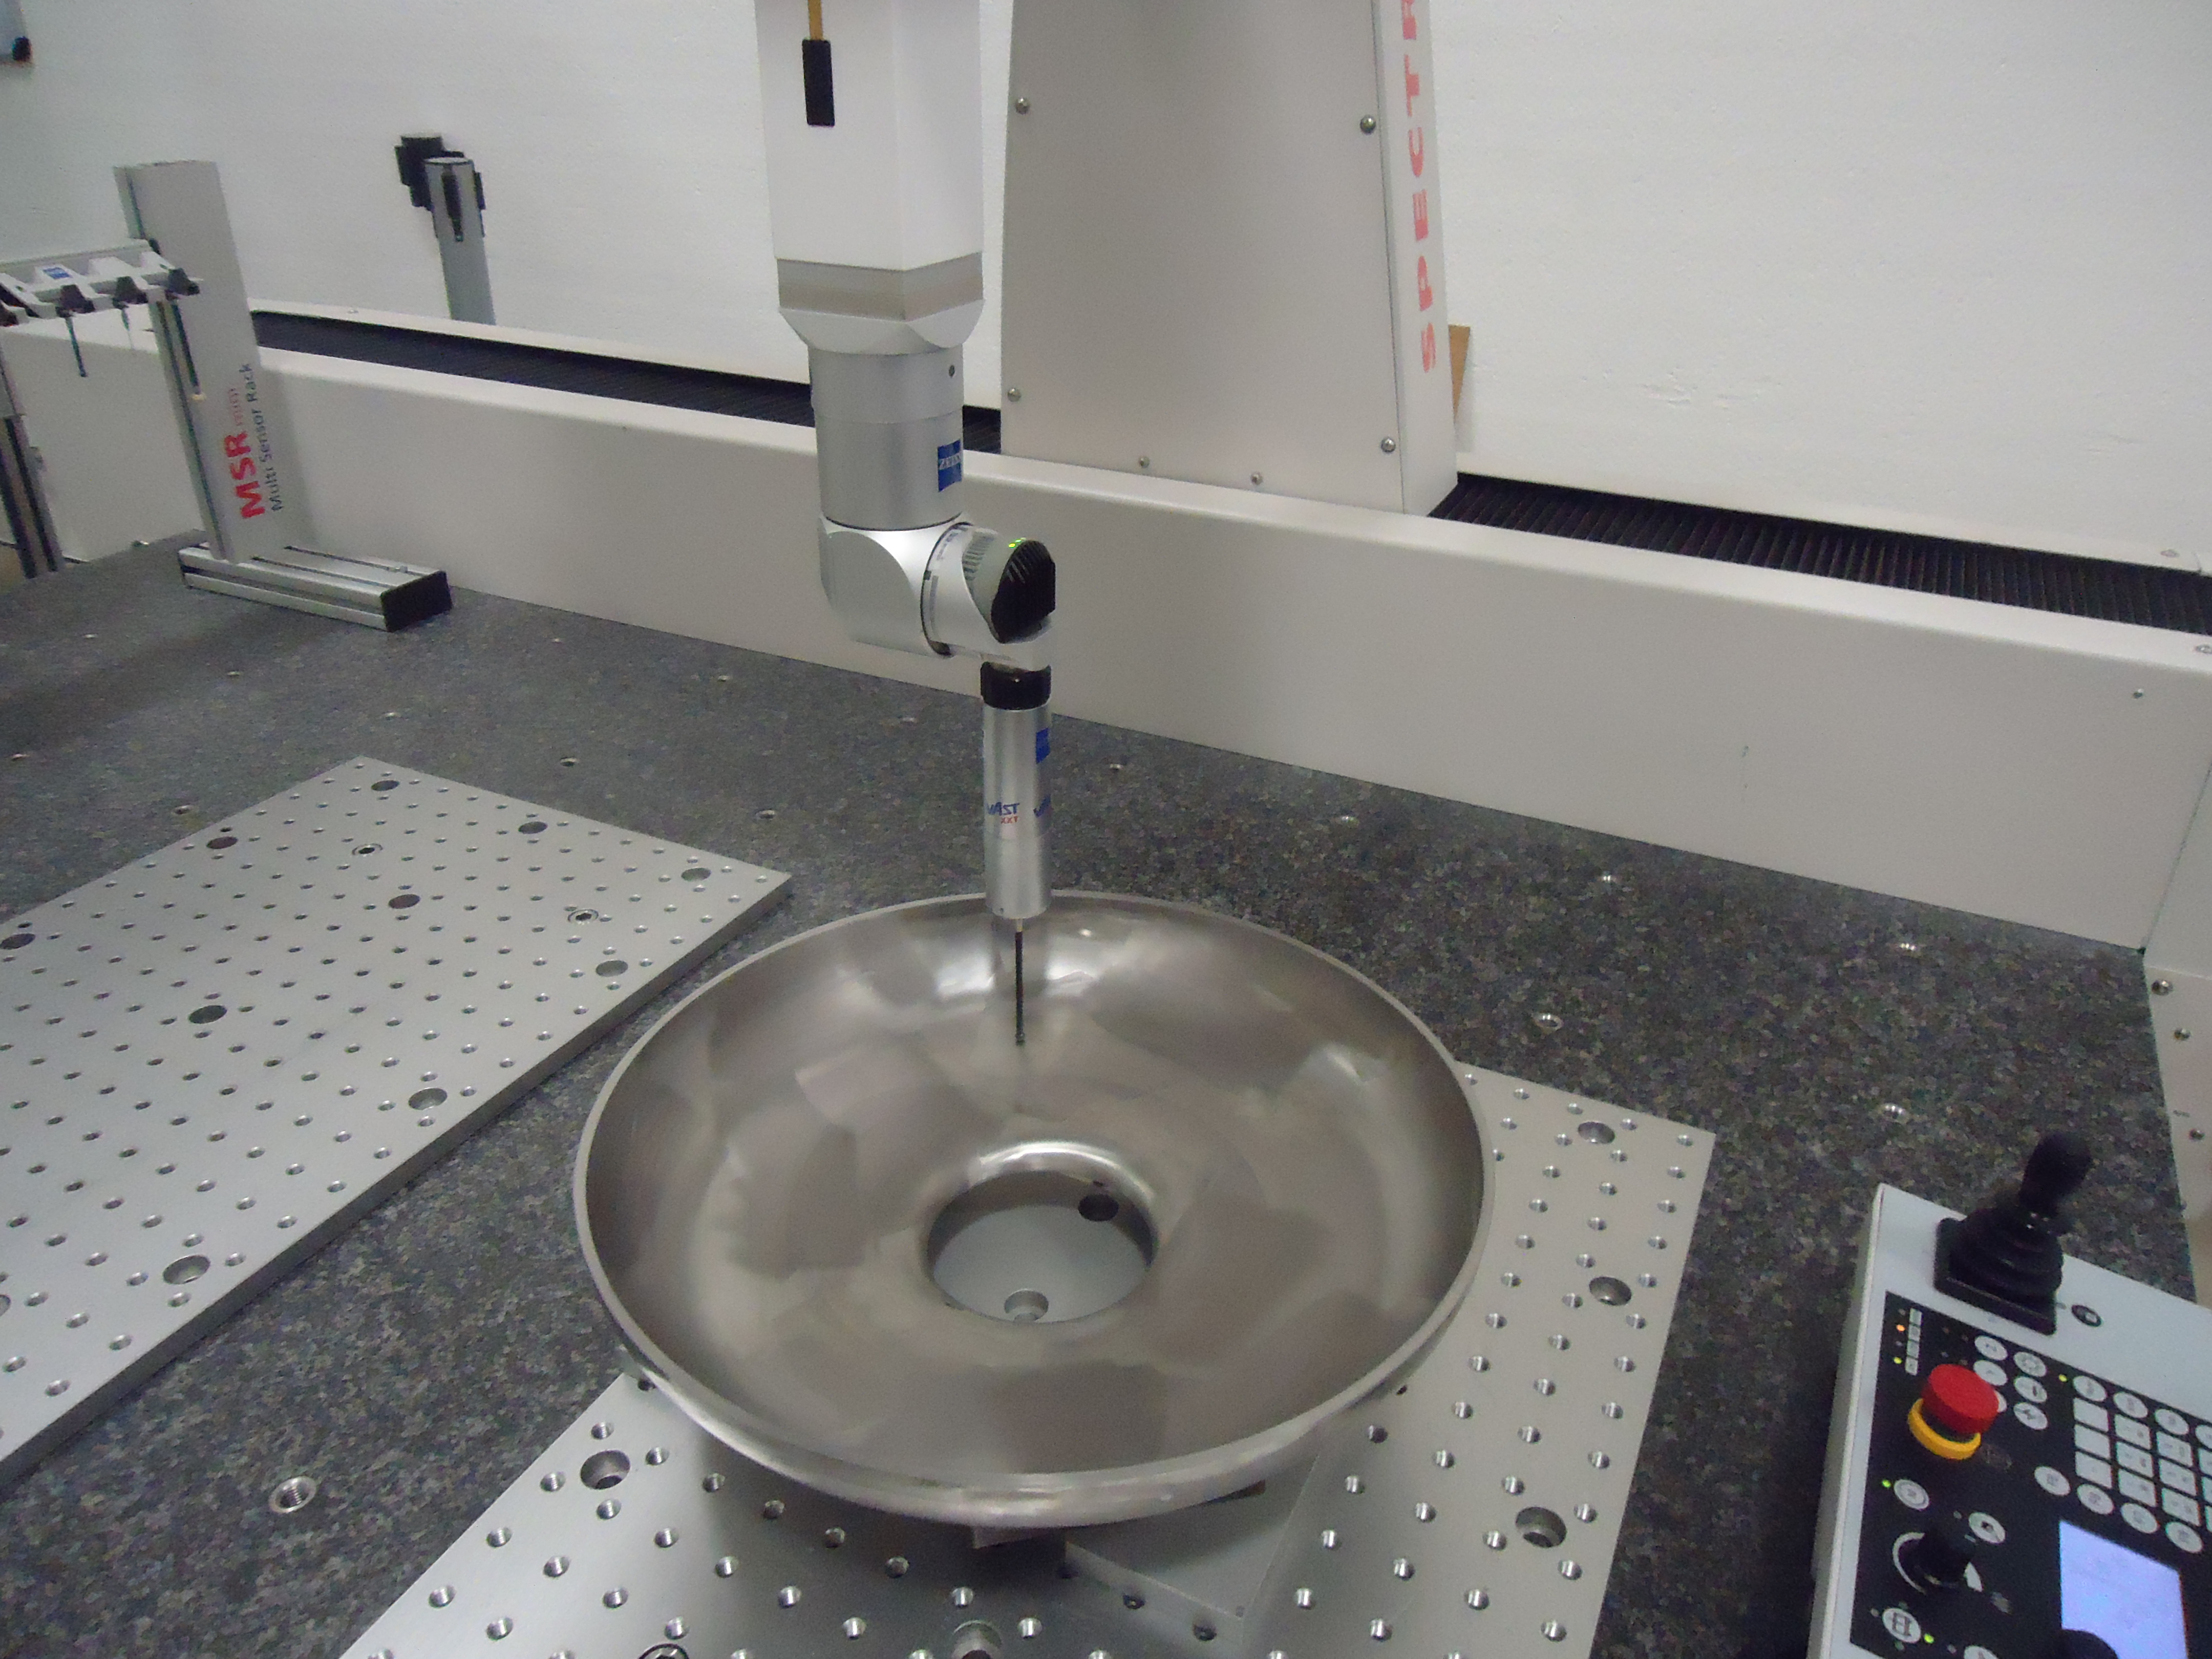
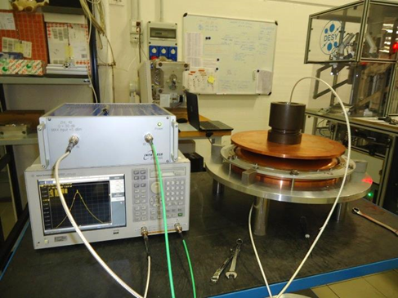
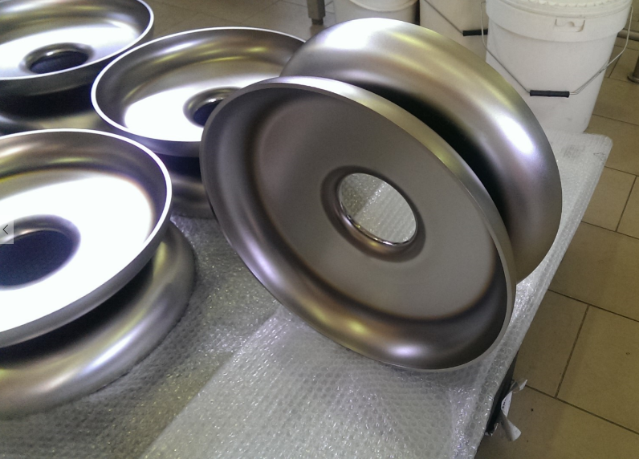
Fine grain prototype: production status
Deep drawing completed for all the half cells
Dimensional control
RF measurement
Dumbell welding + equator
trimming
Final cavity welding foreseen for the third week of july!!!

Slide 10
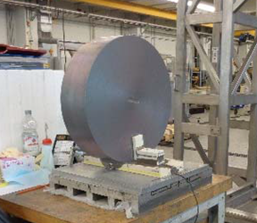
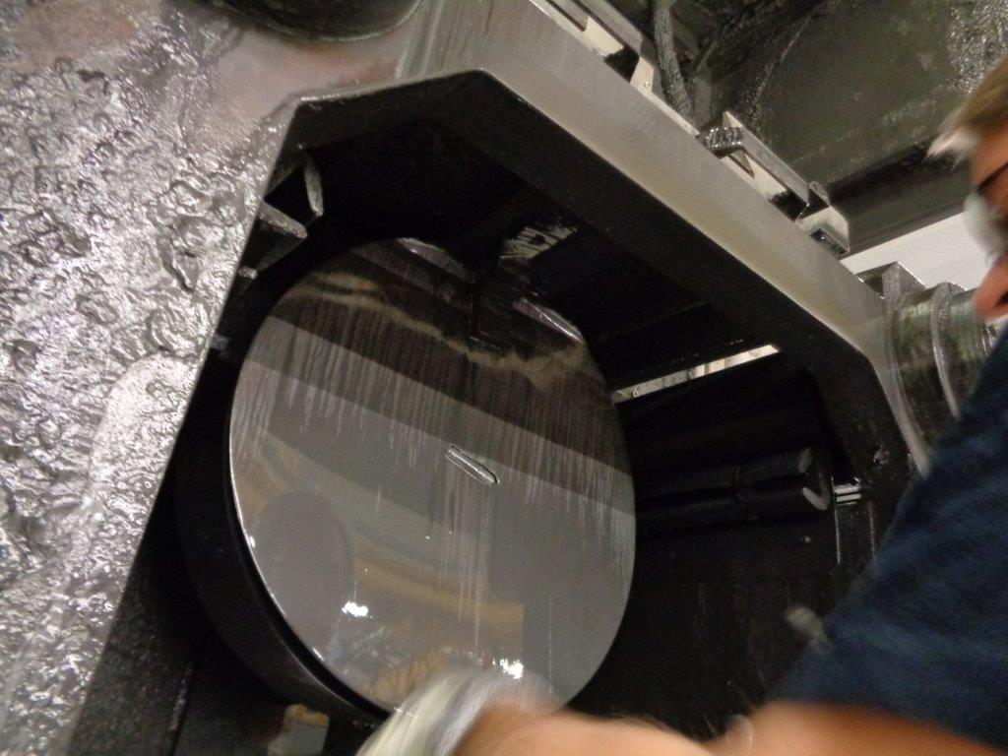
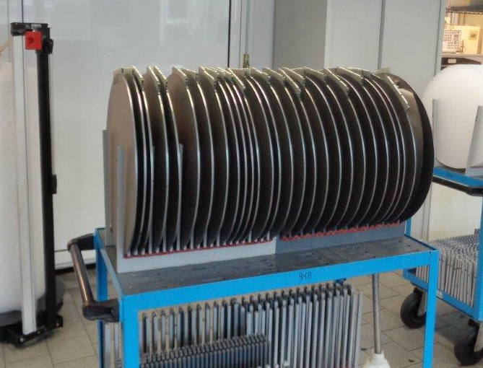
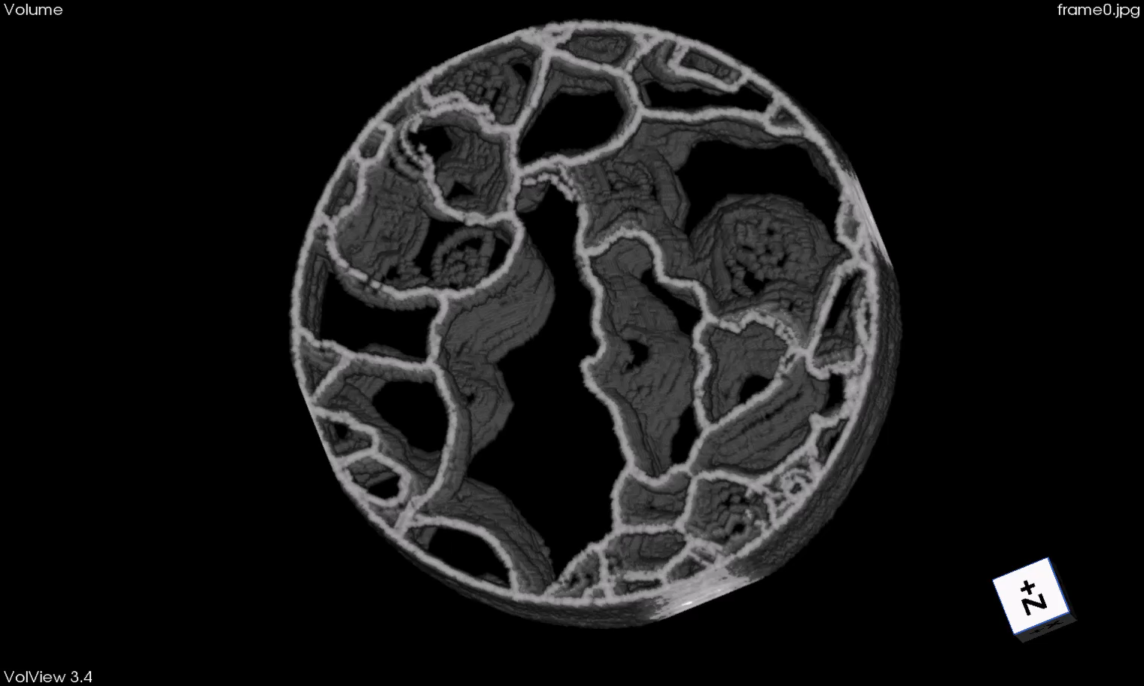

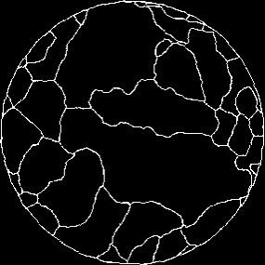
Large grain prototype: production status
CBMM ingot. Ø=480 mm
RRR>300
Wire sawing with oxygen
Protection @Heraeus
25 (+2) 4.675 mm slices
produced:
3D rendering of ingot inner structure
From slices grain boundary pattern.
GB displace but «topological» structure remains nearly unaltered.

Slide 11
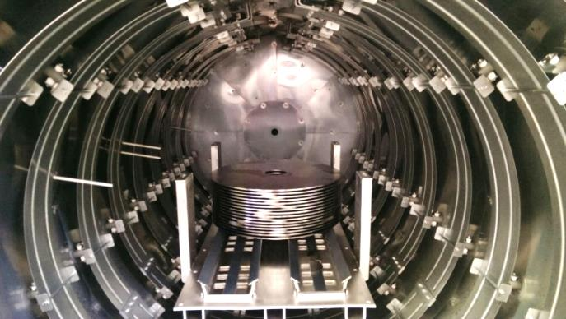
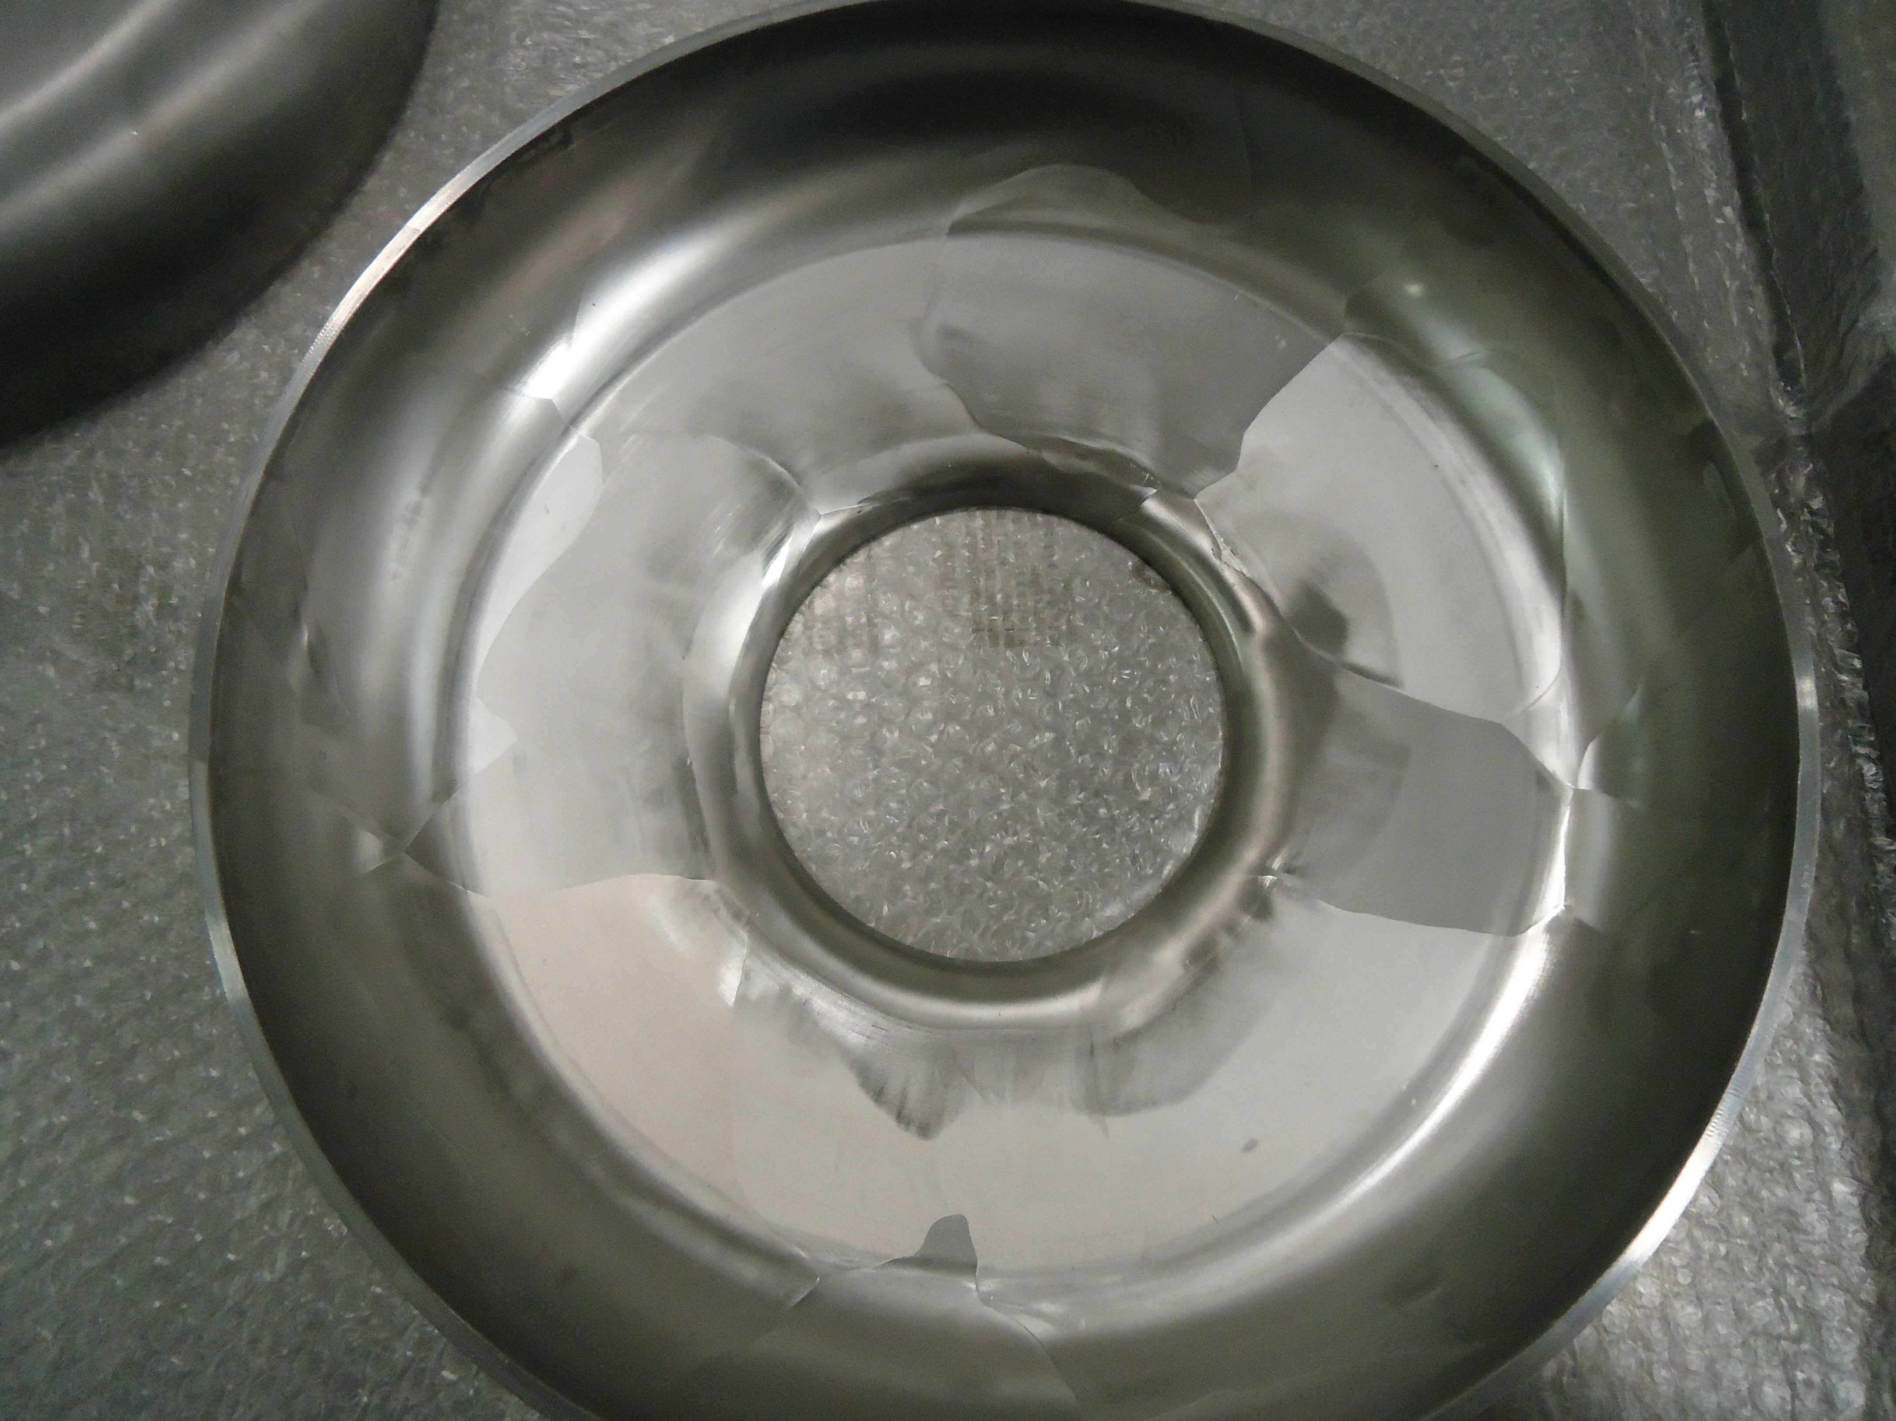
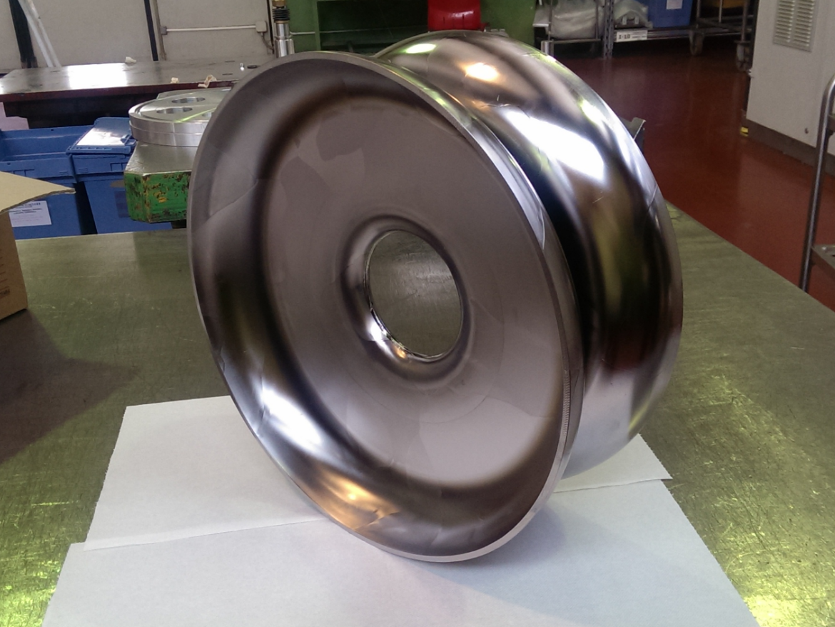
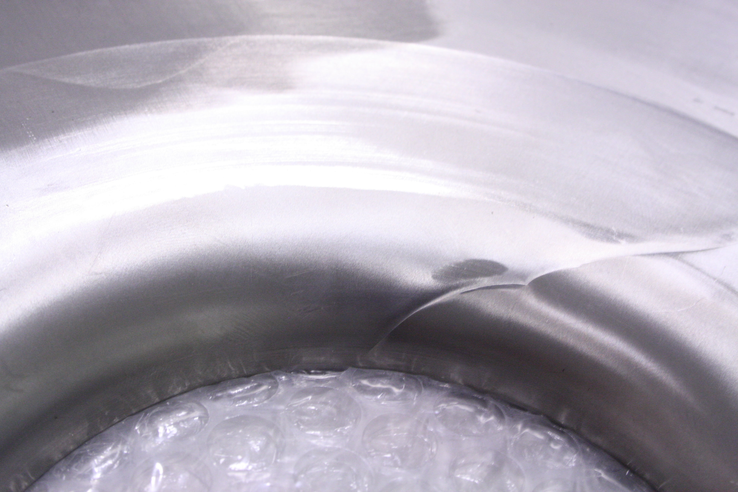
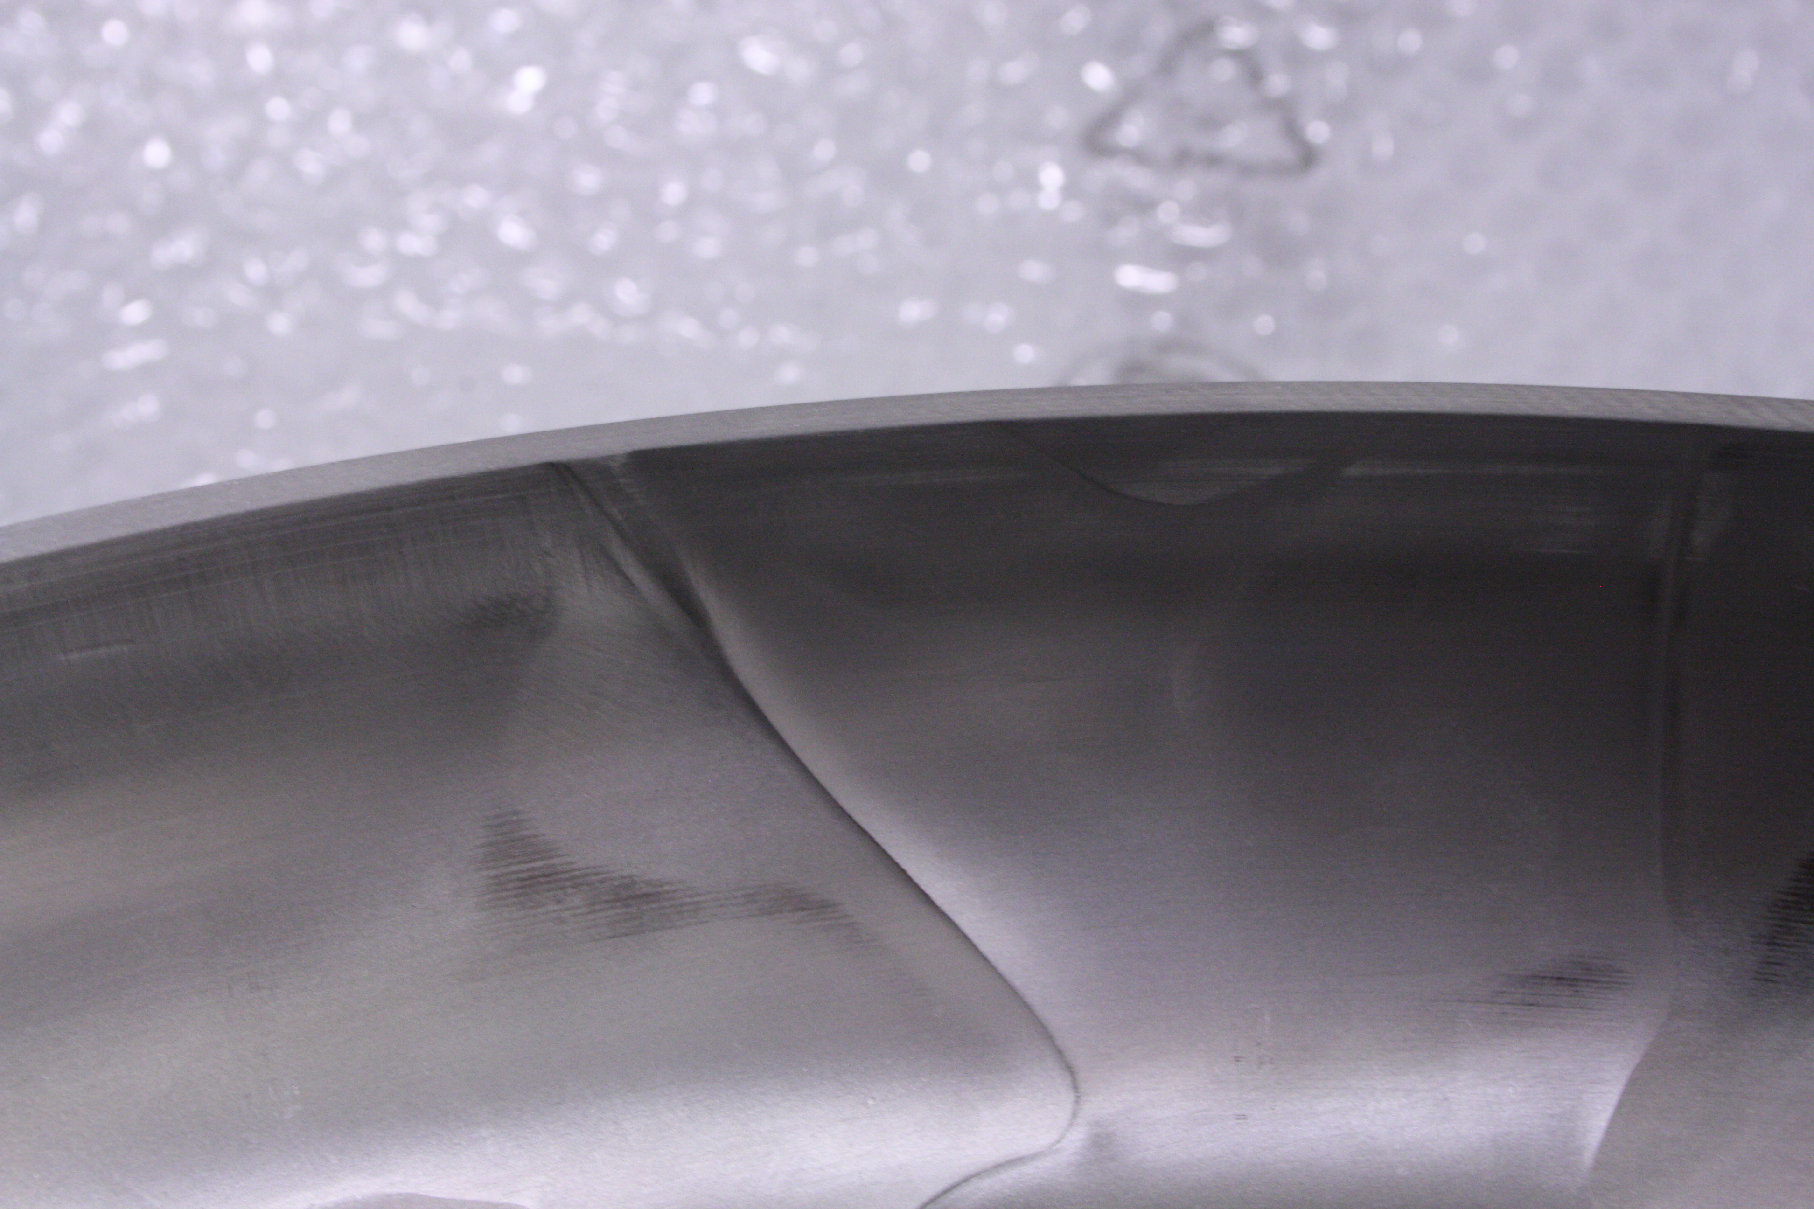
Large grain prototype: production steps
20 μm BCP (for side) + Heat treatment @700°C 2h
Deep drawing
Dumbell welding
Here and there,
Some dislocation on both irises
And equators, to be ground
after DB welding

Slide 12
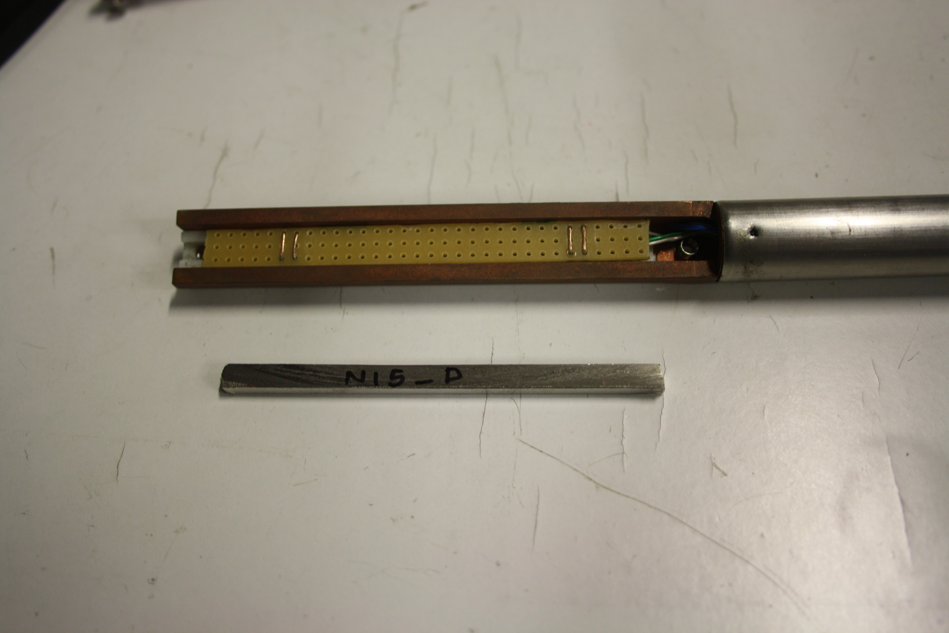
Large Grain: impurity content and
RRR measurement
Sampling for gas analysis and RRR measurement during the various steps of production
  RRR measured @ T=10 K with a 4 probe apparatus.
  Hydrogen content measured with LECO machine
  C, N, O measurement is planned for the future
Position\slice label | Condition | RRR (avg.) | H (W-ppm)
Bottom slice (1B) | After cutting | 310±15 | 19±2
3° slice from top (B11) | after BCP 30 um, before HT | 203±10 | 22±3
2° slice from top (N12) | after BCP 30 um, after failed HT | 209±10 | 10±2
12° slice from top\ (B24_2) | After HT, 1st batch | 240±12 | <1
2° slice from bottom (N15) | After HT, 2nd batch | 342±17 | <1

Slide 13
Prototypes: Cavity cycle and main checks
Cavity EBW
Pretuning
>90%
BCP1_1:
20 μm
Bead Pull in CR
BCP2:
50 - 70 μm
3 x tot: 60 μm
Optical Insp.
Mechanical Check
Mechanical check
Leak test
RF
Each step:
Frequency,
Weight
FF with bead pull in CR after every 20 um BCP
Weight
RF
FF with bead pull in CR
Final Check
Accessories installation
Final
BCP: 20 μm
FF Tuning >93%
Annealing
De Hydrog.
RF (spectrum)
Outcoming insp.
Leak test
RGA
RF
Optical Insp.
Mechanical check
Leak Test
Mechanical check
13

Slide 14
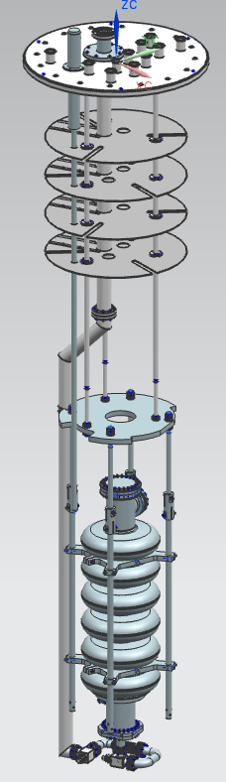
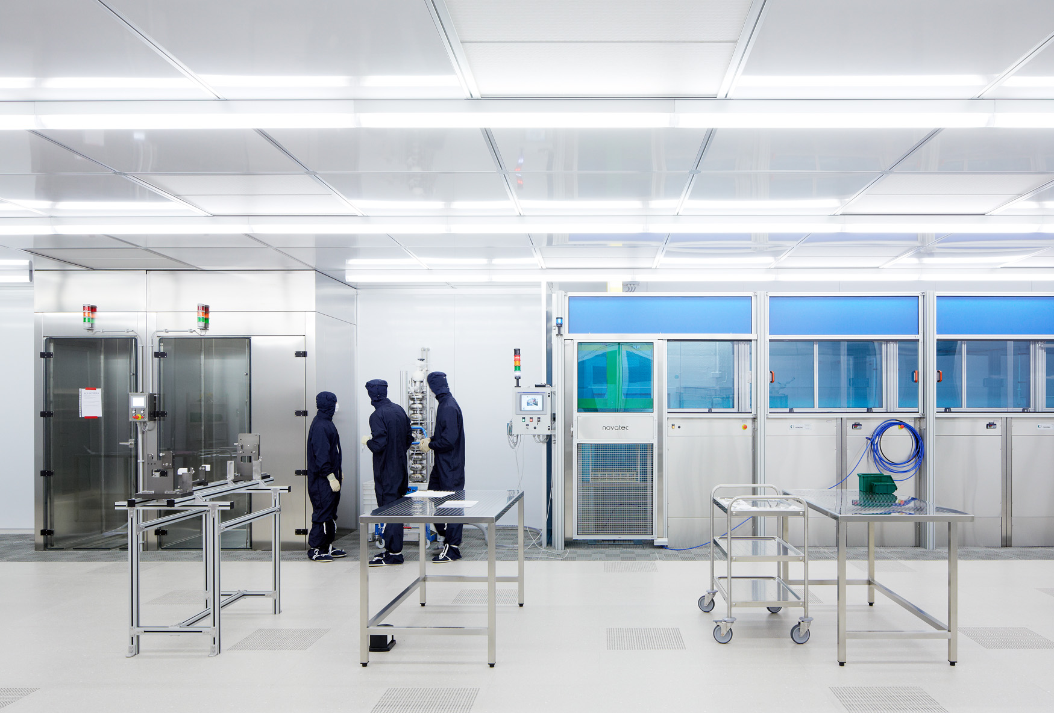
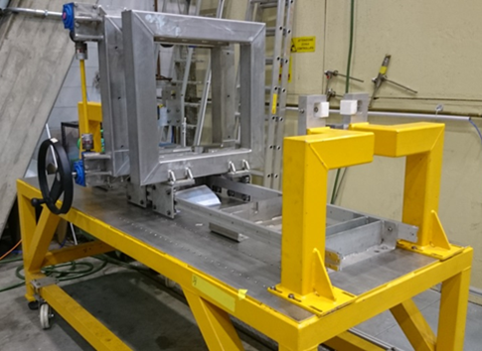
Prototypes: Infrastructure
Cavities delivery
  Both prototypes delivered starting from mid September
Upgrade of E. Zanon infrastructure in progress
  Cavity handling in the clean room
  BCP and acid plant cooling power
  UPW system
  HPR mechanical and hydraulic
  Cleaning and rinsing
  Cavity Tuning Machine
Cold test at LASA in September
  Cold insert at LASA: delivery foreseen in June
    Main accessories already in house
    LHe probes and transfer lines
    Vacuum components
    Diagnostics (fast thermometry, second sound,
    x ray photodiode detectors,…)
  LASA Clean Room upgrade in progress

Slide 15
Series: Data and cavity flow
Industry
NCR
INFN Experts Check
INFN
Managing System
Quality Control
Cavity production data
Database
(parameter analysis)
INFN Managing system
Documents for full equipped cavity acceptance (for string assembly)
NCR
CAVITY with TANK
Documents for cold RF test acceptance
NCR
ESS
(approval)
NCR
NCR
DESY
(Cold RF test)
CEA
CAVITY with TANK
STRING ASSEMBLY
MODULE
Q₀ vs. Eacc
ESS

Slide 16
Series: Procurements
Preliminary Design Review in Milan
  Committee and reviewers were “impressed by both the level of detail of the work and the application of LASA’s previous experience in SRF cavity design and production” and “that the design presented is sufficiently advanced and ready for LASA to proceed detailed design and prototyping”.
  The committee recommended to test the medium-beta cavity in the M-ECCTD: this is foreseen for December 2016.
Niobium procurement
  Specification under definition, starting from the E-XFEL specs, and then reviewed by experts.
  Start call for tender procedure within few weeks
Cavity procurement
  Technical specification under finalization. All treatments will be charged to the manufacturer in order to have cavities ready for vertical test.
  Agreement with DESY for the series cold test under finalization
  Start call for tender in summer this year

Slide 17
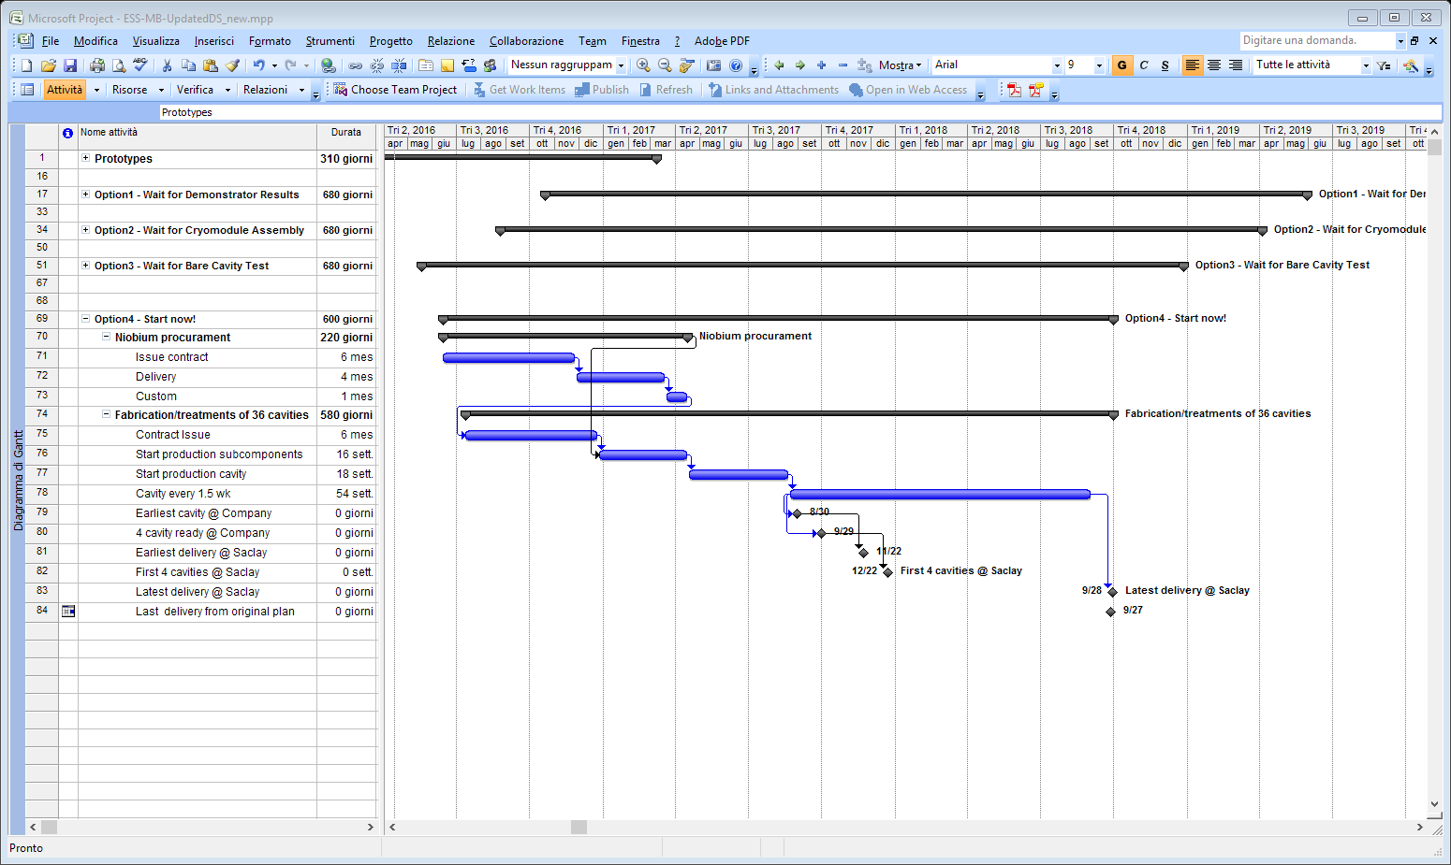
Series: Planning
Critical Design Review: Sep. 2016
  First 4 cavities delivered to CEA by Dec. 2017.
  Last one delivered in Sep. 2018.

Slide 18
Medium beta cavities:
Summary
Series production strategy under finalization
  Procurement process are about ready to start with CFTs
  Cold test agreement under finalization with DESY
    2 cavities will be tested in one cooldown, insert design in progress at DESY taking benefits from LASA insert.
Prototypes activity well advanced
  EBW of both prototypes in July
  First cavity delivered at LASA by mid September 2016
  First cold test results in October 2016, next one within the next month.

Slide 19
Series: QA/QC
Three Acceptance Levels (Al1 – Al2 – Al3) at the producer
One Acceptance Level (Al4) for RF cold test in qualified laboratory
One last Level upon final receiving at CEA
Level | Cavity status | Needed documents | If Level reached
One | “Naked” cavity after mechanical fabrication | Mechanical, RF, vacuum, visual documents | Proceed to Level Two
Two | Cavity before He-tank integration | Mechanical, RF, vacuum, Treatment documents & tank documents | Proceed to Level Three
Three | Accessory assembly, last surface treatments, outer inspection document | Treatment, vacuum, RF, transfer measurements documents | Integrated cavity ready to be cold RF tested
Four | Cavity cold tested | Documents relative to cold test results and in/out checks | Cavity can be sent to CEA for string assembly
Five | Cavity accepted for string assembly | Documents with incoming inspection at CEA | Cavity final approval

