Slide 1

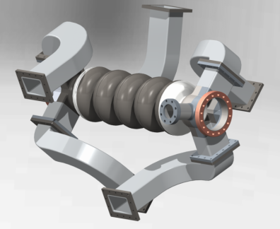
TTC Meeting Paris
BESSY VSR- R&D of SRF Cavities
Adolfo Vélez
Institute for Superconducting Radio Frequency (FG-ISRF)
TTC Meeting Paris
5.- 8.07.2016

Slide 2
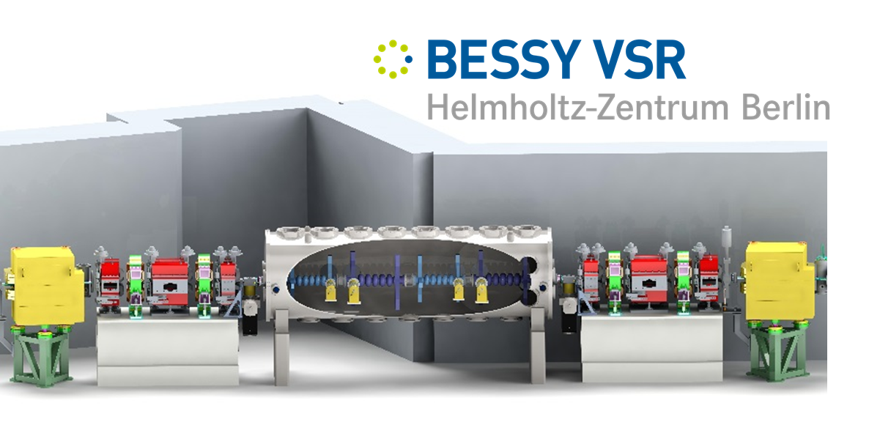
OUTLINE
  BESSY VSR, Design Specifications and Challenges
  Development of SRF Cavities for BESSY VSR-BESSY III
    Design Techniques
    HOM loads
    Module integration
  Prototypes
    Copper Prototypes
    Single Cell cavity
    5-Cell VSR cavities
    High Power Couplers
  Testing & Infrastructure
A.Vélez, TTC Meeting Paris

Slide 3
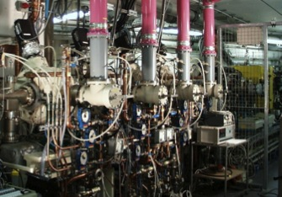
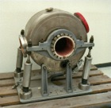

The concept of BESSY ^{VSR}
BESSY II @ present
Limited pulse length in storage ring
Normal conducting cavity system
Machine optics
Hardware (RF cavities)
At high current beam becomes unstable
  For ps pulses, flux is reduced by
  nearly 100
Bursting instability begins
User optics
10
Low alpha optics
I_{th} roughly proportional to V´_{rf} σ²
  Low alfa operation only 12 days/year
  (all beamlines) ------- Low flux
RMS bunch length (ps)
1
  Femtoslicing is continuously operated
  ( only 1 beamline) ---------- Low flux
  Can we design a system offering both possibilities simultaneously?
0.1
10⁻⁴
10⁻³
10⁻²
10⁻¹
1
10
Bunch current (mA)
A.Velez, SRF15 Whistler CA

Slide 4

The concept of BESSY ^{VSR}
BESSY II @ present
Limited pulse length in storage ring
Machine optics
Hardware (RF cavities)
At high current beam becomes unstable
  For ps pulses, flux is reduced by
  nearly 100
User optics
10
  Supply short pulses down to 1.5 ps
    100× more bunch current
Low alpha optics
I_{th} roughly proportional to V´_{rf} σ²
User optics
RMS bunch length (ps)
1
100 × more voltage gradient
  Low α permits few 100 fs
Low alpha
  Configure BESSY^{VSR} so 1.5 ps
  and 15 ps bunches can be supplied
  simultaneously for maximum
  flexibility and flux!
0.1
10⁻⁴
10⁻³
10⁻²
10⁻¹
1
10
Bunch current (mA)

Slide 5
The concept of BESSY ^{VSR}
BESSY II , SC Upgrade
G.Wüstefeld et al.
„Simultaneous long and short electron bunches in the BESSY II storage ring“
IPAC2011
cavity V₁,f₁
cavity V₂,f₂
1.5GHz and 1.75GHz ---- RF beating
(modulate RF focusing)
Odd (voltage cancelation, 15 ps bunches)
Even (voltage addition, long.focussing, 1.7 ps)
~ 4.2 m
Present
Phase I
Phase II
15 ps bunch
1.5 ps bunch
Voltage / MV
sum voltage
Time (ns)
Time (ns)
Time (ns)
Voltage: 1.5 MV @ 0.5 GHz
Voltage: 20 MV @ 1.5 GHz
Voltage: 20 MV @ 1.5 GHz
+ 17.1 MV @ 1.75 GHz

Slide 6
R&D of SRF Cavities for BESSY VSR
Goals:
  Design, fabrication and testing of fully dressed „extremely-damped“ 1.5 GHz Nb cavities (Waveguide damped)
  Development of HOM loads, tuners and neccesary ancillaries
  Fabrication of Copper and Niobium prototypes to validate the proposed RF design techniques
  Design and fabrication of High Power Couplers
  Development of RF sources for cavity operation
  Prototype testing and commissioning: HoBiCaT and Testinghalle Vertical Test Stand.
Collaboration partners
  Helmholtz Association POF-III Topic „Accelerator Research and Development“: DESY, HZDR
  External: Jefferson Lab (USA), TU Dortmund and Uni Rostock
Budget: 2.5 M€
R&D of SRF Cavities
R&D of SRF Cavities

Slide 7
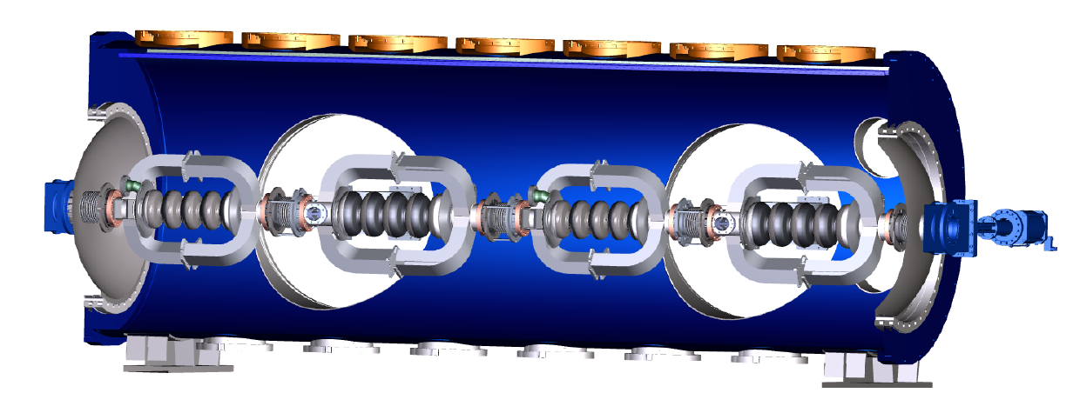
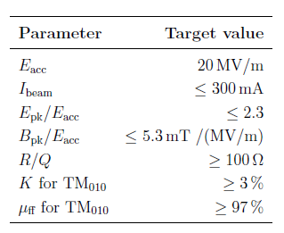
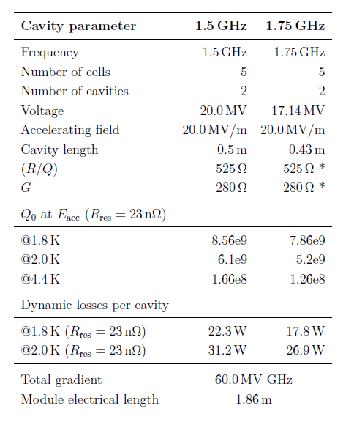
SRF Design specifications and challenges
SRF System
Specifications
2@1.5 GHz
2@1.75 GHz
Challenges
CW operation @ high field levels E=20MV/m
On the edge field values on the surface (discharges, quenching)
High beam current (Ib=300mA), close to 0 beam loading
Cavities must be highly damped (CBIs)
Exotic cavity design (damping end-groups)
Cavity fabrication processes not mature

Slide 8
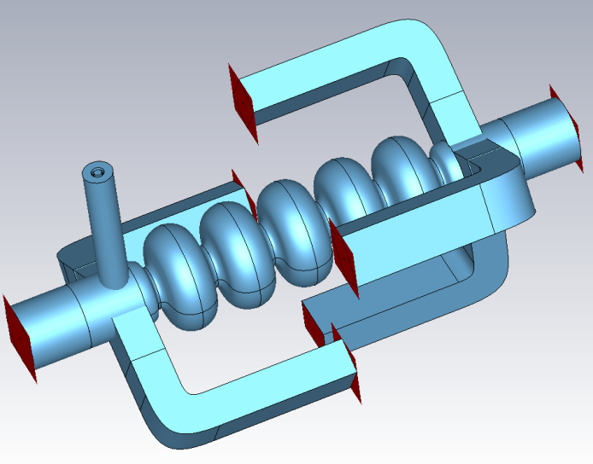
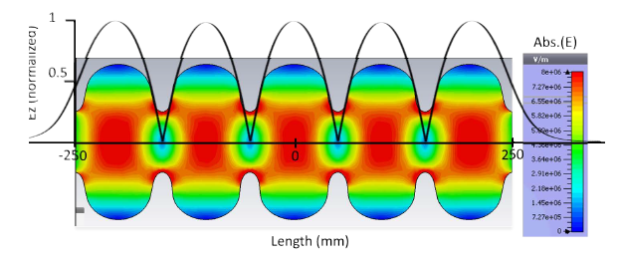
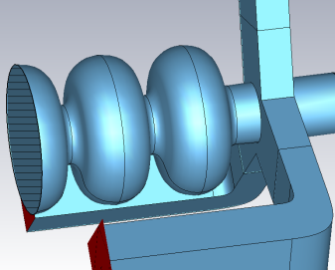
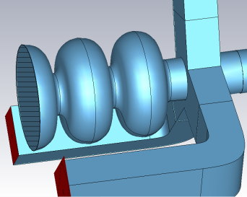
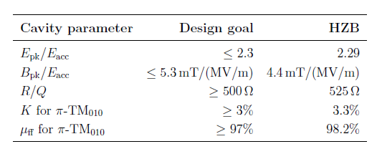
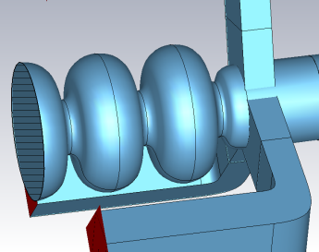
Cav. Design and HOM Damping
Damping Technique
W.G. Dampers chosen
  High power capabilities
  Natural cut-off
  Damping efficiency
  Long distance to loads (dust contamination)‘
  Compact option
High HOM damping level required to avoid CBI‘s
Impedance tresholds with feedback:
  5e4 Ω, longitudinal modes
  1e7 Ω/m, transverse modes

Slide 9
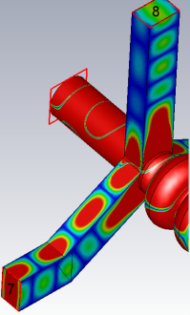
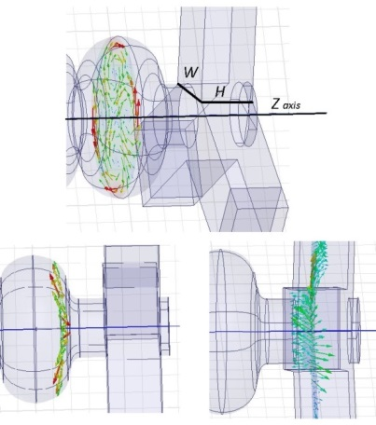


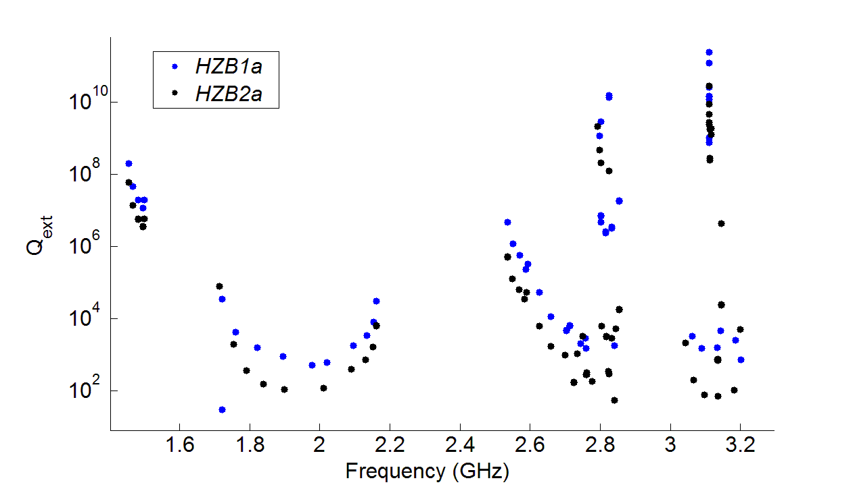
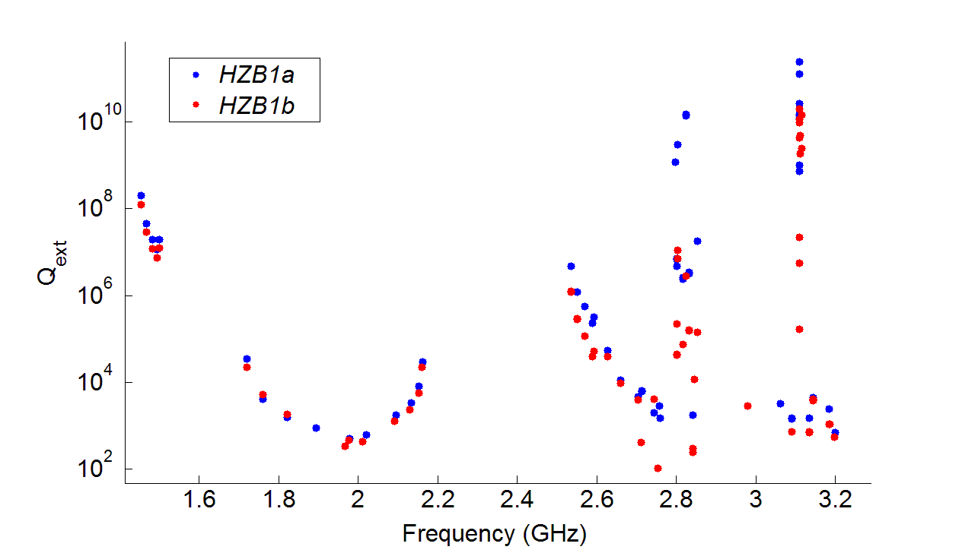
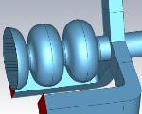
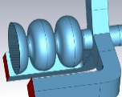
End-groups and Damping
Calculations show high HOM damping level required to avoid CBI‘s
Modified
WG. Damping
(b ≠ a/2)
E
E
H
b
H
b
  5e4 Ω, longitudinal modes
  1e7 Ω/m, transverse modes
a
a
f = 2.755 GHz TM Dipole
4xTE₀₁
Enlarged beam-tubes
2xTE₁₀
A.Velez et al. WEPMA013
IPAC15
A.Velez et al. MOPP071, LINAC‘14
A.Velez, SRF15 Whistler CA

Slide 10
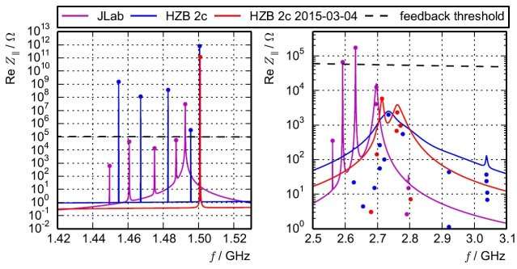
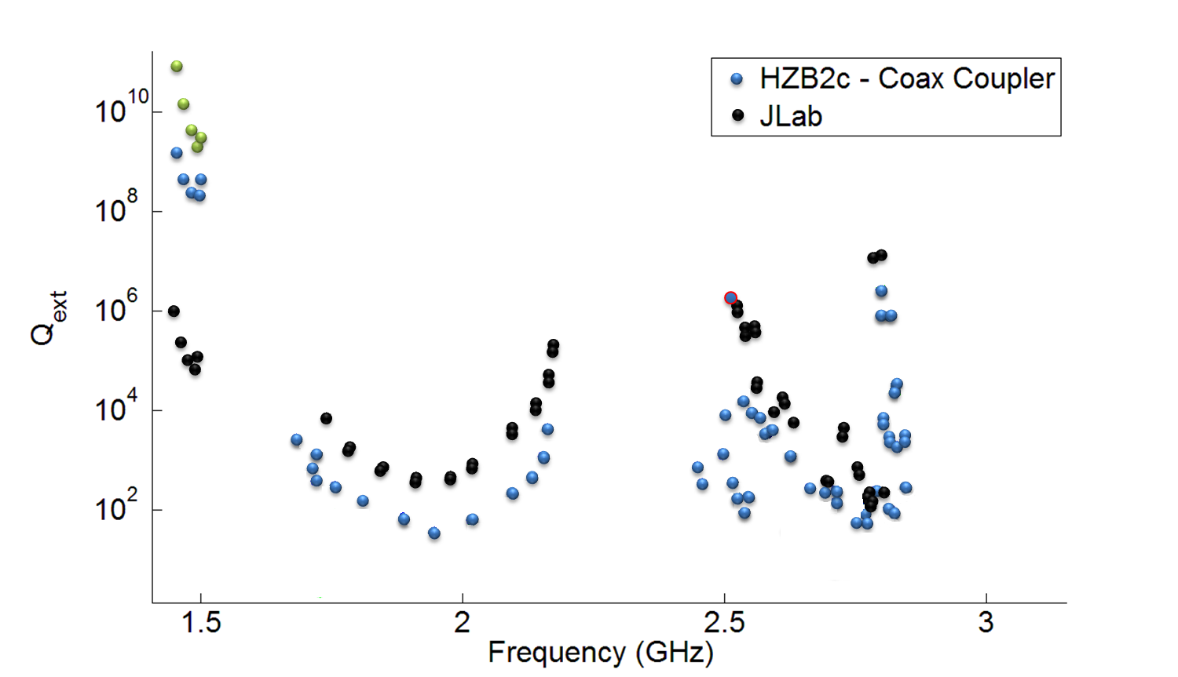
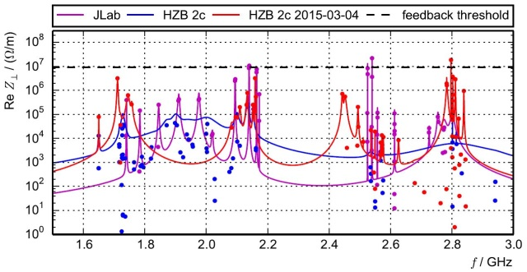
Highly damped 1.5 GHz Cavity
Courtesy of M.Ruprecht
All analyzed modes except 1 are below the Impedance threshold (with feedback)
TE₁₁₁ Dip.
TE₀₁₁
TE₂₁₁
TM₁₁₀
TE₁₁₁
TE₂₁₁ Quad.
TM₀₁₁ Mon.

Slide 11
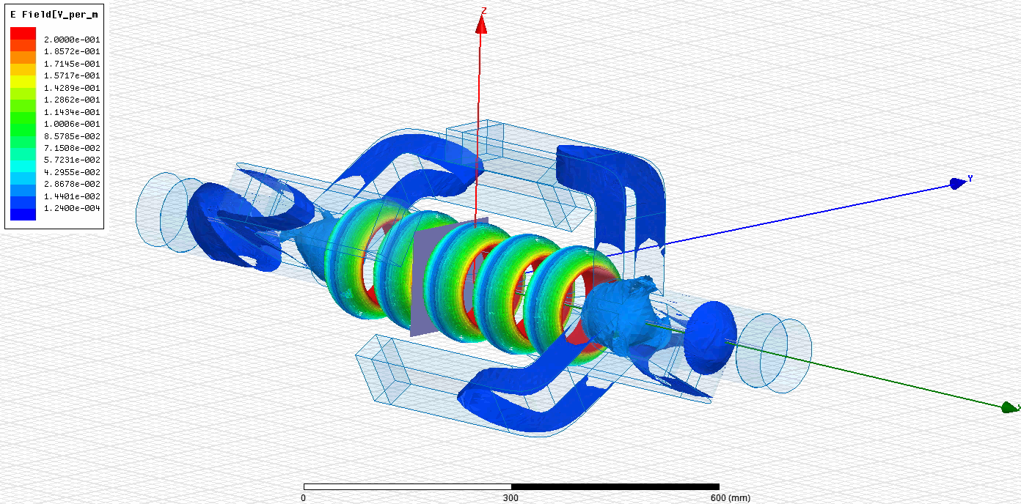
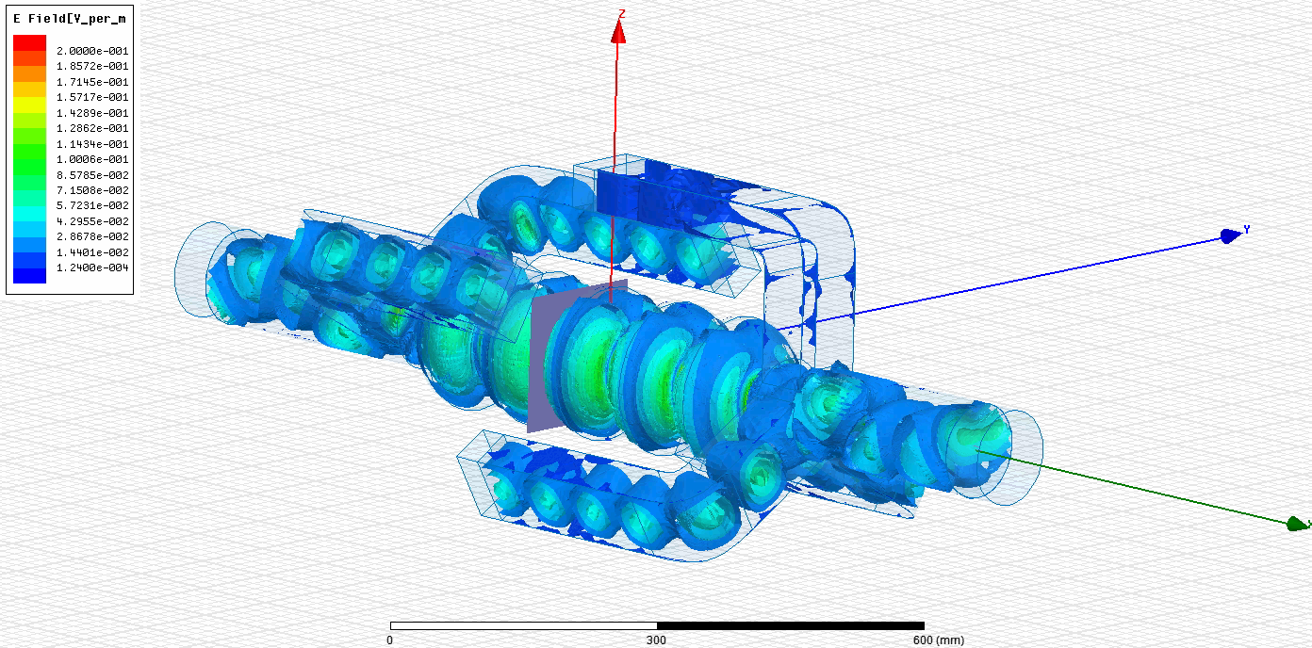
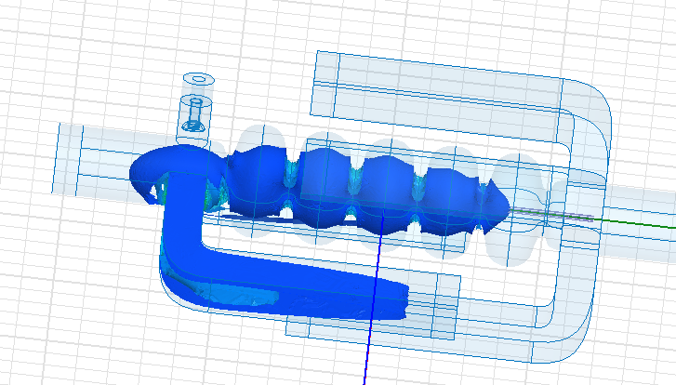
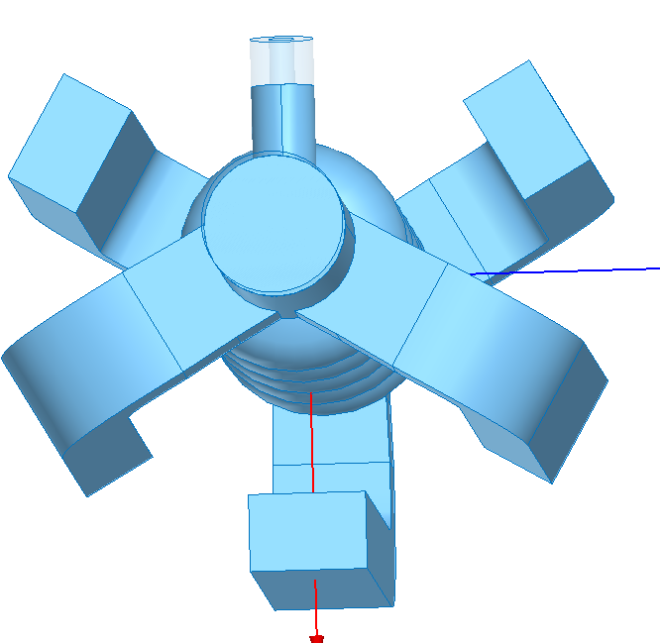
End-groups and Damping
TM₀₁₀ π mode
Dipole HOM
Long WG needed in order to avoid Q droping ( Lwg>400 mm )
Localized end-group modes close to WG cut-off, HOM load matching issues
WG width tapered (88mm-91mm)
fcut=1.64 e9
f=1.7 e9
Qext=1600
R/Q=15

Slide 12
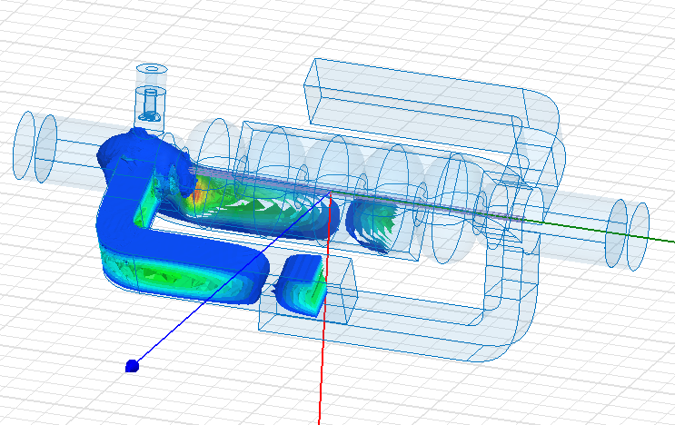
End-groups and Damping
TM₀₁₀ π mode
Dipole HOM
Long WG needed in order to avoid Q droping ( Lwg>400 mm )
Localized end-group modes close to WG cut-off, HOM load matching issues
f=1.69 e9
WG width tapered (88mm-91mm)
fcut=1.64 e9
Qext=60
R/Q=7.3

Slide 13
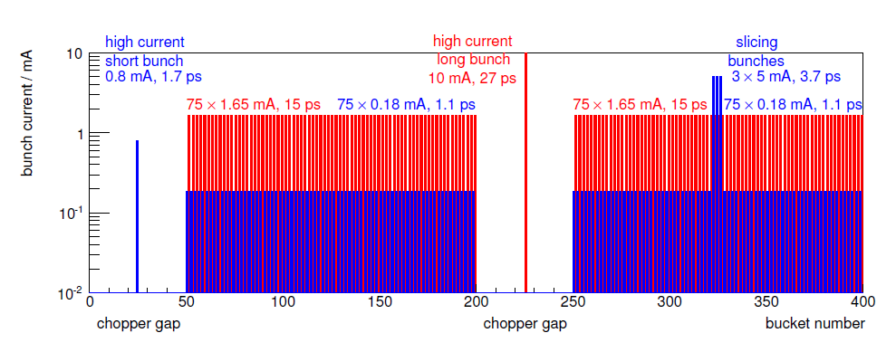
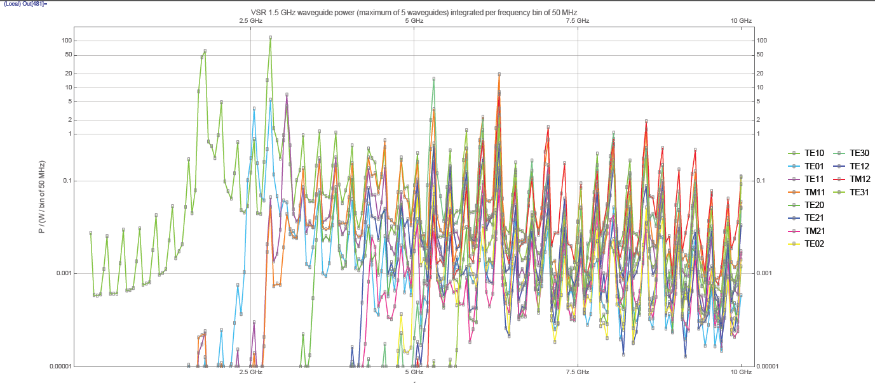
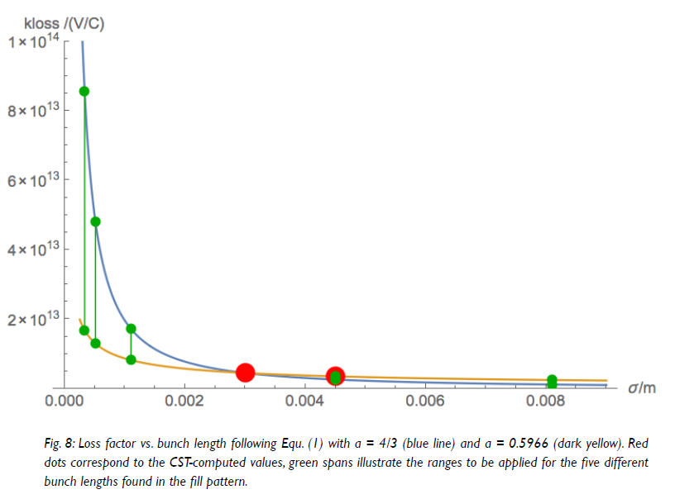

HOM Power
Energy lost by bunch
48,5% fundamental band
51,5% HOMS
Courtesy of H.W.Glock
Energy going to HOMS
67,6% transmitted to waveguides
32,4% travels through beam-pipe
HOM Power = 1.3 KW (5 WG) + 800 W (up/downstream)
Max Power on load = 300 W

Slide 14

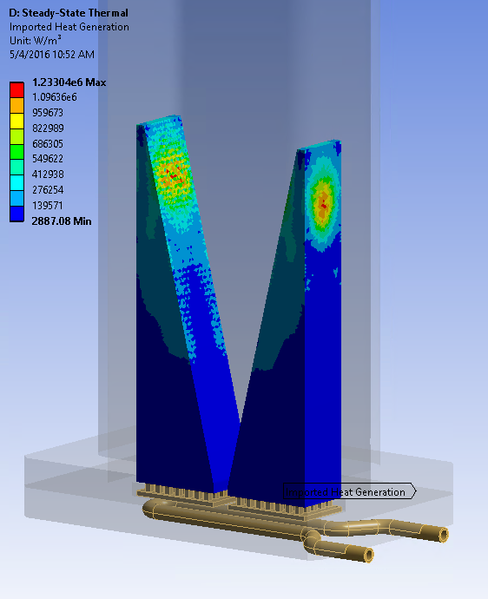
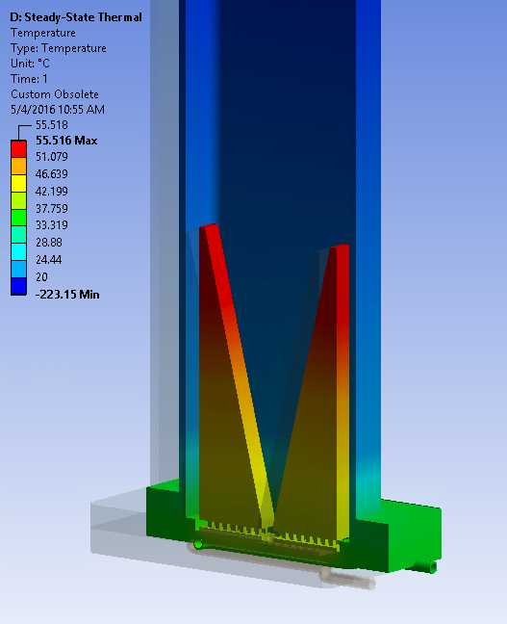
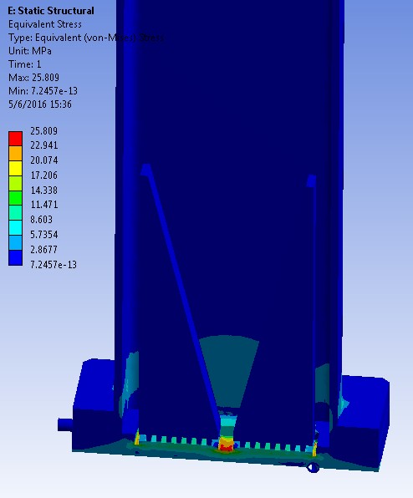
HOM loads
Collaboration with Jefferson Lab
Sinergy with bERLinPro
Water-cooled loads
In design process
Specifications scaled to Max. values on WG + BP power (460W per load)
3 prototype loads (Q4 2016) + series of 15 (2017)
Dust production test (particle counting)
Low power + High Power tests @ JLab
First load designs fro bERLinPro
Imported RF power losses mapped to the absorber
Thermal analysis results
Structural analysis results

Slide 15
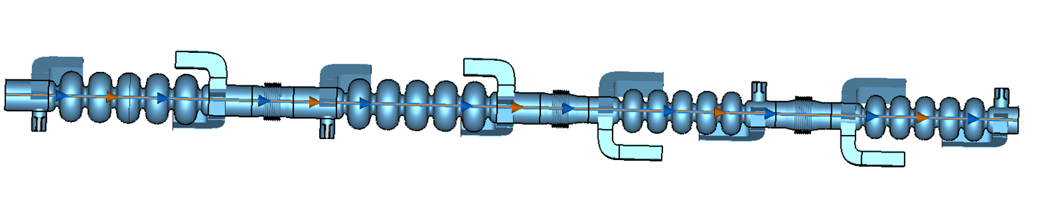


Cold String related aspects
Module length 4.2 m
Preliminary module related considerations (only cold-string)
Limited length straight section, does everything fit inside?
Many elements. Different frequencies, different sizes
Below design, impedance issues
Cavity cross talking.
Realistic HOM power on WG. Can we add extra absorbing elements, ie. BP absorbers?
Tapered bellow transitions
Coupler kicks. Which is the good orientation?
Concatenation Studies

Slide 16
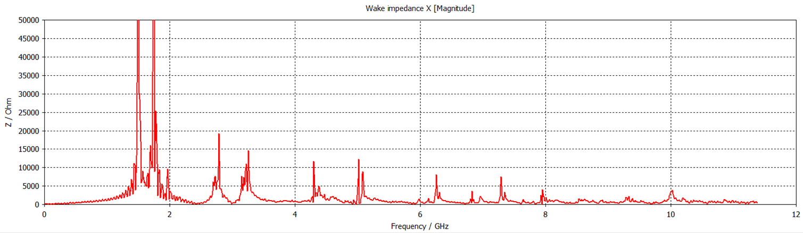
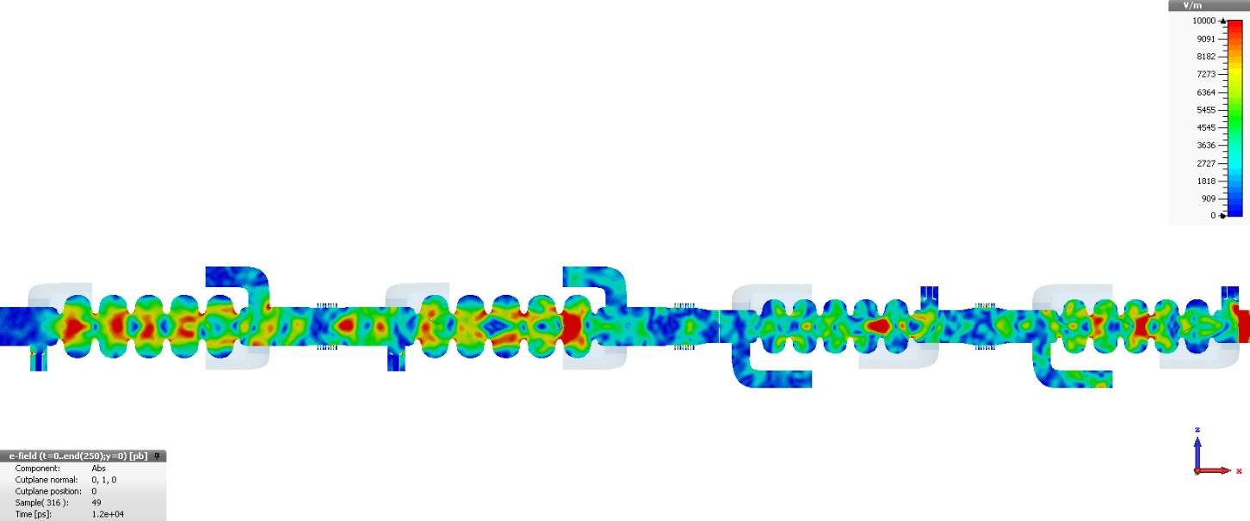
Concatenation studies
First Power calculations of complete cold string (1.5 GHz + 1.75 GHz)
Confirm HOM load specifications
Validate Impedance budget
Tune bellow transitions
High computing resources
Work in progress, still preliminary results!

Slide 17
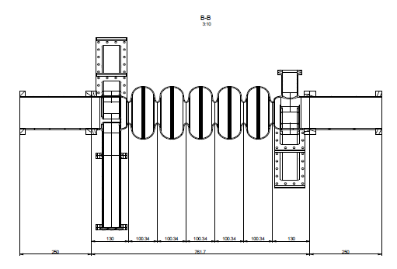
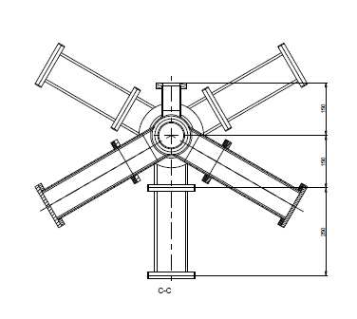
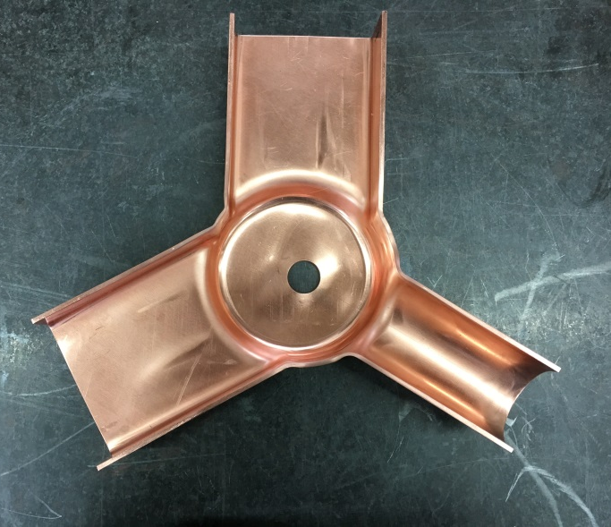
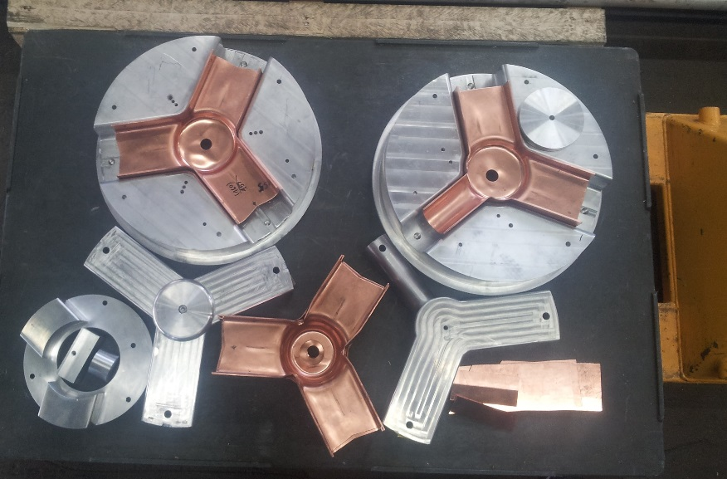
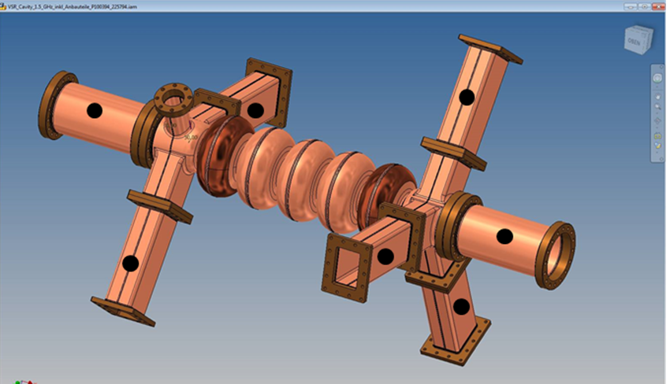
Prototypes, 1.5 GHz 5-cell Cu Cavity
Validate Fabrication Techniques, relatively new development (deep drawing, spring backs, weld shrincage …)
WG loaded cavity with Copper WG extentions
Validate EM design
Under fabrication by Research Instruments (RI)
To be delivered by October 16
@1.75 GHz prototype foreseen
A.Vélez, BESSY-II MAC,14-15.06.2016

Slide 18
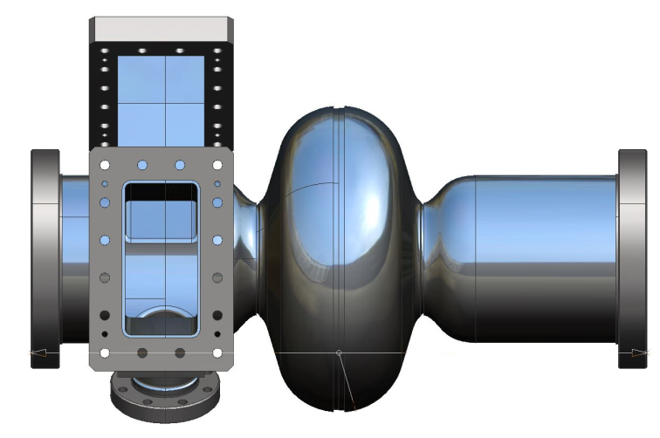
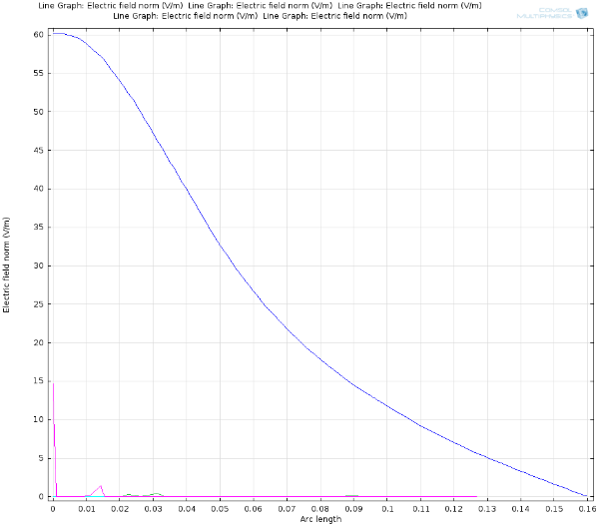
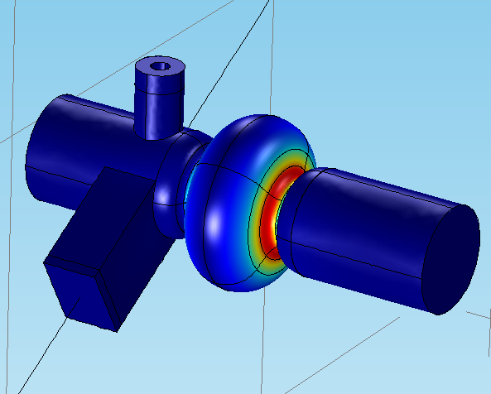
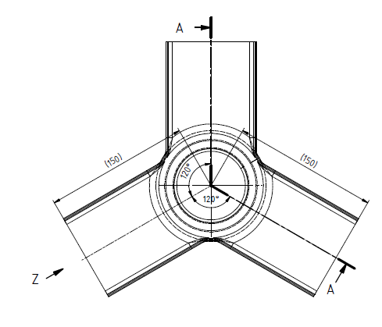
Prototypes, 1.5 GHz Single-cell Niobium Cavity
150 mm
110 mm
100 mm
Niobium single-cell with one sided WG end-group loaded with 2 WG + 1 FPC + 100 mm beam-pipe extension
150 mm extended beam-pipe on the other side (same diameter as copper model)
Fabrication drawings based on the existing copper model
BCP surface treatment
WG flanges? Q drop due to proximity to fundamental mode. Nb flange + Indium sealing ?
R_{vts} 280 mm
Notes:
.

Slide 19
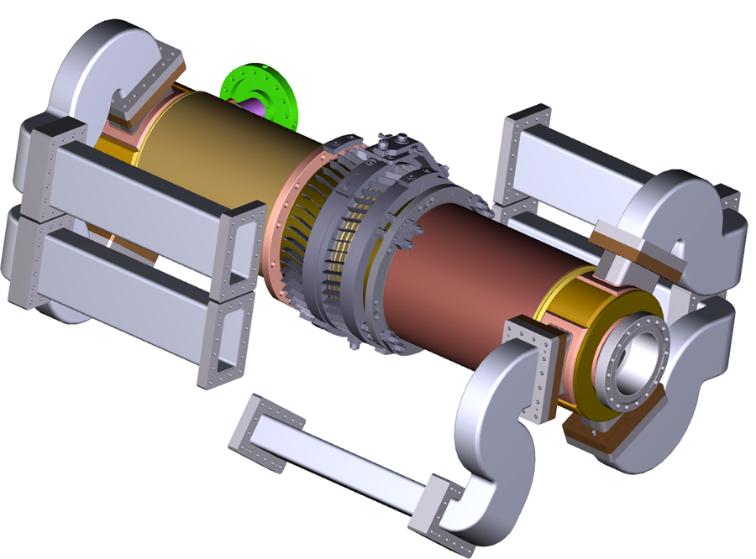
Prototypes, 1.5 GHz Single-cell Niobium Cavity
bERLinPro Linac cav
150 mm
110 mm
100 mm
Niobium single-cell with one sided WG end-group loaded with 2 WG + 1 FPC + 100 mm beam-pipe extension
150 mm extended beam-pipe on the other side (same diameter as copper model)
Fabrication drawings based on the existing copper model
BCP surface treatment
WG flanges? Q drop due to proximity to fundamental mode. Nb flange + Indium sealing ?
R_{vts} 280 mm
Notes:
.

Slide 20
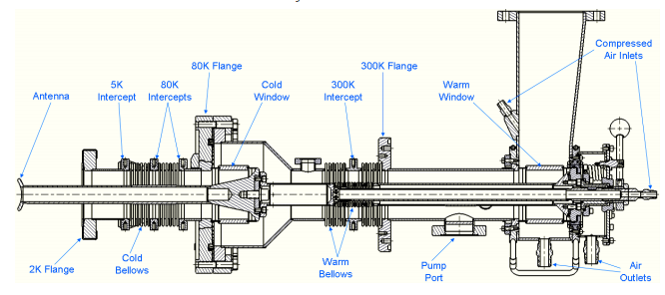
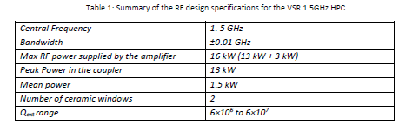
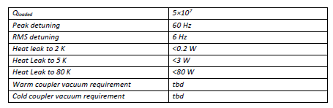
High Power Couplers
2 x 16 KW CW Couplers
@ 1.5 GHz
Close to 0 beam loading expected, high Qext>1e7 with low power < 10kW
Adjustable coupling is required due to parking (different temperature) and impedance control (within power budget)
Design based on the Cornell 60kW injector Coupler
“HIGH POWER TESTS OF INPUT COUPLERS FOR CORNELL ERL INJECTOR”, V. Veshcherevich et al
A.Vélez, BESSY-II MAC,14-15.06.2016

Slide 21
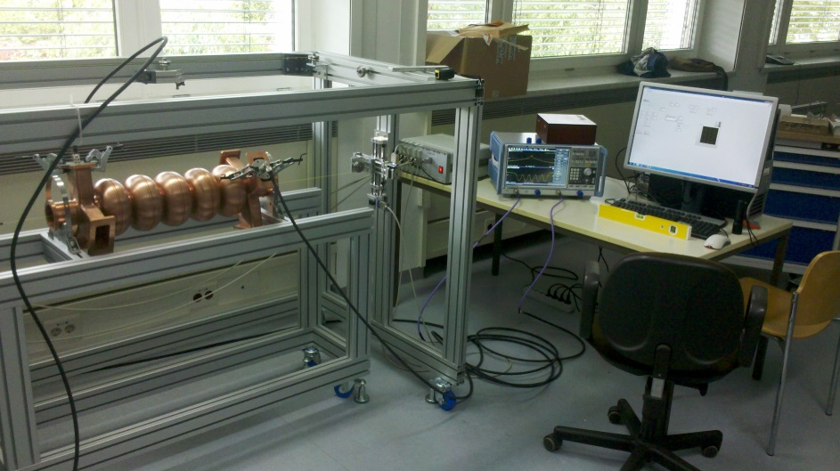





Testing, Bead Pulls
Warm bead-pull
EM cavity characterisation
Schwarzschildstraße RF Lab
Tuning machine is foreseen
Cold Bead-Pull
installation in
HOBICAT
Cold bead-pull
3/9 Pi
Novel design
Inside HOBICAT horizontal test module
Evaluates field profile of SRF cavities
in SC state
Comissioned with a 9 cell Tesla Cavity
Able to characterize HOMs
Results to be published
Cold Bead-Pull Test Results

Slide 22


Testing & Infrastructure
1.5 GHz & 1.75 GHz 5-cell Copper Cavites
  To be tested in Schwarzschildstraße RF Lab
1.5 GHz Single-cell Niobium Cavity
  To be tested in small VTS (HoBiCaT), minor modifications
1.5 GHz 5-cell Niobium Cavities
  Undressed cavities
  To be tested in large VTS, Testing Hall 1 in operation by Q2 2017
  Dressed cavities
  To be tested in Horizontal Test Stand HoBiCaT
  Low power tests
    500 Watts broadband Amp @1.5 GHz+1.75 GHz (to be ordered)
  High power Tests,
    16kW transmitter, SSA
    RF infrastructure: WGs, circulator, water loads …
    Installation in HoBiCaT

Slide 23
Thank you for your attention!
A.Vélez, BESSY-II MAC,14-15.06.2016

