Slide 1


R. Eichhorn, Cornell
Performance (and improvements) of the Cornell ERL injector cryomodule
CLASSE facilities are operated by the Cornell Laboratory for Elementary Particle Physics (LEPP) and the Cornell High Energy Synchrotron Source (CHESS) with major support from the National Science Foundation.

Slide 2
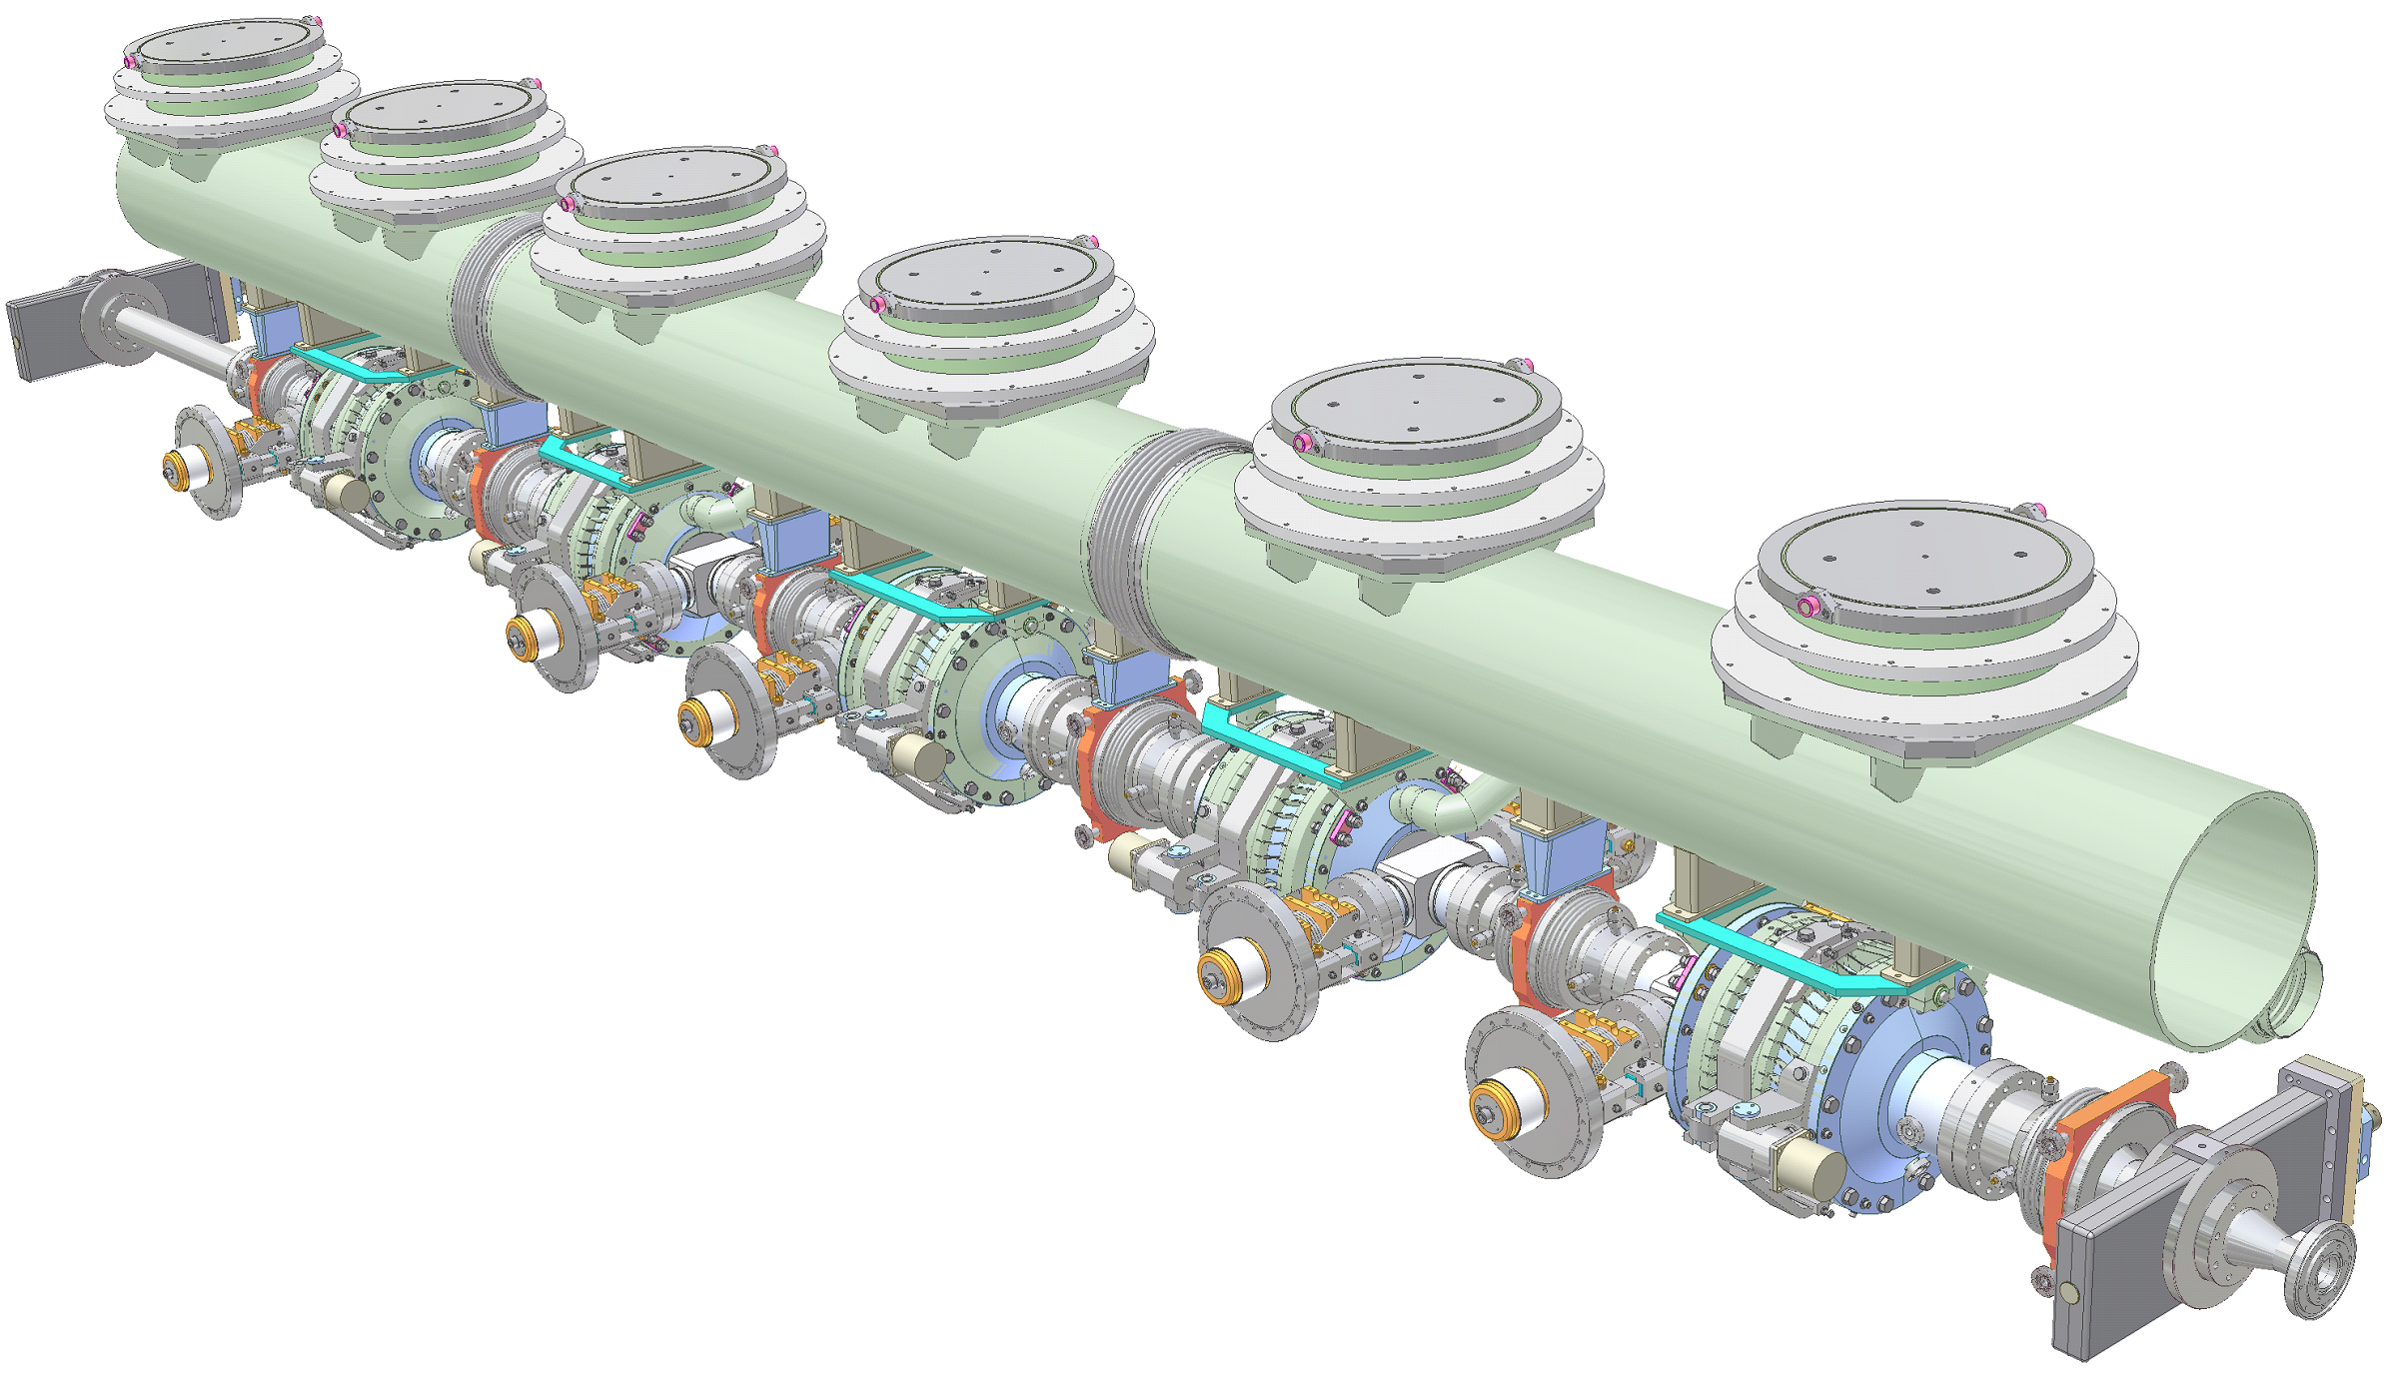
The Cornell ERL Injector Module
HGRP system with 3 sections
15 feet
Frequency tuner
HOM beamline absorber at 80K
between cavities
CW operation of the Cornell SRF injector
Twin Input Coupler
1.3 GHz RF cavity
Number of 2-cell cavities 5
Acceleration per cavity 1 – 3 MeV
Accelerating gradient 4.3 – 13.0 MV/m
R/Q (linac definition) 222 Ohm
Q_{ext} 4.6×10⁴ – 4.1×10⁵
Total 2K / 5K / 80K loads: 30W / 60W / 700W
Number of HOM loads 6
HOM power per cavity 40 W
Couplers per cavity 2
RF power per cavity 120 kW
Amplitude/phase stability 10⁻⁴ / 0.1° (rms)
ICM length 5 m

Slide 3
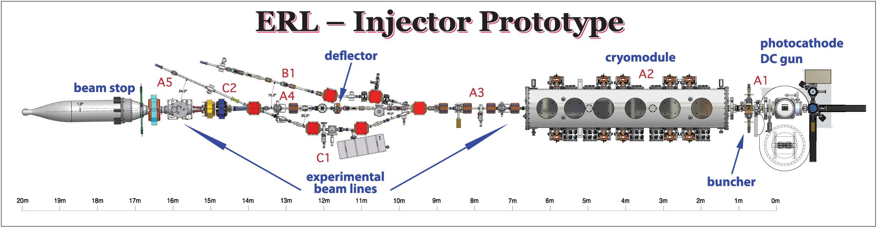
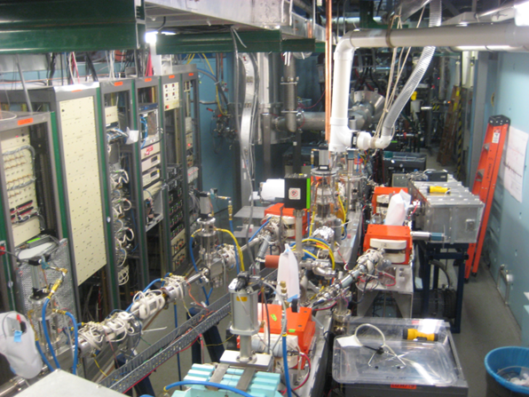
Cornell ERL Injector
ERL Injector Prototype:
Achievements to date (last high current run Sept’13):
75 mA average current @ 4 MeV
0.3 μm emittance @ 77 pC, 8 MeV

Slide 4
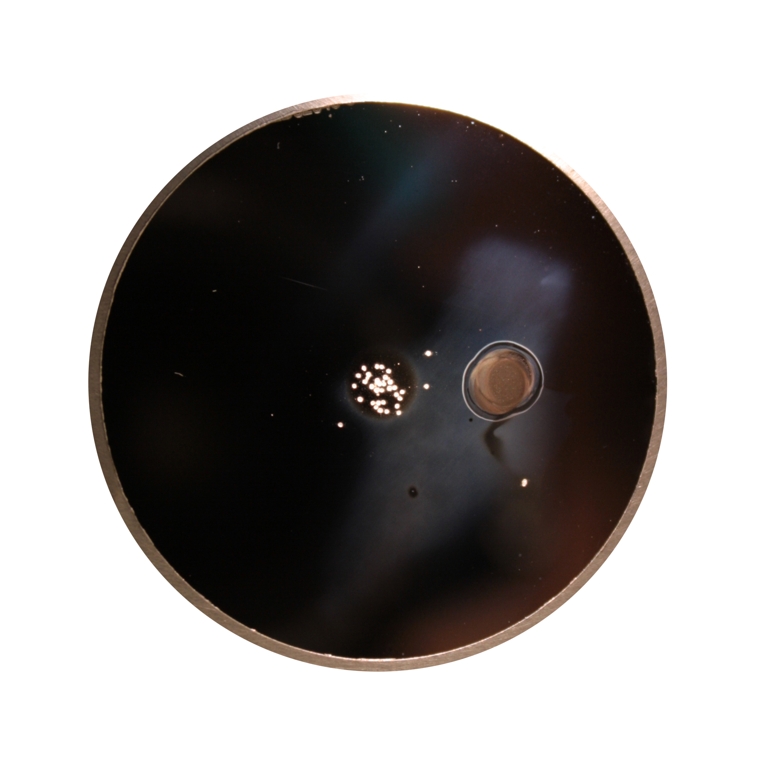
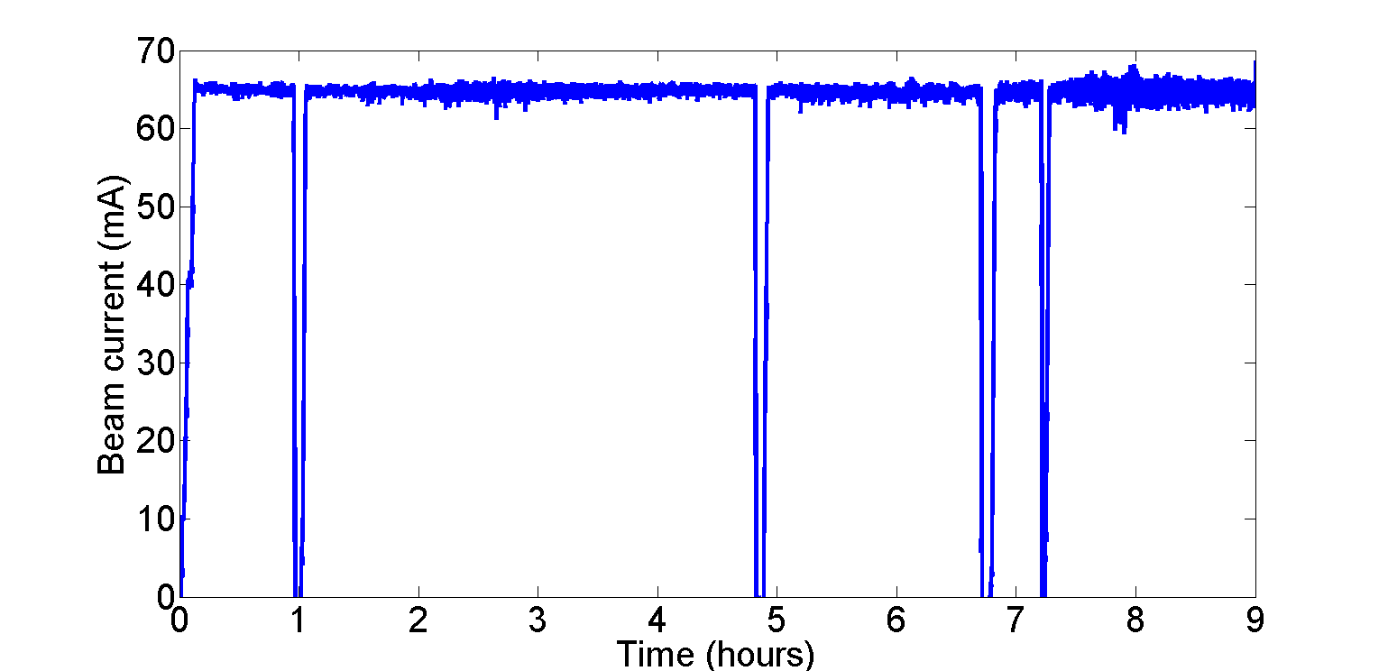
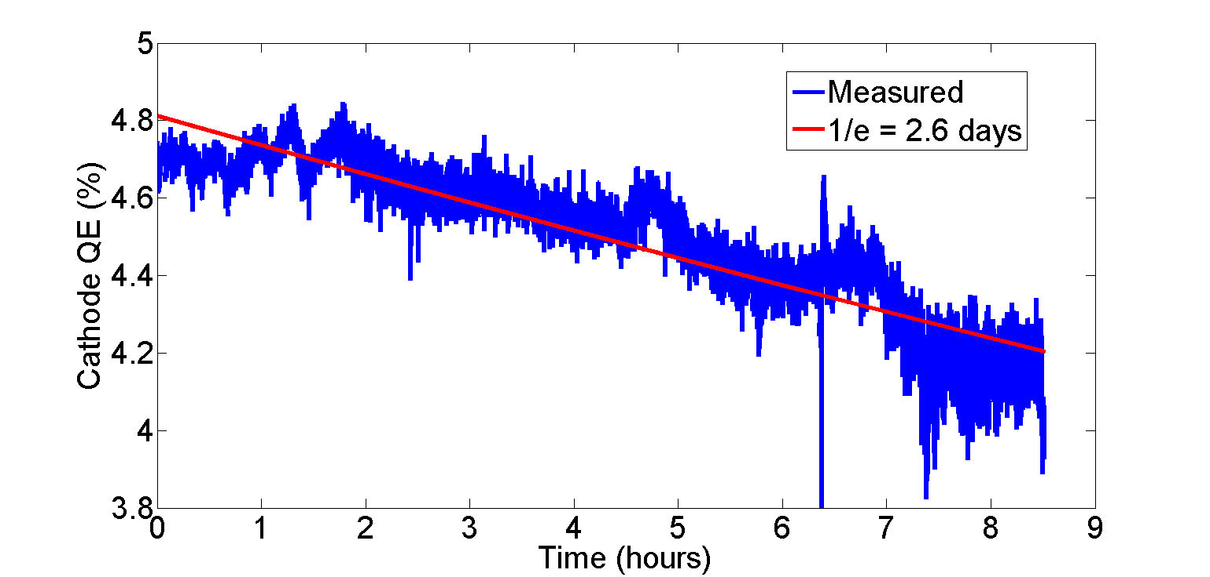
High Currents – Na2KSb
Ion damage limited to the central area
Active area is offset from the center
Front surface of the cathode (CsK₂Sb on Si) after use.
Using a Na₂KSb photocathode, ran over 8 hours at 65 mA (2000 C) with a 2.6 day 1/e cathode lifetime.
Reached as high as 75 mA for a short time.

Slide 5
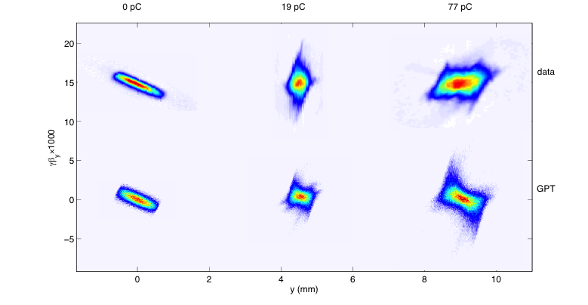
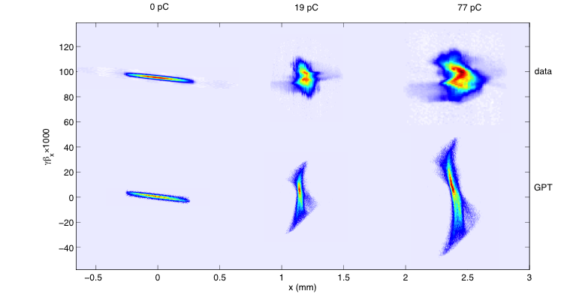
Emittance Results
Projected Emittance for 19 (77) pC @ 8MeV:
data
Vertical
Vertical Phase Space
γβ_{y} X 1000
Data Type | en(100%) [microns] | en(90%) [microns]
Projected (EMS) | 0.20(0.40) | 0.14(0.29)
GPT | 0.16(0.37) | 0.11(0.25)
GPT
0 pc
19 pc
77 pc
y (mm)
Horizontal
Horizontal Phase Space
data
Data Type | en(100%) [microns] | en(90%) [microns]
Projected (EMS) | 0.33(0.69) | 0.23(0.51 )
GPT | 0.31 (0.72) | 0.19(0.44)
γβ_{x} X 1000
GPT
x (mm)

Slide 6
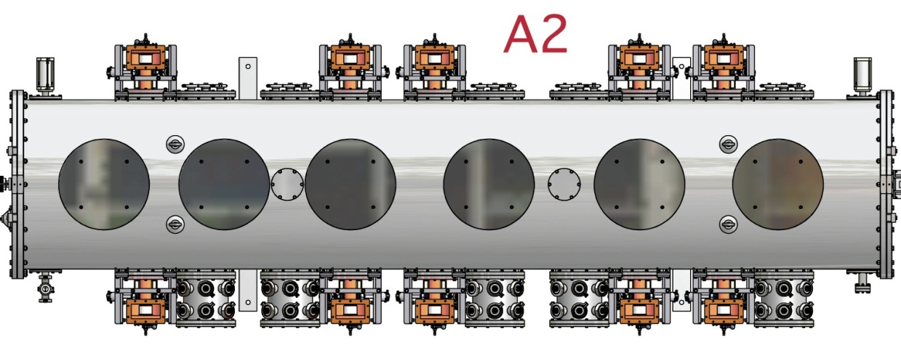
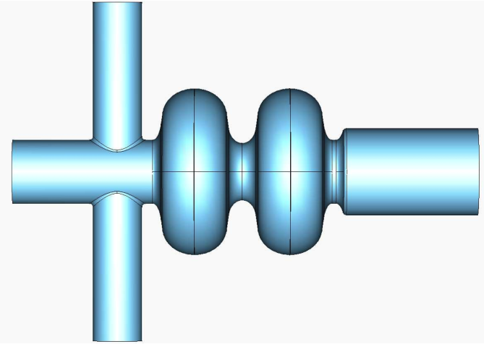
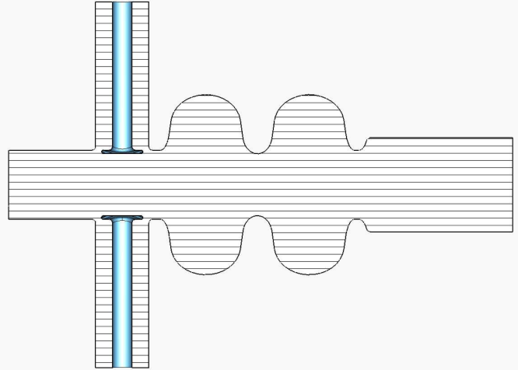
SRF Cavity Couplers
Beam
Coupler antennas only in x-direction!
No dipole kick, but we see ‘quadrupole’ focusing

Slide 7
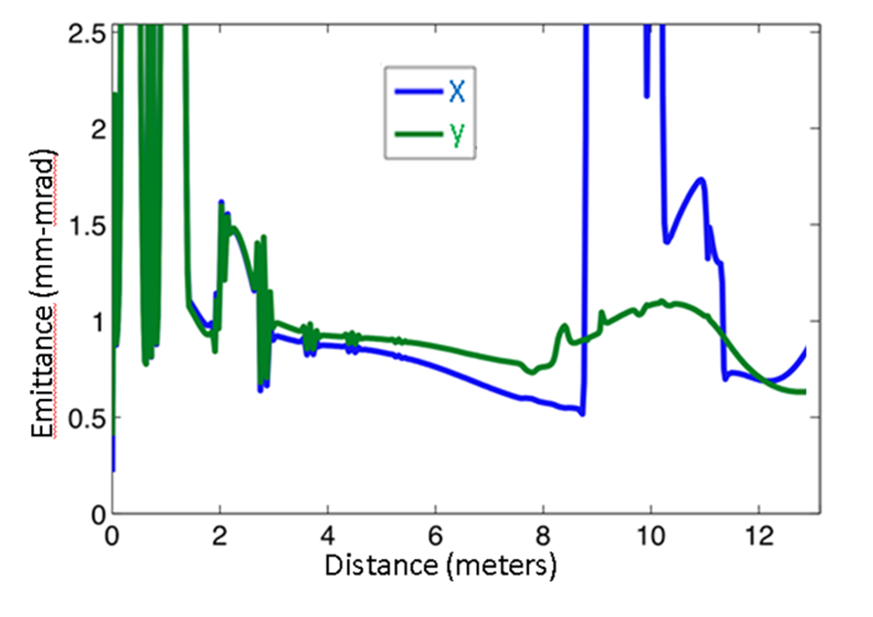
Simulation with Merger
Optimize emittance using a using a genetic algorithm
In the merger, the emittance asymmetry can be (mostly) removed, using the asymmetry provided by the dipoles
Also, optimizations show that a beam energy of 12-13 MeV is needed to maintain minimum emittance in x/y before injection into the main linac
Simultaneous good emittance!

Slide 8
Performance beyond our parameters
Q (pC) | I_{peak} Target (A) | I_{peak} (A) | ε_{n} Target (95%, μm) | ε_{n} (95%, μm) | ε_{n,th} /ε_{n}
20 | 5 | 5 | 0.25 | H: 0.18, V: 0.19 | 58%
100 | 10 | 11.5 | 0.40 | H: 0.32, V: 0.30 | 80%
300 | 30 | 32 | 0.60 | H: 0.62, V: 0.60 | 70%

Slide 9
Injector Achievements
Parameter | Metric | Status | Notes
Average Current | 100 mA |  | 75 mA (1300 MHz)
Bunch Charge | 77 pC |  | Pulsed mode (50 MHz)
Energy | 5 to 15 MeV |  | 14 MeV max (due to cryo limits)
Laser Power | > 20 W |  | > 60 W at 520 nm (1300 MHz)
Laser Shaping | beer can dist. |  | Adequate for now
Gun Voltage | 500 kV |  | Currently operating at 350 kV
Emittance | < 2 μm (norm, rms) |  | Ultimate ERL goal 0.3 μm, with merger
Operational Lifetime | > 1 day |  | Recent improvements with new cathodes

Slide 10
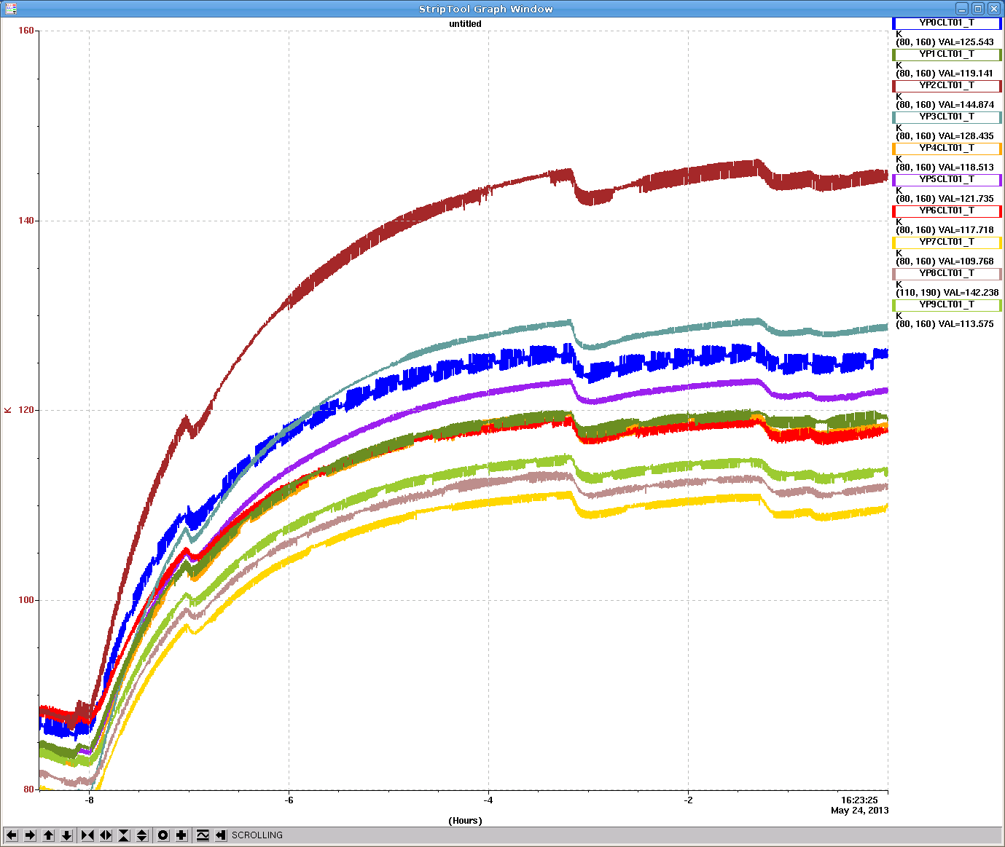
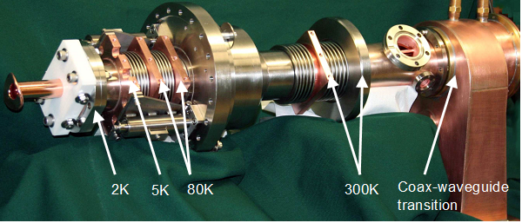
The flow to the HOM’s and couplers are in parallel, but we discovered the coupler tubing is too small. So the HOM’s get more flow, and the couplers less than designed for.
Booster Coupler Heating (80 K system)
We found that the couplers get quite warm during high power operations.
Temperatures reach equilibrium (150 K) in 4 hours

Slide 11
Analysing the findings
Design parameters:
  Coupler heat load 50 W
  HOM heat load 50 W
Findings:
  Coupler: 75 W
  HOM 5-10 W
  In addition: some design flaws in choosing piping
The issue:
  HOM absorbers and couplers are cooled in parallel
  Mass flow ratio was not 1:1 but rather 1:3 in favor of the HOM absorber

Slide 12
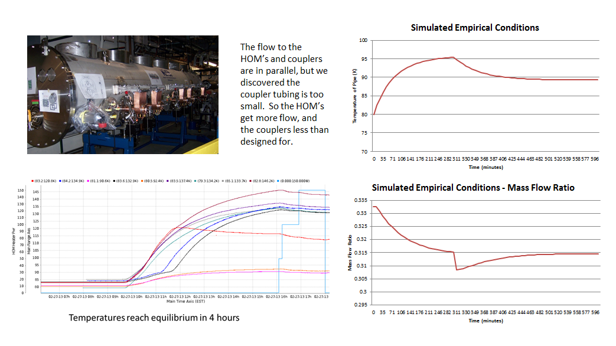
Understanding the coupler heating in the ICM
80 K jumper system
Supply
HOM absorbers
Return
Added heat to the HOM branch
Couplers

Slide 13
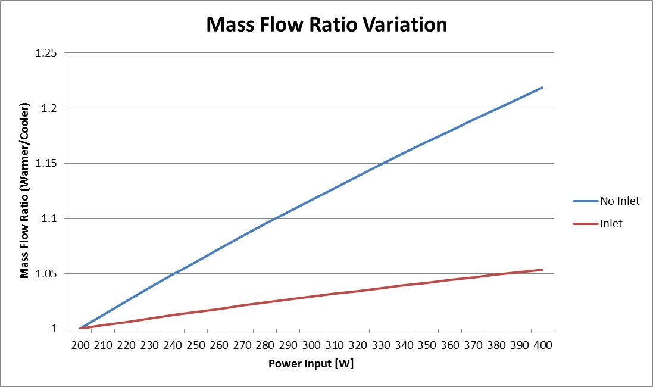
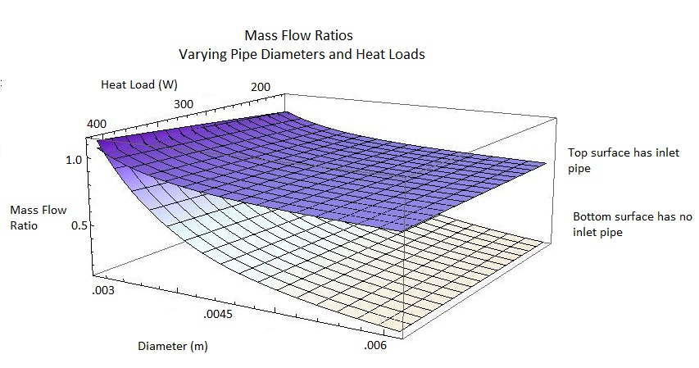
Understanding the coupler
heating in the ICM
Q₁ = 200 W
Q₂ = 200-400W
Q₂
Q₁
=> The cooler channel
steals the flow

Slide 14
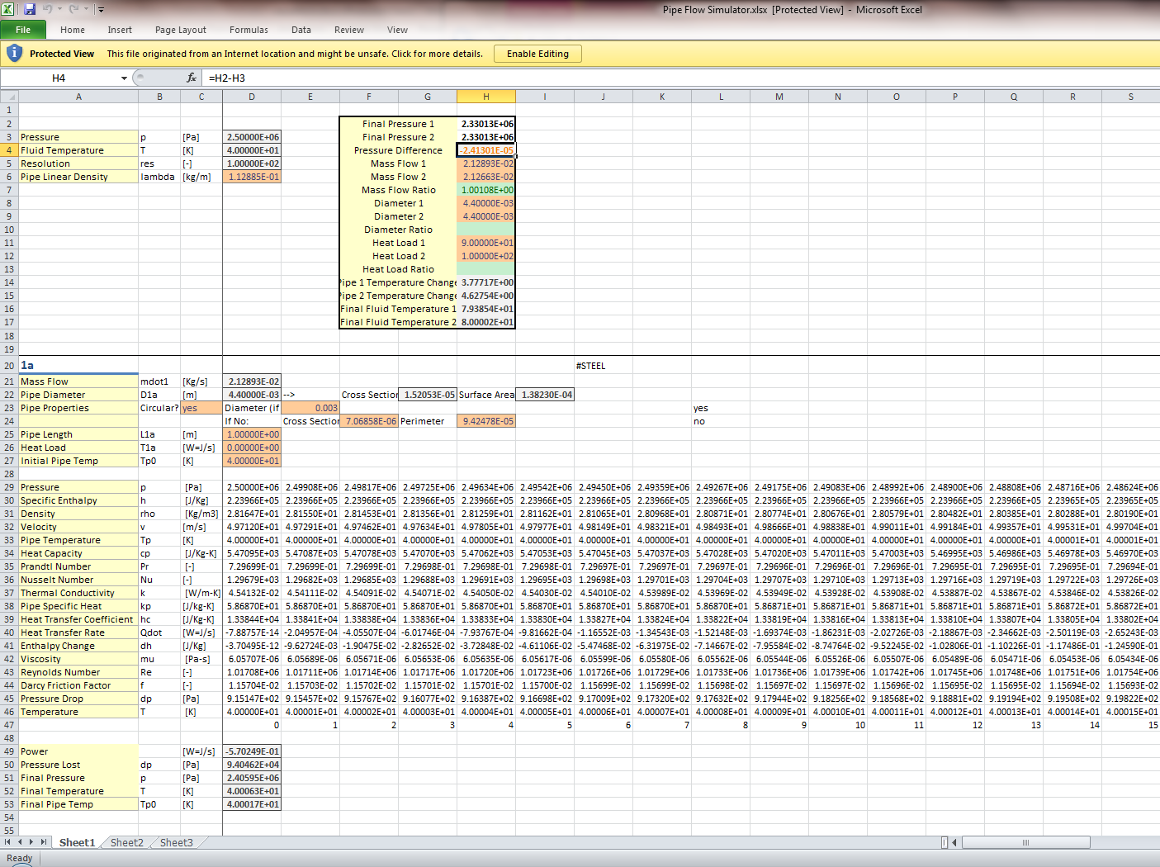
Fluid dynamics calculations
$\text{Pressure}\text{ (}p\text{): }\text{Input} \text{or} p−∆p$*
$$\text{Enthalpy}\text{ (}h\text{): }\text{HEPAK} \text{or} h+∆h$$
$$\text{Density}\text{ (}ρ\text{): }\text{HEPAK}$$
$$\text{Velocity}\text{ (}v\text{): }\frac{\dot{m}}{A ρ}$$
$$\text{Pipe} \text{Temperature}\text{ (}T_{p}\text{): }T_{p}+∆T_{p}=T_{p}+\frac{P}{v r λ C_{p}}−\frac{\dot{Q}}{v λ C_{p}}$$
$$\text{Pipe} \text{Specific} \text{Heat}\text{ (}C_{p}\text{): }\text{Fit} \text{to} \text{empirical} \text{data} \text{from} \text{N}\text{.}\text{I}\text{.}\text{S}\text{.}\text{T}$$
$$\text{Fluid} \text{Specific} \text{Heat} \text{Capacity}\text{ (}C_{f}\text{): }\text{HEPAK}$$
$$\text{Prandtl} \text{Number}\text{ (}Pr\text{): }\text{HEPAK}$$
$$\text{Fluid} \text{Thermal} \text{Conductivity}\text{ (}k\text{): }\text{HEPAK}$$
$$\text{Heat} \text{Transfer} \text{Coefficient}\text{ (}h_{c}\text{): }\frac{k Nu}{D}$$
$$\text{Nusselt} \text{Number}\text{ (}Nu\text{): }0.023 {Re}^{0.8} {Pr}^{0.4}$$
$$\text{Heat} \text{Transfer} \text{Rate}\text{ (}\dot{Q}\text{): }h_{c} A_{S} \left(T_{p}−T_{f}\right)$$
$$\text{Enthalpy} \text{Change}\text{ (}Δh\text{): }\frac{\dot{Q}}{\dot{m}}$$
$$\text{Dynamic} \text{Viscosity}\text{ (}μ\text{): }\text{HEPAK}$$
$$\text{Reynolds} \text{Number}\text{ (}Re\text{): }\frac{D v ρ}{μ}$$
$$\text{Friction} \text{Factor}\text{ (}f\text{): }$$
$$Re<2300→f={64}/{Re}; \\ 2300<Re<2×{10}^{4}→f=0.316 {Re}^{−0.25};$$
$$Re>2×{10}^{4}→f=0.184 {Re}^{−0.20}$$
$$\text{Pressure} \text{Drop}\text{ (}∆p\text{): }\frac{f L v^{2}ρ}{2 r D}$$
$$\text{Fluid} \text{Temperature}\text{ (}T_{f}\text{):} \text{HEPAK}$$
Calculate flow properties
Calculate pressure drop and heat exchange rate
Iterate, record, reset with new pipe temp.
Update pipe temperature

Slide 15
Recalculation of the 80 K system
Pipe | Inner Diameter | Length | Mass
HOM | 5.94 mm | 68.6 cm | 200 g
Coupler | 3.88 mm | 83.8 cm | 200 g
Inlet | 2.00 mm | 50.0 cm | N/A
Flow restrictor pipe
Coupler
HOM absorber
Regime | HOM Heat Load | Coupler Heat Load | Input Pressure | Mass Flow Rate | Initial Fluid Temp
No inlet | 5 W | 50 W | 20 bar | 9 g/s | 80 K
Inlet | 5 W | 50 W | 20 bar | 4.5 g/s | 80 K
High Heat (inlet) | 5 W | 120 W | 20 bar | 6 g/s | 80 K
Inlet flow restrictor: 2.3 mm, 87 cm long

Slide 16
Inlet flow restrictor

Slide 17
HOM inlet flow restrictor, 120 W heat load on couplers
Including the inlet pipe allows more cryogen to flow through the couplers, greatly improving system performance

Slide 18
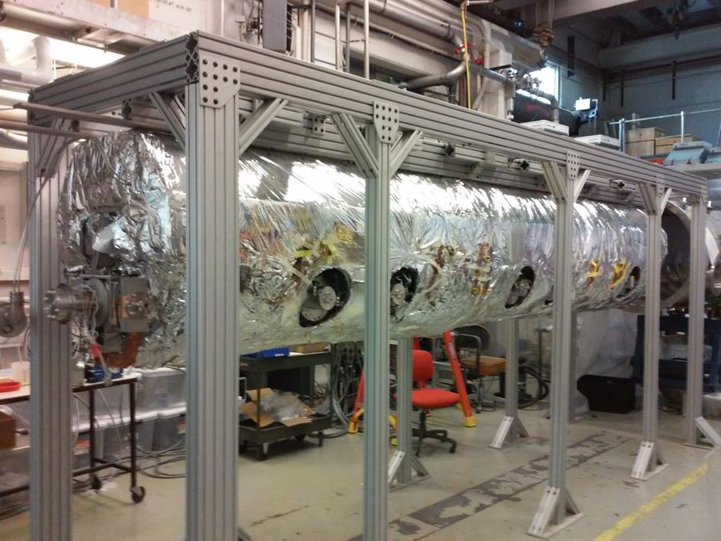
ICM rebuilt 2015/16
Cooling pipes
Adding the flow restrictor took only 2 days. However, disassembling the module and reassembling it after the modification was 6 months of labour.

Slide 19
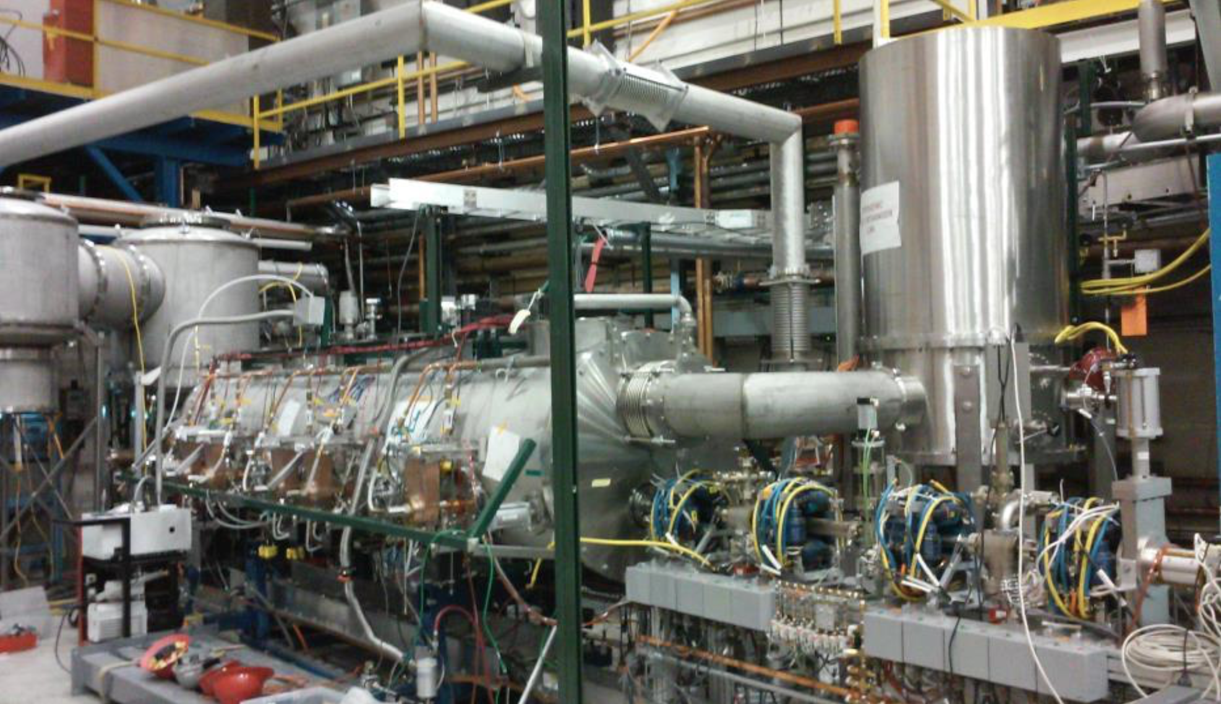

Slide 20
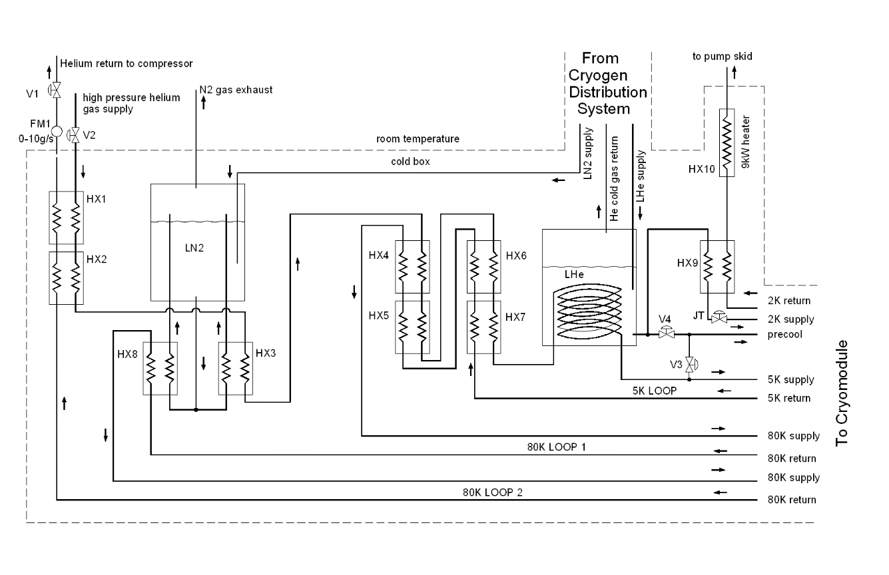
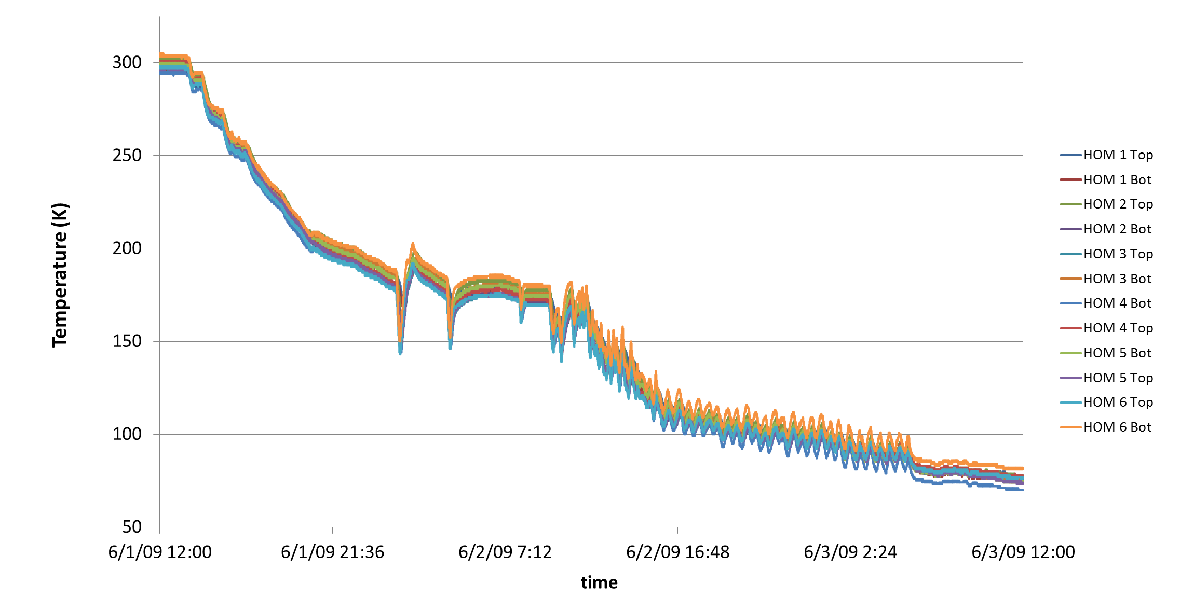
Typical ICM cool-down

Slide 21
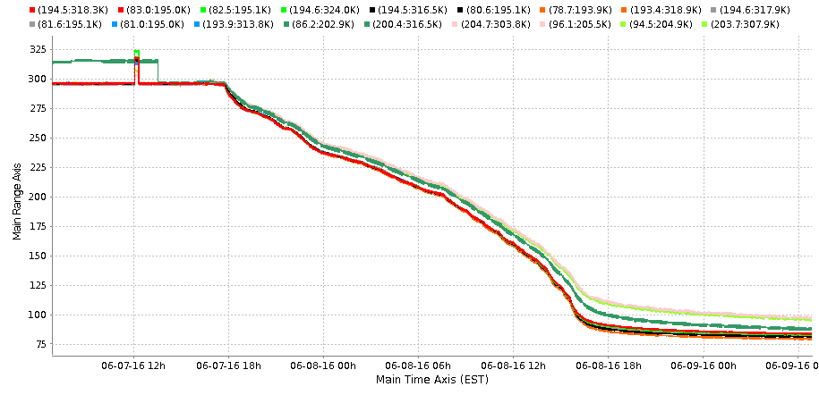
ICM heat exchanger can modifications
Cool-down lines added,
separation of the 5K and the 80K mass-flow

Slide 22
Outlook
ICM has been rebuilt and improved
Achieving 100 mA should be feasible
Cooldown happened June 2016
Installation of beamlines continue
Processing of the DC gun is in progress
Beam operations to resume in August

Slide 23
Thanks

