Slide 1

Ultimate gradient limitation in Nb SRF cavities: the bi-layer model and prospects for high Q at high gradient
Mattia Checchin
TTC Meeting, CEA Saclay, Paris
07 JUL 2016

Slide 2
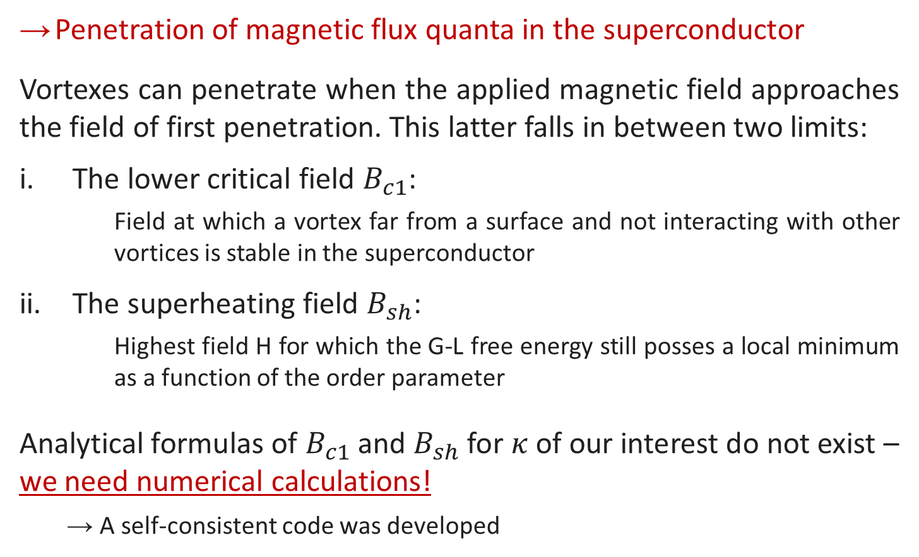
What is the ultimate gradient limitation for bulk Nb cavities?
Penetration of magnetic flux quanta in the superconductor
Vortexes can penetrate when the applied magnetic field approaches the field of first penetration. This latter falls in between two limits:
The lower critical field $B_{c1}$:
    Field at which a vortex far from a surface and not interacting with other vortices is stable in the superconductor
The superheating field $B_{sh}$:
    Highest field H for which the G-L free energy still posses a local minimum as a function of the order parameter
Analytical formulas of $B_{c1}$ and $B_{sh}$ for $κ$ of our interest do not exist – we need numerical calculations!
  → A self-consistent code was developed

Slide 3
H_{c1} calculation

Slide 4


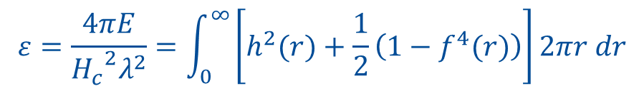
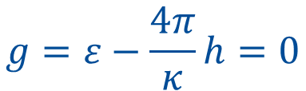



H_{c1} from the Gibbs free energy
The lower critical field corresponds to the H value at which the non-interacting-vortex Gibbs free energy is equal to zero.
Therefore:
Where:
¹
The lower critical field is then defined as:
$$g$$
$$g=ε−\frac{4π}{κ}h=0$$
$$h_{c1}$$
$$h=\frac{H}{\sqrt{2}H_{c}}$$
$$h$$
$$ε=\frac{4πE}{{H_{c}}^{2}λ^{2}}=\int_{0}^{∞}{\left[h^{2}(r)+\frac{1}{2}\left(1−f^{4}(r)\right)\right]}2πr dr$$
$$h_{c1}=\frac{κε}{4π}$$
¹ A. A. Abrikosov, Zh. Eksp. Teor. Fiz. 32, 1442 (1957), [Soviet Phys.—JETP 5, 1174 (1957)]

Slide 5
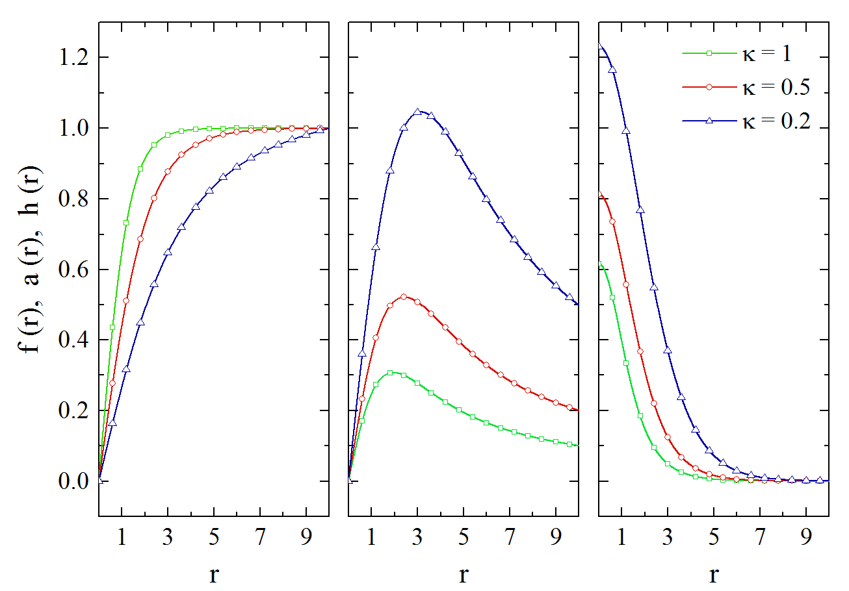
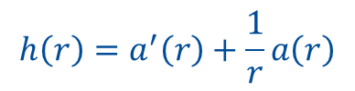
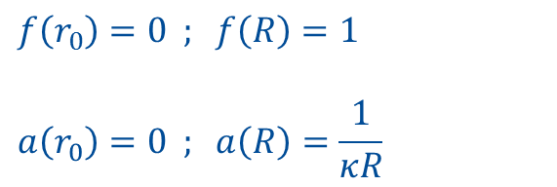
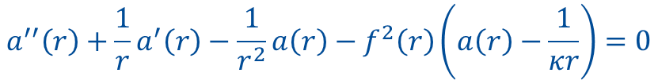
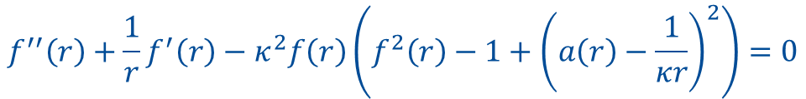
Numerical calculation of GL equations in a vortex
The adimensional GL equations in cylindrical coordinates are:
$$f^{′′}\left(r\right)+\frac{1}{r}f^{′}\left(r\right)−κ^{2}f\left(r\right)\left(f^{2}\left(r\right)−1+{\left(a\left(r\right)−\frac{1}{κr}\right)}^{2}\right)=0$$
$$a^{′′}\left(r\right)+\frac{1}{r}a^{′}\left(r\right)−\frac{1}{r^{2}}a\left(r\right)−f^{2}\left(r\right)\left(a\left(r\right)−\frac{1}{κr}\right)=0$$
$$h\left(r\right)=a^{′}\left(r\right)+\frac{1}{r}a\left(r\right)$$
Order parameter
Vector potential
Magnetic field
Boundary conditions:
$$f\left(r_{0}\right)=0 ; f\left(R\right)=1$$
$$a\left(r_{0}\right)=0 ; a\left(R\right)=\frac{1}{κR}$$

Slide 6
H_{sh} calculation

Slide 7
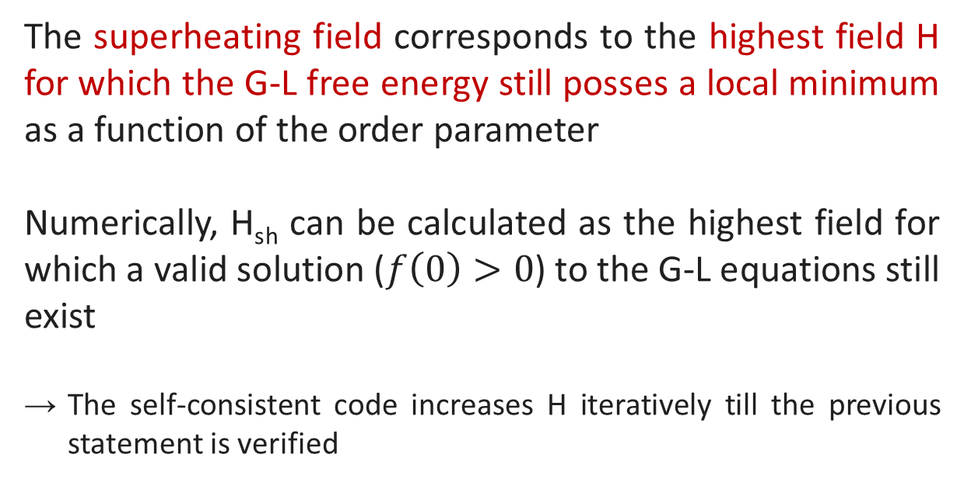
H_{sh} calculation
The superheating field corresponds to the highest field H for which the G-L free energy still posses a local minimum as a function of the order parameter
Numerically, H_{sh} can be calculated as the highest field for which a valid solution ($f\left(0\right)>0$) to the G-L equations still exist
The self-consistent code increases H iteratively till the previous statement is verified

Slide 8
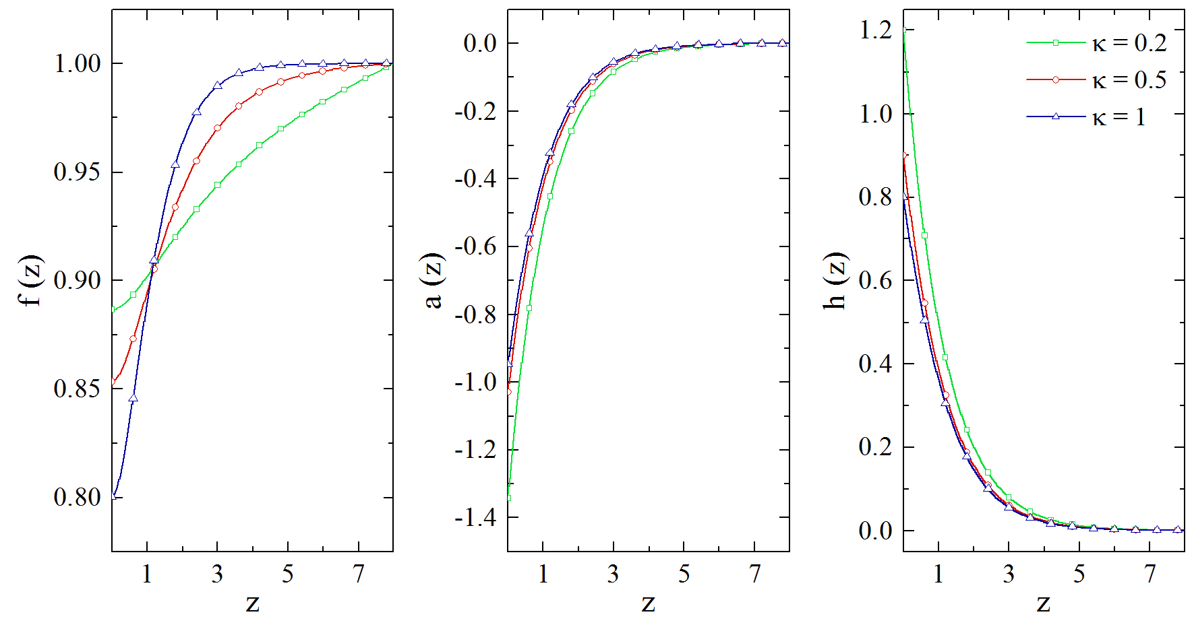


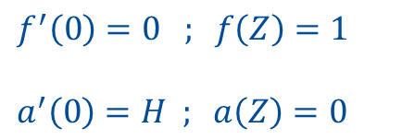

Numerical calculation of GL equations at the surface
The adimensional GL equations in 1 dimension are:
$${\frac{1}{κ^{2}}f}^{′′}\left(z\right)−a^{2}\left(z\right)f\left(z\right)+f\left(z\right)−f^{3}(z)=0$$
$$a^{′′}\left(z\right)−f^{2}\left(z\right)a\left(z\right)=0$$
Order parameter
Vector potential
Magnetic field
$$h\left(z\right)=a^{′}(z)$$
Boundary conditions:
$$f^{′}\left(0\right)=0 ; f\left(Z\right)=1$$
$$a^{′}\left(0\right)=H ; a\left(Z\right)=0$$

Slide 9
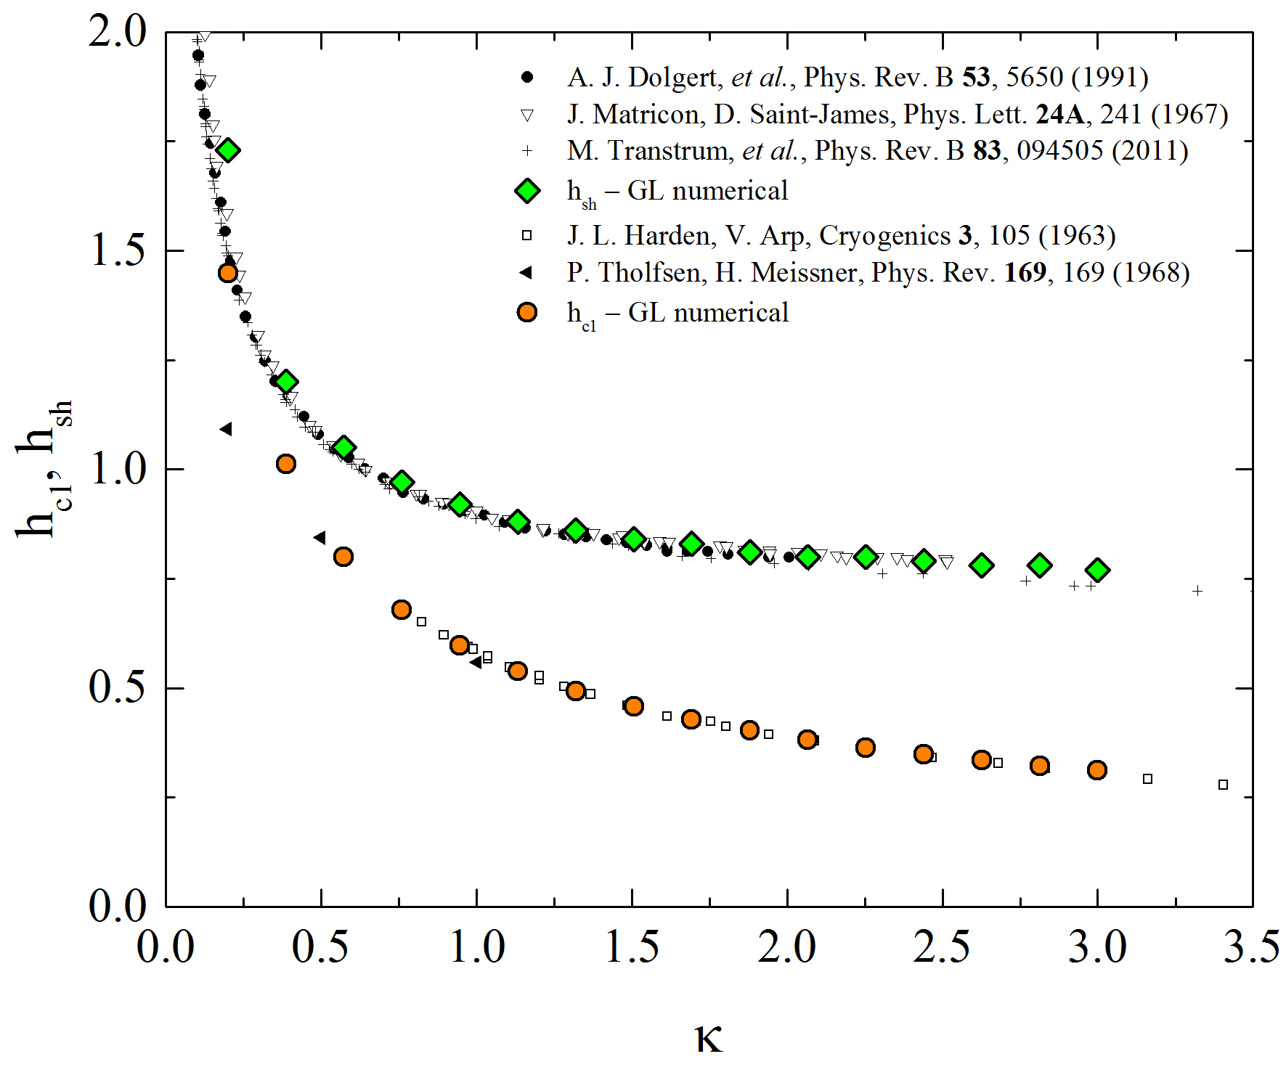

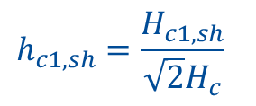
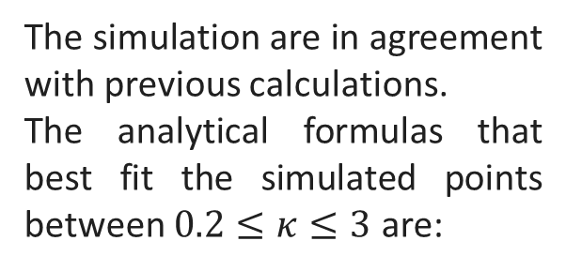
Simulations Summary
The simulation are in agreement with previous calculations.
The analytical formulas that best fit the simulated points between $0.2≤κ≤3$ are:
$$h_{c1}≅0.58{κ }^{−0.57}$$
$$h_{sh}≅0.72+0.18{κ }^{−1}+0.004{κ }^{−2}$$
$$h_{c1,sh}=\frac{H_{c1,sh}}{\sqrt{2}H_{c}}$$

Slide 10
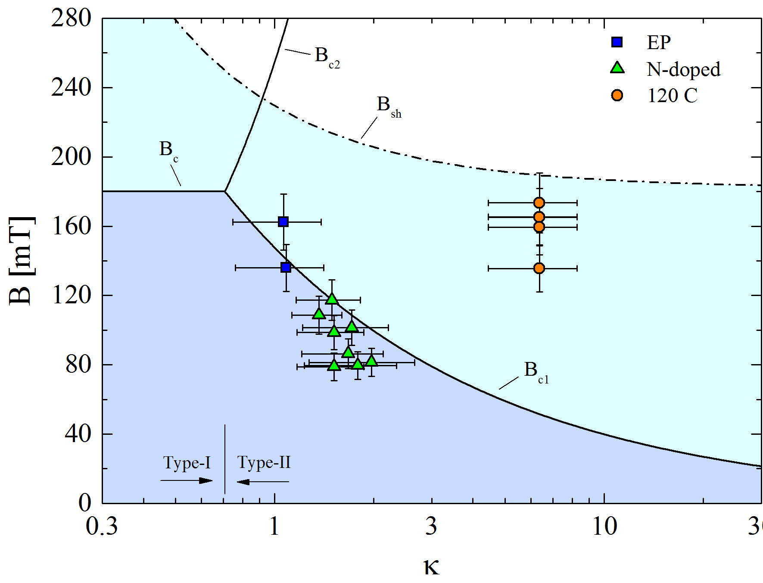



Experimental data vs Theory
The parameters used in the simulation are experimental values from bibliography:
$H_{c}(0)=180 mT$ ¹
$λ_{0}=39 nm$ ²
$ξ_{0}=38 nm$ ²
¹ S. Casalbuoni et al., Nucl. Instr. Meth. Phys. Res. A 583, 45 (2005)
² B. W. Maxfield and W. L. McLean, Phys. Rev. 139, A1515 (1965)

Slide 11
Quench fields summary
N-doped cavities so far quench below B_{c1}
→ statistically, N-doped cavities are quenching close or below the lower critical field
120 C baked cavities quench always above B_{c1}
→ 120 C baked cavities can reach the metastable Meissner state above the lower critical field
EP cavities seem to quench at B_{c1}, but because of the HFQS we cannot conclude that B_{c1} is the limitation
→ the dissipation regime is different
The Bean-Livingston barrier may give us more insight on what’s going on…

Slide 12
Bean-Livingston barrier calculation

Slide 13
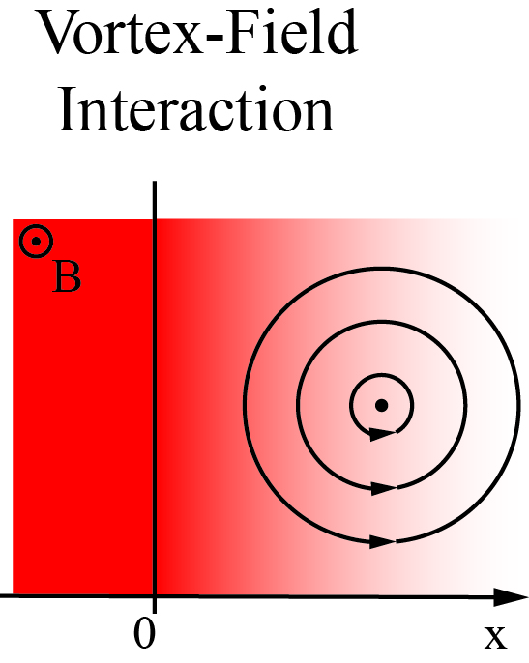
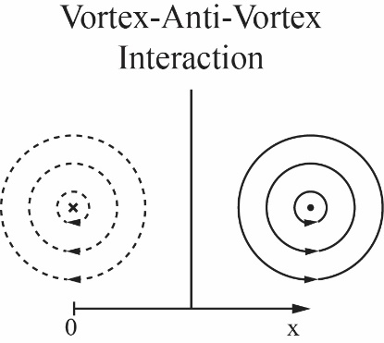
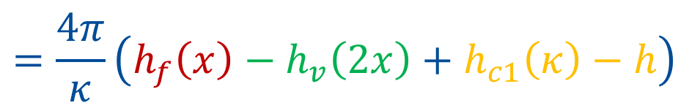
Bean-Livingston Barrier
$$g\left(x\right)=g_{vf}\left(x\right)+g_{vv}\left(2x\right)+g_{∞}$$
$$=\frac{4π}{κ}\left(h_{f}\left(x\right)−h_{v}\left(2x\right)+h_{c1}\left(κ\right)−h\right)$$
Bulk
C. P. Bean and J. D. Livingston, Phys. Rev. Lett. 12, 14 (1964)

Slide 14

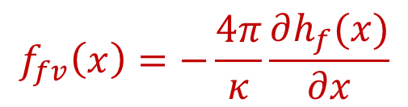

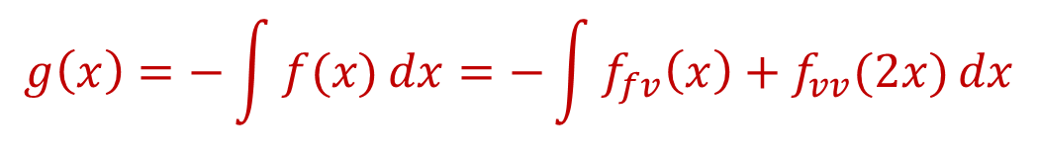


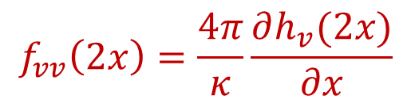

Bean-Livingston Barrier – Forces in play
$$g\left(x\right)=−\int{f(x)}dx=−\int{f_{fv}\left(x\right)+f_{vv}(2x)}dx$$
Vortex – Field interaction
Vortex – Anti-Vortex interaction
$$B$$
$$f_{fv}\left(x\right)=−\frac{4π}{κ}\frac{∂h_{f}(x)}{∂x}$$
$$φ_{0}$$
$$\left|B \right|$$
$$f_{vv}\left(2x\right)=\frac{4π}{κ}\frac{∂h_{v}(2x)}{∂x}$$
$${−φ}_{0}$$
$$φ_{0}$$

Slide 15
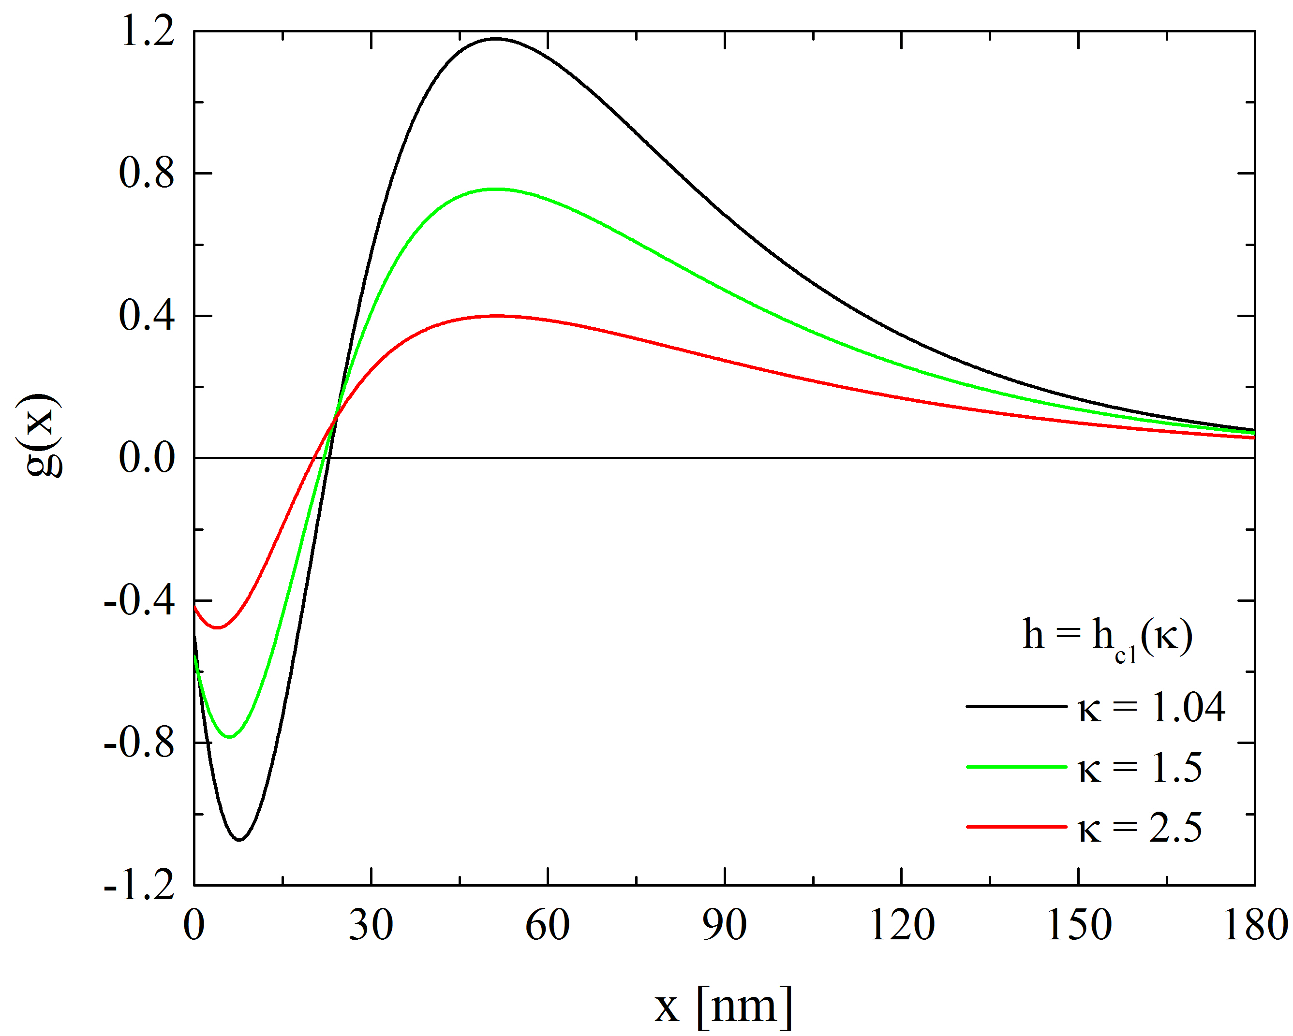
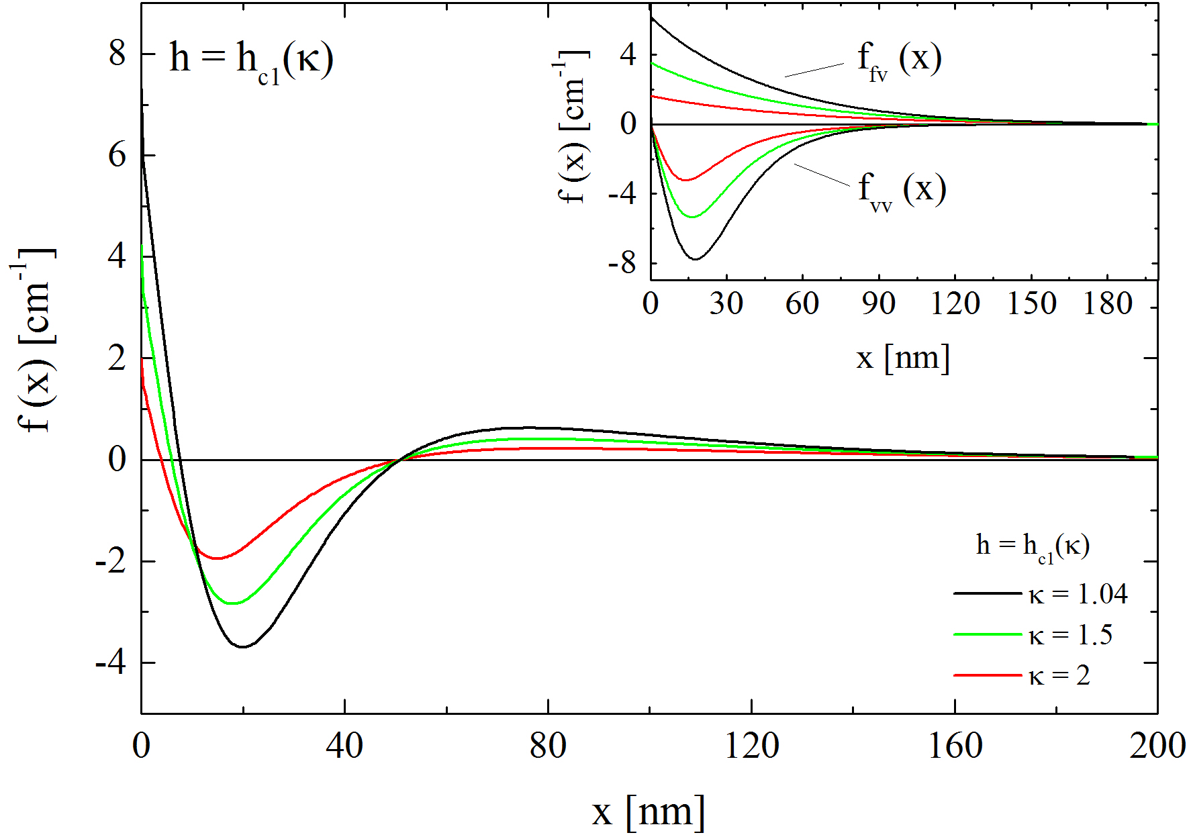

Bean-Livingston barrier
NB: the Bean-Livingston barrier represents the energy cost a vortex has to spend to penetrate the superconductor.
Gibbs free energy
Force per unit of length
$$B=B_{c1}(κ)$$
The cleaner the material (low k) the higher the barrier and the stronger the attractive force
Why 120 C baked cavities overcome B_{c1} if they have the shortest barrier?

Slide 16
Experimental data vs Theory
N-doped possess higher barrier (stronger attractive force) than 120 C baked cavities
Why 120 C baked cavities, that should have lower quench field, are quenching instead at larger field than N-doped cavities?
Why only 120 C baked cavities can systematically overcome B_{c1}?

Slide 17
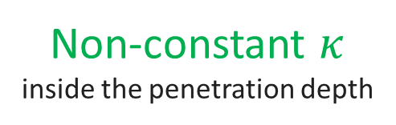
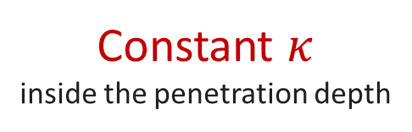
Experimental data vs Theory
Non-constant $κ$ inside the penetration depth
Constant $κ$
inside the penetration depth
A. Romanenko et al., Appl. Phys. Lett. 104, 072601 (2014)

Slide 18
Bean-Livingston barrier with a dirty layer on the surface

Slide 19
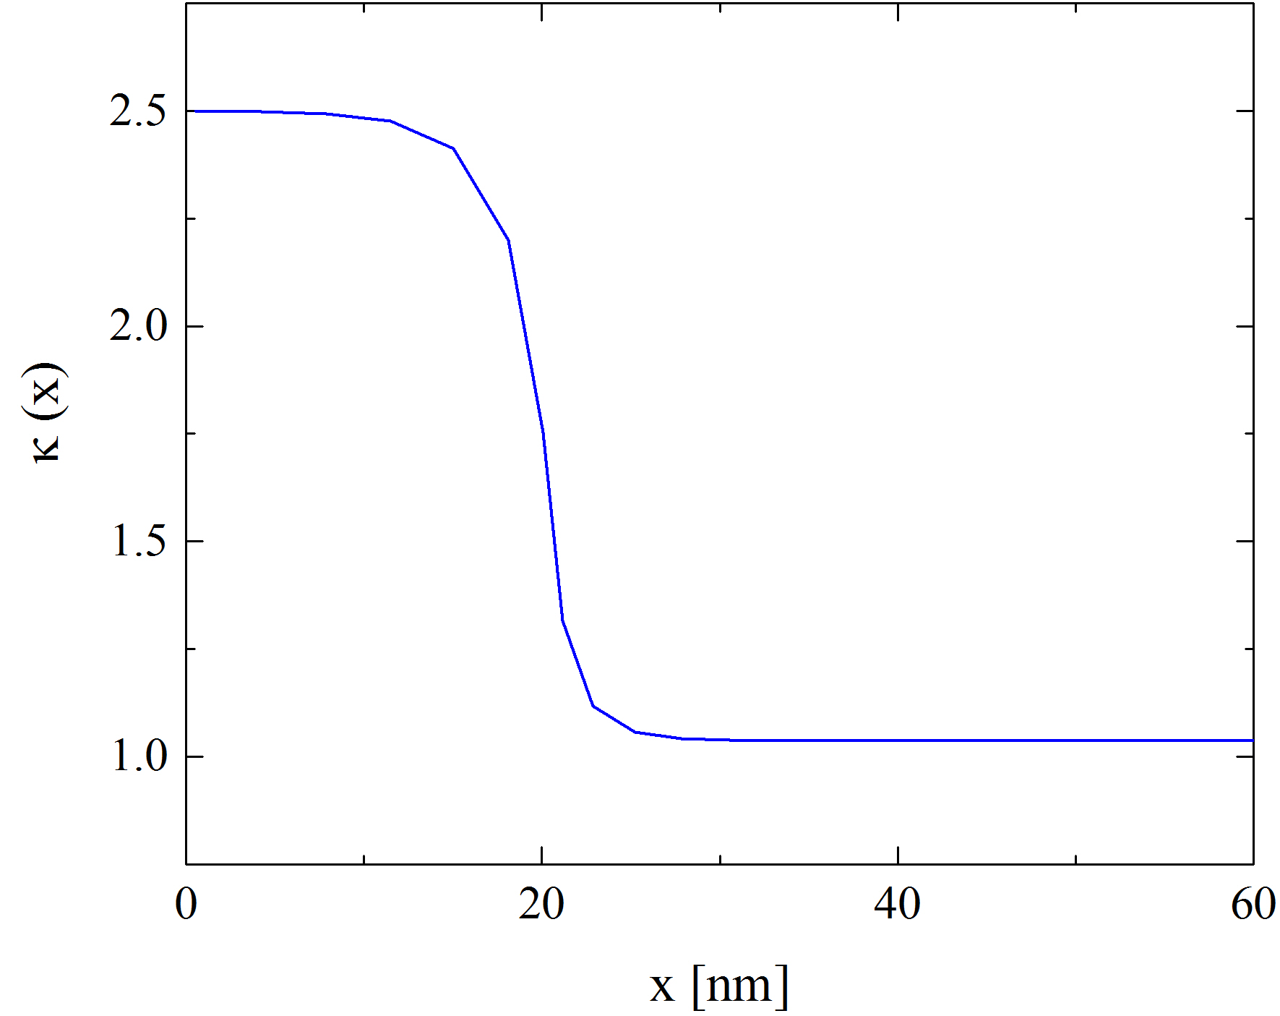
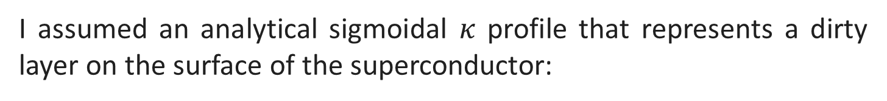
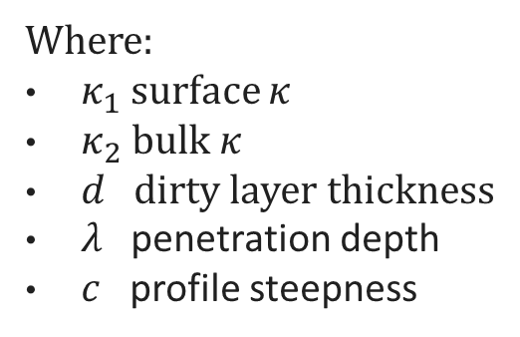
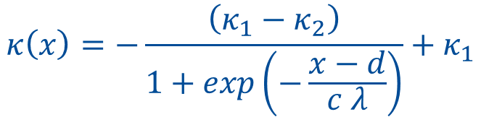
K profile
I assumed an analytical sigmoidal $κ$ profile that represents a dirty layer on the surface of the superconductor:
$$κ\left(x\right)=−\frac{\left(κ_{1}−κ_{2}\right)}{1+exp\left(−\frac{x−d}{c λ}\right)}+κ_{1}$$
Where:
$κ_{1}$ surface $κ$
$κ_{2}$ bulk $κ$
$d$ dirty layer thickness
$λ$ penetration depth
$c$ profile steepness

Slide 20
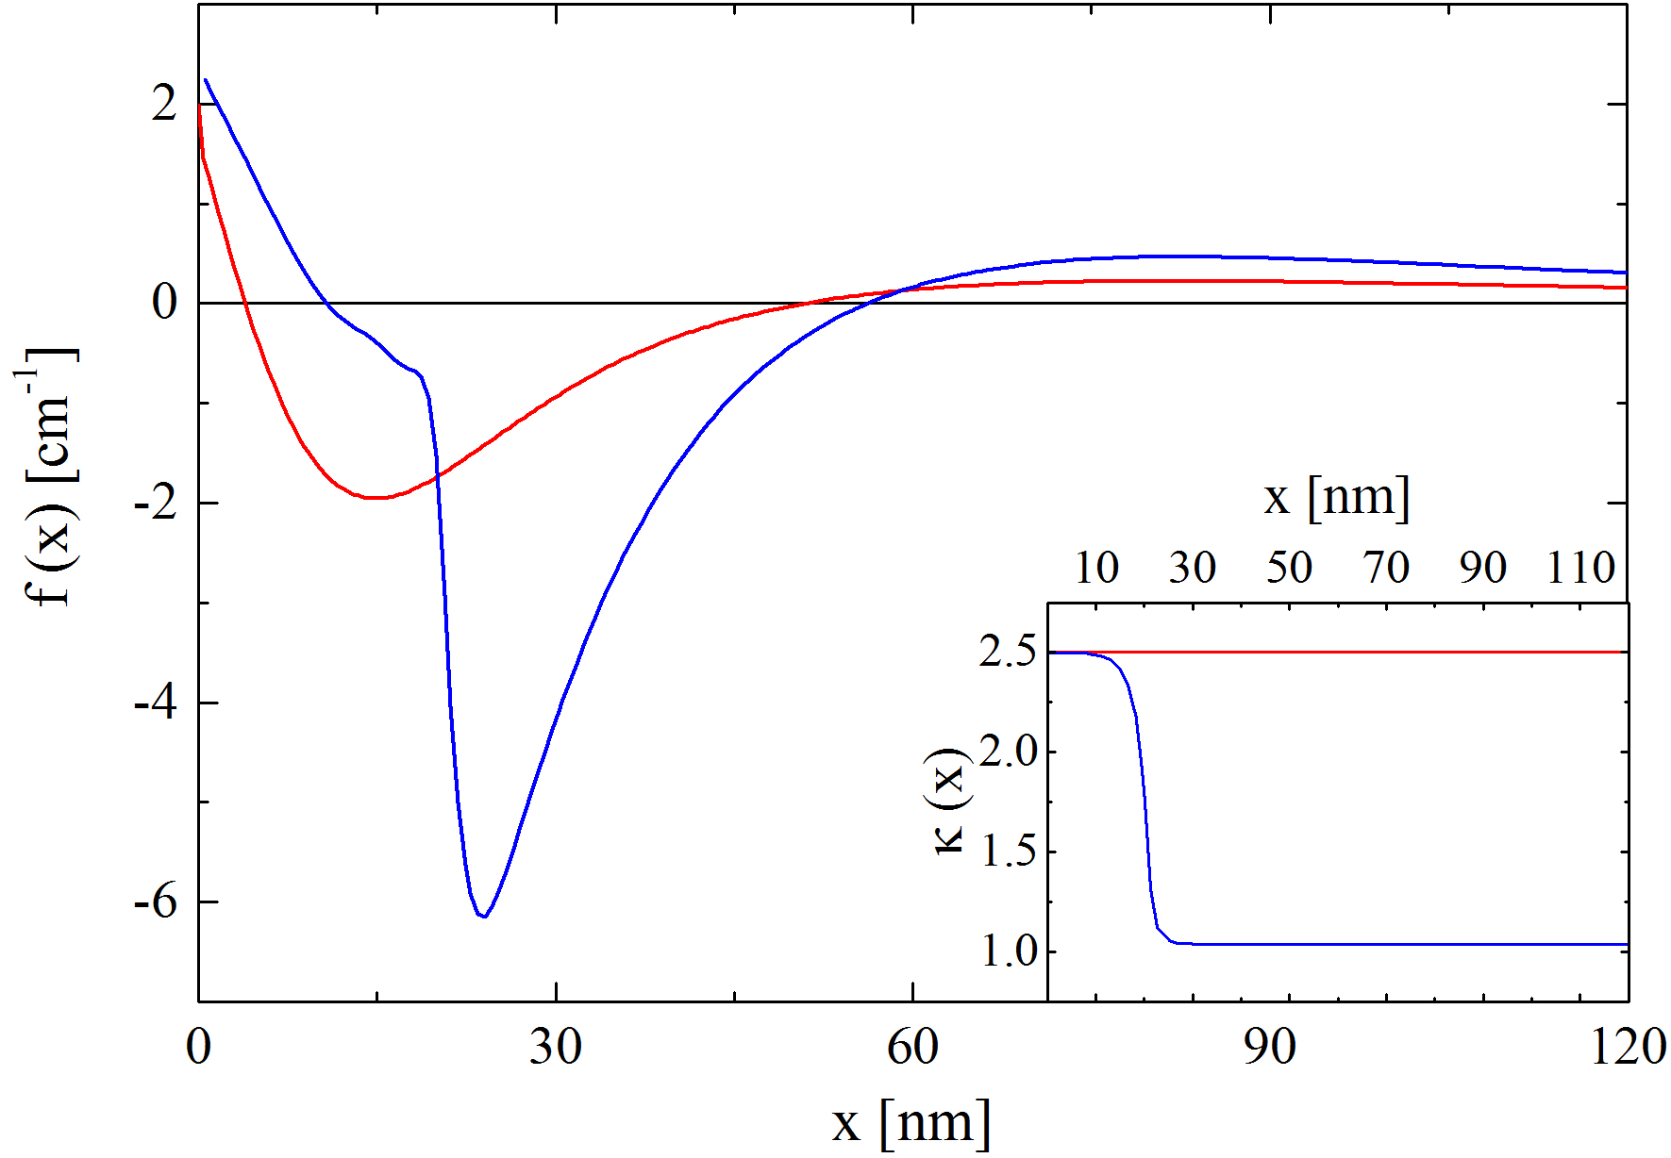


Attractive force enhancement
$κ_{s}=2.5$, $κ_{b}=1.04$
constant $κ=2.5$

Slide 21

Attractive force enhancement
$κ_{s}=2.5$, $κ_{b}=1.04$
constant $κ=2.5$
$$×3$$
3 times larger attractive force!!

Slide 22
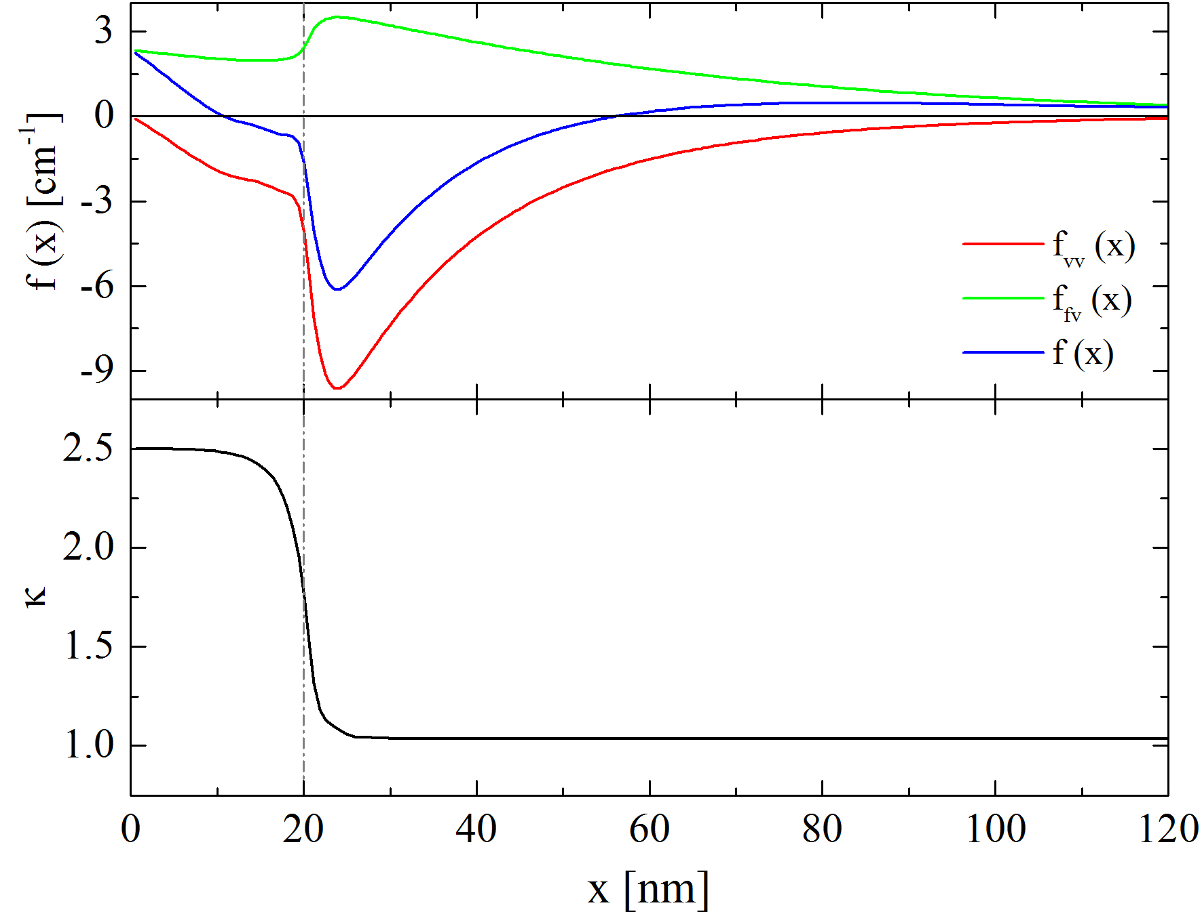
Force enhancement at the interface
repulsive force
attractive force
The force is enhanced by the presence of the dirty-clean interface

Slide 23
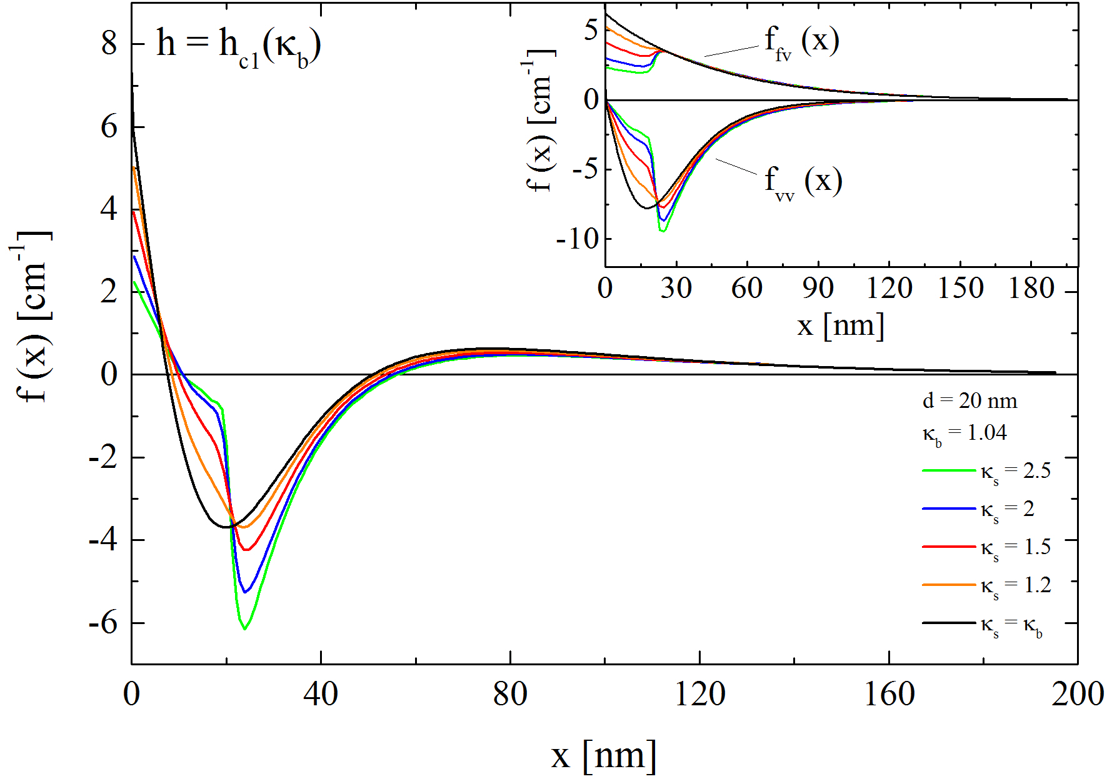
Dependence on the layer’s $κ$
The dirtier the layer, the stronger the attractive force

Slide 24
Prospects for High Q₀ at High Gradient

Slide 25
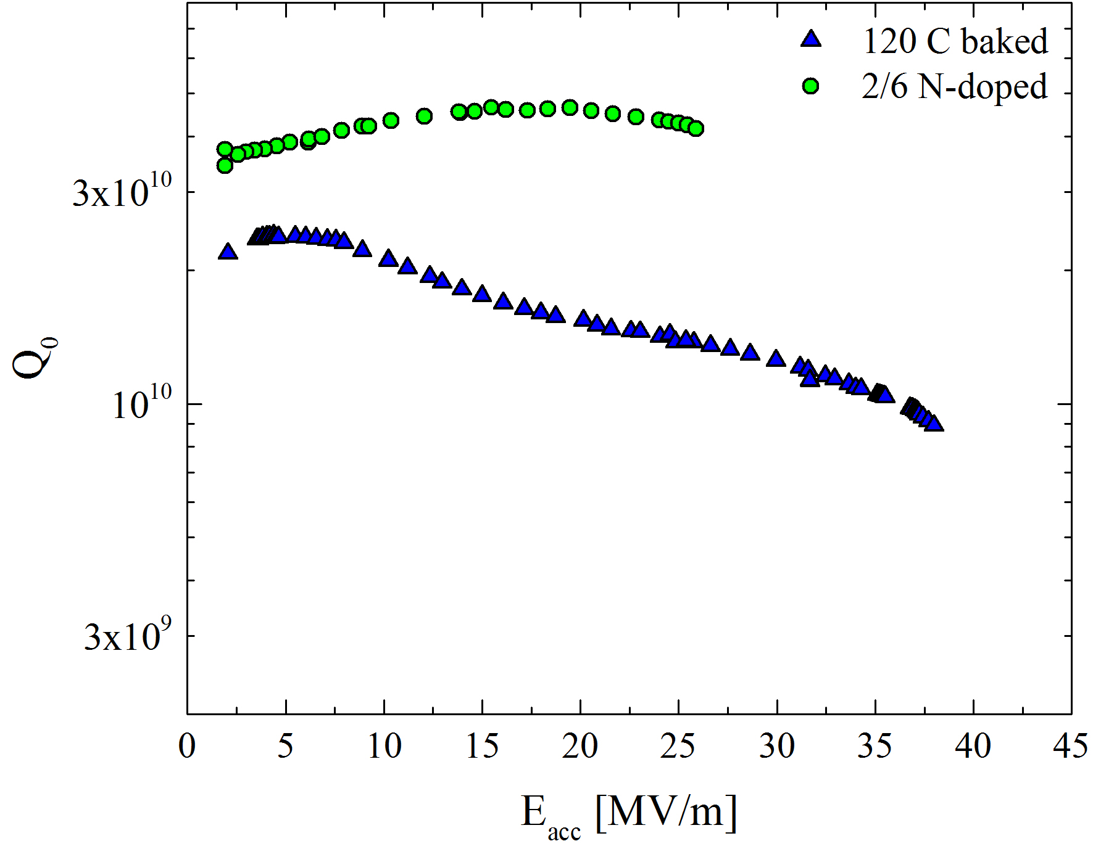
The path for high Q₀ at high gradients
Dirty layer at the rf surface:
Enables high gradients (e.g. 120 C baked cavities)
Nitrogen doping:
Enables high Q-factors

Slide 26
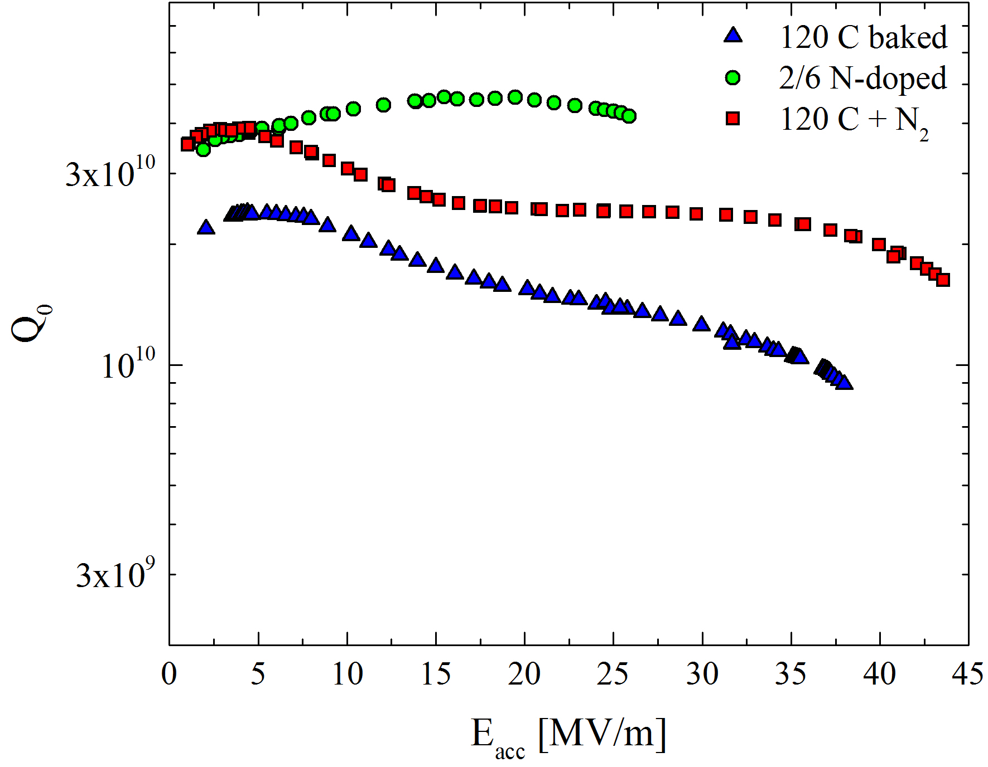
The path for high Q₀ at high gradients
Dirty layer at the rf surface:
Enables high gradients (e.g. 120 C baked cavities)
Nitrogen doping:
Enables high Q-factors
Let’s merge together the two effects
Nitrogen infusion:
Enables high Q-factors at high gradients!

Slide 27
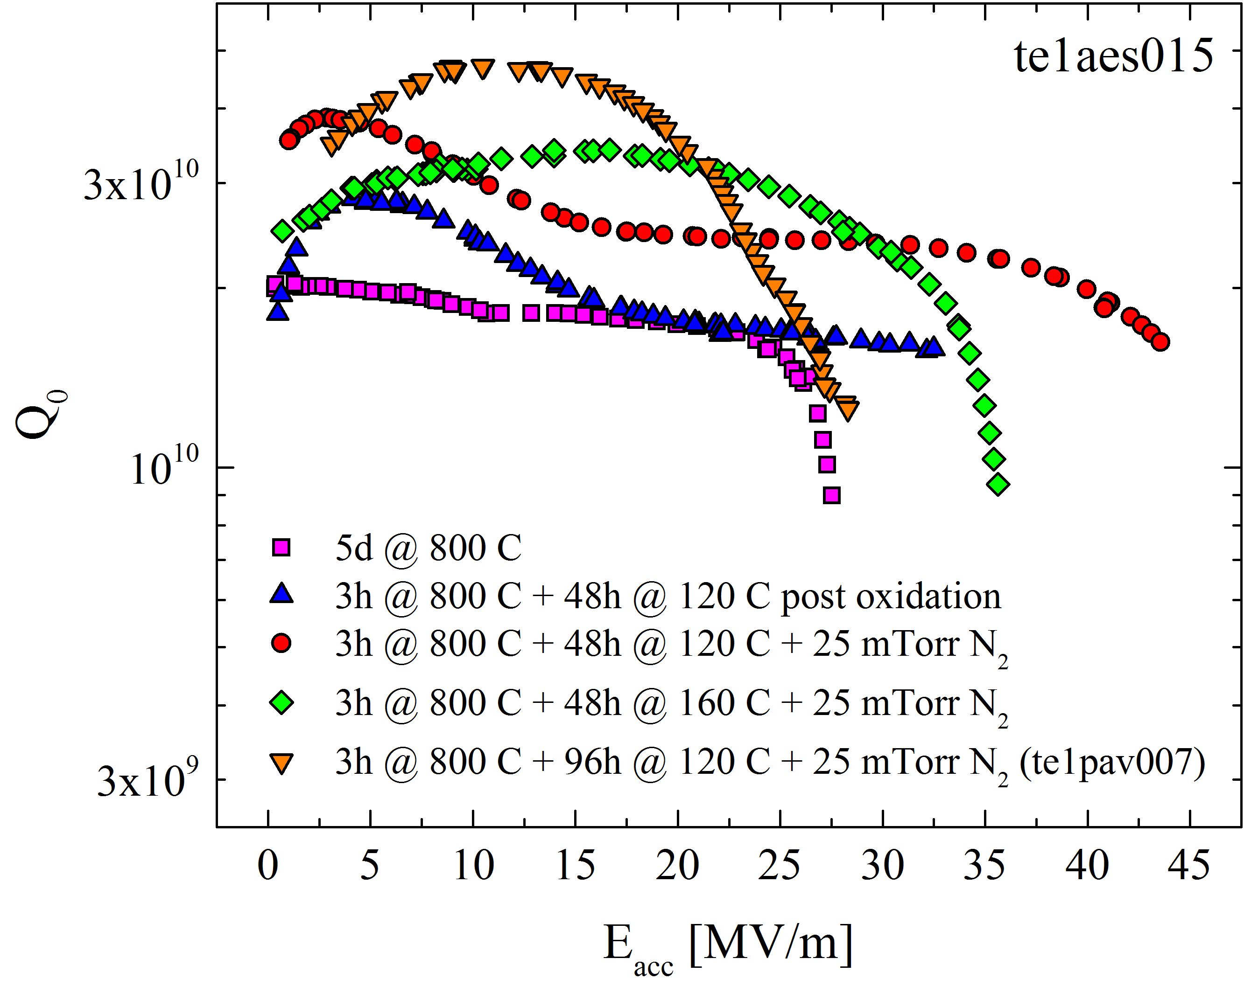
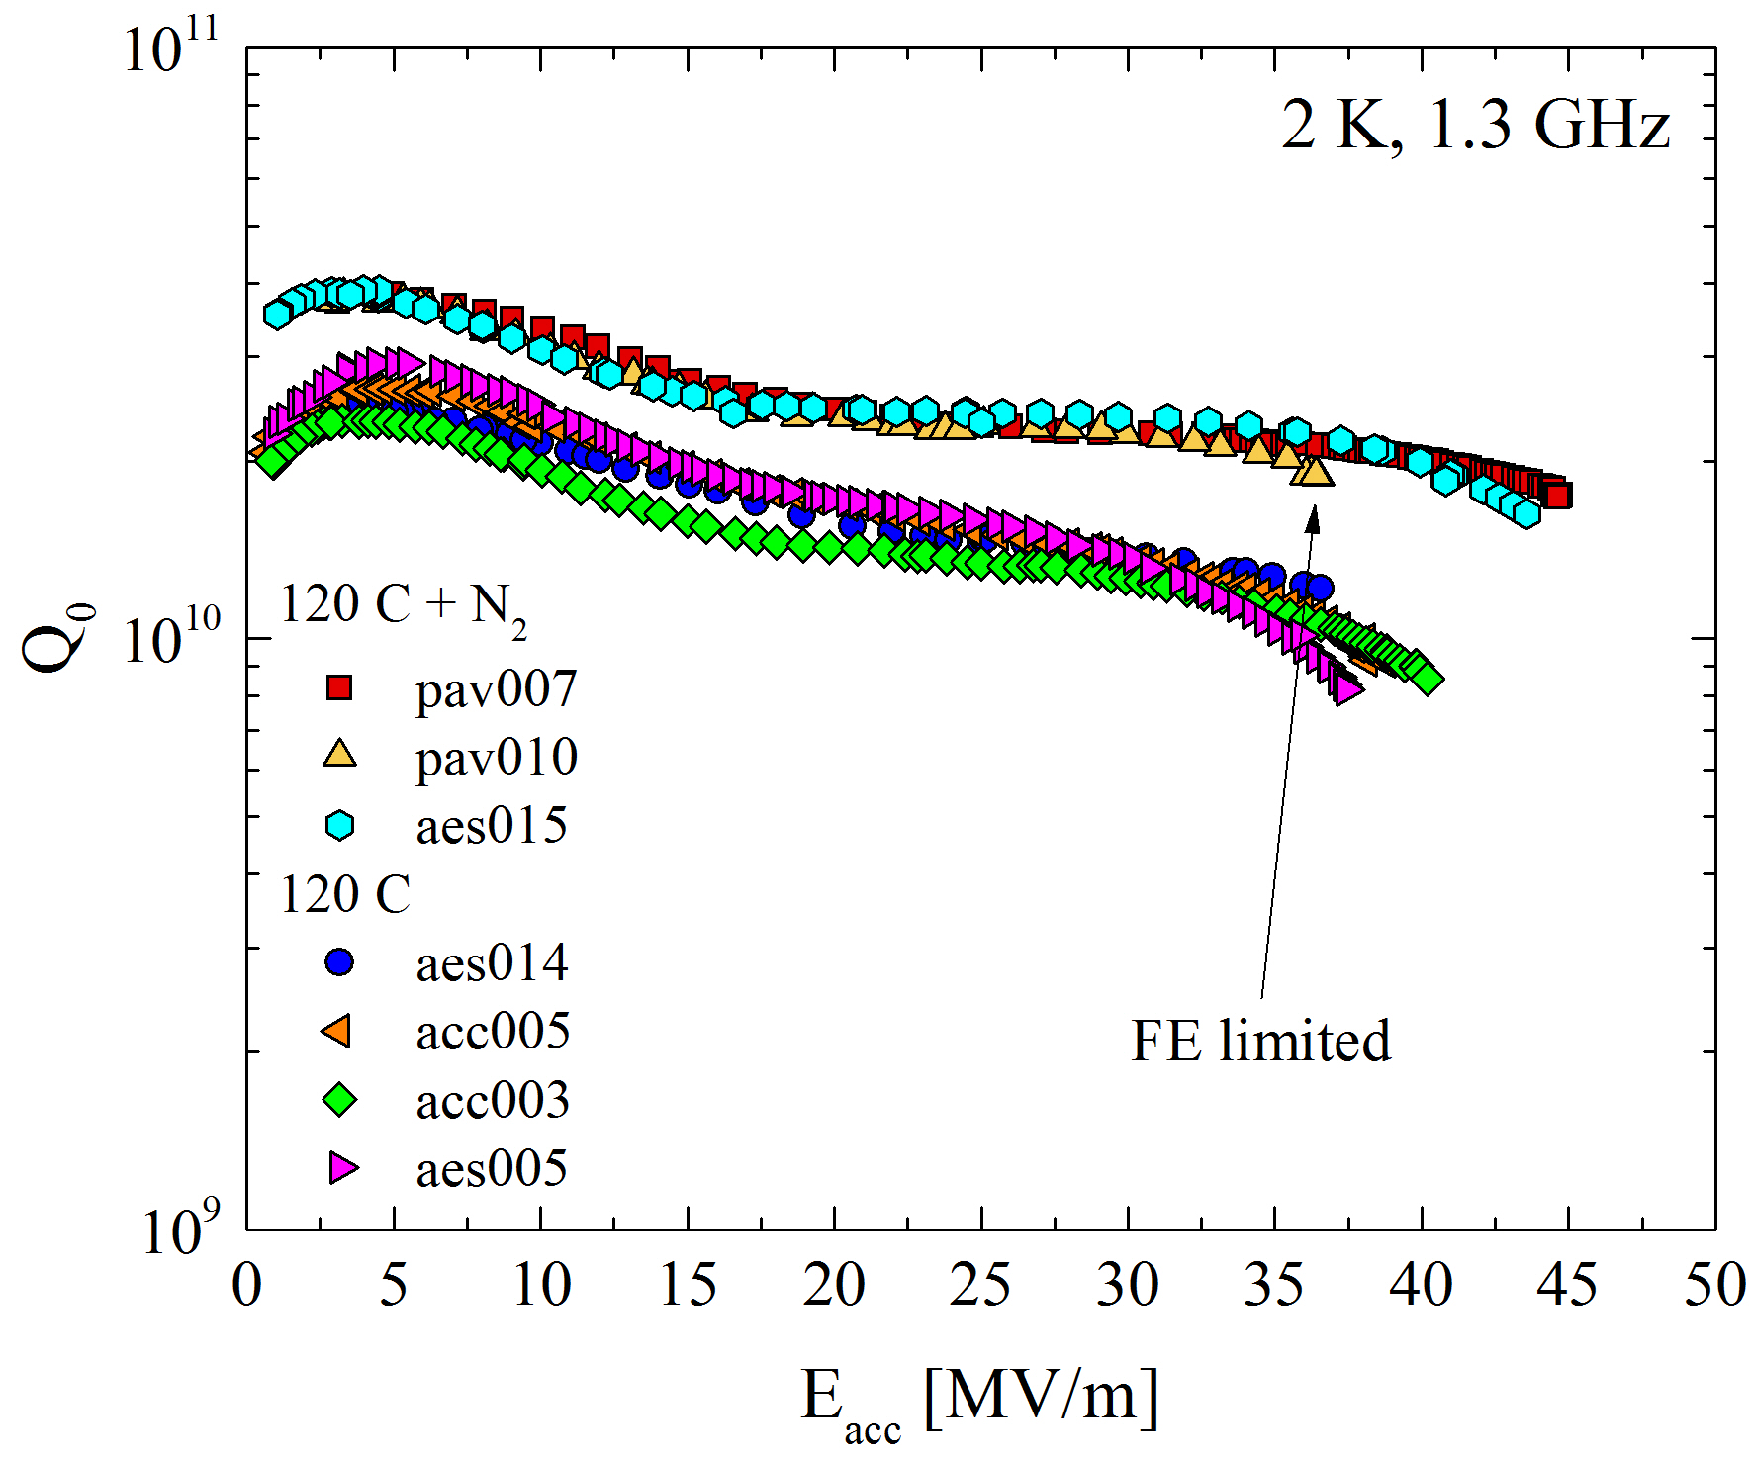
Experimental results
The new Fermilab’s results show high Q₀ at high gradient
The presence of a dirty doped layer at the surface might explain such results!

Slide 28
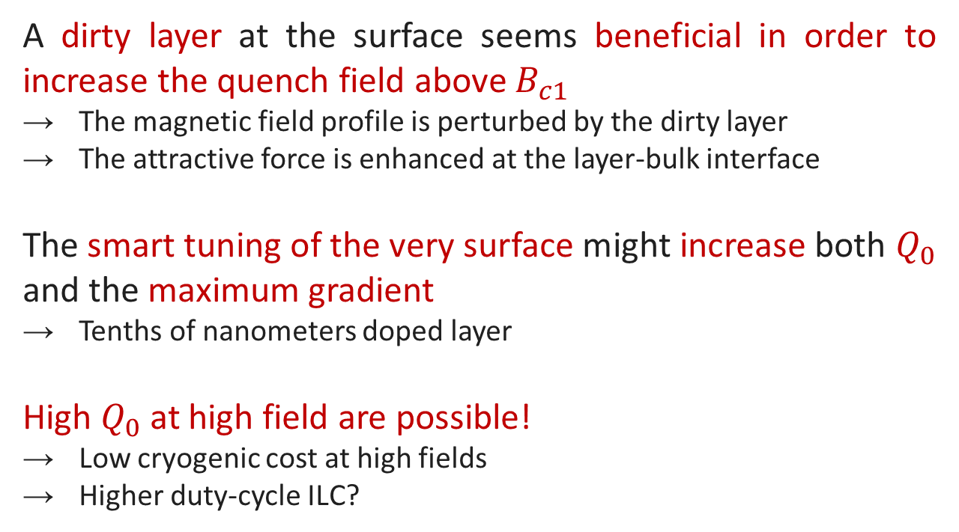
Conclusions
A dirty layer at the surface seems beneficial in order to increase the quench field above $B_{c1}$
The magnetic field profile is perturbed by the dirty layer
The attractive force is enhanced at the layer-bulk interface
The smart tuning of the very surface might increase both $Q_{0}$ and the maximum gradient
Tenths of nanometers doped layer
High $Q_{0}$ at high field are possible!
Low cryogenic cost at high fields
Higher duty-cycle ILC?

Slide 29
Thank you

Slide 30
Backup Slides

Slide 31
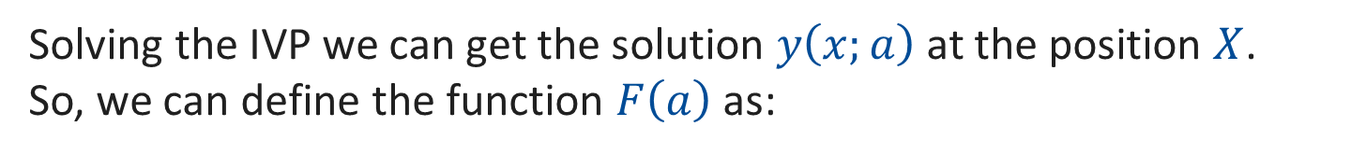

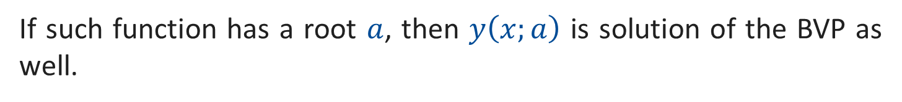
Shooting Method
Lets assume the following BVP
$$y^{′′}\left(x\right)=f\left(x,y\left(x\right),y^{′}\left(x\right)\right)$$
$$y\left(0\right)=y_{0}$$
$$y\left(X\right)=y_{X}$$
The correspondent IVP would be:
$$y\left(0\right)=y_{0}$$
$$y^{′}\left(0\right)=a$$
Solving the IVP we can get the solution $y\left(x;a\right)$ at the position $X$.
So, we can define the function $F\left(a\right)$ as:
$$F\left(a\right)=y\left(X;a\right)−y_{X}$$
If such function has a root $a$, then $y\left(x;a\right)$ is solution of the BVP as well.

Slide 32
H_{c1} calculation code flow chart
BVP
GL equations
f(r0), f’(r0)
a(r0), a’(r0)
yes
STOP
k=kmax
R=Rmax ||
f(R)>1 || f’(R)<0 ||a’(R)>0 ||
a’(R)<-1/(k R²)
yes
Final
Solution
Shooting Method
Solution
f(r0), f’(r0)
a(r0), a’(r0)
ε, Hc1
Print
R = R + Rstep
k = k + kstep

Slide 33
H_{sh} calculation code flow chart
BVP
GL equations
f(0), a(0)
yes
k=kmax
STOP
yes
Flag=true
Z=Zmax ||
f(Z)>1 || f’(Z)<0
yes
Hsh
no solution
Print
Shooting Method
k = k + kstep
Z = Z + Zstep
Solution
f(0), a(0)
H = H + Hstep
yes
f(0)<0.0001
Flag=true

Slide 34
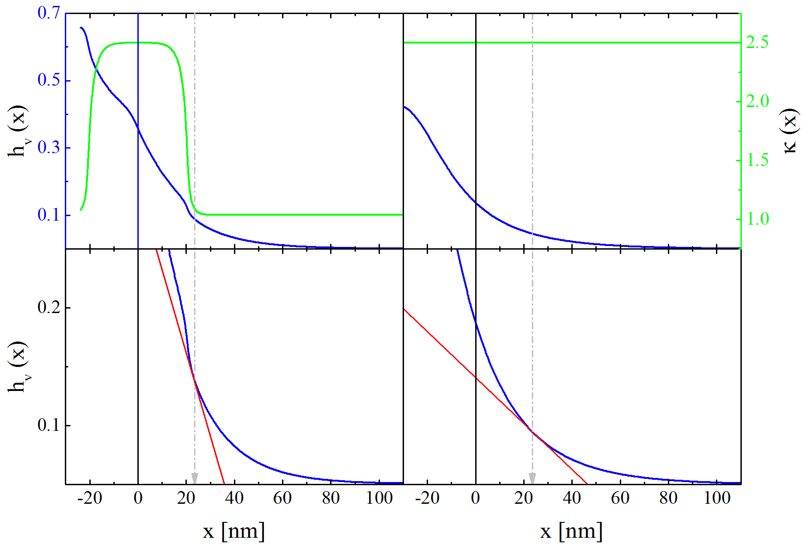




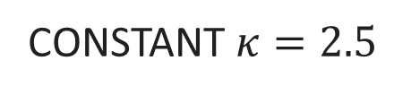

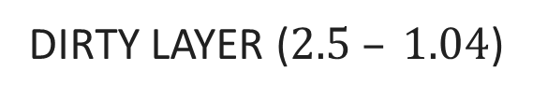

Why does the dirty layer enhance the force?
DIRTY LAYER ($2.5 – 1.04$)
CONSTANT $κ=2.5$
$${−φ}_{0}$$
$$φ_{0}$$
$${−φ}_{0}$$
$$φ_{0}$$
zoom
zoom
$${\left(\frac{∂h_{v}}{∂x}\right)}_{2}$$
$${\left(\frac{∂h_{v}}{∂x}\right)}_{1}$$

Slide 35


Why does the dirty layer enhance the force?
DIRTY LAYER ($2.5 – 1.04$)
CONSTANT $κ=2.5$
$${−φ}_{0}$$
$$φ_{0}$$
$${−φ}_{0}$$
$$φ_{0}$$
$$f∝\frac{∂h_{v}}{∂x}$$
zoom
zoom
$${\left(\frac{∂h_{v}}{∂x}\right)}_{2}$$
$${\left(\frac{∂h_{v}}{∂x}\right)}_{1}$$
$${\left(\frac{∂h_{v}}{∂x}\right)}_{1}>{\left(\frac{∂h_{v}}{∂x}\right)}_{2}$$

Slide 36
LE-$μ$SR results
A. Romanenko et al., Appl. Phys. Lett. 104, 072601 (2014)

