Slide 1

EU-XFEL summary of performance degradation
Detlef Reschke – DESY
for the EU-XFEL Accelerator Consortium
Notes:
How to edit the title slide
Upper area: Title of your talk, max. 2 rows of the defined size (55 pt)
Lower area (subtitle): Conference/meeting/workshop, location, date,
your name and affiliation, max. 4 rows of the defined size (32 pt)
Change the partner logos or add others in the last row.

Slide 2
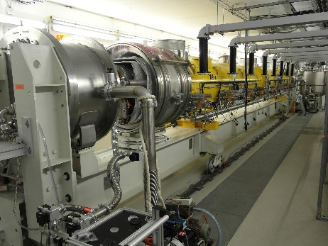
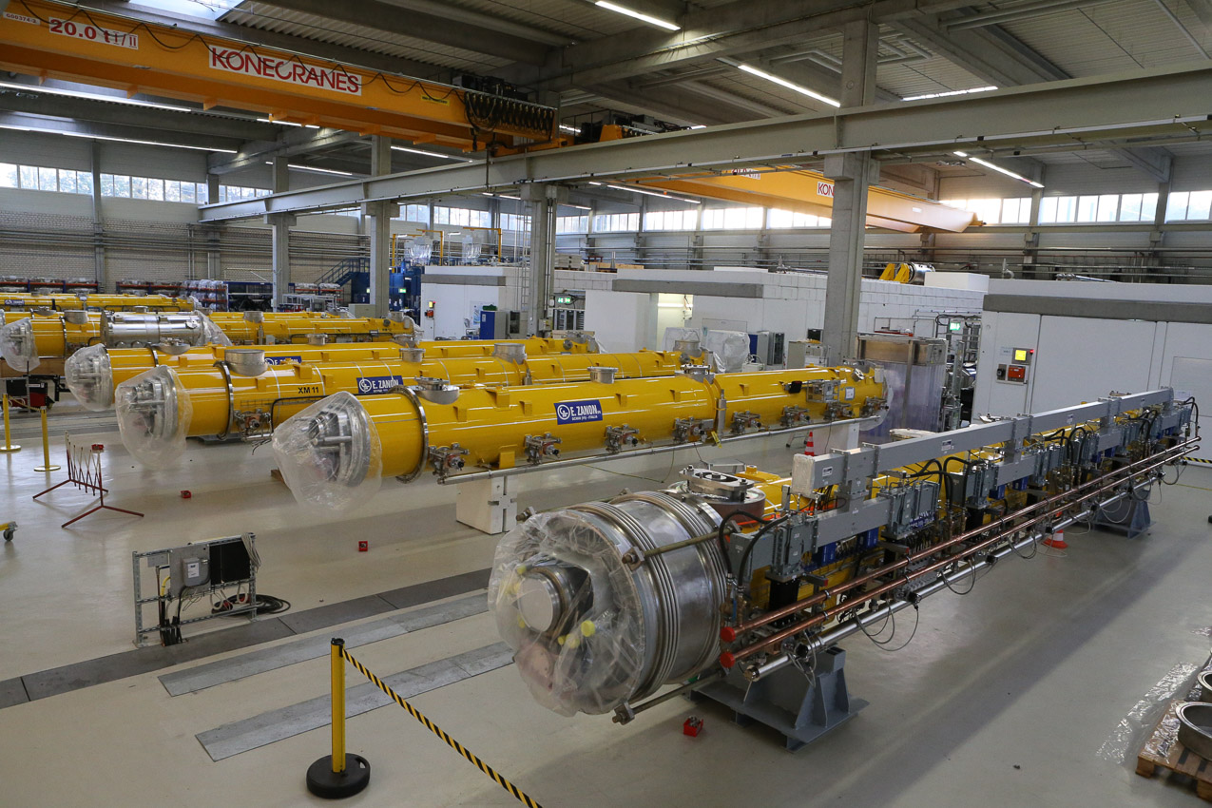
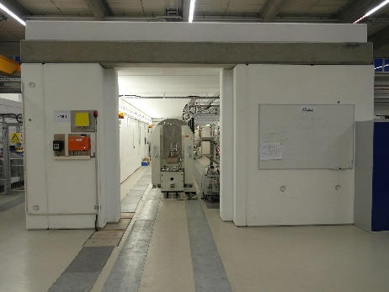
2
Cryomodule Test at AMTF
Jun, 20: 98 modules arrived with 96 modules rf tested (XM-3 excluded)

Slide 3
Statistics of Cryomodules + Cryomodule Tests
3
Cryomodule assembly at CEA Saclay (=> previous talk, O. Napoly)
Analysis of cryomodule tests: June 12, 2016 (~92 cryomodules)
Improved and optimized test procedure since June 2015
=> typical test duration reduced to < 15 days
(assuming no non-conformities!!!)
Non-conformities during testing (causing significant delay):
- cryogenic + vacuum leaks (mainly at temporary connections to test stand)
- warm coupler part (“push rod” bellow leaks, assembly NC’s, …)

Slide 4
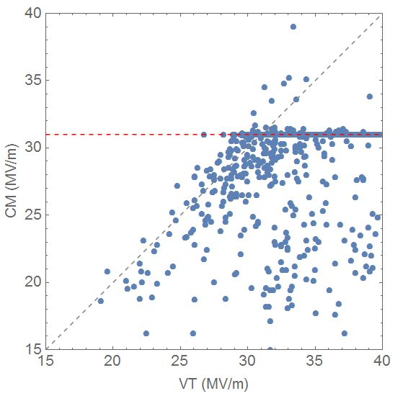
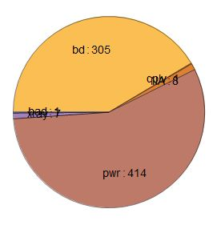
Cryomodule – Vertical Test Comparison:
MAX GRADIENT
individual cavity comparison of max gradient
(upper limit due to 31 MV/m limit in module test)
we lose between vertical
and cryomodule test
average VT: 30.3 MV/m
(clipped at 31 MV/m)
average CT: 28.8 MV/m
(includes limit at 31MV/m)
Ideal case
VT:CM = 1:1
Limitations:
- pwr: 414
- bd: 305
- NA: 8
- xray: 7
- coupler:1
Notes:
Update necessary: average gradients to be checked

Slide 5
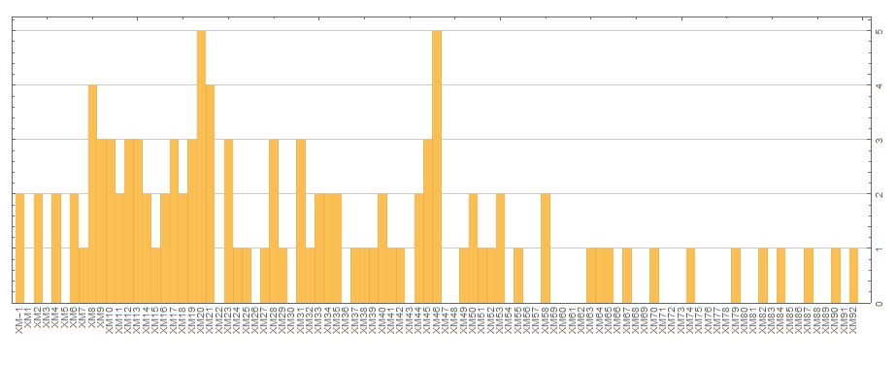
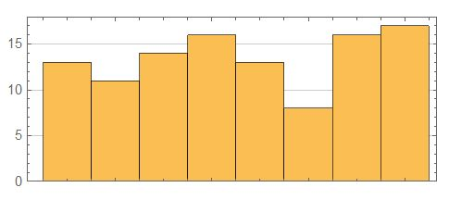
Vertical – Cryomodule Comparison:
Degradation of Max Gradient
Number of cavities with 15% lower max Gradient per Module
5
4
3
2
1
No. of degraded cavities for
i) “BD” and
ii) 15% lower max gradient to vertical test: 145
No. of degraded cavities
Cavity position in module

Slide 6


Vertical Test - Cryomodule Comparison:
USABLE / OPERATIONAL GRADIENT
Vertical Test – min of
Maximum gradient (quench)
FE limit (top/bottom X-ray)
Q₀ limit (= 10¹⁰)
RF power limit at ~200 W
Cryomodule – min of
Maximum gradient (quench)
FE limit (front/back X-ray)
not available
RF power limit at 31 MV/m
P
⁽P⁾
?
when making comparisons,

Slide 7
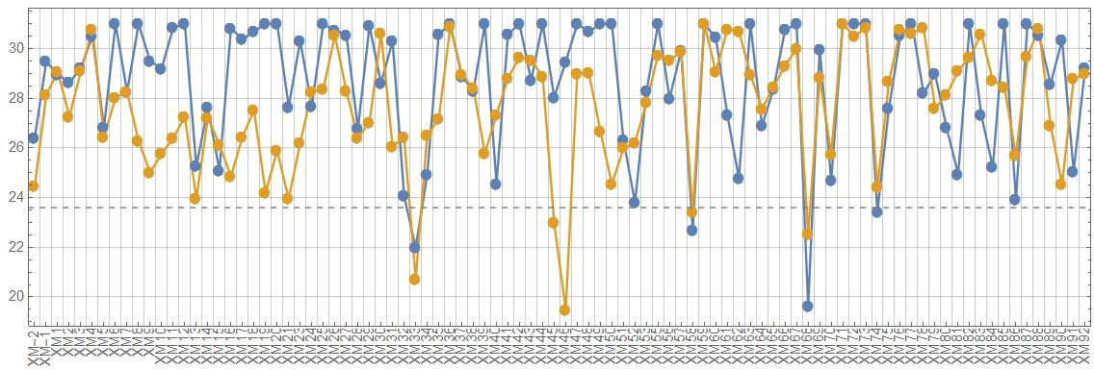

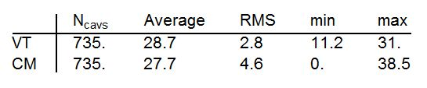
Vertical Test - Cryomodule Comparison:
Average cryomodule operational gradients
CM: upper limit due to 31 MV/m limit by RF power
VT: clipped at 31 MV/m
Average VT performance met within <4%

Slide 8
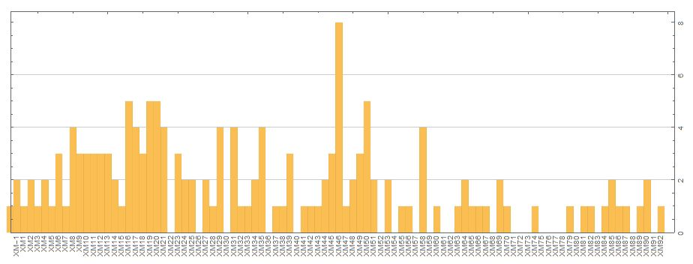
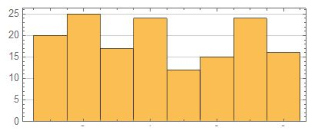
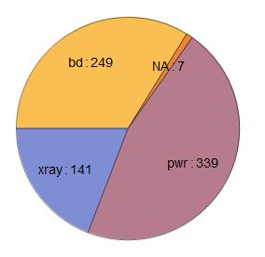
Vertical – Cryomodule Comparison:
Degradation + limitation of Oper. Gradient
Number of cavities with 15% lower Operational Gradient per Module
Limitations:
- pwr: 339
- bd: 249
- xray: 141
- NA: 7
85
No. of degraded cavities
Cavity position in module

Slide 9
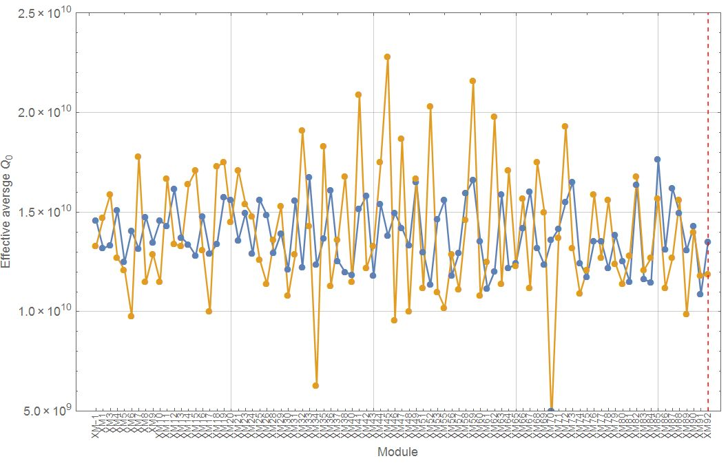
Vertical Test - Cryomodule Comparison:
Q₀-values at ~20-23MV/m
estimated error
of cryomodule
Q-value: ~30%
Average Q₀-value at ~20-23 MV/m: vertical ~1.4 x 10¹⁰
cryomodules ~1.4 x 10¹⁰
Notes:
Update of average Q-values necessary

Slide 10
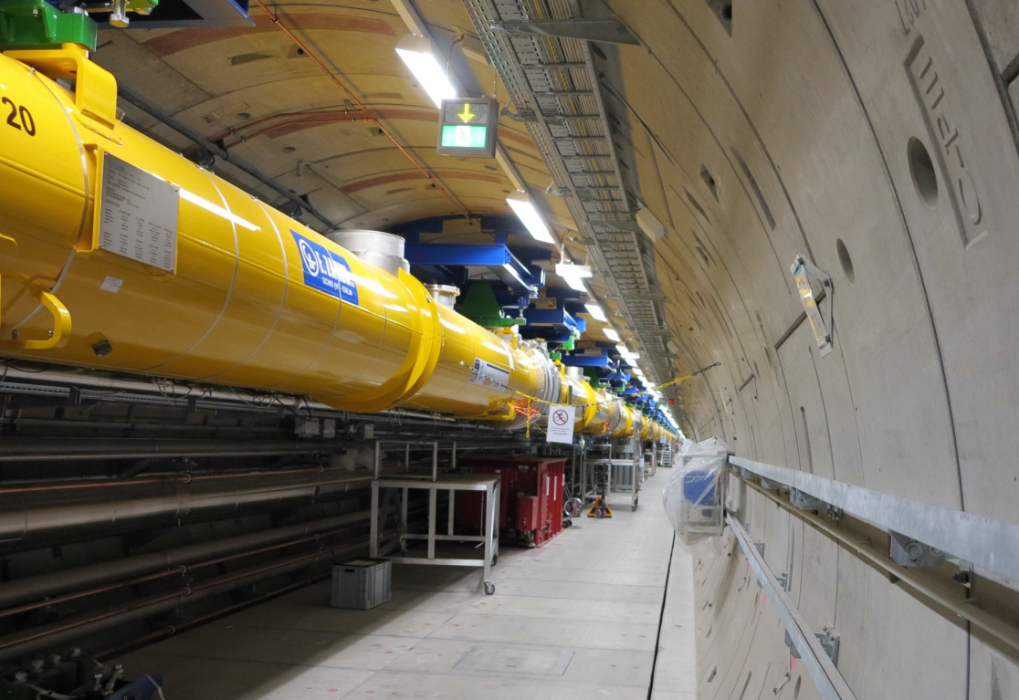
Thanks to all colleagues of:
- IFJ-PAN Krakow (esp. J. Swierblewski, M. Wiencek)
- CEA Saclay
- INFN Milano (esp. L. Monaco)
- E. Zanon
- Research Instruments
- Daher Transkem
- Alsyom
- DESY
(esp. V. Gubarev, J. Schaffran, L. Steder, N. Walker, M. Wenskat, S. Yasar)

Slide 11
:
- Back-up

Slide 12
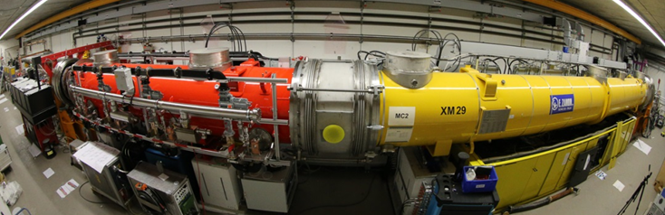
Cryomodule Operation in the Injector
Cold module operation started Dec 2015

Slide 13
Injector Module Performance:
First “cold” 1.3 GHz module A1 (XM29)
=> not cavity limited
Courtesy
D. Kostin
No cavity limitation during injector operation (up to 160 MeV beam energy)

Slide 14
cw R&D on EU-XFEL Cryomodules
EU-XFEL and FLASH originate from the TESLA collider and therefore they nominally operate (FLASH) and will operate (EU-XFEL) in so called short pulse (sp) mode
RF-pulses |  | Max RF DF [%]
Max RF pulse length incl. rise time [µs] | Rep. Rate [Hz]
1400 | 10 | 1.40
Both accelerators are based on the SRF technology and thus have potential for much larger DF, up to 100% (cw).
Having additional cw and long pulse modes will allow for more flexibility in the time structure of the photon beams and will make both facilities even more attractive to the users.
Courtesy
J. Sekutowicz
Notes:
- updated

Slide 15
cw R&D on EU-XFEL Cryomodules
Summary for series XFEL cryomodule in short pulse, long pulse (lp) and cw operation mode:
Courtesy
J. Sekutowicz
Demonstrated Gradients
 | Mode | sp | lp | cw
XM4 / FG | Max <Eacc> [MV/m] | 31.8 | 19 | 15
Demonstrated Qo in lp/cw operation at 2K and 1.8K
Mode | lp (DF≈20%) | cw
XM4 / FG | 2.0E10 @19MV/m | 2.3E10 / 3.5E10 @15MV/m
No quench was observed for cw/lp modes in all conducted tests.
Maximum demonstrated DHL was 71 W in cw mode at ~15 MV/m. Operation was very stable. This proves that the E-XFEL cryomodule helium supply and return system can handle at least 77W dissipation.
Notes:
- updated

