Slide 1
Magnetic field suppression, cavity frequency control, MP free coupler
K. Saito
MSU/FRIB, SRF Development Manager

Slide 2
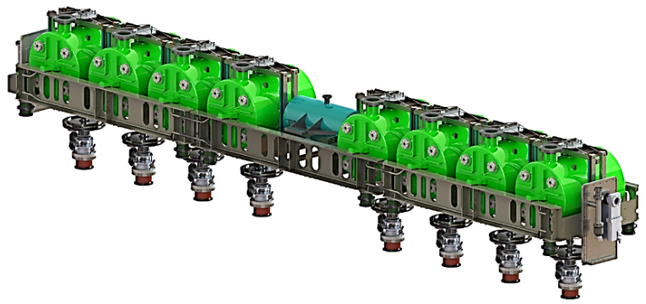
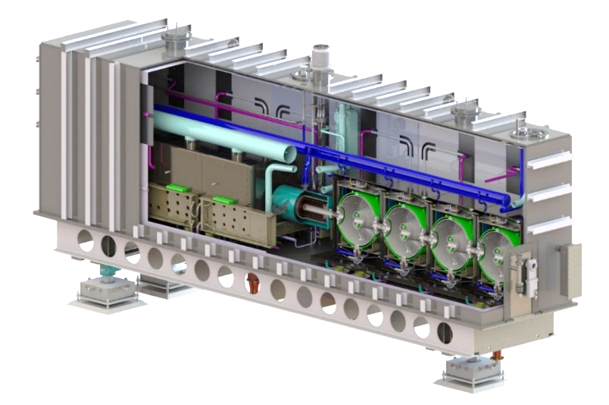
Magnetic Field Suppression of FRIB
Magnetic Field Suppression in the FRIB Cryomodule
  8 T solenoid is placed nearby cavities
  FRIB concerns two things:
    Suppression of remnant field, especially earth magnetic field
    Fringe field from the solenoid package (8 T)
Remnant Field suppression
  FRIB spec is remnant field < 15 mG in the magnetic shield
  Carbon steel vacuum chamber works as a magnetic shield: attenuation ~ 2 (measured)
  Local magnetic shield around cavity, 20-30K: reliable shield effect and cost reduction
  Used conventional Mu-metal (PC Permalloy) with μ > 9000 at 20 K for cost reduction
Firing field suppression
  Fringe field < 300 G on the local magnetic shield surface
  Well designed solenoid package with bucking coil (cancellation), no Iron Yoke

Slide 3
Solenoid Package Design
Attenuation measurement at 10 K for 0.085QWR cylindrical magnetic shield: remarkable field increase in the shield at > 300 G
Solenoid design goal: Fringe field < 300 G on the magnetic shield surface
Critical field 300G (30 mT)
Fringe field 270 G on the shield surface

Slide 4
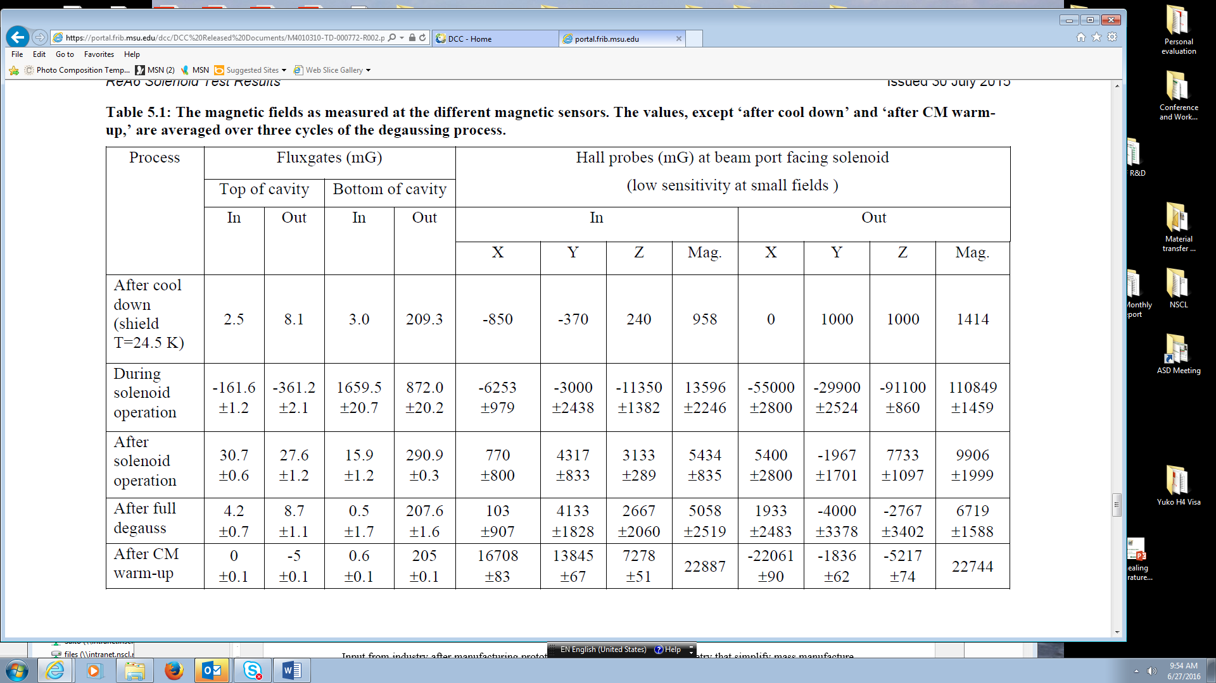
Validation Test with remnant field in ReA6-1 (QWRs)
Local shield performance at 25 K (cavity 4.3K): 2.5 mG at RF high magnetic field area
Fringe field suppression: 162 mG during solenoid operation at 8 T
Degaussing effect, yes; 31 mG to 4.2 mG after degaussing
Remnant field after warmed up (300 K): 0 mG

Slide 5
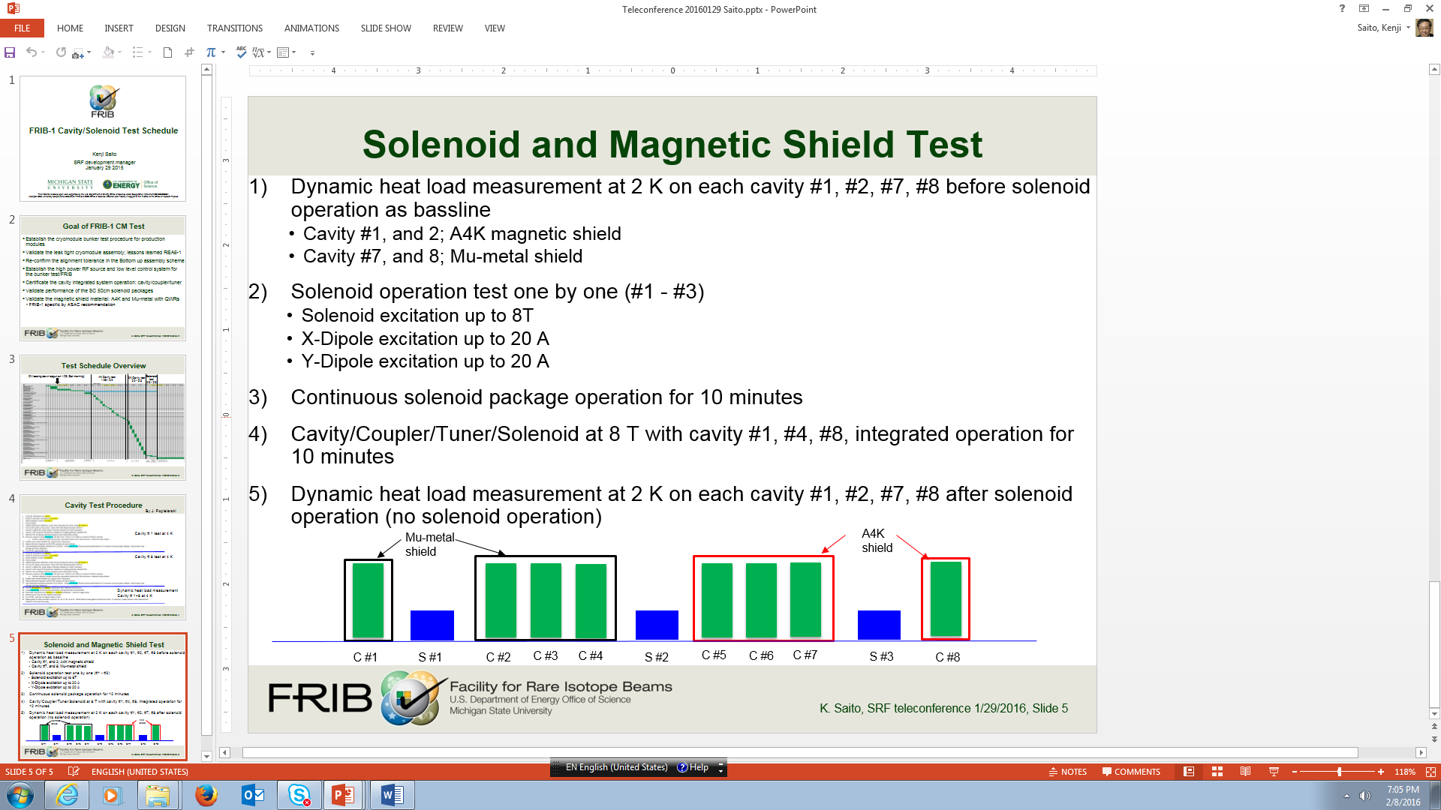
Magnetic Shield Material Validation in FRIB QWR first Cryomodule
The simulation for the QWR magnetic shield concluded that the shield material with the magnetic permeability > 9000 at 20±5K can meet the FRIB requirement
< 15mG.
Conventional Mu-metal can meet this condition according to KEK measurement at 4K
Proposed to use the conventional Mu-metal for FRIB QWR magnetic shield instead of cryogenic shilled material for instance A4K in order to reduce cost.
  Cryogenic material cost expensive as much as three time that of conventional one
ASAC2016 Dec recommended to validate the shield performance in the FRIB-1 CM
ASD accepted the recommendation and two different magnetic shield materials: A4K and Mu-metal, both from Amuneal Co..

Slide 6
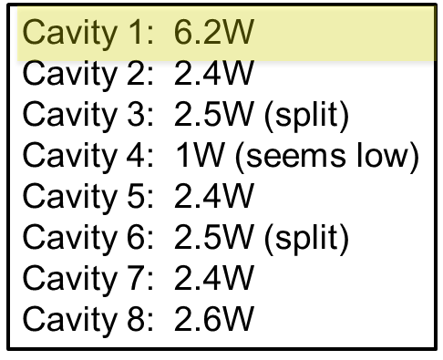
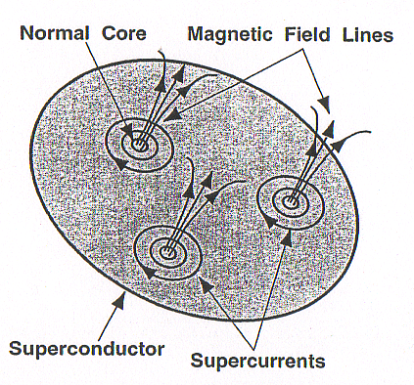
Magnetic Shield Material Validation against Remnant Field in the Cryomodule
The magnetic shielding performance is poor at the cryogenic temperature, the cavity will make flux trapping during cool down.
FRIB requirement is Bin < 15mG.
The cavity dynamic load (at 5.6 MV/m) at 2K has no significant difference between Mu-metal and A4K shielded cavities, except for Cavity#1, which was found wrong calibration later, actually measured at ~ 9 MV/m
Earth magnet filed ~ 0.5G
Magnet filed ~ 0.3G
Magnetic shield
Vacuum vessel by carbon steel
Bin< 15mG
solenoid
(calibration was wrong, really ~ 9 MV/m)
Mu-meatal shield
A4K shield

Slide 7
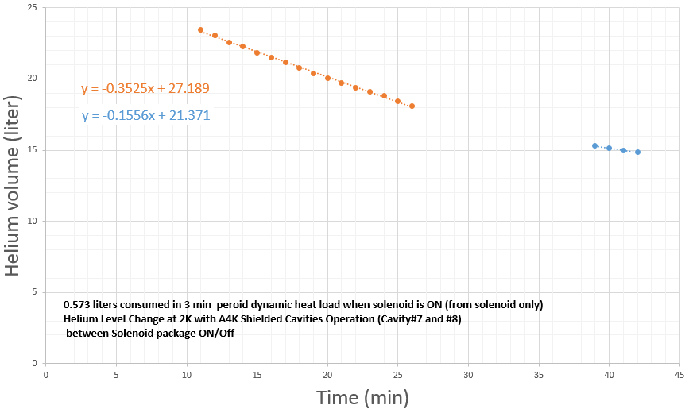
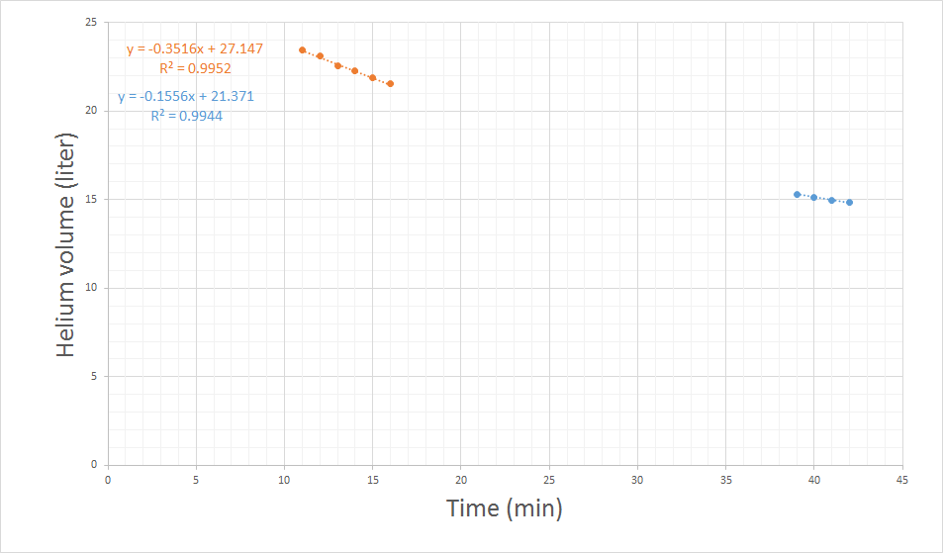
Magnetic Shield Material Validation
Against Fringe Field from Solenoid Package
Charge 2
The material validation against the fringe field
  Cavity is in Meissner state before solenoid excitation. Fringe field ~ 270 G at 8 T solenoid operation should has no impact on the cavity performance
  Compared cavity dynamic heat load at 2 K between w/o solenoid package full operation
  Two combined operations: C#1+S#1+C#2 (Mu-metal) and C#7+S#3+C#8 (A4K)
  Measurement error ~ 2 W in date fitting
Similar cavity dynamic head load at solenoid switched on/off, validated MU-metal against fringe field
  The reason why different from switch off is under investigating
15 min. fit for solenoid on
Solenoid package on
During solenoid package witching off
Solenoid package on
3 min. fit for solenoid on
 | Solenoid on Data it15min/3min | Solenoid off Data fit 3min
C#1+S#1+C#2 Mu-metal shield | 5.9 W/4.5 W | 2.8 W
C#7+S#3+C#8 A4K shield | 7.6 W/5.3 W | 2.3 W

Slide 8
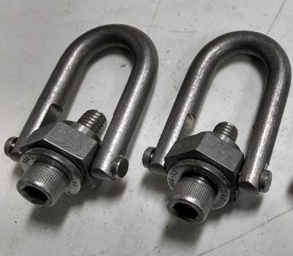
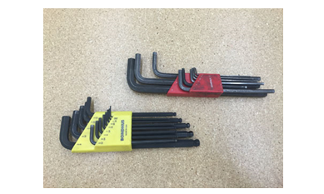
Magnetic Contamination
FRIB controls the residual magnetization less than 15 mG. If the component used in the magnetic shield has magnetization > 15 mG, we will demagnetize.
Even stainless for instance SU316, magnetizes rather ( ~ 1G) when machined or welded.
The tools for example wrenches, shackles ... made of hard steel are usually magnetized > 2 mG and magnetizes the bolts and fastener ~ 1G.
Examples
Shackles
Using the solenoid arm lifting, original shackles were made of carbon steel and magnetized > 2 G, Changed to stainless but still magnetized
2) Wrenches
Using tightening the fasteners and nuts on the cavity flanges. The wrench magnetized 1.3 G and magnetic contaminated the nuts 960 mG.
 | As received | Post demagnetizing
A | 1930 mG | 200 mG
B | 1950 mG | 380 mG

Slide 9
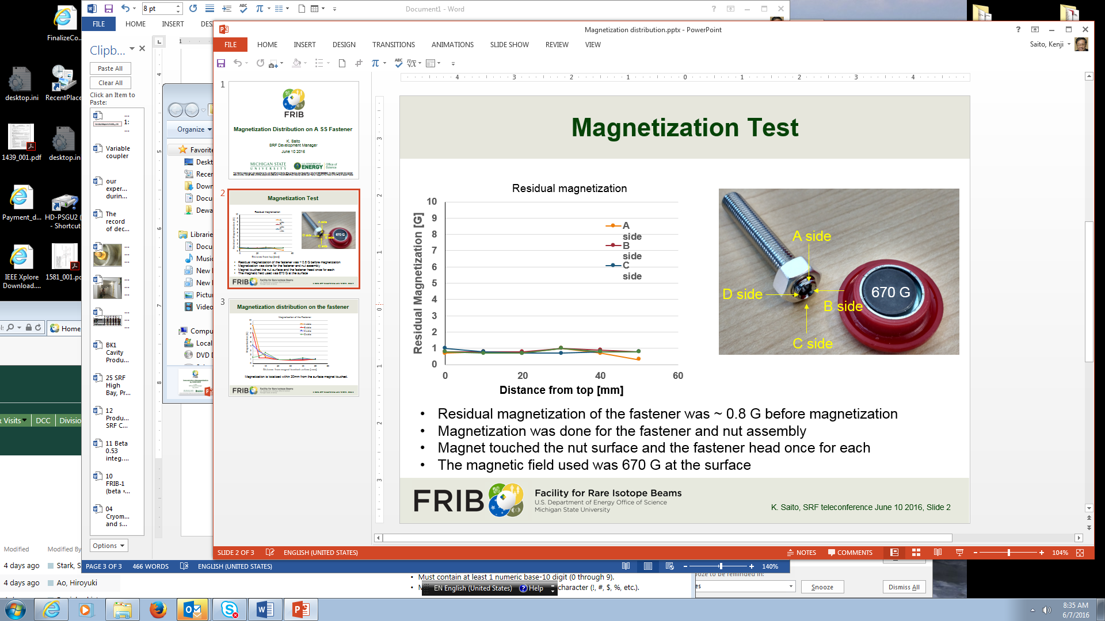
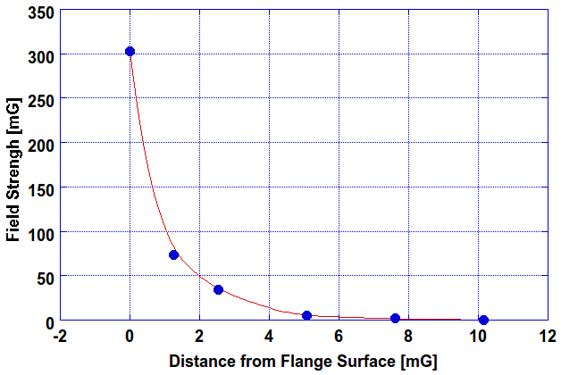
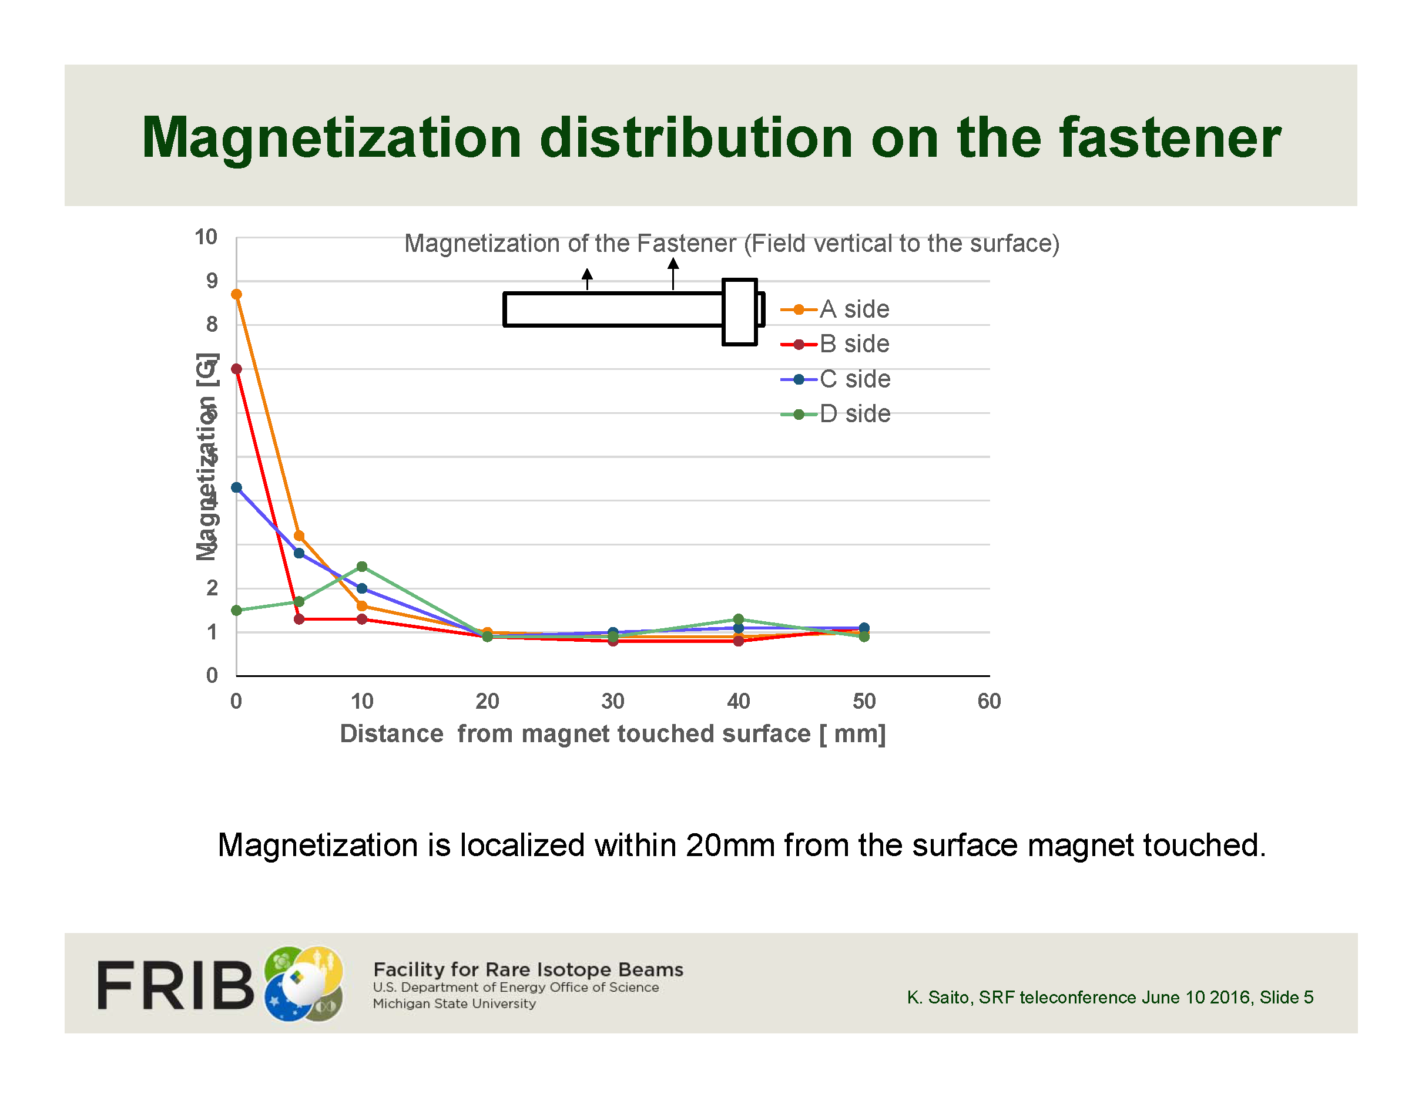
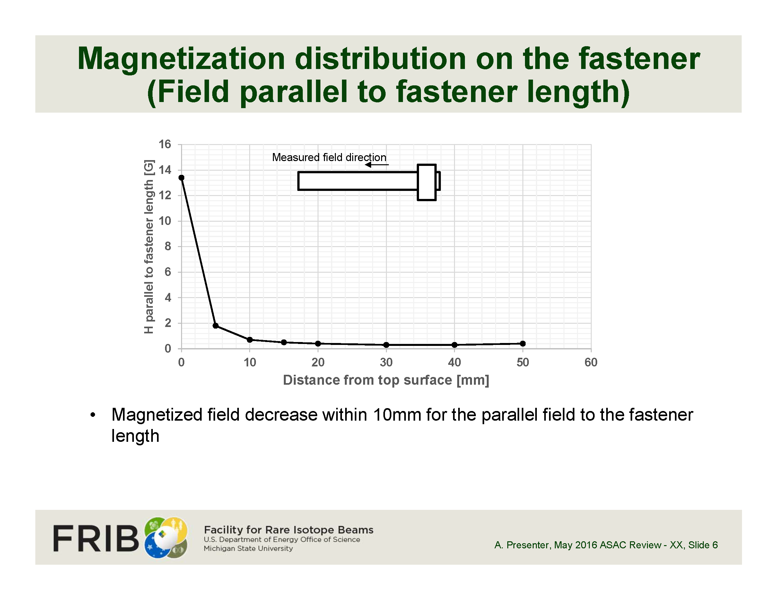
Magnetization Test of Stainless Fastener
Easily magnetized > 10 G but attenuates within 20 mm
Magnetized field attenuation by space distance from the surface
Magnetization results
In the world of the 1 mG remnant field control like LCLS-II
1) Materials of Tooling, Fixtures will be very much carefully chosen.
2) Perfectly none magnetic materials should be used for fasteners and nuts, for instance hard copper (NC25) instead of stainless.
Transvers
Longitudinal

Slide 10
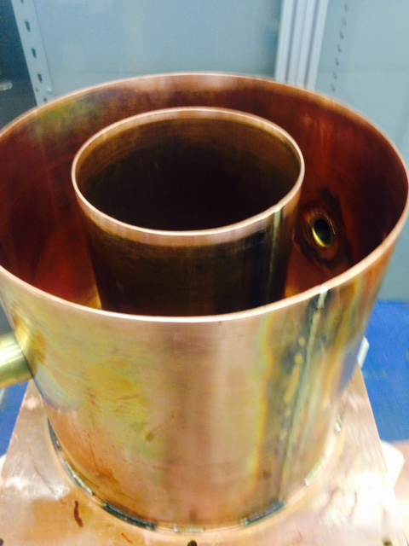
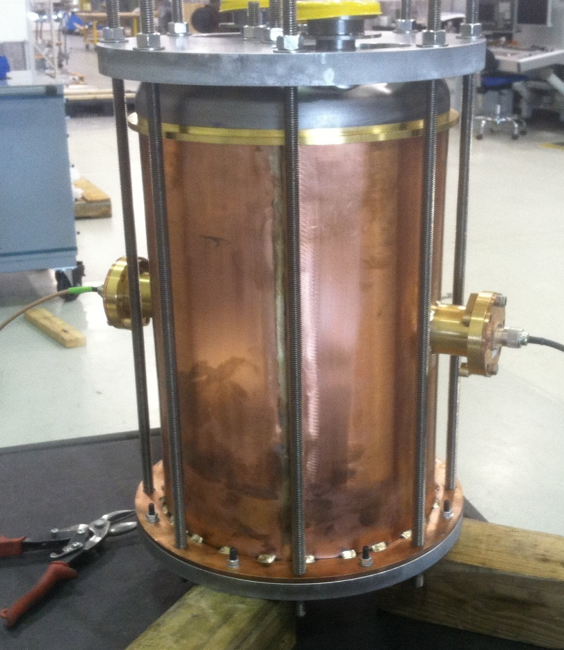
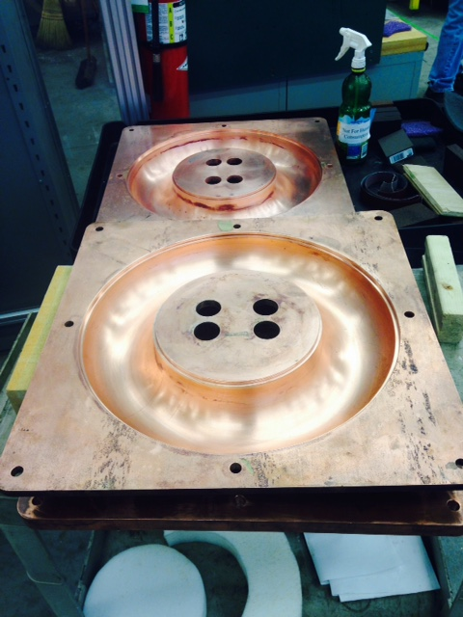
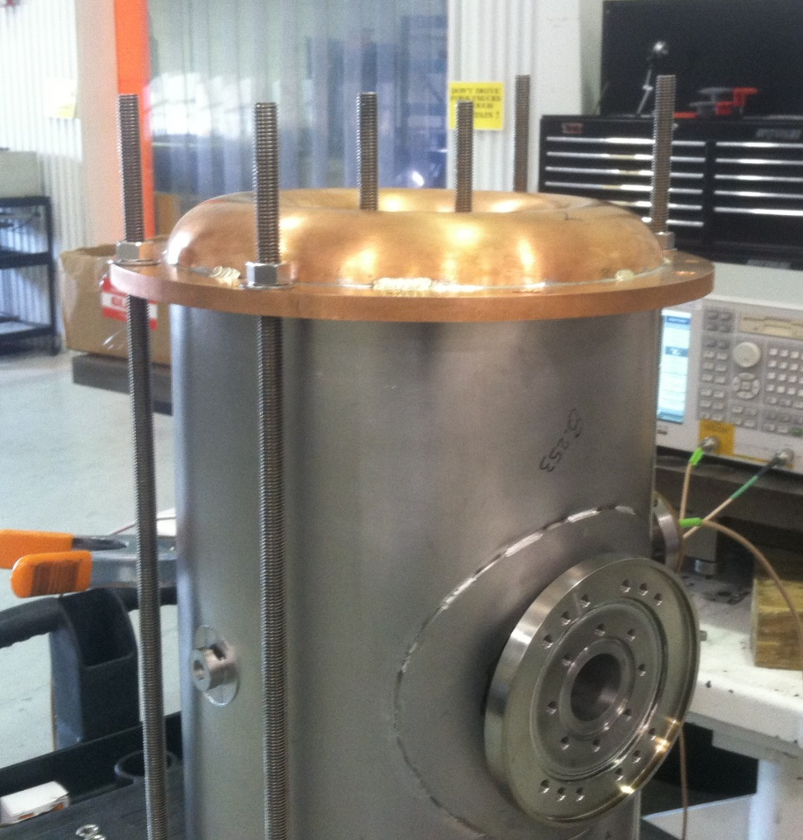
Cavity Frequency Control
Frequency control is much harder than elliptical cavities
EBW of QWRs or HWRs are much more complicated compared to elliptical cavities.
Cavities frequency tuning is not easy by EBW assembly.
FRIB developed reference fixtures to increase reproducibility in the stack-up and trim step of HWR fabrication.
Niobium Short Plate Measurement – niobium short plates are machined complete to drawing. Frequency of finished short plates are measured against a calibrated reference copper cavity.
Niobium Outer and Inner Conductor Measurement – niobium outer and inner conductors are left long. Frequency is determined by stacked-up measurement using calibrated reference copper short plates. The outer and inner conductors are trimmed and re-stacked until goal frequency is met.

Slide 11
Cavity Frequency Control Example – HWR
Frequency control during cavity fabrication

Slide 12

FRIB Innovations
Cavity frequency fine tuning methods
Differential etching for QWR frequency control
  Remove high E-field area locally
  Possible to increase cavity frequency within 5% accuracy
Virtual welding for HWR cavity frequency control
  Cavity shrinkage by EBW to increase cavity frequency
  Possible to increase cavity frequency within a few % accuracy
Virtual TIG welding
  Increase cavity frequency for HWRs with helium vessel
f= 1/2π$\sqrt{LC}$

Slide 13
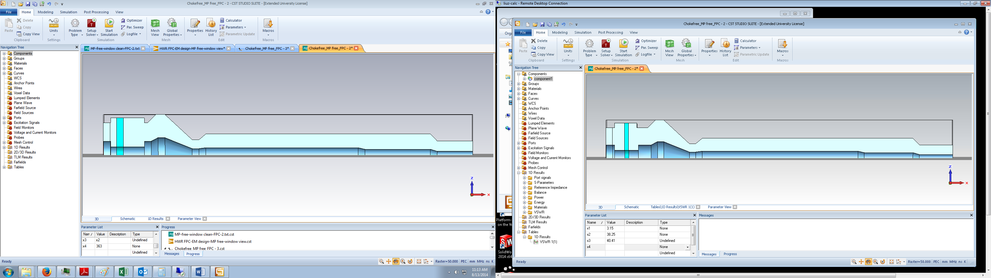
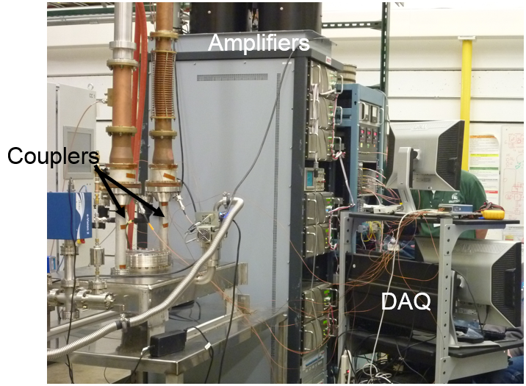
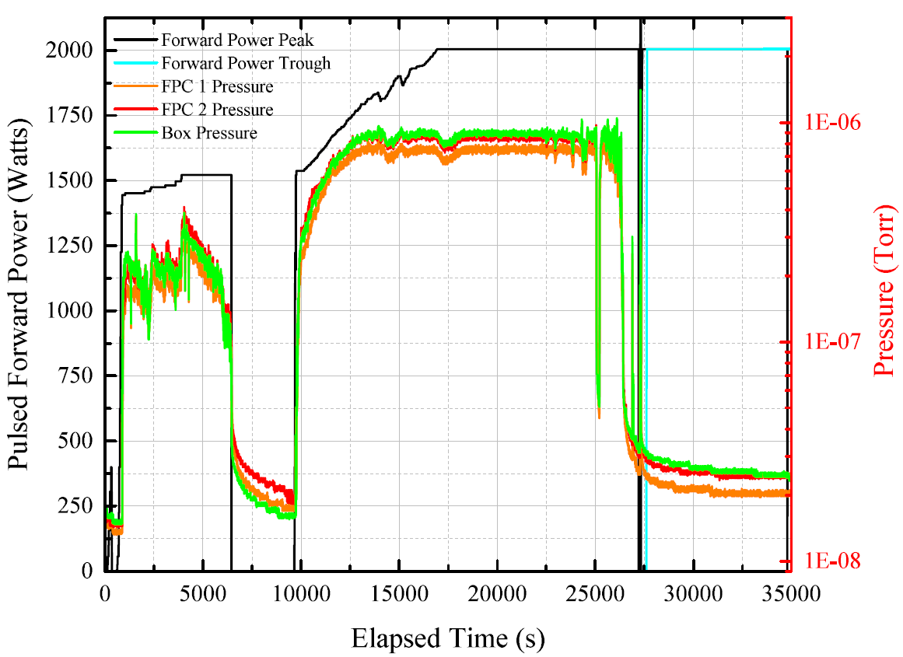
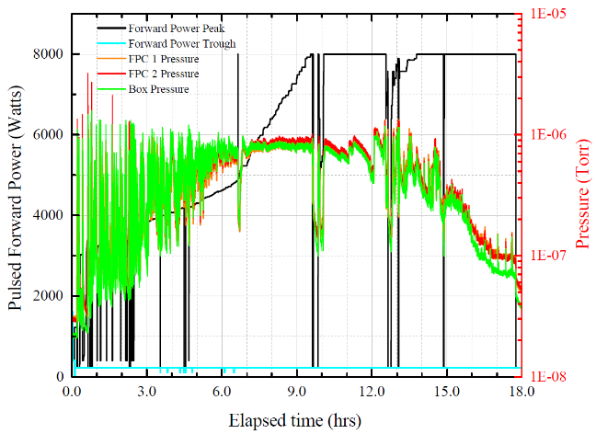
Baseline FPC and Multipacting Free FPC
FRIB HWR coupler: 4 kW @ CW, traveling wave 16 kW
Multipacting barrier at low power level
RF condition needs > 30 hr , very much time consuming process
RF power was limited the MP by 2 kW at TDCM test 2012
Need to improve coupler performance against multipacting
Proposed MPF coupler by S. Zheng
Original design of MPF FPC
FRIB MPF FPC design
5 hr up to 2 kW
10 hr 2kW to up to 8 kW
(a)

Slide 14
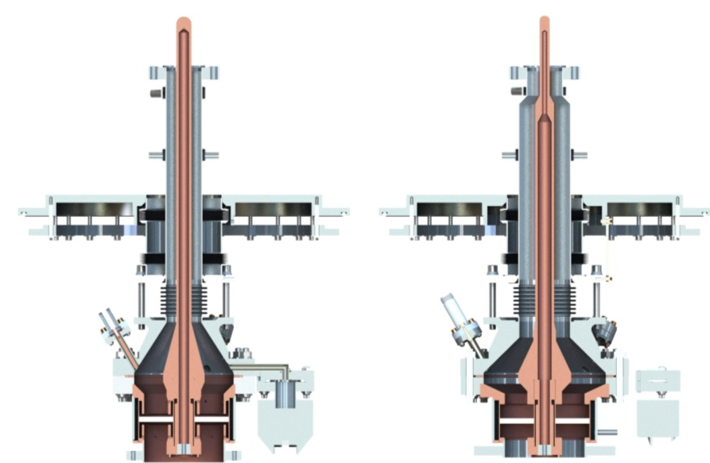
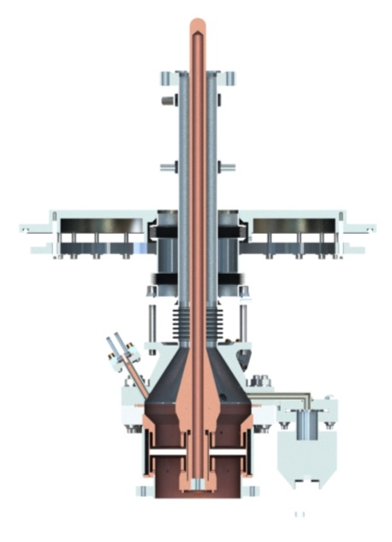
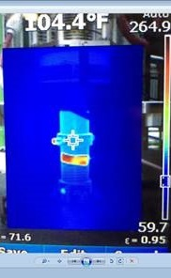
Multipacting Free HWR Power Coupler
MPF FPC Demonstrated Excellent Performance During High Power Conditioning
Base line
MPF
Multipacting Free Fundamental Power Coupler
  Increase impedance (75Ω) and push the MP level higher
  No choke structure at RF window
  Beam blinded RF window structure
Baseline FPC conditioning
  9 out of 10 Baseline Model are conditioned but has heavy multipacting heating at 9 -10 kW (traveling wave model) and very long conditioning time.
  #9 can not reach vacuum goal during after 140 hour conditioning
MPF FPC conditioning
  No multipacting heating observed
  Quick conditioning time
  Confirmed memoirs effect at least 2 week in the
  air cleanroom
Conditioning setup | Required time [h]*¹ | Heating | CW 5 kW*²
BL#3 + BL#4 | 40 | #3 80°C, #4 80°C
BL#5 + BL#6 | 51 | #5 80°C, #6 80°C | ✓
BL#7 + BL#8 | 63 | None | ✓
BL#9 + BL#10 | 140 | #9 120°C, #10 40°C | ✓
BL#2 + (Conditioned) MPF#1 | 6 | None | ✓
Conditioning setup | Required time [h]*¹ | Heating | CW 5 kW*²
MPF#1 + MPF#2 | 18 | None
MPF#1 + MPF#2 | 9 | None
MPF#1 + MPF#2 | 7 | None | ✓

