Slide 1
IFMIF CAVITY AND CRYOMODULE LICENSING
TTC Meeting, Saclay June 5th – 8th | Aline Riquelme

Slide 2
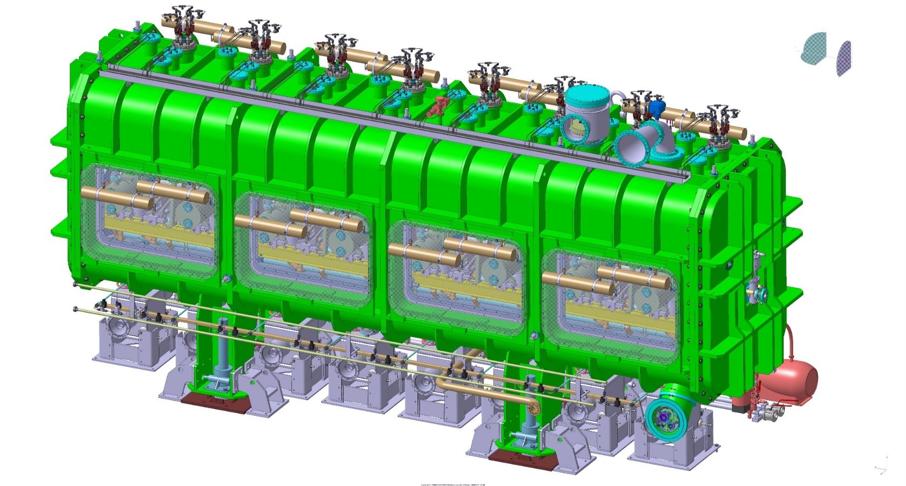



IFMIF CRYOMODULE OVERVIEW
- Design pressure: 0,15 MPa
- Operating pressure: 0,125 MPa
- Operating temperature: 4,45 K
- Assembled and installed in Japan at QST site
(Rokkasho-mura, Aomori Prefecture)

Slide 3
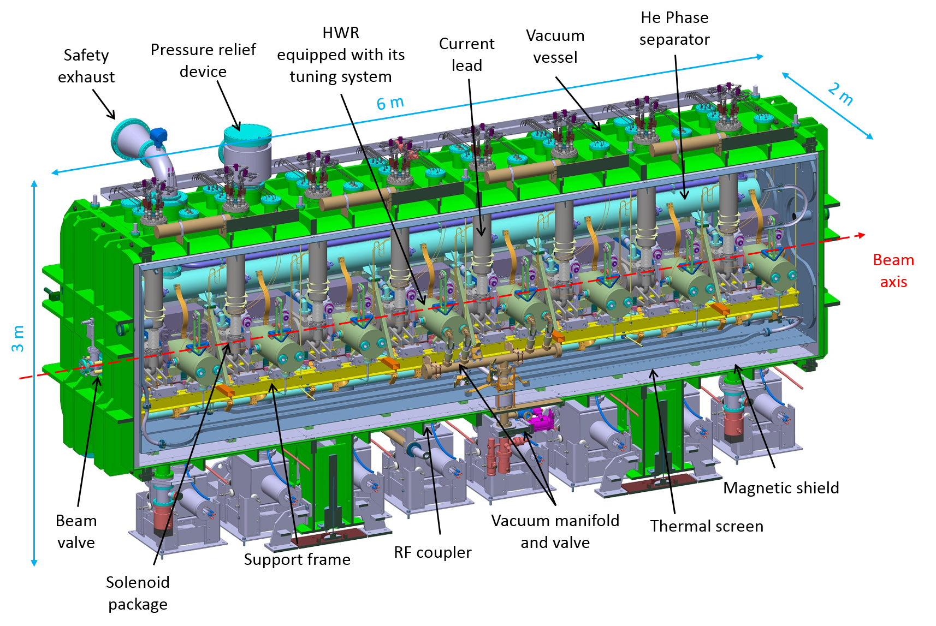
IFMIF CRYOMODULE OVERVIEW

Slide 4
LICENSING STRATEGY
      Cryogenic fluid inside the IFMIF cryomodule ➔ Must comply with the Japanese regulation: High Pressure Gas Safety Law (HPGSL).
      Strategy negotiated with the Japanese authorities : design, fabrication and tests of all the cryomodule components according to ASME BPVC or B31.3.
      All licensed components are subject to Aomori Prefecture approval before installation of the cryomodule in Rokkasho (application form presented by QST).
Component | Licensing procedure | Code
Cavities | YES – Pressure vessel | ASME BPVC Section VIII Div.1
Phase Separator | YES – Pressure vessel
Solenoid vessels (CIEMAT) | YES – Pressure vessel
Current leads assembly (CIEMAT) | YES – Pressure piping | ASME B 31.3
Cryo-piping, thermal shield piping | YES – Pressure piping
Vacuum vessel /thermal shield | NO – ΔP < 0,1 MPa | x
Pressure vessels as per ASME BPVC Sec. VIII Div.1 §U-1
Internal diameter > 6 in. (152 mm)
Piping as per ASME B 31.3
Internal diameter < 6 in.

Slide 5
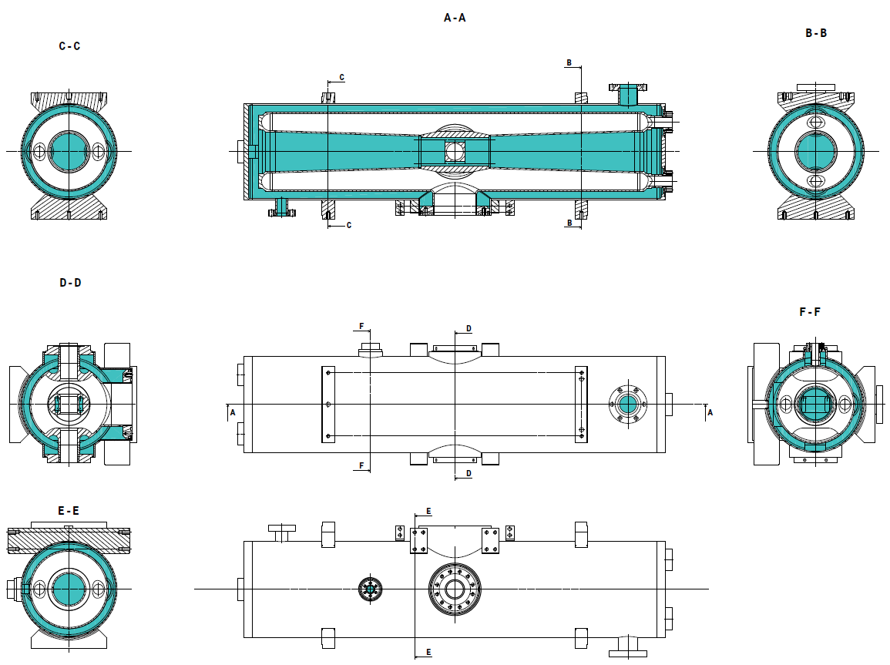
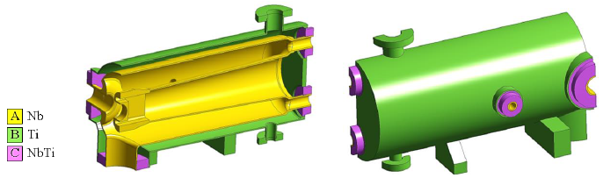
CAVITY LICENSING
  Cavities are considered « Pressure Vessel » as per ASME BPVC Section VIII Div.1. (LHe in the cavities)
LHe
Materials: Nb , NbTi and Ti
Nb and NbTi are not listed in ASME BPVC
+
Complex geometry
Necessity to perform several analytical calculations + numerical simulations: stress analysis with finite element method, calculation of stresses in welded flanges…
Tests samples for Nb, NbTi and Ti to determine tensile properties and Charpy impact energy at 4.45K.
Application form submitted to KHK (High Pressure Gas Safety authority in Japan) for the cavities prior to Prefecture approval. This application form was officially approved in March 2016 (licensing procedure started in Dec. 2013).

Slide 6

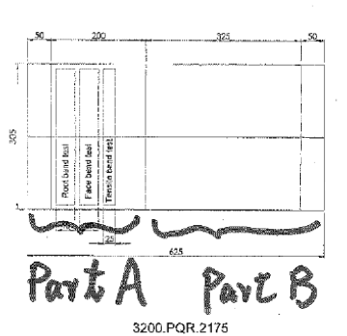
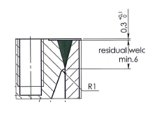

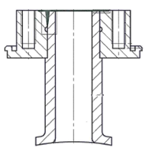
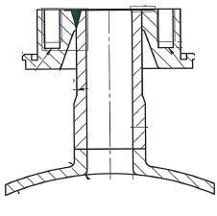
WELDING QUALIFICATION: EXAMPLE OF CAVITIES
Numerous pressure welds in the cavities: Nb-Nb, Nb-NbTi, NbTi-Ti, Ti-Ti.
→ Welding qualification according to ASME BPVC Section IX + KHK requirements (to comply with HPGSL).
6 different WPS — for each WPS:
  1 Qualification test coupon (PQR)
  1 Production test coupon (PTC)
3 samples for bend and tensile tests + 1 coupon for 4K additional tests (performed by QST)
+ Visual, radiographic and liquid penetrant tests performed on samples.
Tensile & bend test samples
4K coupon
Modification of flange design due to full penetration weld issue:
Example of PTC
Weld from top of flange to a groove → does not fulfil ASME requirement of fuul penetration weld
The groove has been removed and the bottom of the flange cut out: full penetration OK

Slide 7
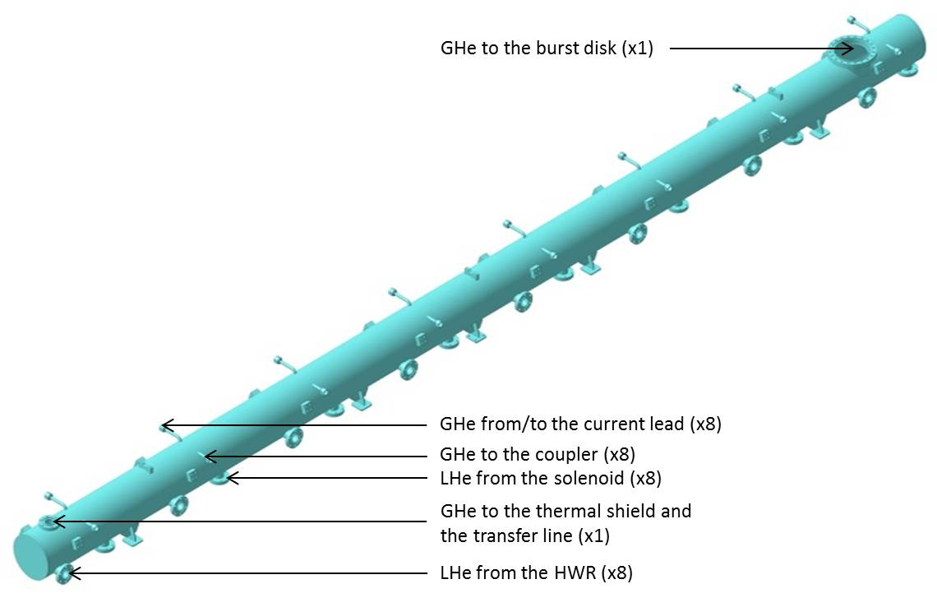
PHASE SEPARATOR
- “Pressure vessel” as per ASME BPVC Section VIII Div.1 (¼ LHe ¾ GHe in volume).
- Material: 316 L stainless steel referenced in ASME BPVC Section II.
It has been decided that an application form form would not be necessary. Furthermore, it has been agreed that a U stamp is not required for the phase separator.
Calculation document checking shell thickness, flanges design and bolt loads according to ASME.
Welding qualification according to ASME BPVC Section IX (WPS, PTCs…).
Third party inspection for pressure/leak tests.
Max. internal pressure:
0,15 MPa
Design | Welding | Material | Manufacturing and testing
ASME BPVC, Section VIII, Division 1 | ASME BPVC, Section IX | ASME BPVC, Section II | ASME rules & third party conformity assessment

Slide 8
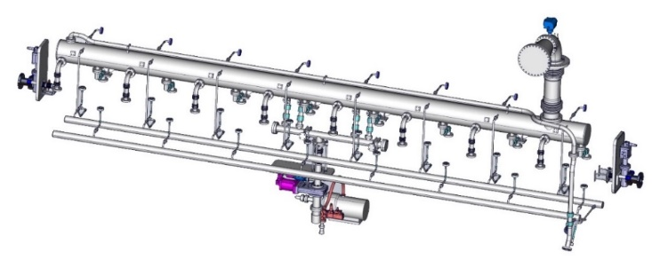
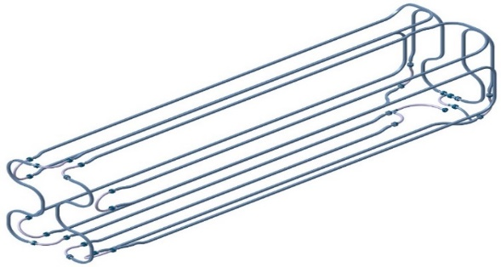
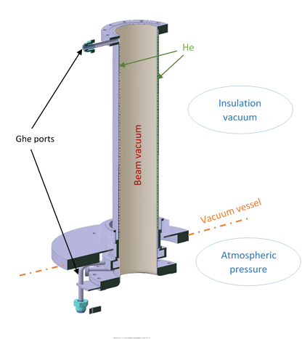
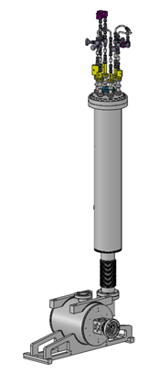
PIPING
  Piping components shall fulfil ASME B 31.3 (ASME code for pressure piping) requirements:
  Material in accordance with ASME BPVC Section II (316L, 304L, 6061 T6).
  Bellows and hoses shall be ASME certified.
  Calculation note checking piping wall thickness and flange design according to ASME, in operating and leak test conditions.
  Welding according to B 31.3/BPVC Section IX.
  Pressure/leak test.
316 L
Cryogenic piping
Al 6061 T6
Thermal shield piping
304 L
316 L
Considered as piping as per ASME B 31.3:
Inner diameter < 6 in. (152 mm)
Max. internal pressure:
0,15 MPa
Power coupler outer conductor
Current leads assembly (CIEMAT)

Slide 9
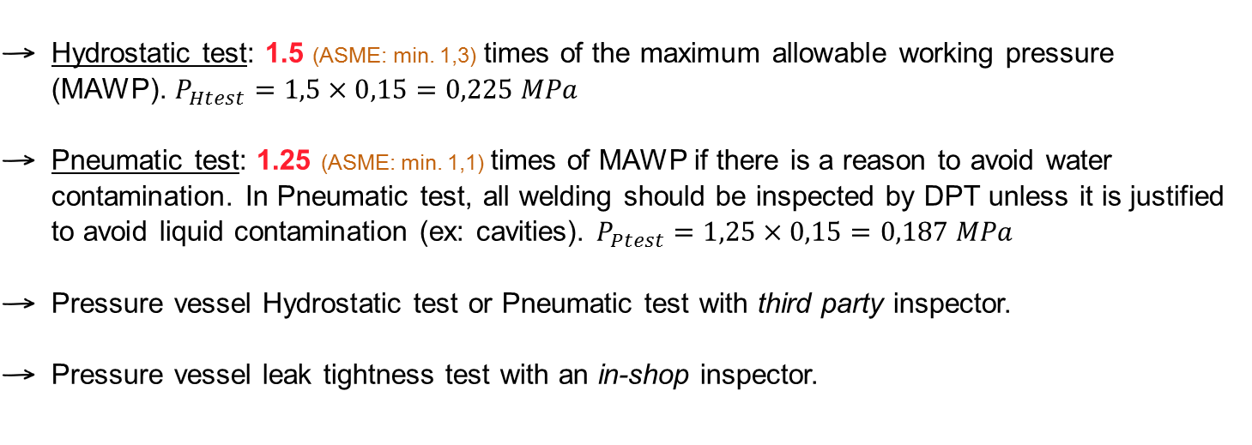

APPLICABLE TESTS
Welding qualification according to ASME BPVC Section IX or ASME B31.3 (WPS, PQR, PTC…)
PRESSURE TESTS: All components falling within the scope of ASME shall be pressure and leak tested (in accordance with ASME and HPGSL requirements).
  Hydrostatic test: 1.5 (ASME: min. 1,3) times of the maximum allowable working pressure (MAWP). $P_{Htest}=1,5×0,15=0,225 MPa$
  Pneumatic test: 1.25 (ASME: min. 1,1) times of MAWP if there is a reason to avoid water contamination. In Pneumatic test, all welding should be inspected by DPT unless it is justified to avoid liquid contamination (ex: cavities). $P_{Ptest}=1,25×0,15=0,187 MPa$
  Pressure vessel Hydrostatic test or Pneumatic test with third party inspector.
  Pressure vessel leak tightness test with an in-shop inspector.

Slide 10
DSM
Irfu
Thank you
for your attention
Commissariat à l’énergie atomique et aux énergies alternatives
Centre de Saclay | 91191 Gif-sur-Yvette Cedex
T. +33 (0)1 69 08 xx xx | F. +33 (0)1 69 08 99 89
  Etablissement public à caractère industriel et commercial | RCS Paris B 775 685 019

