Slide 1
Next Generation Nb₃Sn cavities: Current performance, limitations, and considerations for practical use
Daniel Hall
Matthias Liepe

Slide 2
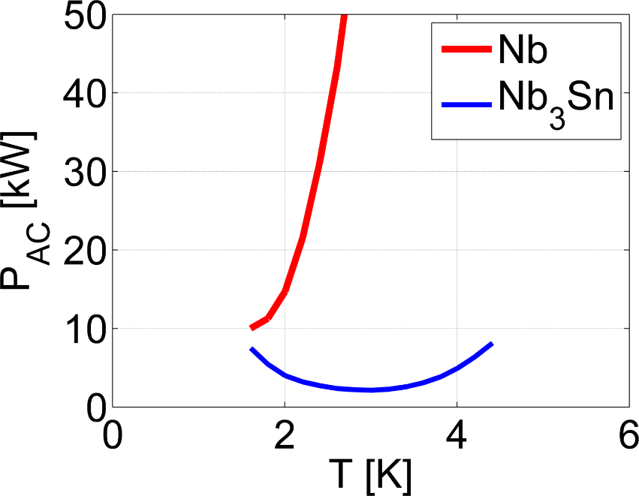
The sales pitch for Nb₃Sn
A15 intermetallic alloy of niobium and tin
Promises:
Higher peak accelerating gradients
Higher cryomodule efficiency
Operation of a cryomodule at 4.2 K
Green: tin
Red: niobium
Parameter | Niobium | Nb₃Sn
Transition temperature | 9.2 K | 18 K
Superheating field | 219 mT | 425 mT
Energy gap Δ/k_{b}T_{c} | 1.8 | 2.2
λ at T = 0 K | 50 nm | 111 nm
ξ at T = 0 K | 22 nm | 4.2 nm
GL parameter κ | 2.3 | 26

Slide 3
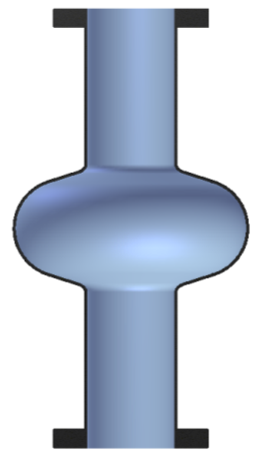
Fabrication process at Cornell
Cornell began coating niobium with Nb₃Sn using the evaporation deposition method in 2010 using a specially modified UHV furnace
Coating chamber in UHV furnace at 1100 C
A crucible of tin is surrounded by a secondary heater that lies within a primary hot zone, directly beneath the cavity or part to be coated
Separate control of the primary and secondary allows us to balance the rate of arrival of tin against the growth rate of the Nb₃Sn layer
Nb cavity substrate
Sn Vapor
Auxilliary Heater for Sn container at 1200 C

Slide 4
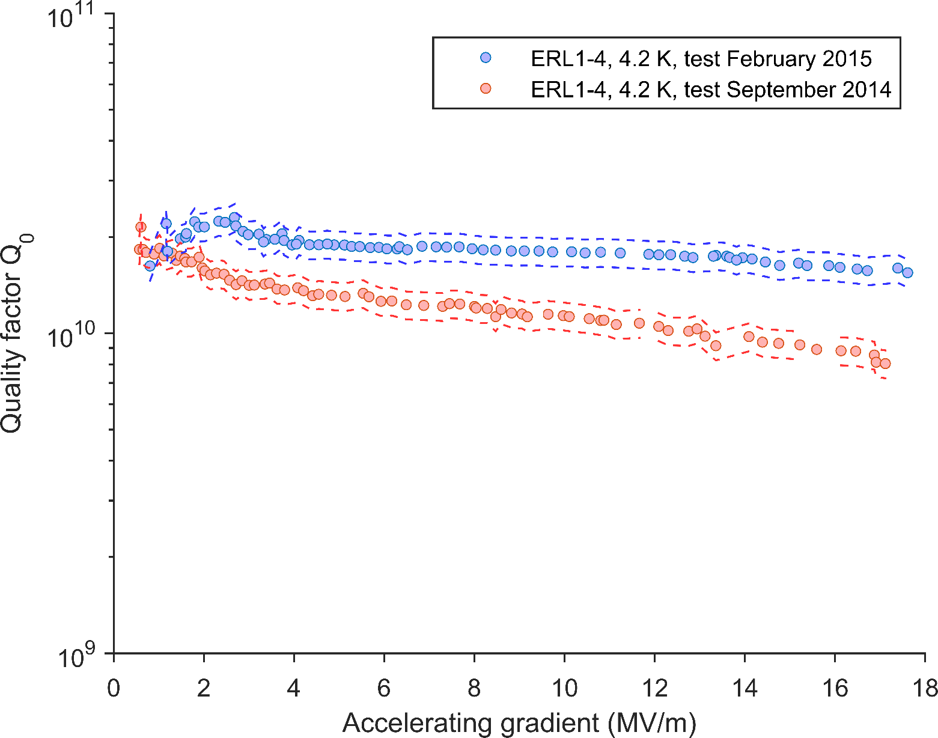
SRF 2015, in Whistler, BC, Canada
LCLS-II spec adjusted for operation at 4.2 K
Bath T = 4.2 K

Slide 5
Talk outline
Altering the coating procedure
Can we meet or exceed the performance seen above in the other cavities available?
Limitations on quality factor
We are dominated by residual resistance; where is this coming from?
Overcoming these limitations
How can we lower our surface resistance further?

Slide 6
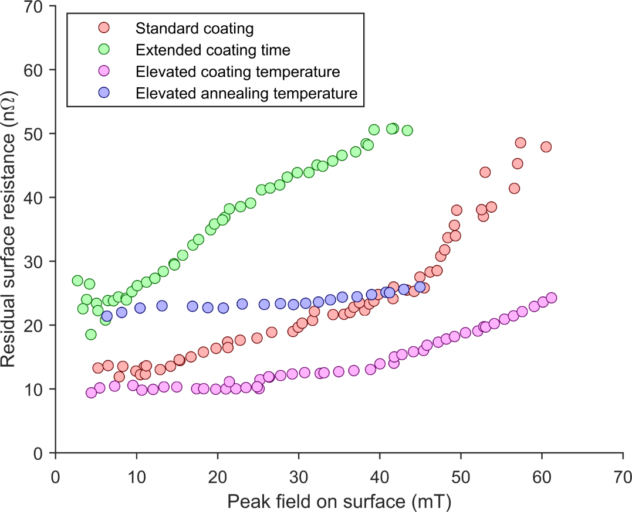
Altering coating parameters
4 coatings of a single-cell 1.3 GHz ILC-style cavity designated LTE1-7
For more: see “Nb3Sn Cavities: Material Characterisation and Coating Process Optimisation”, D.L. Hall, M. Liepe, et al., SRF 2015, Whistler, BC, Canada

Slide 7
New Cornell coating profile
5 hours of nucleation
Ramp to temperature with a ΔT of 150°C
1.5 hours of coating with a ΔT of 150°C
1 hour of annealing after secondary heater is turned off

Slide 8
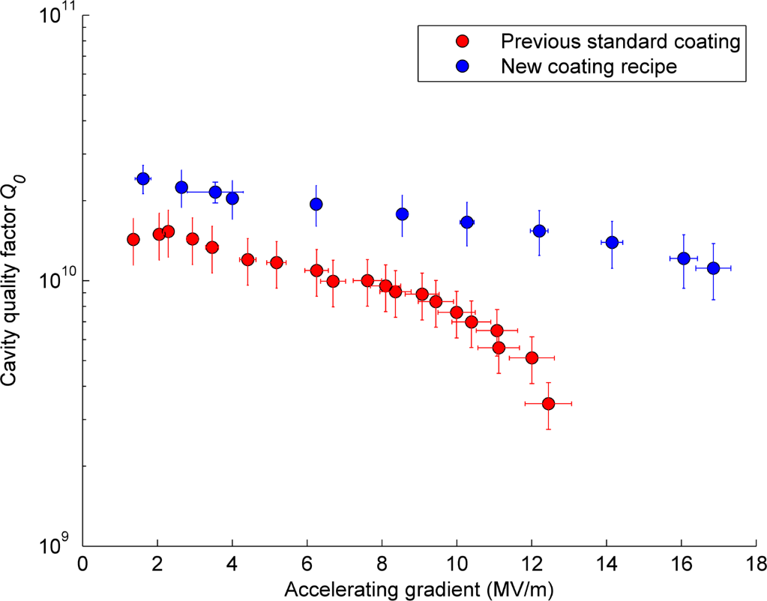
Cavity results
All 3 of Cornell’s single-cell 1.3 GHz cavities now exceed 16 MV/m with high quality factors at 4.2 K – more cavities are in production to improve statistics
Transitioning to the new coating recipe has seen a marked increase in performance for cavities that previously did not achieve this specification
Bath T = 4.2 K
Bath T = 4.2 K

Slide 9
High Pulsed Power RF testing
During high power pulsed RF testing, the cavity exceeded its CW quench field by a considerable margin
Thermal effects from local defects currently limits the ability to probe the superheating field at lower temperatures
Current quench field not fundamental in nature

Slide 10
Cavity quality factor
At 4.2 K, the BCS resistance is on the order of 8 – 10 nΩ in the best performing cavities, on the same order as the residual resistance
Up to the current CW quench fields, the BCS resistance appears constant
Further improving cavity quality factor relies on minimising the residual resistance
Normalised energy gap Δ / ( k_{b}T_{c} )

Slide 11
Sources of residual resistance
8 nΩ
Trapped flux from ambient magnetic fields
Cool in as small an ambient field as possible
Trapped flux from magnetic fields generated by thermal currents during cooldown
Minimise ΔT across the cavity during transition through 18 K
Other sources of residual resistance
0 nΩ

Slide 12
Impact of thermal gradients on Q
To obtain the highest possible quality factor, it is critical that the cavity be cooled in as small a thermal gradient as possible.

Slide 13
Sensitivity to trapped flux
Nb₃Sn demonstrates the same sensitivity to trapped magnetic flux as 120°C baked niobium
The sensitivity data show here was taken at an RF field of 5 MV/m
However, this sensitivity appears to also be a function of accelerating gradient

Slide 14
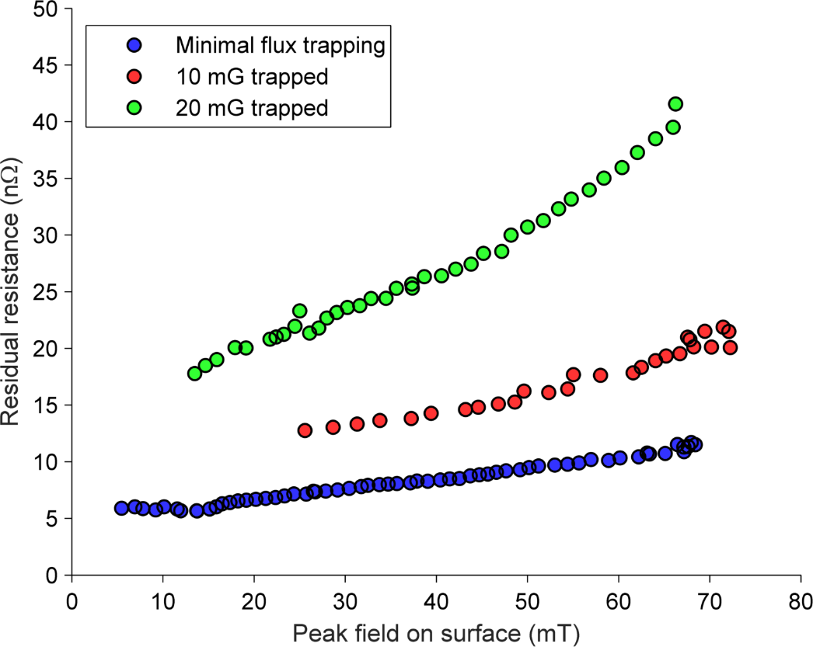
Q-slope depends on trapped flux
Flux trapping with magnetic coil
Cooling in vertical temperature gradient
The Q-slope in these cavities is largely linear with peak RF magnetic field on the surface, and is exacerbated by increasing amounts of trapped magnetic flux

Slide 15
Operating a Nb₃Sn cavity
Thermal gradients of < 50 mK iris-to-iris are necessary to keep contribution from thermal currents to ≤ 1 nΩ
Thermal cycling above T_{c} could be used to obtain these gradients
Minimise ambient magnetic fields
Use heavy shielding like that seen in LCLS-II cryomodules

Slide 16
Sources of residual resistance
8 nΩ
1 nΩ
Trapped flux from ambient magnetic fields
Trapped flux from magnetic fields generated by thermal currents during cooldown
Other sources of residual resistance
Suspected to account for approximately 50% of our lowest achieved residual resistance
3 nΩ
4 nΩ
0 nΩ

Slide 17
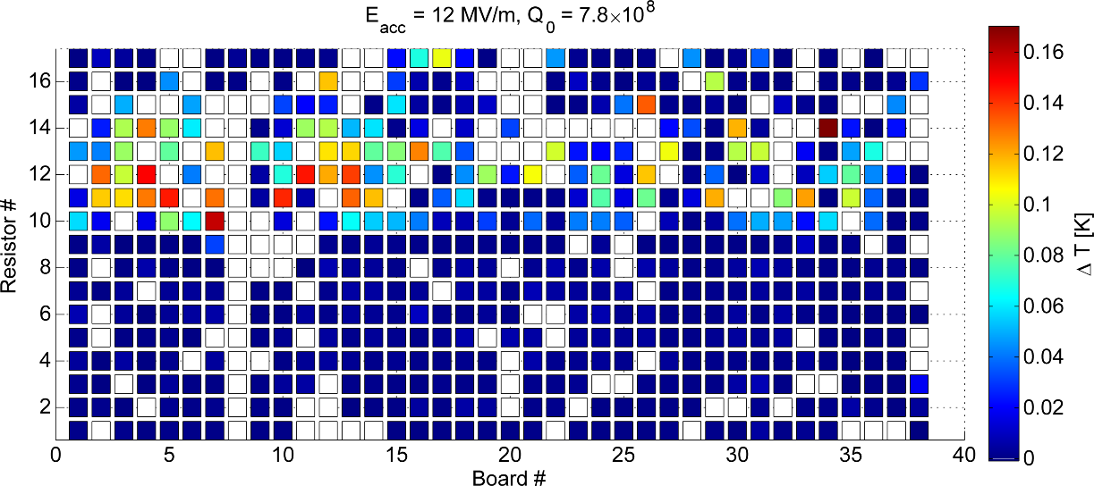
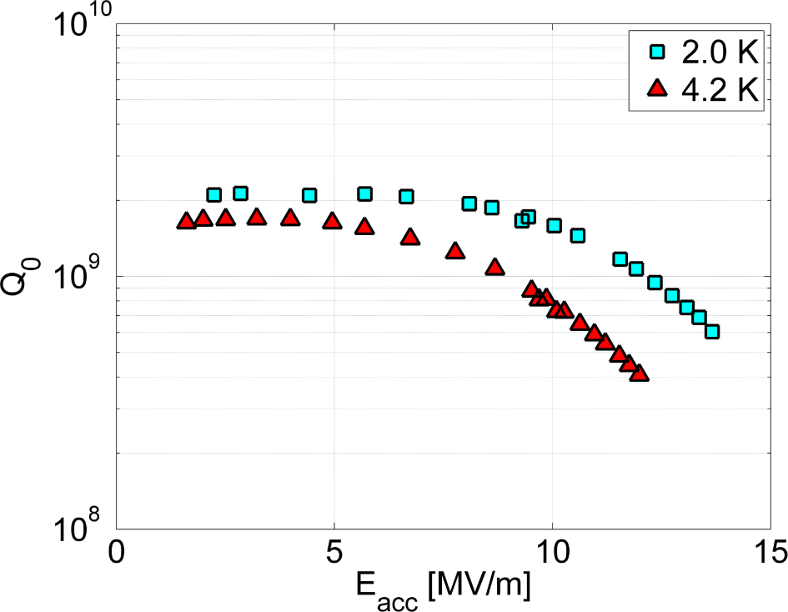
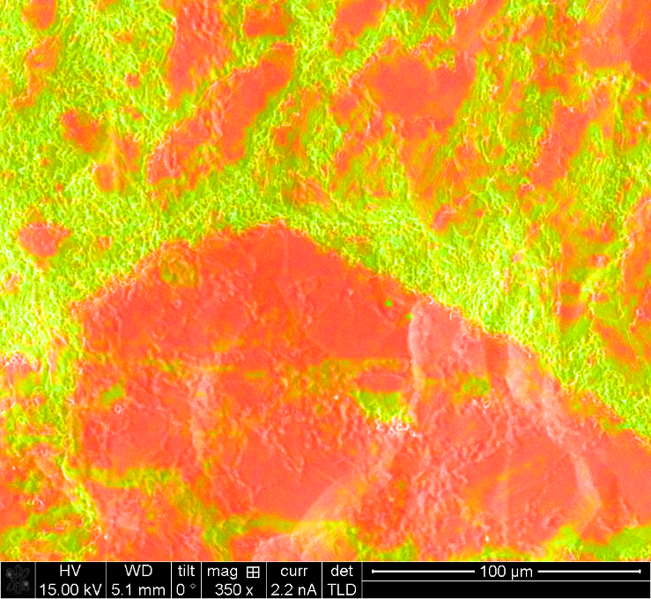
Losses from thin film regions
Cavity demonstrated high surface resistance dominated by losses in one half cell
Cut-outs from the bad half-cell show extensive regions of thin film

Slide 18
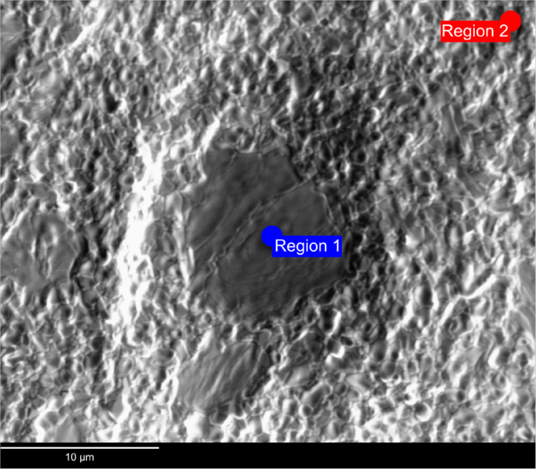
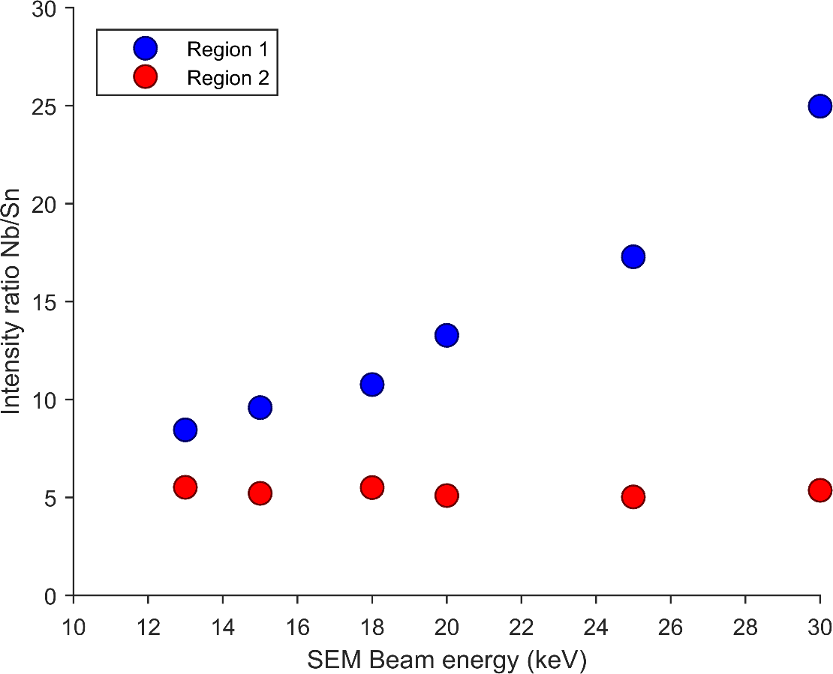
Locating regions of thin film
Regions of thin film have a distinct flat, matte appearance when viewed in the SEM
They can be identified easily at low magnifications using a high-voltage high-count EDS map

Slide 19
Thin film regions in “good” samples
An EDS map of a sample of Nb₃Sn coated using our new coating procedure onto a substrate of RRR = 320 niobium from the same batch as was used to make our cavities shows 7.2 ± 0.5 % of the surface area covered by thin film regions
Image on right: white areas are too thin to fully screen bulk from RF fields

Slide 20
Does increasing substrate RRR help?
There appears to be little, if any, correlation between the coverage by thin film areas and the purity of the substrate
All samples coated as part of this study showed some degree of coverage by thin film regions

Slide 21
Substrate pre-anodisation
Red: not pre-anodised Blue: pre-anodised substrate
An identical set of substrates, which we pre-anodised, showed no detectable thin regions
Hypothesis: growing the oxide layer temporarily slows the entry of tin into the substrate during ramp-up and results in more active nucleation sites once coating temperatures are reached.

Slide 22
Conclusions
Multiple single-cell cavities now reliably achieve useable accelerating gradients with high Q
With small thermal gradients and good magnetic shielding, Q-slope is minimal
Not all the residual resistance is accounted for by magnetic fields alone – another source is most likely from regions of thin coating
Surface pre-anodisation has shown the promise of removing these regions

Slide 23
Acknowledgements
Matthias Liepe
John Kaufman
Ryan Douglas Porter
James Maniscalco
Adam Kline
Alexander Wikner
Gregory Kulina
Holly Conklin
James Sears
Malcolm Thomas
Cornell CCMR facilities are supported through the NSF MRSEC program

Slide 24
Backup slide 1 – Klystron quench
As the fill time of the cavity shortens, the peak field achieved in the cavity is increased
For a fundamental limitation, it would be expected that the peak field would eventually plateau
This is consistent with quench at a localised defect

Slide 25
Backup slide 2 – Nucleation stage
Wuppertal didn’t have an extended nucleation stage
Jefferson Lab do 1 hour, but have no secondary heater
One Cornell cavity omitted this step, and saw slightly lower performance, but it is inconclusive if this was caused by the omission
Keep it for now!
Optional?

